Slide 1
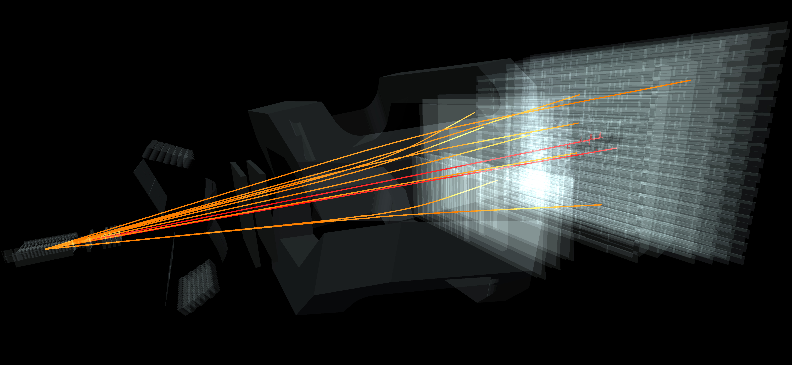
Data Analysis at lhc
HSSIp 2017. Final presentation
Marcell Dorian kovacs
Vendel Peter Kupas
Project Leaders:
Attila krasznahorkay
Zoltan Mathe

Slide 2


Data flow in cern
Grid
Trigger
Raw data
Reco Data
Results
Reconstruction
Analysis
Bookkeeping

Slide 3
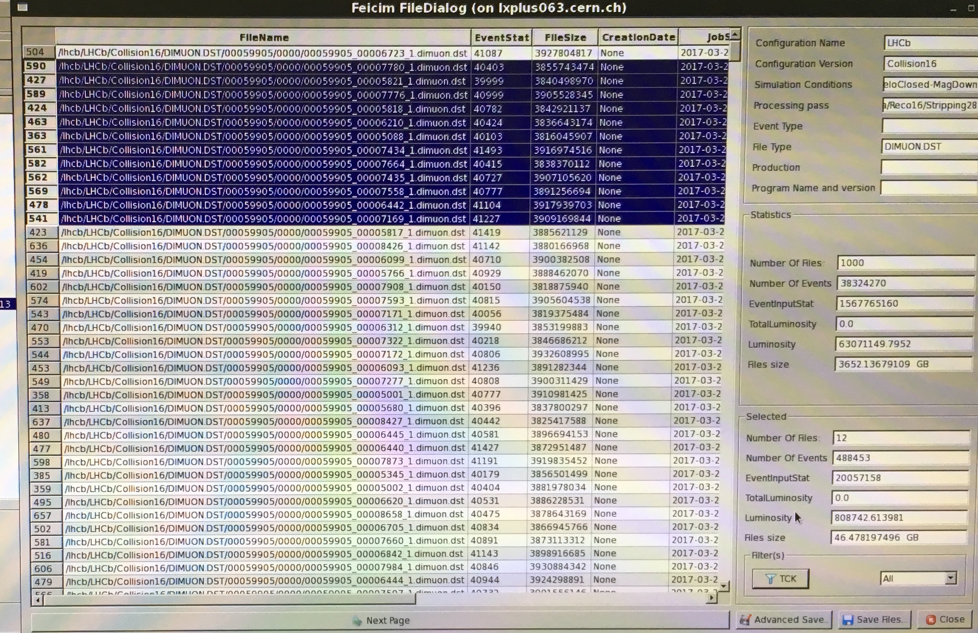
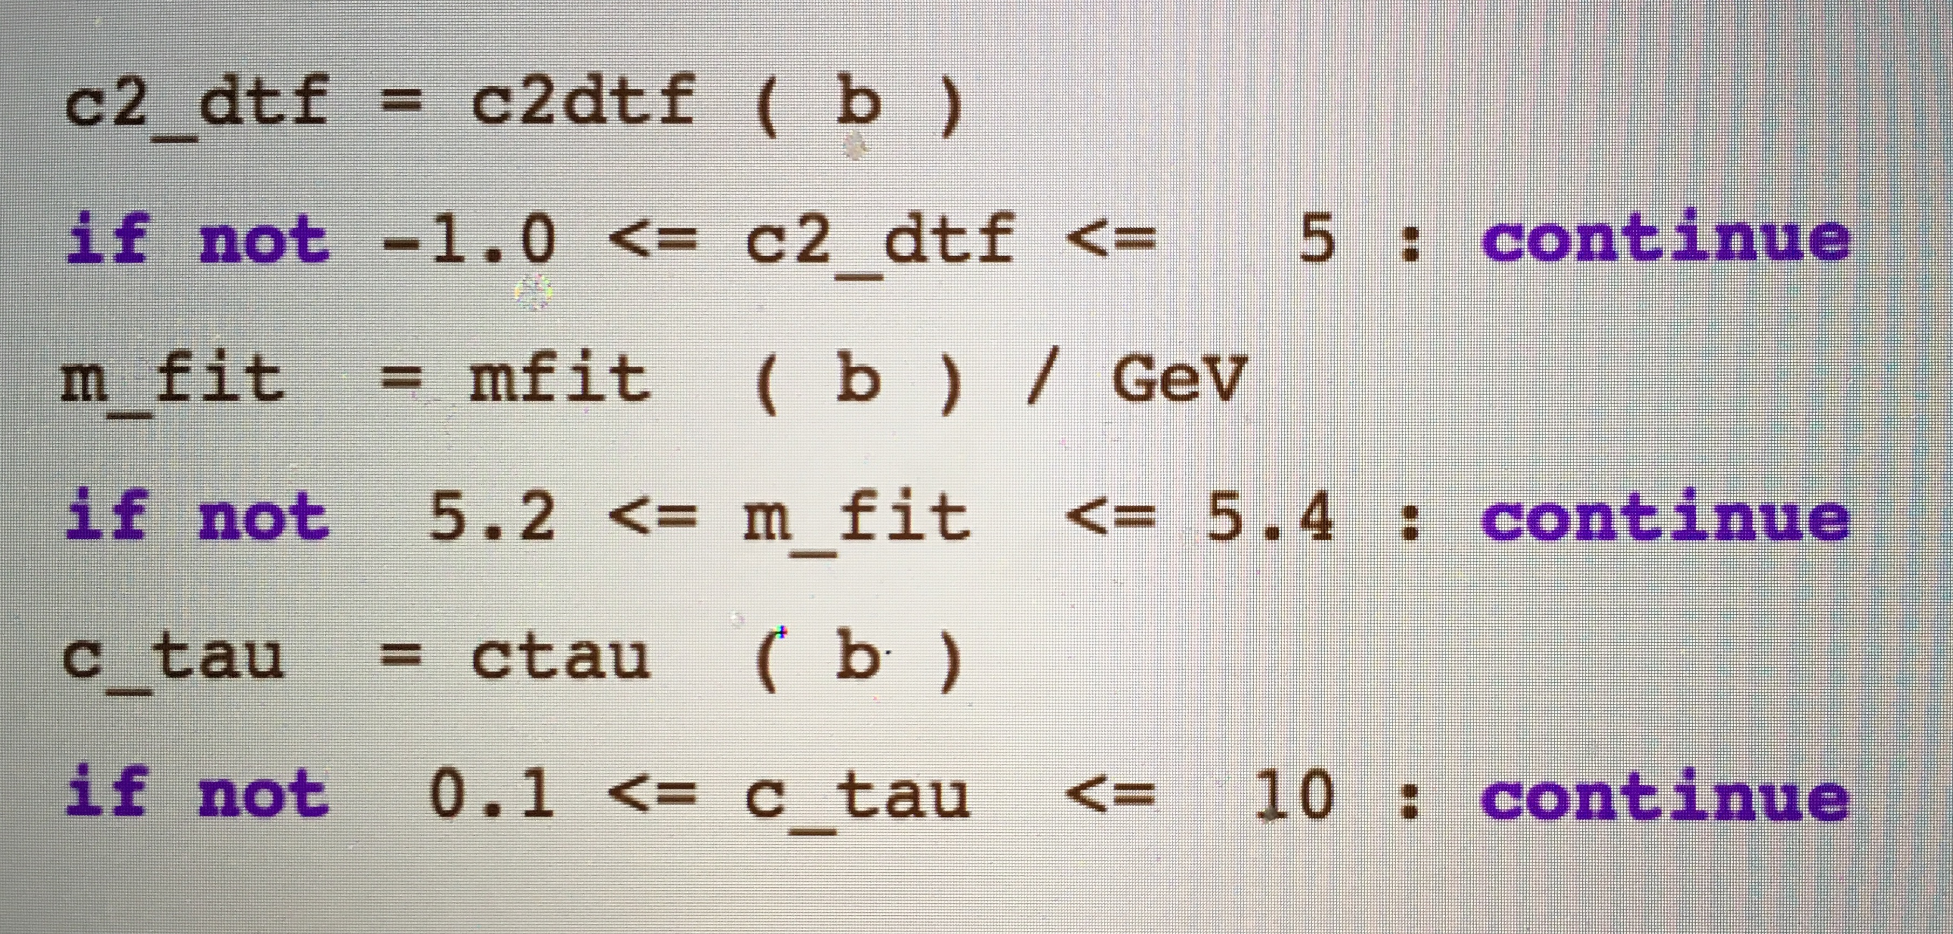
Stripping at lhcb
Tools we used :
LHCb Dirac— Accessing the data files
Bender — The selection application
Ganga — Grid program which runs the job
ROOT — CERN analysis framework
Data files for a B+ Meson decay

Slide 4
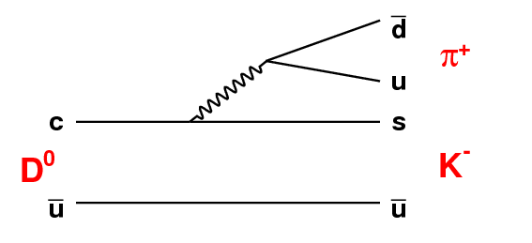
D0 decay experiment
The D0 meson consists of a charm and an anti-up quark
It can decay into a K- kaon and a π+ pion
We measured this decay’s properties in order to determine the lifetime of D0
For this, we used LHCb’s Masterclass program and its Virtual Machine

Slide 5
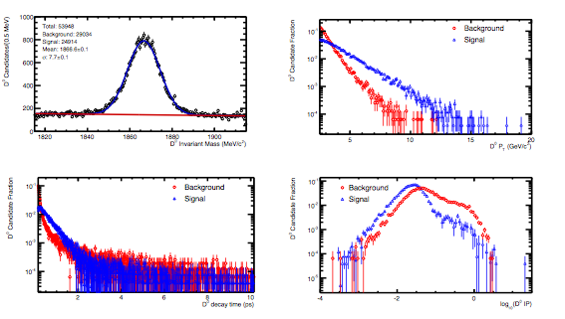
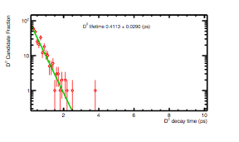
D0 decay experiment
Parameter plots of decay

Slide 6
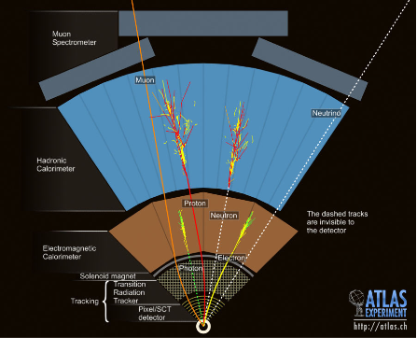
Z boson analysis at atlas
About the decay
The Z⁰ boson is a fundamental particle mediating the weak force
It decays into a lepton-antilepton (muon or electron) pair with different charge
The aim was to measure the mass of the Z boson from these products

Slide 7
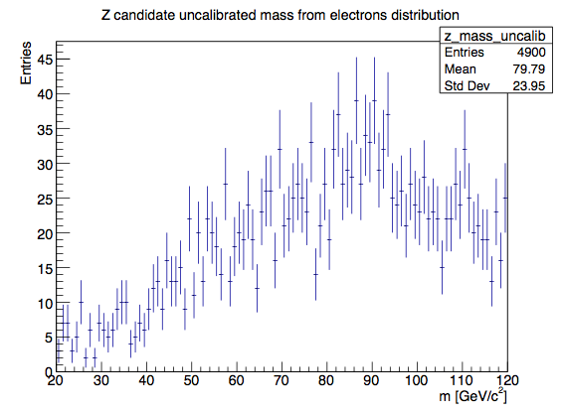
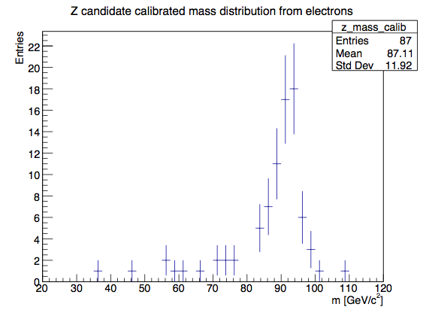
The measurement process
Our project consisted of a simple analysis and a calibrated one (using ATLAS’s recommended selection criteria) on the events
We ran both programs on both data and on Monte Carlo simulations for comparison
We measured other properties as well, such as the location of particles and transverse momenta
After the selection the results were plotted and analysed using ROOT

Slide 8
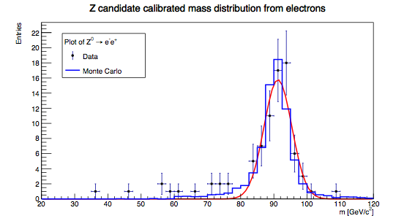
Results
M = 91.223 ± 0.620 GeV/c²

Slide 9
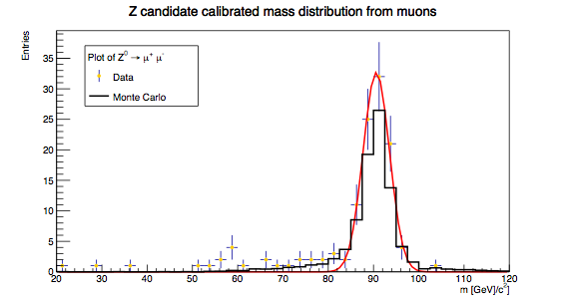
Results
M = 90.6187 ± 0.3093 GeV/c²

Slide 10
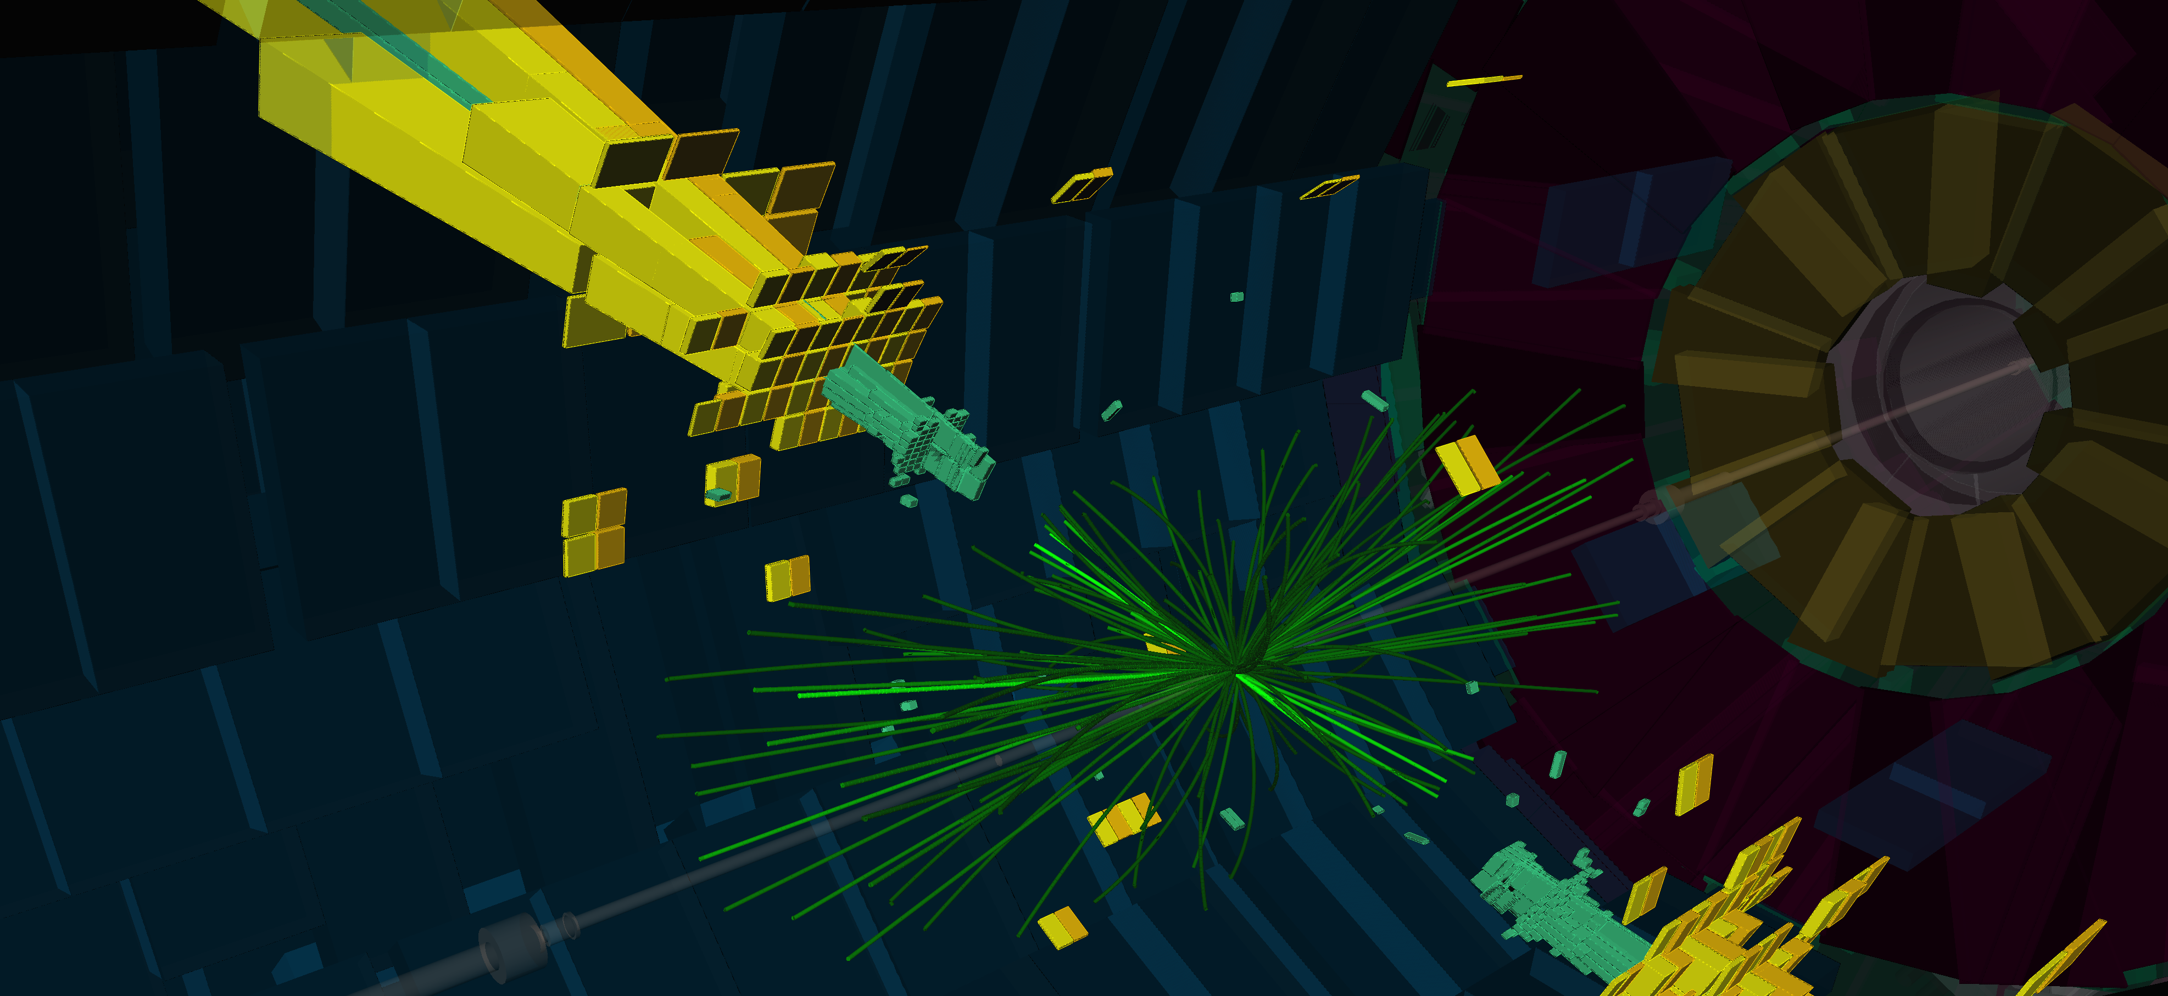
02. 06. 2017.
CERN

