Slide 1
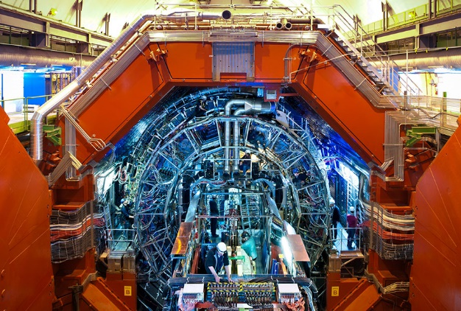
GBT Link Skew Measurement on the ALICE CRU Card
Image source:theday.co.uk
Made by Moni Vajay and Bence Osvart

Slide 2
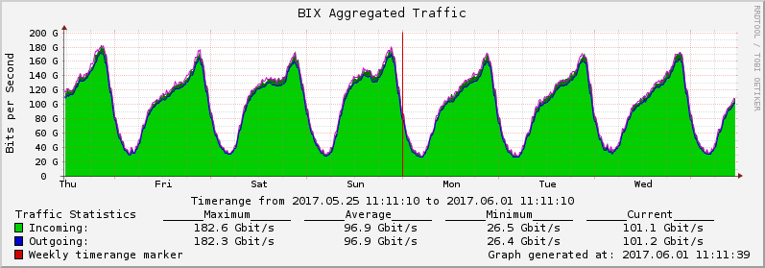
Introduction
Cern, ALICE Experiment Upgrade
CRU cards - Bix
Optic cables

Slide 3
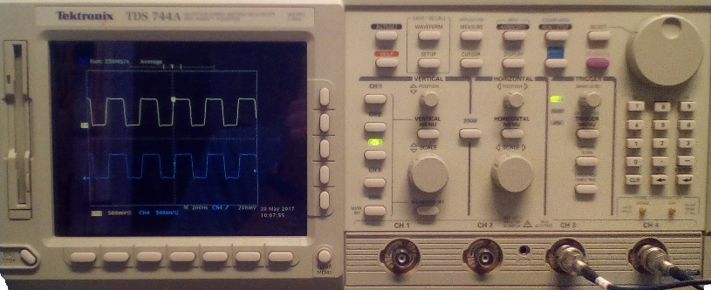
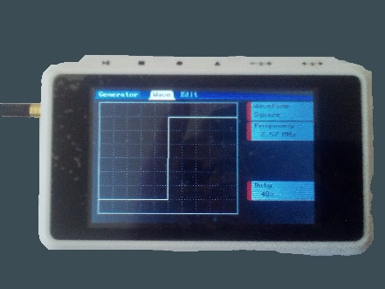
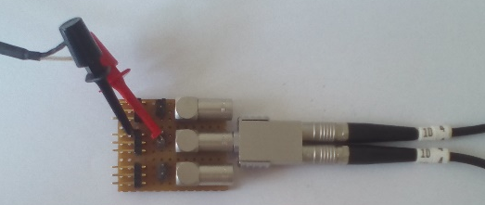
Measurement #1 - Setup
Tektronix TDS744A
DSO QUAD
We built the experiment
We set the scope controls and moved the waveform to the right position
We measured the time difference between the two waveforms
Notes:
Circuit
Experiment
Optic cable
Oscilloscope
Signal generator
(Breakoutboard)
Pin header
Wawe form, trace – fuggv. gorbe

Slide 4
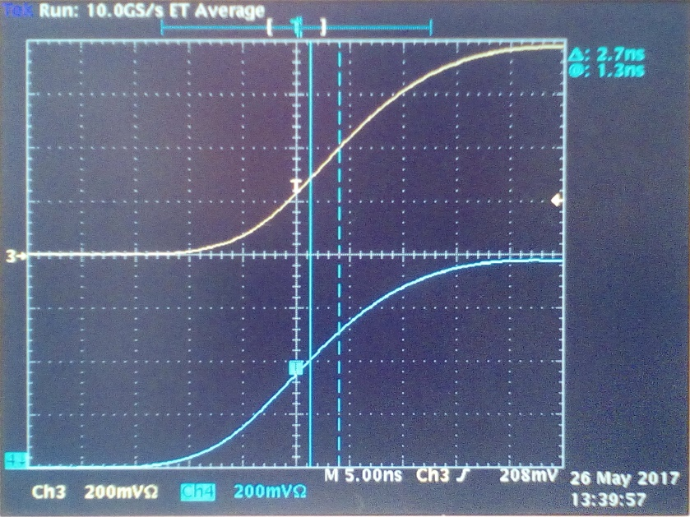
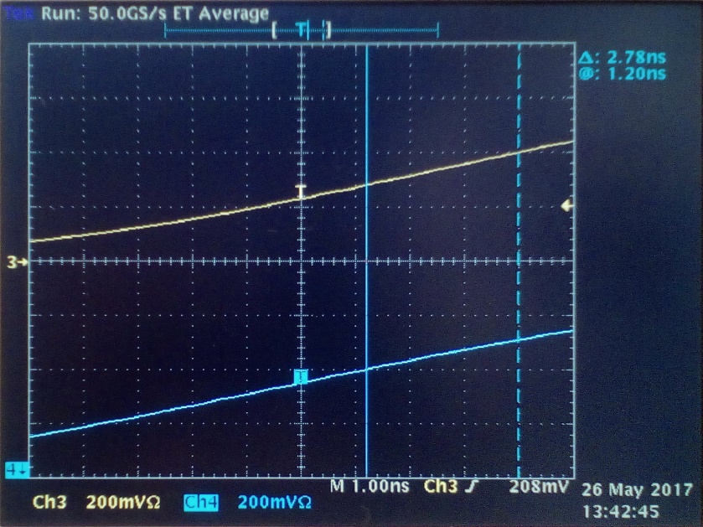
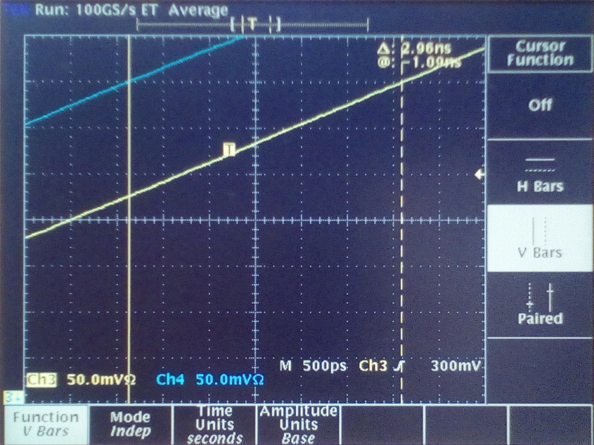
Measurement #1 - Results
∆_{meas.} (ns) | T_{meas.} (ns) | F_{meas.} (kHz) | ∆_{nom.} (ns) | T_{nom.} (ns) | F_{nom.} (kHz)
30.2 | 388 | 2577 | 30 (16+16-2) | 400 | 2500
2.7; 2,78; 2,96 | 23200 | 43.1 | 3 (5-2) | - | -
Notes:
Nominal – nevleges ertek

Slide 5
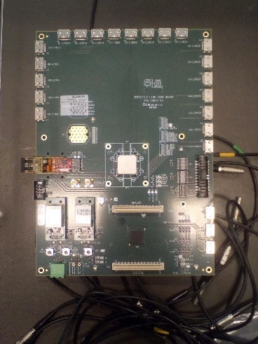
Measurement #2 – Setup and Results
VLDB
HDMI to SMA
1
2
SCOPE
A10Gx
3
No. | ∆ (ns)
1 | 116.50
2 | 116.51
4 | 116.57
4
SFP to SMA
Tektronix TDS744A

Slide 6
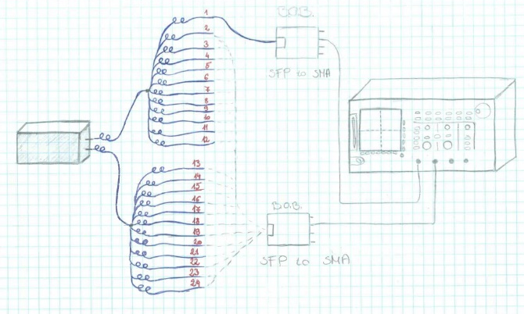
CRU Measurement #3 – Setup
CRU => optic cables (24) => B.o.b => Oscilloscope

Slide 7
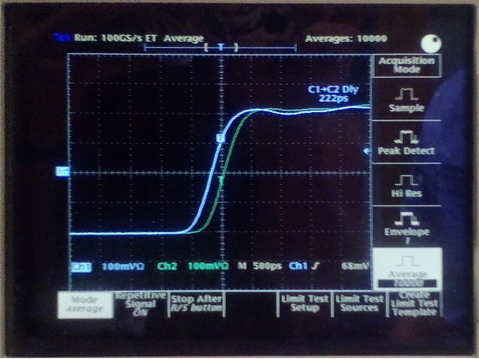
CRU Measurement #3 - Results
1
2 | 75 ps
3 | 173 ps
4
5 | 195 ps
6 | 248 ps
7 | 272 ps
8 | 100 ps
9 | 101 ps
10 | 116 ps
11 | 395 ps
12 | 137 ps
13 | 161 ps
14 | 211 ps
15 | 196 ps
16 | 222 ps
17 | 180 ps
18 | 286 ps
19 | 226 ps
20 | 300 ps
21 | 184 ps
22 | 367 ps
23 | 290 ps
24 | 446 ps

Slide 8
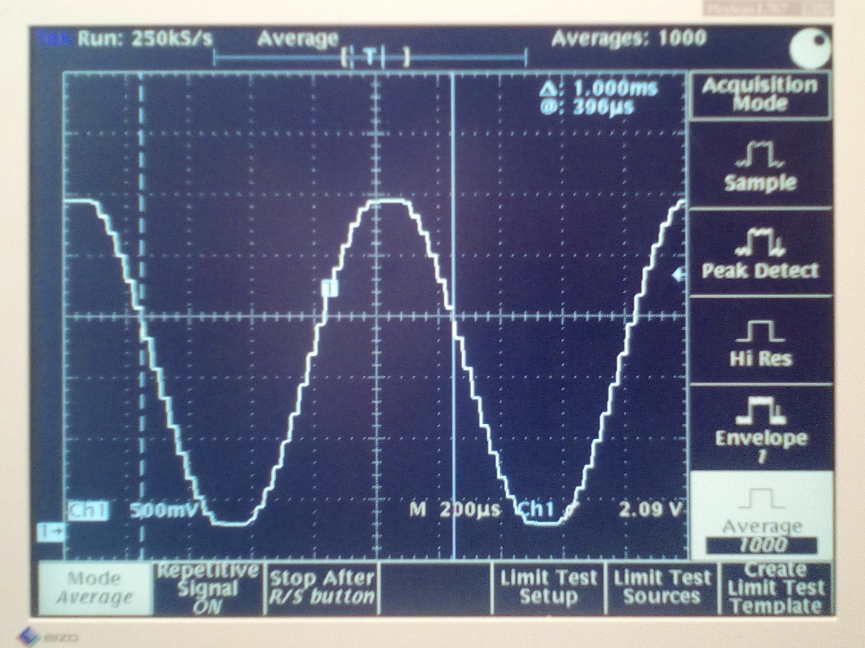
Thanks for the attention!

