Slide 1
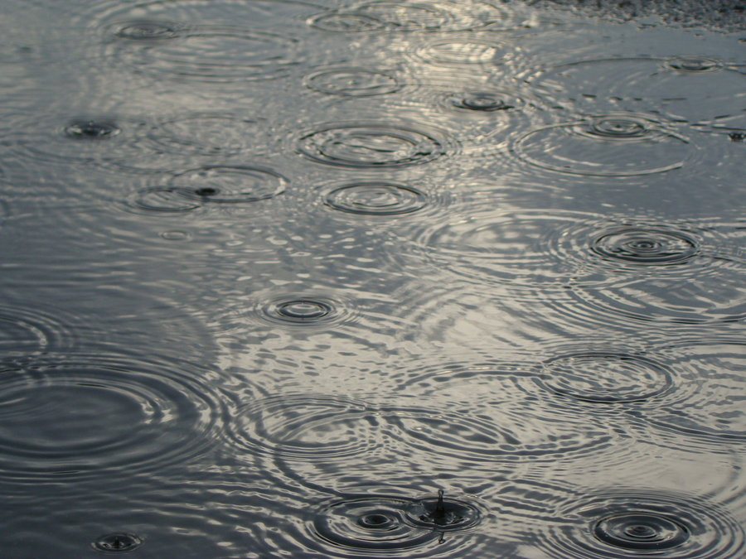
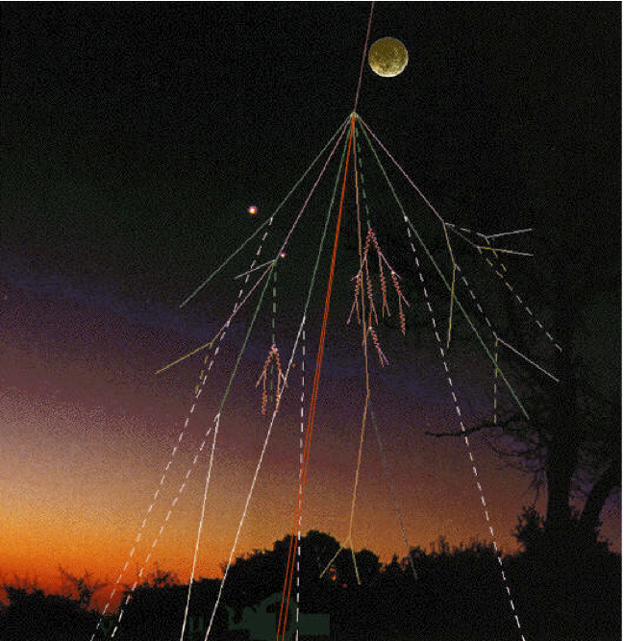
Raindrops and Muons
Darvas Dóra, Wittmann Kevin
Mentors:
Vadai Mihály
Ady Márton
Málnási-Csizmadia Örs
HSSIP 2017

Slide 2
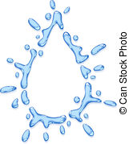
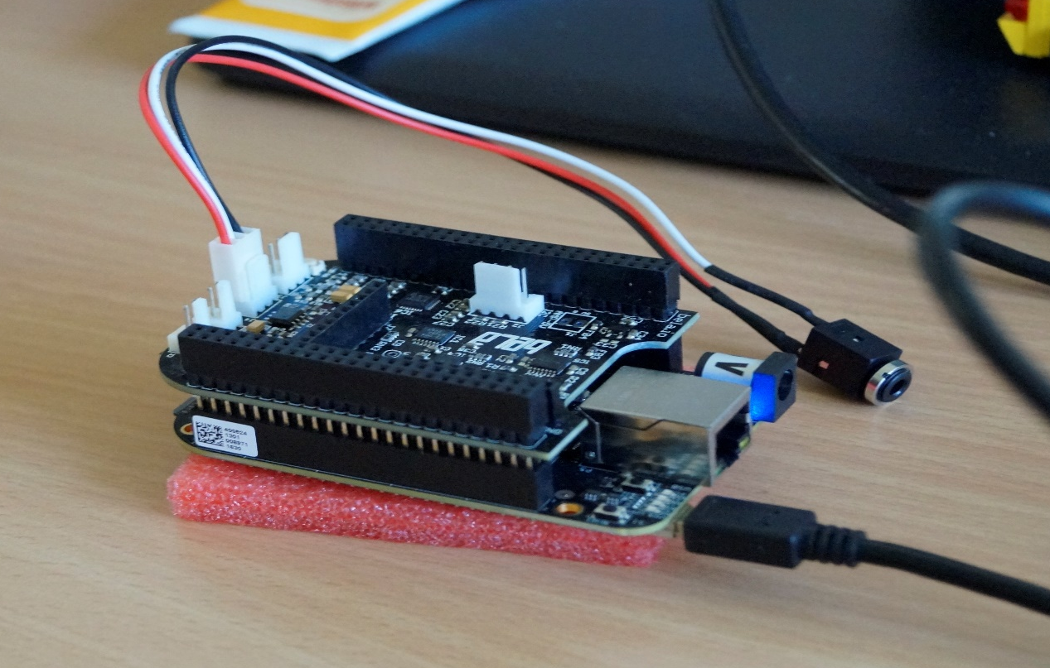
Raindrops
How do we detect raindrops in a sound file?
The plan was to suppress background noise and select raindrops.
We’ve characterized what the raindrops are.

Slide 3
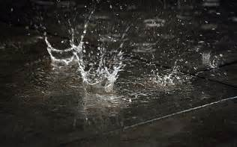


How much do you have to wait for the next rain drop to come?

Slide 4
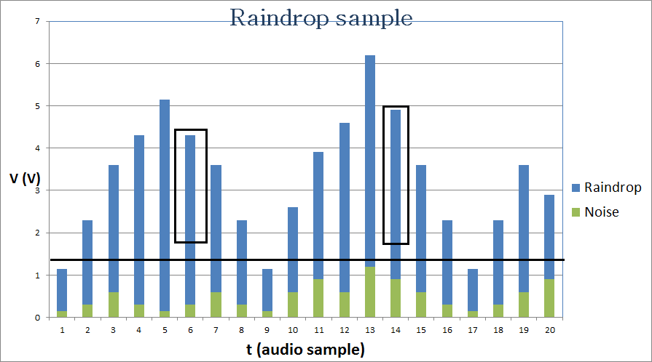
Raindrops

Slide 5
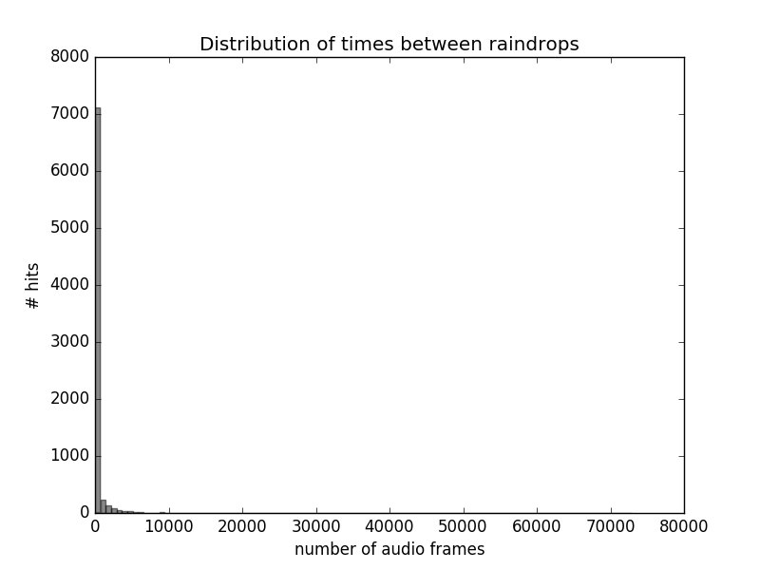

Slide 6
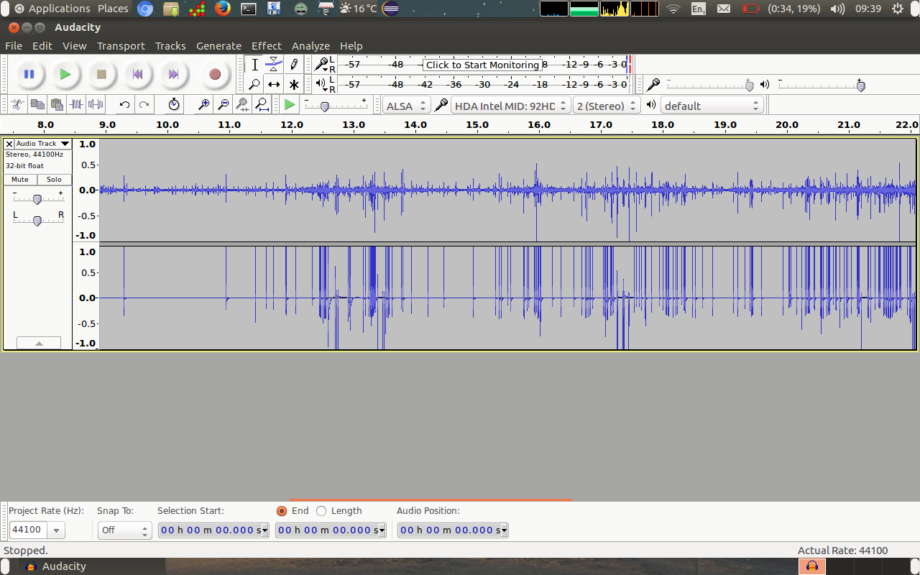
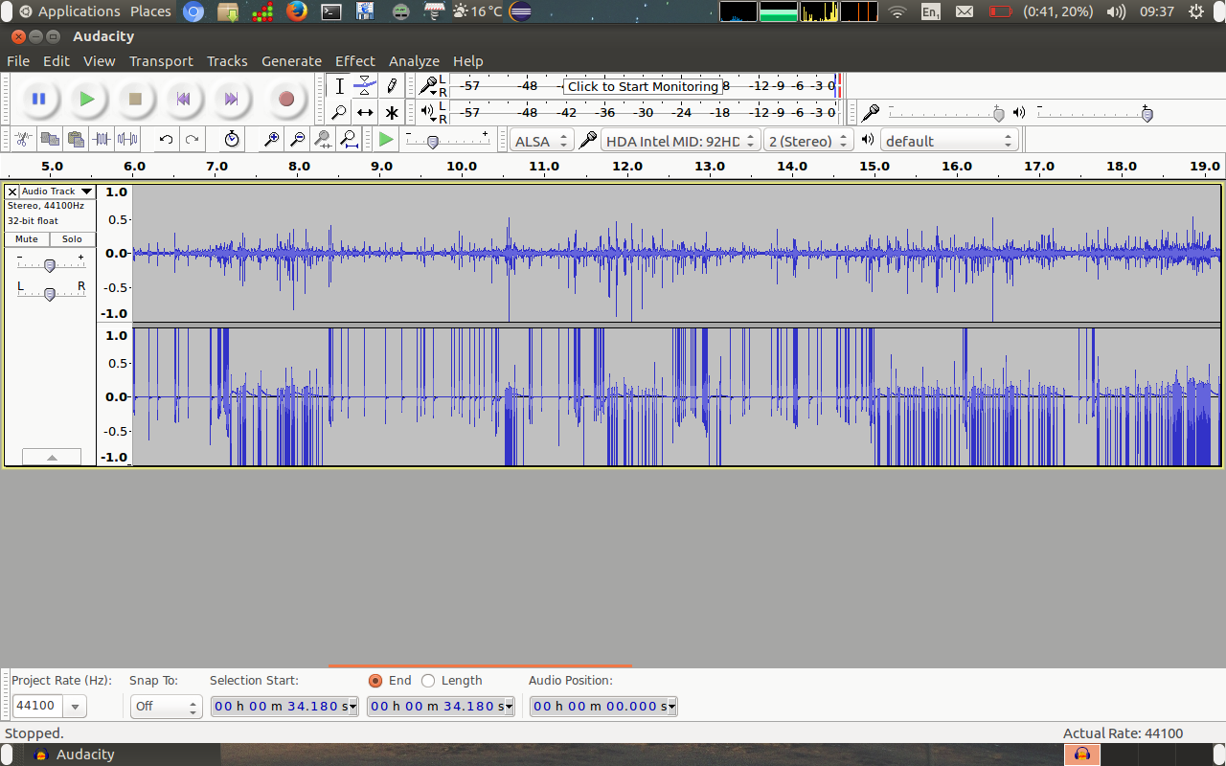
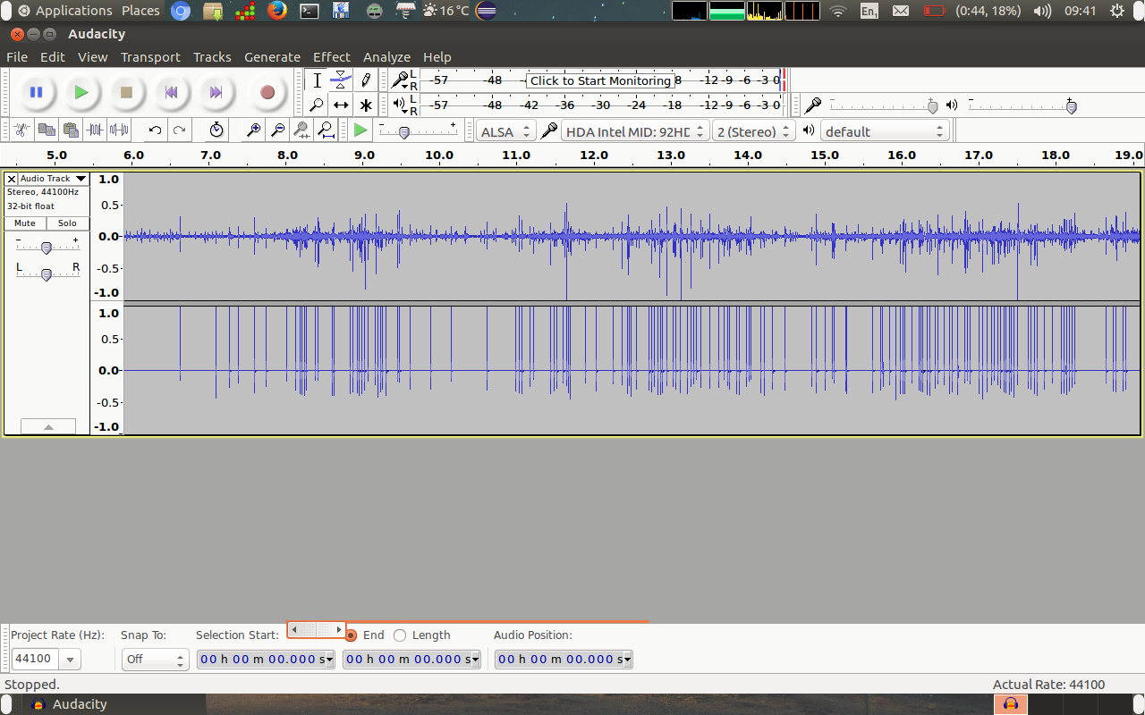

Slide 7
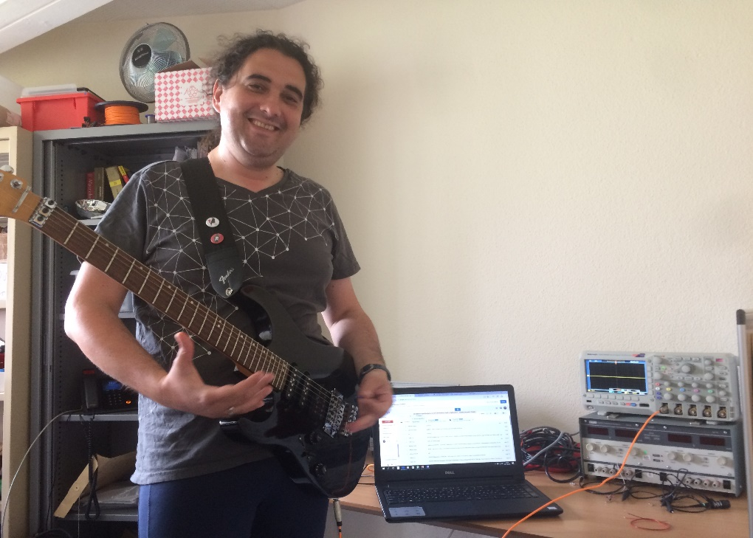
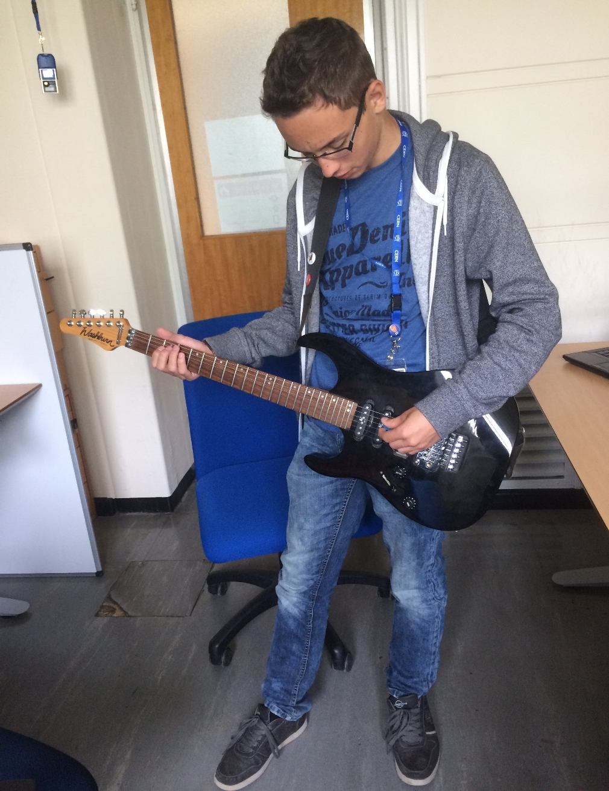
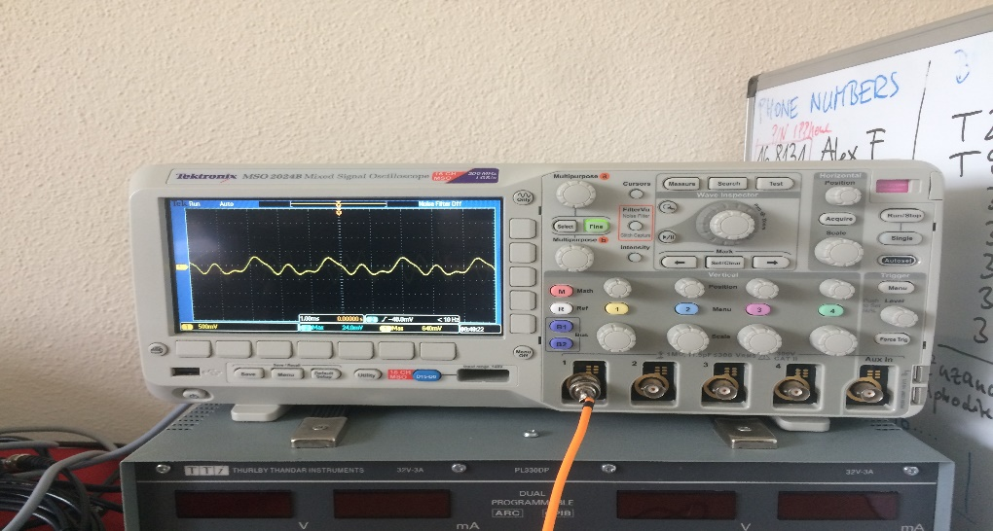
We looked at the sound waves with an oscilloscope.

Slide 8
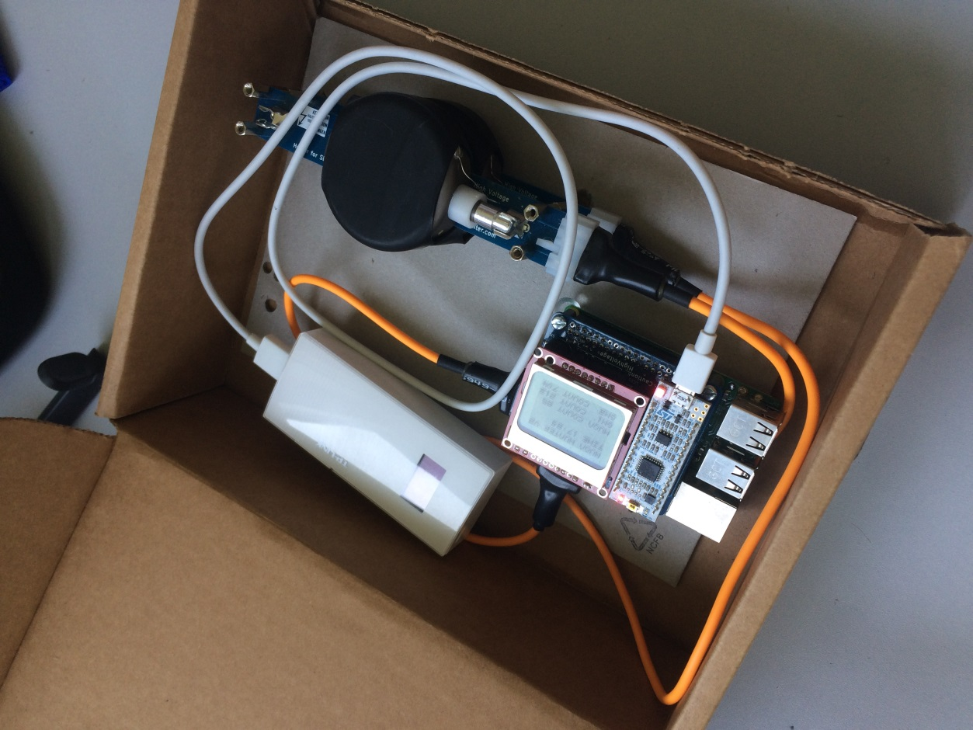
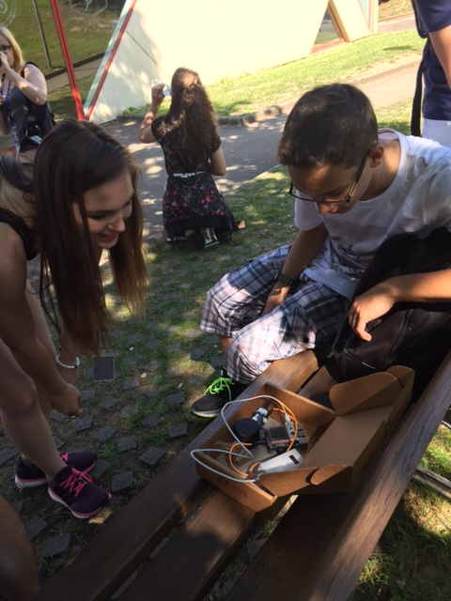
Measurement on the mountain
We measured 90 muon/10minutes at CERN (380m).
There were 170 muon/10 minutes on the top of the Salève (1210m).

Slide 9
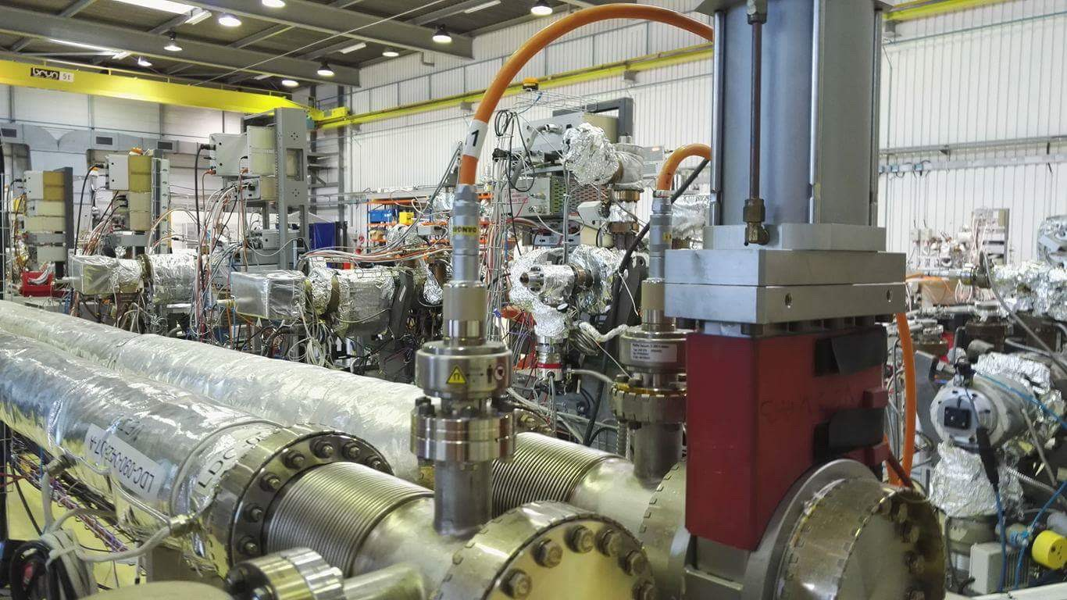
Vacuum

Slide 10
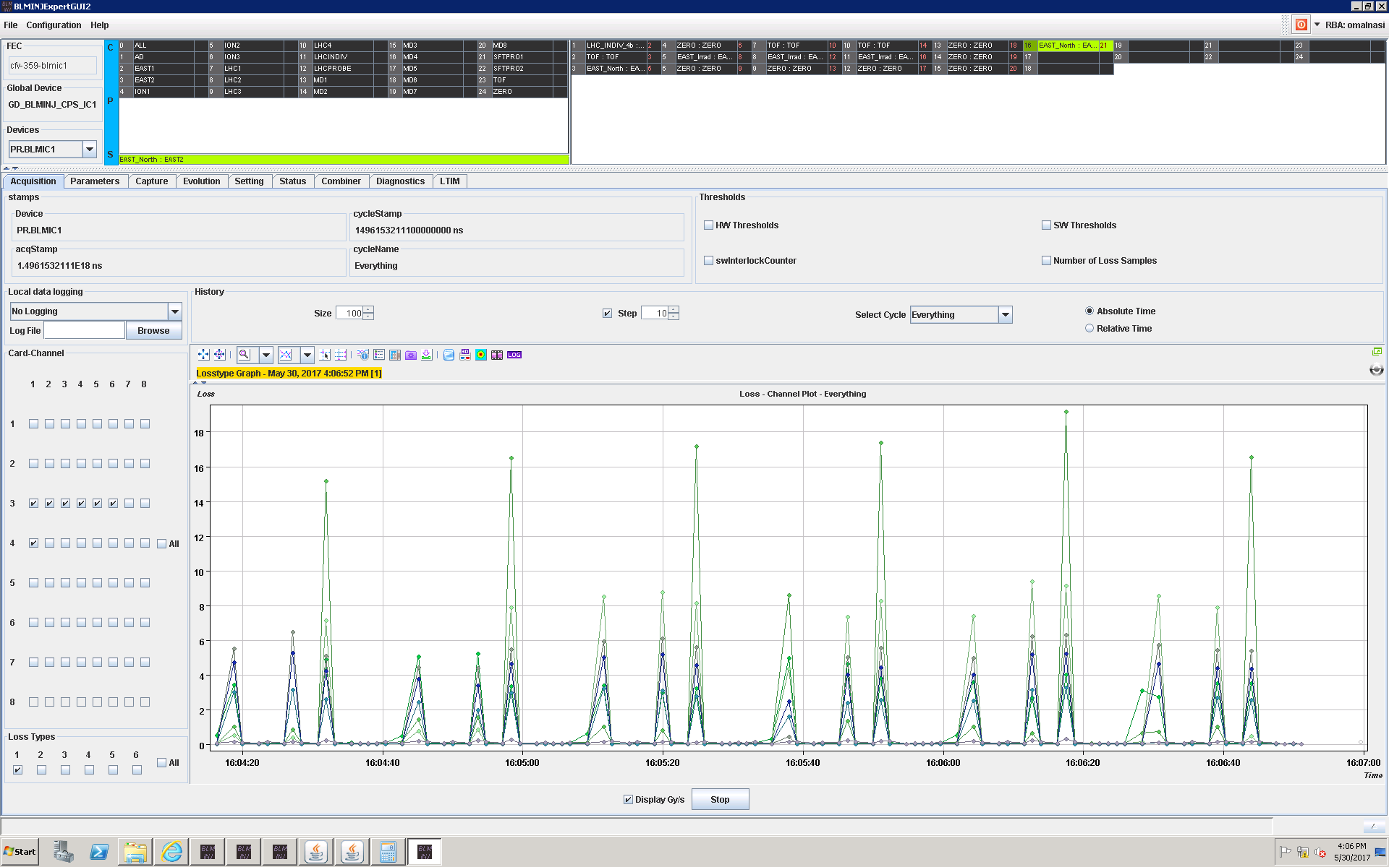
Beam Loss
The protonscynhroton particle loss was considered. The figure shows the function of the first type of integral.

Slide 11
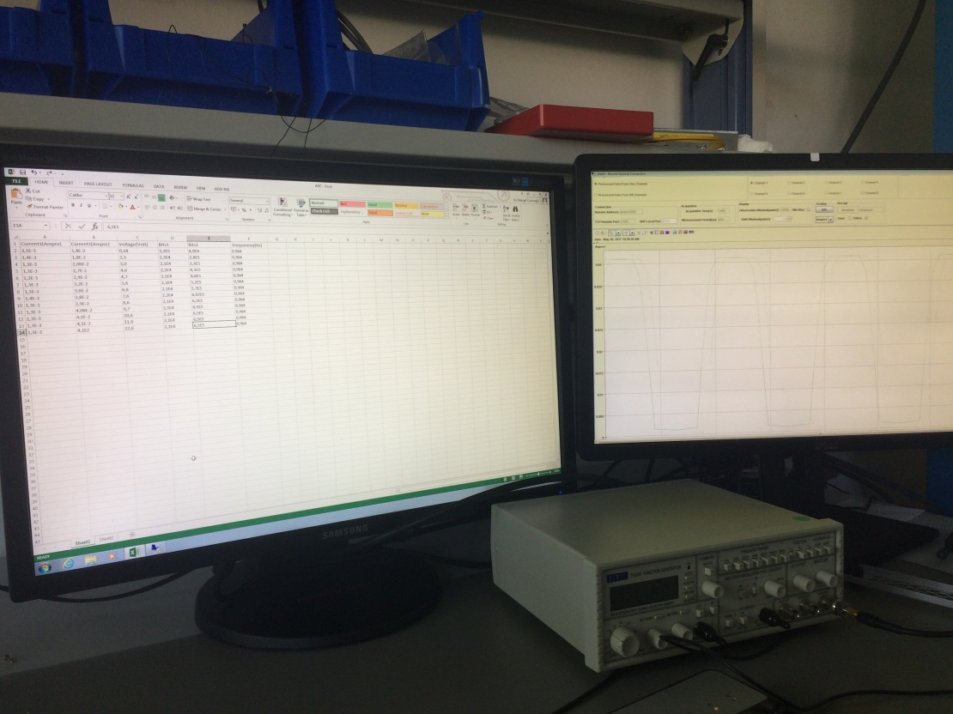
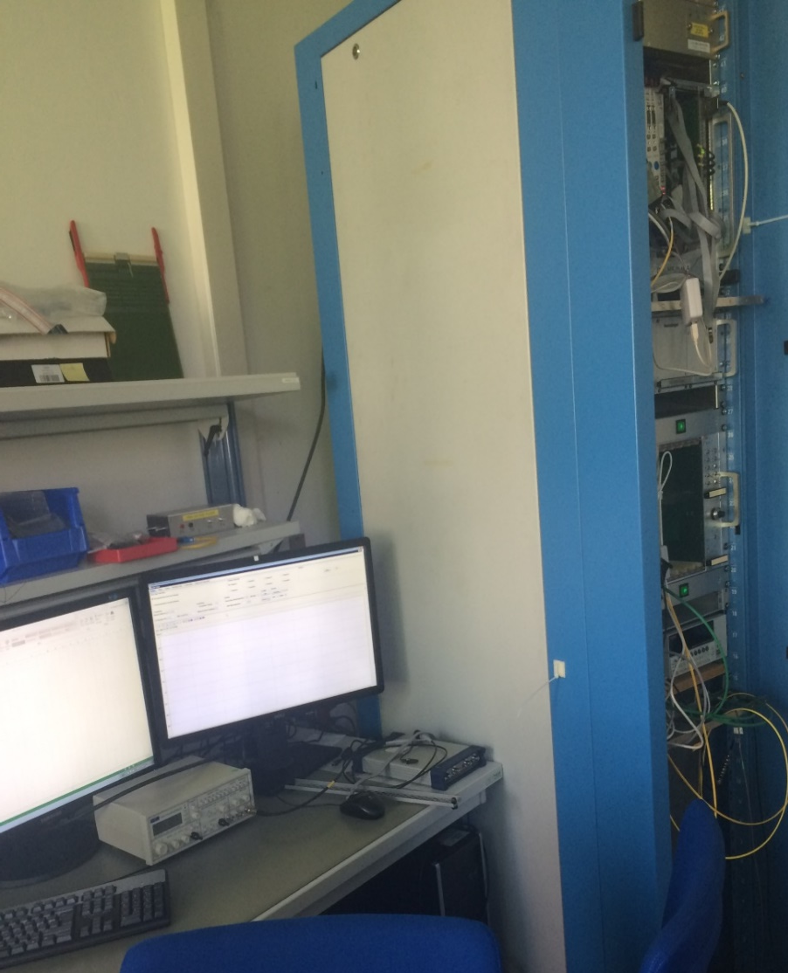
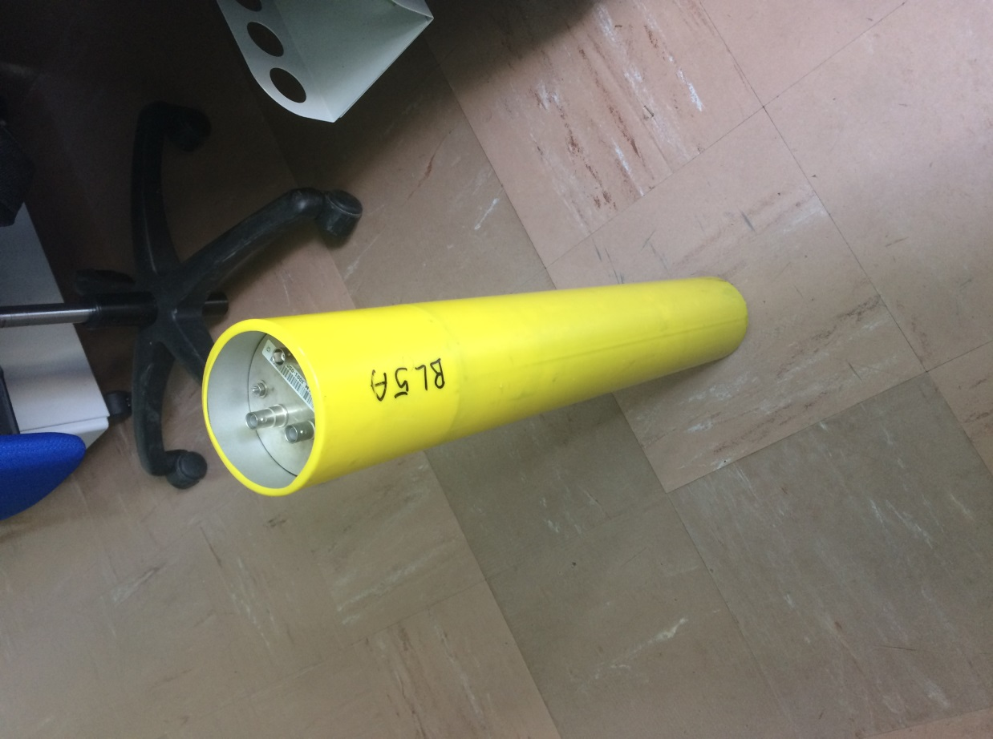
We used these tools

Slide 12
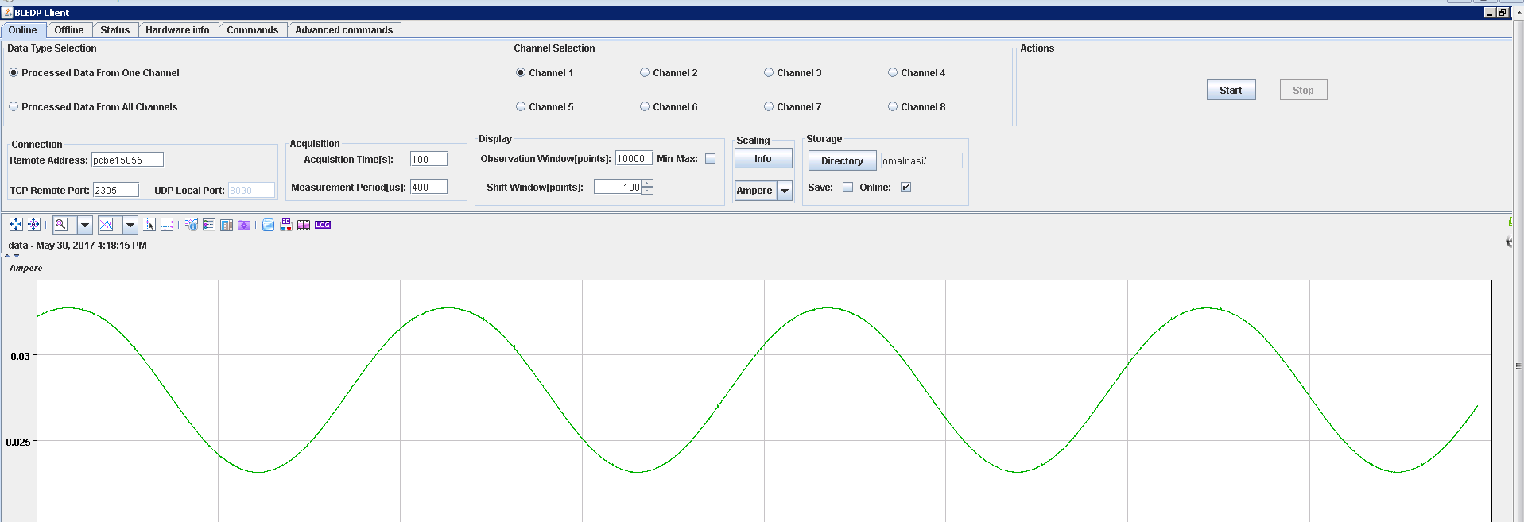

Slide 13
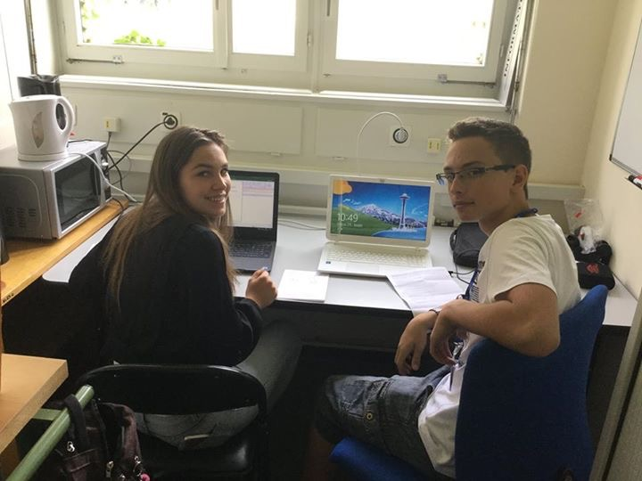

Thank you for your attention

Slide 14
References
https://cernbox.cern.ch/index.php/s/2ksrwjNLx9EMY6w?path=%2F
Password: muonmuon

