Slide 1
SEY measurements of the arc 1-2 removed-magnet beam screen
Valentine Petit 05.04.2017

Slide 2
Outline
Global configuration and aim of the study
Characterisation techniques
Analysed components
Results
Conclusions and perspectives
LHC Machine Committee 05.04.2017

Slide 3
Global configuration and aim of the study
Dipole
Quadrupole
04.01.17
  Nitrogen venting
  Filtered air (RF ball)
10.01.17
  Dipole extraction
V1
Dipole A31L2
V2
Investigate surface modifications due to exposure to the e-cloud in the machine
Secondary Electron Yield reduction (conditioning)
Surface chemistry modification
Air exposure : deconditioning

Slide 4
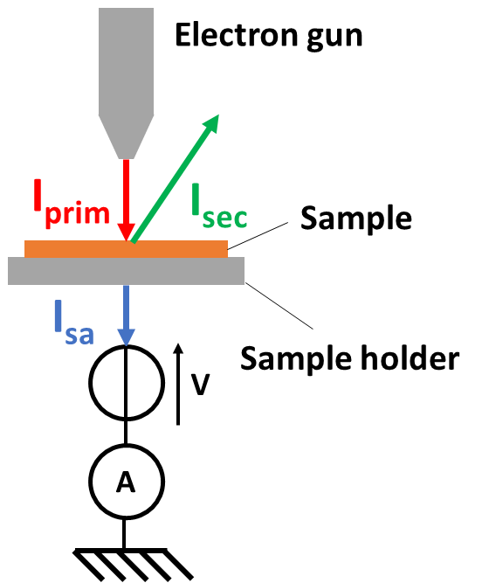
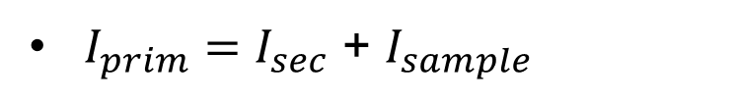
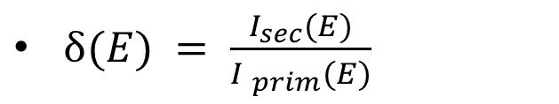
Characterisation techniques
SEY measurements
$δ(E) = \frac{I_{sec}(E)}{{I }_{prim}(E)}$
$I_{prim}=I_{sec}$ + $I_{sample}$
Dose received by the sample during a measurement : 10⁻⁷ C/mm² (no conditioning effect)
Reproducibility (twice the same point) : ± 0.02
Reproducibility (day by day) : ± 0.05

Slide 5
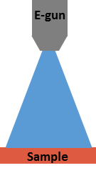
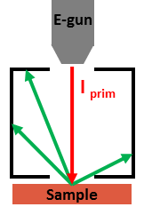
Characterisation techniques
Conditioning in laboratory
Follow up of maximum SEY versus irradiation dose
Irradiation by electrons
E_{p} = 250 eV
SEY measurement

Slide 6

Characterisation techniques
X-Ray photoelectron spectroscopy
Analysis of surface chemical composition
  Probed thickness : few nm
Irradiation with photons E = 1486.6 eV
Emission of photoelectrons
Cu 2p
$$E_{k}=hν −E_{binding} −Φ_{s}$$
O KLL
C KVV
Cu LMM
N KLL
O 1s
C 1s
chemical environment
specific for each element
N 1s
Cu 3s
Cu 3p

Slide 7
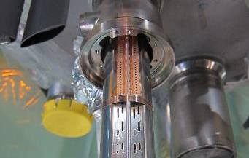
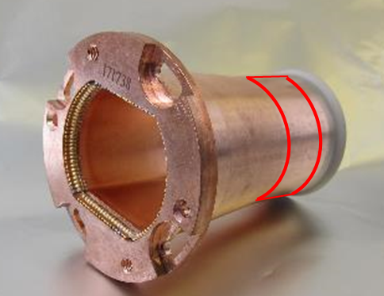
Analysed components
Transition tube (Dipole – Quadrupole)
Pumping slot shield
Beam screen
Top side
Transition tube (copper)
  magnetic field free region
Beam screen (colaminated copper on stainless steel)
  Looking for SEY differences due to electron confinement and synchrotron radiations
Pumping slot shield (copper – beryllium alloy)
  Looking for SEY differences due to masking by beam screen
Sawtooth side
Welding side
Bottom

Slide 8
Transition tube
0
-90°
90°
±180°
Fully conditioned + 3 weeks air exposed sample: lowest possible limit
No difference between 0°/180° and ±90° positions

Slide 9
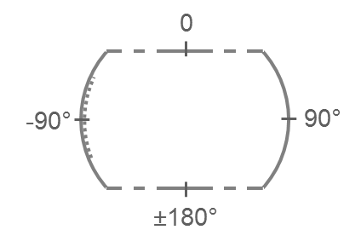
Beam Screen : A31L2 magnet
Side
Sawtooth side
Top side
Welding side
Bottom
Distance from beam screen extremity
No difference between flat sides / welding side in spite of dipole field
NB : ranking of SEY of samples does not correspond to chronology of measurements

Slide 10
Beam Screen : A31L2 magnet
Side
Sawtooth side
Top side
Welding side
Bottom
Not installed beam screen
Distance from beam screen extremity
Maximum SEY below « not installed » beam screen

Slide 11
Beam Screen : comparison LHC A31L2 and “not installed”
9 days air exposed
Conditioning at E_{p} = 250 eV
Room temperature
Base pressure P = 2.10⁻⁹ mbar
Error bars : dispersion over 4 measurement points
LHC beam screen samples
  Identical conditioning path for both samples
  Ultimate limit δ_{max} = 1.05
LHC versus «not installed » beam screen
  extracted LHC beam screen needs a lower dose to reach δ_{max} =1.35 (threshold for e-cloud in dipole) than « not installed » one

Slide 12
Beam Screen : comparison LHC A31L2 and “not installed”
Cu(OH)₂
Cu/Cu₂O
LHC beam screen : intermediate Cu 2p peak shape between « not installed » and deconditioned beam screen

Slide 13
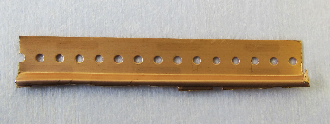
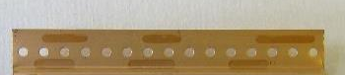
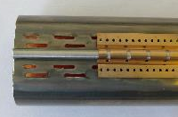
Pumping Slot Shield
Dark traces corresponding to pumping slot shield shape and spacing
10 mm
As received
10 mm
26h at 120°C
Baked to enhance colour contrast
Dark traces
    Low SEY regions
Out of dark traces
    High SEY regions

Slide 14
Pumping Slot Shield
Dark traces corresponding to pumping slot shield shape and spacing
Cleaned
Cleaned + cond. + air exposed 1 week
10 mm
As received
10 mm
26h at 120°C
Baked to enhance colour contrast
Dark traces
  Low SEY regions
  Compatible with “deconditioned” state
Out of dark traces
  High SEY regions
  same δ_{max} as “clean” material

Slide 15
Pumping Slot Shield
Cu/Cu₂O
Cu(OH)₂
In dark traces
δ_{max} : low SEY regions versus high SEY regions
Cu 2p peak : high Cu(OH)₂ versus low Cu(OH)₂ peak
  SEY measurements
  Cu 2p peak
  Parts exposed to e-cloud : conditioned
  Parts exposed to e-cloud : conditioned

Slide 16
Conclusions
Transition tube
  Uniform SEY in azimuth
Beam screen :
  Uniform SEY in azimuth
  Maximum SEY globally lower than “not installed” beam screen
      → compatible with a partial conditioning state in the machine
Pumping slot shield
  zones presenting the memory of conditioning

Slide 17
Perspectives
  Influence of the conditioning level reached on the SEY value observed after air exposure (deconditioning)
  Analysis of V2 beam screen
  More statistics on the sawtooth extracted from the A31L2 magnet
  Long-term : conditioning at low temperature

Slide 18
Acknowledgments
M. Taborelli, E. Garcia-Tabares, H. Neupert, P. Garritty, H. Kos, N. Kos, H. Rambeau, G. Bregliozzi, P. Maurin, V. Baglin, P. Chiggiato

Slide 19
Thank you

Slide 20
Spares

Slide 21
Transition tube
Plug-In Module
Conditioning at E_{p} = 250 eV
Base pressure P = 2.10⁻⁹ mbar
Error bars : dispersion over 4 measurement points
As received : δ_{max} = 1.84
Fully conditioned : δ_{max} = 1.09
Deconditioned 3 weeks : δ_{max} = 1.58
Fully reconditioned : δ_{max} = 1.09

Slide 22
Transition tube
Plug-In Module
Conditioning :
Shift to lower binding energy
Remove bump at 288.5 eV

Slide 23
Beam Screen : A31L2 magnet

Slide 24
Beam Screen : A31L2 magnet

Slide 25
Heat load
G.Iadarola

Slide 26
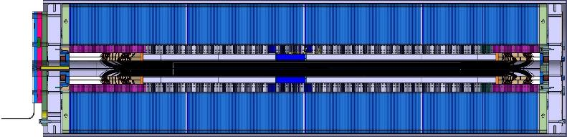
Magnetic field
Magnetic Yoke
Magnetic Length
Coil Length
Total Yoke Length
250 mm non magnetic
(43 laminations)
S. Izquierdo Bermudez
150 mm non magnetic
(26 laminations)

