Slide 1
MULCOPIM conference: impressions and highlights
P. Dijkstal, G. Rumolo
E-cloud meeting, 10.04.2017
https://indico.cern.ch/event/630626/

Slide 2
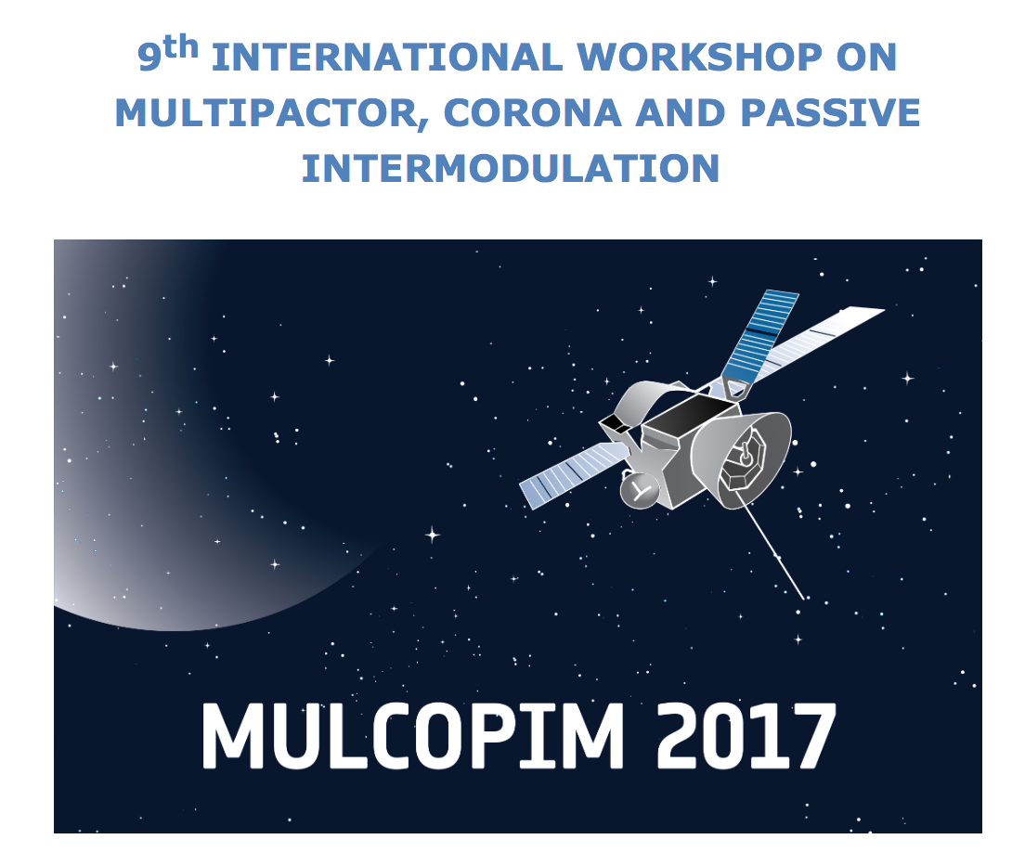

MULCOPIM 2017
MULCOPIM conference organized by the European Space Agency (ESA), took place 5-7 April in Noordwijk (NE)
It is devoted to MULtipacting, COrona, Passive Inter Modulation (PIM)
  Strong synergy with electron cloud activities in the multipacting part
  However, for satellite application, the concern lies mainly in avoiding occurrence of multipacting in high power RF cavities (no beam)
  5 sessions were entirely devoted to SEY modeling and measurements, many contributors mainly from Spanish institutes, ONERA (France), Frascati, China

Slide 3
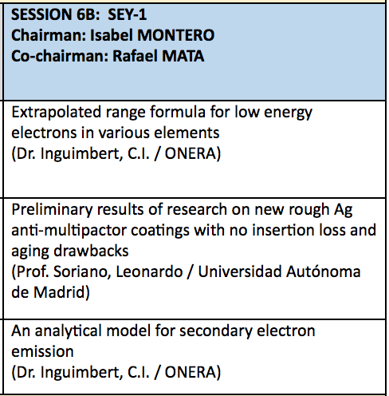
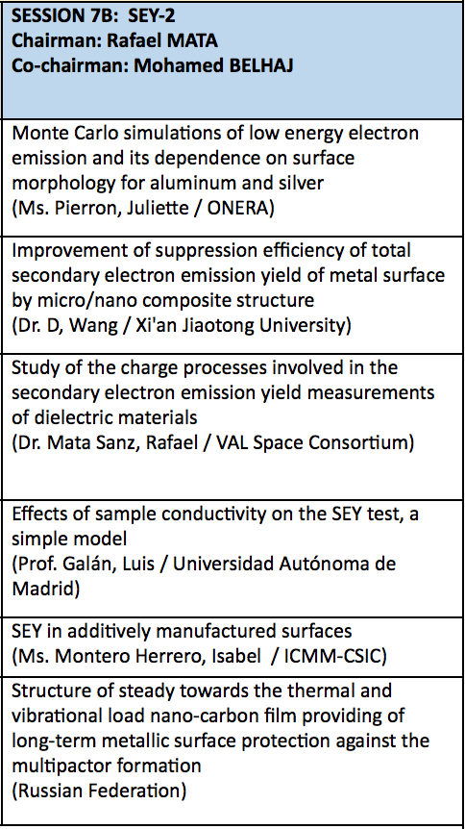
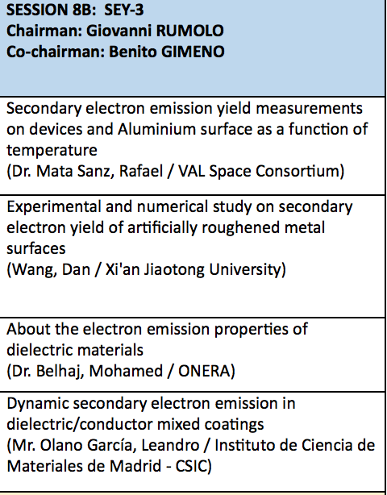
MULCOPIM: SEY sessions
Surface modeling
Coating
SEY Measurement
Techniques
SEY Measurements

Slide 4
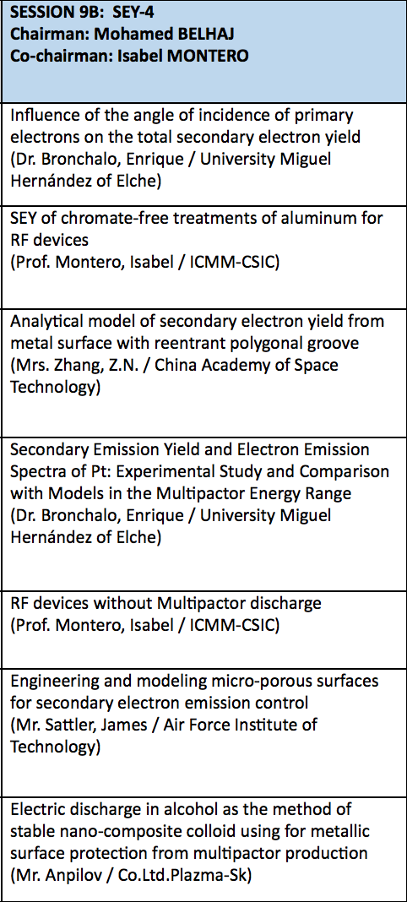
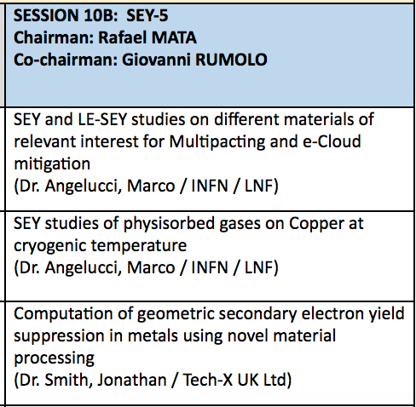
MULCOPIM: SEY sessions
Surface modeling
Coating
SEY Measurement
Techniques
SEY Measurements

Slide 5
Some general impressions
Lots of ongoing work on SEY physics and modeling
  Physics of secondary electron emission process for both conductors and dielectrics (and mixed structures used for coating)
  Detailed modeling of roughness at different scales
  Fitting with existing models, dependence on incidence angle
No mention (interest) in surface conditioning or scrubbing
  Main goal is to reduce SEY in order NOT to have multipacting – which would prevent the RF device from working!
    In accelerators, we can ‘afford’ living with e-cloud, at least for some time (if beam is stable enough, heat load is within limits and scrubbing works)
  Conditioning is an ‘issue’ to be avoided in lab measurements
  Aging (change of surface properties in time without e⁻ bombardment) is relevant for space applications
Usual SEY parameters like E_{max} and SEY_{max} are important, however lots of emphasis on E₁ (‘first crossover point’, it is the lower energy at which SEY=1) and little interest in the behaviour of low energy electrons

Slide 6
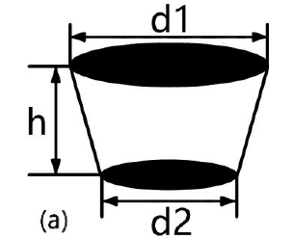
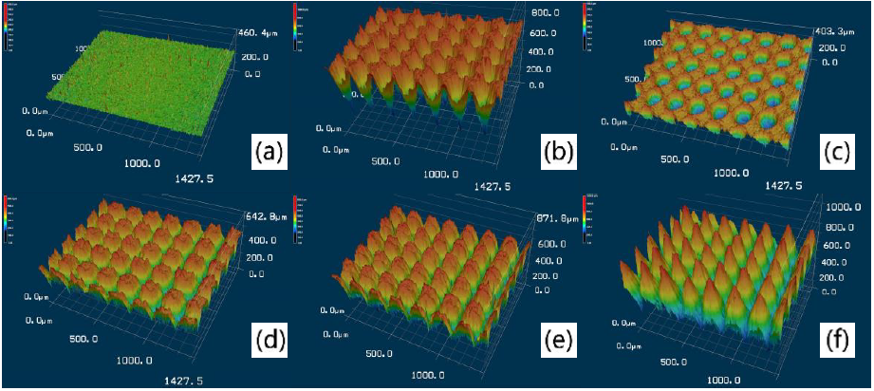
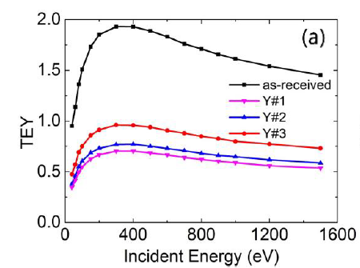
Some highlights
Since interest is mainly in low SEY surfaces, surface geometry is simulated in detail to explain the property of lowering SEY (e.g., D. Wang, J. Smith)
  Modeling of laser etched surfaces to assess whether the SEY reduction depends on change of chemical or geometric properties
  Modeling of porous surface
  Machined surfaces

Slide 7
Some highlights
SEY of dielectric materials (M. Belhaj, ONERA)
  Usually assumed to be very high (>>1)
  However, when secondary emission occurs, the dielectric charges up and there are internal and external space charge forces changing the SEY behaviour
  For mono-energetic electron bombardment, SEY tends to become 1 for basically all energies of incident electron → Implications for our cases of ferrites, ceramic tubes, dielectric exposed to the beam?

Slide 8
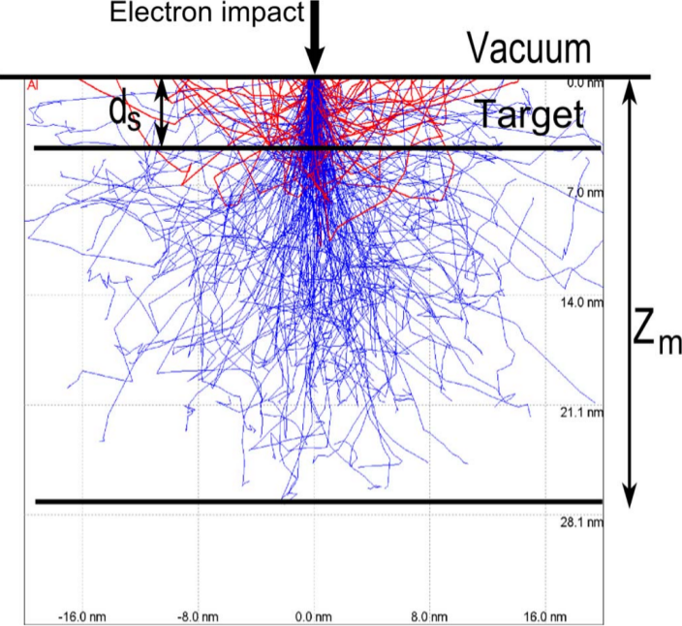
Some highlights
Monte-Carlo simulations of SEY
Secondary Electron Emission on Space Materials: Evaluation of the Total Secondary Electron Yield from Surface Potential Measurements
M. Belhaj, V. Inguimbert et al., 2012

Slide 9
Some highlights
Interesting measurements, e.g. dependence of SEY on temperature (R. Mata, M. Angelucci)
  Measurements at Valencia Space Consortium (VSC) between -150 and 150º C (relevant due to the temperature fluctuations of satellites in space) → suggest lower SEY curves at lower temperatures, however very preliminary
  Measurements at LNFL, focusing especially on the SEY curve in the low energy region (towards the work function of the metal)
    Tends to vanish for cleaned metal surface, independently of temperature
    Remains high for ‘as received’ samples, confirming that reflection is mainly due to the non-metallic nature of the contaminant layer

Slide 10
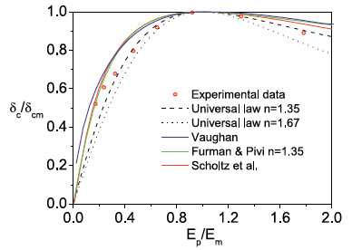
Some highlights
Fitting the best modeling analytical description to experimental data (E. Bronchalo, University of Elche)
  SEY curve: universal law with n=1.35
  Energy distribution of secondaries (which does not depend on the incident energy): Scholtz
  Angular dependence of SEY for different incident energies (Pt surface, for Cu in future?) → Philipp will receive the slides/papers

Slide 11
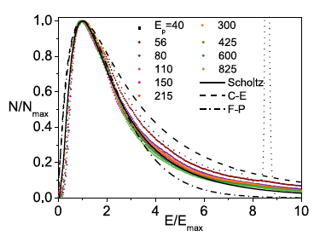
Some highlights
Fitting the best modeling analytical description to experimental data (E. Bronchalo, University of Elche)
  SEY curve: universal law with n=1.35
  Energy distribution of secondaries (which does not depend on the incident energy): Scholtz
  Angular dependence of SEY for different incident energies (Pt surface, for Cu in future?) → Philipp has received slides/papers

Slide 12
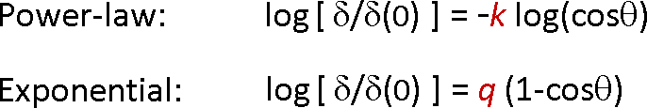
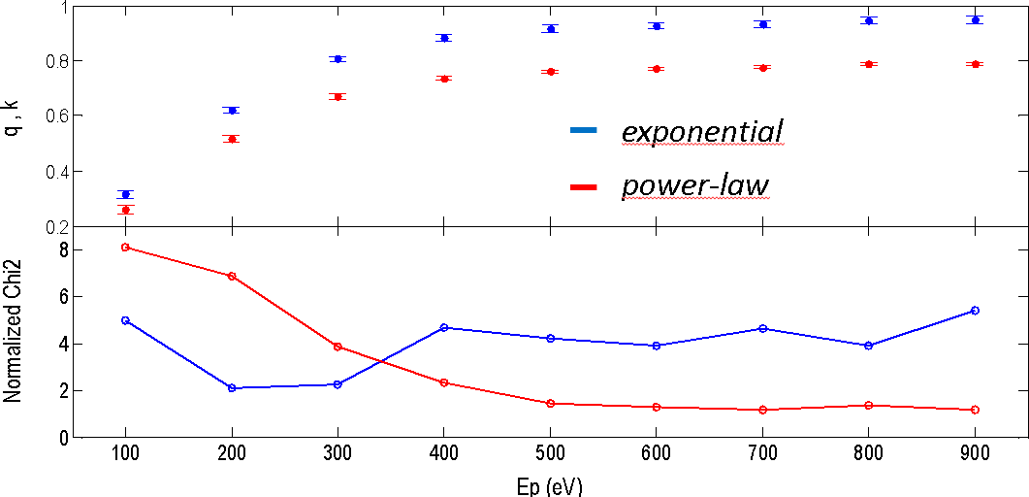
Some highlights
Angular dependence of SEY up to 55 degrees (for Pt only ☹)
In PyECLOUD: Exponential with q=0.5 independent of energy

Slide 13
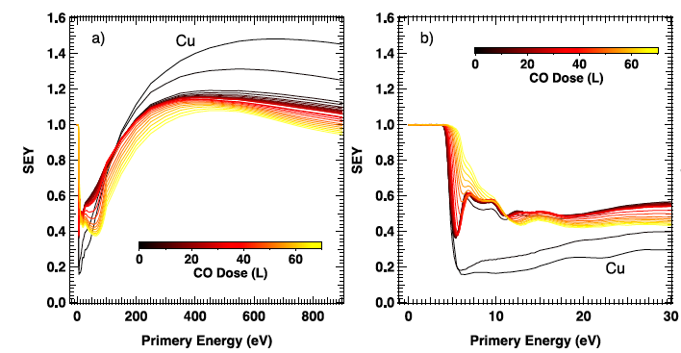
Some highlights
Measurements of SEY with different amounts of condensed gas on cryogenic Cu surface (M. Angelucci, LNFL)
  Measurements were done at 10 K
  Different values of monolayers (L) of condensed Ar or CO
  Interesting observation that SEY goes rapidly below 1.2 when physisorbing CO (amount ≥ 1 ML is enough!) → Shall we condense CO on the beam screen surfaces of LHC? ☺

Slide 14
And finally …
Very interesting experience, next MULCOPIM in three years in Valencia
Many many thanks to Frank Zimmermann and Eucard for inviting us to participate in this conference and for supporting our participation!
Meanwhile, ECLOUD’18 at Elba island, tentatively 3-6 June, 2018, possibly in the ARIES framework
  Organised by R. Cimino, myself, F. Zimmermann, G. Franchetti
  We could ask Benito Gimeno (VSC, University of Valencia) to be in the International Advisory Committee and propose speakers on the SEY modeling and measurements

Slide 15
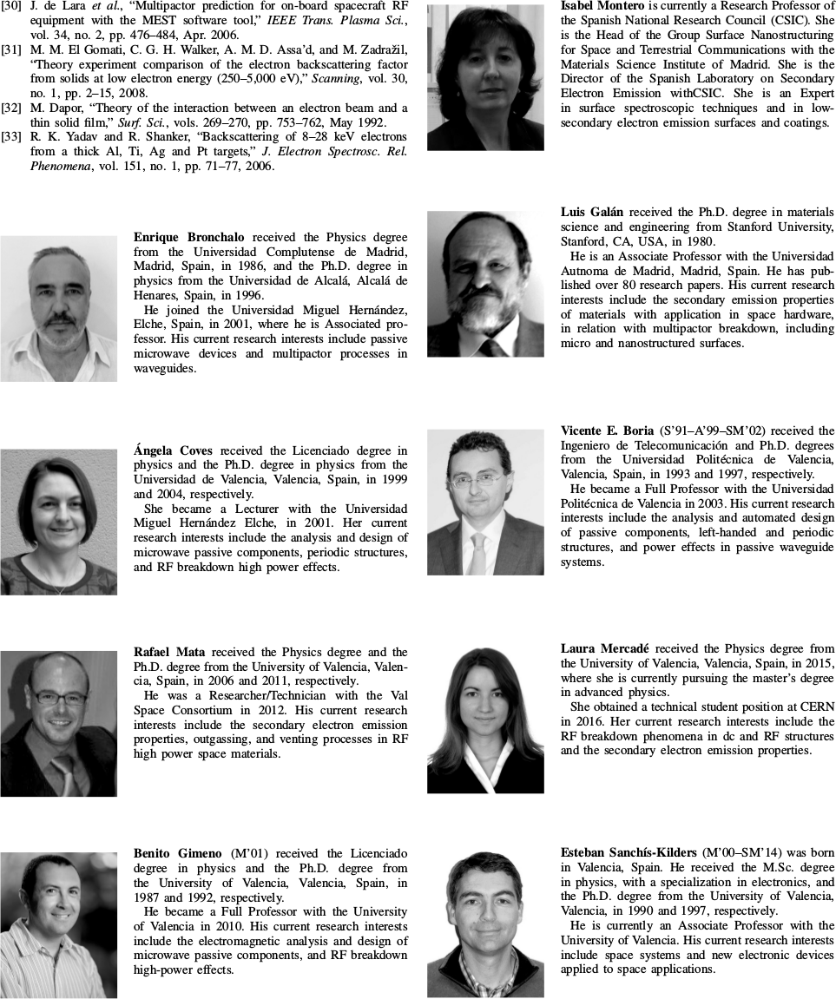
Some People

