Slide 1
Representation of
magnetic test data at CERN
Marco Buzio (CERN)
Introduction
Examples
Conclusions
Notes:
We foresee brief introductions to measurement techniques and motivating examples from CERN and PSI magnets. After that there should be plenty of time to discuss field descriptions and numerical techniques and explore possibilities for R&D projects on the subject.

Slide 2
Introduction

Slide 3
Objectives of magnetic measurements
Different test scenarios during a magnet’s lifetime →
latitude for different trade-offs between accuracy and resources
design time: fill in information missing in computer models:
- material properties, mechanical tolerances ()
complement models: provide hard-to-get information
- time constant of eddy currents (difficult)
- hysteresis effects (practically impossible)
magnet acceptance: go-no go decision
- accept/reject/do further tests
- spot checks (series tests)
fiducialization data for installation and alignment
magnetic axis (transversal), longitudinal center
characterization for beam physics
- input data for beam optics codes
- operating information for the control room
- one-off questions (e.g. measure a specific harmonic)

Slide 4
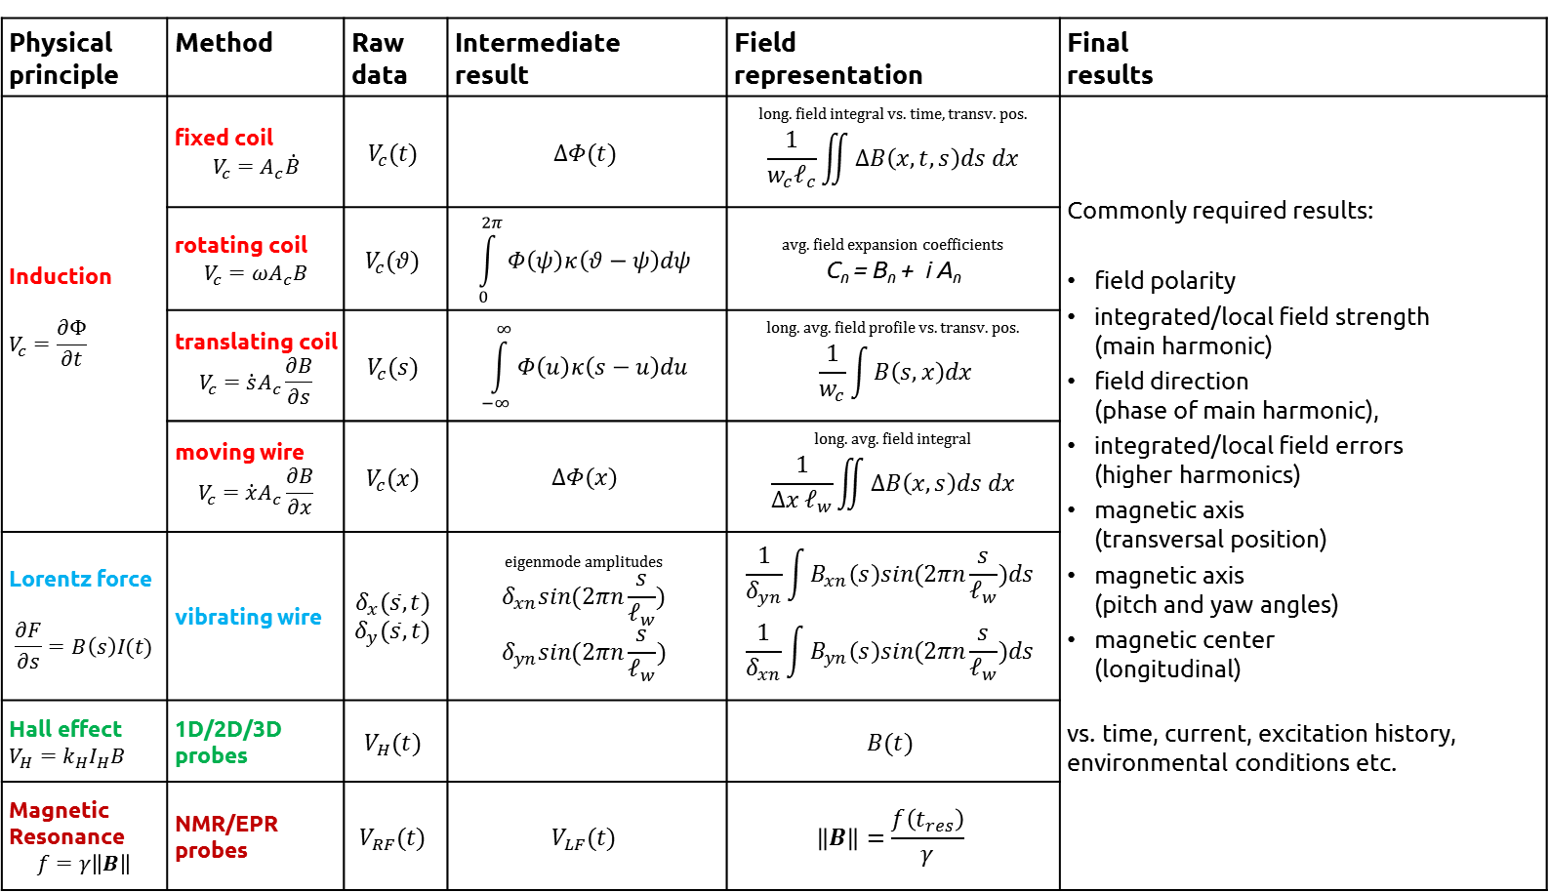
Magnetic measurement dataflow
CALIBRATION
DATA REDUCTION
Physical principle | Method | Raw data | Intermediate result | Field representation | Final results
Induction $$V_{c}=\frac{∂Φ}{∂t}$$ | fixed coil $$V_{c}=A_{c}\dot{B}$$ | $$V_{c}(t)$$ | $$ΔΦ(t)$$ | long. field integral vs. time, transv. pos. $$\frac{1}{w_{c}ℓ_{c}}\iint{ΔB\left(x,t,s\right)ds dx}$$ | Commonly required results: field polarity integrated/local field strength (main harmonic) field direction (phase of main harmonic), integrated/local field errors (higher harmonics) magnetic axis (transversal position) magnetic axis (pitch and yaw angles) magnetic center (longitudinal) vs. time, current, excitation history, environmental conditions etc.
 | rotating coil $$V_{c}={ωA}_{c}B$$ | $$V_{c}(θ)$$ | $$\int_{0}^{2π}{Φ\left(ψ\right)κ\left(θ−ψ\right)dψ}$$ | avg. field expansion coefficients C_{n} = B_{n} + i A_{n}
 | translating coil $$V_{c}=\dot{s}A_{c}\frac{∂B}{∂s}$$ | $$V_{c}(s)$$ | $$\int_{−∞}^{∞}{Φ\left(u\right)κ\left(s−u\right)du}$$ | long. avg. field profile vs. transv. pos. $$\frac{1}{w_{c}}\int{B\left(s,x\right)dx}$$
 | moving wire $$V_{c}=\dot{x}A_{c}\frac{∂B}{∂x}$$ | $$V_{c}(x)$$ | $$ΔΦ\left(x\right)$$ | long. avg. field integral $$\frac{1}{{Δx ℓ}_{w}}\iint{ΔB\left(x,s\right)ds dx}$$
Lorentz force $$\frac{∂F}{∂s}=B\left(s\right)I(t)$$ | vibrating wire | $$δ_{x}(\overline{s},t)$$ $$δ_{y}(\overline{s},t)$$ | eigenmode amplitudes $$δ_{xn}sin(2πn\frac{s}{ℓ_{w}})$$ $$δ_{yn}sin(2πn\frac{s}{ℓ_{w}})$$ | $$\frac{1}{δ_{yn}}\int{B_{xn}\left(s\right)sin(2πn\frac{s}{ℓ_{w}})ds}$$ $$\frac{1}{δ_{xn}}\int{B_{yn}\left(s\right)sin(2πn\frac{s}{ℓ_{w}})ds}$$
Hall effect $$V_{H}=k_{H}I_{H}B$$ | 1D/2D/3D probes | $$V_{H}(t)$$ |  | $$B(t)$$
Magnetic Resonance $$f=γ\left\|B\right\|$$ | NMR/EPR probes | $$V_{RF}(t)$$ | $$V_{LF}(t)$$ | $$\left\|B\right\|=\frac{f\left(t_{res}\right)}{γ}$$
s : longitudinal coordinate; x,y : transversal coordinates. B : magnetic field component normal to the coil, the movement of the wire and to the Hall sensor
Notes:
Angle given by encoder, high precision.
Challenge find a common framework for the various field description.

Slide 5
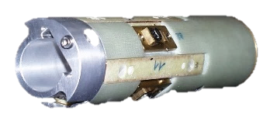
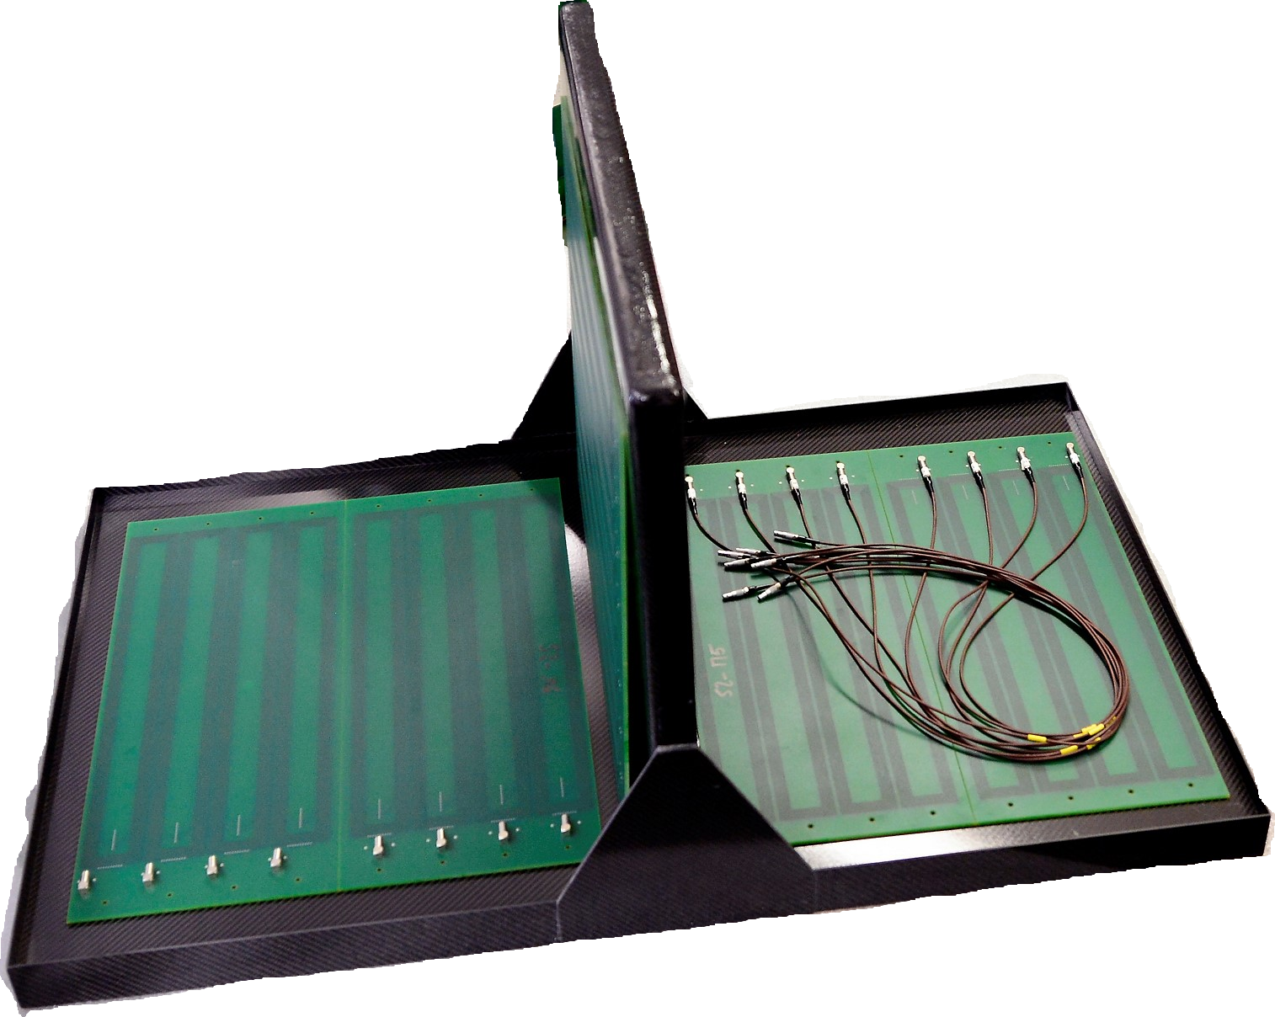
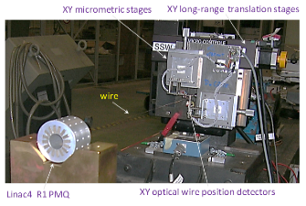
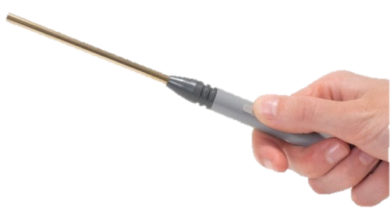
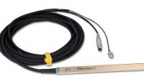
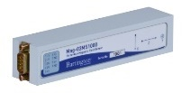
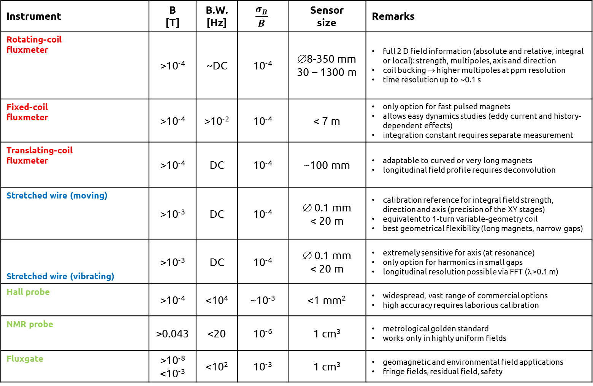
Magnetic instruments
Instrument | B [T] | B.W. [Hz] | $$\frac{σ_{B}}{B}$$ | Sensor size | Remarks
Rotating-coil fluxmeter | >10⁻⁴ | ~DC | 10⁻⁴ | ∅8-350 mm 30 – 1300 m | full 2 D field information (absolute and relative, integral or local): strength, multipoles, axis and direction coil bucking → higher multipoles at ppm resolution time resolution up to ~0.1 s
Fixed-coil fluxmeter | >10⁻⁴ | >10⁻² | 10⁻⁴ | < 7 m | only option for fast pulsed magnets allows easy dynamics studies (eddy current and history-dependent effects) integration constant requires separate measurement
Translating-coil fluxmeter | >10⁻⁴ | DC | 10⁻⁴ | ~100 mm | adaptable to curved or very long magnets longitudinal field profile requires deconvolution
Stretched wire (moving) | >10⁻³ | DC | 10⁻⁴ | ∅ 0.1 mm < 20 m | calibration reference for integral field strength, direction and axis (precision of the XY stages) equivalent to 1-turn variable-geometry coil best geometrical flexibility (long magnets, narrow gaps)
Stretched wire (vibrating) | >10⁻³ | DC | 10⁻⁴ | ∅ 0.1 mm < 20 m | extremely sensitive for axis (at resonance) only option for harmonics in small gaps longitudinal resolution possible via FFT (λ>0.1 m)
Hall probe | >10⁻⁴ | <10⁴ | ~10⁻³ | <1 mm² | widespread, vast range of commercial options high accuracy requires laborious calibration
NMR probe | >0.043 | <20 | 10⁻⁶ | 1 cm³ | metrological golden standard works only in highly uniform fields
Fluxgate | >10⁻⁸ <10⁻³ | <10² | 10⁻³ | 1 cm³ | geomagnetic and environmental field applications fringe fields, residual field, safety
Notes:
All raw data are voltages
Schematic table with typical values for illustration: accuracy depends a lot on the time and effort devoted to calibration

Slide 6
2D field representation

Slide 7
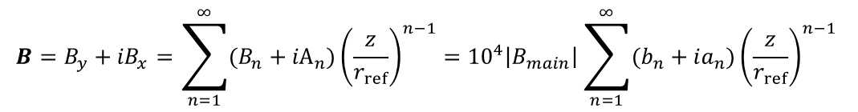

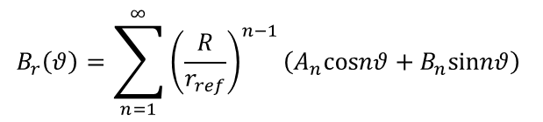

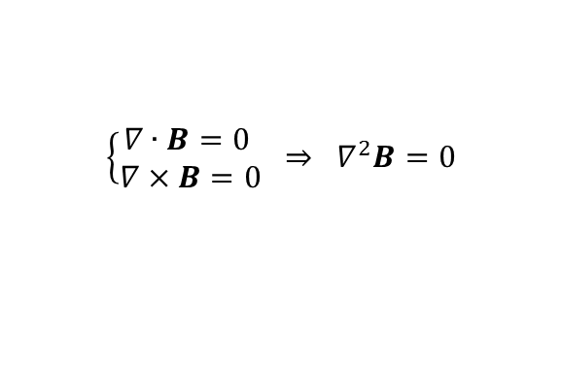
2D disk
Simplest, most commonly used example: analytic solution of Maxwell’s equations in a disk
$$B=B_{y}+{iB}_{x}=\sum_{n=1}^{∞}{(B_{n}+{iA}_{n}){\left(\frac{z}{r_{ref}}\right)}^{n−1}}={10}^{4}\left|B_{main}\right|\sum_{n=1}^{∞}{(b_{n}+ia_{n}){\left(\frac{z}{r_{ref}}\right)}^{n−1}}$$
$$\left\{\begin{matrix}∇∙B=0 \\ ∇×B=0\end{matrix} ⇒ ∇^{2}B=0\right.$$
Magnetostatic equations in
a source-free region
C_{n} =absolute harmonics c_{n}=normalized harmonics
$$\frac{∂B}{∂x}+i\frac{∂B}{∂y}=∇×B+i∇∙B=0$$
general solution (hint: )
$$B_{r}\left(θ\right)=\sum_{n=1}^{∞}{{\left(\frac{R}{r_{ref}}\right)}^{n−1}\left(A_{n}cosnθ+B_{n}sinnθ\right)}$$
boundary condition:
reference radius: typically 2/3 of magnet gap or size of the beam or
r at which expected field errors have similar magnitude
$$K_{n}=\frac{𝓁_{m}}{B_{1}ρ_{0}}\frac{∂^{n}B_{y}}{∂x^{n}}=\frac{n! 𝓁_{m}}{ρ_{0}r_{ref}^{n}}\frac{B_{n+1}}{B_{1}}, J_{n}=\frac{𝓁_{m}}{B_{1}ρ_{0}}\frac{∂^{n}B_{x}}{∂x^{n}}=\frac{n! 𝓁_{m}}{ρ_{0}r_{ref}^{n}}\frac{A_{n}}{B_{1}}$$
virtual kicks
(normalized gradients)
B is an harmonic function determined by the boundary values B_{r}(ϑ) or B_{t}(ϑ)
A limited number of coefficients is sufficient for precise mapping
Peak values always on the boundary (theorem of the average) → far boundary gives accuracy

Slide 8
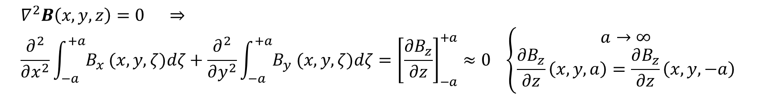
When s the field 2D ?
2D field: B_{z}≡ const.
`
translational symmetry →
central part of long magnets
(irrespective of end symmetry)
mid-plane of
symmetric magnets
$$∇^{2}B\left(x,y,z\right)=0 ⇒ \\ \frac{∂^{2}}{∂x^{2}}\int_{−a}^{+a}{B_{x} (x,y,ζ)dζ}+\frac{∂^{2}}{∂y^{2}}\int_{−a}^{+a}{B_{y} (x,y,ζ)dζ}={\left[\frac{∂B_{z}}{∂z}\right]}_{−a}^{+a}≈0 \left\{\begin{aligned}a→∞ \\ \frac{∂B_{z}}{∂z}\left(x,y,a\right)=\frac{∂B_{z}}{∂z}\left(x,y,−a\right)\end{aligned}\right.$$
the integral field of any straight magnet is harmonic

Slide 9

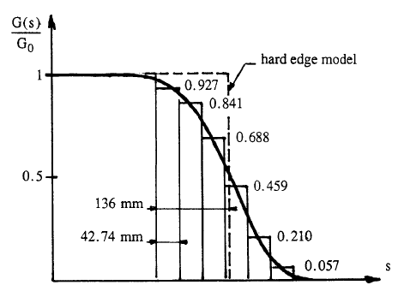
When is 2D not enough ?
«hard edge» and «thin lens» models measurement of field integral ∫B_{n}(s)ds
tracking codes
full map B_{n}(s) (€€!)
examples of situations where the profile B_{n}(s) is important:
impact of fringe field on beam stability: normally negligible, except if β(s) has a large swing inside the magnet (typically in IR quads). In this case, integrated field harmonics ∫B_{n}(s) may not be sufficient for accurate beam optics calculations
NB: this effect is more evident in accelerators of small size (fast phase advance, short magnets → larger fringe fields effects)
longitudinal field in quadrupole ends ⇒ beam deflection:
validity of thin lens model: in LEP MQs, the β(s) computed
with 1 thin lens was 5% lower than detailed computations using
1+2×6 lenses ⇒ nominal field strength had to be increased
⇒ B₂(s) profile should be measured at least once for large series !
J. Weif,et al., SCALING LAW FOR THE
IMPACT OF MAGNET FRINGE FIELDS,
EPAC2000
J. P. Gourber, Philosophy of series measurements, in Proceedings of the CERN Accelerator School
on Magnetic measurement and alignment, Anacapri, Italy, 1998

Slide 10
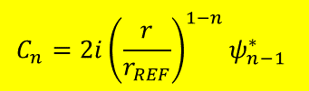
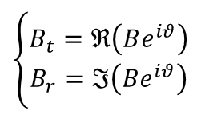
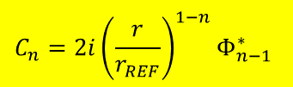




Field sampling around a circle
  Radial or tangential field components are (in principle) equivalent
  Treatment valid for Hall probes and (in the limit) narrow induction coils in stop-and-go mode
B_{t}
B_{r}
B_{t}+iB_{r}=(B_{y}+iB_{x})e^{iϑ}
r
r
$$θ$$
$$θ$$
$$\left\{\begin{matrix}B_{t}=ℜ\left(Be^{iθ}\right) \\ B_{r}=ℑ\left(Be^{iθ}\right)\end{matrix}\right.$$
$$B_{y}+iB_{x}=\sum_{n=1}^{N/2}{C_{n}}{{\left(\frac{r}{r_{REF}}\right)}^{n−1}e}^{i(n−1)θ} B_{t}+iB_{r}=\sum_{n=1}^{N/2}{C_{n}}{{\left(\frac{r}{r_{REF}}\right)}^{n−1}e}^{inθ}$$
$$\left\{Φ_{n}\right\}=FFT\left(\left\{B_{r}\left(θ_{k}\right)\right\}\right)$$
$$\left\{ψ_{n}\right\}=FFT\left(\left\{B_{t}\left(θ_{k}\right)\right\}\right)$$
$$C_{n}=2i{\left(\frac{r}{r_{REF}}\right)}^{1−n}Φ_{n−1}^{∗}$$
$$C_{n}=2i{\left(\frac{r}{r_{REF}}\right)}^{1−n}ψ_{n−1}^{∗}$$

Slide 11
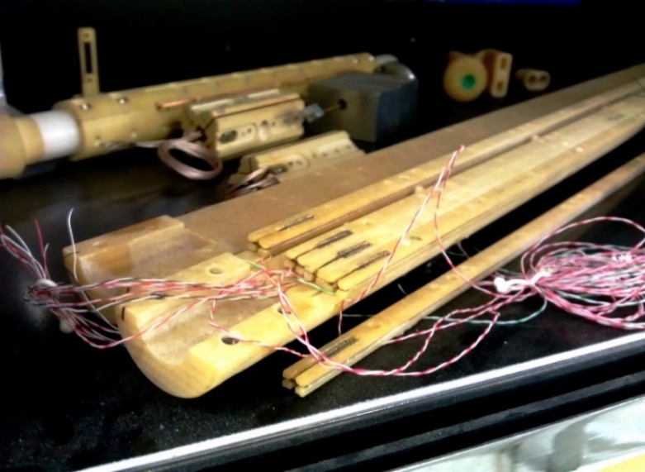
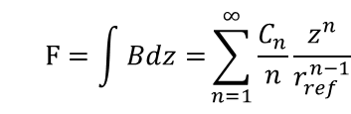
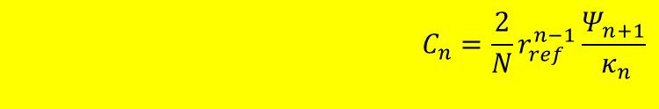


Harmonic coil method
  workhorse of CERN instrumentation park: most accurate and cost-effective method for the integral field of beam line magnets
y
windings
(filament approx.)
s
x
$$F=\int{Bdz=}\sum_{n=1}^{∞}{\frac{C_{n}}{n}\frac{z^{n}}{r_{ref}^{n−1}}}$$
Complex field potential:
$$Φ\left(θ\right)=N_{t}L_{c}ℝ\left(F\left(z_{20}\right)−F\left(z_{10}\right)\right)e^{inθ}=N_{t}L_{c}ℝ\left(\sum_{n=1}^{∞}{\frac{C_{n}}{n}\frac{z_{20}^{n}−z_{10}^{n}}{r_{ref}^{n−1}}}e^{inθ}\right)=ℝ\left(\sum_{n=1}^{∞}{\frac{κ_{n}C_{n}}{r_{ref}^{n−1}}}e^{inθ}\right)$$
Linked flux :
$$κ_{n}=\frac{N_{T}L_{c}}{n}\left(z_{20}^{n}−z_{10}^{n}\right)$$
$$C_{n}=\frac{2}{N}r_{ref}^{n−1}\frac{Ψ_{n+1}}{{ κ}_{n}}$$
Sensitivity coefficients:
$\left\{Ψ_{n}\right\}=FFT\left(\left\{Φ\left(θ_{k}\right)\right\}\right) ⇒$
n, k = 1… N

Slide 12
Flux measurements
in 3D fields

Slide 13
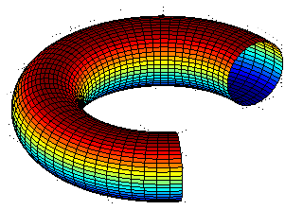
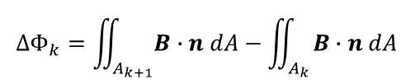
Rotating coils in a 3D field
Natural extension of the 2D measurement, prototype hardware tested successfully
Negligible error in small-curvature magnets (LHC cryodipoles),
new mathematics necessary for strongly bent dipoles
Output: collection of flux increments (NB: standard FFT → pseudo-multipoles C_{n} !)
Open points: best-fitting eigensolution, partial overlapping between rings
$$∆Φ_{k}=\iint_{A_{k+1}}{B∙n dA}−\iint_{A_{k}}{B∙n dA}$$
piezomotor
rotating
coils
slip ring
angular encoder
“toy train” prototype
rails + longitudinal transport
(magnet-specific)
Courtesy: Ernesto de Matteis
Notes:
toy train: ER-15 Nanomotion , tolerance (<10⁻⁴) distance of 5 cm Electrical interference < 300 µV close to coil transducer (7 cm and 3 cm, respectively, Speed RMS of about ± 1 % and P-to-P < ± 8 %
Rotation performance doesn’t depend on magnetic field

Slide 14
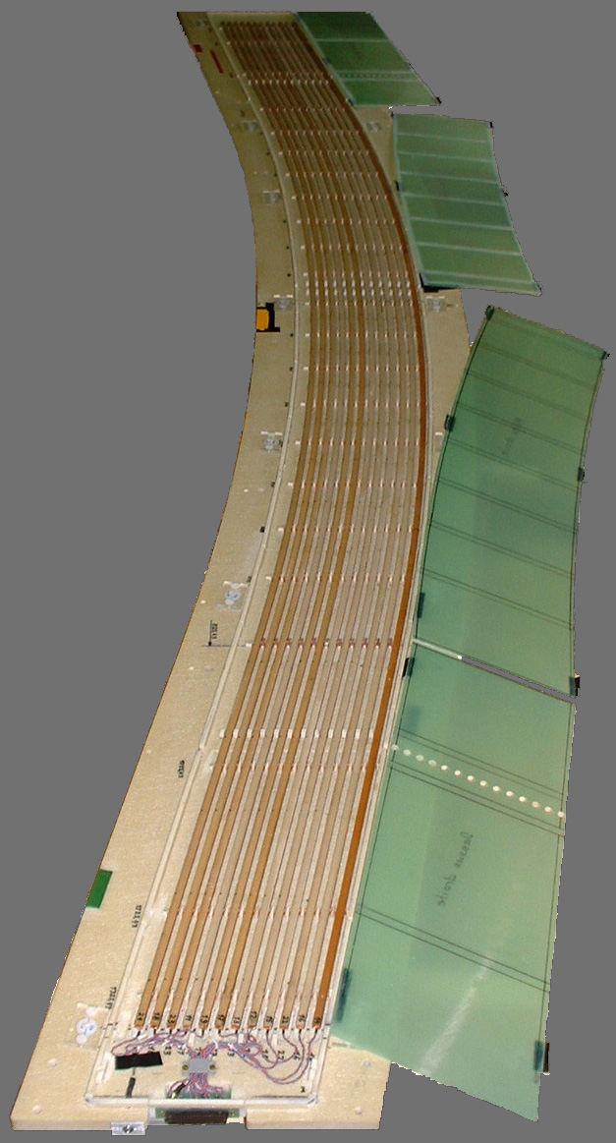
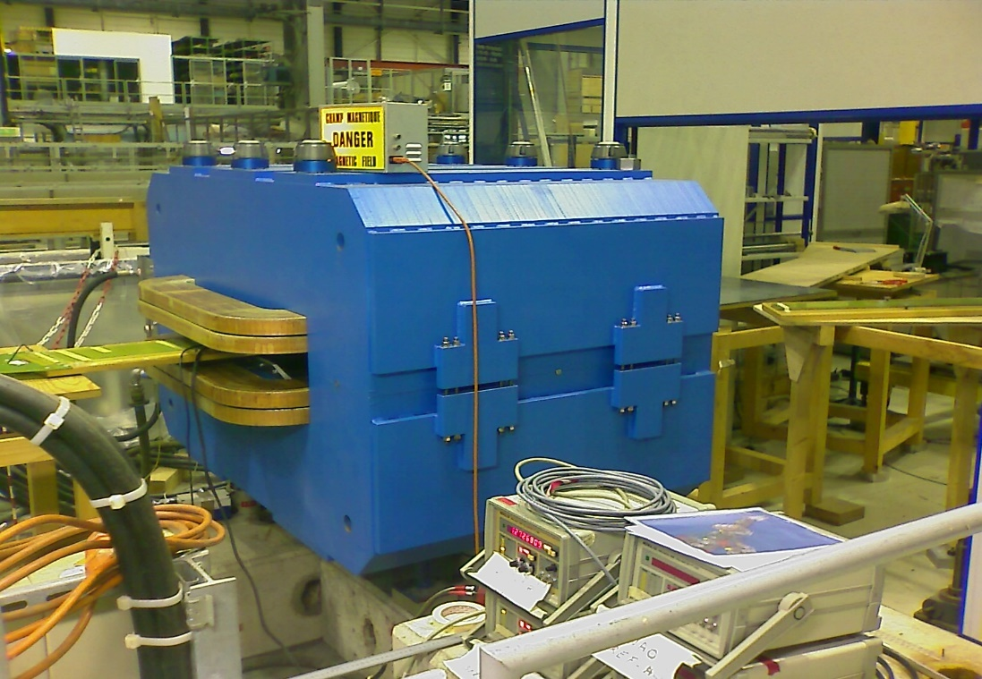
Curved fluxmeter for CNAO dipoles
CNAO main dipole
13-coil fluxmeter
2.75 m length

Slide 15
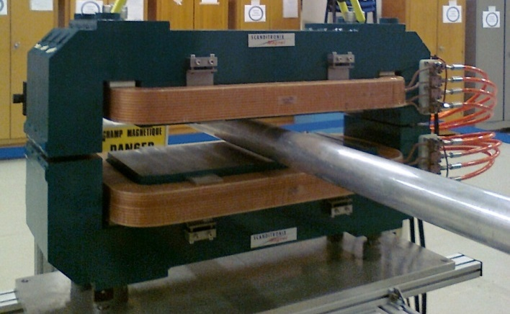
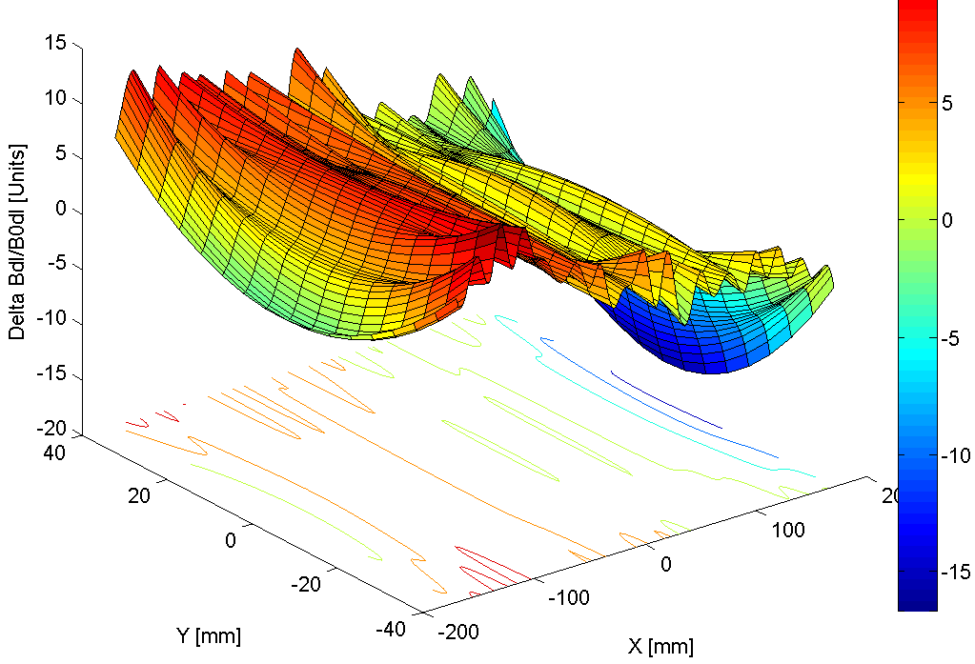

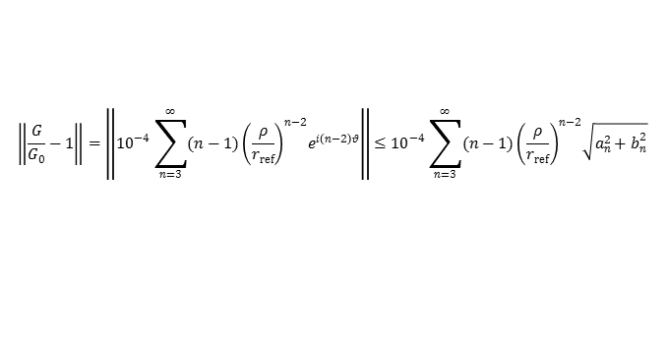

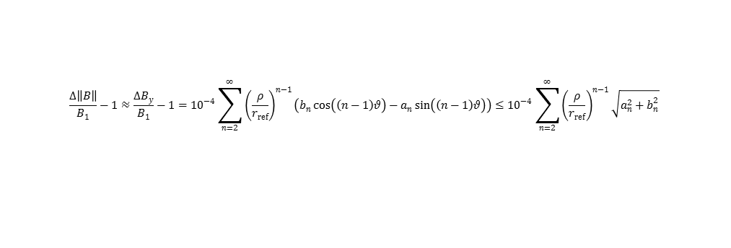
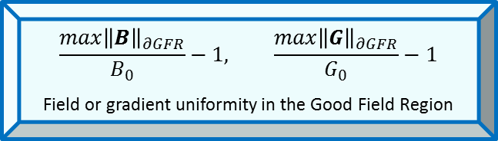
2D field uniformity
Field quality is expressed differently according to the beam model used:
For a dipole (small errors):
For a quad: field uniformity …
… or gradient uniformity
In both cases, a field map along the boundary of the GFR is sufficient
Rectangular/elliptical GFR → extrapolation typically needed to get peak values in the corners !
$${\left\{b_{n}+ia_{n}\right\}}_{n=1}^{n_{max}}$$
harmonic coefficients, r ≤ r_{ref}
$$\frac{max{\left\|B\right\|}_{∂GFR}}{B_{0}}−1, \frac{max{\left\|G\right\|}_{∂GFR}}{G_{0}}−1$$
Field or gradient uniformity in the Good Field Region
⇒
$$\frac{∆\left\|B\right\|}{B_{1}}−1≈\frac{∆B_{y}}{B_{1}}−1={10}^{−4}\sum_{n=2}^{∞}{{\left(\frac{ρ}{r_{ref}}\right)}^{n−1}\left(b_{n}\cos\left(\left(n−1\right)θ\right)−a_{n}\sin\left(\left(n−1\right)θ\right)\right)}≤{10}^{−4}\sum_{n=2}^{∞}{{\left(\frac{ρ}{r_{ref}}\right)}^{n−1}\sqrt{a_{n}^{2}+b_{n}^{2}}}$$
$$\left\|\frac{B}{B_{2}\frac{z}{r_{ref}}}−1\right\|=\left\|{10}^{−4}\sum_{n=3}^{∞}{\left(b_{n}+{ⅈa}_{n}\right){\left(\frac{ρ}{r_{ref}}\right)}^{n−2}e^{i\left(n−1\right)θ}}\right\|≤{10}^{−4}\sum_{n=3}^{∞}{{\left(\frac{ρ}{r_{ref}}\right)}^{n−2}\sqrt{a_{n}^{2}+b_{n}^{2}}}$$
$$\left\|\frac{G}{G_{0}}−1\right\|=\left\|{10}^{−4}\sum_{n=3}^{∞}{{(n−1)\left(\frac{ρ}{r_{ref}}\right)}^{n−2}e^{i\left(n−2\right)θ}}\right\|≤{10}^{−4}\sum_{n=3}^{∞}{{(n−1)\left(\frac{ρ}{r_{ref}}\right)}^{n−2}\sqrt{a_{n}^{2}+b_{n}^{2}}}$$
Notes:
But in the corner the beam does not go !

Slide 16
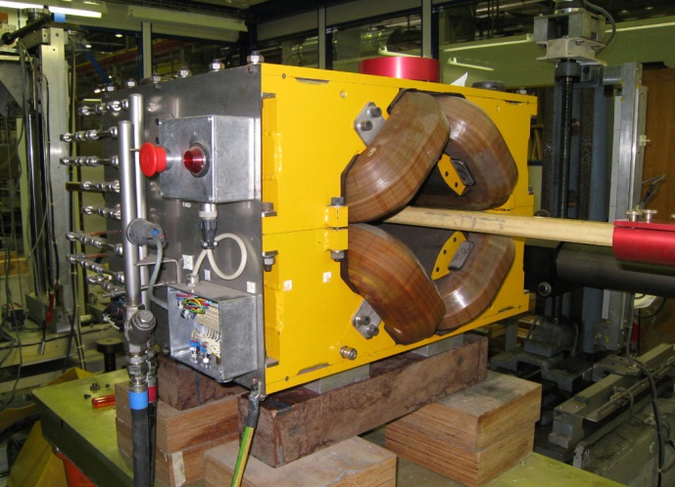
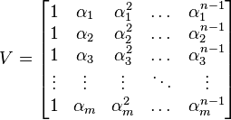
Line scan measurment → harmonics
Example: get n_{h} harmonic coefficients B_{n} from measurements of B_{y}(x) G(x)=∂B_{y}/∂x at n_{p} points
Intrinsically ill-defined problem: Laplace equation needs a closed boundary
Direct interpolation → ill-conditioned Vandermonde matrix system
Best fit with variable number of harmonics n_{h} → well-conditioned Hankel matrix system,
but: slow convergence as n_{h} → n_{p}, estimated errors up to 20%
Risky procedure, even a perfect interpolation of the
discrete values measurement does not contain the full information
about the field
G
b_{n}
0.5% meas. uncertainty
→ 10% interpolation errors
scan line
spread over
repeated takes
b₅
n_{h}
b₄
gradient-measuring coil
b₃
harmonic cancellation
⇒ slow convergence !
x

Slide 17
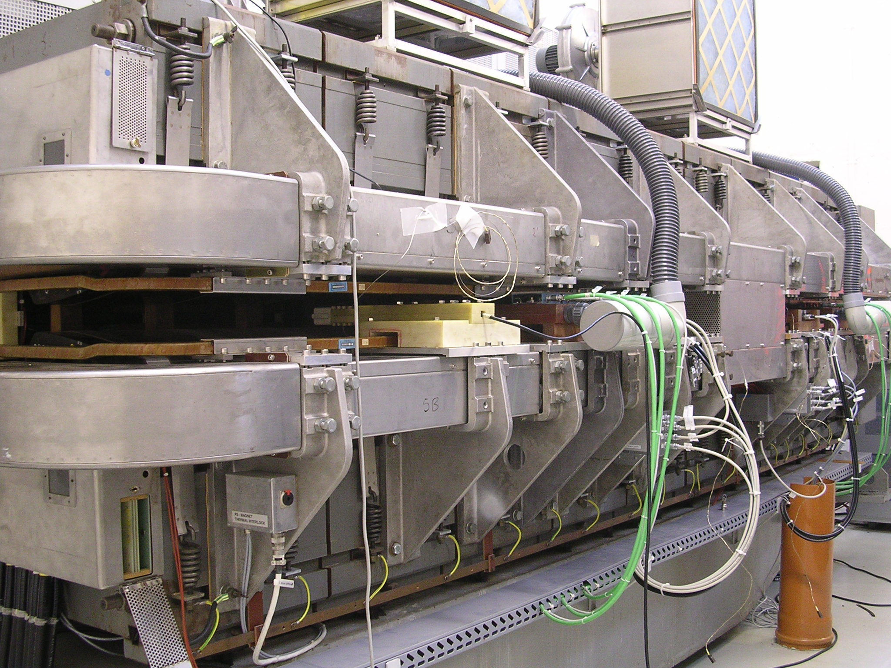
PS main unit
quadrupole tune
trim circuit
main excitation coils
10 × yoke blocks
with gaps

Slide 18
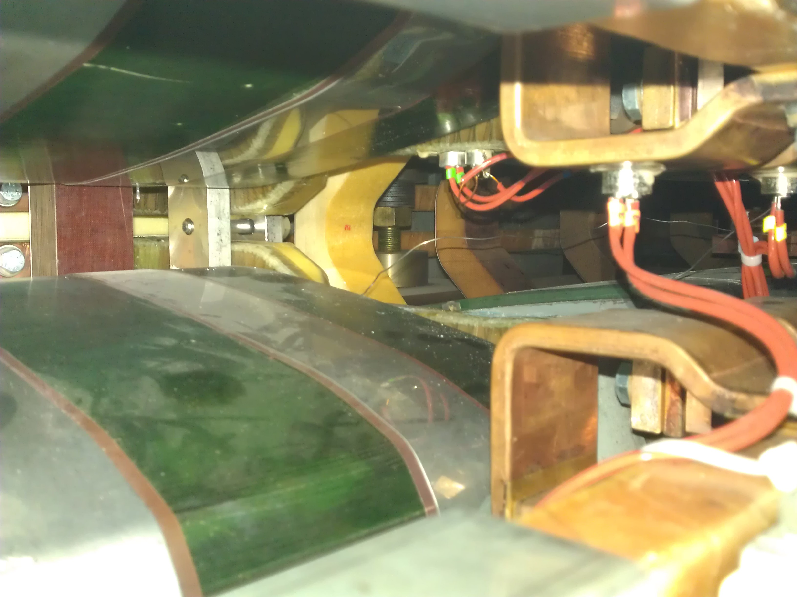
PS main unit
focusing half
defocusing half
4 × B₂, B₃, B4
pole face windings

Slide 19
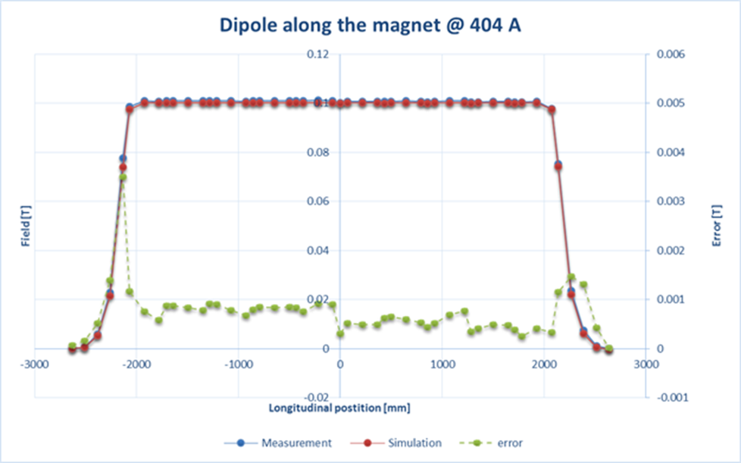
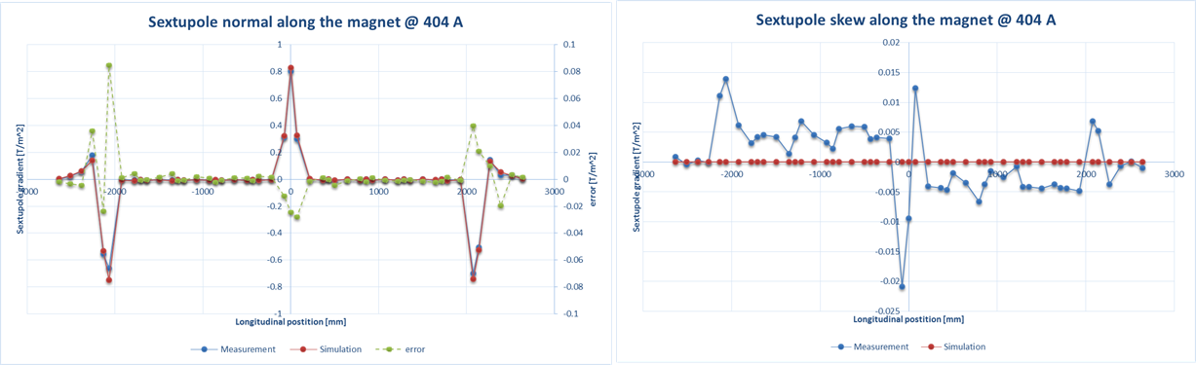
Rotating-coil measurements of PS main unit
combined-function magnet with 6 coupled excitation circuits and 10 longitudinal blocks + gaps
magnetic knowledge still (!) incomplete today
Need both real-time measurements (integral B₁ to B₄) and full field map vs. all combinations of excitation currents and history
Initial rotating coil magnetic measurements at injection (main excitation circuit only) agree reasonably well with 3D simplified FEM (symmetry-respecting norma components only)

Slide 20
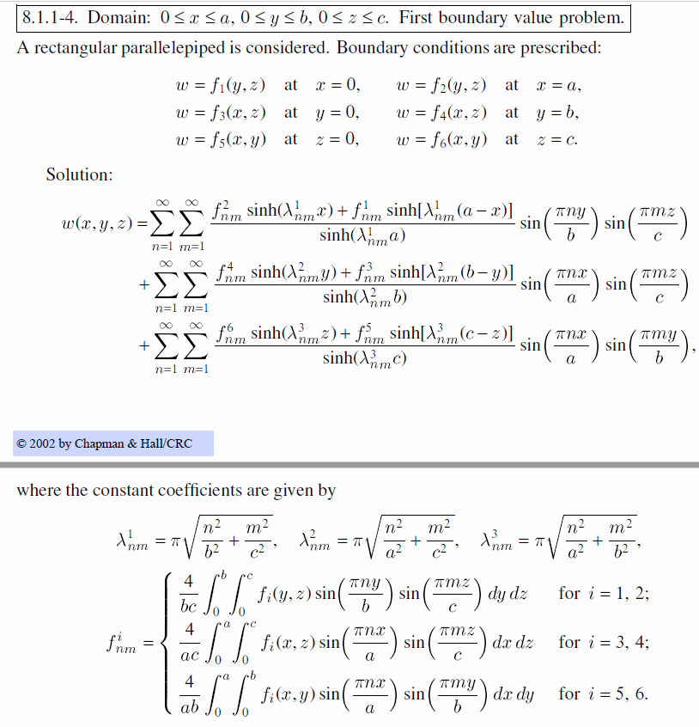
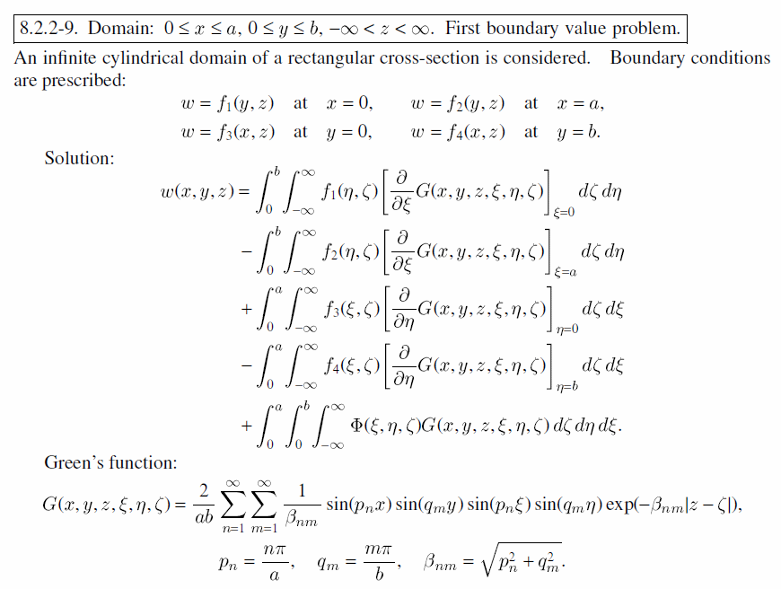
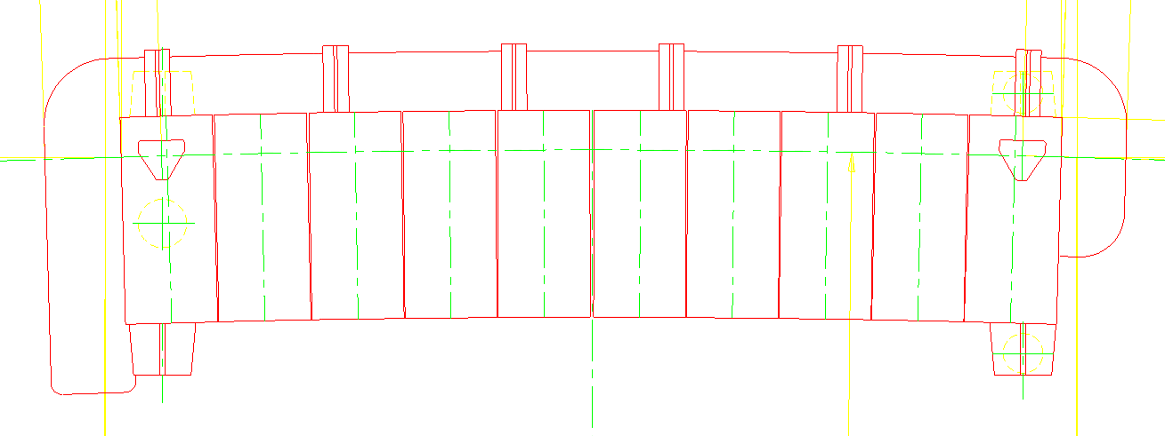
Box fluxmeter project
Well-known (3D or 2D) box eigensolutions converge too slowly (especially in the corners)
Is the any alternative domain geometry with more favorable properties ?
Where is it best to place our coils ? What is the impact of a partially open box ?
PCB measuring coil arrays at the top and bottom allow
the measurement of normal and skew harmonics referred to the central axis
full integral coils allow the precise measurement of all nonlinear and dynamic effects
box structure open on one side allows field markers
to be installed precisely on the reference axis
field markers at multiple longitudinal positions
minimize the uncertainty linked to magnetic length fluctuations
field markers at multiple radial positions
to reference multipolar field components B₂, B₃ …

Slide 21
3D field maps

Slide 22
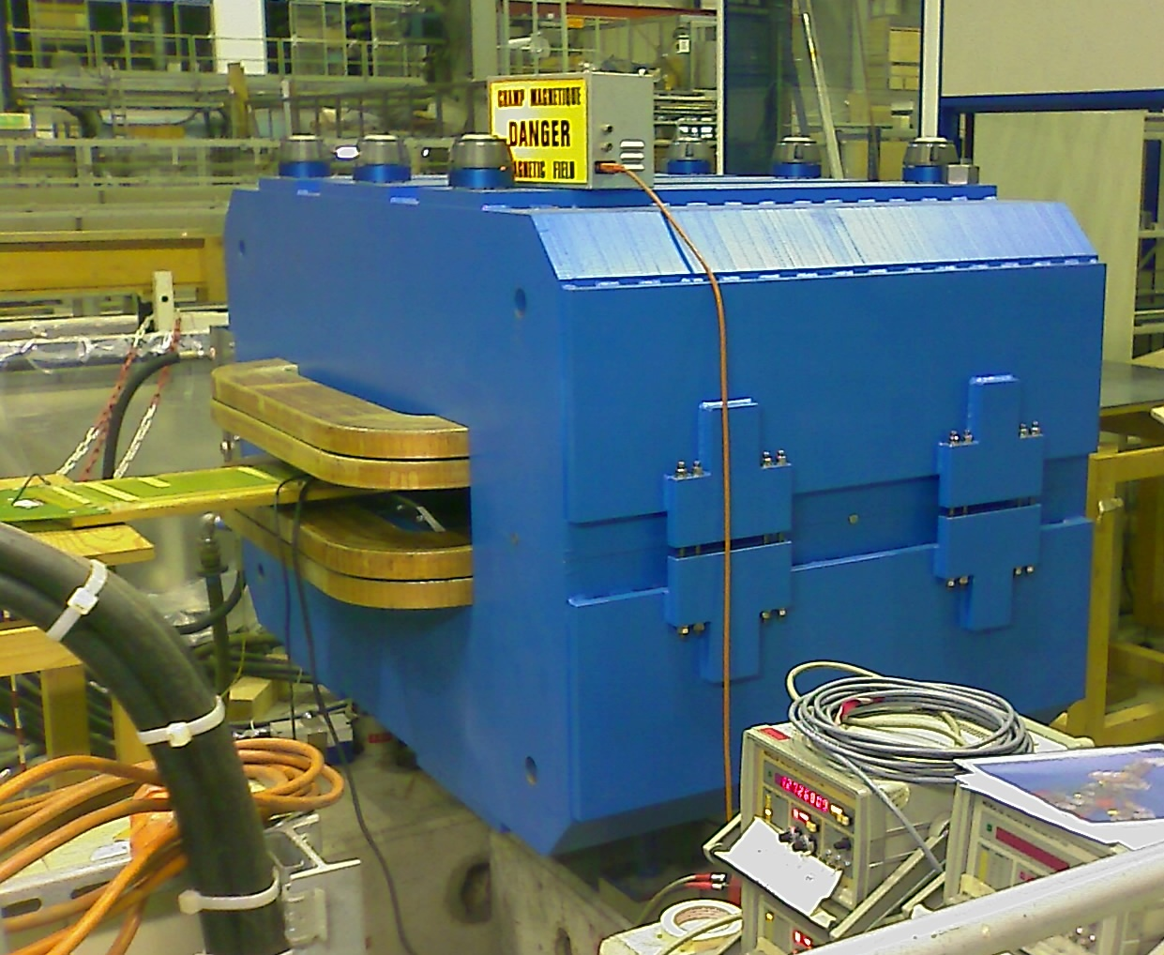
Fringe field map
fringe fields are routinely mapped for a number of reasons:
define length of integral coils
feedback to beam optics
safety concerns
B < 1 mT
externally to iron yoke
1.5 T inside
5 mT @ 260 mm outside

Slide 23
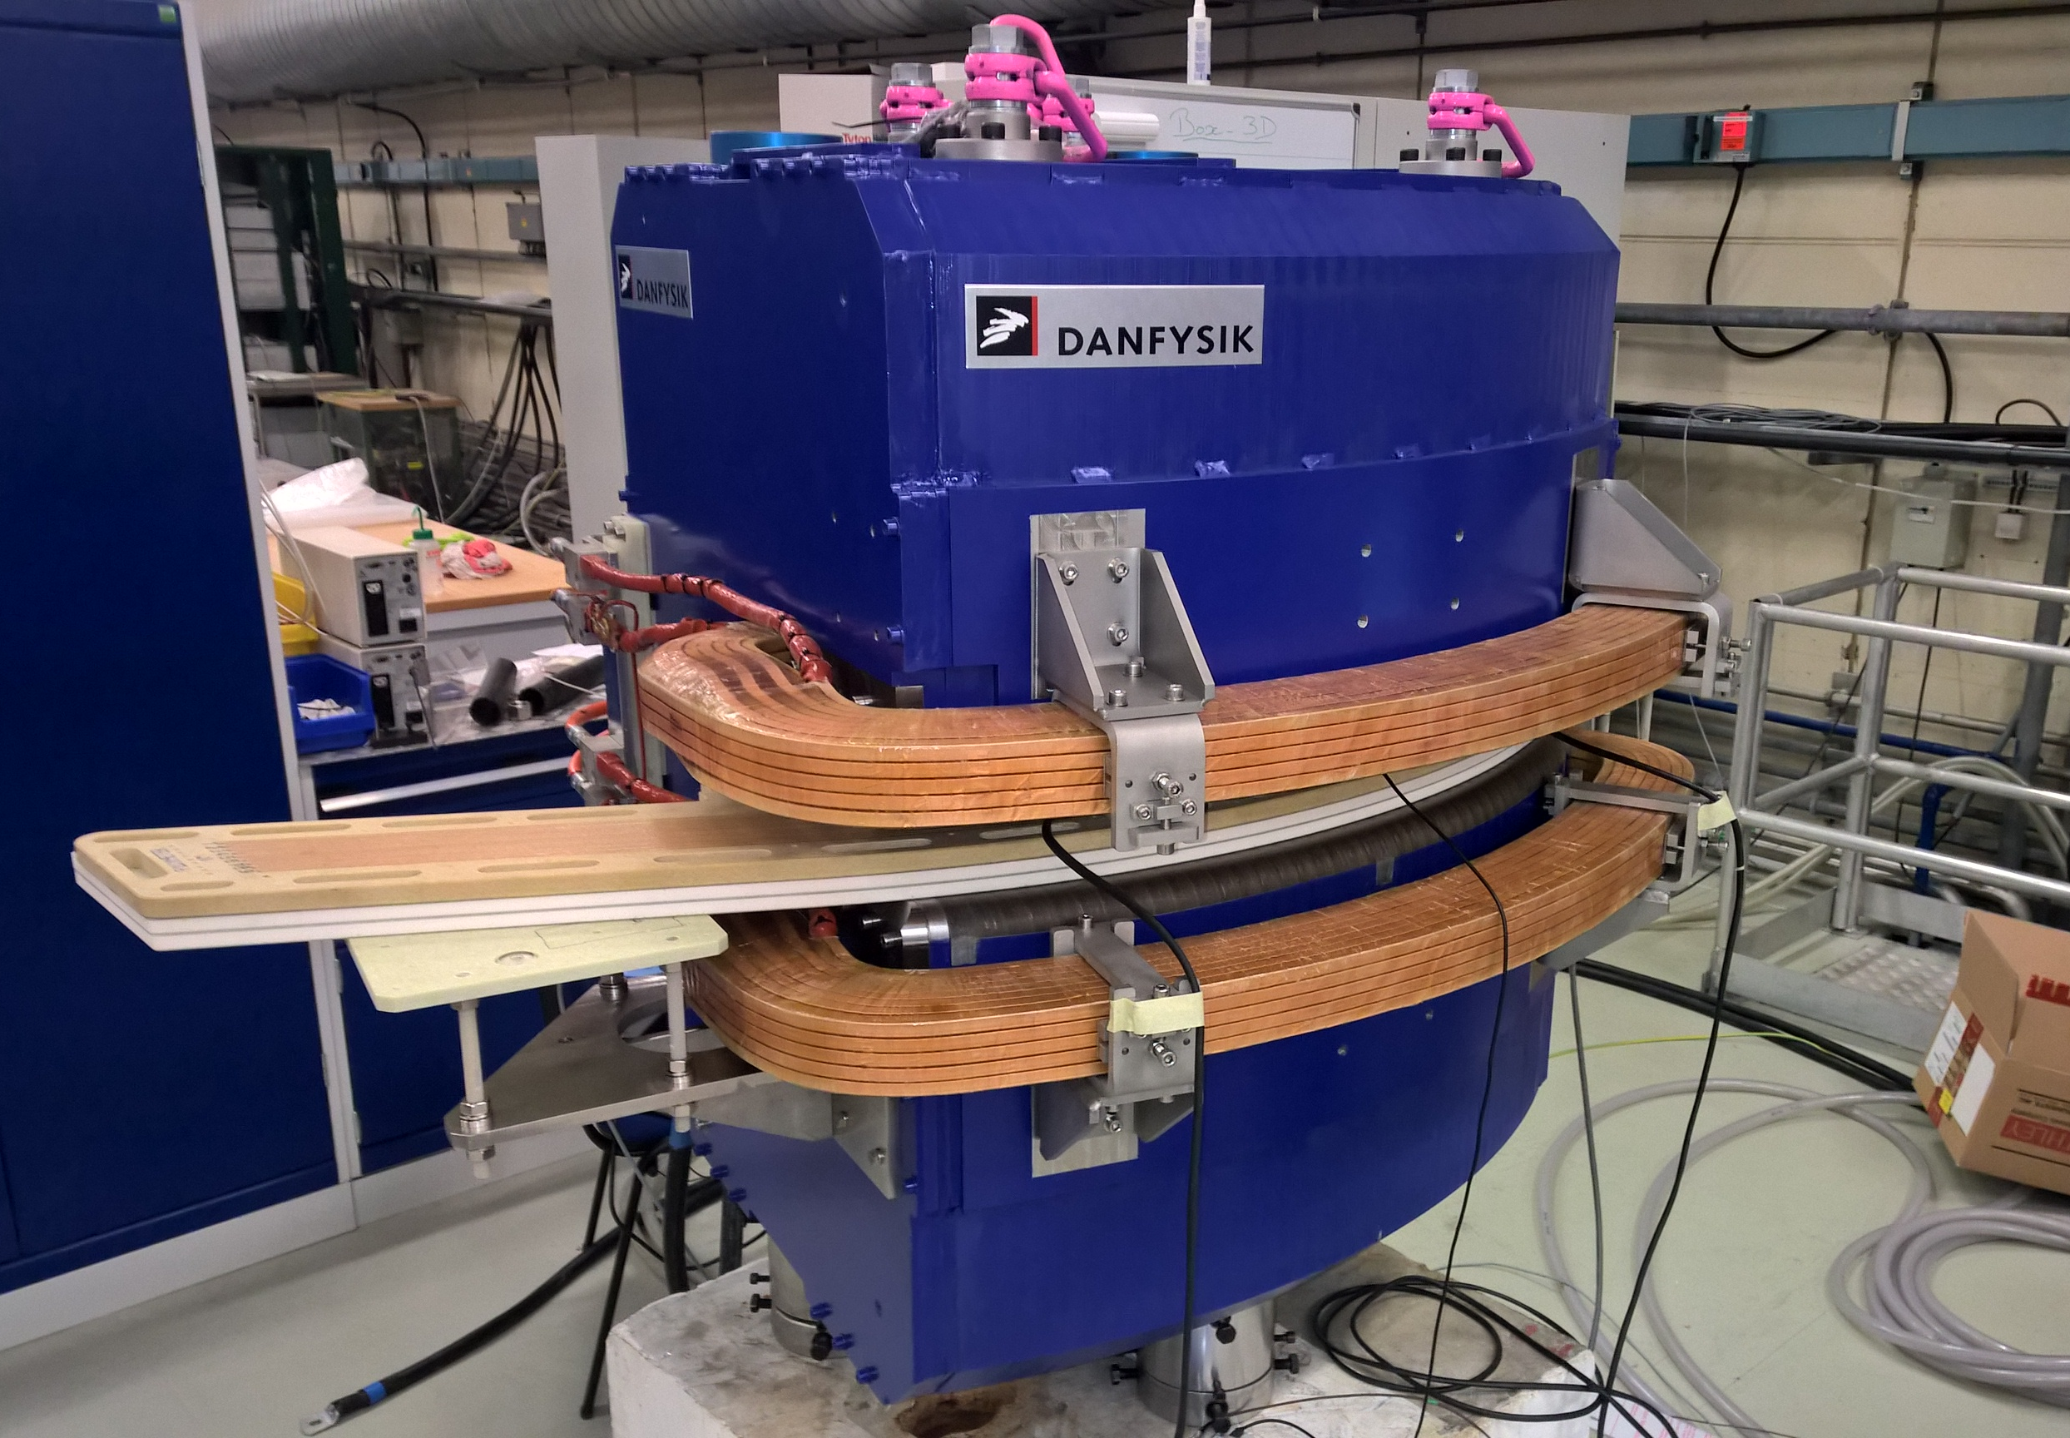
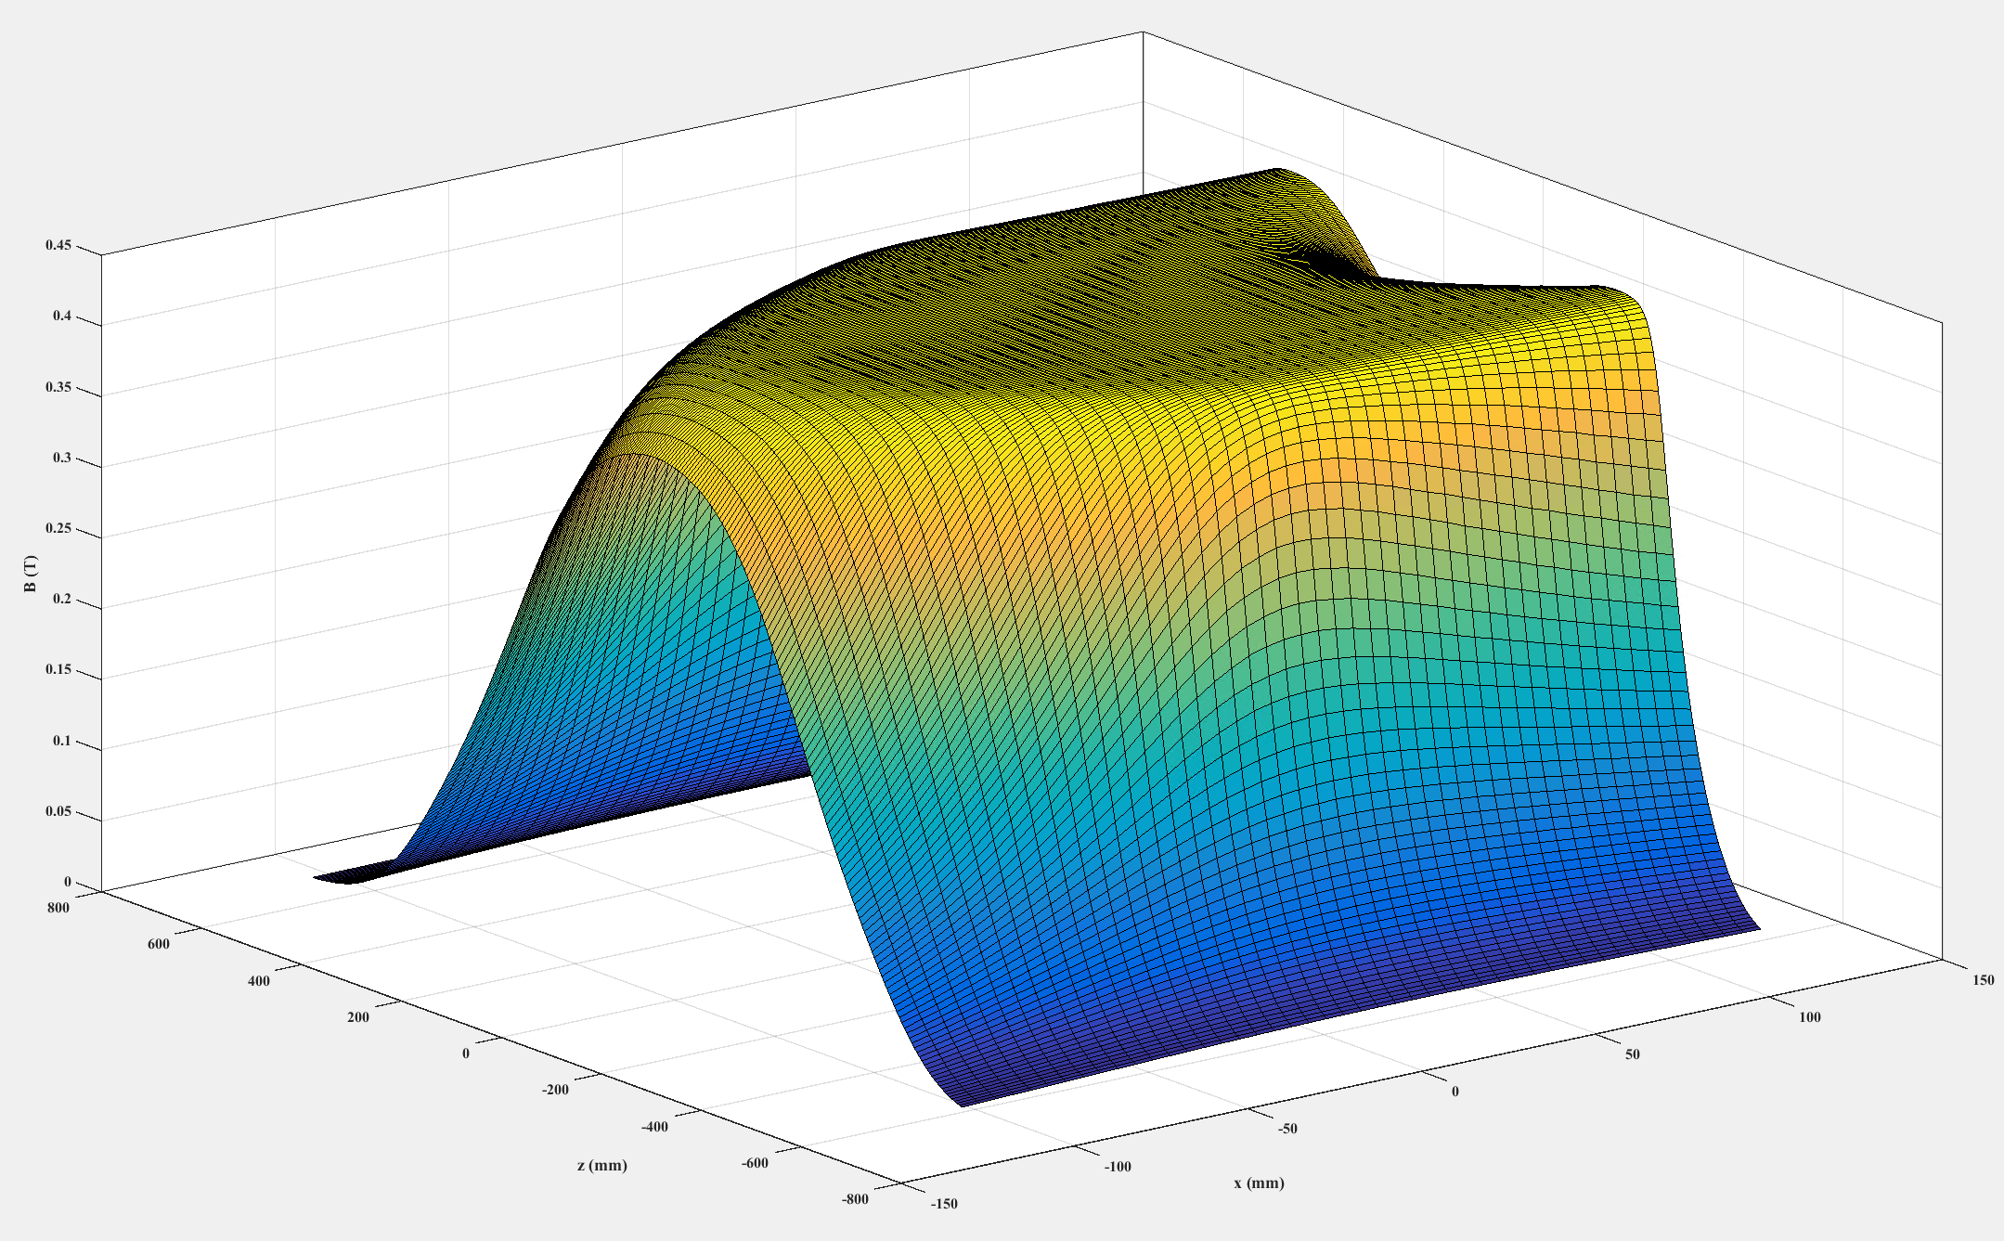
ELENA main dipole
difficult case: strongly bent, low-field 60° dipole
labor-intensive combination of four different measurement methods:
- curved fluxmeter (dynamic and RT measurements)
- Hall probe (fluxmeter calibration)
- NMR probe (calibration of Hall probe)
- stretched wire (calibration of Hall-probe)
field map on the mid plane interpolated along:
- curved paths (to match fluxmeter)
- straight paths (to match stretched wire)
Good candidate for a data fusion project !
fluxmeter
Profile interpolated on a curved path
Measurements courtesy of Lucio Fiscarelli

Slide 24
ATLAS solenoid map
2 T, ∅2 × 6 m
4.1 T
2 T
rotating arms
Field map of ATLAS inner solenoid needed due to impact of mechanical tolerances
CERN/NIKHEF 3D Hall probes: 0.05% accuracy @ 2T, 2 mrad angular uncertainty, CANbus serial output
rotating scanner with 2×15 probes, 20000 total points on a cylindrical grid 50 mm x 76 mm x 22.5°
Permanently installed: 1730 Hall probes in the muon spectrometer + few NMR probes in the center
“Implicit” compliance to Maxwell: least-squares best-fit measurement to FEM/Biot-Savart model
What other strategies are there to enforce consistency on a cloud or volume or surface data points ?
Credit: F. Bergsma, CERN

Slide 25
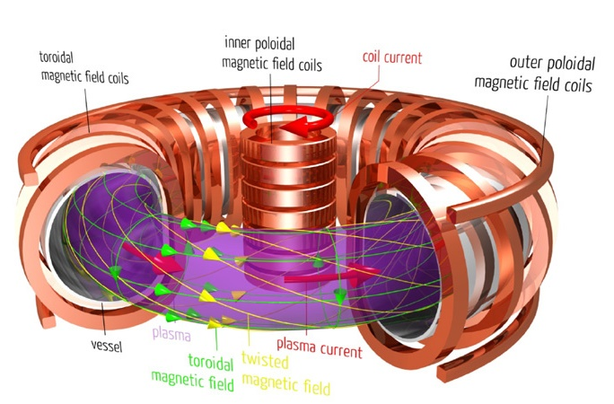
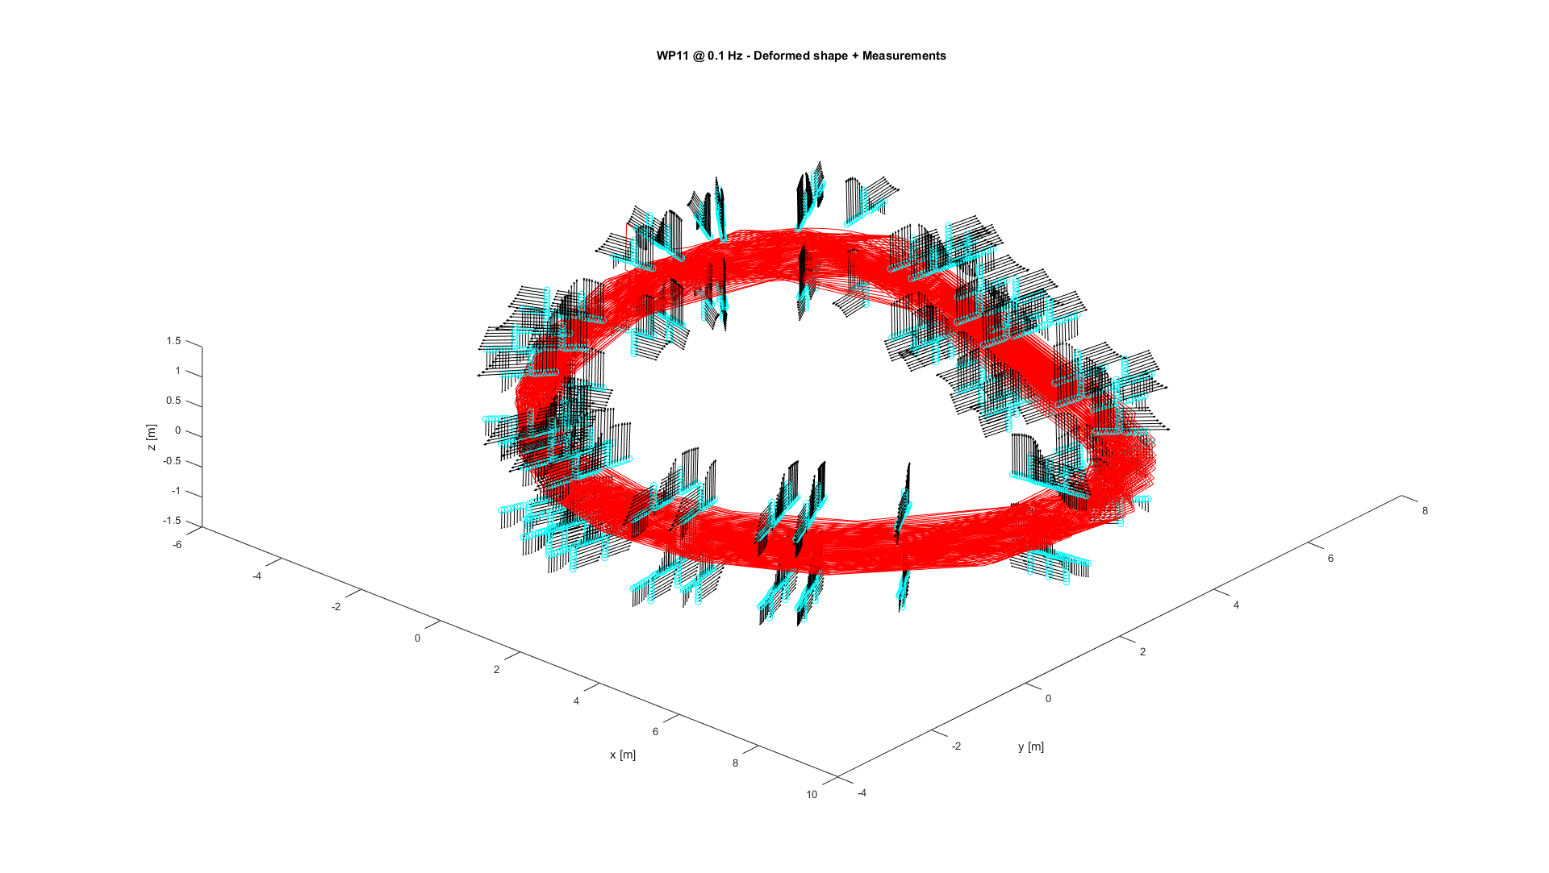
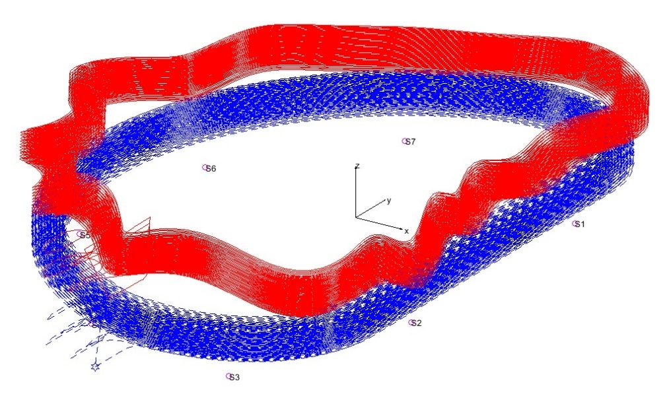
ITER TF Coil Mapping (1/2)
context: warm magnetic measurements of ITER TF coils
objectives: (1) optimize insertion of the Winding Pack in its casing and (2) compute the field map in the plasma region from the superposition of all 18 coils
initial approach: reconstruct an equivalent current distribution that best-fits measurements close to the coil
ill-conditioned inverse problem, requires constraints (prior knowledge) on the current distribution to regularize
results from first full-scale tests: uncertainty 4~6 mm
(target 1~2 mm, work still in progress)
18 × Nb₃Sn Toroidal Field coils
(134 turns, 68 kA, 11.8 T @ 4.2K, 7×12 m, 310 ton)
the field of each coil impacts all the plasma volume
2400 measurements around the coil at 30 azimuthal stations
(1.6 mT peak field, 2 μT uncertainty )
reconstructed deformed current distribution
(not to scale)

Slide 26
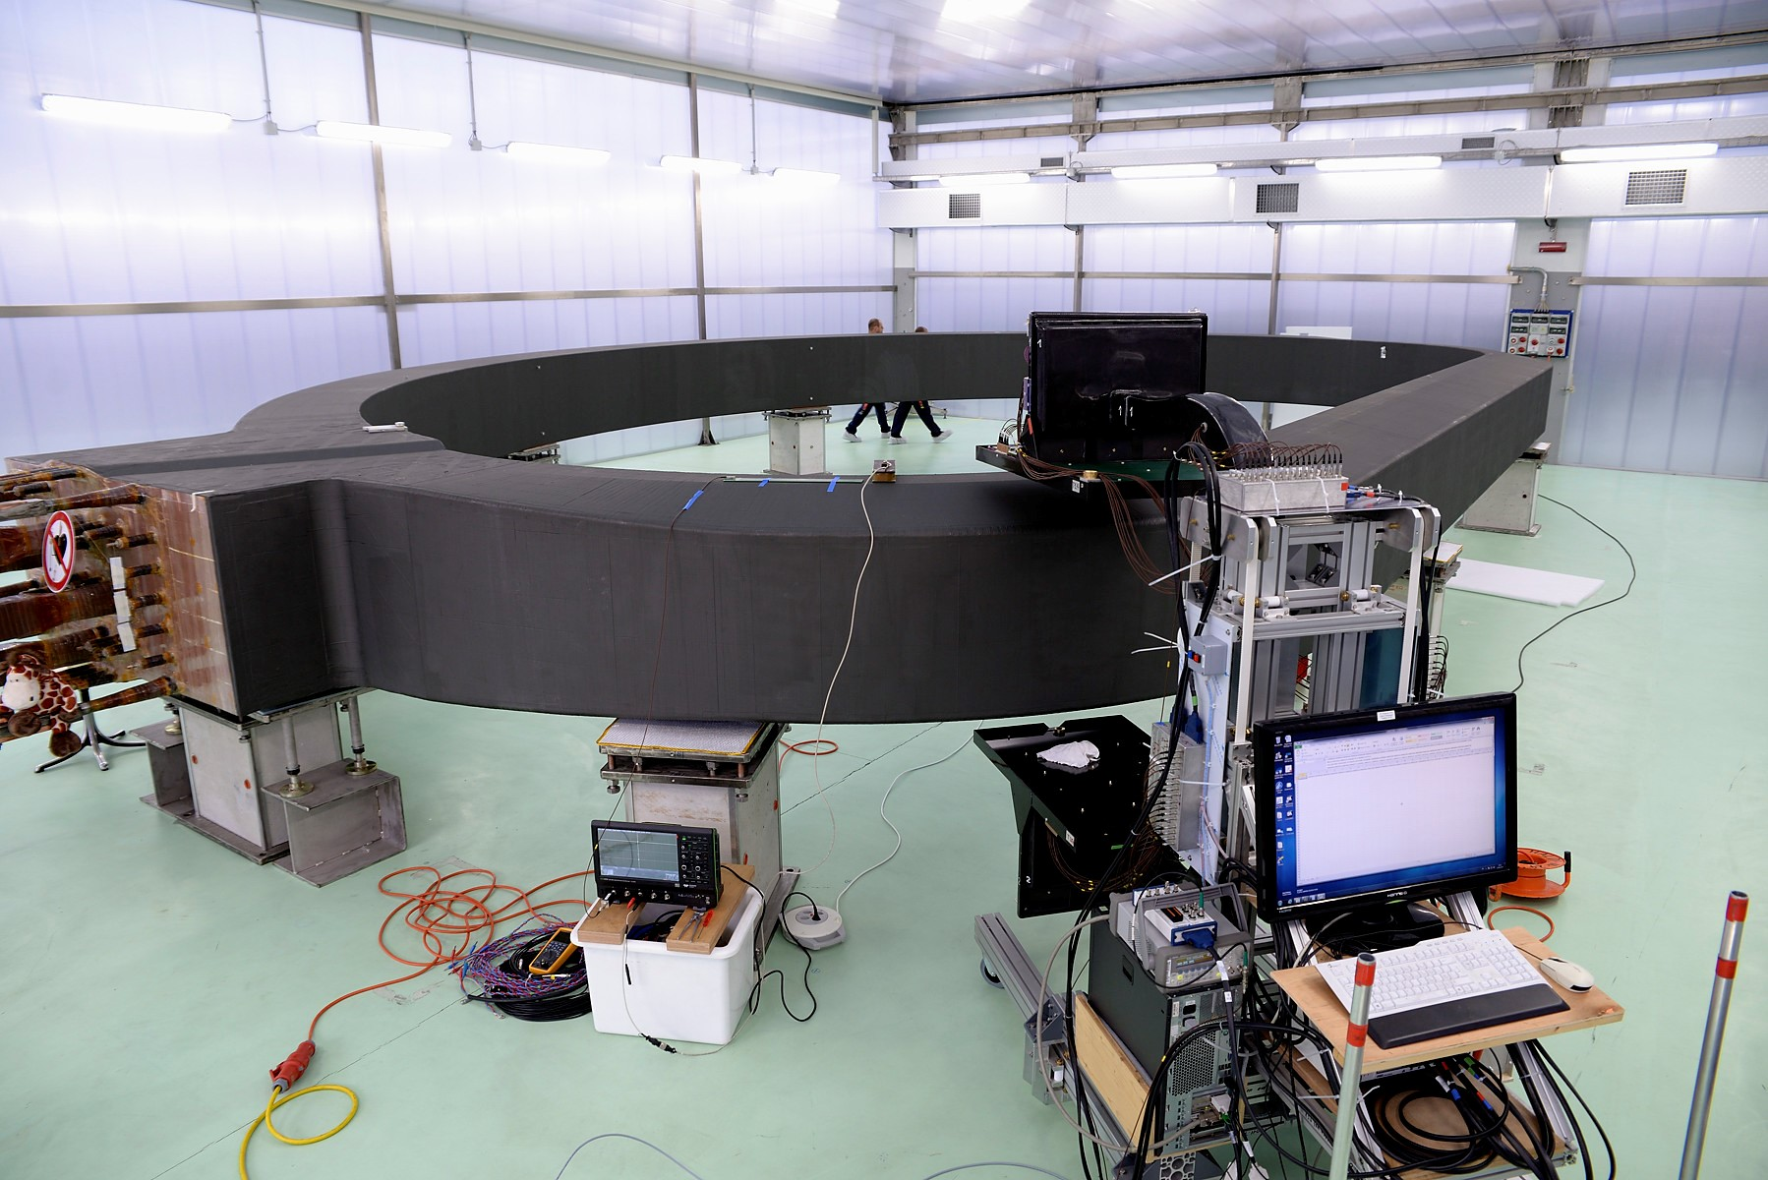
ITER TF Coil Mapping (2/2)
possible alternative: forget current distribution, measure and model the field in the source-free space
measurements in the whole toroidal volume of interest impossible →
measure on the boundaries of an appropriate domain and then fit an appropriate eigensolution
objectives: don’t leave gaps when superposing 18 coils; define practically measurable surfaces
many open questions: best domain shape, measurement point number and location,
error when fitting eigenmodes to irregularly scattered (but known) data points, …
is this R&D transposable to HEP experimental magnets ?
movable AC fluxmeter
boundaries should ideally include vertical and horizontal surfaces,
as close as possible to the coil to maximize the field to be measured

Slide 27
Conclusions

Slide 28
What we would like to define
a coherent way to express various types of averaged field representations:
– file and database formats
– automated data reduction
– post-processing with BEM/FEM
better eigensolutions for different classes of 2D and 3D problems
criteria to design optimally test equipment and procedures
– how do we dimension coils and where do we place them to fit a given series expansion with the best possible conditioning
– is it always ok to measure at the boundary, or to use regular grids ?
the best way to exploit redundant data
– impose consistency to Maxwell equations to clouds of B_{k} or ||B|| data points
an efficiency metric to express the tradeoff between cost of redundant data
and uncertainty of the final result
a general representation of the field based on equivalent field sources
– Biot-Savart appealing simple for iron-free volumes
– can we use it for beam line magnets ?

