Slide 2
Indico at CERN
Usage / Current Status / Plans
Pedro Ferreira, CERN, Apr. 2017
Notes:
Numbers, Infrastructure, Fault prevention, Custom parts, Future/Goals

Slide 3
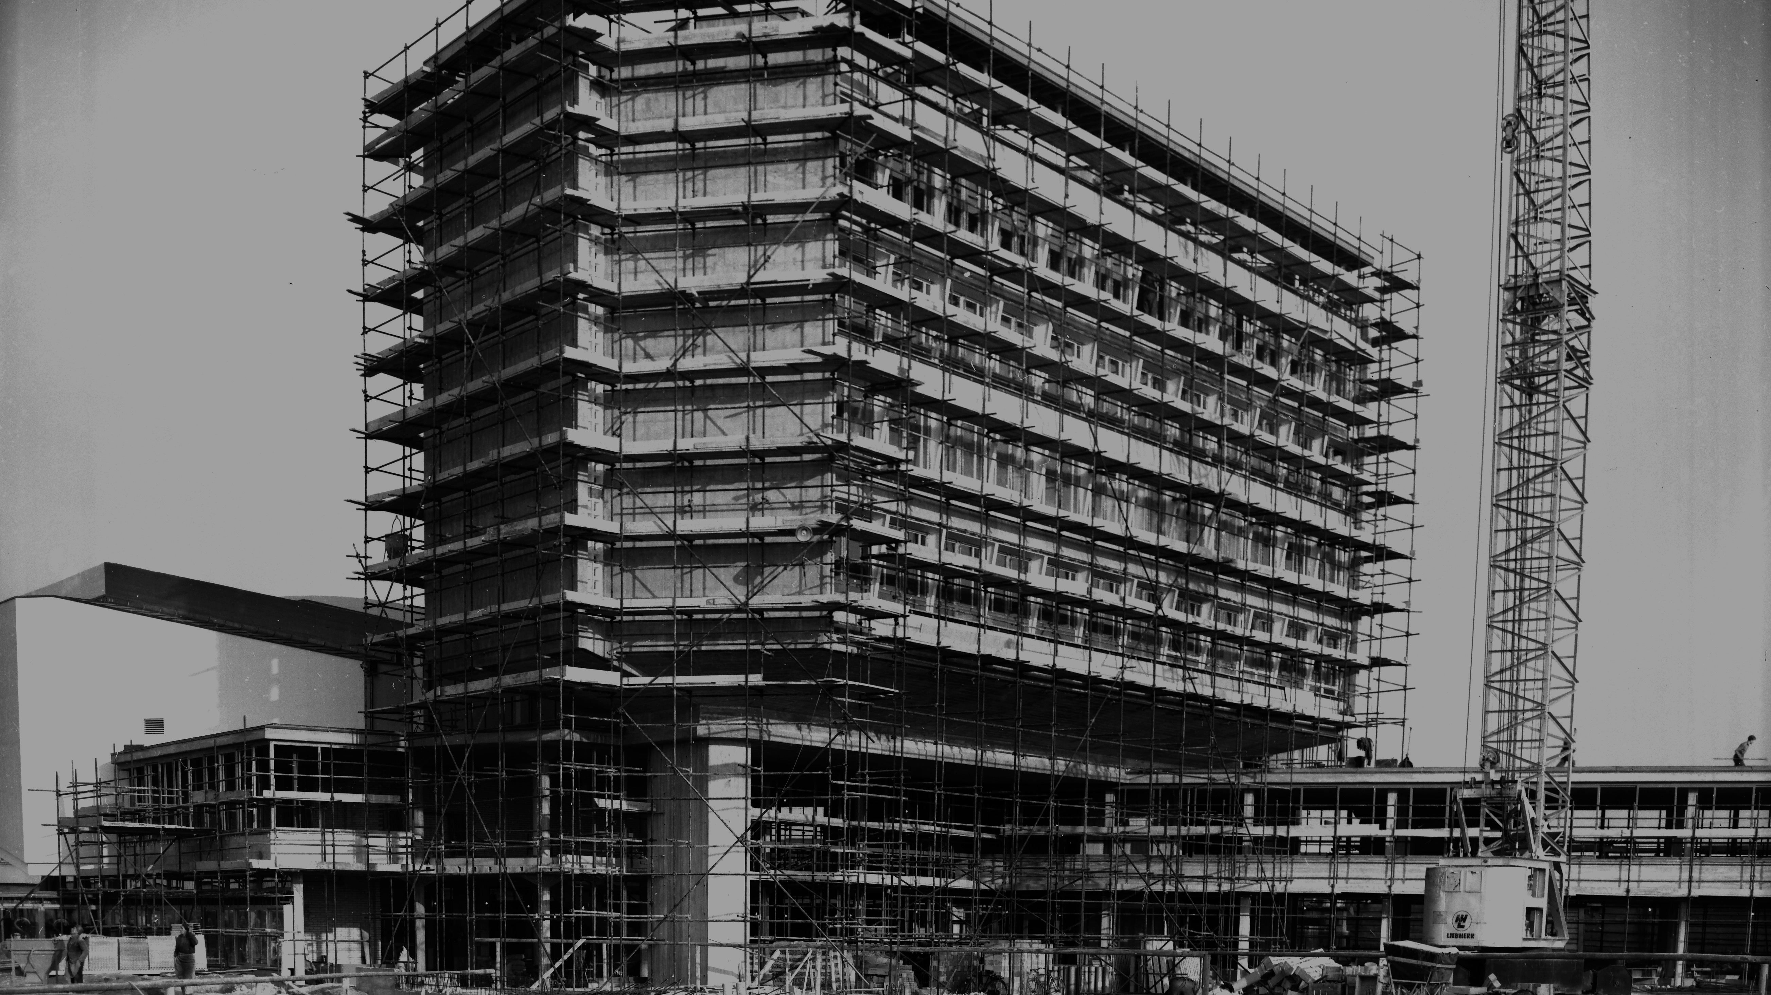
Motivation

Slide 4







Slide 5
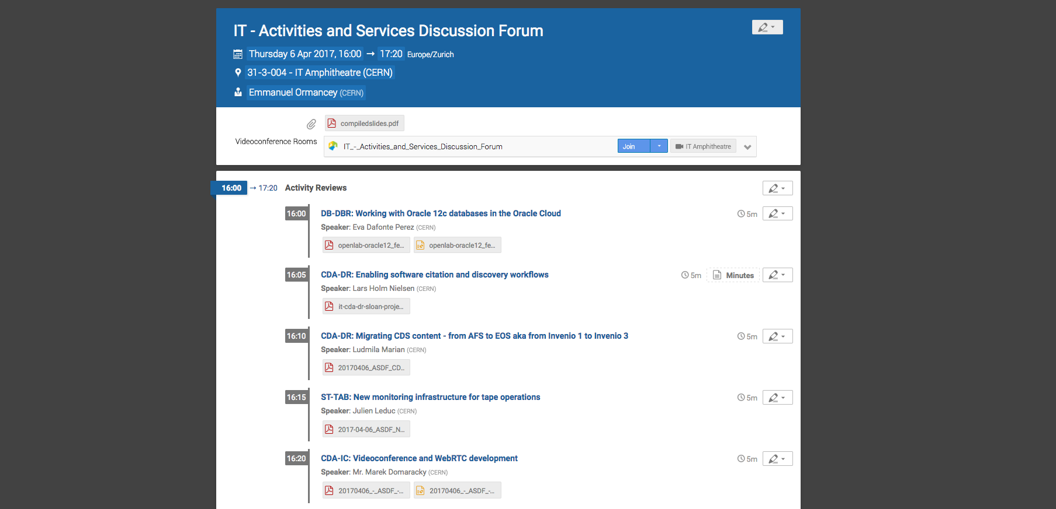
Meeting Organization

Slide 6

Conference Management

Slide 7
Custom web site
Timetable
Paper subm.
Call for abstracts
Badges
Evaluation
Conference
Abstracts selection
Registration
Paper reviewing
Programme
Slides submission

Slide 8
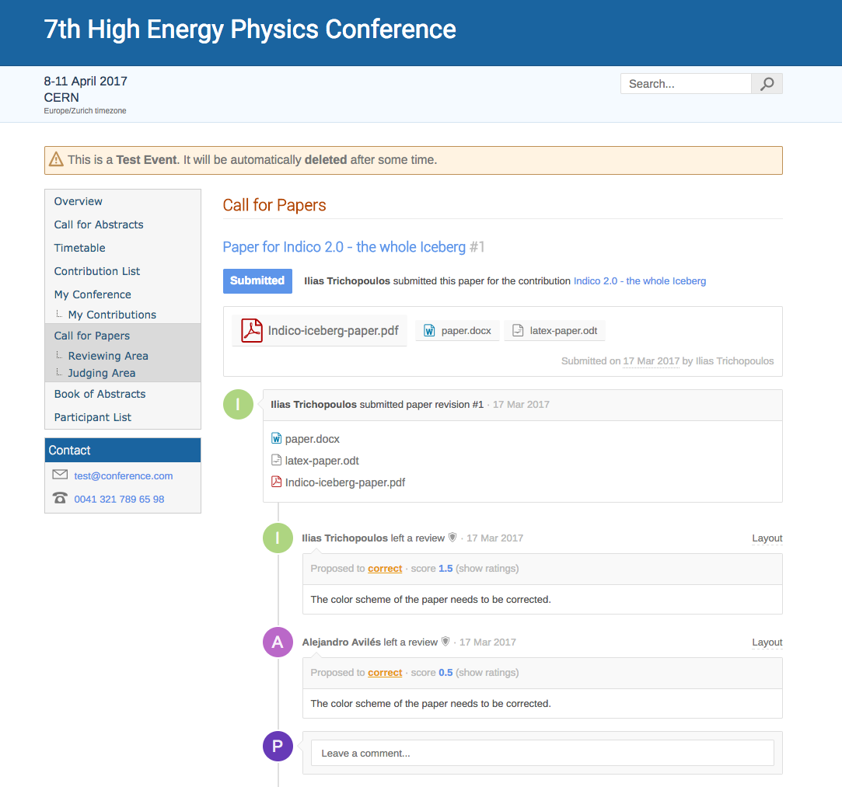

Slide 9
Collaborative Services
Notes:
Demo

Slide 10
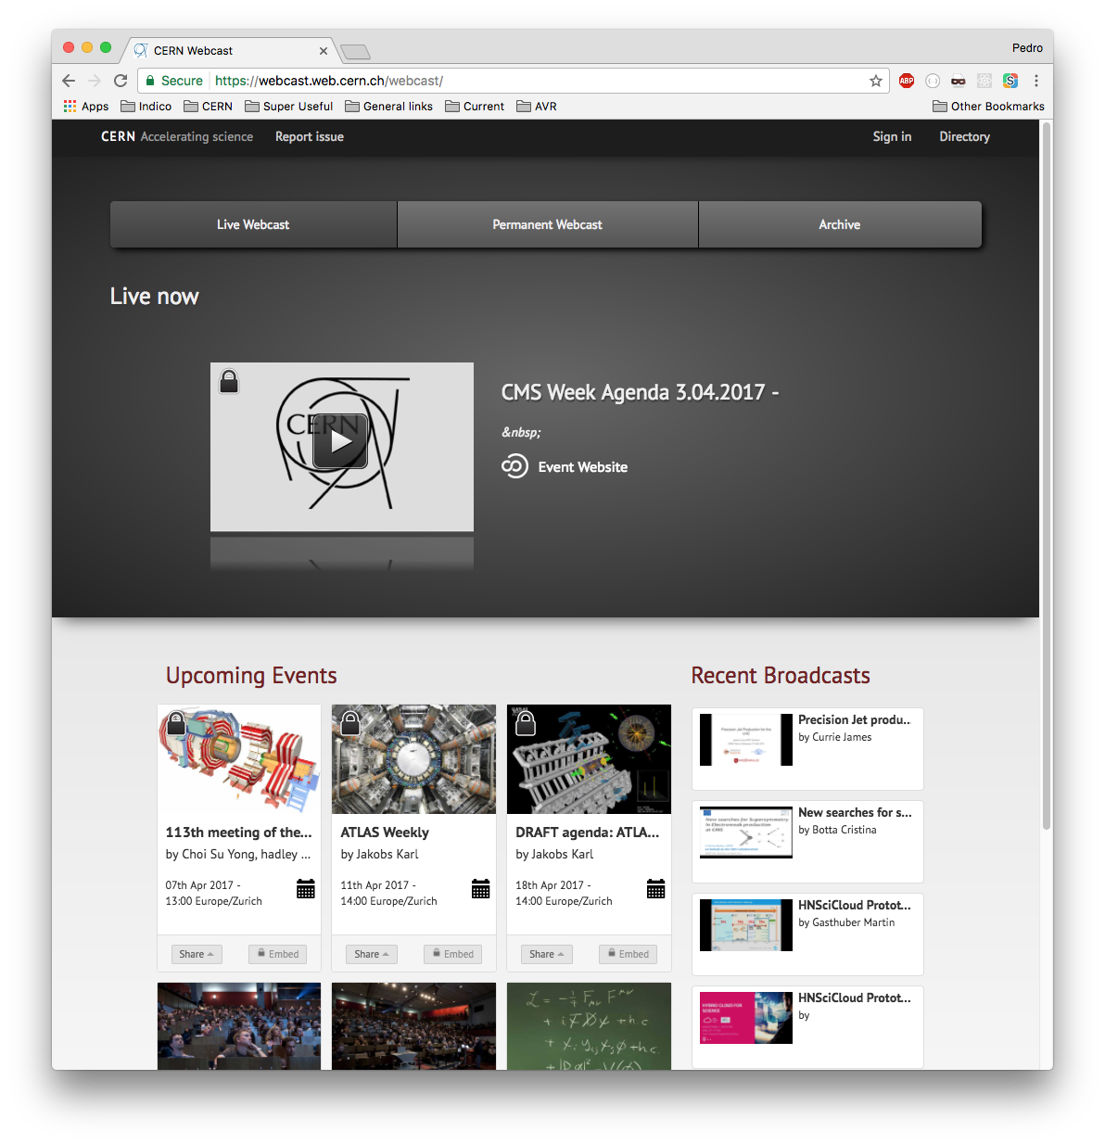
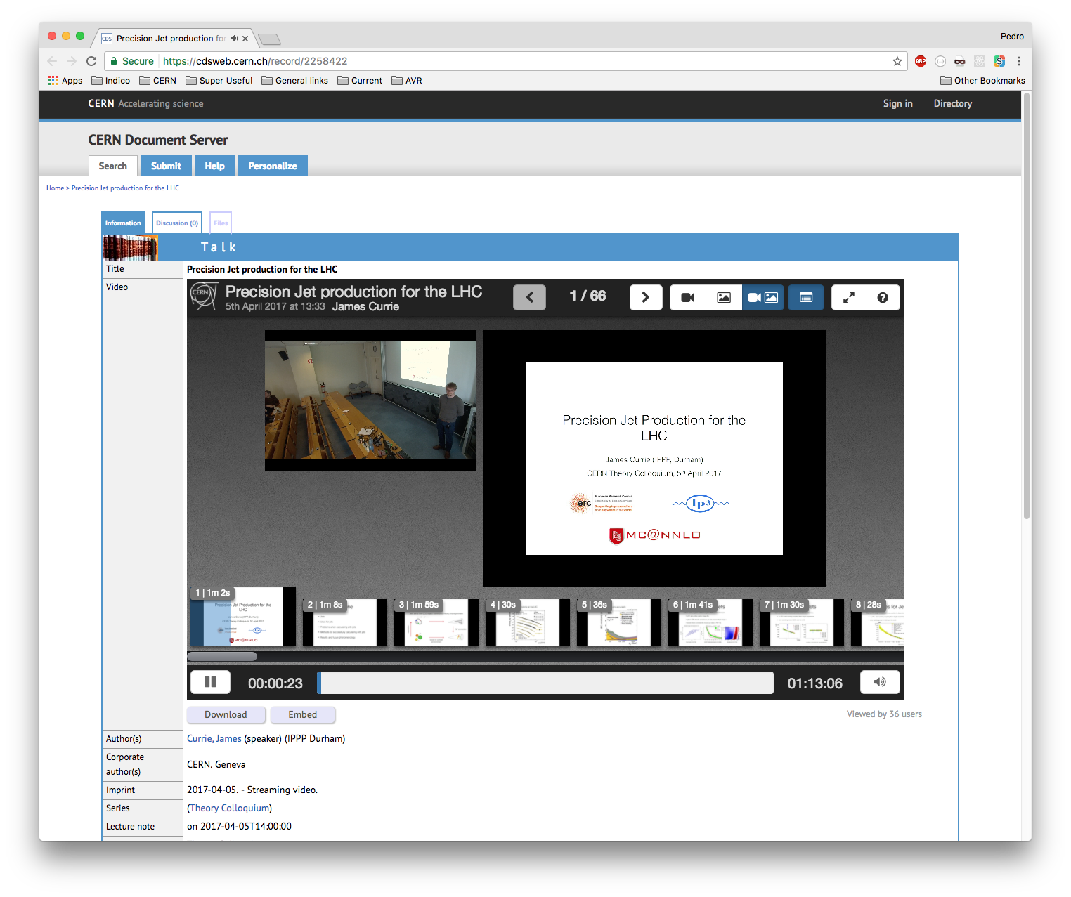
Service Requests

Slide 11
Service Requests
Timetable
Webcast / Recording
Request
Speaker Release
Form

Slide 12
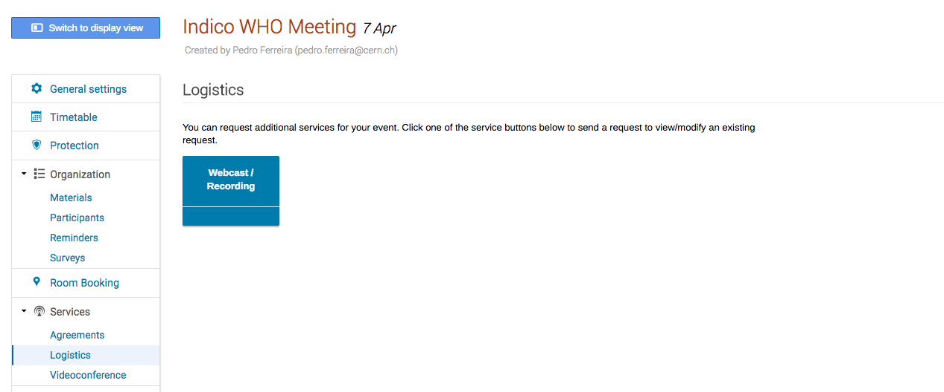
Service Requests

Slide 13
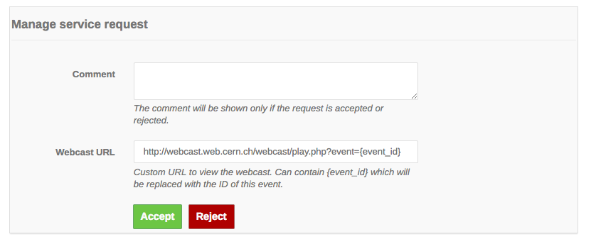
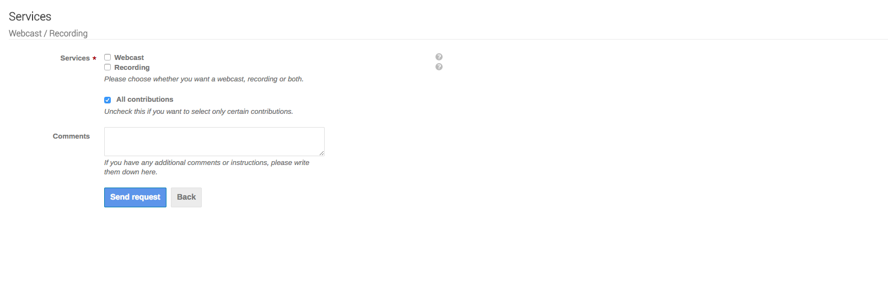
Service Requests

Slide 14
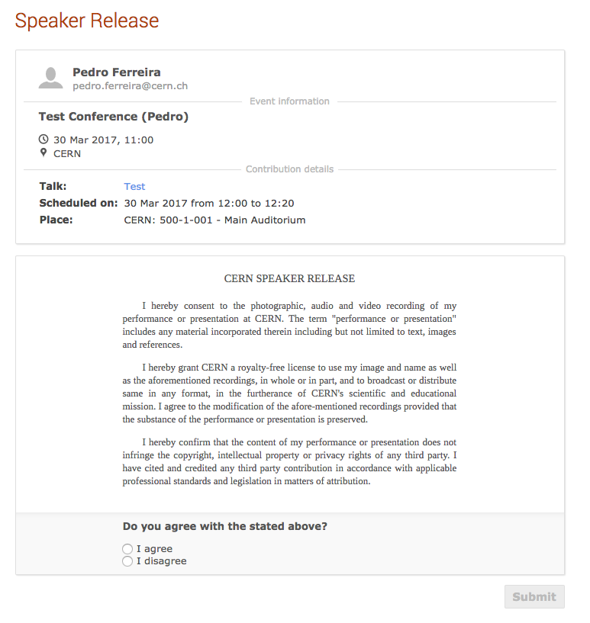
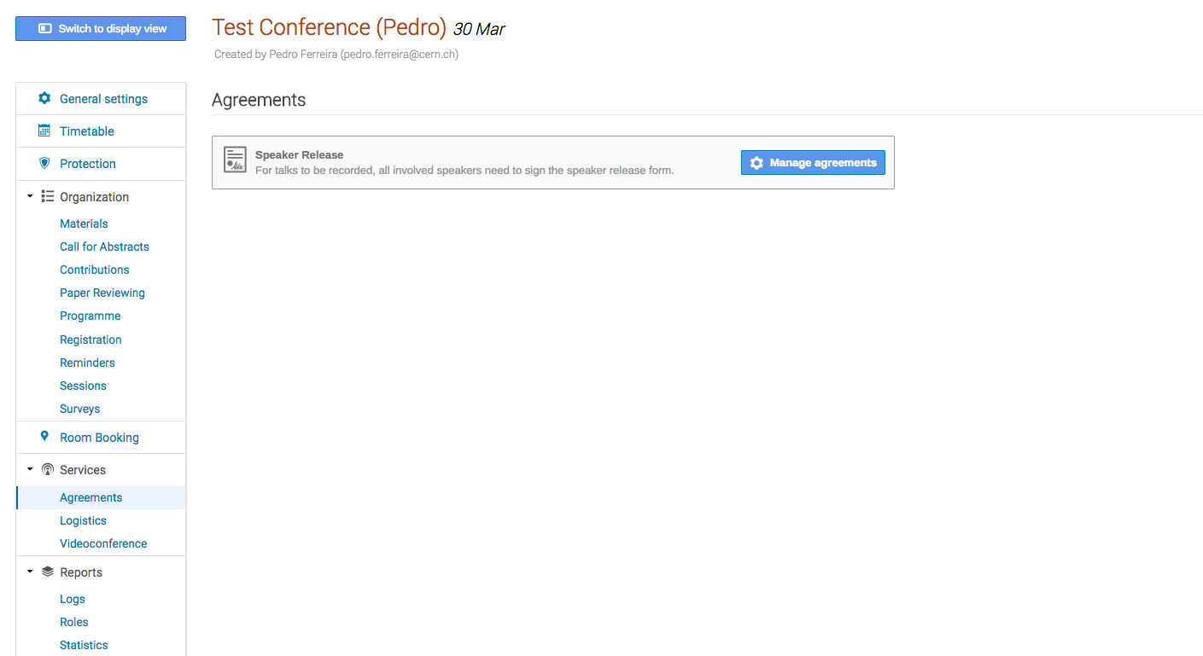
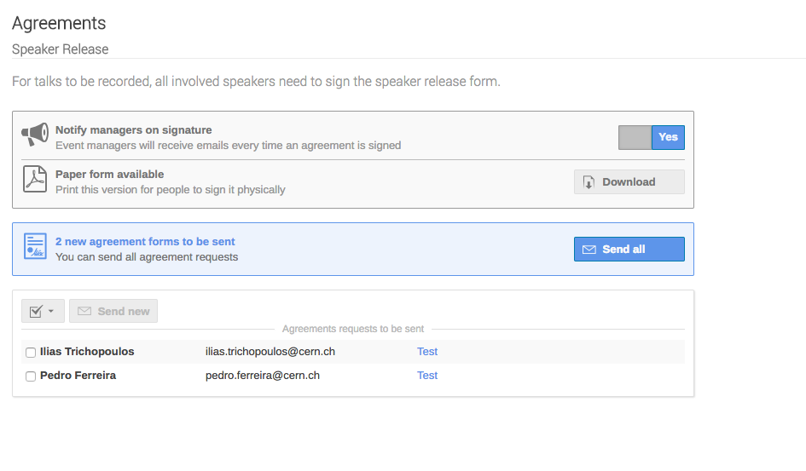
Release Form

Slide 15
CERN
Webcast
Indico
RAVEM
(VC equipment)
Micala
(Recording mgmt.)
Vidyo
(Videoconf.)
VC Devices

Slide 16
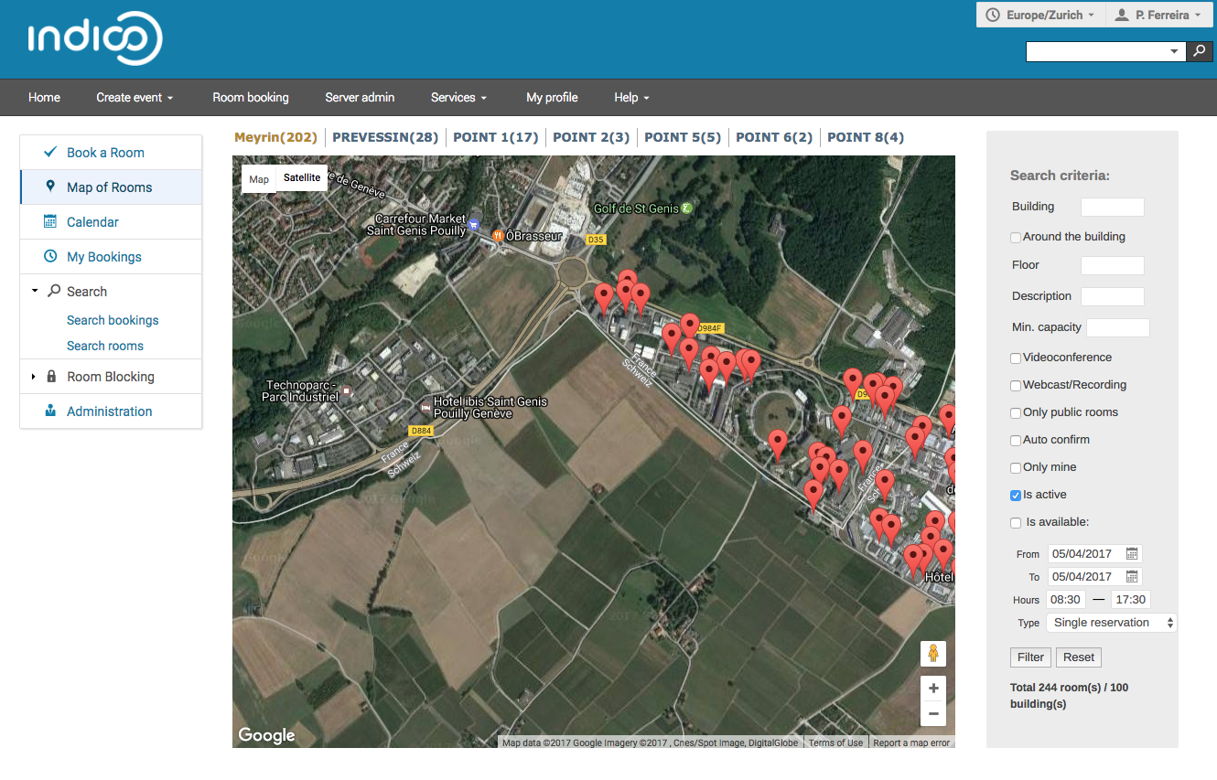
Physical Resources (Rooms)
250 Rooms
1700 bookings/week
Notes:
Demo
- Filtering by equipment types

Slide 17
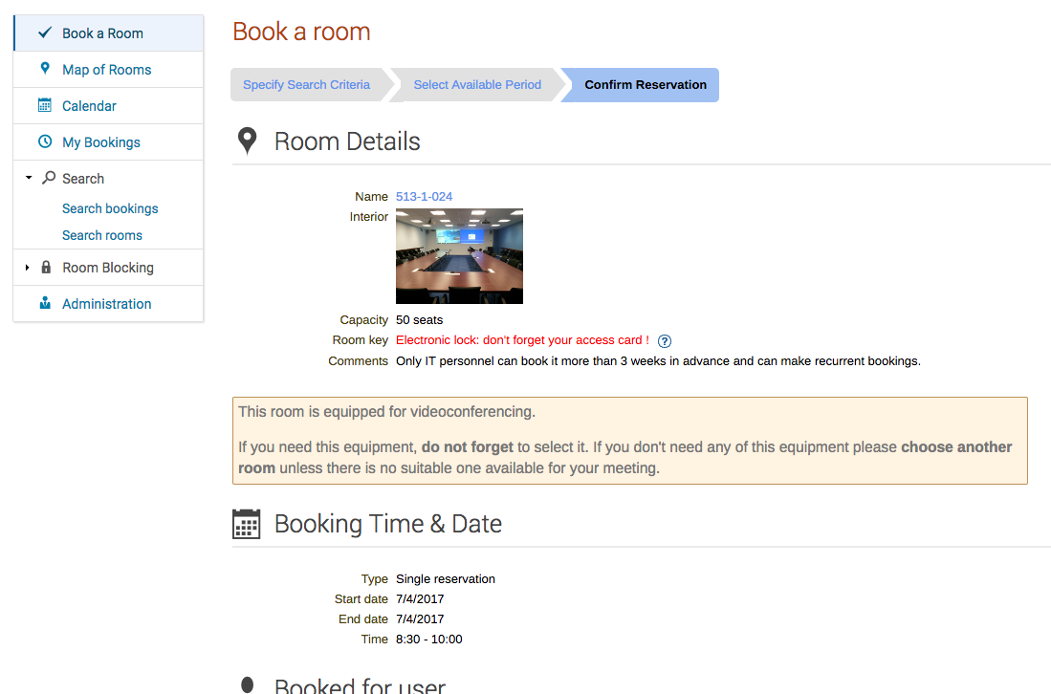
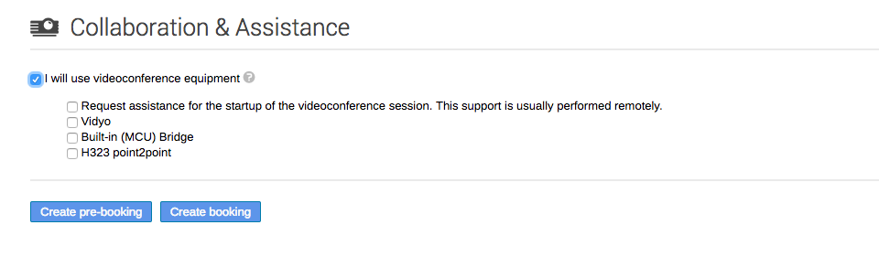
Physical Resources (Rooms)
Notes:
Demo
- Filtering by equipment types

Slide 18

Numbers

Slide 19
Milestones
2004 - Indico goes live at CERN
For CHEP2014 conference
Focused on conference events
2007 – Indico replaces CDS Agenda
Support for meeting/lecture events
Room Booking introduced

Slide 20
Milestones
2009 – Collaborative tools
Integration with VC systems
“Growth” phase
2014 –2017 – Path to Indico 2.0
Growth accelerates

Slide 21
Milestones
2017 – Indico 2.0
New Database system (Postgres)
New technology stack (SQLAlchemy + Flask + Jinja…)

Slide 22
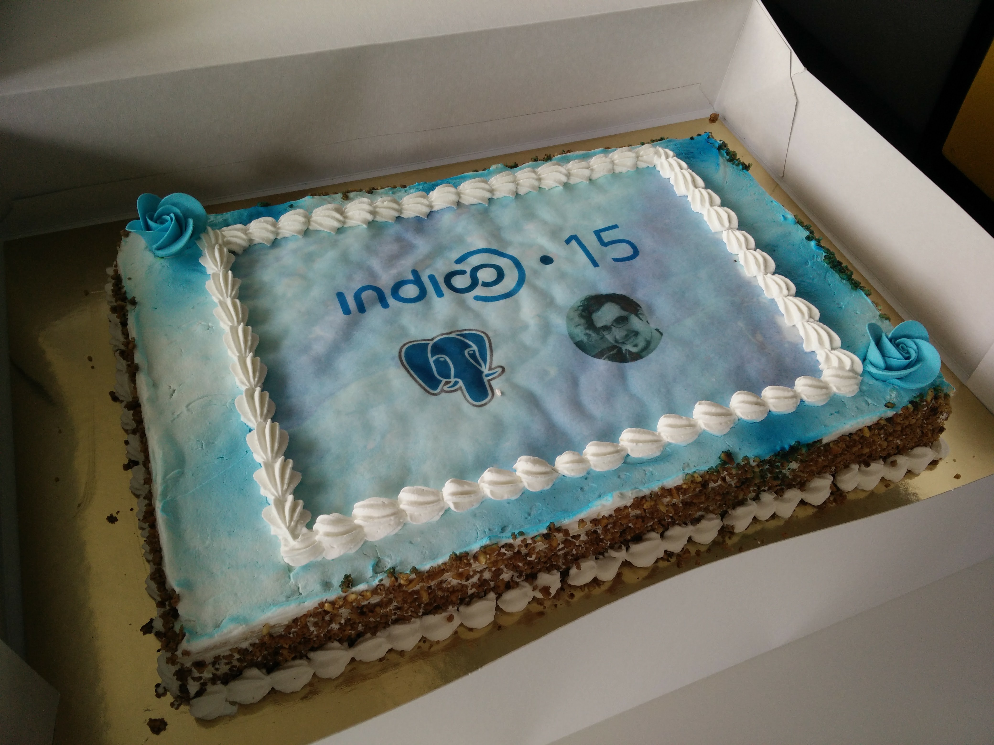

Slide 23
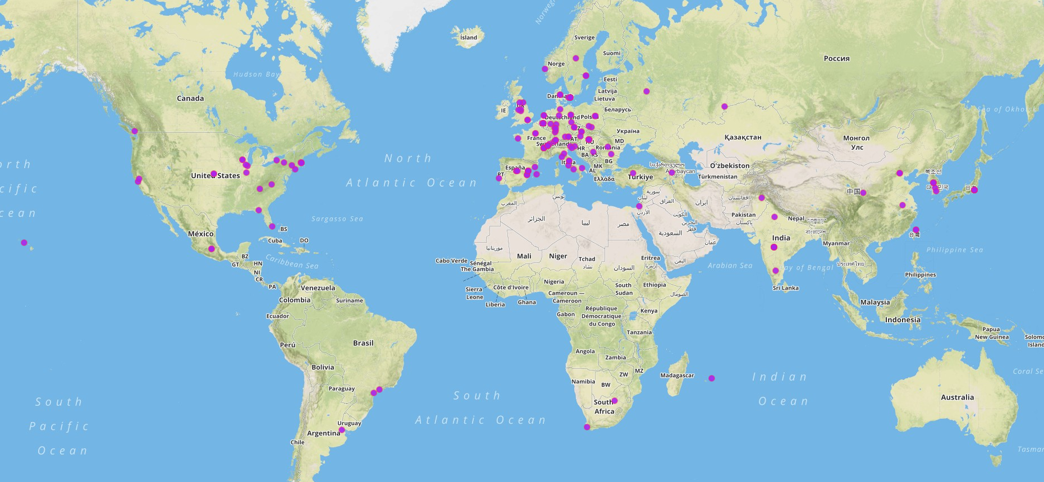
Community

Slide 24
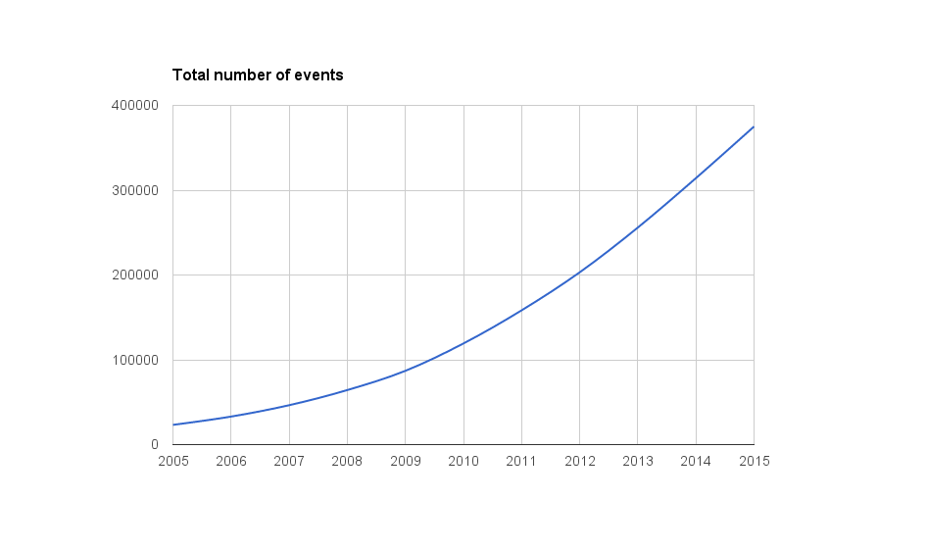
Statistics

Slide 25
Nowadays
480.000 hosted events
28.000 so far this year
71.000 in 2016
6200 categories
~2M attached files

Slide 26

Technology

Slide 27
Indico
Open Source Software
Mature (15 years)
Utilizing state of the art technology
Extensible architecture (through plugins)
Official plugins – E-payment, VC, Search…

Slide 28
Integrations
Integrations with internal tools
CERN Plugins
Not Open Source, since very CERN-specific
Available in internal code repository

Slide 29
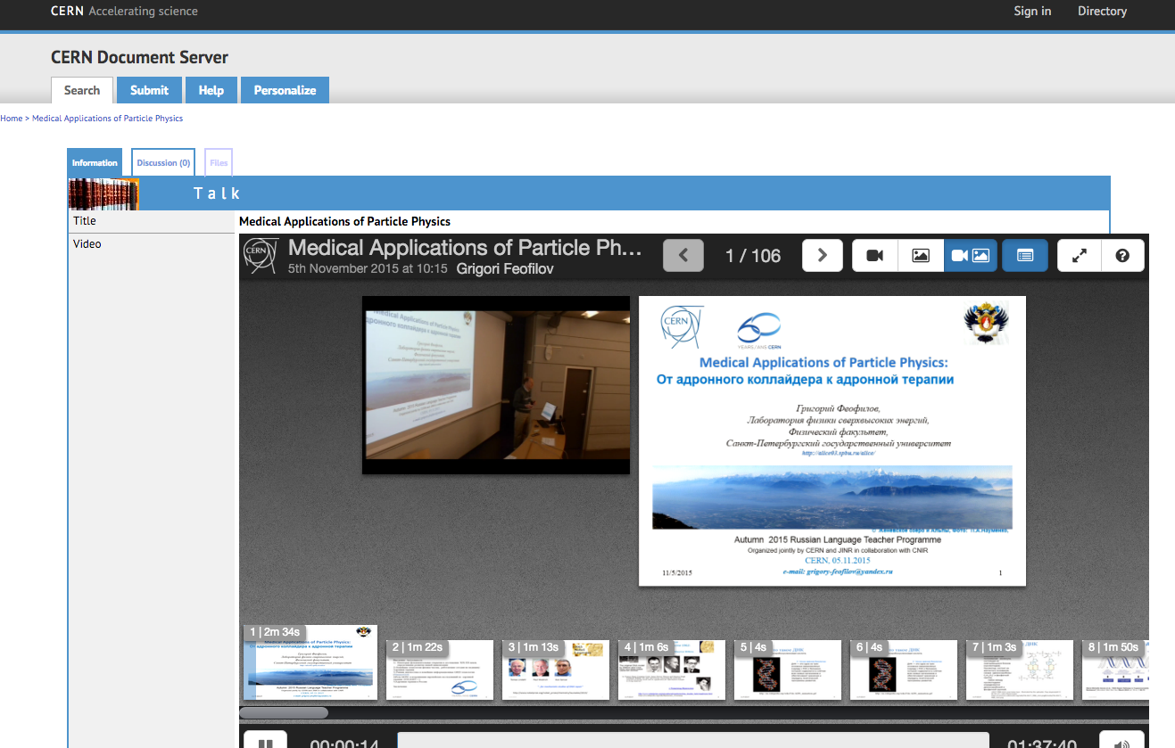
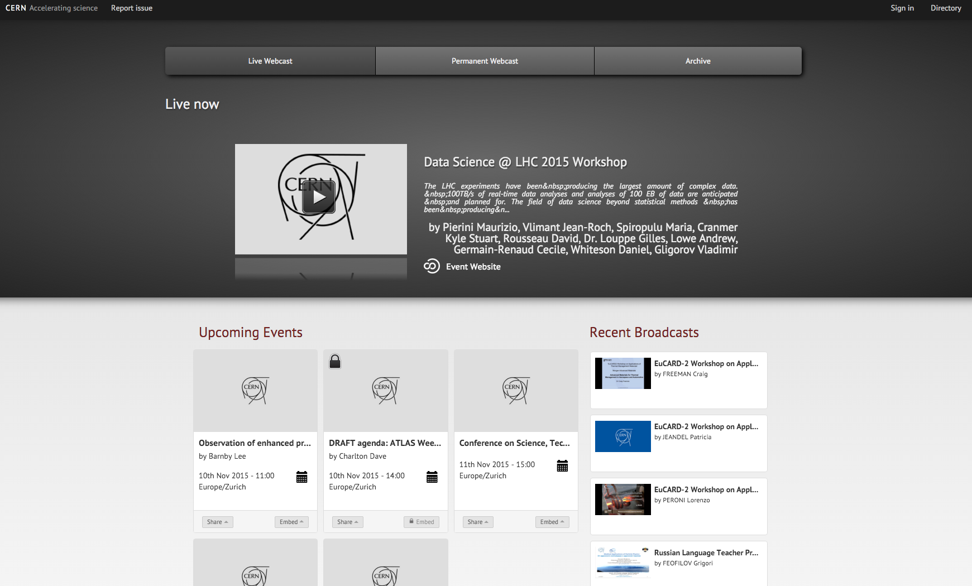
Audiovisual workflow

Slide 30
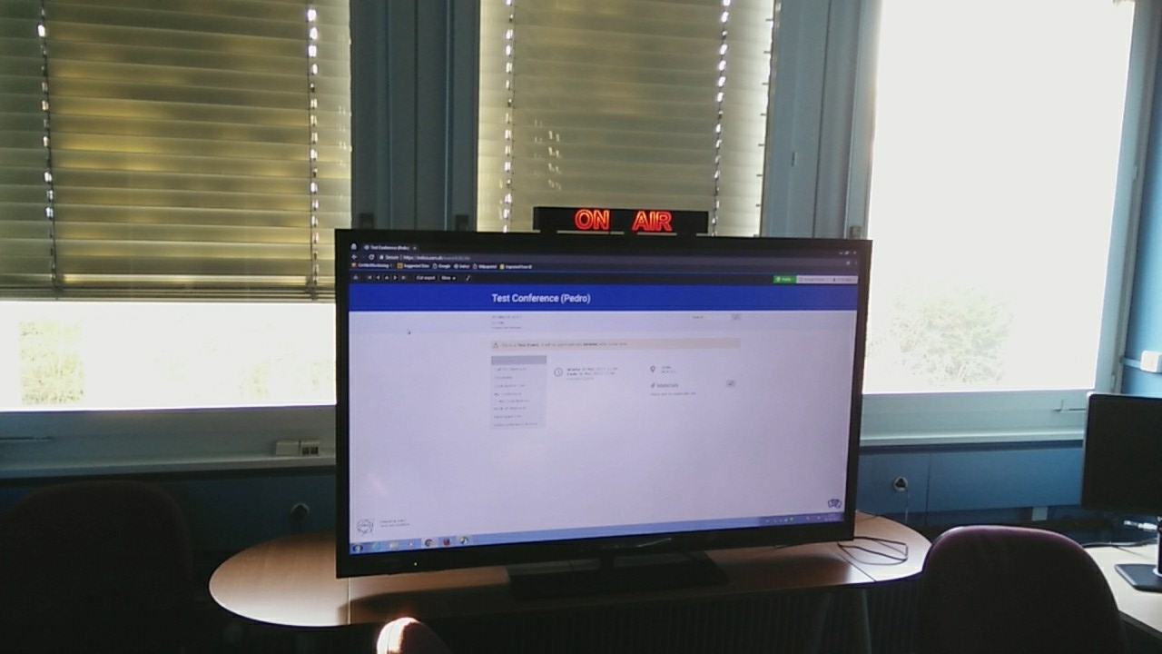
RAVEM

Slide 31
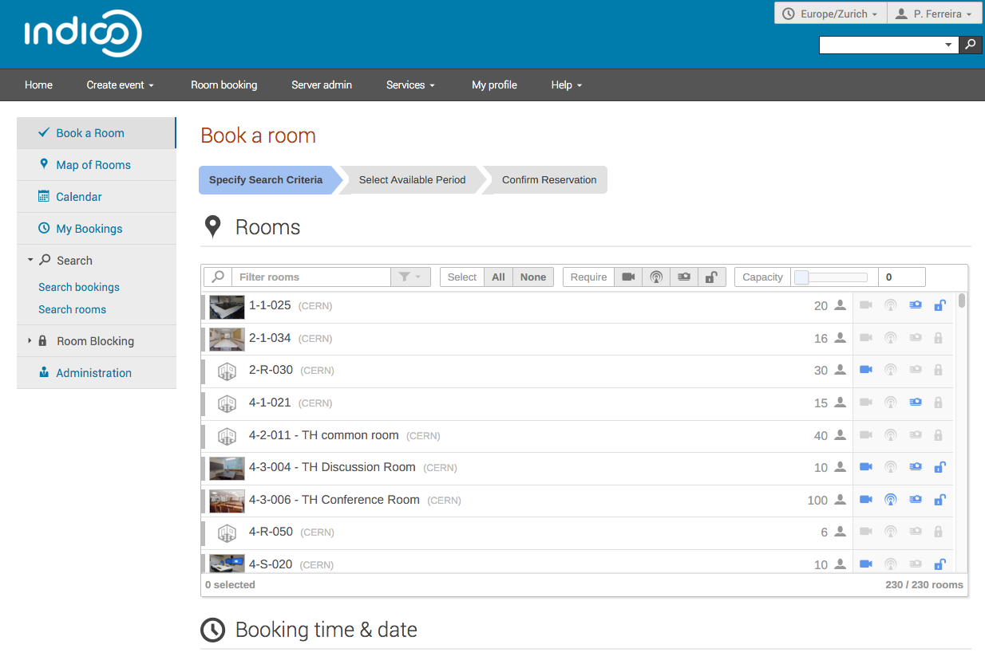
Room synchronisation

Slide 32
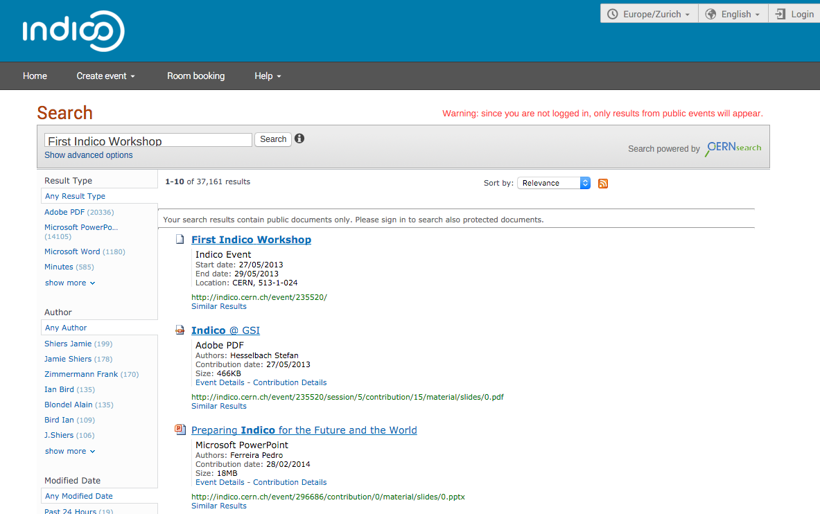
Search engine integration

Slide 33
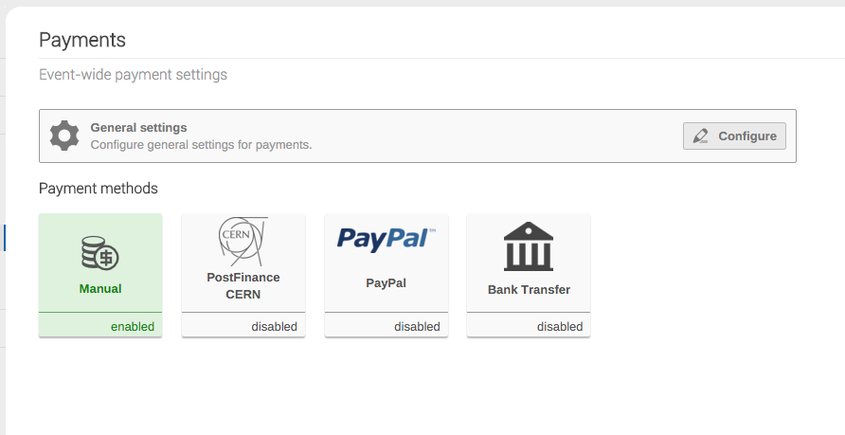
Electronic Payment

Slide 34
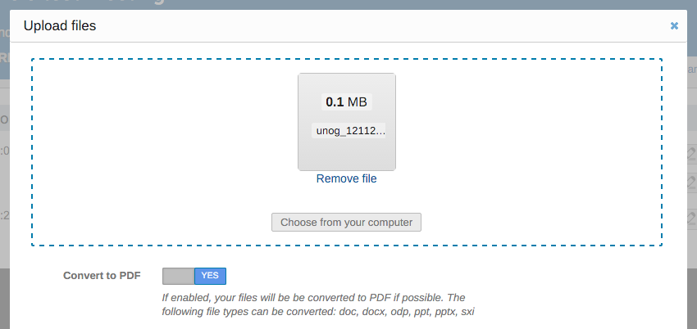
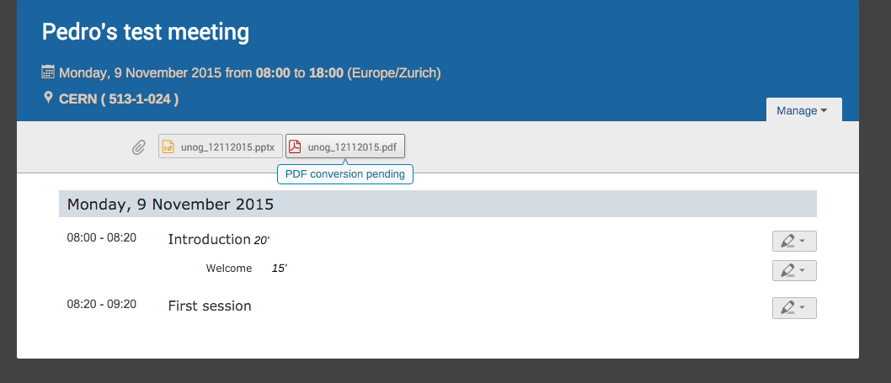
PDF Conversion

Slide 35
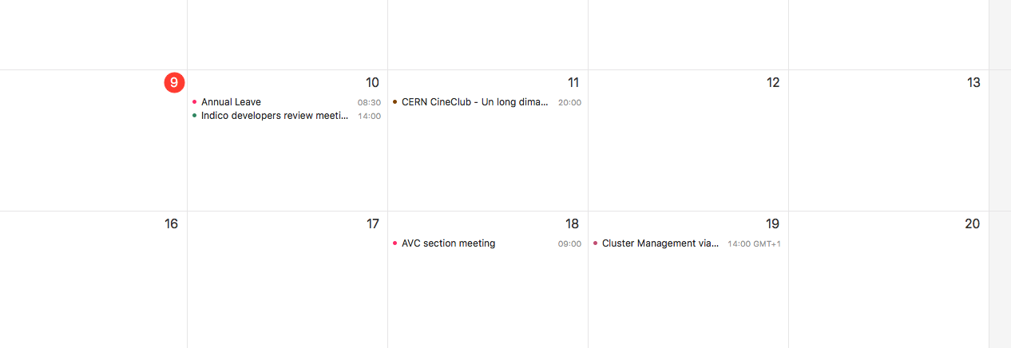
Exchange integration

Slide 36

Goals

Slide 37
Goals for 2017
Version 2.0
Community-ready, fully PostgreSQL
Consolidation of improvements, no legacy code
Improvements in Room Booking
Tighter integration with rest of application
Improvements in Conference Management tools

Slide 38
Conclusion
Growing project
Mature, active community
Ambitious goals
Growing service
CERN: Indico is synonymous with “events”
Scaling up when needed, solid an reliable
Open to the World
Providing universal building blocks

Slide 39
Questions?

