Slide 1
Computing in High Energy Physics
John Apostolakis
SoFTware for Physics Group,
EP Dep, CERN
V1.0
2016.02.10
John.Apostolakis@cern.ch
Notes:
V0.98, 00:30 22η Αυγουστου 2012

Slide 2
Outline - Part 2
Uses of Computers
  Data Acquisition – record
  Reconstruction: Online, and off-line
  Simulation
  Data analysis
Size of challenge
  the GRID solution and its other applications
12 February 2016
J. Apostolakis
Notes:
Detectors and their Simulation
Simulation packages, toolkits
Key capabilities and concepts
Alternatives
Physics processes and their modelling
EM, hadronic, optical, …
GEANT4
an example of a modern simulation toolkit,
highlights of capabilities.

Slide 3
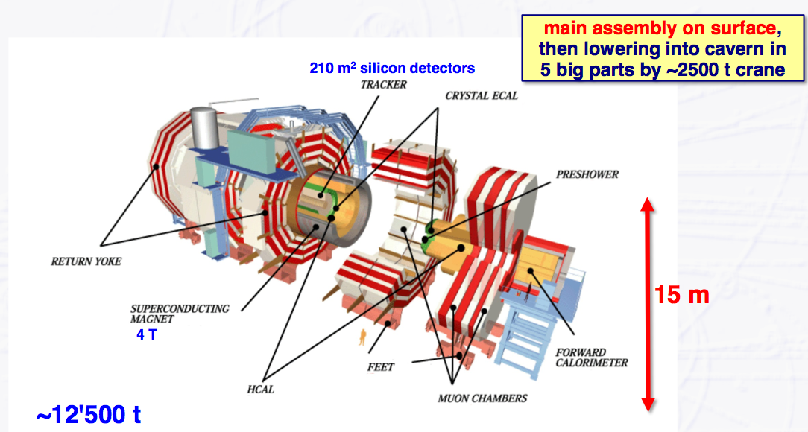
An LHC detector - CMS
12 February 2016
J. Apostolakis

Slide 4
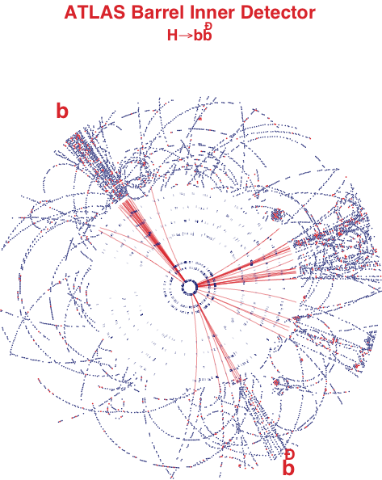
Data Acquisition (DAQ)
Convert analog electronic signals into digital data
Trigger – decision to record
  Find interesting coll.
  Assess – do they meet selection criteria
12 February 2016
J. Apostolakis
Notes:
Detectors and their Simulation
Simulation packages, toolkits
Key capabilities and concepts
Alternatives
Physics processes and their modelling
EM, hadronic, optical, …
GEANT4
an example of a modern simulation toolkit,
highlights of capabilities.

Slide 5
Reconstruction
A lightning introduction

Slide 6
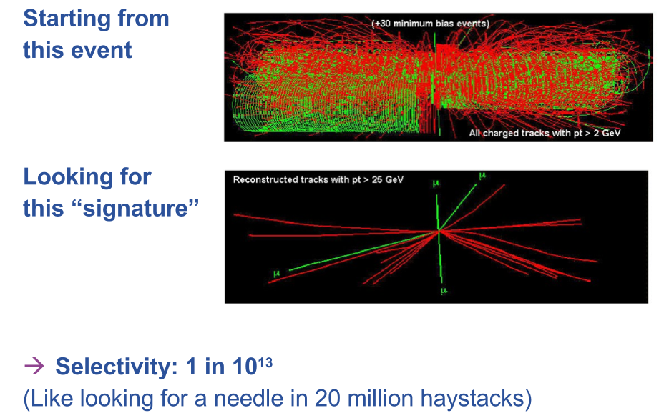
The Reconstruction challenge
12 February 2016
J. Apostolakis

Slide 7
Online and offline reconstruction
Are collisions first-tagged really interesting enough to keep (given capacity constraints)?
  Online reconstruction – seek to reconstruct ‘as much as you can’ quickly to enable decision
Critical part of experiment – collisions which are not recorded are lost
Later there is more time to reconstruct the contents of a collision – but this is also complex
12 February 2016
J. Apostolakis

Slide 8
What is reconstruction
Tracker hits form a puzzle
  Which tracks created them?
Each energy deposition is a clue
  There are thousands of measurements in each snap-shot
The experiment’s reconstruction must obtain a solution!
  In well measured magnetic field
  Matches the traces to tracks
12 February 2016
J. Apostolakis
Notes:
Εικονα/ Picture from ATLAS – copied from talk of John Harvey at Global Grid Forum, 13 March 2004
The measurements from an event are like a ‘puzzle’
What tracks created them?
Reconstruction will tell!
Each tracking detector can measure a hit’s positions
They can come from tens to thousands of tracks
Must identify
which of these hit ‘traces’ belong to the same track

Slide 9
How it works – a simple example
Start with the locations of the traces on first two planes
Magnetic field
Β
12 February 2016
J. Apostolakis

Slide 10
Reconstruction in practice
Μαγνητικο
Πεδιο
Β
Start with the locations of the traces on first two planes
Try different combinations
  Project to subsequent planes
  Calculate differences between measured positions and ‘predictions’
(Kalman filter)
12 February 2016
J. Apostolakis

Slide 11
Reconstruction: result
Μαγνητικο
Πεδιο
Β
Start with the locations of the traces on first two planes
Try different combinations
  Project to subsequent planes
  Calculate differences between measured positions and ‘predictions’
Finally the candidate tracks are identifed
  else look ‘quickly’ for the straight(er) ones – high energy tracks
P= 11 GeV/c
P= 22 GeV/c
P= 7.5 GeV/c
12 February 2016
J. Apostolakis

Slide 12
Simulation and Detectors
What is simulation ?
Why it exists ?
How is it done ?

Slide 13
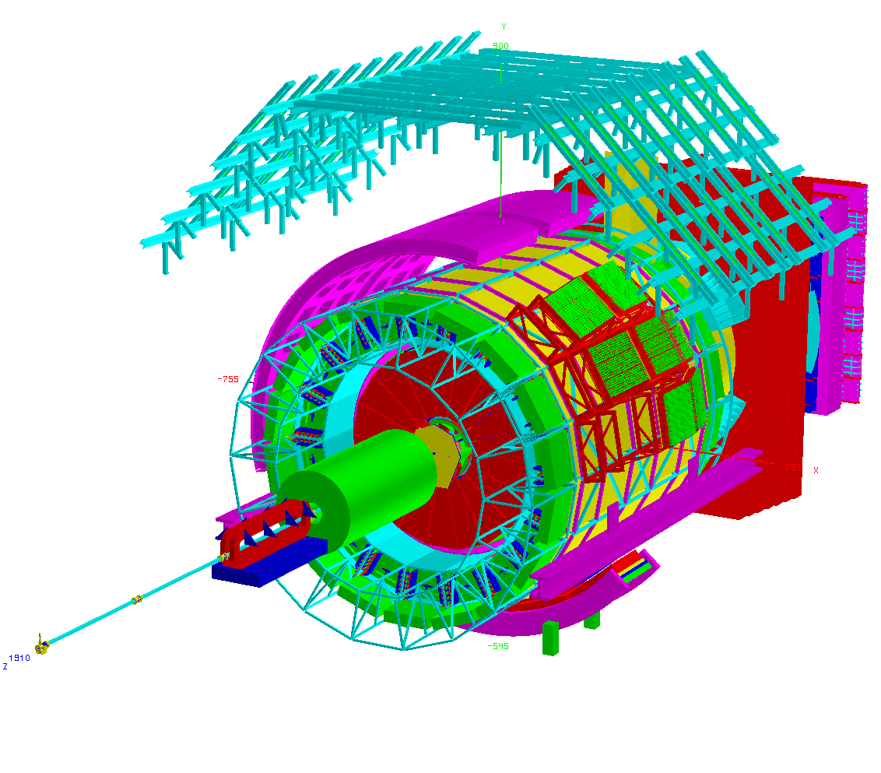
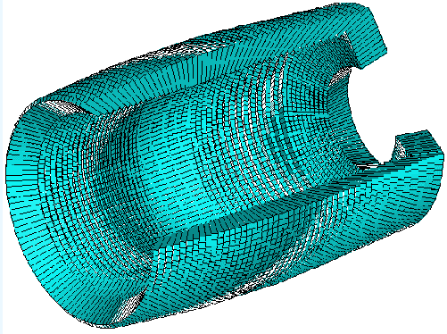
Today’s detectors
Many different parts
  Different capabilities
    Measuring Location (trackers)
    Measuring energy (calorimeters)
Due to complexity
  Different materials,
  Most studies must use computers to create samples of tracker hits & energy deposition
ALICE Exp.
12 February 2016
J. Apostolakis

Slide 14
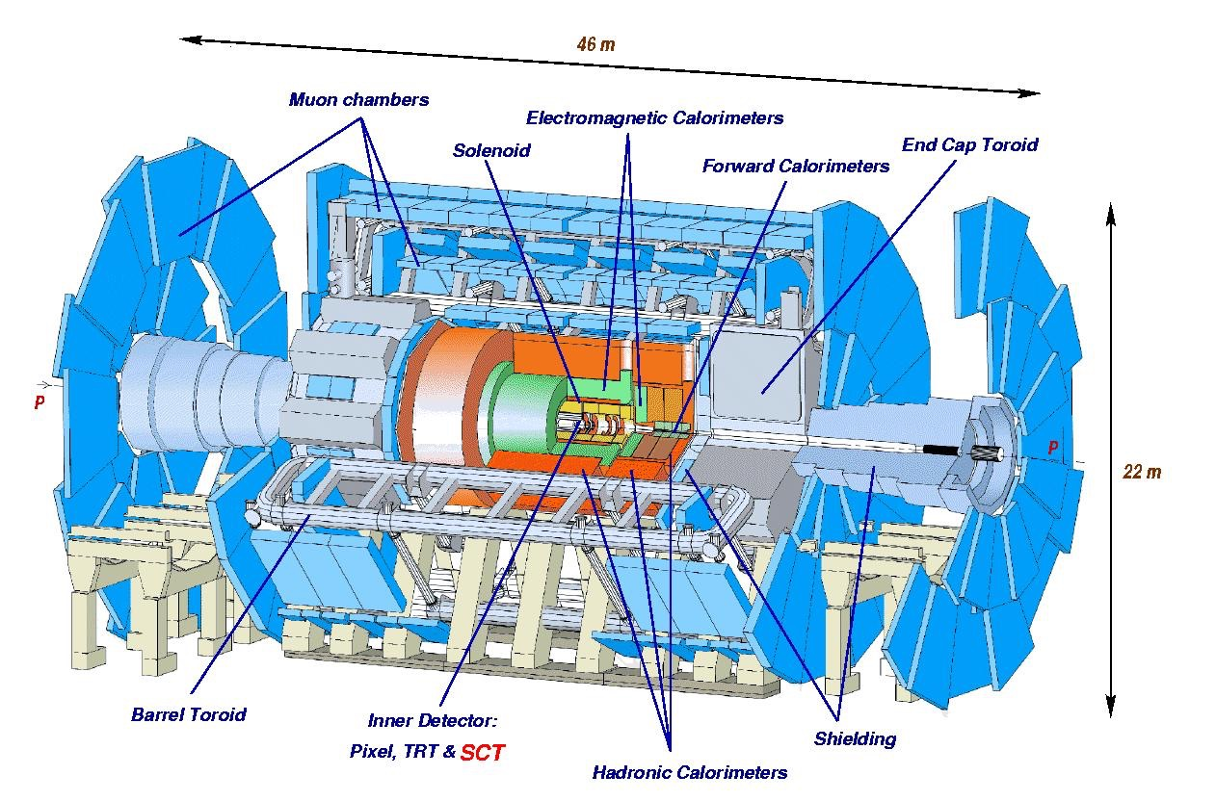
Today’s detector Technologies: ATLAS
12 February 2016
J. Apostolakis
Notes:
20 m ~ a 5 story building

Slide 15
What is simulation ?
We build models
  Detector’s Geometry
    Shape, Location, Material
  Physics interactions
    All known processes
      Electromagnetic
      Nuclear (strong)
      Weak (decay
Silicon
Tracker
σ_{total} = Σ σ_{per-interaction}
2.5 MeV e⁻
electron
12 February 2016
J. Apostolakis
300 μ
Notes:
To create such a virtual reality we need
to model the particle-matter interactions, geometry and materials in order to propagate elementary particles in the model detector.
to describe the sensitivity of the detector for generating raw data.

Slide 16

Geant4 geometry: what it does
Describes a Detector
Hierarchy of volumes
Many volumes repeat
  Volume & sub-tree
Up to millions of volumes for LHC era
Import detectors from CAD systems
Navigates in Detector
Locates a point
Computes a step
  Linear intersection
12 February 2016
J. Apostolakis

Slide 17
Physics processes
Physics processes are modelled
For example Electromagnetic processes include:
Gammas:
  Gamma-conversion, Compton scattering, Photo-electric effect
Leptons(e, μ), charged hadrons, ions
  Energy loss (Ionisation, Bremstrahlung) or PAI model energy loss, Multiple scattering, Transition radiation, Synchrotron radiation,
Photons:
  Cerenkov, Rayleigh, Reflection, Refraction, Absorption, Scintillation
High energy muons and lepton-hadron interactions
12 February 2016
J. Apostolakis

Slide 18
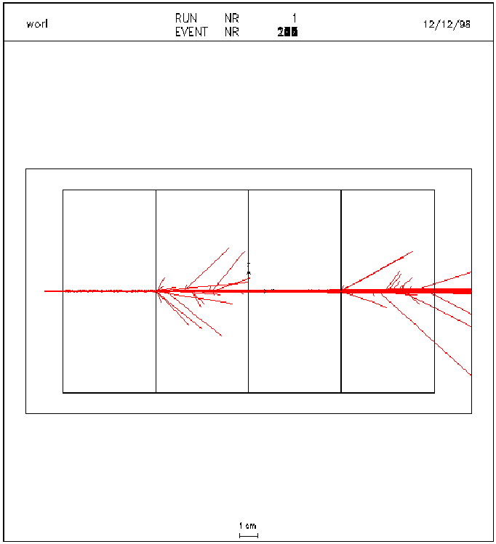
A simple particle shower
In lead many secondary particles are produced
  Most are contained
  A few escape into CO2
Energy deposition is measured in gas
  Charged tracks ionise gas
  Fewer new tracks produced
Pb CO2 Pb CO2
GEANT 3
12 February 2016
J. Apostolakis

Slide 19
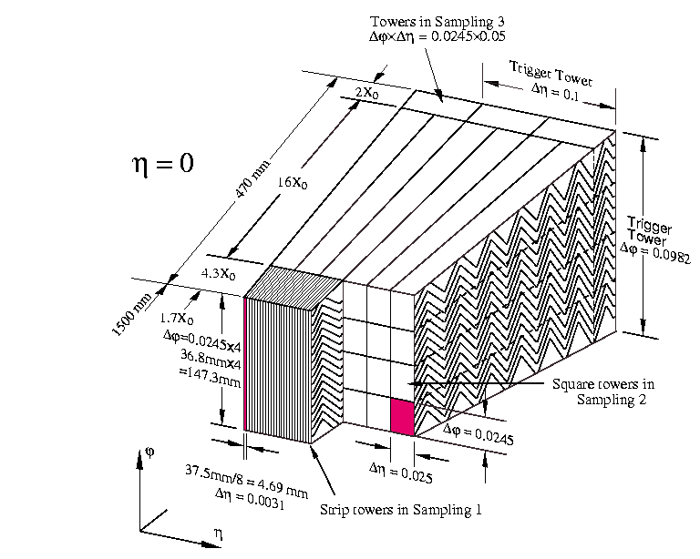
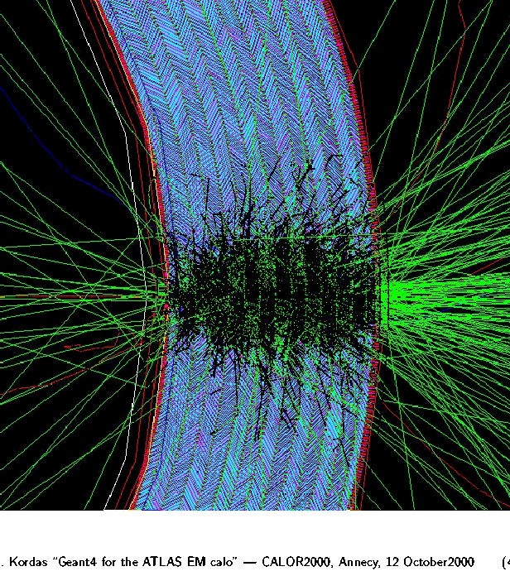
Example detailed geometry
12 February 2016
J. Apostolakis

Slide 20
Atlas : Physics Signatures and Event Rates
Beam crossing rate 40 MHz
σ_{inelastic} = 80 mb
  In each beam crossing (rising each year, in 2012 ~ 25 interactions)
Different physics ‘targets’
  Higgs Boson(s) (Discovery 2012)
  Supersymmetric partner particles
  Unexpected
  Matter-antimatter differences (B mesons)
Many examples of each channel are simulated
12 February 2016
J. Apostolakis
Notes:
Taken from talk of John Harvey at Global Grid Forum, 13 March 2004

Slide 21
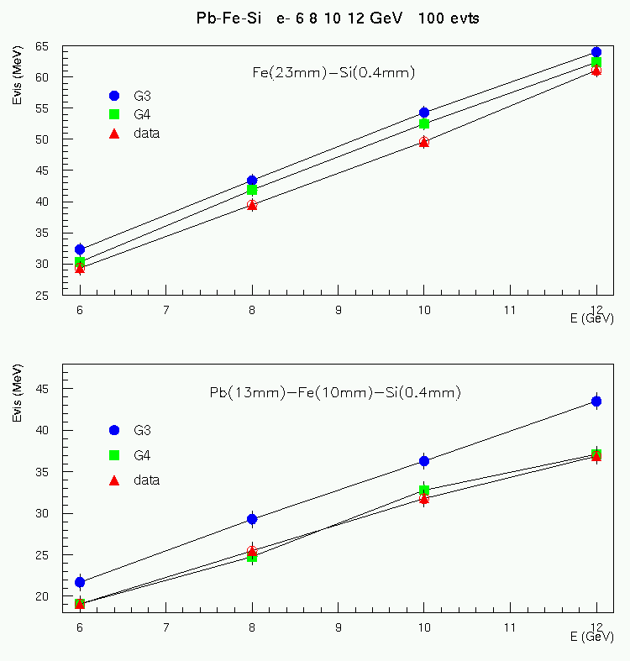
Why simulate ?
To design detectors
  Decise details
To prepare the reconstruction
  Before the detector is built and operates
To understand events in the analysis
12 February 2016
J. Apostolakis

Slide 22
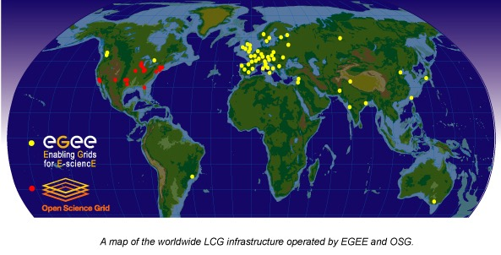
Data Analysis
12 February 2016
J. Apostolakis

Slide 23
Data Analysis
Uses the results of Reconstruction
  the products are reconstructed tracks, Energy deposits (calorimeters)
  Hierarchy of data from original (RAW), to summary (AOD)
An experiment’s physics teams use the (large) pool of data
  No longer in one central location, but in multiple locations (cost, space of building, computers, disks, network) .... using the GRID
Hypatia: a small part of analysis for a school setting
  Introduction /Portal
    http://hypatia.iasa.gr/en/index.html
  http://indico.cern.ch/conferenceDisplay.py?confId=257353#2013-07-08
12 February 2016
J. Apostolakis

Slide 24
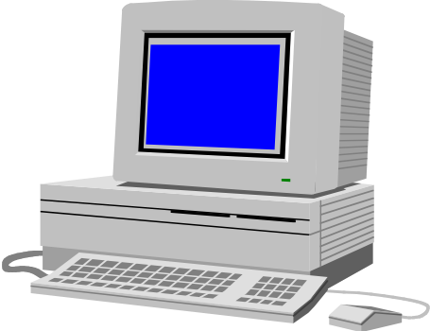

HEP Processing stages and datasets
event filter
(selection &
reconstruction)
detector
processed
data
Event Summary
Data (ESD)
raw
data
batch
physics
analysis
event
reconstruction
Analysis Object Data (AOD)
(extracted by physics topic)
event
simulation
individual
physics
analysis
12 February 2016
J. Apostolakis
Notes:
Raw data are staged to disk and archived on tape
Data for subsequent processing (ESD, AOD) are cached on disk
Production analysis typically involves skims and archiving according to event type for ease of replication and caching (department servers and desktop)
Few cycles re-reconstruction – most data/cpu intensive
Several cycles on production analysis
Very many cycles on end user analysis – least data/cpu intensive

Slide 25
Data Hierarchy
~2 MB/event
RAW
Raw data (DAQ)
Detector digitisation
10⁹ events/yr * 2 MB =2 PB/yr
First reconstruction data
Pattern recognition information:
Clusters, track candidates
~100 kB/event
ESD
Physical information:
Transverse momentum,
Association of particles, jets,
(best) id of particles,
~10 kB/event
AOD
Summary data for analysis
Classification
information
Relevant information
for fast event selection
~1 kB/event
TAG
12 February 2016
J. Apostolakis

Slide 26
Event Data
Complex data models
  ~500 structure types
References to describe relationships between event objects
  unidirectional
Need to support transparent navigation
Need ultimate resolution on selected events
  need to run specialised algorithms
  work interactively
Not affordable if uncontrolled
RAW
ESD
AOD
AOD
versions
Event
Event
Event
Event
Phys
Raw
Rec
Phys
Velo
Calo
Coord
Tracks
Cand
MyTrk
Collaboration Data
Private
12 February 2016
J. Apostolakis
Notes:
Time moves from left to right
Raw event structure generated online
Reconstruction clone event header with link to raw and add link to Rec and new objects generated.
AOD – clone ESD Event and add link to Physics objects
Left box is typically batch production – because links exist do not necessarily navigate them too expensive - Sequential processing through files of data - New calibration do new production reprocessing of reconstruction and analysis
Unidirectional links backward in time
No links between events – autonomous
Private analysis is where can make use of links – copy Event and Phys objects and generate new private information e.g.
interactive event display shows tracks on selected (very) few events – want to see raw hit
want to run specialised physics algorithms on Higgs candidates
Typically span namy runs just looking at Higgs candidates, very few events per run
Can save results of private analysis for reuse - making plots later, sharing results with colleagues etc.

Slide 27
HEP Metadata - Event Collections
Run Data
Event 1
Event 2
…
Event 3
Run Data
Event 1
Event 2
…
Event 3
Bookkeeping
Run Data
Event 1
Event 2
…
Event N
Run Catalogue
Physics : Run 21437
MC: B -> π π
MC: B -> J/Ψ (μ⁺ μ⁻)
…
Collection Catalogue
B -> ππ Candidates (Phy)
B -> J/Ψ (μ⁺ μ⁻) Candidates
…
Dataset
Event 1
Event 2
…
Event 3
Dataset
Event 1
Event 2
…
Event 3
Event tag collection
Tag 1 5 0.3
Tag 2 2 1.2
…
Tag M 8 3.1
12 February 2016
J. Apostolakis
Notes:
Run Catalogue – Associates runs to Data files – implicit collections implying sequential processing of data – no pointers
Event collection - a collection of references to events, plus other attributes (tags) – implies explicit colections and to pointers – allows to read from different files
This is the primary interface for reading back events for analysis
Can query attributes without retrieving the objects themselves which allows selection of specific subsets to be selected from large collections
File catalog - keeps track of files of the “Event DB”
Does the mapping of logical file names to physical file names
Need to know how the collection was produced (provenance)
which selection algorithm was used
which reconstruction algorithm
which calibration
Need to define a common schema that physicists can query to answer these questions
Otherwise they will produce their own collections wasting resources and adding to the confusion
Apply query to collection w/o touching data – result can be a new collection –continual process of refinement
Replicate and distribute over wide area
BaBar has now accumulated 80M) good production collections
There are so many options/configurations/releases/settings for each collection that people easily get lost

Slide 28
Detector Conditions Data
Reflects changes in state of the detector with time
Event Data cannot be reconstructed or analyzed without it
Versioning
Tagging
Ability to extract slices of data required to run with job
Long life-time
Version
Time
VDET alignment
HCAL calibration
RICH pressure
ECAL temperature
t1
t2
t3
t4
t5
t6
t7
t8
t9
t10
t11
Data Item
Time = T
Version
Tag1 definition
Time
12 February 2016
J. Apostolakis
Notes:
Detector Conditions synonym for calibration, alignment, operational parameters, environmental parameters etc.
Tag for each data item to identify which version to use at any time
Slice is a cut on tag (which data items you need) and on time

Slide 29
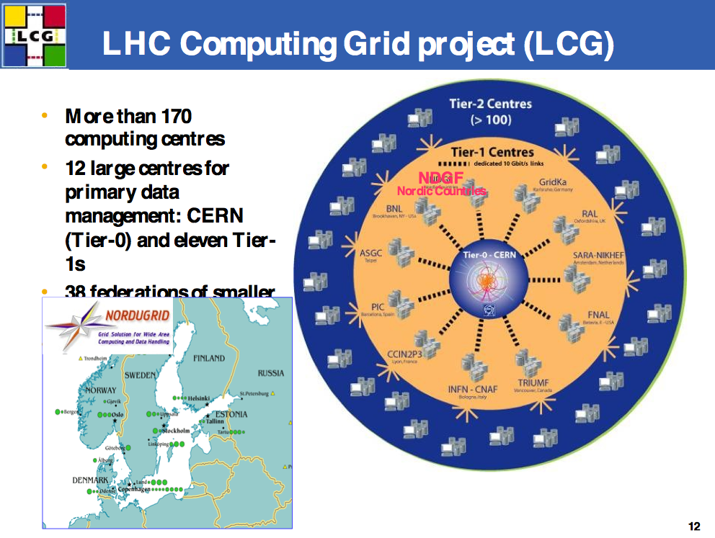
12 February 2016
J. Apostolakis

Slide 30
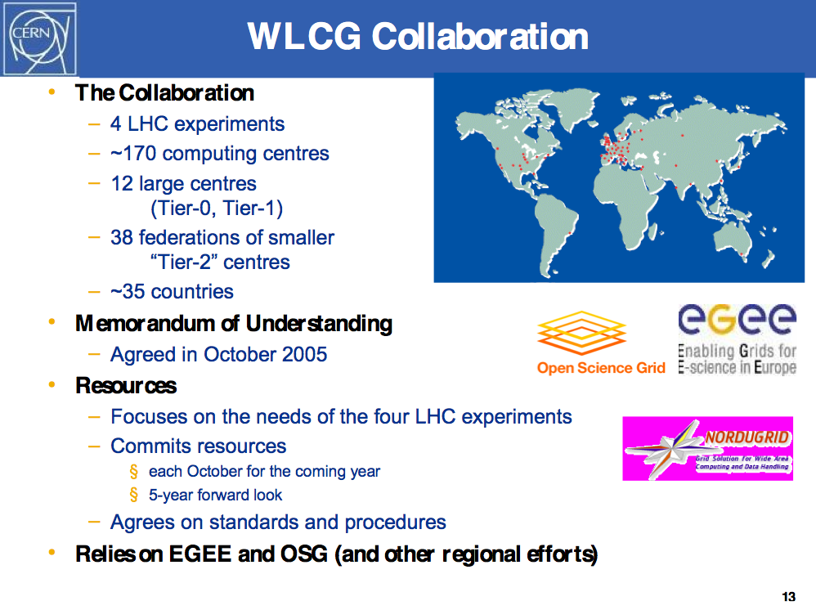
12 February 2016
J. Apostolakis

Slide 31
LCG depends on two major science
grid infrastructures ….
EGEE - Enabling Grids for E-Science
OSG - US Open Science Grid

Slide 32
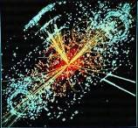


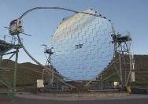
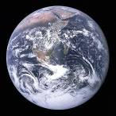

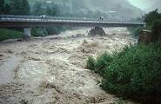
Applications
Many applications in different domains
  High Energy Physics (Pilot domain)
    Experiments at CERN (LHC), DESY, Fermilab
  Biomedical (Pilot domain)
    Bioinformatics
    Medical imaging
  Earth Sciences
    Geo-surveying
    Solid Earth Physics
    Hydrology, Climate
  Computational Chemistry
  Fusion
  Astronomy
    Cosmic Microwave Background
    Gamma ray astronomy
  Geology
  Industrial Applications
J. Apostolakis

Slide 33
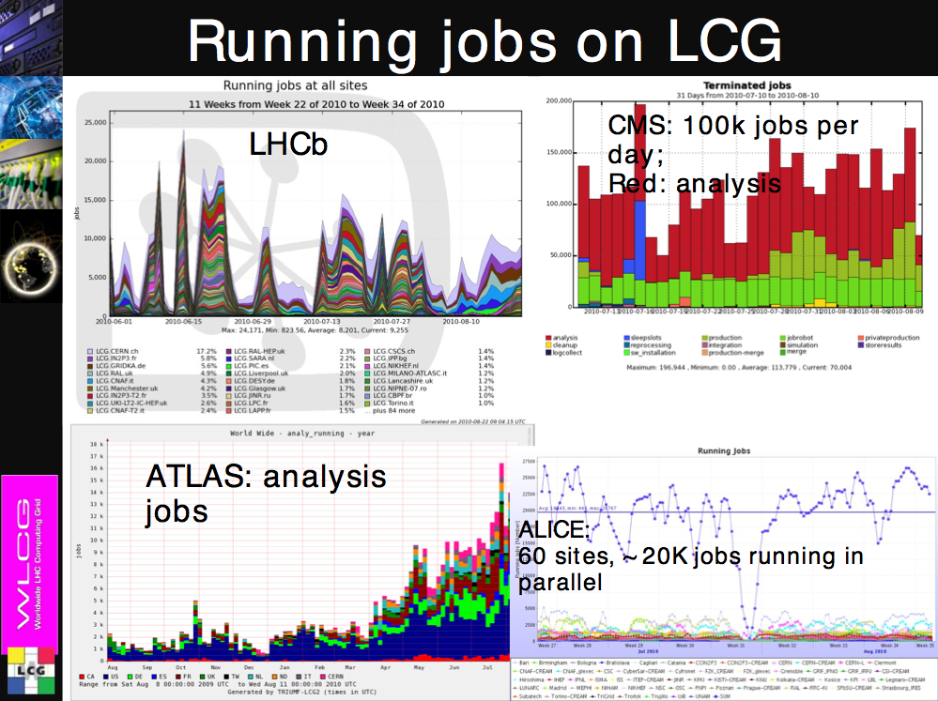
12 February 2016
J. Apostolakis

Slide 34
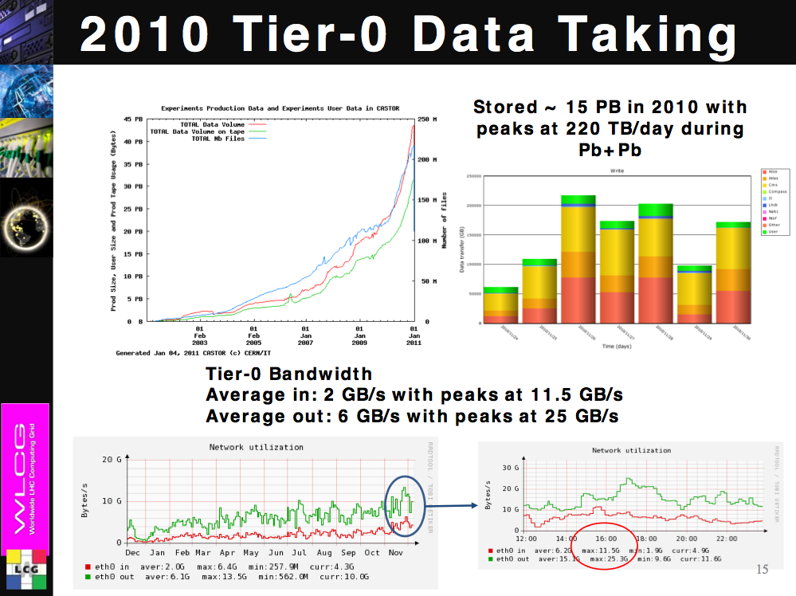
12 February 2016
J. Apostolakis

Slide 35
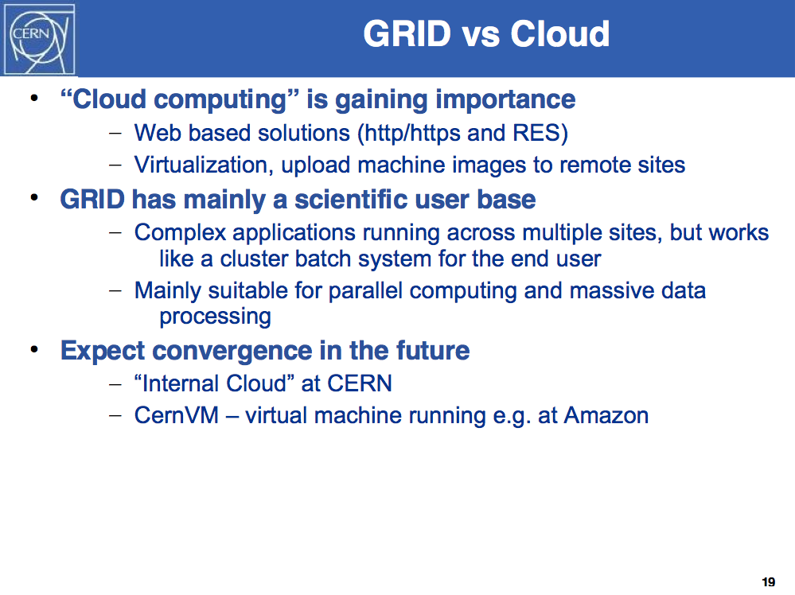
12 February 2016
J. Apostolakis

Slide 36
Distributed Analysis – the real challenge
Analysis will be performed with a mix of “official” experiment software and private user code
  How can we make sure that the user code can execute and provide a correct result wherever it “lands”?
Input datasets not necessarily known a-priori
Possibly very sparse data access pattern when only a very few events match the query
Large number of people submitting jobs concurrently and in an uncoordinated fashion resulting into a chaotic workload
Wide range of user expertise
Need for interactivity - requirements on system response time rather than throughput
Ability to “suspend” an interactive session and resume it later, in a different location
Need a continuous dialogue between developers and users
12 February 2016
J. Apostolakis
Notes:
sparse data scan – acche data in shallow (pointers only) or deep (write out events) copy

Slide 37
Backup
More on simulation

Slide 38
Applications beyond HEP
  Biomedical Bioinformatics
    Medical imaging
  Earth Sciences
    Geo-surveying
    Solid Earth Physics
    Hydrology, Climate
  Astronomy
    Cosmic Microwave Background
    Gamma ray astronomy
  Computational Chemistry
  Fusion
  Geology
  Industrial Applications
12 February 2016
J. Apostolakis

Slide 39
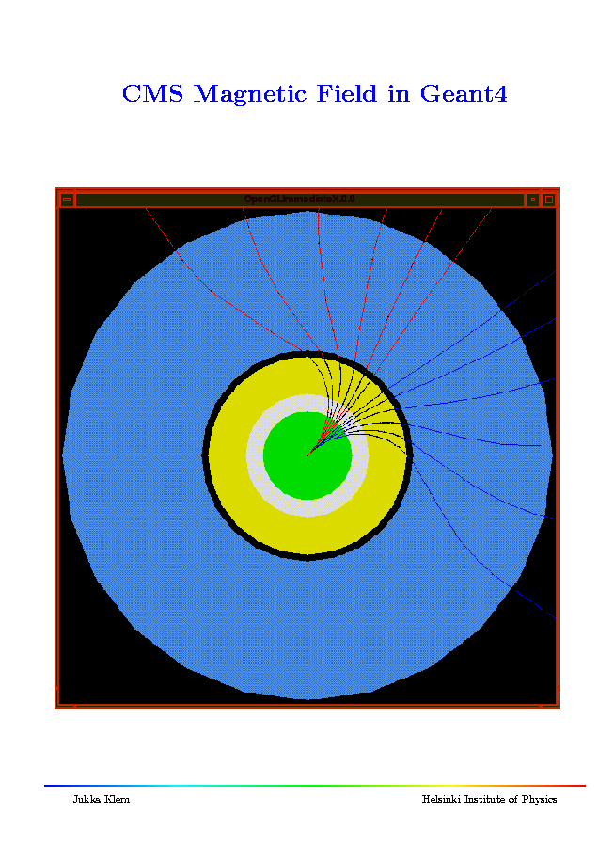
Propagating in a field
Charged particles follow paths that approximate their curved trajectories in an electromagnetic field.
It is possible to tailor
  the accuracy of the splitting of the curve into linear segments,
  the accuracy in intersecting each volume boundaries.
These can be set now to different values for a single volume or for a hierarchy.
12 February 2016
J. Apostolakis

Slide 40
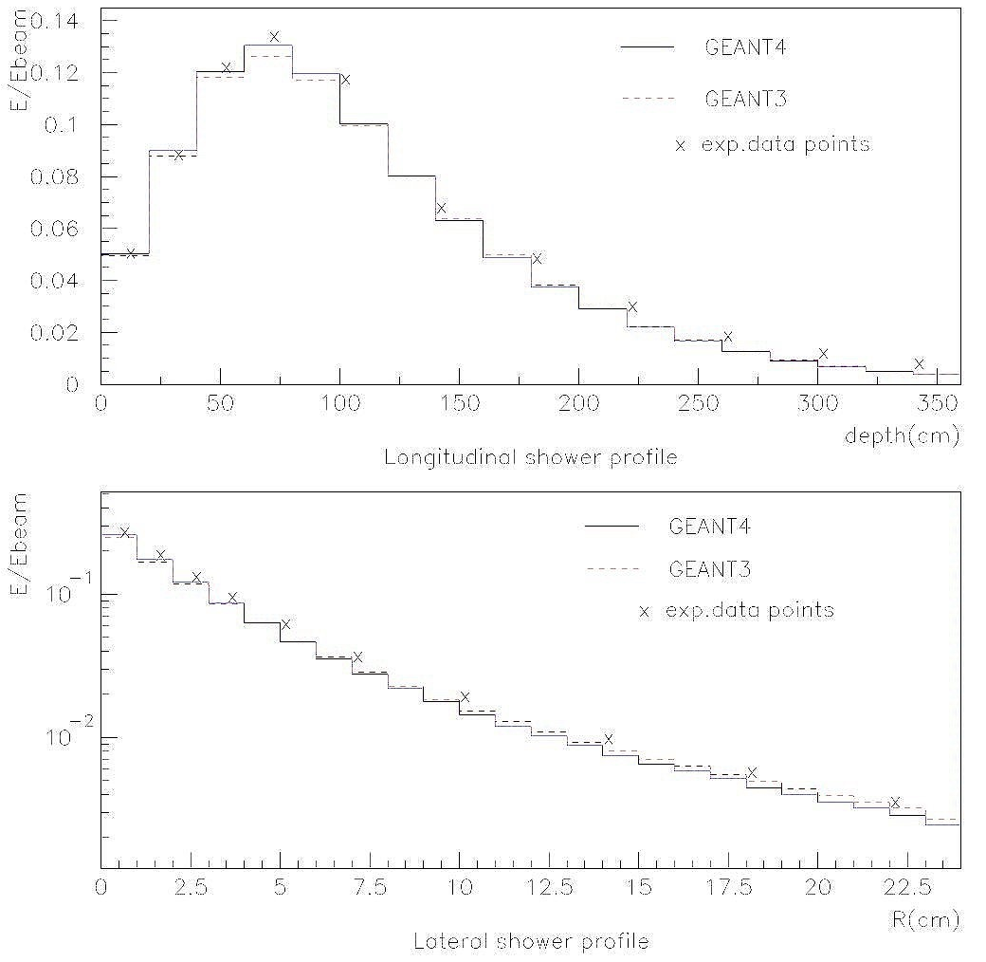
Shower profile
1 GeV electron
  in H2O
    G4,
    Data
    G3
Good agreement seen with the data
12 February 2016
J. Apostolakis

Slide 41
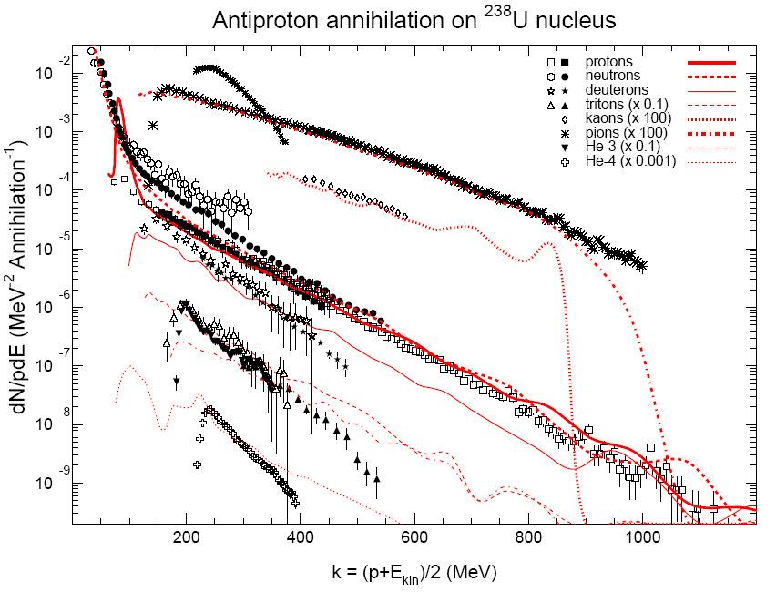
Antiproton annihilation - CHIPS Model
neutron
π
K
triton
deuteron
proton
He-4
He-3
12 February 2016
J. Apostolakis
M. Kossov
Notes:
Secondary particles spectrum data and simulations

Slide 42

Simulation ‘packages’
Provides the means to simulate
  the physical processes and
  detector response of an experiment.
As was realised by many in the past,
  most of the parts needed can be common between experiments (eg physics, geometry blocks) .
So it makes eminent sense to create and use a general purpose package
  That includes the common parts,
  And enables an experiment to describe those parts with are specific to it.
12 February 2016
J. Apostolakis

Slide 43
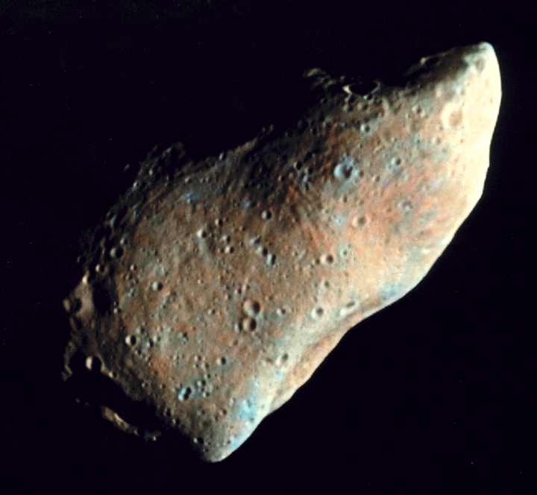
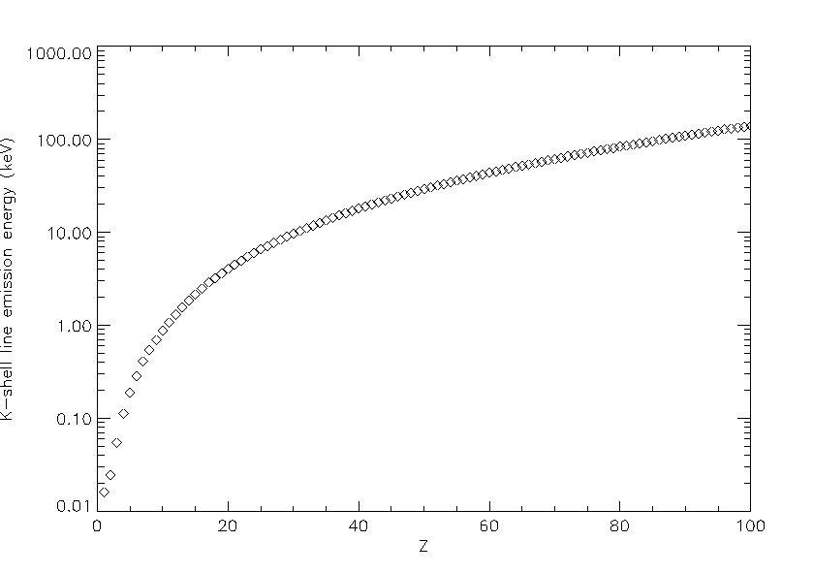
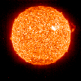


X-Ray Surveys of Asteroids and Moons
Cosmic rays,
jovian electrons
Solar X-rays, e, p
Geant3.21
ITS3.0, EGS4
Courtesy SOHO EIT
Geant4
Induced X-ray line emission:
indicator of target composition
(~100 μm surface layer)
C, N, O line emissions included
ESA Space Environment &
Effects Analysis Section
12 February 2016
J. Apostolakis

Slide 44
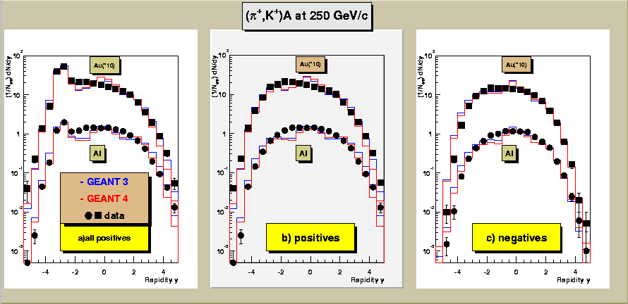
High Energy K,pi on Al, Au
12 February 2016
J. Apostolakis

Slide 45
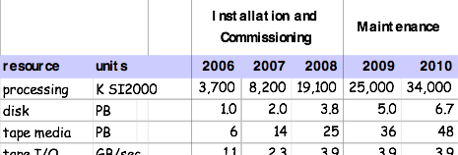
CERN Centre Capacity Requirements for all expts.
(made July 2003)
Other experiments
LHC
Other experiments
LHC
Moore’s law
12 February 2016
J. Apostolakis
Notes:
1/3 capacity at CERN, 2/3 capacity outside CERN
Takes account of PASTA reassessment of requirements

Slide 46


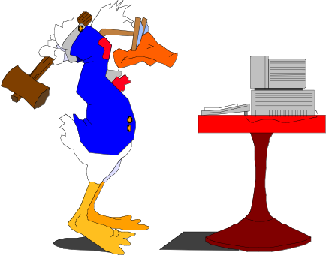
A Multi-Tier Computing Model
Tier 0
(Experiment Host lab)
CERN
Uni x
Lab m
Tier 1
(Main
Regional
Centres)
622 Mbps
2.5 Gbps
regional group
Uni a
Lab a
CERN Tier 1
FNAL
RAL
IN2P3
UK
USA
Tier 1
France
155 mbps
155 mbps
Tier3
Uni n
622 Mbps
Italy
……….
Tier2
Desktop
γ
……….
Germany
Tier2
Lab a
Uni b
Lab c
Uni n
Lab b
Lab c
β
Uni y
physics group
Tier 3
α
β
γ
α
Uni b
Desktop
Manager View
User View
12 February 2016
J. Apostolakis
Notes:
Centres categorised in Tiers according to the resources (cpu and storage) they have available and their connectivity into grid
Production Manager’s view of computing model (Traditional) is shown on left.and is based on two premises :
Easier to move job to the data
Make data where the job will run
Experiments develop policies for implementation of reconstruction, calibration and analysis activities – where these jobs run and how data are replicated i.e. models for replication of RAW, ESD and AOD from Tier 0 to Tier 1 and 2.
In the past left hand diagram also represents the user view i.e. user β gets data from RAL
New model shown on right sees groups of centres in clouds implying movement of data and jobs is transparent to the user
Ideas are evolving
Need flexibility – adjust according to experience

