Slide 1
FCC BI specs
HS, 12.4.2017

Slide 2
Discussion points
BPM sensitivity FCC pp (button vs short striplines)
BPM FCC hh bunch spacing
Electrode orientation (45 degrees also for pp)?, 6 electrodes design for reliability?
At least launch a study/prototype for interlocked BPMs?
Need for k-modulation (FCC pp)
K- modulation for FCC e+ e- in whole machine (polarization)
Instrumentation of beam screen slit?
DCCT standard modulation frequency close to frev
Proposed R&D for emittance measurement devices (pp and e+e-)

Slide 3
BPM sensitivity
“save” pilot defined as 5 * 10^8 protons = 10% LHC
Almost same vacuum chamber dimensions (10% smaller), similar bunch length
LHC systems gets problems below 5 (2) * 10^9 protons
Factor 10 (4) from better electronics or from larger electrodes?

Slide 4
FCC hh beam parameters:
Nominal:
25 ns bunch spacing, 10600 bunches with 1 * 10^11 charges
Option:
5 ns bunch spacing, 53000 bunches, 0.2 * 10^11 charges

Slide 5
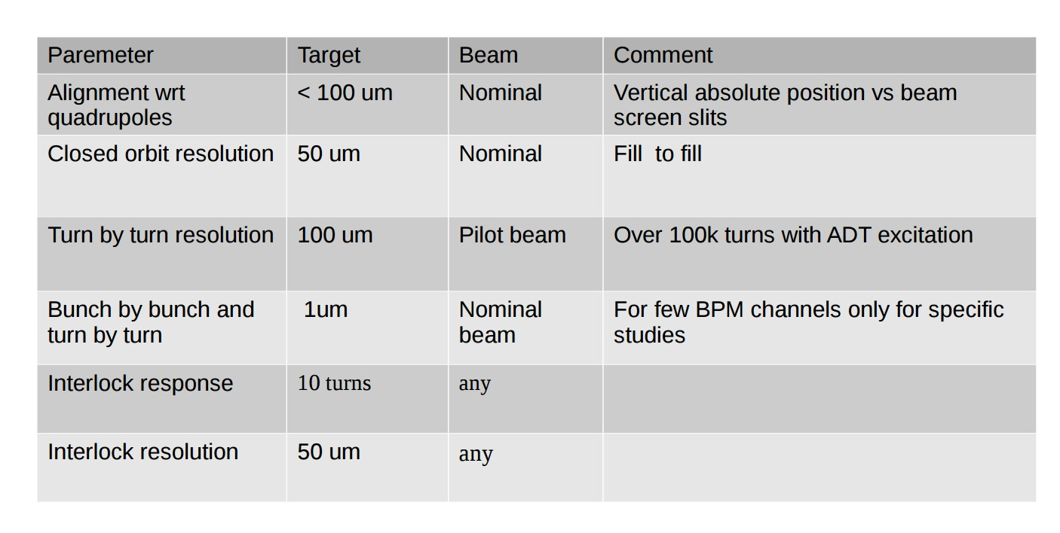

Slide 6
Parameter table
 | Z | Z | W | H | tt
Circumference [km] | 100
Bending radius [km] | 11
Beam energy [GeV] | 45.6 |  | 80 | 120 | 175
Beam current [mA] | 1450 |  | 152 | 30 | 6.6
Bunches / beam | 30180 | 91500 | 5260 | 780 | 81
Bunch spacing [ns] | 7.5 | 2.5 | 50 | 400 | 4000
Bunch population [10¹¹] | 1.0 | 0.33 | 0.6 | 0.8 | 1.7
Horizontal emittance e [nm] Vertical emittance e [pm] | 0.2 1 | 0.09 1 | 0.26 1 | 0.61 1.2 | 1.3 2.5
Momentum comp. [10⁻⁵] | 0.7 | 0.7 | 0.7 | 0.7 | 0.7
Betatron function at IP Horizontal b* [m] Vertical b* [mm] | 0.5 1 | 1 2 | 1 2 | 1 2 | 1 2
Horizontal beam size at IP s* [μm] Vertical beam size at IP s* [nm] | 10 32 | 9.5 45 | 16 45 | 25 49 | 36 70
Crossing angle at IP [mrad] | 30
Energy spread [%] Synchrotron radiation Total (including BS) | 0.04 0.22 | 0.04 0.09 | 0.07 0.10 | 0.10 0.12 | 0.14 0.17
Bunch length [mm] Synchrotron radiation Total | 1.2 6.7 | 1.6 3.8 | 2.0 3.1 | 2.0 2.4 | 2.1 2.5
Energy loss / turn [GeV] | 0.03 |  | 0.33 | 1.67 | 7.55
SR power / beam [MW] | 50
Total RF voltage [GV] | 0.4 | 0.2 | 0.8 | 3 | 10
RF frequency [MHz] | 400
Longitudinal damping time [turns] | 1320 |  | 243 | 72 | 23
Energy acceptance RF [%] | 7.2 | 4.7 | 5.5 | 7.0 | 6.7
Synchrotron tune Q_{s} | 0.036 | 0.025 | 0.037 | 0.056 | 0.075
Polarization time t_{p} [min] | 11200 |  | 672 | 89 | 13
Interaction region length L_{i} [mm] | 0.66 | 0.62 | 1.02 | 1.35 | 1.74
Hourglass factor H (L_{i}) | 0.92 | 0.98 | 0.95 | 0.92 | 0.88
Luminosity/IP for 2IPs [10³⁴ cm⁻²s⁻¹] | 207 | 90 | 19.1 | 5.1 | 1.3
Beam-beam parameter Horizontal Vertical | 0.025 0.16 | 0.05 0.13 | 0.07 0.16 | 0.08 0.14 | 0.08 0.12
Luminosity lifetime [min] | 94 | 185 | 90 | 67 | 57

Slide 7
Beam position
Functionality:
The BPMs must be able to measure the closed orbit (i.e. average over N turns, typically a 50 Hz) and provide turn-by-turn data for injection oscillations, optics measurements…
  The closed orbit data should be integrated into a real-time orbit and radial position feedback.
The BPMs should also foresee a machine protection functionality in the form or a beam abort signal in case the orbit / trajectory excursions exceed a pre-set threshold.
A few special BPMs should provide high resolution (μm) bunch-by-bunch and turn-by-turn data for special purposes (instability observations etc) – similar to the ADT for LHC.

Slide 8
Beam position
Performance: for lattice BPMs – specs for the low beta section BPMs could be harsher !
Parameter | Target | Beam | Comment
Alignment wrt quadrupole (and electronic offsets) | ≤ 40 um |  | Combined quad+BPM alignment
Short term closed orbit resolution | ≤ 0.1 um | few bunches | ~minutes, vertical dispersion measurement with 0.1% dp/p, radial control at Z (energy)
Medium term closed orbit resolution | 1 um | few bunches | ~ hours
Closed orbit accuracy | 10 um | few bunches | ~ weeks, stability and accuracy over time scale of week(s)
Turn by turn resolution | 10-100 um | 1 - few bunches | with AC-dipole excitation, to be checked with R. Tomas (wrt LHC)
Interlock resolution | 10-20 um | few bunches
Interlock response | 10 turns | few bunches | maximum reaction time for interlock functionality. Should be checked wrt the time constants of electrical circuits. 10 turns could be a good start.
Interlock threshold | 500 um | few bunches | see above
Bunch by bunch and turn-by-turn orbit resolution for special BPMs | ≤ 1 um | any | for a few BPM channels only - should be sufficient. No need to have bunch by bunch on all BPMs
Few bunches = ~ 10-20 ~nominal bunches (few x 10¹⁰ charges)

Slide 9
Emittance measurement devices
pp: - prototype of gas jet wire scanner
(beam scanning by reflection of gas jet on a mirror on a translation stage plus mirror)
pp: Sync light interferometer, imaging, LDM, coronagraph
ODR?
E+e-: same wire scanner?
Pin-hole camera
BEXE type divergence monitor?

Slide 10
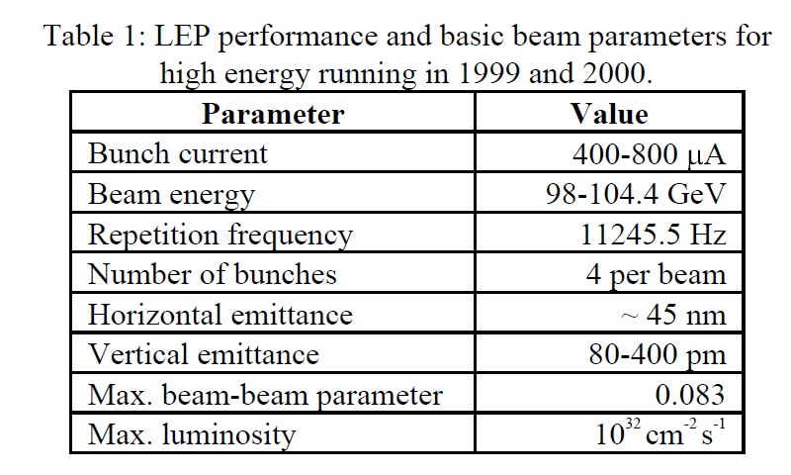
LEP parameters
LEP at higher energies (up to 100 GEV/beam):
ex = 30…40 nm, coupling <= 0.5%
ey = 150 … 200 pm

Slide 11
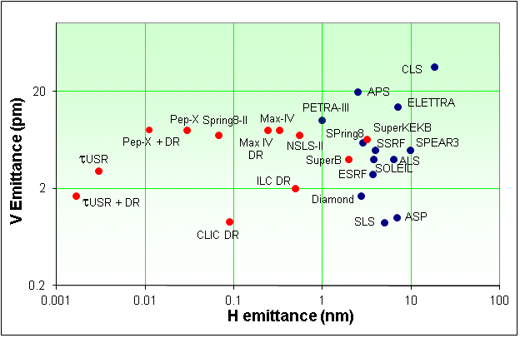
Emittances
FCC-ee is a very large machine, scaling of achievable emittances (mainly vertical) is not straightforward.
  Coupling, spurious vertical dispersion
Low emittances tend to be more difficult to achieve in colliders as compared to light sources or damping rings – beam-beam !
Limits for FCC-ee baseline parameters:
  ε_{y}/ε_{x} ≥ 0.001 ,
  ε_{y} ≥ ≈2 pm
LEP2
FCC-ee
→ Drives terrific alignment tolerances
R. Bartolini, DIAMOND

