Slide 1
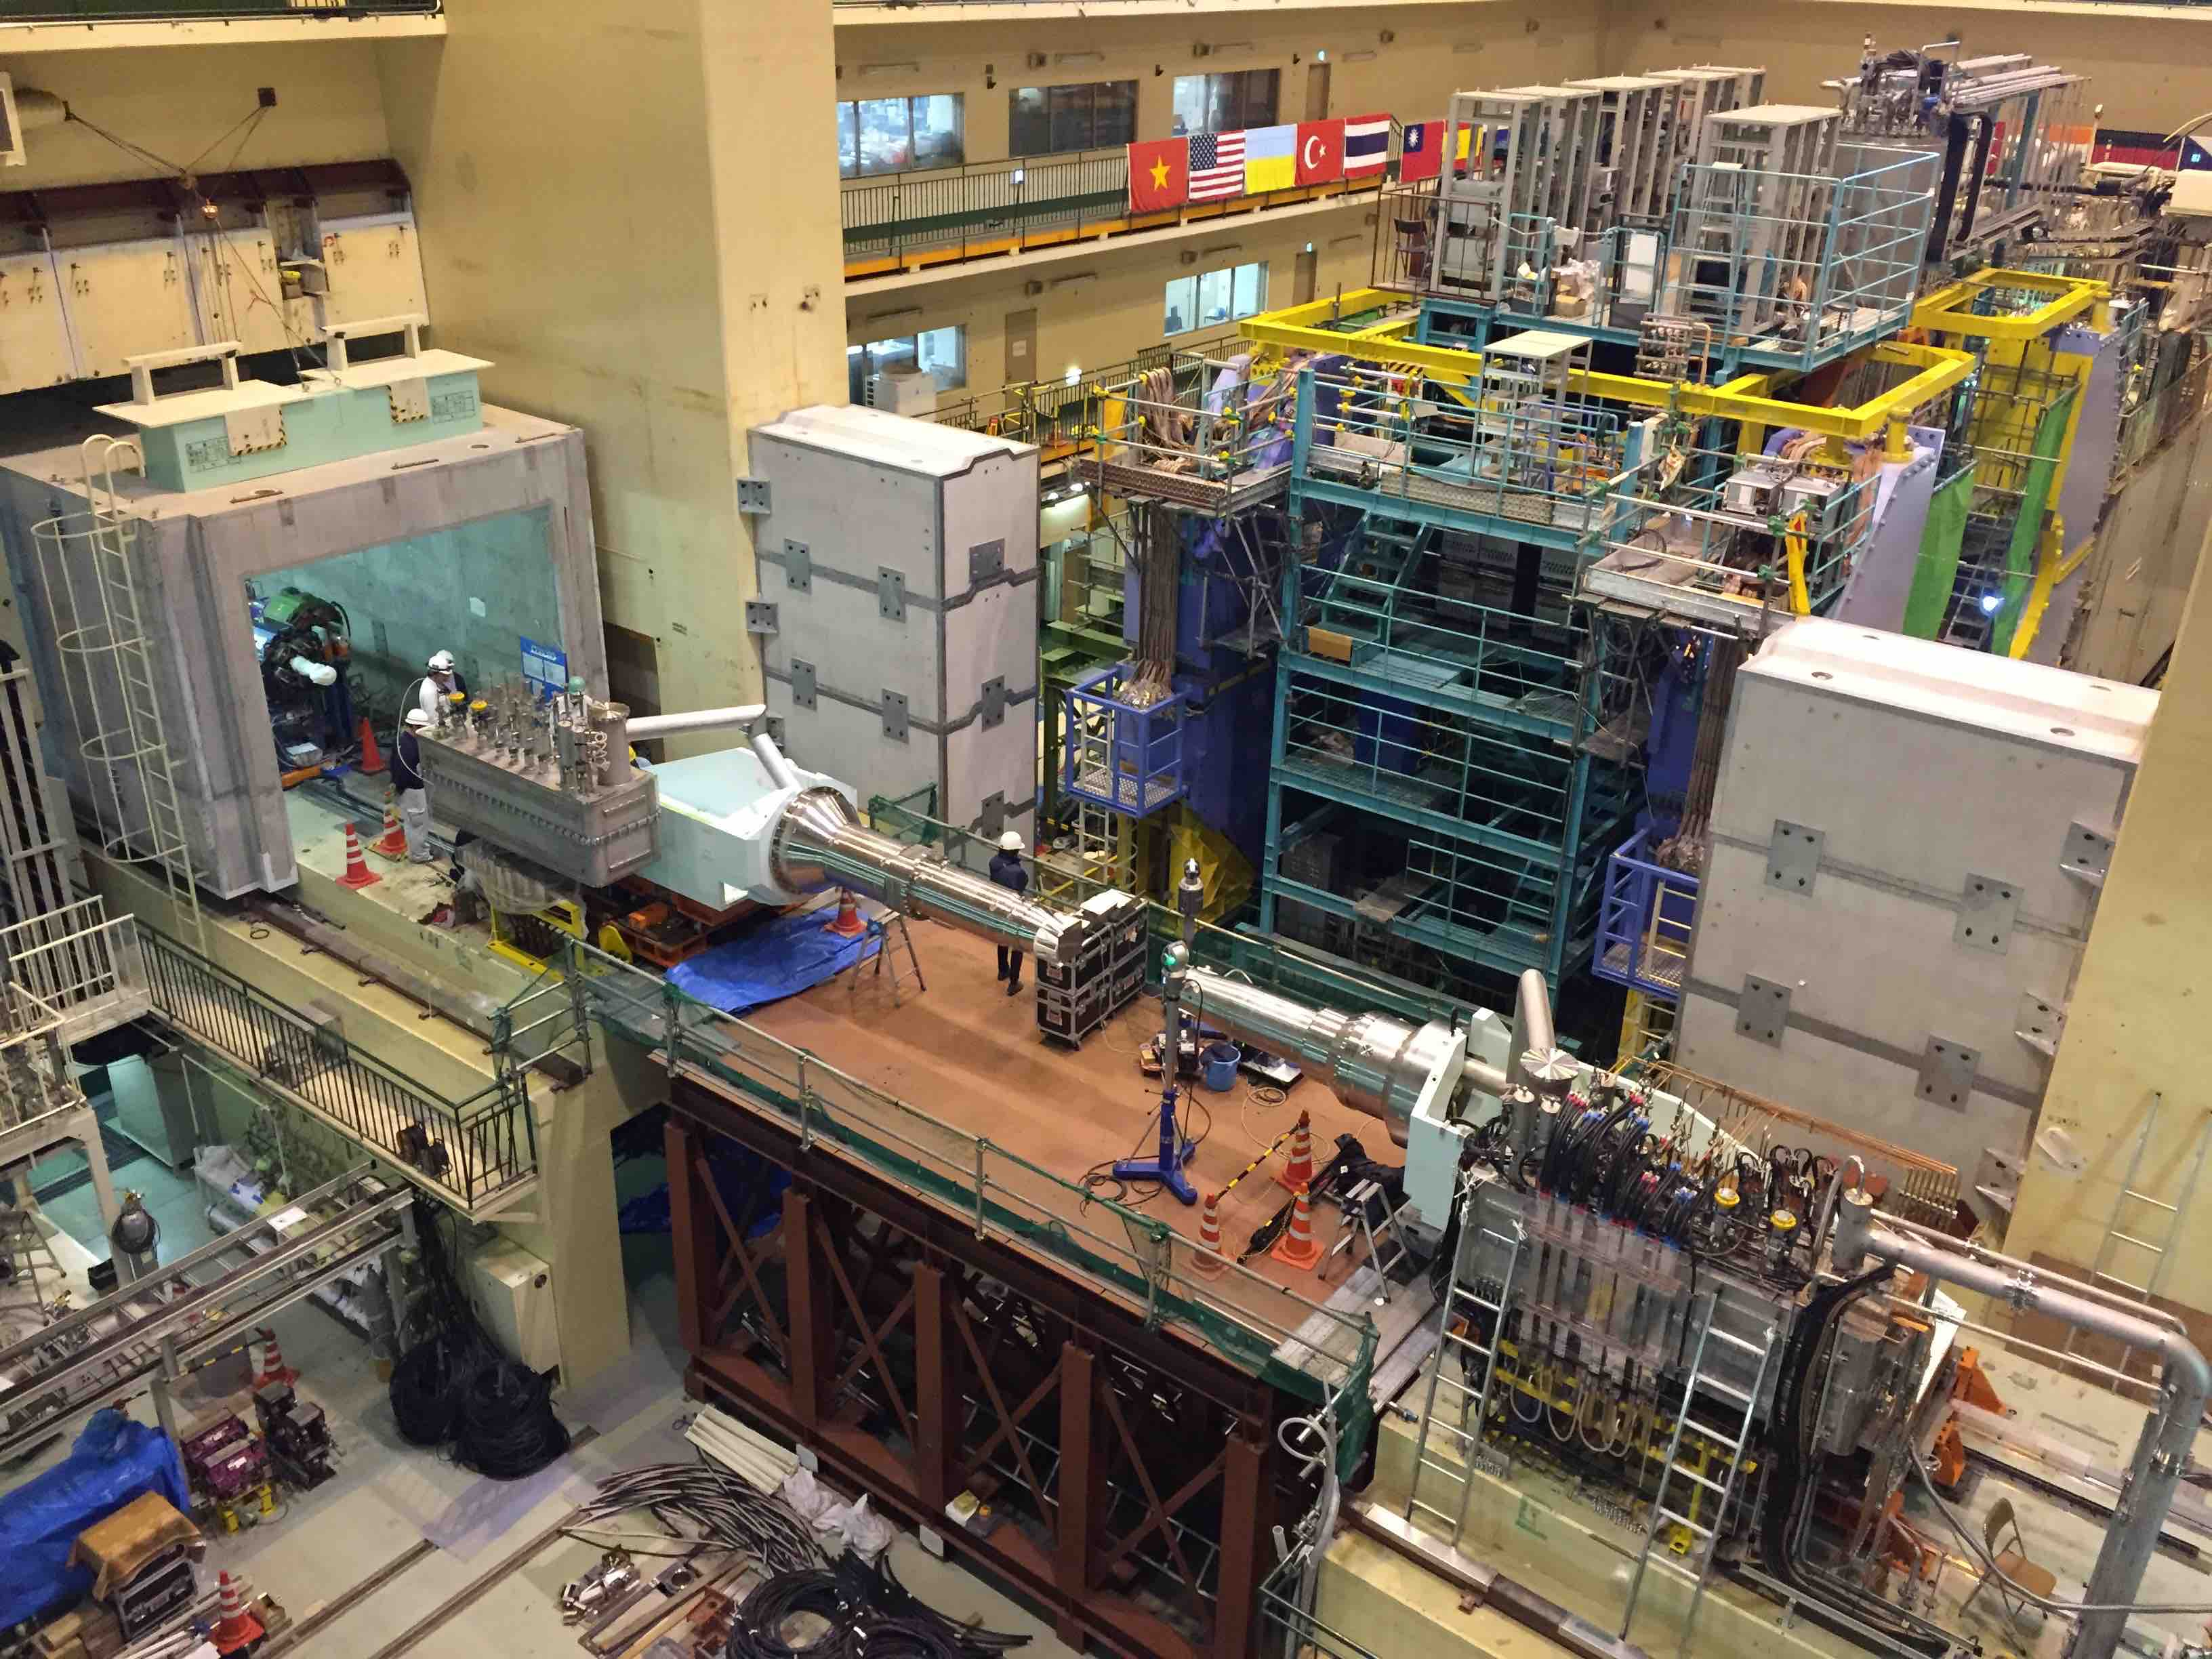
Belle II: New Physics and the Next Generation
Tom Browder
(University of Hawai’i)
Belle II/SuperKEKB milestones
Progress on Belle II
A different approach to New Physics (charged Higgs, new weak couplings)
QCSR and QCSL, the complex superconducting final focus is at the IP, Belle II is in the background awaiting roll-in
Notes:
Emphasis on US Belle II highlights

Slide 2
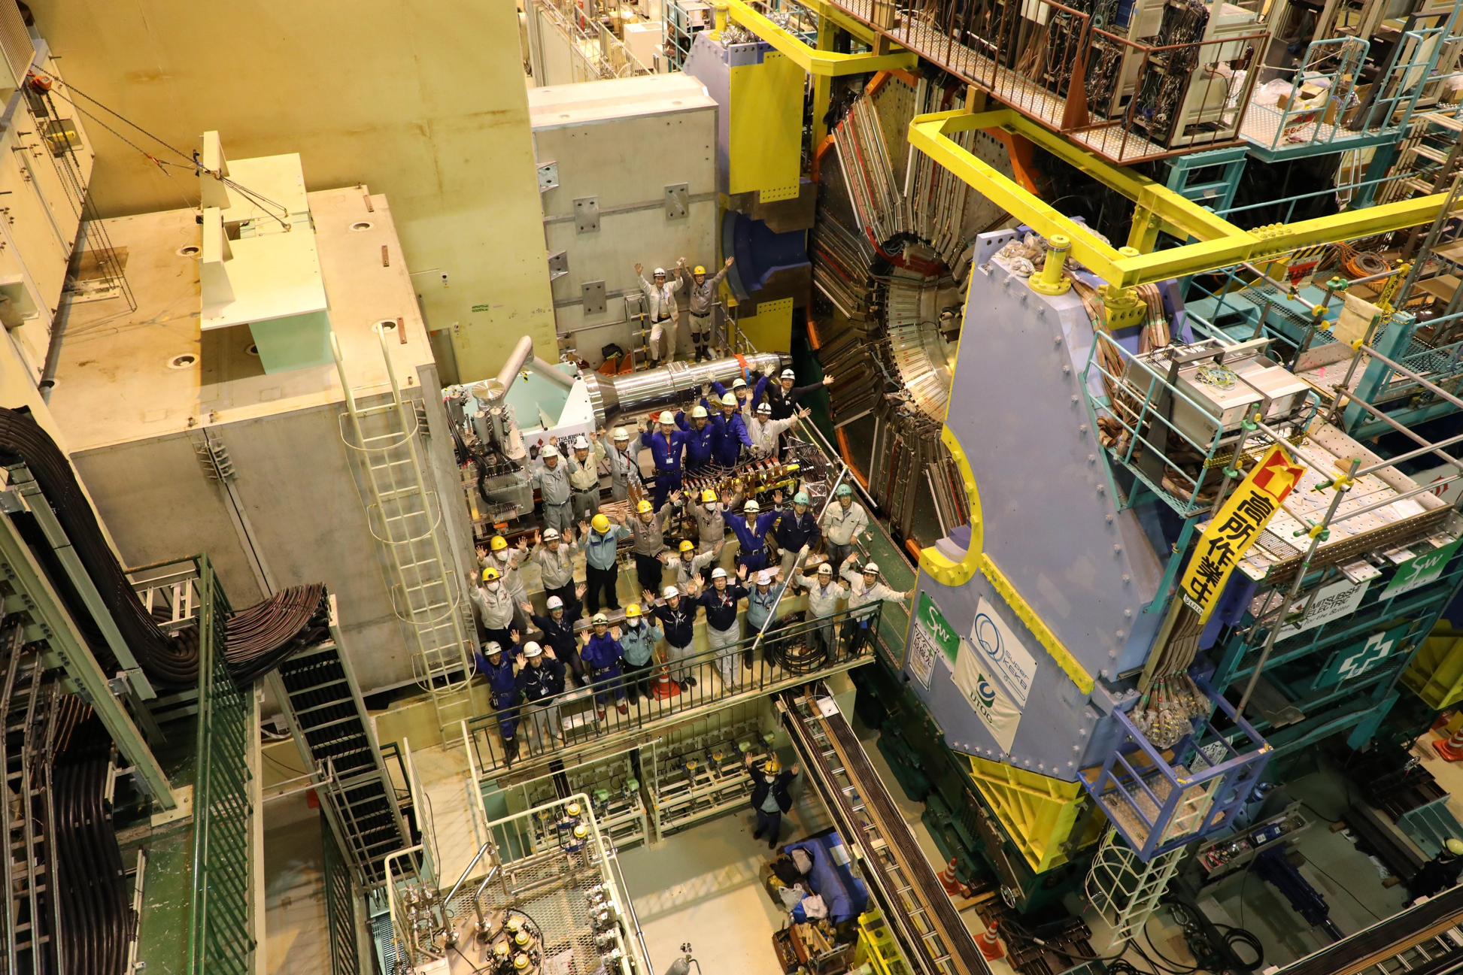
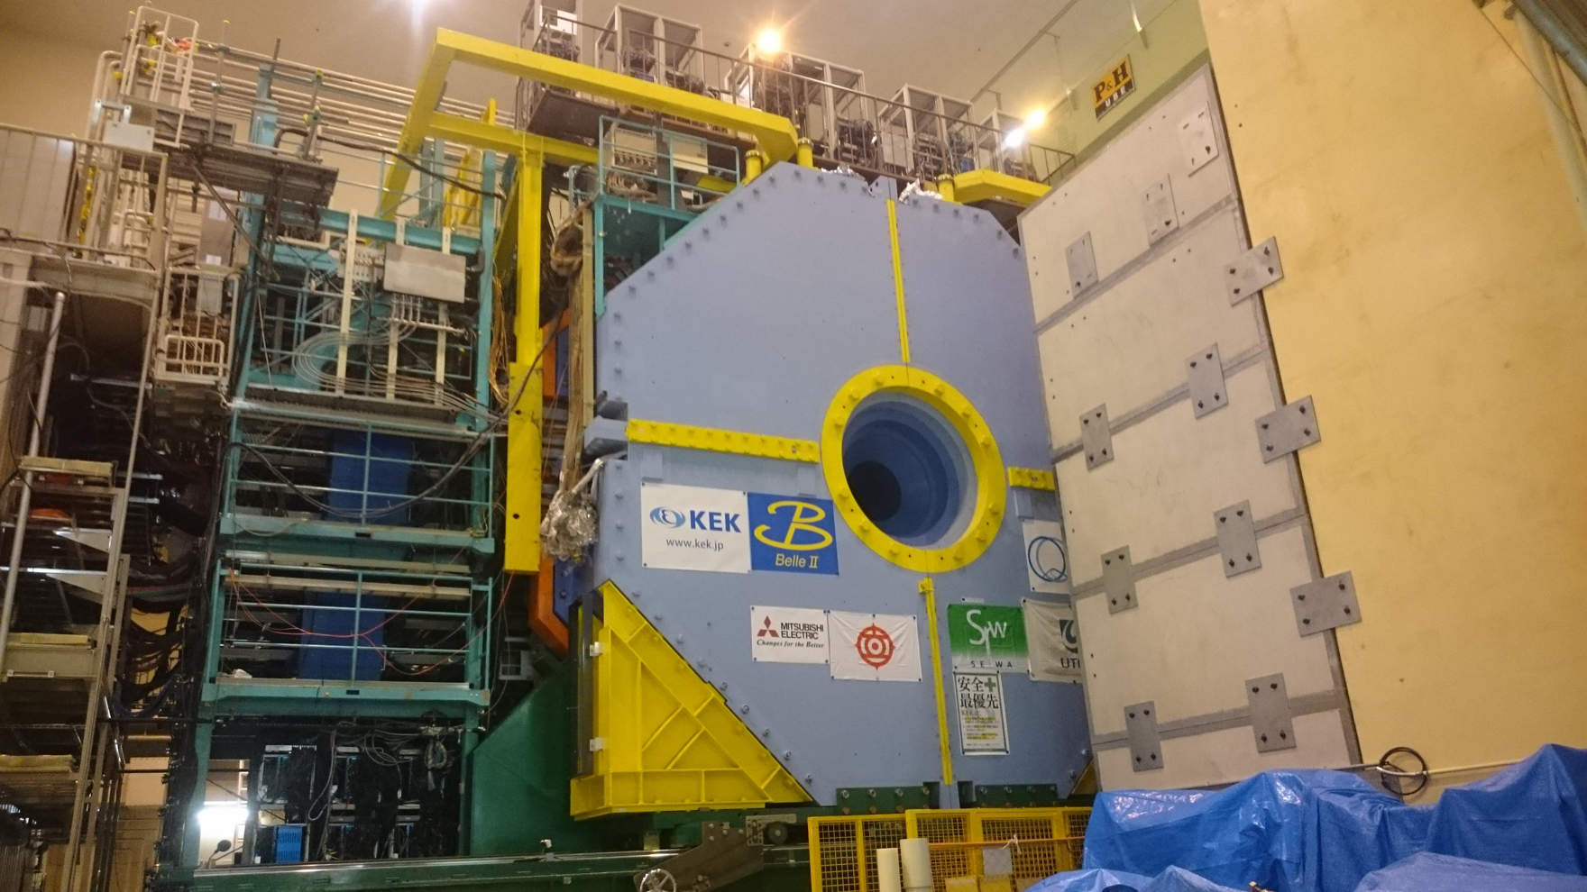
Belle II “roll-in” April 11, 2017: 9am-3pm
Recall Belle II/SuperKEKB groundbreaking in 2011
1400 tons, 8m x 8m, moved 13m horizontally, Banzai !
Notes:
Major Milestone for Belle II and SuperKEKB. Ground breaking in 2011. A moving event after 6 years of hard work.

Slide 3
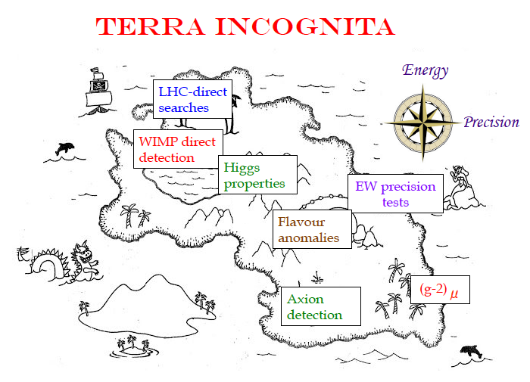
Focus of the most exciting experimental and theoretical talks at Moriond this year.
From the summary talk on the future of HEP at
Moriond Electroweak 2017 (A. Casas)

Slide 4
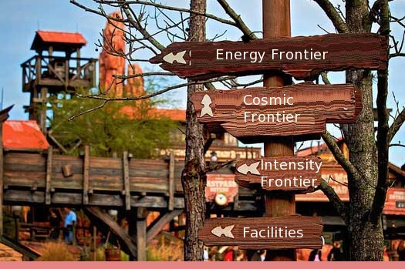
Belle II/SuperKEKB Physics Summary
SuperKEKB/Belle II is the intensity frontier facility for B mesons, charm mesons and τ leptons.
Unique new physics capabilities and unique detector capabilities (“single B meson beam”, neutrals, neutrinos), clean environment with good systematics, which are critical for the next round of New Physics searches e.g. charged Higgs, new weak couplings and phases, lepton flavor violation.)
Photo credit: R. Lipton
2014 US P5 report: This provides unique sensitivity to physics
at energy scales far higher than can be accessed directly at colliders.

Slide 5
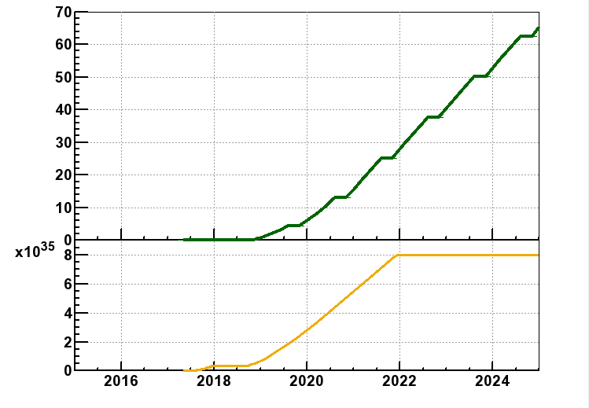
SuperKEKB/Belle II Luminosity Profile
Belle/KEKB recorded ~1000 fb⁻¹ . Now have to change units on y-axis to ab⁻¹
Beam currents only a
factor of two higher
than KEKB (~PEPII)
“nano-beams” are the key; vertical beam size is 50nm at the IP
N.B. To realize this steep turn-on, requires close cooperation between Belle II and SuperKEKB [and international collaboration on the accelerator].
This plot assumes a full and stable operation funding profile.
Notes:
And full funding of operations is needed !

Slide 6
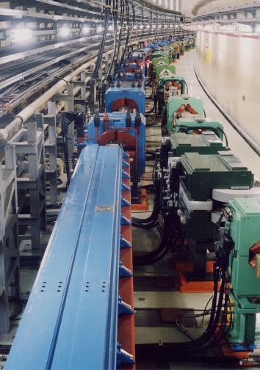

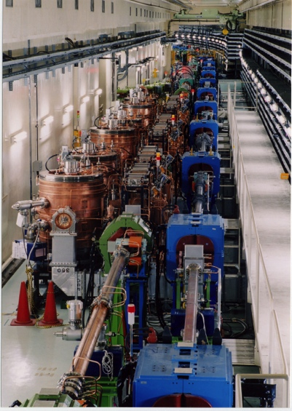


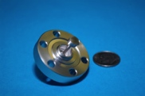
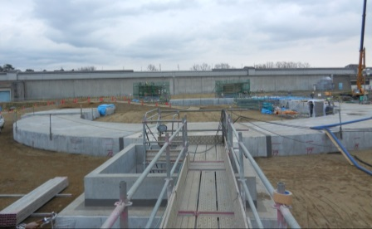
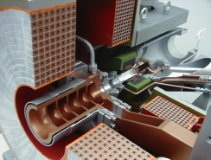
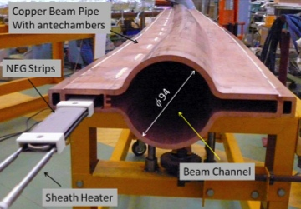
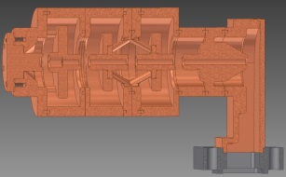
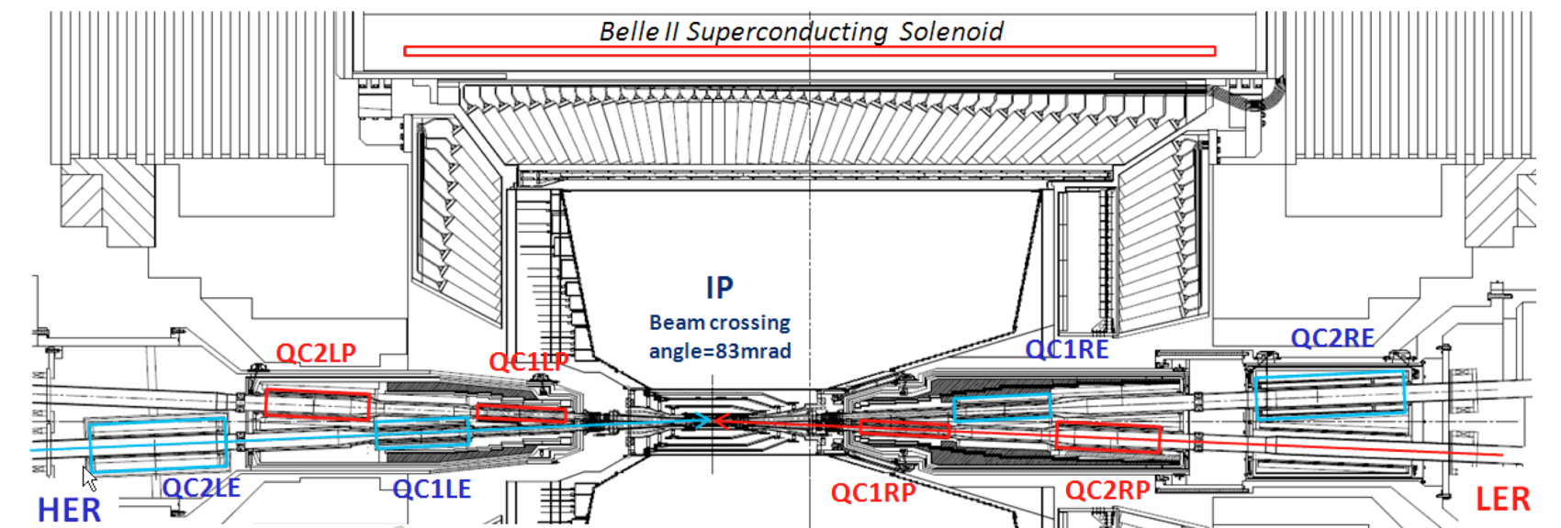
2017: All accelerator hardware now in place
New superconducting final focusing magnets near the IP
e⁺ 3.6A
e⁻ 2.6A
KEKB to SuperKEKB
Redesign the lattice to reduce the emittance (replace short dipoles with longer ones, increase wiggler cycles) (being tuned)
Nano-Beam scheme
extremely small β_{y}*
low emittance
Beam current X 2
Reinforce RF systems for
higher beam currents
40 times higher luminosity
2.1x10³⁴ → 8x10³⁵ cm⁻²s⁻¹
Replace beam pipes with TiN-coated beam pipes with antechambers (works well)
Improve monitors and control system
Injector Linac upgrade
Upgrade positron capture section
DR tunnel
Low emittance
RF electron gun
New e+ Damping Ring
constructed
Notes:
Construction is complete. Initial commissioning of SuperKEKB took place in 2016. Phase II starts in 2017 with damping ring commissioning and in 2018 with first collisions.

Slide 7
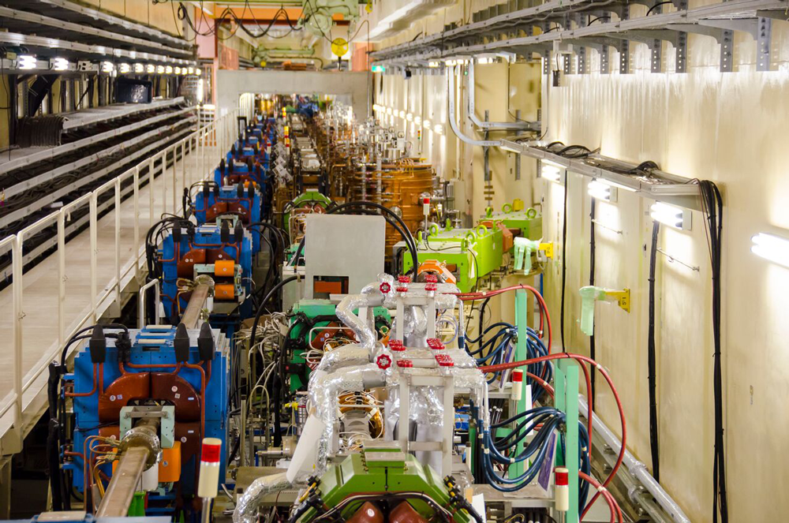
Feb 2016: First Turns at SuperKEKB (4 GeV e+’s and 7 GeV e-’s)
June 28, 2016 (LER beam current at 1000 mA, HER at 870 mA)
Feb 2018: Collisions at the Υ(4S) will produce pairs of QM entangled (B-anti B) mesons
First new particle collider since the LHC in 2008 (intensity frontier rather than energy frontier; e⁺e⁻ rather than p p)
Notes:
Progress has been impressive. Phase I of SuperKEKB commissioning has completed and achieved ampere level beam currents. Phase II starts in November 2017.

Slide 8
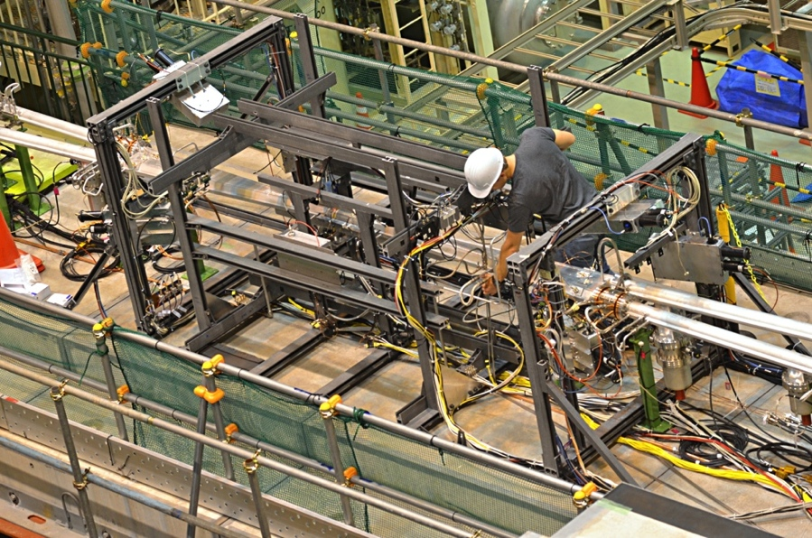


Some Belle II jargon
BEAST PHASE I: Simple background commissioning
detector (diodes, diamonds TPCs, crystals…). No final focus. Only single beam background studies possible [started in Feb 2016 and completed in
June 2016].
off
BEAST PHASE II: More elaborate inner background commissioning detector. Full Belle II outer detector. Full superconducting final focus. No vertex detectors. Collisions ! [Starts in Feb 2018.]

Slide 9
Belle II Detector
BEAST (Background commissioning detector)
KL and muon detector:
Resistive Plate Chambers (barrel outer layers)
Scintillator + WLSF + MPPC (end-caps , inner 2 barrel layers)
EM Calorimeter:
CsI(Tl), waveform sampling (barrel)
Pure CsI + waveform sampling (end-caps)
Particle Identification
iTOP detector system (barrel)
Prox. focusing Aerogel RICH (fwd)
electrons (7 GeV)
Beryllium beam pipe
2cm diameter
Vertex Detector
2 layers DEPFET + 4 layers DSSD
positrons (4 GeV)
Central Drift Chamber
He(50%):C2H6(50%), small cells, long lever arm, fast electronics
US contributions in red
Notes:
Reuses the structure, solenoid and CsI(Tl) crystals and part of the barrel RPCs. Most other components are new.
We must prepare for backgrounds a factor of 10-20 higher. Hence the use of DEPFET pixels for inner vertexing and a new silicon vertex detector with the APV2.5 readout chip from CMS. The PID is based on Cherenkov counters. For the barrel, the Cerenkov light is totally internally reflected to an array of pixelated PMTs. High precision timing and position information is used to distinguish kaons from pions.

Slide 10
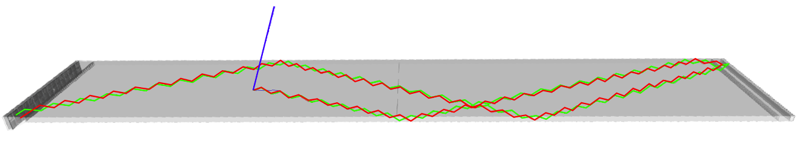
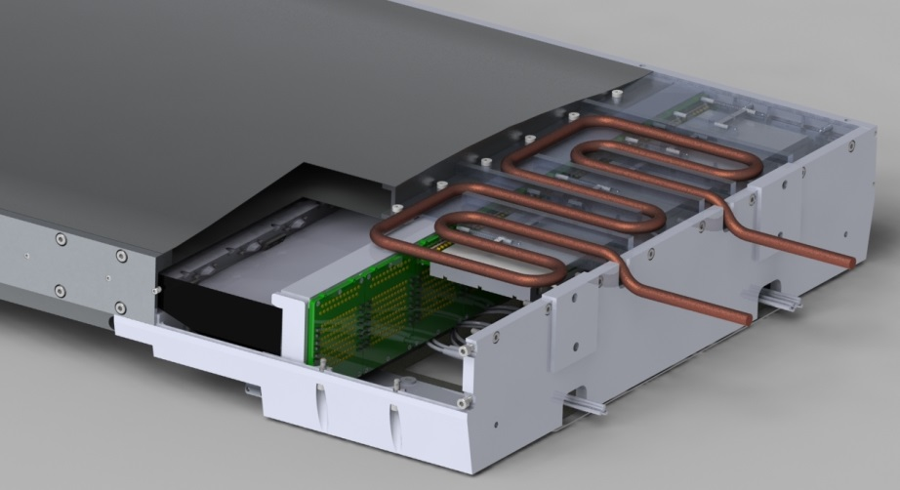
Barrel Particle Identification
A GEANT4 event display of a 2 GeV pion and kaon
interacting in a iTOP [imaging Time Of Propagation] quartz bar.
(US, Japan, Slovenia, Italy)
Incoming track
CAD view of an iTOP readout module
The DIRC of BaBar (B. Ratcliff et al) measures x,y,z for photons in the Cerenkov ring. Here measure
x, y, t.
No SOB due to space constraints.
Uses the IRSX “oscilloscope on a chip” ASIC for fast waveform sampling with a large buffer depth. Very flexible and powerful but firmware and readout integration is non-trivial.
Notes:
Pion is green and kaon is red. What is an SOB ?
Old Acronyms SOB =Stand Off Box. DIRC = Detection of Internally Reflected Cherenkov light

Slide 11
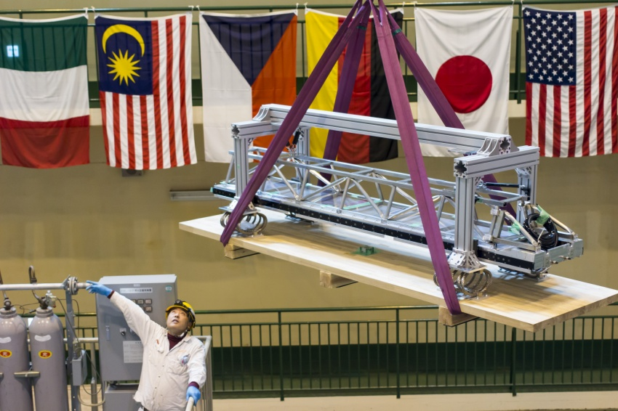
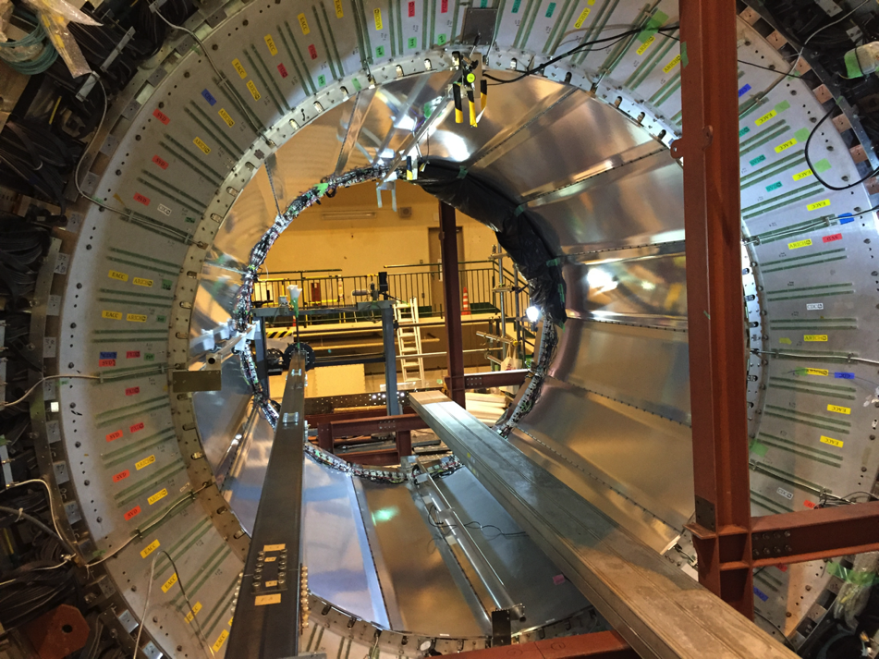
US Belle II Construction Highlights
1st iTOP module arriving at Tsukuba Hall
May 2016: 16 iTOP modules now form a self-supporting “Roman Arch”
This was followed by an intense readout integration campaign.
In June 2016, during the detailed mapping of the 1.5 T solenoid field, a problem with decoupling of photo-sensor modules was first noticed. (MCP-PMTs contain a magnetic material called Kovar).
A 2 month long campaign of “shimming” by Nagoya University took place to fix this problem.

Slide 12
The Current Big Picture I
Much was accomplished in Belle II construction between May 2016 and present including iTOP, CDC, and BWD ECL installation. The BKLM and EKLM were installed earlier.
Outer detector DAQ integration is progressing well. The CDC is fully instrumented and delivering multi-track events; TOP feature extraction firmware works.
MC8 GRID MC campaign completed (~5 ab⁻¹ ; kudos to the data production group led by Jake Bennett (CMU))
Belle II Roll-in was completed on April 11, 2017
There were delays due to a CDC cooling problem and late delivery of QCSR (half of final focus). Nevertheless we will start Phase II in November 2017 with positron damping ring commissioning.
We will launch the main ring in mid-Feb 2018 and then expect collisions in spring 2018. The Phase II run will continue until July 2018.
Progress is amazing !
Notes:
Some unexpected problems but amazing progress.

Slide 13
The Big Picture II (What’s ahead)
Anticipate more progress including the global cosmic ray run in summer 2017 (June-August) with all outer detector subsystems [KLM,ECL,TOP,CDC]. DAQ stress tests at 30 kHz trigger rates.
Installation of RPC readout electronics in July 2017.
“Dress rehearsal” for Phase II running.
BEAST Phase I Paper and refined predictions for Phase II and Phase III backgrounds.
Installation of endcap ARICH (Aerogel Rich) in Sept 2017 followed by FWD ECL (Forward Calorimeter) and BEAST Phase II hardware (Nov 2017).
Release of the Belle II Physics Book.
Notes:
Some unexpected problems but amazing progress. On track to be ready for collisions in Feb 2018.

Slide 14
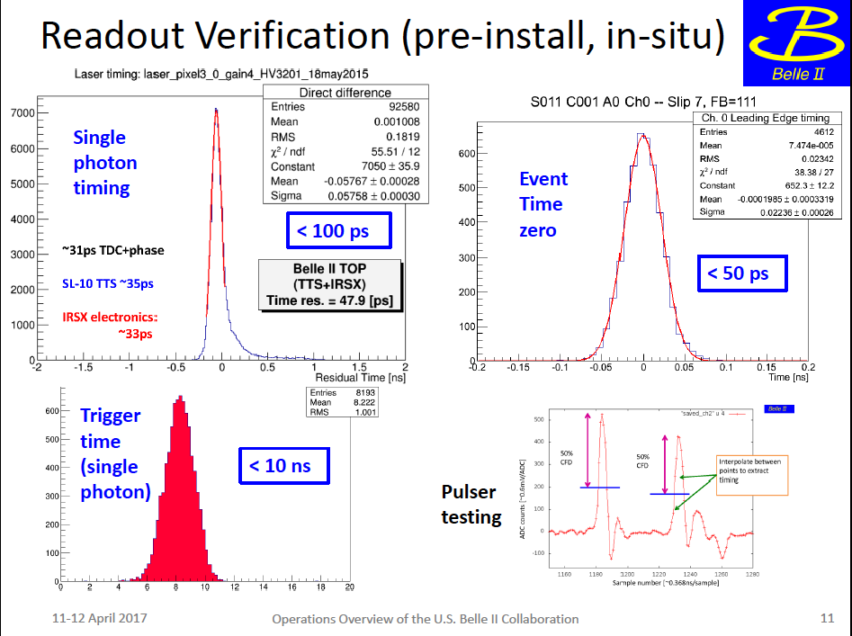

Slide 15
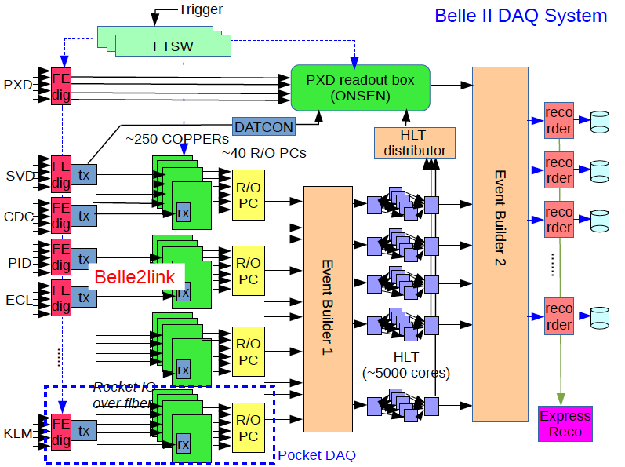
DAQ and readout integration
Note the distinction between Pocket DAQ (standalone) and full DAQ with event building.
Uses fiber optics between the front-end and COPPER boards.
Notes:
Moving on to trigger, DAQ and readout integration. Note the distinction between Pocket DAQ (standalone) and full DAQ with event building.

Slide 16
CDC Event displays
(with fully instrumented readout)
Single cosmic ray track
Multiple tracks
(showering cosmic ray event)
Notes:
やった！

Slide 17
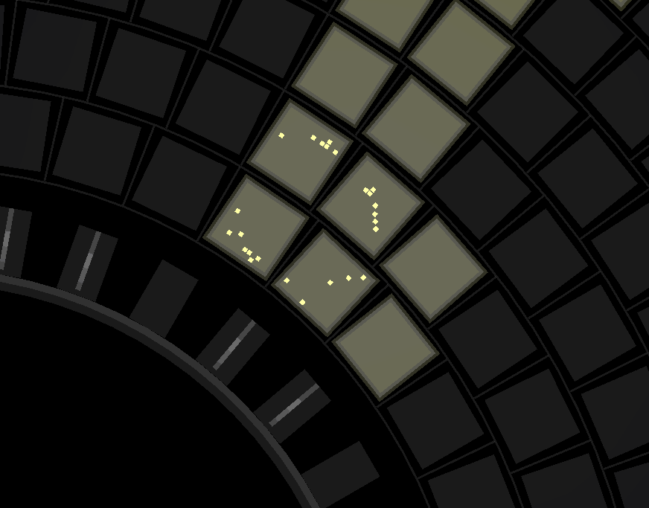
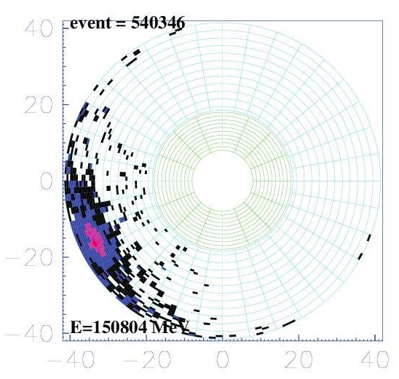
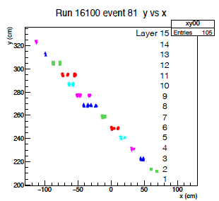
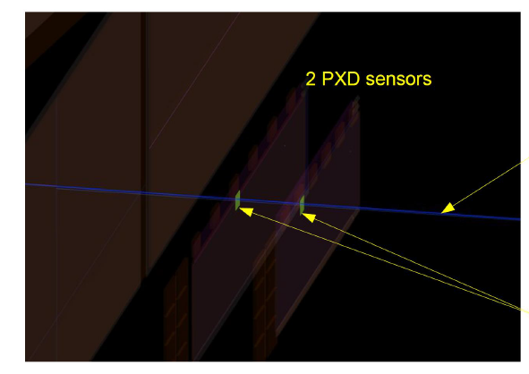
Cherenkov rings in one sector of the endcap Aerogel RICH.
A spectacular cosmic event in the ECL
Matched PXD hits from a projected SVD track in the DESY e⁻ test beam
KLM cosmic: hits in the BKLM and RPC’s

Slide 18
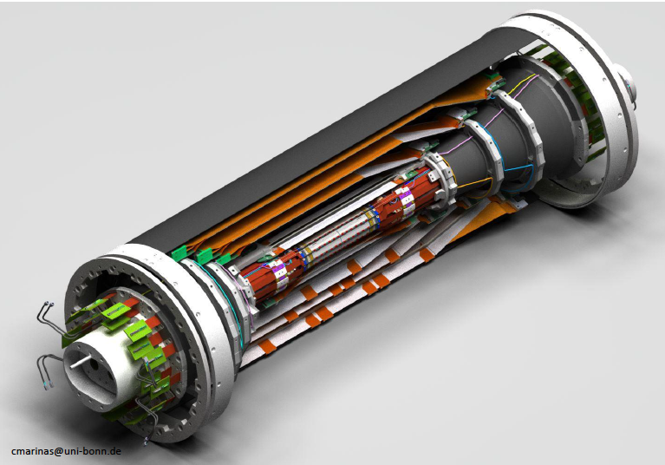
Vertexing/Inner Tracking
Smaller beampipe; shorter lever arm for multiple scattering.
Goes further out in r (important for K_{S} vertexing and low momentum stand-alone tracking).
CO₂ cooling
Beampipe r= 10 mm !
DEPFET pixels (Germany, Czech Republic, Spain…)
Layer 1 r=14 mm
Layer 2 r= 22 mm
DSSD (double sided silicon detectors)
Layer 3 r=38 mm (Australia)
Layer 4 r=80 mm (India)
Layer 5 r=115 mm (Austria)
Layer 6 r=140 mm (Japan)
3 Custom readout ASICs
FWD/BWD (Italy)
Uses CMS APV25 chip for readout.
+Poland (software), Korea
Notes:
The most interesting features of Belle II are PID and vertexing. How does this SVD work ? QCG = Quality Control Group + Francesco Forti.

Slide 19
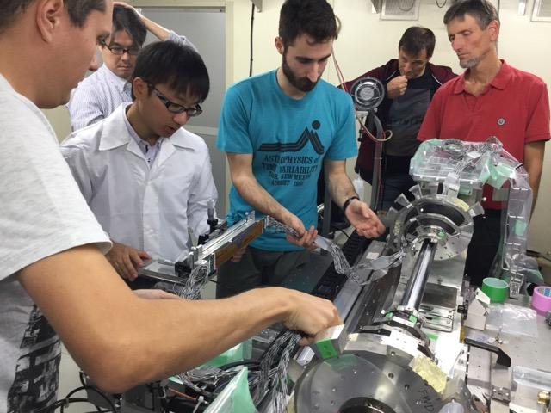
SVD ladder production status
A ladder mount practice at KEK with representatives of all VXD groups.
Pisa (FW/BW) Production of the nominal 47 forward and backward sub-assemblies completed, a few more subassemblies can be built with spare sensors
Melbourne ( L3 ) 11 ladders built out of 7+2 ladders needed
TIFR ( L4 ) 6 ladders built out of 10+2 ladders needed – ready for SVD half-shell mount
HEPHY ( L5 ) 9 ladders built out of 12+3 ladders needed – ready for SVD half-shell mount
Kavli IPMU ( L6 ) 8 ladders built out of 16+4 ladders needed
✔
✔

Slide 20
Updated milestones for SVD
Ladder assembly
Half shell + spares | July 2017
Full SVD | December 2017
Full SVD + spares | March 2018
Ladder mount
Start first half shell | July 2017
End first half shell | October 2017
Start second half shell | November 2017
End second half shell | March 2018
SVD ready for integration | March 2018

Slide 21
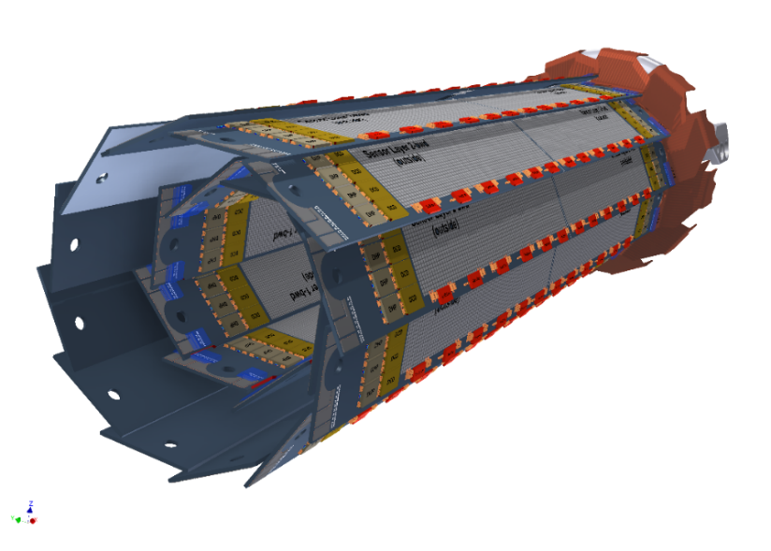
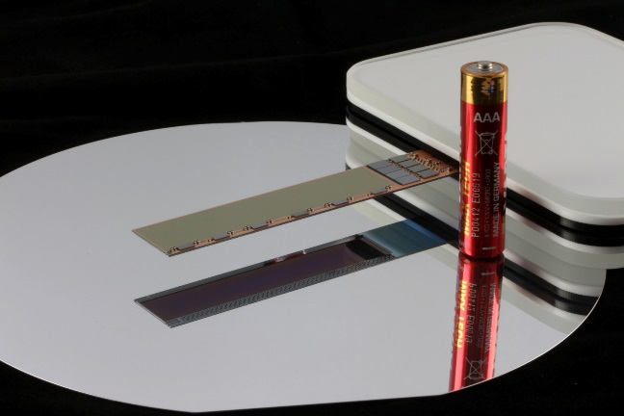
Pixel detector (PXD) construction status
Sensor production almost completed:
  Have 1.5X to 2X more prime grade sensors (>99%) than needed,
  plus medium class sensors (>98%)
  ASICs (3 different custom ones needed)
  DCDB4.2 – final version (done)
  DHPT1.2b – final version (done)
  SwitcherBv2.1 – final version
  Gated mode for injection background blanking
  works.
  Completed third DESY beam test:
  ROI (Region Of Interest) sparsification works well and event misalignment problem with the
  SVD has been fixed.
Ready to install by summer 2018
First full sized DEPFET detector. ASICs are visible on the right and the edge (switchers)

Slide 22
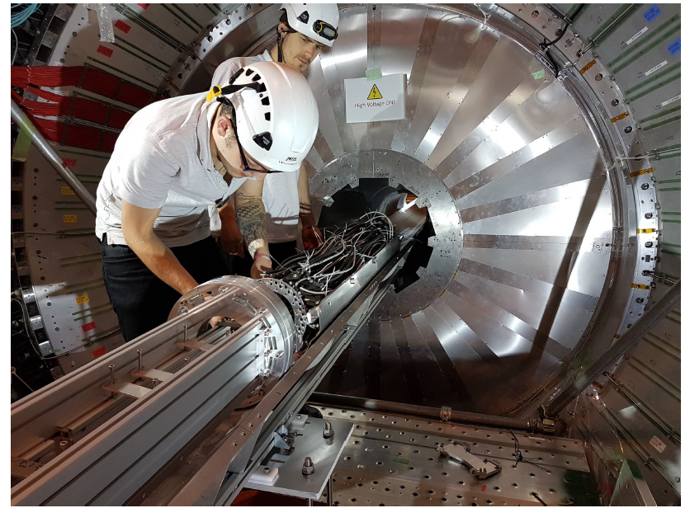
Practicing for Phase III (Physics run)
Scene from the last VXD Practice Installation in Nov 2016 (a 2nd one in April 2017)

Slide 23
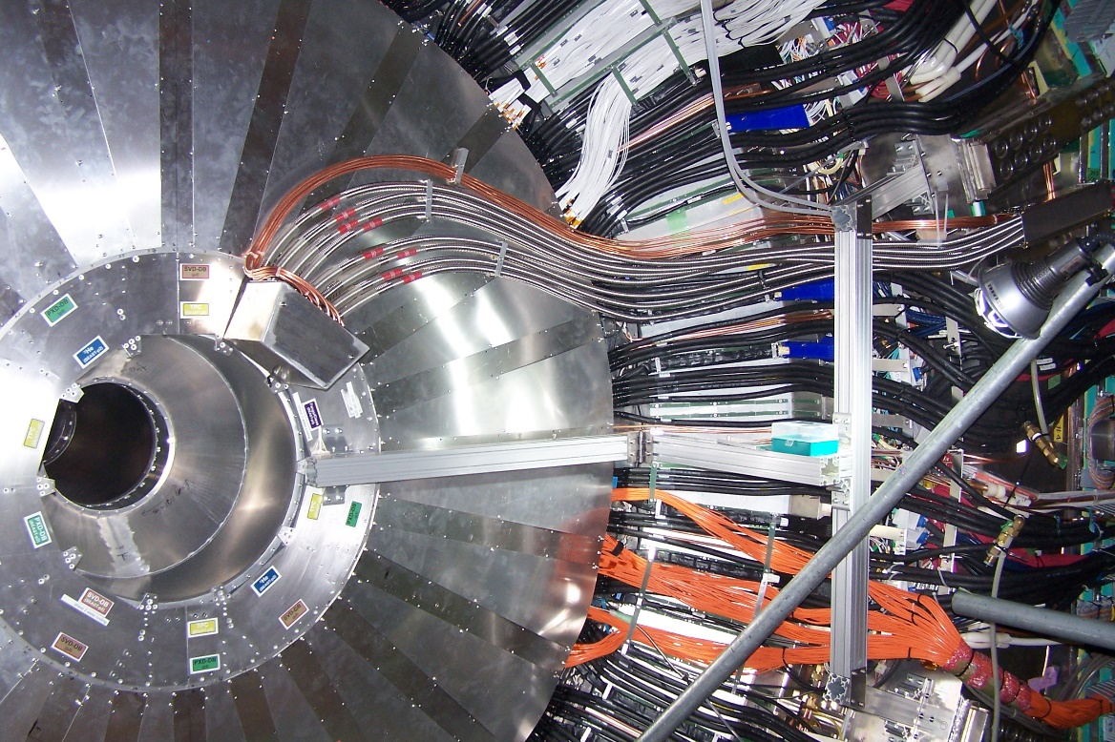
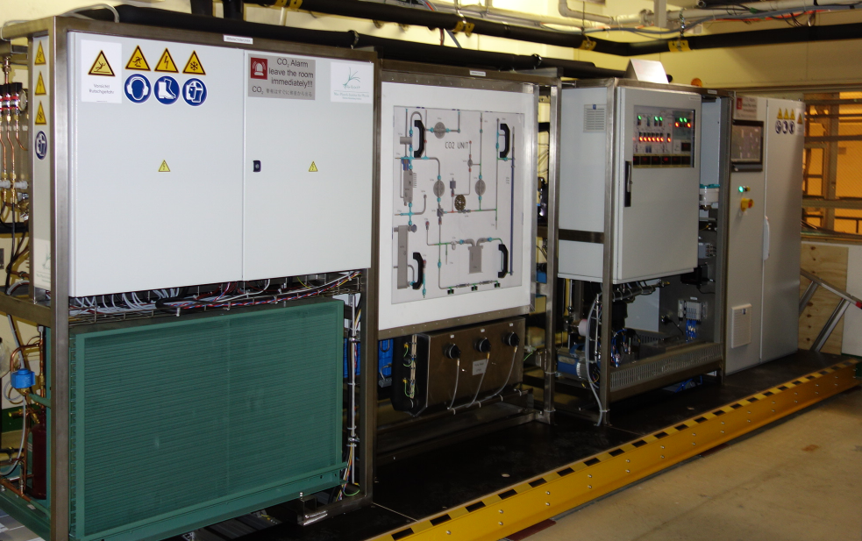
First Operation of IBBelle (ATLAS-style CO₂ cooling)
IBBelle installed in October / November in Tsukuba Hall
  Successful cool-down to -30 °C @ 3 kW
  December: Installation of CO₂ flex lines and CO₂ dock boxes
  First cool-down of flex lines (with short circuit loops at the dock box)
IBBelle in Tsukuba B1
Flex lines and CO2 dock box installed both on the BWD and FWD sides,
Cool down successful, system operational

Slide 24
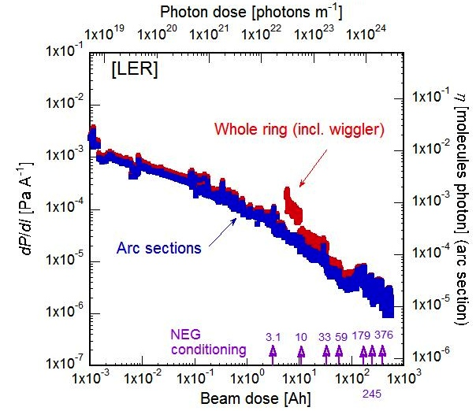
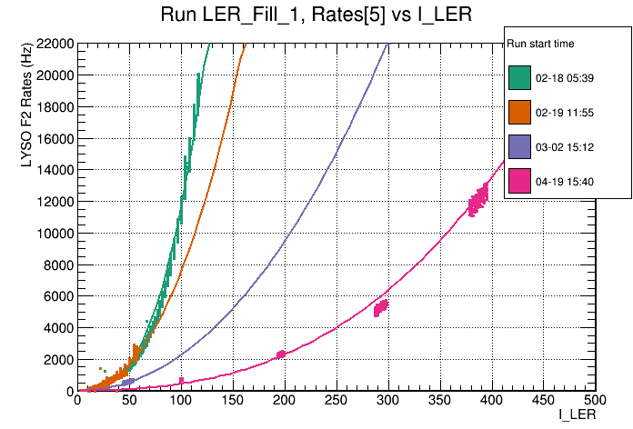
SuperKEKB vacuum scrubbing to reduce
LER beam gas backgrounds in Belle II
“Brand new” 3km long beampipe
LER integrated beam dose > 500 A-h
BEAST background in the LER vs time
A. Beaulieu
Y. Suetsugu et al (SuperKEKB vacuum group) [N.B. log-log plot]
BEAST data shows the LER backgrounds decreasing as vacuum scrubbing proceeds.
Notes:
LER vacuum scrubbing

Slide 25
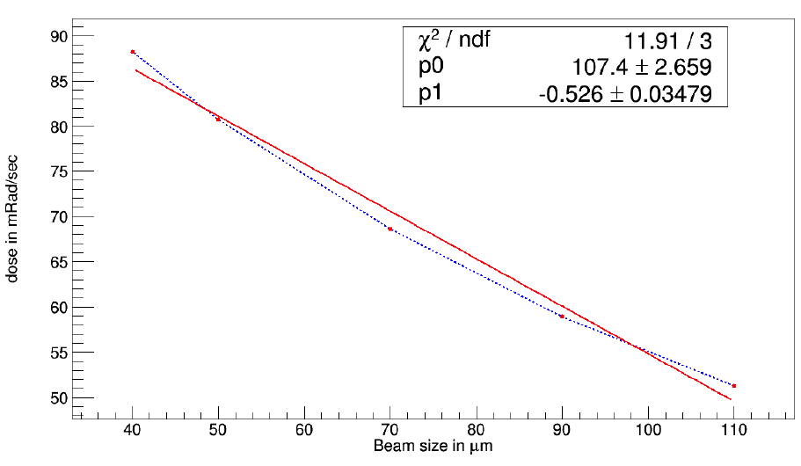
BEAST Phase I Highlight
April 2016: Large Touschek background observed
in the LER (extensively studied in dedicated runs)
M. Nayak
B_{Touschek}~1/(σ_{y}σ_{x})
Bkg in BEAST
Vertical beam size from size monitor (not measured at IP)
→Will need excellent collimators to handle nano-beam backgounds (only a small subset of these available in Phase I)
Notes:
The collimators will be installed in Phase II

Slide 26
Beam Background Studies
BEAST Phase 1 analyses now near completion, documented in a 100 page note (and growing)
A number of new techniques developed
Current focus: ensure internal consistency, consult with SuperKEKB group, extrapolate to phase III
Three consecutive LER beam-size sweeps. Shapes correspond to beam currents and colors to beam size settings.
P. Lewis
BGO dose rate / IP (a.u.)
Touschek
Beam Gas
[A/(Pa*μm)]
Improved model and re-calibrated beam size measurements. BGs for a wide range of beam currents and beam sizes now described consistently by a single set of parameters.

Slide 27
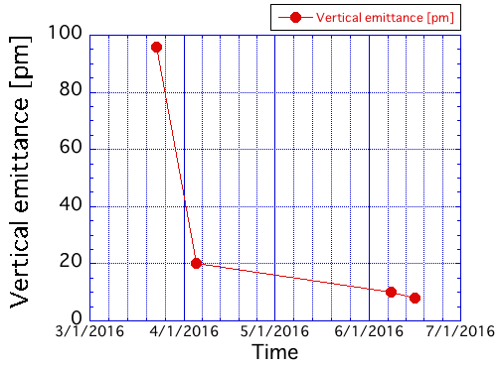
SuperKEKB Highlight from Phase I:
“Cool” flat beams (LER plot below)
Units are picometers
Optics corrections using SF skew-Q coils
Optimization of strength of
permanent skew-Q magnets
Permanent skew-Q magnets
Target: 5pm
Y. Funakoshi et al
Notes:
Low emittance is needed for nano-beams.

Slide 28
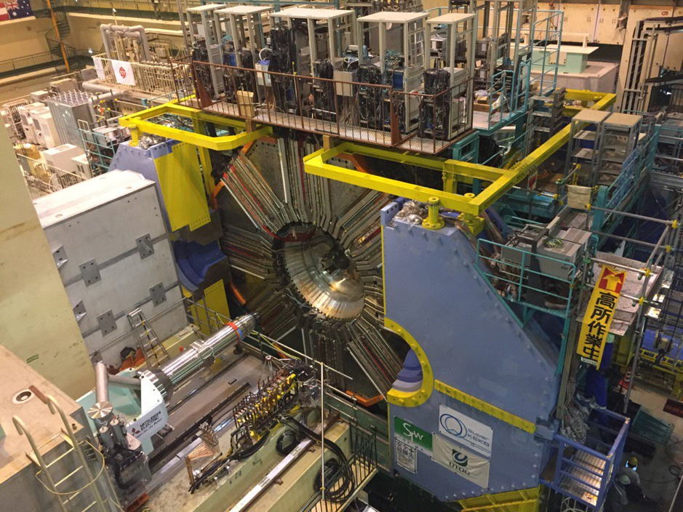
HEP world: So when do we start Belle II ?
BEAST PHASE I:
Feb-June 2016
(Belle II roll-in, April 11, 2017).
Phase II Operation:
Starts in ~Nov 2017 [Begin with damping ring commissioning;
Main ring (Feb 2018); First collisions; limited physics without vertex detectors]
Phase III: Belle II Physics Running: end of 2018 [vertex detectors in]
✔
QCSL at the IP, Aug 2016
QCSR delivered at KEK,
Feb 13, 2017
✔
Notes:
Much depends on the success of Phase II. We hope to run on the Upsilon(6S) after initial commissioning on the Upsilon(4S).

Slide 29
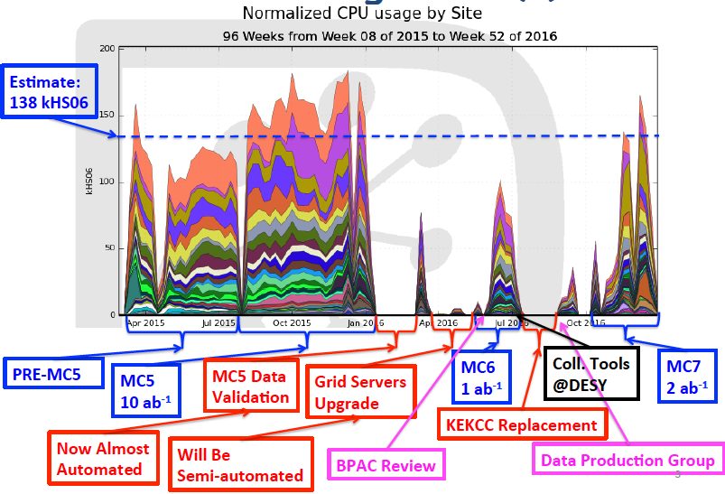
Belle II International GRID MC campaigns follow the LHC model. Recent campaigns have generated the equivalent of 5 ab⁻¹ of data
But this was pure MC for physics studies, now it is time for dress rehearsal for real data (cosmic rays and then collision data)

Slide 30

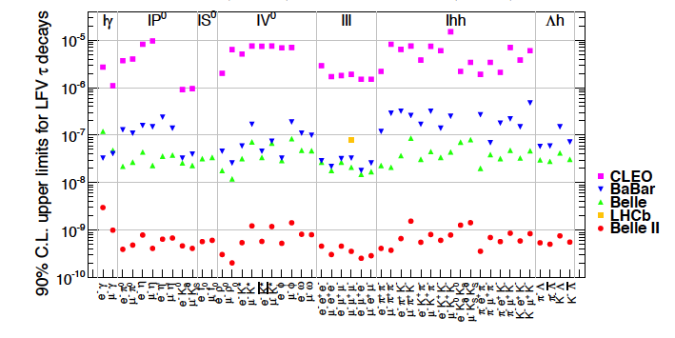
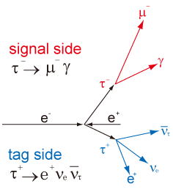
τ Lepton Flavor Violation
Example of the decay topology
Note vertical log-scale (50 ab⁻¹ assumed for Belle II; 3 fb⁻¹ result for LHCb
Belle II will push many limits below 10⁻⁹ ;
LHCb, CMS and ATLAS have very limited capabilities.
LHC people: The modes τ→μγ and τ →μ h+ h-
provide important constraints on H→μτ
Notes:
Belle and BaBar pushed many limits far beyond CLEO. Belle II will move below 10^-9

Slide 31
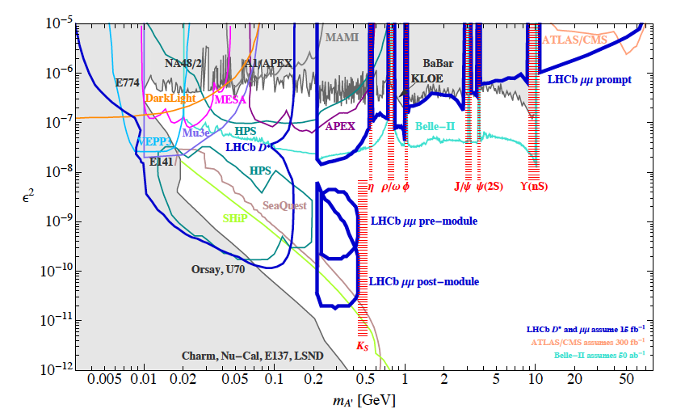
“Dark Photon”→e⁺e- sensitivity
One process used in Belle II is e⁺e⁻→γ A’→γ (e⁺e⁻)
Notes:
Belle and BaBar pushed many limits far beyond CLEO. Belle II will move below 10^-9

Slide 32
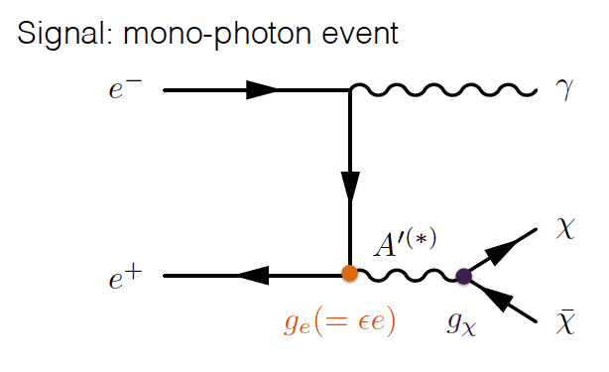
“Light DM” sensitivity in e⁺e⁻→γ+nothing
YiMing Zhong et al. (B2TIP)
This is hard. Requires a special new trigger that is being developed for Belle II.
May be tested during Phase II
Notes:
Belle and BaBar pushed many limits far beyond CLEO. Belle II will move below 10^-9

Slide 33
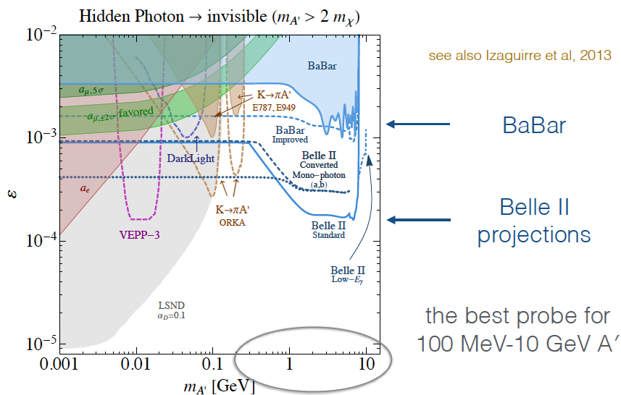
“Light DM” sensitivity in γ+nothing
Notes:
Belle and BaBar pushed many limits far beyond CLEO. Belle II will move below 10^-9

Slide 34
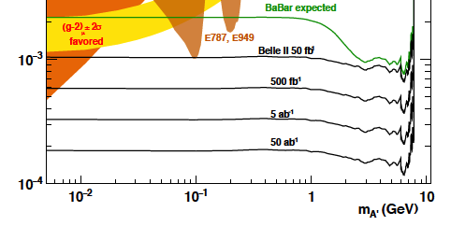
“Light DM” sensitivity in γ+nothing
Sensitivity increases rapidly with integrated luminosity.
This is an e+e- project.
Notes:
Excellent sensitivity in the 100 MeV-few GeV range

Slide 35
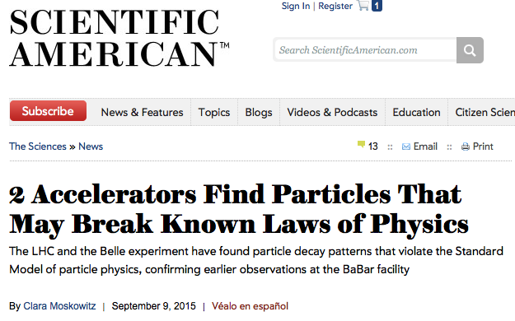

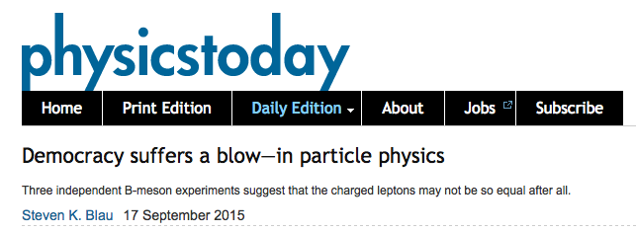
2015: “Missing Energy Decays” of the B meson
Start of a NP program that will last a decade.
Notes:
Let’s now discuss “missing energy decays” and the excitement in this area. This started In 2015

Slide 36
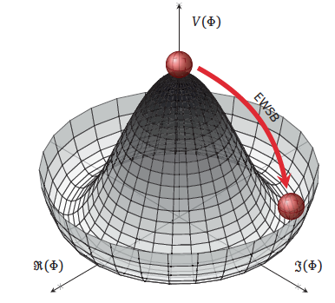

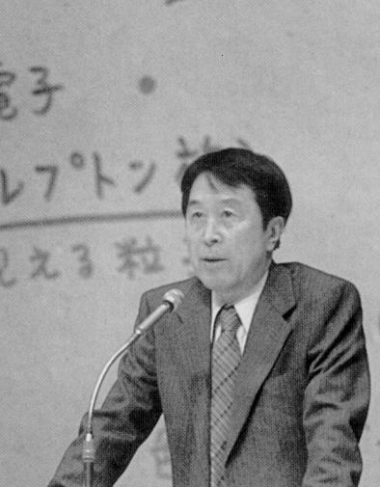
The BEH boson is now firmly established by experimental results from ATLAS and CMS. Now planning for future Higgs flavor factory facilities
(e.g ILC, HL-LHC, CEPC, FCC).
.
Does the GP (Brout-Englert-Higgs particle) have a “brother” i.e. the charged Higgs ?
Y. Nambu, 1921-2015
Measurements at Belle II and direct searches at hadron colliders take complementary approaches to this important question.
Notes:
This prompted Leon Lederman to write a new book entitled “Beyond the God Particle”.
Sensitivity from tau nu, D(*) tau nu decays and b→s gamma.
Hadron colliders directly search for H+ →tau nu.

Slide 37
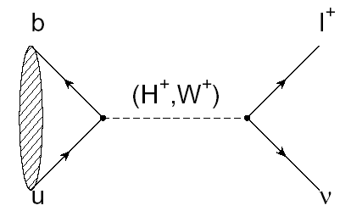


B→τ ν
(Decay with Large Missing Energy)
Sensitivity to new physics from a charged Higgs
W.S.Hou,. PRD 48, 2342 (1993)
The B meson decay constant, determined by the B wavefunction at the origin
(|V_{ub}| taken from indep. measurements.)
Notes:
In the SM this is mediated by a charged W. In addition there is a NP contribution from the charged Higgs.

Slide 38
Consumer’s Guide to the Charged Higgs
Higgs doublet of type I (φ₁ couples to upper (u-type) and lower (d-type) generations. No fermions couple to φ₂)
Higgs doublet of type II (φ_{u} couples to u type quarks, φ_{d} couples to d-type quarks, u and d couplings are different; tan(β) = v_{u}/v_{d}) [favored NP scenario e.g. MSSM, generic SUSY]
Higgs doublet of type III (not type I or type II; anything goes.
“FCNC hell”→many FCNC signatures)
Thanks to theorist Xerxes Tata
Notes:
Thanks to Xerxes Tata for corrections. Remaining mistakes are my own.

Slide 39
Why measuring B⁺→τ⁺ν is non-trivial
e⁺
ϒ(4S)
B⁻
B⁺
Most of the sensitivity is from tau modes with 1-prongs.
ν_{e}
B⁻→X
ν_{e}
The experimental signature is rather difficult: B decays to a single charged track + nothing
(This may be hard at a hadron collider)

Slide 40



Example of a Missing Energy Decay (B→τν) in Data
The clean e+e- environment makes this possible

Slide 41



Example: Belle B→τν results with full reprocessed data sample: either hadronic or semileptonic tags (PRD 92, 051102 (2015))
Hadronic tags: 63±22.5 (3σ)
Idea: With the “single B meson beam”, we look for a single track from a τ, missing energy/momentun and extra calorimeter energy close to zero.
Semileptonic tags:
222±50 (3.8σ)
With the full B factory statistics only “evidence”. No single observation from either Belle or BaBar.
➔The horizontal axis is the “Extra Calorimeter Energy”
Notes:
The signal peaks at zero

Slide 42



Complementarity of e+ e- and LHC
Thanks to Luis Pesantez and Phil Urquijo
The current combined B→τυ limit places a stronger constraint than direct searches from LHC exps. for the next few years.
1 ab⁻¹
Belle II
Currently inclusive b→sγ rules out m_{H+} below ~480 GeV/c² range at 95% CL (independent of tanβ), M. Misiak et al. (assuming no other NP)
This region is allowed
http://arxiv.org/abs/1503.01789
Notes:
New ATLAS charged Higgs limit shown at this meeting (SUSY2016) by Elliot Lipeles.

Slide 43


A three-body tale
Signal
Normalization (l=e, μ)
Slide adapted from A. Soffer
Notes:
Let me tell you a fascinating three-body story

Slide 44

Example from a BaBar paper
Signals in B→D^{(*)} τν (489±63, 888±63)
Missing mass variable:
m_{miss}² =p_{miss}²=(p[e⁺e⁻]-p_{tag}-p_{D(*)}-p_{l})²
P_{l}* = momentum of lepton in B rest frame
But wait !!! B→D*τν possible at LHCb
Production of B meson pairs at threshold is critical to the separation of backgrounds from the missing energy/ momentum signal.

Slide 45

BaBar collaboration, Phys. Rev. Lett. 109, 101802 (2012)
“However, the combination of R(D) and R(D*) excludes the type II 2HDM charged Higgs boson with a 99.8% confidence level for any value of tan(β)/m_{H+}”
In other words, found NP but killed the 2HDM NP model.
This was not the end of the “three-body tale” and started a new multi-year (decade-long ?) program of experimental and theoretical work.
Notes:
Shocking – who ordered that ?

Slide 46


2015 World Averages for R(D) and R(D*)
3.9σ from SM
It became obvious that we need two orders of magnitude of data to solve these issues related to the charged Higgs.
Notes:
Sumer 2015 HFAG plot for R_D and R_D*. Belle will try to squeeze a little more out of its data. LHCb will try to do D tau nu..

Slide 47



One more Belle update
Uses semileptonic B tagging
and leptonic tau decays
Y. Sato et al (Belle collab); Phys. Rev. D 94, 072007
Examples of NP constraints for charged Higgs or leptoquark models.
Notes:
Need more data !

Slide 48

NP diagnosis
Y. Sato et al (Belle collab); Phys. Rev. D 94, 072007
Try to distinguish SM and charged Higgs in kinematic distributions.
Both SM and NP fit well.
Can also constrain other types of NP couplings (e.g. leptoquarks) , but need much more data

Slide 49


Belle update: another possible path to NP
Uses 1-prong hadronic tau’s and hadronic B tagging
First determination of τ polarization
S. Hirose et al (Belle collab),
arXIv: 1608.06391
2017 Nagoya Workshop
Interesting path to NP but current statistics are too low.
Notes:
Need more data !

Slide 50


Credit: Djouadi
Simple message from the world’s flavor physicists:
WE NEED MORE DATA !!!
With apologies to Herodotus, Thucydides, Sparta, Persia…
Initial Belle II projections for charged Higgs sensitivity
Itoh, Sato

Slide 51


“Missing Energy Decay” in a Belle II GEANT4 MC simulation
B→τν, τ→eνν B→Dπ, D→Kπππ
Zoomed view of the vertex region
e

Slide 52

Red Hot Flavor Physics
The stakes are getting higher
Notes:
Now let me briefly turn to the most important and surprising result in flavor physics. First some pedagogical introduction.

Slide 53



High Energy Physics History: finding NP in A_{FB} (using interference)
Conclusion: There is a Z boson at higher energy even though colliders of the time did not have enough to produce it
Notes:
Gargamelle discovered weak neutral currents in 1973; SLAC found parity violation in e N scattering in 1978. This set the stage for the discovery of the Z⁰ boson by UA1 and UA2.

Slide 54

A_{FB}(B→K*l⁺l⁻)(q²)
Forward
Backward
The SM forward-backward asymmetry in b→s l⁺ l⁻ arises from the interference between γ and Z⁰ contributions.
l⁻
l⁺
B
B
θ
K*
θ
K*
l⁺
l⁻
Ali, Mannel, Morozumi, PLB273, 505 (1991)
Note that all the heavy particles of the SM (W, Z, top) enter in this decay.

Slide 55

More on A_{FB}(B→K*l⁺l⁻)(q²)
Can in effect vary √s for NP
A_{FB} depends on q²= M²(l⁺l⁻)
Ali, Mannel, Morozumi, PLB273, 505 (1991)
The “zero-crossing” of A_{FB} depends only on a ratio of form factors and is a clean observable.

Slide 56

B→K* l l angular variables
(skip today)
K* and l⁺ l⁻ helicity angles
Angle φ between the normals to the two decay planes.
N.B. Recent LHCb and Belle measurements include the φ angle data. Also CMS and ATLAS at Moriond 2017.
From http://xxx.lanl.gov/pdf/1606.00916v1

Slide 57

B→K*l⁺l⁻(q²) bootcamp (for reference)
Angular dependence
F_{L} is the longitudinal polarization fraction.
(-) means the term is only in
Introduce P_{4,5}’= S_{4,5}/sqrt[F_{L} (1-F_{L})] to reduce/eliminate dependence on form factors
Thanks to Rahul Sinha
Notes:
A little technical but may help with understanding the issues…..Thanks to Rahul Sinha for tutoring and debugging. All remaining mistakes are my own.

Slide 58


LHCb 3fb⁻¹ results on B→K* μ⁺μ⁻ (q²)
Angular Asymmetries based on 2398±57 signal events
“The P₅’ measurements are only compatible with the SM prediction at a level of 3.7σ…..A mild tension can also be seen in the A_{FB} distribution, where the measurements are systematically <=1σ below the SM prediction in the region 1.1<q²< 6.0 GeV²”
Blank regions are the J/ψ and ψ’ vetos
Theory from http://arxiv.org/abs/1510.04329
R. Aaij et al., JHEP 1602, 104 (2016)

Slide 59


Recent results on B→K* μ⁺μ⁻ (q²)
Is HEP History repeating itself ? [But be sure this is not a tricky SM form factor effect.]
Why does NP appear first in this mode
(and not others) ?
Possible answer: All the heavy particles of the SM (t, W, Z) and maybe NP (except the Higgs) appear here. Sensitive to NP via interference (linear effects and many types of couplings).
Notes:
Let’s think about this (along with Auguste Rodin).
However, there must be other signatures !

Slide 60



NP could mean “new particles” (bump in some mass spectrum at the LHC) or “new couplings” (flavor physics)
We would be happy to break the Standard Model.
Places where we might find New couplings
Right-handed currents:1- γ₅➔1+ γ₅
Notes:
We would he happy to break the Standard Model. Paradigm shift (find new couplings instead of new particles). But wait new couplings are due to new particles. This might be just beyond the reach of the LHC direct production

Slide 61


A recent example of NP Fits to B→s l⁺l⁻ data
J. Matias et al., Moriond March 2017, 4.7σ deviation from SM
Fits use LCSR at low q² and lattice form factors at high q² and all data on b→s l l
Why should I care ?
These plots mean there are NP coupling(s) in the weak interaction
Notes:
What does this mean ? Why should you a leading SM theorist care ? https://arxiv.org/pdf/1704.02821.pdf

Slide 62

Theory issues on B→K* μ⁺μ⁻ (q²)
➔Check dependence on light-cone form factors (some checks already done by Lattice QCD groups)
Major concern
➔Can tails of large B→K* [c-cbar] or non-factorizable effects produce the anomalies found in the angular distributions ? (If all non-perturbative effects float with arbitrary normalization in the fit then the data can explained,
http://lanl.arxiv.org/abs/1512.07157)
→ Use data near q² =q²_{max} (K* at rest), where symmetry works (Heavy Quark Effective Theory) and constrains ratio of polarizations (no hadronic corrections)➔Still find NP
Notes:
Theory issues. Crab restaurant in Osaka.

Slide 63


Fit LHCb finely binned angular data at q²_{max}
(HQET limit)
★ is the SM
SM
Contours at 1,3,5σ
Data with 1σ, 5σ uncertainties
5σ signal for NP, requires right-handed currents
A. Karan et al. (arXiv: 1603.04355) [R.Sinha group]
Still confirmation and more data is needed to close the case for NP

Slide 64


Paths to the future:
A_{FB}(q²) for Inclusive b→s l⁺ l⁻
(Skip if time is short)
No form factors
~301 b→s l⁺l⁻ signal events in Belle data sample
Precise result useful for NP diagnosis but Belle II only (see
http://arxiv.org/abs/1503.04849)
http://arxiv.org/abs/1402.7134
To appear in PRD.

Slide 65

How can we establish NP in B→K* l⁻l⁺ ?
Ans: Observe and measure the rate for
and thus isolate the Z’ penguin (C₉) at Belle II
Answer from Buras et al.

Slide 66

How can we establish NP in B→K* l⁻l⁺ ?
Ans: Verify hint of lepton universality breakdown at Belle II
(good electron eff and mass resolution)
Updates to R(K*) expected soon from LHCb.
According to http://xxx.lanl.gov/abs/1605.07633, no significant SM radiative corrections
Control region R_{K} consistent with unity;
R. Aaij et al. (LHCb collab); PRL 113, 151601 (2014)

Slide 67


Example of Belle II Physics studies
“Missing Energy Decay” in a Belle II GEANT4 MC simulation
Signal B→K ν ν tag mode: B→Dπ; D→Kπ
Zoomed view of the vertex region in r--phi
View in r-z
Notes:
Let’s talk some more about physics.

Slide 68


“We need more data !!”
Apologies to Director Akira Kurosawa
To find out whether there are NP couplings in the weak interaction
Try to squeeze out a bit more from the Belle I data sample.
Notes:
To find out whether there are new physics couplings in the weak interaction, we need more data.
For illustration, we show the Belle analysis by S. Wehle et al (DESY), which has about 187 events and measures P_5^’

Slide 69


“We need more data !!”
Signal of ~312 events
P₅’
Belle I data. S. Wehle et al. (Belle collab)
arXiv: 1612.05014, published in PRL
Notes:
To find out whether there are new physics couplings in the weak interaction, we need more data.

Slide 70

First attempt to measure lepton flavor violating angular asymmetries by Belle.
We need more data to find NP!
Published in
S. Wehle et al (Belle collab)
PRL 118, 111801 (2017)

Slide 71
Conclusions
Flavor physics is exciting and fundamental. Did we just find NP via new weak interaction couplings ?
Flavor could be the path for the future of HEP but we need much more data.
Time for a Paradigm Shift ?
SuperKEKB Phase I commissioning Feb-June, 2016. Belle II rolls in April 2017. First collisions in Feb 2018. Belle II physics runs at the end of 2018 [and the LHCb upgrade in ~2021]. These facilities will inaugurate a new era of flavor physics and the study of CP violation.
Notes:
2014 was the 50th anniversary of the discovery of CP violation. We are now entering the 2nd generation. Time for a paradigm shift ?

Slide 72

Backup Slides

Slide 73



Results from Global Fits to Data (CKMFitter Group)
Great progress on ϕ₃ or γ (first from B factories and now in the last three years from LHCb).These measure the phase of V_{ub}
Similar results from UTFIT as well from G. Eigen et al.
J. Charles et al, Phys. Rev. D89 (2014) 033016
NP Phase
Extrapolation to 50 ab⁻¹
NP/SM amplitude ratio
But a 10-20% NP amplitude in B_{d} mixing is perfectly compatible with all current data.
Looks good
(except for an issue with |V_{ub} |)
Notes:
So what does this triangle mean ? Is NP completely ruled out ? The picture on the left is often wildly misinterpreted. Perhaps it is the most misinterpreted plot in the field of high energy physics.

Slide 74


BEAST Phase I data taking
(US and German experts)
IBBelle CO₂ cooling plant arriving at KEK shipped on a boat from Germany
Notes:
Let’s go back to physics

Slide 75


In e⁺ e⁻ scattering at 10-11 GeV, a critical issue for vertexing is multiple scattering.
Reduce the multiple scattering lever arm; reduce X₀
Belle: r(beampipe) 2 cm→1.5 cm
Belle II: r(beampipe) 1cm
Improved resolution and nano-beams will open new possibilities for vertex analysis
Large improvement in ΔS(B→[K_{S}π⁰] γ)
Ks track
π⁺ π⁻
γ
γ
B vertex
IP profile
γ
Larger radial coverage of SVD
B decay point reconstruction
from the K_{S} vertex, used in searches
for NP right handed currents.

Slide 76


April 2016, March 2017
: Belle II VXD beam tests at DESY
(DESY provides the infrastructure and facilities for this critical beam test)
Incident DESY (2-6) e- test beam

Slide 77
Compare the Parameters for KEKB and SuperKEKB
 | KEKB Design | KEKB Achieved : with crab | SuperKEKB Nano-Beam
Energy (GeV) (LER/HER) | 3.5/8.0 | 3.5/8.0 | 4.0/7.0
β_{y} * (mm) | 10/10 | 5.9/5.9 | 0.27/0.30
β_{x} * (mm) | 330/330 | 1200/1200 | 32/25
ε_{x} (nm) | 18/18 | 18/24 | 3.2/5.3
ε_{y} /ε_{x} (%) | 1 | 0.85/0.64 | 0.27/0.24
σ_{y}(μm) | 1.9 | 0.94 | 0.048/0.062
σ_{x}(cm) | 0.052 | 0.129/0.090 | 0.09/0.081
σ_{z} (mm) | 4 | 6 - 7 | 6/5
I_{beam} (A) | 2.6/1.1 | 1.64/1.19 | 3.6/2.6
N_{bunches} | 5000 | 1584 | 2500
Luminosity (10³⁴ cm⁻² s⁻¹) | 1 | 2.11 | 80
Nano-beams are the key (vertical spot size is ~50nm !!)
This is not a typo
Notes:
The jump from CESR to the B factories (PEP-II, KEKB) was not significant in per bunch parameters. However, the number of bunches and the beam currents were much larger. There is greater than an order of magnitude reduction in beam size and emittance.

Slide 78

Belle II: High Speed Networking is needed
along with GRID computing
Recent WAN data challenge between major sites (KEK, PNNL, DESY, KIT, CNAF, Napoli, Signet) in Nov 2016. Major US contribution: PNNL.
➔Results demonstrate that the Belle II networking requirements are satisfied.
Notes:
Networking and Resource Estimates

Slide 79

Slide from R. Mandal
Systematics from charmonium resonances in ArXiv:1603.04355
Conclusions about the presence of NP unchanged.

Slide 80






MCP-PMT Rotation Problem
Major mobilization by Nagoya team (K. Matsuoka et al)
Peeled off from here
Rotate
Repaired all 16 modules and retested in B-field prior to CDC installation
  Shim between PMT modules and aluminum enclosure on side that wants to move towards the prism to restrict rotation
New problem of individual PMTs moving found in 2 MCPPMT modules
  Fixed these and decided to install CDC and observe TOP until Phase II-III shutdown

Slide 81




MCP-PMT Rotation Issue
Study of physics impact of decoupled PMTs
(BPAC charge)
Current concern is mechanical safety
(June B2GM update)

Slide 82


Slide 83


Eighth official MC production campaign (MC8)
Production start: Feb. 16, 2017
Ongoing…
In total: ~2.1 million jobs,
~20 billion events (~100 TB)
At maximum:
23.7k concurrent jobs
and > 266 kHS06 (new record!)
Higher than expected resource usage
MC8 will finish much earlier than expected
Added a few samples based on additional resource available (eg. BGx2)

Slide 84
Physics: P5 Comments on Belle II
High precision and rare decay experiments often do not require
the highest energy accelerators but instead rely on very intense
beams to produce large numbers of particles that can be studied
with great precision. This provides unique sensitivity to physics
at energy scales far higher than can be accessed directly at colliders.
* Heavy quarks and tau leptons:
The study of decays of hadrons containing a heavy quark (charm, bottom) and decays of the tau lepton at Belle II and LHCb will
provide more precise tests of the validity of Standard Model predictions (including the possible sources of CP non-conservation), increasing the sensitivity to the mass scale of new physics by dramatically increasing the sample of such decays by roughly two orders of magnitude.
P5 report, delivered in 2014

Slide 85


Slide 86

TOP: Time Calibration Progress
Major data corruption problem solved.
30ps electronics time resolution
Notes:
Figures on the top show the raw distributions and after time base calibration (TBC). “T0 Offsets” are shown in the lower figure.

