Slide 1


MQXFS
Impact of Flux Jumps
92nd HiLumi WP2 Meeting. 18-04-2017
Lucio Fiscarelli, Susana Izquierdo Bermudez, Ezio Todesco

Slide 2
Introduction
In Nb₃Sn, voltage spikes at low field are typically observed due to the flux jumps on the superconductor.
This is critical for the quench detection system, requiring the use of a threshold voltage/validation delay which is a function of the magnet current.
Is there something to worry in terms of transfer function (and field quality)?

Slide 3
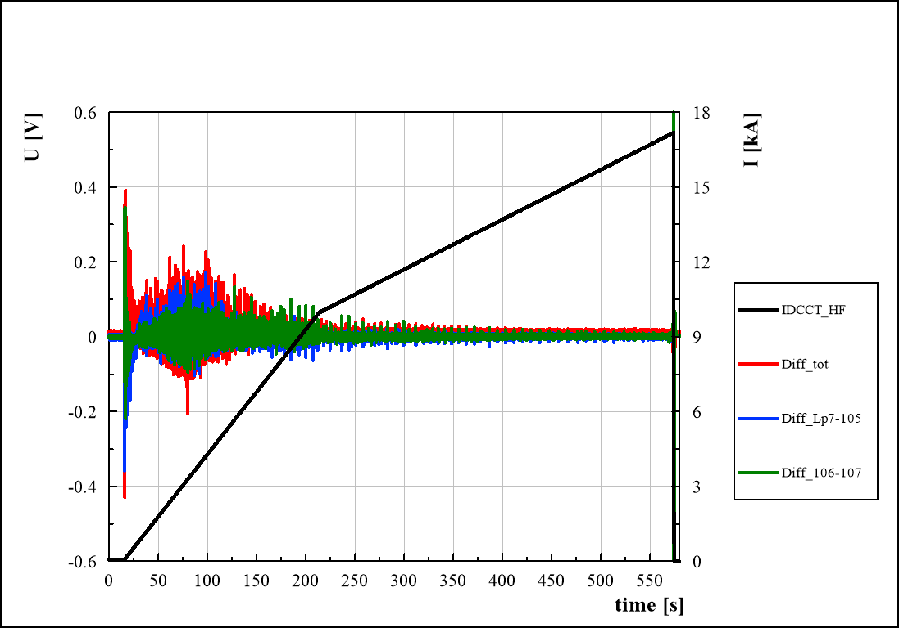
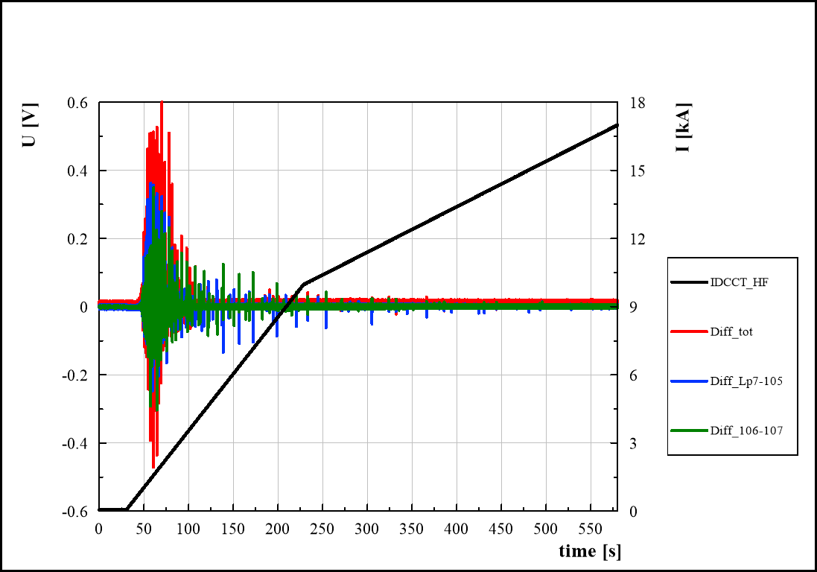
Introduction
Observations on the voltages: large voltage spikes that would trigger the detection system (nominal: 100 mV, 10 ms validation)
At 1.9 K, more flux jumps with smaller amplitude
At 4.3 K, fewer flux jumps but with larger amplitude
2.1 K
4.3 K
H. Bajas

Slide 4
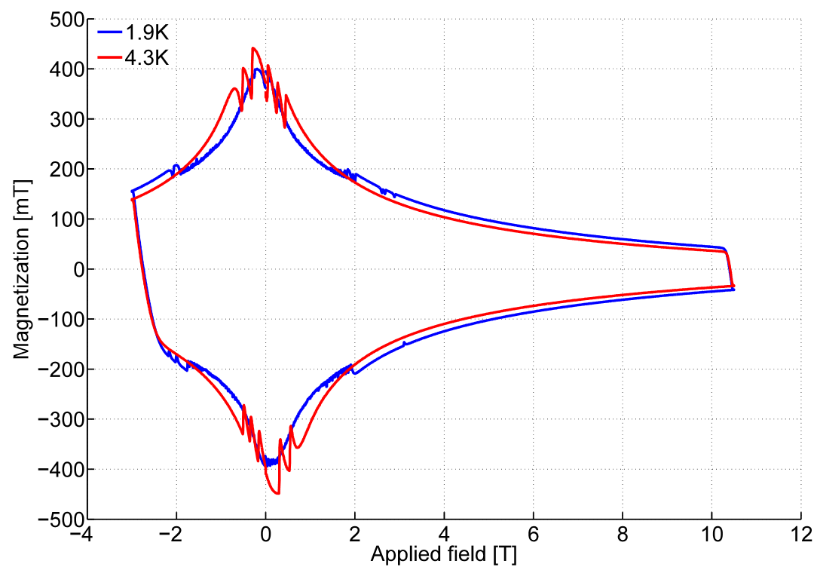
Introduction
Effects of flux jumps are also visible on strand magnetization measurement, consistent with the observations on the magnets (larger amplitude @ 4.3 K but less frequent)
Effects of flux jumps are also different depending on the type of conductor (PIT or RRP): Less flux jumps are expected for PIT conductor
  MQXFS5 measurements will be done to characterize flux jumps effects on a magnet produced using PIT technology.
RRP
1.9 K
B. Bordini
B. Bordini
MQXF review: https://indico.cern.ch/event/524804/

Slide 5
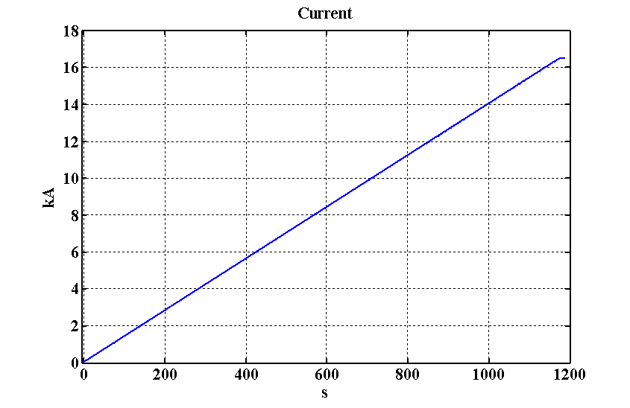
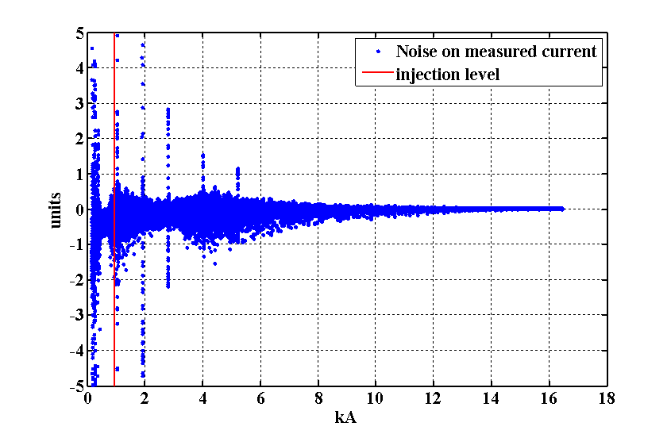
MQXFS3 – Flux jumps effects on the current
Linear ramp from 100 A to 16470 A with a ramp rate of 14 A/s (ramp up of a pre-cycle), for a cycle at 2.1 K
Sampling rate: 50 Hz
Difference of the measured current and a perfect linear ramp ±1 unit
The effect is smaller than 1 unit below 6 kA, and smaller than 0.1 unit at 7 TeV
  The larger spikes visible at 1 , 1.9 , 2.8, 4.0, and 5.2 kA should be related to an interference produced by thyristors present in the SM18 circuit.
L. Fiscarelli

Slide 6
MQXFS3 – Impact on transfer function
The impact of flux jumps on the transfer function is within the measurements noise, both at 1.9 K and 4.3 K
L. Fiscarelli
1.9 K
4.3 K

Slide 7
MQXFS3 – Impact on b6
Visible effect, but small, in b₆
The measurements are consistent with the evidences we see in the voltage signals and strand magnetization measurements:
  At 1.9 K, more flux jump with smaller amplitude
  At 4.3 K, fewer flux jumps but with larger amplitude
L. Fiscarelli
1.9 K
4.3 K

Slide 8
Measurement on upcoming magnets
Short models (measurements on He bath)
  Rotating coils: High accuracy for the harmonics, low bandwidth (1 Hz)
  Fixed coils (same shaft as the one using for rotating coil measurements): Lower accuracy for the harmonics, high bandwidth (1-5 kHz)
  Hall probe: not clear what we will get. At 50 Hz should work, at higher frequency to be checked
Prototype (anti-cryostat for magnetic measurements)
  Hall probes
    Try to use the sextupole head that was used in the LHC to measure decay and snapback with high bandwidth (to be verified)
  NMR cannot be use for MQXF, but will be use for the 11 T
    High precision on the main field (better than rotating coils) , low bandwidth (1 Hz)

Slide 9
Conclusions
Flux jumps as observed in the tested MQXF short model (MQXFS3) do not affect significantly the quadrupole gradient and are no critical in terms of field quality.
  For gradient: less than 1 unit around injection, less than 0.1 units at 7 TeV
Systematic characterization of the flux jumps effects will be done on the different magnets to be tested.
Measurements on the prototype will tell us how this effect scales with the magnet lengh.

