Slide 1
GUINEA-PIG
Daniel Schulte

Slide 2
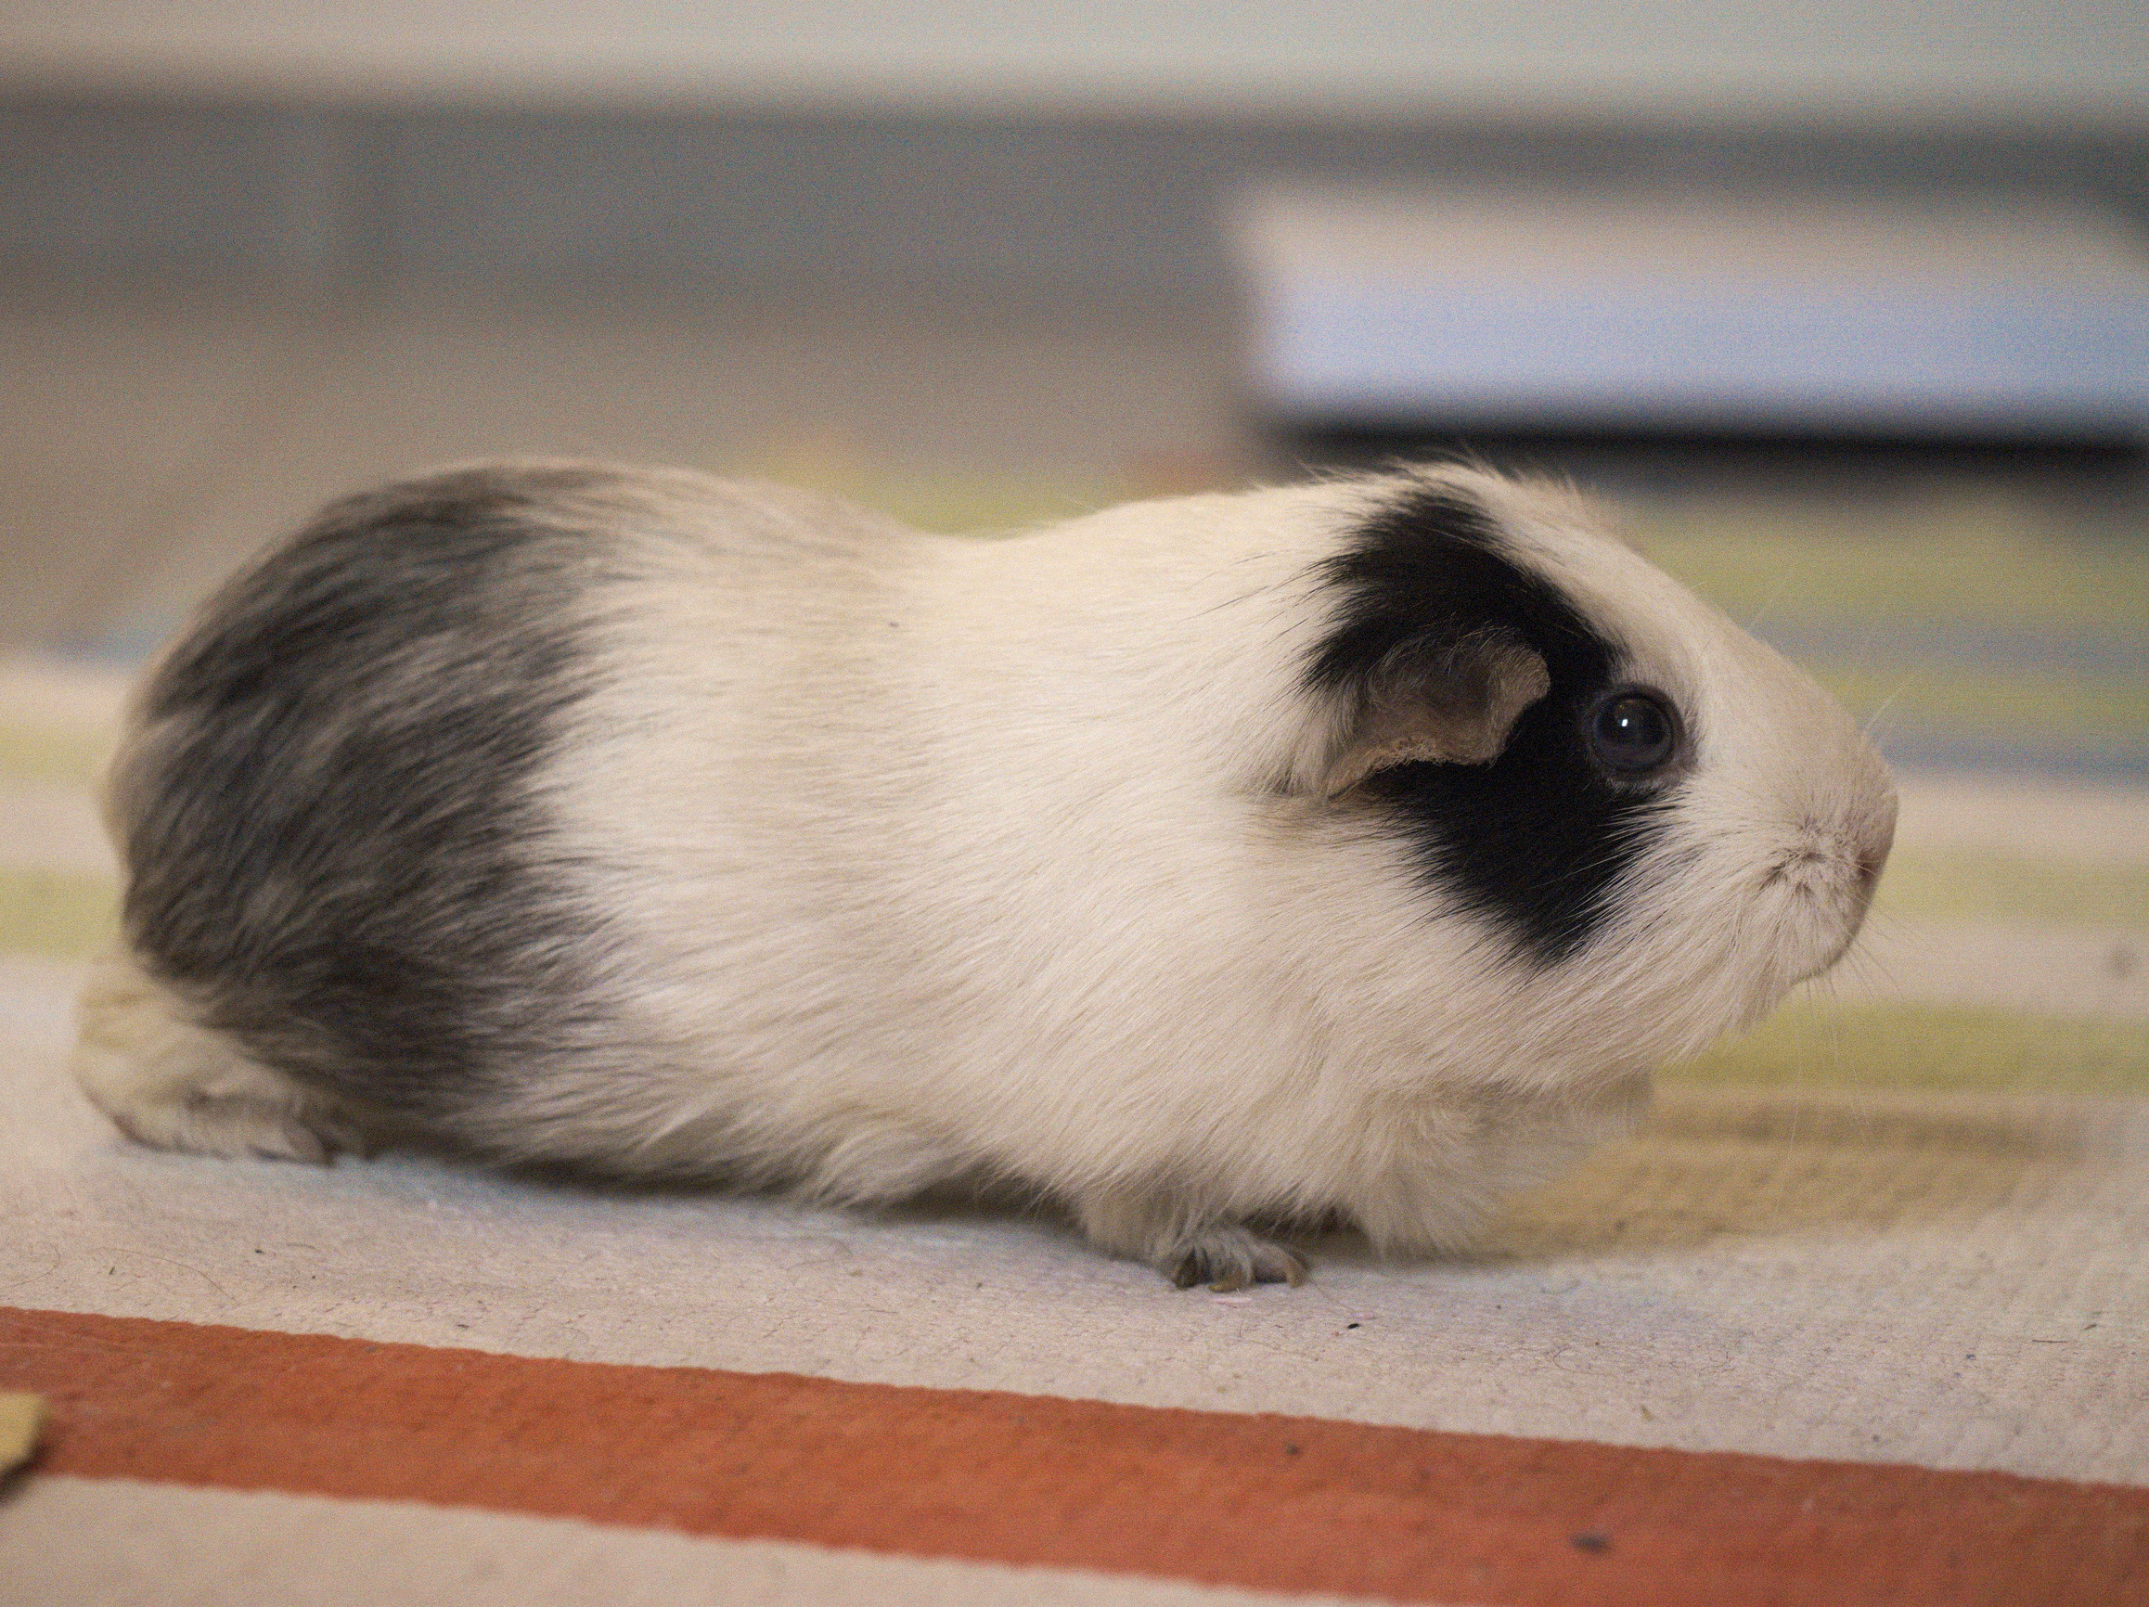
Introduction
GUINEA-PIG:
Generator of Unwanted Interactions for Numerical Experiment Analysis – Programme Interfaced to GEANT
Original code written in C as PhD project at DESY (first version 1994)
Mainly a tool for my detector and physics studies for TESLA
Still in use
GUINEA-PIG++:
Translation into C++ at LAL, some additions (written in 2007)
But also some bugs, which hopefully have been removed

Slide 3
Scope
Input for physics studies
Luminosity and luminosity spectrum to estimate physics performance
Beam-beam induced background for detector design and physics reach studies
Feeds several physics databases and tools (e.g. CIRCE, HADES, …)
Input for machine design
Estimate luminosity
  For nominal collisions
  And with imperfections
Model of spent beam
Identify luminosity signals for machine tuning

Slide 4
Physics
GUINEA-PIG simulates the interaction of two colliding ultra-relativistic beams containing electrons, positrons and photons (others can be done using tricks)
It includes:
Pinching of the beams
Emission of beamstrahlung
Production of incoherent pair background
Bremsstrahlung
Production of coherent pair background
Production of hadronic background (also minijets)
With external program can produce photon beams for gamma-gamma collider
GUINEA-PIG++ also includes
Beam polarisation
Trident cascade process

Slide 5
Generic Linear Collider
Power
Physics
Power
Can reach high electron-positron centre-of-mass energies
almost no synchrotron radiation
Single pass, hence two main challenges
gradient
luminosity

Slide 6
ILC and CLIC Main Parameters
Parameter | Symbol [unit] | SLC | ILC | CLIC | CLIC
Centre of mass energy | E_{cm} [GeV] | 92 | 500 | 380 | 3000
Geometric luminosity | L_{geom} [10³⁴cm⁻²s⁻¹] | 0.00015 | 0.75 | 0.8 | 4.3
Total luminosity | L [10³⁴cm⁻²s⁻¹] | 0.0003 | 1.8 | 1.5 | 6
Luminosity in peak | L_{0.01} [10³⁴cm⁻²s⁻¹] | 0.0003 | 1 | 0.9 | 2
Gradient | G [MV/m] | 20 | 31.5 | 72 | 100
Particles per bunch | N [10⁹] | 37 | 20 | 5.2 | 3.72
Bunch length | σ_{z} [μm] | 1000 | 300 | 70 | 44
Collision beam size | σ_{x,y} [nm/nm] | 1700/600 | 474/5.9 | 149/2.9 | 40/1
Emittance | ε_{x,y} [μm/nm] | ~3/3000 | 10/35 | 0.95/30 | 0.66/20
Betafunction | β_{x,y} [mm/mm] | ~100/10 | 11/0.48 | 8.2/0.1 | 6/0.07
Bunches per pulse | n_{b} | 1 | 1312 | 352 | 312
Distance between bunches | Δz [ns] | - | 554 | 0.5 | 0.5
Repetition rate | f_{r} [Hz] | 120 | 5 | 50 | 50
There are more parameter sets for ILC and CLIC at different energies
CLIC at 3TeV has higher order optics and radiation effects

Slide 7
Beam-beam Effect
Bunches are squeezed strongly to maximise luminosity
Electron magnetic fields are very strong
CLIC at 3TeV
Beam particles travel on curved trajectories
They emit photons (O(1)) (beamstrahlung)
L_{0.01}
They collide with less than nominal energy
L
Request from physics
L_{0.01}/L>0.6 below 500GeV
L_{0.01}/L>0.3 at 3TeV

Slide 8
Beam Focusing
Beam have linear focusing force
Very flat beam
We define the disruption parameters to compare the bunch length to the focal length
Typically smaller than 1
Typically much larger than 1
Parameter | Symbol [unit] | SLC | ILC | CLIC | CLIC
Horizontal disruption | D_{x} | 0.6 | 0.3 | 0.24 | 0.2
Vertical disruption | D_{y} | 1.7 | 24.3 | 12.5 | 7.6

Slide 9
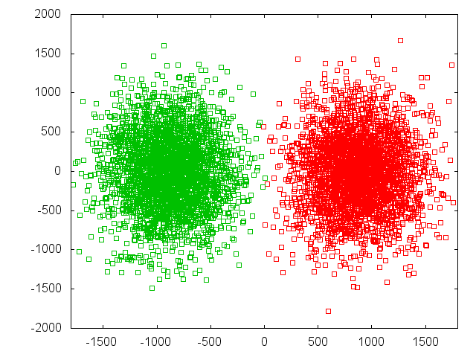
Pinch Effect
Need strong-strong code
CAIN (K. Yokoya et al.)
GUINEA-PIG (D. Schulte et al.)
Beams => macro particles
Beams => slices
Slices => cells
The simulation is performed in a number of time steps in each of them
The macro-particle charges are distributed over the cells
  The forces at the cell locations are calculated
  The forces are applied to the macro particles
  The particles are advanced
X direction
ILC
Z direction
All simulation performed with GUINEA-PIG
Predicted focal points
(for beam centre)

Slide 10
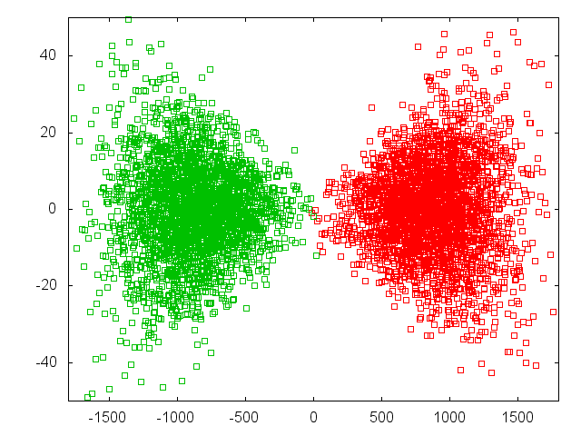
Pinch Effect
Beam-beam force switched off
Need strong-strong code
CAIN (K. Yokoya et al.)
GUINEA-PIG (D. Schulte et al.)
Beams => macro particles
beams => slices
Slices => cells
The simulation is performed in a number of time steps in each of them
The macro-particle charges are distributed over the cells
  The forces at the cell locations are calculated
  The forces are applied to the macro particles
  The particles are advanced
Y direction
Z direction

Slide 11
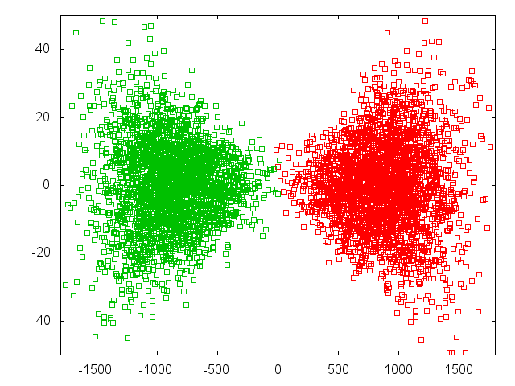
Pinch Effect
Beam-beam force switched off
Need strong-strong code
CAIN (K. Yokoya et al.)
GUINEA-PIG (D. Schulte et al.)
Beams => macro particles
beams => slices
Slices => cells
The simulation is performed in a number of time steps in each of them
The macro-particle charges are distributed over the cells
  The forces at the cell locations are calculated
  The forces are applied to the macro particles
  The particles are advanced
Y direction
Note: Luminosity increase has been benchmarked to SLC (F. Zimmermann et al.)
Z direction

Slide 12
Beamstrahlung
Power
[a.u.]
Classical regime
ILC (0.06), CLIC at 380GeV (0.17)
Quantum regime
CLIC at 3TeV Υ=5
The spectrum is given by
Sololov-Ternov Spectrum
With modified Bessel functions
and

Slide 13
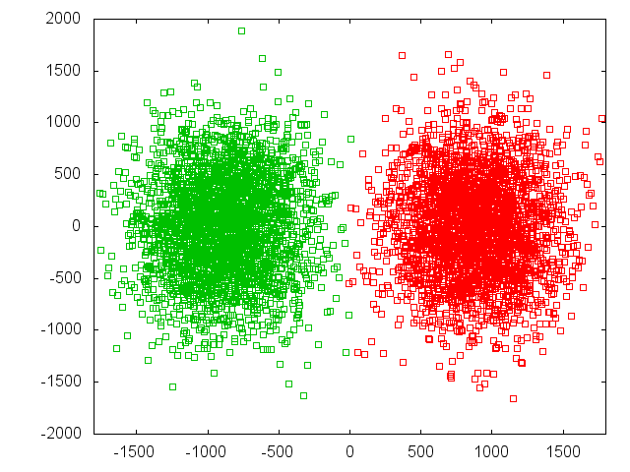
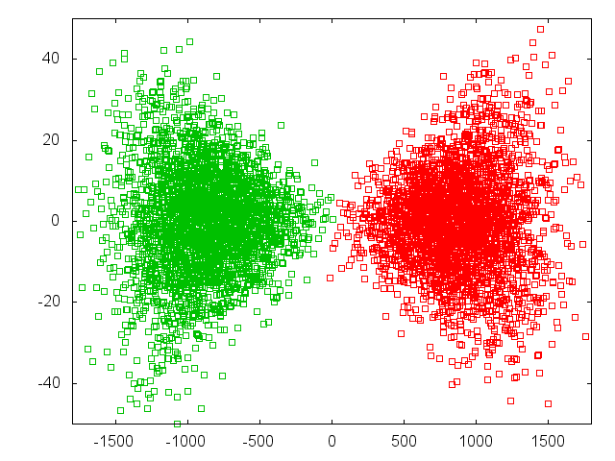
Photon Production
Horizontal plane
Vertical plane

Slide 14
Luminosity Spectrum
The total luminosity L varies strongly with beta-function
So tend to use L_{0.01}/L=60% as criterion
i.e. typically n_{γ}=1.5-2
Reasonable compromise for most physics studies
But L_{0.01} does not change so much

Slide 15
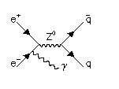
Example: Top Production at Threshold
K. Seidel et al. arXiv:1303.3758
Top production at threshold is strongly affected by beam energy spread and beamstrahlung
For L_{0.01} > 0.6 L impact of beamstrahlung is comparable to ISR
But depends on physics

Slide 16
Hourglass and Beam-beam Effects
Including pinch effect
There is an optimum value for beta
For smaller beta-function the geometric luminosity increases but the enhancement is reduced
Small beta-functions lead to
High chromaticity
Optics is difficult
Large divergence
Quadrupole aperture is limited
ILC choice
CLIC choice

Slide 17
Luminosity and Offset
Luminosity loss for beam offsets depends strongly on disruption parameter
Δy = 0.4 σ_{y}
L = 0.71 L₀ D_{y}~24
L = 0.92 L₀ D_{y}~12

Slide 18
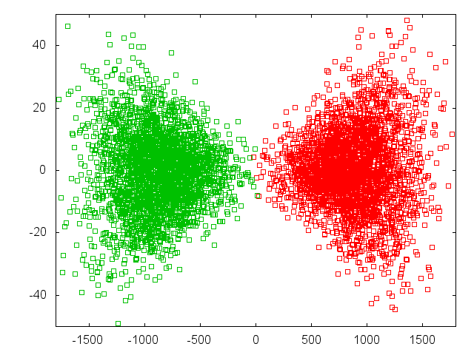
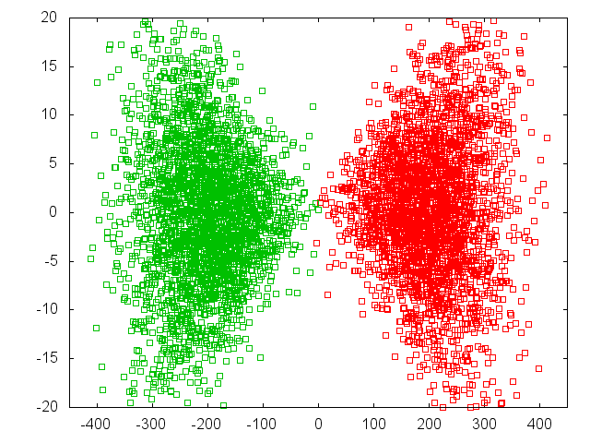
Luminosity and Offset
Luminosity loss for beam offsets depends strongly on disruption parameter
Δy = 0.4 σ_{y}
L = 0.71 L₀ D_{y}~24
L = 0.92 L₀ D_{y}~12
92%
71%
ILC
CLIC

Slide 19
Note: The Banana Effect
a) Wakefields+dispersion can create banana-shaped bunch in main linac
b) Do not model with projected emittance
c) The correct shape should be used
For large disruption (ILC) banana can reduce luminosity
Study done for TESLA
Similar disruption as ILC

Slide 20
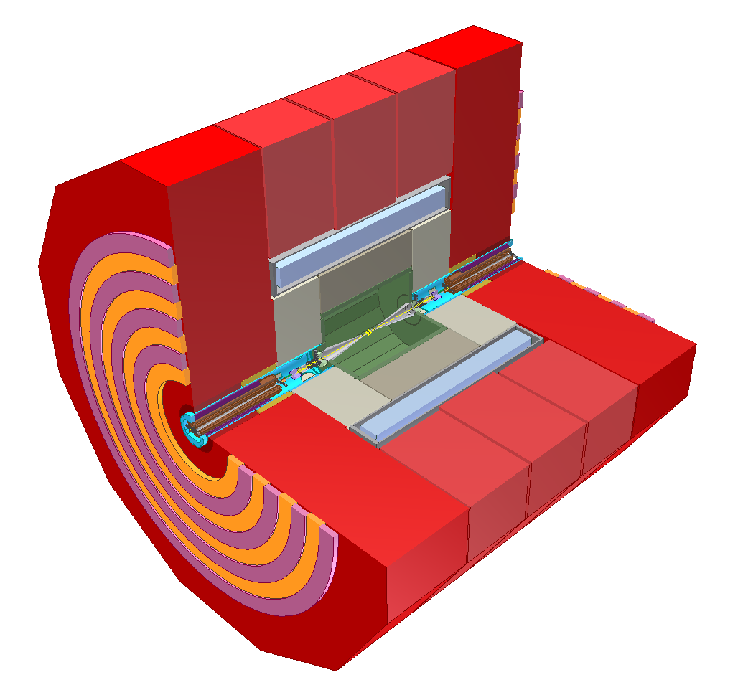
Linear Collider Experiment
10⁹ readout cells
Field return and muon particle identification
Final steering
of nm-size beams
B-field for momentum and charge measurement
Energy measurement of (charged and) neutral particles
6 m
Measure momentum
and charge of charged particles
Measure vertex and
Short-lived particles
L. Linssen

Slide 21
Lepton Pair Production
Colliding Photons can produce electron-positron pairs (incoherent pair production)
O(10⁵) per bunch crossing
Beamstrahlung photons can turn into pair in strong field
(coherent pair production)
O(1-10⁸) per bunch crossing
Trident cascade

Slide 22
Spent Beam Content
Spent beam particles
Beamstrahlung
Coherent pairs
Trident cascade pairs
Incoherent pairs
Hadrons
…
J. Esberg

Slide 23
Spent Beam Divergence
Beam particles are focused by oncoming beam
Photons are radiated into direction of beam particles
Coherent pair particles can be focused or defocused by the beams but deflection limited due to their high energy
-> Extraction hole angle should be significantly larger than 6mradian
We chose 10mradian for CLIC
-> 20mradian crossing angle
ILC requires 14mradian crossing angle
CLIC

Slide 24
Electron-Positron Pair Production
Colliding photons can produce electron-positron pairs (incoherent pair production)
O(10⁵) per bunch crossing
Virtual photon approximation used (beam size and external field effect can be included)
Benchmarked to Vermaseren Monte Carlo
Note: better than CAIN
ϑ₀
r B_{z}

Slide 25
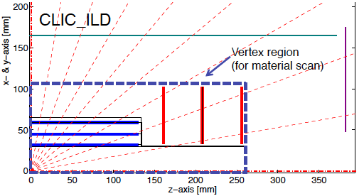
Vertex Detector Design
Background limits vertex detector
Defines forward detector design

Slide 26
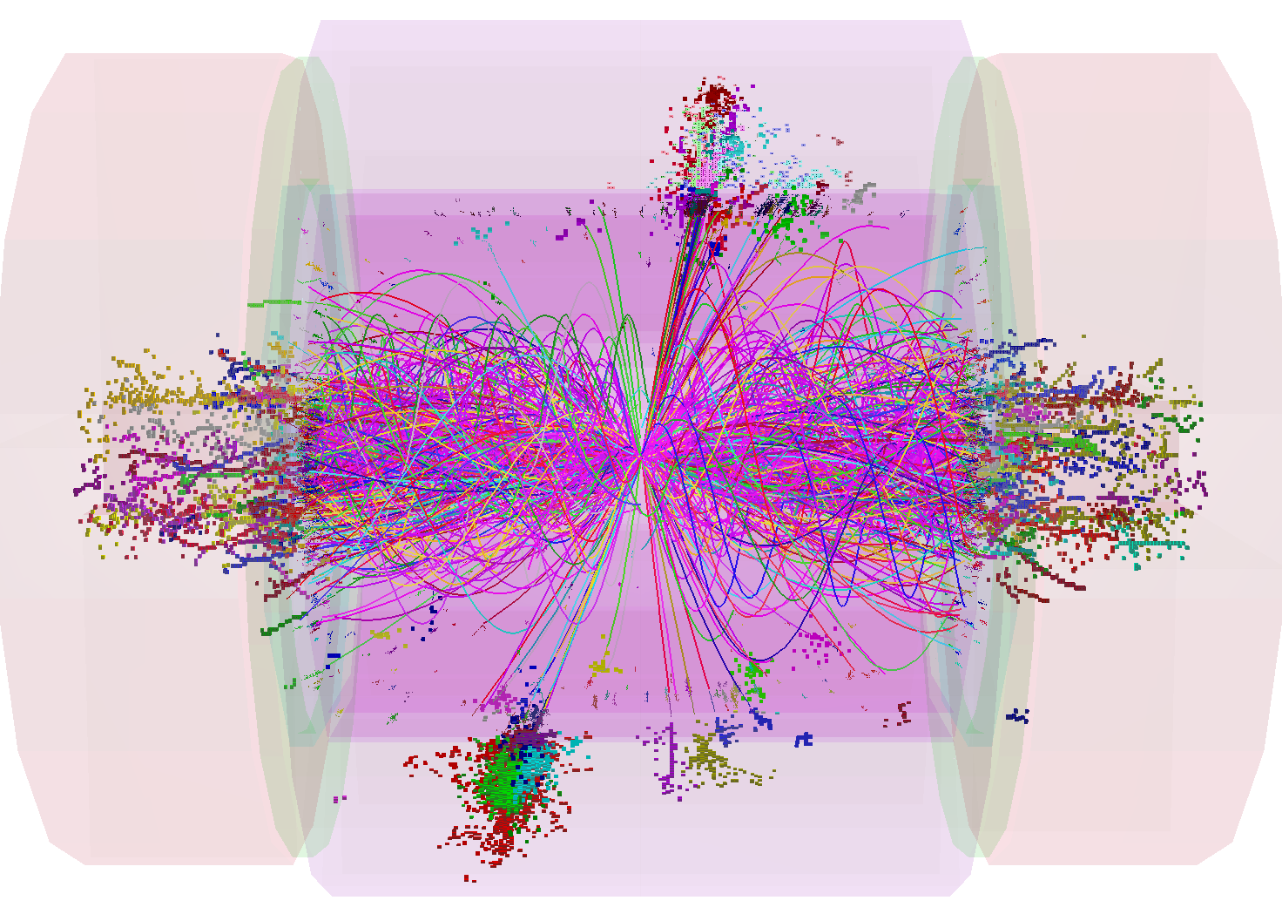
Hadronic Background
Two colliding photons can also produce hadrons
(photons look like part-time like a hadron)
CLCI at 3TeV has 3 events per crossing
Two implementations in GUINEA-PIG:
Parametrisations of the total cross section
In particular cross section in PYTHIA, stored initial states can be then be turned to events with PYTHIA
Direct calculation of parton-scattering
Based on parametrisations of Glück, Reya and Vogt or Drees and Grassie
Works only for hard scattering
Fragment with JETSET

Slide 27
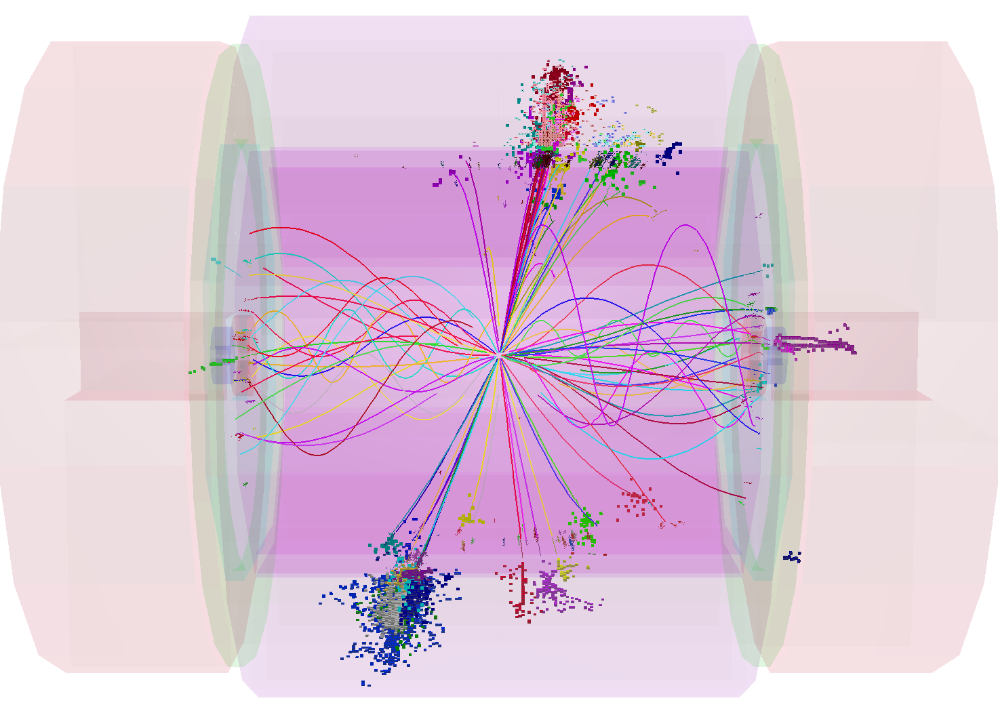
Hadronic Background
Two colliding photons can also produce hadrons
(photons look like part-time like a hadron)
CLCI at 3TeV has 3 events per crossing
Two implementations in GUINEA-PIG:
Parametrisations of the total cross section
In particular cross section in PYTHIA, stored initial states can be then be turned to events with PYTHIA
Direct calculation of parton-scattering
Based on parametrisations of Glück, Reya and Vogt or Drees and Grassie
Works only for hard scattering
Fragment with JETSET

Slide 28
GUINEA-PIG Impact on CERN Studies
GUINEA-PIG is central for linear collider machine, detector and physics studies
Used on TESLA, SLC, SBLC, JLC, VLEPP, CLIC, ILC, plasma-based collider, …
Luminosity estimates
  Including imperfections
Produces luminosity spectrum for physics analysis
  Actually used in optimisation of machine for physics
  Used for estimation of physics performance
Produces background data for detector design
  E.g. pair background defines vertex detector
  Used for estimation of physics performance
LHeC and FCC-he
Prediction of luminosity
Impact of electron beam on proton beam emittance
FCC-ee, LEP3
Some simulations of beam-beam and particle energy loss

Slide 29
Computational Model
The beam is represented by macro-particles (typically 10⁵)
Can be generated on the fly or loaded from
The beams are sliced, slices interact pairwise (typically 30)
Slice interactions are using grids (typically 64x64 cells)
Beam particles are distributed
Transverse fields use clouds-in-cell model and FFT for the convolution
Generation of
  Beamstrahlung photons
  Coherent pairs
  (Trident cascade)
Virtual photons are created at each step and also distributed on the grid
Particles in the same cell can collide and produce secondaries
  Hadrons are stored
  Pairs are tracked further
Stepping of particles
Note: Larger grids are used for low energy background

Slide 30
Code Implementation
GUINEA-PIG
Written in C
Mainly functional, some object oriented methods
Requires C compiler, GCC is a great choice
Advisable to use FFTW2 or FFTW3
Can use input from beam tracking (e.g. PLACET)
Some output can be used in physics tools (e.g. PYTHIA)
No parallelisation in public version
GUINEA-PIG++
Translation of GUINEA-PIG to C++

Slide 31
Performance
The performance is adequate for many applications
Has been the basis for a large set of linear collider studies for the machine and for the detector
For some applications a speed-up would be useful
Simulation of dynamic effects in linear colliders (many subsequent collisions)
Circular colliders (many turns)

Slide 32
Conclusion
GUINEA-PIG simulates beam-beam interaction in lepton colliders
Strong-strong beam dynamics
Production of secondaries
Core tool for linear colliders
Machine studies
Detector design
Physics performance prediction
Code(s) are publicly available
Limited maintenance
But at the same level as the past 20+ years

Slide 33
Reserve

Slide 34
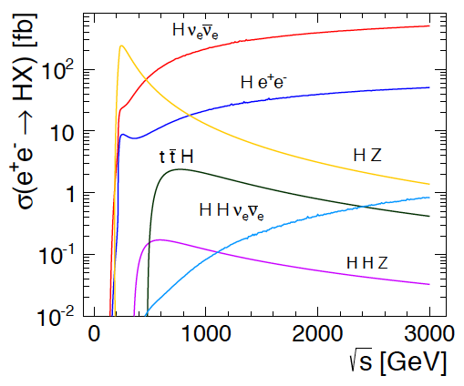
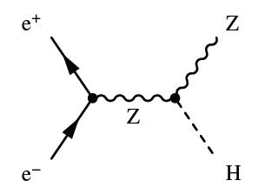
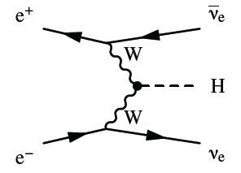
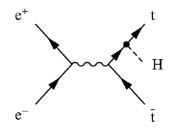
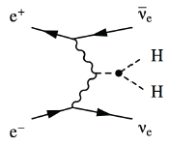

Higgs Physics in e+e- Collisions
Precision Higgs measurements
Model-independent
  Higgs couplings
  Higgs mass
Large energy span of linear colliders allows to collect a maximum of information:
  ILC: 500 GeV (1 TeV)
  CLIC: ~350 GeV – 3 TeV

Slide 35
Invisible Higgs Decays
Can we check that the Higgs does not decay into something invisible, e.g. neutrinos?
Yes, missing mass (or recoil mass) analysis:
1) Measure the Z, e.g. from produced jets
2) Subtract Z momentum from initial state
(E_{cm},0,0,0)-(E_{Z}, P_{Z,x}, P_{Z,y}, P_{Z,z})=(E_{H}, P_{H,x}, P_{H,y}, P_{H,z})
3) Result is mass and momentum of other particle
Even if we do not see it
So we know the missing particle

Slide 36
Automatic Parameter Determination
Structure design fixed by few parameters
a₁,a₂,d₁,d₂,N_{c},φ,G
Beam parameters derived automatically to reach specific energy and luminosity
Consistency of structure with RF constraints is checked
Repeat for 1.7 billion cases
Design choices and specific studies
Use 50Hz operation for beam stability
Scale horizontal emittance with charge to keep the same risk in damping ring
Scale for constant local stability in main linac, i.e. tolerances vary but stay above CDR values
BDS design similar to CDR, use improved β_{x}-reach as reserve
…

Slide 37
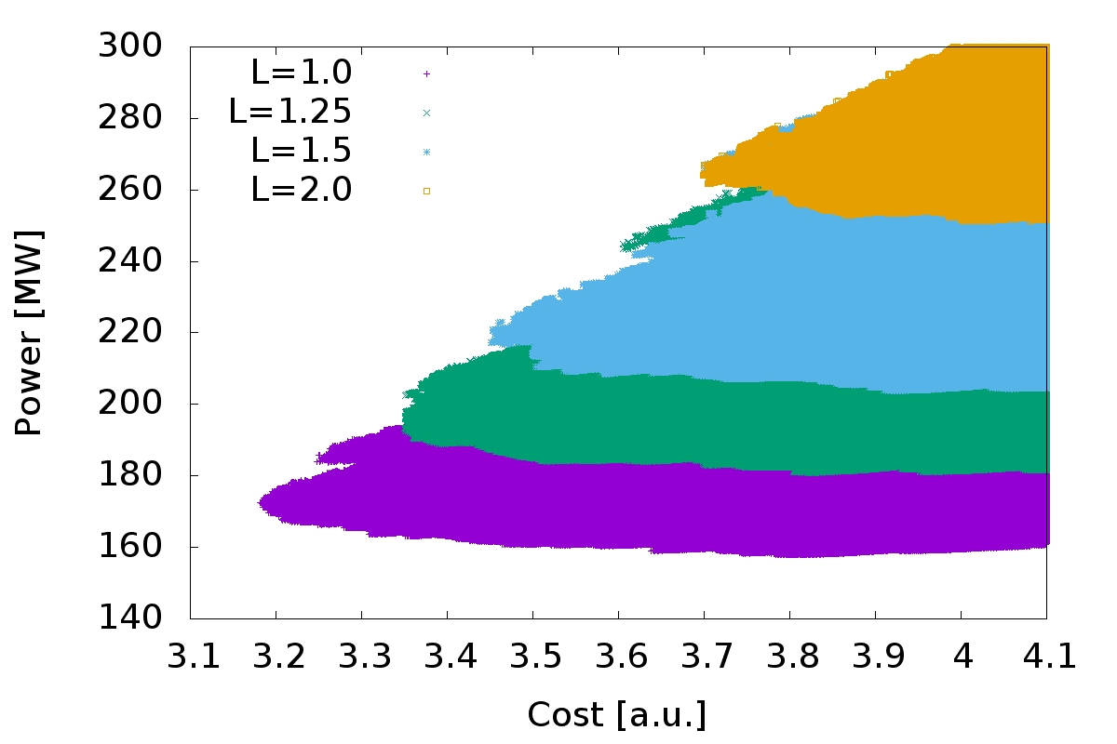
Optimisation at 380GeV
S=1.1
L=1.0x10³⁴cm⁻²s⁻¹
L=1.25x10³⁴cm⁻²s⁻¹
L=1.5x10³⁴cm⁻²s⁻¹
L=2.0x10³⁴cm⁻²s⁻¹
Many thanks to the rebaselining team that provided the models that are integrated in the code
Luminosity goal significantly impact minimum cost
For L=1x10³⁴cm⁻²s⁻¹ to L=2x10³⁴cm⁻²s⁻¹ :
Costs 0.5 a.u.
And O(100MW)
Cheapest machine is close to lowest power consumption => small potential for trade-off

Slide 38
Note: Luminosity Enhancement
Parameter | Symbol [unit] | ILC | CLIC | CLIC
Centre of mass energy | E_{cm} [GeV] | 500 | 380 | 3000
Total luminosity | L [10³⁴cm⁻²s⁻¹] | 1.8 | 1.5 | 6
Luminosity in peak | L_{0.01} [10³⁴cm⁻²s⁻¹] | 1 | 0.9 | 2
Particles per bunch | N [10⁹] | 20 | 5.2 | 3.72
Bunch length | σ_{z} [μm] | 300 | 70 | 44
Collision beam size | σ_{x,y} [nm/nm] | 474/5.9 | 149/2.9 | 40/1
Vertical emittance | ε_{x,y} [nm] | 35 | 40 | 20
Geometric luminosity | L_{geom} [10³⁴cm⁻²s⁻¹] | 0.75 | 0.8 | 4.3
Enhancement factor | H_{D} | 2.4 | 1.9 | 1.5

Slide 39
Note: Travelling Focus
Travelling focus (Balakin):
We focus each slice of the beam on one point of the oncoming beam, e.g. 2σ_{z} before the centre
The beam-beam forces keep the beam small
Additional gain of 10% in luminosity

Slide 40
Note: ILC with β_{y}=0.24mm
Even stronger offset dependence for smaller beta-function
So in practice less gain than expected

Slide 41
Generic Linear Collider
Single pass poses luminosity challenge
Low emittances are produced in the damping rings
They must be maintained with limited degradation
The beam delivery system (BDS) squeezes the beam as much as possible

Slide 42
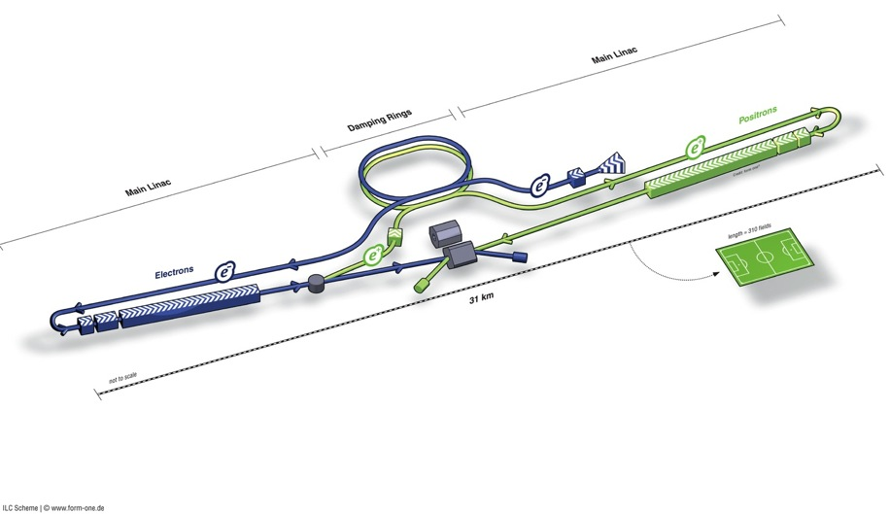
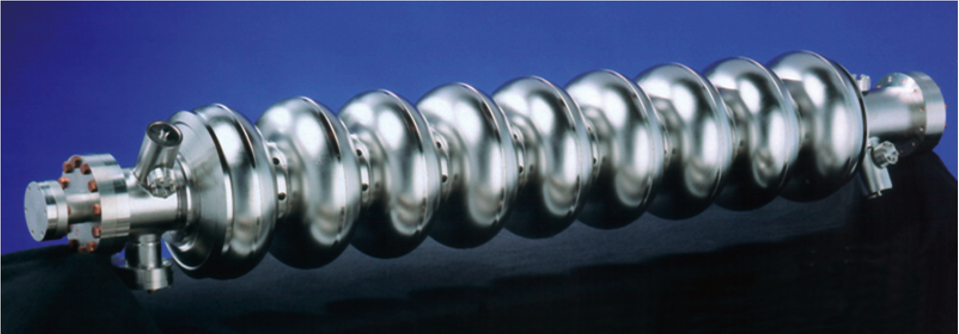
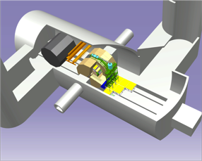
ILC
Damping Rings
BDS (beam delivery system)
Ring to Main Linac (RTML)
(w. bunch compressors)
e+ Main Linac
e- Main Linac
E+ source
Parameters | Value
C.M. Energy | 500 GeV
Peak luminosity | 1.8 x10³⁴ cm⁻²s⁻¹
Beam Rep. rate | 5 Hz
Pulse duration | 0.73 ms
Average current | 5.8 mA (in pulse)
E gradient in SCRF acc. cavity | 31.5 MV/m +/-20% Q₀ = 1E10

Slide 43
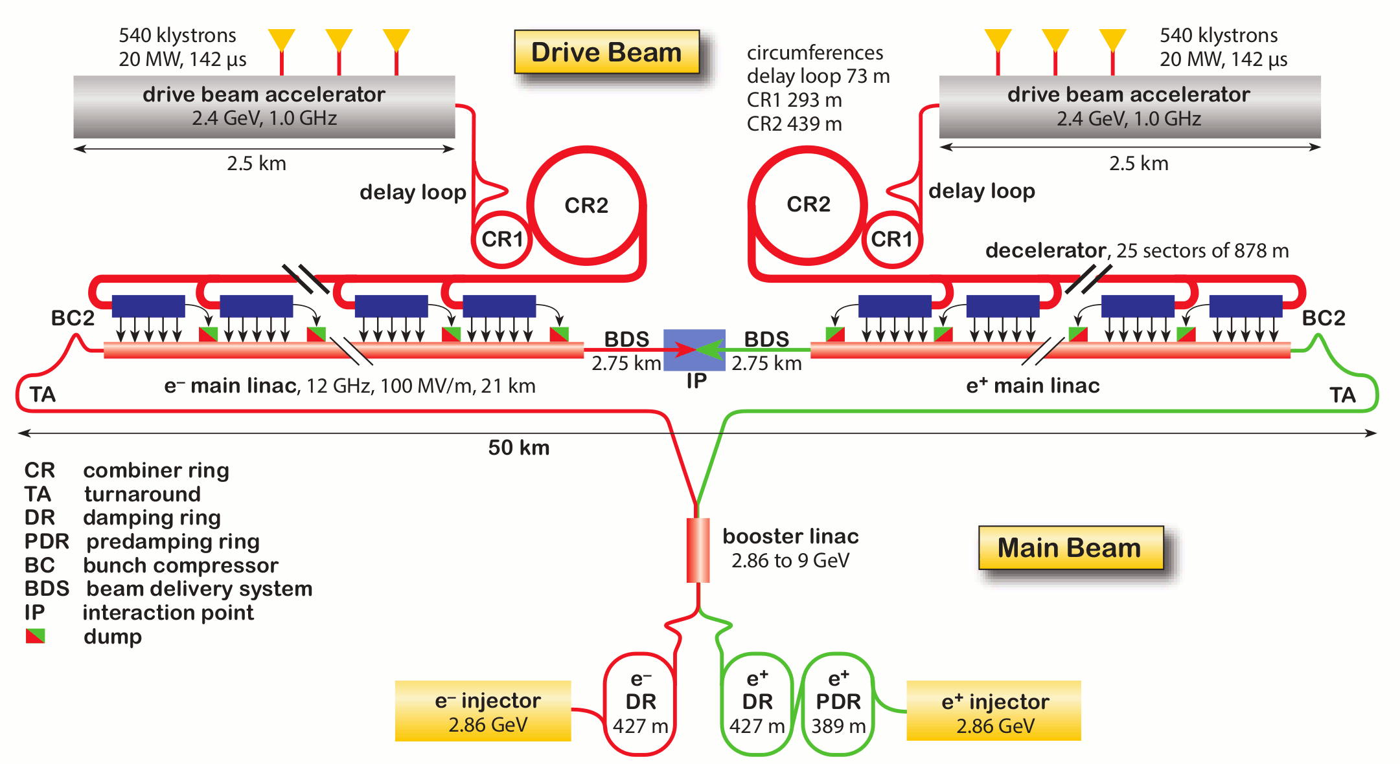
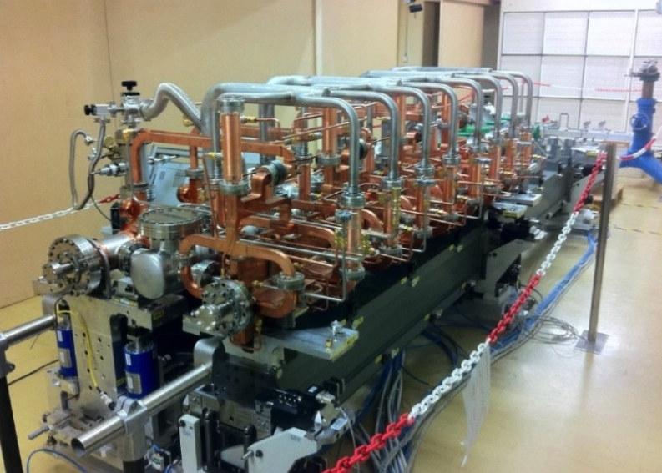
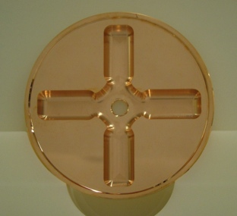
CLIC (at 3TeV)
Drive beam time structure - initial
Drive beam time structure - final
240 ns
240 ns
5.8 μs
140 μs train length - 24 × 24 sub-pulses
4.2 A - 2.4 GeV – 60 cm between bunches
24 pulses – 101 A – 2.5 cm between bunches

Slide 44
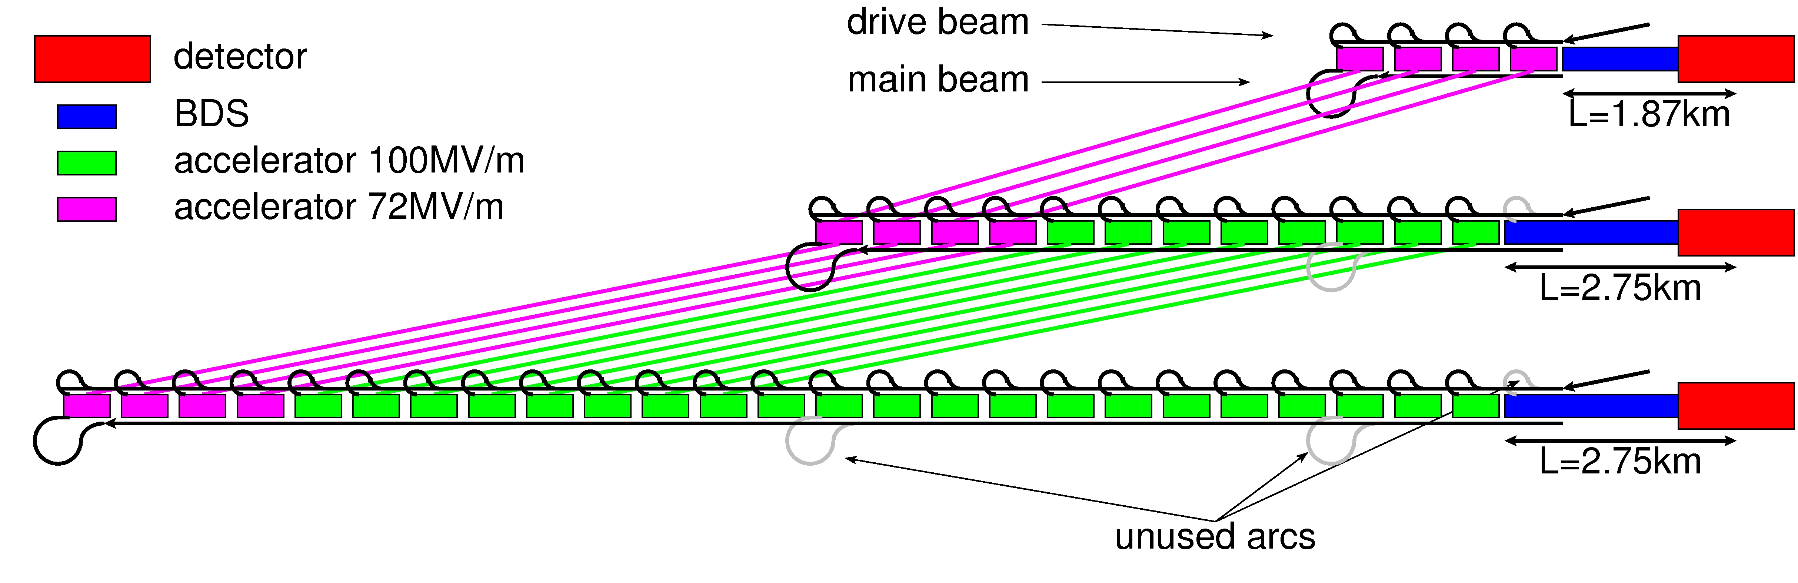
CLIC Staged Approach
  First stage: E_{cms}=380Gev, L=1.5x10³⁴cm⁻²s⁻¹, L_{0.01}/L>0.6
Second stage: E_{cms}=O(1.5TeV)
Final stage: E_{cms}=3TeV, L_{0.01}=2x10³⁴cm⁻²s⁻¹, L_{0.01}/L>0.3

Slide 45
Note: ILC TDR
http://www.linearcollider.org/ILC/Publications/Technical-Design-Report

Slide 46
Note: CLIC CDR
Vol 1: The CLIC accelerator and site facilities
- CLIC concept with exploration over multi-TeV energy range up to 3 TeV
- Feasibility study of CLIC parameters optimized at 3 TeV (most demanding)
- Consider also 500 GeV, and intermediate energy range
- https://edms.cern.ch/document/1234244/
Vol 2: Physics and detectors at CLIC
- Physics at a multi-TeV CLIC machine can be measured with high precision, despite challenging background conditions
- External review procedure in October 2011
- http://arxiv.org/pdf/1202.5940v1
Vol 3: “CLIC study summary”
- Summary and available for the European Strategy process, including possible implementation stages for a CLIC machine as well as costing and cost-drives
- Proposing objectives and work plan of post CDR phase (2012-16)
- http://arxiv.org/pdf/1209.2543v1
In addition a shorter overview document was submitted as input to the European Strategy update, available at:
http://arxiv.org/pdf/1208.1402v1
Input documents to Snowmass 2013 has also been submitted:
http://arxiv.org/abs/1305.5766 and
http://arxiv.org/abs/1307.5288
ILC costing 500 GeV
CLIC costing 500 GeV
46

Slide 47
Luminosity and Parameter Drivers
Can re-write normal luminosity formula
(note: no crossing angle assumed)
Beam power
Luminosity
spectrum
Beam Quality
(+bunch length)
Somewhat simplified view

Slide 48
Note: Crossing Angle
Have crossing angles
ILC: 14mradian
CLIC: 20mradian
to reduce effects of parasitic crossings
to extract the spent beam cleanly
Luminosity with crossing angle
0.1-0.2
Use crab cavities:
Can ignore crossing angle for beam-beam calculation
But not in detector design

Slide 49
Vertical Beamsize
Using the naïve luminosity calculation with beta-function at the IP we find that the luminosity can be increased by reducing β_{y}
There are two limits:
The lattice design tends to find a practical lower limit a bit below β_{y}=100 μm
CLIC at 3TeV has β_{y}=70 μm but strong geometric aberrations
Not excluded that this can be improved but people worked on it for years
Luminosity actually increases not as predicted

Slide 50
Hourglass Effect
Taking into account hourglass effect
Luminosity does not improve much below β_{y} < σ_{z}
For flat beams, the optimum is around β_{y} = 0.25 x σ_{z}
Note: This is different for round beams

Slide 51
Luminosity and Offset
Luminosity loss for rigid bunches with offset
Actual loss depends strongly on disruption
Note: the simulations suffer from noise (use of macroparticles)
Need to enforce symmetric charge distribution to simulate high disruption
Can you trust the results in real life?

Slide 52
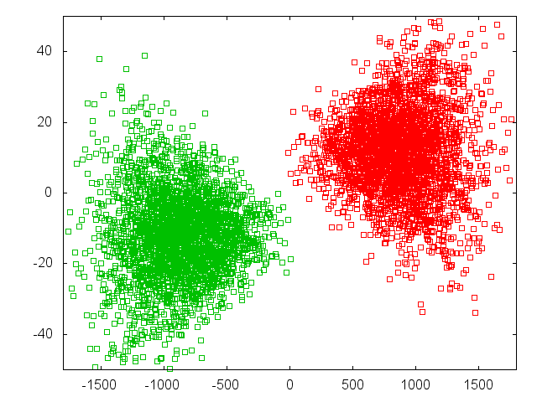
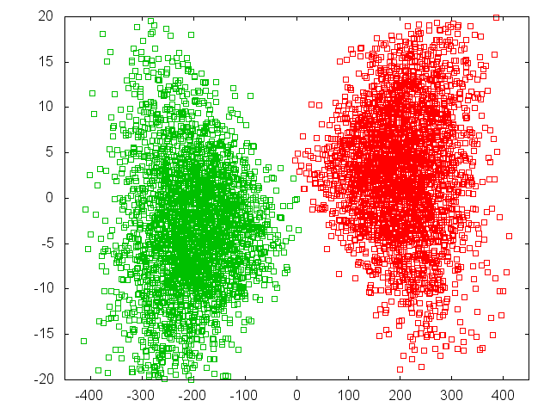
Luminosity and Offset
Luminosity loss for beam offsets depends strongly on disruption parameter
Δy = 2 σ_{y}
L = 0.38 L₀
L = 0.59 L₀
59%
38%
ILC
CLIC at 380GeV

Slide 53
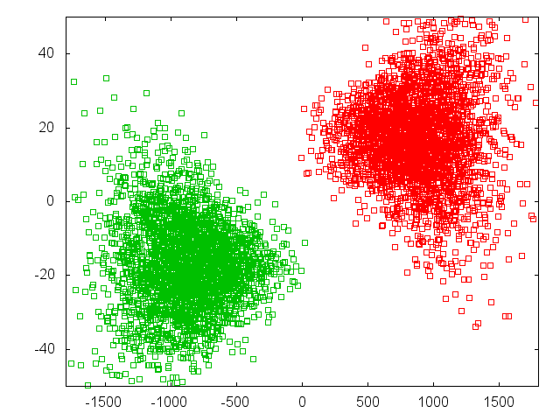
Luminosity and Offset
Luminosity loss for beam offsets depends strongly on disruption parameter
Δy = 4 σ_{y}
L = 0.26 L₀
26%
ILC

Slide 54
Note: ILC Full Optimisation
For ILC could consider smaller vertical beta-functions
Smaller beta-functions profit more from waist shift
0.24mm seems best
Would gain 15% luminosity
But still more difficult to produce (larger divergence)
And tolerances become tighter

Slide 55
Beam-beam Deflection
Strong deflection allows to easily measure and correct offset
In CLIC an offset Δ_{y} = 0.1σ_{y} = 0.1nm
3m downstream of IP 40μm beam offset
Get great signals for the BPMs

Slide 56
Impact on Vertex Detector
To vertex detector can identify particles originating from decays of other particles
Secondary particles
B-meson
Need a certain angular coverage
Hit density from pairs depends on radius and field
Edge is due to beam-beam deflection
Limit O(1mm⁻²)
e⁺
e⁻

Slide 57
CLIC Inner Detector Layout
The last focusing magnet of the machine is inside of the detector
A. Seiler

Slide 58
CLIC Inner Detector Layout
Increased ratio x/s
10mradian
For the beam
10mradian
To fit the quadrupole

Slide 59
ILC and CLIC Main Parameters
Parameter | Symbol [unit] | ILC | CLIC | CLIC
Centre of mass energy | E_{cm} [GeV] | 500 | 380 | 3000
Total luminosity | L [10³⁴cm⁻²s⁻¹] | 1.8 | 1.5 | 6
Luminosity in peak | L_{0.01} [10³⁴cm⁻²s⁻¹] | 1 | 0.9 | 2
Particles per bunch | N [10⁹] | 20 | 5.2 | 3.72
Bunch length | σ_{z} [μm] | 300 | 70 | 44
Collision beam size | σ_{x,y} [nm/nm] | 474/5.9 | 149/2.9 | 40/1
Vertical emittance | ε_{x,y} [nm] | 35 | 40 | 20
Photons per beam particle | n_{γ} | 1.9 | 1.5 | 2.1
Average photon energy | <E_{γ}/E₀> [%] | 2.4 | 4.5 | 13
Coherent pairs | N_{coh} | - | - | 6.8x10⁸
Their energy | E_{coh} [TeV] | - | - | 2.1x10⁸
Incoherent pairs | N_{incoh} | 196x10³ | 58x10³ | 300x10³
Their energy | E_{incoh} [TeV] | 484 | 187 | 2.3x10⁴

Slide 60
The Spent Beam
Particles move little in the horizontal plane
Can see the field profile
They start to oscillate in the vertical plane
=> Final angle depends also on the phase that they happen to have at the end of the collision

Slide 61
Coherent Pair Creation
Beam fields in the rest system of a photon can reach the Schwinger Critical Field
The quantum electrodynamics becomes non-linear
A photon in a very strong field can form an electron-positron pair
Coherent pair creation
Produce 6.8x10⁸ pairs
Average particle energy 0.3TeV

Slide 62
Note: Initial State Radiation
Electrons often emit a photon before the collision
Initial State Radiation
The electron can be replaced by a spectrum of electrons
This yields a luminosity spectrum
About 65% probability of collision with more than 99% of nominal energy

Slide 63
CLIC 3TeV Beamstrahlung
Goal is to maximise L_{0.01}
And L_{0.01}/L > 0.3
CLIC parameter choice

Slide 64
Waist Shift
Focusing before IP leads to more luminosity (D.S.)
For CLIC and ILC ~10% luminosity gain

