Slide 1
IOP Seminar Notes

Slide 2
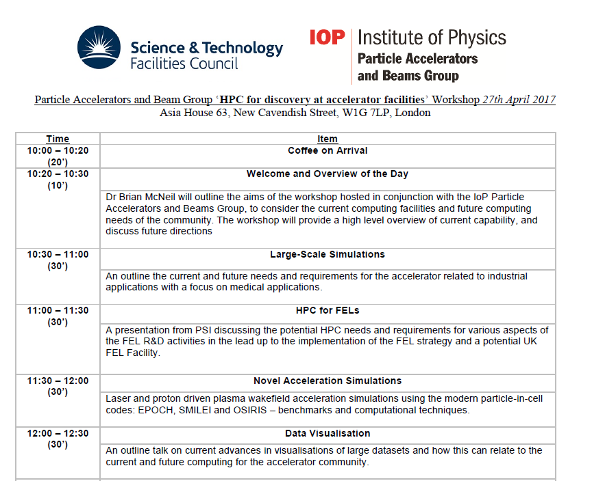
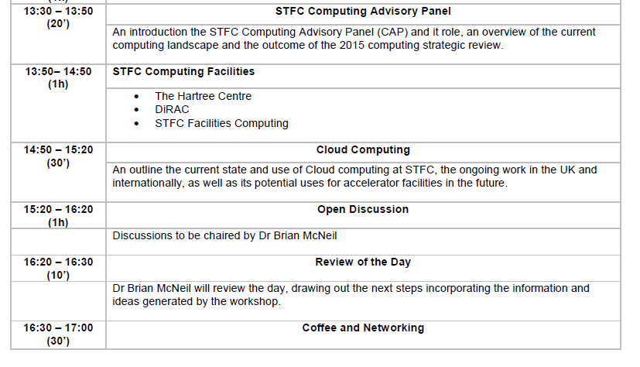
Program

Slide 3
Notes
Medical application uses HPC, google service (e.g. 10$ core-month, paid by the minute, very short queue regardless of number of cores) , turn-around-time, verification.
FEL: framework for particle exchange (Desy, swissFell) and lattice description, 1-1 simulation (1e9 particles) to get micro-bunch shot noise right. Automatic optimization works better than human, but computational expensive. Cluster needs are very discontinuous in time.

Slide 4
Notes
EPOCH, OSIRIS, SMILEI open sources code for plasma. ARC: 0.01$ core-hour
Visualization: use topological analysis on isosurface, continuous scatter plot, fiber surfaces, topological analyses (<10GB data)
Software engineer, data science: formation and career.
DIRAC 2.5: 76k cores 1PFlops, 149k cores, 17k cores, 75 Tflops KNL, 150TFlops GPU, 7000 cores. Classification: Loosely (no inter-core communication), Weakly (sporadic communication), Strongly (constant communication) Parallel, Data Intensive

