Slide 1
GPU Benchmarks

Slide 2
Benchmark
LHC: 8k drifts, 4.6k >11th multipoles, 20000 particles, 10 turns
 | Cores | Clock [MHz] | Cost [$] | GFlops FP64 | Year | Bench [us/part/turn]
i7 920 | 1 | 2670 | 260/4 | 5.2 | 2009 | 545
Xeon E5-2630 | 1 | 2200 | 660/10 | 17 | 2016 | 364
2x Xeon E5-2630 | 2x10 | 2200 | 2x660 | 2x340 | 2016 | 16
GTX 1080 | 2560 | 1700 | 600 | 288 | 2016 | 12.8
K20x | 2688 | 732 | 3000 | 1312 | 2015 | 10.8
R9 280x | 2048 | 1000 | 300(150) | 1.024 | 2013 | 4.3
W8100 | 2560 | 824 | 1000 | 2110 | 2014 | 4.0
P100-12 | 3584 | 1330 | 4600 | 4670 | 2016 | (~2)
P100-nv | 3584 | 1480 | 7000 | 5300 | 2016 | 1.8
GPU Bottleneck seems to be the number of registers that brings occupancy to 20%

Slide 3
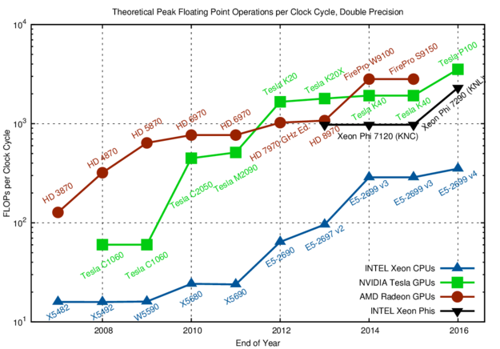
CPU vs GPU double precision
August 19, 2016 by Karl Rupp.
Processor | Clock GHz | Cost $
E5 2699 v4 | 2.2 | 1700
Phi 7290 | 1.5 | 6294
Phi 7120 | 1.2 | 1500
P100 | 1.3-1.5 | 4600-7000
W9100 | 0.9 | 3200
S9150 | 0.9 | 3300
https://www.karlrupp.net/2016/08/flops-per-cycle-for-cpus-gpus-and-xeon-phis/

