Slide 1

Results and operational aspects of AD's CCC
Mini workshop on CCC with GSI, Jena and TU Darmstadt @ CERN
Main CERN contributors:
BE-BI: M. Fernandes, J. Tan, D. Louro, E. Oponowicz, M. Ludwig
TE-CRG: T. Koettig, A. Lees, A. Vacca, F. Carrasco
EN-MME: J.P. Brachet, D. Lombard, G. Foffano
BE-ICS: R. Speroni
My University PhD supervisor:
Carsten P. Welsch
miguel.fernandes@cern.ch
CERN / Geneva
26/04/2017

Slide 2
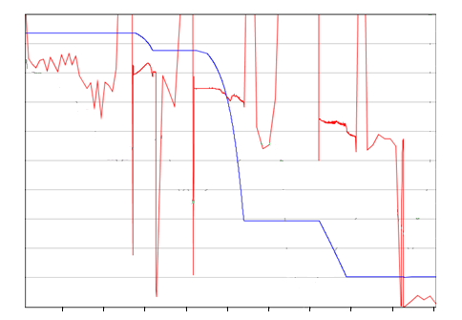
AD cycle and beam parameters
AD beam parameters
Beta | 0.97 … 0.11
Frev [MHz] | 1.59 … 0.17
Cycle | ~114 s
N particles | (5 … 1) x 10⁷
Current | (12 … 0.1) μA
Coasting beam
Schottky Intensity Measurement
Bunched beam
1.0
4
0.8
3
0.6
N [x 10⁷ pbar]
β [c]
2
0.4
Requirements for new monitor:
Current resolution: <10 nA
Intensity resolution: 5 x 10⁵ charges
Bandwidth: DC - 1 kHz
1
0.2
0
10
20
30
40
50
60
70
80
90
0.0
time [s]

Slide 3
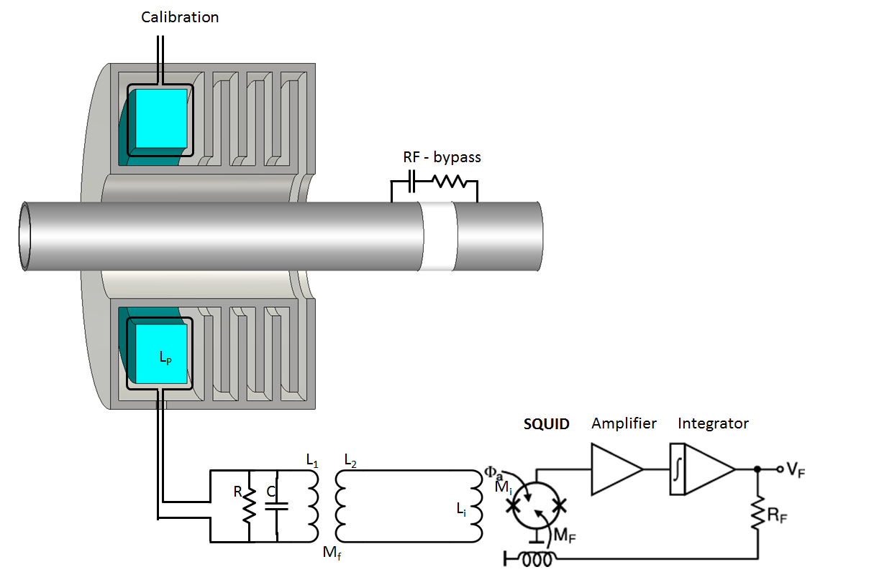
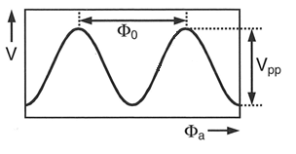
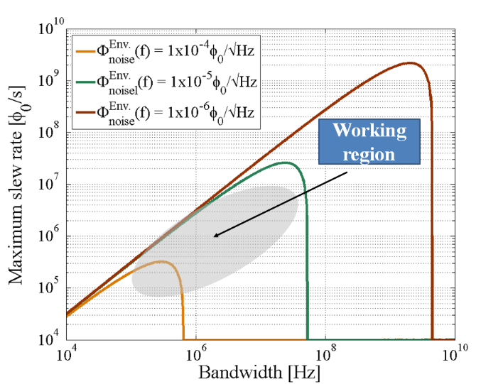

CCC in a nutshell
SQUID transfer function
$$φ_{0}=2.07×{10}^{−15} \text{Wb}$$
w
150 uF
1 Ohm
SQUID slew-rate limit
Dynamics performance
Slew-rate of signal flux: < 5 𝝋₀/𝜇𝑠
Bandwidth of FLL system: 20 𝑀𝐻𝑧
SC
SC
f_{c} = 1 kHz

Slide 4
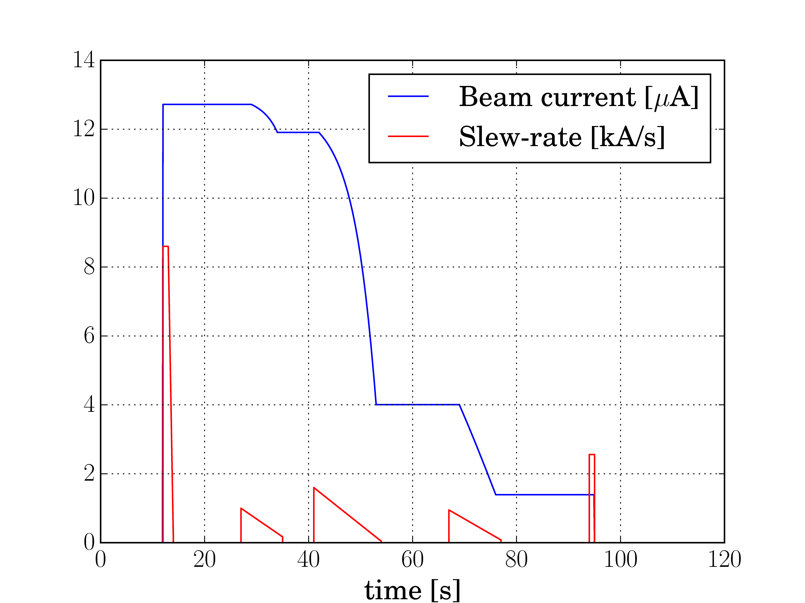
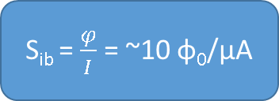
AD slew-rate requirement
AD beam current slew-rate
S_{ib} = $\frac{φ}{I}$ = ~10 φ₀/μA
Filtering | Slew-rate
None | 86 Gφ₀/s
Lp permeability | 1.2 Gφ₀/s
Lp + RC filter | 0.97 Mφ₀/s

Slide 5
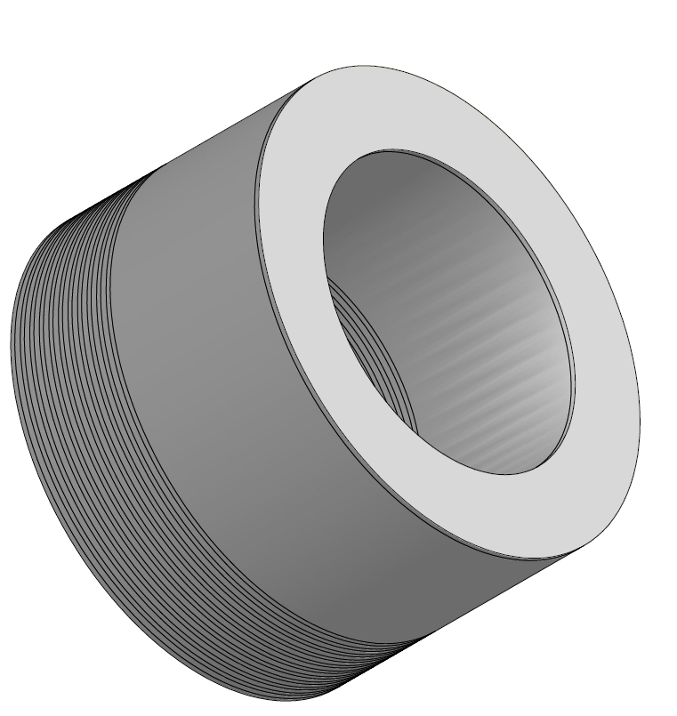
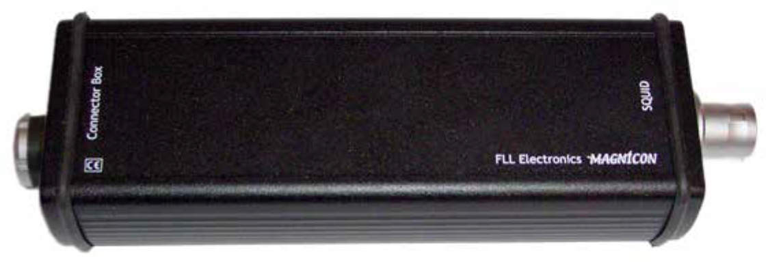
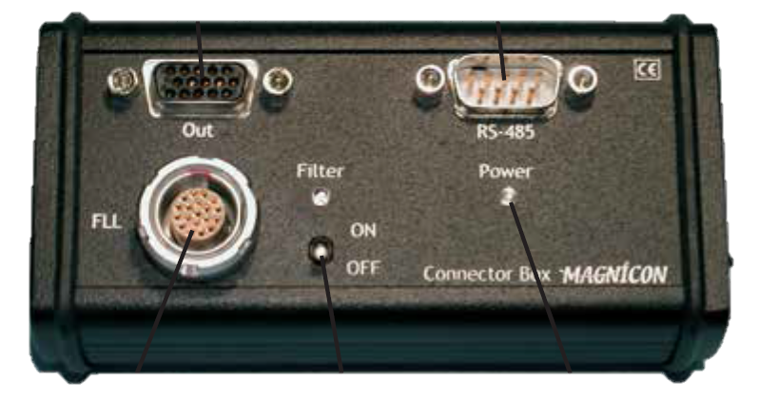
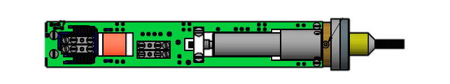
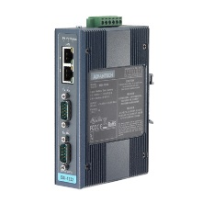
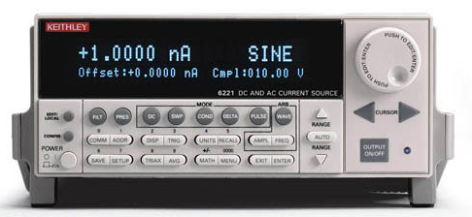
CCC monitor acquisition
Cartridge
Magnicon SQUID
L_{i} = 400 nH
RC filter: f_{LP} = 1 kHz
S_{ib} = 10.4 φ₀/μA
FLL Electronics
Magnicon (20MHz)
Settings:
  R_{FLL} = 1 kOhm
  GBW = 1.04 GHz
  BW_{FLL} = 1.04 GHz
Acquisition / Controls
VME architecture
FESA SW
Acquisition of signals at end of cycle (1kHz)
Control of multiple parameters possible
FAIR Nb shield
D_{i} = 185 mm
D_{o} = 280 mm
N_{meander} = 20
Gap_{l} = 0,5 mm
Gap_{t} = 1 mm
VME Crate
CPU L866
CTRV timing
VD80 ADC
  16 channels
  16 bit
  +/- 10V
  800kOhm
  Isolated diff. inputs
Ethernet
Triax
RS-232
Calibration loop
HF filtre
Advantech
Serial Server
NIM Crate
AD B-field cycle
Current/Nparticlenormalization
Calibration Source

Slide 6
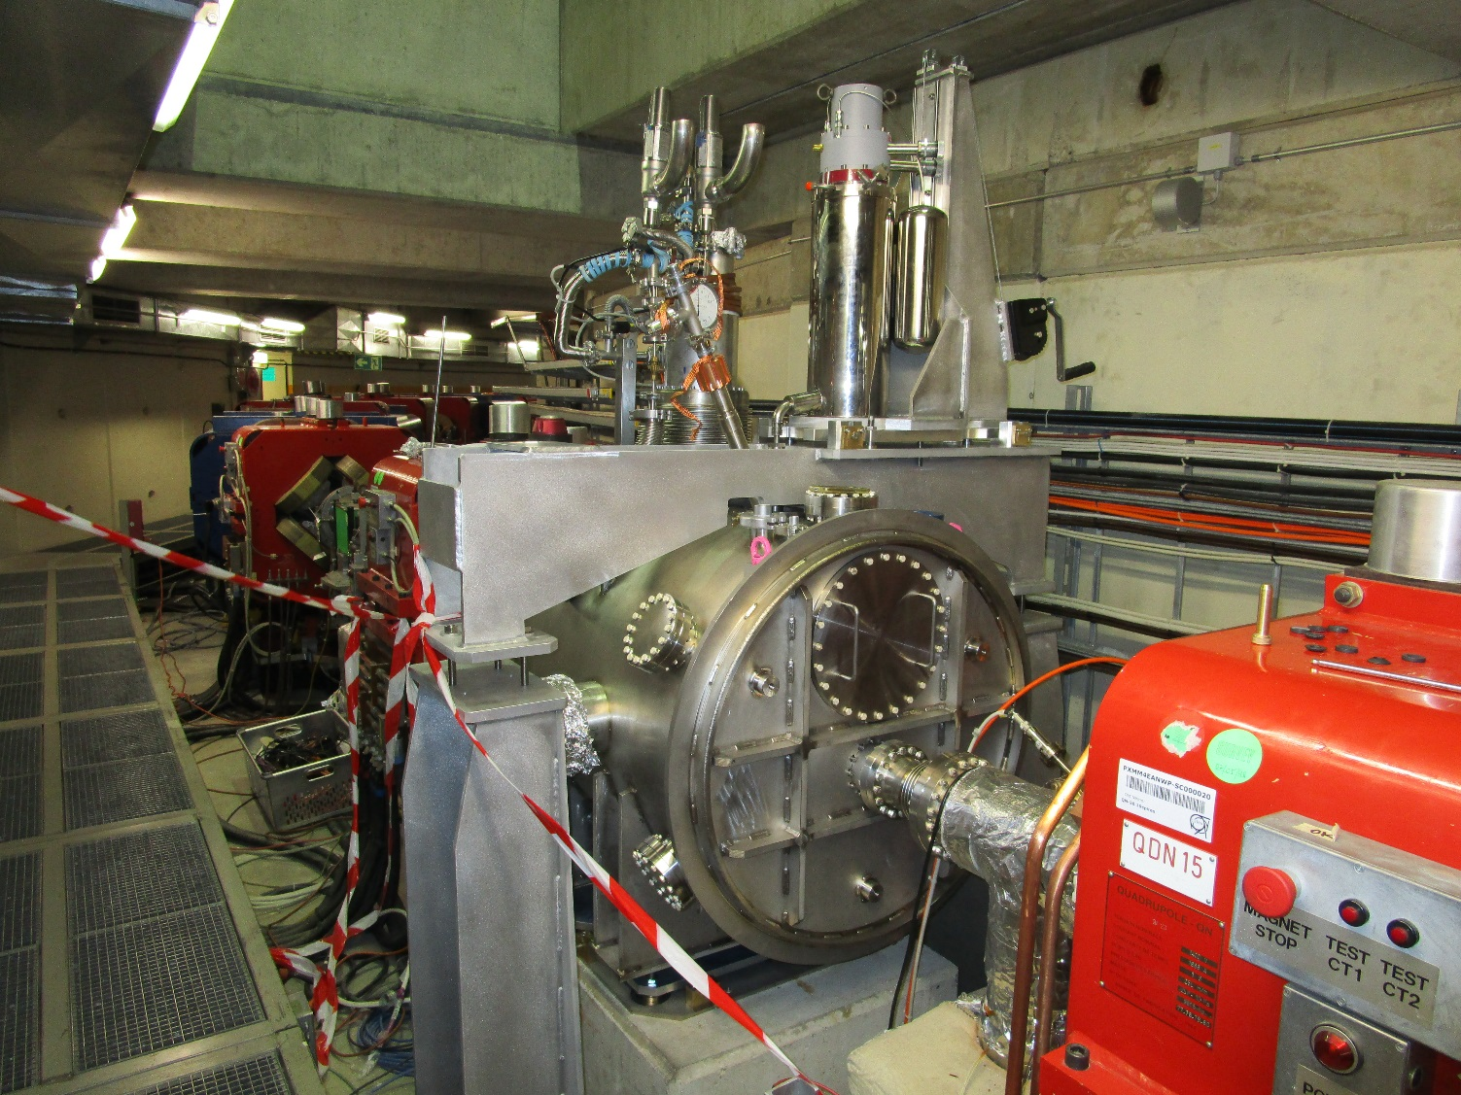
Installation in AD tunnel

Slide 7
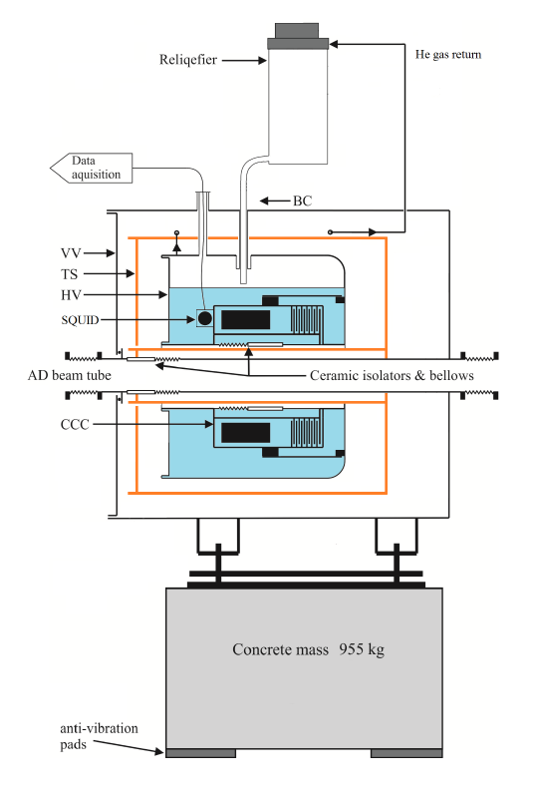
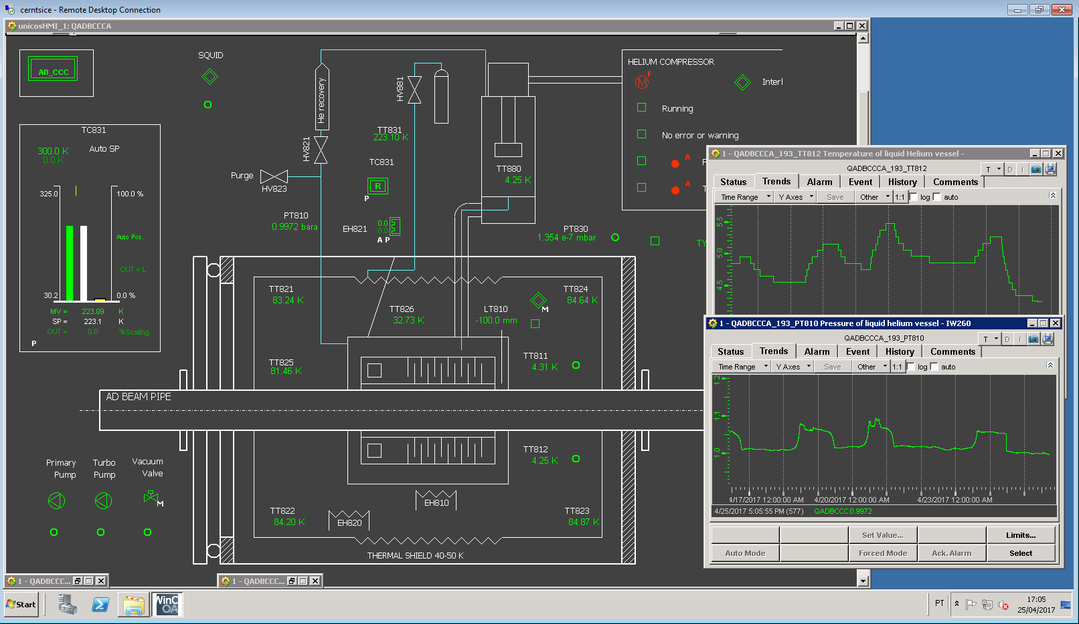
Cryostat Acquisition & Control

Slide 8
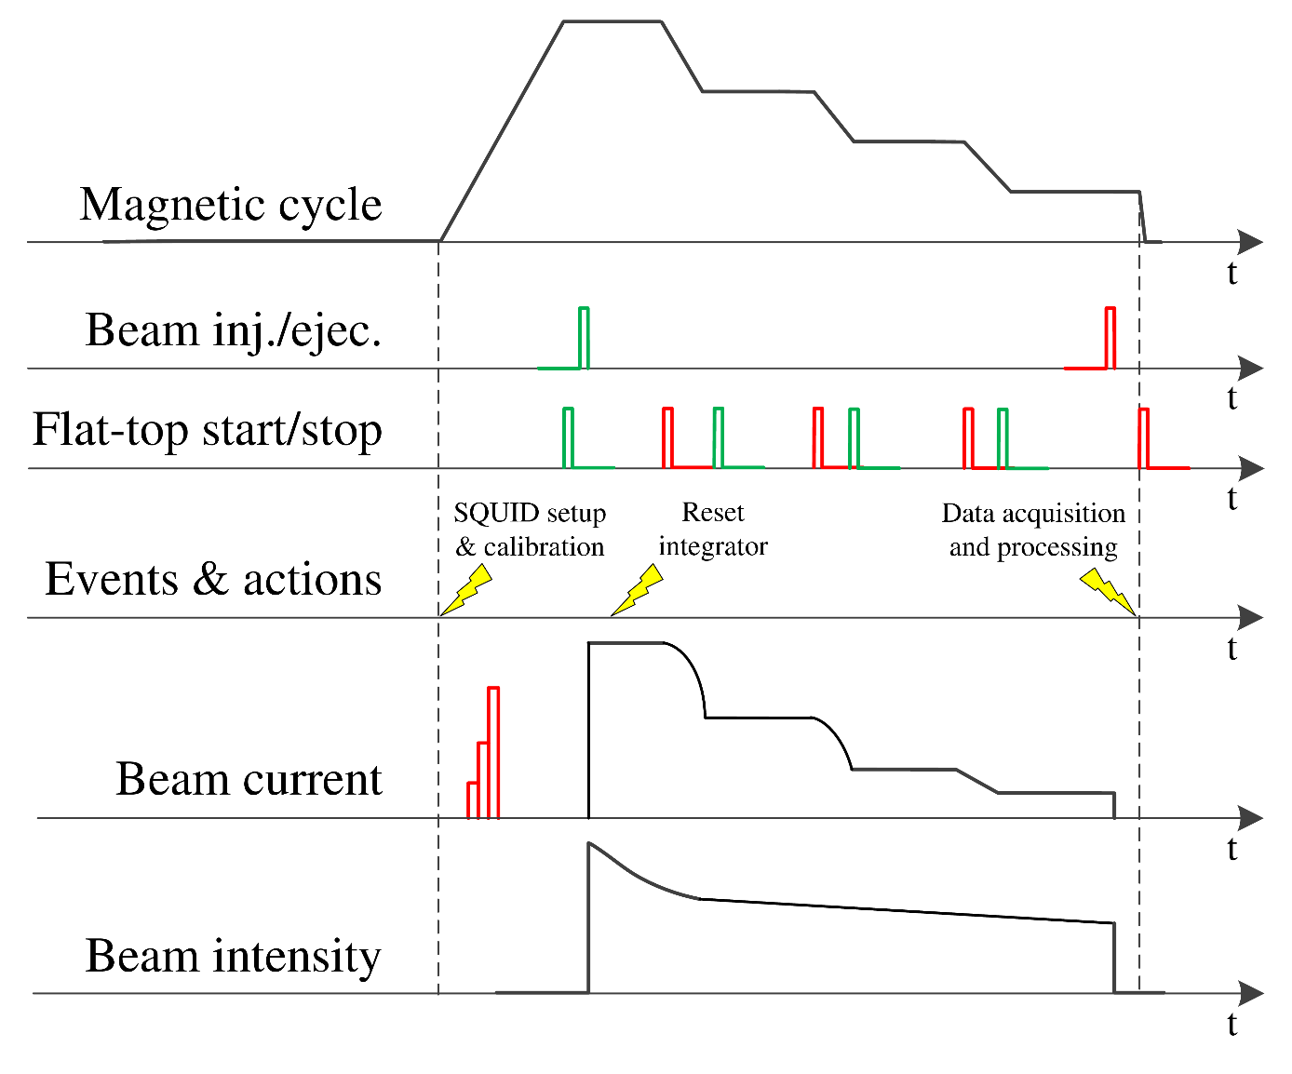
CCC Acquisition and Control

Slide 9
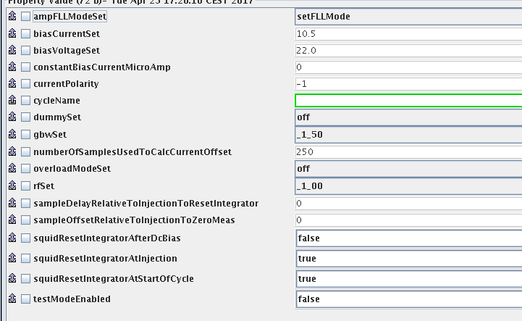
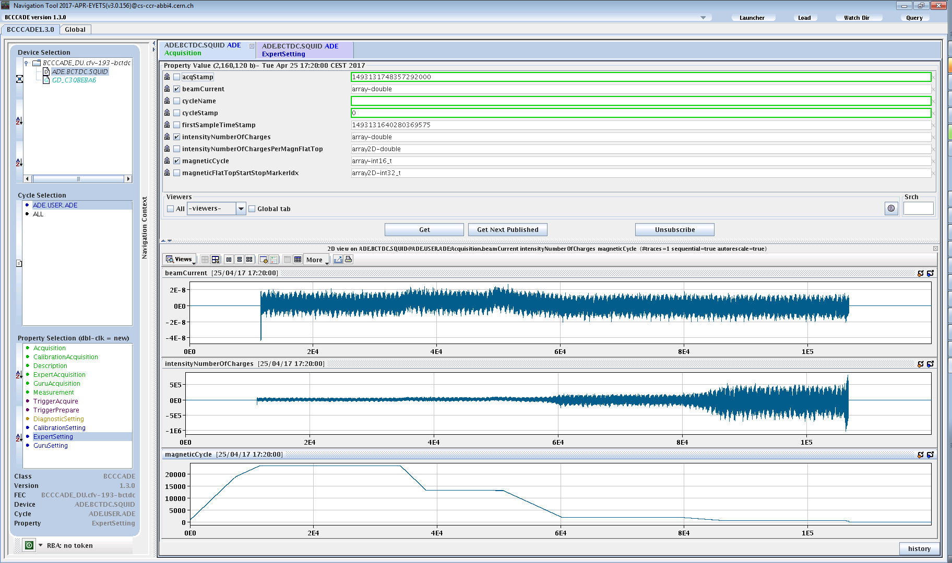
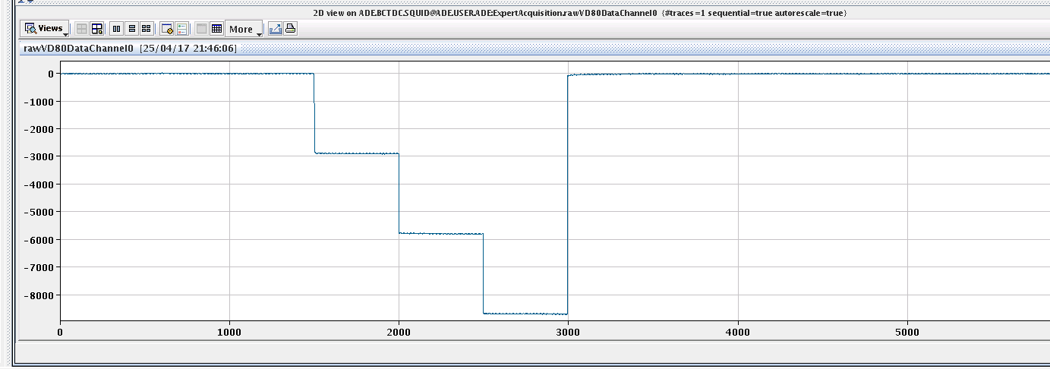
Software - FESA class
BEAM CURRENT [uA]
m_{i} = 1.2 nA
σ_{total} = 5.8 nA
m_{f} = -0.3 nA
NUMBER OF PARTICLES

Slide 10
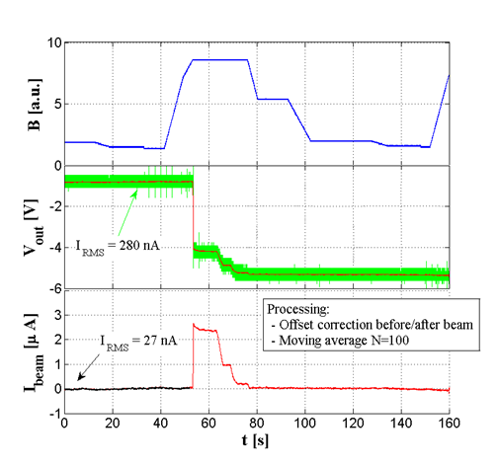
Performance in 2015
Monitor
Current resolution: 280 nA (BW=1kHz)
After filtering: 30 nA (BW=11Hz)
Offset jump at injection
RF-bypass in ceramic pipe responsible for excess noise (mostly at 50Hz)
Cryogenic
Cryostat & cryocooler clearly not performing as expected
Cryostat empty 3 days after a full refill
Heat in-leak reduced by:
  Better MLI shielding
  Thinner support rods
  Improved insulation vacum pumping
Raw signal (T_{s} = 0.4ms)
Filtered signal (N_{avg} = 100)
σ(I_{beam}) = 280 nA
σ(I_{beam}) = 27 nA

Slide 11
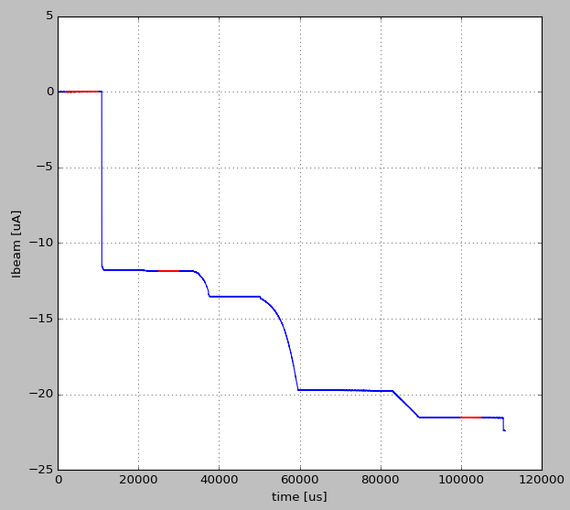
2016: Performance first beams
AD beam current
Noise and perturbations are much more reduced after removal of RF-bypass
Noise figure depends on cryostat conditions:
  Pressure/temperature variations
  Reliquifier vibrations (when LHe level covers tip of transfer line)
  Worst case σ = 20 nA.
Jump at injection is still present
Raw signal f_{s}=1kHz
No filtering
σ = 3.6 nA
Jump at injection
σ = 4.2 nA
σ = 4.3 nA
Beam ejection

Slide 12
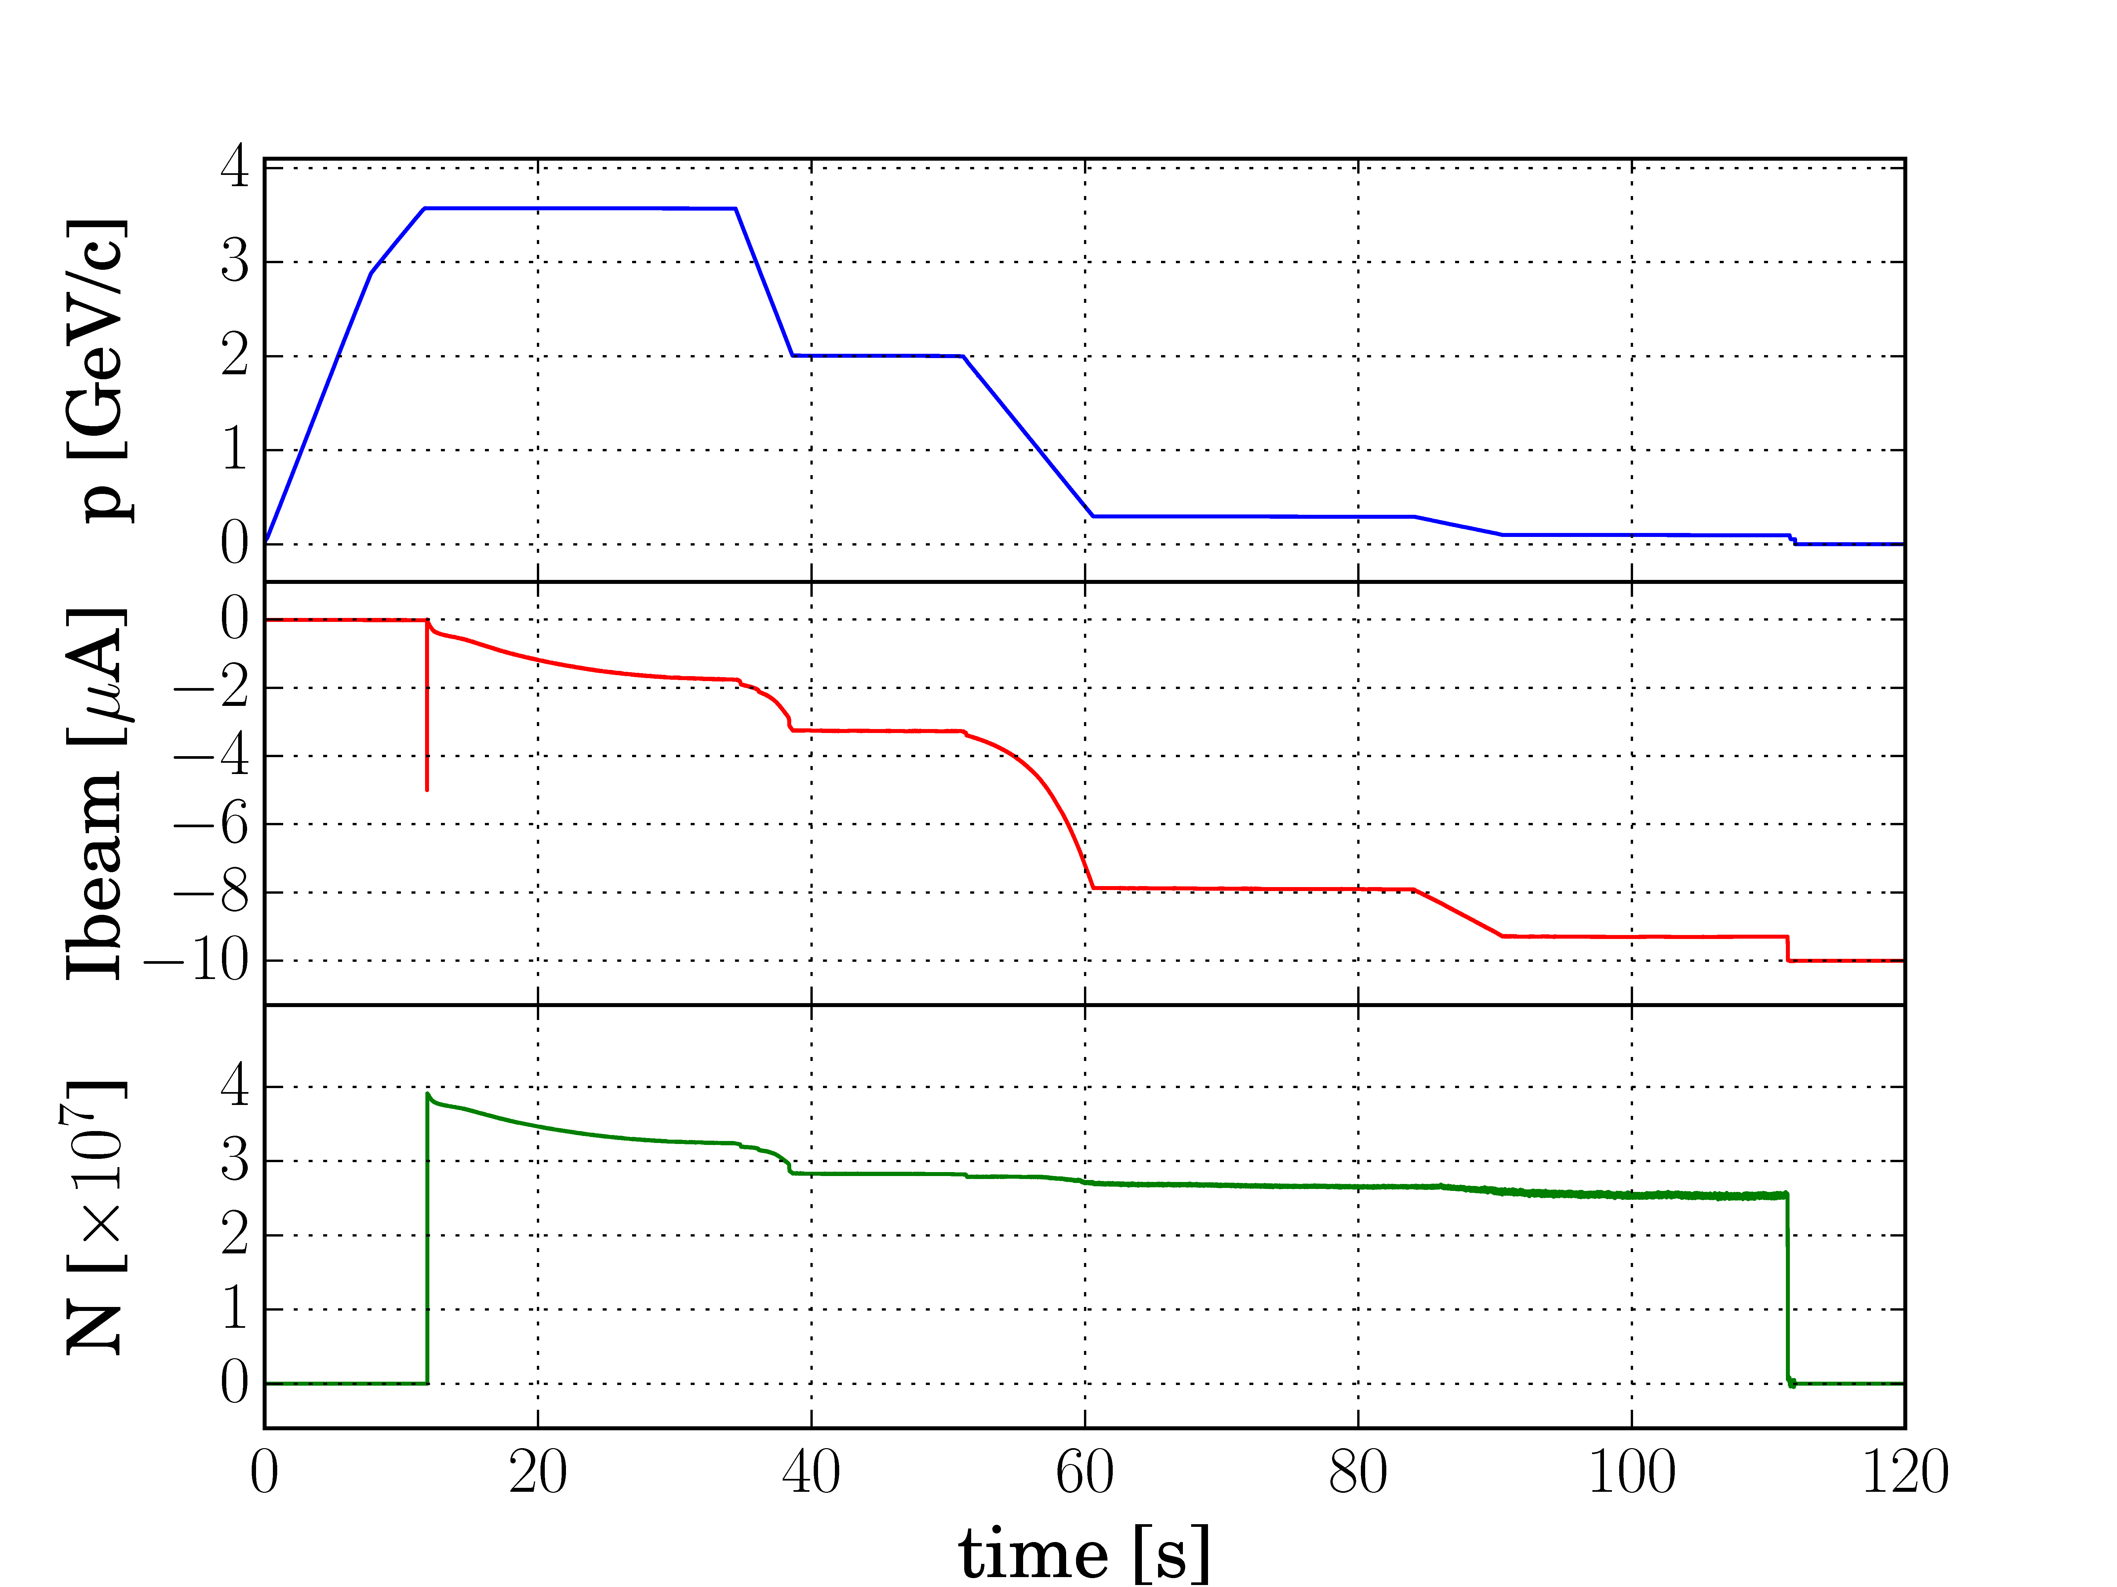
2016: AD measurement
Measurement of number of particles
σ = 0.018x10⁷
σ = 0.001x10⁷

Slide 13
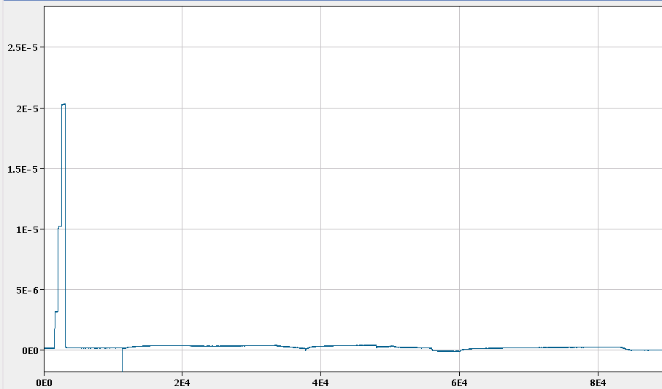
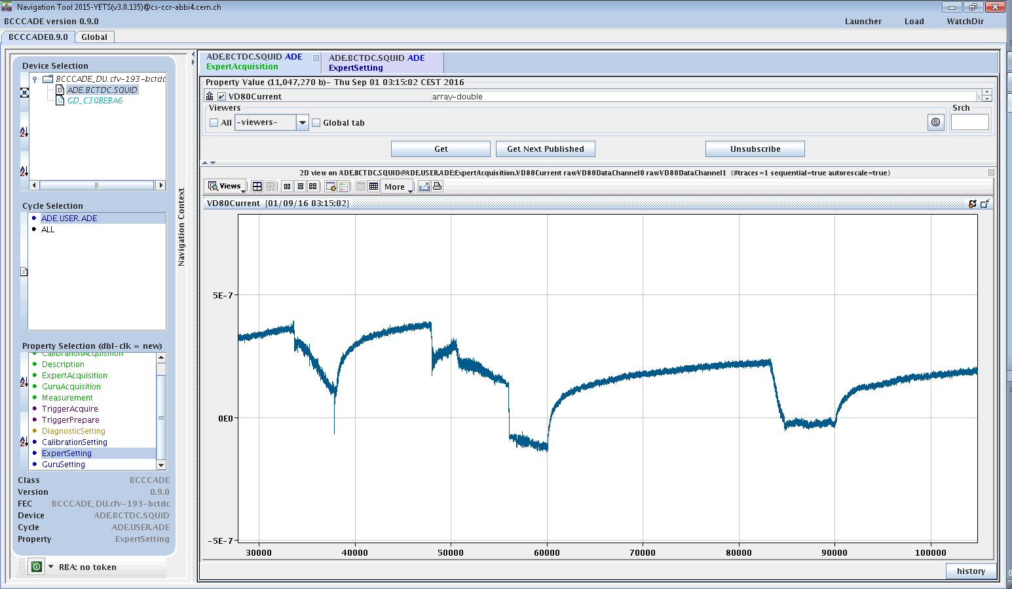
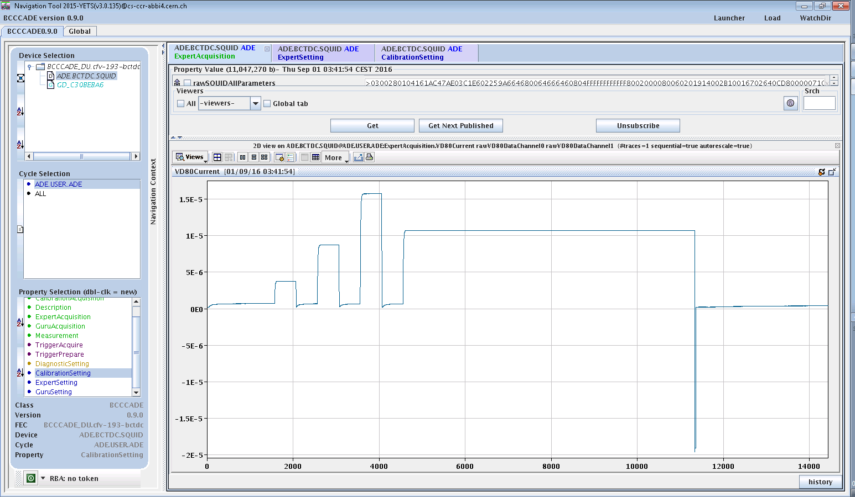
Problem in CCC measurement
Very weird behaviour
It seemed like DC coupling is not working
Explanation (not fully confirmed):
  Accumulated flux in superconducting loops
  Due to jumps occuring at injection
  Made coupling SC loop non-SC
  Remnant magnetization in pickup core
But calibration pulses look fine

Slide 14
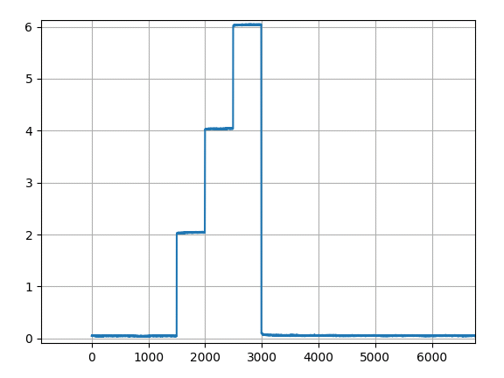
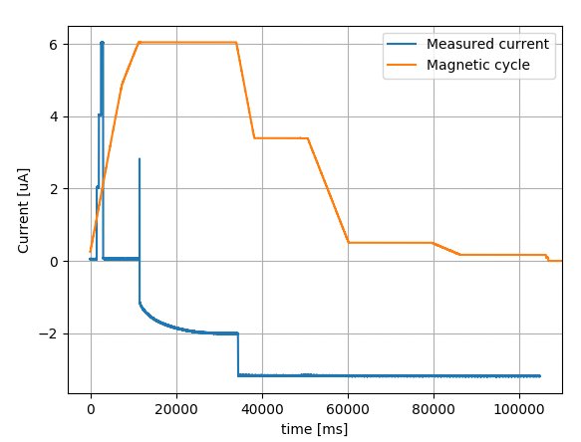
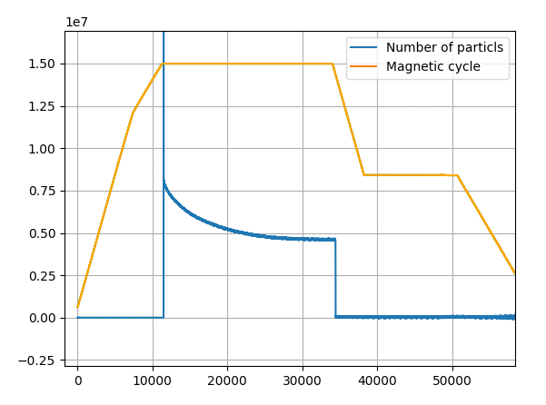
2017: AD intensity measurement
Calibration signal
Number of particles
σ = 2.2x10⁴
σ = 5.8 nA

Slide 15
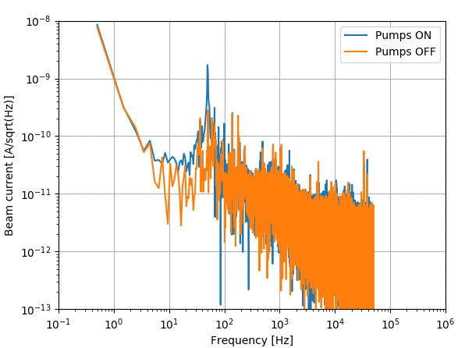
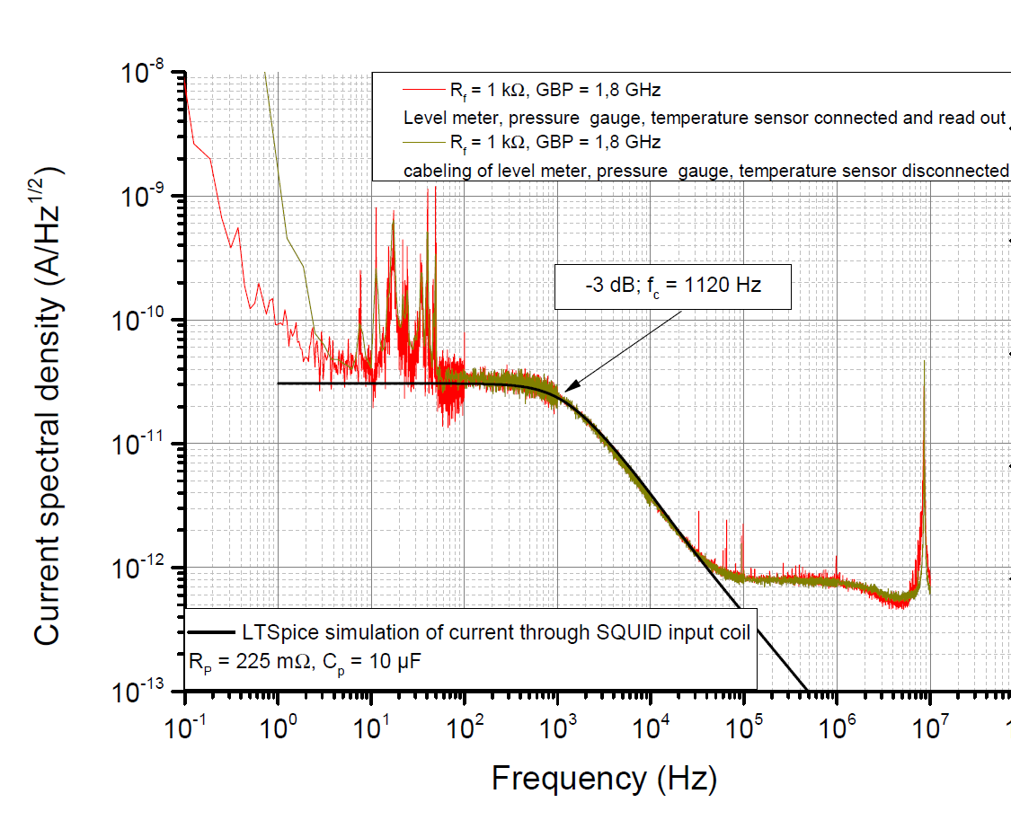
Noise permormance
Measurement in AD-ring
Measurement at lab in Jena
Measurement in AD-ring performed with and without running vacum pumps connected to cryostat insulation vacum (primary and turbomolecular pump)

Slide 16
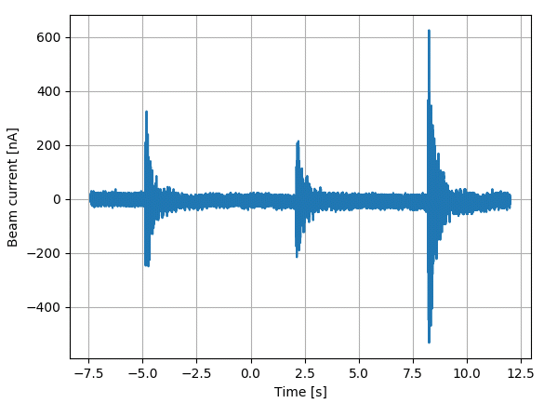
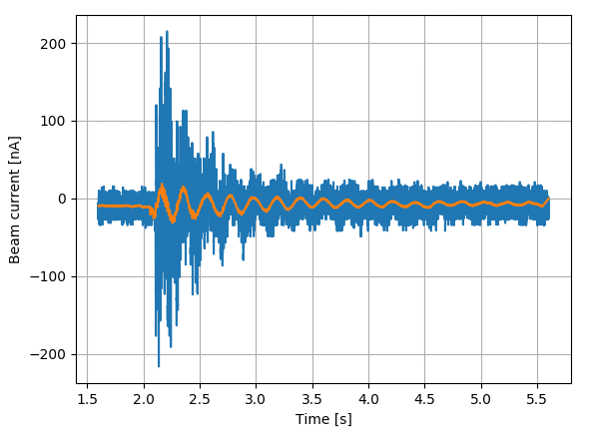
Immunity to mechanical vibrations
Main vibration modes as captured by SQUID:
  65 Hz
  115 Hz
  78 Hz
  5 Hz
Preliminary !

Slide 17
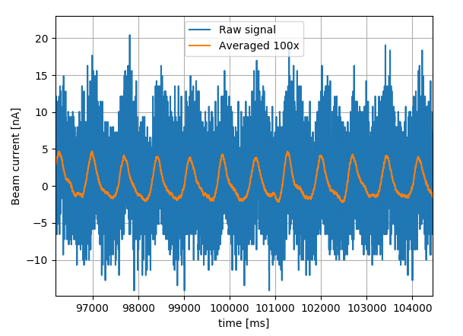
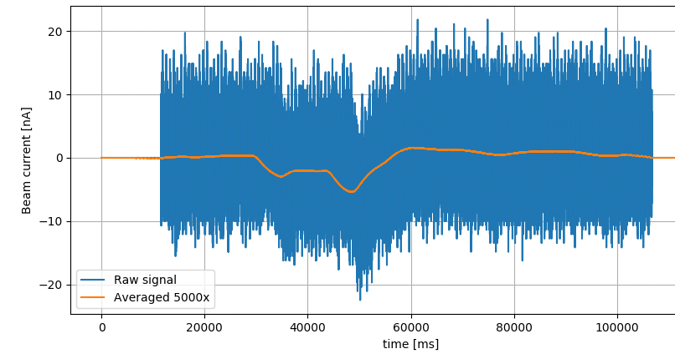
Noise performance improvements
Perturbation from cryocooler
Perturbation from magnetic cycle
σ = 5.5 nA
It should be possible to subtract both these perturbations in a robust way !

Slide 18
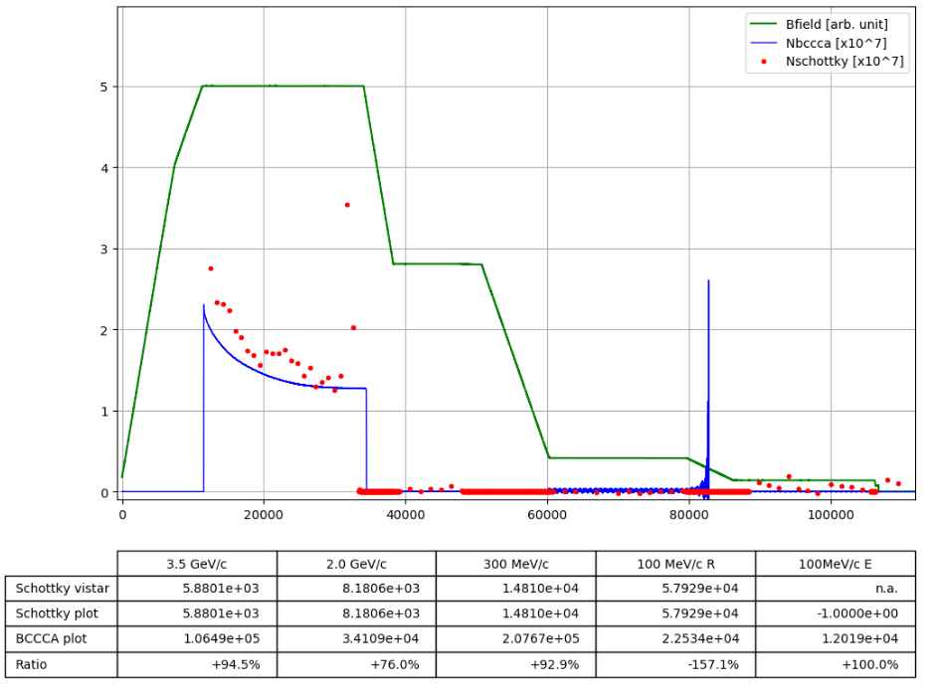
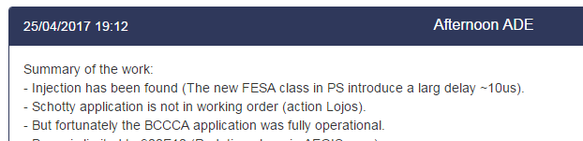
First beams in 2017

Slide 19
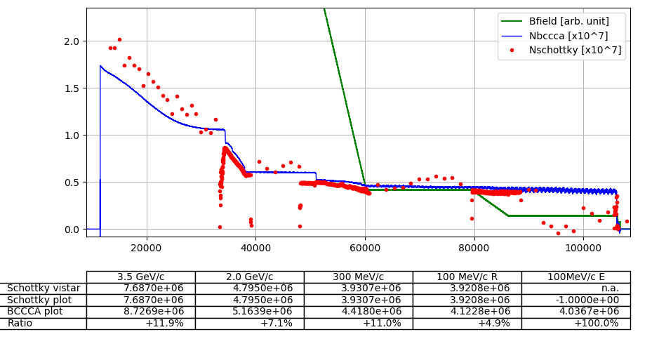
First beams in 2017

Slide 20
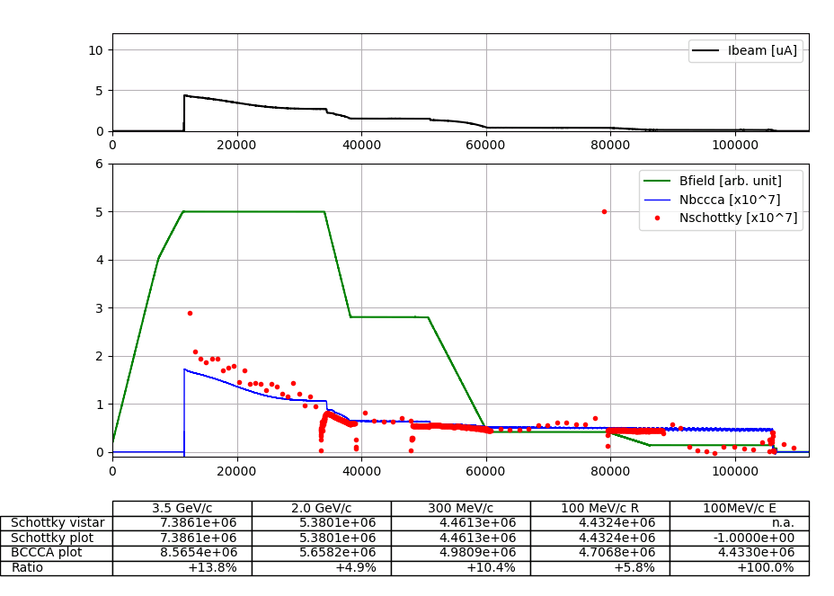
First beams in 2017

Slide 21

Conclusions and next steps
Measurement noise performance as initially specified ☺
Very good immunity to mechanical vibrations ☺
Stand-alone cryogenic system enables long term operations ☺
Flux jump at injection still present, and most likely perturbative sources have now been discarded… ☹
Develop expert GUI
Resolution can still be improved through signal processing
Solution for injection jump (additional EM filtering ?)
Assess long term stability over entire year run
Implement automatic SQUID setup in FESA class
Replace Magnicon “Connector box” and “Power supply” by improved electronics, to be installed in a single box
…

Slide 22






Thank you!

Slide 23
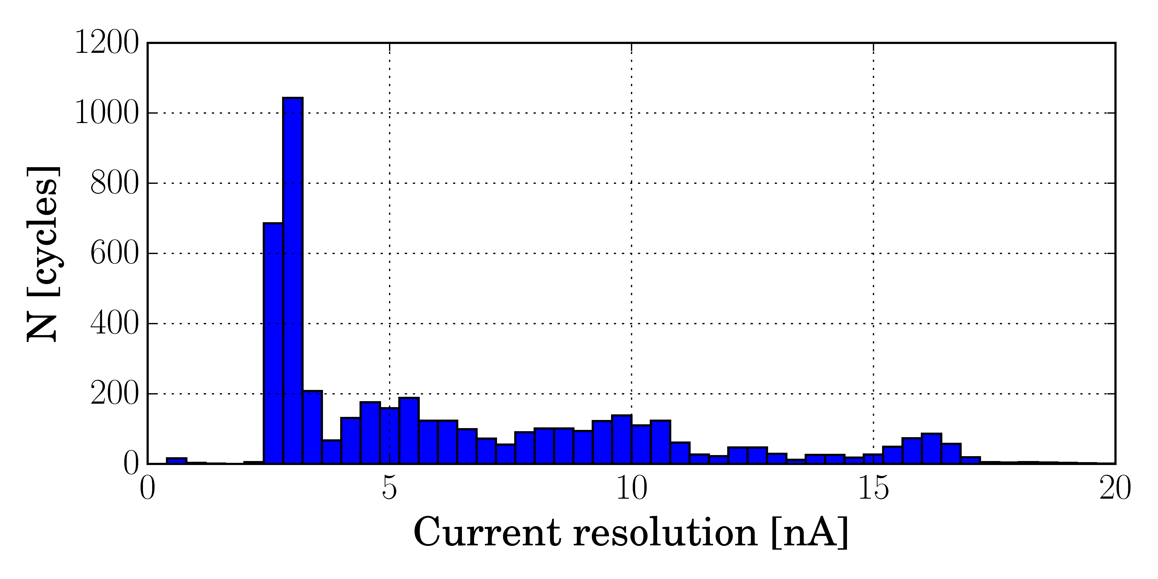
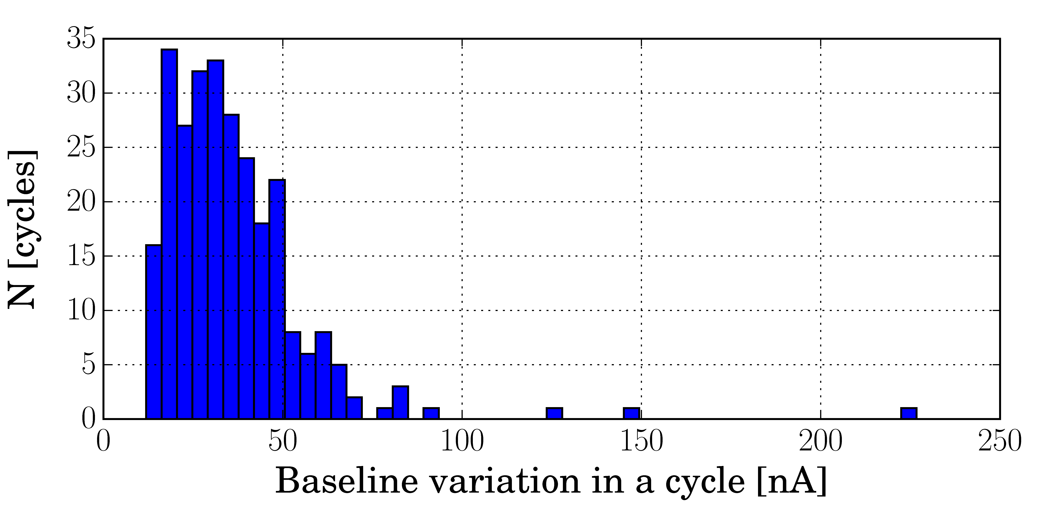
Baseline stability

Slide 24
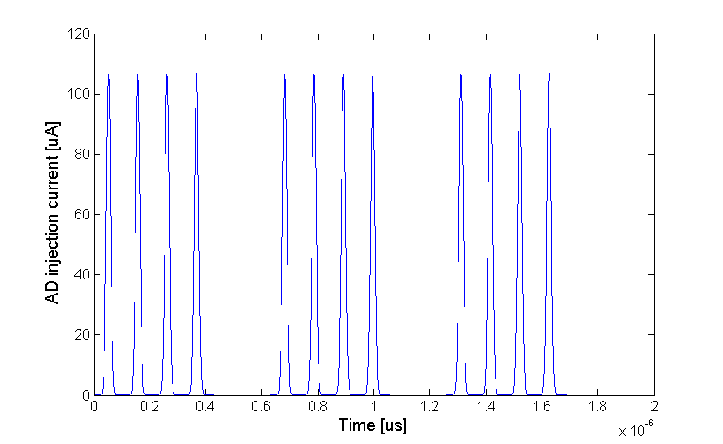
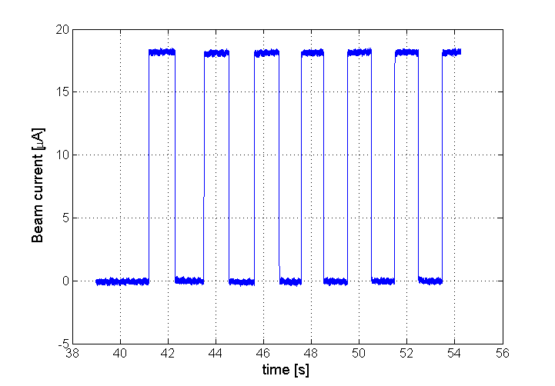
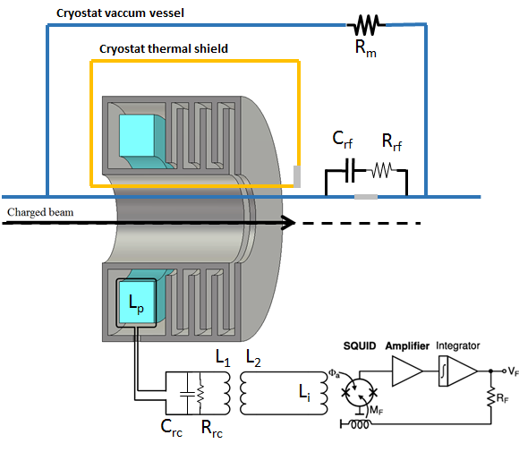
Limiting input signal slew-rate
Injected bunch train
Necessary to limit slew-rate of coupled signal to avoid flux-jumps
    $$\frac{dφ_{s}}{dt}≤1…5 Mφ_{0}/s$$
    AD injection: $\frac{dφ_{s}}{dt}≈400 Mφ_{0}/s$ !!
AD inj current:
12muA
Laboratory measurement

Slide 25
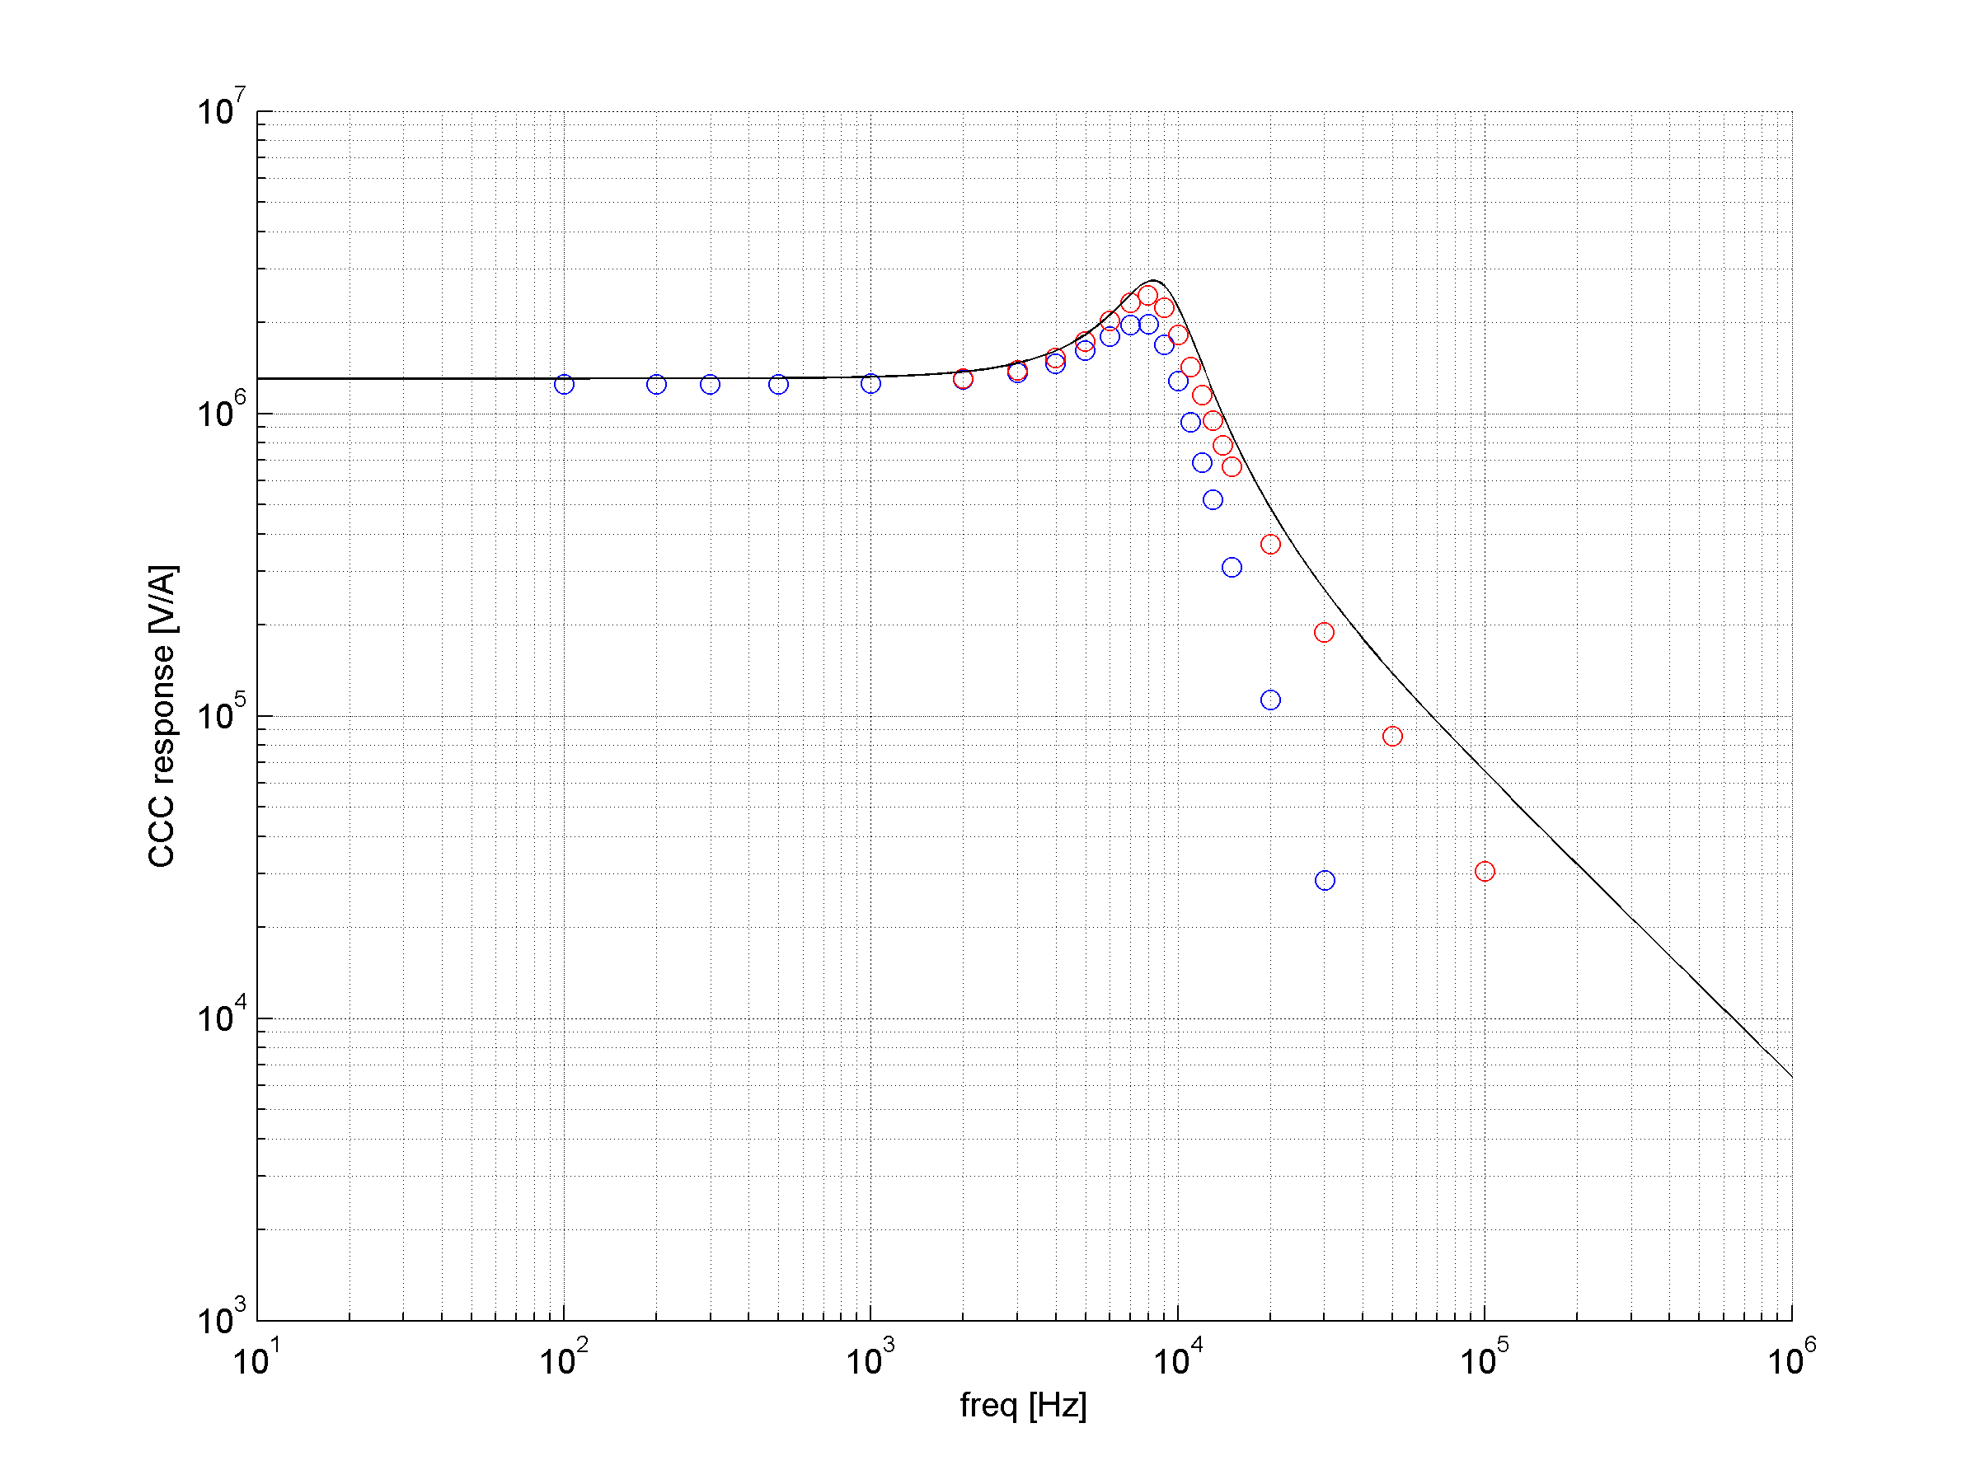
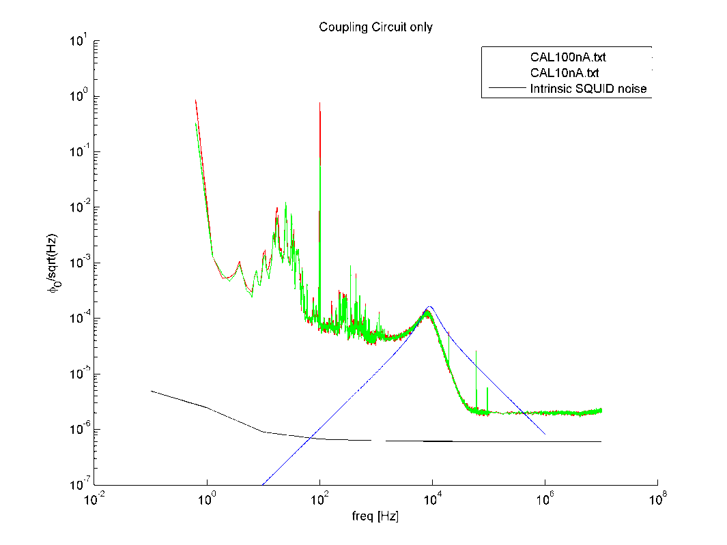
CCC Transfer function – RC series
R=1Ω; C=10uF
Rf = 2.73kΩ
100nA = 768 mφ₀^{RMS}
10nA = 77 mφ₀^{RMS}
DC gain = 1.25 mV/nA
RC noise
Frequency response closely follows the theoretical curve
With 10 kHZ low-pass filter at SQUID output turned ON

Slide 26
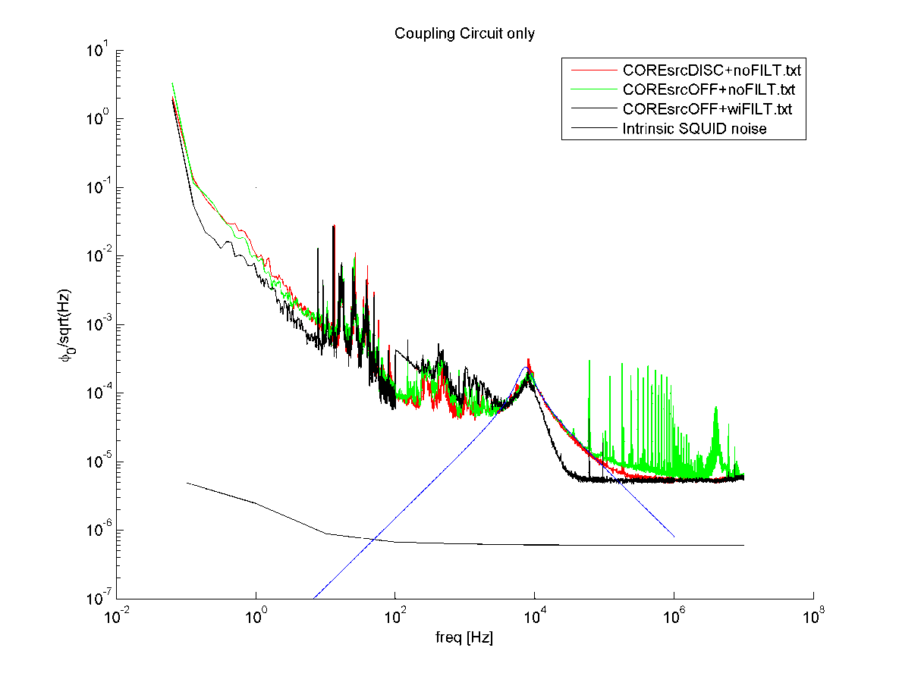
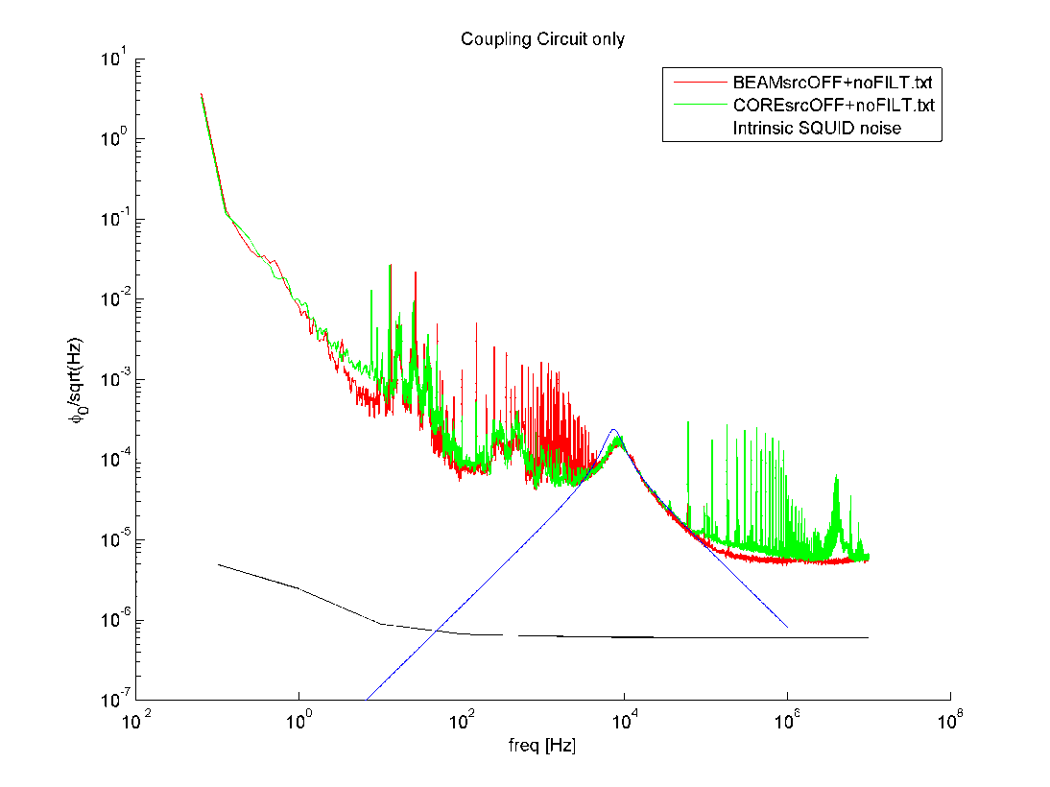
CCC Transfer function – RC series
Rf = 1kΩ
Flux noise RMS (1Hz – 1MHz) [mφ] | Total | RC-shunt
Calibration @ Core | 34.4 | 14.5
Noise from RC-shunt is a big contribution to total noise.

