Slide 1



A CCC for ELENA
Jocelyn TAN (BE-BI)
With the contributions of my BI and CRG colleagues
GSI & Jena Visit at CERN
26th April 2017

Slide 2
Agenda
Recap on ELENA
Proposal for a CCC
Cost and timeline
Summary

Slide 3
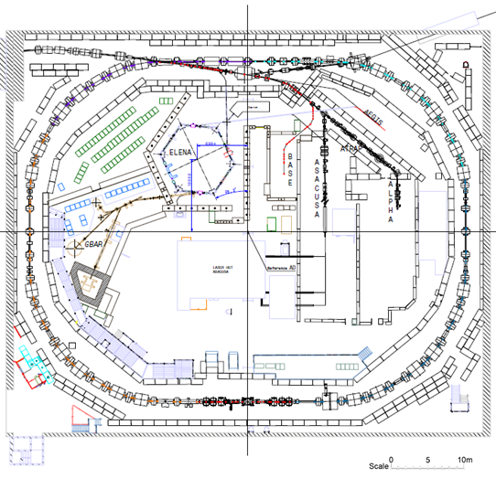
ELENA for experiment efficiency improvement
Factors considered in the synchrotron design
Space constraints: in AD hall
e-cooler: get space + small dispersion
Tune: keep β away from resonances
Bucket to bucket beam transfer from AD
Possibility of a second extraction line
ELENA parameters
Circumference (1/6 of AD) | 30.4m
Triplet-based optics | 6-fold layout
Machine tunes h/v | 2.3 / 1.3
Ekin range | 5.3 MeV – 100 keV
Relativistic β | 0.11 – 0.01
N_{bunches} at extraction | 4
Bunch length at extraction | 75 ns (rms)

Slide 4
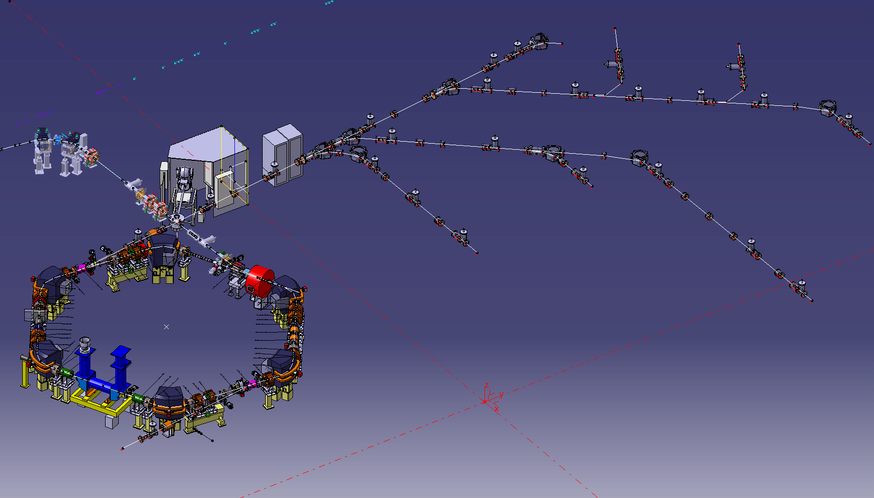
Facility overview and layout
Transfer line
(magnetic)from AD
External source
for commissioning
Electro-static line towards
existing experimental area
Extraction towards new
experimental area
Courtesy: C. Carli

Slide 5
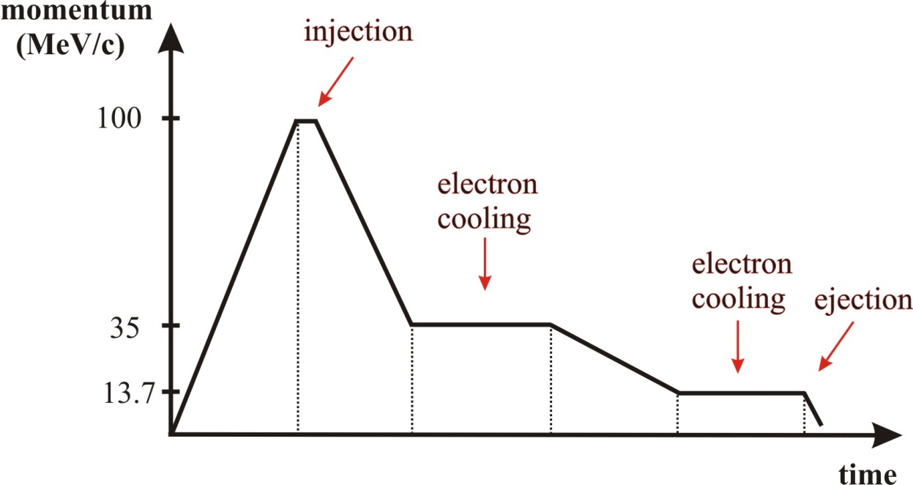
ELENA Cycle
ELENA parameters
Ekin range | 5.3 MeV – 100 keV
Frev | 1.1 MHz – 100 kHz
Total N_{particles} | 3 – 1.8 x 10⁷
DC current range | 5.2… 0.3 μA
Beam aperture | 63 mm
ε_{h,v} = 15 π mm mrad
ΔP/P = 1x10⁻³
ε_{h,v} [95%]= 6/4 π mm mrad
ΔP/P = 2x10⁻⁴
L_{bunch} (max) = 1.3 m
Cycle length about 20 seconds

Slide 6
Steps for instrumentation upgrade
Phase1: Two LPUs, scaled down from AD system
  Commissioning, LLRF, beam intensity, tomography
  Combined 4 decade BW = [3kHz - 30MHz]
  Ferrites, bakeable
Phase2: Equivalent of a “large Schottky PU”
  Superposition of 20 BPMs signals : LLRF, dp/p, intensity
Phase3: A CCC instead of LPUs (if poor performances). But feasibility study should start now.

Slide 7
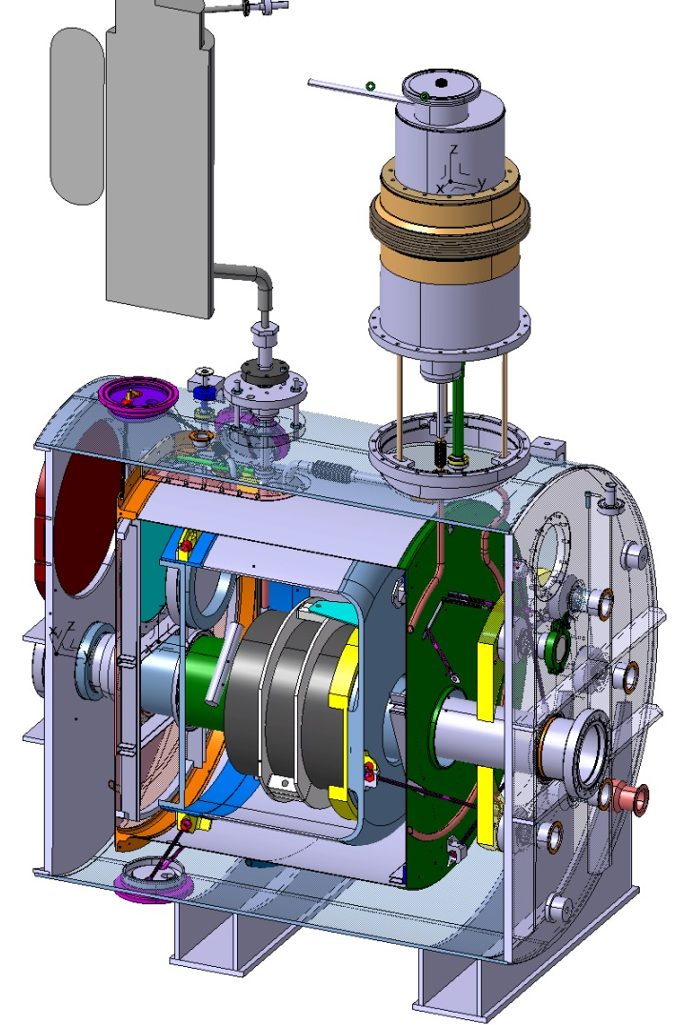
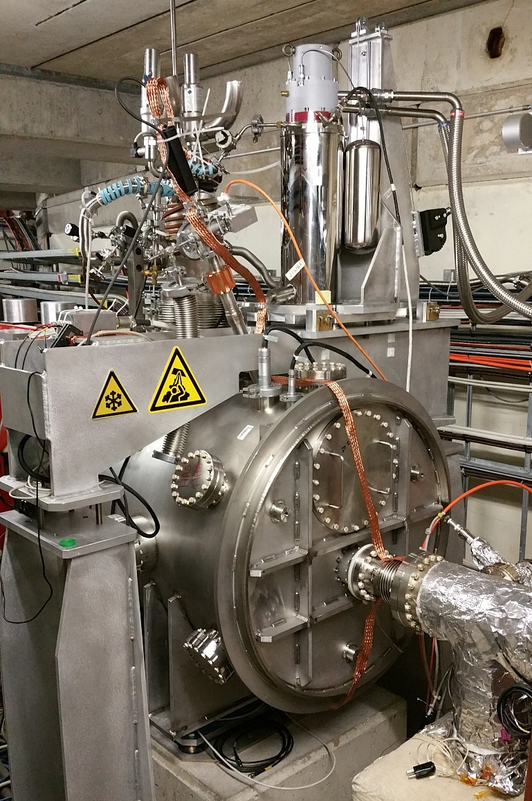
AD Cryostat: Starting point
Safety valves
Pulse tube
+ He hose
Instrumentation
+ vacuum equip.
840
1032
Courtesy: A. LEES

Slide 8
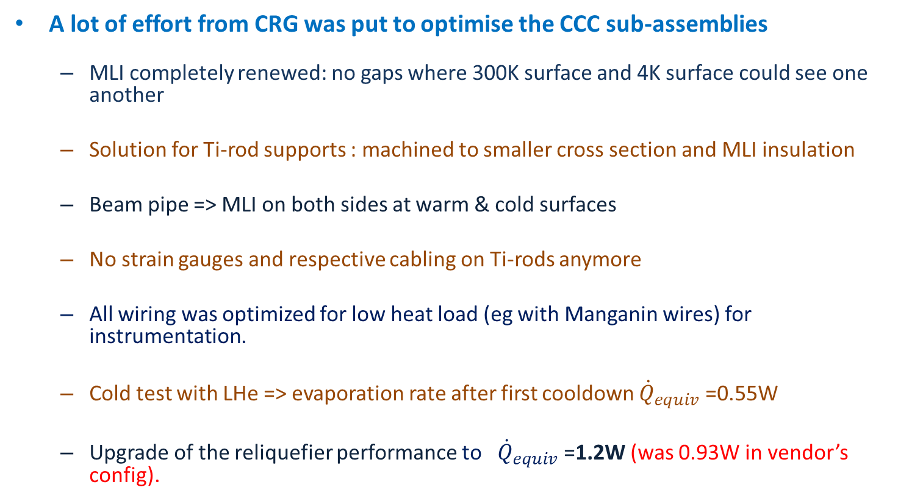
AD cryostat:
Work during winter 2015-16
A lot of effort from CRG was put to optimise the CCC sub-assemblies
  MLI completely renewed: no gaps where 300K surface and 4K surface could see one another
  Solution for Ti-rod supports : machined to smaller cross section and MLI insulation
  Beam pipe => MLI on both sides at warm & cold surfaces
  No strain gauges and respective cabling on Ti-rods anymore
  All wiring was optimized for low heat load (eg with Manganin wires) for instrumentation.
  Cold test with LHe => evaporation rate after first cooldown ${\dot{Q}}_{equiv}$=0.55W
  Upgrade of the reliquefier performance to ${\dot{Q}}_{equiv}$=1.2W (was 0.93W in vendor’s config).

Slide 9
ELENA cryostat:
Hints to further improve performance
Reduce monitoring inside the cryostat ⇒ less wires
Better insulation between warm beam pipe and thermal shield : now 63mm beam aperture (100mm for AD)
Improve insulation vacuum: Reduce He diffusion through Al₂O₃ gaps (test of material…).
The use of 316L for the He Vessel would allow the use of standard components, helping to reduce cost and weight.
Increase cooling power: New Cryomech pulse tube PT420 provides 2W.
Would a more compact cryostat help in terms of heat in-leak ?
Synergy with GSI’s design ?

Slide 10
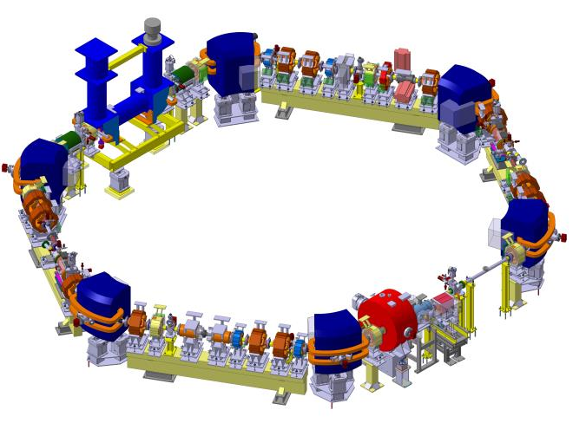
Integration options
1.25m drift tube
in Section 1: near septum and kicker
LPUs in Section 2

Slide 11
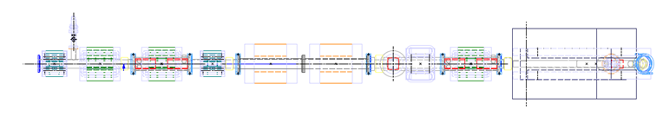
Section2: magnetic environment
Corrector dipole
Bending magnet
Quadrupole
Quadrupole
Study performed in 2013
Sextupole
1 m
CCC
697 mm
899 mm
1087 mm
1286 mm
1589 mm
Field from beam current:
  Aperture: 60 mm (now 63 mm)
  Distance: 54 mm
  Current: 5.2 … 0.3 μA
  B_{θ} field: 19.2 … 1.05 pT
Assuming:
  Infinitely straight current
  Calculated at mid-point between r_{inner} and r_{outer} of a CCC with dimensions proportional to that of GSI (r_{inner}=69mm and r_{outer}=112mm)
Courtesy: M. Fernandes

Slide 12
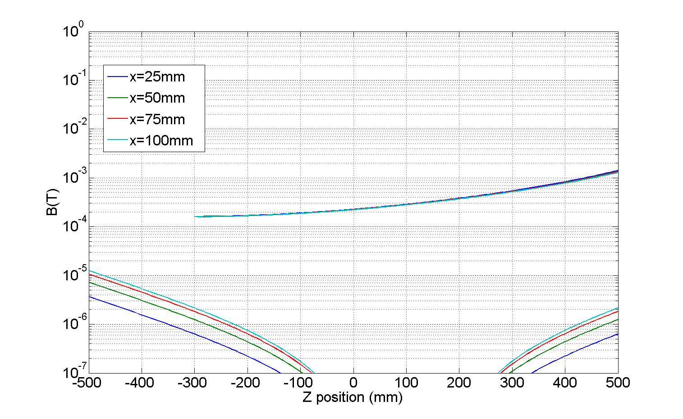
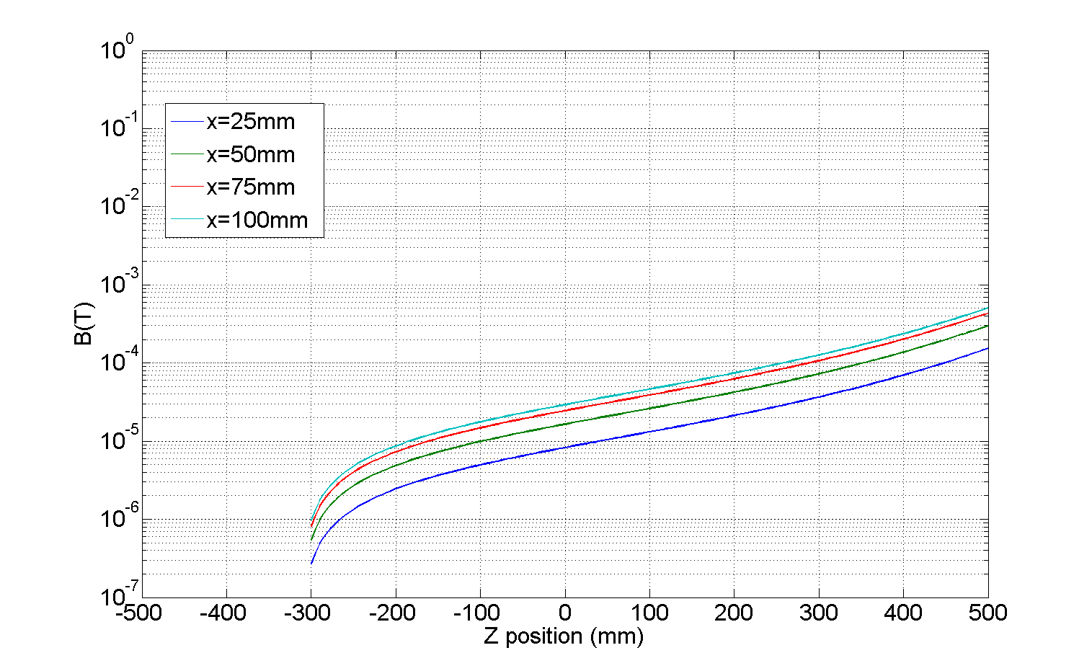
Section2: magnetic environment
Transverse component
CCC region
Only closest quadrupoles and dipole corrector simulations are available
Maximum magnetic field was considered
Field obtained in XZ plane at Y=0
In XZ-plane long. component of quadrupole field is zero (this should remain small in other longitudinal planes)
Study performed in 2013
DIP.-CORR.
QUAD-2
QUAD-1
Longitudinal component
CCC region
  |z|<300 mm → |B_{trans}|<50 µT
DIP.-CORR.
Courtesy: M. Fernandes

Slide 13
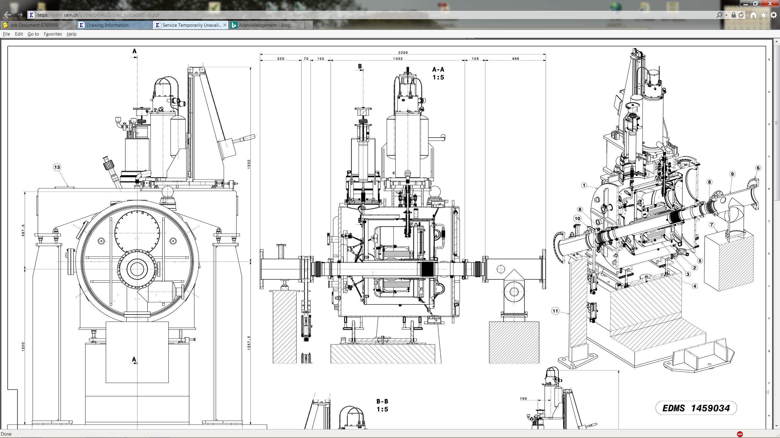
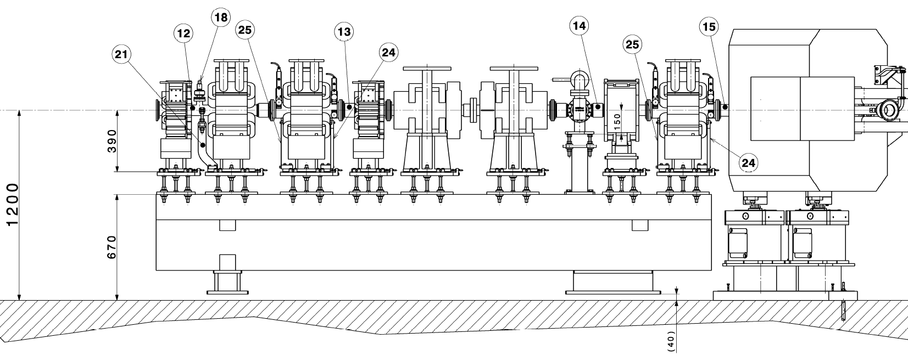
Section 2: CCC integration
LPU_A LPU_B
1035

Slide 14
Cost breakdown: AD vs ELENA
CCC & Acq chain | Cost [kCHF] | New cost [kCHF] | Comments
Niobium shielding + Core | 140 | 140 | If we keep the same monitor
SQUID & current generator | 26 | 26
Cabling, network, electronics | 18 | 18
Ring modifications | Cost [kCHF] | New cost [kCHF]
Vacuum sectorisation | 53 | 53 | ELENA: Not an official quotation from VSC group !
Chilled water, power supply, etc | 11 | 11
340 kCHF: fixed expenses
Cryogenics parts | AD [kCHF] | ELENA [kCHF]
Cryo parts | 13 | 13
Cryocooler | 79 | 79 | New PT420 with 2W cooling power !
Ceramic gaps + Ti coating | 23 | 16 | 1 spare of each only, instead of a pair
Ti rods with strain gauges | 46 | 34 | w/o strain gauges, 8weeks delivery instead of 4
CERN store | 137 | 45 | -33%: 316LN →316L
548 kCHF → 268 kCHF
Cryogenics jobs | AD [kCHF] | ELENA [kCHF]
Design office | 51 | 5 | With slight changes (~100 h)
Vac. Test, cryo controls, He recovery line | 18 | 18 | Not much savings
Cryostat production and assembly | 273 | 150 | -30%: 316LN →316L, -15%: assembly
GRAND TOTAL | 888 | 608 | Swiss price EN13445 standard: Qualification of cold parts for pressure and vacuum operations

Slide 15
Options for cost reduction
Outsource the CCC production
We could benefit from series production for FAIR, assuming:
  GSI’s CCC is compatible with standalone operation,
  both ELENA and FAIR installation planning are in phase (2021?)
NB: not an official planning. Transfer line installation might take place in 2020

Slide 16
Summary
New CCC project in a lower-constrained time scale than with AD
Risk mitigation with high production EN 13445 standard
ELENA’s CCC is 30% cheaper, yet still an expensive device.
Hidden cost: expertise and support of CRG group
  Conceptual design
  Tests and commissioning
  Risk analysis
  Helium supply
Open point: future collaboration with GSI and Jena

Slide 17
Acknowledgement
I’m grateful to my colleagues who helped me for preparing this talk, namely:
Miguel Fernandes
Lars Soby
Gerard Tranquille
Rhodri Jones
Torsten Koettig
Andrew Lees

