Slide 1

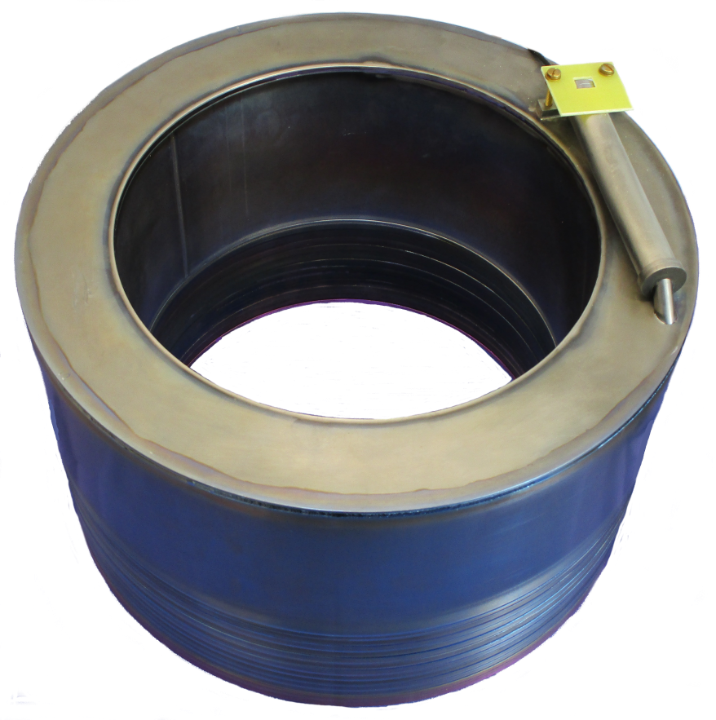
Status of the BMBF project
Interim report 2016 + I/2017
(1) BMBF- Joint Project 05P2015
R&D Accelerator (CCC):
„Entwicklung, Sensoroptimierungen und Tests von kryogenen
Stromkomparatoren zum Einsatz an neuartigen Ionenquellen,
Beschleunigeranlagen und Speicherringen“
Project partners: FSU Jena + TU Darmstadt
Associated partners: GSI Darmstadt + CERN Genf
(2) Collaboration Agreement CERN, GSI, FSU (# KE2915/BE)
(3) Collaboration Agreement FSU Jena IOQ, IFK und TU Darmstadt
Volker Tympel (HIJ)
Mini-workshop on CCC 26th and 27th April 2017 CERN Geneva

Slide 2
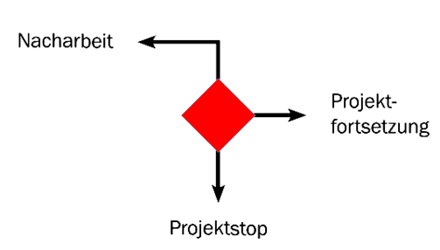

Interim report 2016
Milestone 1
return
parties agree to continue with the project as foreseen
M1
forward
stop
V. Tympel (Helmholtz-Institute Jena) GSI Helmholtzzentrum für Schwerionenforschung, Darmstadt Germany

Slide 3
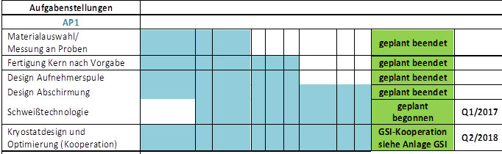
Interim report 2016
Task 1
on time
V. Tympel (Helmholtz-Institute Jena) GSI Helmholtzzentrum für Schwerionenforschung, Darmstadt Germany

Slide 4
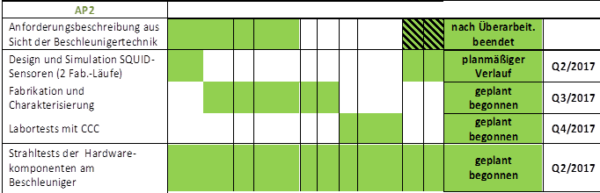
Interim report 2016
Task 2
on time
V. Tympel (Helmholtz-Institute Jena) GSI Helmholtzzentrum für Schwerionenforschung, Darmstadt Germany

Slide 5
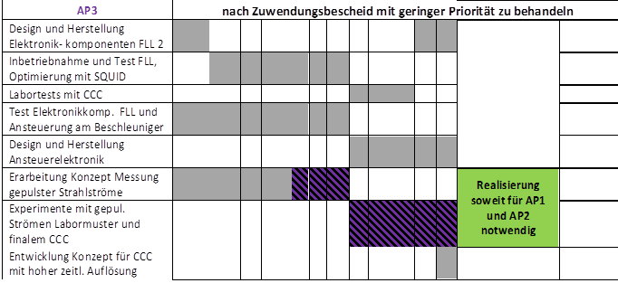
Interim report 2016
Task 3
BMBF-decision: “with minor priority”
V. Tympel (Helmholtz-Institute Jena) GSI Helmholtzzentrum für Schwerionenforschung, Darmstadt Germany

Slide 6
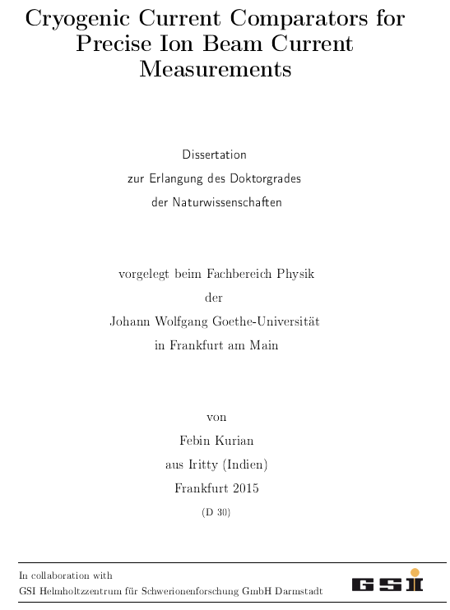
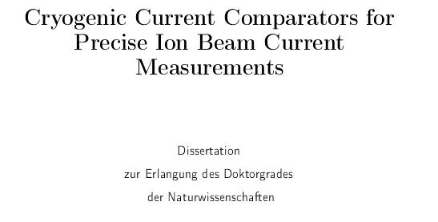
Interim report 2016
Publications
PhD –thesis
Defense: 23rd March 2016
Dr. Febin Kurian
V. Tympel (Helmholtz-Institute Jena) GSI Helmholtzzentrum für Schwerionenforschung, Darmstadt Germany

Slide 7
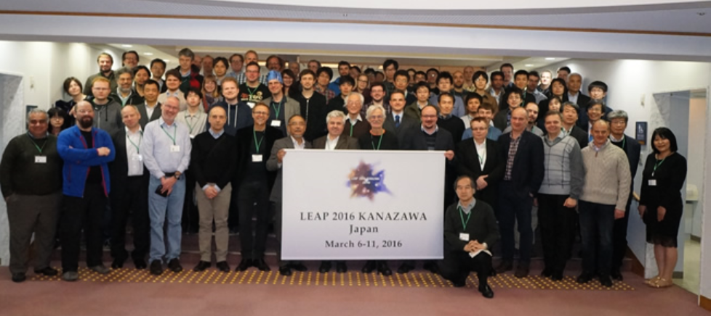
Interim report 2016
Publications
LEAP, Low Energy Antiproton Physics, Japan
1x Oral + poster + proc.
V. Tympel, …,
Superconducting Beam Charge
Monitors for Antiproton Storage
Rings
Events 2016 | Q1/2016 |  |  | Q2/2016 |  |  | Q3/2016 |  |  | Q4/2016
 | J | F | M | A | M | J | J | A | S | O | N | D
LEAP, Low Energy Antiproton Physics, Japan |  |  | 1P 1O
V. Tympel (Helmholtz-Institute Jena) GSI Helmholtzzentrum für Schwerionenforschung, Darmstadt Germany

Slide 8
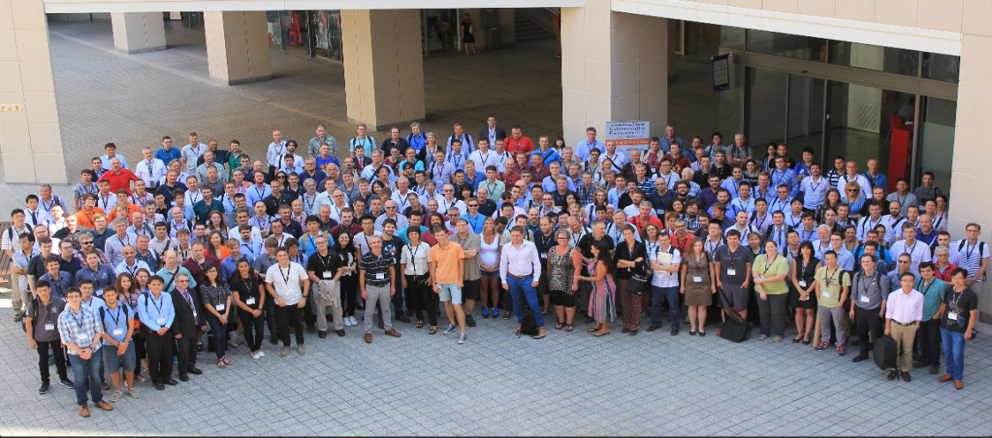
Interim report 2016
Publications
International Beam Instrumentation Conference, Barcelona
4x Poster + proc.
M. Schwickert, …,
Status of beam current transformer developments for FAIR.
T. Sieber , ...,
Optimization studies for an advances Cryogenic Current Comparator
(CCC) system for FAIR.
M. Fernandes (CERN), ...,
Optimized Cryogenic Current Comparator for CERN’s low-energy
antiproton facilities.
V. Tympel (FSU), …,
The next generation of Cryogenic Current Comparators for
beam monitoring.
Events 2016 | Q1/2016 |  |  | Q2/2016 |  |  | Q3/2016 |  |  | Q4/2016
 | J | F | M | A | M | J | J | A | S | O | N | D
LEAP, Low Energy Antiproton Physics, Japan |  |  | 1P 1O
IBIC, Spanien |  |  |  |  |  |  |  |  | 4P
Events 2016 | Q1/2016 |  |  | Q2/2016 |  |  | Q3/2016 |  |  | Q4/2016
 | J | F | M | A | M | J | J | A | S | O | N | D
LEAP, Low Energy Antiproton Physics, Japan |  |  | 1P 1O
V. Tympel (Helmholtz-Institute Jena) GSI Helmholtzzentrum für Schwerionenforschung, Darmstadt Germany

Slide 9
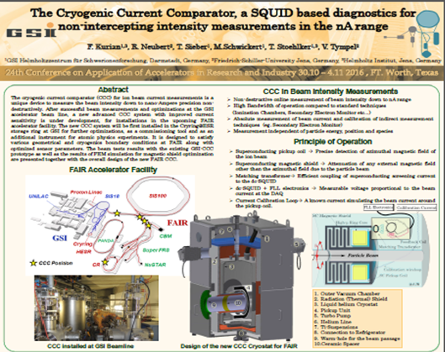
Interim report 2016
Publications
Conference on Application of Accelerators in Research and Industry, Texas, USA
1x Poster
F. Kurian, …,
The Cryogenic Current Comparator, a
SQUID based diagnostics for non-
intercepting intensity
measurements in the nA range.
Events 2016 | Q1/2016 |  |  | Q2/2016 |  |  | Q3/2016 |  |  | Q4/2016
 | J | F | M | A | M | J | J | A | S | O | N | D
LEAP, Low Energy Antiproton Physics, Japan |  |  | 1P 1O
IBIC, Spanien |  |  |  |  |  |  |  |  | 4P
CAARI, Conference on Application of Accelerators in Research and Industry, USA |  |  |  |  |  |  |  |  |  |  | 1P
V. Tympel (Helmholtz-Institute Jena) GSI Helmholtzzentrum für Schwerionenforschung, Darmstadt Germany

Slide 10
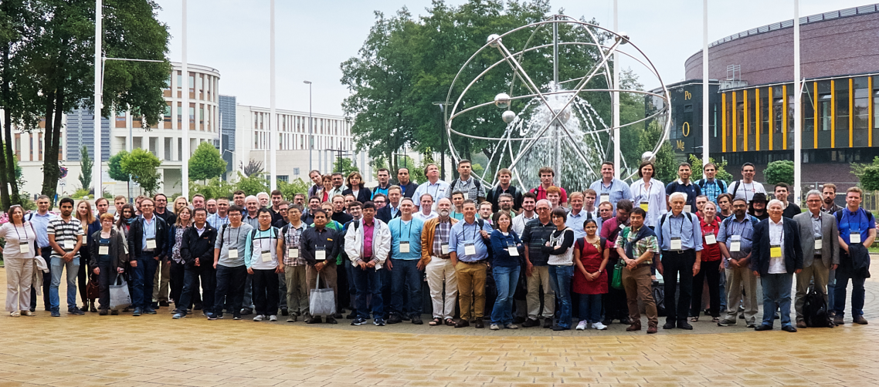
Interim report 2016
Publications
Stored Particles Atomic Physics Research Collaboration Workshop, Krakow
1x Oral
V. Tympel, …,
Cryogenic Current Comparators –
basics and the next generation
Events 2016 | Q1/2016 |  |  | Q2/2016 |  |  | Q3/2016 |  |  | Q4/2016
 | J | F | M | A | M | J | J | A | S | O | N | D
LEAP, Low Energy Antiproton Physics, Japan |  |  | 1P 1O
IBIC, Spanien |  |  |  |  |  |  |  |  | 4P
CAARI, Conference on Application of Accelerators in Research and Industry, USA |  |  |  |  |  |  |  |  |  |  | 1P
SPARC Workskop , Polen |  |  |  |  |  |  |  |  | 1O
V. Tympel (Helmholtz-Institute Jena) GSI Helmholtzzentrum für Schwerionenforschung, Darmstadt Germany

Slide 11
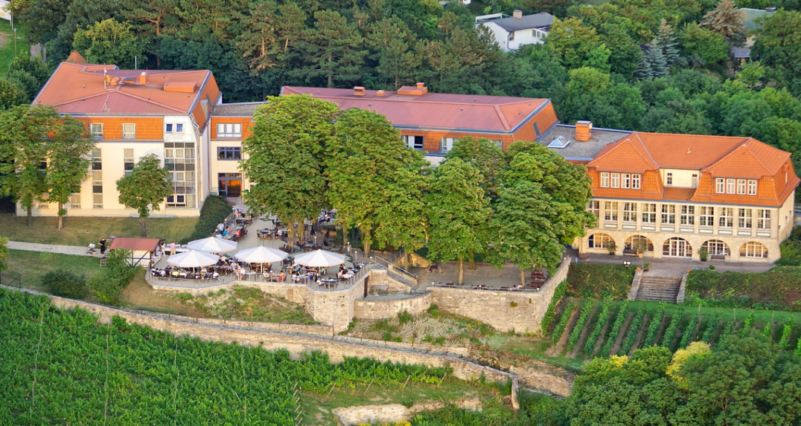
Interim report 2016
Publications
Tagung Kryoelektronische Bauelemente, Freyburg (Unstrut)
4x Poster
F. Kurian, …,
Temperature induced fluctuations in SQUID Measurements –
Cryogenic Current Comparator.
J. Golm, ...,
Adapted Cryogenic Current Comparator for the Antiproton Decelerator
at CERN.
R. Neubert, ...,
A tailor-made Cryostat for CCC-XD.
Tympel (FSU), …,
CCC-XD – the next generation of superconducting beam-line monitoring.
Events 2016 | Q1/2016 |  |  | Q2/2016 |  |  | Q3/2016 |  |  | Q4/2016
 | J | F | M | A | M | J | J | A | S | O | N | D
LEAP, Low Energy Antiproton Physics, Japan |  |  | 1P 1O
IBIC, Spanien |  |  |  |  |  |  |  |  | 4P
CAARI, Conference on Application of Accelerators in Research and Industry, USA |  |  |  |  |  |  |  |  |  |  | 1P
SPARC Workskop , Polen |  |  |  |  |  |  |  |  | 1O
Kryo, Kryoelektronische Bauelemente |  |  |  |  |  |  |  |  |  | 4P
V. Tympel (Helmholtz-Institute Jena) GSI Helmholtzzentrum für Schwerionenforschung, Darmstadt Germany

Slide 12
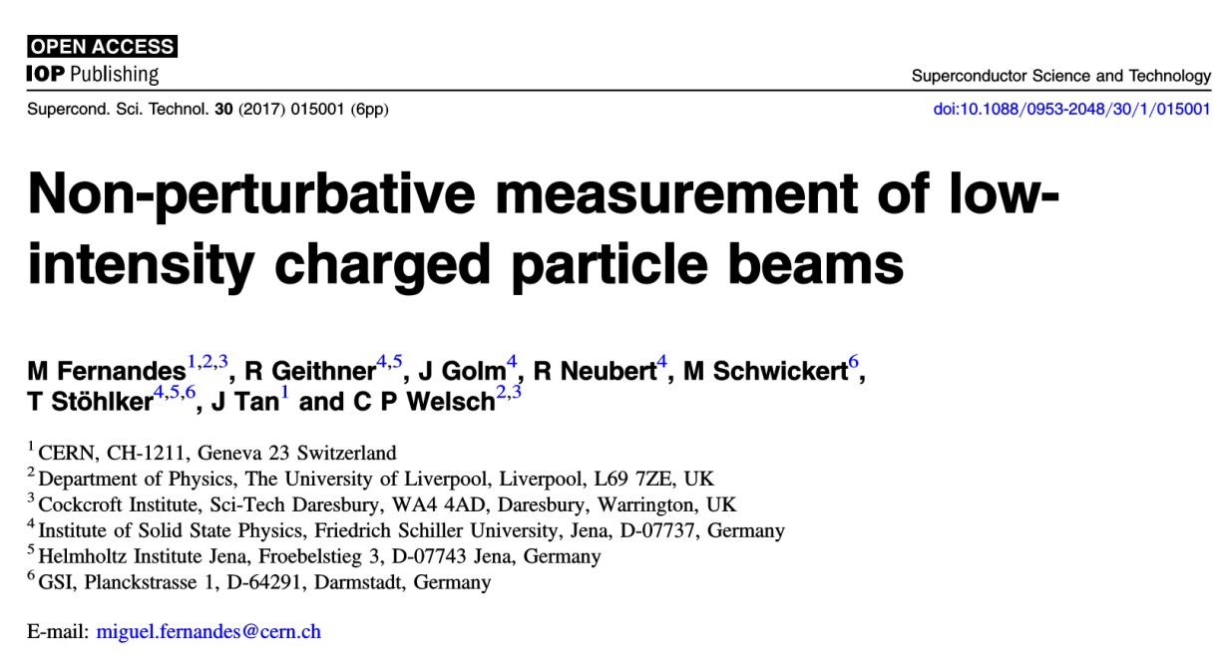
Interim report 2016
Publications
Superconductor Science and Technology
1x Paper
M. Fernandes, …,
V. Tympel (Helmholtz-Institute Jena) GSI Helmholtzzentrum für Schwerionenforschung, Darmstadt Germany

Slide 13
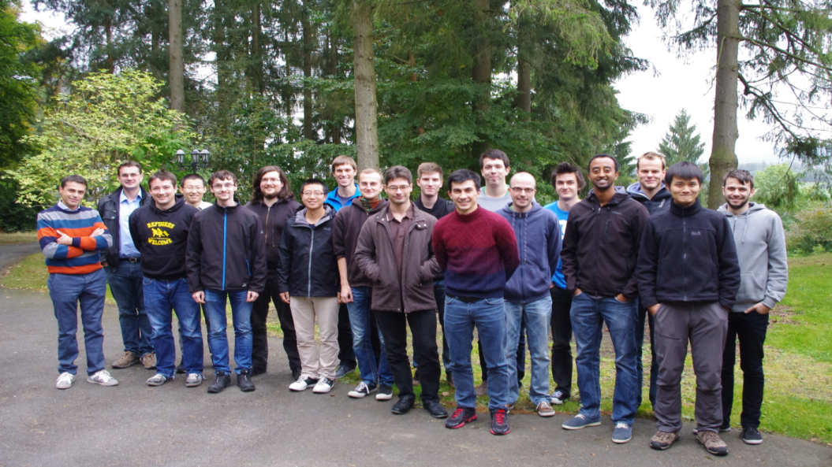
Interim report 2016
Publications
4th Joint HGS-HIRe & RS-APS
Lecture Week on Atomic and Laser/
Plasma Physics - Fall 2016 - Haus Ebersberg
1x Lecture
V. Tympel, …,
Cryogenic Current Comparators
V. Tympel (Helmholtz-Institute Jena) GSI Helmholtzzentrum für Schwerionenforschung, Darmstadt Germany

Slide 14
I/2017
CCC-XD
Ready for
Testing &
Optimising
Lab-results
IBIC2017
deadline:
Saturday, 20 May at 24:00 EST (GMT-5)
V. Tympel (Helmholtz-Institute Jena) GSI Helmholtzzentrum für Schwerionenforschung, Darmstadt Germany

Slide 15
I/2017
noise
measurement
white noise:
< 4 pA/√Hz
pre limited
V. Tympel (Helmholtz-Institut Jena) GSI Helmholtzzentrum für Schwerionenforschung, Darmstadt Germany

Slide 16
I/2017
transfer function
pre limited
pre limited
V. Tympel (Helmholtz-Institut Jena) GSI Helmholtzzentrum für Schwerionenforschung, Darmstadt Germany

Slide 17
I/2017
transfer function
SQUID – electronic
corrected
pre limited
V. Tympel (Helmholtz-Institut Jena) GSI Helmholtzzentrum für Schwerionenforschung, Darmstadt Germany

Slide 18
2017
BMBF
2 milestones !
follow-up proposal
2018-20
V. Tympel (Helmholtz-Institute Jena) GSI Helmholtzzentrum für Schwerionenforschung, Darmstadt Germany

Slide 20
Toroid measurements, FAIR CCC tests, error analysis at CERN + GSI CCC
● Meander Shielding
● Cable problems
● Matching transformer
● Next challenges
Volker Tympel (HIJ), Ralf Neubert (FSU)
Mini-workshop on CCC 26th and 27th April 2017 CERN Geneva

Slide 21
Superconducting shielding
Pick-up coil
Transformer
SQUID
Four-wire
Measurement
Flux
Compensator
Flux gap
Compensation
Current
Magnetic field B
Charged particle beam
Cryogenic liquid
LHe
Magnetic flux
Concentrator ring
Metrology
Calibration
Current

Slide 22
Meander Shielding
CCC-XD
12 Nb-inside-discs
12 Nb-outside-discs
Electron-beam welding
1x inside-disc-stack
1x outside-disc-stack

Slide 23
Meander Shielding
CCC-XD
12 Nb-inside-discs
12 Nb-outside-discs
Electron-beam welding
1x inside-disc-stack
1x outside-disc-stack
Testing & „ free burning“
Low-Voltage upto 30 V
High-Voltage upto 1,4 kV in LN₂
Ready: R > 40 MΩ C = 44 nF
DMM

Slide 24
Meander Shielding
CCC-XD
Add top cover
Stacks fixed
Before:
Pick-up-coil & flux-concentrator

Slide 25
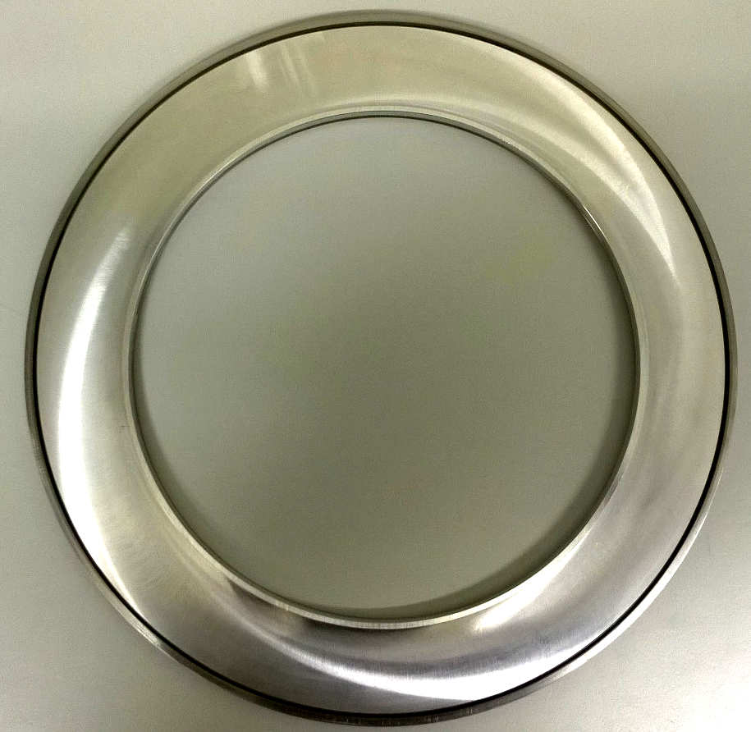
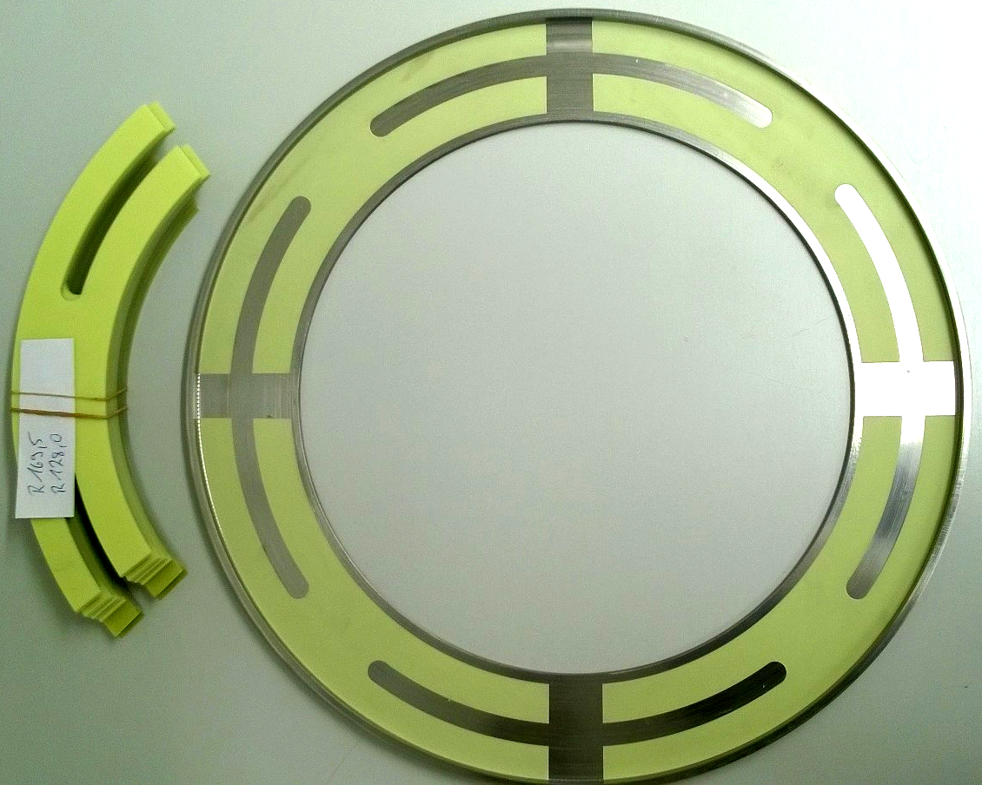
Meander Shielding
CCC-XD discs
V. Tympel (Helmholtz-Institut Jena) GSI Helmholtzzentrum für Schwerionenforschung, Darmstadt Germany

Slide 26
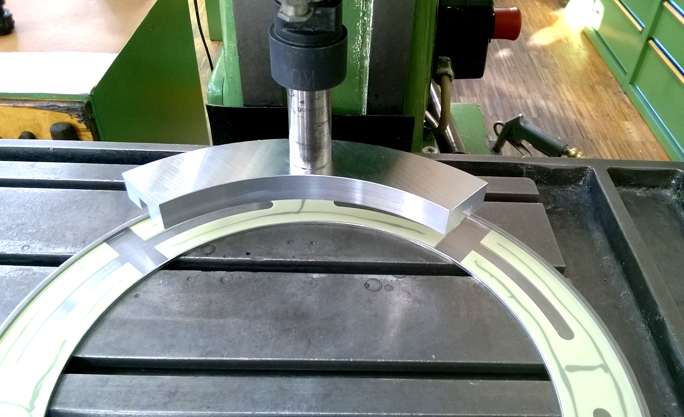
Meander Shielding
CCC-XD discs
GFK-Spacer
(glass fibre reinforced plastic)
V. Tympel (Helmholtz-Institut Jena) GSI Helmholtzzentrum für Schwerionenforschung, Darmstadt Germany

Slide 27
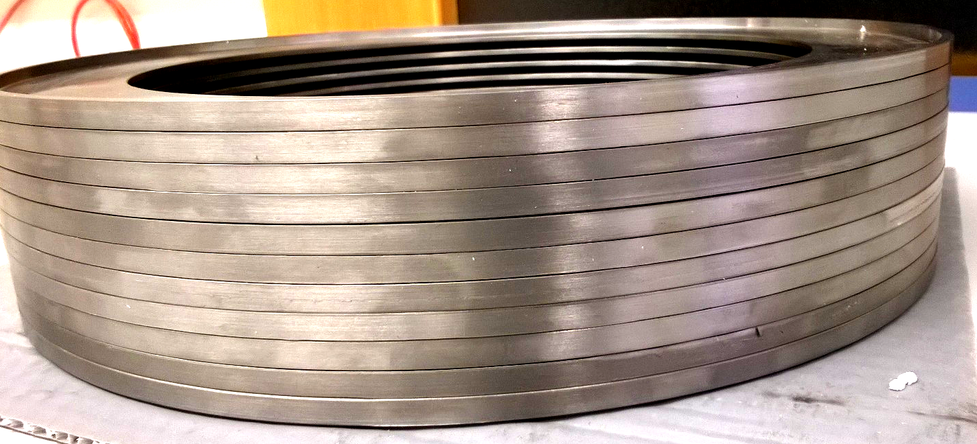
Meander Shielding
CCC-XD discs
V. Tympel (Helmholtz-Institut Jena) GSI Helmholtzzentrum für Schwerionenforschung, Darmstadt Germany

Slide 28
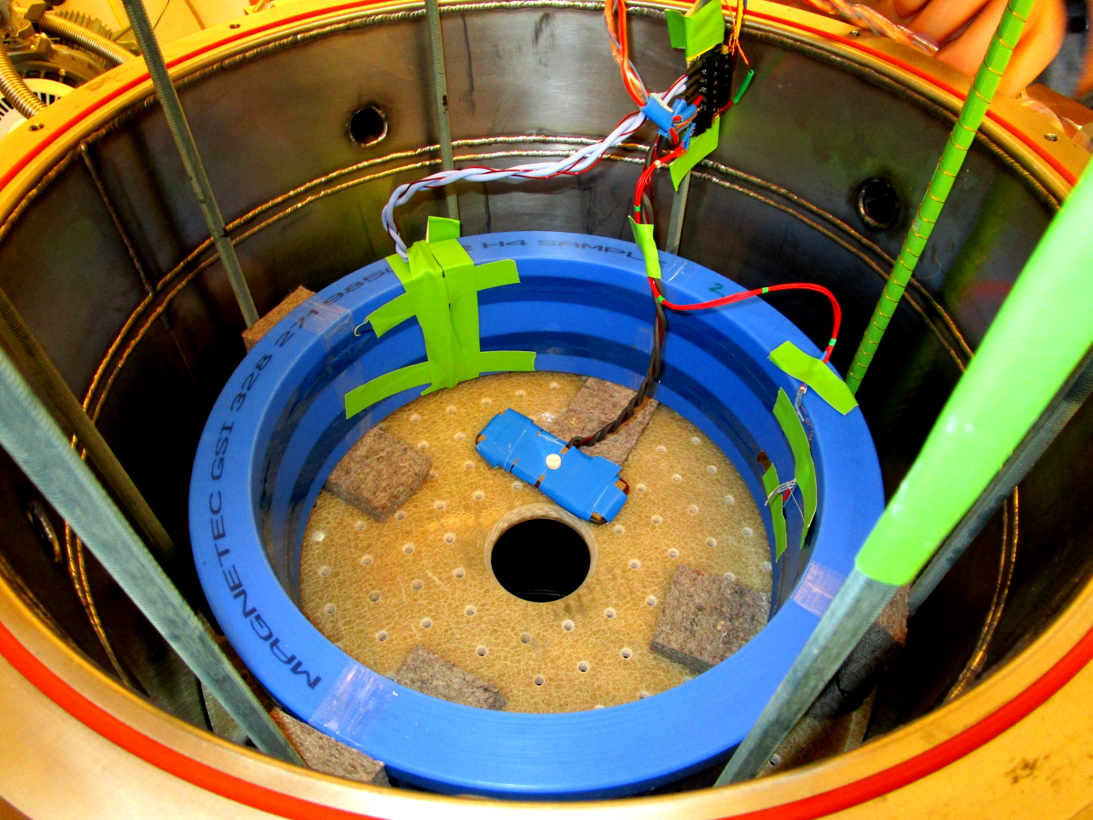
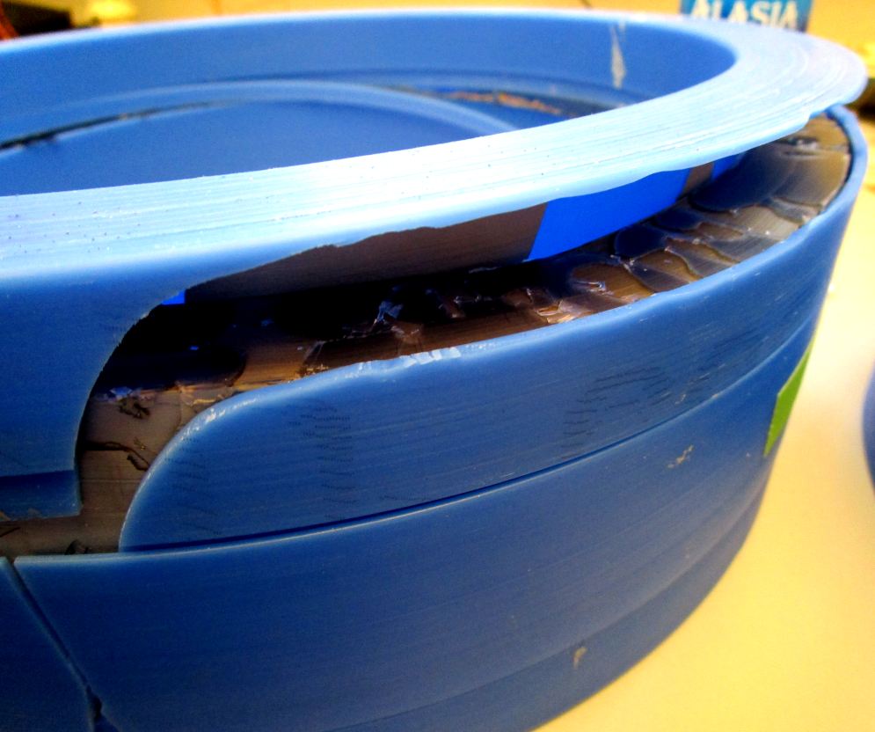
Meander Shielding
CCC-XD pick-up coil
V. Tympel (Helmholtz-Institut Jena) GSI Helmholtzzentrum für Schwerionenforschung, Darmstadt Germany

Slide 29
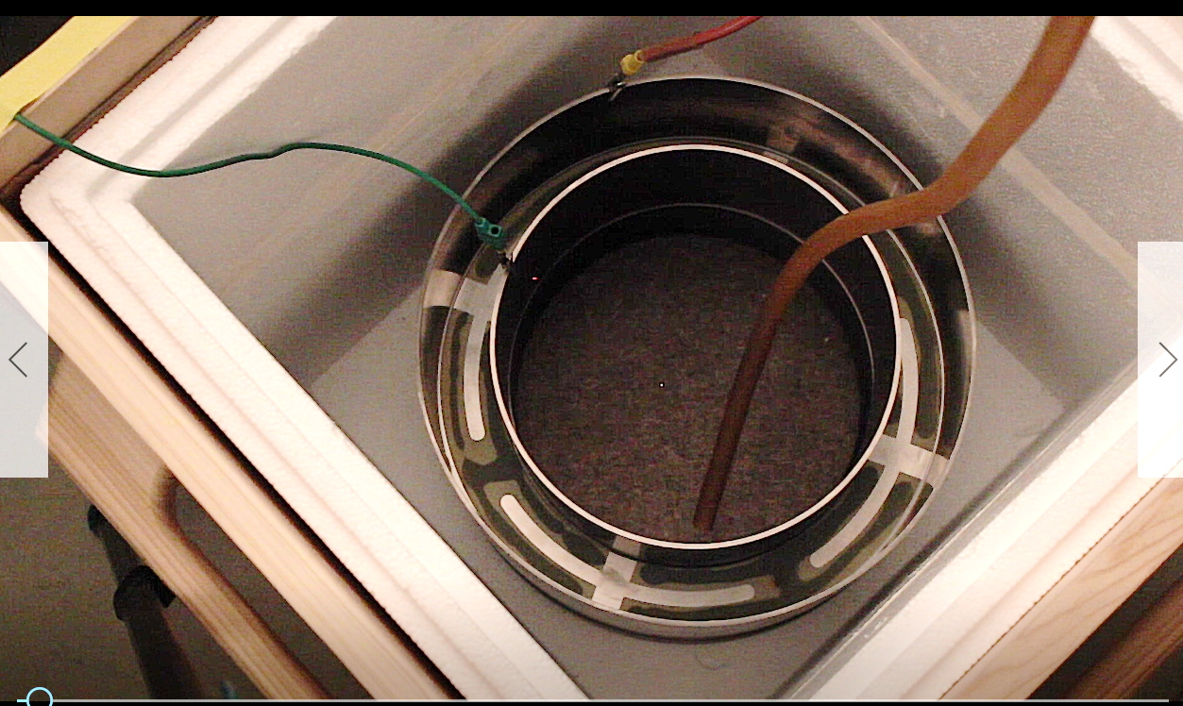
Meander Shielding
CCC-XD pick-up coil
High-Voltage-
Test
in LN₂
Cover of
Pick-Up-Coil
V. Tympel (Helmholtz-Institut Jena) GSI Helmholtzzentrum für Schwerionenforschung, Darmstadt Germany

Slide 30
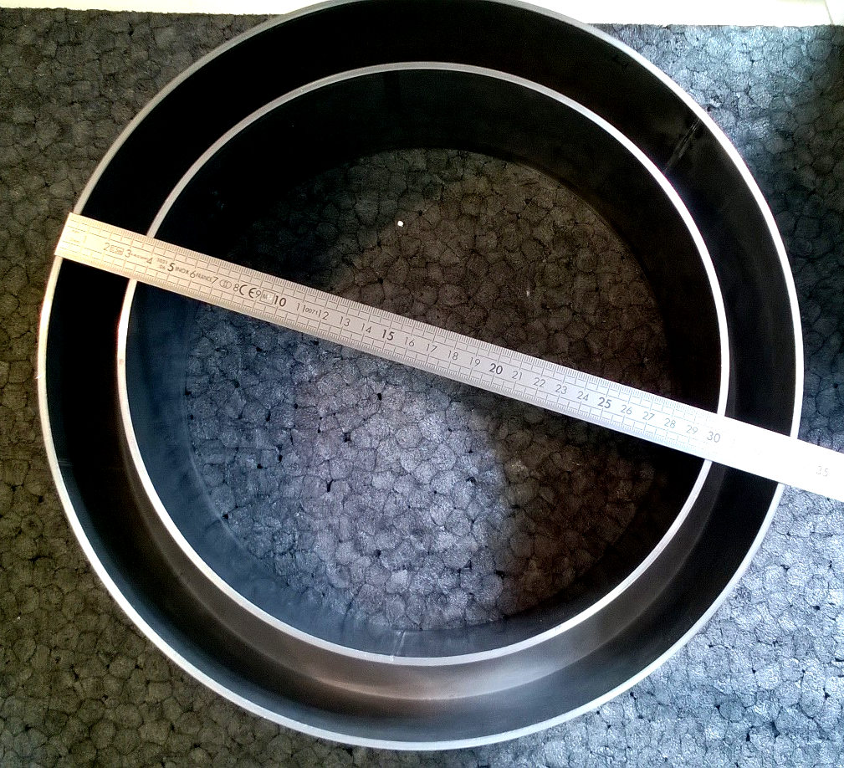
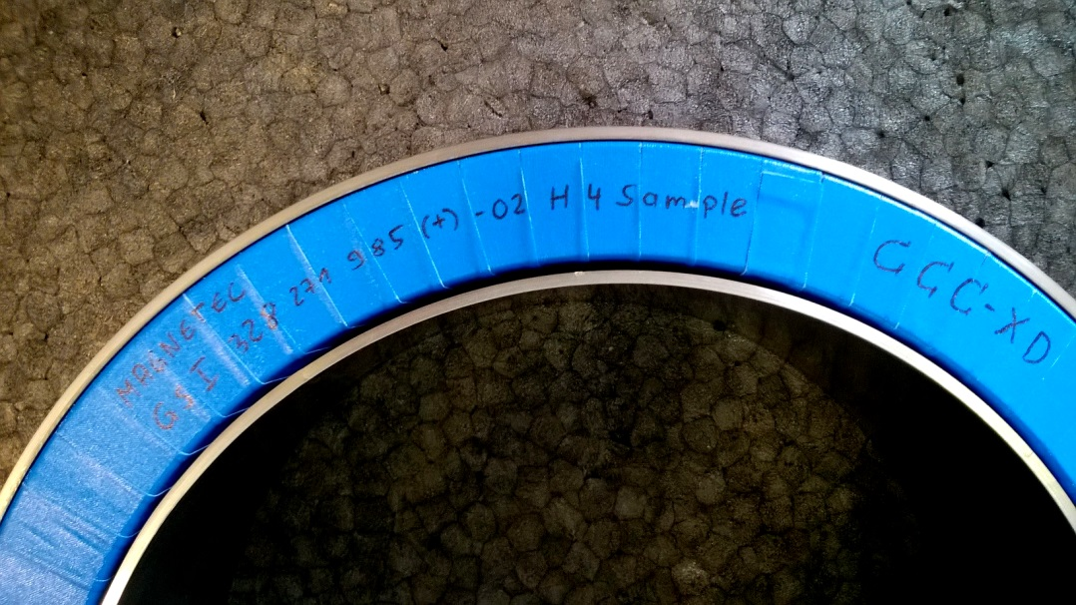
Meander Shielding
CCC-XD pick-up coil
Flux-concentrator added
Nb-Pick-Up-Coil
V. Tympel (Helmholtz-Institut Jena) GSI Helmholtzzentrum für Schwerionenforschung, Darmstadt Germany

Slide 31
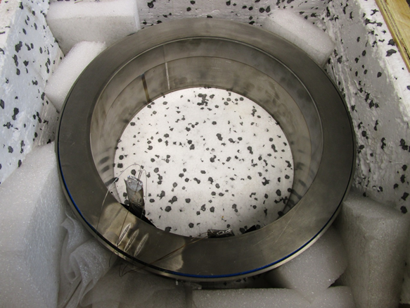
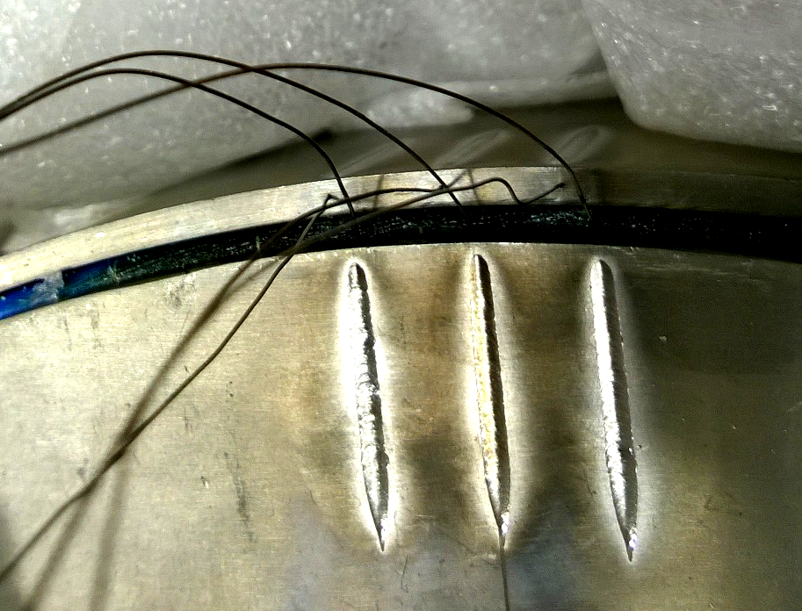
Meander Shielding
CCC-XD pick-up coil
Pick-Up-Coil closed - ready
Nb-wire
V. Tympel (Helmholtz-Institut Jena) GSI Helmholtzzentrum für Schwerionenforschung, Darmstadt Germany

Slide 32
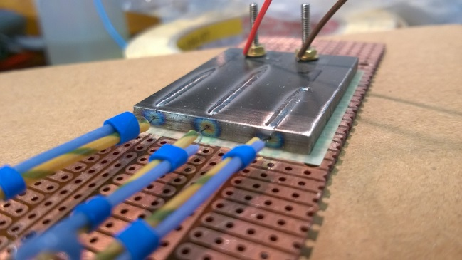
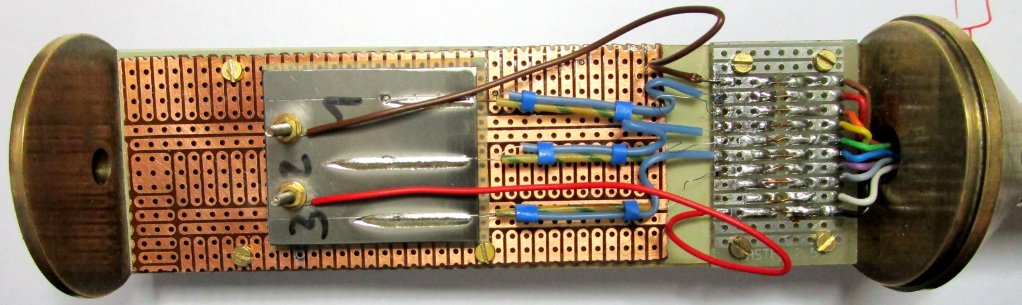
Meander Shielding
CCC-XD pick-up coil
Nb-wire
SC-testing: Nb-wire
V. Tympel (Helmholtz-Institut Jena) GSI Helmholtzzentrum für Schwerionenforschung, Darmstadt Germany

Slide 33
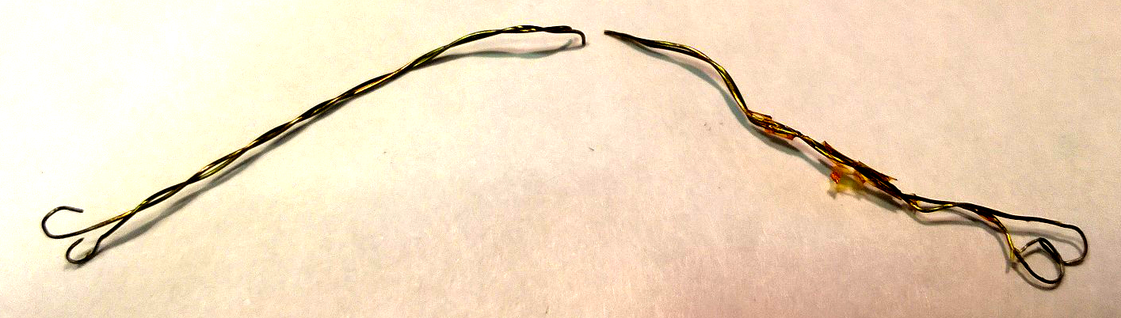
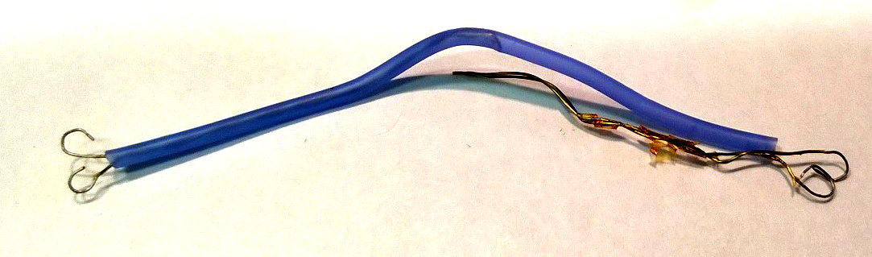
Cable problems
CCC-XD pick-up coil
GSI-
Probleme
V. Tympel (Helmholtz-Institut Jena) GSI Helmholtzzentrum für Schwerionenforschung, Darmstadt Germany

Slide 34
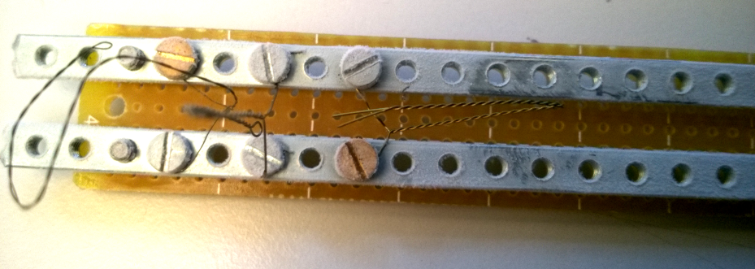
Cable problems
CCC-XD pick-up coil
Sample
No problem!
H₂0
H₂0
LN₂
V. Tympel (Helmholtz-Institut Jena) GSI Helmholtzzentrum für Schwerionenforschung, Darmstadt Germany

Slide 35

Cable problems
CCC-XD pick-up coil
Sample
LN₂
LHe
Use only soft-annealed wire!
V. Tympel (Helmholtz-Institut Jena) GSI Helmholtzzentrum für Schwerionenforschung, Darmstadt Germany

Slide 36


Slide 37

Meander Shielding
CCC-XD
End of December 2016:
First L-Measurements
☹
Houston, we have a problem.
V. Tympel (Helmholtz-Institut Jena) GSI Helmholtzzentrum für Schwerionenforschung, Darmstadt Germany

Slide 38
Meander Shielding
CCC-XD
Ende Dezember 2016:
Erste Messung CCC-XD fertig geschweißt!
V. Tympel (Helmholtz-Institut Jena) GSI Helmholtzzentrum für Schwerionenforschung, Darmstadt Germany

Slide 39
Meander Shielding
CCC-XD
January 2017:
Room-temperature
L-Measurements
V. Tympel (Helmholtz-Institut Jena) GSI Helmholtzzentrum für Schwerionenforschung, Darmstadt Germany

Slide 40
Meander Shielding
CCC-XD
January 2017:
Room-temperature
L-Measurements
V. Tympel (Helmholtz-Institut Jena) GSI Helmholtzzentrum für Schwerionenforschung, Darmstadt Germany

Slide 41
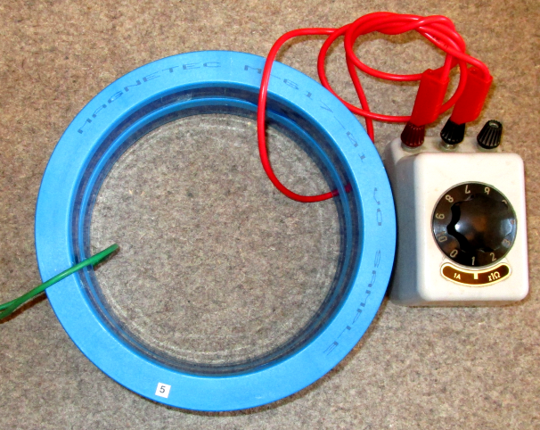
Meander Shielding
CCC-XD
Hardware-
Simulation: Inductance
Similar inductance
Additional turn with
resistor
V. Tympel (Helmholtz-Institut Jena) GSI Helmholtzzentrum für Schwerionenforschung, Darmstadt Germany

Slide 42
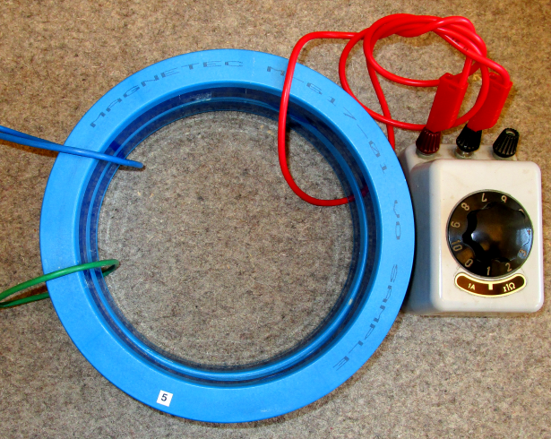
Meander Shielding
CCC-XD
Hardware-
Simulation: transfer func.
Similar inductance
Additional turn with
resistor
Additional turn with
AC-Voltage-meter
V. Tympel (Helmholtz-Institut Jena) GSI Helmholtzzentrum für Schwerionenforschung, Darmstadt Germany

Slide 43
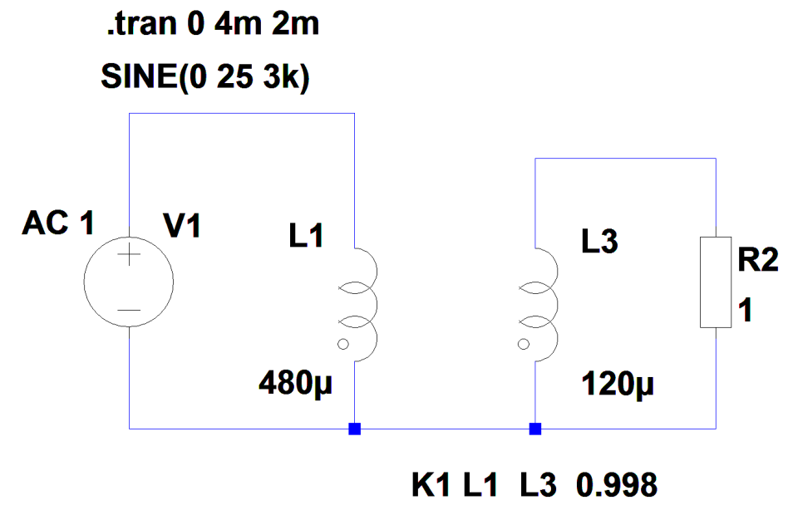
Meander Shielding
CCC-XD

Slide 44
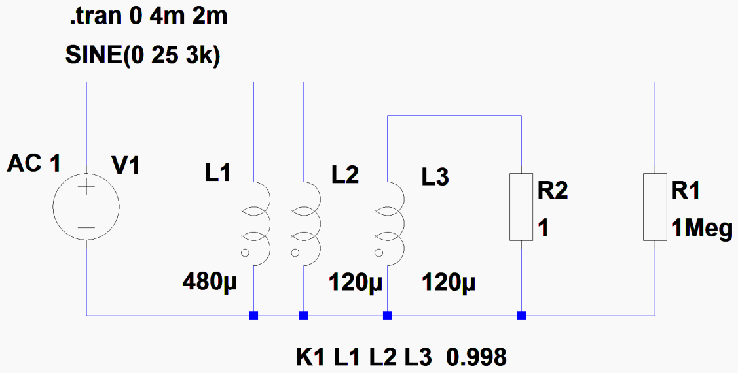
Meander Shielding
CCC-XD
AC: 3 kHz 25 V
ShortCut: 8 A => 16 A at meander
Free: 2 A

Slide 45
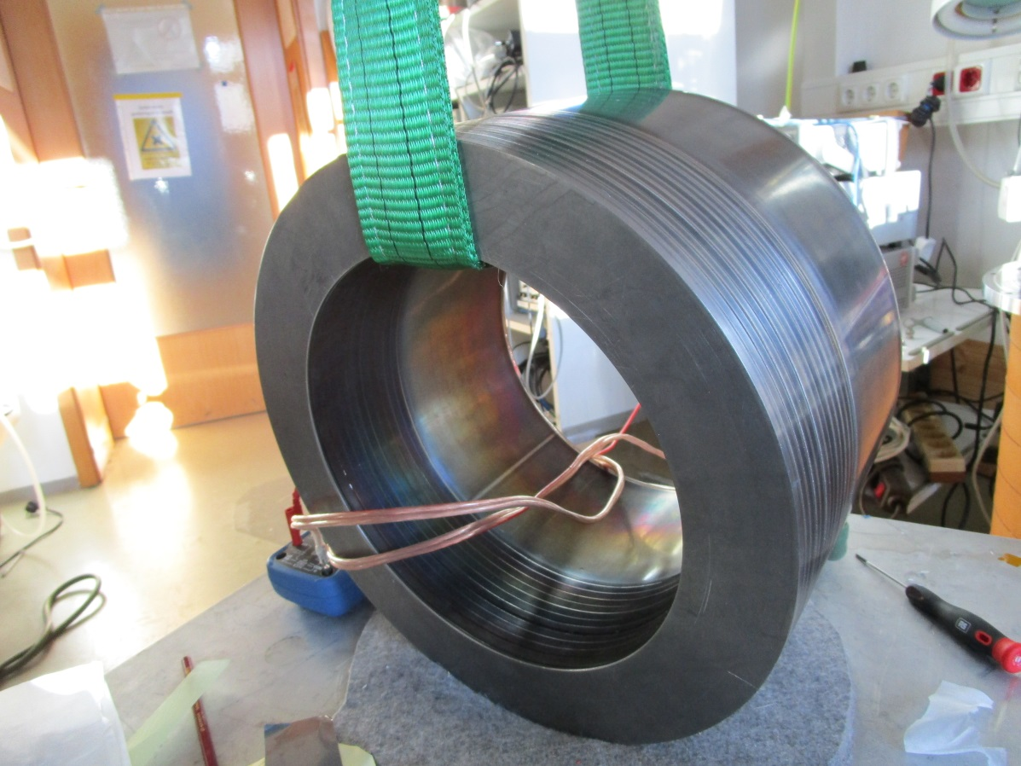
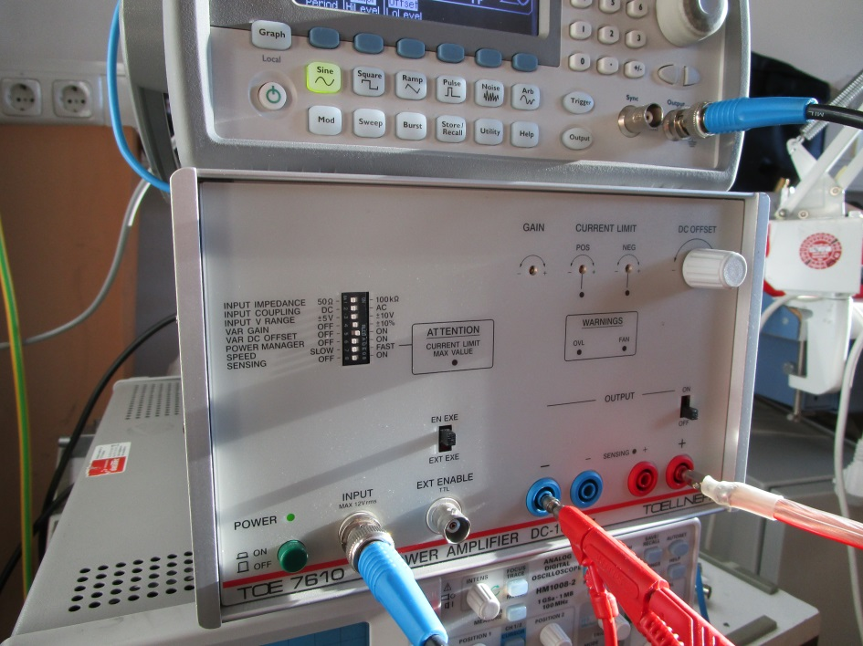
Meander Shielding
CCC-XD
16 A @ 3 kHz
V. Tympel (Helmholtz-Institut Jena) GSI Helmholtzzentrum für Schwerionenforschung, Darmstadt Germany

Slide 46
Meander Shielding
CCC-XD
Room temperature
Input 10V_{pp} PickUp
Output Calib. coil
Red : OK
Black: Short Cut
V. Tympel (Helmholtz-Institut Jena) GSI Helmholtzzentrum für Schwerionenforschung, Darmstadt Germany

Slide 47
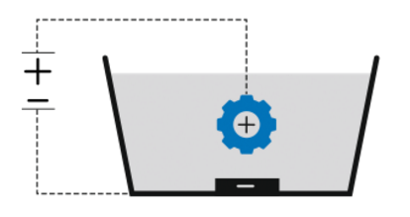
Meander Shielding
Anodize
Nb:
2,4 nm / V
+
_
V. Tympel (Helmholtz-Institut Jena) GSI Helmholtzzentrum für Schwerionenforschung, Darmstadt Germany

Slide 48
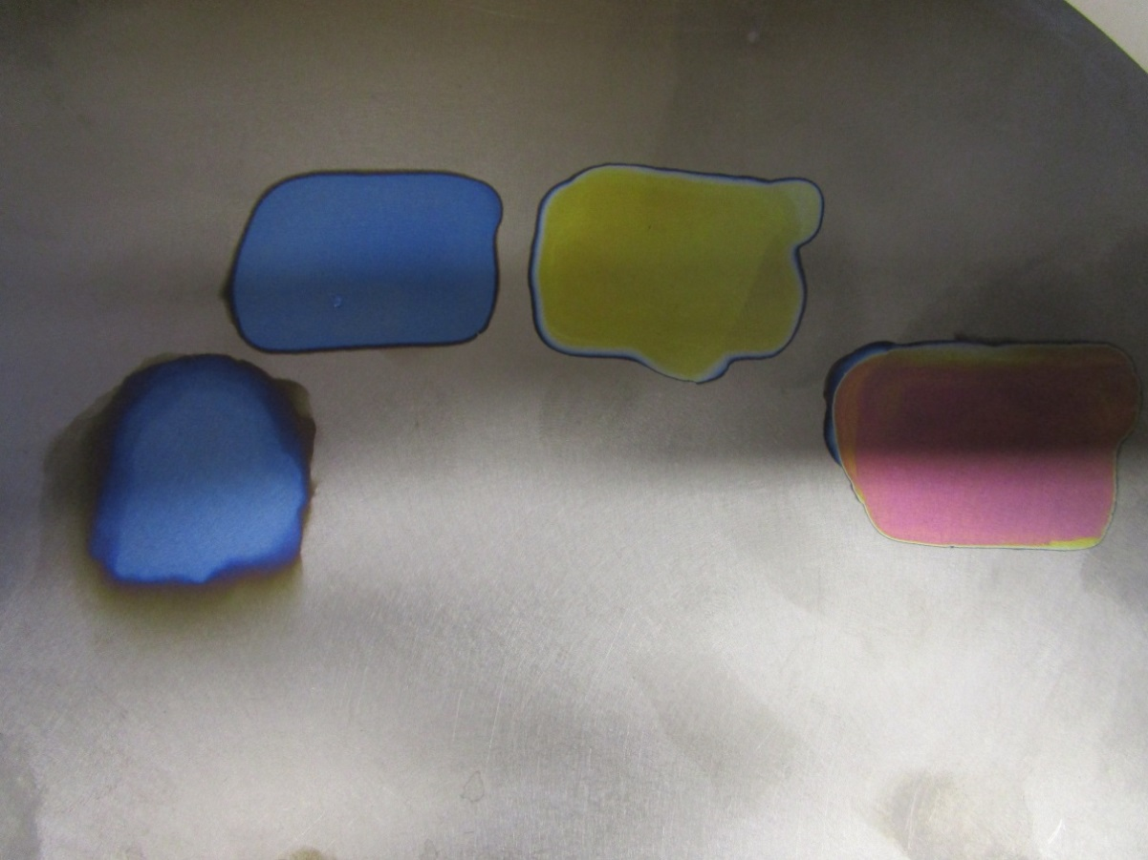
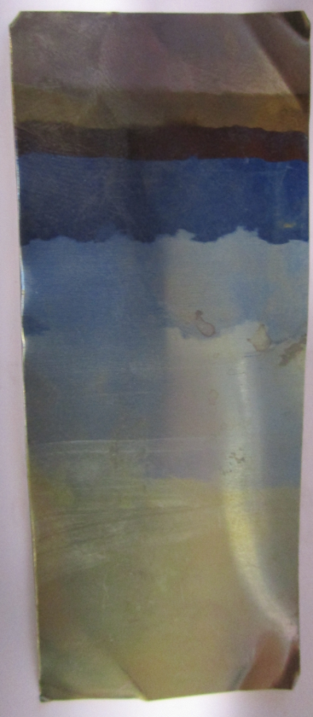
Meander Shielding
Anodize
0 V
60 V short
10 V
20 V
30 V
30 V
40 V
60 V
30 V
50 V
60 V
V. Tympel (Helmholtz-Institut Jena) GSI Helmholtzzentrum für Schwerionenforschung, Darmstadt Germany

Slide 49
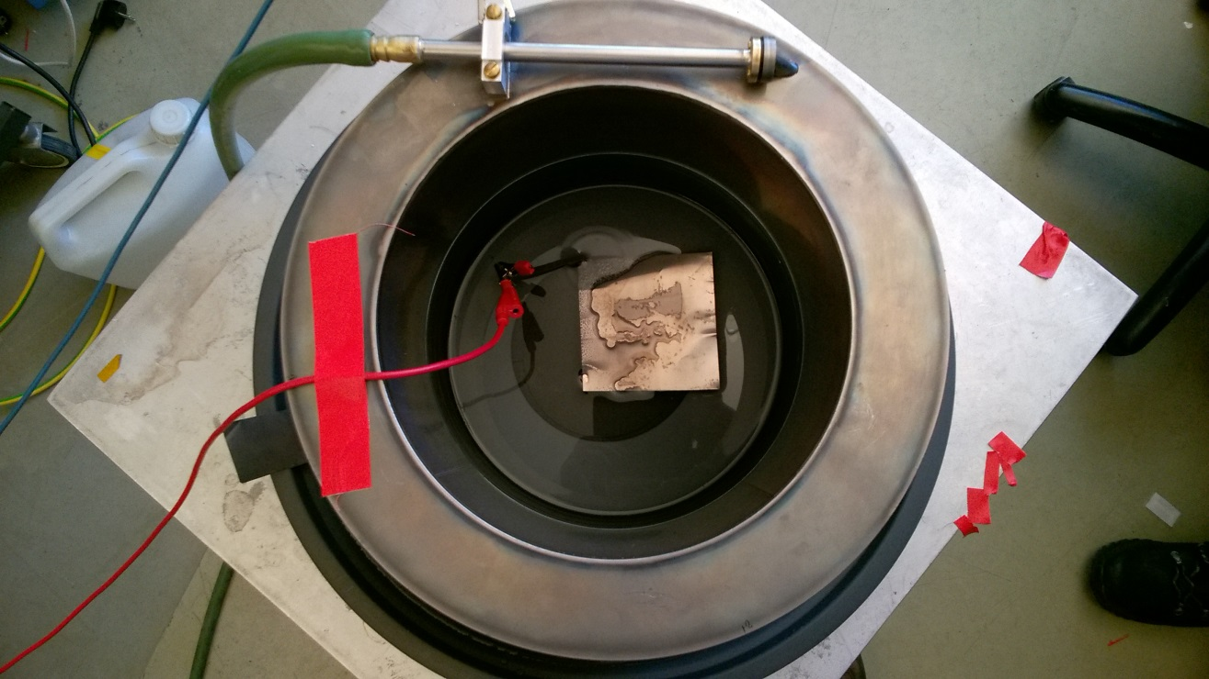
Meander Shielding
Anodize
+
“pickling”
0,2 % HCl
+ 60 V
+ 1 h
_
V. Tympel (Helmholtz-Institut Jena) GSI Helmholtzzentrum für Schwerionenforschung, Darmstadt Germany

Slide 50
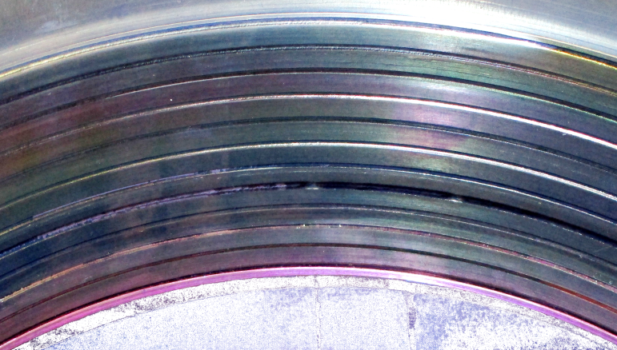
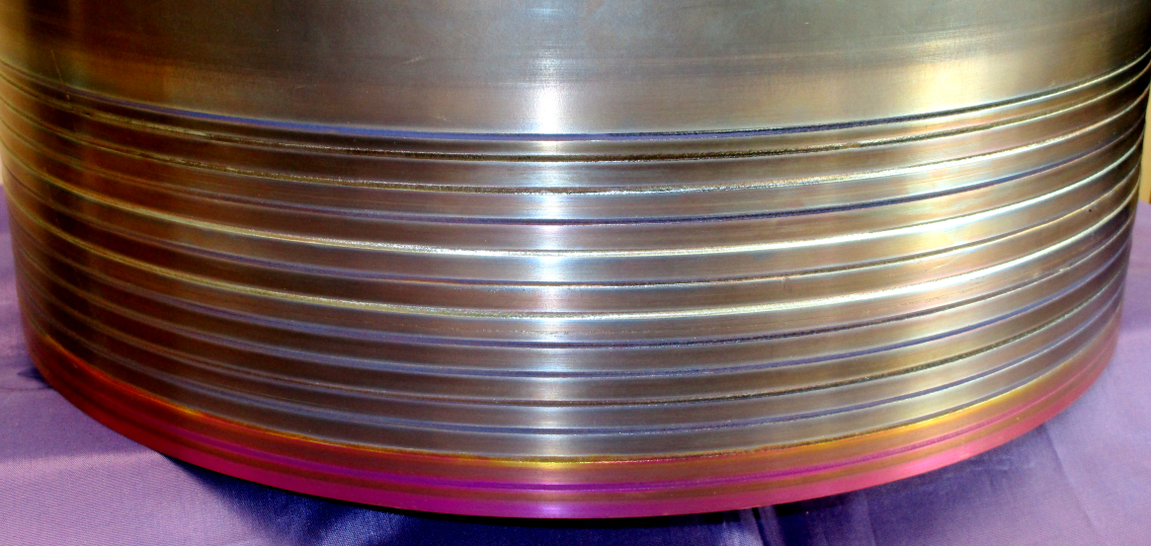
Meander Shielding
Anodize
“pickling”
0,2 % HCl
+ 60 V
+ 1 h
V. Tympel (Helmholtz-Institut Jena) GSI Helmholtzzentrum für Schwerionenforschung, Darmstadt Germany

Slide 51

Meander Shielding
CCC-XD
☺
V. Tympel (Helmholtz-Institut Jena) GSI Helmholtzzentrum für Schwerionenforschung, Darmstadt Germany

Slide 52
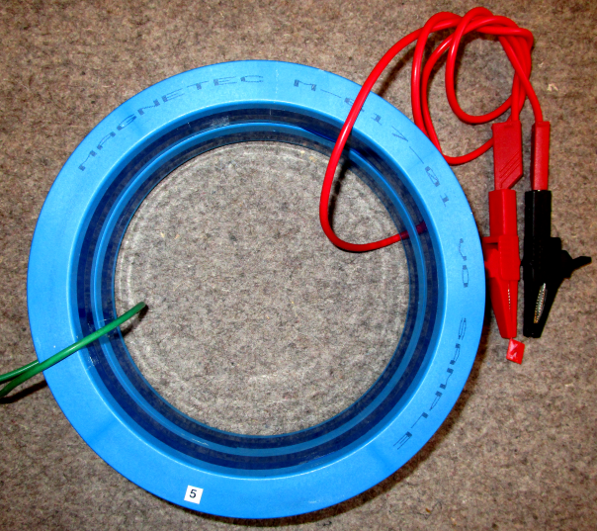
Meander Shielding
CCC-XD
Hardware-
Simulation: Inductance
Similar inductance
Additional turn with
capacity
V. Tympel (Helmholtz-Institut Jena) GSI Helmholtzzentrum für Schwerionenforschung, Darmstadt Germany

Slide 53
Transformer
Matching
80 µH 1 µH
V. Tympel (Helmholtz-Institut Jena) GSI Helmholtzzentrum für Schwerionenforschung, Darmstadt Germany

Slide 54
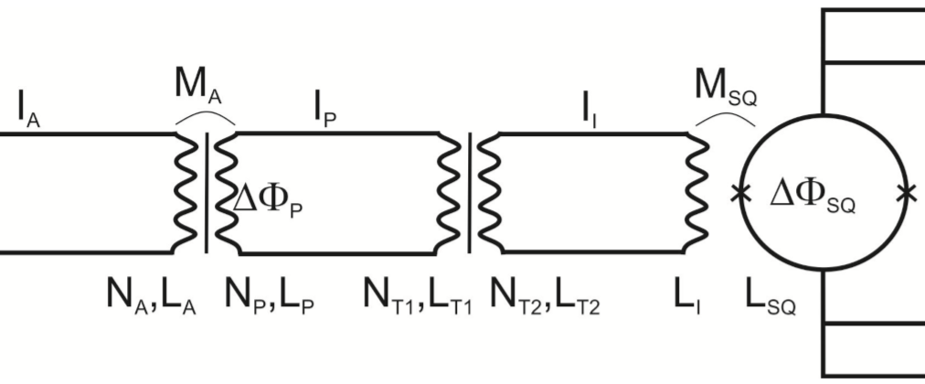
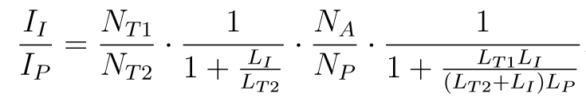

Transformer
Dissertation
René Geithner, 2013
„Um eine Impedanzanpassung zu gewährleisten, muss die Induktivität der Sekundärseite des Anpass-transformators an die Induktivität der Einkoppelspule angepasst werden (L_{T2} = L_{I}) und andererseits wird die Induktivität der Primarseite des Anpasstransformators an die Induktivität der Pick-up-Spule angepasst (L_{P} = L_{T1}).“
1 81µH
1 81µH
9 81µH
1 1µH
1µH
1:1
9:1
(3.26)
9
1
$$=9∙\frac{1}{2}∙\frac{1}{\frac{3}{2}}=\frac{9}{3}=3$$
1
1
1
81·1
A
( 2 ) ·81
V. Tympel (Helmholtz-Institut Jena) GSI Helmholtzzentrum für Schwerionenforschung, Darmstadt Germany

Slide 55
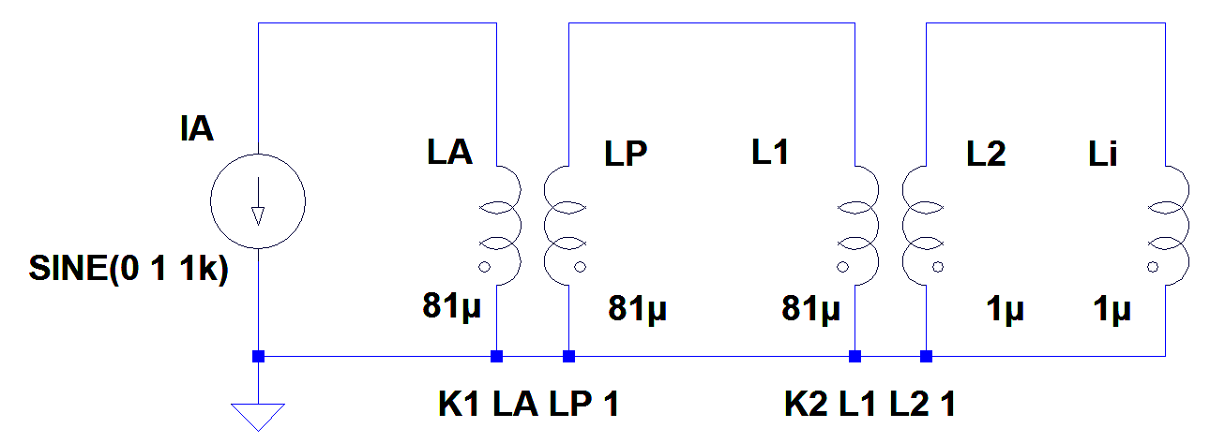




Transformer
CCC-XD
$$1 A$$
$$0,667 A$$
$$3 A$$
$$\frac{I_{I}}{I_{A}}=3$$
V. Tympel (Helmholtz-Institut Jena) GSI Helmholtzzentrum für Schwerionenforschung, Darmstadt Germany

Slide 56
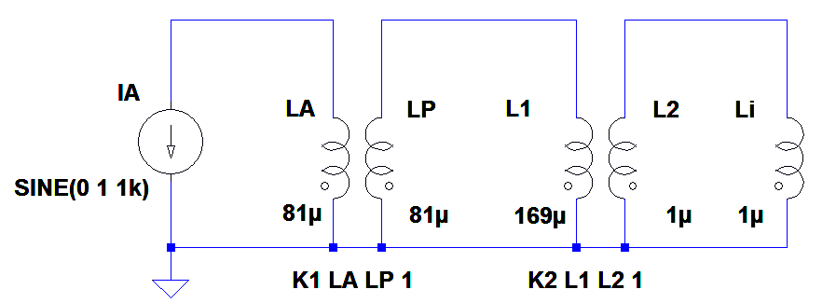



Transformer
CCC-XD
$$1 A$$
$$0,5 A$$
$$3,2 A$$
$$\frac{I_{I}}{I_{A}}=3,2$$
V. Tympel (Helmholtz-Institut Jena) GSI Helmholtzzentrum für Schwerionenforschung, Darmstadt Germany

Slide 57
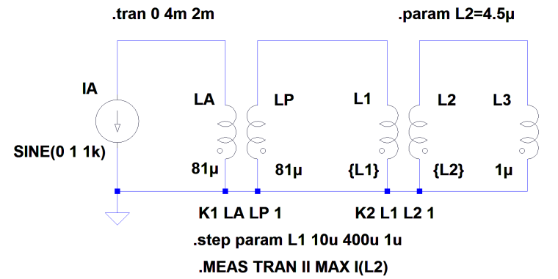
Transformer
CCC-XD
V. Tympel (Helmholtz-Institut Jena) GSI Helmholtzzentrum für Schwerionenforschung, Darmstadt Germany

Slide 58
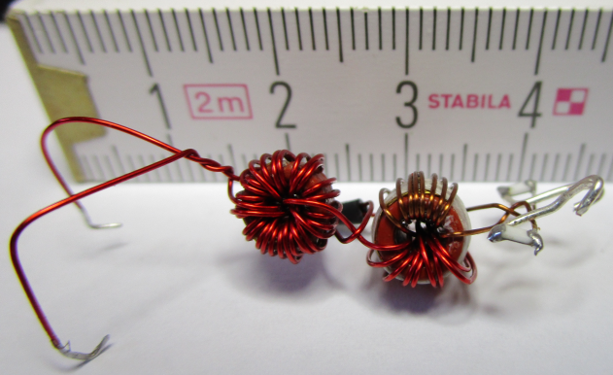
Transformer
CCC-XD
measured
3,7
measured
CCC-XD
V. Tympel (Helmholtz-Institut Jena) GSI Helmholtzzentrum für Schwerionenforschung, Darmstadt Germany

Slide 59
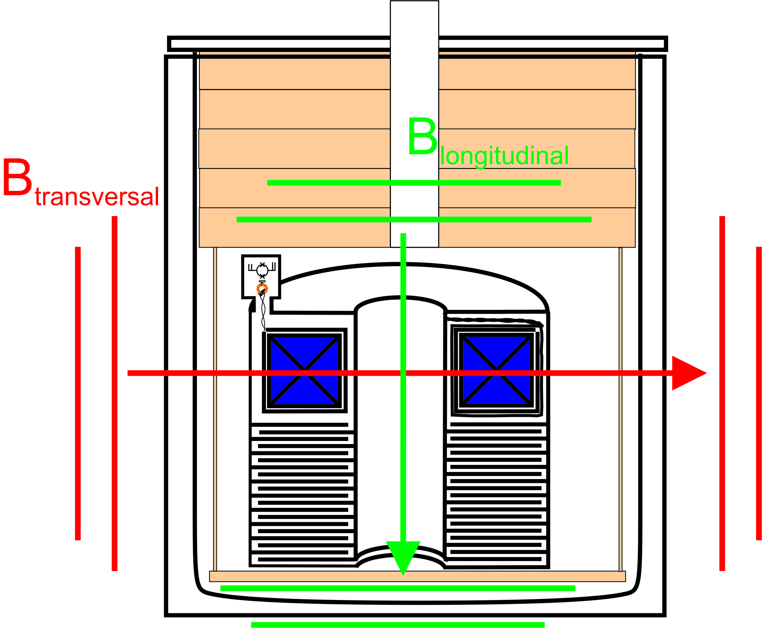
Attenuation Factor
FAIR-CCC
Increased number of meander from 7 auf 12
Transvers fields
(perpendicular to beam)
  187 dB, (DESY-CCC:167 dB)
Longitudinal fields
(parallel to beam)
  199 dB, (DESY-CCC: 187 dB)

Slide 60


Slide 61







Next challenges
Attenuation Factor
[IBIC2016 T. Sieber, F. Kurian et. al.]
[CAARI2016 F. Kurian, R. Neubert et. al.]
V. Tympel (Helmholtz-Institut Jena) GSI Helmholtzzentrum für Schwerionenforschung, Darmstadt Germany

Slide 62



Next challenges
Attenuation Factor
Helmholtz-Coil
Φ₀ ≈ 2∙10⁻¹⁵ T m²
CCC-XD
± 4 µT
B= 2,8 µT_{RMS}
R_{i} = 142,5 mm
A = R_{i}² ∙ π
=> A= 0,064 mm²
=> Φ_{HH} = B∙A = 0,18 µTm²
=> 0,9 ∙10⁸ Φ_{0RMS}
Peak: 3,3 mV_{RMS}/√Hz Bereich: 25 Hz / 800 Linien
Fenster: Flat Top (exp: 2x)
Umrechnung in V_{RMS} =
2∙18 mV_{RMS}/√Hz ∙√(25 Hz / 800)
V_{RMS} ≈ 6,4 mV_{RMS}
SQUID feedback sensitivity:
45 µA/Φ₀ ∙10 kΩ = 450 mV/Φ₀
=> Φ_{SQUID} = 0,014 Φ_{0RMS}
Φ_{CCC} = Φ_{SQUID} / 2,8
Φ_{CCC}/ Φ_{HH} = 0,005 / (0,9 ∙10⁸)
S_{CCC}≈ 5,5 ∙10⁻¹¹ ( -205 dB )
10 V_{pp} @ 1 Hz
=> ± 170 mA
V. Tympel (Helmholtz-Institut Jena) GSI Helmholtzzentrum für Schwerionenforschung, Darmstadt Germany

Slide 63

Next challenges
Attenuation Factor
SL-Mäander
NL-Kryostat
besser
-200 dB ???
V. Tympel (Helmholtz-Institut Jena) GSI Helmholtzzentrum für Schwerionenforschung, Darmstadt Germany

Slide 64
Next challenges
Attenuation Factor
Helmholtz-Coil
Φ₀ ≈ 2∙10⁻¹⁵ T m²
CCC-XD
± 4 µT
B= 2,8 µT_{RMS}
R_{i} = 142,5 mm
A = R_{i}² ∙ π
=> A= 0,064 mm²
=> Φ_{HH} = B∙A = 0,18 µTm²
=> 0,9 ∙10⁸ Φ_{0RMS}
Peak: 3,3 mV_{RMS}/√Hz Bereich: 25 Hz / 800 Linien
Fenster: Flat Top (exp: 2x)
Umrechnung in V_{RMS} =
2∙18 mV_{RMS}/√Hz ∙√(25 Hz / 800)
V_{RMS} ≈ 6,4 mV_{RMS}
SQUID feedback sensitivity:
45 µA/Φ₀ ∙10 kΩ = 450 mV/Φ₀
=> Φ_{SQUID} = 0,014 Φ_{0RMS}
Φ_{CCC} = Φ_{SQUID} / 2,8
Φ_{CCC}/ Φ_{HH} = 0,005 / (0,9 ∙10⁸)
S_{CCC}≈ 5,5 ∙10⁻¹¹ ( -205 dB )
10 V_{pp} @ 1 Hz
=> ± 170 mA
V. Tympel (Helmholtz-Institut Jena) GSI Helmholtzzentrum für Schwerionenforschung, Darmstadt Germany

Slide 65
Next challenges
Attenuation Factor
Helmholtz-Coil
Φ₀ ≈ 2∙10⁻¹⁵ T m²
CCC-XD
± 4 µT
B= 2,8 µT_{RMS}
R_{i} = 142,5 mm
A = R_{i}² ∙ π
=> A= 0,064 mm²
=> Φ_{HH} = B∙A = 0,18 µTm²
=> 0,9 ∙10⁸ Φ_{0RMS}
S_{CCC} = S_{Mäander} ∙ S_{PickUp}
S_{PickUp} – to measure!
Setup
Pick-Up-Coil only
B_{PickUp}
B= 2,8 µT
10 V_{pp} @ 1 Hz
=> ± 170 mA
V. Tympel (Helmholtz-Institut Jena) GSI Helmholtzzentrum für Schwerionenforschung, Darmstadt Germany

Slide 66
Thank you for your attention.
Short summary
Charged beam:
Squid it !
V. Tympel (Helmholtz-Institut Jena) GSI Helmholtzzentrum für Schwerionenforschung, Darmstadt Germany

