Slide 1
Collaboration Meeting Ultra-sensitive Beam Current Measurements for future Accelerator Facilities
26. + 27.04.2017, CERN
T.Sieber
Status of the FAIR CCC and Cryostat
26.+27.04.2017
CCC Collaboration Meeting
Thomas Sieber

Slide 2
Contents
CCC status at FAIR
Design of the CCC cryostat
Outlook
26.+27.04.2017
CCC Collaboration Meeting
Thomas Sieber

Slide 3
CCC application at FAIR / CRYRING
FAIR
Transmission / loss monitoring for slow extracted beams
Extraction efficiency of the synchrotrons
Analysis of the spill structure
Absolute calibration of BI devices like SEM
nA intensity measurements for experiments reaction rates
CR
CRYRING
Accurate tool for ring commissioning and ring operation
nA intensity measurements for experiments reaction rates
26.+27.04.2017
CCC Collaboration Meeting
Thomas Sieber

Slide 4
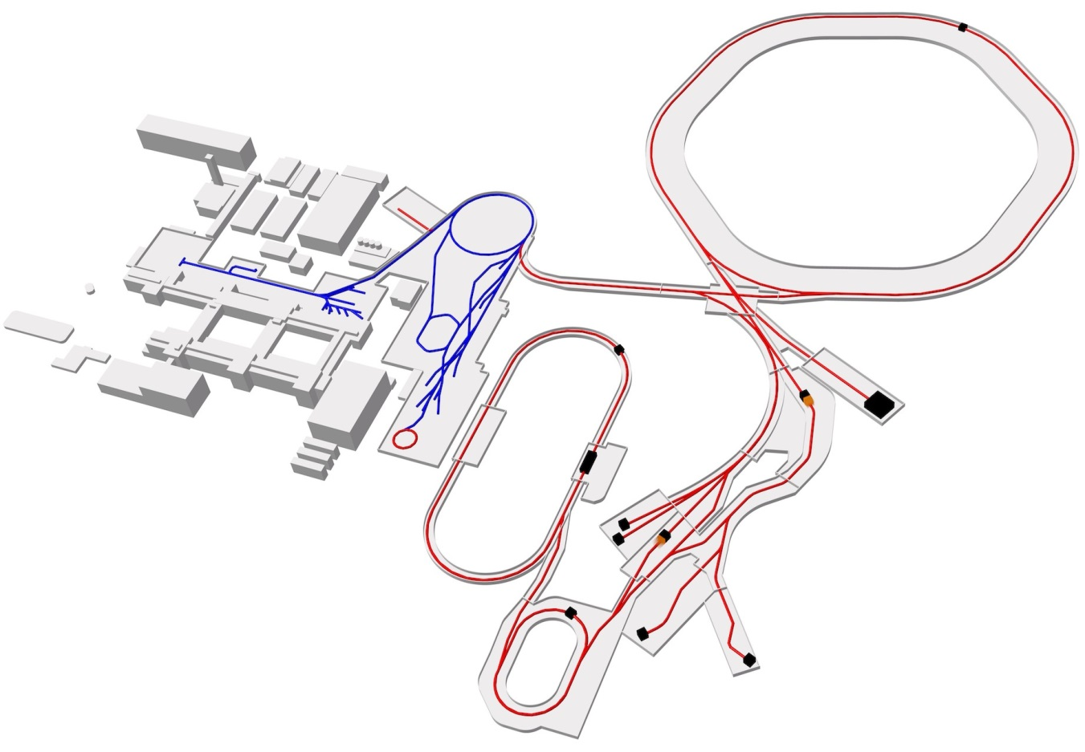
CCC locations at FAIR
Proton Linac
UNILAC
SIS18
SIS100
FAIR
GSI
CBM
Cryring
PANDA
HESR
Super FRS
CCC Position
CR
NuSTAR
26.+27.04.2017
CCC Collaboration Meeting
Thomas Sieber

Slide 5
CCC requirements at FAIR
Detector
- Current resolution as demonstrated in the 2014 runs (or better)
High bandwidth (10 kHz or better)
Improved system robustness
Radiation hardness; estimate 300 Gy/20a → tests at SIS18
Full integration in FAIR control system (FESA)
Cryostat
UHV / 150 mm beam tubes
Stand alone system → reliquefier (not in CRYRING)
Standard operation and testbench for CCC development
Vibration damping relativized but still an issue (→ N. Marsic)
Full integration in FAIR control system (FESA)
26.+27.04.2017
CCC Collaboration Meeting
Thomas Sieber

Slide 6
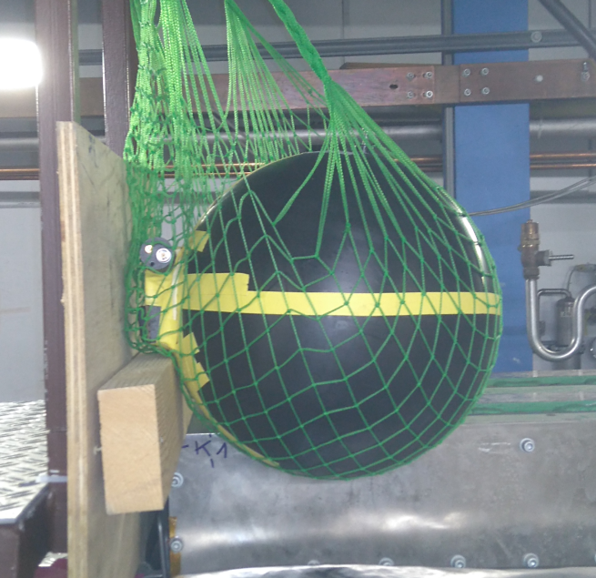
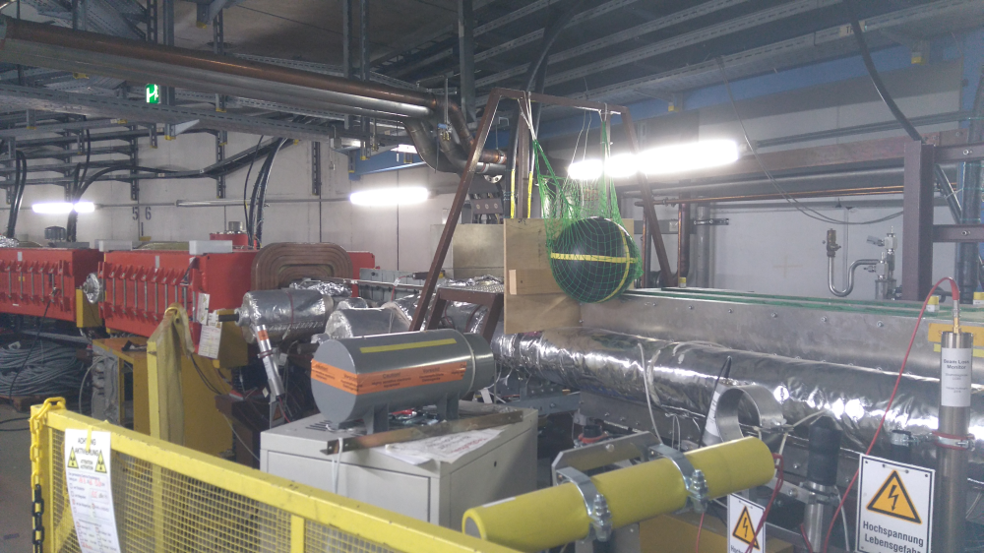
Radiation hardness test
Supracon SQUIDs + electronics
Magnicon SQUIDS
Installation in SIS18 extraction-line in May 2016
Desired total dose: 100 Gy
Accumulated dose measured weekly by radiation protection
→ after 4 months only 1 Gy accumulated due to low intensities and improved extraction scheme
26.+27.04.2017
CCC Collaboration Meeting
Thomas Sieber

Slide 7
CCC requirements at FAIR
Detector
- Current resolution as demonstrated in the 2014 runs (or better)
High bandwidth (10 kHz or better)
Improved system robustness
Radiation hardness; estimate 300 Gy/20a → tests at SIS18
Full integration in FAIR control system (FESA)
Cryostat
UHV / 150 mm beam tubes
Stand alone system → reliquefier (not in CRYRING)
Standard operation and testbench for CCC development
Vibration damping relativized but still an issue (→ N. Marcsic)
Full integration in FAIR control system (FESA)
26.+27.04.2017
CCC Collaboration Meeting
Thomas Sieber

Slide 8
Status at FAIR
- Shielding and SQUID system of FAIR CCC successfully tested at Jena ☺
- Basic design of the cryostat done (with FSU), detailed spec in review ☺
- LOBIDS started to look into control application ☺
- Priority on project planning for FAIR during last months ☹
- Call for tender still blocked by budget restrictions ☹
Demonstration for Tech. Director + Letter to FAIR management
Alternative solutions ? (Cryring)
- First beam in Cryring achieved, bakeout going on
- ecool commissioning in May, first ‚competing‘ experiments in 2018
26.+27.04.2017
CCC Collaboration Meeting
Thomas Sieber

Slide 9
Design of the cryostat
- GSI BI develops basic cryo + mechanical design and specifications
- FSU Jena provides 3D model and preliminary set of drawings
- GSI cryo department reviews design and spec
TU generates in parallel model for mechanical simulations
→ call for tender (negotiated procedure)
- manufacturer provides detailed cryo concept and drawings
- TU verifies mechanical properties by adjusting the theoretical model
→ production
Parameter | Value
Pump down time for isolation vacuum (2 x 500 l/s turbo) | <10 hours
Vacuum pressure in IVC (mbar) | 5*10⁻⁷ ± 3*10⁻⁷
Temperature of cooled thermal shielding (without He) (K) | <50
Leakage rate isolation vacuum (mbar l/s) | <1*10⁻⁹
Leakage rate UHV beam tube (mbar l/s) | <1*10⁻¹¹
Number of temperature sensors (cryo-physics) | 8
Standing time with 80 l He (hours) | >80
Maximum heat load to the He-container (shield at 50K) | <200 mW
Basic parameters fixed
In detailed spec
26.+27.04.2017
CCC Collaboration Meeting
Thomas Sieber

Slide 10
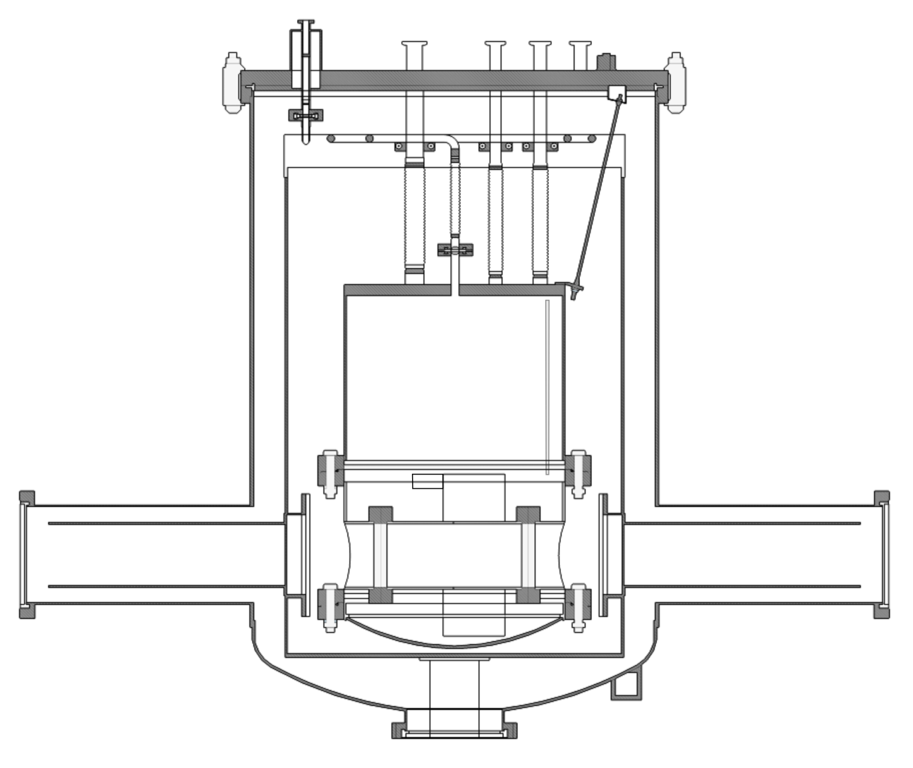
The GSI prototype
CCC system developed during early 1990’s at GSI (A. Peters, H. Reeg, W. Vodel et al.)
Test device required for new improved sensor components → system was recommissioned 2013 / 2014
CCC system developed during early 1990’s at GSI (A. Peters, H. Reeg, W. Vodel et al.)
Test device required for new improved sensor components → system was recommissioned 2013 / 2014
Titanium suspensions
He Gas Outlet
40 K Radiation shield covered by MLI
Low thermal conductivity feedthroughs
30 liter helium container / bath cryostat
Vacuum vessel; isolation vacuum = beamline vacuum
Liquid helium level sensor
SQUID
Pickup unit (SC shield, pickup coil and ring core)
Beam
Warmhole for beam passage
Ceramic gap
GM cryocooler cold head / Enthalpie cooling
Rubber feet
26.+27.04.2017
CCC Collaboration Meeting
Thomas Sieber

Slide 11
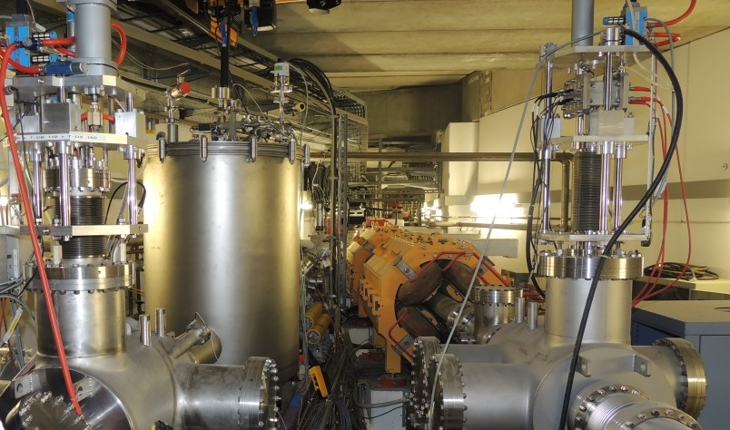
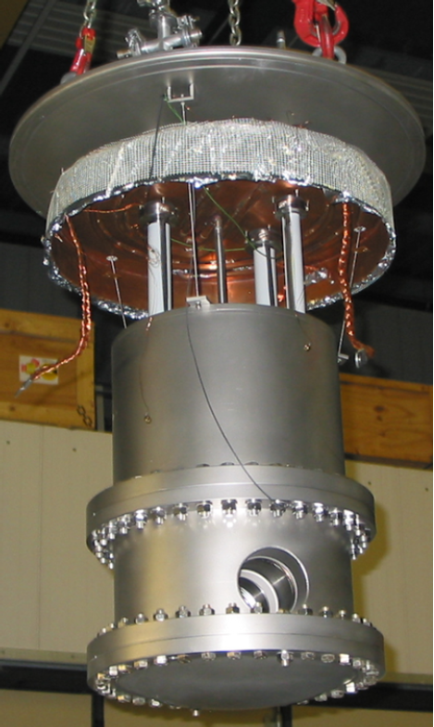
The GSI CCC prototype
26.+27.04.2017
CCC Collaboration Meeting
Thomas Sieber

Slide 12
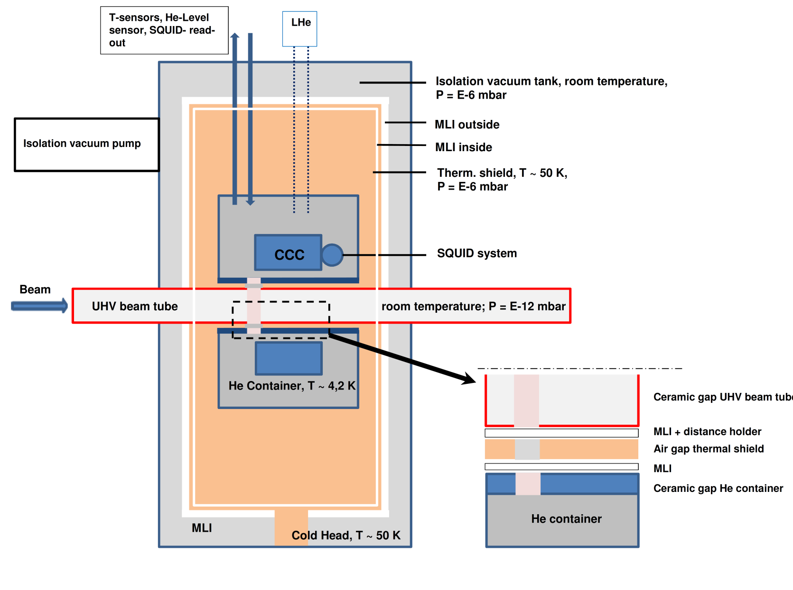
Design of the FAIR cryostat
26.+27.04.2017
CCC Collaboration Meeting
Thomas Sieber

Slide 13
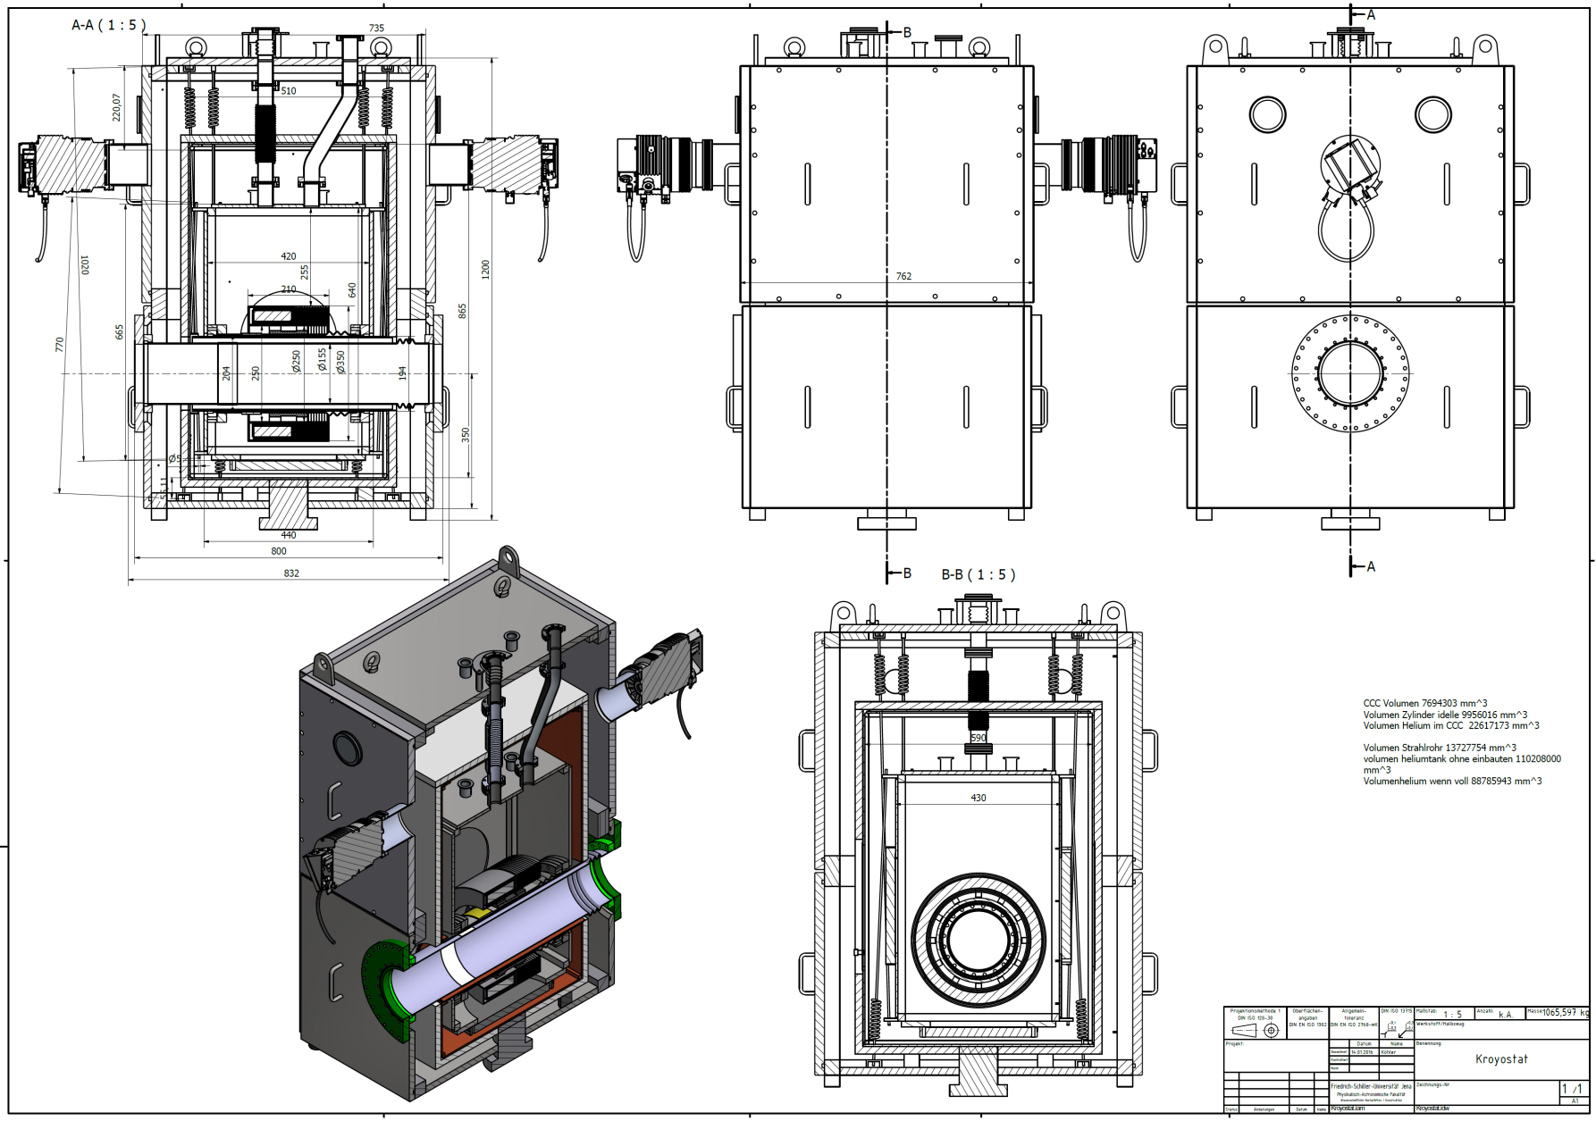
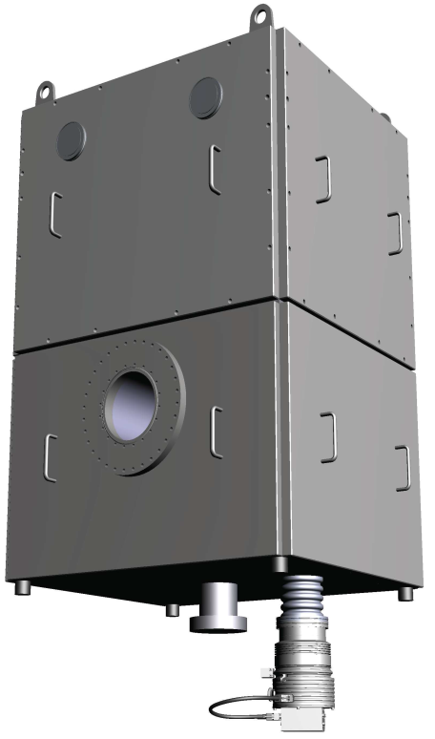
Mechanical layout
26.+27.04.2017
CCC Collaboration Meeting
Thomas Sieber

Slide 14
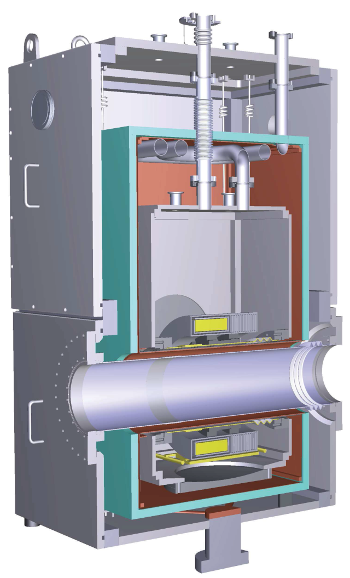
Mechanical layout
yz -cut
Top plate, feedthroughs, He filling
xy -cut
Vacuum chamber
Ti Suspensions
He lines
Thermal shield, Cu
MLI
Liquid He container
150mm beam tube
Thermal shield tube
He container inner tube
Pickup unit/GFK spacers
Connection to refrigerator
(strips)
CCC support
Turbo pump
26.+27.04.2017
CCC Collaboration Meeting
Thomas Sieber

Slide 15
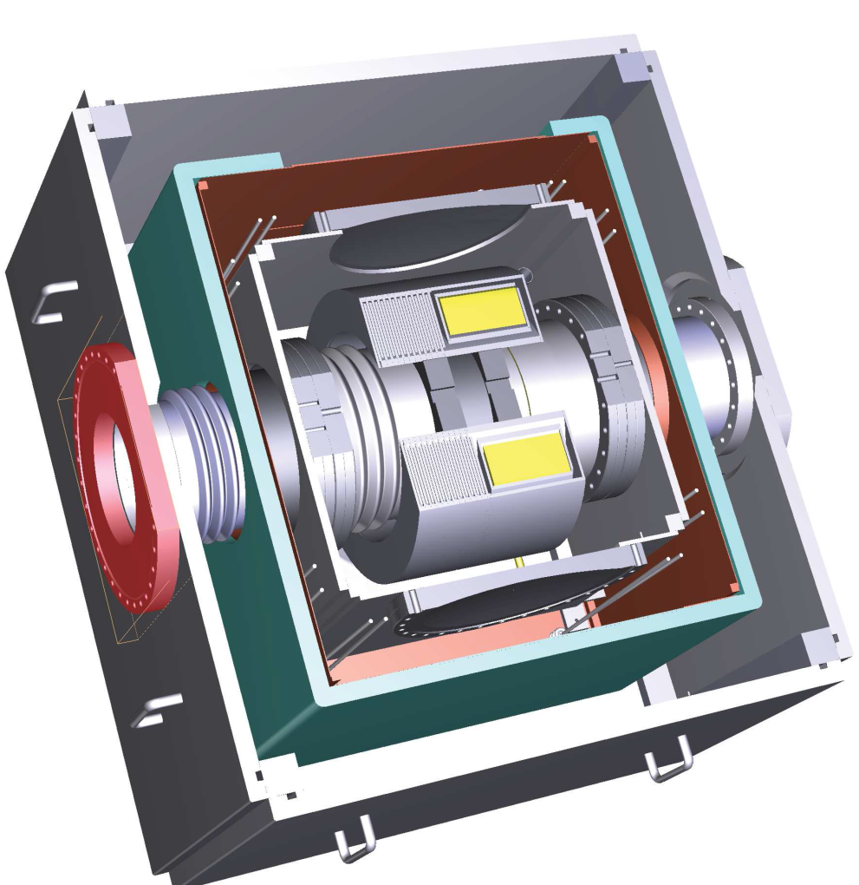
Mechanical layout
Vacuum chamber
Ti Suspensions
Thermal shield, Cu
Liquid He container
150mm beam tube
Thermal shield tube
He container inner tube
Pickup unit/GFK spacers
CCC support
26.+27.04.2017
CCC Collaboration Meeting
Thomas Sieber

Slide 16
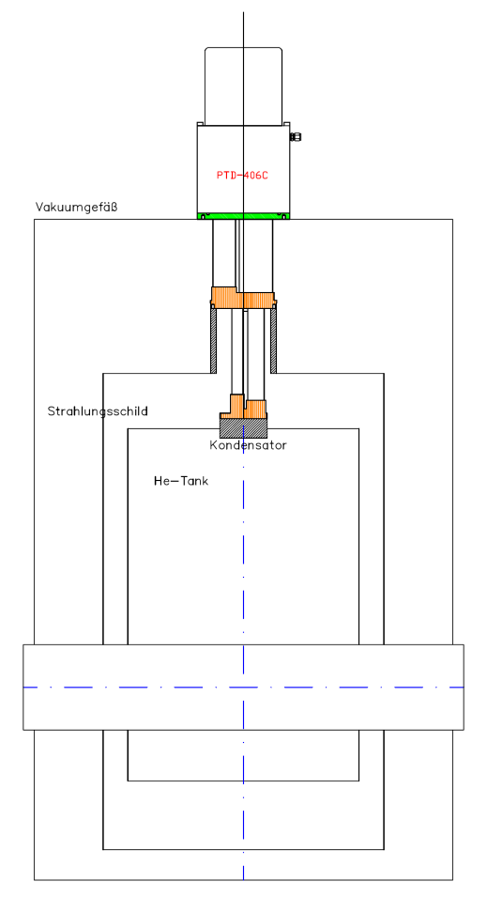
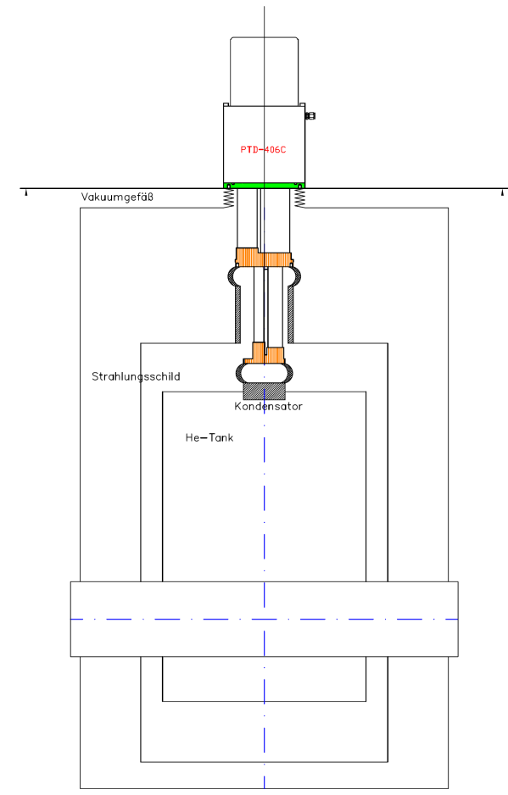
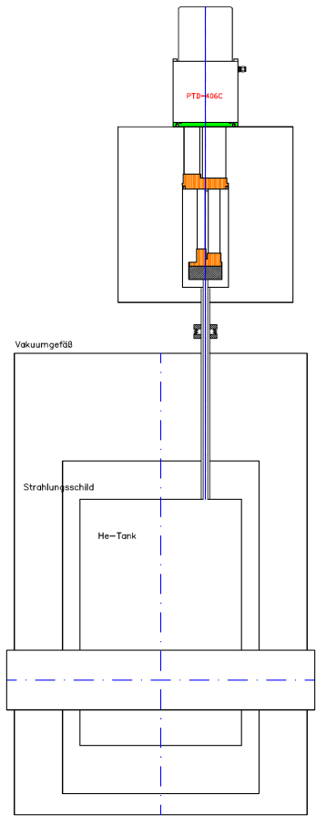
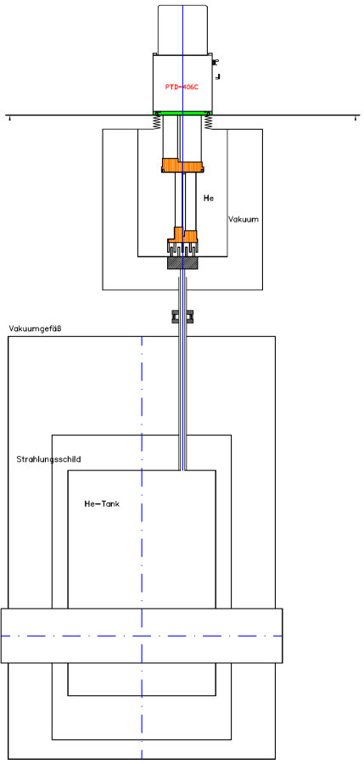
Re-Liquefaction schemes (TransMIT)
Inlet exhaust
gas from shield
gas cooling
Inlet exhaust
gas from shield
gas cooling
direct
direct with damping
separate shield cooling
separate shield cooling
with damping
Liquefaction rate with pulsed tube cooler (He at room temperature): 0.7 l/hour. Costs: ~ 50 k€
Displacement measured at the cooler: 5 μm, damping reduces motion by factor ~10²
26.+27.04.2017
CCC Collaboration Meeting
Thomas Sieber

Slide 17
Summary / Outlook
CCC detector
Some lessons learned from 2016 (Nb cabling, thermal drift, radiation...)
- Investigation of temperature drift in Jena / develop standard measurement for noise figure
- Repeat radiation hardness test at GSI
Cryostat
Detailed spec: review process to be finished
→ Call for tender as soon as budget is clarified (in the meantime intensify contact with industry)
Provide input for mech. simulations at TU
New PhD student, David Haider, starting in Nov to support this work !!!
Cryring
vacuum commisioning ongoing
restart with beam in May 2017 for 4 weeks
→ shutdown. Further planning depending on results
26.+27.04.2017
CCC Collaboration Meeting
Thomas Sieber

Slide 18
Thank you for your attention !
26.+27.04.2017
CCC Collaboration Meeting
Thomas Sieber

