Slide 2
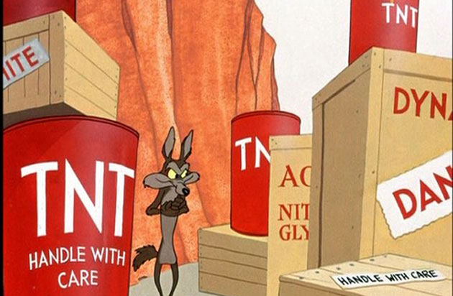
Powering tests after 16/17 EYETS
M. Solfaroli and M. Pojer
On behalf of all teams involved in the powering tests
19/04/2017

Slide 3
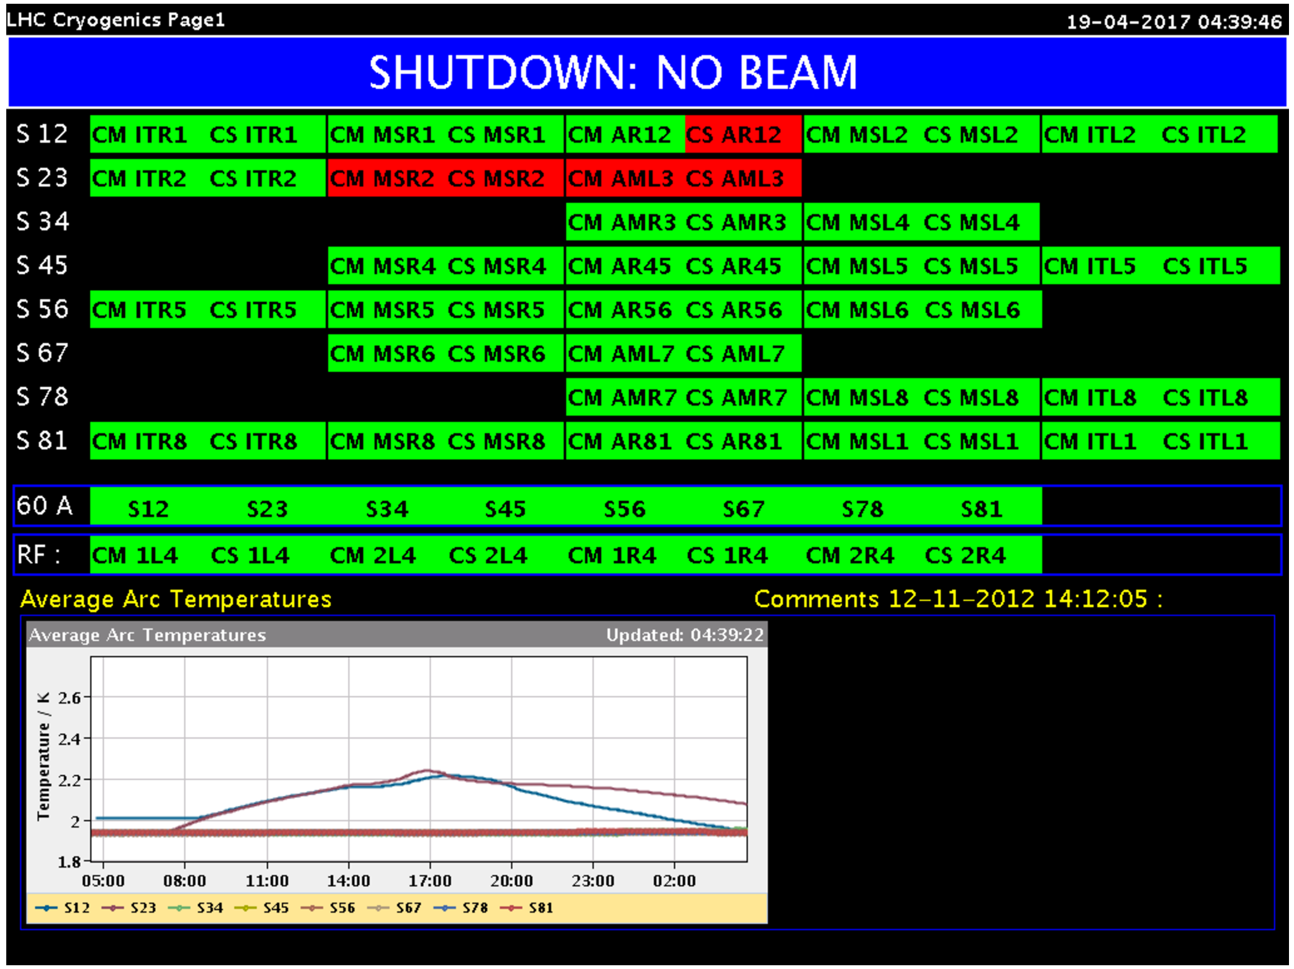
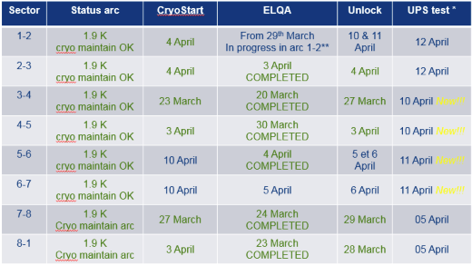
Preparation status
ElQA is completed
Cable connected everywhere
Power converters de-condemned everywhere
EE released everywhere
QPS-IST missing on few circuits
To be done today
To be done today
DONE
DONE
DONE
DONE
DONE
DONE

Slide 4
General
Many 60 A PNO.a1 are failing on a “high resistance” error: not clear whether the measurement is more precise with the new FGC lite or there is an error in the value used for the analysis
Several PIC and PNO.d1 spread across the machine have to be signed in the ACCTESTING by MP3 and EPC
Some specific issues sent directly to Reiner:
QPS_DCCT saturated for some RSD/F circuits (jumps at 590A)
Drift of I_DCCT for few circuits - tight some bolts?
To be done:
Calibration of high current circuits DCCT – tomorrow p.m.
Test on 1 converter per type with new FGC-lite in one RR to be planned
Test of water interlock stopping water pumps in all sectors
RQ8.L8B1 eletta to be replaced today
Internal splice measurements in 9 positions in S12 (after commissioning, with ElQA support)
RCS.A78B2 and RCO.A78B1: fault localization when powering Mains
Conical joint measurement in UA27, with prototypal installation (issues after LS1)

Slide 5
IPQ inversion
Inversions of aperture identified during powered and corrected:
(several circuits still to check!)
 | Powered | Checked by QPS
RQ4.R2 | Y | Y
RQ8.R2 | Y | Y
RQ9.R2 | Y | Y
RQ10.R5 | Y | Y
RQ9.R5 | Y | Y
RQ5.R8 | Y | Y
RQ7.R8 | Y | Y
RQ8.R8 | Y | Y
RQ9.R8 | Y | Y

Slide 6
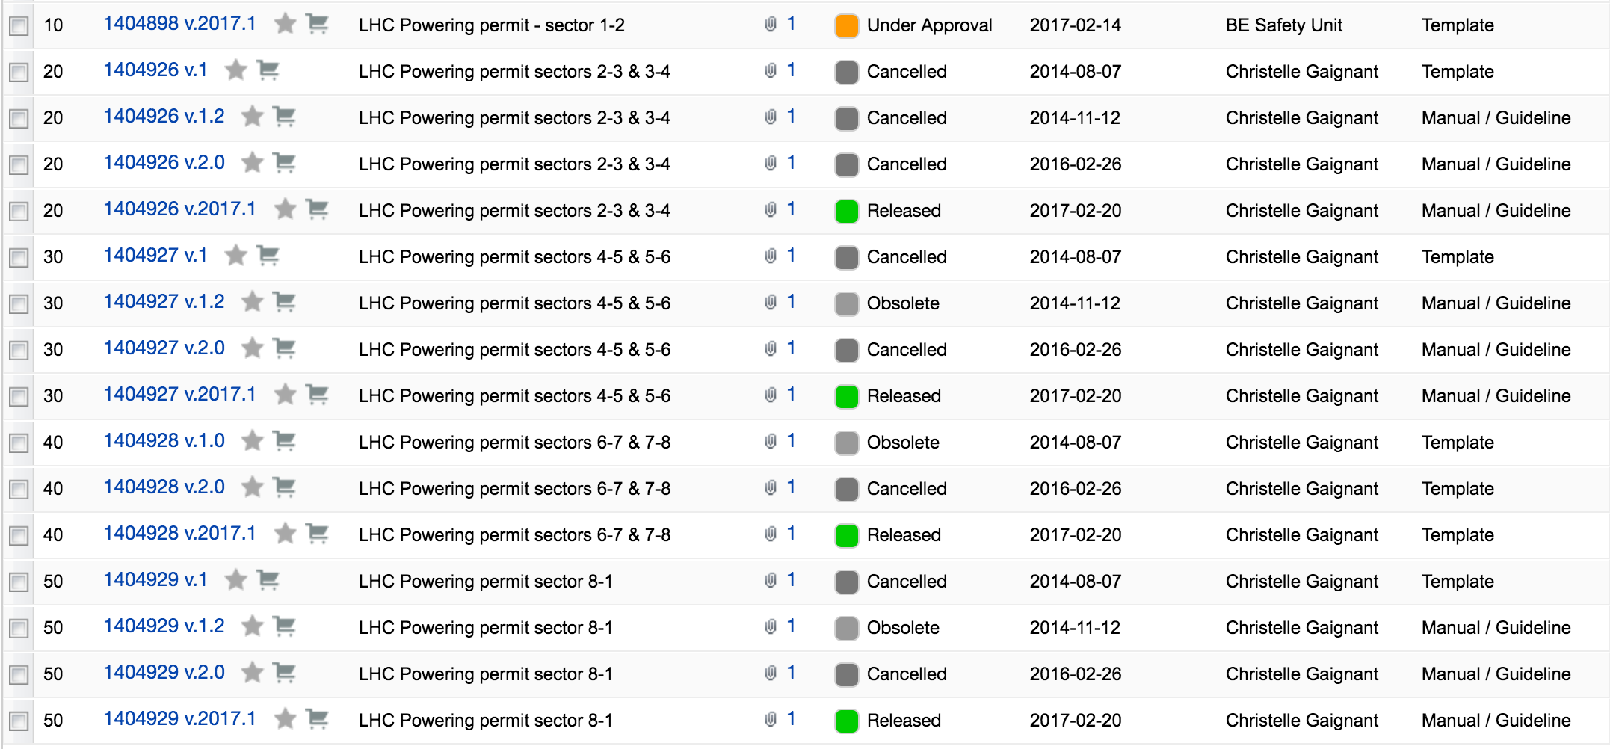
Phase II powering permits
Only S12 and S23 are missing and will be released after the UPS test

Slide 7
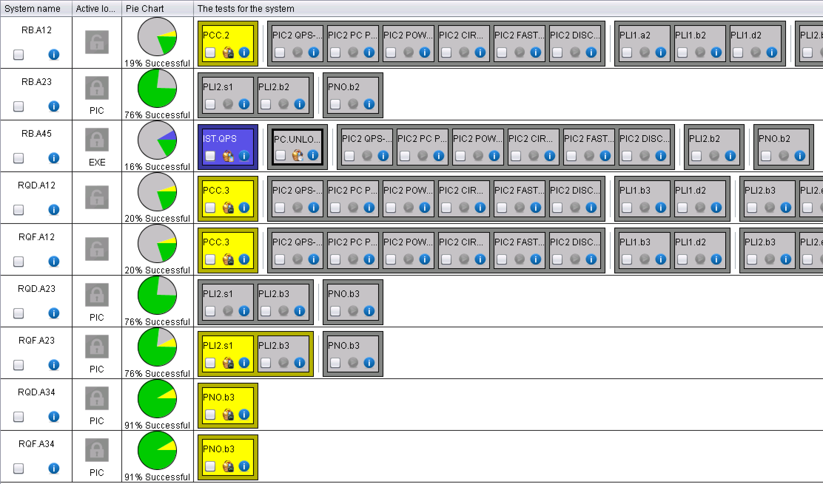
MAINS

Slide 8
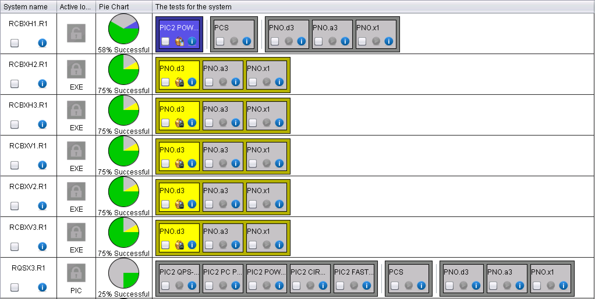
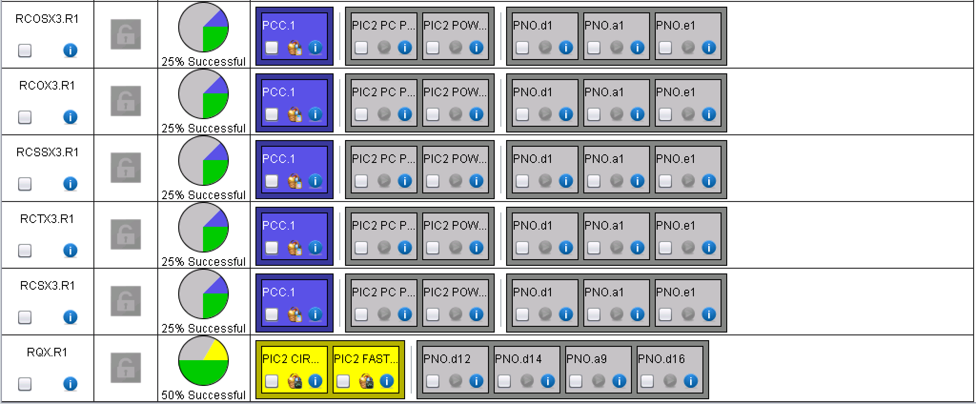
XR1
RQX.R1: QH discharge to be looked at by MP3
Quenched due to bad cooling
Blocked by Cryo

Slide 9
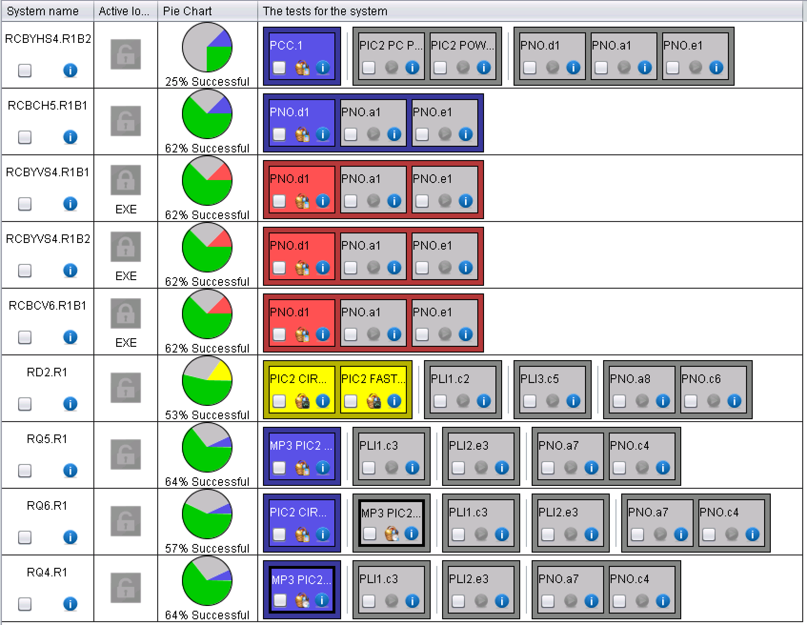
LR1
RQ6.R1 was stalled after the PIC2-circuit quench and had to be reset
MP3 and EPC signatures for the 120 A and RQ6.R1

Slide 10
ARC12
Just started…
PCC done on the Mains and ongoing on the IPQs
PIC2 done on the 600 A
ROF.A12B2 and RQTF.A12B2 blocked by cryo
RCBCH10.L2B2 has an offset on U_Lead_pos and it is failing the automatic analysis

Slide 11
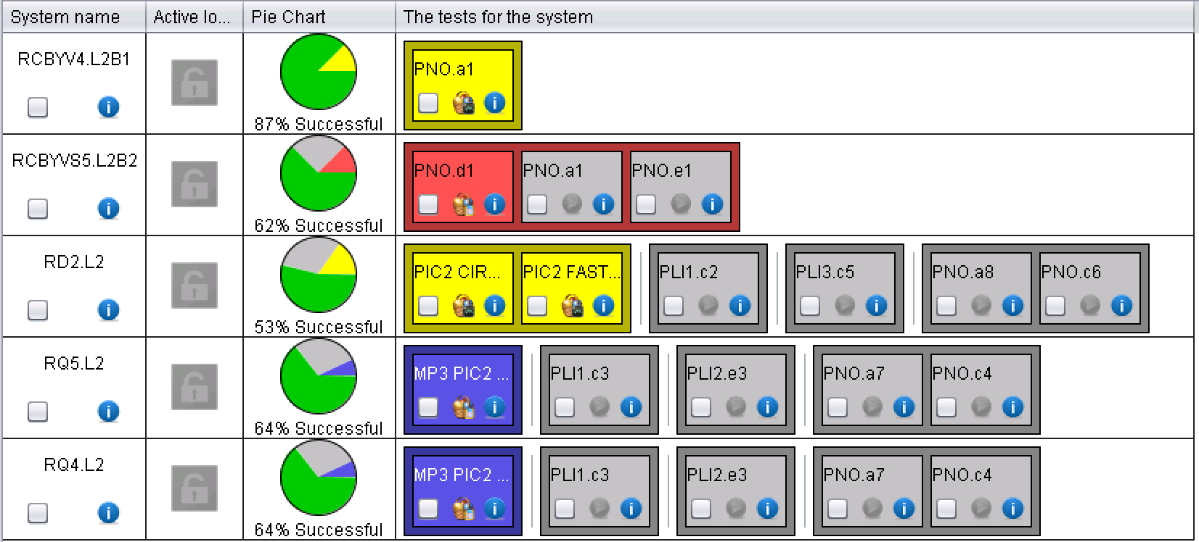
ML2
RCBYVS5.L2B2 had an earth fault during test, but could be reset: EPC to check!
U_lead_neg has offset

Slide 12
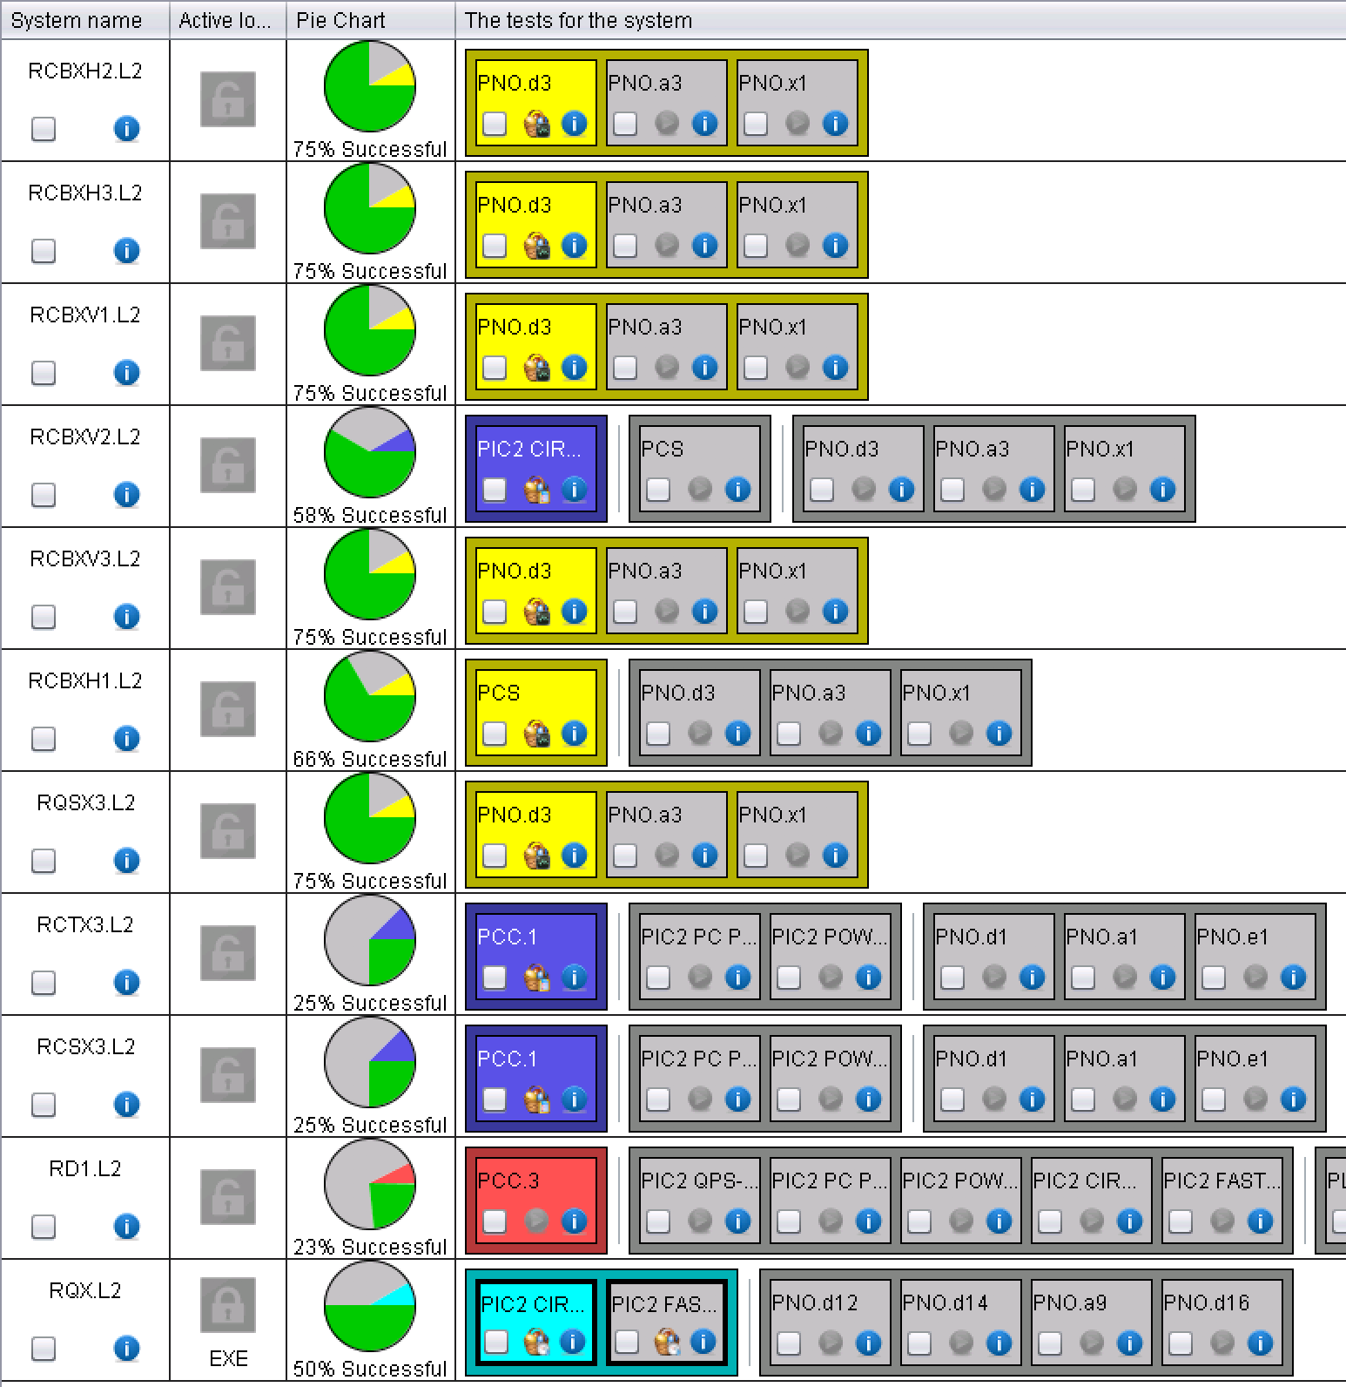
XL2
Ongoing

Slide 13
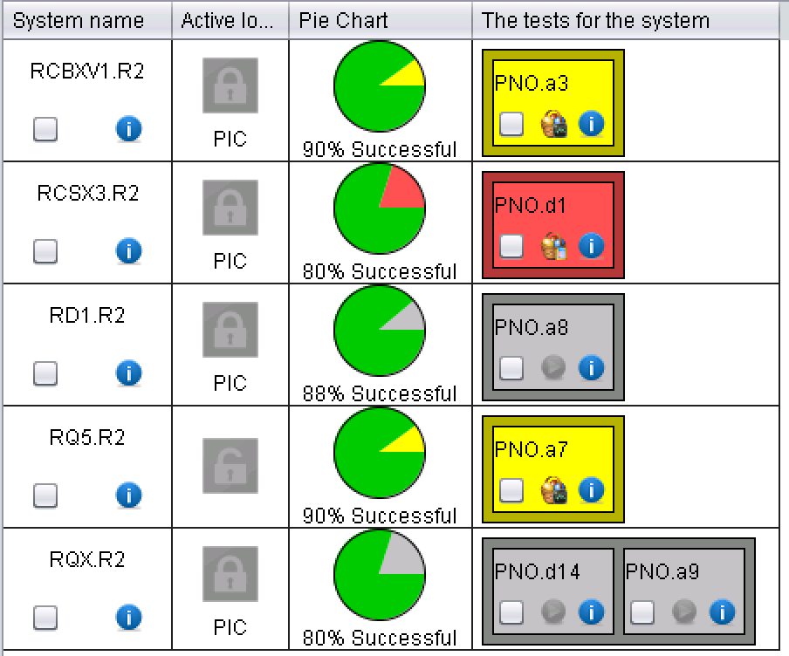
XR2 and MR2
Waiting for Phase II
T regulation
MP3 to sign

Slide 14
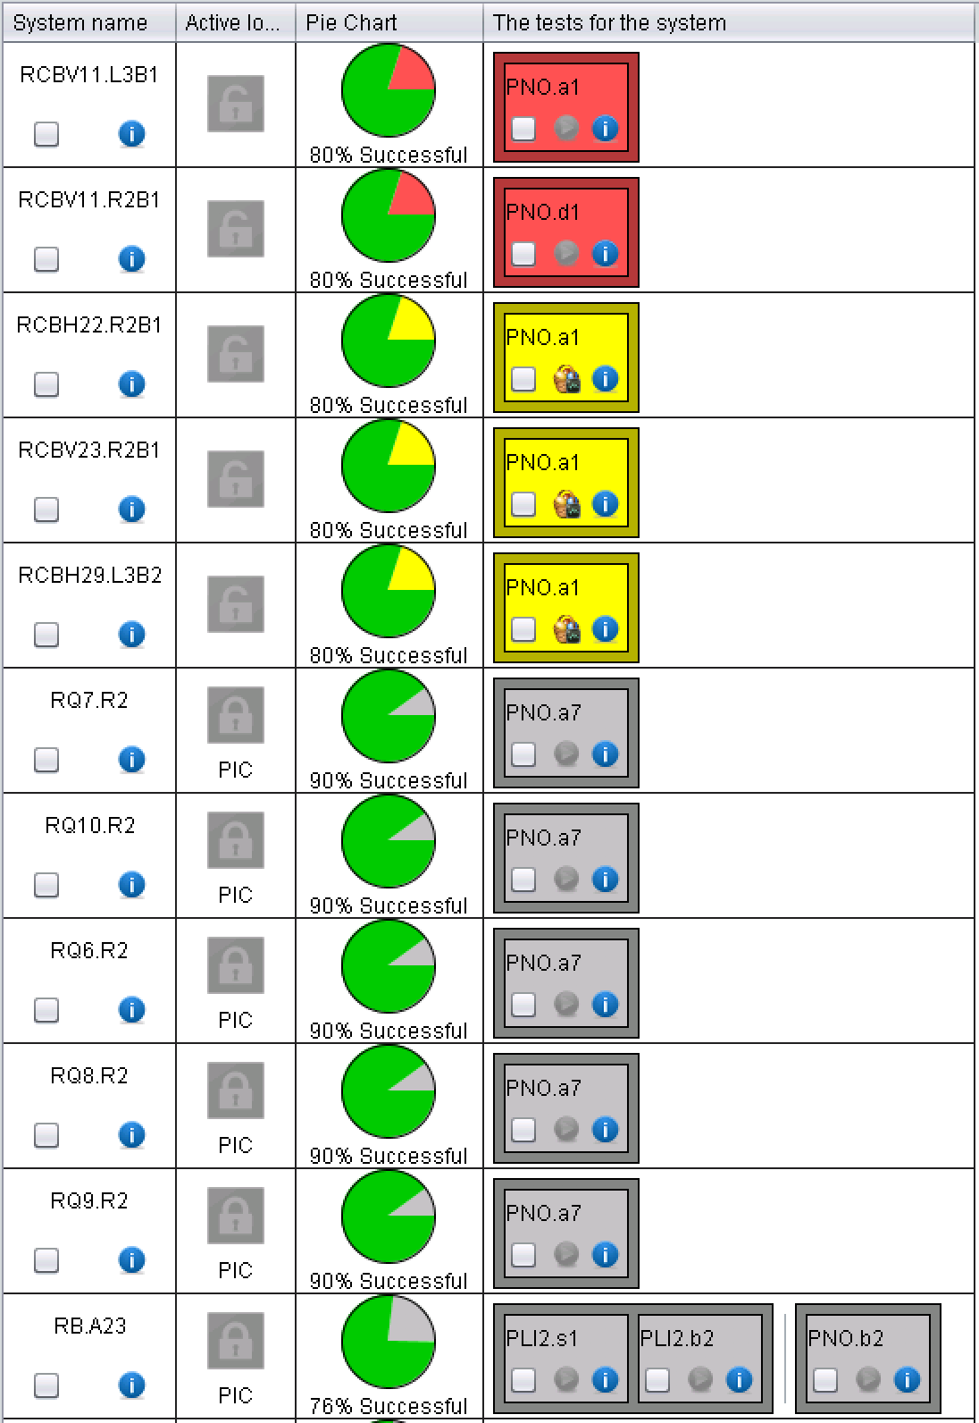
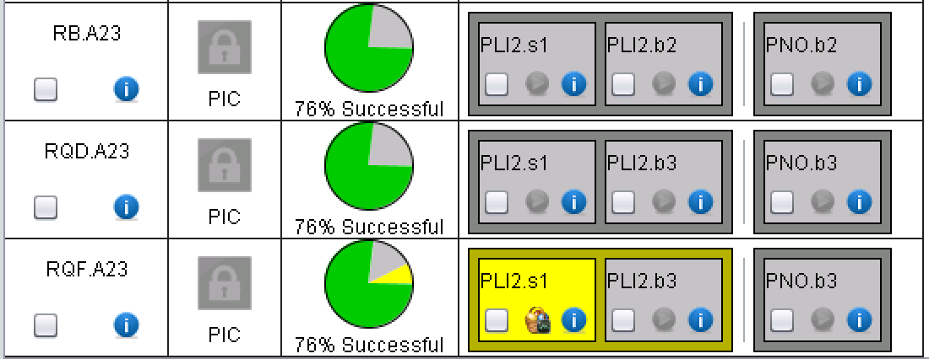
ARC23
“High resistance”
Waiting for Phase II
4x60 A failed because of “high resistance”
“High resistance”
“High resistance”
“High resistance”

Slide 15
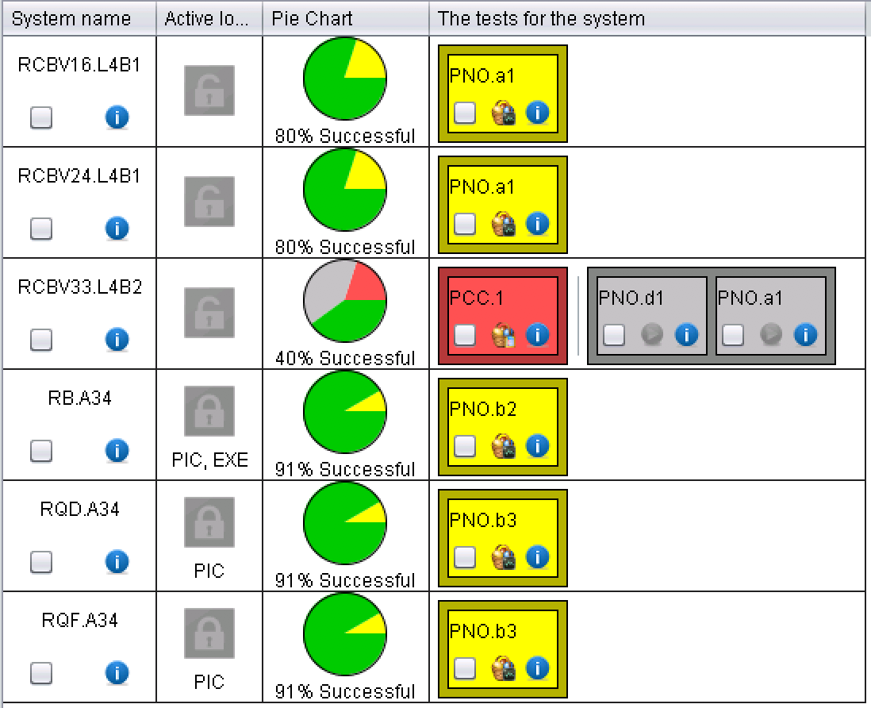
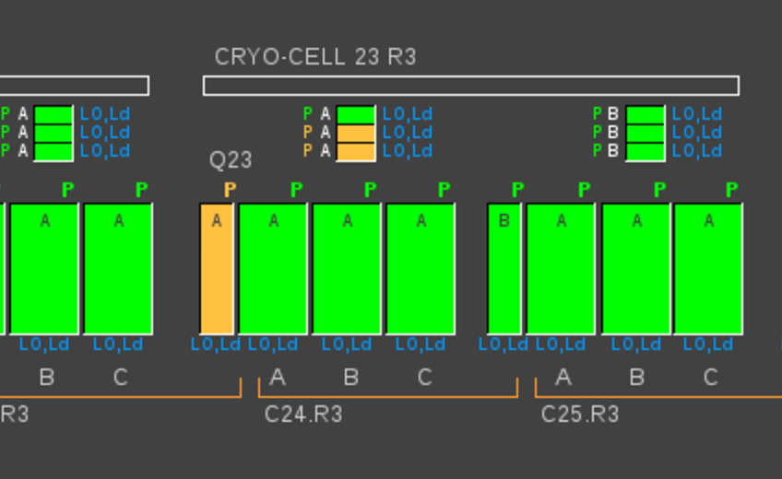
ARC34
PNO test failed on the quads during ramp-down: QPS to analyze and fix
“High resistance”
“High resistance”
EPC sign.
In MQ23.R3, heaters fired during the ramp-down: QPS to advice!

Slide 16
ML4 and MR4
Completed

Slide 17
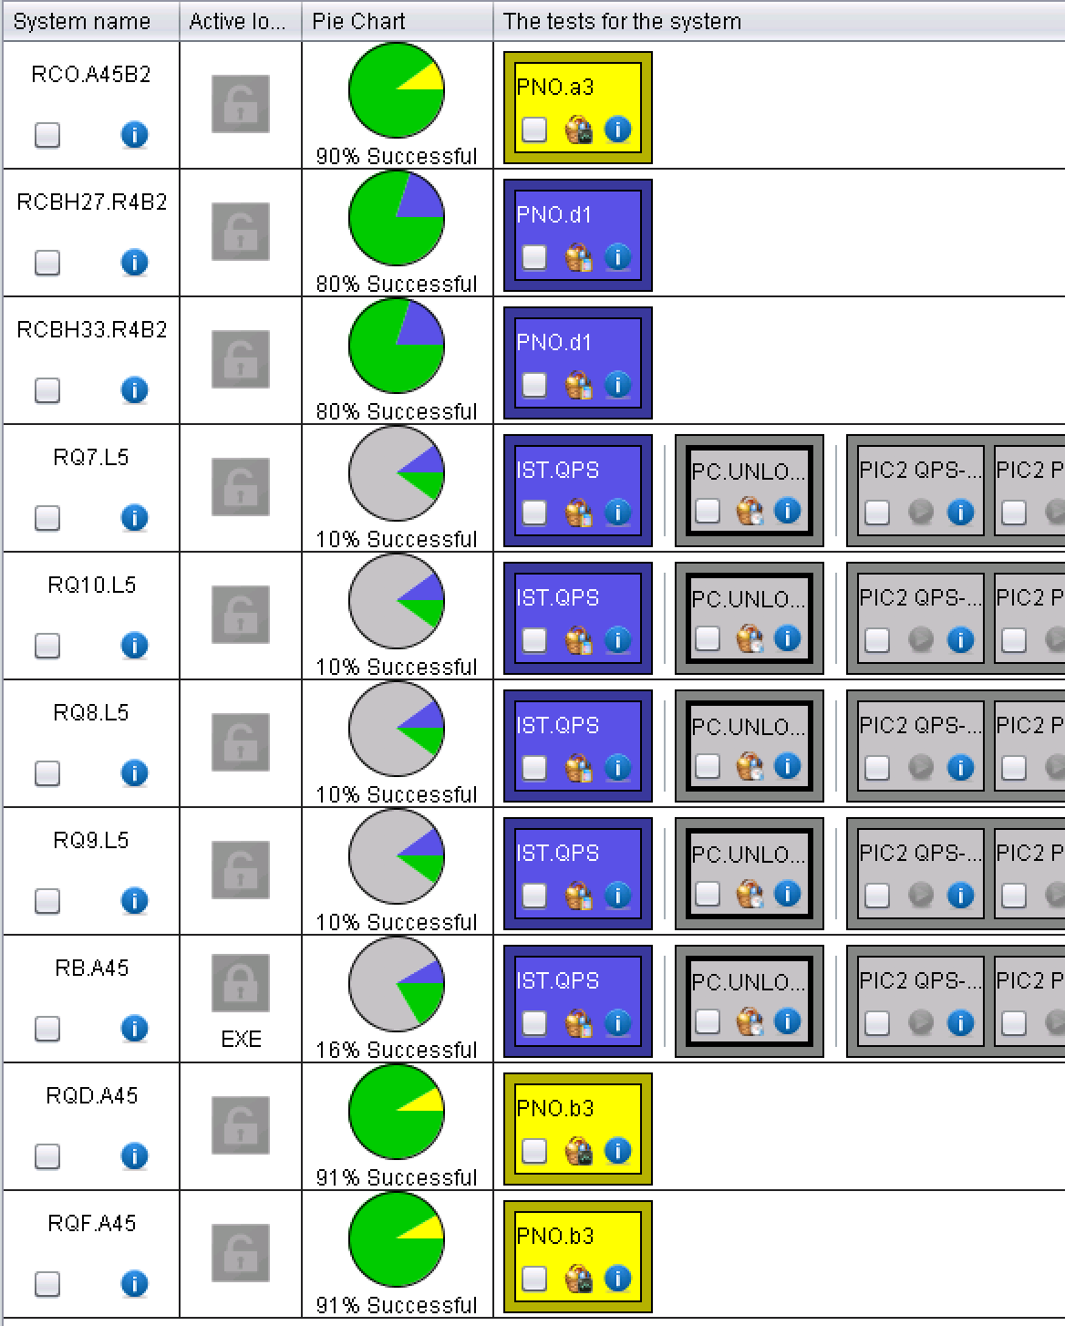
ARC 45
RB and some IPQs not yet available
13 x 60 A failed due to “high resistance”
large sigma_U_diff
(155 mV vs 5 mV)
EPC and MP3 to sign
EPC and Mp3 to sign

Slide 18
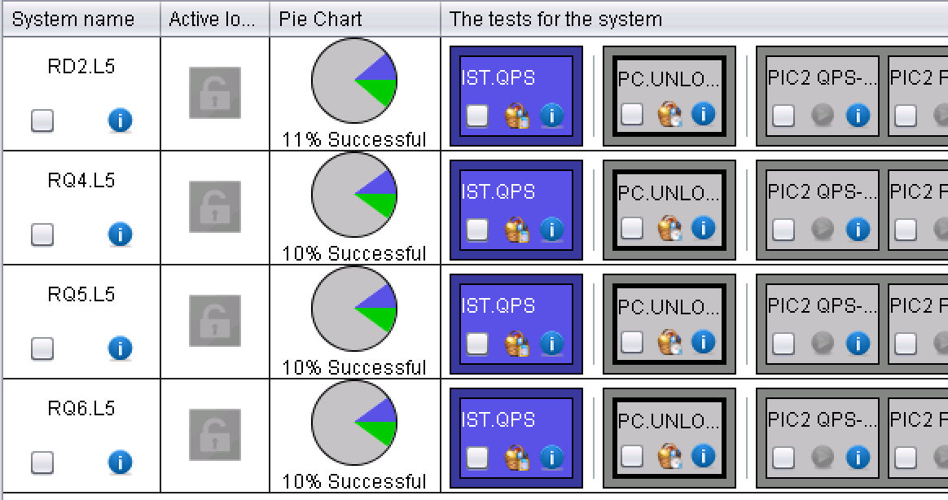
LL5
IPQs and IPD not yet available

Slide 19
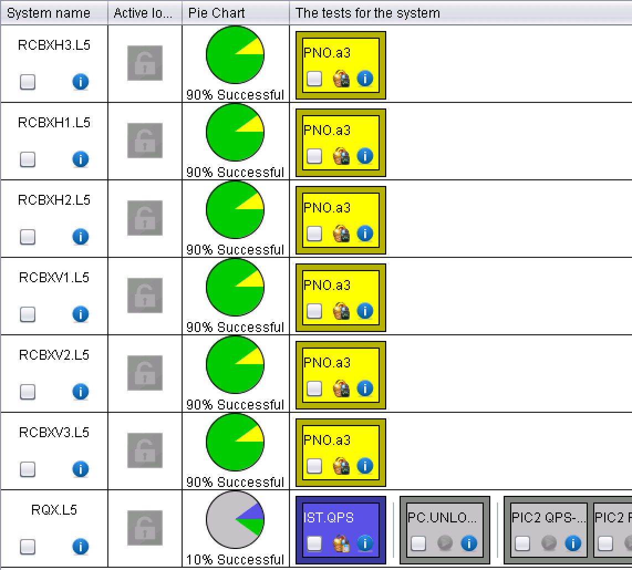
XL5
IT not yet available
T regul not OK
T regul not OK
T regul not OK
T regul not OK
T regul not OK
T regul not OK

Slide 20
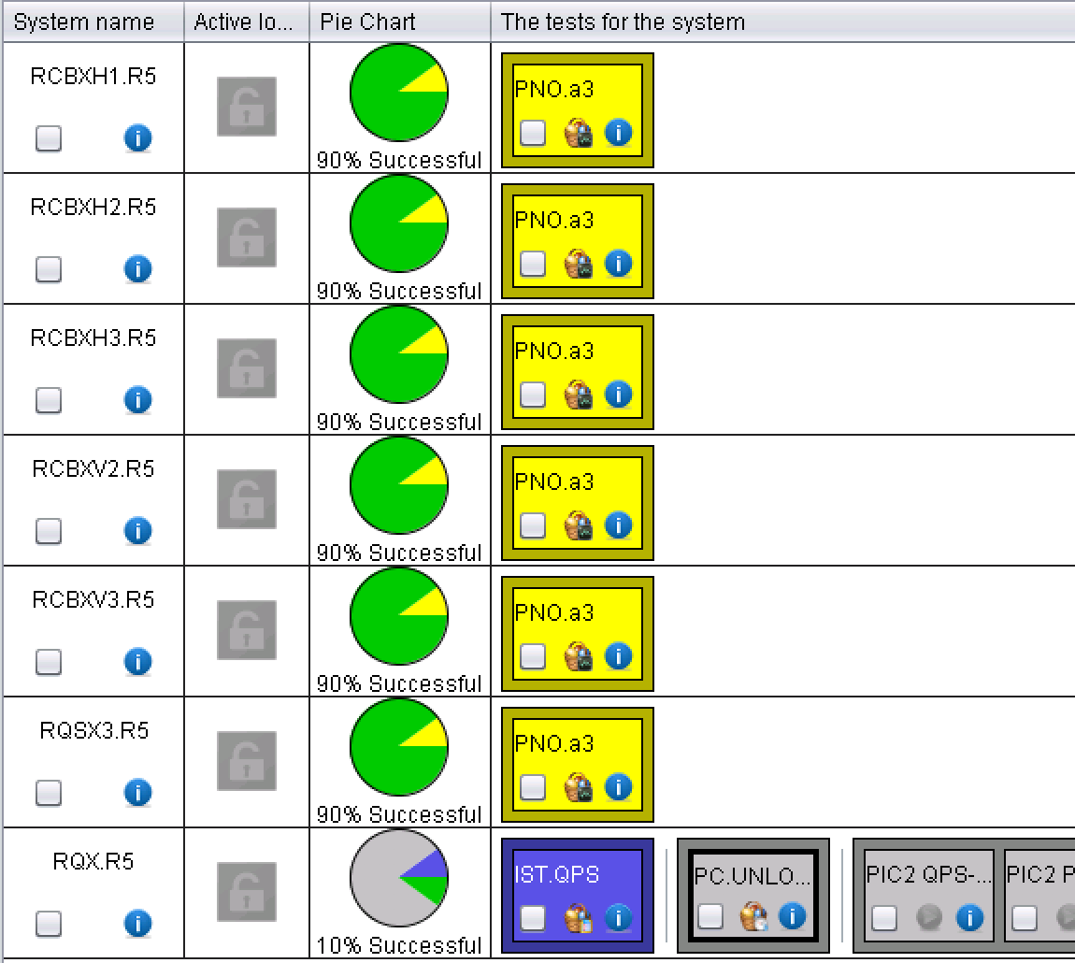
XR5
IT not yet available
T regul not OK
T regul not OK
T regul not OK
T regul not OK
T regul not OK
T regul not OK

Slide 21
LR5
Completed

Slide 22
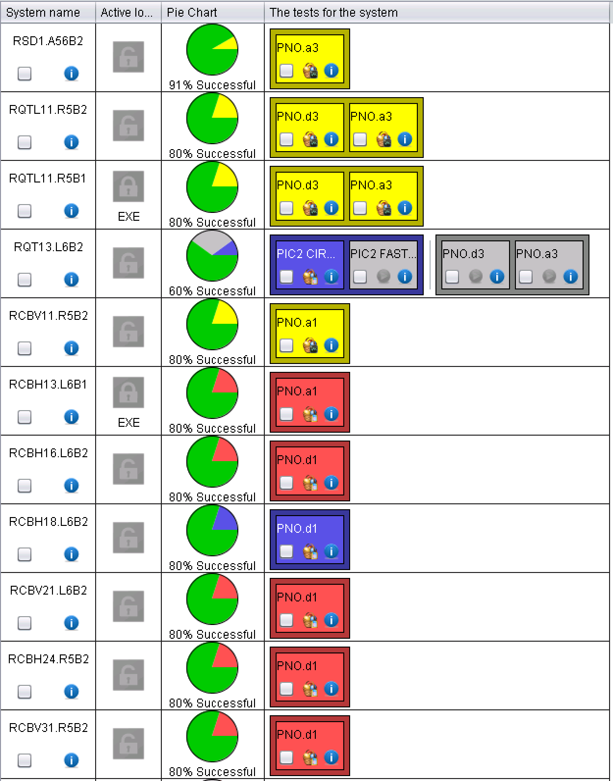
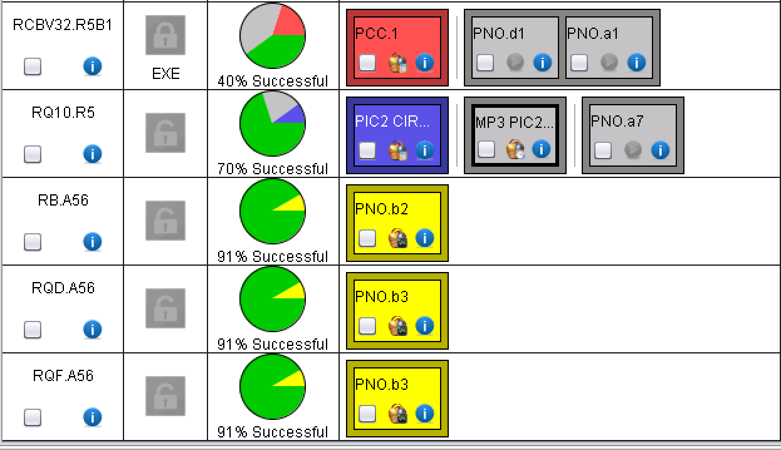
ARC56
Large U_res
0V-crossing
RQTL11.R5B1: 0-V crossing
RQTL11.R5B1: training quench at 482 A, 1 QPS file missing
RQTL11.R5B2 : 0-V crossing
Train@482A + 0V-crossing
MP3 sign.
MP3 sign.
MP3 and EPC to sign
MP3 sign.
MP3 sign.
MP3 sign.
PC in FLT_OFF

Slide 23
ML6 and MR6
Completed

Slide 24
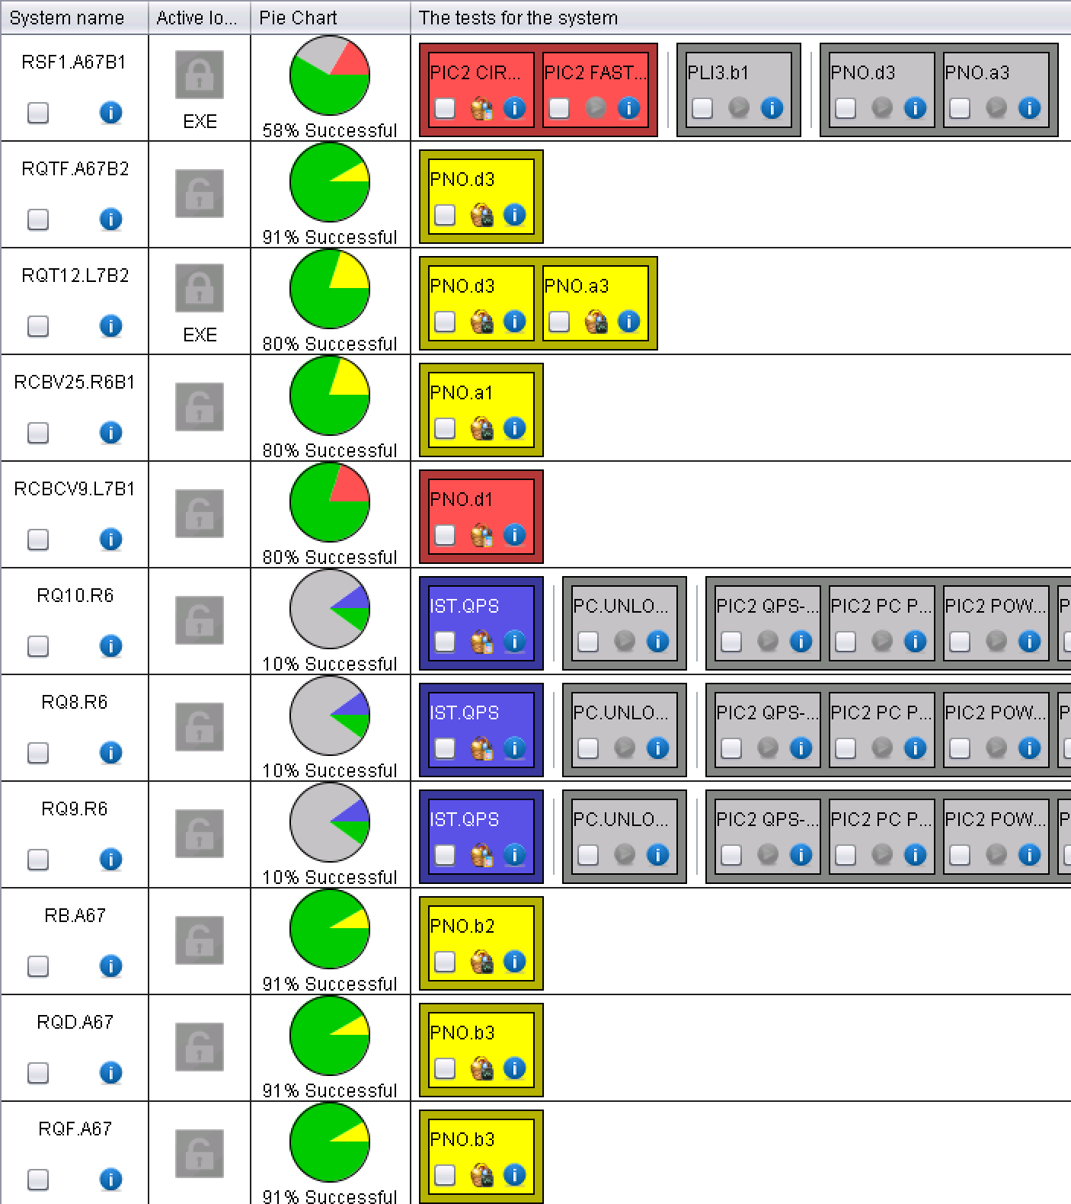
ARC 67
Few IPQs not yet available
RQT12.L7B2 = DC CONTACTOR FAULT at startup (intervention required)
RSF1.A67B1: breaker B replacement needed; agreed for this morning

Slide 25
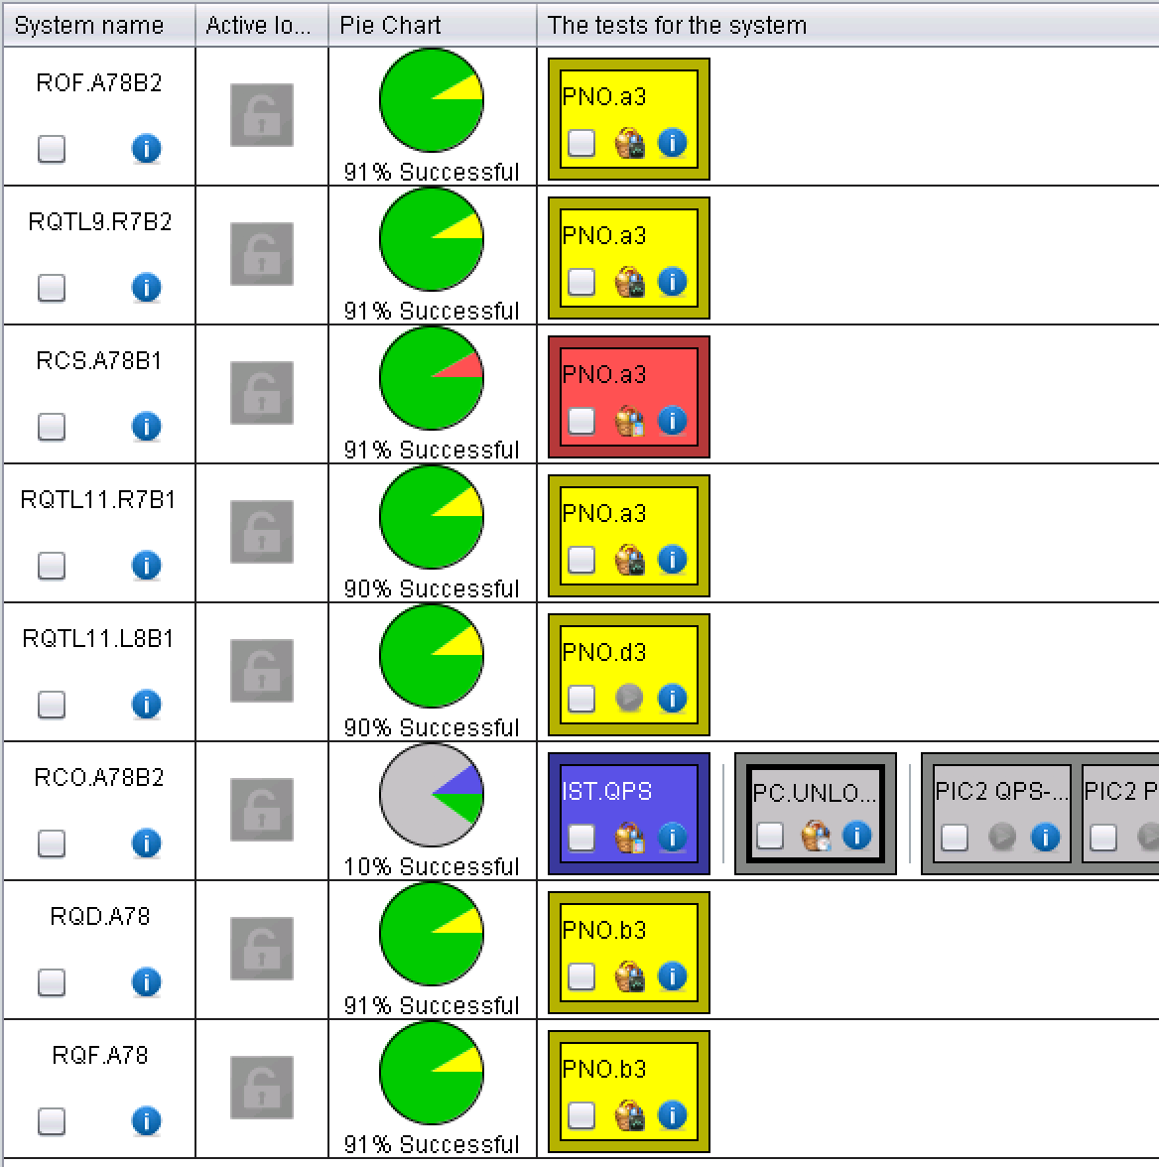
ARC 78
~40 x 60 A with “high resistance”
RQTL9.R7B2: 0-V crossing
Large U_res
I_earth overcurrent!
Large U_res

Slide 26
ML8
Completed

Slide 27
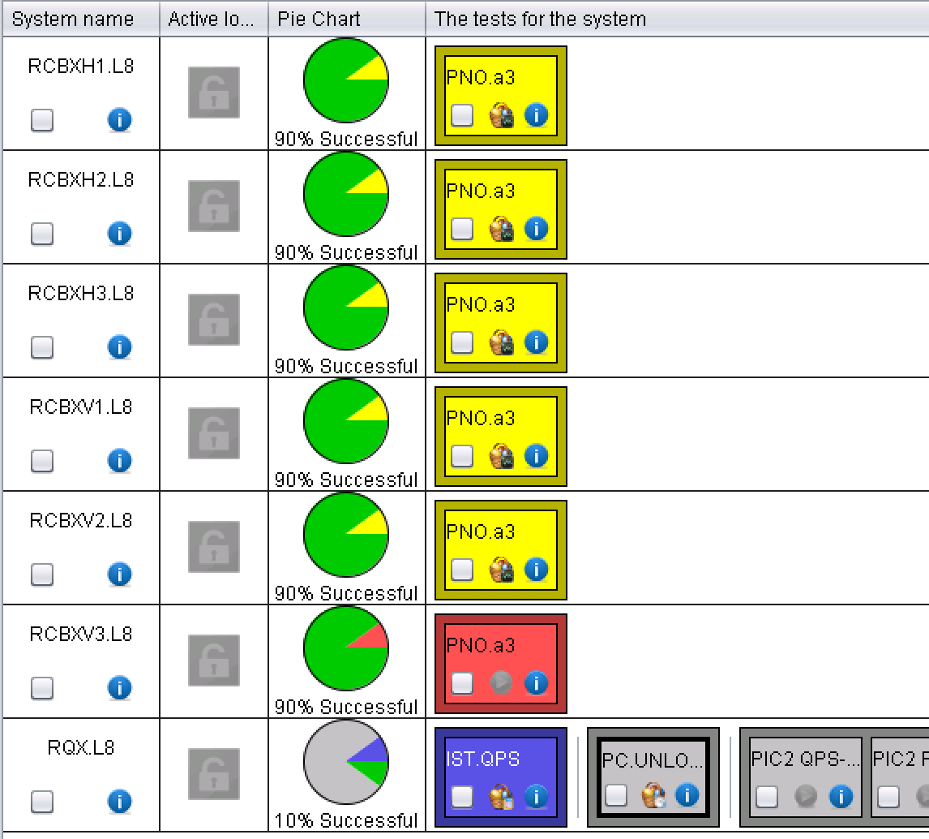
XL8
IT not yet available
T regul not OK
T regul not OK
T regul not OK
T regul not OK
T regul not OK
T regul not OK

Slide 28
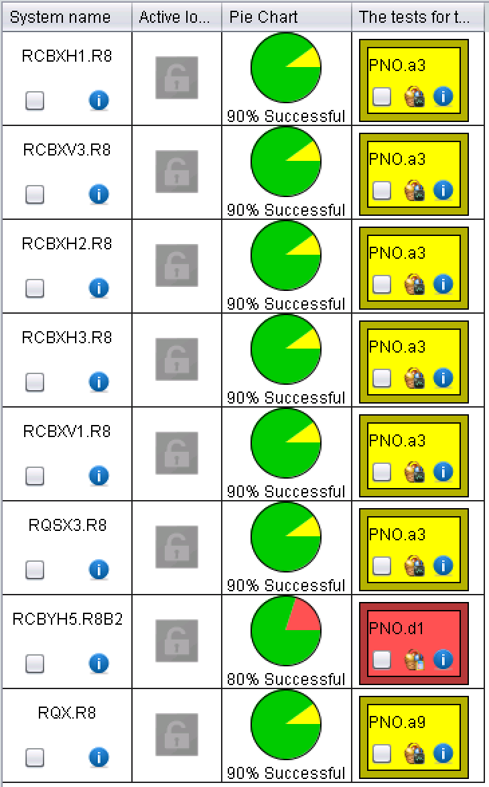
XR8 and MR8
T regul not OK
T regul not OK
T regul not OK
T regul not OK
T regul not OK
T regul not OK
MP3 sign.

Slide 29
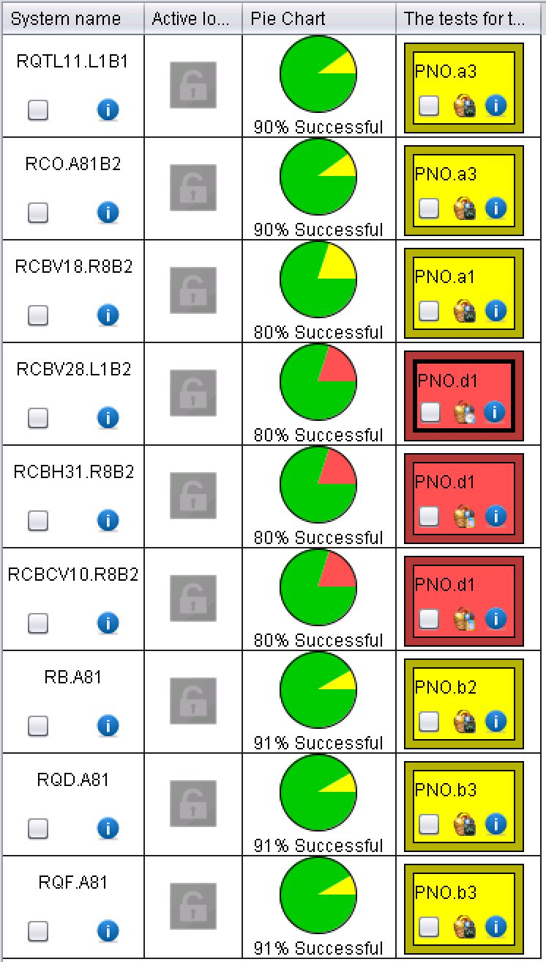
ARC81
Large U_res
T oscillations
“High resistance”
MP3 to sign
MP3 to sign
MP3 to sign

Slide 30
LL1
Completed

Slide 31
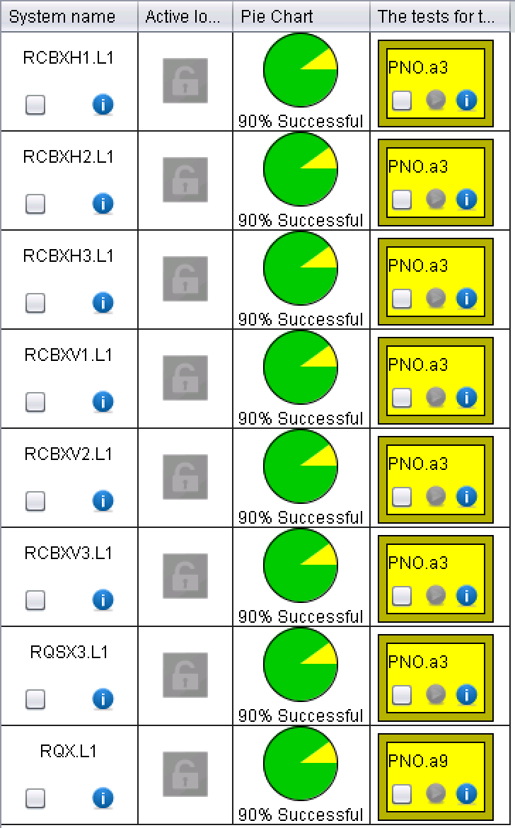
XL1
T regul not OK
T regul not OK
T regul not OK
T regul not OK
T regul not OK
T regul not OK
T regul not OK

Slide 32


