Slide 1
Fast Timing for Collider Detectors
Chris Tully (Princeton University)
CERN Academic Training Lectures (1/3)
10 May 2017
Notes:
The goal of today’s lecture is to present a glimpse of what to expect from collider detectors that have fast timing capabilities.
Tomorrow we’ll discuss fast timing detector technologies, light and charge collection methods, and on Friday we’ll discuss how
fast timing can be realized within the Phase 2 Upgrade for High-Luminosity LHC and what physics at the HL-LHC will benefit most
from fast timing.

Slide 2
Outline
Conventional event “snapshots” at the LHC
Timescales and collision densities at the HL-LHC
Time-aware event vertexing and particle flow

Slide 3
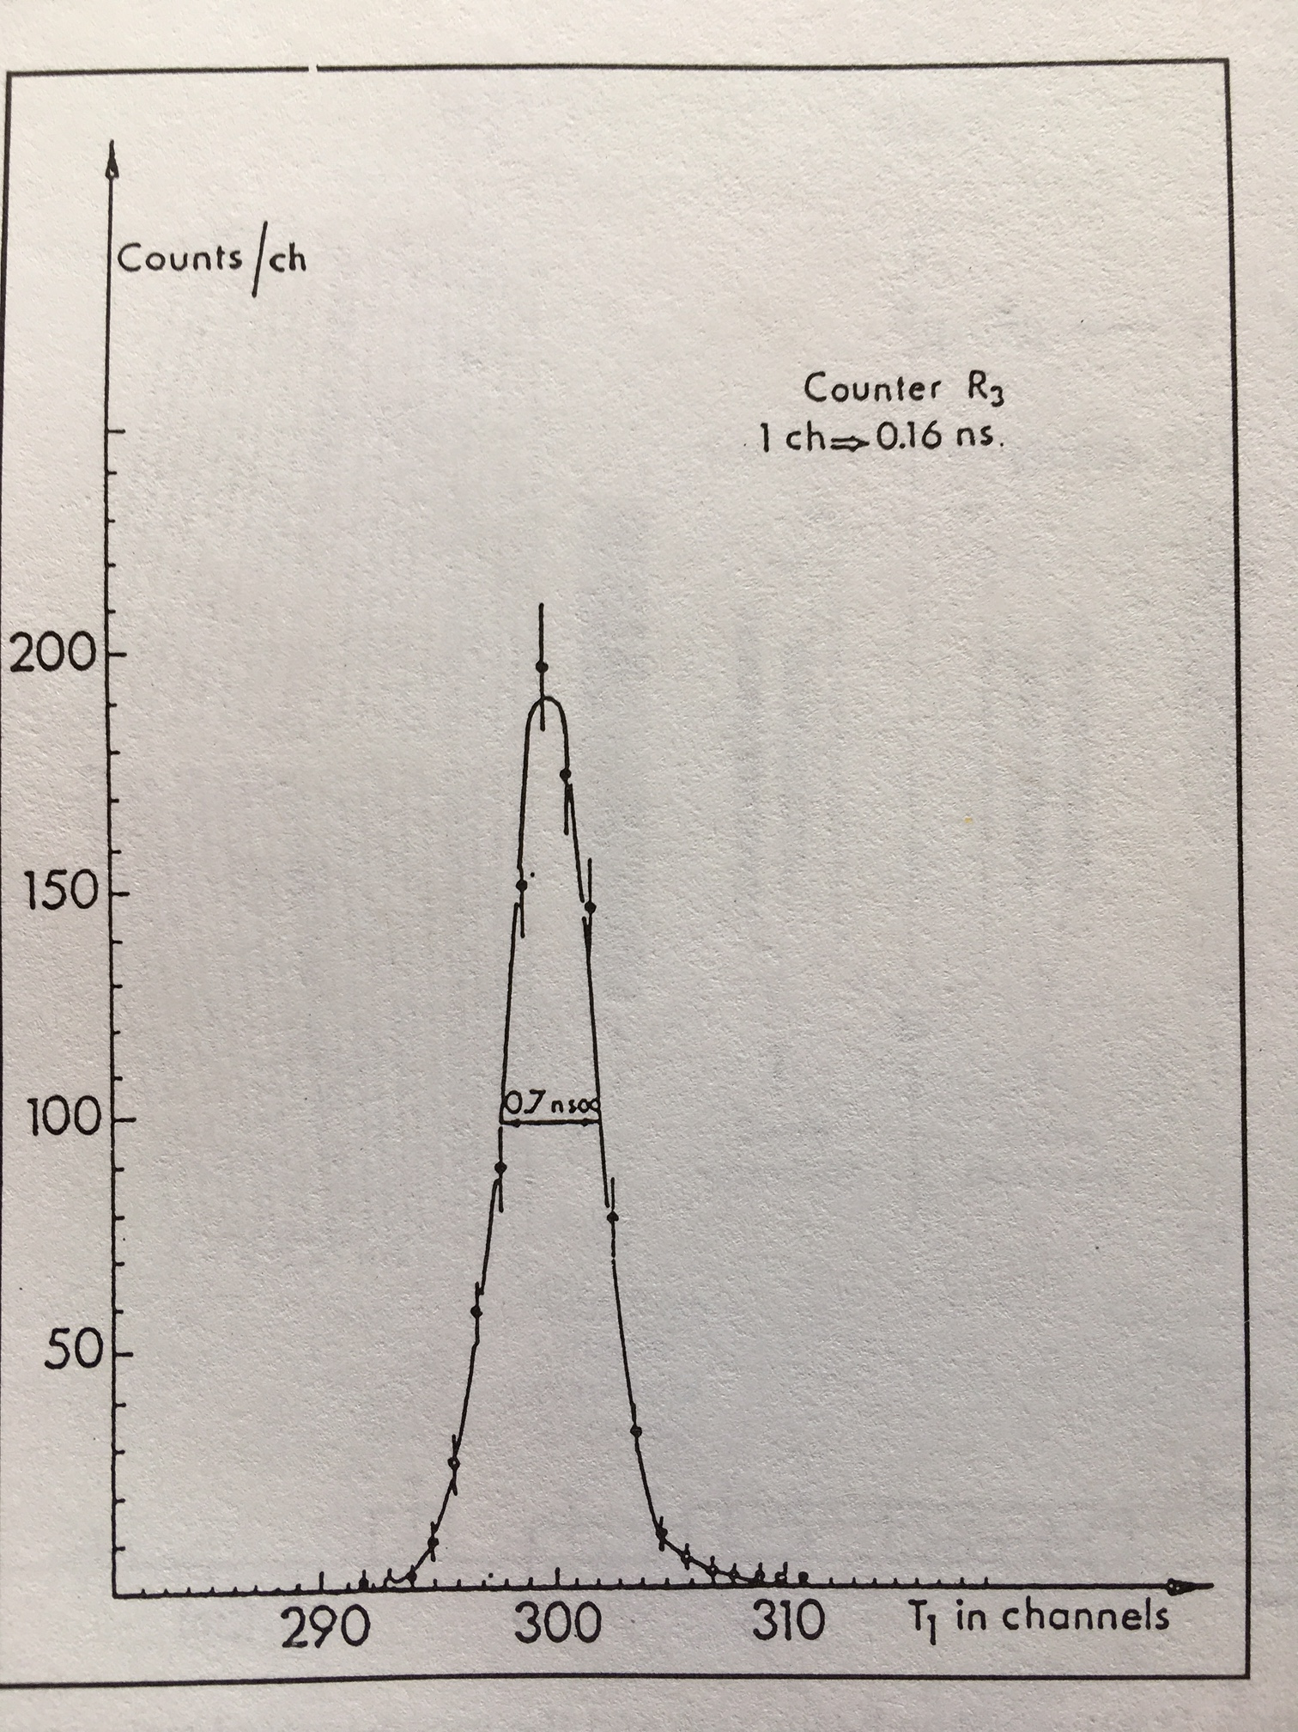
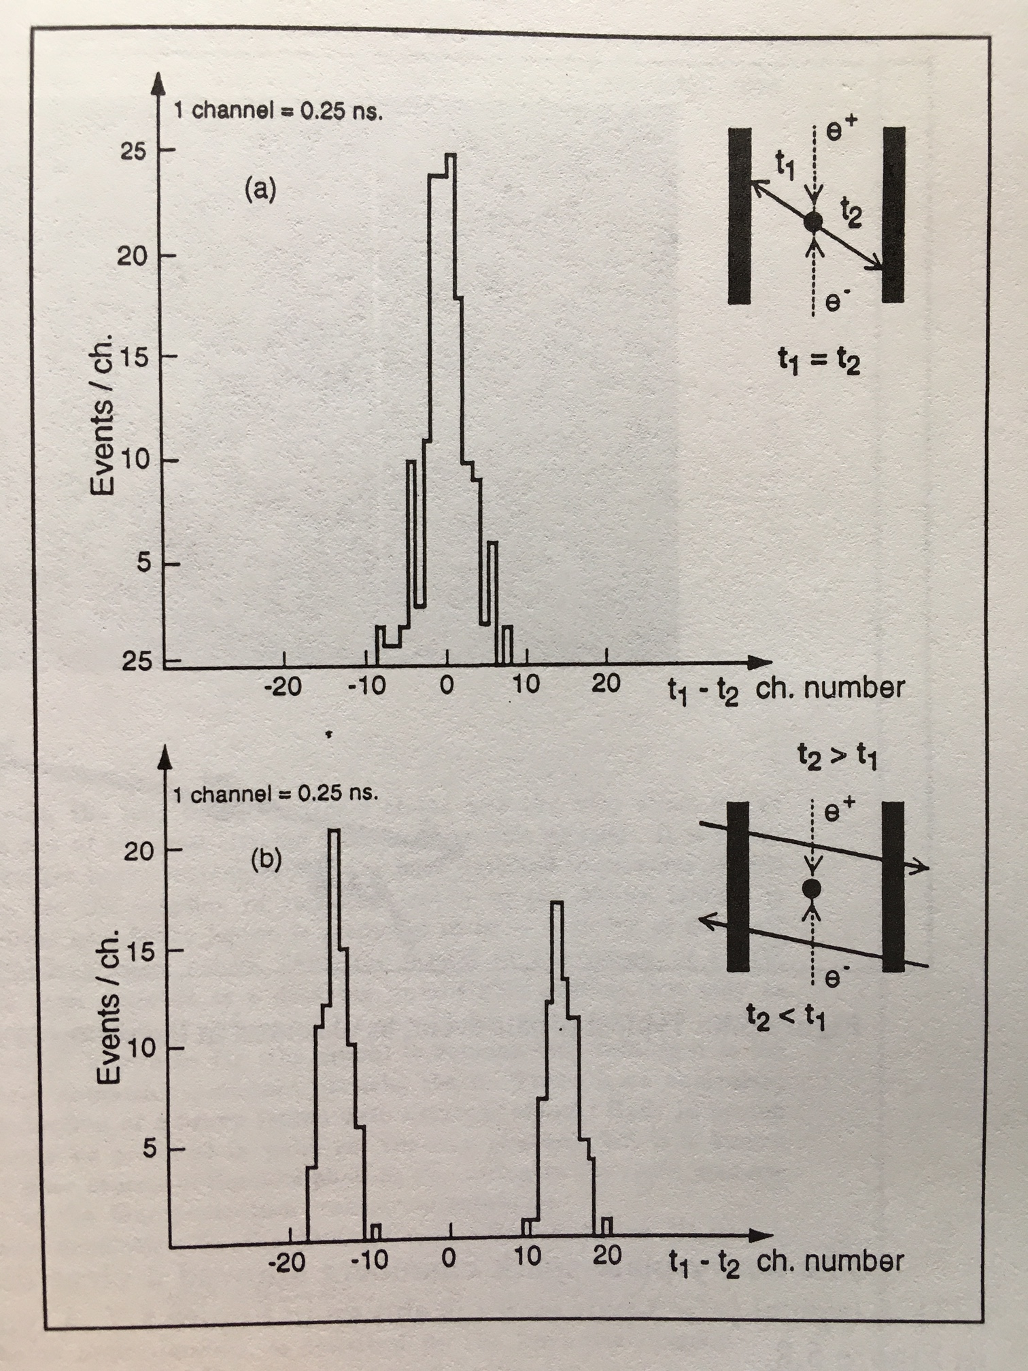
Historical Trends in Timing Resolution at Colliders
ADONE (1969)
Collisions distinguished from cosmic rays with ΔT~350ps timing resolution
ΔT~350ps
Notes:
Timing in colliders dates back to the first high-energy collier, the ADONE e+e- collider (1.5 GeV) in Frascati.
In this case a time difference resolution of 350ps was achieved from plastic scintillators on each side of the collider region.
This timing resolution was sufficient for the separation of counters to distinguish cleanly between collision events and cosmic rays.
Timing measurements have traditionally had an important, but limited role in collider detectors.
At colliders, it common to assume then go after secondary measurements with timing information such as in a time-of-flight system
for semi-relativistic particles or part of a veto system for cosmic rays or beam halos.

Slide 4
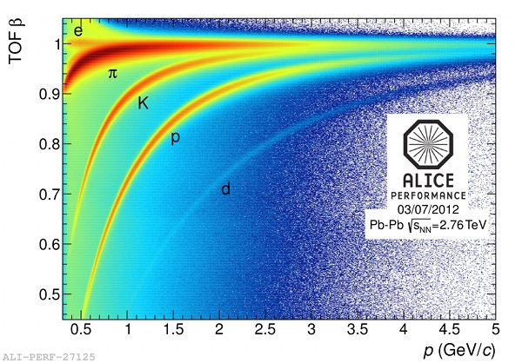
State-of-the-Art Time-of-Flight
σ_{t}~80ps
Time-of-flight σ_{t}~80ps Particle Identification System (semi-relativitistic particles) with a time reference (t0) forward detector that uses a high multiplicity of tracks
Notes:
Nearly 50 years later, the most precise time-of-flight system at a collider is at CERN installed in the ALICE detector.
This system uses multigap resistive plate chambers (RPCs) and achieves 80ps resolution and has a forward t0 counter
that uses a multiplicity of tracks to form the time reference.

Slide 5
High-Luminosity LHC
time
z
Luminous region
t_{RMS} ~ 180 ps
z_{RMS} ~ 4.6 cm
VBF H→ττ in 200 pp collisions
Notes:
A time-of-flight system for semi-relativistic particles or a veto system for cosmic rays or
beam halos are ancillary functions, much in the same way that silicon vertex detectors in the 90’s were ancillary devices to the
primary measurement of the central tracking systems which was to measure the momentum of charged particles.
Today, we could hardly imagine doing collider physics without reconstructing the primary vertex, and now over 50+ vertices at the LHC,
much less being able to tag heavy flavor, without pixel vertex detectors installed close to the beam pipe of the interaction region.
We have come to turning point in fast timing, where the measurement resolution is a factor of 5-10 smaller than the timing spread of
the beam collisions within a single crossing. Instead of viewing the beam crossing as the simultaneous
emission of hundreds of particles, fast timing pulls apart the collision vertices in the time domain.
To add to the confusion about timing within a bunch crossing, the multiplicity of events shown here are often called “in-time” pile-up.

Slide 6
Timing from the Machine
Notes:
At the LHC the mean time of the bunch crossing is well known and reasonably stable. The physical beam can move around in
the machine RF bucket and so ultimately the reference provided by the machine is limited to 1-2ps by the beam movement.
The clock reference is the RF of the LHC machine and the clock distribution system to provide a reference clock to the experiments
has a jitter better than typically 10ps (with a frequency spectrum distribution). We will discuss clock distribution from the machine
and through the detector systems in the last lecture. Detector physicists know the LHC clock to be 40.07897 MHz which is a division
by a factor of 10 of the RF of the LHC beam. (TTC System designed by Bruce Taylor (CERN) RD12.) Now the TCDS.

Slide 7
Luminal Region at the LHC and HL-LHC
Notes:
We begin by looking at the simplifying assumptions about timing that have gone into how LHC detectors are designed to take data.
Collider detector readout systems are designed to operate with a beam structure that comes from the machine.
The bunch and orbit structure of the beams dictate when beam collisions occur. The leading assumption in collider detector design is
that the spread of collisions times within a bunch crossing is small compared to the bunch spacing. And, indeed,
for the LHC, the spread in the collision times is roughly +/- 200ps, which is less than 1% of the 25ns bunch spacing.
This is an example of an HL-LHC beam spot distribution showing the z-distribution and time spread on separate axes.
We also plot here the line density of vertices along the z-direction. These distributions will be important later.

Slide 8
“Snapshots” of Higgs Boson Events at the LHC
H → γγ
H → ΖΖ∗ ◊ eeμμ
Notes:
Collider detectors implement synchronous readout based on the RF clock. Synchronous trigger logic means that the detectors
are designed to do the same thing for every bunch crossing, assuming the same timing reference, etc., at every crossing.
In general terms, detectors “open their shutters” before the beam collisions are expected to occur - oftentimes
recording previous samples in a pipeline buffer - and then integrate over the bunch crossing for fast detectors, such as
silicon trackers, Cherenkov calorimeters and resistive plate chambers, and continue a sample record beyond the bunch crossing
for slower detectors, such as scintillator and ionization calorimeters and gas drift chambers. The result is a snapshot as shown
here for two Higgs boson events.
These two types of Higgs boson events are very different when it comes to how the primary vertex is used. The Higgs to
gamma gamma has to infer the correct vertex to have sufficient resolution on the invariant mass. The requirement is to find the
vertex within 1cm, which is not terribly precise, but without the correct vertex - the spread of 4.5cm would destroy the signal if
the PV were assumed to be at (0,0,0). The ATLAS LAr EM calorimeters have longitudinal segmentation and can have a photon
pointing resolution comparable to 1cm, but the CMS experiment does not have photon pointing. Therefore, the PV has to be found
For Higgs to gamma gamma, not based on the high-pT Higgs boson decay products, but from the recoil in the production process,
where a large fraction of the inclusive production is from gluon-gluon fusion - which produce hard tracks (sum pT^2),
but not necessarily high-pT jets.
The 4lepton vertex, on the other hand, is different. Here the requirement is that all 4 leptons come from the same spatial vertex.
This is a powerful way to reduce backgrounds, such as from leptons from Z+heavy flavor or from fake leptons which are picked up
from tracks that originate from pile-up vertices. We will look more at these physics cases in the last lecture once we have learned
more about what fast timing can provide to event reconstruction.

Slide 9
Circular Colliders and Detector Timing Measurements
Bunch Trains at LEP (1995)
  Four bunch trains of up to 4 bunchlets each (spacing 247.5ns, 87λ_{RF})
  Phase lock for synchronous BGO calorimeter readout gate (5μs)
  Offline analysis tagged which bunchlet within a train the signal event originated from (and corrected for signal integration)
  e⁺e⁻ is forgiving – less than 1 event per crossing and very loose trigger (triggered on and counted single photons above 1 GeV to cross-check number of neutrino families from ISR)
General truism: Experimentalists will do everything they can to accommodate higher luminosity operation of the collider
Notes:
We can still record events synchronously and record fast timing to provide offline correction. Do we ever have to correct for
vertex time? Not really. We are already used to the time-of-flight spread of arrival times at the detector cells, and each front-end
digitization has a range of clock phases that vary already from cable lengths and phase-lock loops. Timing is already central
to the low level pulse reconstruction because of the clock phase and time-of-flight variation, but throughout, the t0 of the
interaction is assumed to be t=0 with no variation. The only exceptions that I know of are in the formation of an analysis variable
such as in the delayed photon searches where an average of the timing measurements from all calorimeter cells are compared
against the maximum cell hit of the photon - but the precision of those techniques were limited at roughly 300ps in timing resolution
on the bunch crossing t0 and that in turn has a spread of roughly 200ps on the event collision time.
Historical example from LEP.

Slide 10
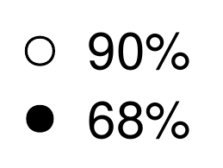
Signal Vertex Efficiency
z_{RMS} ~ 4.6cm
Notes:
It’s important to realize that detectors at the LHC rely on the spread of the beams in z to disentangle signal vertices
from pile-up vertices. The transverse spread of the beam is below of the position resolution of the track d0 resolution -
sometimes called impact point resolution or distance of closest approach. In the z-direction, the track intercept is denoted z0.
Without this spatial spread and the high impact resolution of the tracking systems, the multiple
interactions per crossing would be lumped together, where we see as high as 50+ reconstructed vertices at the LHC
and that number will push up to 200 at the HL-LHC.
The ability to associate a track uniquely with a vertex degrades rapidly with eta, as the most of the tracking position resolution
and track span is in transverse radius, not longitudinally along the beam.

Slide 11
Time-Aware Vertexing
Notes:
With time-aware vertexing, it’s possible to take two or more vertices that are spatially overlapping and to disentangle them
in the time domain. This is an example depicting heuristically how jet counting can be affected.

Slide 12
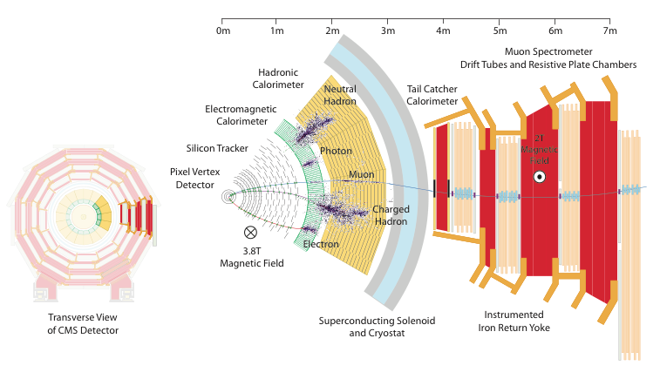
Particle-flow Event Reconstruction
MIP Timing Layer
Notes:
This is a transverse slice of the CMS detector.
What’s mainly important here is to see the breakdown of measurements as a function of distance from the interaction region.
In order to understand what is happening within the beam pipe, we have to back extrapolate from what we measure outside of the beam pipe in the trackers and calorimeters.
Tracking, as we discussed before gives us snapshot information – it’s all there, but we don’t record when it happened within the bunch crossing. By attaching a timing hit
to all MIPs in or exiting the tracking system, we can use the trajectory of the track and its momentum to extrapolate not only the position, but the time corresponding to when a
track began. Interaction vertices are places where tracks have a common spatial origin and simultaneous emission time – they are synchronized at this point.

Slide 13
3D vs. 4D Vertex Reconstruction
Pile-up = 50
Notes:
What is done in 4D vertex algorithm is to give each charged track a fast timing hit, such as from a MIP timing layer as shown in the previous slide.
We will demonstrate in the third lecture how that can be implemented in a collider detector.
The spatial location of the timing hit along the trajectory of the track must be known in order to use the reconstructed track
parameters to back propagate the timing information of the track into the beam pipe to form common time, common space
intersecting vertices.
In collider physics, we often speak of the primary vertex reconstruction efficiency - also called the signal vertex efficiency.
What is that? That’s the efficiency of reconstructing a sufficient number of tracks from the signal interaction (the hard interaction)
to form a spatial vertex location that is within the estimated vertex measurement uncertainties of the true signal vertex location.
If you can form the vertex, then the vertex resolution in z0 is fairly good, 300 micron or so, with good tracks. It’s better in the
transverse plane because of the beam constraint and increased measurement precision. That signal vertex can in turn
be used to look for displaced tracks such as V0’s (K0short, Lambdas, etc.), heavy flavor decay or at higher resolution,
tau lepton decay. Beyond the standard model, new physics could also manifest as displaced vertices.
In the most extreme case, pile-up vertices can merge and have a higher sum pT^2 than the signal vertex - as effect that
is particularly relevant for Higgs to gamma gamma vertex selection - as will be discussed later.

Slide 14
Signal Vertex Track Purity
Notes:
We have begun to observe at the LHC that it’s not only the efficiency of the signal vertex that is relevant, but the purity of
the tracks from that vertex. Namely, the impurity of the track content is the fraction of the tracks from a signal vertex that
are pile-up tracks. These tracks get sucked into the PV reconstruction because of proximity of the neighboring pile-up vertices
and finite track resolution - which degrades rapidly at high eta.
The impact of time-aware vertexing can mitigate the pile-up track contamination of of 30-50% depending on eta down to
the few percent level present at the LHC. The timing resolution required to achieve that level of reduction is 30ps.
Simulation shows that the improvements to track purity scale largely with the fraction of the timing resolution per track to the
luminal beam spread in time. In terms of eta coverage the improvement in purity goes largely as the acceptance until one
goes beyond eta=2 where the impurity begins to grown from 30% (central) to 50% (eta>2) at the highest vertex line densities.

Slide 15
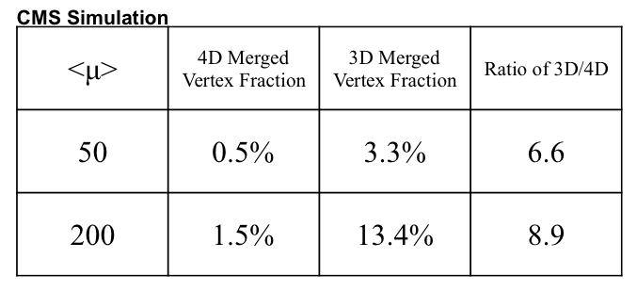
Pile-up = 200
Notes:
At pile-up = 200, the merge rate of the 3D algorithm exceeds 13% and the number of merged vertices grows non-linearly
with instantaneous luminosity.

Slide 16
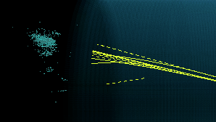
Track-Cluster Association with Timing
Track Fast Timing Hits
recorded in low occupancy region before reaching calorimeter
Cluster association with track aided by EM core timing (when available)
Notes:
Matching a track with a cluster seems obvious. If the track points to the cluster, then it must match, right – no, not really. Even for LHC pile-up conditions, track momentum and cluster energy
have to match. Mismatches are assumed to be overlapping neutrals, and increasingly with cluster density, the clusters are difficult to separate. High granularity calorimeters will improve this at
Phase 2, but only up to a point - the clusters have a finite size and hadronic showers have a significant spread.
At the moment, cluster centers are geometrically defined. However, time-aware cluster centers instead of geometrical cluster centers could help split cluster or identify overlapping
clusters, then the MIP timing from the track can be more readily matched to time-aware clusters and hadronic neutrals more efficiently identified.
The purpose of the calorimeter is to stop the particle and measure the total energies. Therefore, there will be a transition from relativistic to non-relativistic showering particles.
For EM showers, this transition is at such a low energy and end-stage of the shower that has good timing throughout. There is big benefit to highly granular calorimeters even if
individual cell timing is over 100ps, one gains from 1/sqrt{N} where N can be big.

Slide 17
Time Development of Energy Deposition in Hadronic Showers
A. Para (CALOR 2016)
Tail of
Non-relativistic
Particles
Depth into calorimeter
Depth into calorimeter
At nsec scale the timing is dominated by geometry (time of flight) even for hadronic showers. ‘Local’ time = T – z/c
Dual-Gate Calorimeter (TOF within hadronic shower for energy compensation.
Notes:
Hadronic showers are different, non-relativistic particles will be liberated already at the first nuclear interaction (in one lambda). These hits are indistinguishable from time-of-flight dominated timing hits. One therefore has to look for the EM component of the hadronic shower and try to get the timing for that part. Unfortunately, the EM part of pion showers drops off fairly quickly with decreasing pion momentum, but fortunately, for particle-flow one wants to match MIP track timing to timed showers in cases where one has a substantial shower in the calorimeter – so in those cases one expects to have timing for both. Neutral hadrons with an EM core should have a timing consistent with the production vertex if it comes from that vertex and have no tracks directly pointing to it in non-overlapping cases.

Slide 18
Missing Transverse Energy Resolution vs. Vertex Density
vertex
Notes:
Vertex density is bound to affect the bottom line on the HL-LHC physics program if we don’t do something about it.
If the core density of the MET resolution doubles with vertex density, then new physics searches for dark matter which search the tails of the MET distribution
are degraded by the square of the MET resolution in the exponential. It’s not hard to see factors of 2 to 10 in MET tail increase when one looks
3-5 sigma out on the tail (~150 GeV).

Slide 19
Summary – Lecture 1
Fast timing resolutions that are a factor 5-10 smaller than the timing spread of the beam collisions open up new capabilities for collider detectors at the HL-LHC
Time-Aware Vertex Algorithms pull apart collision vertices in the time domain.
Signal Vertex Track Purity grows to an order one problem without fast timing
Particle-flow methods at the HL-LHC are directly degraded by track purity loss in the primary vertex – further enhancement of timing in the calorimeters will benefit track-cluster association and provide neutral EM timing
Notes:
We have come to turning point in fast timing, where the measurement resolution is a factor of 5-10 smaller than the timing spread of
the beam collisions within a single crossing. Instead of viewing the beam crossing as the simultaneous
emission of hundreds of particles, fast timing pulls apart the collision vertices in the time domain.
Furthermore, with this level of time-aware event reconstruction, fast timing may open up new possibilities for future machines - and
it is very exciting to think about where that may lead.

Slide 20
Backup

Slide 21
Event “snapshots” at the LHC
Timing at the LHC was not an immediate concern for Run 1
  Triggers identify events that are low probability for pp collisions
    Include high-pT leptons, photons, jets, MET
  With increasing instantaneous luminosity, triggers tighten ID/isolation and require multiple trigger objects and bring in additional kinematical or topological requirements
    If you know what you are looking for, then this tightening is straight-forward and known signals are evaluate for efficiency with Monte Carlo and existing data are evaluated to extrapolate the rates for higher luminosities

Slide 22
Silicon Devices with no gain

Slide 24
Timing Resolution depends on amplitude of signal

Slide 25
Silicon device timing

Slide 26
Fast Component of Showers
After the time-of-flight correction the core of the shower develops at the time scales of tens of picoseconds. Even for hadronic showers.

Slide 27
Fast Component of Showers
About 80% (on average) of the energy of hadronic showers is deposited within 0.5 ns)

