Slide 1
Energy deposition in the
HL-LHC experimental IRs (v1.3)
A. Tsinganis, F. Cerutti (EN/STI/FDA)
WP3 Meeting – May 24, 2017

Slide 2
Outline
Layout and optics
Results for v.1.3
  Total power, peak dose, peak power density, losses
  Triplet-D1
  Matching section
  Dispersion suppressor
Summary

Slide 3
Layout and optics

Slide 4
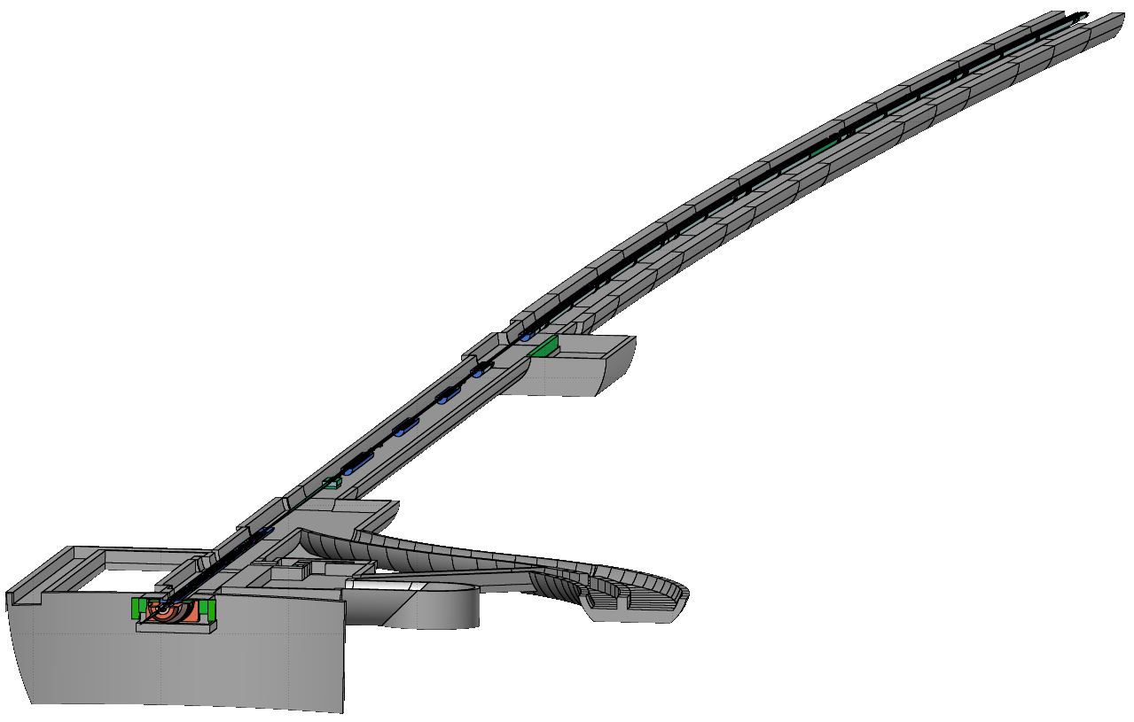
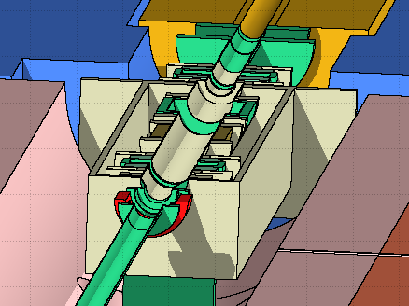
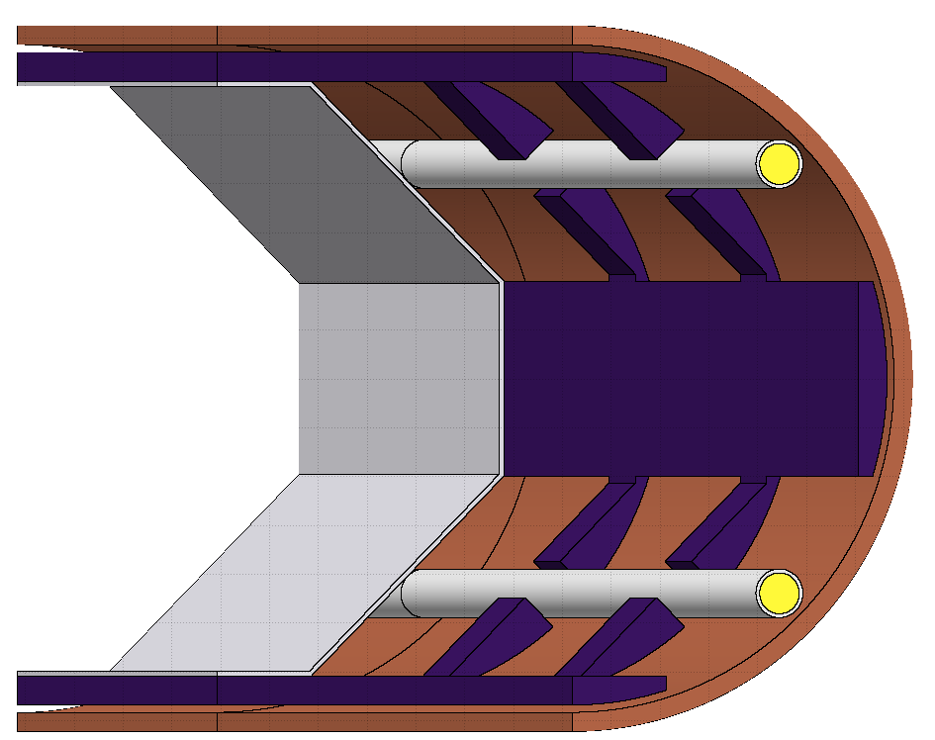
Simulated geometry
Full geometry from IP to end of DS
HL-LHCV1.3
  255μrad half crossing
  angle, β*=20cm
Dispersion suppressor
Various updates wrt v1.2 calculations:
  Cryostat (position, composition)
  Detailed VAX added
  Realistic BS shielding extension to 45º (20% filling factor, explicitly modelled)
  Triplet interconnects (see later slides)
Matching section
RR
Triplet – D1
UJ
UL
Experimental cavern

Slide 5
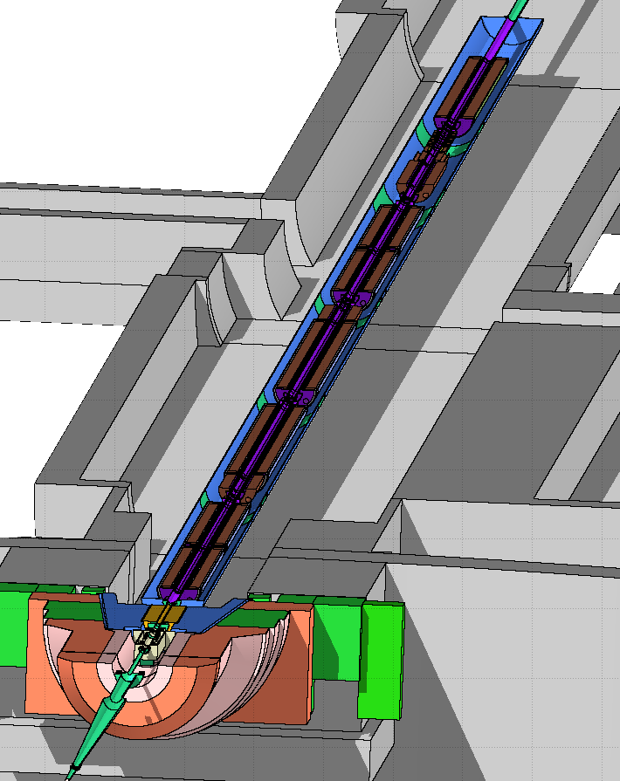
Triplet-D1

Slide 6
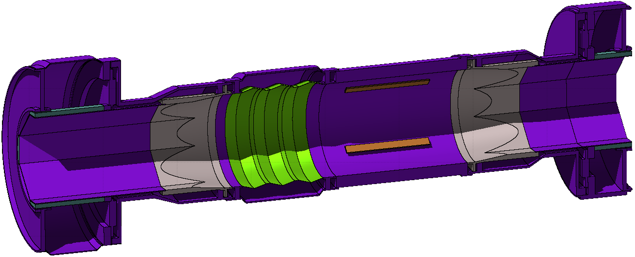
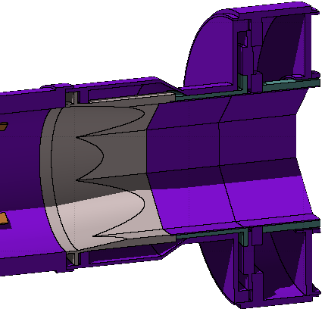
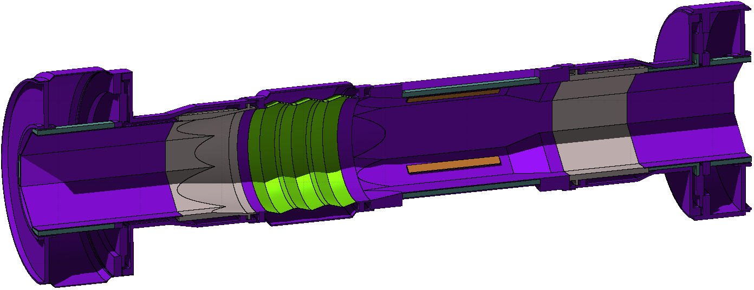
Triplet interconnects and BPMs
with T. Lefevre, R. Jones, D. Draskovic (BE/BI)
C. Garion, R. Kersevan, R. Fernandez-Gomez (TE/VSC)
BS shielding gap 70.8cm
The interruption of the Inermet BS shielding in the interconnect was the primary cause of the localised 36MGy/3000fb⁻¹ dose peak at the IP face of Q2B in IR5
Shielding improvements:
Outgoing
beam
BS shielding
(Inermet)
“Circular” BPM
Addition of 7cm Inermet insert on non-IP side
“Octagonal” BPM with incorporated 18cm Inermet pieces on the mid-planes (retaining 7cm insert)
Additional shielding (Inermet, 7cm)
BPM shielding (Inermet, 18cm)
Further ~15% reduction (26MGy)
Only in front of Q2B (for now)
Peak value reduction by ~15% (30MGy)

Slide 7
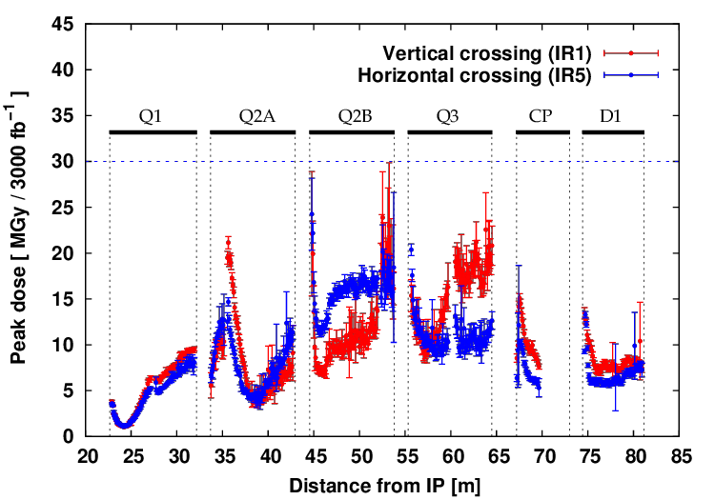
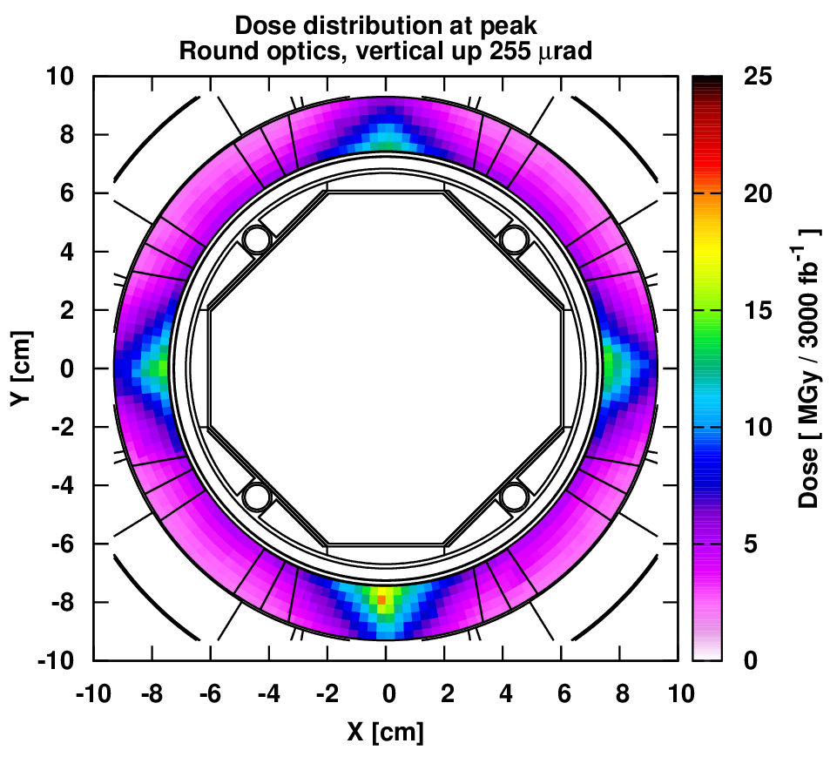
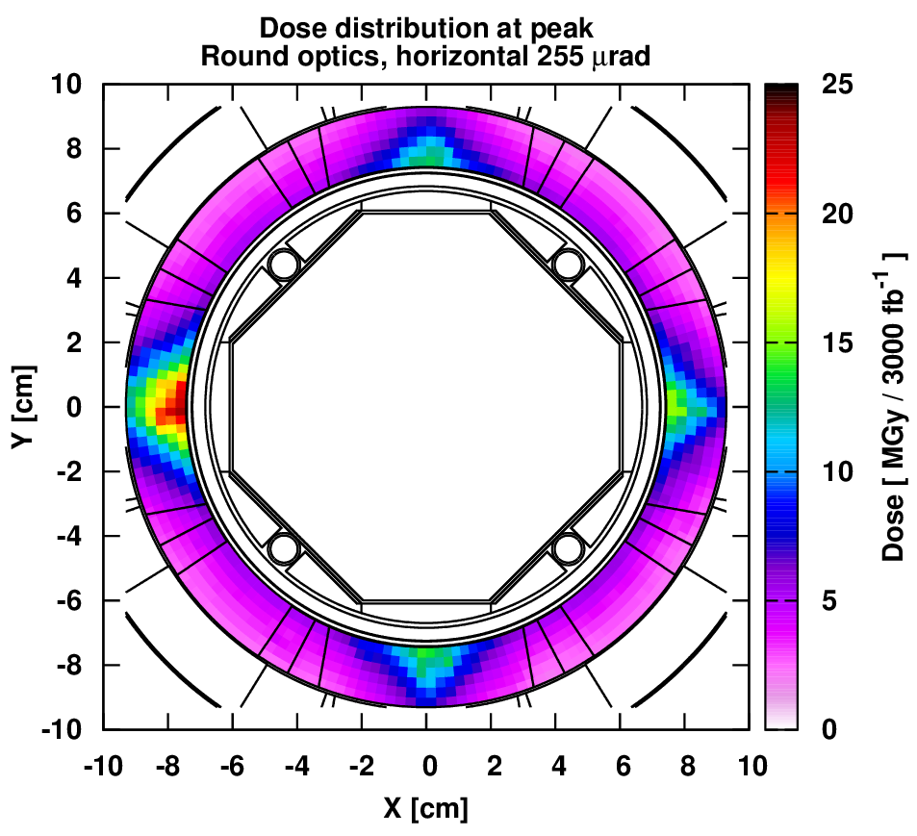
Triplet-D1: Peak dose profile

Slide 8
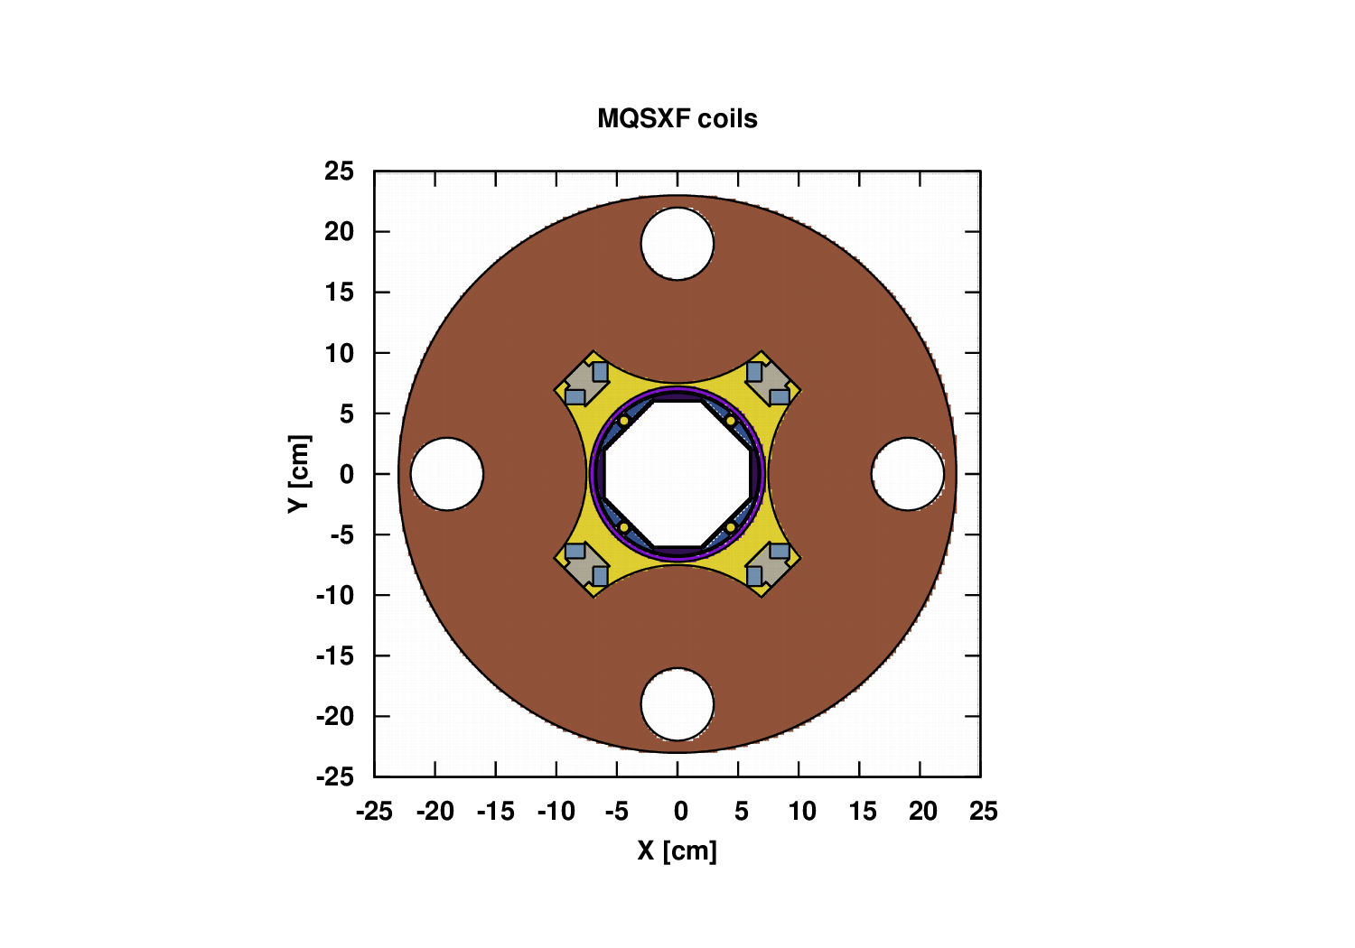
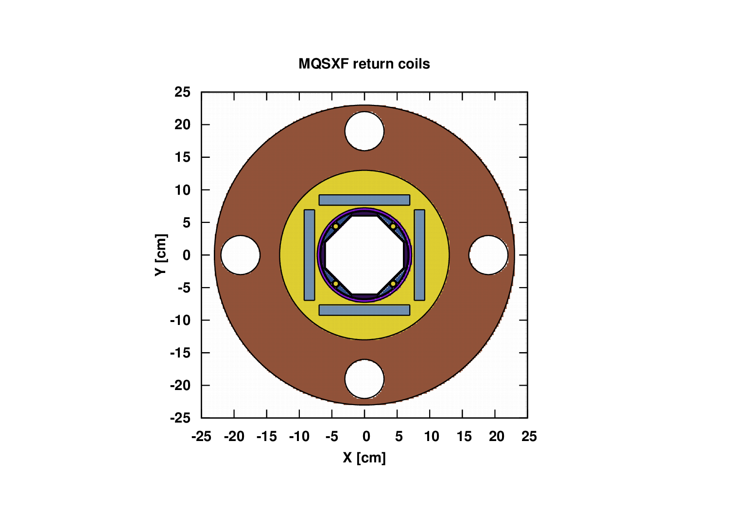
Skew quadrupole (MQSXF)
FLUKA model cross-sections
Iron
He 1.9K
Titanium
NbTi
+
insulator

Slide 9
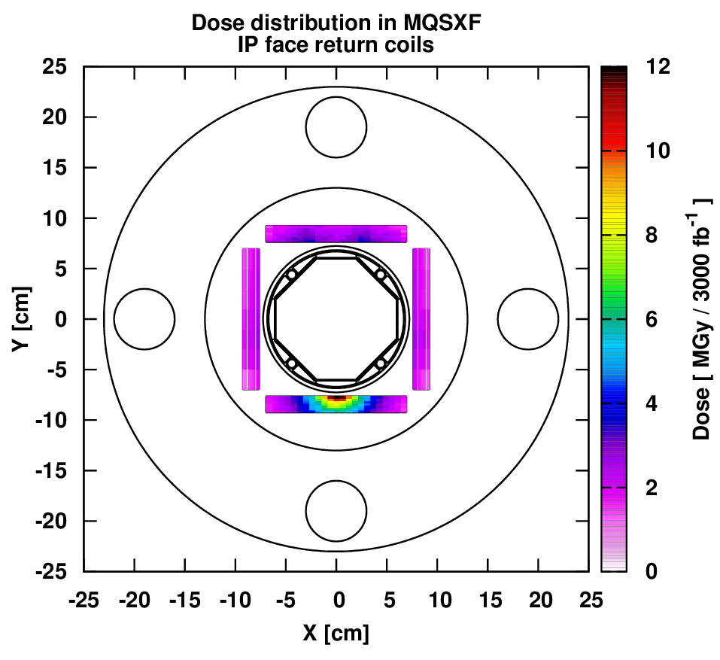
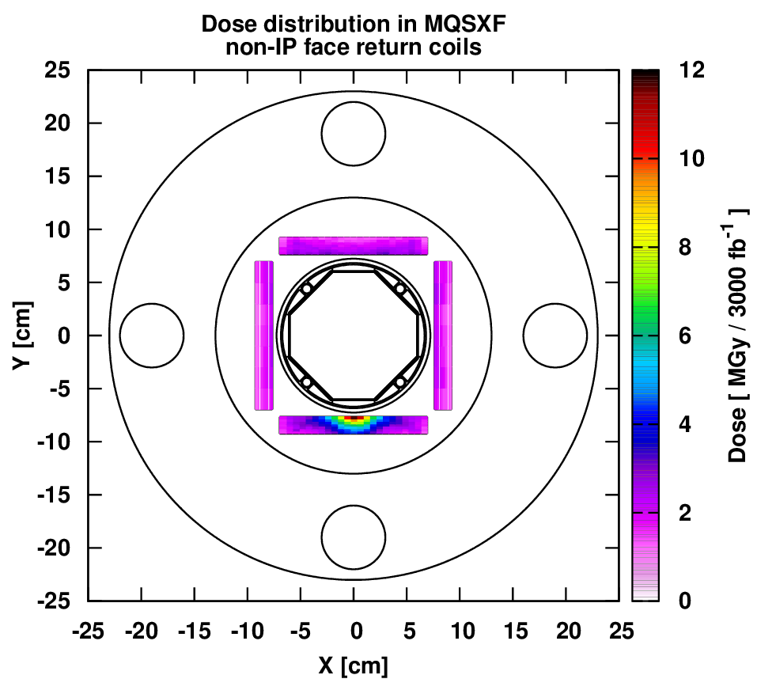
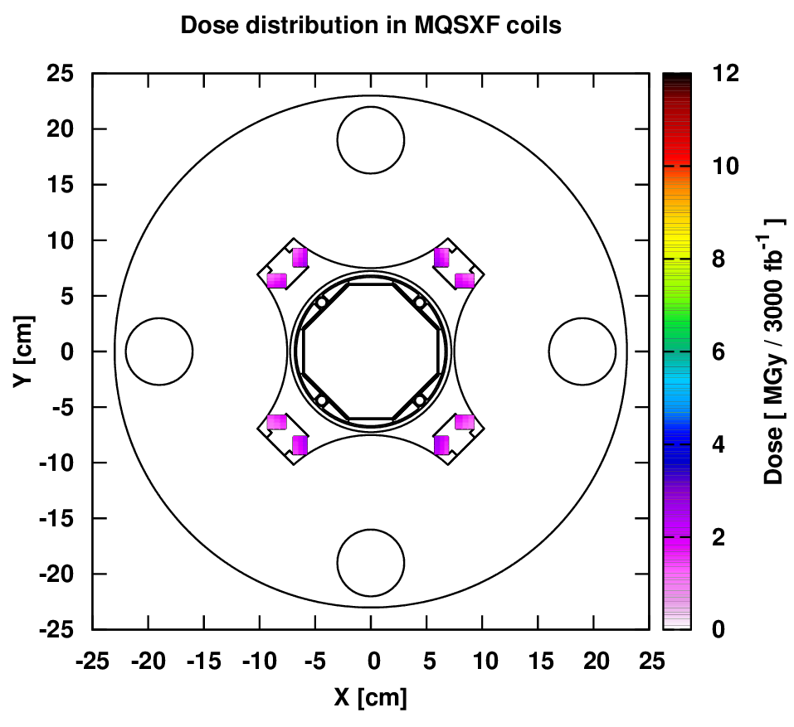
Dose profile in IR1 MQSXF (L_{int}=3000 fb⁻¹)
Dose values up to 12MGy in return coils and up to 3MGy elsewhere
Overall, a maximum value of 15 MGy is expected in the CP coils

Slide 10
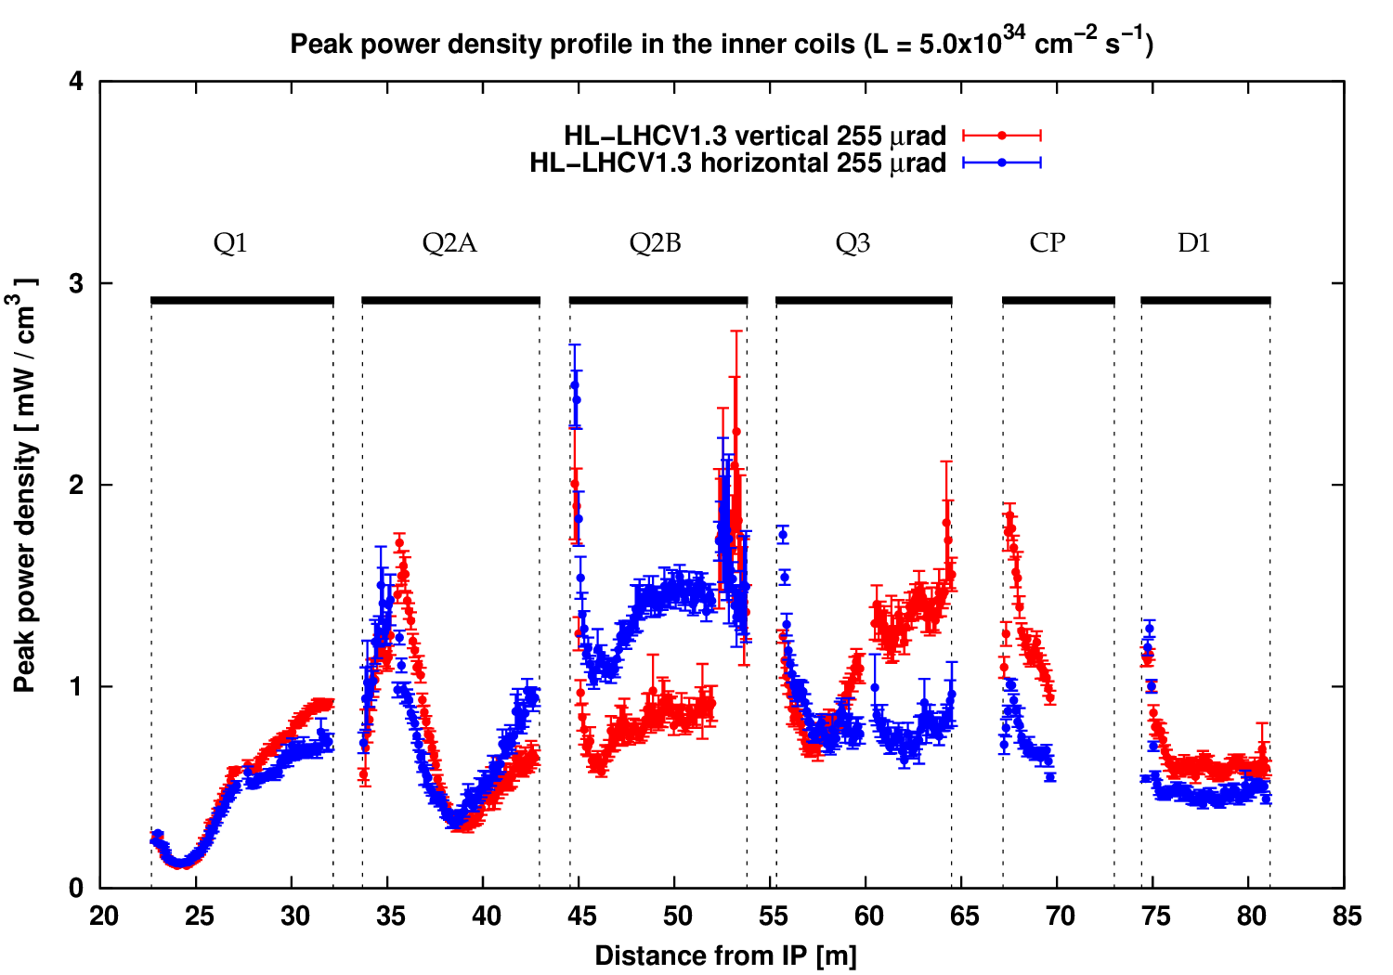
Triplet-D1: Peak power density profile (L=5.0x10³⁴ cm⁻² s⁻¹)
Peak power density values below 3mW/cm³ everywhere

Slide 11
Total power (triplet-D1)
(L=5.0x10³⁴ cm⁻² s⁻¹)
 | Vertical |  | Horizontal
Magnets | Magnet cold mass | Beam screen | Magnet cold mass | Beam screen
 | Power [W]
Q1A + Q1B | 114 | 170 | 113 | 168
Q2A + corr. | 101 | 68 | 96 | 62
Q2B + corr. | 126 | 87 | 137 | 98
Q3A + Q3B | 134 | 80 | 118 | 68
CP | 54 | 62 | 45 | 49
D1 | 79 | 56 | 67 | 46
Beam pipe extensions | 21 | 72 | 19 | 64
TOTAL | 629 | 595 | 595 | 554

Slide 12
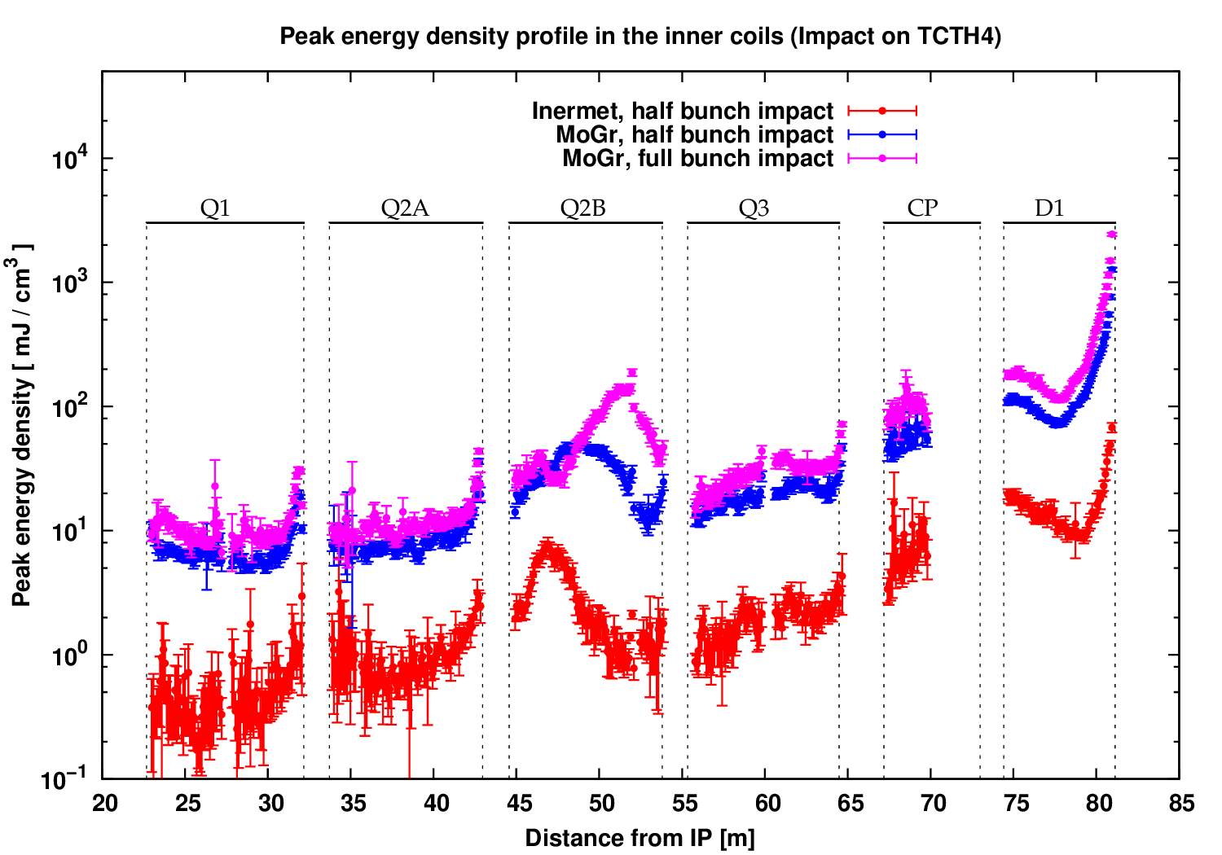
Asynchronous beam dump
Impact on TCTH4.R5
All values well below damage limit (~100J/cm³)
Only D1 would quench in the Inermet / half bunch scenario
Values higher by at least a factor of 10 in MoGr case

Slide 13
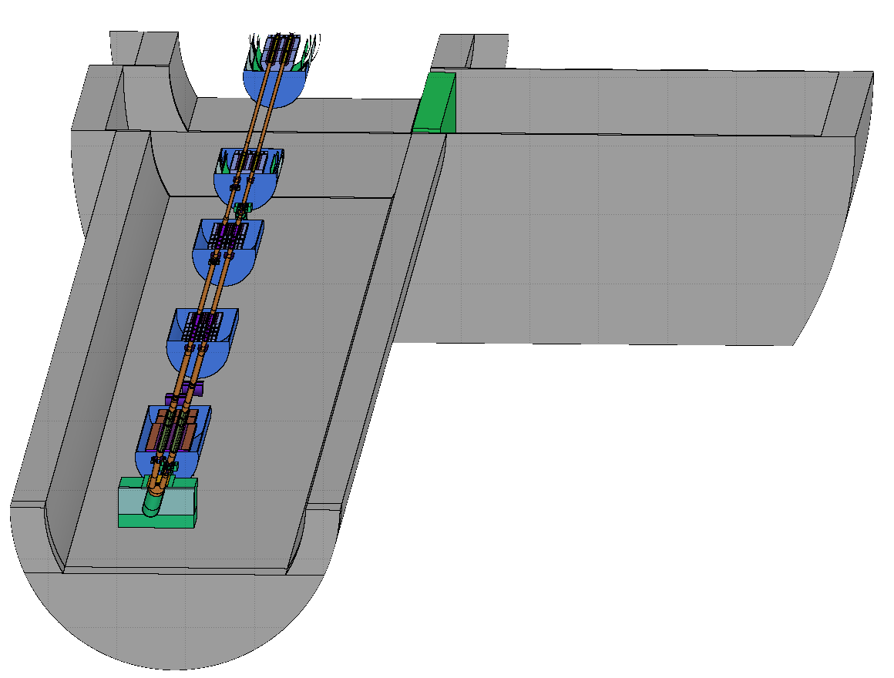
Matching section

Slide 14
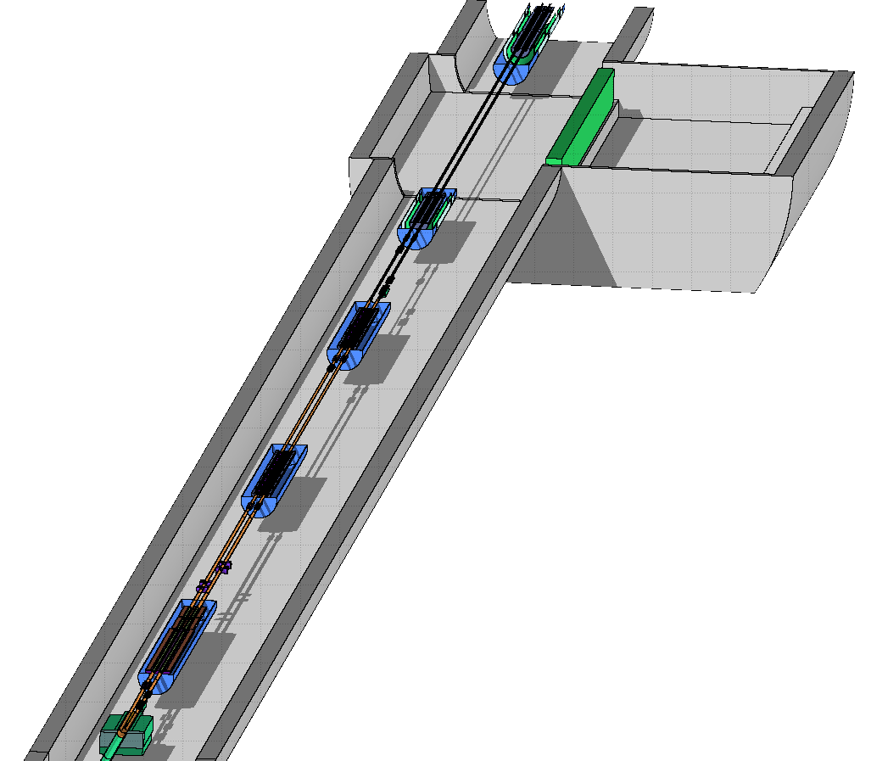
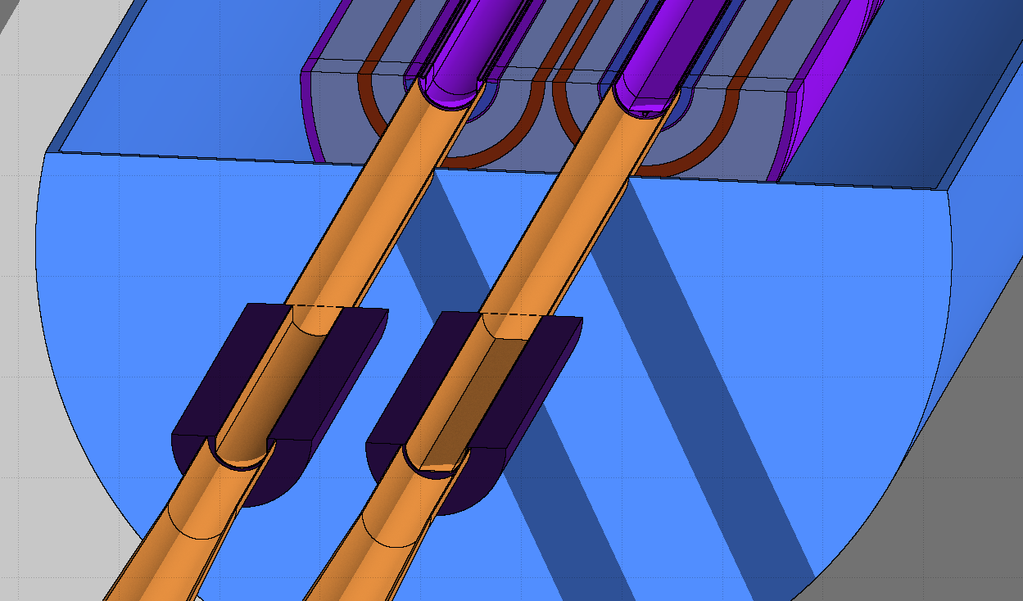
Simulated geometry (matching section)
Major change: Q4 & associated correctors
  Now at 70mm coil aperture
Masks already in place in front of Q4, Q5 (TCLMB) and Q6 (TCLMC)
  Present on both bores
Updated RR
shielding
All collimators in place
  TCLs @ 13.5σ
  (instead of 12σ)
  TCTs @ 12σ
  (instead of 10.9σ)
Q7
Q6
Q5
Q4
D2
TAXN

Slide 15
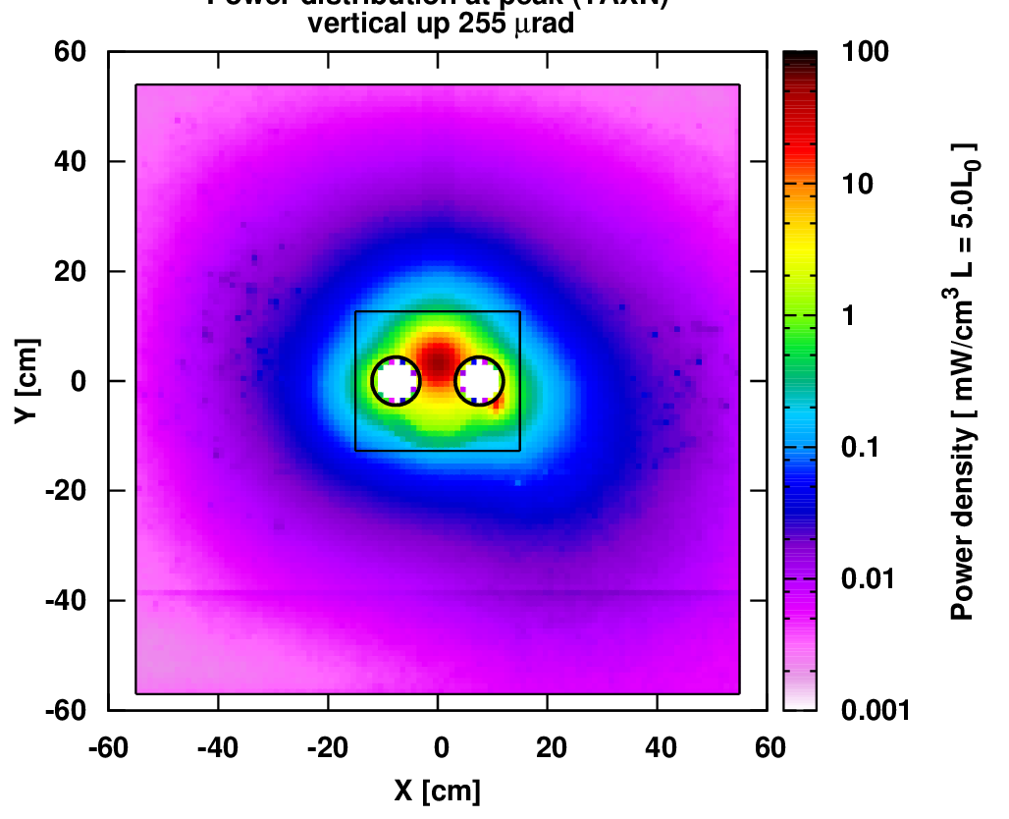
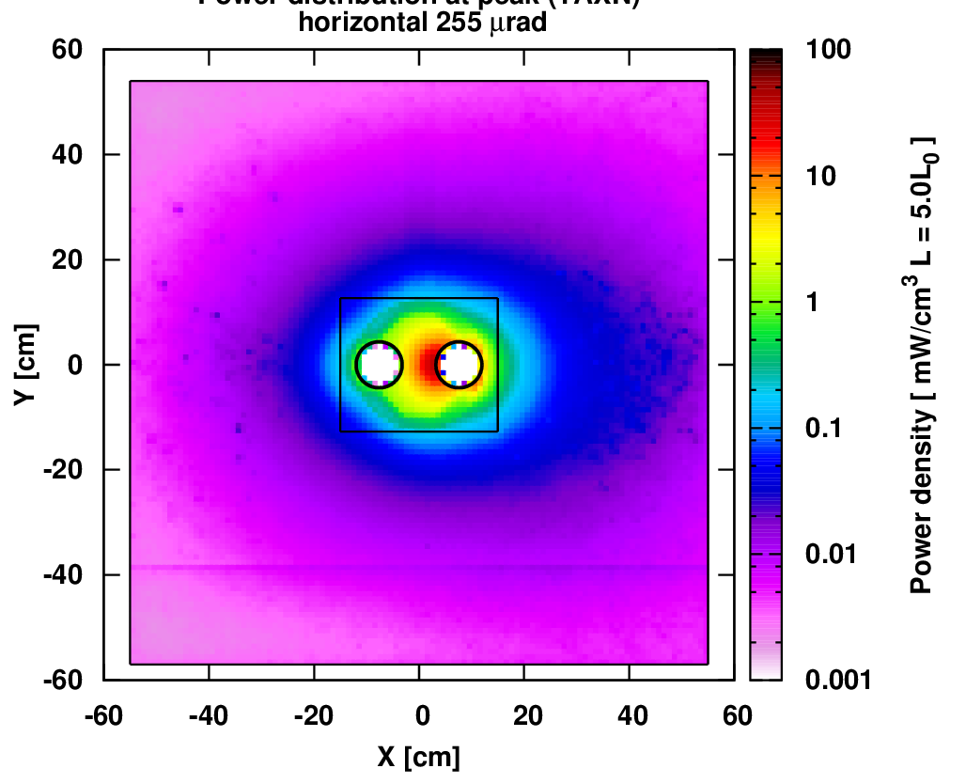
TAXN effectiveness
Greater leakage in the horizontal case, hence the lower power on the TAN itself and higher radiation in the matching section

Slide 16
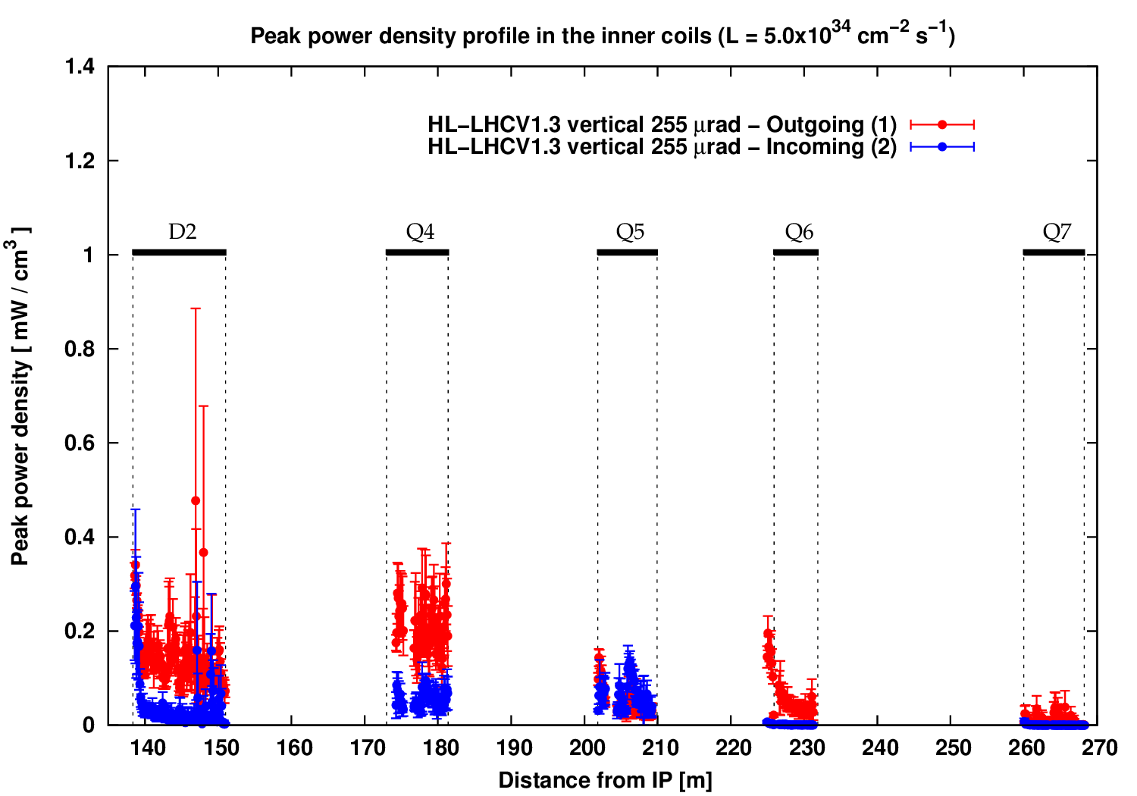
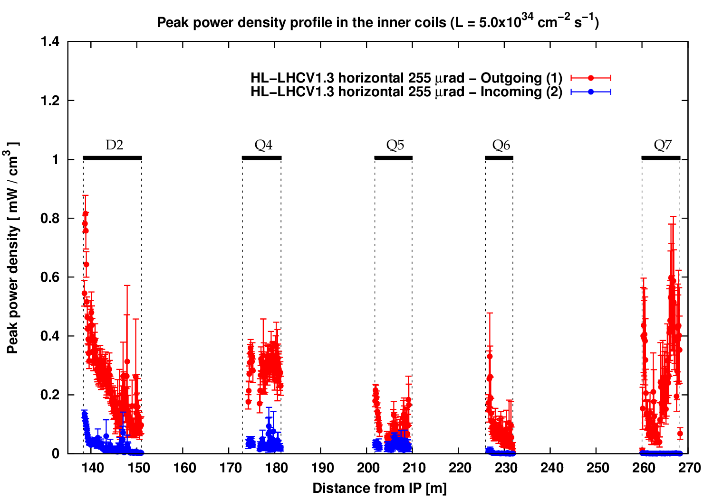
Matching section: peak power density profile (L=5.0x10³⁴ cm⁻² s⁻¹)
Vertical crossing
Horizontal crossing
6 MGy/3000fb⁻¹
12 MGy/3000fb⁻¹
Peak power density values well below 1mW/cm³ in the matching section
Dose values /3000fb⁻¹ up to 12MGy in front face of D2 (for horizontal crossing)
CRITICAL POINT: the overall good result (despite the significant restriction of the Q4 aperture) is largely due to the beneficial presence of the masks on the outgoing beam bore (especially before Q4), as well as the TCLs and the TCTs on the incoming beam bore

Slide 17
Total power (matching section) (1/2)
(L=5.0x10³⁴ cm⁻² s⁻¹)
 | Vertical |  | Horizontal
Magnets | Magnet cold mass | Beam screen | Magnet cold mass | Beam screen
 | Power [W]
D2 + corr. | 17 | 1.1 | 33 | 1.9
Q4 + corr. | 6.8 | 0.2 | 8.2 | 0.4
Q5 + corr. | 0.9 | <1mW | 0.9 | 0.04
Q6 + corr. | 0.9 | 0.03 | 2.3 | <1mW
Q7 + corr. | 0.1 | <1mW | 0.7 | 0.1

Slide 18
Total power (matching section) (2/2)
 | Vertical |  | Horizontal
Collimators | Inner/ upper jaw | Outer/ lower jaw | Inner/ upper jaw | Outer/ lower jaw
 | Power [W]
TCLX4.B1 | 25 | 53 | 156 | 89
TCTPV4.B2 | 11 | 6 | 4.2 | 3.6
TCTPH4.B2 | 5 | 19 | 1.6 | 8.6
TCL5.B1 | 7 | 45 | 13 | 83
TCL6.B1 | 10 | 32 | 12 | 27
TCTV6.B2 | 0.9 | 0.9 | 0.3 | 0.4
TCTH6.B2 | 0.4 | 0.05 | 0.3 | 0.03
Masks | Beam 1 | Beam 2 | Beam 1 | Beam 2
TCLM4 | 19 | 1.3 | 19 | 0.7
TCLM5 | 2.6 | 1.3 | 3.6 | 0.8
TCLM6 | 0.7 | 0.06 | 1.5 | 0.05

Slide 19
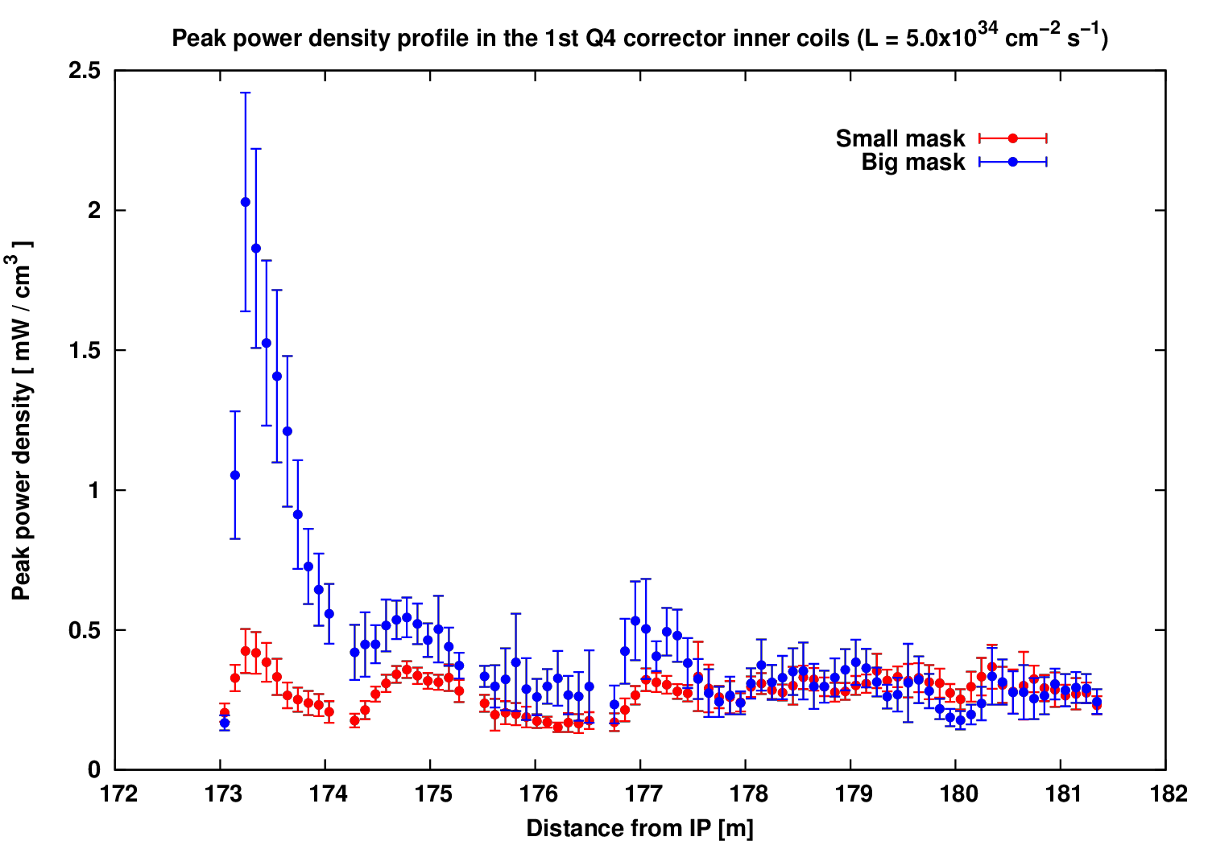
Peak power density profile (Q4+corr.) with larger mask aperture (+2mm)
~35MGy / 3000fb⁻¹
~7MGy / 3000fb⁻¹
Increasing the mask aperture by 2mm:
  Significant increase on the IP-face of the first Q4 corrector (MCBYV)
  Max. value of 2mW/cm³ still within operational limits, while the impact on the total heat load is small
  However, the local increase in the accumulated dose becomes worrisome

Slide 20
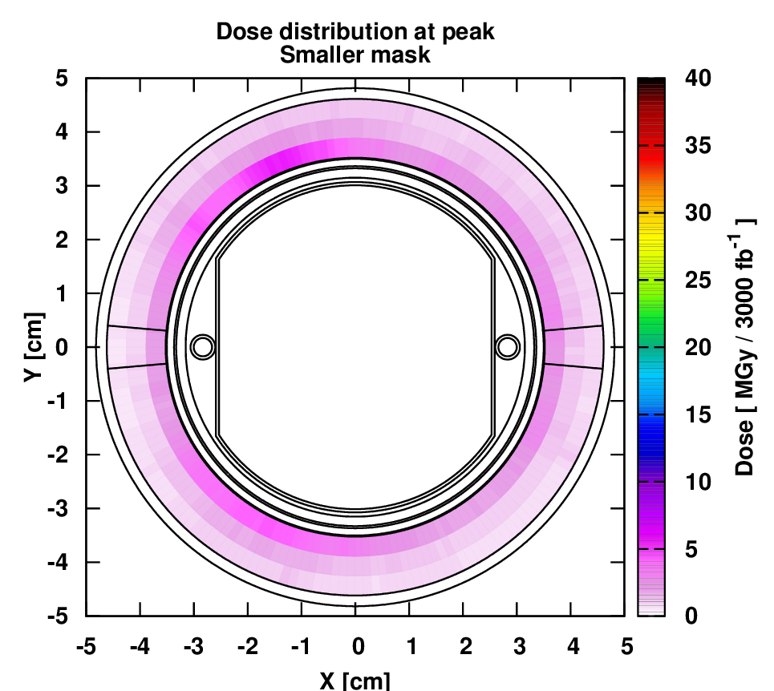
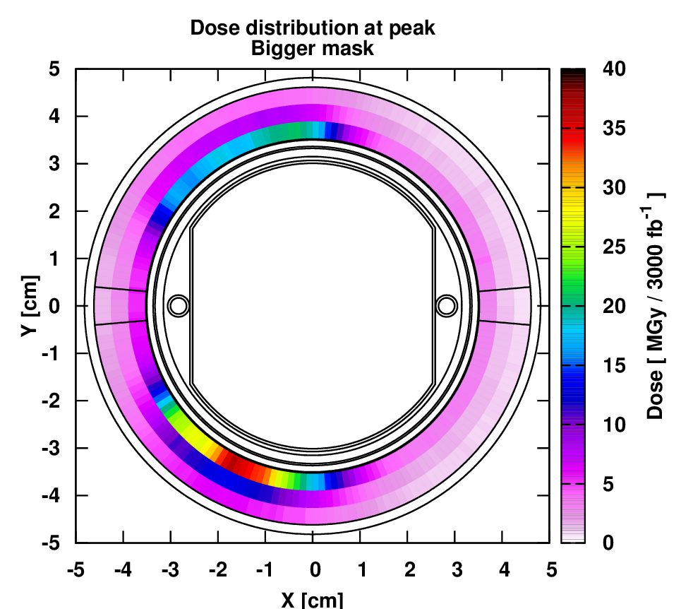
2D dose distribution at peak on Q4 corr. (3000 fb⁻¹) with larger mask aperture (+2mm)
Regardless of possible misalignments, the aperture increase of the mask exposes the front face of the first Q4 corrector to an accumulated dose of ~35MGy for 3000fb⁻¹
In Q5 (which already benefits from the presence of TCL5), the aperture change moves the dose peak from the horizontal plane to the vertical, but without leading to worrying values

Slide 21
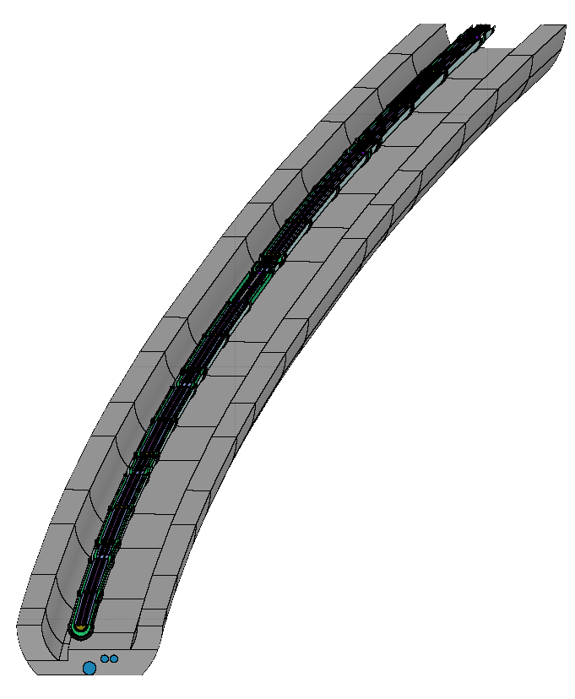
Dispersion suppressor

Slide 22
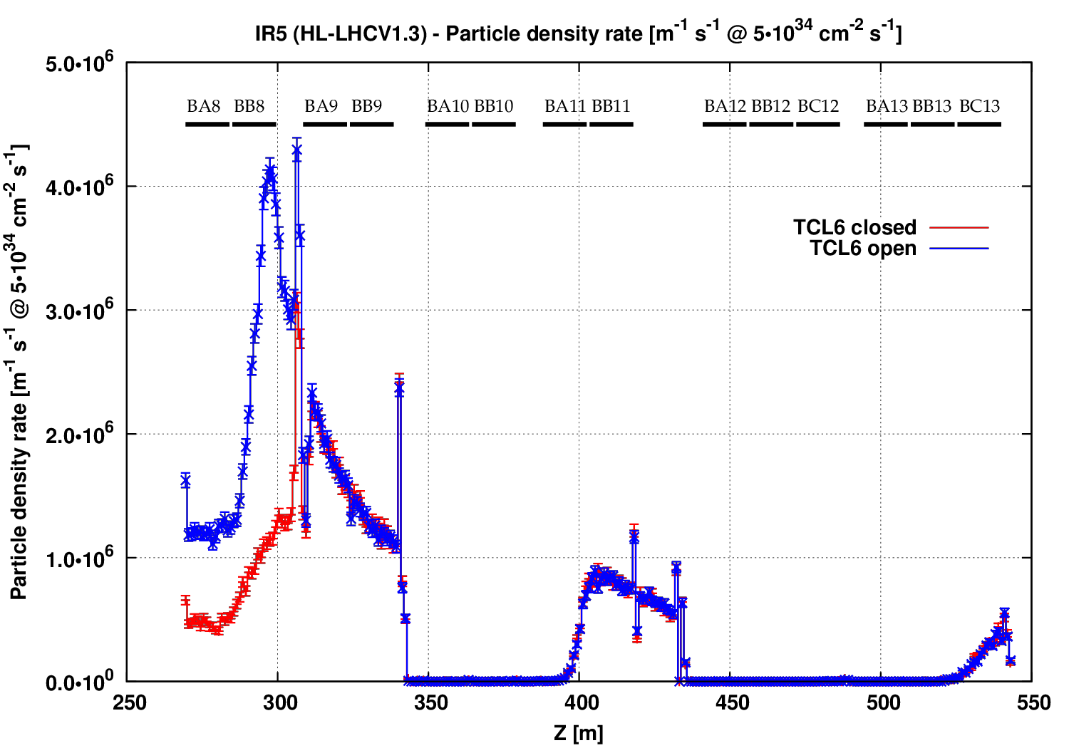
Losses in the HL-LHC DS
Losses dominated by off-momentum protons
Two cases: 1) TCLs at 12σ, 2) TCL6 open (25mm halfgap)
Opening TCL6 has a noticeable impact only up to cell 8

Slide 23
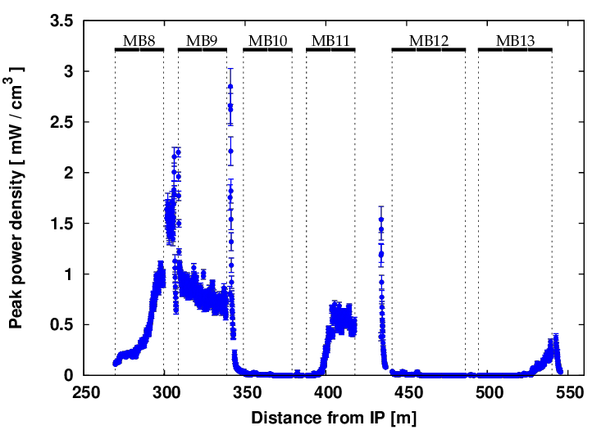
Impact on the HL-LHC DS coils
Maximum peak power density values in the coils around 2-3mW/cm³
Maximum dose values in the coils could be challenging between cells 8 & 9 (up to 40MGy locally, especially in MQMC in cell 9)

Slide 24
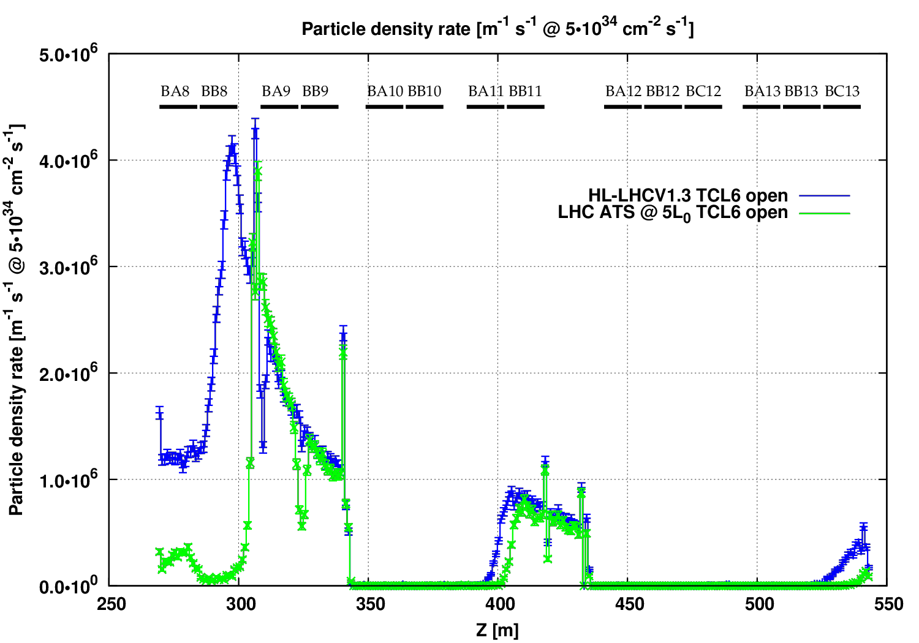
Losses in the HL-LHC DS
Comparing to present LHC ATS optics (scaled to HL luminosity) it is clear that losses from cell 9 onward rise purely with the luminosity
However, contrary to LHC, in HL-LHC cell 8 is more exposed without TCL6

Slide 25
Summary
Situation in the triplet-D1 region remains largely unchanged in v.1.3 (no major changes in the layout)
  Use of shielded BPM in interconnect before Q2B is important
Despite reduced Q4 aperture, peak dose and peak power density values in the matching section remain acceptable, largely due to the presence of masks on the outgoing beam (especially before Q4), as well as TCLs and TCTs
Peak power density in DS up to 3mW/cm³, but local dose peaks could be challenging

Slide 27
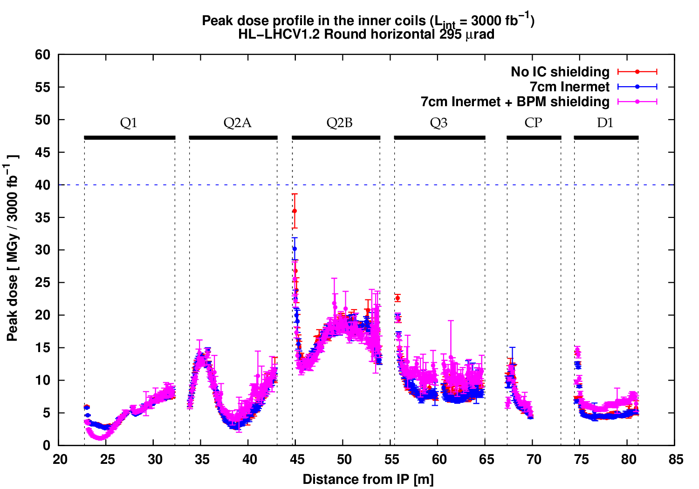
Summary of results
36MGy
30MGy
26MGy
TCC decision (used for v.1.3 calculations):
  Interconnect with shielded BPM only before Q2B (for now)
  Interconnect with 7cm insert kept elsewhere

Slide 28
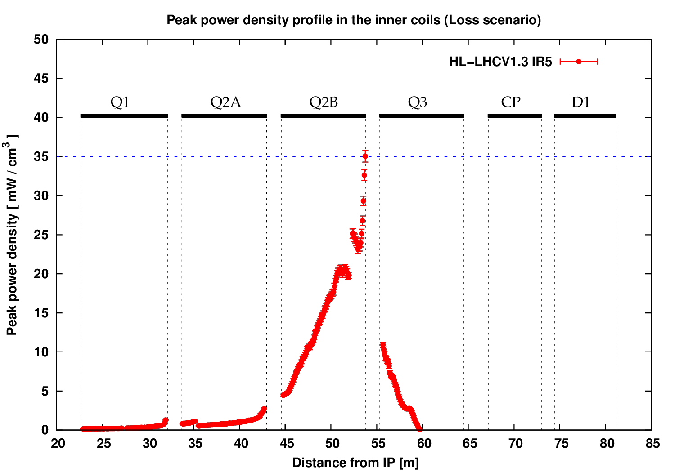
Triplet-D1: Peak power density profile
(Losses, normalised to 35mW/cm³ quench limit)
*
*
To be checked for the MCBX corrector!
Corresponds to 4.1x10⁹ p/s lost locally ➔ 7.36x10¹³ p/s global loss rate
A few seconds of beam life-time
~80 MW of power lost

Slide 29
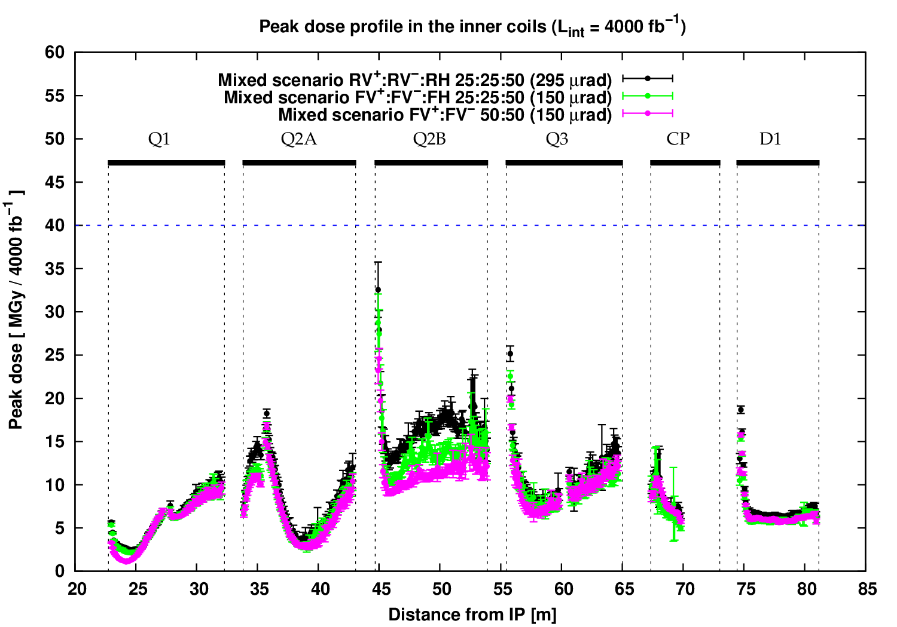

Peak dose minimisation scenarios
Comparison of three mixed scenarios:
Energy deposition in the Triplet-D1 region (V1.2) | 5th Joint HiLumi LHC-LARP Annual Meeting – CERN, October 26-30, 2015 | AT

Slide 30
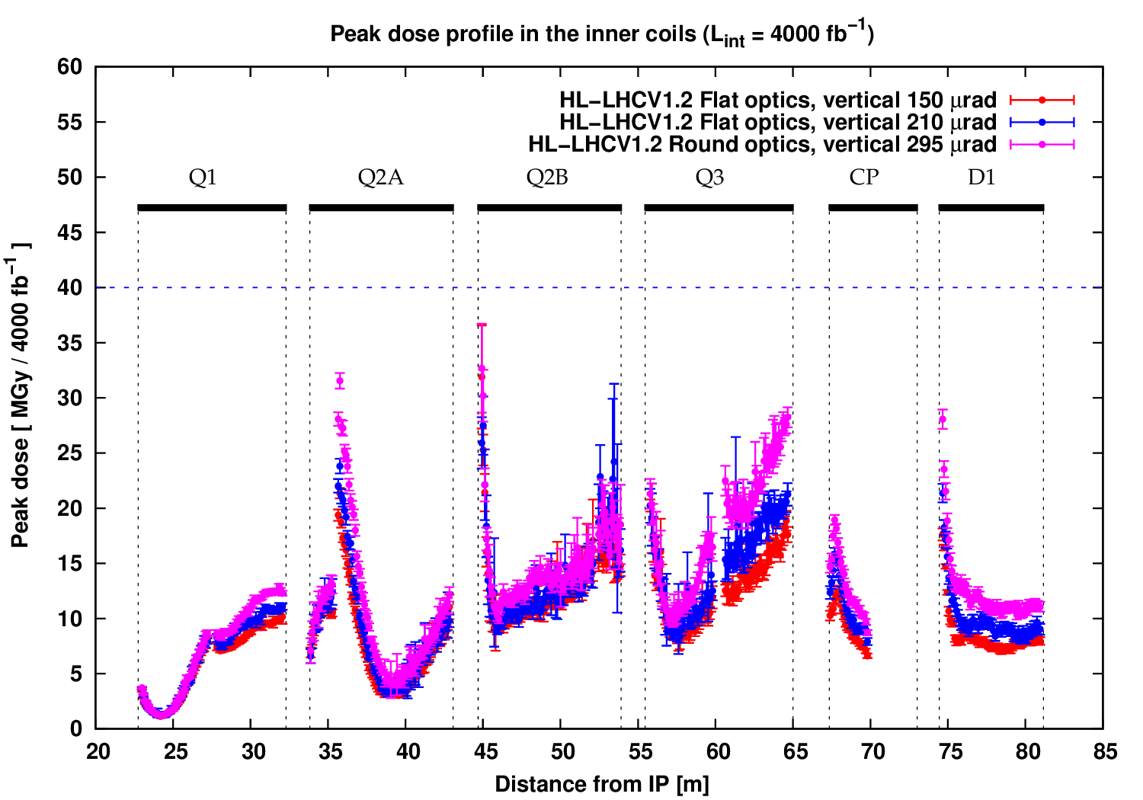
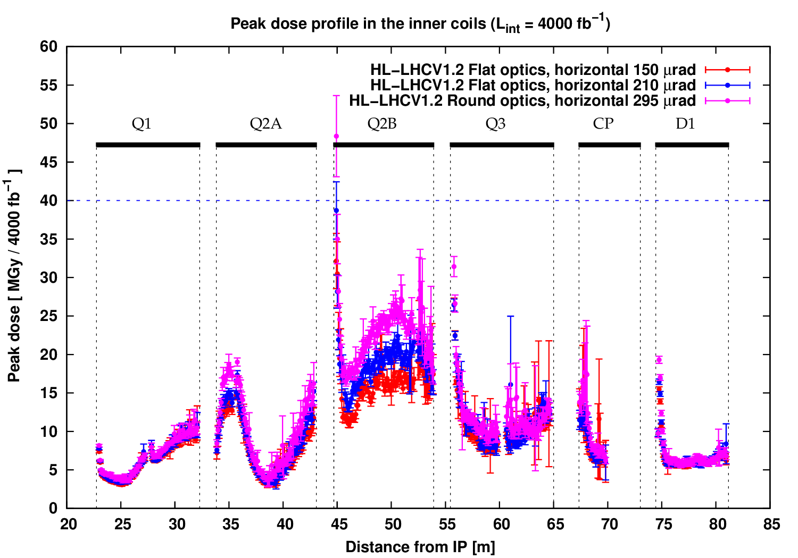
Further studies: flat optics
Two flat optics scenarios were also studied for both vertical and horizontal crossing
  150μrad half-crossing angle, β*_{x} / β*_{y} = 40 / 10 cm
  210μrad half-crossing angle, β*_{x} / β*_{y} = 40 / 10 cm
Sensitivity of results to changes in bunch length and beam divergence is limited
On the contrary, the crossing angle plays an important role
  Lower dose for lower crossing angle
Vertical crossing
Horizontal crossing
295μrad
210μrad
295μrad
150μrad
210μrad
Energy deposition in the Triplet-D1 region (V1.2) | 5th Joint HiLumi LHC-LARP Annual Meeting – CERN, October 26-30, 2015 | AT

