Slide 1
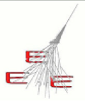



Time resolution
E. Bossini, C. Cicalò, D. De Gruttola,
I. Gnesi, M. Garbini, S. Grazzi, M.P. Panetta
30/11/2016
EEE meeting

Slide 2
Status
time slewing correction works
many different results (σ_{t} ranges from 210 ps to 700 ps…)
big contribution outside the peak
many telescopes show an offset in the Δt distribution
some examples in the next slides (data from Run 3)
20/04/2017
EEE meeting
2

Slide 3
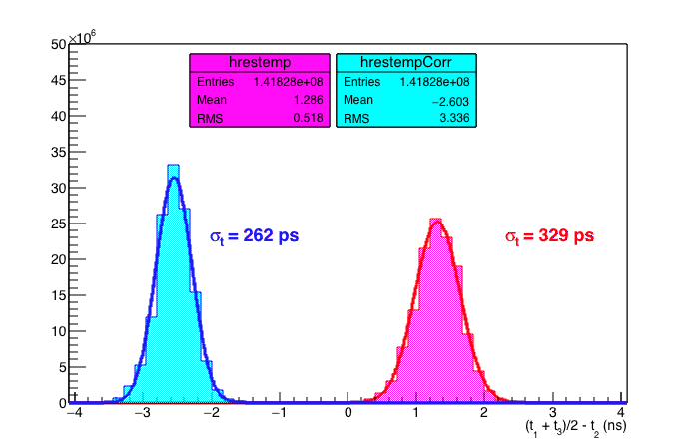
ALTA-01
20/04/2017
EEE meeting
3

Slide 4
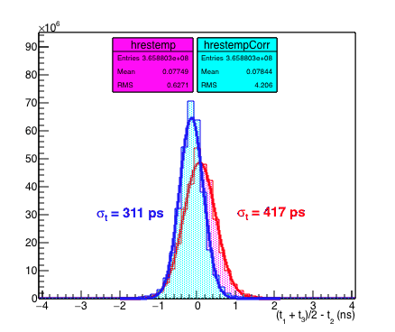
BOLO-01
20/04/2017
EEE meeting
4

Slide 5
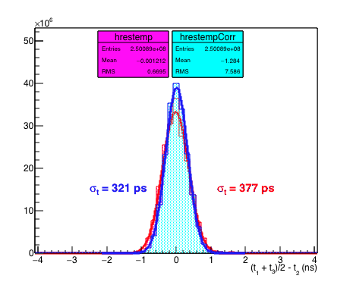
BARI-01
20/04/2017
EEE meeting
5

Slide 6
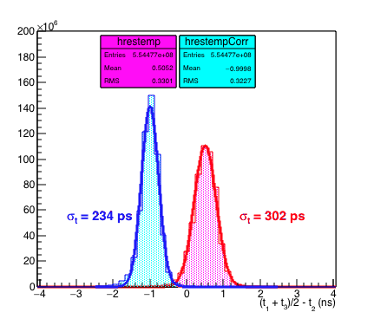
TORI-01
20/04/2017
EEE meeting
6

Slide 7
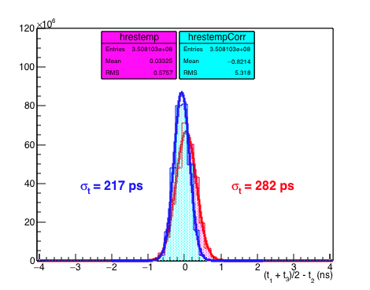
BOLO-03
20/04/2017
EEE meeting
7

Slide 8
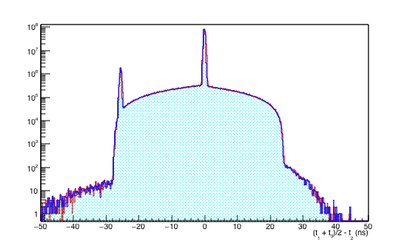
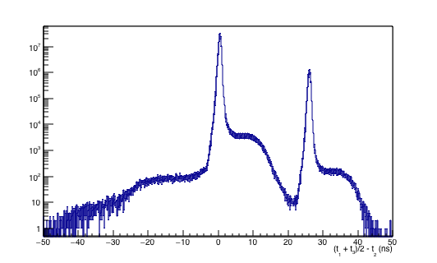
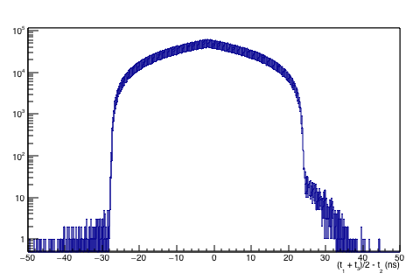
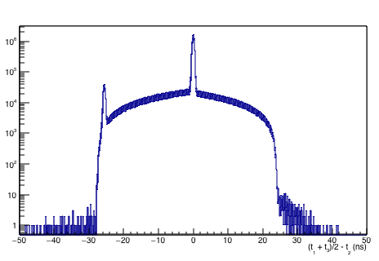
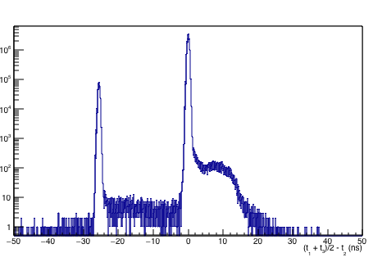
BOLO-03 (log y scale)
whole Run 3
Nov 2016
Dec 2016
Jan 2017
no clock card here
no clock card here
in part of this period
clock card ok
but what is the other peak?
20/04/2017
EEE meeting
8

Slide 9
TORI-03 (log y scale)
whole Run 3
clock card ok
but what is the other peak?
20/04/2017
EEE meeting
9

Slide 10
Status
time slewing improves time res of about 20%
different values to be understood
offsets to be understood
ALTA01 offset
ANCO01 forse bad clock
AREZ01 ok
BARI01 ok
BOLO01 ok
BOLO02 small offset
BOLO03 ok
BOLO04 small offset
CAGL01 small offset
CAGL02 forse bad clock
CAGL03 forse bad clock
CATA01 ok
CATA02 ok
CATZ01 ok
CERN01 small offset
CERN02 forse bad clock
GROS01 small offset
GROS02 forse bad clock
LAQU01 small offset
LAQU02 forse bad clock
LECC01 small offset
LECC02 small offset
LODI01 small offset
LODI02 small offset
PATE01 small offset
PISA01 offset
REGG01 forse bad clock
SALE01 forse bad clock
SALE02 forse bad clock
SAVO01 ok
SAVO02
SAVO03 small offset
TERA01 small offset
TORI01 offset
TORI03 small offset
TORI04 ok
TRAP01 small offset
TREV01 ok
TRIN01 ok
VIAR01 offset
VIAR02 forse bad clock
this table is not final
(to be studied in different periods)
20/04/2017
EEE meeting
10

