Slide 1
EP-DT: LAB ROTATIONS
Kaja Hivand Hiorth, Elisabeth Koren Halvorsen

Slide 2
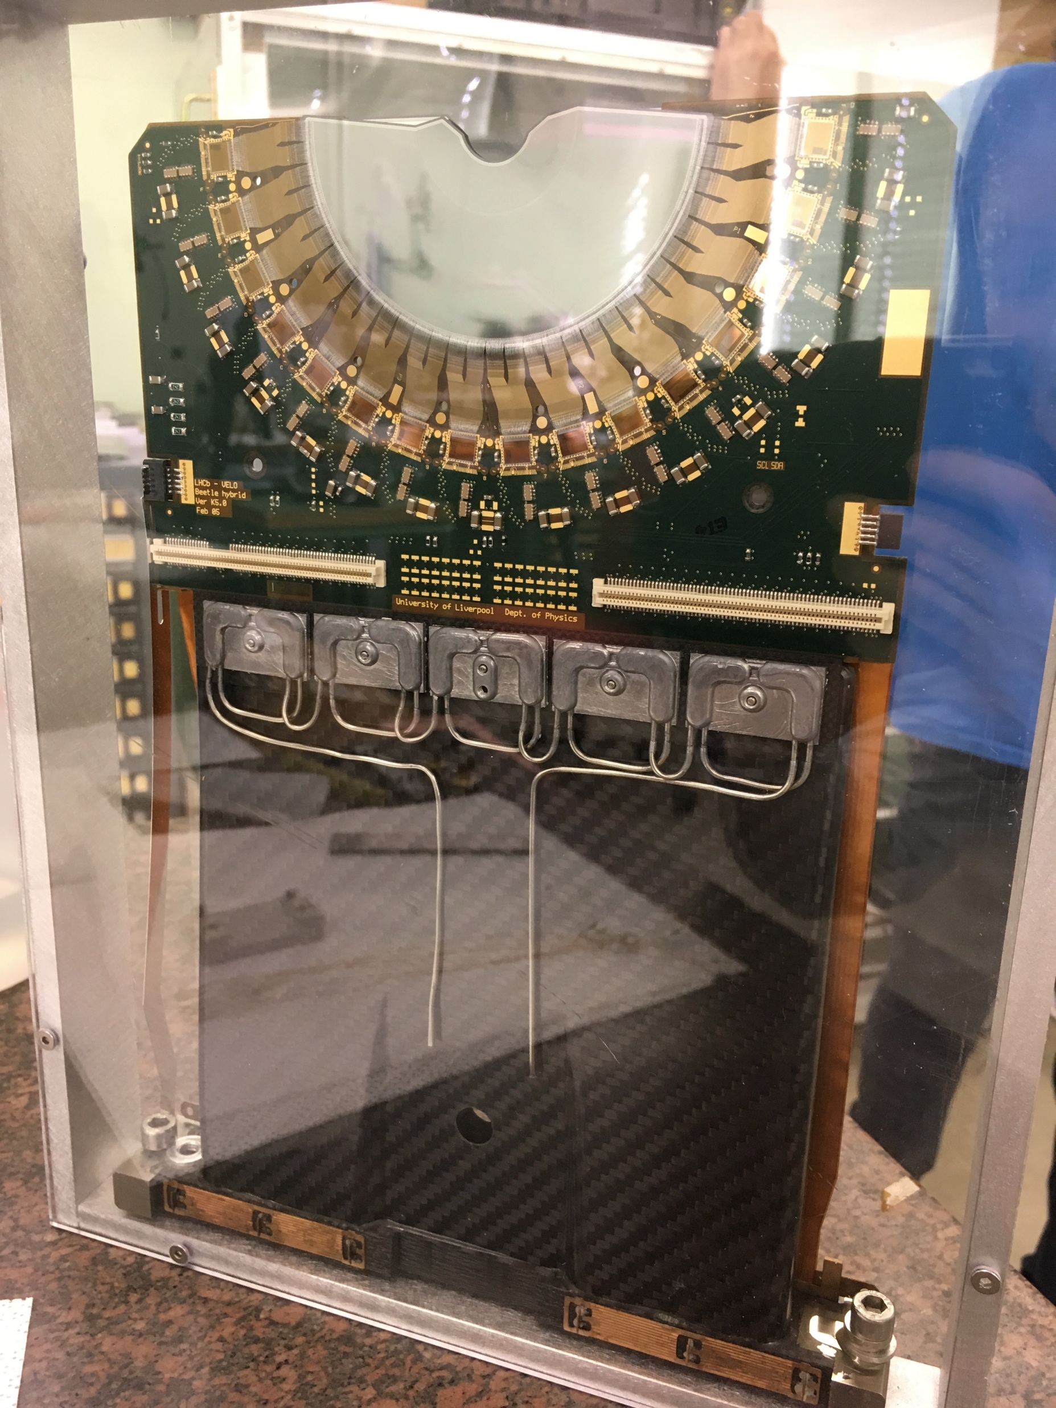
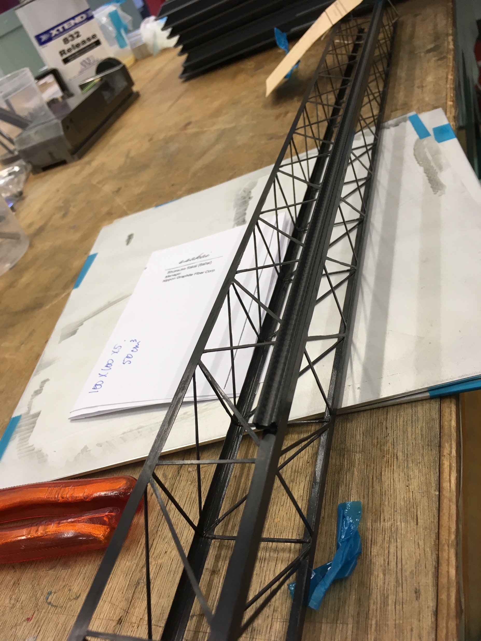
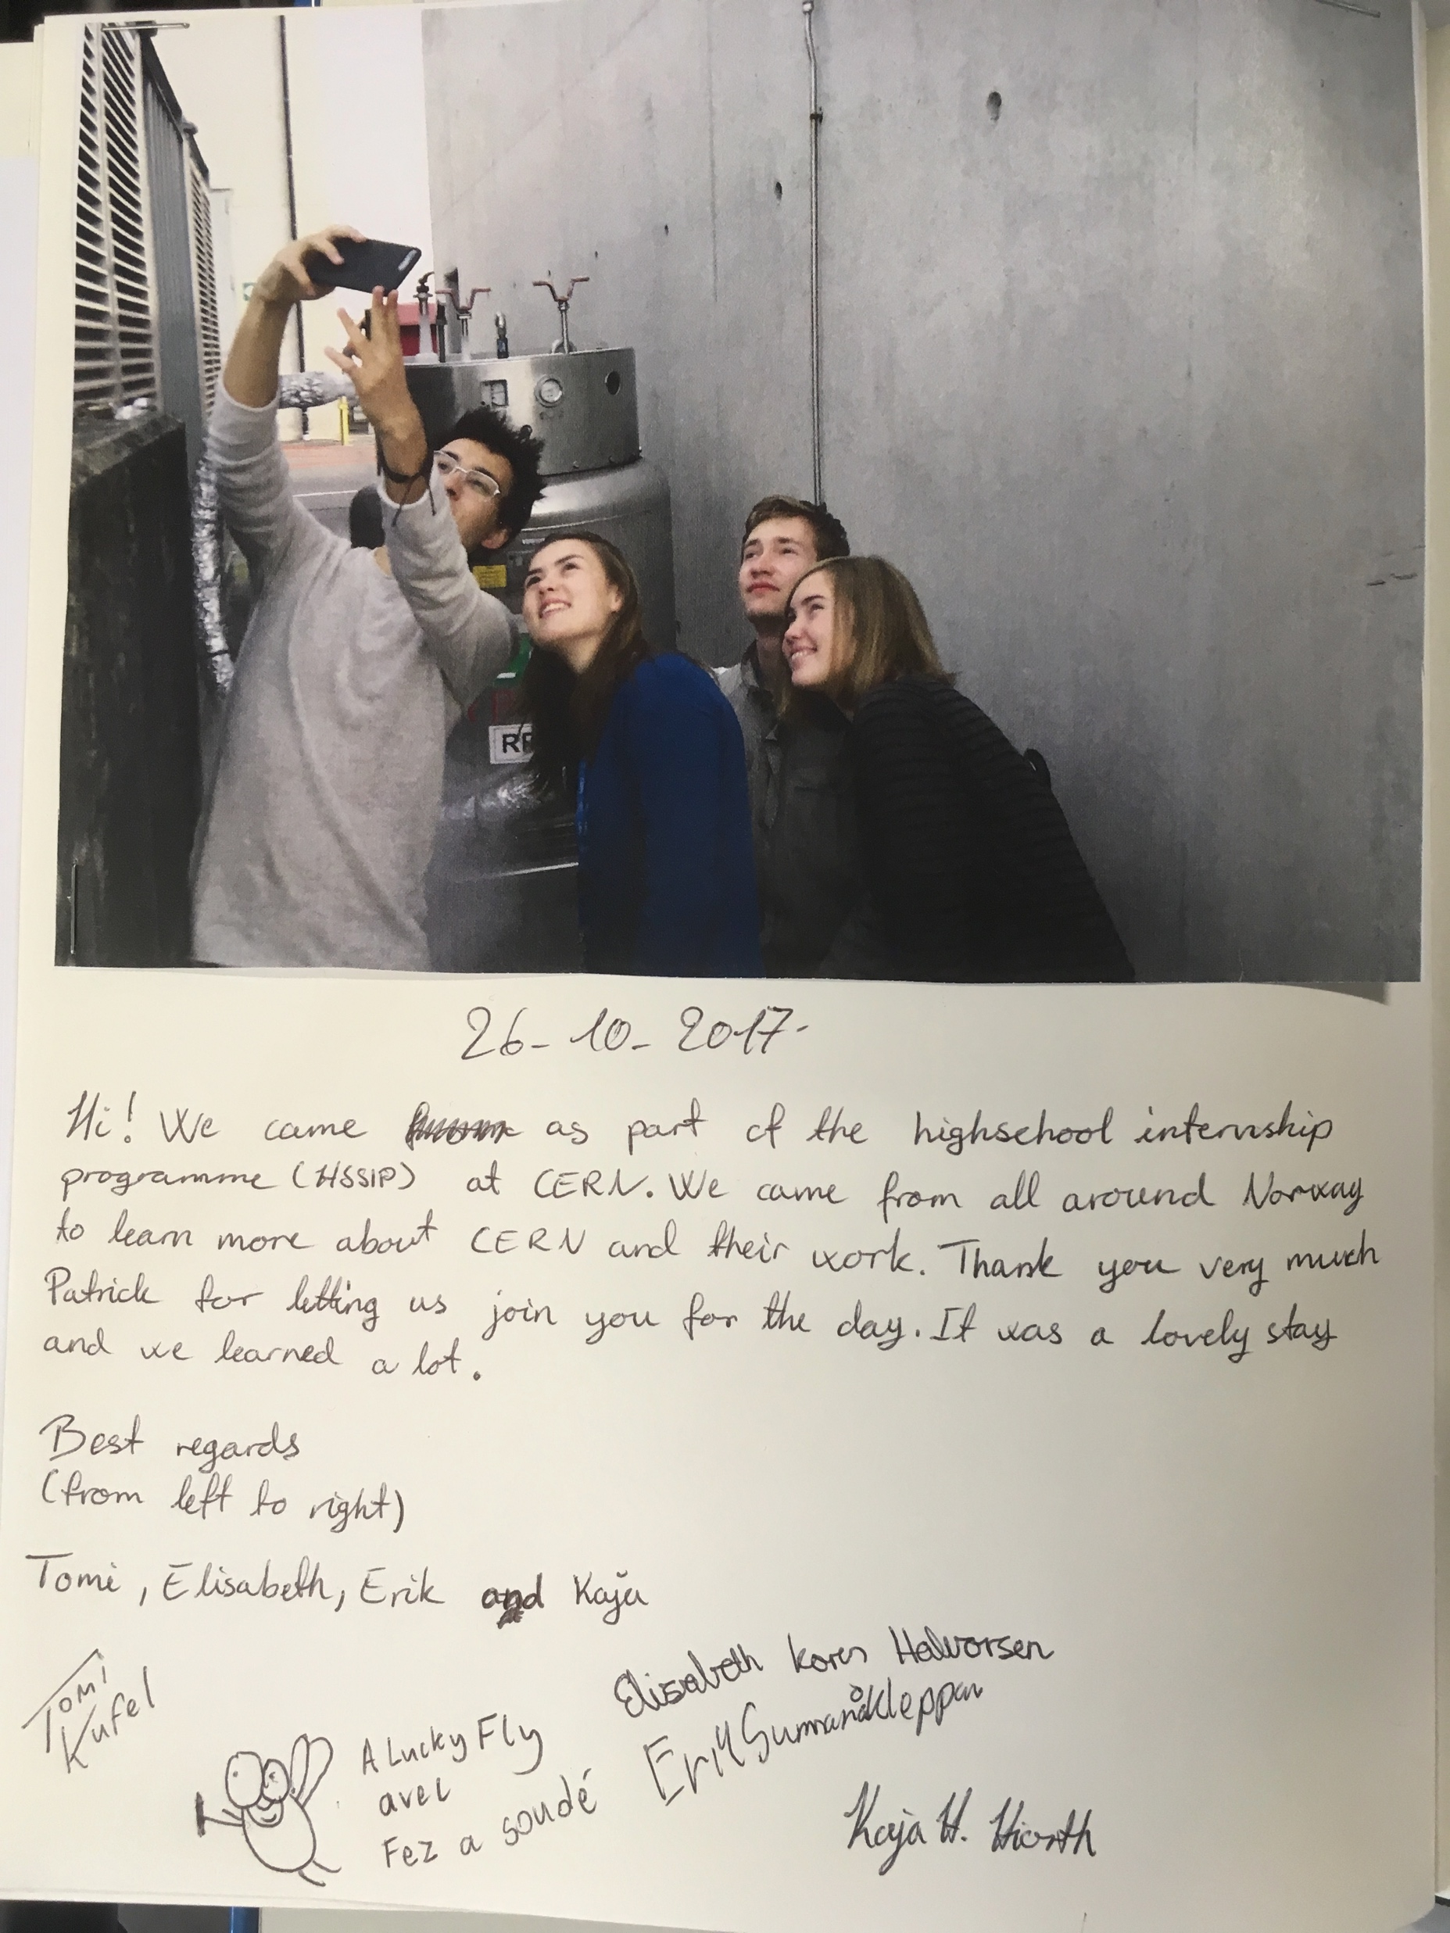
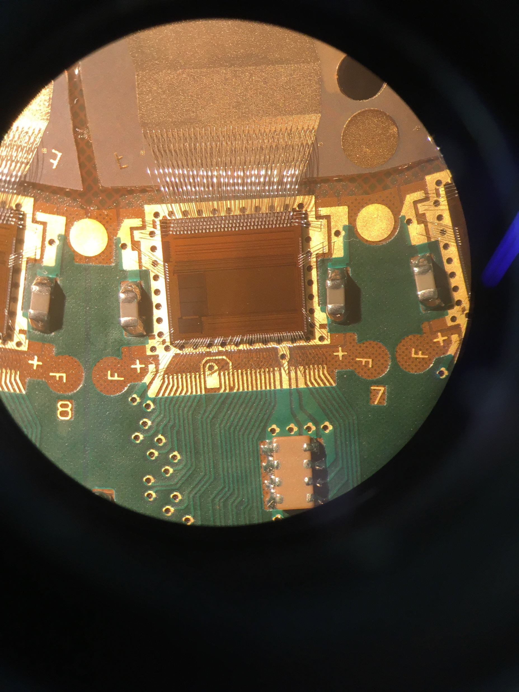
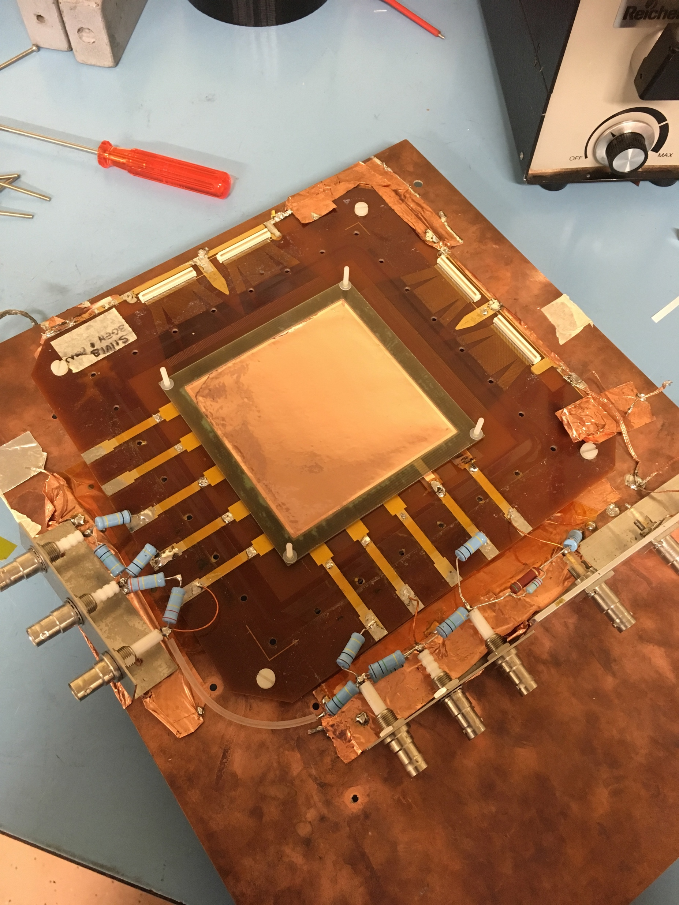
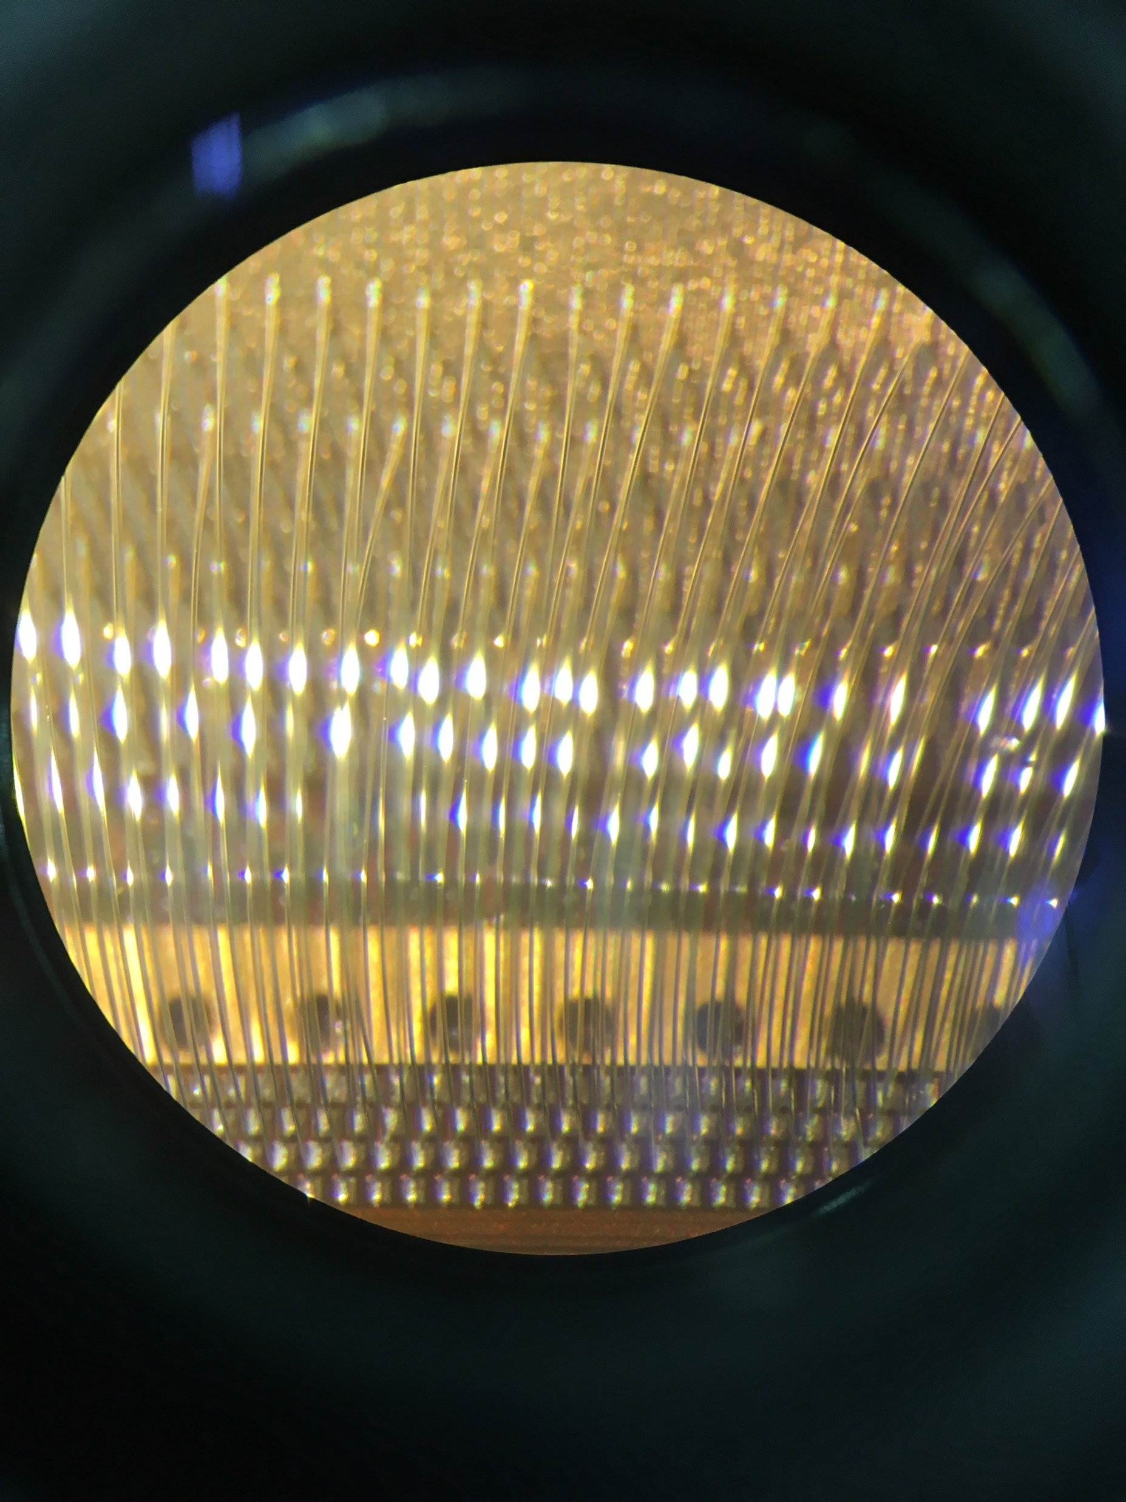
Work place
Day 1: Cooling related activities
Day 2: Carbon-composites
Day 3: LHCb scint
Day 4: R&D 51
Day 5: TFG
Day 6: Magnets activities
Day 7: R&D 50
Day 8: Gas related activities
Day 9: TFG
Notes:
Day 1: Cooling related activities
2 face cooling system using CO2 for the silicon detectors. 2 face is that you use both the liquid and the gass form of CO2 in the cooling process
Day 2: Carbon-composites
Carbon fibers used in mechanical support, in the detectors. Carbon, because really light and strong.
Day 3: LHCb scint
How the sensors looks and works in the LHCb
Day 4: R&D 51
Developing detectors for photons, using electrical signals from electrons.
Day 5: TFG
Thin Fiber Glass. How you can identify substance based on reflection and transition, by using a spectrometer.
Day 6: Magnets activities
Magnet used right after the collision to detect charged particles.
Day 7: R&D 50
Silicon detectors and how they work
Day 8: Gas related activities
We learned about the gasses they uses in the detectors (CO2, O2, Xeon)
Day 9: TFG
Thin film and glass
Coating of galss to increase or decreas the amount of light reflected.

Slide 3
Experiences
Each day something new
  Information
  Thrown around
  Exciting
  Fun
Notes:
Because of our time limit in one place, we haven’t received any big tasks so we have been thrown around to so many different labs in this short period of time, that we’re just overwhelmed by all the information we’ve received. Each day something new.

Slide 4
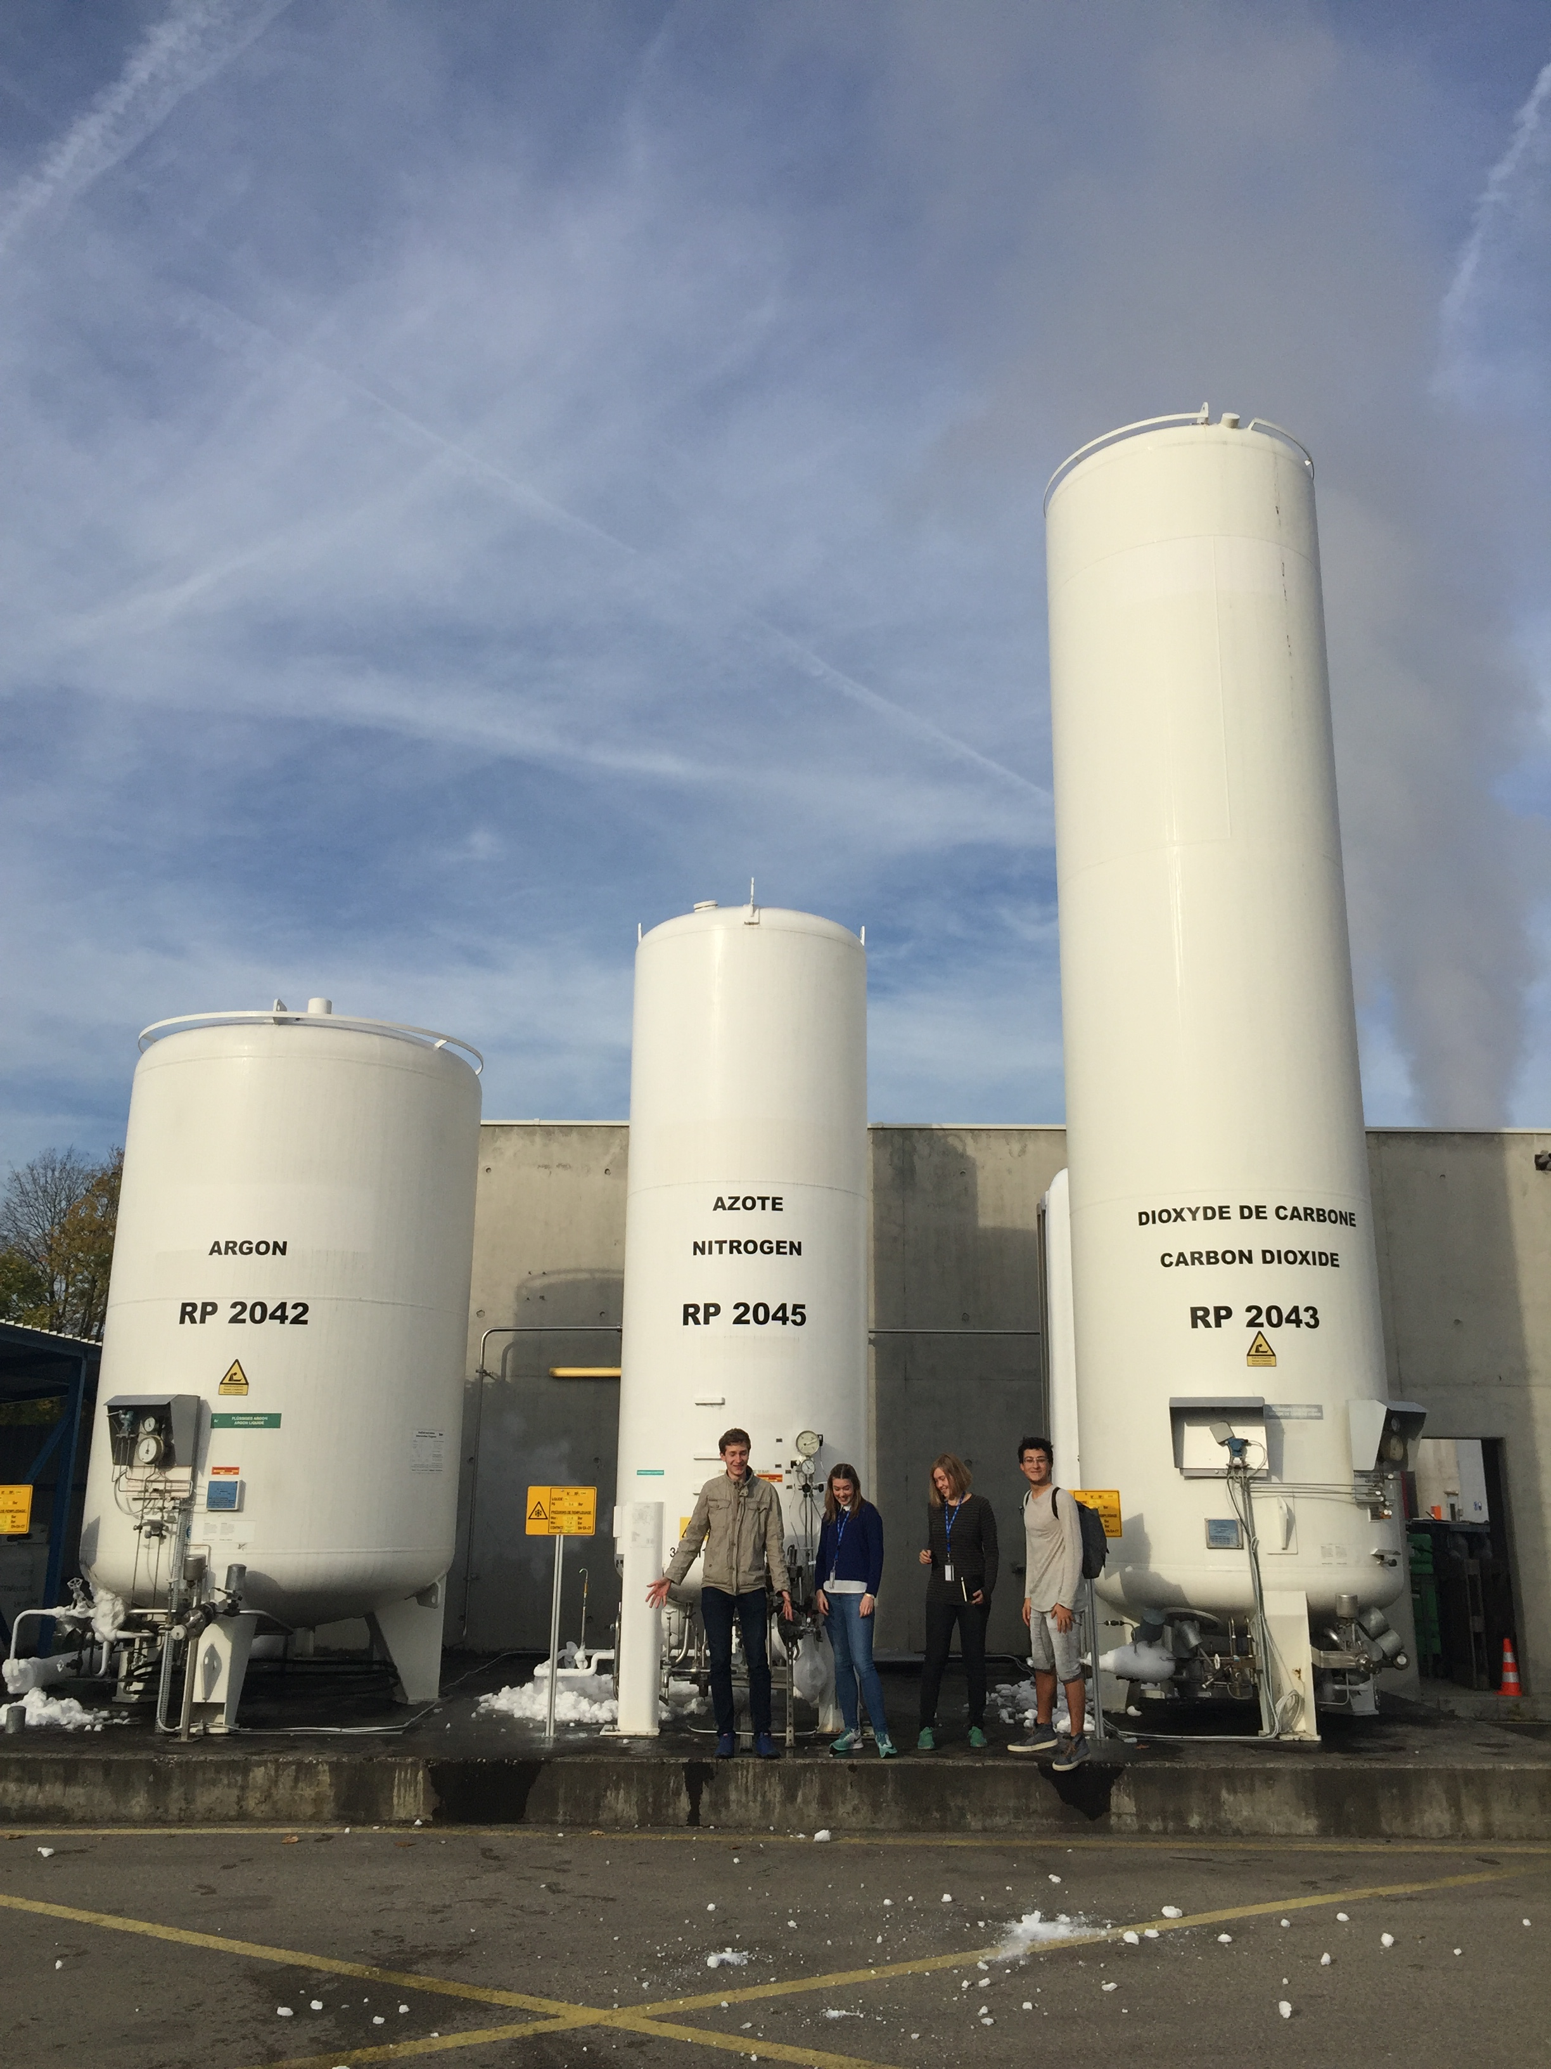
The big picture
EP-DT
New technology
Upgrades
Notes:
The next step in technology here.

Slide 5
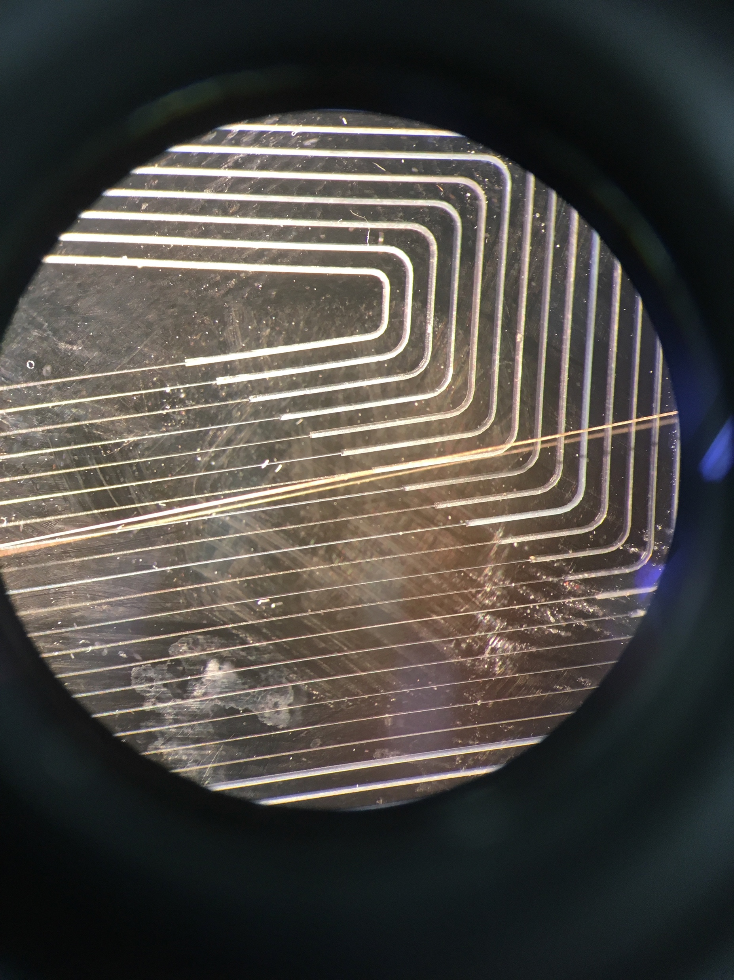
The future of CERN
Collaborations
Faster and better –Demands more energy and resources
Upgrades might not be enough
Notes:
The future of CERN:
More collaborations on a global scale => more experiments and broader expertise => more discoveries and greater scientific progress.
The challenges CERN will face:
Everything needs to be faster and better the further CERN comes with their research and this takes a lot of resources and energy
Maybe sometime in the future upgrades aren’t good enough, and everything will have to be built again from scratch.

Slide 6
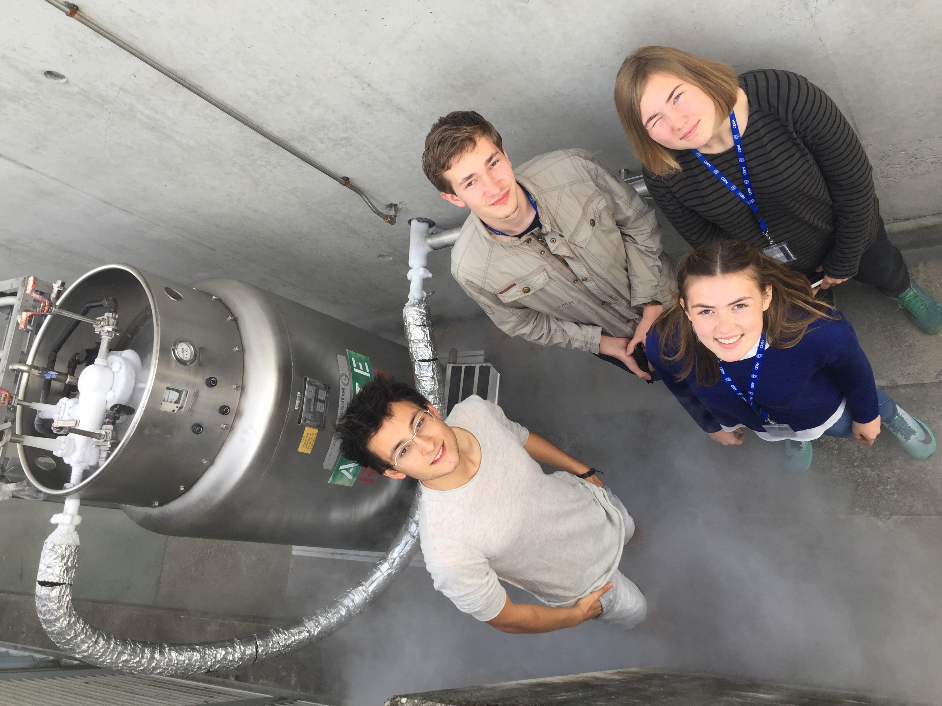
Advice to the next HSSIP students
Photos
Notes
Socialize
Sleep
Eat a lot!!!!!!
Notes:
Take photos!
Take notes or you will forget everything really fast
Socialize with the others
Go to bed early, or you will mentally become a zombie

