Slide 1
SMB-SE
Jonas Rossavik Johannessen

Slide 2
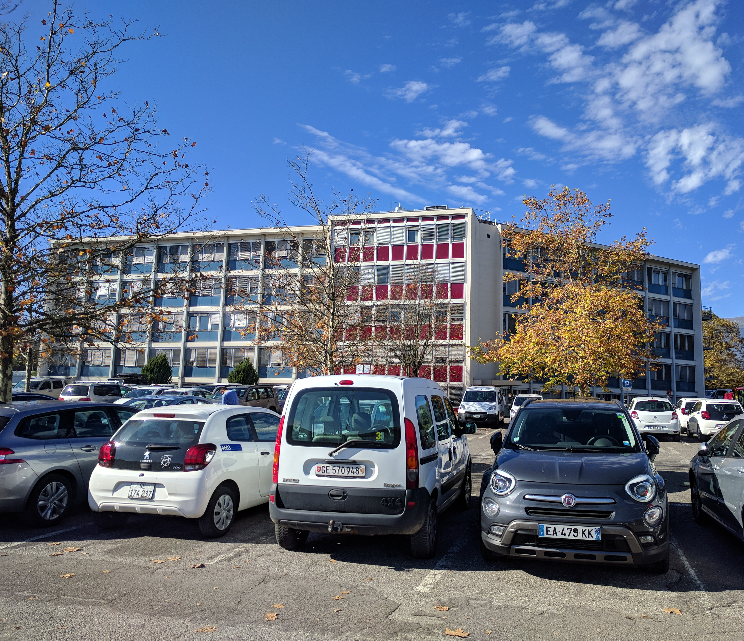
General
Site management and Buildings – Site Engineering
Civil engineers
Buildings and infrastructure
Responsibilities:
  Buildings satisfy needs of offices, experiments etc.
  Good working conditions
  Safety

Slide 3
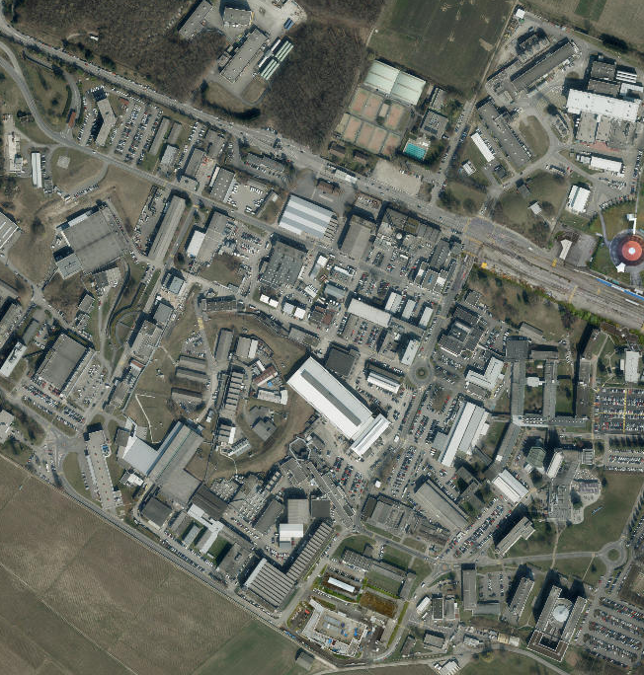
"The big picture"
No particle physics
  Important for the particle physics
Building requirement
  Right conditions
  Effectiveness
  Safety

Slide 4
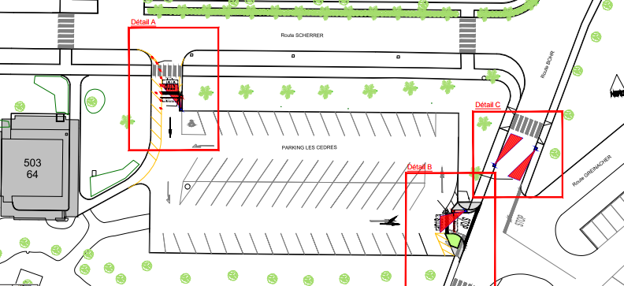
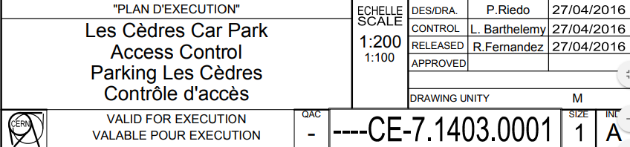
Drawings archive
Easier to find old drawings
Safety copy
CDD
16-digit code
  Design office, building, type of drawing
  Easy to search

Slide 5
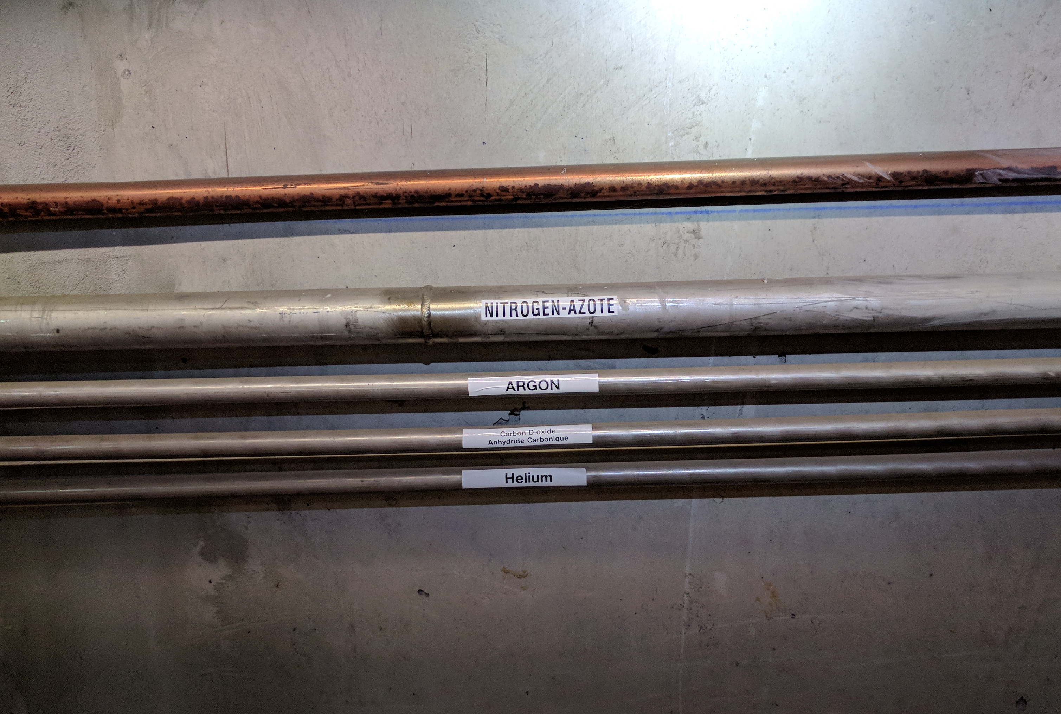
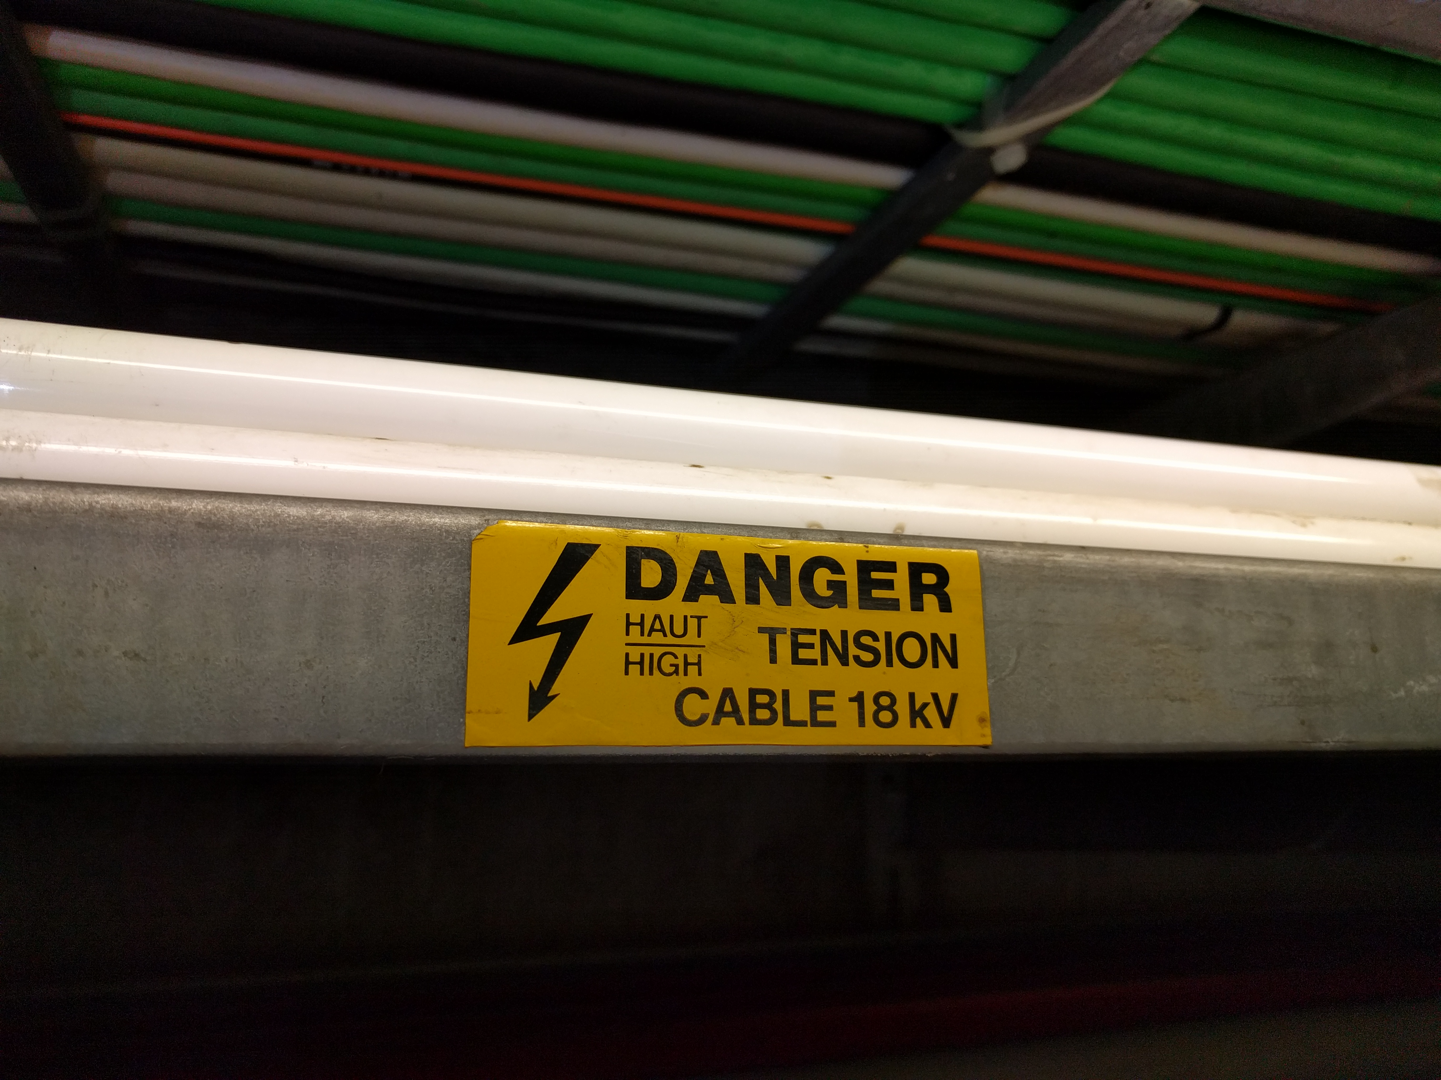
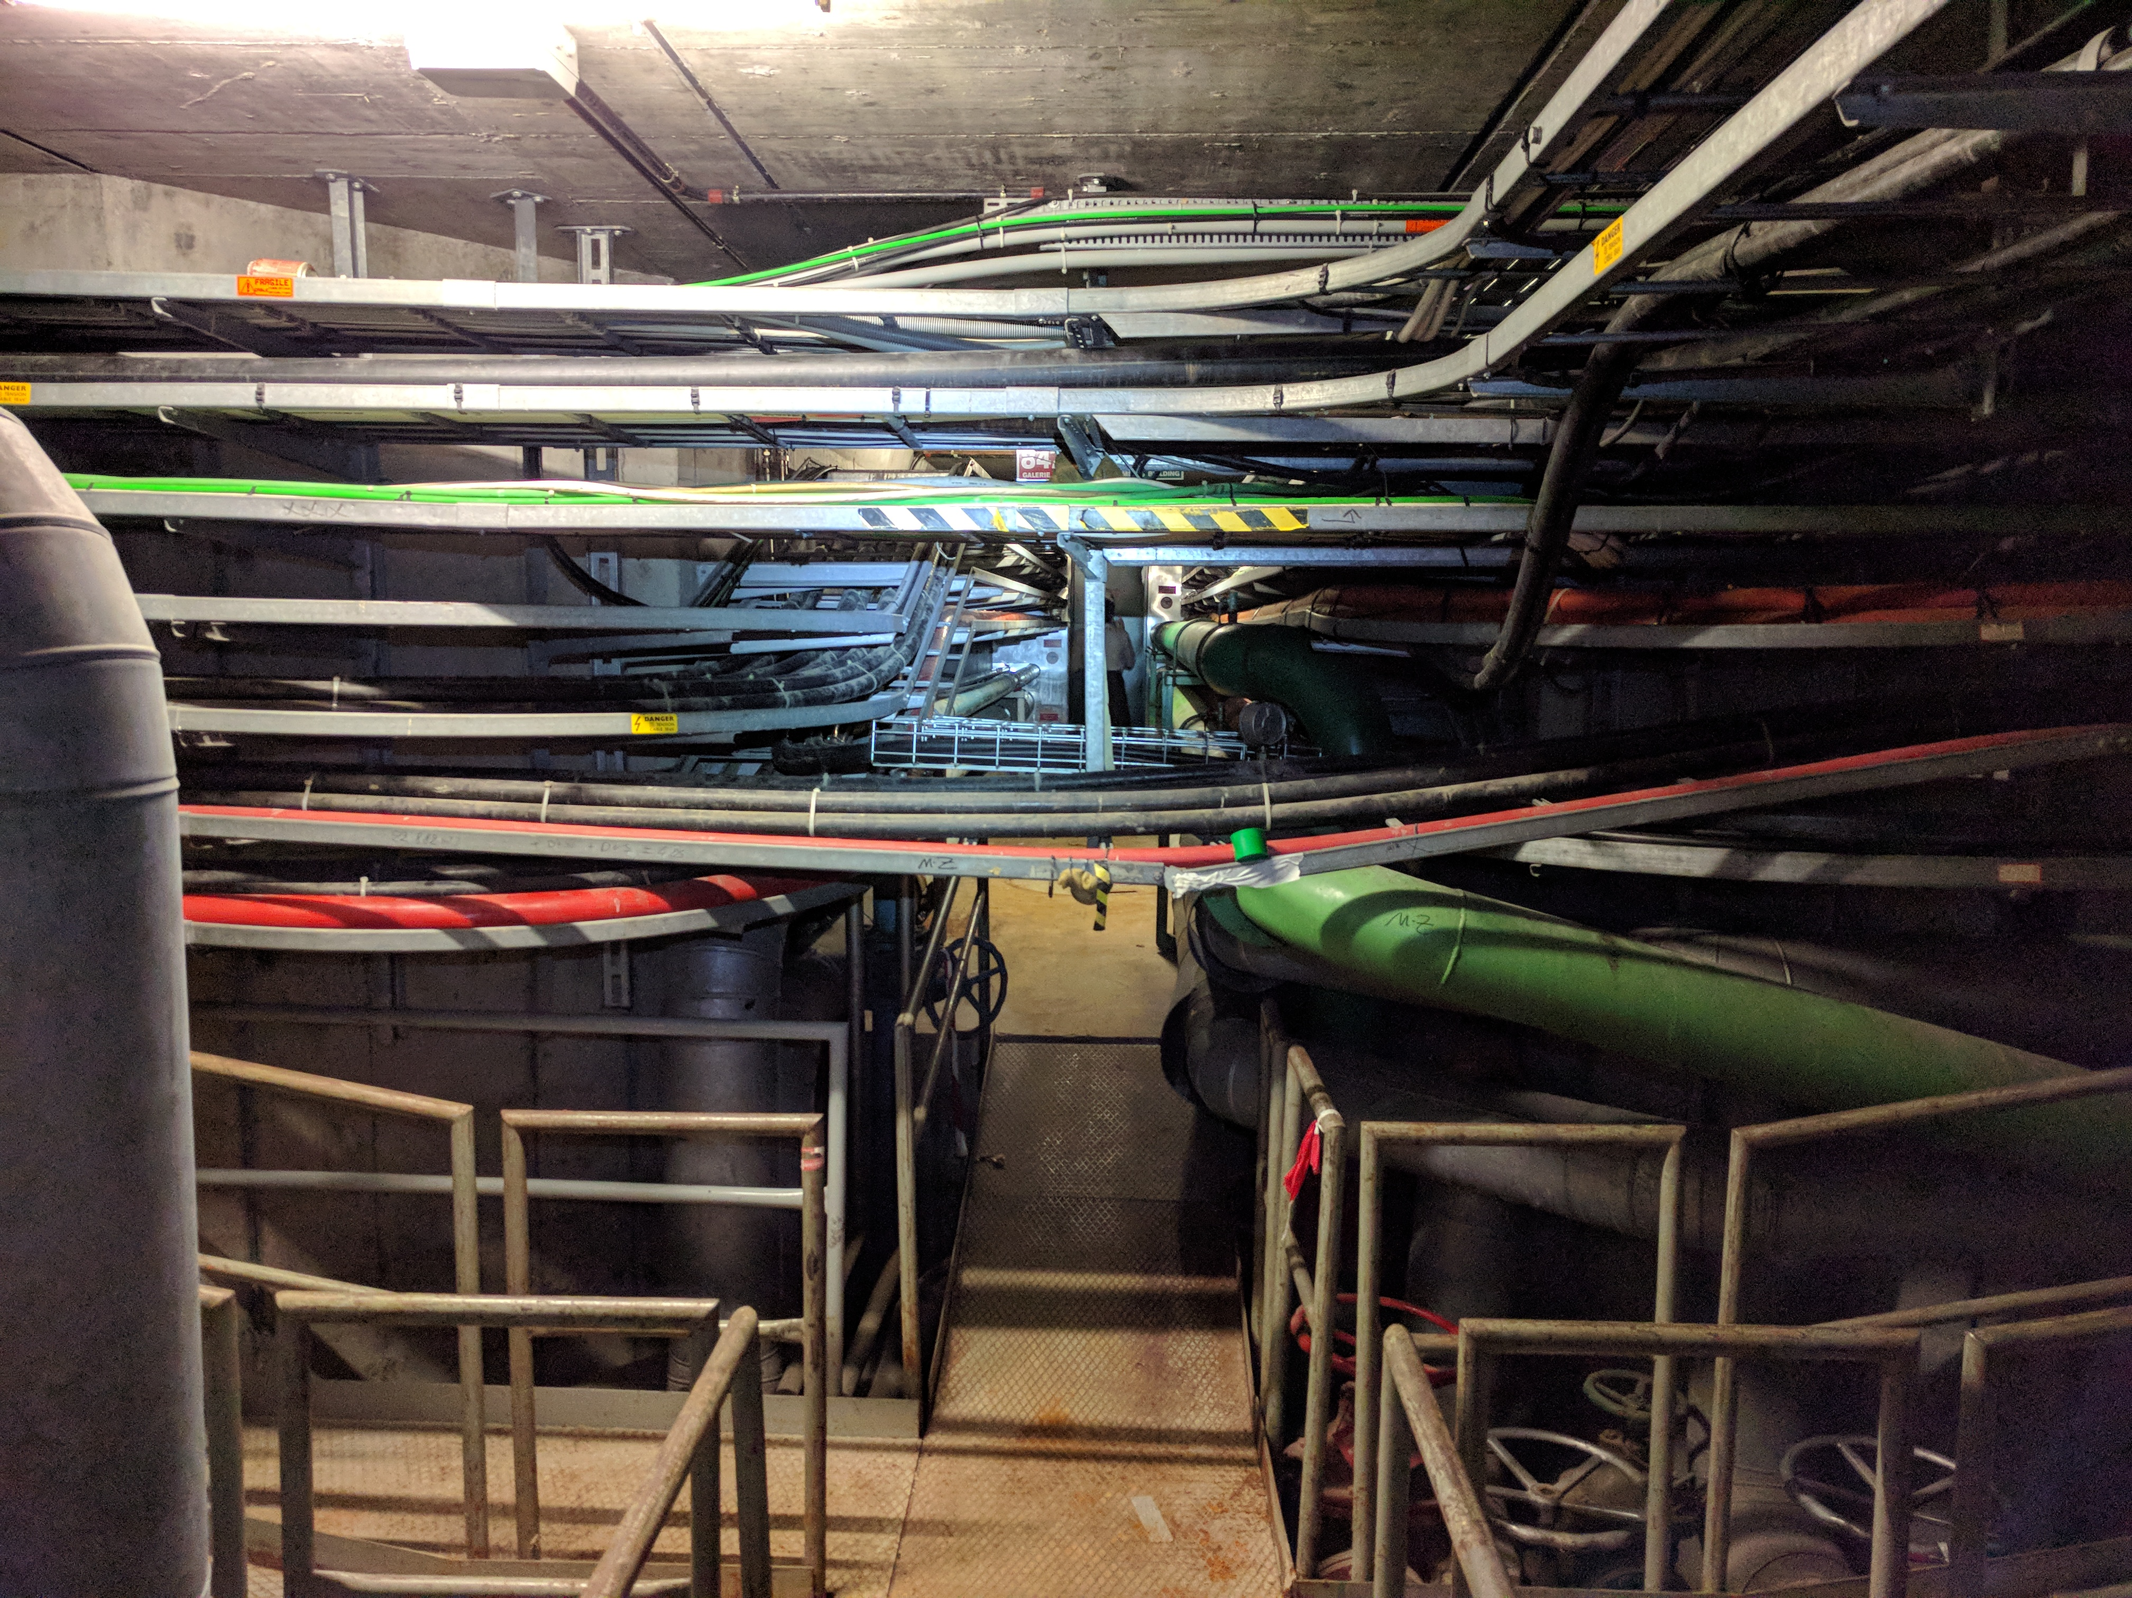
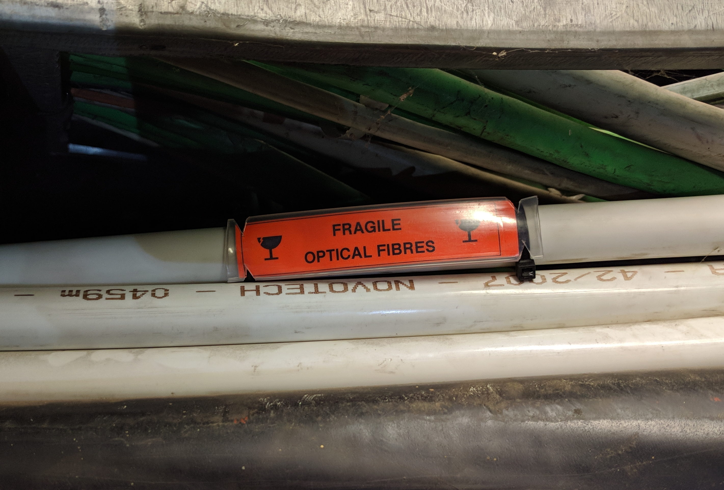
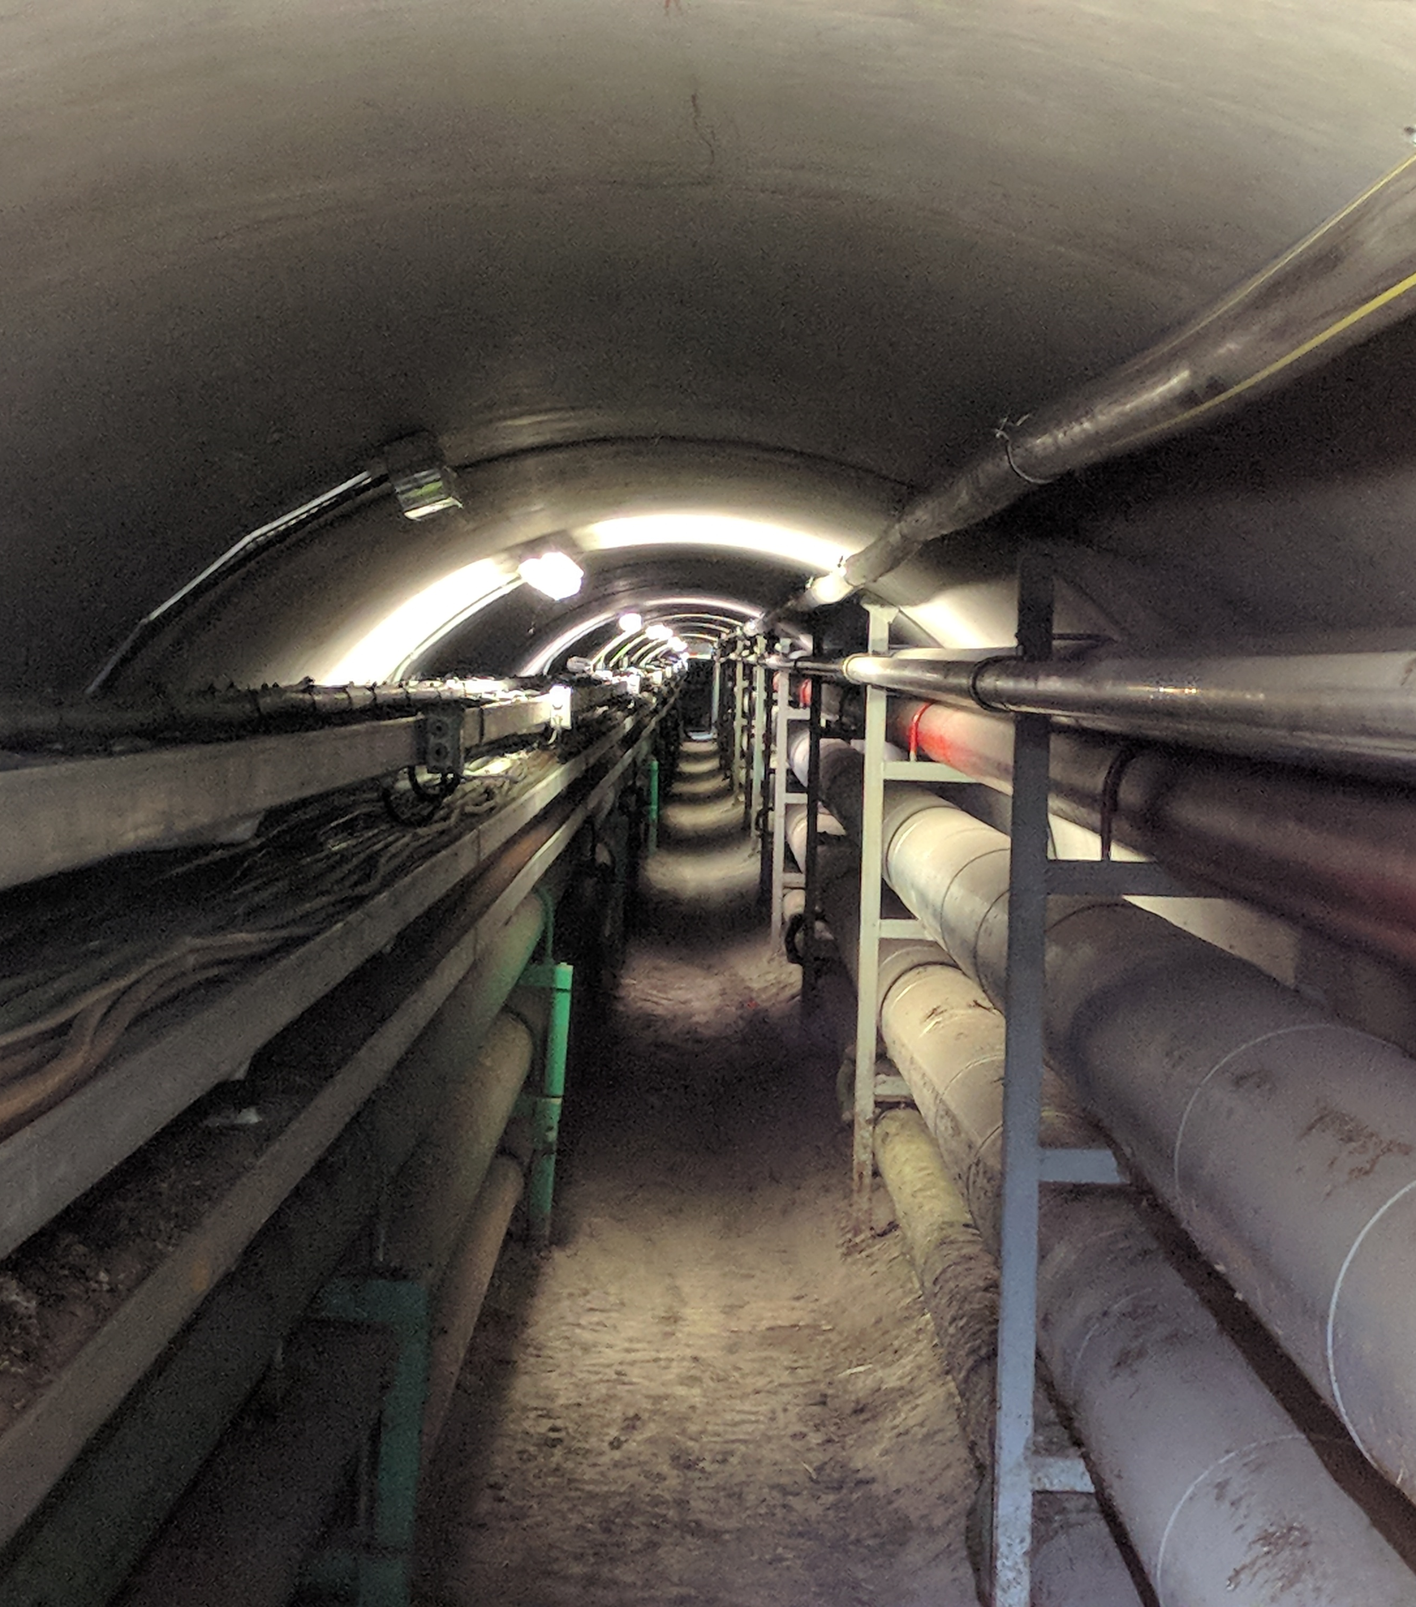
Technical galleries
Cables and pipes
Safety risk – fire spread
Fire doors
Gets destroyed without notice
  New cables or pipes, removed cables or pipes
  No longer air tight
Localize doors and check them
Report it
High energies – things can go wrong
  Stop the spread of a potenial fire

Slide 6

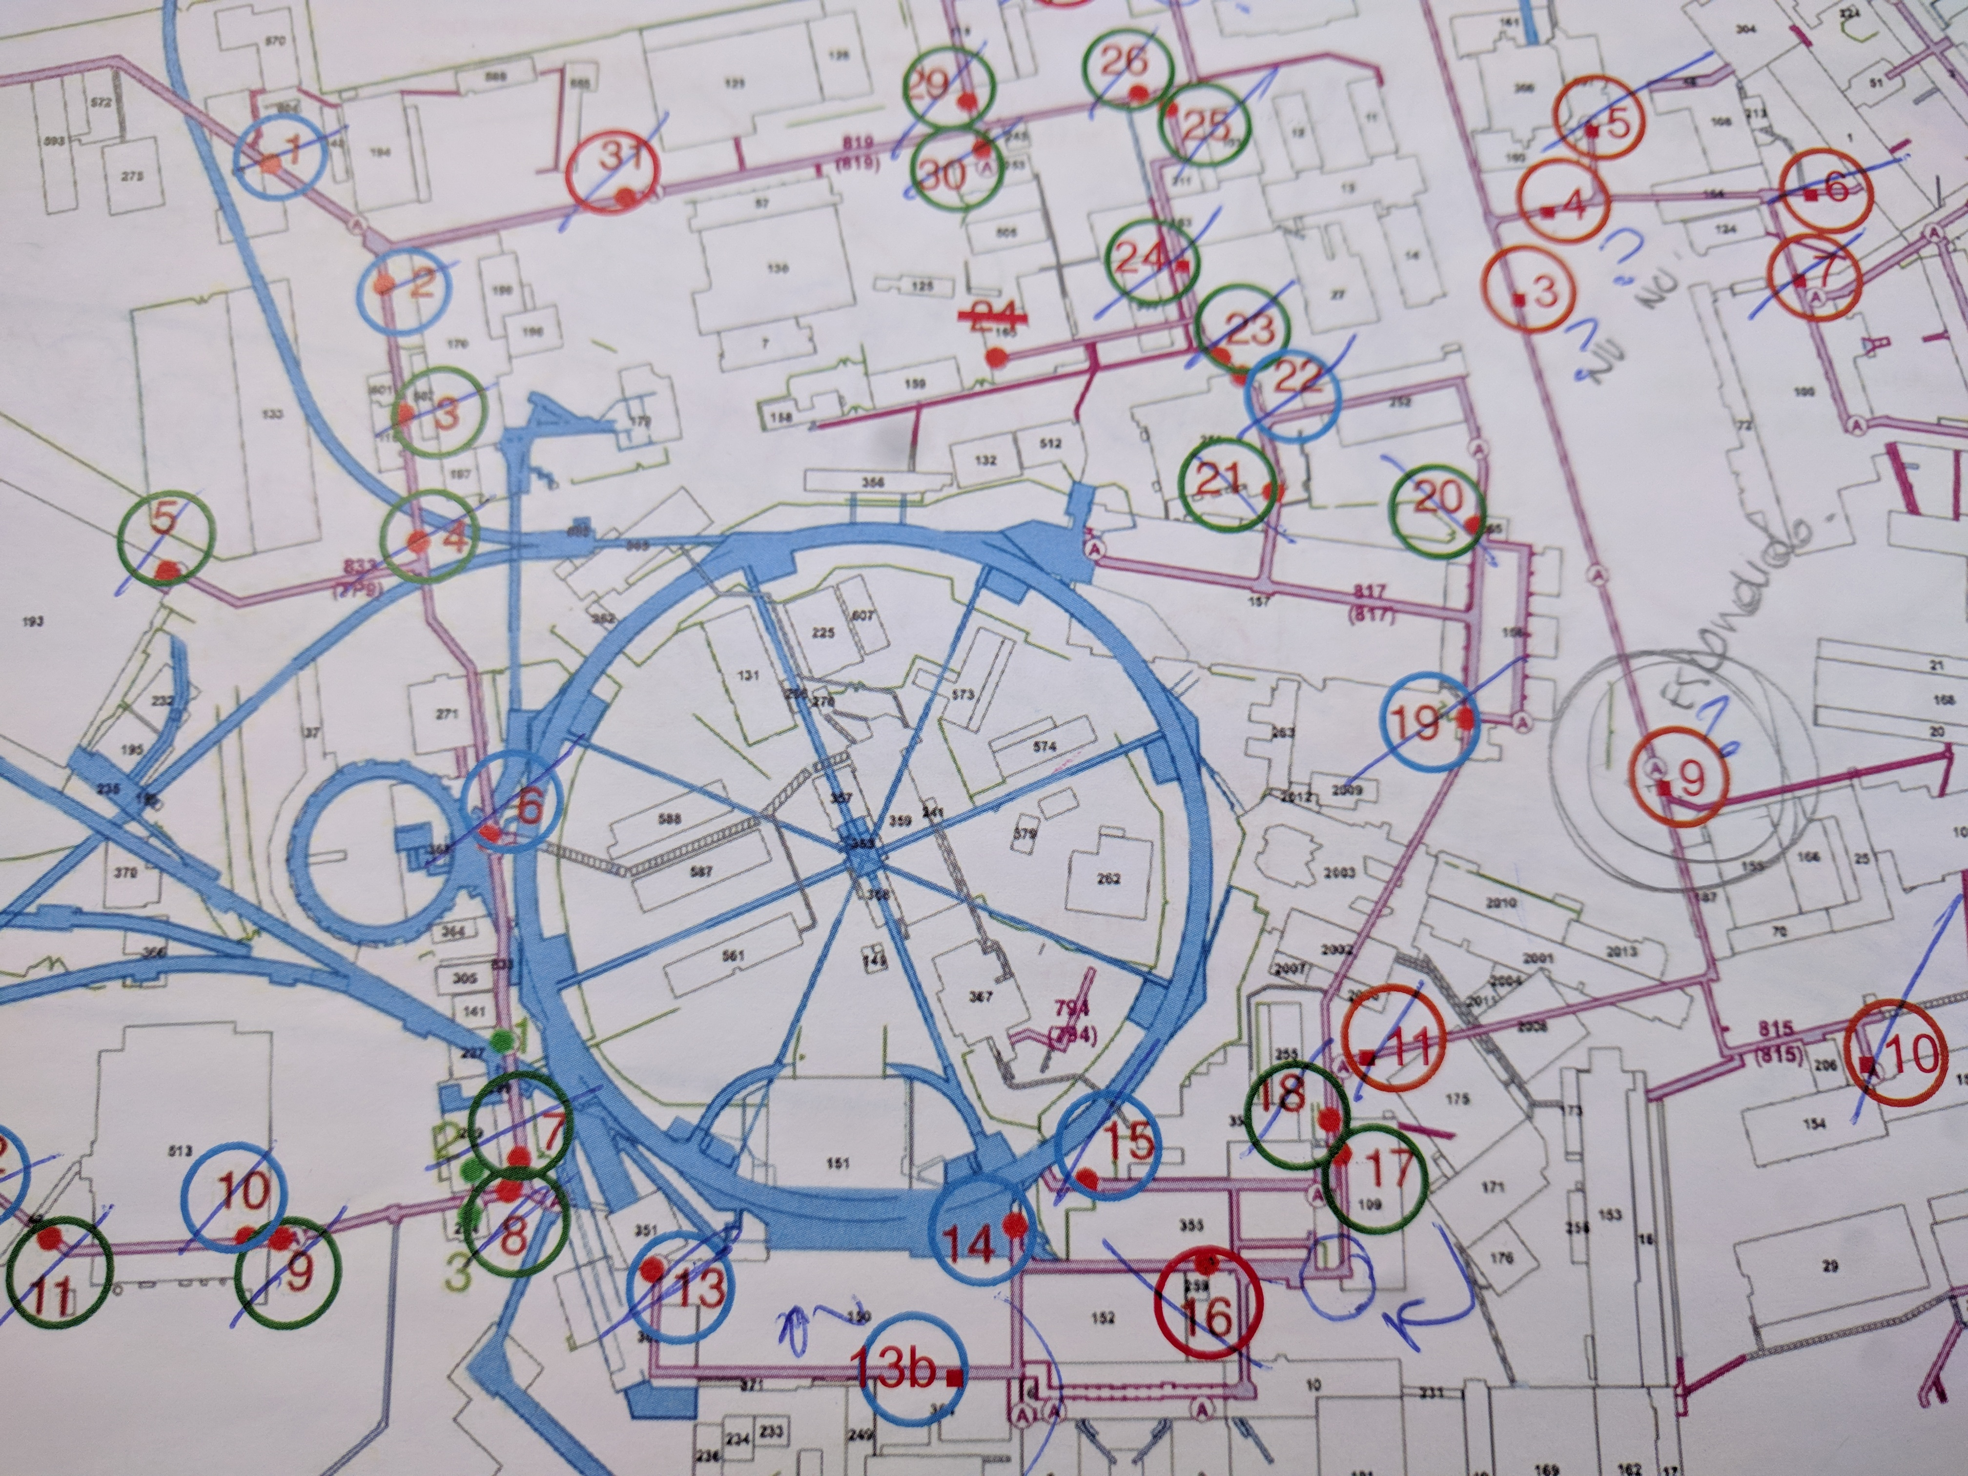
Challenges
Archiving
  No access
  Wait
Technical galleries
  Orient myself
  Find the nearest exit, to locate
  myself with the buildings around

Slide 7
Tips for future HSSIP-participants
Do the most out of your time
  Learn
  See
  Meet
Unique experience

