Slide 1
TH & EP

Slide 2
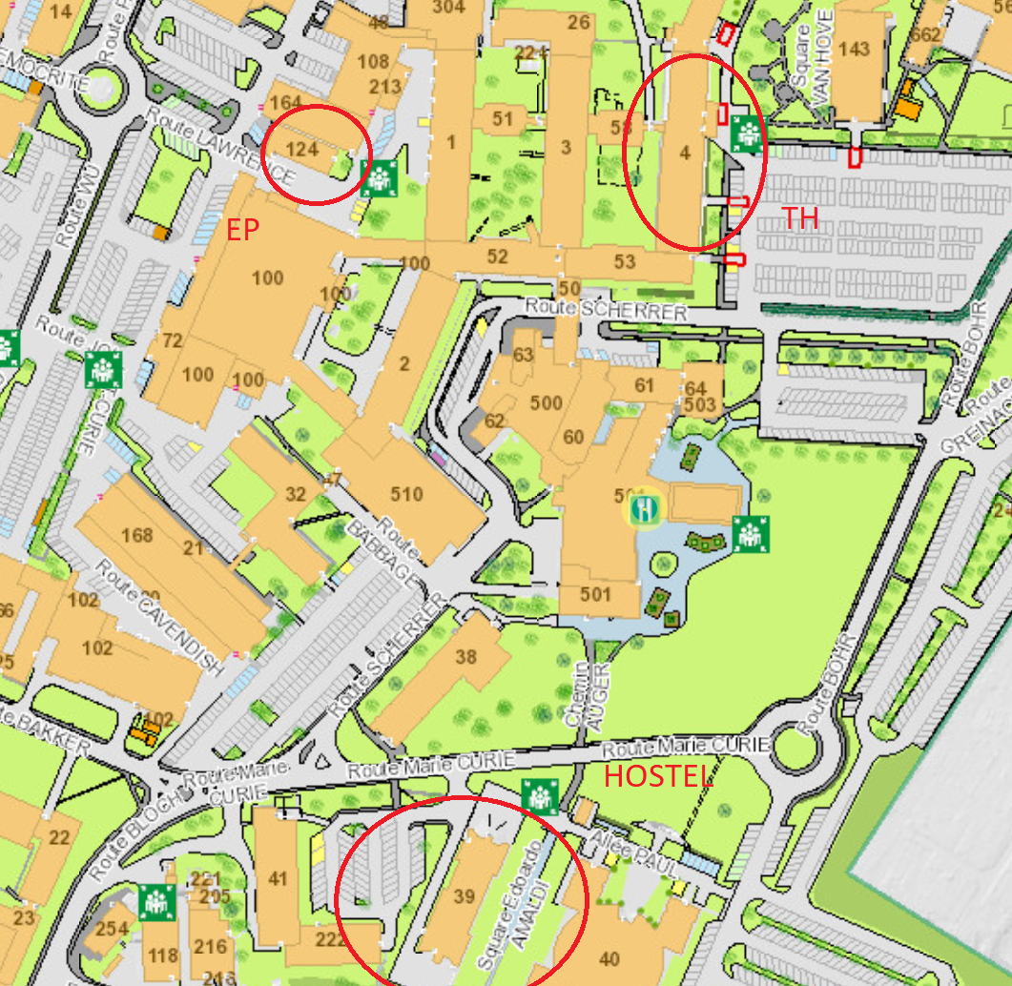
Where?
Theoretical Physics (TH)
  IT
Experimental Physics (EP)
  Logistics

Slide 3
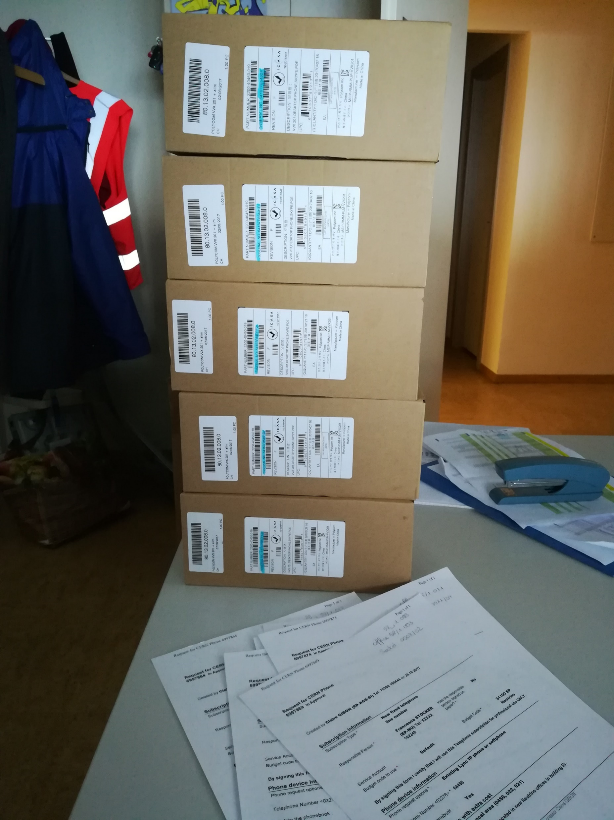
What did I do?
TH
EP
Updating databases
Updating databases
Setting up telephones

Slide 4
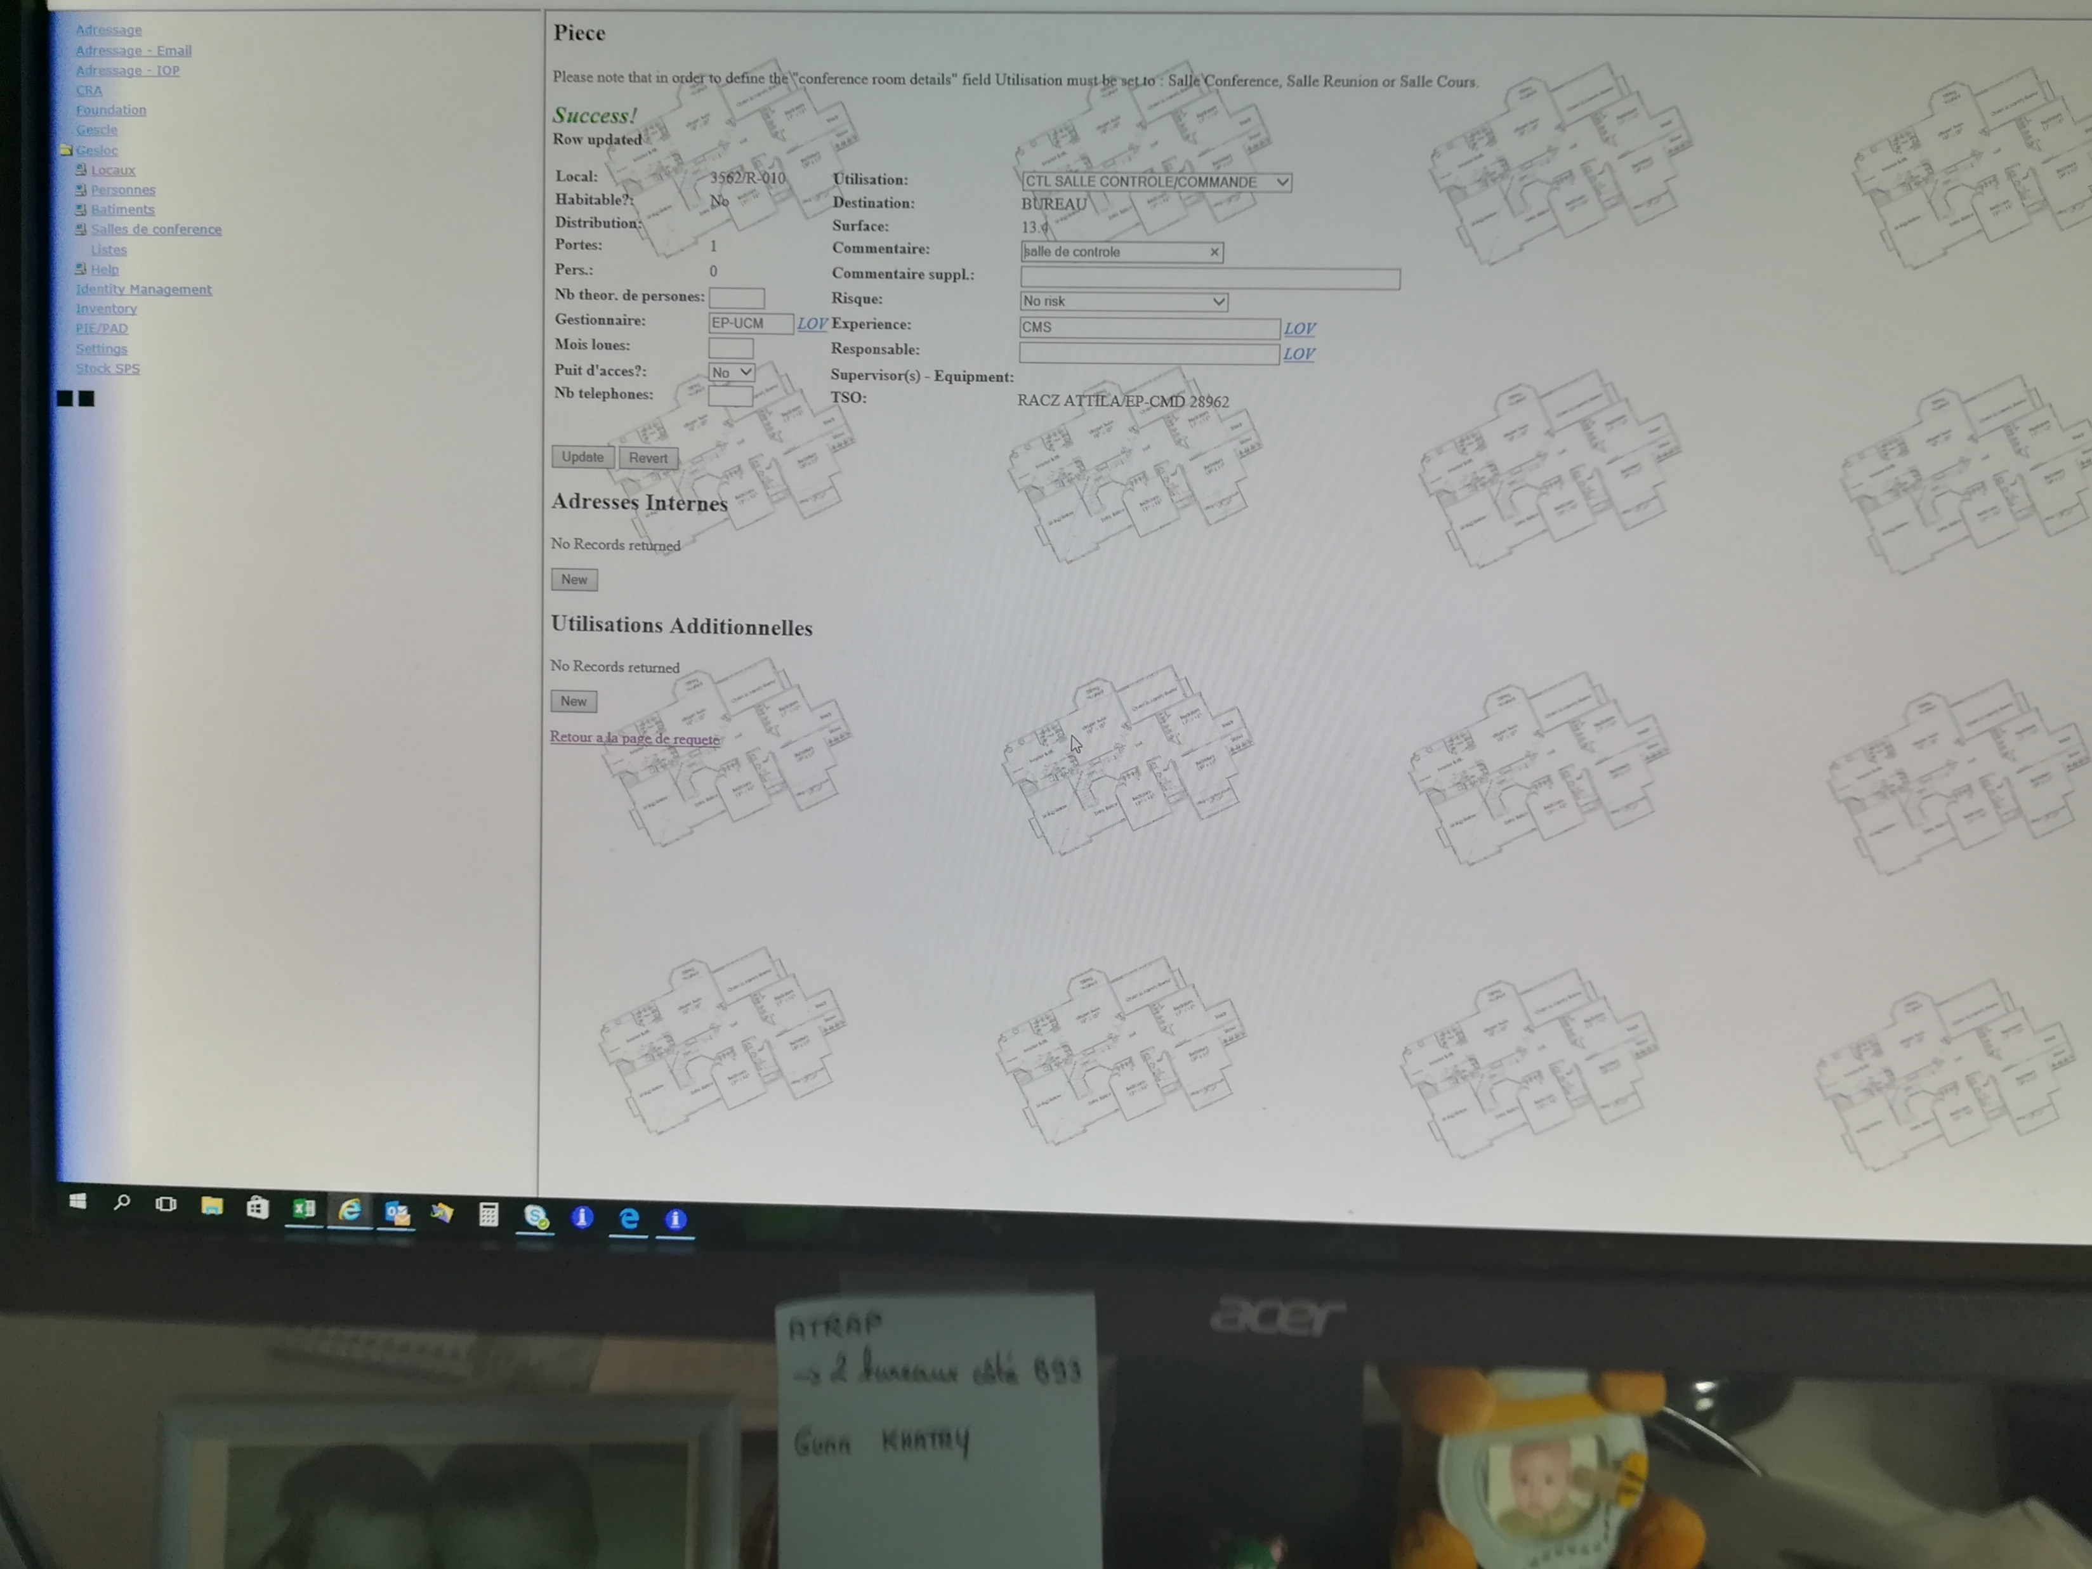
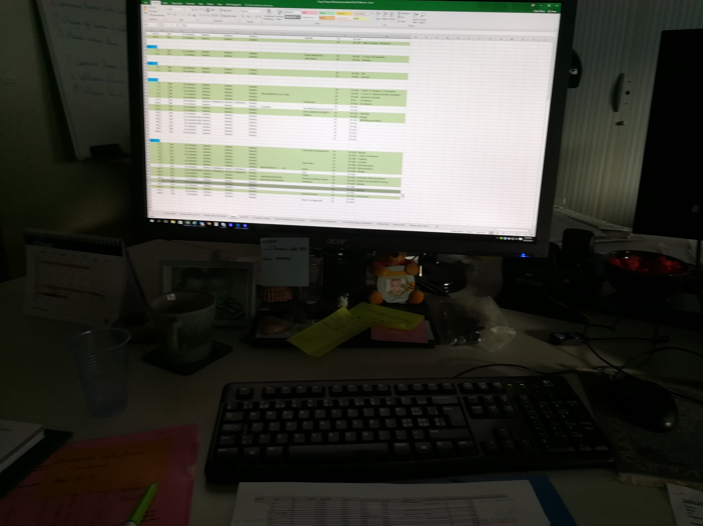
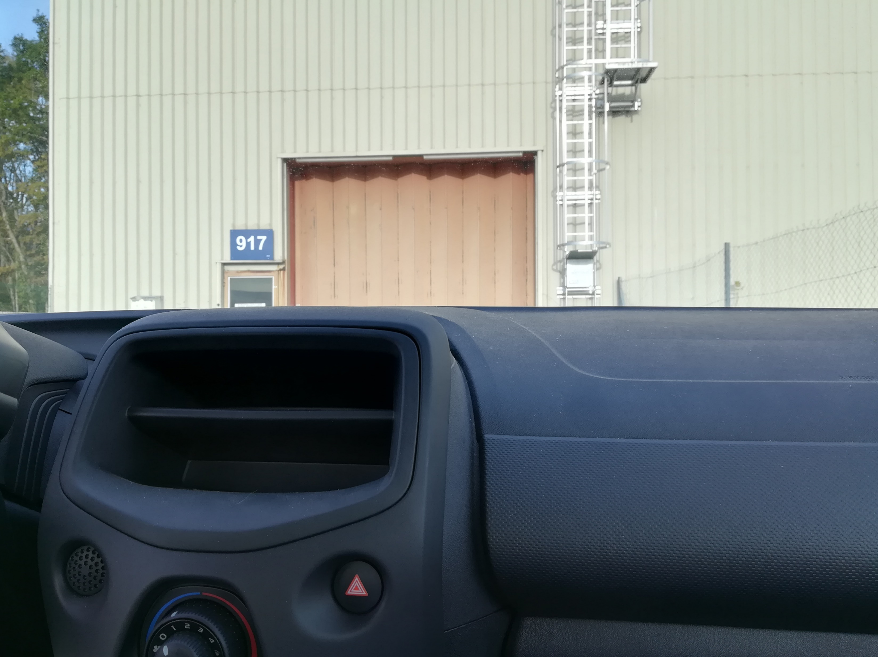
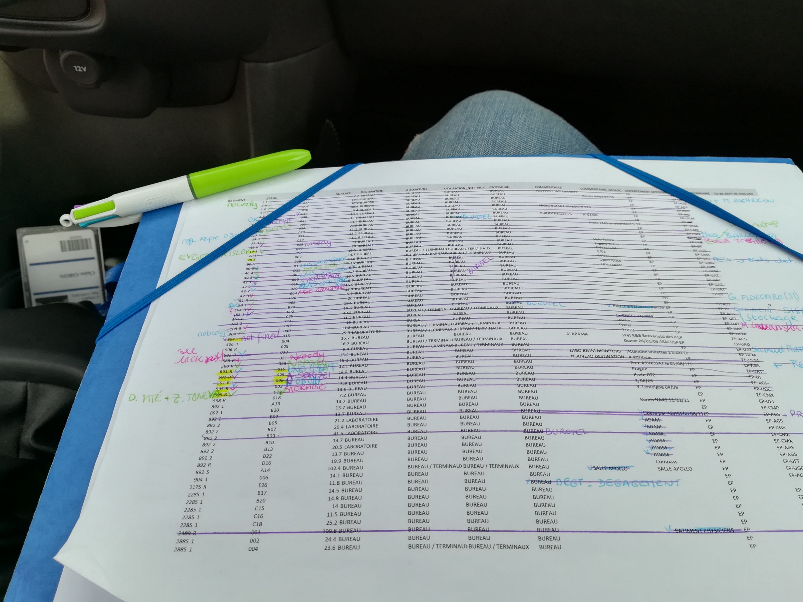
Step-by-step
Find «affected» offices
Go & find needed information
Take notes
Update database

Slide 5
The Big Picture
Support
  Help the others at the department
Trying to keep the databases up to date

Slide 6
Challenges
Very few challenges
  Keeping up with all the numbers and names

Slide 7
Tips to others traveling with HSSIP
Be open-minded
Talk to people

