Slide 2
The group
Julie Haffner (@Julie_Haffner): CERN’s social media manager
Hilde Lynnebakken (@hildelyn): EPPCN member for Norway @Fysikk_UniOslo
Arnaud Marsollier (@amarsollier): Head of press office, CERN
Melissa van der Sande: communications officer @_nikhef, The Netherlands
Perrine Royole-Degieux (@particlefan): EPPCN member for France @IN2P3_CNRS

Slide 3

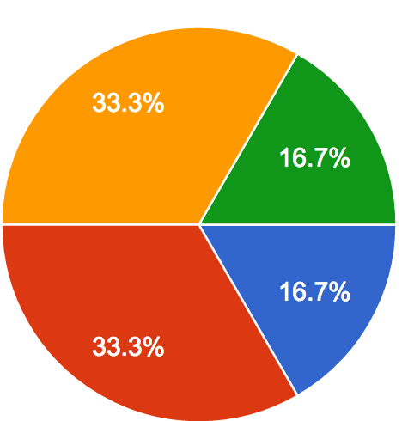
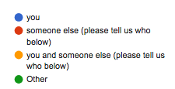
Survey results:
MS and social media
50% of EPPCN members are very familiar with social media
67% post regularly, for professional purpose

Slide 4
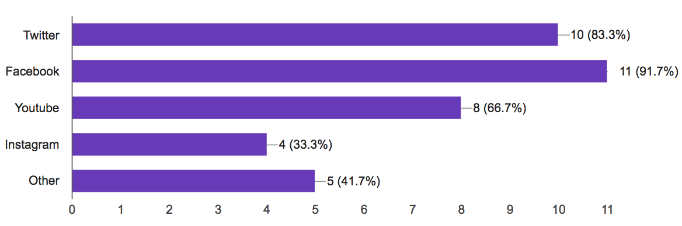
Survey results: MS accounts
Nearly all of us are on Twitter and Facebook.
We’re less familiar with Instagram or Youtube.

Slide 5


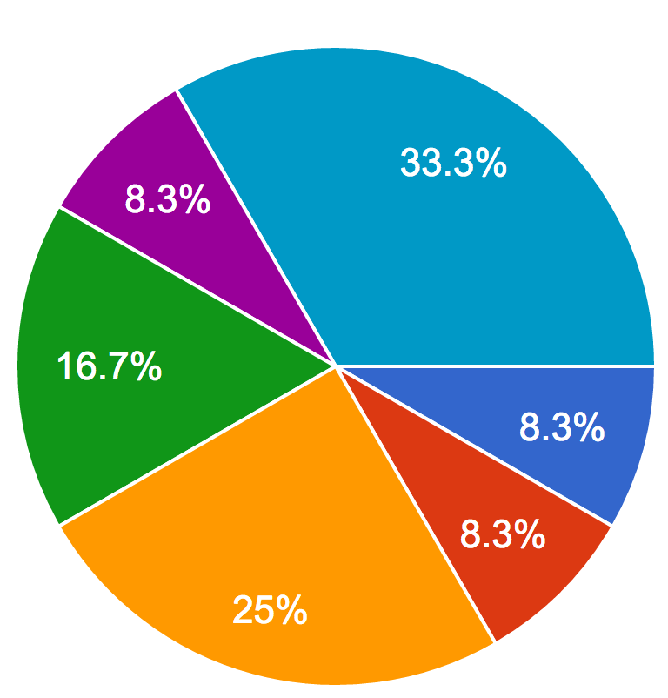
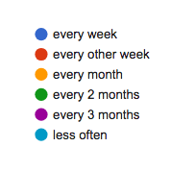
Survey results: MS and CERN

Slide 6
Survey results: what are our goals?
Gain followers/subscribers
Twitter: 60% - Facebook: 40% - Instagram: 60% - YouTube: 71%
Reach out to new types of followers/subscribers
Twitter: 80% - Facebook: 80% - Instagram: 80% - YouTube: 29%
Increase engagement rate (RT, shares, mentions, likes, comments…)
Twitter: 80% - Facebook: 40% - Instagram: 60% - YouTube: 43%
Increase website traffic
Twitter: 70% - Facebook: 60% - Instagram: 20% - YouTube: 20%

Slide 7
Survey results:
in an ideal world… (1/2)
We’d like to see:
more CERN stories in MS languages
highlights of MS’ involvement in CERN projects and experiments
highlights of MS collaboration (mixing our different cultures)
national profiles
pro-active sharing of strategic social media plan
more mentions of our #CountryatCERN hashtags
more coordinated actions between MS and CERN (special events, #)
We’d try to:
find more ambassadors in our countries willing to communicate on social media
share more content with CERN (photos, stories, profiles, milestones…)

Slide 8
Survey results:
in an ideal world… (2/2)
But also
Some said that CERN did a great job so far ☺
Some raised funding issues to sustain a solid social media plan in the MS
Some were not that convinced of the impact that social media could have on their communication

Slide 9
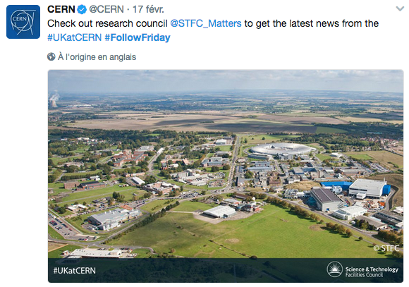
#FollowFriday campaign
Our first step into a real collaboration with social media!
So far, 8 countries were featured: France, The Netherlands, Portugal, the UK, Germany, Finland, Italy and Spain. Norway to come!
Who’s next?
Notes:
The Follow Friday campaign started with France on 6 January.
One post every two weeks.
So far, eight countries had been in the spotlight.
For the ones that have not been featured yet, please send me the accounts that you would like to highlight and a beautiful photo so that we can run the campaign over the next months.

Slide 10




#FollowFriday – Engagement
Country | Engagement
#ITatCERN | 3.3K
#DEatCERN | 3.3K
#NLatCERN | 2.2K
Country | Engagement
#FINatCERN | 165
#DEatCERN | 157
#NLatCERN | 149
#FRatCERN | 142
#ITatCERN | 141
#ESatCERN | 128
#PTatCERN | 126
#UKatCERN | 113
Country | Engagement
#PTatCERN | 613
#ITatCERN | 338
#UKatCERN | 265
#DEatCERN | 245
#NLatCERN | 240
#ESatCERN | 186
#FINatCERN | 120
Country | Engagement
#UKatCERN | 7
Notes:
Instagram is the most engaging social media channels. We had three Follow Friday posts on Instagram: Italy, Germany and Netherlands.

Slide 11
#FollowFriday – Feedback
Some feedback from the labs:
  Great impact on the number of followers for Nikhef, STFC, DESY/Weltmaschine and LIP
  IN2P3/CNRS didn’t see any real impact but the #FollowFriday is their best mention so far this year
Need to do more in order to really be able to measure the impact of such a campaign
Please send me your statistics!
Notes:
Some feedback from the labs:
Melissa from Nikhef → great impact:
Usually, Nikhef has 15 new Twitter followers per month ; in January, they had 81 now follower.
On Facebook, 30 likes on the day itself.
On Instagram, 58 new followers on the day itself.
Rebecca from STFC:
Increase of 208 new followers on Twitter.
More likes than usually on Facebook.
Barbara from DESY:
Big impact on instagram → + 300 new followers.
Small impact on Twitter (+ 8 new followers), no impact on Facebook.
Impact on Weltmaschine good: on Twitter, average of 15 new followers / month. In March, 86 new followers. The day with highest impact, however, was 2 March for the insertion of the CMS pixel detector - I am not sure the high numbers are due to that or to the fact that it was still 2 March in the US when you tweeted?? See graph below. Facebook: 2 new followers and 17 new likes.
Perrine from IN2P3: best mention of the year but no impact on the number of Twitter followers.
Pedro from LIP:
Twitter: 30 new followers and since that tweet we started to be noticed in several other tweets, something that did not happened before.
Facebook: increase of 50 likes in just one day is the greatest growth rate until the 30th of March (2018 likes).
Statistics: it would be useful to know if your account gained more followers than usually, if the engagement changed, if the demographics changed (is there more people from other countries following you?)…

Slide 12
#MycountryAtCERN – Mentions
1 January – 27 April
#FranceAtCERN: 53 mentions
#NLatCERN: 2.4K mentions
#PTatCERN: 586 mentions
#UKatCERN: 625 mentions
#DEatCERN: 3.6K mentions
#FINatCERN: 220 mentions
#ITatCERN: 3.6K mentions
#ESatCERN: 188 mentions
Notes:
The two most used hashtag are #NLatCERN, #ITatCERN and #DEatCERN (due to the fact that photos were posted on Instagram)
Other than that, #UKatCERN is the most used hashtag (often used by STFC via Steph)
Use your hashtag more!

Slide 13
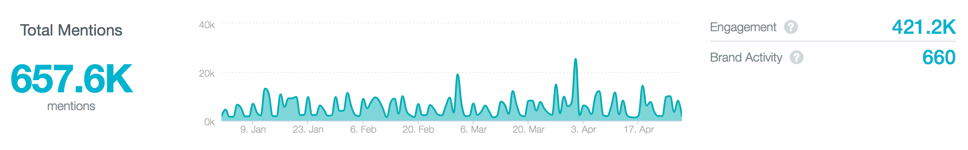
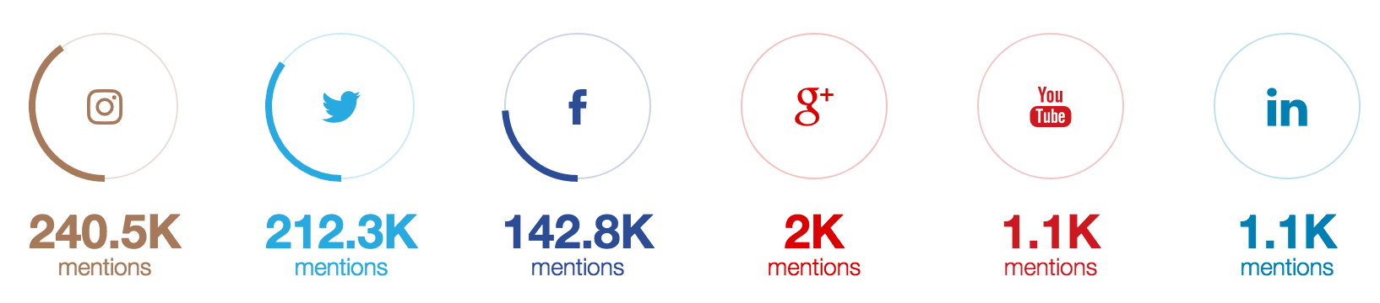
About CERN social media
Notes:
These are stats for 2017.
We got 657.6K mentions of « CERN » or « LHC ». 660 of them were from CERN accounts.
The top source in terms of mentions is Instagram, followed by Twitter and Facebook. We stopped using Google + in December.
Therefore, Instagram is definitively an engaging social media platform!

Slide 14
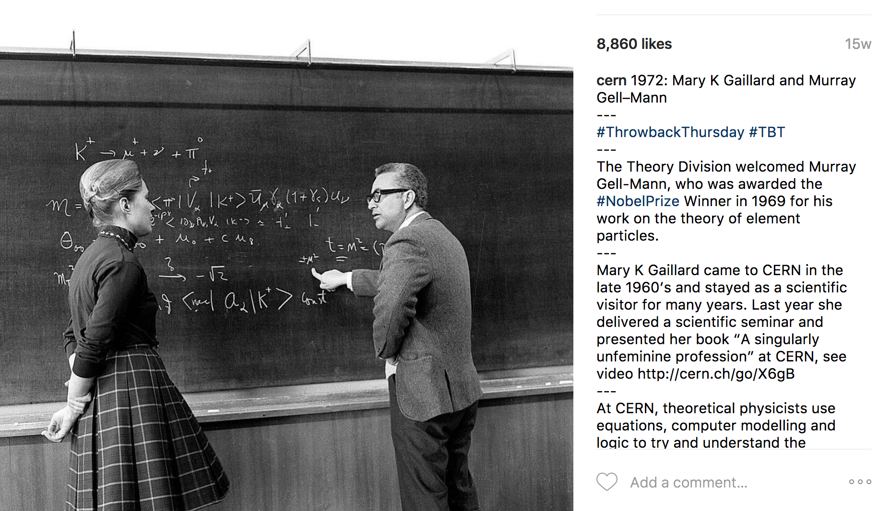
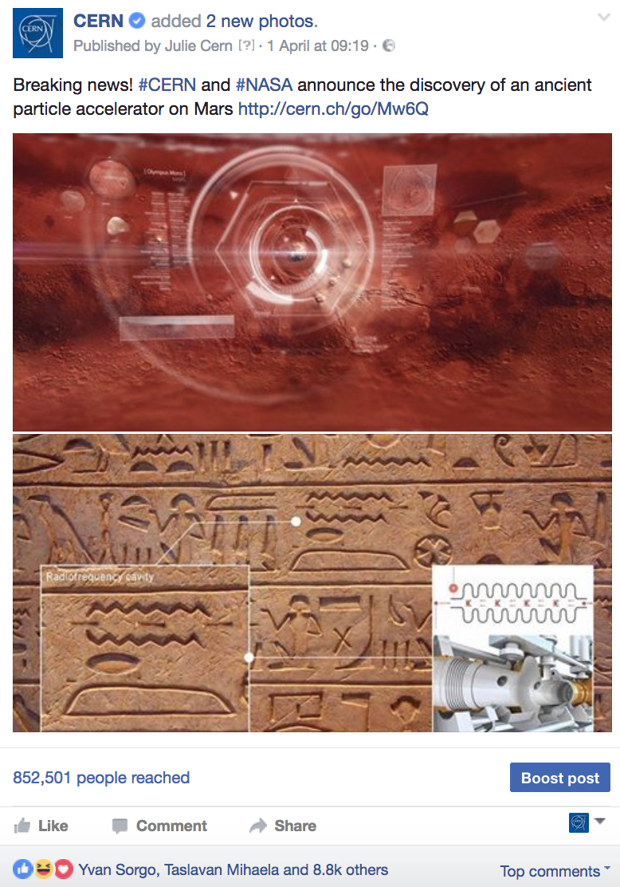
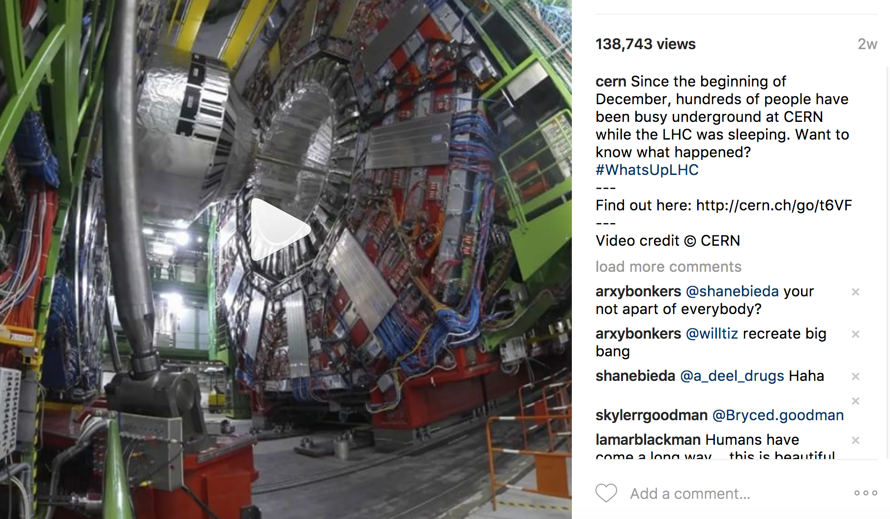
About CERN social media
TOP POSTS IN 2017 (engagement)
April Fools: 9.4K
Throwback Thursday: 9K
#WhatsUpLHC winter shutdown: 8.3K
Notes:
These are the three top posts for 2017.
April Fools: make science fun! Social media can be used for various things and in non-traditional ways, e.g. humor.
Throwback Thursday: retro photos of CERN’s early day. Tell a story on social media!
CMS Live: different Instagram content with the timelapse video.
If you see any interest in getting social media stats from CERN, please let me know, this is something we can put in place.

Slide 15
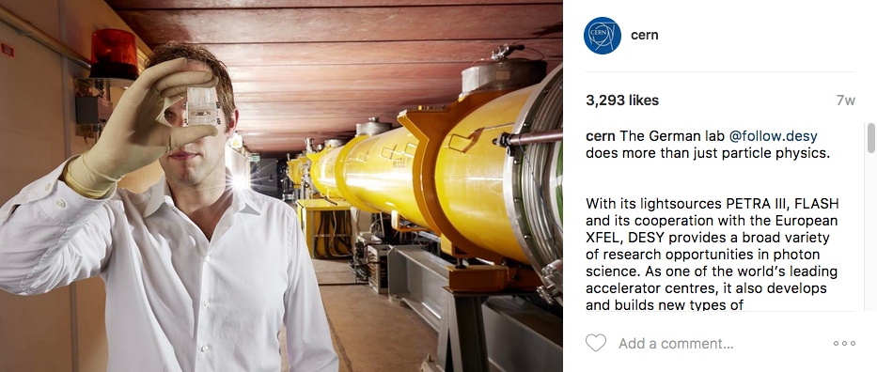
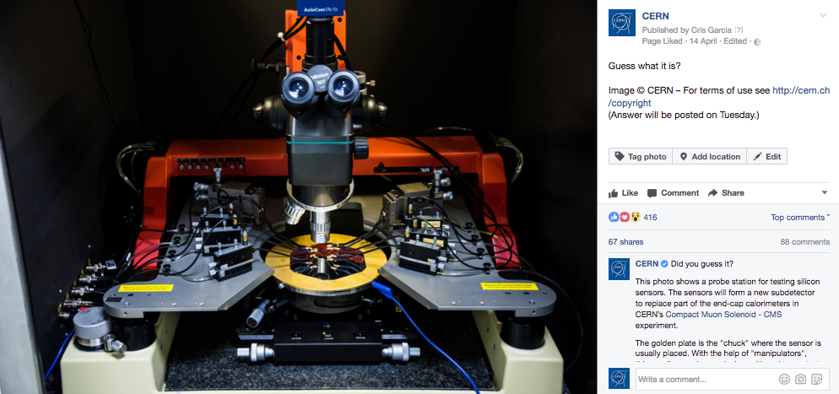
What’s next?
Twitter group!
Guess What It Is?
Throwback Thursday
The engaging Instagram
Youtube and subtitles
Notes:
Now that we have launched the collaboration, it needs to evolve. Here’s what CERN can propose you, how CERN can help you:
Lesson one: the more connected we are, the better. We need at least one social media contact per EPPCN member in a Twitter group.
Lesson two: the more beautiful the photo is, the better.
Guess what it is:
As you know, every Friday, we post a photo on Facebook asking people to guess what they see on the photo. The next Monday, we select the winner and post the description of the photo on Facebook AND on Instagram.
Conditions: beautiful photo, nice text, link with CERN.
Benefits: highlight your social media accounts, highlight your website or a webpage, highlight your lab.
Throwback Thursday:
Every Thursday, we choose a photo from the archives, highlighting CERN’s history (past experiments, important events…). It goes on Facebook, on Twitter and on Instagram.
Conditions: nice photo (black & white appreciated!), nice story, link with CERN.
Benefits: highlight your social media accounts, highlight the history of your lab and your relations with CERN
Instagram
As we said earlier, Instagram is a great platform to showcase beautiful photos. It’s quite an easy one because people are more looking for great photos and nice stories than for news.
Conditions: you don’t need to be on Instagram → we’ll highlight your lab and not your Instagram account.
Benefits: highlight your lab.

Slide 16
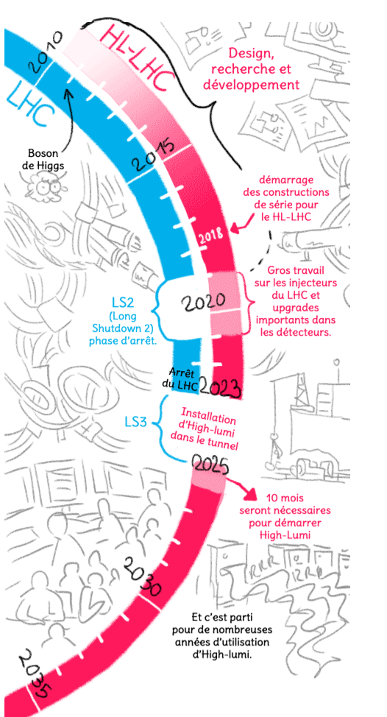
What kind of content
to share with CERN?
HL-LHC detectors (and some accelerator parts) will be prototyped and constructed in your labs! We’ll have many stories to tell, videos and photos to shoot.
We could promote local profiles
Do you have other ideas? -> let’s share them together!
©Lison Bernet
from la BD du LHC

Slide 17
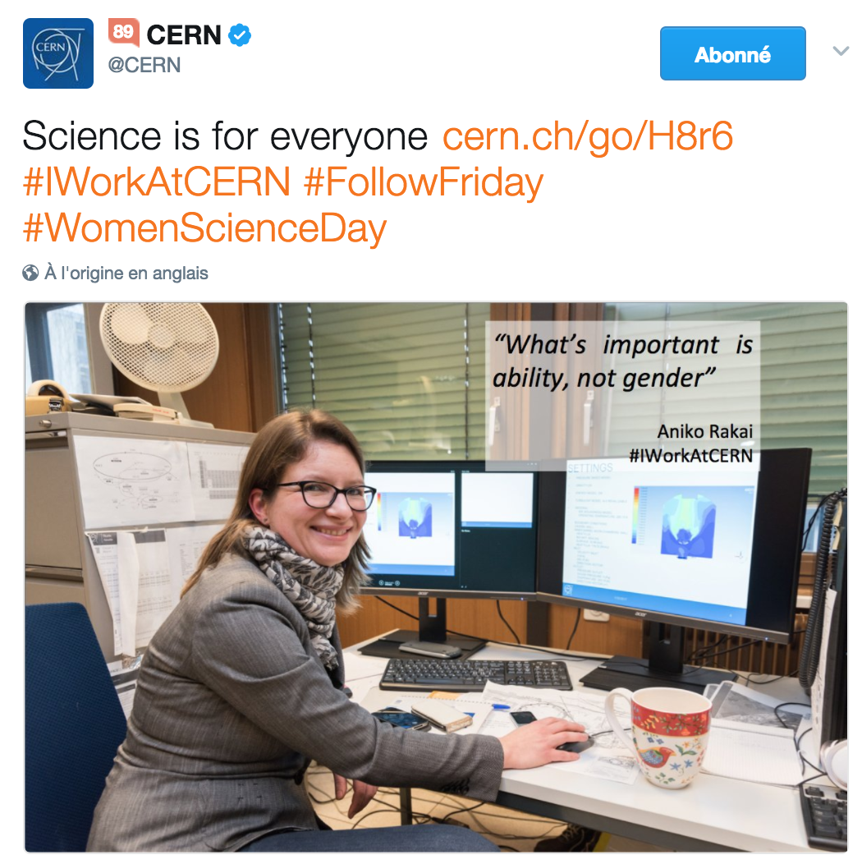
Ideas for the future
Create Storifies / Tweet collections / Twitter Moments to promote MS states posts through one special event
Create trending topics for special occasions (e.g. women science day, European Researchers’ Night…).
Ideas welcome! Use your ambassadors!

