Slide 1
Other points noted:
The huge question of “no power pulsing” will lead to additional material in vertex, tracker (?) and elsewhere; the
calorimeter longitudinal segmentation might have to be revised
In order to adjust the tracker layout to the new outer radius, it is – in a first attempt – proposed to scale everything
“out” to the new outer radius; the separation of inner and outer tracker must remain, the (new) diameter of the
support tube must be checked against mechanical issues and interference with other elements in the FCCee detector
region // opening the detector for maintenance may in the first round be neglected
LumiCal design and performance is not part of our tasks
The complex interplay between the three solenoids and the final quadrupole, etc., are in the hands of MDI and are
not part of our worries – we should assume that anyting inside theta = 100 mrad is “forbidden territory”
Initial validation and performance studies can follow the scheme of what is done for CLICdet

Slide 2
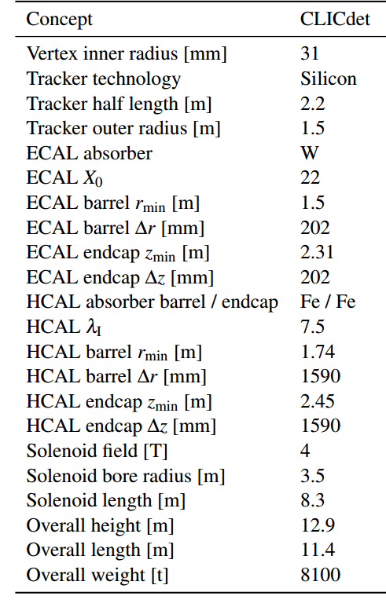
FCCee
17
unchanged
2.15
unchanged
unchanged
5.5 (= ILD)
1166
1166
2
3.7
unchanged

