Slide 1
Update on SPS coupled bunch instabilities
-
Simulation studies s
28th of April 2017
J. Repond

Slide 2
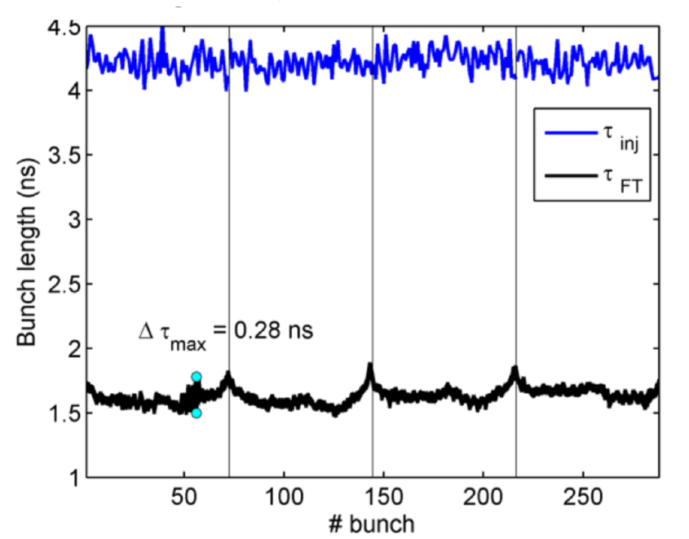
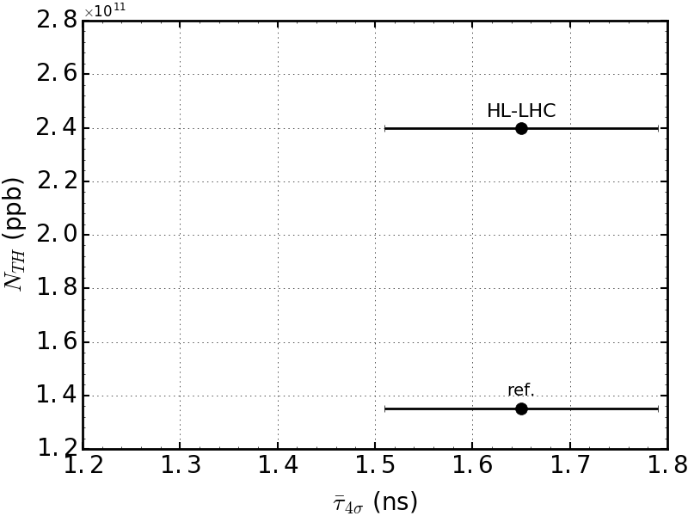
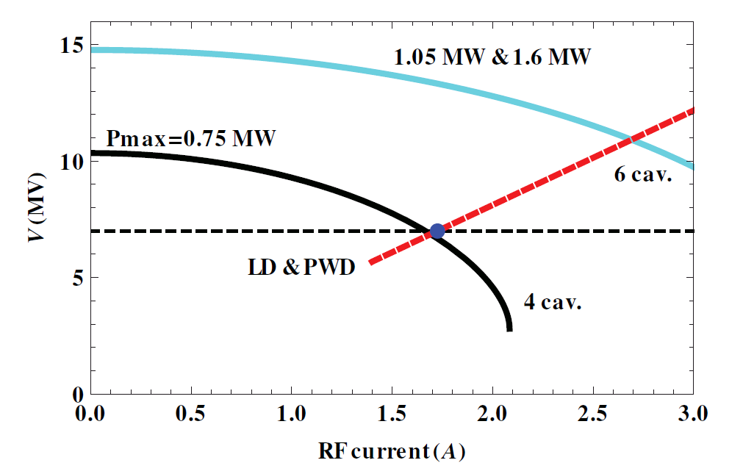
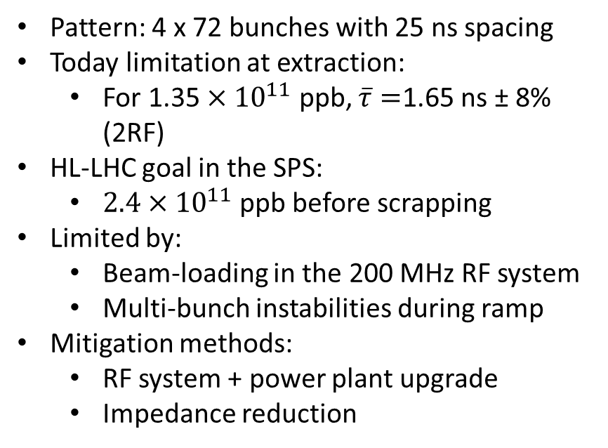
(HL)-LHC proton beam in the SPS
Pattern: 4 x 72 bunches with 25 ns spacing
Today limitation at extraction:
  For 1.35 $×{10}^{11}$ ppb, $\overline{τ}=$1.65 ns ± 8% (2RF)
HL-LHC goal in the SPS:
  $2.4×{10}^{11}$ ppb before scrapping
Limited by:
  Beam-loading in the 200 MHz RF system
  Multi-bunch instabilities during ramp
Mitigation methods:
  RF system + power plant upgrade
  Impedance reduction
Ref: IPAC16, MOPOY058
RF upgrade
Ref: IPAC16, MOPOY058

Slide 3
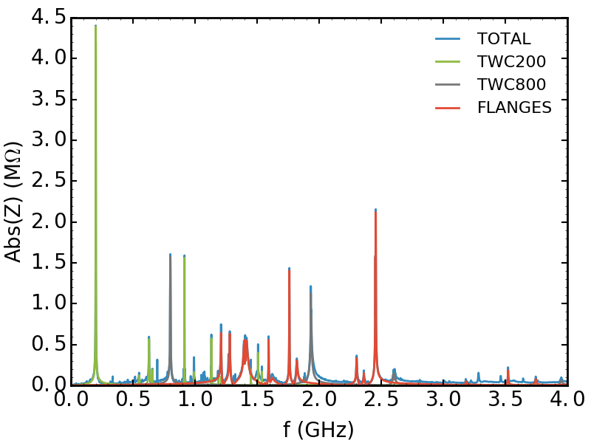
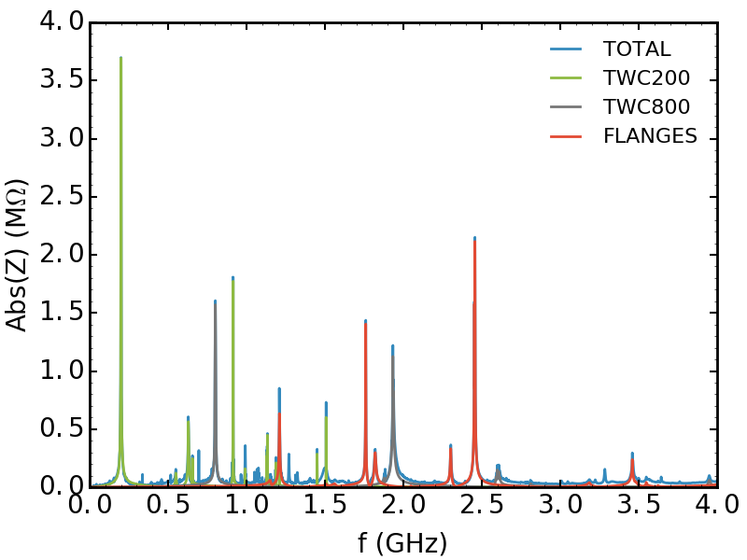
SPS longitudinal impedance model
Simulations and measurements used to characterize most of the ring elements (J. Varela et al.)
Accelerating cavities: 200 and 800 MHz
  → main 200 MHz harmonic reduced by feedback and feed-forward (current reduction in stationary state: 20 dB, future: 26 dB)
  → 630 MHz HOM of 200 MHz cavities damped by RF couplers
Kickers (broad-band impedance)
  impedance of extraction kickers (MKE) damped by serigraphy
  main contribution currently from injection kickers (MKP), possible damping considered
Vacuum flanges (main contribution in 1.4 GHz range)
  → shielding of one type during LS2
Current model
Imp. reduction + RF upgrade

Slide 4
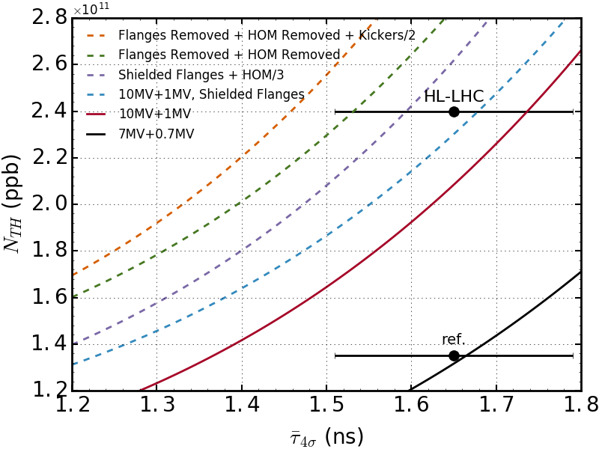
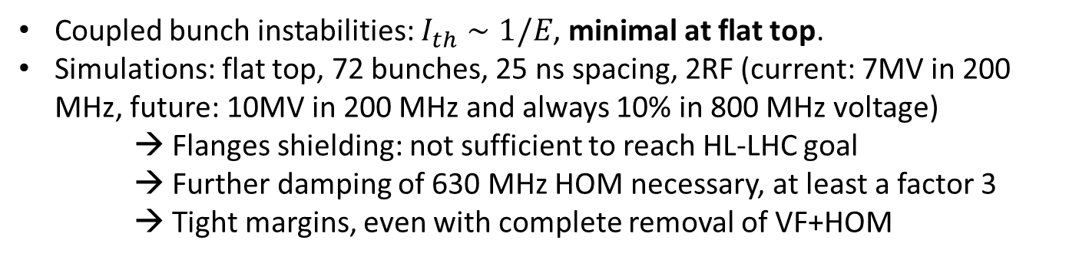
Impedance reduction – Effect on flat top stability
Coupled bunch instabilities: $I_{th}∼1/E$, minimal at flat top.
Simulations: flat top, 72 bunches, 25 ns spacing, 2RF (current: 7MV in 200 MHz, future: 10MV in 200 MHz and always 10% in 800 MHz voltage)
→ Flanges shielding: not sufficient to reach HL-LHC goal
→ Further damping of 630 MHz HOM necessary, at least a factor 3
→ Tight margins, even with complete removal of VF+HOM
Flanges shielding + HOM / 3
15%
Flanges shielding
10%
After RF upgrade
50%
Current impedance and RF

Slide 5
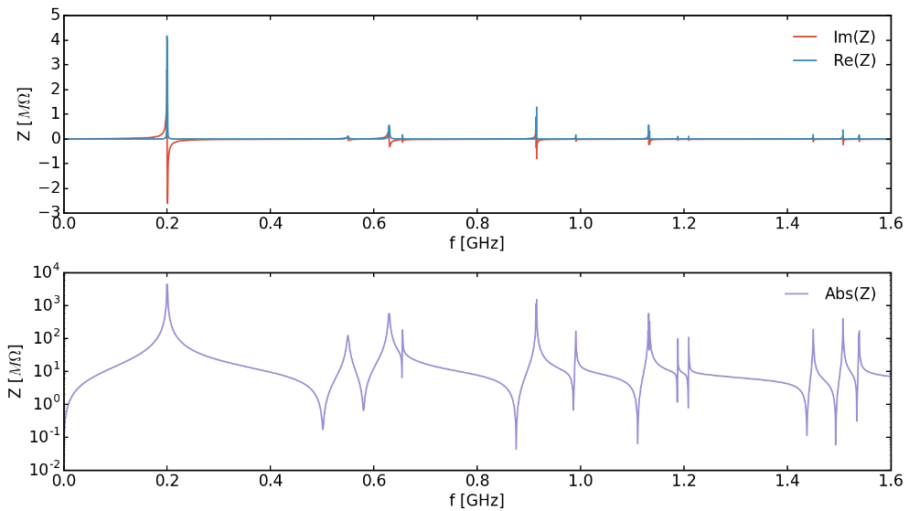
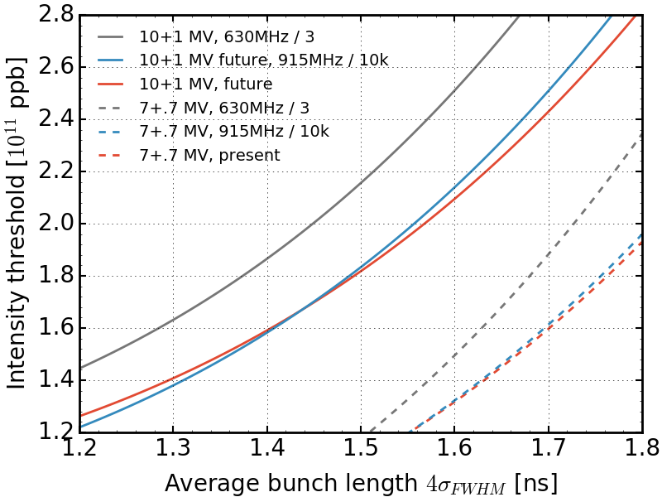
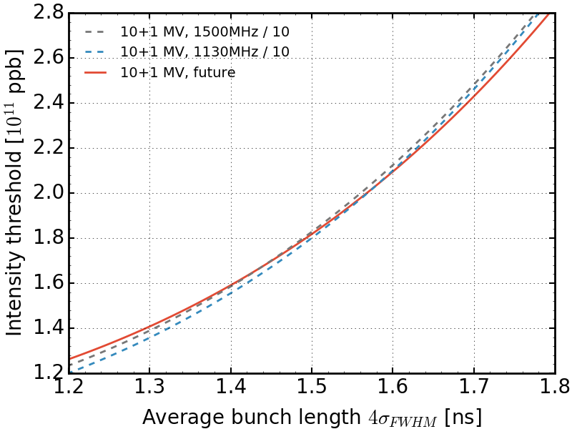
Higher order modes – 200 MHz TW cavity
200 MHz TWC contains several HOMs, potentially harmful.
Study damping in simulation:
→ 630 MHz HOM is the critical one regarding stability
→ Effect of the three other HOMs negligible.
630 MHz
914 MHz
1133 MHz
1507 MHz
200 MHz cavities impedance

Slide 6
Higher order modes – 630 MHz damping
630 MHz HOM must be damped by at least a factor 3.
Currently passive damping via couplers (already efficient).
New means of minimizing Rsh studied:
  938 MHz transverse couplers have a negative effect on the 630 MHz longitudinal HOM damping
  Spreading of HOM peaks from 6 cavities in frequency is equivalent to damping
  Shifting the HOM frequency has an effect too

Slide 7
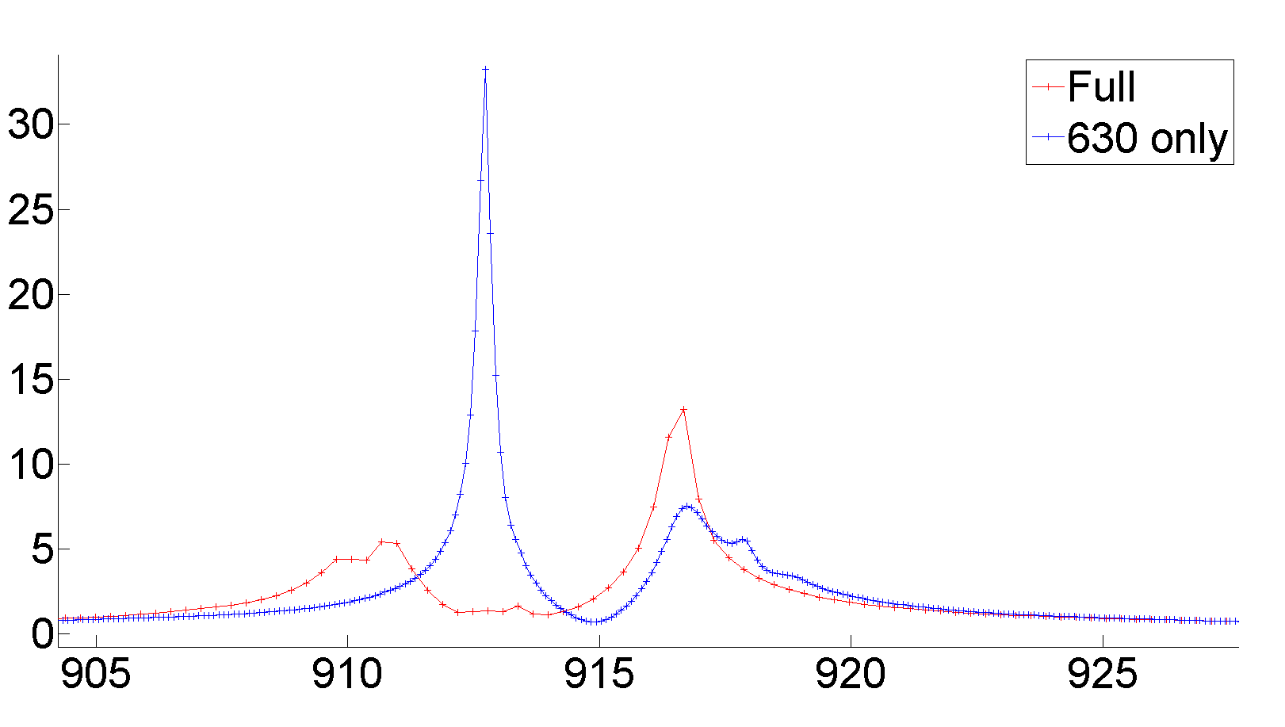
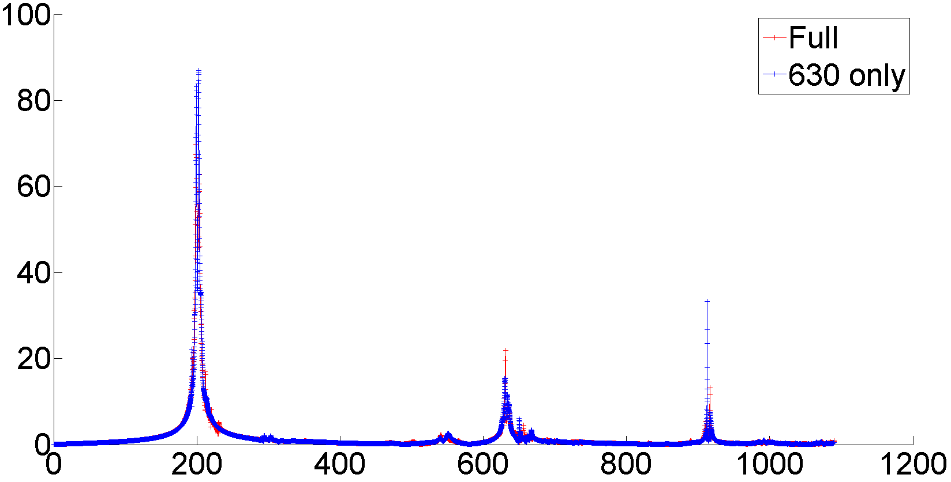
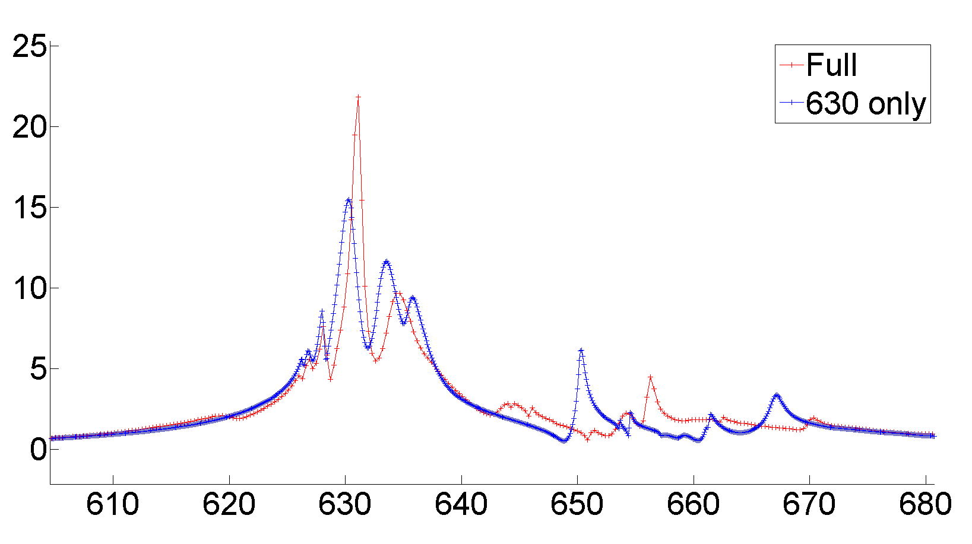
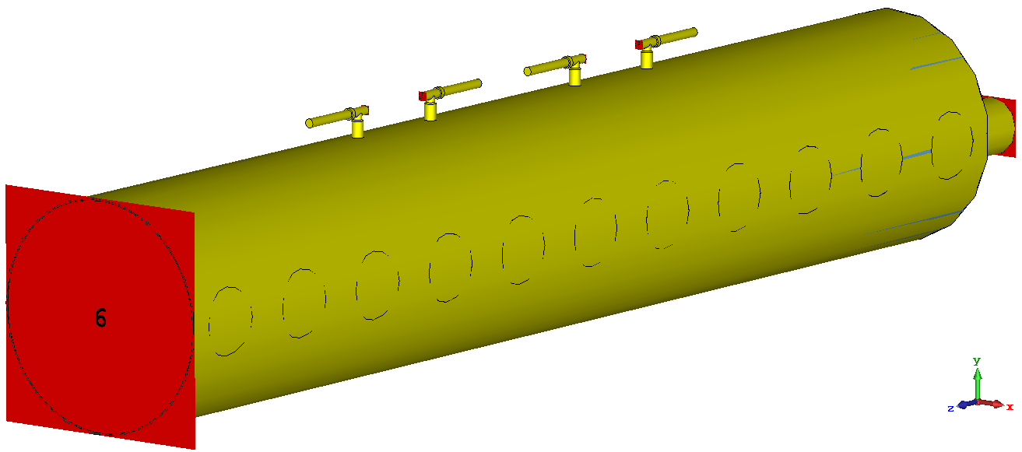
Effect of 938 MHz transverse coupler
CST simulations (single section) show increase in 630 MHz longitudinal impedance due to transverse 938 MHz HOM coupler
938 MHz OFF
938 MHz ON
938 MHz OFF
938 MHz ON
SINGLE SECTION
Courtesy T. Roggen

Slide 8
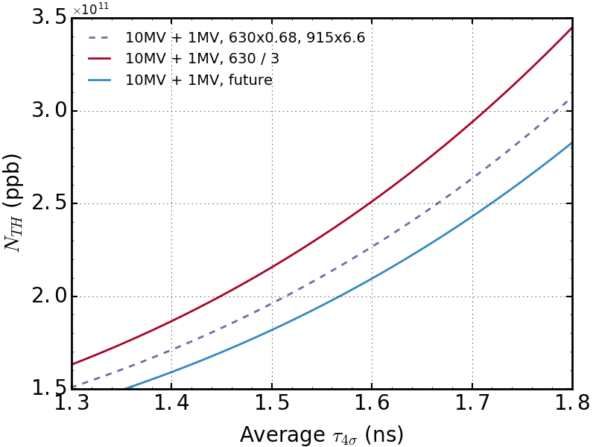
Effect of 938 MHz transverse coupler
Removing the load of the 938 MHz transverse couplers increases the longitudinal stability threshold by almost 10%.
Ongoing study on transverse damping requirements (RF, ABP).
→Preliminary results: Reducing transverse damping possible

Slide 9
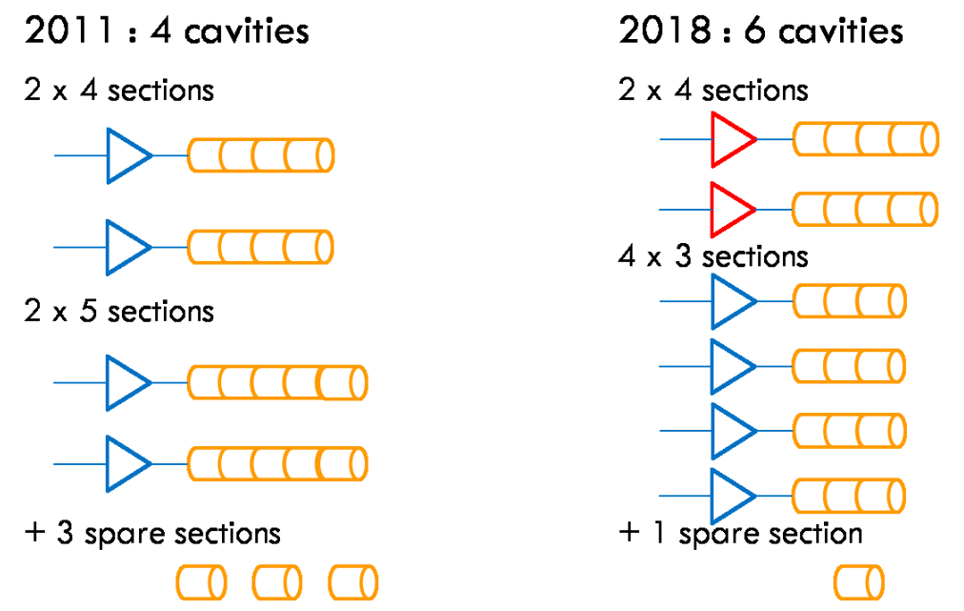
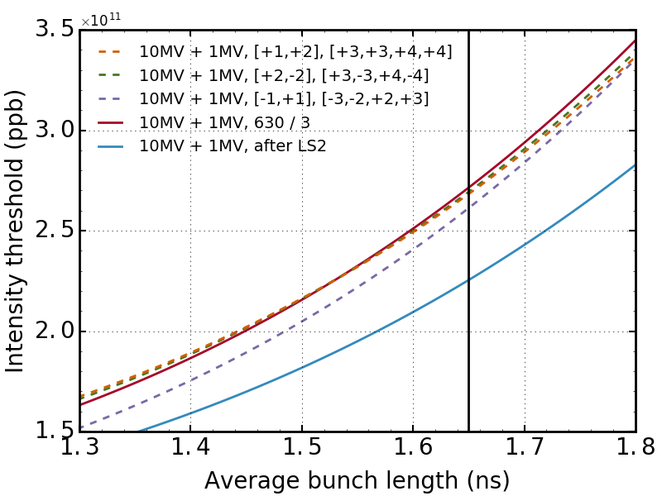
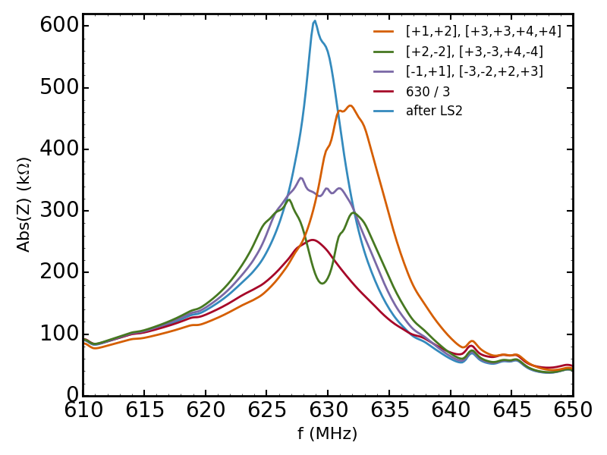
Spreading of 630 MHz HOM
Spread in frequency from cavity to cavity
  Total effect equivalent to damping.
Sources: IPAC11, mopc058

Slide 10
Spreading of 630 MHz HOMs
Spread in frequency from cavity to cavity
  Total effect equivalent to damping.
Sources: IPAC11, mopc058
shift in MHz

Slide 11
Spreading of 630 MHz HOM
Spread in frequency from cavity to cavity
  Total effect equivalent to damping.
Few MHz spread (3-4 MHz)
  →Damping by factor 3 recovered
Sources: IPAC11, mopc058
shift in MHz

Slide 12
Spreading of 630 MHz HOM
Spread in frequency from cavity to cavity
  Total effect equivalent to damping.
Few MHz spread (3-4 MHz)
  →Damping by factor 3 recovered
Positive shift more favorable
Sources: IPAC11, mopc058
shift in MHz

Slide 13
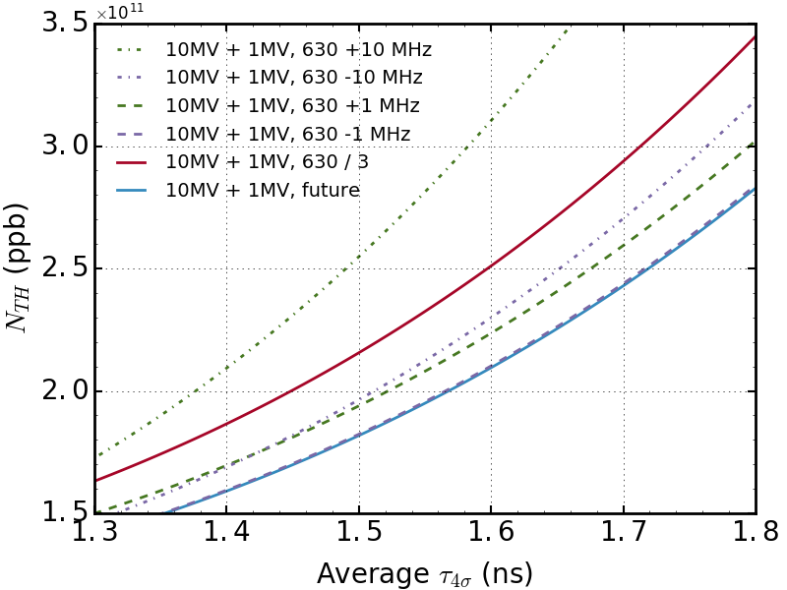
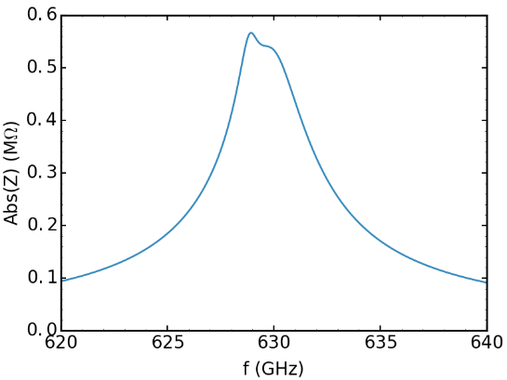
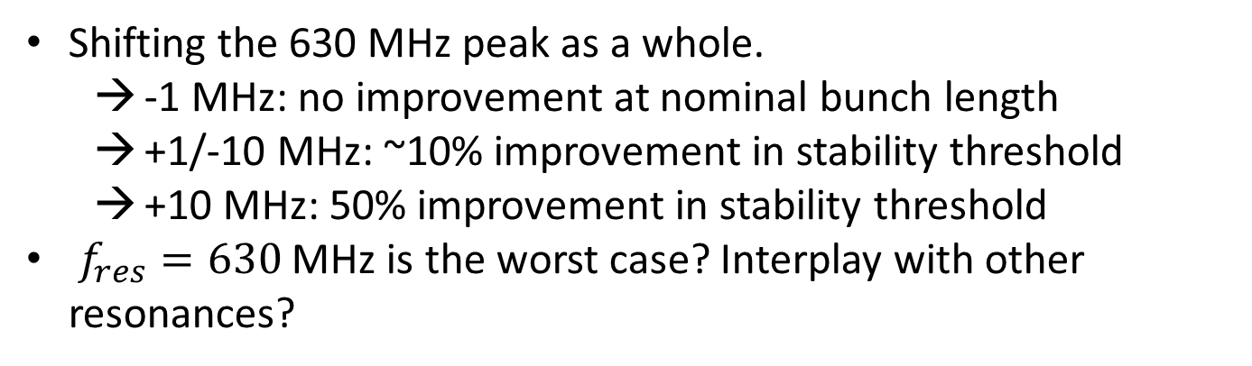
Shifting of 630 MHz HOM in the SPS
Shifting the 630 MHz peak as a whole.
  -1 MHz: no improvement at nominal bunch length
  +1/-10 MHz: ~10% improvement in stability threshold
  +10 MHz: 50% improvement in stability threshold
$f_{res}=630$ MHz is the worst case? Interplay with other resonances?
4 sections
fr (GHz) | 0.6289 | 0.6299
Rsh (kOhm) | 40 | 110
Q | 700 | 250

Slide 14
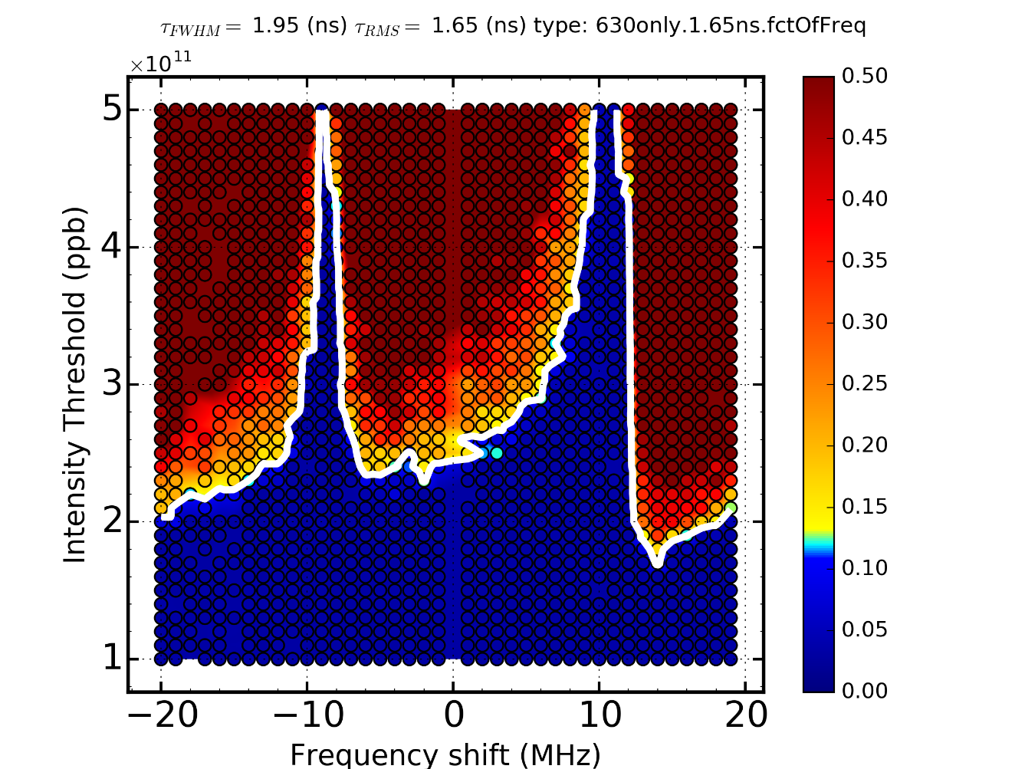

Isolated 630 MHz HOM – frequency dependence
Goal: observe resonant frequency dependence of stability.
  Simulations for given bunch length
  1RF with 10 MV
  Including the impedance of the 630 MHz HOM only
  Shift the resonant frequency
630 MHz
color: $max(\frac{τ_{max}−τ_{min}}{τ_{mean}})$
620 and 640 MHz: zero growth rate
630 MHz ~ minimum stability
Non-symmectric dependence
Better stability for positive frequency shift

Slide 15
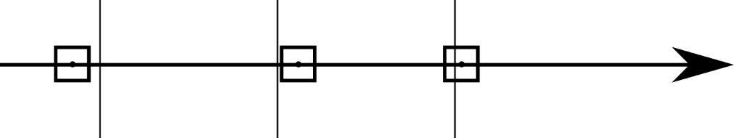




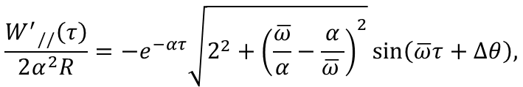
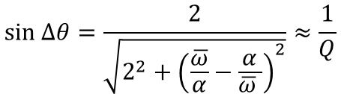







Growth rate – Dipole oscillations
The zero growth rate every 20 MHz can be explained by point-bunch oscillations
…
$$φ_{0}$$
$$φ_{1}$$
$$φ_{2}$$
$$τ$$
$$Δτ_{0}$$
$$Δτ_{1}$$
$$τ_{bb}$$
$$Δτ=Δτ_{0}+Δτ_{1}$$
$$\ddot{φ_{1}}+Ω_{0}^{2}φ_{1}=\frac{ηNe}{E_{s}T_{0}}W_{//}\left(τ_{bb}+Δτ\right)=\frac{ηNe}{E_{s}T_{0}}{(W}_{//}\left(τ_{bb}\right)+{W′}_{//}\left(τ_{bb}\right)Δτ+O(Δτ^{2}))$$
EoM $φ_{1}$:
Contributes to potential well distortion not multi-bunch dynamics.
N = number of bunches
Next neighbours, important term: $\sum_{k=0}^{N−1}{W_{//}^{′}\left[\left(N−k\right)τ_{bb}\right]Δτ_{k}}$
For a single resonator with $f_{r}, R, Q$:
${\overline{ω}}^{2}=ω_{r}^{2}(1−\frac{1}{4Q^{2}})$,
$$α=ω_{r}/2Q$$
$$\frac{{W^{′}}_{//}\left(τ\right)}{2α^{2}R}=−e^{−ατ}\sqrt{2^{2}+{\left(\frac{\overline{ω}}{α}−\frac{α}{\overline{ω} }\right)}^{2}}\sin\left(\overline{ω}τ+Δθ\right),$$
$$sin Δθ=\frac{2}{\sqrt{2^{2}+{\left(\frac{\overline{ω}}{α}−\frac{α}{\overline{ω} }\right)}^{2}}}≈\frac{1}{Q}$$

Slide 16
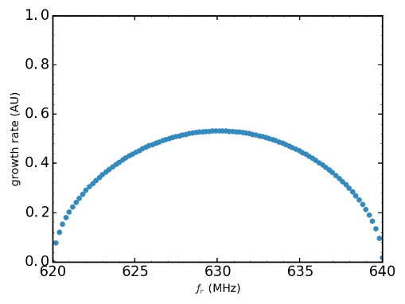
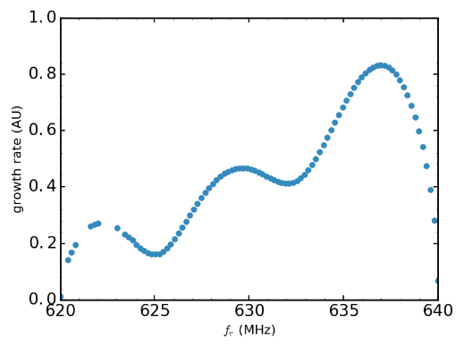
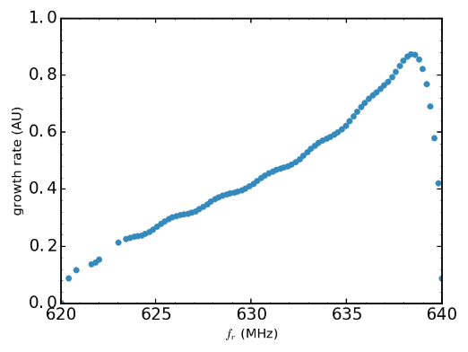
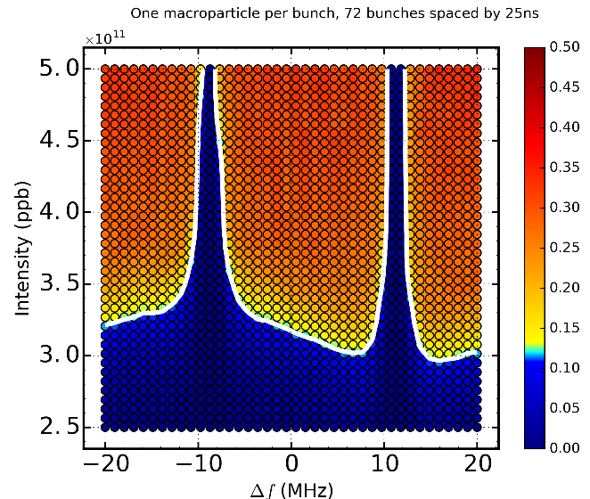
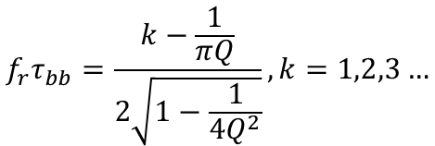



Growth rate – 630 MHz case
Considering first neighbour interaction, perfect cancellation for:
$$f_{r}τ_{bb}=\frac{k−\frac{1}{πQ}}{2\sqrt{1−\frac{1}{4Q^{2}}}}, k=1,2,3…$$
$τ_{bb}=25$ ns
With
$f_{r}≈k×20$ MHz
$Q=200$
Growth rate: summing all contributions, small oscillations
bunch 2
bunch 6
bunch 16
Consistent with simulations of this model
Cannot explain the better stability for positive shift
Next step: To use wakefield from a bunch

Slide 17
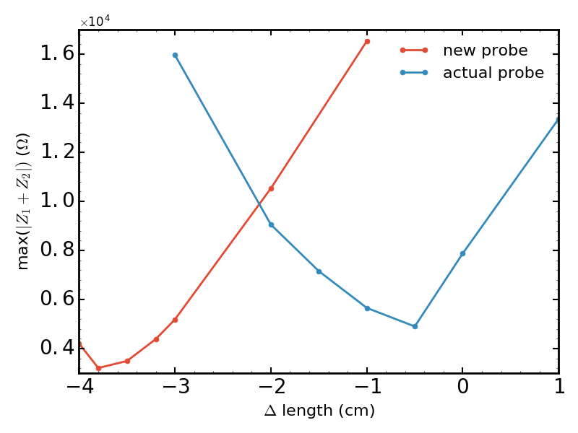
630 MHz HOM – Tuning/damping possibility
Impossible to drill holes in the cavities:
  → Current couplers have to be optimized
Simulations of 4 sections take too long ~week(s)
  Development of an equivalent circuit to extrapolate single cell simulations (2 min) (still ongoing, N. Nasresfahani)
Preliminary results (single cell), maximum Z of the mode:
  Current probe shortened by 0.5cm: factor 1.6
  Using new probe design with optimized length: factor 2.5
Additional factor 2 maybe possible by changing the probe filter
Simulations of 4 sections will confirm the scaling
current situation
7880
4900
3210
X 0.6
X 0.4
Courtesy: N. Nasresfahani

Slide 18
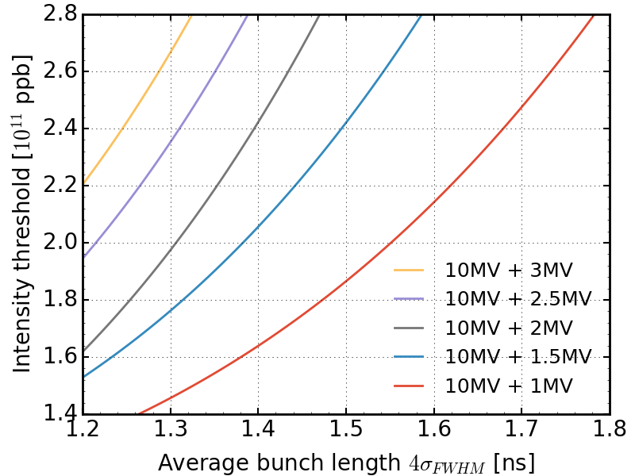
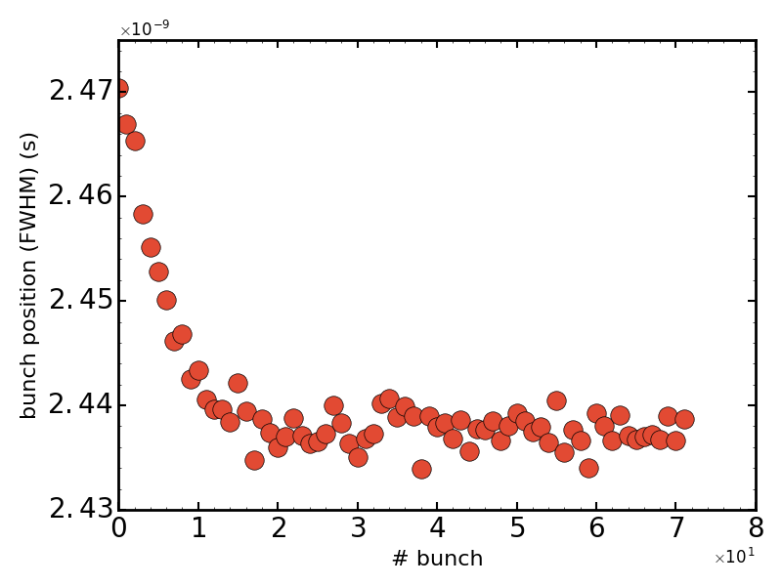
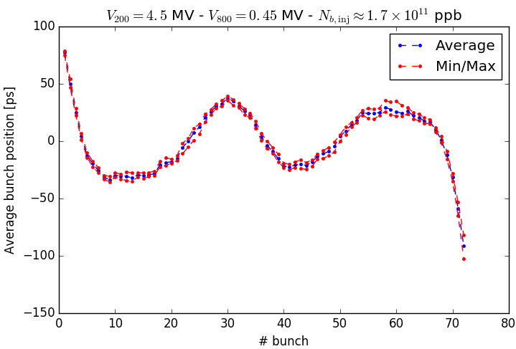
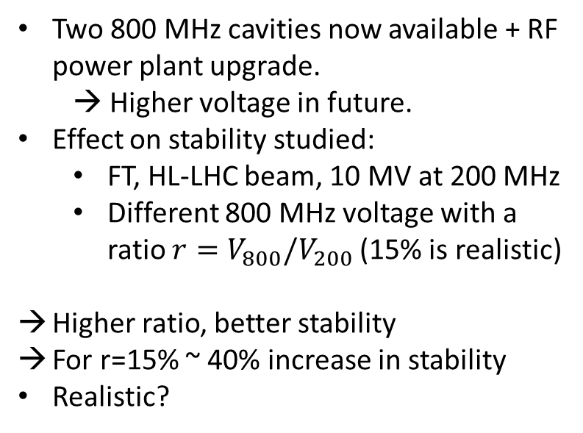
SPS 800 MHz in simulation – update
Two 800 MHz cavities now available + RF power plant upgrade.
  → Higher voltage in future.
Effect on stability studied:
  FT, HL-LHC beam, 10 MV at 200 MHz
  Different 800 MHz voltage with a ratio $r=V_{800}/V_{200}$(15% is realistic)
Higher ratio, better stability
For r=15% ~ 40% increase in stability
Realistic?
  Bunch by bunch displacement due to beam loading in the 200 MHz cavity, but no correction from feedback/feed-forward (in simulations)
  During ramp, the phase is defined by acceleration
Simulation
Measurement
~100 ps
~300 ps
Courtesy: A.Lasheen

Slide 19
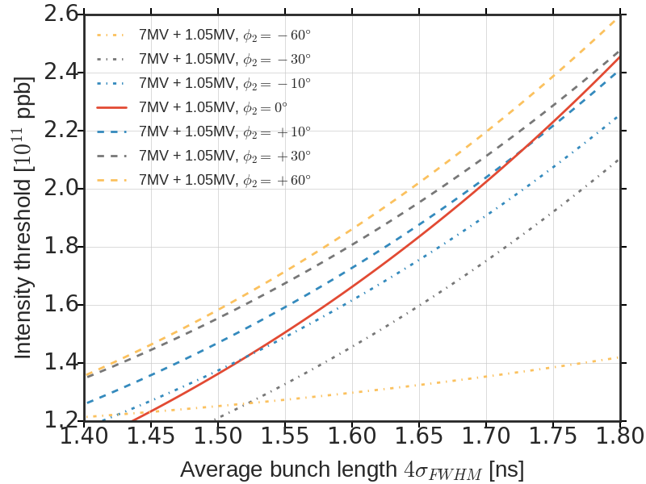
SPS 800 MHz in simulation – phase shift
Because of displacement each bunch sees different 800 MHz phase → How sensitive is the stability threshold to this phase ?
Simulations with constant phase shift in the 800 MHz voltage
Non-monotonic effect (sensitive, 30% stability lost for -200ps):
  positive shift improves stability, negative one reduces it
  realistic synchronous shift needed for more precise stability threshold (effect of feedback and feed-forward)
  calibration of 800 MHz phase in operation needed (MD)
0° = bunch shortening mode
60° ~ 200 ps
FT 72 bunches, 7 MV + 15%

Slide 20
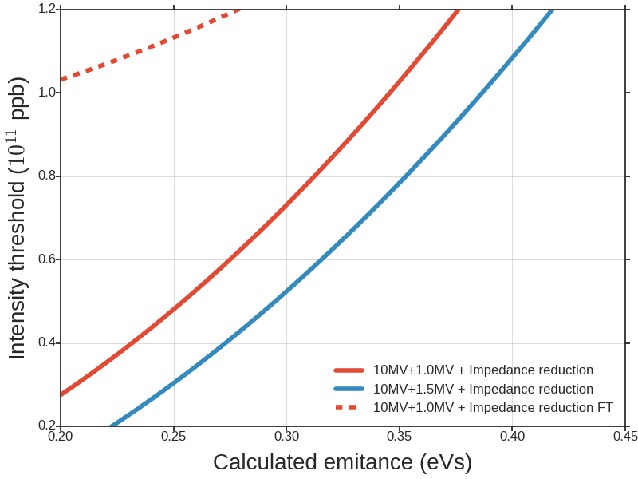
SPS 800 MHz in simulation – ramp
During ramp, the bunch length shrinks → controlled emittance blow-up necessary in simulations (not the case here)
Observations:
  Now in operation V800 = 0.1 V200
  Higher V800 at flat top increases stability (previous slide)
  Increase of V800 starting from flat bottom decreases stability
Optimization to recover more stability during ramp? (may not be possible)
ramp
A = 0.6 eVs
No controlled emittance blow-up

Slide 21
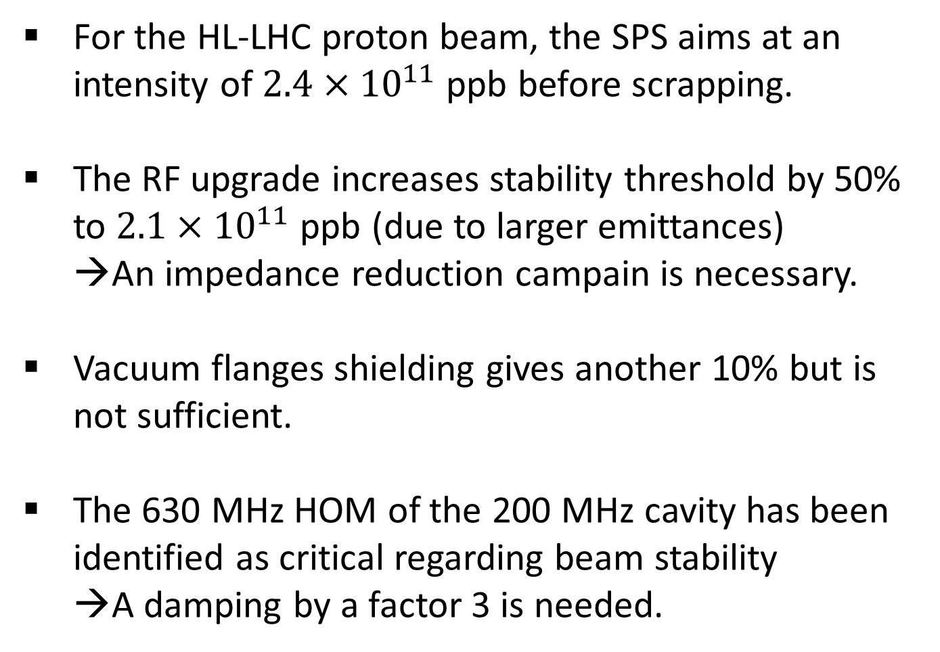
Conclusion and future work
For the HL-LHC proton beam, the SPS aims at an intensity of $2.4×{10}^{11}$ ppb before scrapping.
The RF upgrade increases stability threshold by 50% to $2.1×{10}^{11}$ ppb (due to larger emittances)
  An impedance reduction campain is necessary.
Vacuum flanges shielding gives another 10% but is not sufficient.
The 630 MHz HOM of the 200 MHz cavity has been identified as critical regarding beam stability
  A damping by a factor 3 is needed.

Slide 22
Conclusion and future work
Different possibilities of HOM damping are studied:
  Modify the transverse probe at 938 MHz
    → 10% increase in stability threshold
  Spreading/shifting the 630 MHz HOM independently at each cavity
  Modification of the probe geometry
→from preliminary results, factor 2.5 seems to be achievable (changing the filter can increase this factor)
A voltage increase from the usual 10% in the 800 MHz RF system is another mean to stabilize the beam
→ study and optimization through ramp necessary

Slide 23
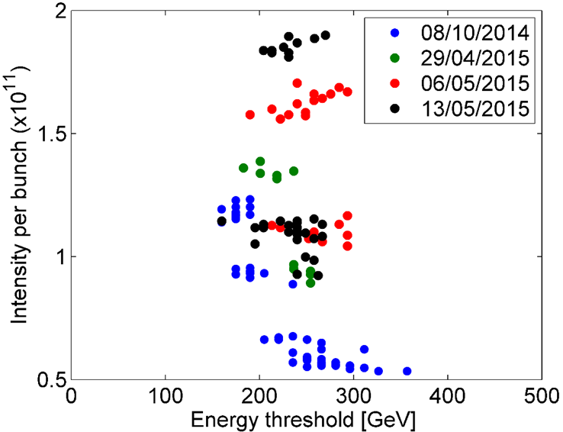
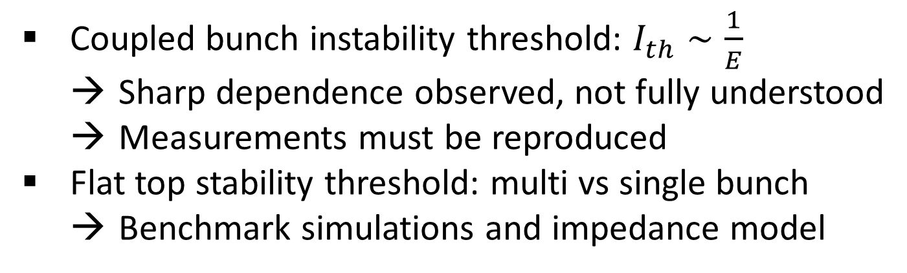
Related list of SPS 2017 MDs
Coupled bunch instability threshold: $I_{th}∼\frac{1}{E}$
  Sharp dependence observed, not fully understood
  Measurements must be reproduced
Flat top stability threshold: multi vs single bunch
  Benchmark simulations and impedance model
Calibration of 800 MHz phase w.r.t the 200 MHz
  Single bunch low intensity
SPSU BD WG, T. Argyropoulos 21 May 2015

Slide 24
Thank you for your attention.
Acknowledgements
  Thank to E. Shaposhnikova for constant help and support.
  Thank to R. Calaga to have suggested the spreading study.
  Thank to N. Nasresfahani for the great work with the probes design and CST simulations.
  Thank to A. Lasheen for countless fruitful discussions
  Thank to the BLonD team for constant developments and improvements of the BLonD code.

Slide 25
Backup slides

Slide 26
TWC 200 MHz impedance
Two 4 tank 200 MHz Cavities
Two 5 tank 200 MHz Cavities
fr [GHz] | Rsh [kOhm] | Q | R/Q [Ohm]
0.1997 | 850 | 450 | 1888. 9
0.2003 | 2060 | 400 | 5150
0.201 | 850 | 425 | 2000
0.6289 | 80 | 700 | 114.3
0.6299 | 220 | 250 | 880
0.914 | 770 | 5000 | 154
0.9148 | 772 | 5000 | 154.4
1.1319 | 132 | 4000 | 33
1.1331 | 156 | 5000 | 31.2
1.1335 | 160 | 5000 | 32
1.5073 | 174 | 8000 | 21.75
1.5076 | 236 | 8000 | 29.5
fr [GHz] | Rsh [kOhm] | Q | R/Q [Ohm]
0.1999 | 600 | 600 | 1000
0.2 | 2400 | 370 | 6486.5
0.2006 | 2200 | 600 | 3666.7
0.6291 | 260 | 300 | 866.7
0.6299 | 140 | 500 | 280
0.9142 | 940 | 4500 | 208.9
0.9148 | 720 | 4500 | 160
1.1317 | 520 | 4000 | 130
1.1332 | 196 | 4500 | 43.6
1.5074 | 240 | 7000 | 34.3
1.5078 | 184 | 7000 | 26.3

Slide 27
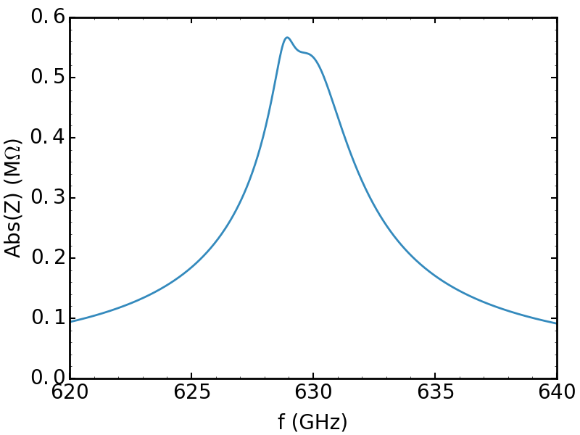

Shifting of 630 MHz HOM (alone)
Colorbar: $max(\frac{τ_{max}−τ_{min}}{τ_{mean}})$
4 sections
fr (GHz) | 0.6289 | 0.6299
Rsh (kOhm) | 40 | 110
Q | 700 | 250
3 sections
fr (GHz) | 0.6289 | 0.6299
Rsh (kOhm) | 24 | 66
Q | 420 | 150
630 MHz
SRF

Slide 28
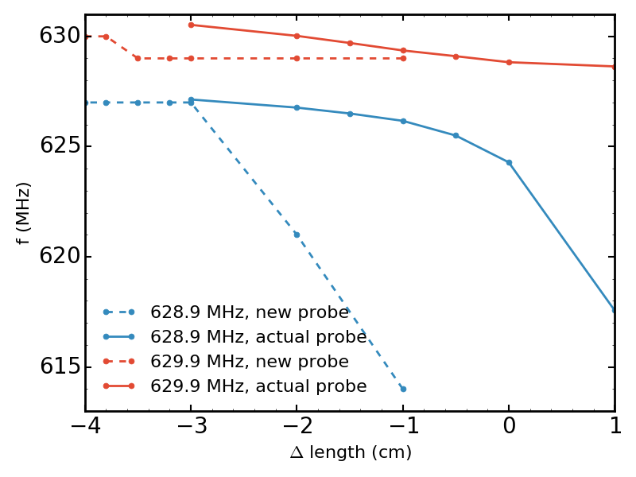
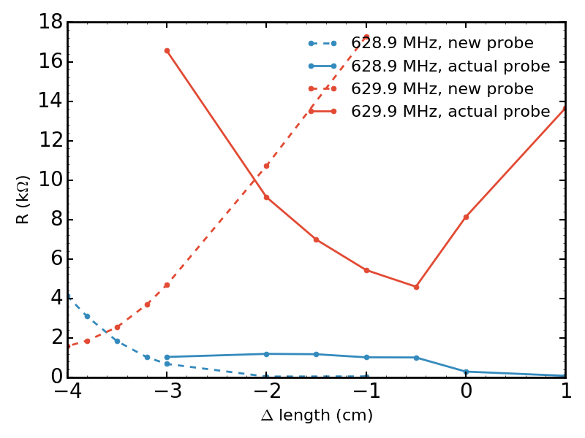
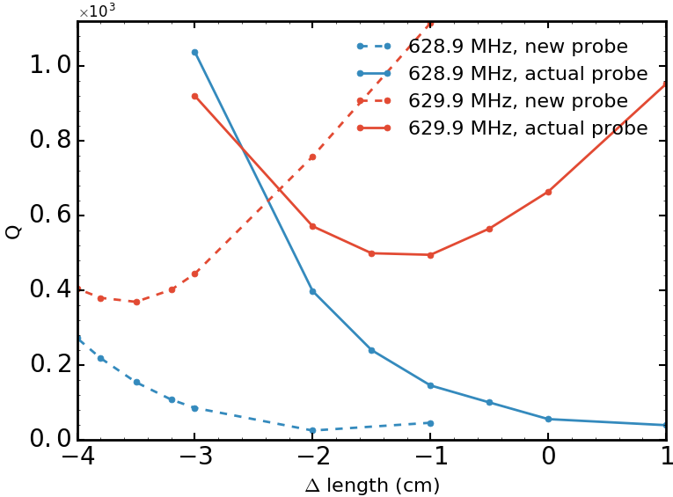
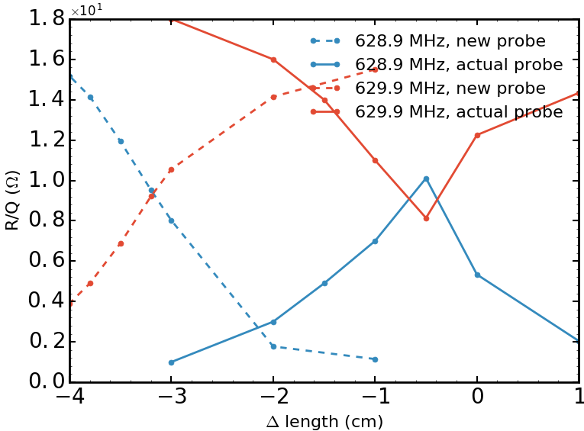
630 MHz HOM – Tuning/damping possibility

Slide 29
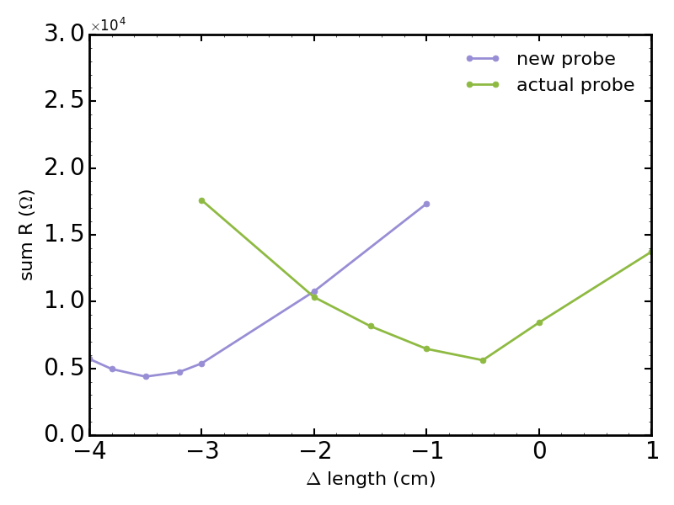
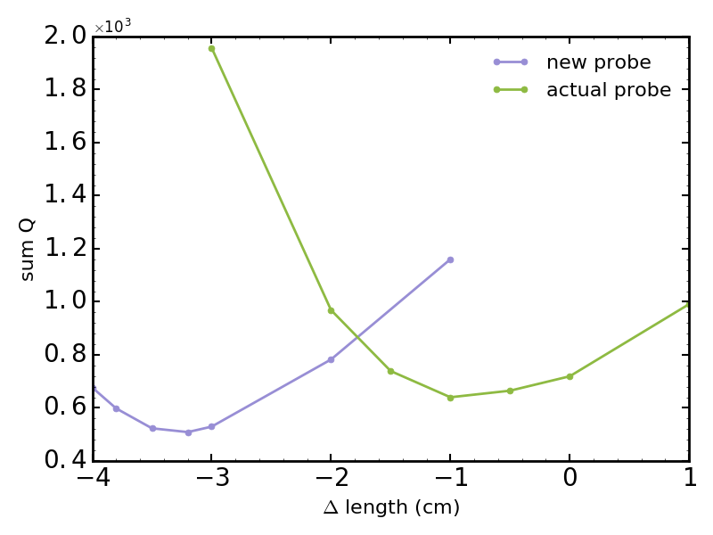
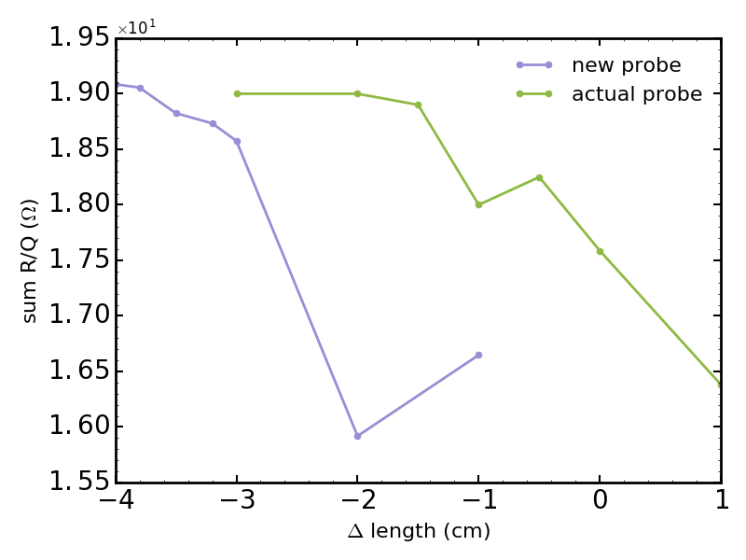
630 MHz HOM – Tuning/damping possibility

