Slide 1
ARIES-WP 17
Materials for extreme thermal management
(PowerMat)
CERN, 5th of May 2017
M. Tomut and A. Bertarelli for PowerMat

Slide 2
PowerMat WP Objectives
Optimization of carbide-graphite composite materials with respect to radiation hardness for LHC collimator system upgrade, exploring properties with new doping.
Development of a carbon-based composite solutions for high power targets and beam dumps with improved resistance to short, intense pulse ion beam-driven shock waves.
Testing and optimization and of diamond-metal matrix composites for applications as luminescence screens for high intensity beams (optimization will be performed as a function of beam-induced luminescence signal by changing diamond doping, to beam-induced shock resistance by using special light alloys and to diamond-matrix interface by using special additions).

Slide 3
PowerMat WP Description
Comprehensive and integrated R&D activity, including:
Investigation, development, manufacturing, characterization, testing and integration of novel Ceramic Matrix and Metal Matrix Composites based on graphite and diamond reinforcements.
Development of new experimental methods to test materials at energy density conditions relevant for accelerators beyond LHC (e.g.FCC) in more accessible experimental areas and producing less activation.
Development of new monitoring techniques for online tests of radiation-induced material degradation.
Simulating behavior of novel composites at very high strain rates.
Exploring challenging and/or unconventional applications of such materials for high power accelerators and society.

Slide 4
PowerMat WP Innovations
Online thermomechanical dynamic testing under high intensity beams.
Study of ion-induced color centers in diamond for quantum computing applications.
Prediction of radiation-induced microstructural damage and studies of methods to mitigate and cure such effects.
Application to particle accelerator devices beyond collimators (e.g. novel luminescence screens for high intensity beams, beam windows, high power targets and beam catchers...).
Exploration of demanding thermal management applications such high-end electronics, avionics, gas turbines, aerospace, advanced braking systems.
Notes:
Luminescence in D due to impurities which are in proximity of a vacancy

Slide 5
PowerMat WP Organisation
The WP is organized in the following tasks:
Communication & Coordination (A. Bertarelli – CERN, M. Tomut – GSI)
Materials development and characterization
(A. Bertarelli – CERN)
Dynamic testing and online monitoring (L. Peroni – POLITO)
Simulation of irradiation effects and mitigation methods
(A. Lechner – CERN)
Broader accelerator and societal applications (M. Tomut – GSI)
Within WP1 (Task 1.4) – Industries for resistant materials (F. Carra– CERN)

Slide 6
PowerMat Participants
 | Laboratories
1 | CERN | Geneva, Switzerland
2 | ELI-NP (Extreme Light Infrastructure – Nuclear Physics) | Bucharest-Magurele, Romania
3 | GSI | Darmstadt, Germany
4 | POLIMI | Milan, Italy
5 | POLITO | Turin, Italy
6 | UM | Malta
X | NIMP (National Institute of Materials Physics)* | Bucharest, Romania
 | Industries (in WP1 Innovation)
X | Brevetti Bizz | Verona, Italy
X | RHP Technology | Seibersdorf, Austria
* Participating as associated (subcontractor)

Slide 7

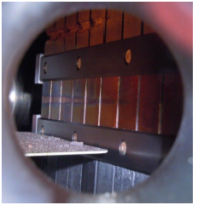
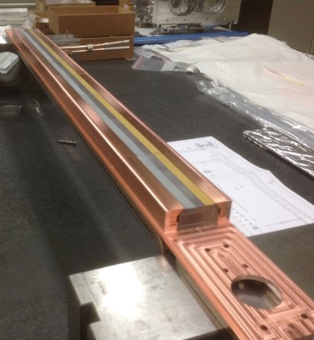
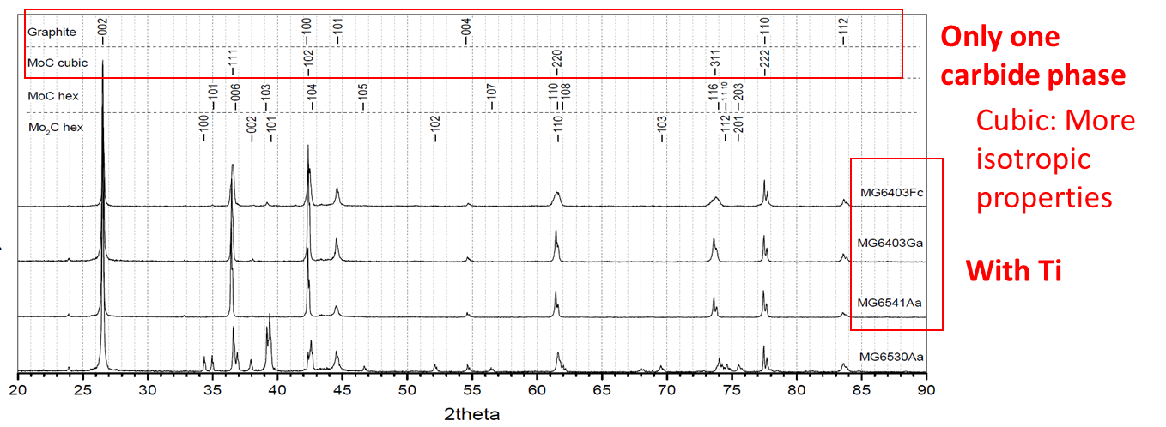
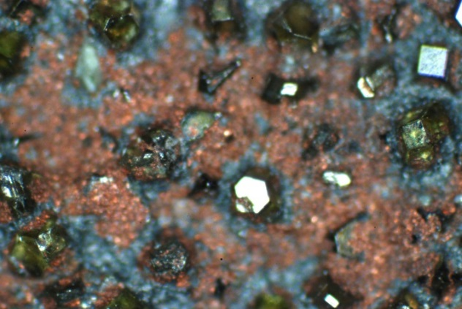
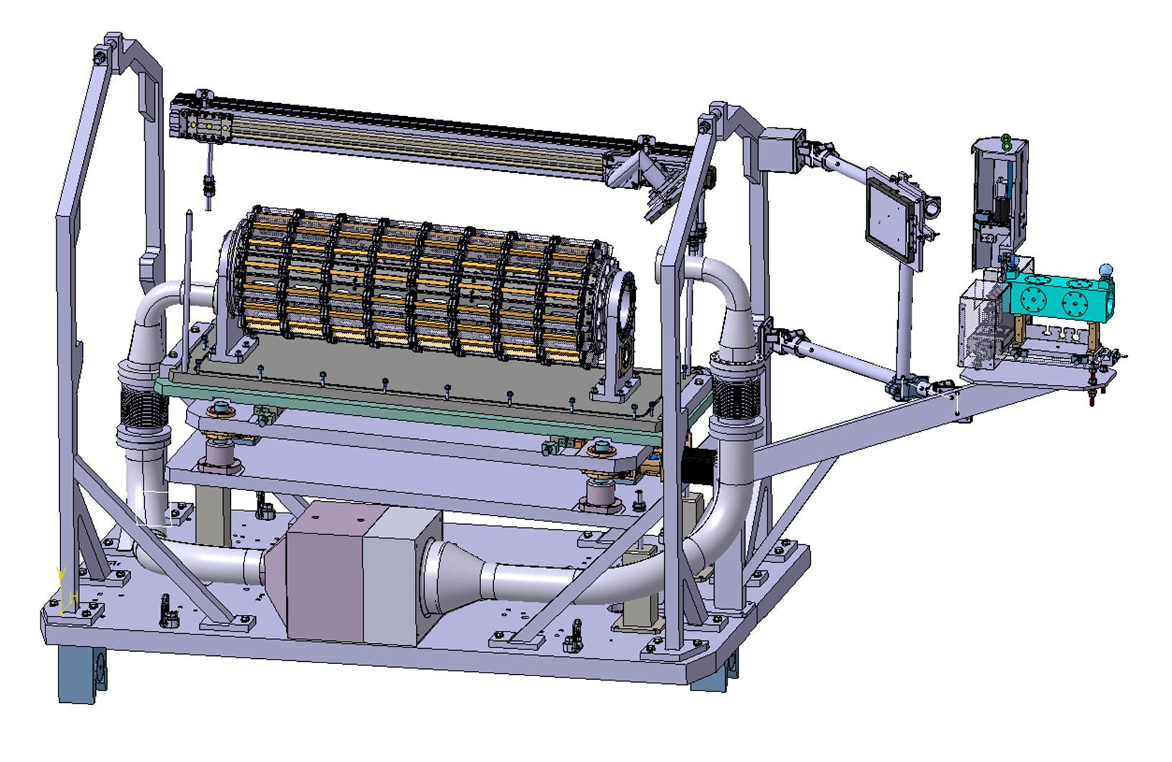
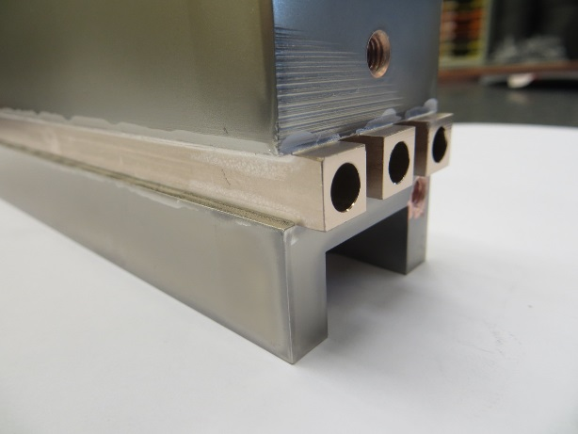
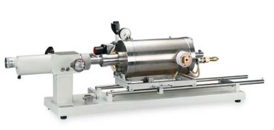
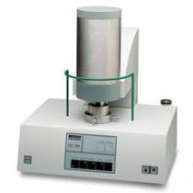
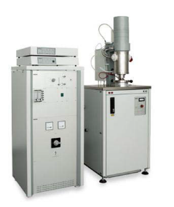
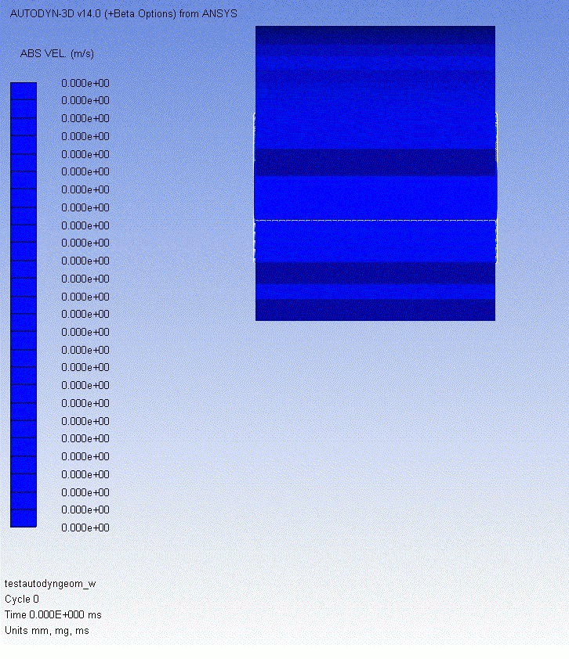
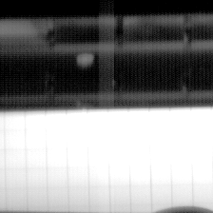
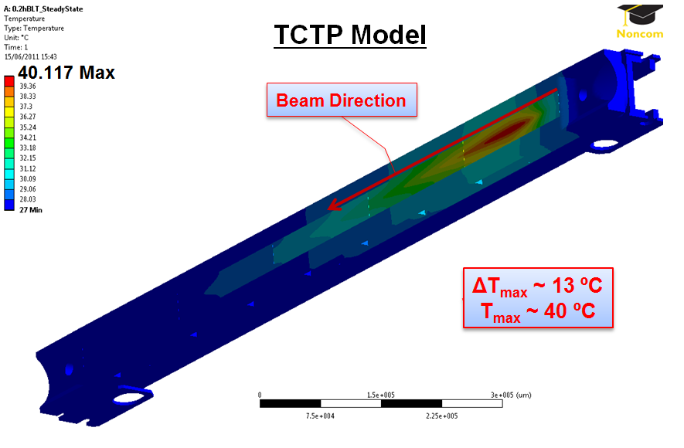
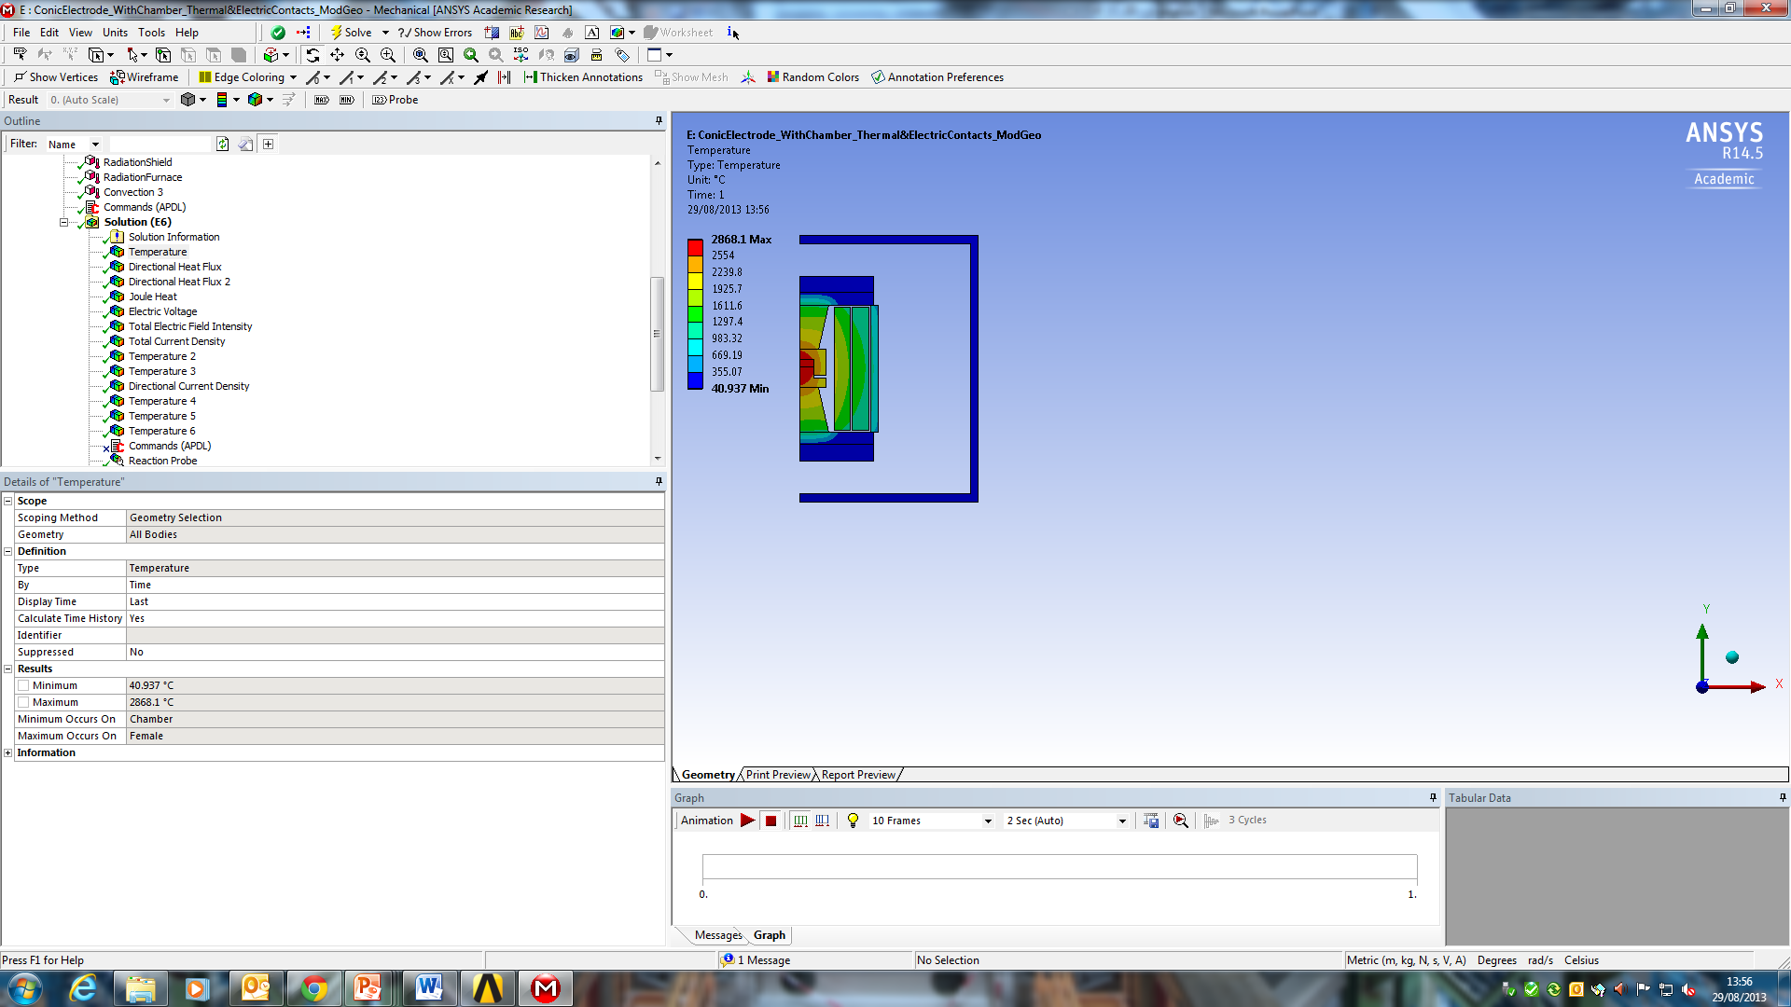
CERN in WP17 and WP14
Prototyping
Material micro and macro characterization
Testing under beam impact
Multiphysics simulation of material response and technology processes
Notes:
Mo-Gr with c oating C (per ridurre impedenza)

Slide 8
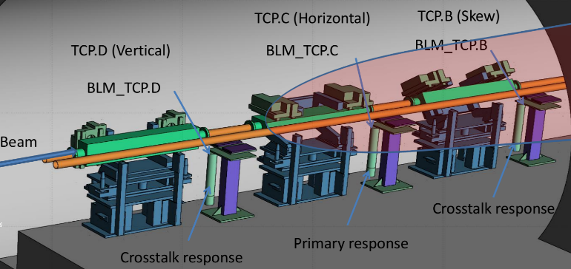
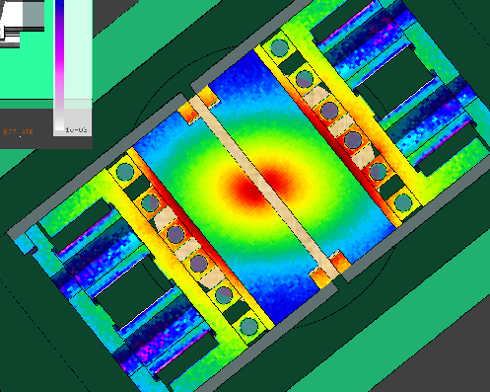

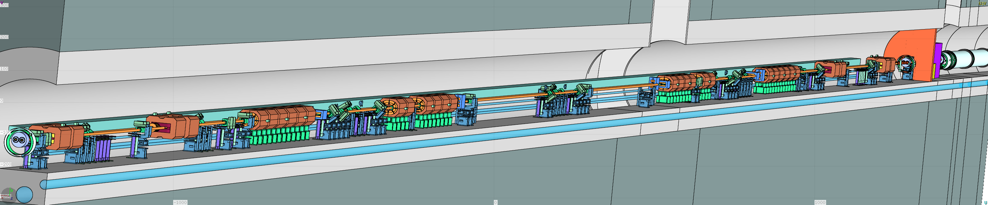
CERN FLUKA team
Expertise in simulating particle-matter interactions and radiation effects
Responsible for beam-induced shower studies for all CERN accelerators and future upgrades (e.g. HL-LHC)
Coordination of ARIES Task 17.4

Slide 9

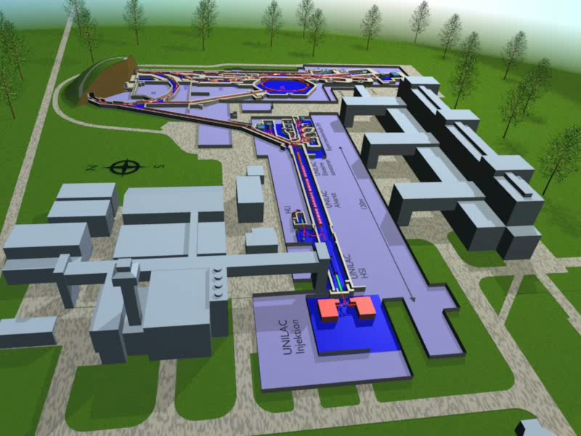
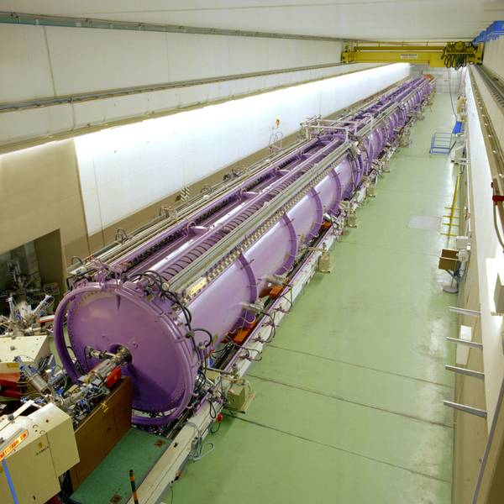
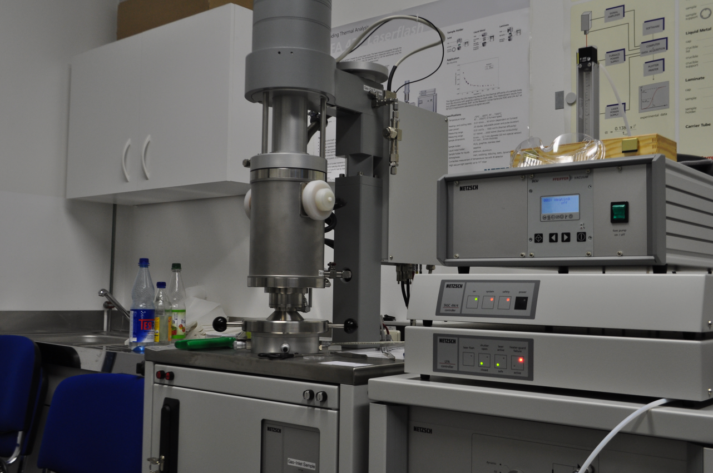
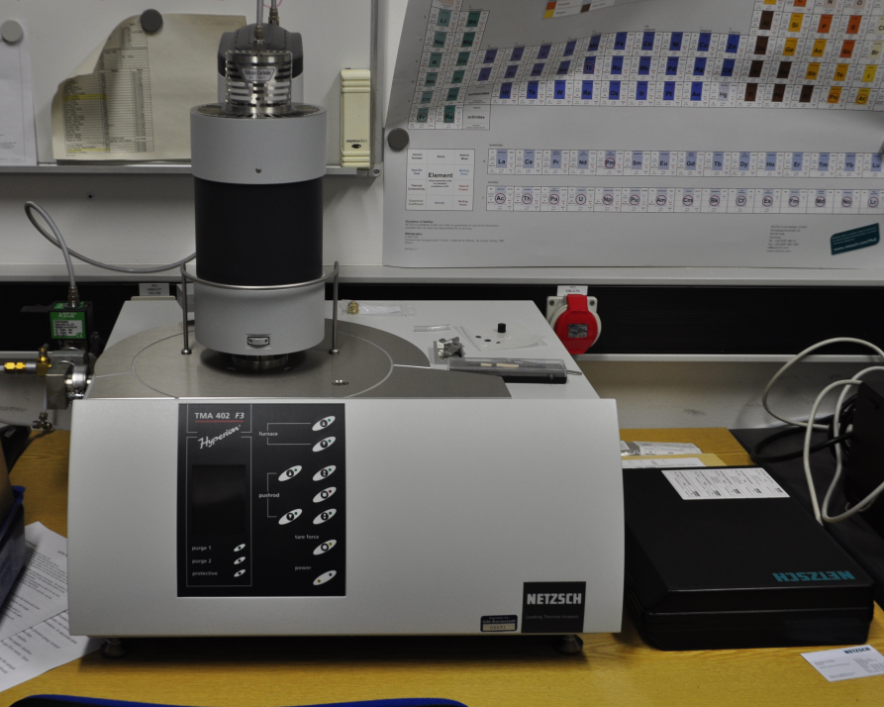
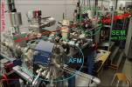

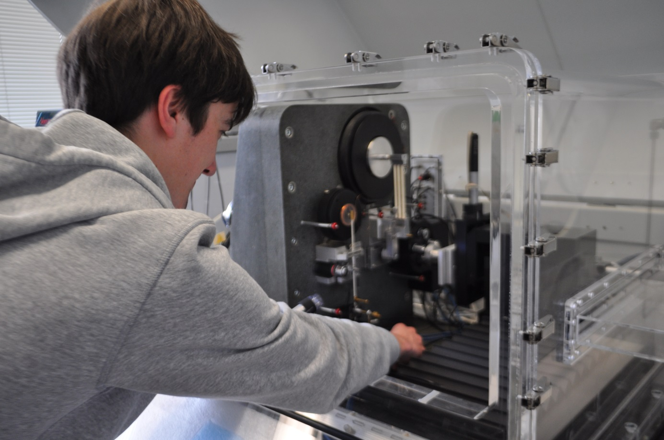

Acceleration of p to U²⁸⁺ from 1.4 to 11.6 MeV/u..
SIS
up to
2 GeV/u
M3
UNILAC
3.6-11.4 MeV/u
Range ~ 100µm
X0
Cave A
M-Branch
In-situ and On-line Analysis of Irradiated Material
M1
Microscopy
M2
X-Ray Diffraction
M3
Multi-Analysing Chamber
Cryostat
UV/Vis and Fluorescence
Long-distance
Microscopy
IR Spectrometer
Sample
Curvature
Measurement
Ion Beam
Mass
Spectrometer
Gas Flow
Controller
University of Stuttgart
University of Duisburg Essen
Universities of Darmstadt, Dresden
Göttingen, Jena, Heidelberg
Helmholzzentrum Berlin / GSI

Slide 10
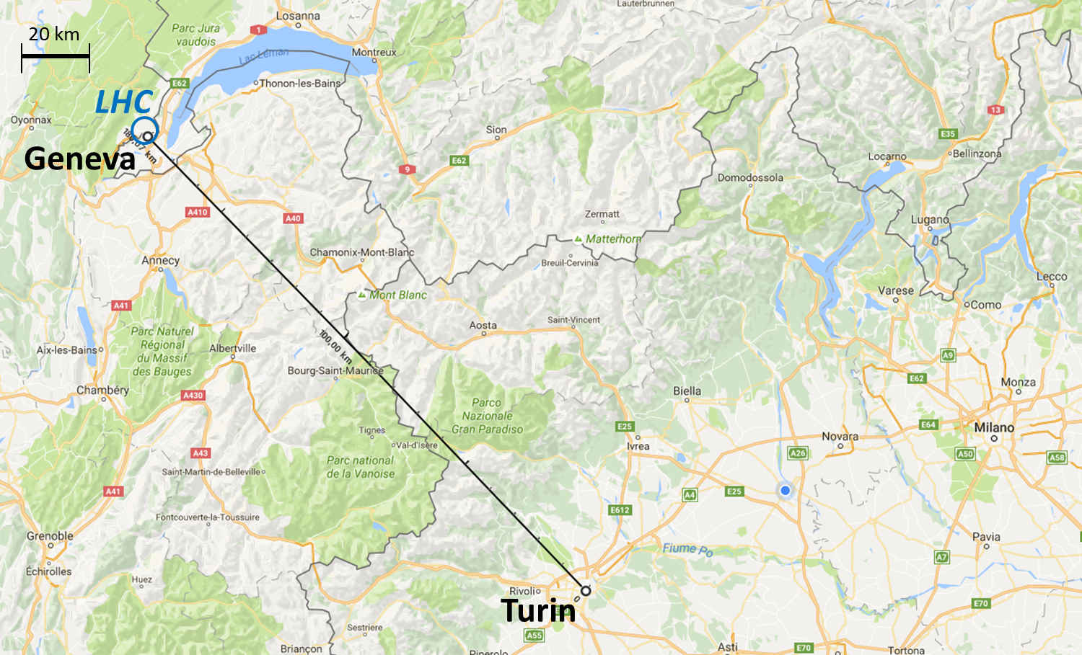
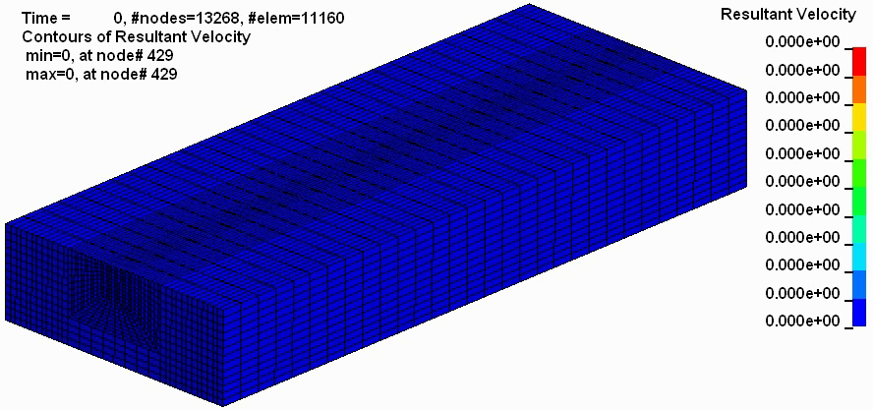
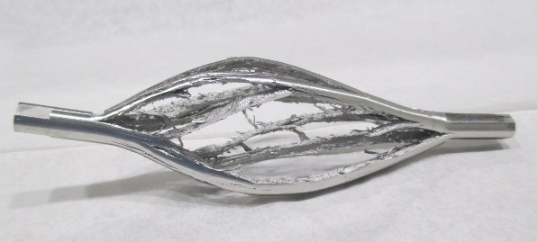
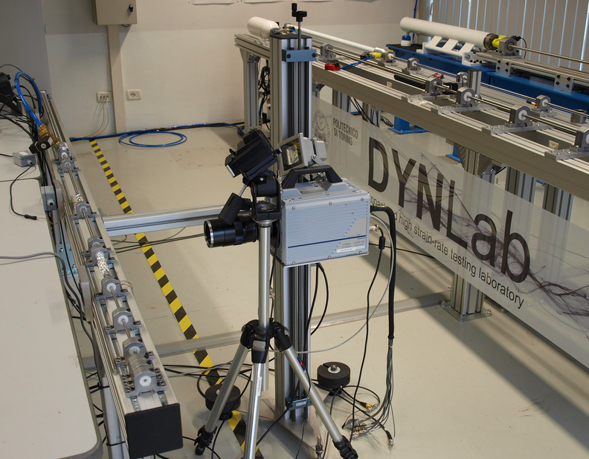
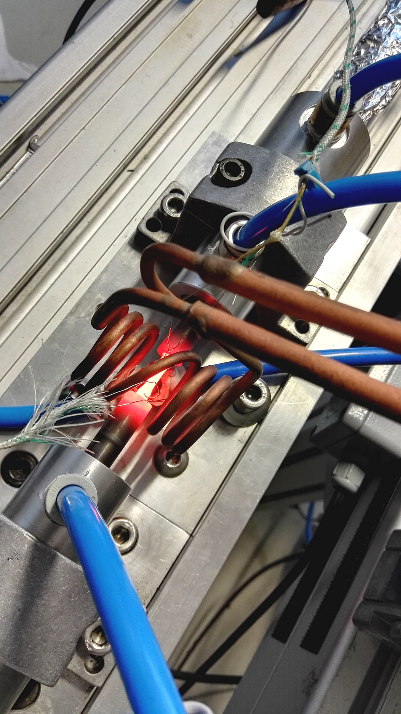
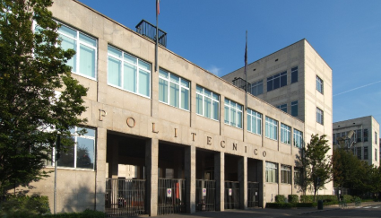
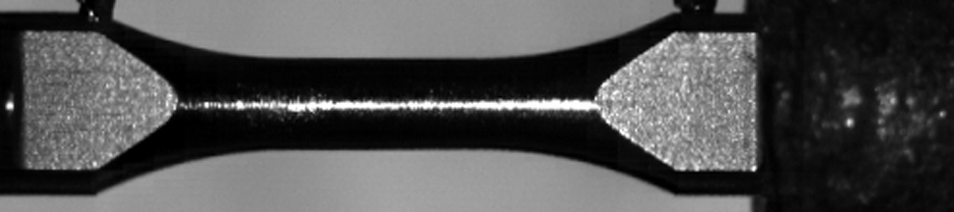

Hydrodynamic simulations of structures interacting with particle beams (equation of state)
Mechanical characterization of advanced materials at high temperature and strain-rate

Slide 11

University of Malta
Highest research and teaching institution in Malta
Track record of collaboration with CERN (EuCard2):
  PhD, Marija Cauchi: ‘Thermo-Mechanical Studies of Large Hadron Collider Collimators in Accident Scenarios’, inermet blocks, collimator
  MSc, Miryea Borg: ‘Numerical Modelling and Experimental Testing of Novel Materials for LHC Collimators’, new candidate materials Molybdenum Graphite, Copper Diamond, Carbon composites
  MSc, Marcus Portelli (on-going): ‘Preliminary Thermo-mechanical Design of a high-power absorber for HL-LHC Crystal Collimation’, investigation on new crystal collimation designs
Expertise:
  Thermo-mechanical finite element analysis (FEA) simulations (ANSYS)
  Analysis of high temperature (e.g. welding) induced stresses through full and reduced (computationally efficient) methods
  Residual stresses hole drilling equipment
  Sensor technology
WP 17 Task 17.2
Main foreseen contribution: support for analysis for assessment of components performance, testing planning and validation

Slide 12
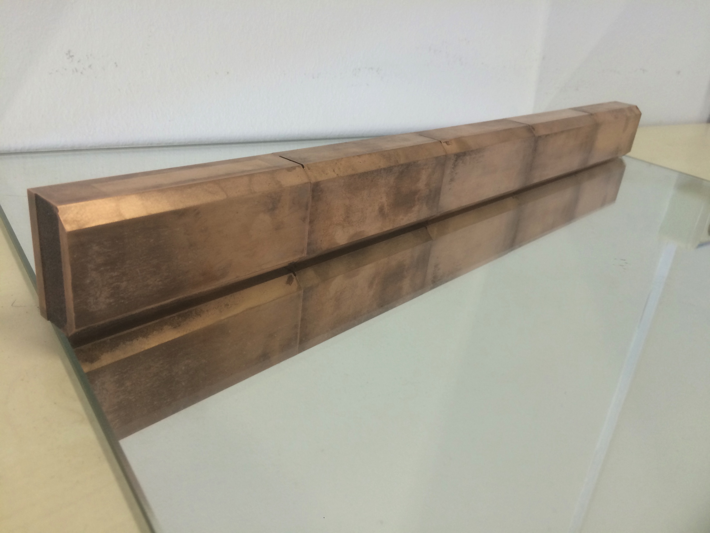
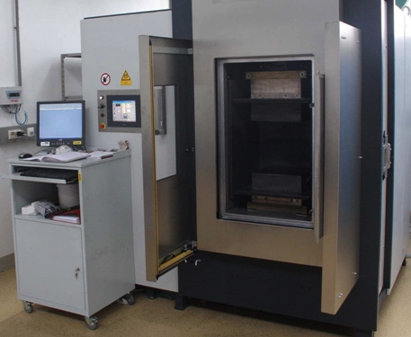
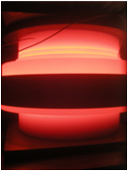
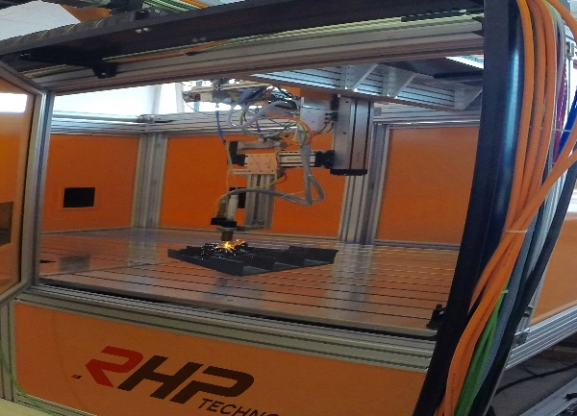
RHP-Technology @ ARIES
2 Technologies &
many material compositions
3 different topics to work on
CuCD as collimation material
SPS/FAST SINTERING
RAPID SINTER PRESSING
Metal-Diamond composite applications like novel luminescence screens for particle beams, quantum computing, florescence imaging,....
Demonstrate Additive Manufacturing of MgB2 for large dimensions (applications: novel beam pipes, RF cavities, …)
ADDITIVE MANUFACTURING

Slide 13


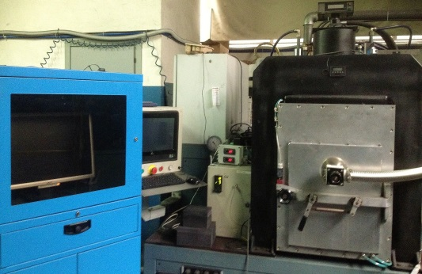
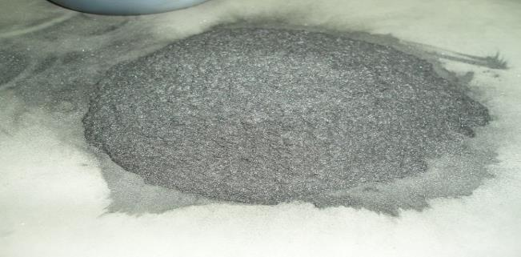
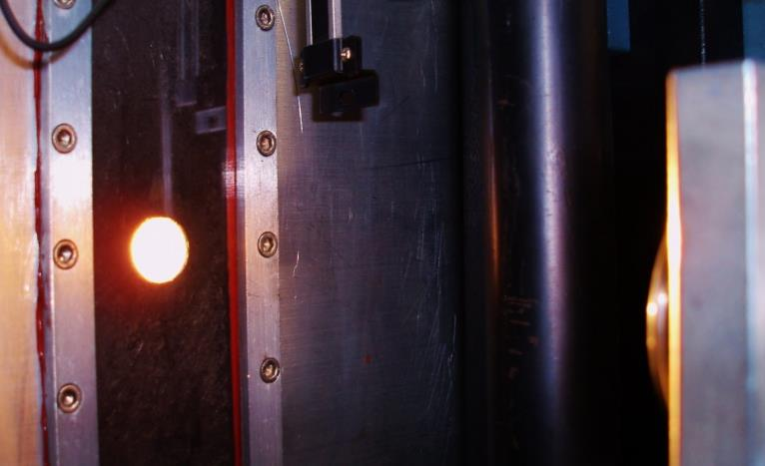
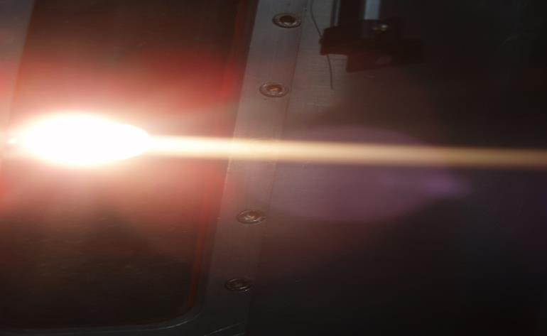
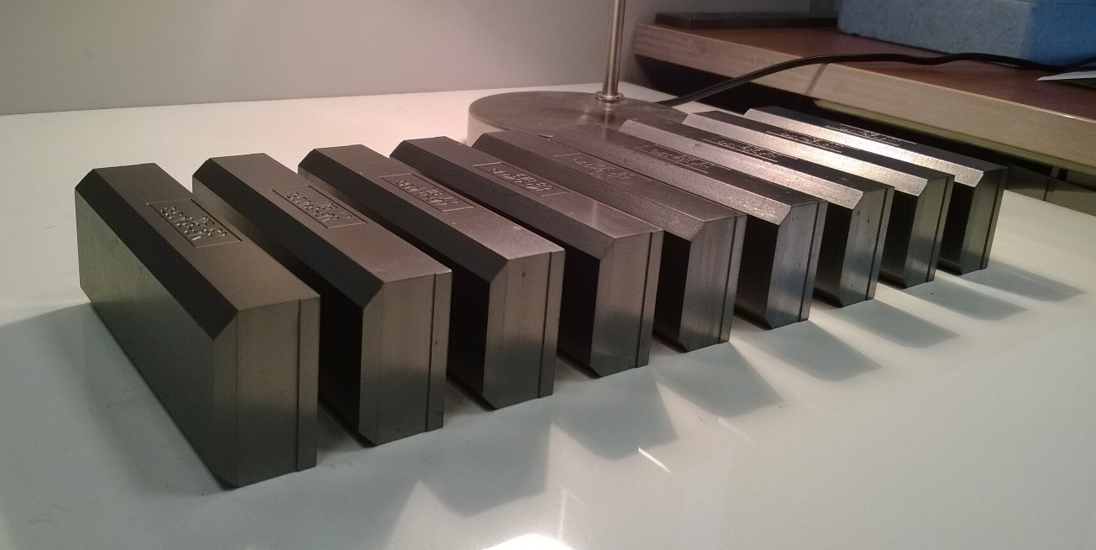
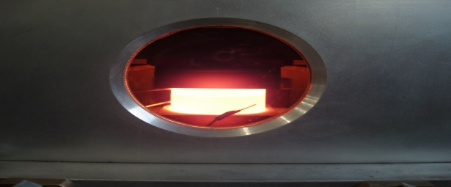
VACUUM HOT-PRESSING C°1200
Mixed Powders
VACUUM SPS 1200°C
VACUUM SPS >2600°C
Spark Plasma Sintering (SPS)
INDUCTION VACUUM HOT
PRESSING 1500 C°
Molybdenum carbide - Graphite material. Produced by SPS at >2600°C.
Production of the absorber blocks for the HL-LHC TCSPM collimator prototype
Notes:
MATERIAL

Slide 14
Task 2 description
Task 2: Materials development and characterization
(A. Bertarelli – CERN)
  Research, investigation, development, manufacturing, characterization of novel CMC and MMC based on graphitic, carbide or diamond reinforcements. Continuous material optimization will be fostered by the feedbacks provided by tasks 3 and 4.
  Study and development of electrically conductive coatings, resisting the impact of high intensity particle beams.
  Characterization of thermophysical properties measurements, microstructural analysis (SEM, XRD, EDS ...), study of phases and of their change under various environments …
  Participants: CERN, GSI, NIMP, POLIMI, POLITO, UM, Brevetti Bizz, RHP Technology

Slide 15
Task 3 description
Task 3: Dynamic testing and online monitoring
(L. Peroni – POLITO)
  Testing of material samples in a broad range of environments:
  Mechanical testing in quasi-static and dynamic conditions, at various temperatures
  Tests with high power beams (CERN,GSI, ELI-NP)
  Irradiation tests with online monitoring of properties evolution (GSI)
  Hydrodynamic simulations of experiments –constitutive models, spall strengths for new materials
  Participants: CERN, ELI-NP, GSI, POLIMI, POLITO, UM

Slide 16
Task 4 description
Task 4: Simulation of irradiation effects and mitigation methods
(A. Lechner – CERN)
  Simulations on the degradation due to irradiation, ions (with ion tracks) and protons bombardment.
  Understand effect of time of energy deposition on damage and property degradation, taking into account dose rate and dynamical annealing effects for high intensity beams.
  Include effects of nuclear transmutations and gas production.
  Participants: CERN, GSI, POLIMI
  This task will contribute as well to an extra European collaboration (RaDIATE - Radiation Damage In Accelerator Target Environment), aimed at understanding the effects of radiation on material

Slide 17
Task 5 description
Task 5: Broader accelerator and societal applications
(M. Tomut – GSI)
  This task will follow broader applications of new developed materials for high-power accelerators, space, society (energy, medicine, computing)
  Irradiation induced defect centers in diamond for luminescent screens, medical imaging and quantum computing.
  Novel materials for high power targets, beam catchers, beam windows.
  Applications for advanced engineering solutions, efficient energy solutions, space.
  Applications for thermal management.
  Participants: CERN, GSI, UM, Brevetti Bizz, RHP Technology

Slide 18
Deliverables
Task 17.2) Comparative compendium of the developed materials [month 40]
Task 17.4) Report on simulations on irradiation effects [month 44]
Task 17.3) Irradiation test results: Beam impact on new material and composite [month 48]
Task 1.4) Production of material samples (as large as possible for each industry to demonstrate workability) [month 24]

Slide 19
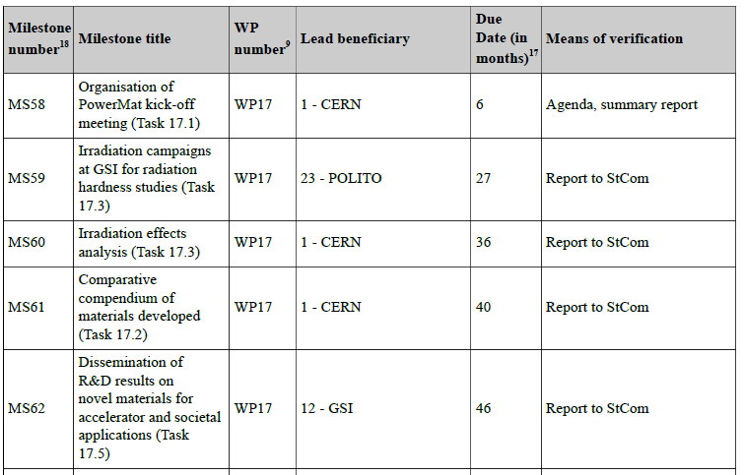
Milestones

Slide 20
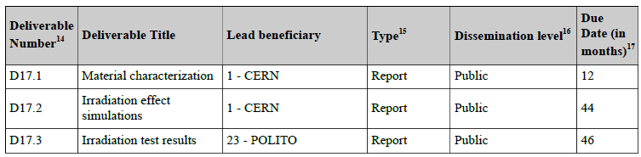
Deliverables

Slide 21
Deliverables and Milestones
Task | Year 1 |  |  |  | Year 2 |  |  |  | Year 3 |  |  |  | Year 4
 | Q1 | Q2 | Q3 | Q4 | Q1 | Q2 | Q3 | Q4 | Q1 | Q2 | Q3 | Q4 | Q1 | Q2 | Q3 | Q4
17.1 |  | M
17.2 |  |  |  | D |  |  |  |  |  |  |  |  |  | M
17.3 |  |  |  |  |  |  |  |  | M |  |  | M |  |  |  | D
17.4 |  |  |  |  |  |  |  |  |  |  |  |  |  | D
17.5 |  |  |  |  |  |  |  |  |  |  |  |  |  |  |  | M
1.4 |  |  |  |  |  |  |  | D

Slide 23


