Slide 1


Bottomonia Suppression from AdS/CFT
W. A. Horowitz
University of Cape Town
October 2, 2018
Based on:
N. N. Barnard and WAH, arXiv:1706.09217
Notes:
Interested in the physics that determines 99% of the mass of the visible universe

Slide 2
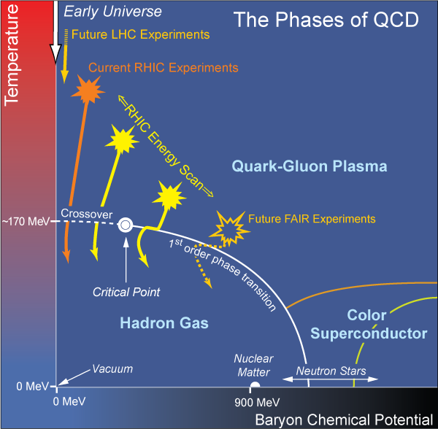
Motivation
  What are the emergent, “moderate body” dynamics of non-Abelian plasma?
    Unique theory/experiment opportunity with QCD

Slide 3
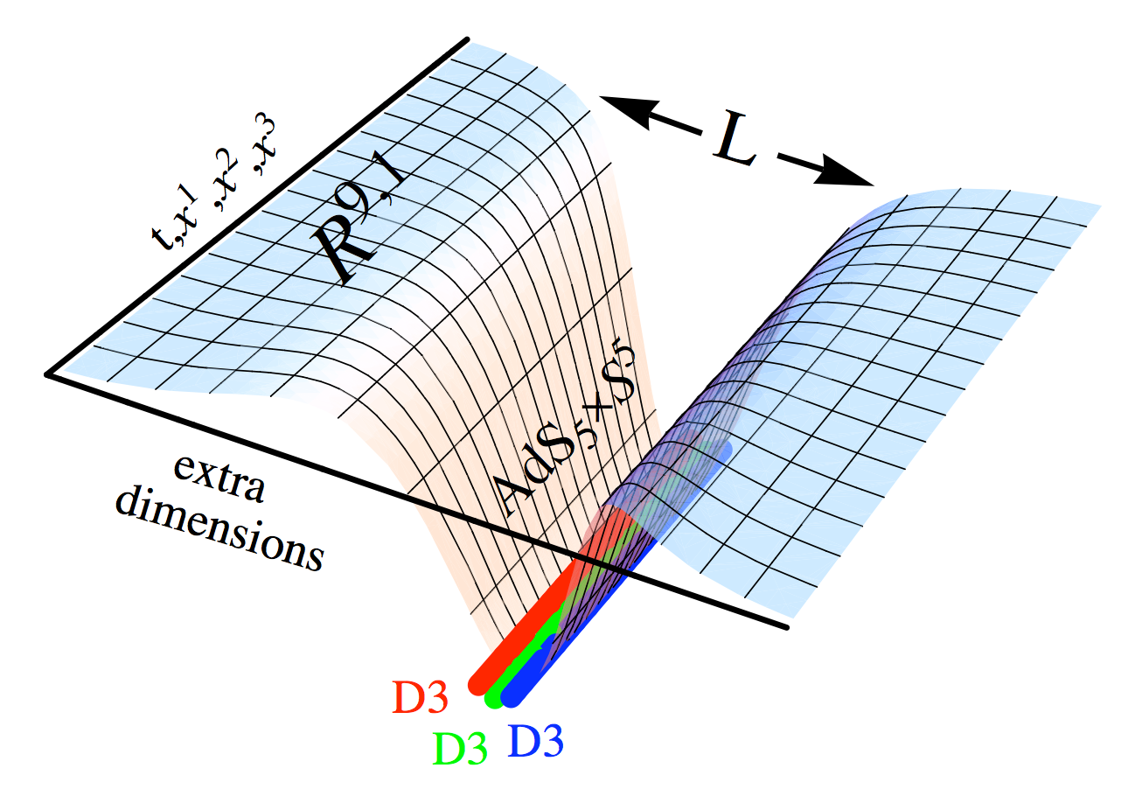
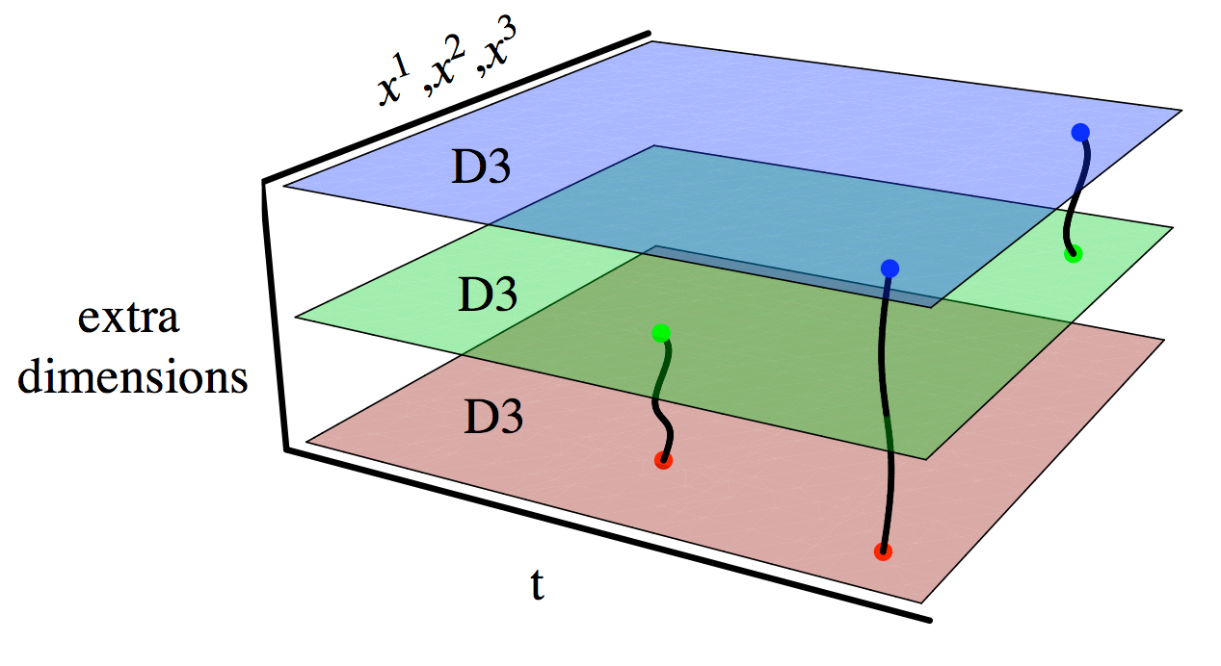
Apply AdS/CFT to HI Phenomenology
Maldacena conjectures exact correspondence: N = 4 SYM ~ IIB ST
  Power: weak/strong connection
    Strongly coupled SYM ⬄ classical gravity
    Strongly coupled (?) QGP ⬄ classical gravity (?)
Notes:
Can use AdS/CFT to study strongly coupled string theory via weakly coupled QFT _or_ strongly coupled QFT using weakly coupled string theory. Conjecture isn’t proven => seek experimental/phenomenological evidence for it. There is a dictionary of results mapping quantities in one theory into the other.

Slide 4
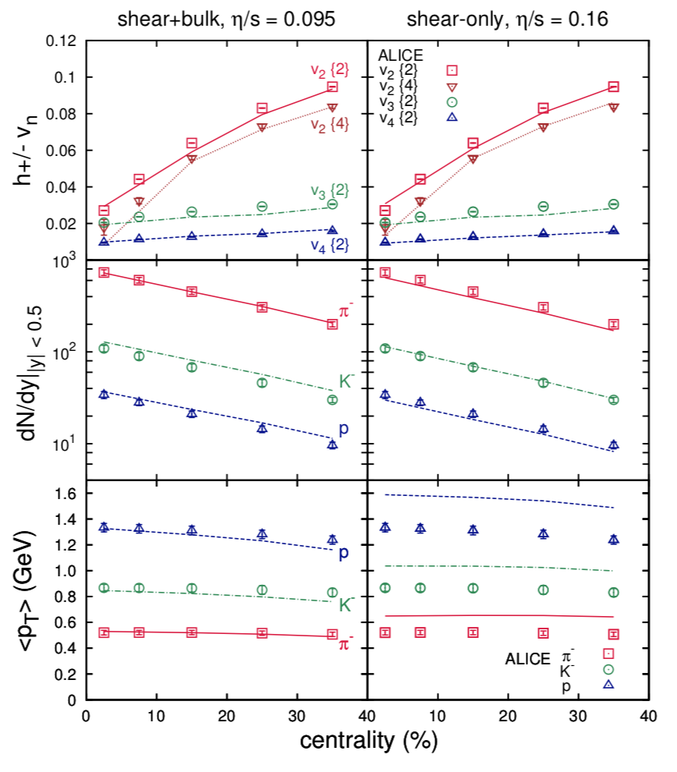
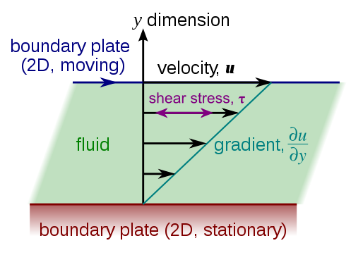
AdS Successes I: η/s
Naive pQCD:
  η/s ~ 1
Naive AdS/CFT:
  η/s ~ 1/4π
Shear Viscosity, Wikipedia
Ryu et al., Phys.Rev. C97 (2018)

Slide 5
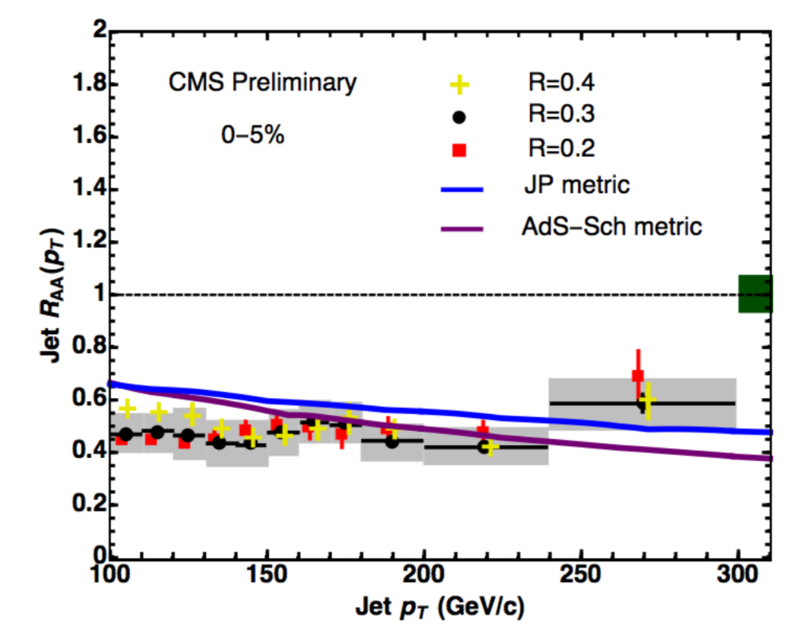
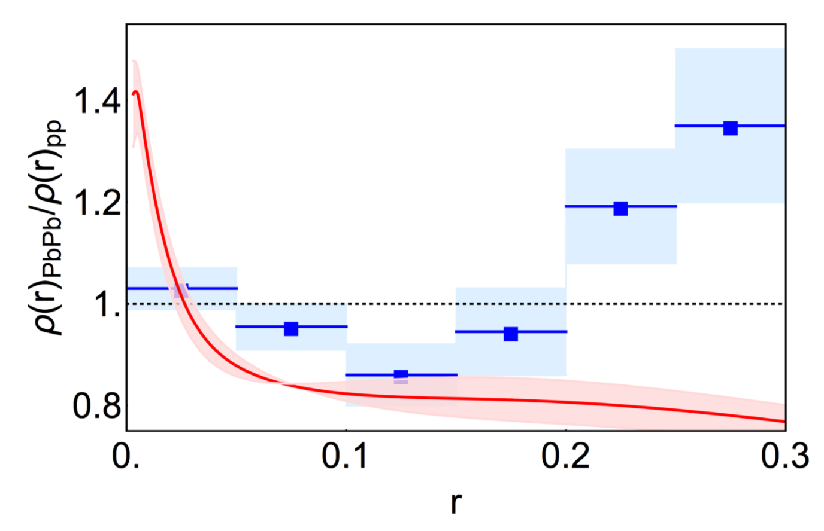
AdS Successes II: Jets and Jet Shapes
Morad and WAH, JHEP 1411 (2014) 017
Brewer et al., JHEP 1802 (2018) 015
Evolution of string profile => jet suppression and evolution of light flavor jet shapes

Slide 6
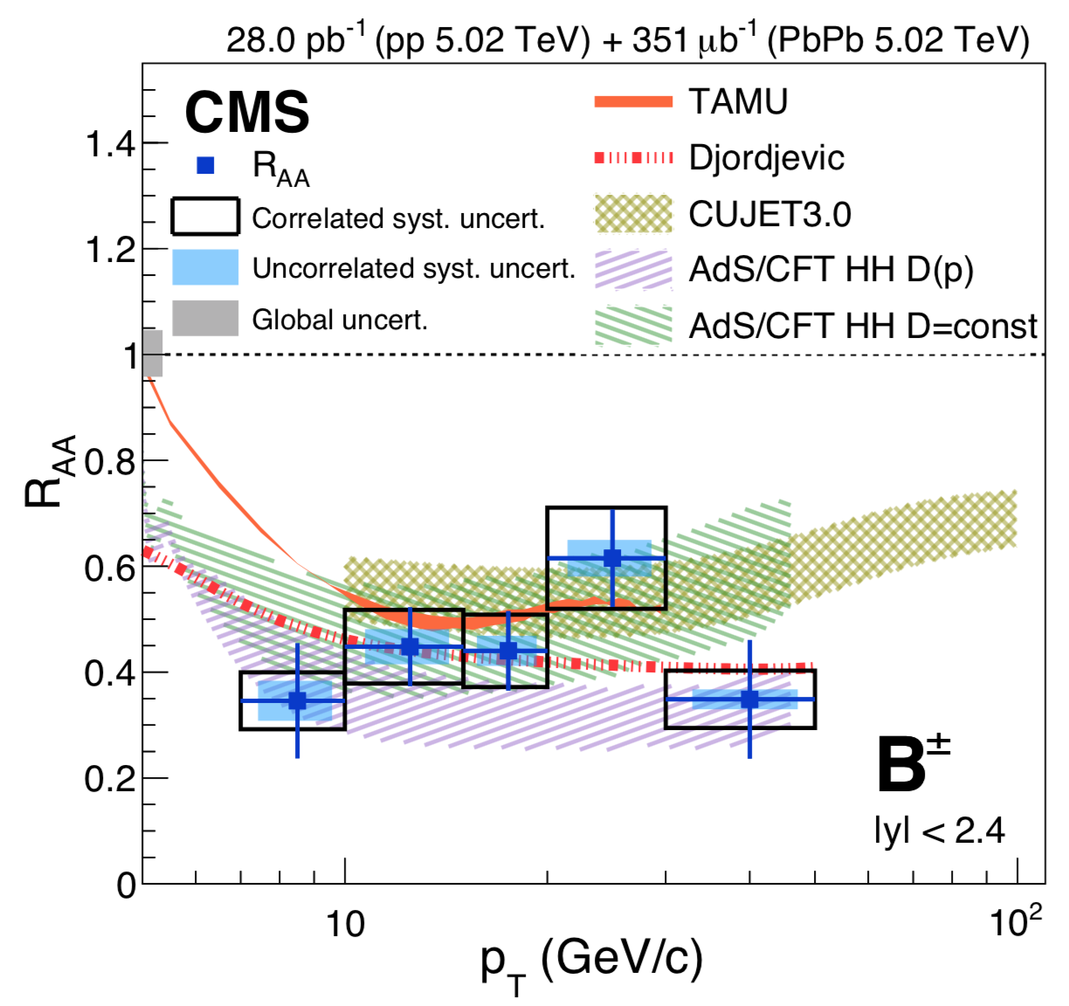
AdS Successes III: Open Heavy Flavor
WAH, PRD91 (2015) 085019
CMS, PRL119 (2017)
Inclusion of fluctuations yields results qualitatively similar to D and B suppression
  See also talk by R Hambrock, 3pm Tuesday (Parallel 4)

Slide 7
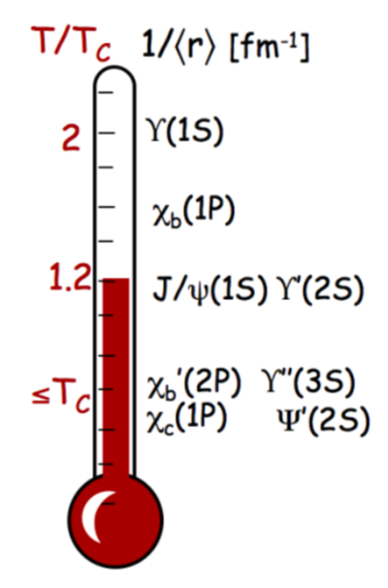
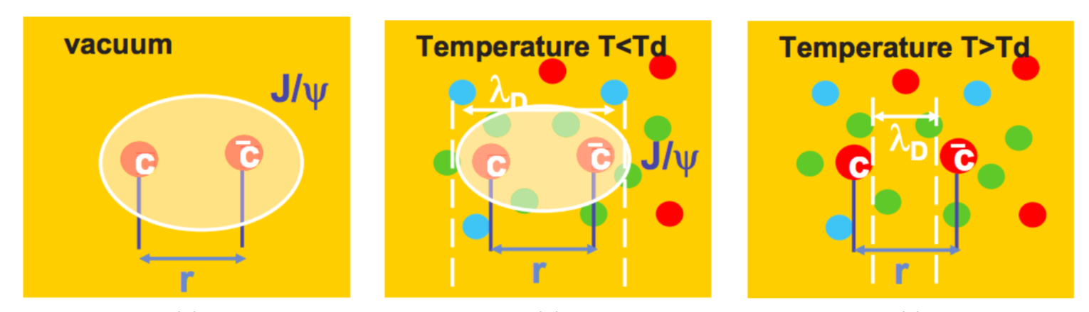
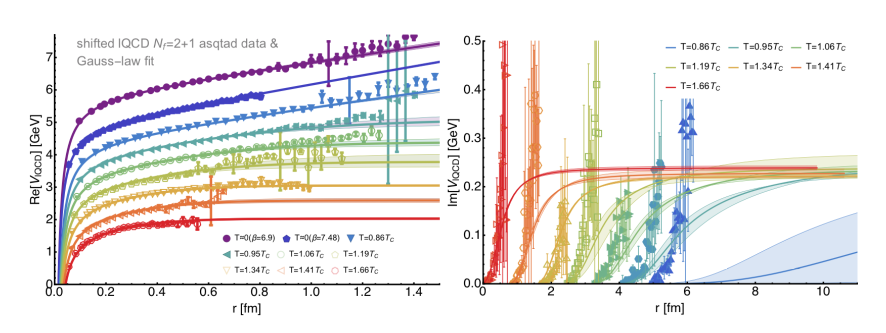
What about Quarkonia?
Another probe of QGP physics:
A Mocsy, EPJC61 (2009)
R Arnaldi, EPJ Web Conf. 7, 02004 (2010)
Krouppa, Rothkopf, Strickland, PRD97 (2018)

Slide 8
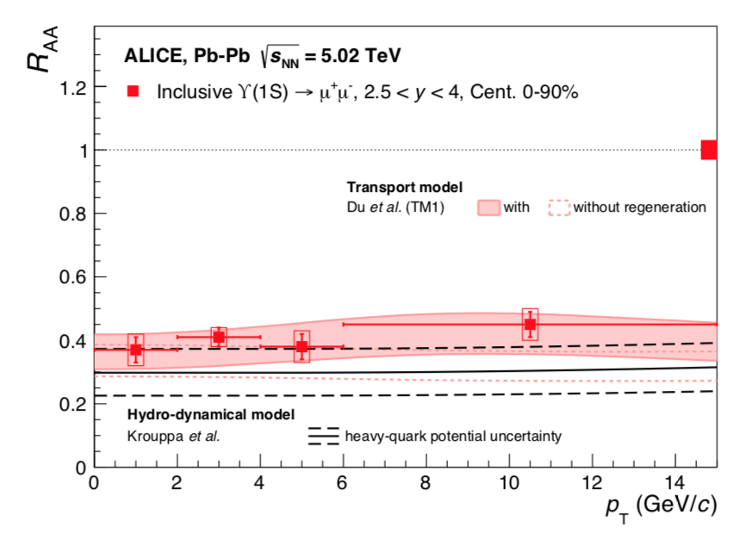
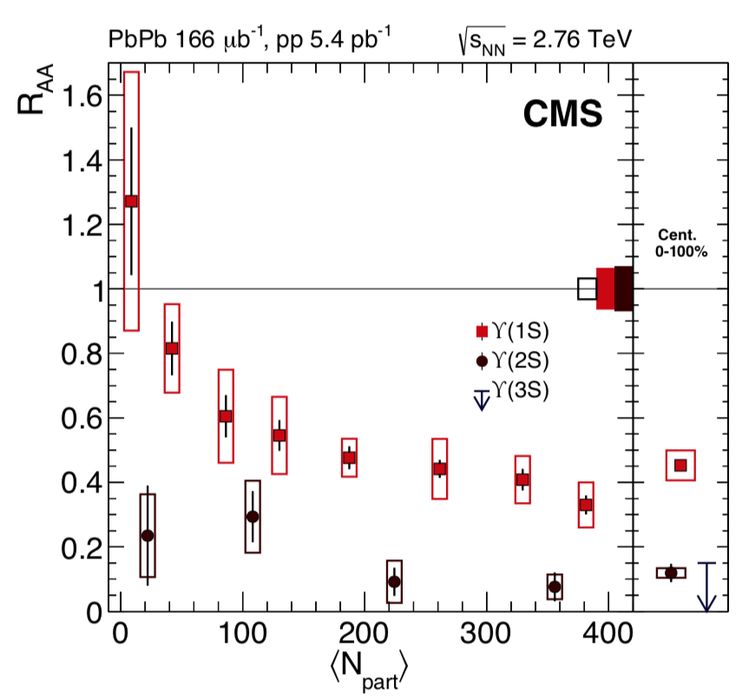
Data are Available
ALICE, arXiv:1805.04387
CMS, PLB770 (2017)
How do predictions from AdS/CFT compare?

Slide 9

From AdS to Data
Follow Krouppa, Ryblewski, Strickland PRC92 (2015):
  QGP dynamics => Heavy quark potential V(r)
  V(r) => E_{bind}
  R_{AA} ~ < exp[-L Im(E_{bind})] >_{geometry}
Exciting because potential (!) to see hot wind screening: L_{AdS} ~ (1-v²)^{1/4}
  Liu, Rajagopal, Wiedemann,
  PRL98 (2007)
Nadia Barnard

Slide 10
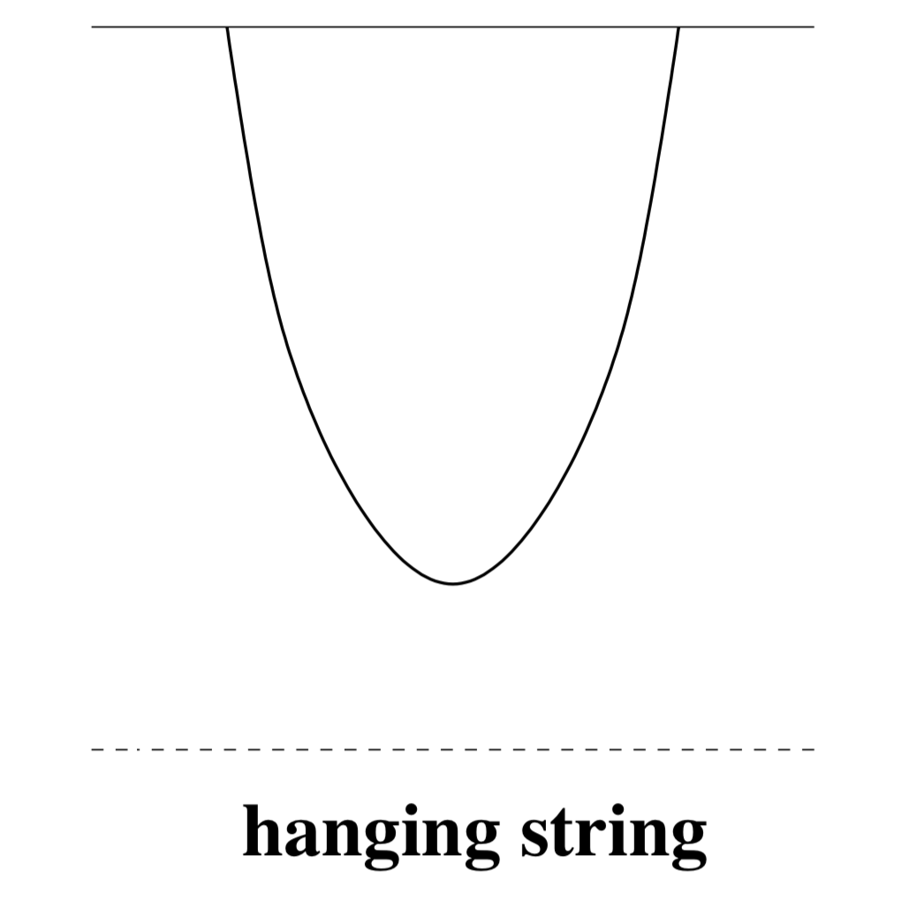

AdS HQ Potential
r
t
$$\overset{⃑}{x}$$
4D
Minkowski
z: 5th dimension
String worldsheet
Black hole horizon ⬄
Hawking temperature T
𝛿S_{NG} = 0 => EOM => worldsheet shape
Worldsheet shape => E(r) => V(r)

Slide 11
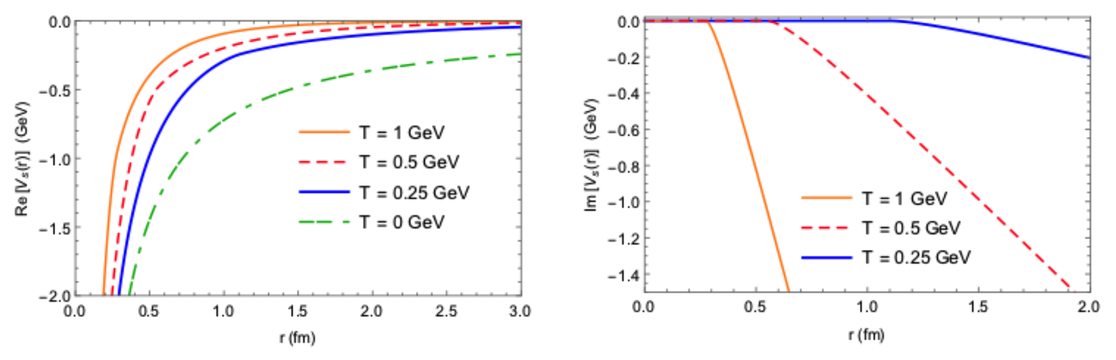
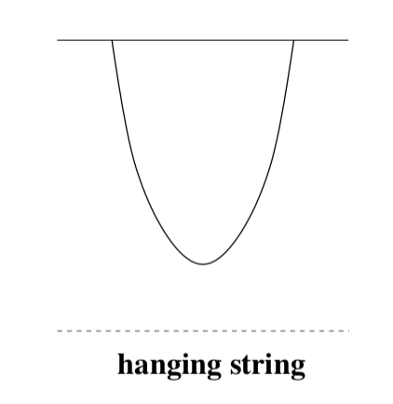
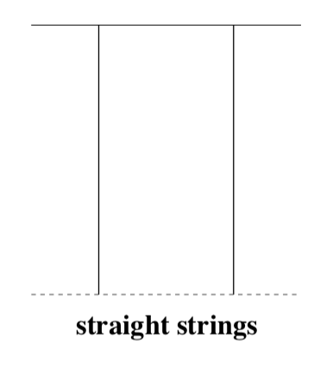

Static AdS QQbar V(r) for $Υ$
Following Albacete, Kovchegov, and Taliotis, PRD78 (2008):
Coulomb-like 1/r
Energetically favorable
configuration:
1/N_{c}² suppressed
string breaking
N. N. Barnard and WAH, arXiv:1706.09217

Slide 12
Comparison to pQCD: Real Part
AdS: Albacete et al., PRB78 (2008)
pQCD: HTL from Margotta et al., PRD83 (2011)
N N Barnard and WAH, arXiv:1706.09217
Very similar shapes
  NB: constant vertical offset irrelevant for E_{bind}

Slide 13
Comparison to pQCD: Im Part
AdS: Albacete et al., PRB78 (2008)
pQCD: HTL from Margotta et al., PRD83 (2011)
N N Barnard and WAH, arXiv:1706.09217
AdS Im(V) grows with r
pQCD Im(V) asymptotes with r

Slide 14
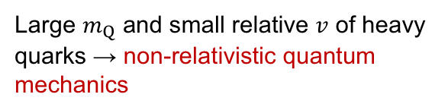
Compute E_{bind}: Find Ground State
NRTDSWE
Large $m_{Q}$ and small relative $v$ of heavy quarks → non-relativistic quantum mechanics
Real time evolution operator of wave function ~
Wick rotation
Imaginary time evolution operator ~
At large τ, only ground state wave function survives

Slide 15
Computing E_{bind}
From ψ₀ to E_{bind}:
  E_{bind} = <ψ₀|H|ψ₀> − Re[V(r = ∞)]
Independent check on E_{bind}:
  Use Complex Ritz Variational Method
    For complex potentials, complex ground state energy E is a stationary state when wavefunction parameters are varied
    cf E is minimum for real V(r) and usual Ritz

Slide 16
Weak Coupling E_{bind}
Compare to Krouppa et al. PRC92 (2015)
  Consistency check on method
Using Krouppa et al. potential V(r), we find
  E_{bind} using Wick method (thick solid)
  E_{bind} using Ritz method (dashed)
  Two methods yield identical results
Cf. Krouppa et al. E_{bind}
(thin solid)
  Modest differences in absolute values, although large relative difference in Im(E_{bind})
N N Barnard and WAH, arXiv:1706.09217

Slide 17
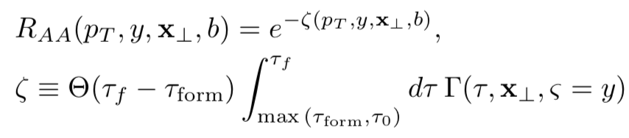
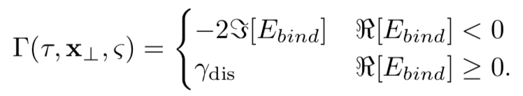
Modelling R_{AA}
Follow Krouppa et al.:
  Relatively naive dN/dp_{T} ~ 1/E⁴
Bjorken expanding optical Glauber medium:
  T ~ (ρ_{part}/τ)^{1/3}
  Cf Krouppa’s aHydro

Slide 18
Weak Coupling R_{AA}
Compare to Krouppa et al. PRC92 (2015)
  Consistency check on geometry model
Blue: our E_{bind} and geometry
Red: KRS E_{bind} and our geometry
  Significantly greater suppression from Im(E_{bind})
Purple: KRS reported R_{AA}
  Suppression significantly reduced using aHydro vs. Glauber
N N Barnard and WAH, arXiv:1706.09217

Slide 19
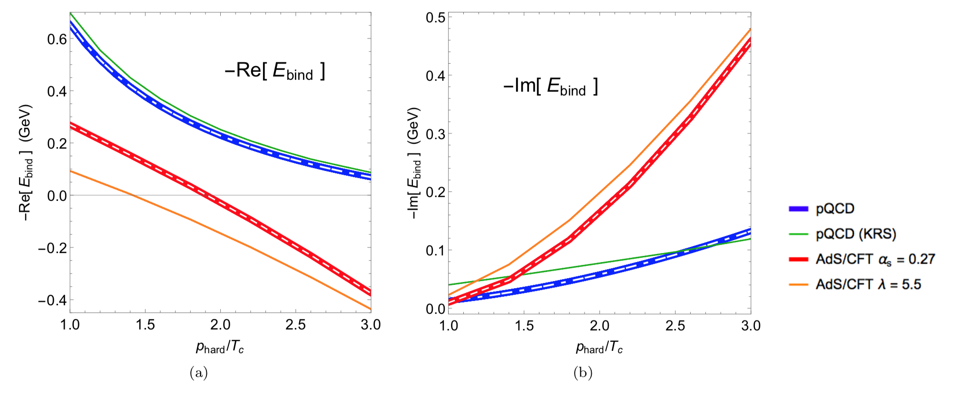
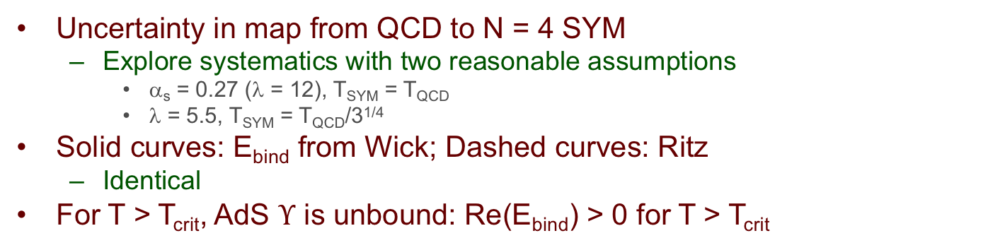
pQCD and AdS Binding Energies
p_{hard} = T
N N Barnard and WAH, arXiv:1706.09217
Uncertainty in map from QCD to N = 4 SYM
  Explore systematics with two reasonable assumptions
    α_{s} = 0.27 (λ = 12), T_{SYM} = T_{QCD}
    λ = 5.5, T_{SYM} = T_{QCD}/3^{1/4}
Solid curves: E_{bind} from Wick; Dashed curves: Ritz
  Identical
For T > T_{crit}, AdS $Υ$ is unbound: Re(E_{bind}) > 0 for T > T_{crit}

Slide 20
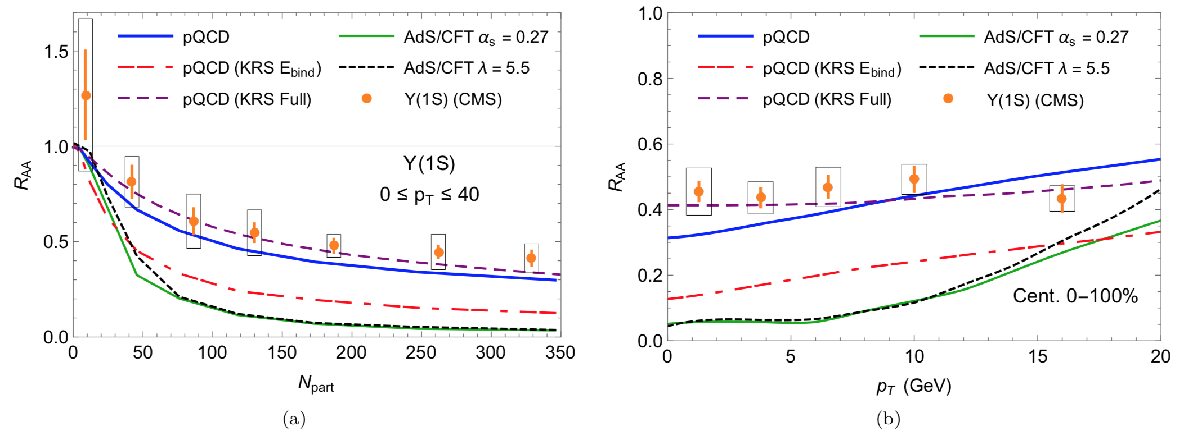
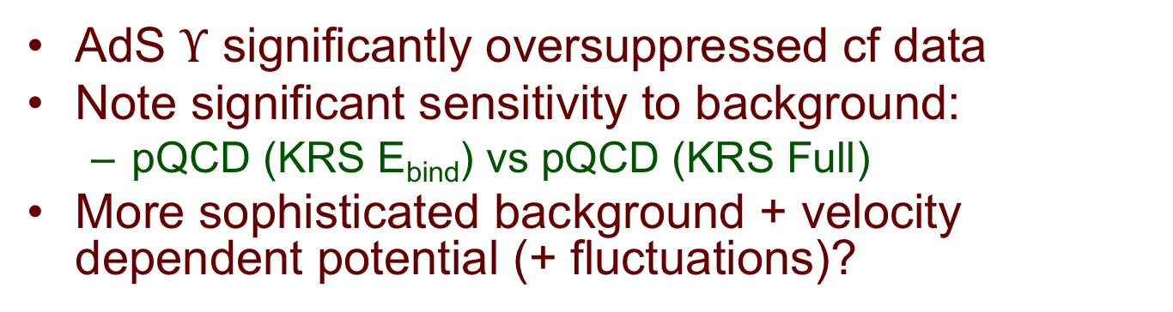
Quarkonia Suppression
N N Barnard and WAH, arXiv:1706.09217
AdS $Υ$ significantly oversuppressed cf data
Note significant sensitivity to background:
  pQCD (KRS E_{bind}) vs pQCD (KRS Full)
More sophisticated background + velocity dependent potential (+ fluctuations)?

Slide 21
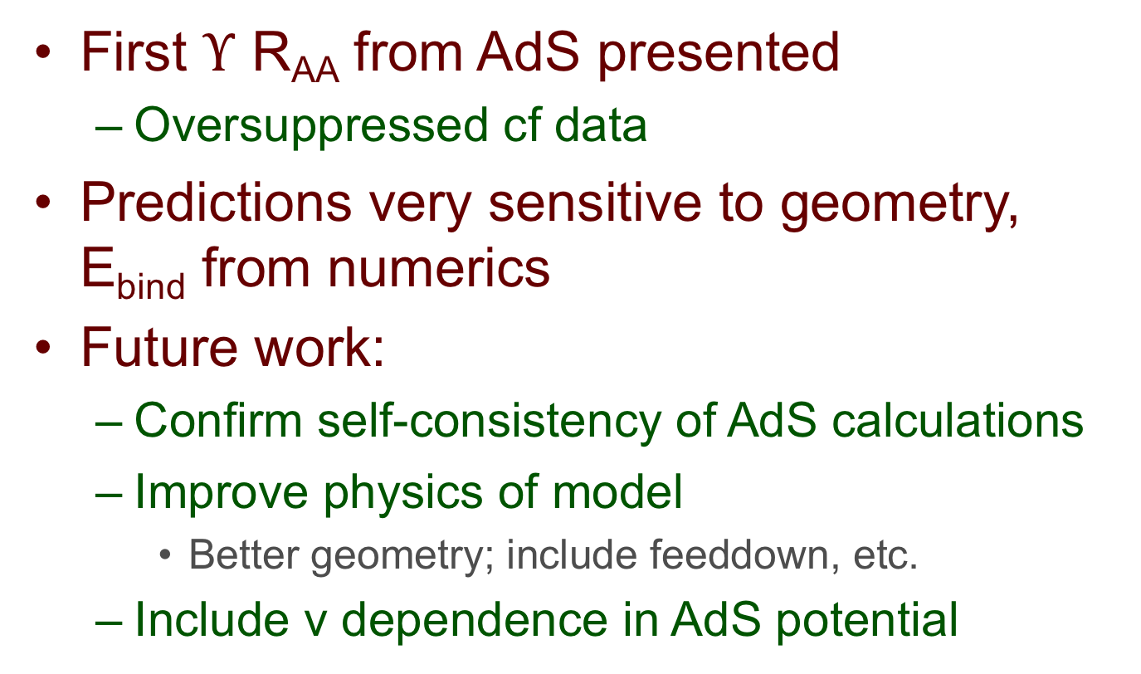
Conclusions
First $Υ$ R_{AA} from AdS presented
  Oversuppressed cf data
Predictions very sensitive to geometry, E_{bind} from numerics
Future work:
  Confirm self-consistency of AdS calculations
  Improve physics of model
    Better geometry; include feeddown, etc.
  Include v dependence in AdS potential

Slide 22
Bonus Material

Slide 23
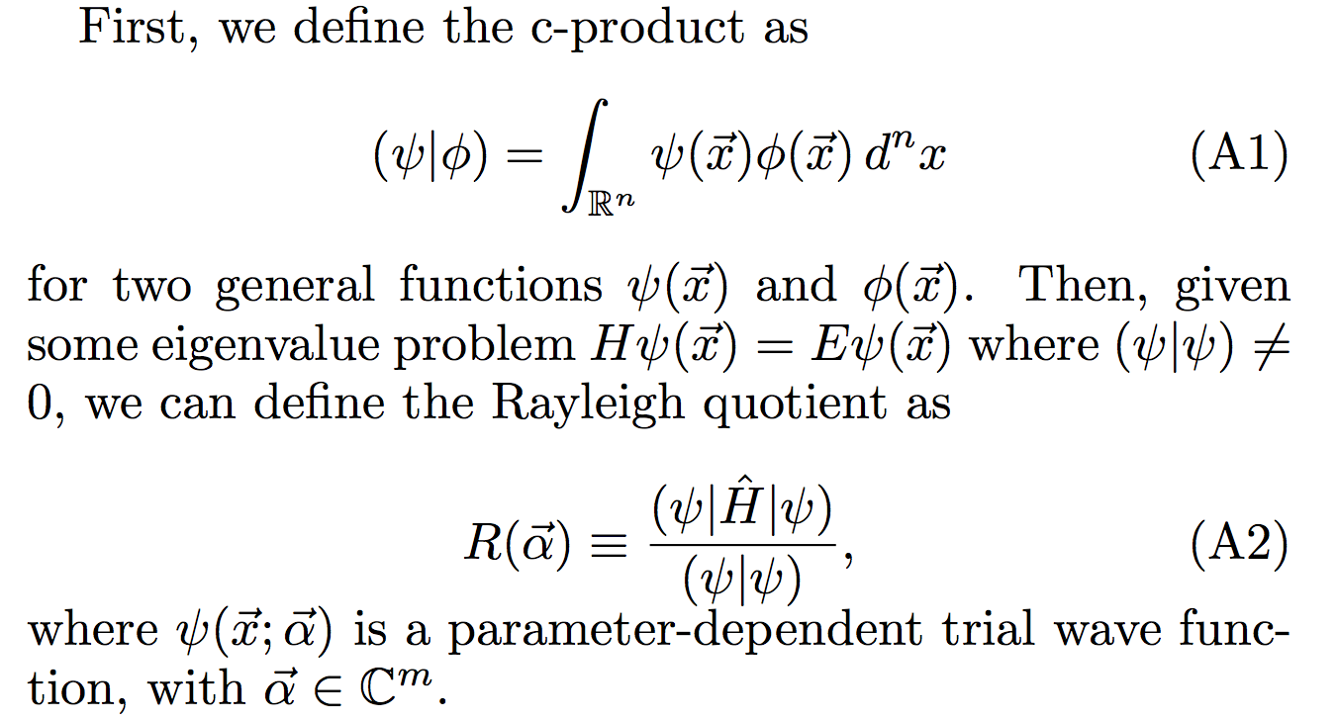
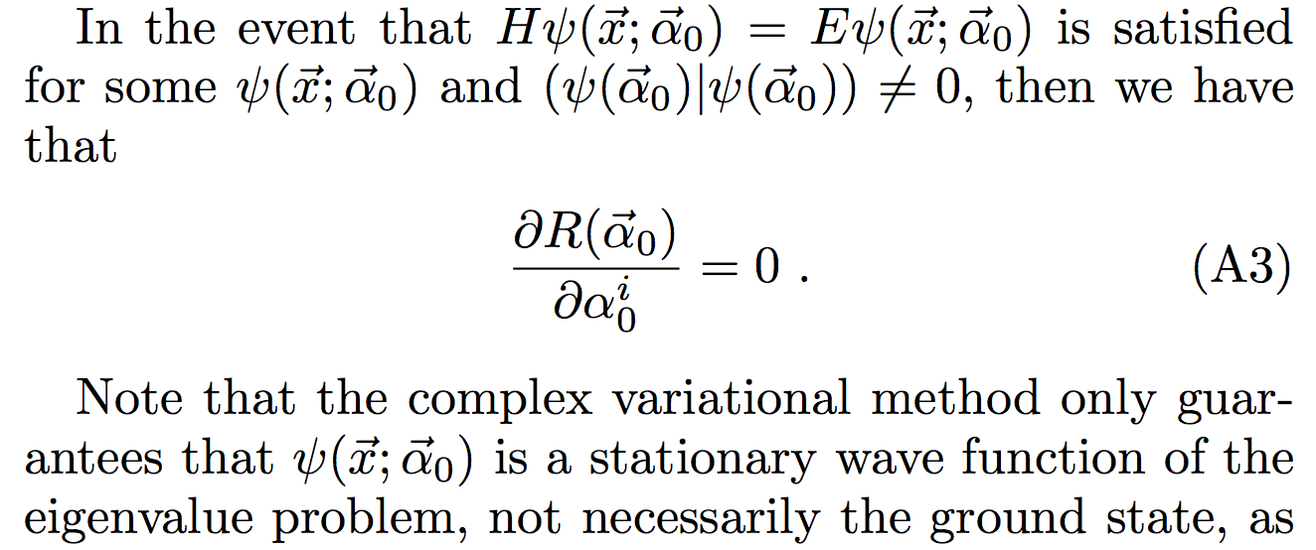
Complex Ritz Variational Method
c-product:
Given eigenvalue problem
where
Rayleigh quotient:
where
a parameter-dependent trial wave function with
If
for
given
then

Slide 24
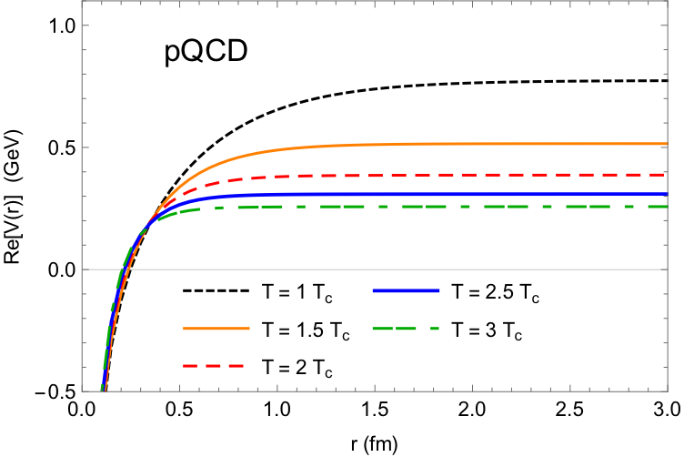
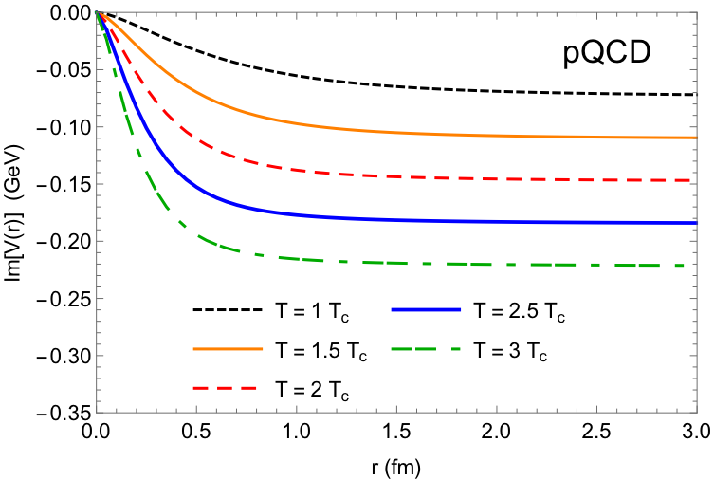
Weakly Coupled Potential from pQCD
where
B. Krouppa et al., Phys. Rev. C92, 061901 (2015)
N N Barnard and WAH, arXiv:1706.09217
Notes:
Here we have the weakly coupled potential from pQCD used in Strickland. The potential is complex-valued, with both the real and imaginary part stemming from leading-order perturbative calculations. The real part was found from a Fourier transform of the gluon propagator in the real time formalism, and the imaginary part from that of the symmetric propagator in the imaginary time formalism.

Slide 25
Strongly Coupled Potential from AdS
where
,
,
and is found using
J. L. Albacete et al., Phys. Rev. D78, 115007 (2008)
Solid root chosen over complex conjugate to ensure Im[V_{s}] < 0 → probability of state < 1

Slide 26
Consistent AdS E_{bind}?
Kruczenski, Mateos, Myers, Winters JHEP 0307 (2003)
  E_{bind} from classical fluctuations on D branes
Consistency between
  non-relativistic quantum mechanics (NRQM) approach and
  large J, classically non-relativistic region of Myers et al.
    NRQM self-consistent E_{bind} small correction to rest mass, v << 1 for all J
Myers et al. breaks down for J too small

Slide 27
Why AdS at High-p_{T}?
Perturbatively, 3 couplings for rad E-loss
  Not known at which scale(s) couplings run
T_{QGP} ~ Λ_{QCD} => g(2πT) ~ 2
  Always “small” scale in problem
  Perhaps low-Q² plasma physics dominates over high-Q² in E-loss physics?
    Factorization not proven in AA
Work here assumes all couplings strong
  Cf, e.g., Casalderrey-Solana et al. [JHEP 1410 19], Iancu et al. [JHEP 1506 3] for alternative hybrid models

Slide 28
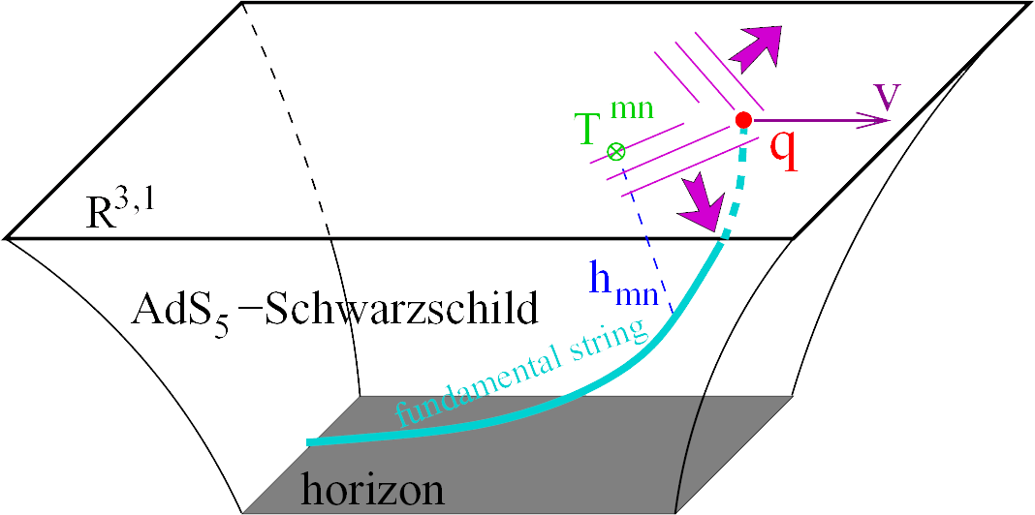
LO AdS for Heavy Quark E-Loss
Result is a drag:
  dp_{T}/dt = - μ p_{T}
  μ = πλ^{1/2} T²/2M_{q}
Herzog et al., JHEP 0607 (2006)
Gubser, PRD74 (2006)
  Similar to Bethe-Heitler
    dp_{T}/dt ~ -(T³/M_{q}²) p_{T}
  Very different from usual pQCD and LPM
    dp_{T}/dt ~ -LT³ log(p_{T}/M_{q})
J Friess, et al., PRD75 (2007)

Slide 29
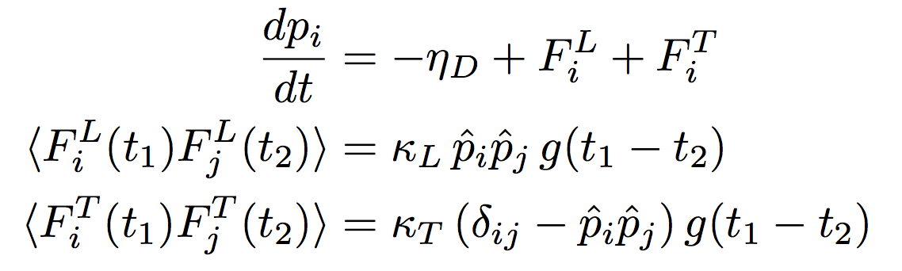
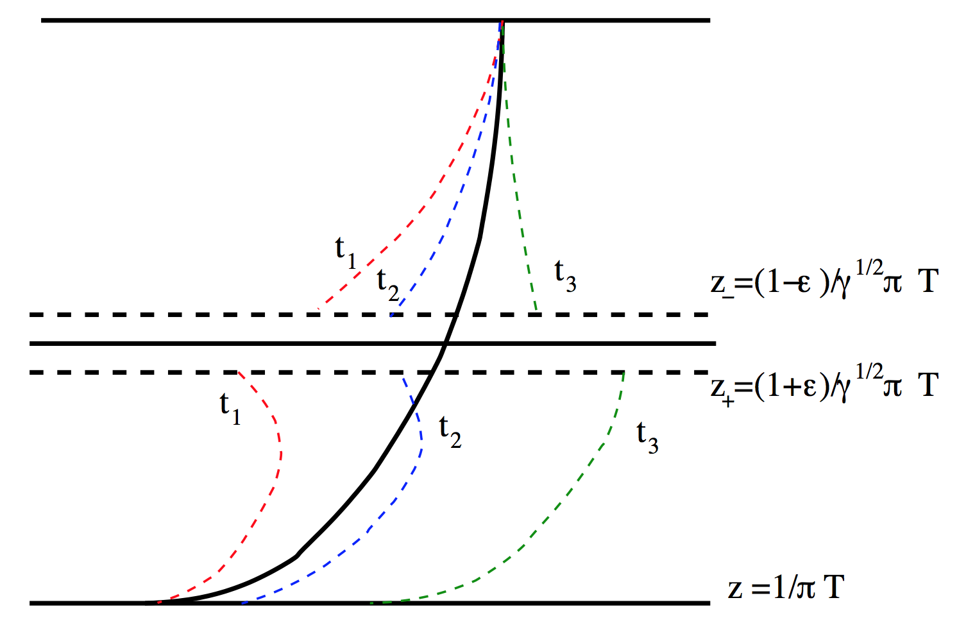
Including Fluctuations in AdS HF
Gubser, NPB790 (2008)
Obeys Einstein’s relations only at v = 0
Multiplicative Langevin problem!
  Results depend on time within timestep kicks are evaluated
    Ito, Stratonovich, Hänggi-Klimontovich
Non-Markovian:
  Colored (not white) noise
    Momentum kicks have a memory
Teaney and Casalderrey-Solana,
JHEP 0912 (2009) 066

Slide 30
Compare to RHIC HF Electrons
WAH, PRD91 (2015) 085019
Agreement in sweet spot p_{T} ~ 3 – 4 GeV/c
  Below 3 GeV production unreliable
  Above 4 GeV theory corrections necessary (col. noise, non-const p)
NB: VISHNU medium hotter than from previous calc => larger LO supp.

Slide 31
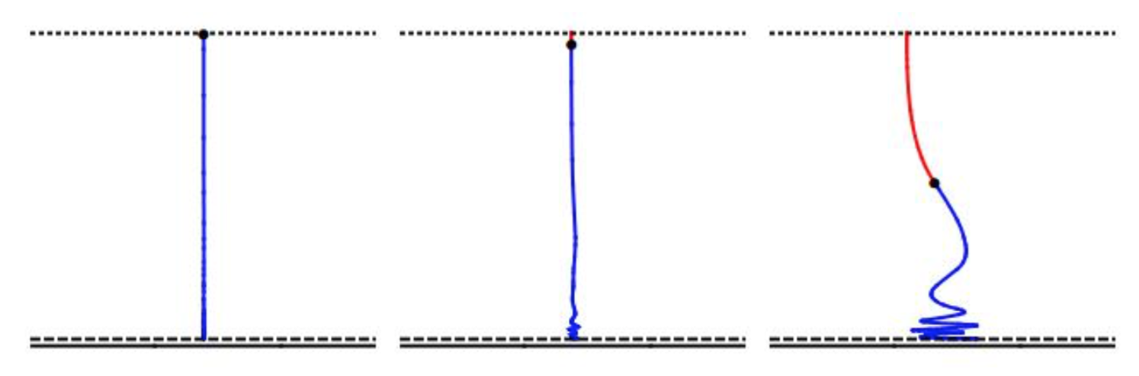
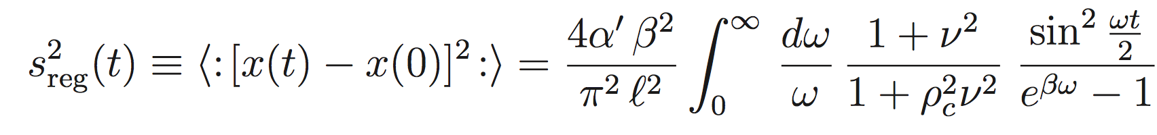
Extending Fluctuating E-Loss to Lights
Extremely difficult problem
  Solve simpler initial v = 0 in AdS₃
    Compute mean distance squared travelled by the endpoint as it falls
  Performed in the semi-classical approx by de Boer et al. for a heavy quark:

Slide 32
Outline of Solution:
Derive classical solution
Quantize perp dir’s of motion given classical sol’n
Populate quanta according to Bose statistics (semi-classical approx.)
Compute correlators
  For details, see arXiv:1605.09285

Slide 33
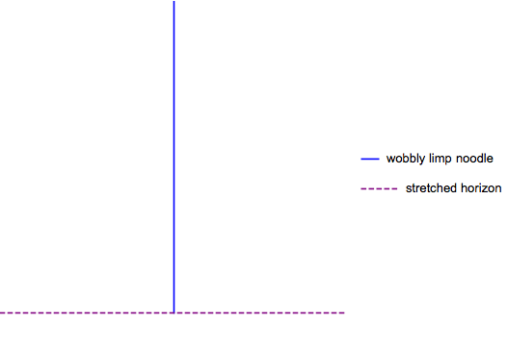
Non-equilibrium Thermodynamics
Extend to massless sol’n:

Slide 34
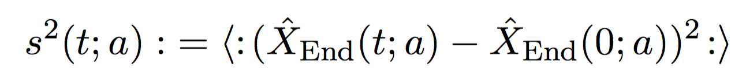
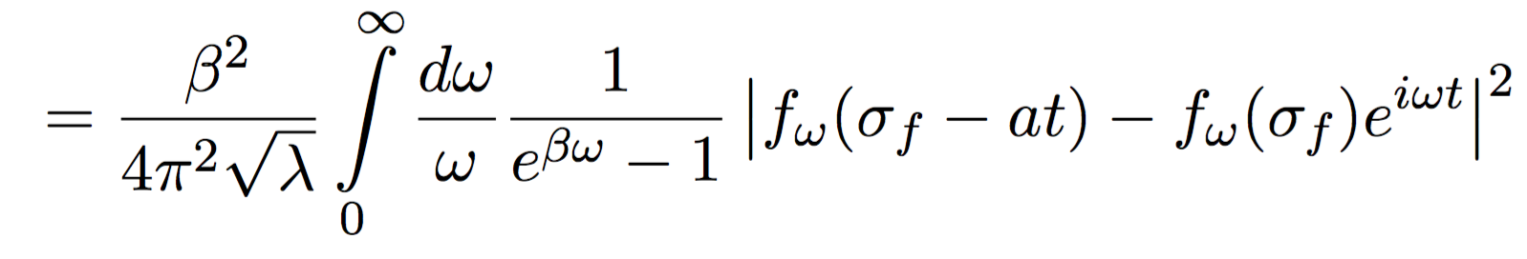
Analytic Brownian Motion
Average distance squared travelled as a fcn of time t
  a is the speed at which the endpoint falls
    Allows interpolation btwn known HQ and new light quark results
    Will also allow for qhat(t)

Slide 35
Explicit Evaluation in Various Limits
Small virtuality
  Initial string length small compared to size of BH
    l₀ << r_{H}
Arbitrary virtuality
  Early times t << β
    Ballistic regime
  Late times t >> β
    Diffusive regime

Slide 36
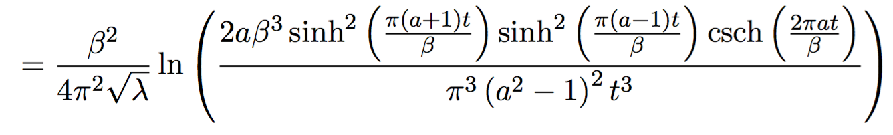
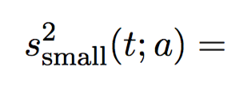
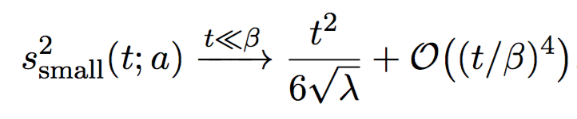
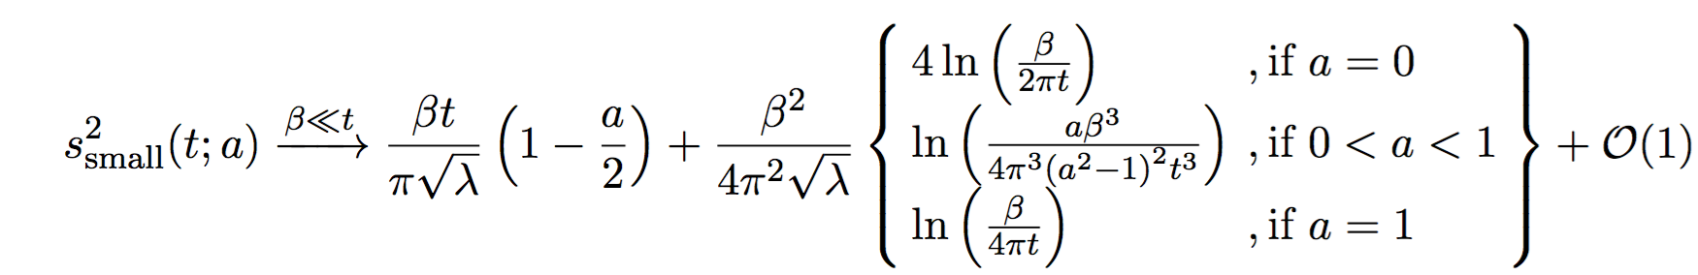
Small Virtuality Limit
Complicated, but analytic
Examine:
  Early times:
    Characteristic of ballistic behavior: s ~ t
  Late times:
    Characteristic of diffusive/Brownian motion: s ~ t^{1/2}

Slide 37
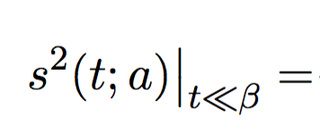
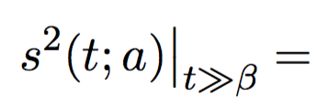
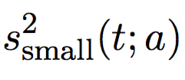
Arbitrary Virtuality Result
Early times:
  Ballistic dynamics at early times for all virtualities
Late times:
  Critical result: late time dynamics independent of initial string length and solely determined by dynamics near the horizon

Slide 38
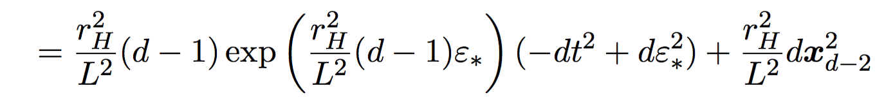

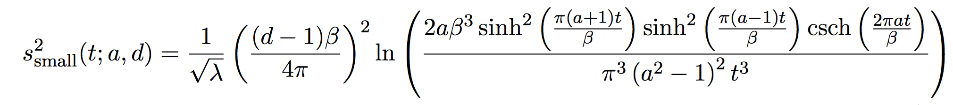
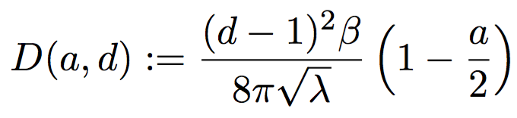
Small Virtuality Result in d Dims
Examine the metric, sol’n near BH horizon
=>
At late times t >> β, s² = 2 D(a,d) t, with

Slide 39
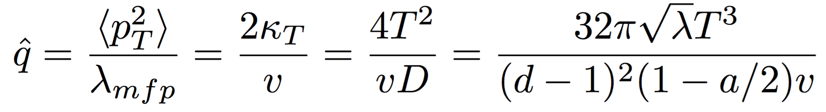
Relate D(a,d) to qhat(t)
qhat is the average transverse momentum squared transferred from the plasma to the probe per unit distance travelled
  Important transport coefficient
    In pQCD, related to radiative energy loss of hard parton, ΔE ~ α_{s} qhat L²
  Can relate qhat to the diffusion coefficient:
Time dependence in a(t) and v(t)
  Rate that endpoint falls in “5th” dimension

Slide 40
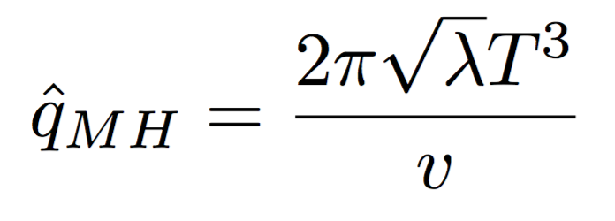
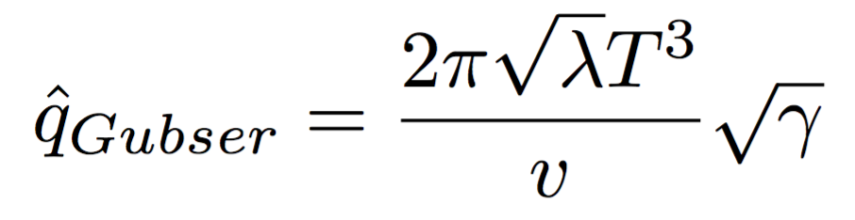
Heavy Quark qhat
For heavy quarks a = 0
  MH result behaves sensibly as v => 1
  No speed limit
<= This work
<= Gubser, NPB790 (2008)

Slide 41

Relate D(a,d = 5) to qhat(t)
We have numerical solutions for leading order falling strings in AdS₅
  Our numerical sol’n gives us the rate at which the endpoint is falling, the a in the previous!!
Minkowski Boundary
Snapshots of string evolution
5th Dimension
BH Horizon
Morad and WAH,
JHEP 1411 (2014) 017 [1409.7545]

Slide 42


How Fast Does the Endpoint Fall?
Note:
  rapid thermalization, t ~ 1 – 2 fm
  interesting scaling a(t = 0) ~ 1 – 2^{-4Q^2}

Slide 43


t Dependent qhat
qhat(t = 0) ~ 3 – 10 GeV²/fm, then increases
  T = 350 MeV
qhat(t=>∞) => ∞ trivially as v => 0

