Slide 1



Continuing Education on Radiation
G. Bourban, Deputy Director, Swiss Space Center
09.05.2017

Slide 2
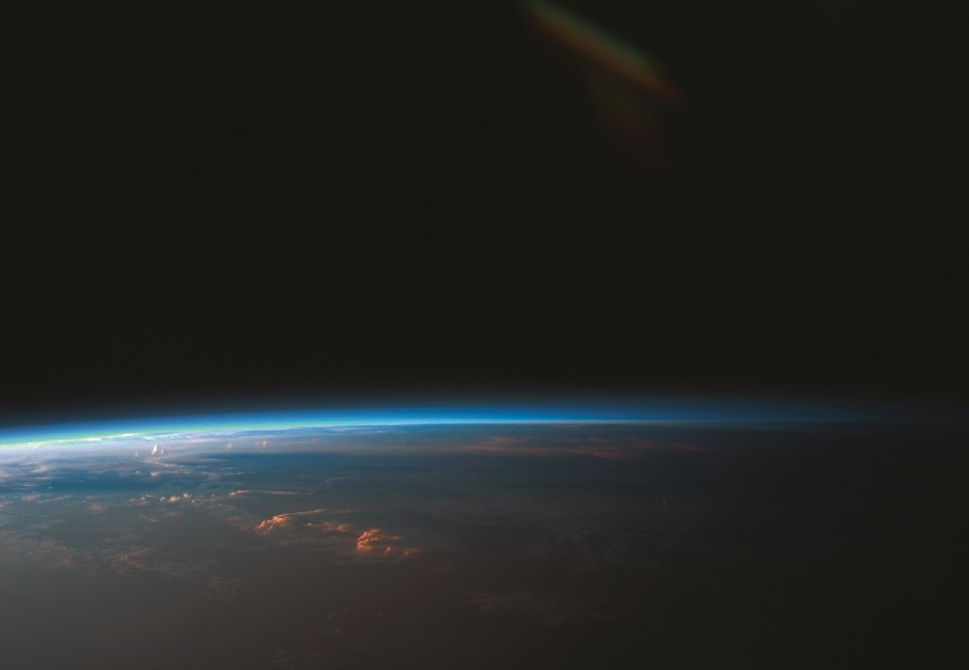

“The Swiss Space Center shall support institutions, academia and industry to access space missions and related applications and promote interaction between these stakeholders”

Slide 3
Roles and Responsibilities
Swiss Space Office
  prepares and implements the Swiss Space Policy (SSP)
  represents Switzerland in the ESA Council and its subordinate bodies
  implements the complementary national activities
  coordinates space activities at Federal level
Swiss Space Center supports SSO in implementing the SSP by
  networking Swiss actors at national and international level
  facilitating access to space projects for established actors and for newcomers
  providing education and training
  promoting public awareness of space

Slide 4
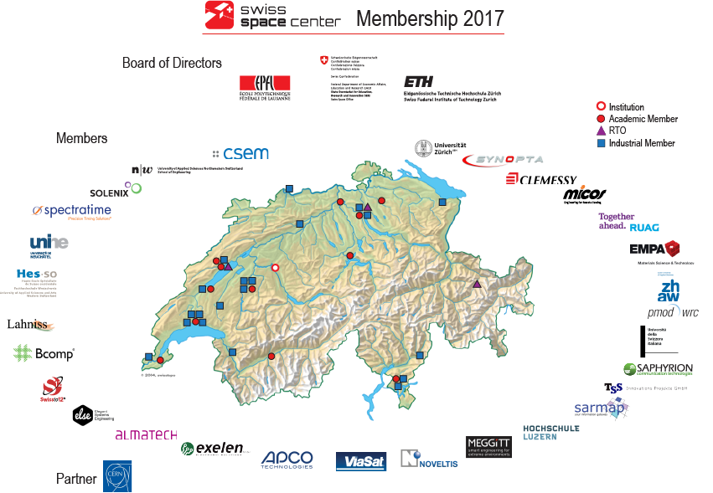

Geographical distribution

Slide 5
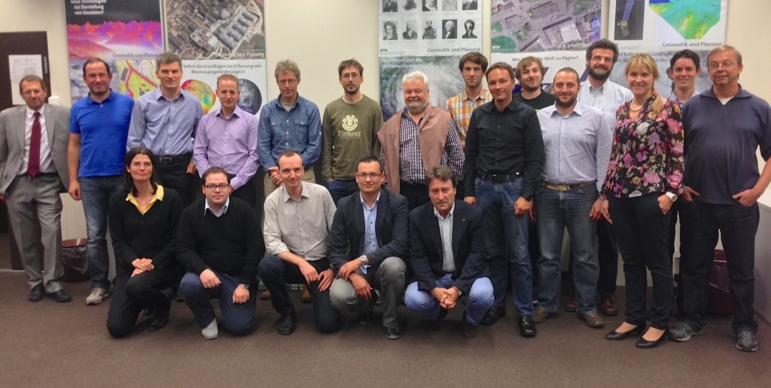
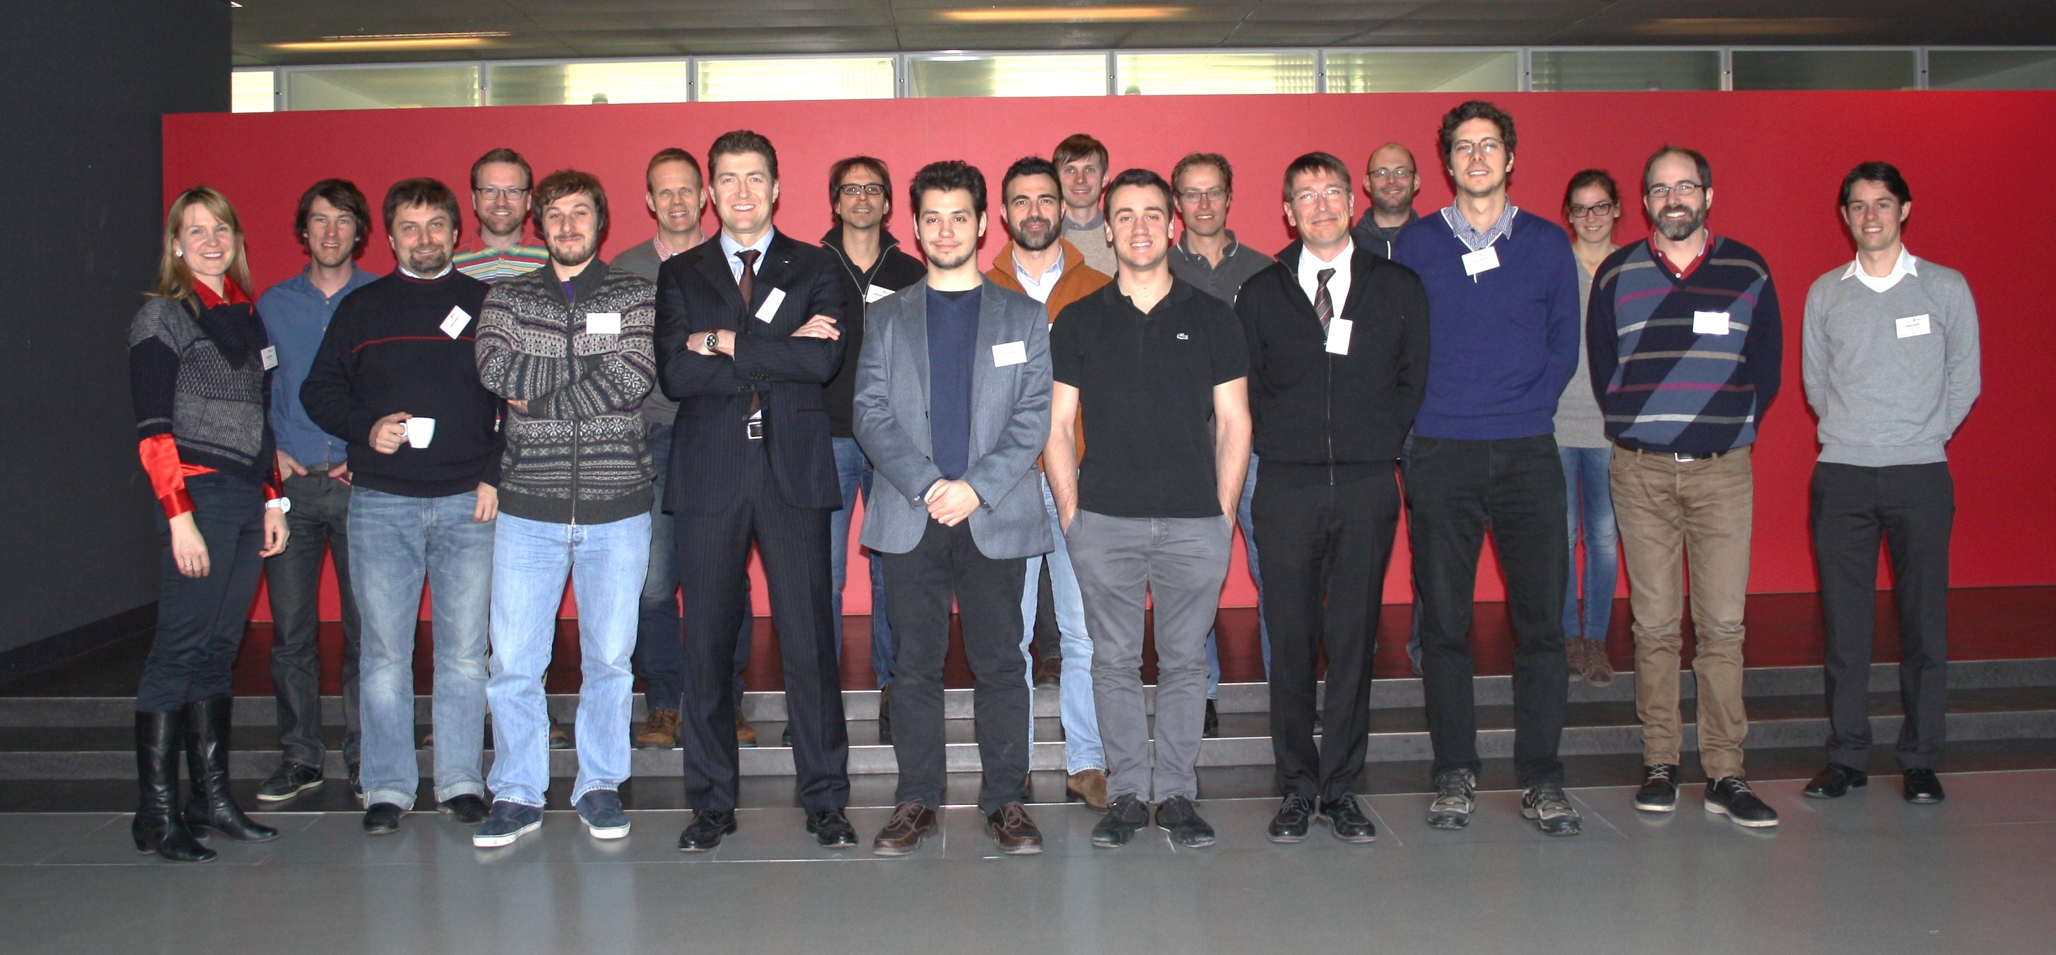
Continuing Education
Numbers of courses organized in 2015 / 2016:
ESA Space Segment Software through ECSS and SAVOIR (09.2016)
By Jean-Loup Terraillon, ESA
Reliability for Space (02.2016)
with CSEM, by L. Marchand and T. Ghidini, ESA
Model-driven Systems Engineering (09.2015)
by Dr. Laurent Balmelli, COO AND CO-FOUNDER of the Sana Elias Group
The Role of Failure Investigation in the Space Systems Safety (02.2015)
by T. Ghidini, Head TEC-QTM, ESA

Slide 6
Program for today
10h00-10h15 Welcome and Introduction (SSC, CERN Knowledge Transfer)
10h15 -12h15 Basic definitions/Space environment (Hugh Evans, ESA)
12h15 – 13h30 Lunch Break
13h30 - 15h30 SEE effect, mechanism and testing (Cesar Boatella Polo, ESA)
15h30 – 16h00 Coffee Break
16h00 – 17h30 TNID effects, mechanism and testing (Christian Poivey, ESA)
19h00 Gala dinner at CERN

Slide 7
Program for tomorrow
8h30 – 10h00 TID effect, mechanisms and testing (Marc Poizat, ESA)
10h00 – 10h30 Coffee Break
10h30 – 12h00 Radiation Hardness Assurance of space systems
(Christian Poivey, ESA)
12h00 – 13h00 Lunch break
13h00 – 14h00 COTS Components at CERN (Raffaello Secondo, CERN)
14h00 – 15h30 CERN radiation facilities tour
15h30 End of the workshop

Slide 8
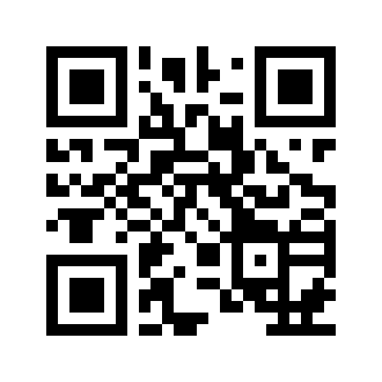


Contact
EPFL
PPH 338, Station 13
CH-1015 Lausanne
ETH Zürich
c/o Institute of Geodesy and Photogrammetry, HIL C 61.3
Stefano-Franscini-Platz 5
CH-8093 Zürich
http://space.epfl.ch
www.space.ethz.ch

