Slide 2
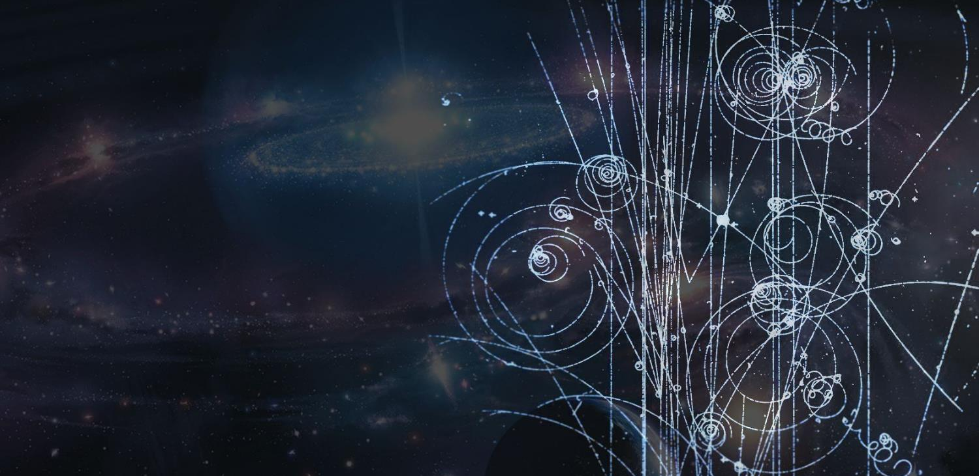
CERN
Introduction
Enrico Chesta
CERN IPT/KT

Slide 3
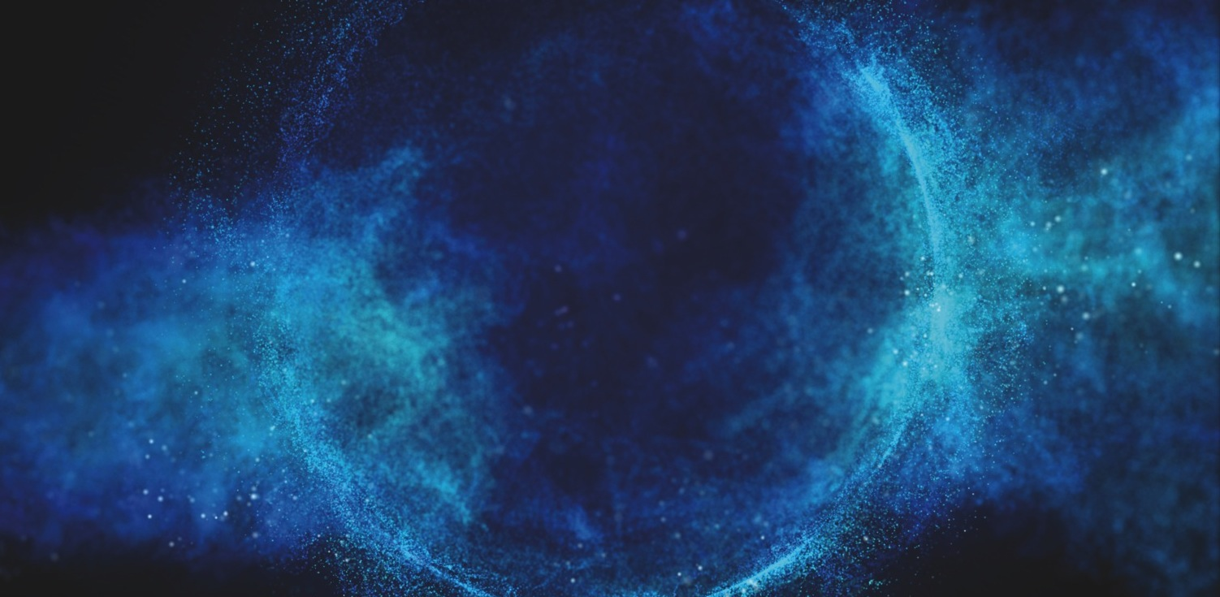
CERN
What is it ?

Slide 4
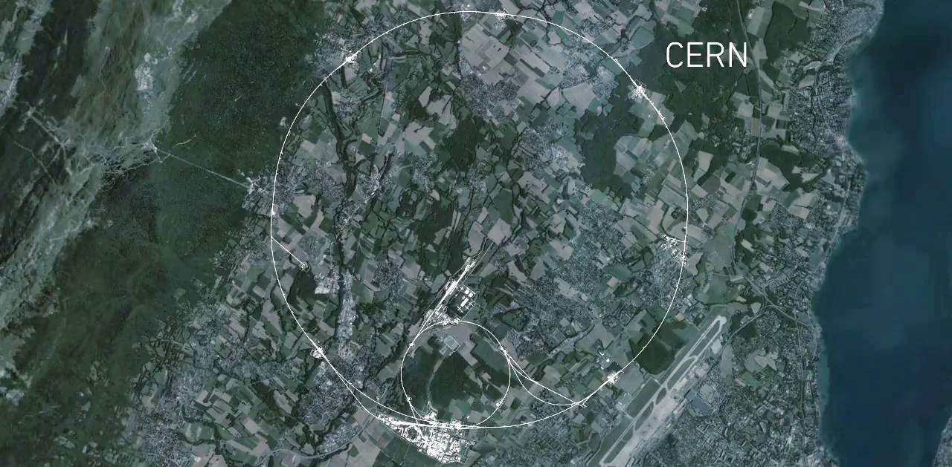
CMS
Largest
machine
on Earth
ALICE
ATLAS
LHCb
Notes:
This is a map of the complex of main accelerators of CERN.
The dotted line is the French-Swiss border.
The 2 main CERN sites are Meyrin and Prévessin (as big, but not as built nor populated)
The PS is the tiny 600m ring on the Meyrin site, the SPS goes accross the border and the LHC takes all the space between Geneva airport and the Jura (dark green on the left).
The 4 red dots represent where the 4 detectors are located.

Slide 5
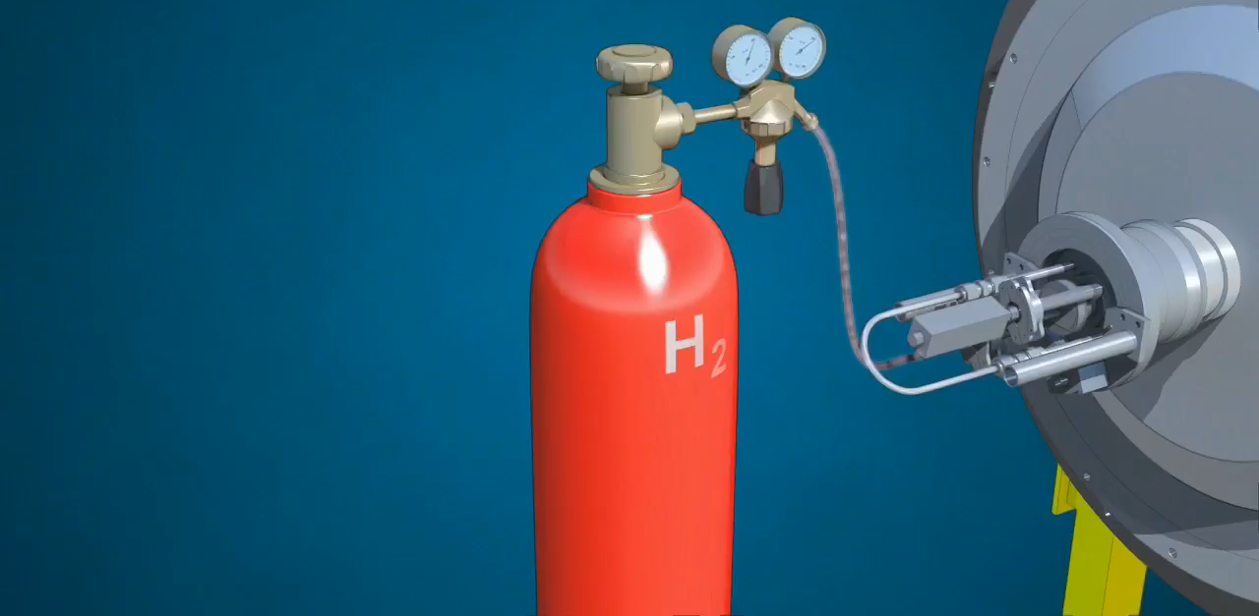
Notes:
But how do we produce protons and grant them the energy of a flying mosquito?
First we start with a bottle of hydrogen gas.
Hydrogen is quite close to what we want. It’s made of protons. With one electron orbitting around.
We send hydrogen gas through an electric field. Proton which has a positive charge goes through. Electron whic has negative charges bounces back and it removed. We are then left only with protons.
They are sent through the LINAC (LINear Accelerator) which uses alternating electric fields to either attract or push the protons. It is so efficient that after only 45m they have been accelerated to a 1/3 of the speed of light, that is 100’000 km per second. Needless to say that continuing in straight lines will be impractical.
We then send the protons to the Booster which will prepare bunches of protons in 4 superposed rings.
They are then sent in the PS (Proton Synchrotron). This machine is 600m circumference, was built in 1959 and is still in use! In 1.2 seconds it accelerate protons to 99% of the speed of light. Very efficient. But cannot go faster. We then need to transfer protons to the «2nd gear of our accelerator complex».
The SPS (Super Proton Synchrotron) build in 1976 and of 7km curcumference. In 3 seconds, it accelerate particle to 99.9% of the speed of light. Once again cannot go faster.
Then half of the particles are sent clockwise and half anti-clockwise into the LHC (Large Hadron Collider). This machine is the largest machine on Earth: 27 km circumference. It will take about 20 minutes to reach our maximum velocity: 99.9999991% of the speed of light which correspond to 7 TeV energy.

Slide 6

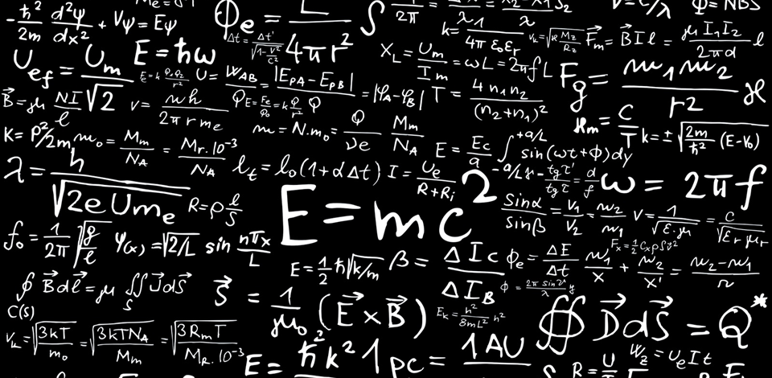
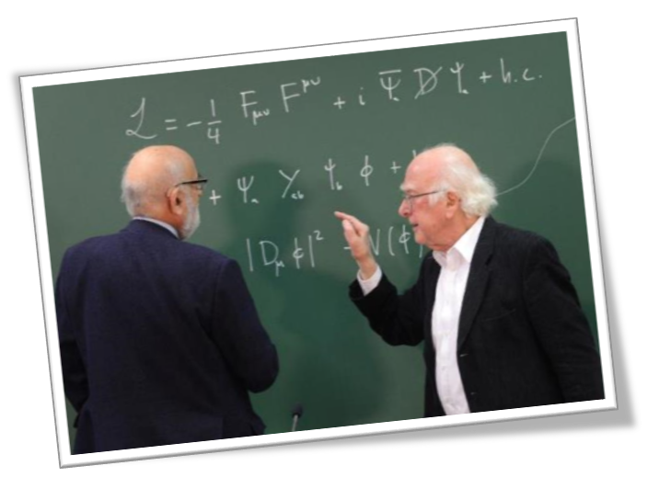
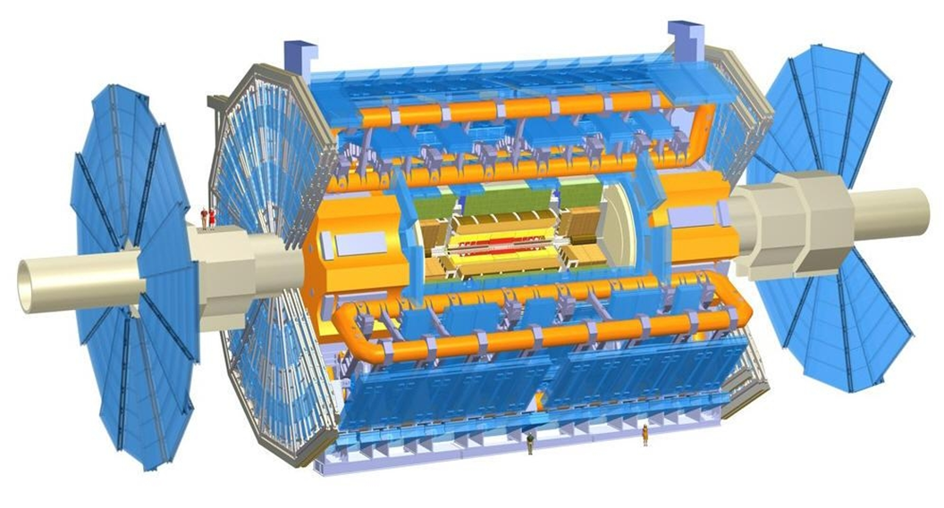
Reference particle physics lab

Slide 7
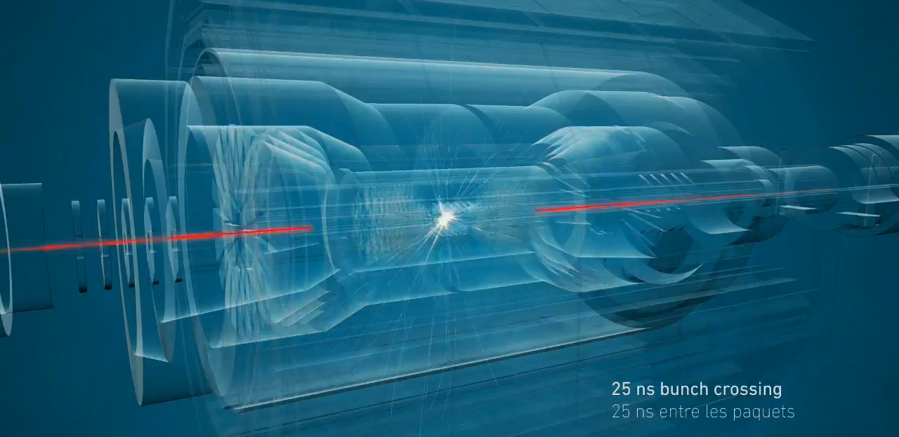
Notes:
The 2 beams are circulating in separate pipes and in 4 places we cross the 2 pipes over so that collision occur there and only there.
We have built particle detectors which will observe and record the traces of new particles created in the collision.
There are so many protons and they go so fast that around 600 million collisions will occur every SECOND in each of the 4 detectors.
These detectors are a bit like huge digital cameras of about 100 Megapixel resolution. Guess the size of the SD card to store the LHC’s pictures?

Slide 8
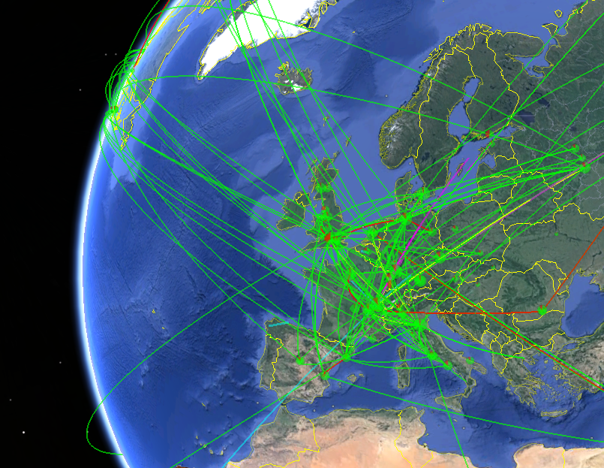
Biggest
computing
grid
Notes:
All these detectors will generate loads of data… about 1 PB (petabyte = million of gigabyte per… SECOND!)
Impossible to store so much data. Anyway not needed.
The event the experiments are trying to create and observe are very rare.
That’s why we make so many collisions but we keep only the interesting ones.
Therefore next to each detector is a «trigger», a kind of filter made of various layers (first electronic, then computers) which will select and keep only 1 collision out of a million average.
In the end will still generate dozens of Petabytes of data each year. We need about 200’000 computer CPUs to analyze this data.
As CERN has only about 100’000 CPUS we share the date over more than 100 computer centre over the planet (usually located in the physics institutes participating to the LHC collaboration). This is the Computing Grid, a gigantic planetary computer and hard drive!

Slide 9
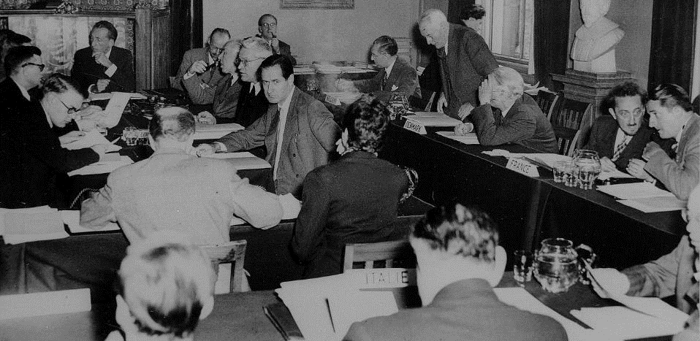

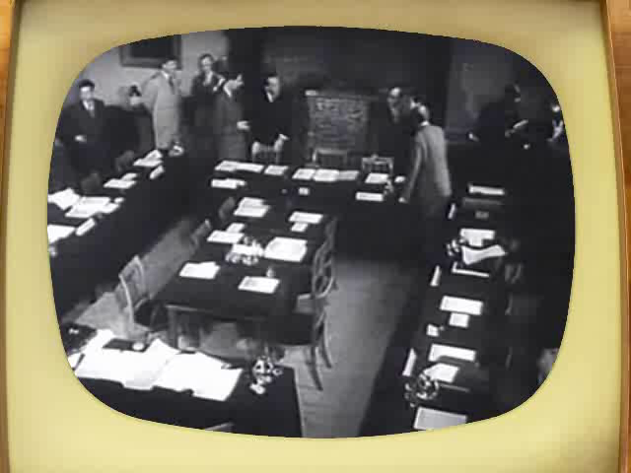


Oldest European scientific joint venture
1952

Slide 10

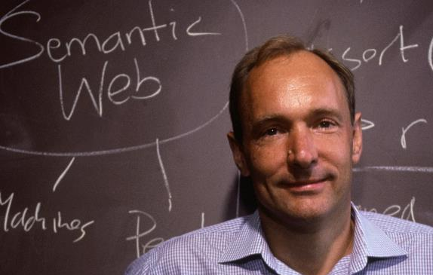
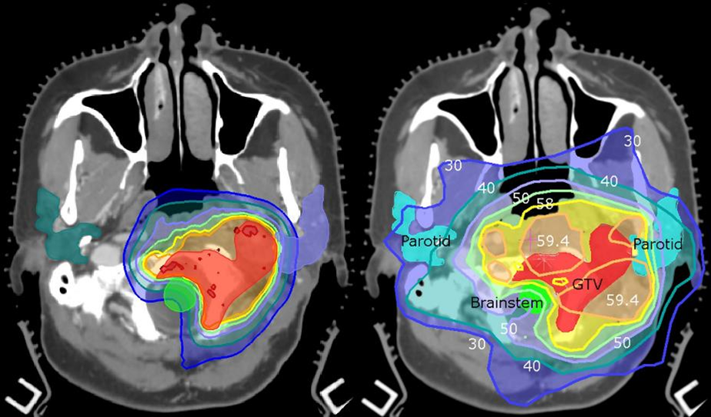
A very high impact source of innovation

Slide 11
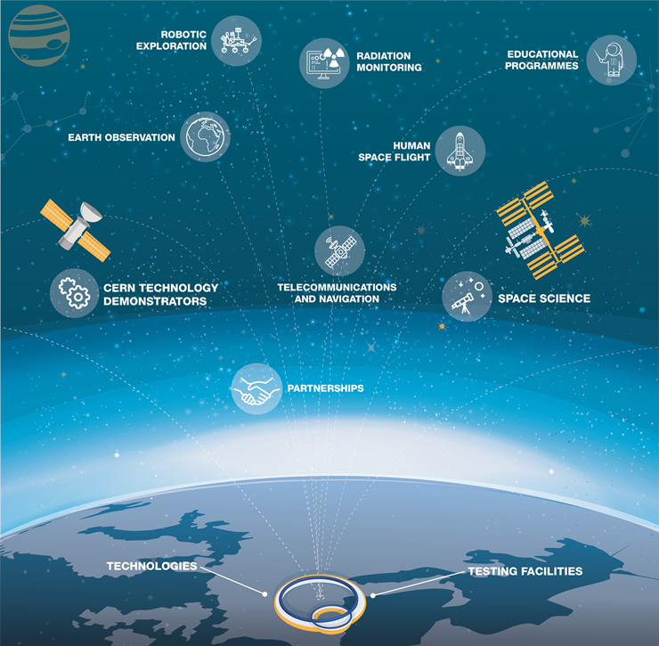
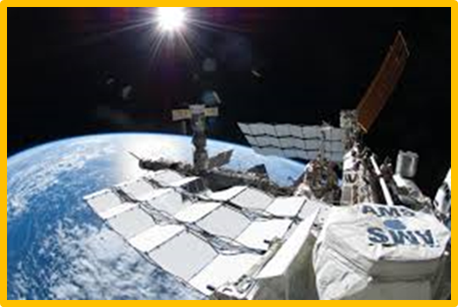
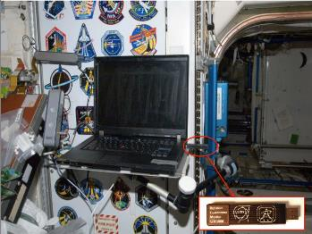
Aerospace applications
www.cern.ch/kt/aerospace

Slide 12


Slide 13
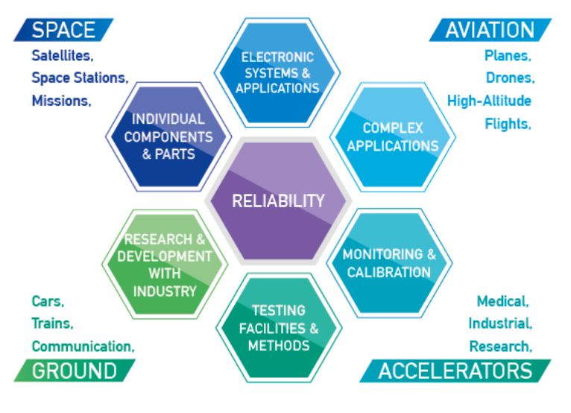



Slide 14
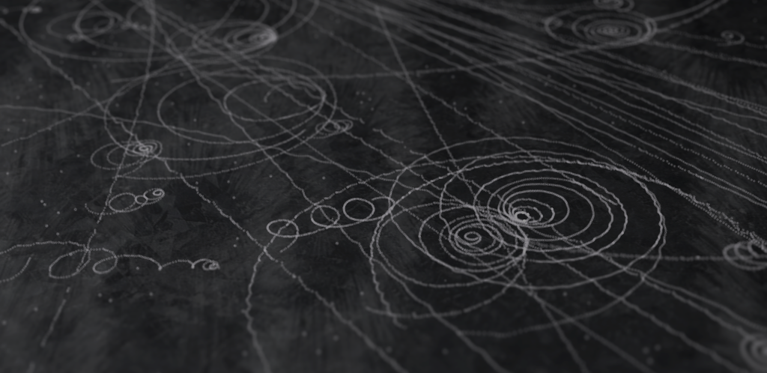
Meeting agenda https://indico.cern.ch/event/635099/

Slide 15
Logistics
30-7-018
Kjell Johnsen Auditorium
Restaurant 2
Restaurant 1
503-1-001
Council Chamber
CERN Hostel
https://maps.cern.ch/

