Slide 1
The PSI CCT Program
B. Auchmann (CERN/PSI), L. Brouwer (LBNL), S. Caspi (LBNL), J. Gao (PSI), G. Montenero (PSI),
M. Negrazus (PSI), G. Rolando (CERN), S. Sanfilippo (PSI)
26.06.2017, CD1 Conceptual Design Review

Slide 2
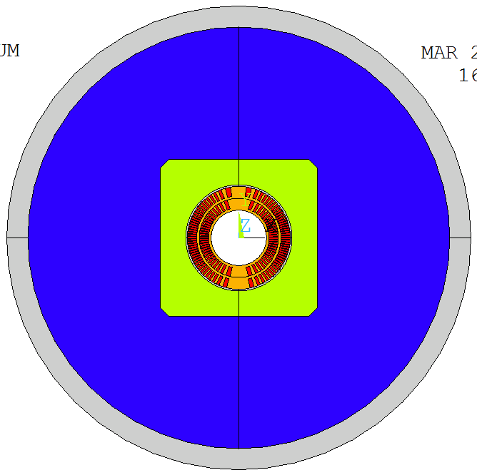
Overview
Review Charge
CCT for FCC
The PSI CCT Model Program

Slide 3
Overview
Review Charge
CCT for FCC
The PSI CCT Model Program

Slide 4
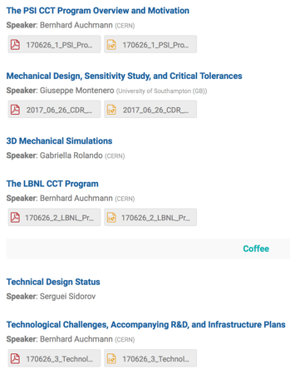
Review Charge
The goal of this review is to evaluate the current design of a first PSI-produced technology model dipole, identify technical risks, and provide feedback on technical issues and possible mitigation strategies. Note that this is the first step in the PSI program. A fabrication-readiness review is foreseen for the end of the year / beginning of 2018. The questions to the review committee are as follows:
Is the PSI program well motivated in view of the FCC design requirements?
  Is the staged approach with two different sets of coils, CD1 and CD2, in a shared mechanical structure appropriate?
  Is it reasonable for PSI, at this time, to move ahead with ordering conductor for CD2, given that conductor delivery times are ~1.5 years?
Is the mechanical design of the shared structure in CD1 and CD2 configuration sound, i.e. have risks been identified and addressed in a reasonable manner?
Is the electromagnetic and electro-thermal modelling sufficiently detailed to start the technical design and, eventually, the procurement of parts, or is there additional analysis that should be performed?
Have major technical risks been appropriately identified and are the foreseen tests adequate to address them?
Are the PSI infrastructure goals and plans realistic and appropriate from a technical perspective?
http://indico.cern.ch/e/cd1cdr
1
1,2
2
4
3
3,4,5

Slide 5
Overview
Review Charge
CCT for FCC
The PSI CCT Model Program

Slide 6
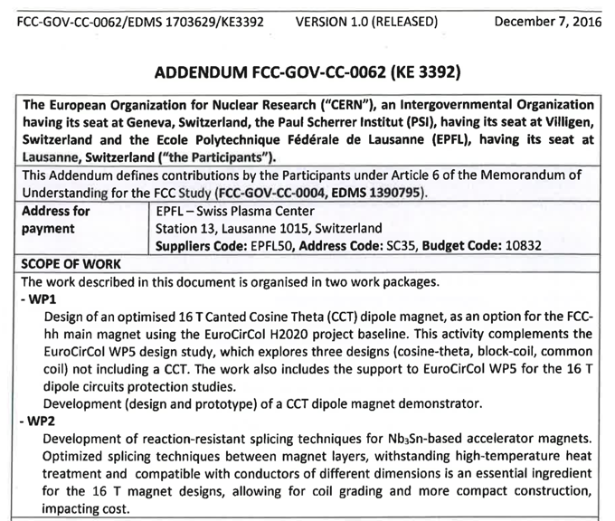

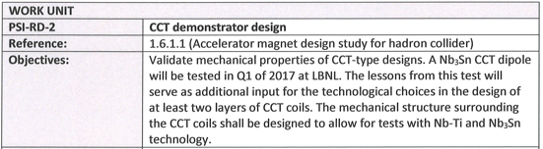
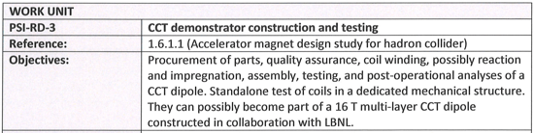

CERN-PSI(-EPFL) Agreement

Slide 7
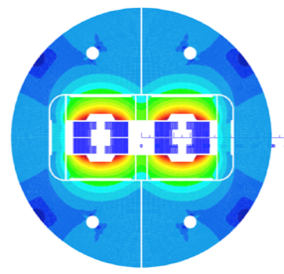
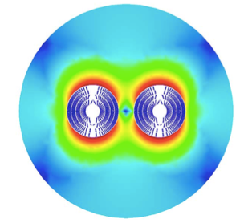


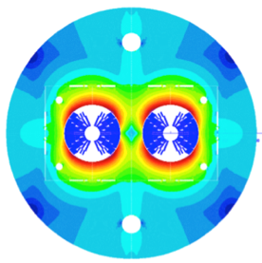
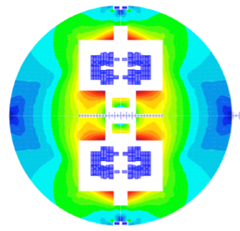


Preliminary Designs
Block coil
Canted Cosine Theta
Cos-theta
Common coils

Slide 8
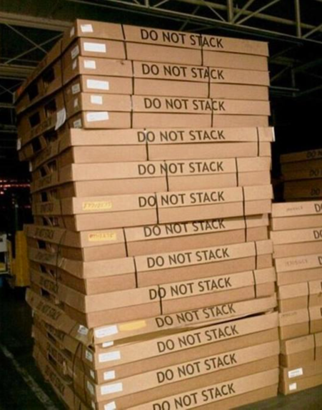
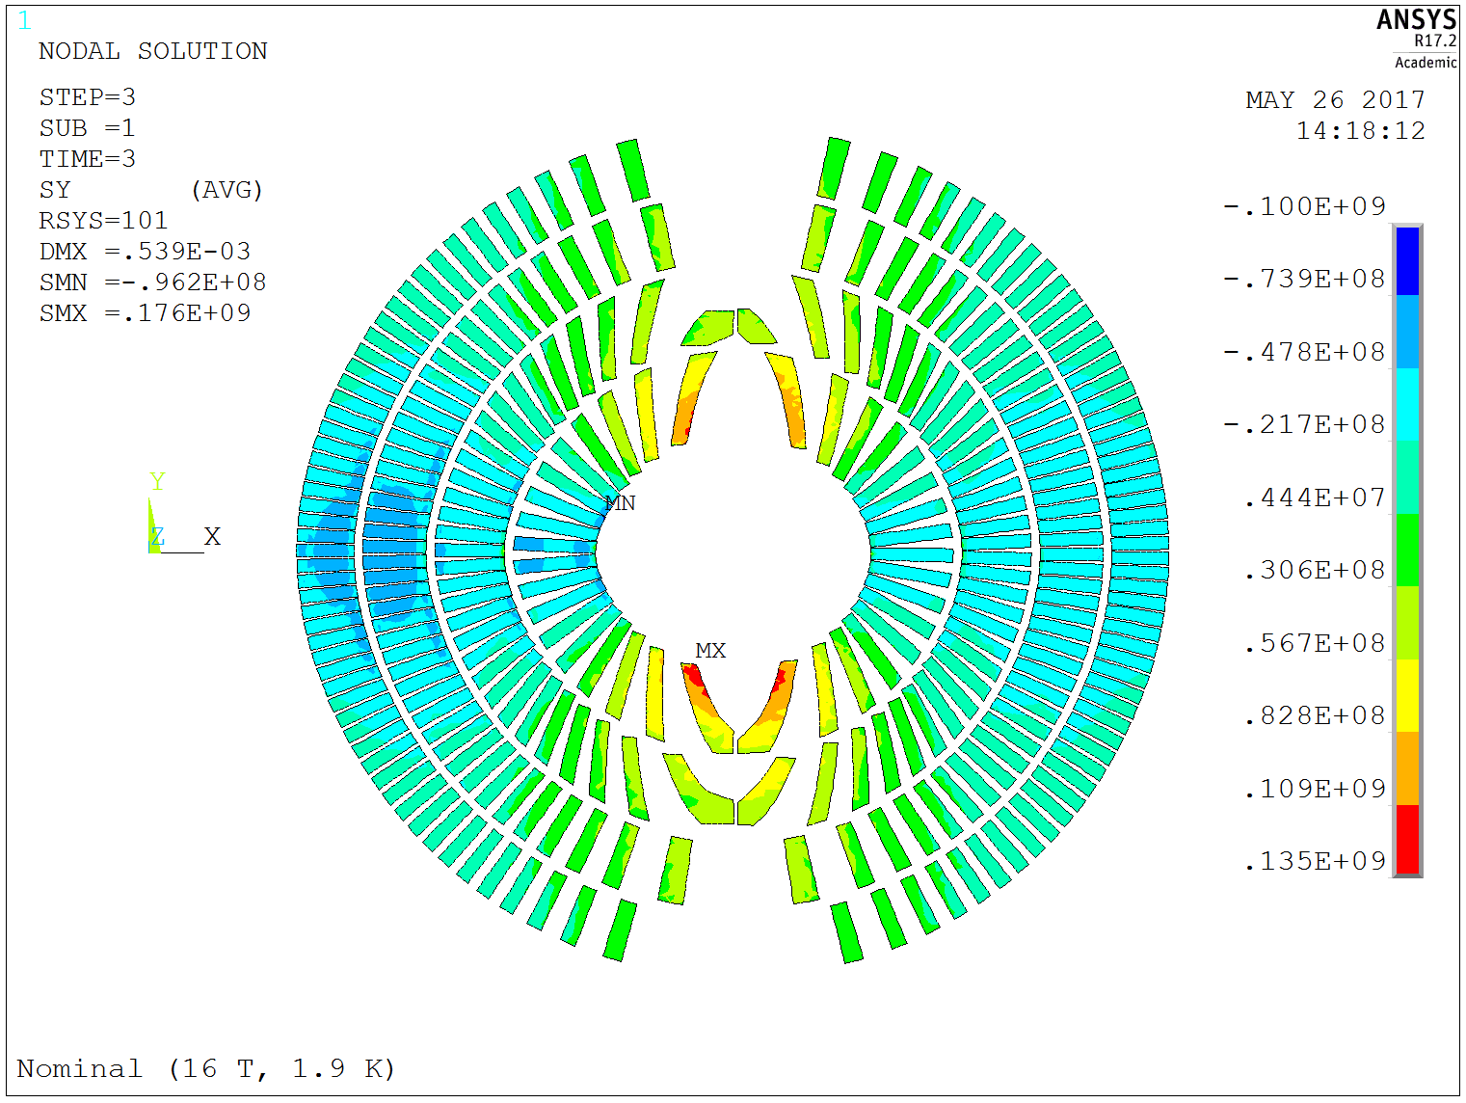
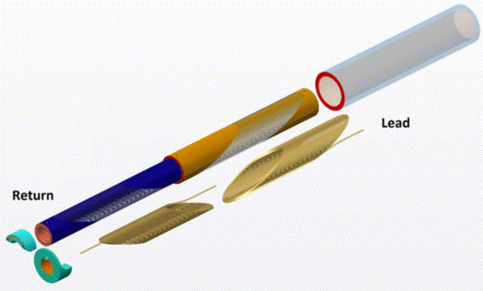
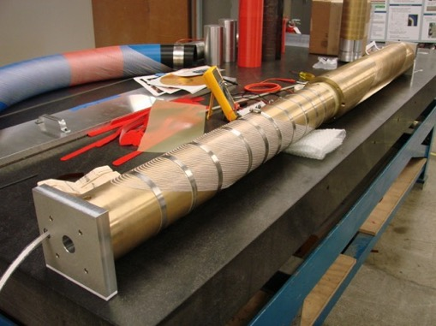
Mechanics Challenge
Canted Cosine Theta program for HFM started at LBNL (US).
Promises a decisive reduction of coil transverse stress through individual support of turns.
Many challenges ahead:
  efficiency
  former manufacturing
  impregnation scheme and training performance
135 MPa @ 16 T
Courtesy: C. Senatore

Slide 9
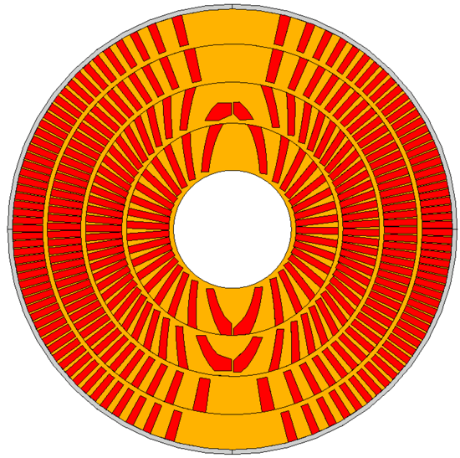
PSI’s CCT Design for FCC
Keys to an efficient CCT design:
  Thin spars
  (+ external mech. structure)
  Wide cable, large strands
  Thin ribs.
  Increase J_{e}.

Slide 10
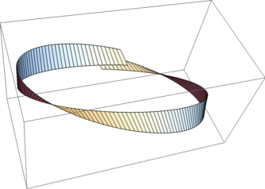
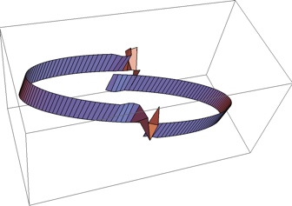
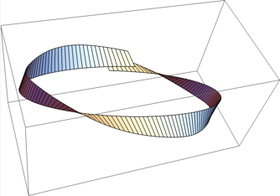
Windability
The ideal CCT magnet places the cable radially on the mandrel.
This approach induces moderate hardway bend on the midplane, and strong hardway bend (bending rad. ~ mandrel rad.) on the pole.
A tilted-racetrack-shaped solution exists that has zero hardway bend (and a discontinuity on the midplane).
Assumption: We can use an interpolation between the radial solution (around the midplane) and the tilted solution on the pole to improve windability.

Slide 11


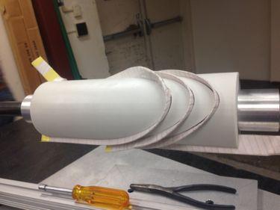
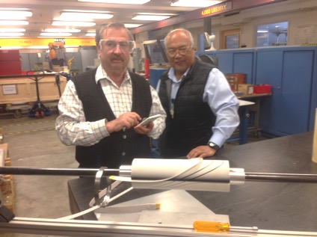
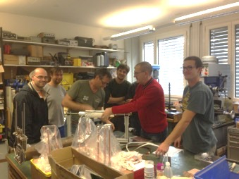
Winding Tests
Improve windability through inclined channels.
Winding tests at LBNL and PSI.
Successful tests with LD1 cable (@LBNL),
LBNL CCT cable, and 11-T cable (@PSI).
inclined channel: successful
radial channel: de-cabeling

Slide 12
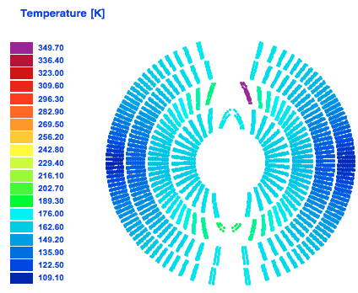
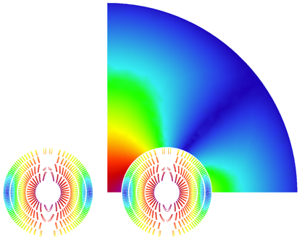
PSI’s CCT Design for FCC
Current: 18055 A
FCC-wide conductor use
  Total: 9.77 kt (~ +30% wrt. CT)
  NonCu: 3.75 kt
  Cu: 6.02 kt
Total inductance: 19.2 mH/m
Total energy: 3.2 MJ/m
Layer # | n_{S} | cuNc | loadline marg. [%] | current marg. [%] | T_{peak} [K] | V_{grnd} [V] | J_{cu} [A/mm²]
1 | 29 | 0.8 | 14.2 | 111 | 292 | 1133 | 1237
2 | 25 | 1.1 | 14.4 | 95 | 342 | 1264 | 1217
3 | 22 | 1.95 | 14.4 | 74 | 310 | 1156 | 1096
4 | 20 | 2.6 | 15.7 | 70 | 338 | 1144 | 1103

Slide 13

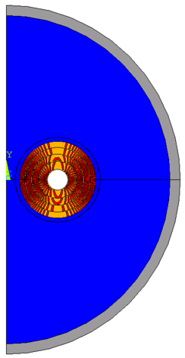
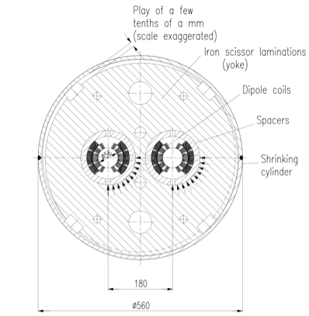
Mechanical Structure
CCT does not require azimuthal prestress.
Radial prestress on the midplane provided by “scissor” laminations.

Slide 14
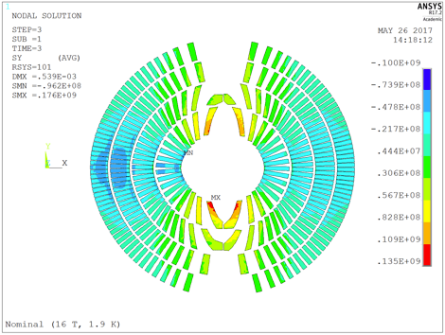
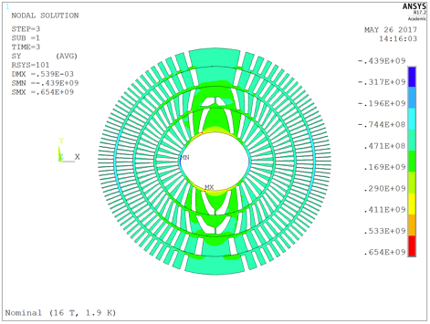
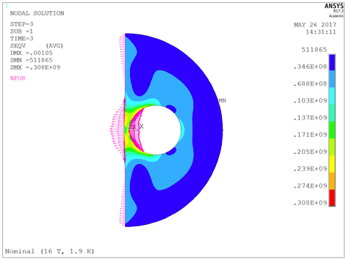
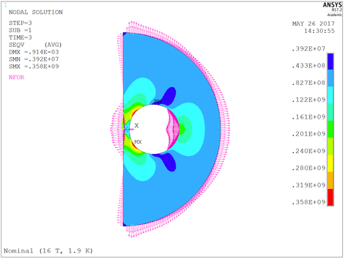
FCC 2D Mechanical Design
135 MPa on conductor

Slide 15
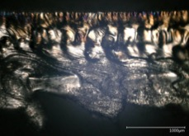
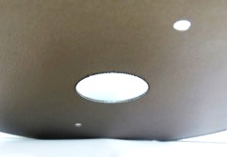
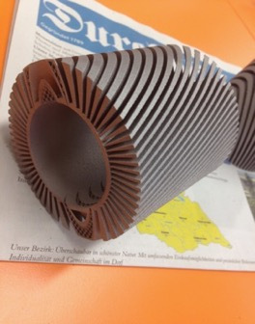
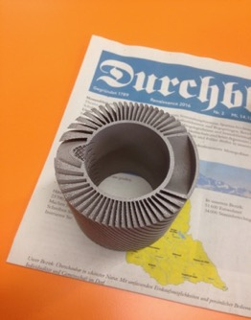
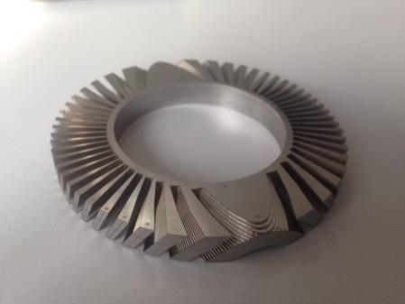
Manufacturability and Cost
Deep channels, aspect-ratio ~10 with inclined, tapered channels.
  Machining trials started – limited room for cost reduction.
  Selective Laser Melting (3-D printing) not successful in keeping tolerances.
  Thin-lamination formers, R&D in
  collaboration with IWS Fraunhofer.
    Laser “weld-cutting”.
    Goal: improve scalability and cost.
Trial C: weld-cutting two discs.
Trial A: SLS.
Trial B: laser cutting, laser spot welding.
Notes:
add more on former manufactuiring, insulation, impregnation challenge

Slide 16
Overview
Review Charge
CCT for FCC
The PSI CCT Model Program

Slide 17
PSI Goals towards FCC Requirements
Thin spars
Exterior Bladder and Key structure
Impregnation system (NHMFL resin, etc.).
Fast quench detection and CLIQ protection.
Wide Rutherford cable.
Inclined channels manufacturing.
Former manufacturability and cost reduction (with Fraunhofer/industry).
PSI program to be complementary to US MDP program.
CD1
CD2

Slide 18
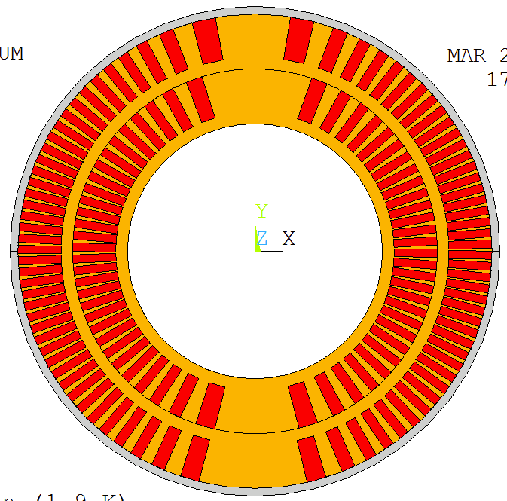
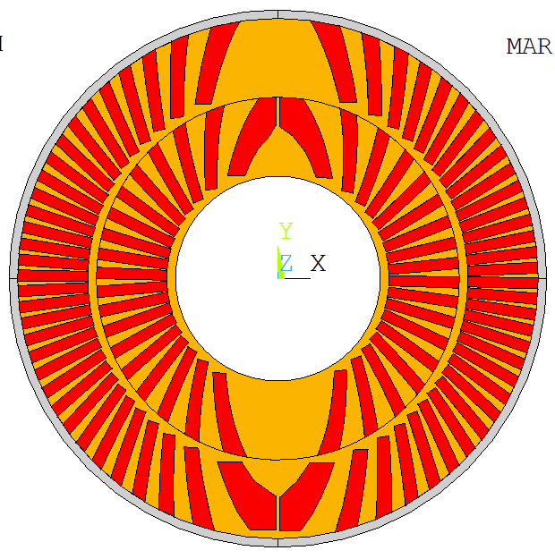
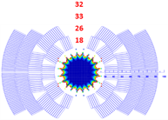
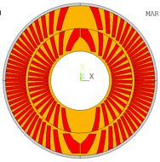
CD1 and CD2 Cable and Geom. Params.
PSI builds one mechanical structure for
  CD1:
    LBNL CCT cable (0.85 mm diam, RRP 108/127, 21 strand),
    10.6 mm channel depth, 3 mm spar, 0.5 mm assembly gap
    Layer-2 OD = 122 mm, ID = 65.6 mm (clear bore).
  CD2:
    15-T IL cable, (1 mm diam, RRP 150/169, 28 strand)
    16 mm inclined channel,
    Layer-2 OD = 122 mm, ID = 48 mm (clear bore).
CD1 introduces CCT technology to PSI.
CD2 fits into MDP 15-T outer layers 3&4.
Use LBNL coil-manufacturing
experience with this cable!
Use FNAL wire and cable
resembling FCC IL requirements!
Demonstrate CCT ILs
functioning in high-field (>15 T)

Slide 19
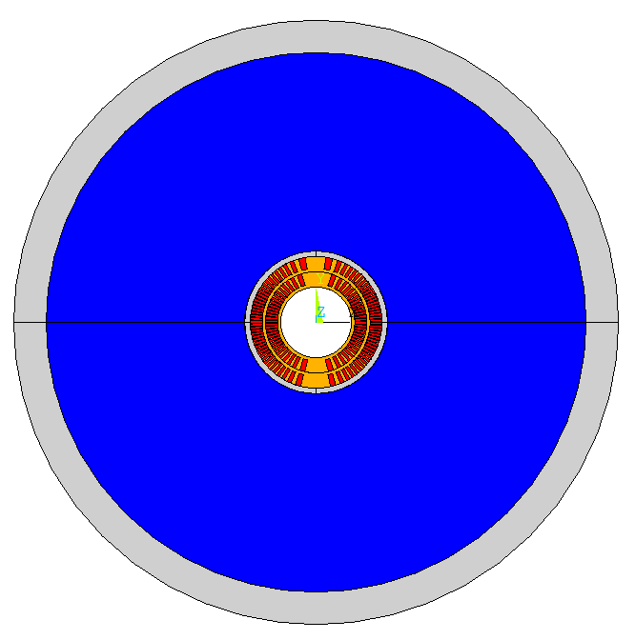
Mechanical Structure Evolution
Scissors laminations with Al shrink cylinder.
  System proposed for FCC
  Al cylinder rather than stainless welded shell due to lack of welding-press infrastructure.
  Open questions concerning assembly, mounting/dismounting risk, tuneability.
Classical bladder&key structure with open vertical gaps in yoke and pad.
  Difference to SMC/RMC/HD1: 2-part pad (no need for azimutal pre-stress).
  Structure found too elastic to effectively limit peak stresses in formers.

Slide 20
Mechanical Structure Evolution
Bladder&key structure with closed yoke gap.
  Tapered interface like MFISC, 11-T, etc. through graded yoke keys.
  Could not provide enough pre-stress to limit former stress AND keep the gap closed at room temperature.
Bladder&key structure with closed pad gap.
  Closed and pre-loaded pad gap for maximum-rigidity cage around coils.
  Steel pads to better match coil differential contraction.

Slide 21
Mechanical Structure
Bladder and Key technology chosen for tuneability and relative simplicity.
  Closed and pre-loaded pad gap for maximum-rigidity cage around coils.
  Steel pads to better match coil differential contraction.
Closed pad gap
Bladder locations
Vertical and horizontal keys
Al shell 25 mm
Protective Al shell 5 mm
Vertically split steel pad
Vertically split yoke, OR 250 mm
Al-bronze former
Open yoke gap
Notes:
show loading concept via reaction forces

Slide 22
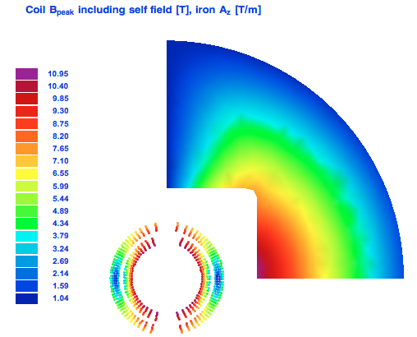
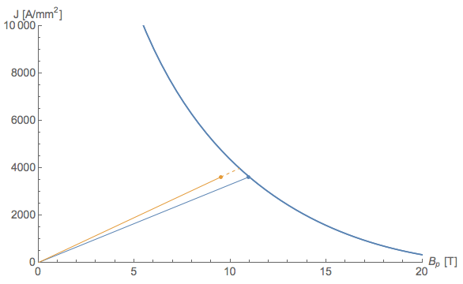
CD1 Magnetic Design
Selected for mechanical design
→ ultimate load.
At 4.2 K: I_{SS} = 20 kA, ~11 T bore field.
At 1.9 K: I_{SS} = 21.6 kA, ~11.7 T bore field (NB: CERN I_{max} = 20 kA)
With iron pads at 4.2 K: I_{SS} = 19 kA, ~11.35 T bore field
With iron pads at 1.9 K: I_{SS} = 20 kA, ~12 T bore field
J_{c}(B, 4.2 K)

Slide 23
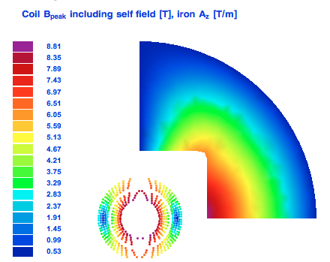
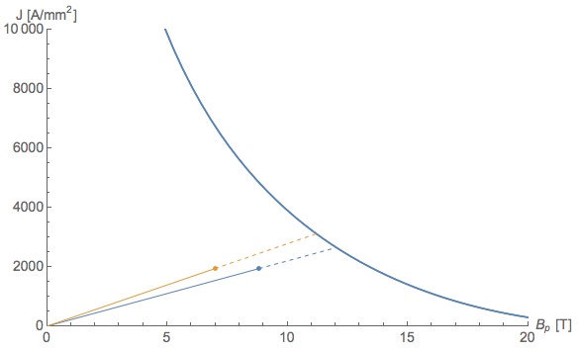
CD2 Magnetic Design
I_{max} = 22 kA; 9.5 T bore field, 81% on LL at 4.2.
I_{max} limited by LBNL test station.
Cable is oversize for a 2-layer magnet!
J_{c}(B, 4.2 K)

Slide 24
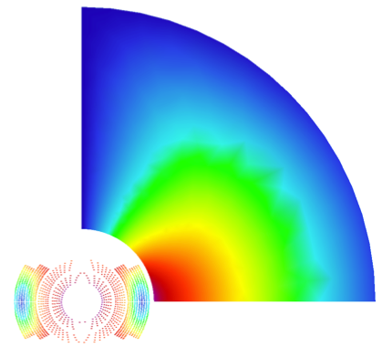
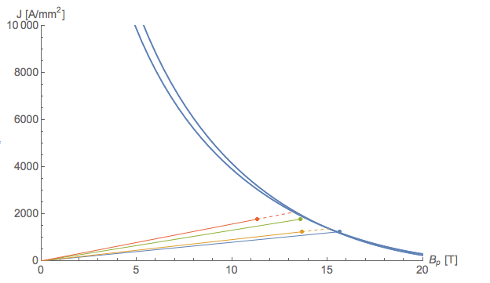
CD2 in MDP 15-T Layers 3&4
B_{SS} = 15.4 T (Iss = 12.8 kA) at 4.2 K .
B_{SS} = 16.8 T (Iss = 14.1 kA) A at 1.9 K.
Field quality not optimized (140 units b3),
peak field on midplane.
J_{c}(B, 4.2 K)

Slide 25
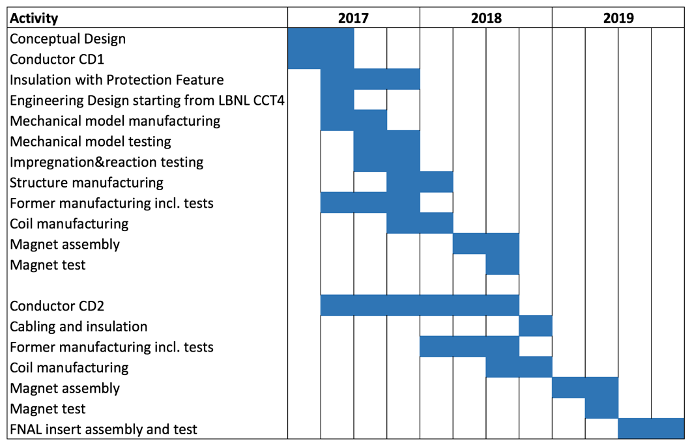
First Planning (Feb. ‘17)

Slide 26
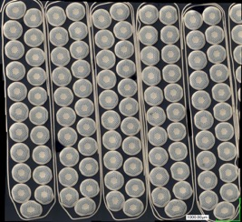
CD1 Conductor Plans
CD1 unit lengths for a 70-turn magnet: Layer 1: 44.3 m,
layer 2: 60.7 m. Total: 106.5 m.
Tests in 4 areas:
  insulation: 10 m
  winding: 10 m
  reaction: 15 m
  impregnation: 38 m
179 m of CD1 cable have been produced by LBNL and are being shipped to PSI.
Cable for tests insulated with sleeve.
Company contacted to insulate magnet cable with mica and braided S2 glass.

Slide 27
CD2 conductor plans
PSI plans to order Bruker OST strand (1 mm diam, RRP 150/169).
Quantity for 150 m of 28-strand cable, using the specifications of FNAL 15-T-magnet program.
FNAL agreed to perform cabling for PSI end of 2018.
In the meantime FNAL provides copper cable for winding and impregnation tests.
Risk mitigation: If more CD1-type coils are needed, and if CD1-strand is difficult to come by, the above strand could be drawn down to 0.85 mm diameter, which yields conductor in excess of two more CD1 coils.
The cabling must not happen before the CD1 test!

Slide 28

Summary
The CCT option was established as a valid contender in the FCC design study.
The PSI program has been designed to be complementary to and closely coordinated with the LBNL program, pushing towards specific features needed in an FCC magnet.
CD1 benefits fully from LBNL coil-manufacturing experience.
CD2 conductor needs to be ordered now.
Support by LBNL and CERN, but also FNAL are essential
for our program. We are grateful for the generosity.

Slide 29
Outlook
CD1 design will be discussed in more detail in the following presentations.
  2-D Mechanical Design and Tolerances (Giuseppe)
  3-D Mechanical Models (Gabriella)
  LBNL CCT Program (Bernhard)
  (coffee)
  Technical Design (Serguei)
Technological Challenges, R&D Topics, and Infrastructure Plans are
covered in the last presentation (Bernhard)

Slide 30
END

Slide 31
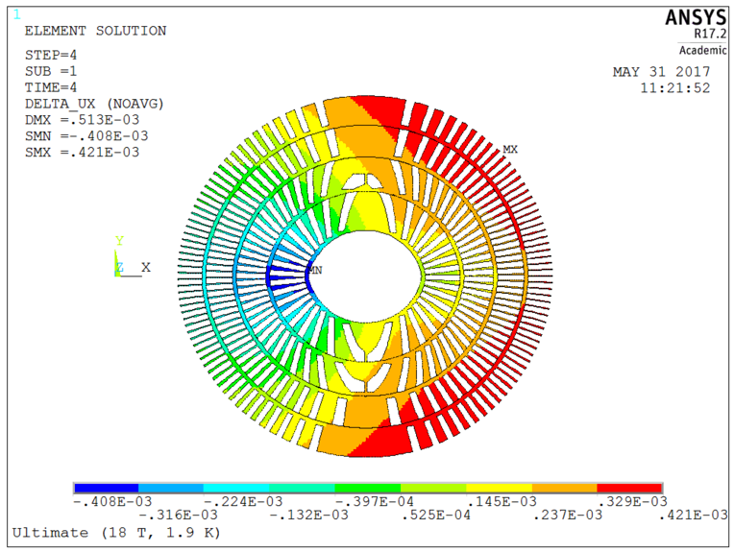
Movement Cryo to 16 T

Slide 32
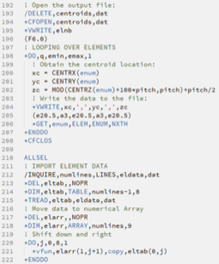
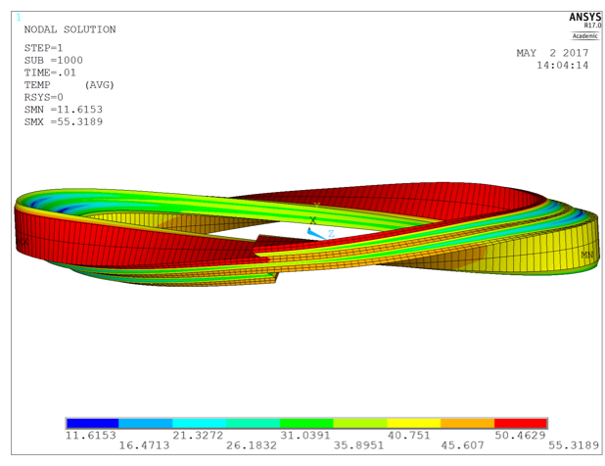
Quench Simulation
Tool : Mechanical APDL (ANSYS Parametric Design Language)
    A scripting language to build models & analyses
    Features : design optimization & adaptive meshing
Electric
Electro-thermal
Electro
magnetic

Slide 33
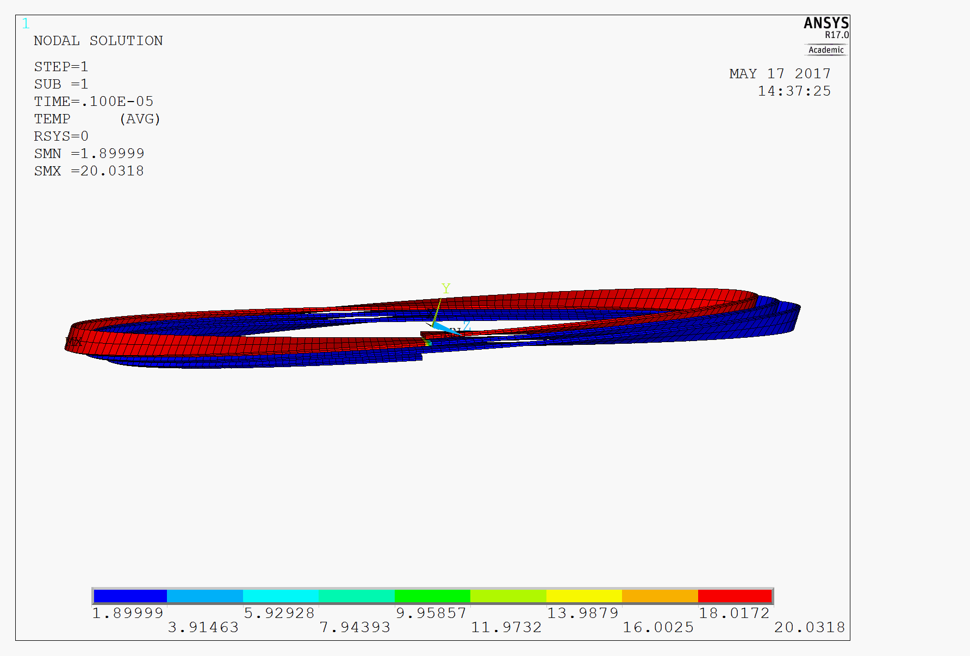


Quench Simulation
Model I : Helical Propagation
  Determination of propagation velocity per layer and per excitation level.
  Quantification of detection problem.
  CD1 Layer1 3-turn model results, working at I_{ss} = 20kA, IC : T = 20K for 1st turn

Slide 34


3-D Magnetic Design
3-D modeling results:
Yoke cut-back not needed (20 mT peak-field enhancement in ends).
Magnetic length with yoke equal to that of bare coil.
Physical length minus magn. length = 53 cm; equal to 11 T magnet.
Peak field minus main field at 16-T bore field: 0.14 T excluding self field.
  comparable or lower than cos-theta due to continuous current distribution.
Courtesy M. Negrazus

Slide 35


3-D Periodic Simulation
Generalized plane stress condition applied (following D. Arbelaez, L. Brouwer, LBNL)
Initial 3-D results confirm 2D, but show distinct imprint of scissors lams
→ increase protective shell thickness, change its material to iron
→ decrease lamination thickness.
135 MPa on conductor

Slide 36



Curvature parameters
Ideal CCT.
Tilted racetrack.
Inverse of hardway
bending radius.
Optimized tilted design.
Slightly reduced torsion.
10-fold reduced hard-way bend.
Unchanged easy-way bend.

Slide 37


CD1 Magnetic Design
I_{SS} = 20 kA at 1.9 K (~12 T bore field).
For steel pad we would reach short sample
at 4.2 K and 11 T.
J_{c}(B, 1.9 K)

