Slide 1
The LBNL CCT Program
B. Auchmann (CERN/PSI)
See also: the US-MDP CCT Program Review
https://conferences.lbl.gov/event/88/
26.06.2017, CD1 Conceptual Design Review

Slide 2
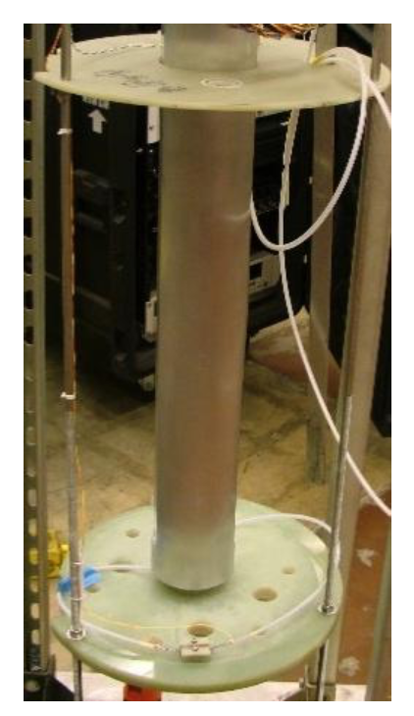
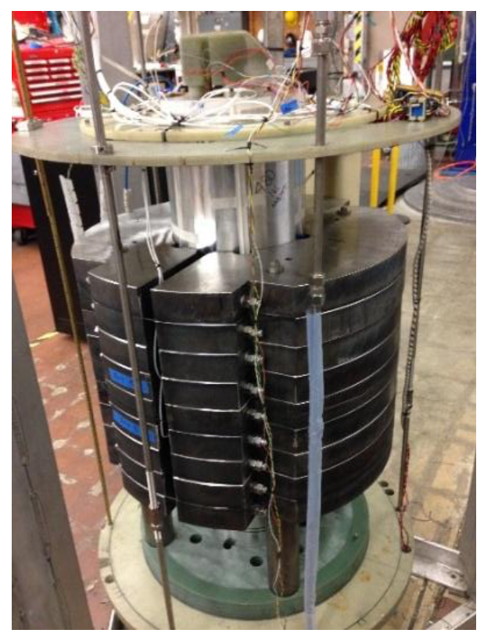
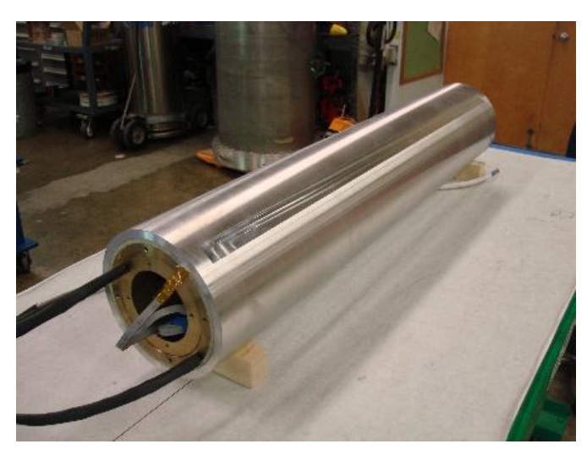
LBNL/MDP CCT Program Up to Now
CCT1
  2.5 T short-sample dipole
  50 mm clear bore
  8 strd. NbTi cable (0.65 mm
  SSC Outer)
  not impregnated
  11/2013: tested up to 2.5 T
CCT2
  5.3 T short-sample dipole
  90 mm clear bore
  23 strd. NbTi cable
  (0.8 mm SSC Inner)
  epoxy impregnated
  5/2015: tested up to 4.7 T
CCT3
  10.0 T short-sample dipole
  90 mm clear bore
  23 strd. Nb3Sn cable
  (0.8 mm OST 54/61)
  3/2016: tested up to 7.4 T
  Suspect Conductor damage
  as possible cause of current
  limit
Source: D. Arbelaez (LBNL)

Slide 3
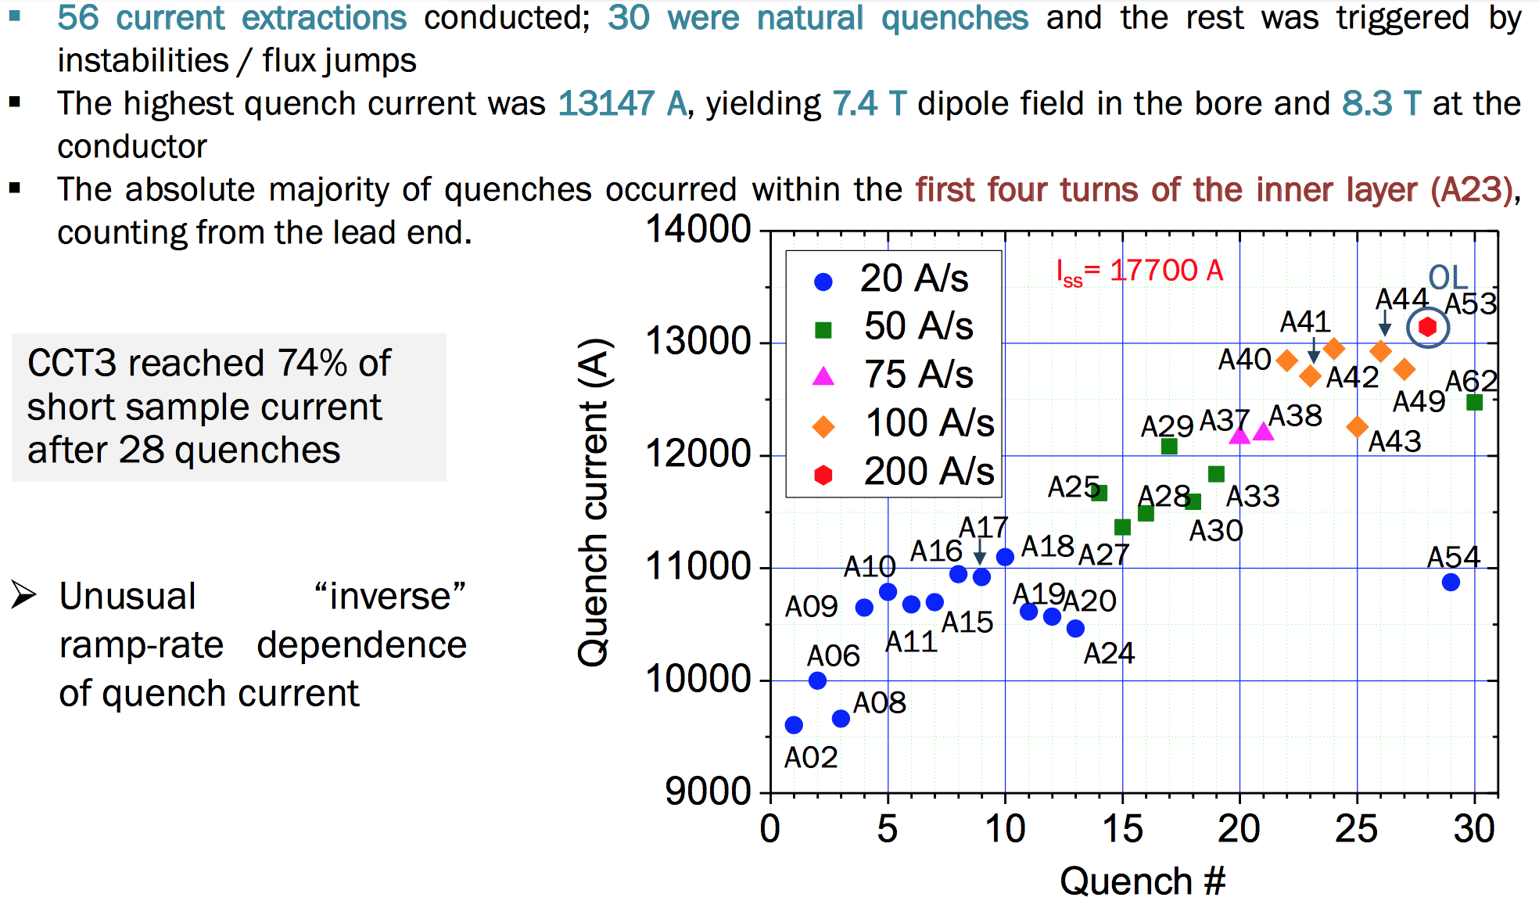
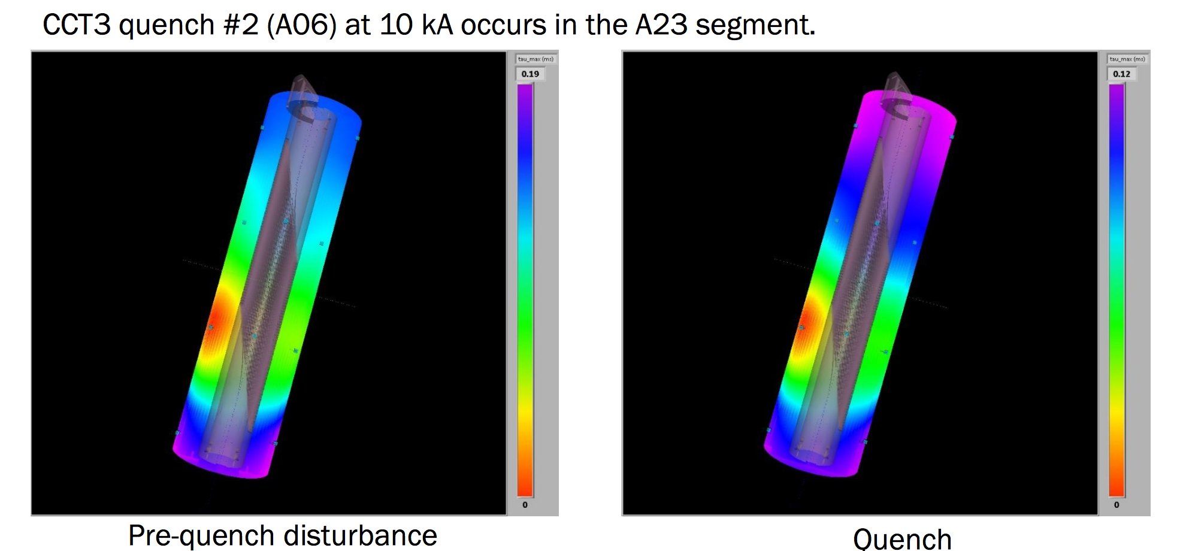
CCT3 Results
Quench #2,
acoustic localization
Source: M. Marchevsky (LBNL)

Slide 4
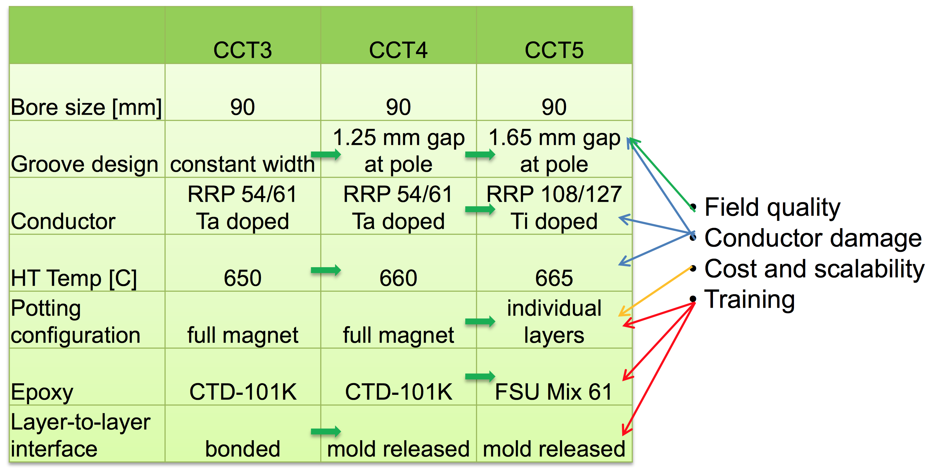
LBNL/MDP CCT 2-Layer Program
Source: D. Arbelaez (LBNL)

Slide 5
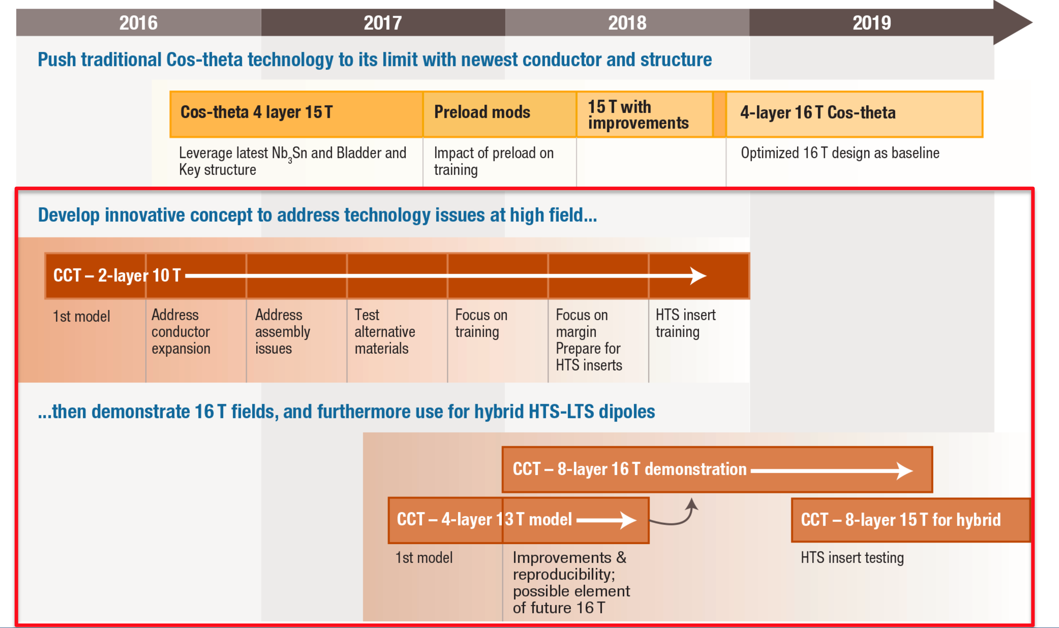
LBNL/MDP: Beyond 2-Layer Magnets
Source: MDP

Slide 6
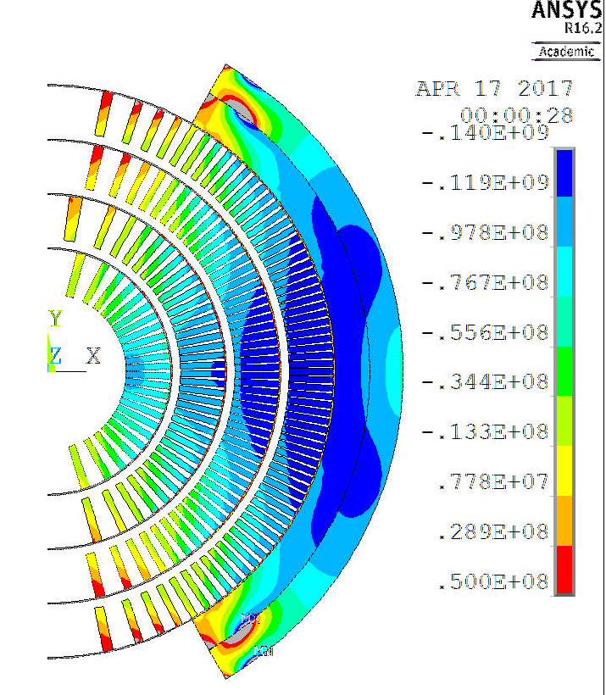
Beyond FCC Specs
2 layers of Nb₃Sn CCT or CT
The future of high field
magnets will depend on
a structure that significantly
reduces conductor stress.
2 layers of Nb₃Sn CCT
2 layers of HTS CCT
 | mat. | I0-ss (A) | Bcond
Lay1,2 | Bi2212 | 10788 | 19.49
Lay3,4 | Nb3Sn | 10788 | 16.75
Lay5,6 | Nb3Sn | 10788 | 15.58
Bore field | 19.33
Fields with iron in 2D tosca
Source: L. Brouwer, S. Caspi

Slide 7
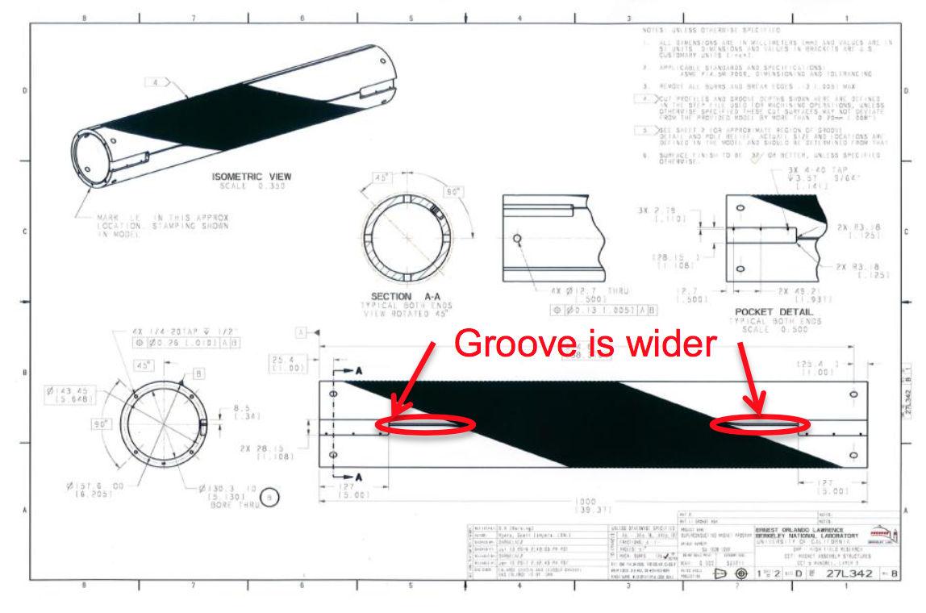
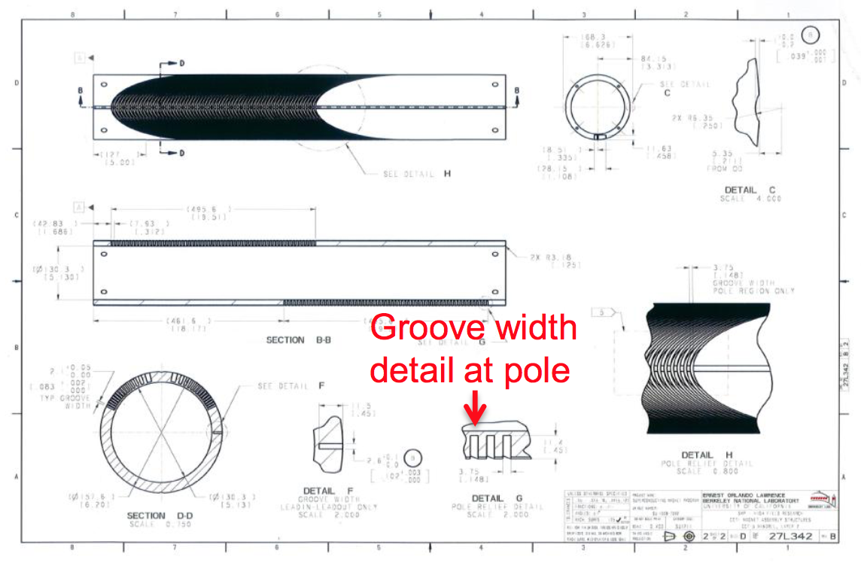
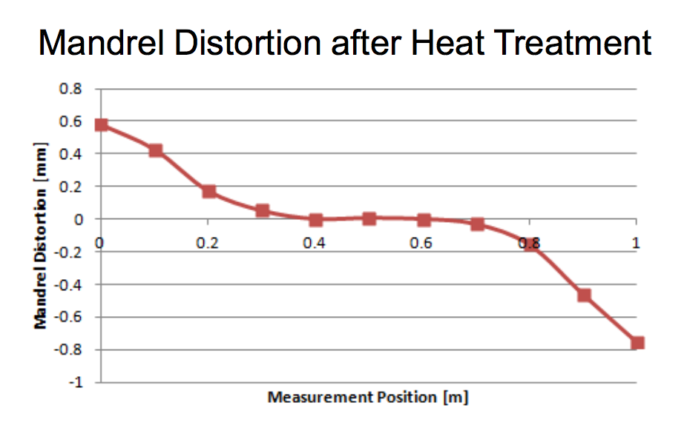
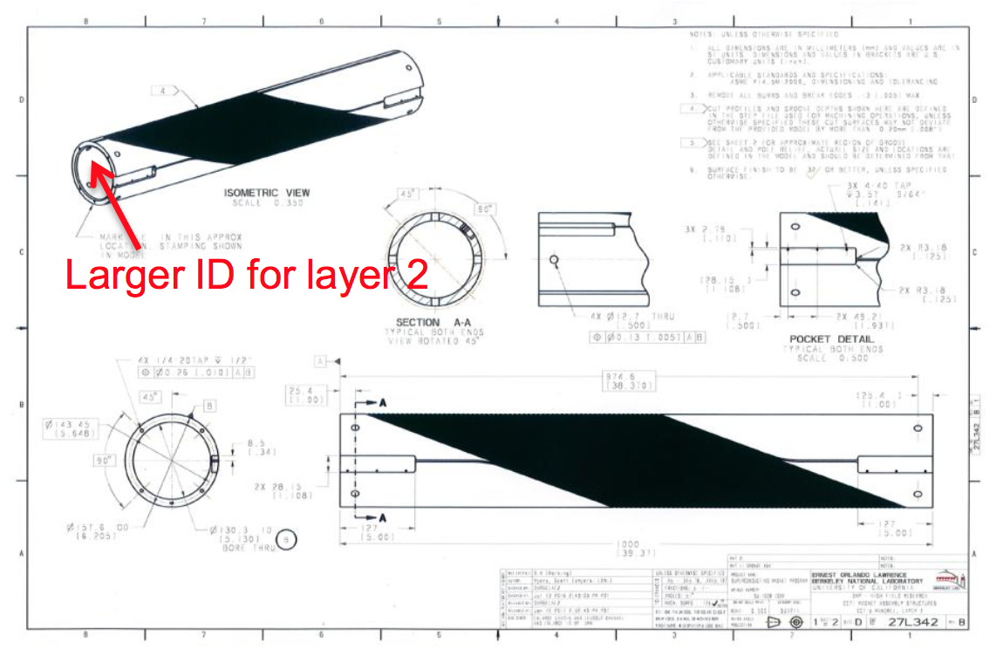
LBNL/MDP CCT Experience
CCT3 alleged cable damage → increase in groove width.
CCT4 mandrel distortion and assembly problems → increase layer-2 ID.

Slide 8
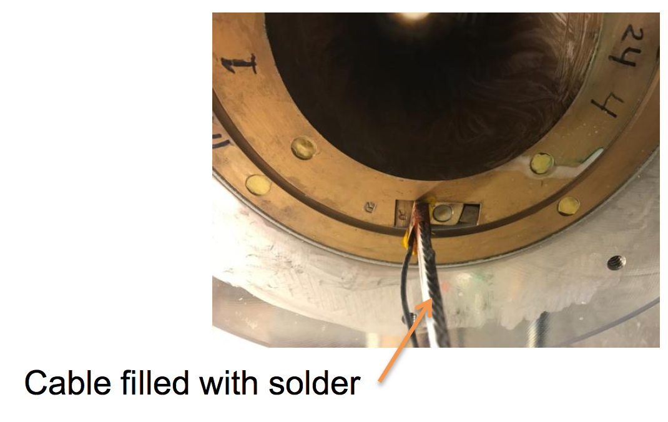
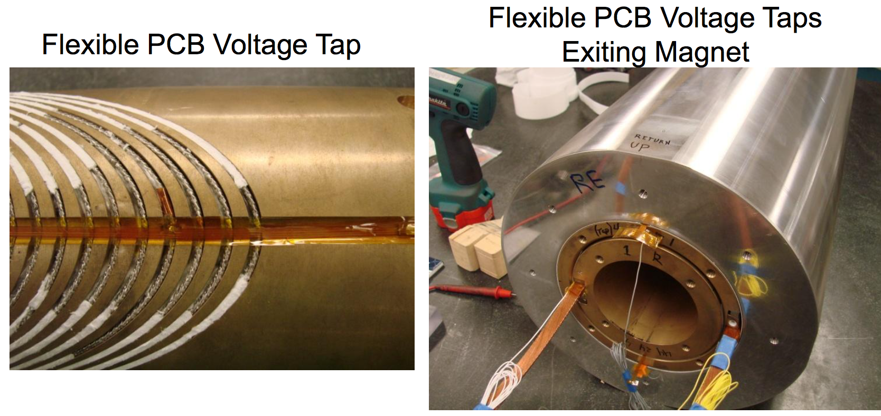
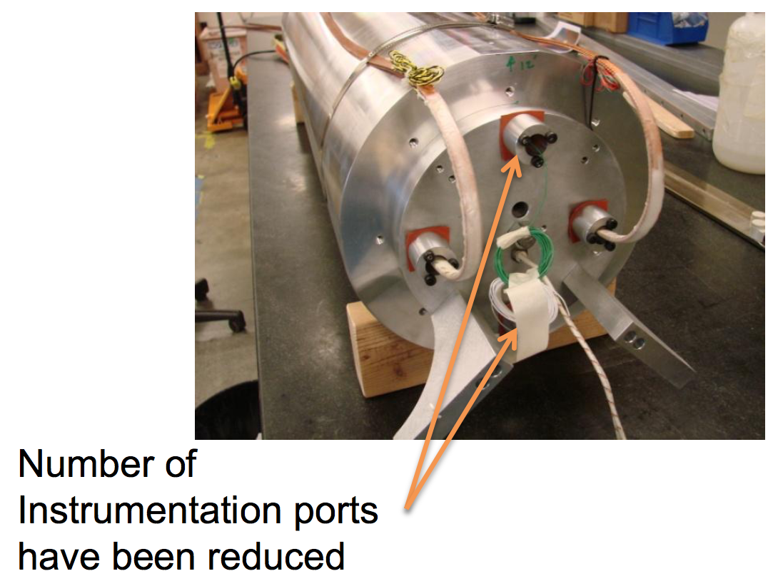
LBNL/MDP CCT Experience
Cable filled with solder rather than silicon for improved leak tightness.
Fewer instrumentation wires through use of PCB V-taps.

Slide 9
Similarities and Differences with LBNL Program
Similarities and direct input:
  Former material.
  Cable, heat treatment
  Channel dimensions, assembly gaps.
  Mold-released layers.
  NHMFL Mix 61 resin (as CCT5).
  Possibly individual-layer impregnation and assembly options.
  3-D mechanical-modeling techniques.
  Review of technical design by LBNL Engineer Ray Hafalia.
  Use of extensive foto documentation, LBNL drawings, skype consultancy, etc.
Complementary PSI topics:
  Mica insulation.
  Inductive-compensation wire.
  Spar thickness.
  Thin Al protective shell and external structure.
  CD2 inclined channels.
  Study of alternative manufacturing processes.

Slide 10
END

