Slide 1
Mechanical Modelling of the PSI CD1 Dipole
G. Rolando, B. Auchmann, G. Montenero, M. Negrazius
CERN - 26 June 2017

Slide 2
Presentation Layout
Mechanical modelling of CCT dipoles
PSI CD1 dipole
  Overview
  Mechanical model
  Vertical bladder operation
  Horizontal bladder operation
  Room temperature
  Cool down
  Operation
  Conductor stress & strain
  Comparison with 2D analysis
Full length 3D model
Conclusions & next

Slide 3
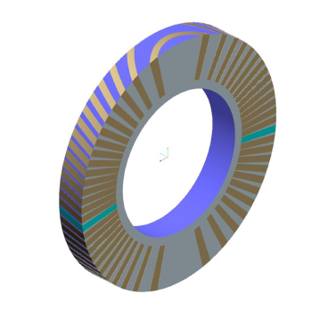
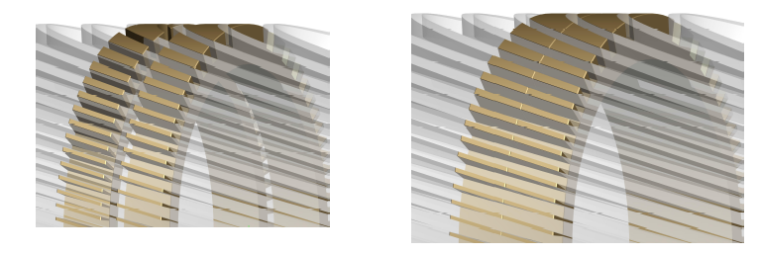
Mechanical modelling of CCT dipoles
The conductor path in a CCT layer creates a region of symmetry that is axially periodic. By repeating the symmetry region, a complete CCT layer can be created.
A symmetry region for each layer and a mechanical outer structure of the same axial thickness can be combined to form a symmetry region for the magnet as a whole.
Courtesy of L. Brouwer

Slide 4
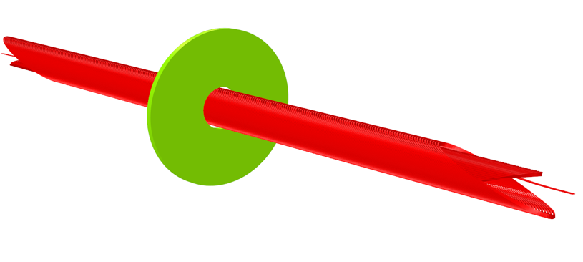
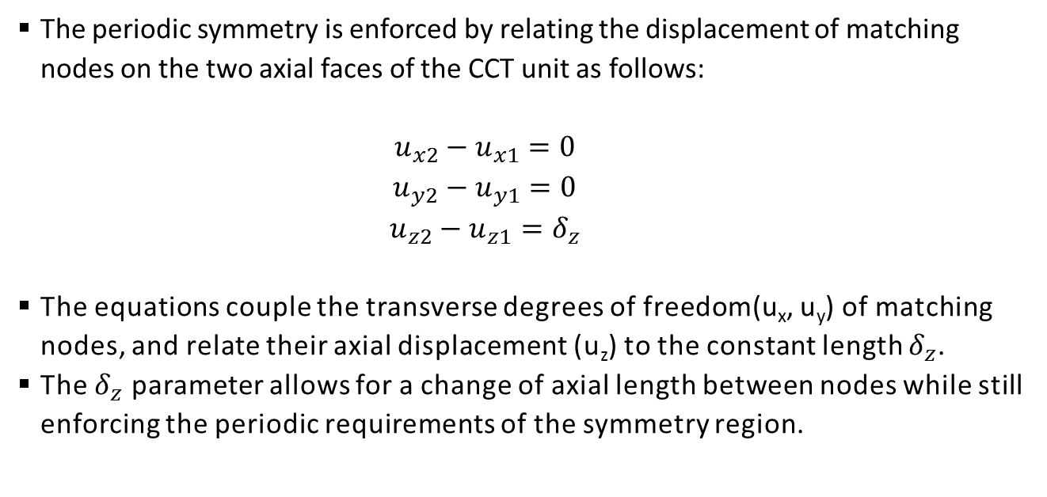
Mechanical modelling of CCT dipoles
We take advantage of this periodic structure to reduce the size of the mechanical model, which consists of a single CCT unit (period).
The periodic symmetry is enforced by relating the displacement of matching nodes on the two axial faces of the CCT unit as follows:
      $$u_{x2}−u_{x1}=0$$
      $$u_{y2}−u_{y1}=0$$
      $$u_{z2}−u_{z1}=δ_{z}$$
The equations couple the transverse degrees of freedom(u_{x}, u_{y}) of matching nodes, and relate their axial displacement (u_{z}) to the constant length $δ_{z}$.
The $δ_{z}$ parameter allows for a change of axial length between nodes while still enforcing the periodic requirements of the symmetry region.

Slide 5
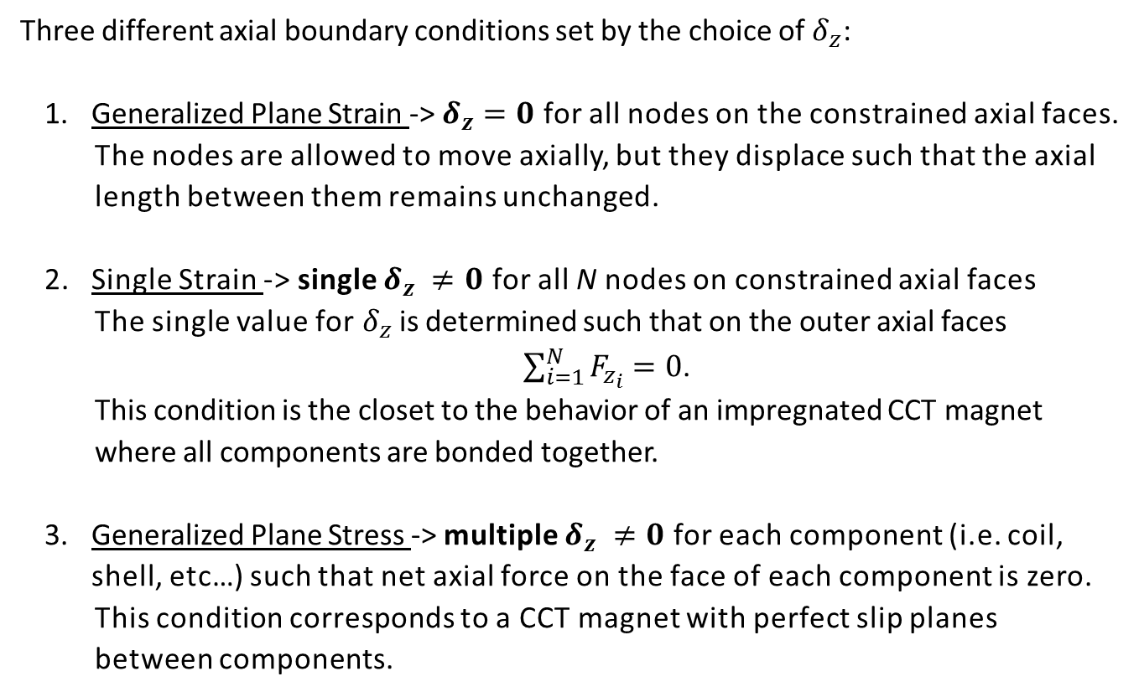
Mechanical modelling of CCT dipoles
Three different axial boundary conditions set by the choice of $δ_{z}$:
  Generalized Plane Strain -> $δ_{z}=0$ for all nodes on the constrained axial faces.
      The nodes are allowed to move axially, but they displace such that the axial length between them remains unchanged.
  Single Strain -> single $δ_{z} ≠0$ for all N nodes on constrained axial faces
      The single value for${ δ}_{z}$ is determined such that on the outer axial faces
      $\sum_{i=1}^{N}{F_{z_{i}}}=0$.
      This condition is the closet to the behavior of an impregnated CCT magnet where all components are bonded together.
  Generalized Plane Stress -> multiple $δ_{z} ≠0$ for each component (i.e. coil, shell, etc…) such that net axial force on the face of each component is zero.
      This condition corresponds to a CCT magnet with perfect slip planes between components.

Slide 6
PSI CD1 dipole - Overview
  PSI is contributing to the FCC project by studying the feasibility of a high-field accelerator dipole based on the CCT design.
  In the framework of this R&D activity, PSI is designing a model dipole with the following characteristics:
        Single aperture
        2 layers
        Inner bore: 50 mm
        Target field: 10 T (with 20% current margin)
        Cable: 11 T Rutherford cable for LHC Hi-Lumi
    Although scissor laminations are envisaged to provide radial pre-stress on the mid-plane in the FCC dipole, the PSI CD1 dipole relies on a bladder &keys mechanical structure for ease of assembly and reduction of costs.

Slide 7
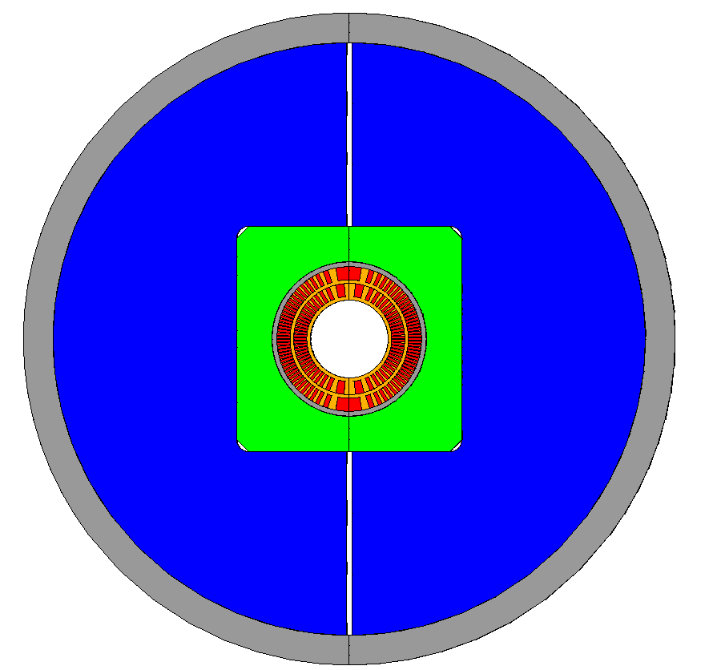
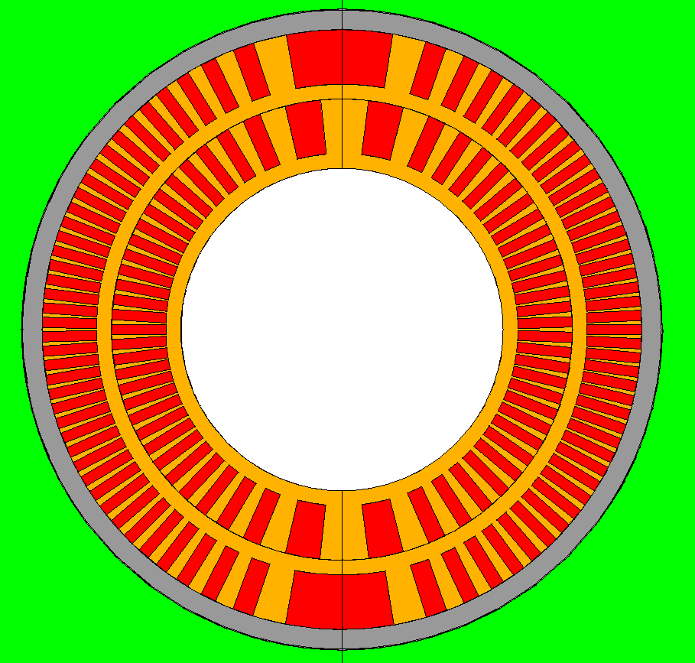
PSI CD1 dipole – Mechanical model
  The complete mechanical model features:
Aluminum outer shell
Split iron yoke
Stainless steel pads
Kapton layer
Aluminum protective shell
Al-bronze mandrels for the coils
Sliding contact between:
  CCT layers
  CCT coil – protective shell
Bonded contact between:
  Protective shell - Kapton
Standard contact (µ = 0.2) between:
  Pads – yoke
No friction contact (µ = 0) between:
  Kapton - pads
  Yoke – outer shell

Slide 8
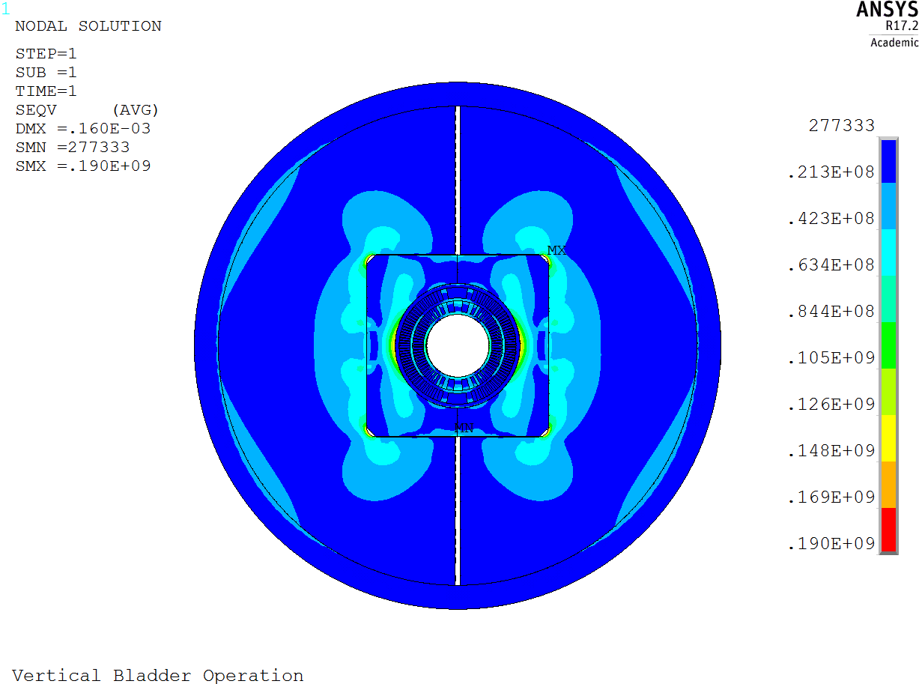
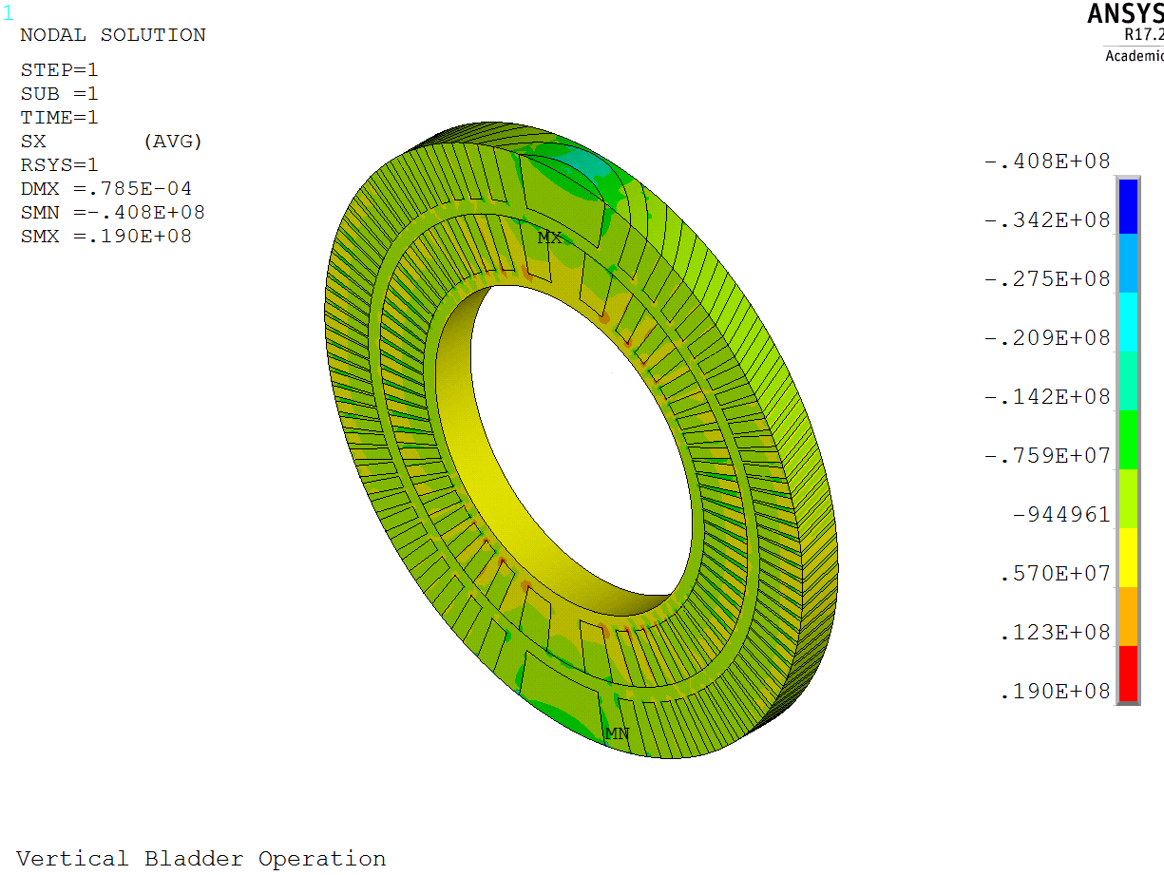
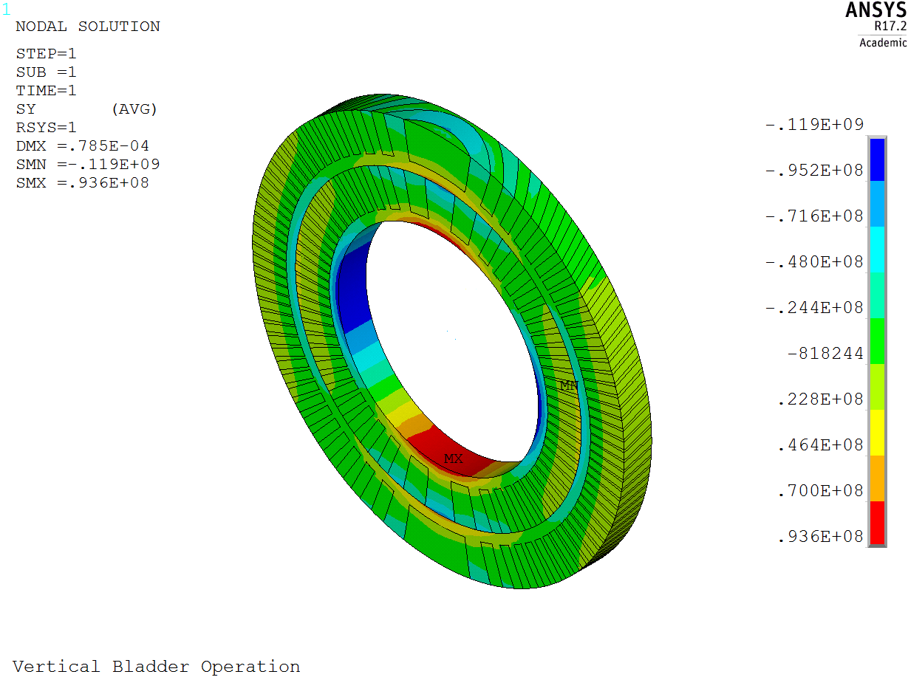
PSI CD1 dipole – Vertical bladders operation
Component | σ_{r} [MPa] | σ_{θ} [MPa]
Conductor 1 | -17 | -43
Former 1 | 36 | -119
Conductor 2 | -27 | -29
Former 2 | -41 | -77
von Mises stress
Component | σ_{VM} [MPa] | σ_{limit} [MPa]
Conductor 1 | 36 | 150
Former 1 | 107 | 250
Conductor 2 | 23 | 150
Former 2 | 65 | 250
Prot. Shell | 83 | 480
Pads | 159 | 350
Yoke | 190 | 180
Outer shell | 23 | 480
Radial stress
Azimuthal stress

Slide 9
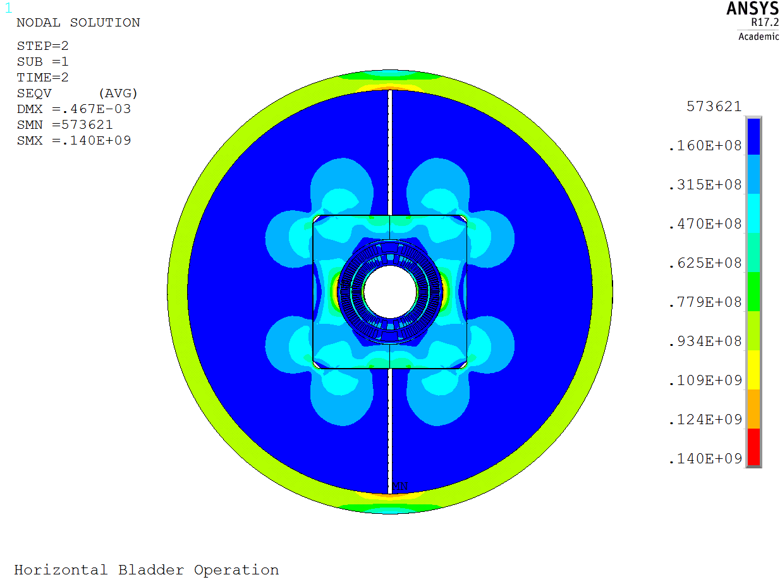
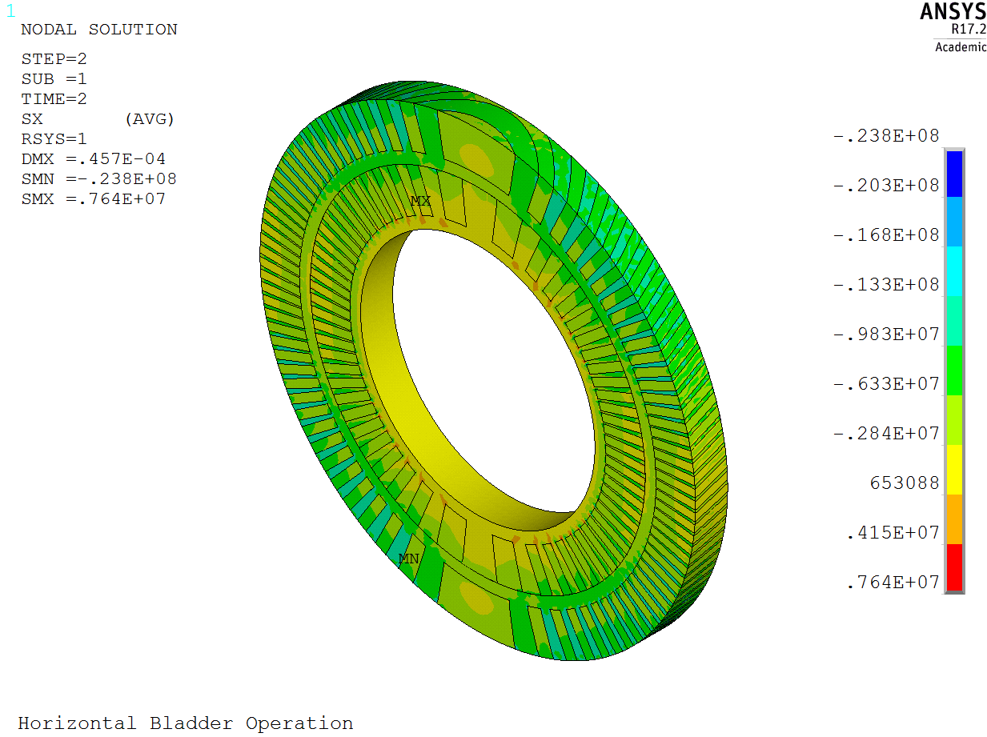
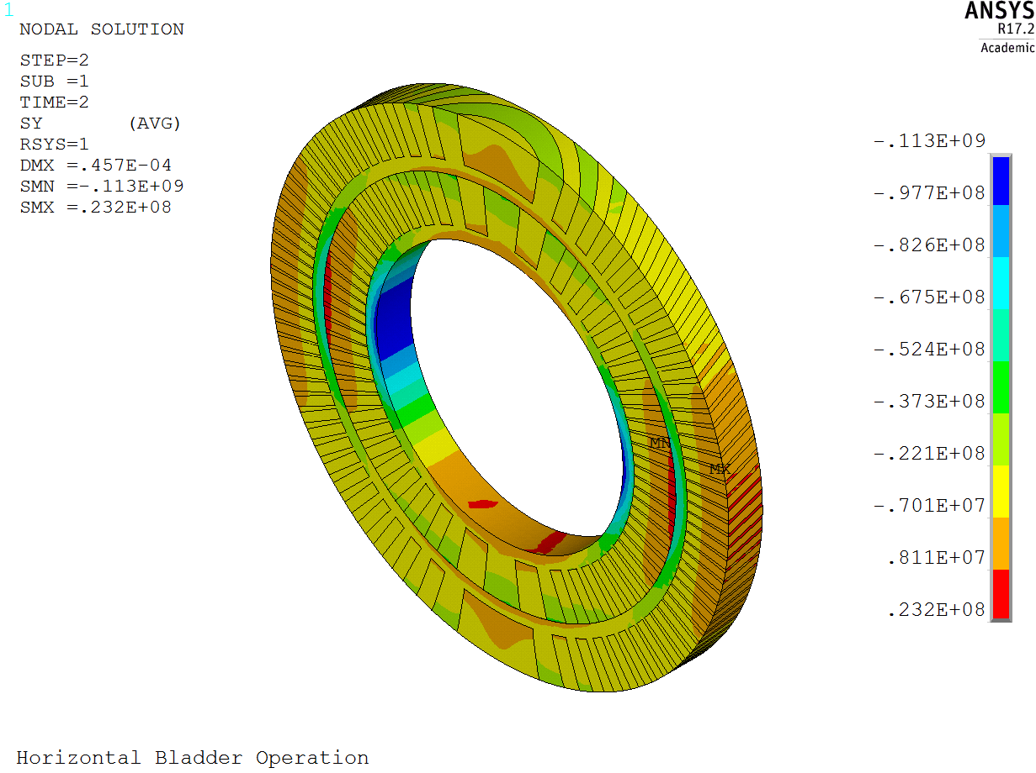
PSI CD1 dipole – Horizontal bladders operation
Component | σ_{r} [MPa] | σ_{θ} [MPa]
Conductor 1 | -11 | -30
Former 1 | -27 | -113
Conductor 2 | -13 | -22
Former 2 | -24 | -73
von Mises stress
Component | σ_{VM} [MPa] | σ_{limit} [MPa]
Conductor 1 | 23 | 150
Former 1 | 102 | 250
Conductor 2 | 16 | 150
Former 2 | 65 | 250
Prot. Shell | 78 | 480
Pads | 140 | 350
Yoke | 109 | 180
Outer shell | 129 | 480
Radial stress
Azimuthal stress

Slide 10
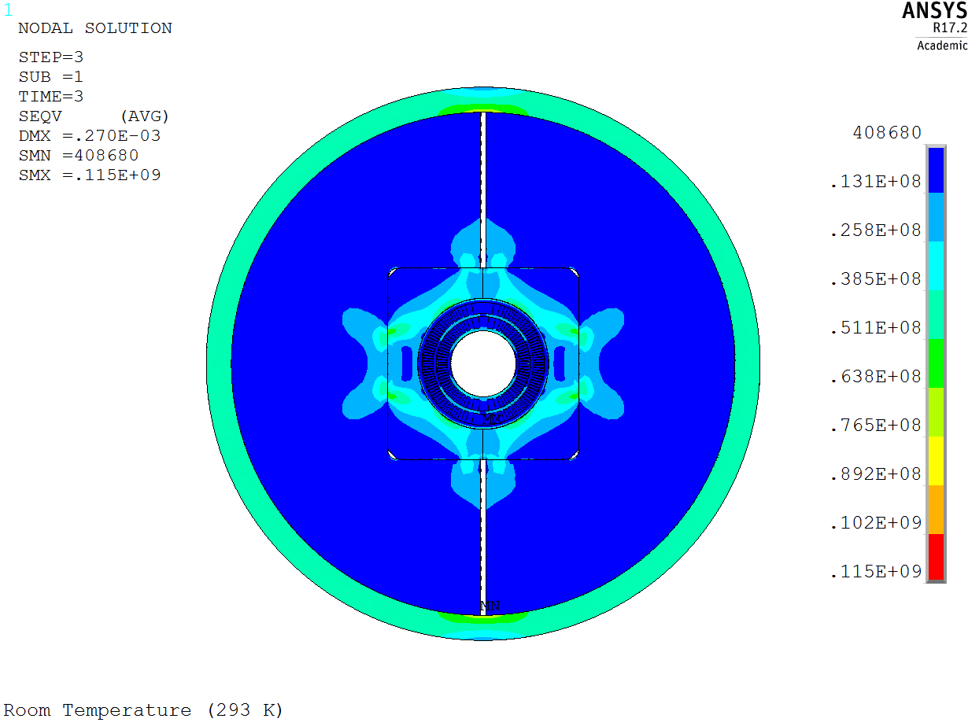
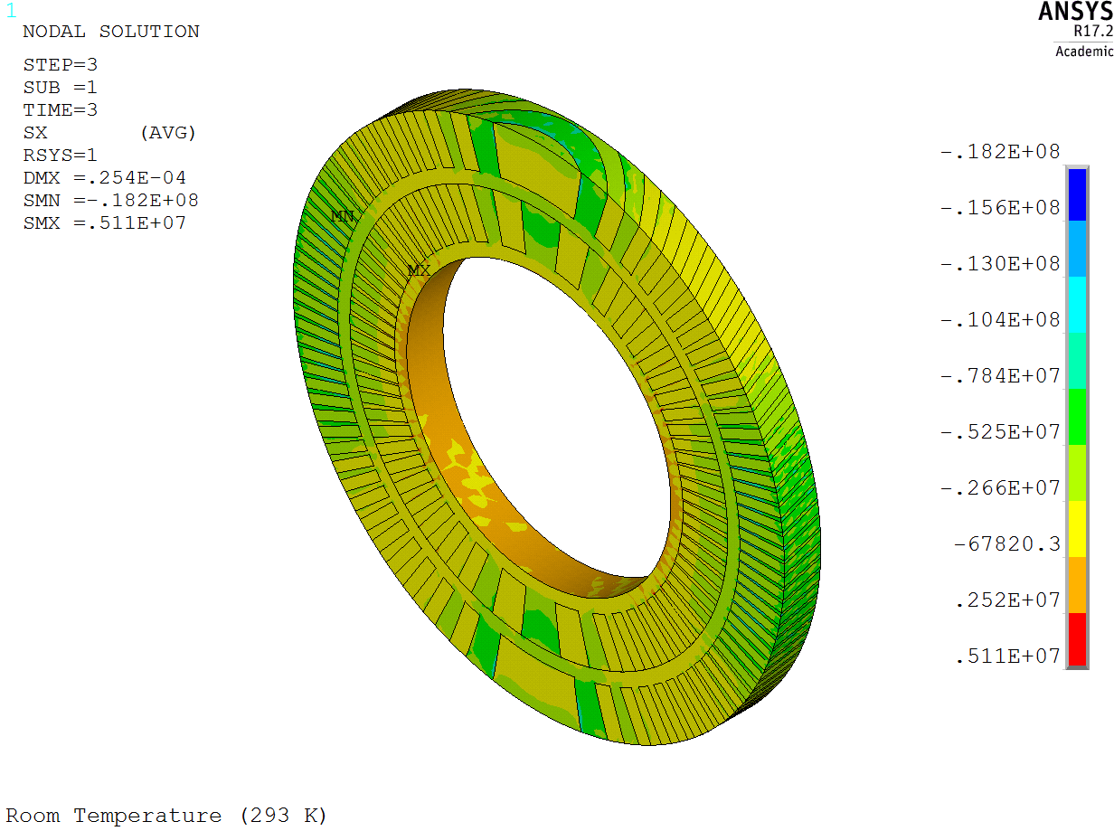
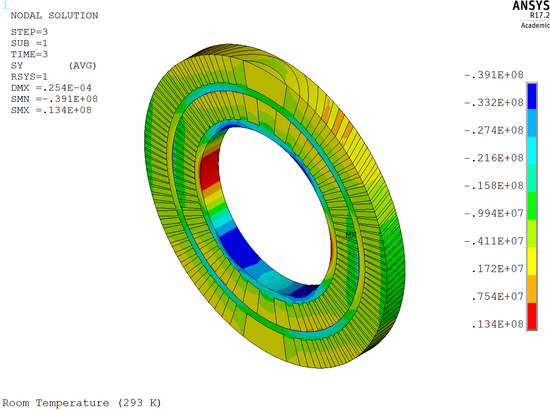
PSI CD1 dipole – Room temperature
Component | σ_{r} [MPa] | σ_{θ} [MPa]
Conductor 1 | -8 | -19
Former 1 | -21 | -39
Conductor 2 | -10 | -14
Former 2 | -18 | -27
von Mises stress
Component | σ_{VM} [MPa] | σ_{limit} [MPa]
Conductor 1 | 15 | 150
Former 1 | 37 | 250
Conductor 2 | 10 | 150
Former 2 | 28 | 250
Prot. Shell | 115 | 480
Pads | 85 | 350
Yoke | 62 | 180
Outer shell | 73 | 480
Radial stress
Azimuthal stress

Slide 11
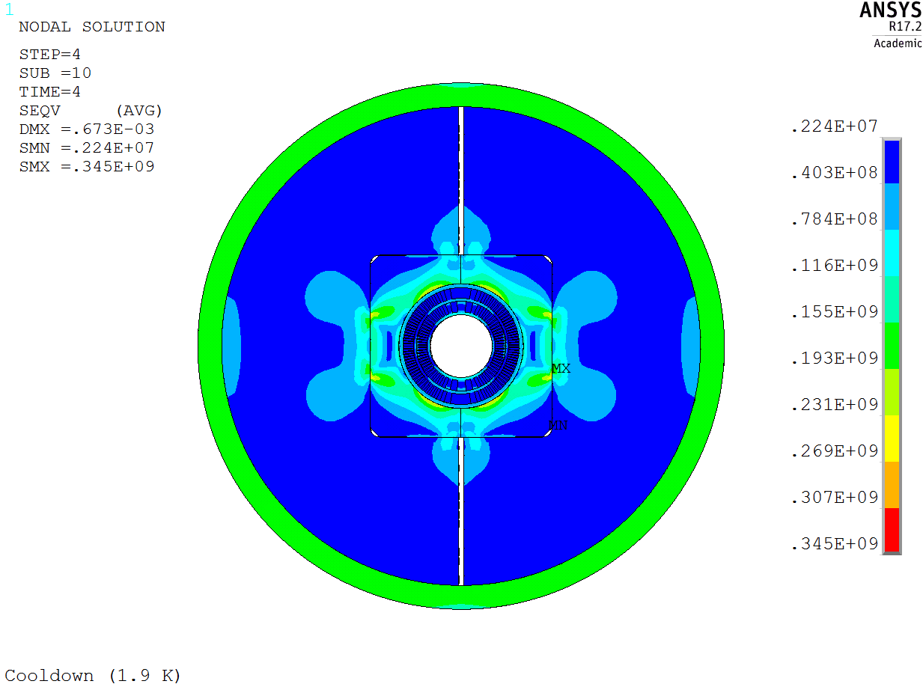
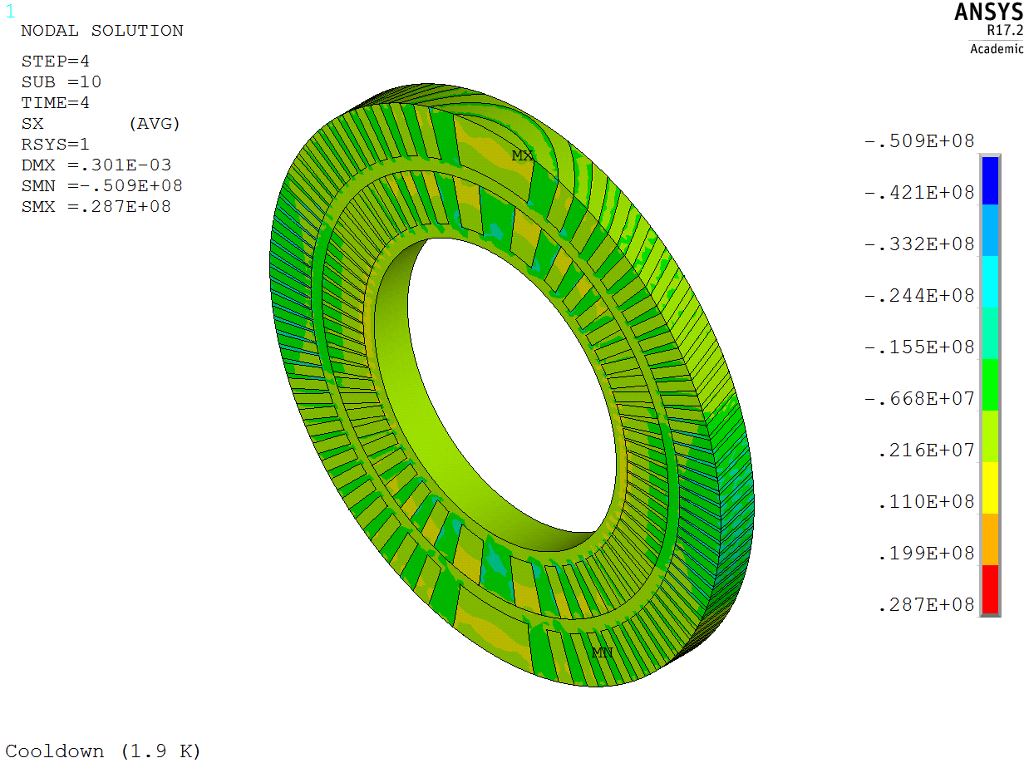
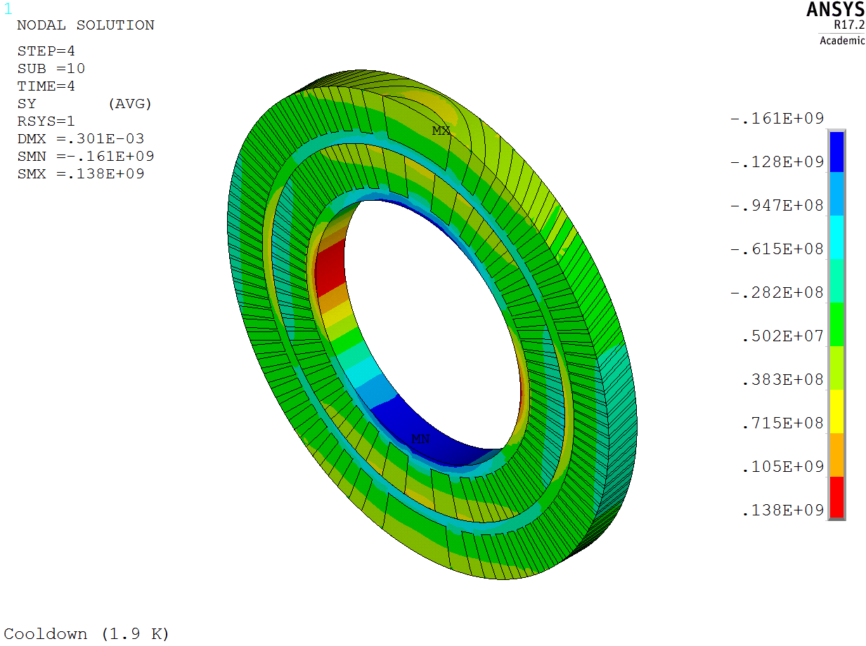
PSI CD1 dipole – Cool down
Component | σ_{r} [MPa] | σ_{θ} [MPa]
Conductor 1 | -21 | -73
Former 1 | -61 | -172
Conductor 2 | -23 | -49
Former 2 | -81 | -199
von Mises stress
Component | σ_{VM} [MPa] | σ_{limit} [MPa]
Conductor 1 | 59 | 200
Former 1 | 184 | 400
Conductor 2 | 44 | 200
Former 2 | 181 | 400
Prot. Shell | 162 | 690
Pads | 345 | 1050
Yoke | 242 | 720
Outer shell | 189 | 690
Radial stress
Azimuthal stress

Slide 12
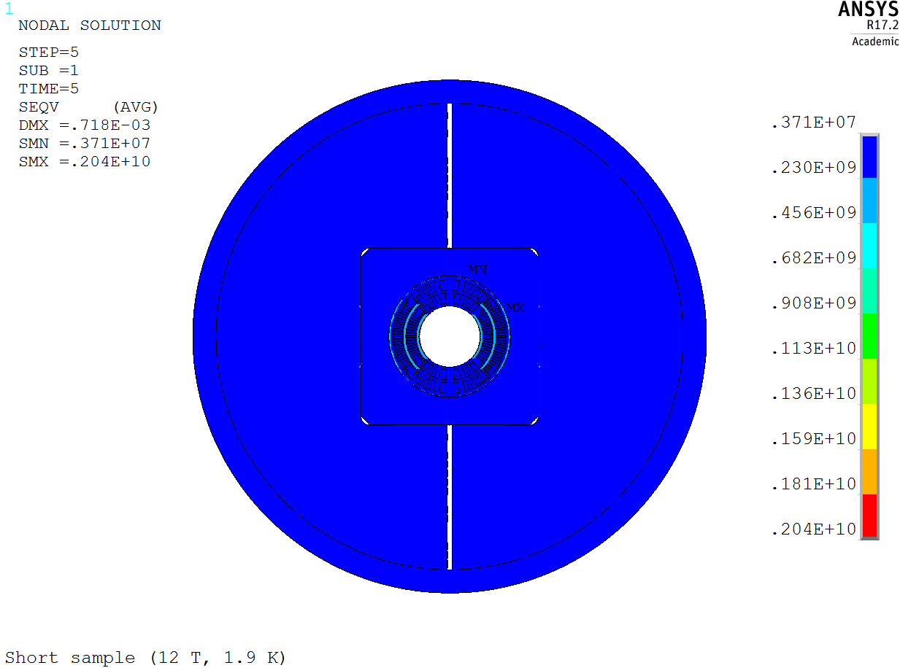
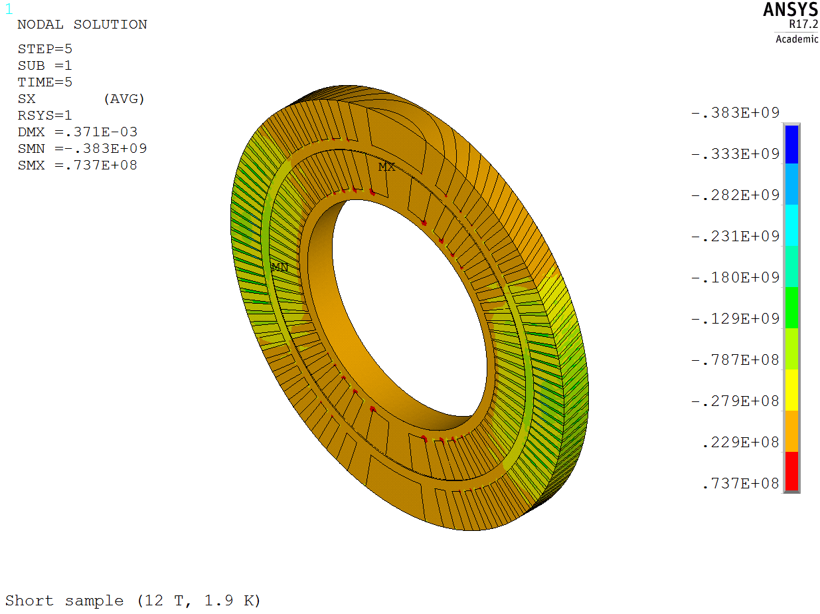
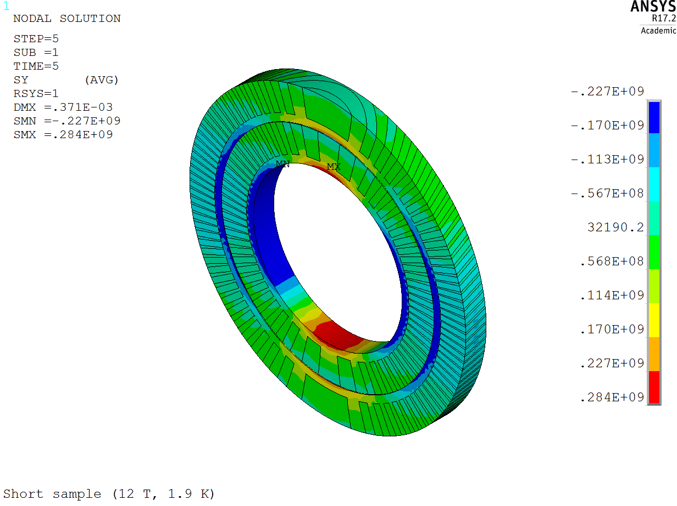
PSI CD1 dipole – Operation
Component | σ_{r} [MPa] | σ_{θ} [MPa]
Conductor 1 | -113 | -101
Former 1 | -383 | 284
Conductor 2 | -135 | -120
Former 2 | -315 | -255
von Mises stress
Component | σ_{VM} [MPa] | σ_{limit} [MPa]
Conductor 1 | 123 | 200
Former 1 | 380 | 400
Conductor 2 | 156 | 200
Former 2 | 437 | 400
Prot. Shell | 2040 | 690
Pads | 281 | 1050
Yoke | 320 | 720
Outer shell | 207 | 690
Radial stress
Azimuthal stress

Slide 13
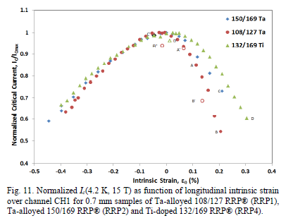
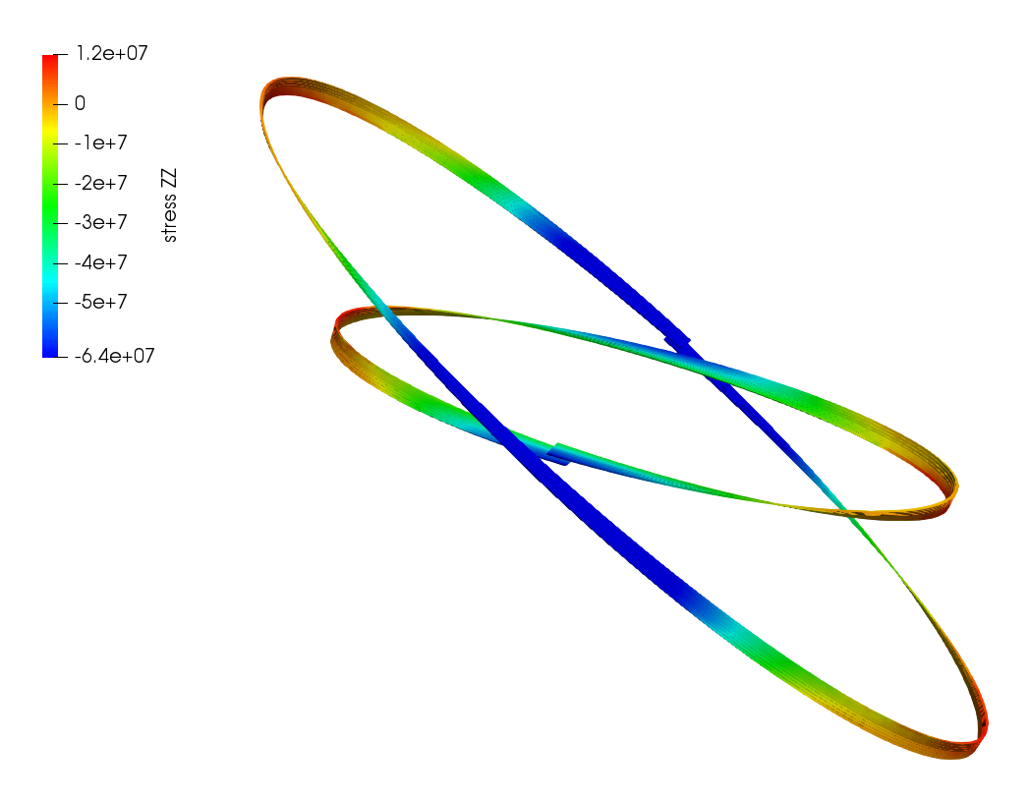
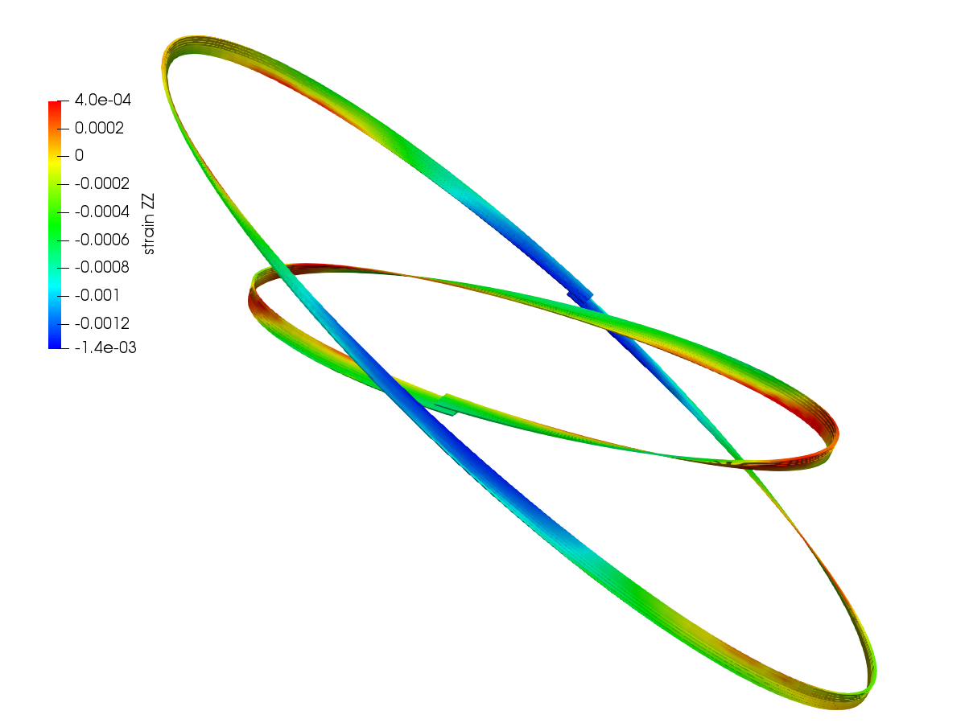
PSI CD1 dipole – Conductor stress & strain
Stress along the conductor
Stress [Pa]
Strain along the conductor
Strain reference from:
  “Progress in Nb3Sn RRP strand studies and Rutherford cable development at FNAL, Barzi E. et al., FERMILAB-CONF-13-298-TD
Peak strain along the conductor resulting in minimal current degradation based on measured reference values
Strain [m]

Slide 14
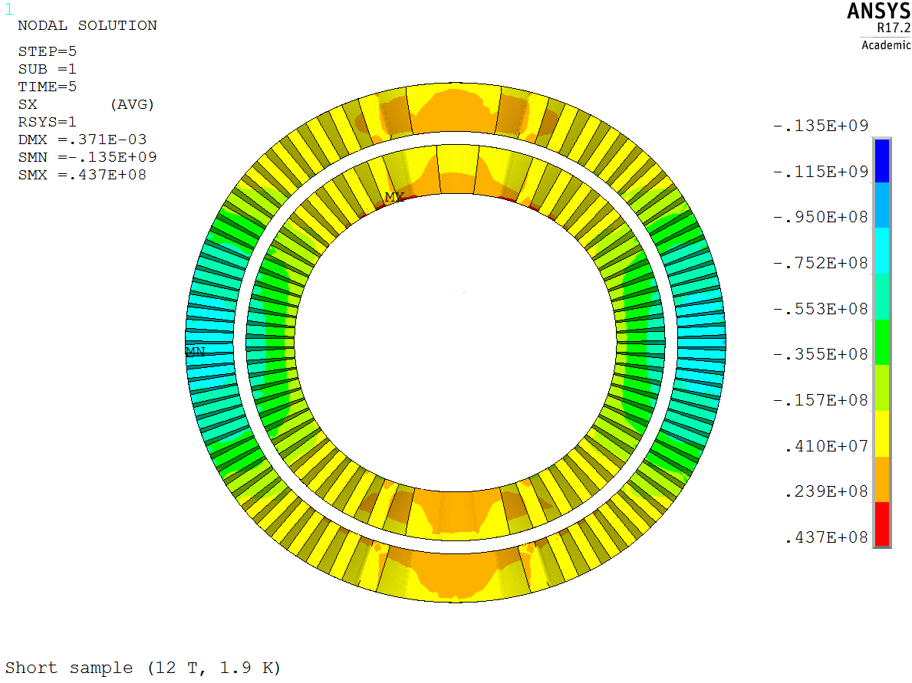
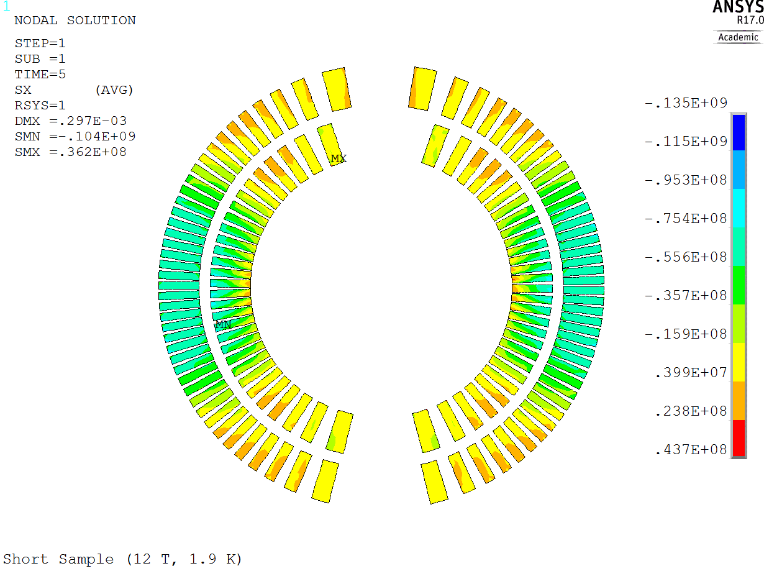
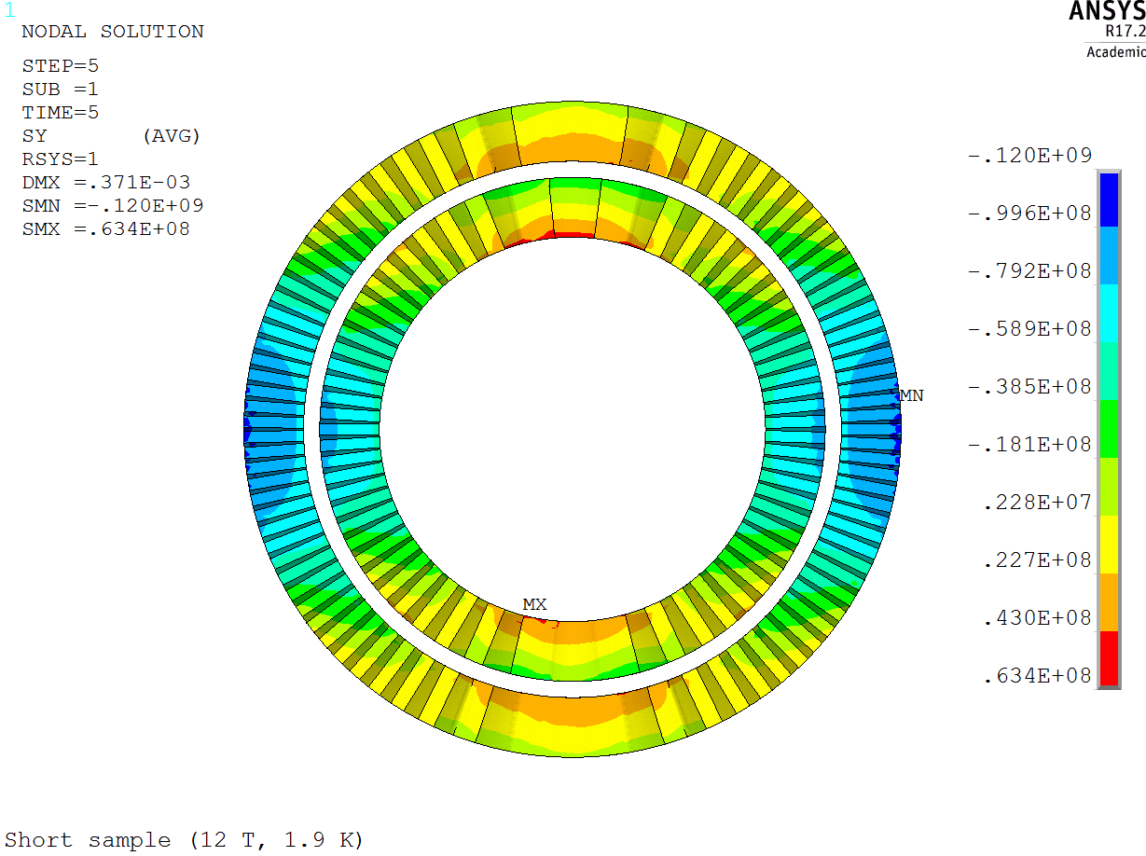
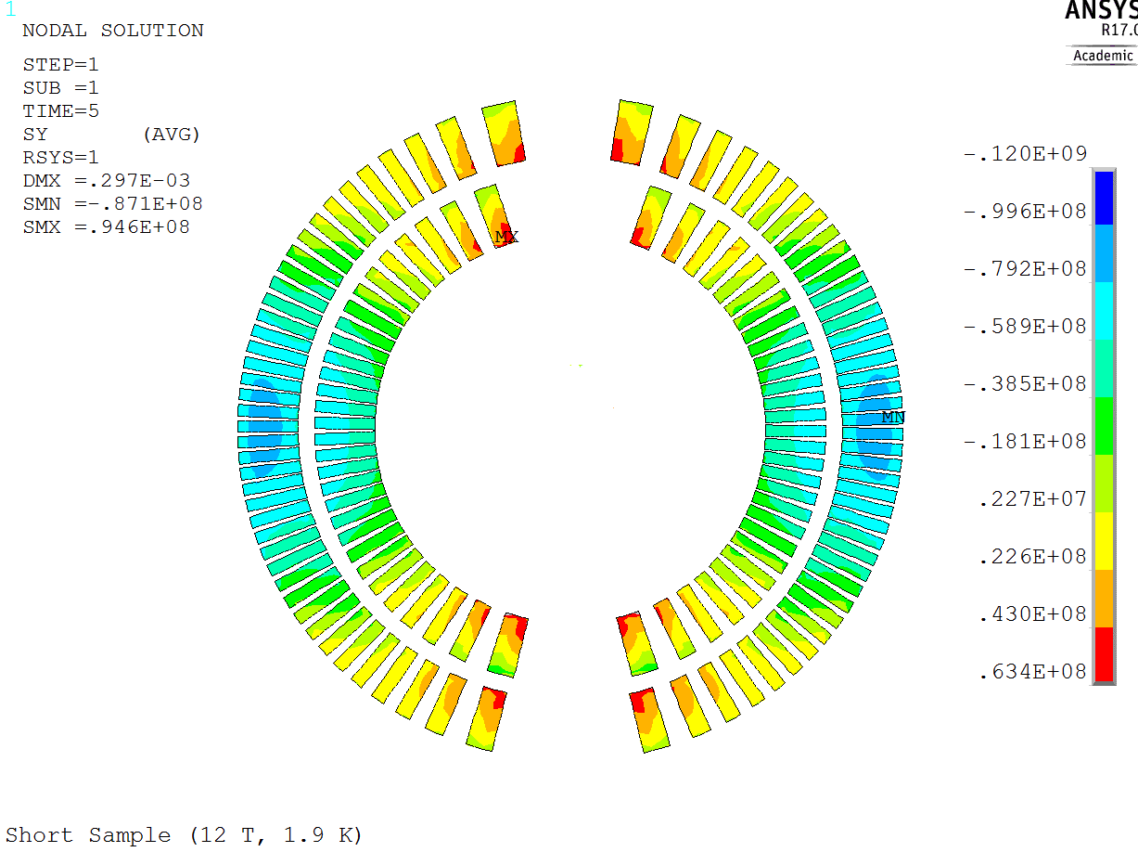
PSI CD1 dipole – Comparison with 2D analysis
Conductor – Radial stress
Conductor – Azimuthal stress

Slide 15
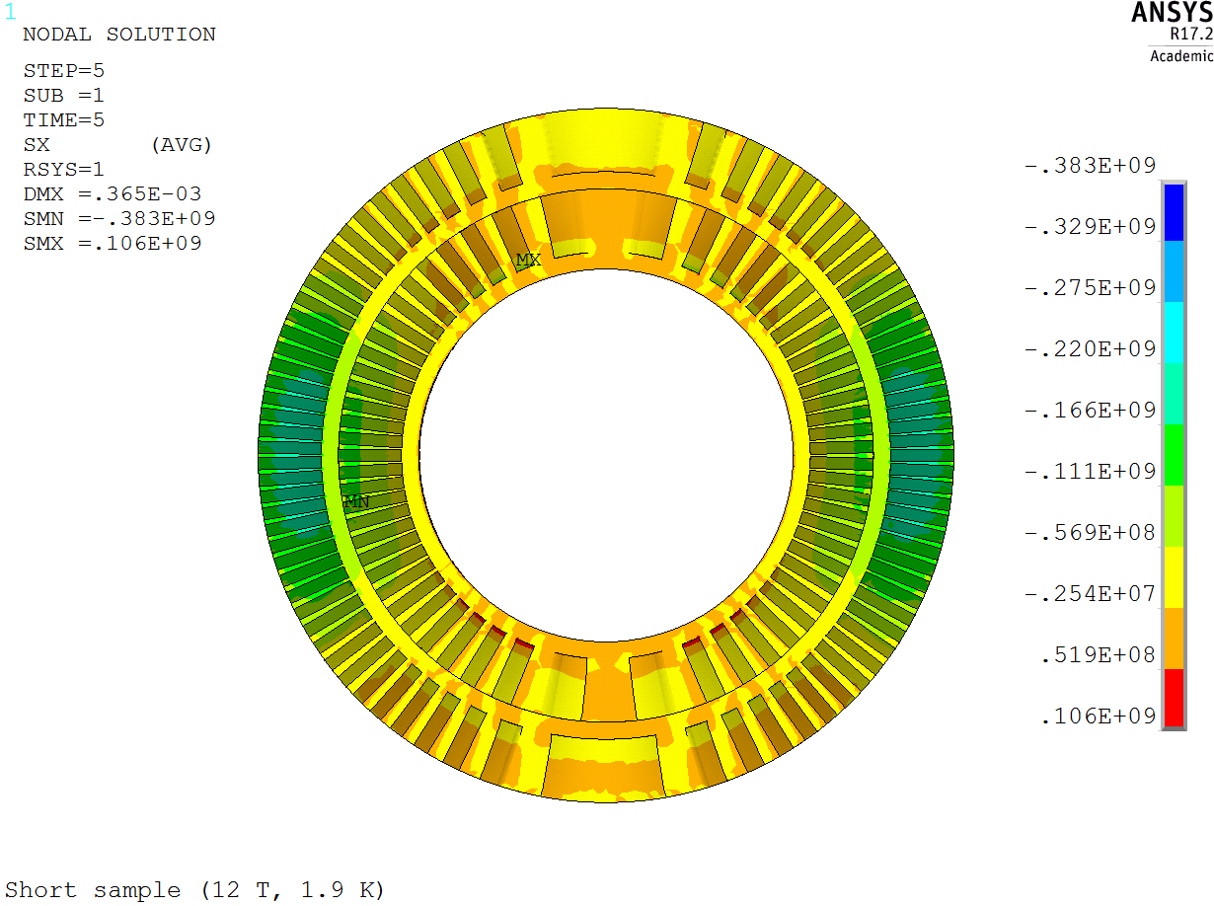
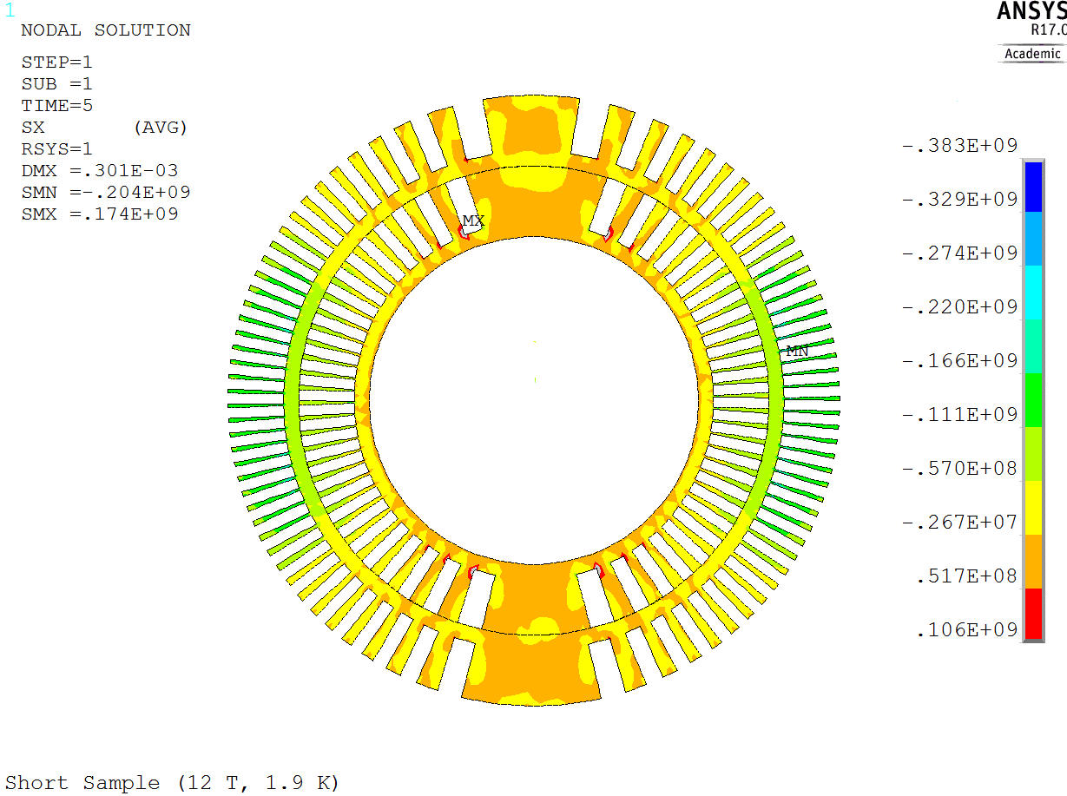
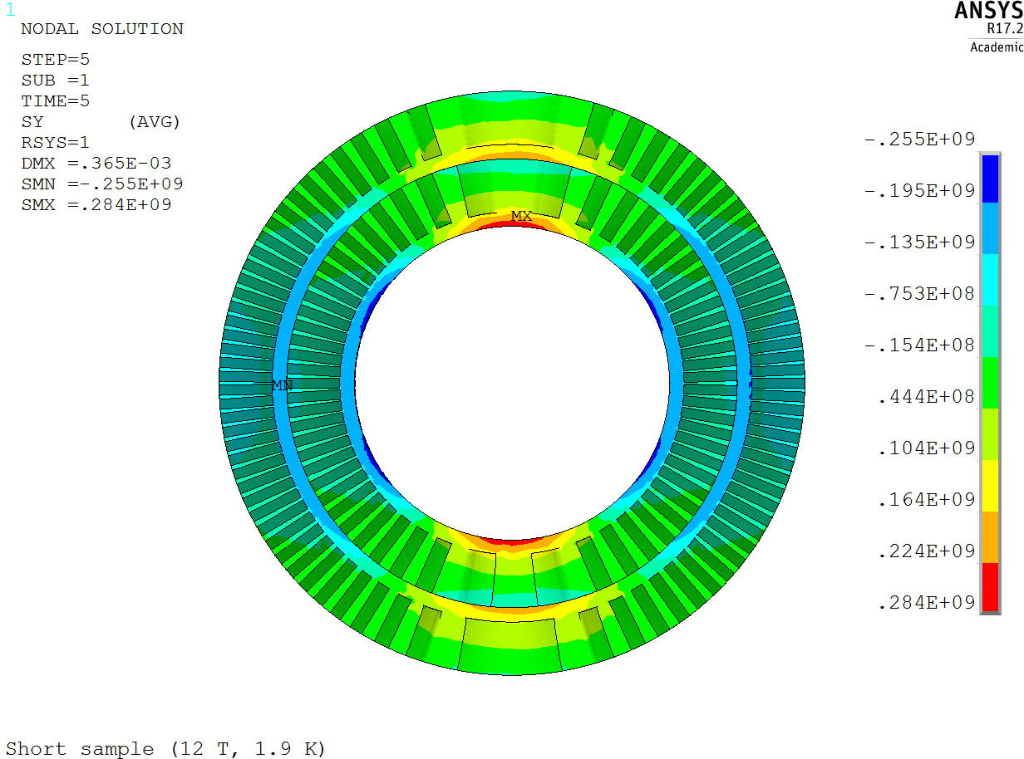
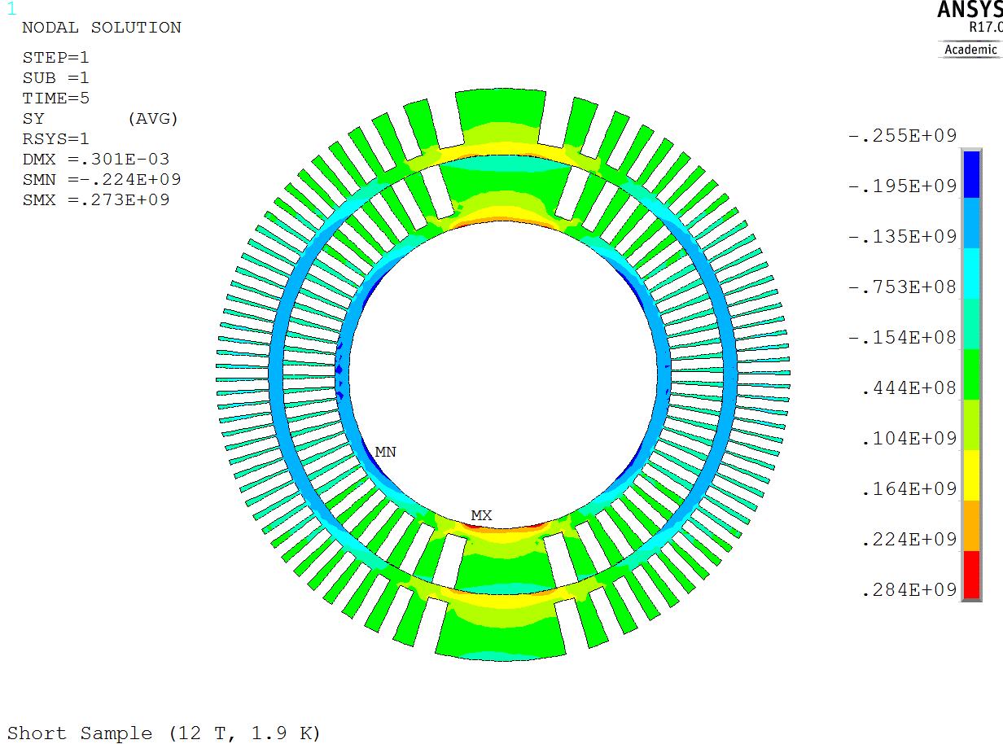
PSI CD1 dipole – Comparison with 2D analysis
Former – Radial stress
Former – Azimuthal stress

Slide 16
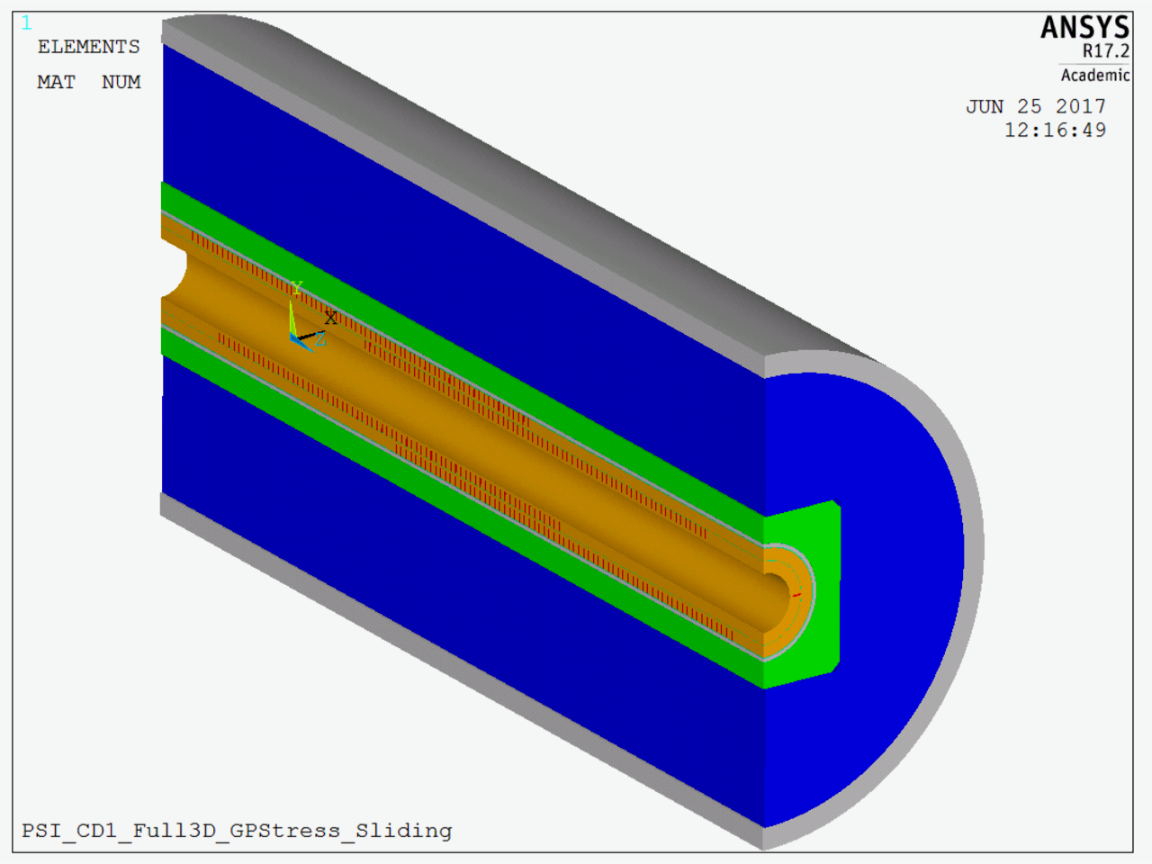
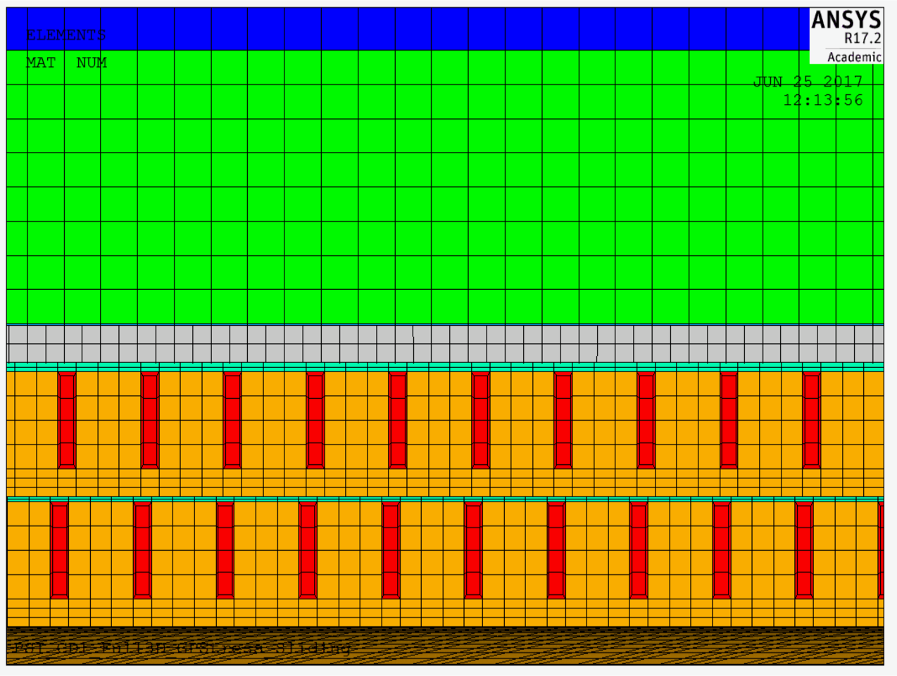
Full length 3D model
Development of the full length 3D model of the PSI CD1 is ongoing
Full coil geometry and mechanical structure already generated in ANSYS
Definition of contacts and solution steps in progress
Future developments:
  Epoxy layer around conductor
  Anisotropic epoxy properties

Slide 17
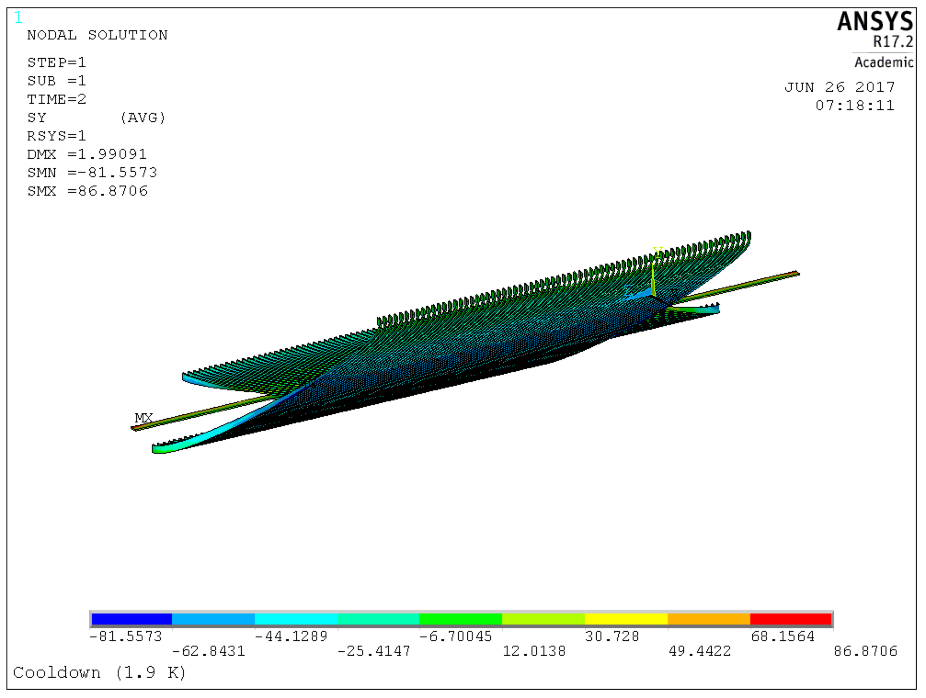
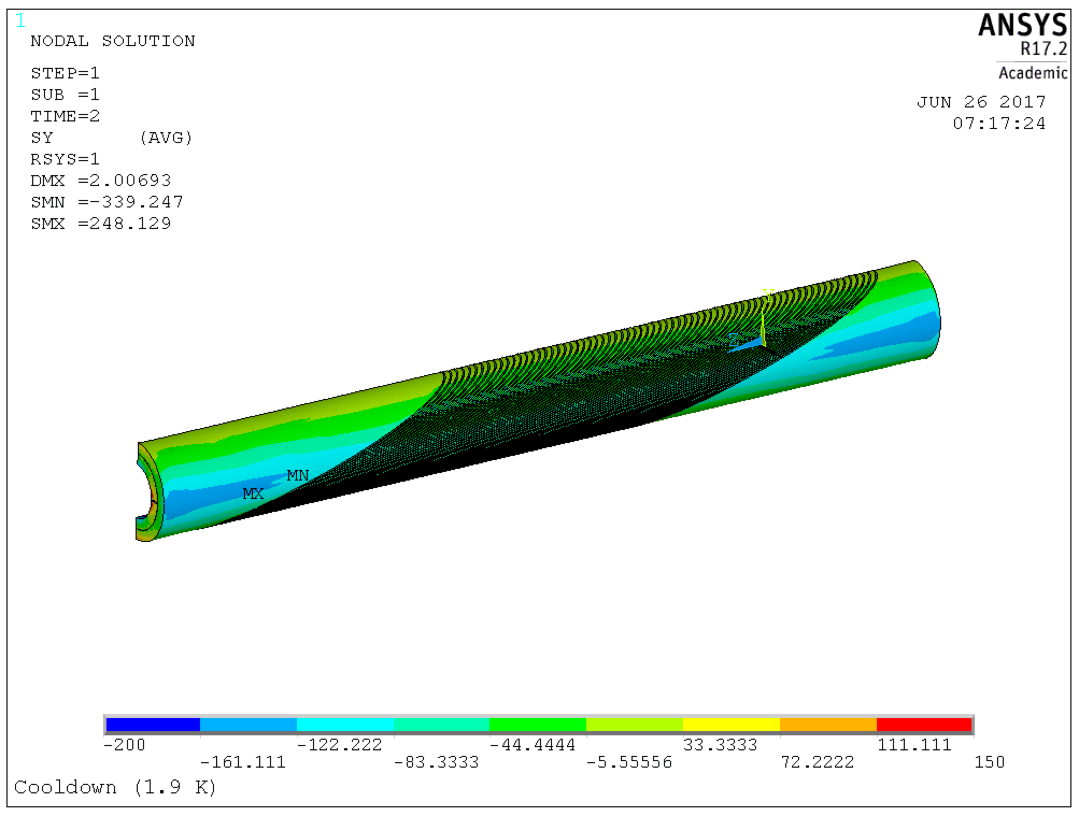
Full length 3D model
Azimuthal stress in conductor and former in the PSI CD1 dipole with bonded layers

Slide 18
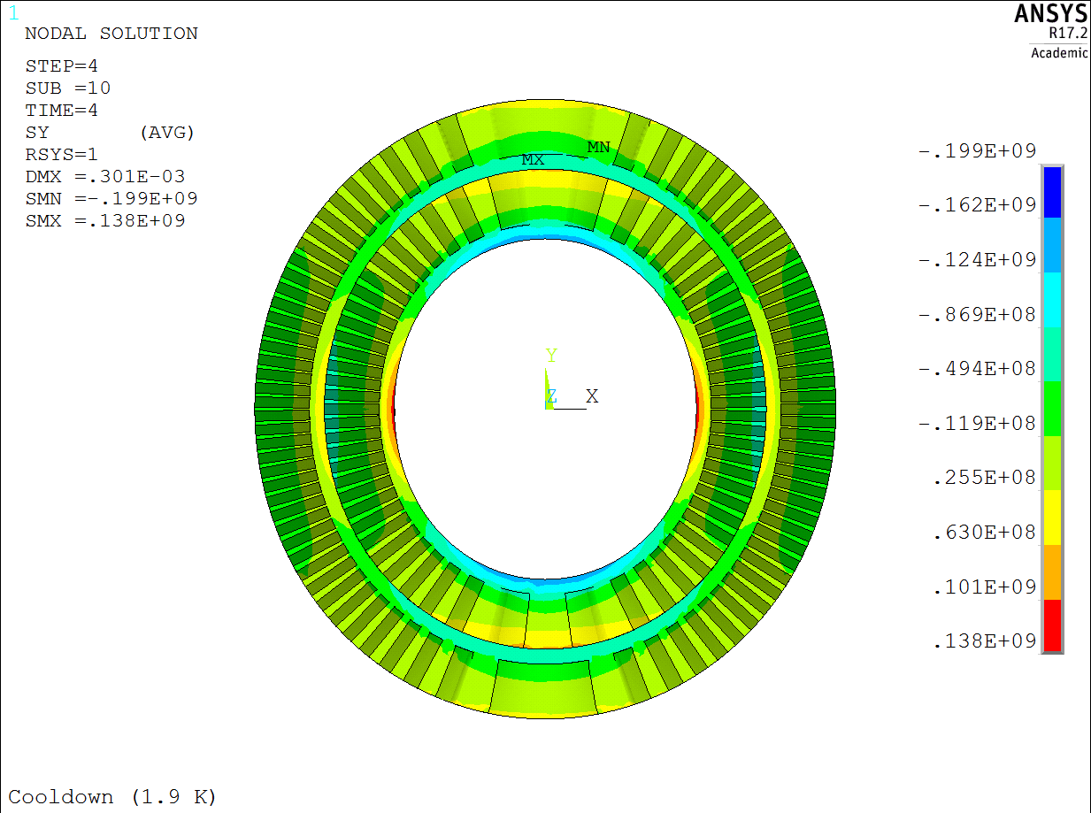
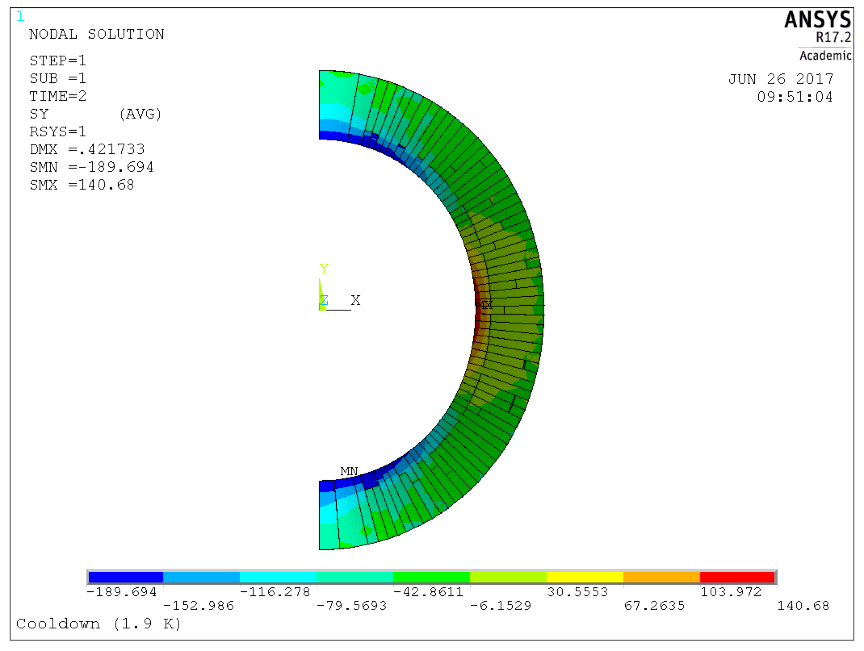
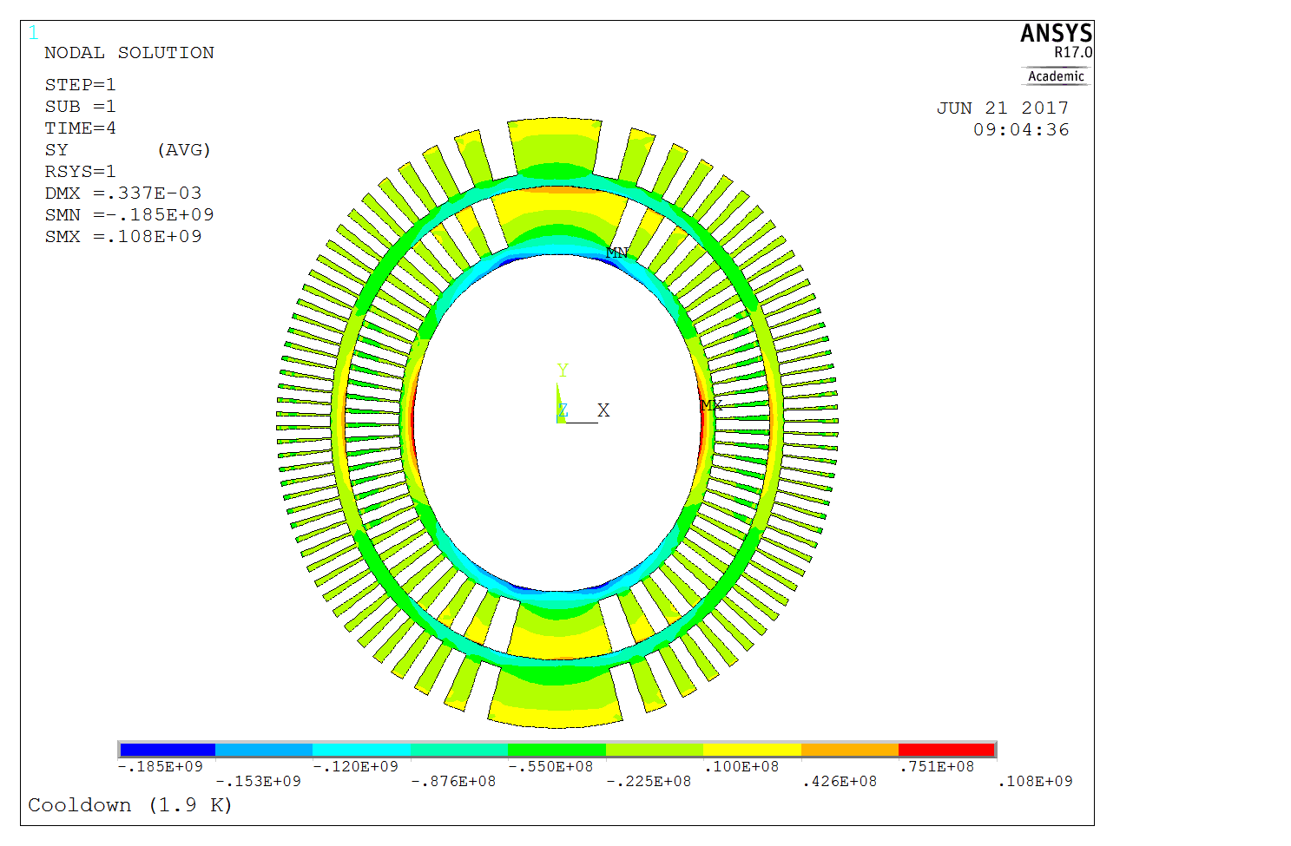
Full length 3D model
3D slice model -sliding contact
Comparison of stress in the former at the center of the coil after cool down
2D model - sliding contact
Full length 3D model with bonded layers
Stress in MPa

Slide 19
Conclusions & next
Developed a 3D CCT slice model with sliding interface between CCT layers and Generalized Plane Stress boundary conditions
Other boundary and layer-to-layer interface conditions tested as well (results not presented)
Good comparison between 2D and 3D analysis: fast 2D model can be used for preliminary mechanical analysis
Radial and azimuthal stress in conductor and former below max allowed values at each assembly and operation step
Excessive vonMises stress in protective shell during operation likely related to BCs. To be further analyzed with full 3D model
Full length 3D model of the CD1 dipole under development to understand stress distribution along the magnet
Page 19

Slide 20
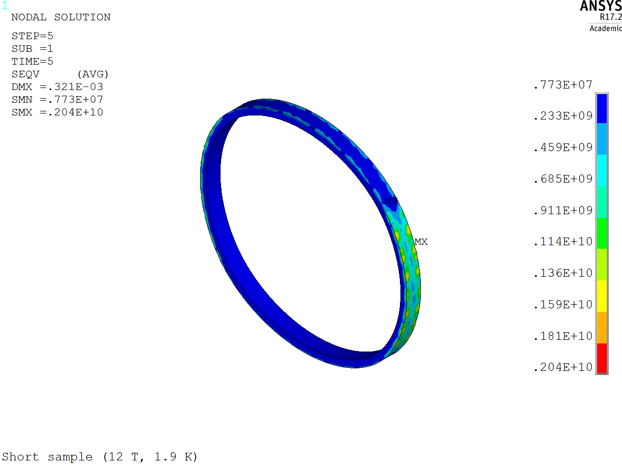
Protective shell – von Mises stress at Operation
Page 20

Slide 21
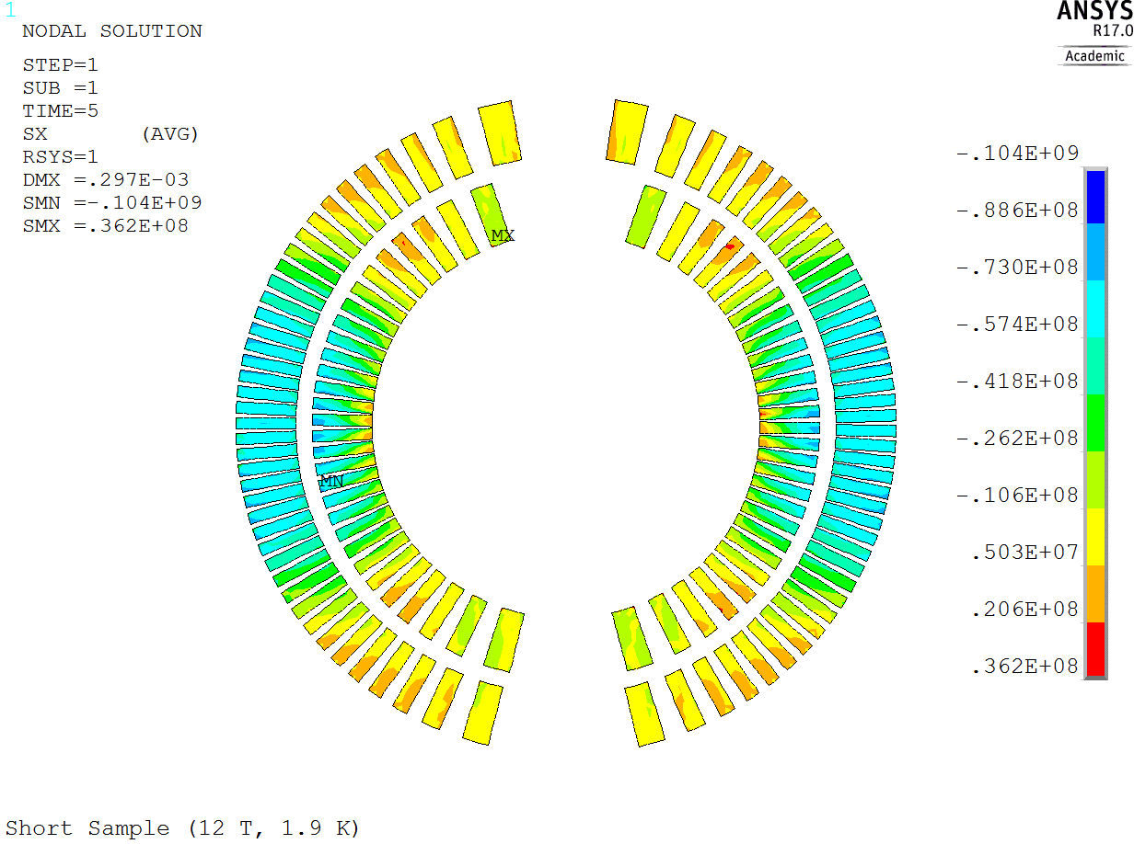
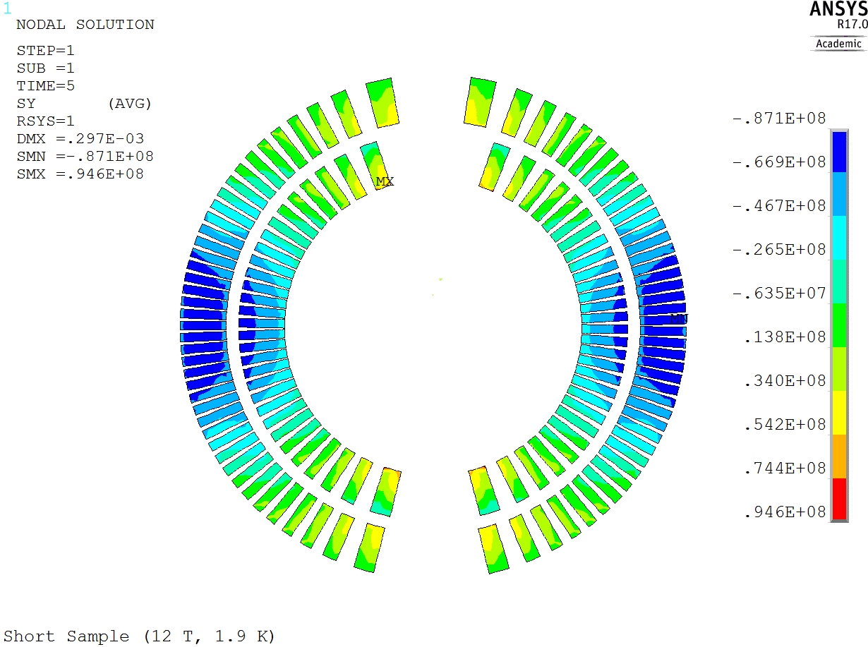
PSI CD1 dipole – Comparison with 2D analysis
Conductor – Radial stress
Conductor – Azimuthal stress

Slide 22
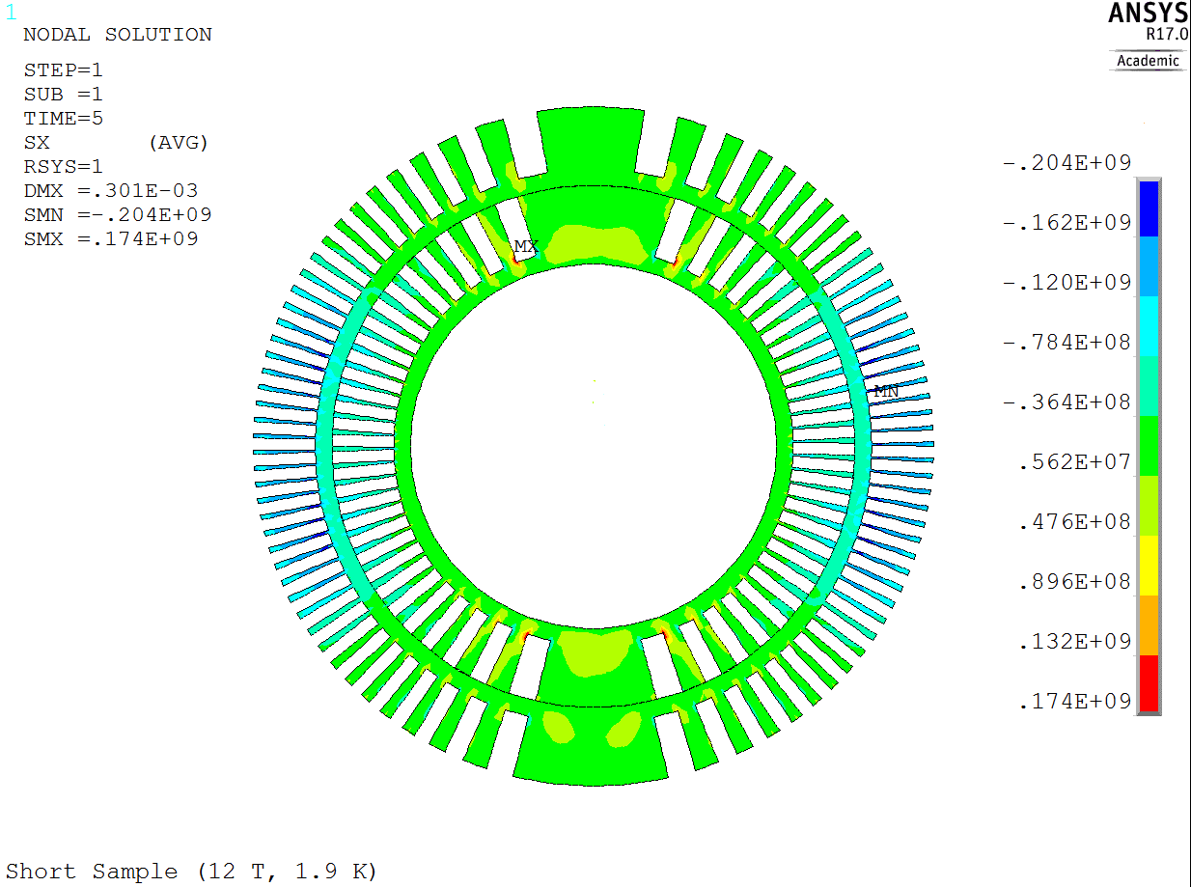
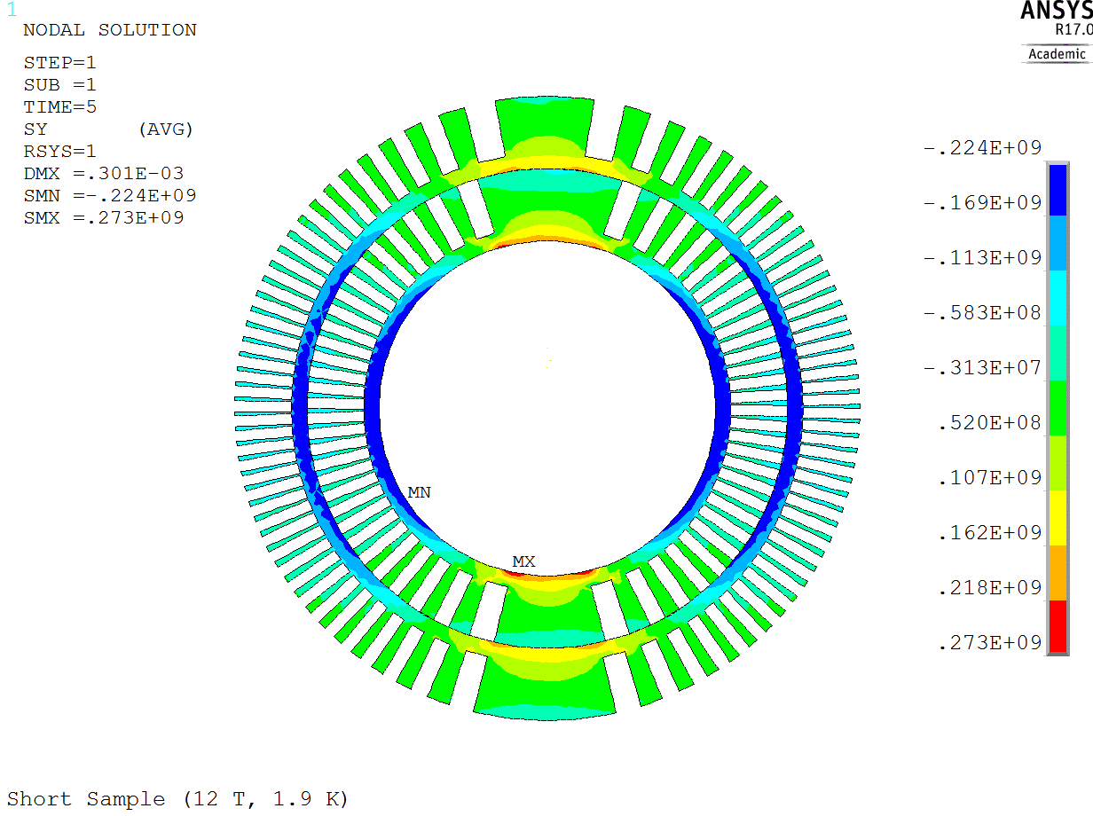
PSI CD1 dipole – Comparison with 2D analysis
Former – Radial stress
Former – Azimuthal stress

Slide 23
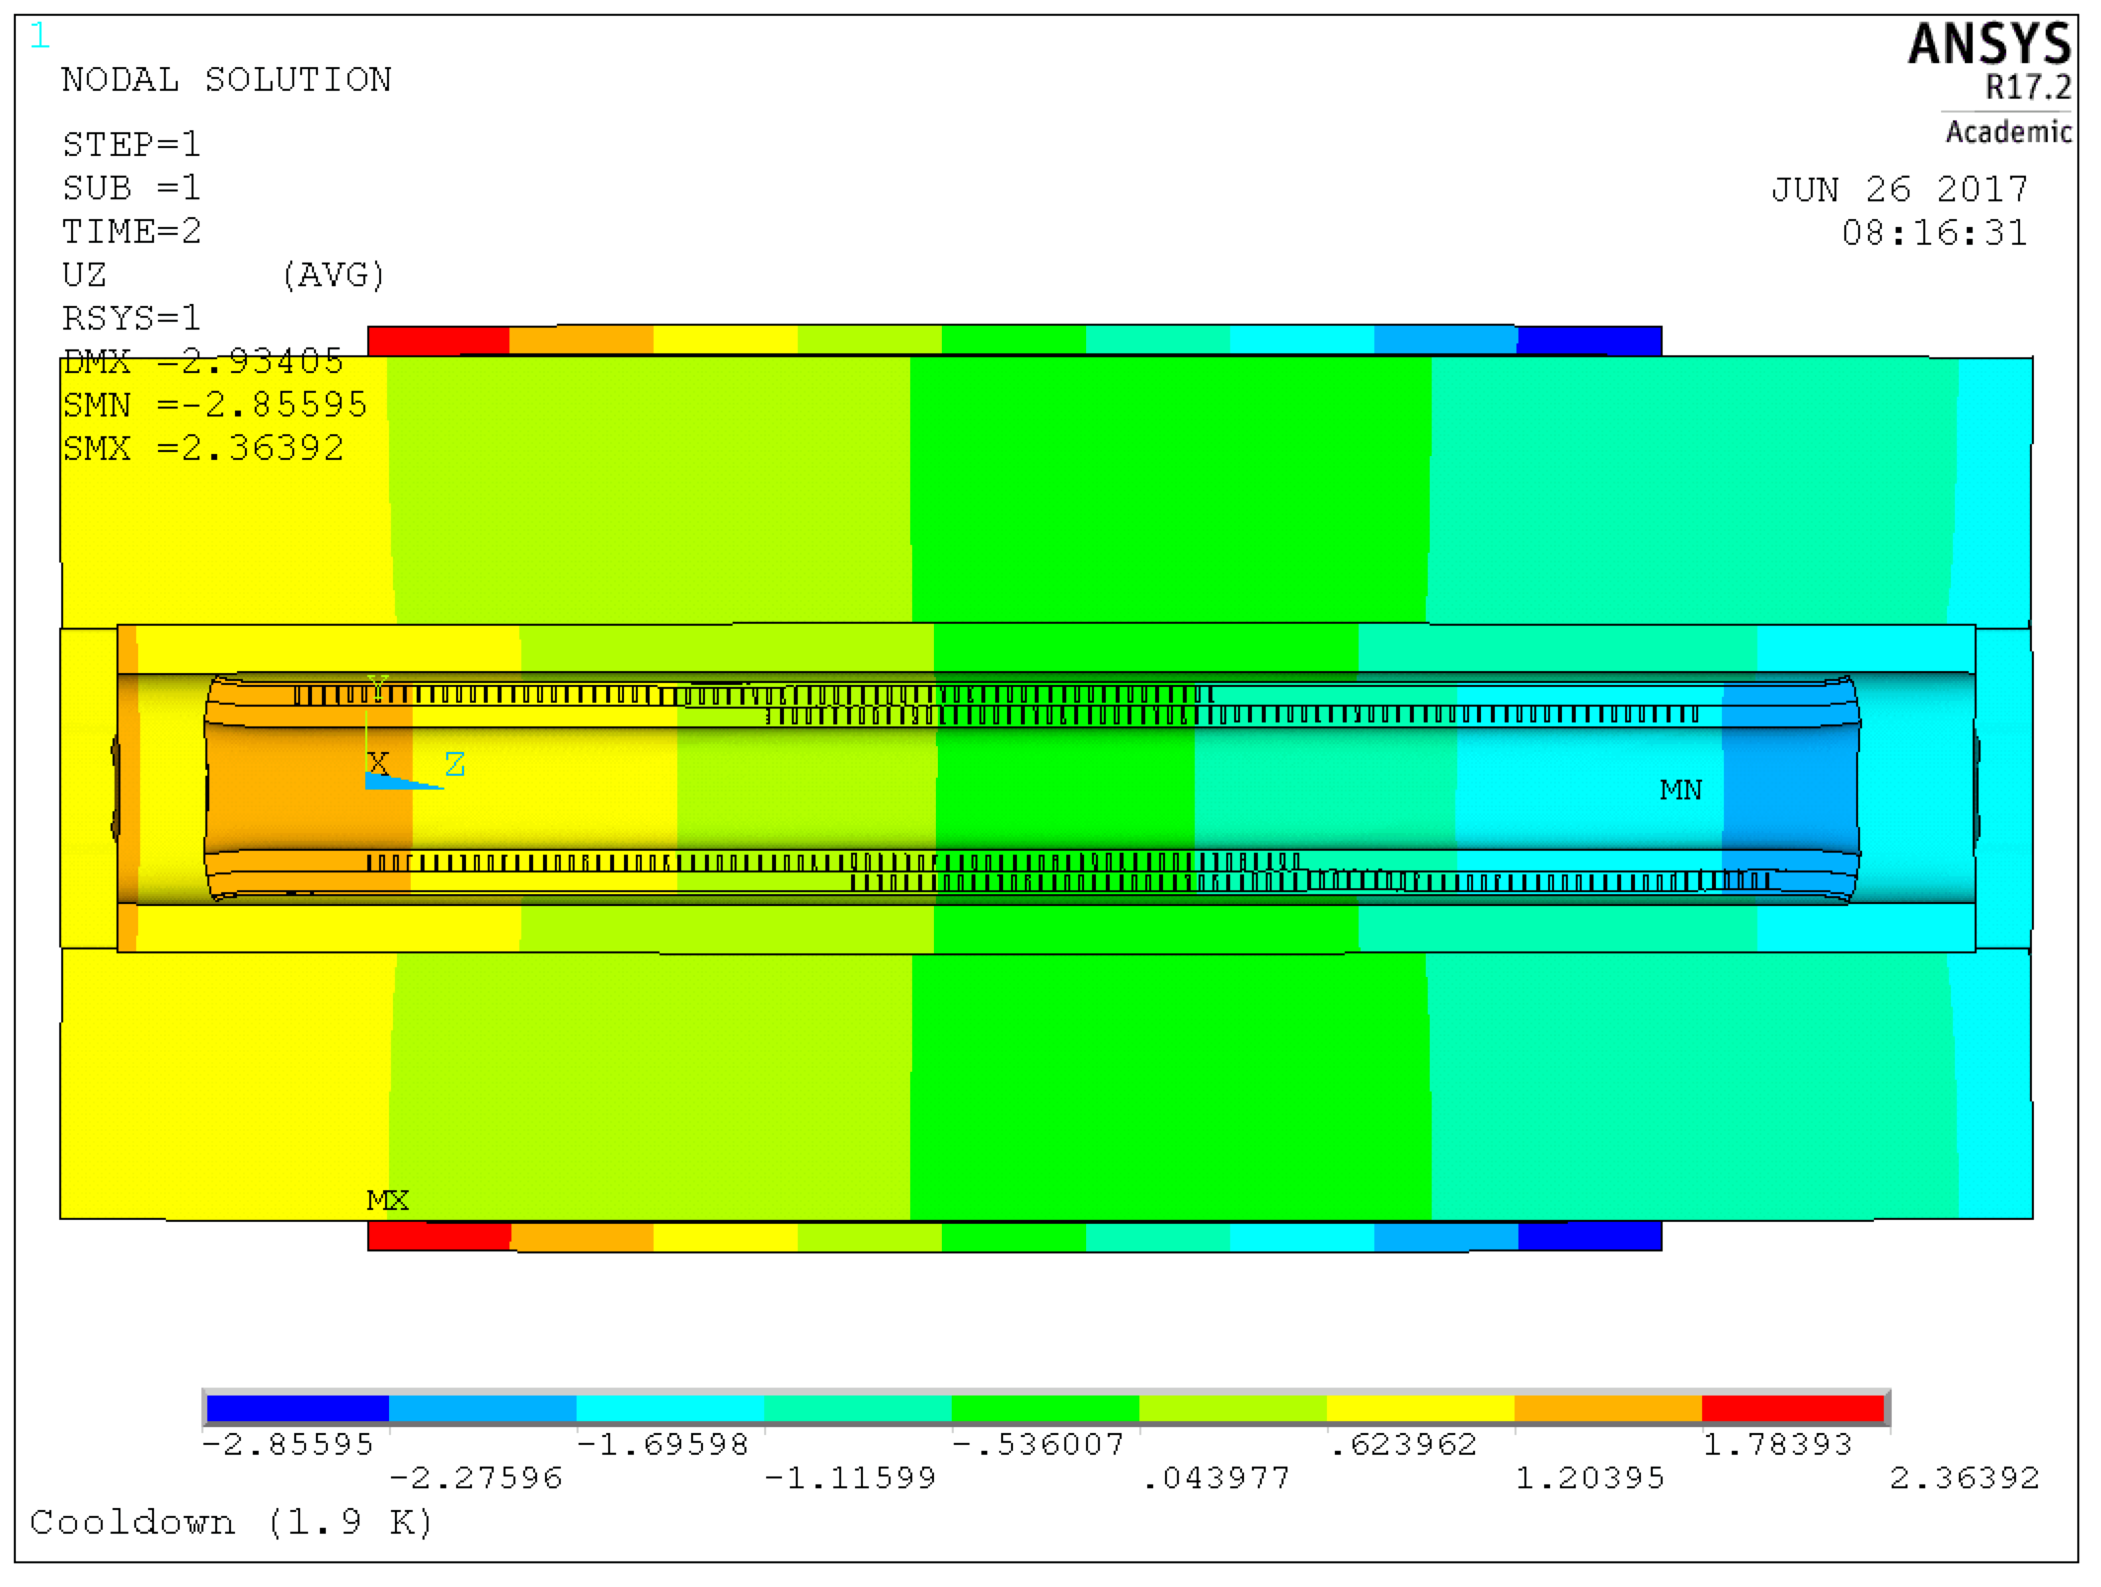
PSI CD1 dipole – Full length 3D model

Slide 24
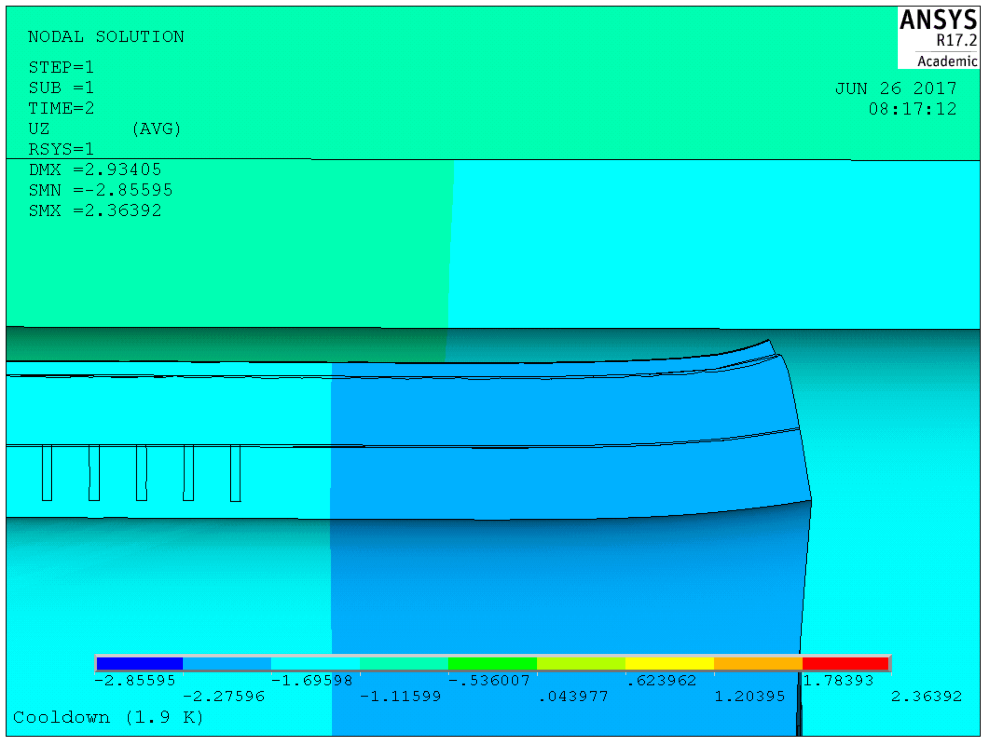
PSI CD1 dipole – Full length 3D model

