Slide 1
2D Sensitivity Study and Critical Tolerances of CD1 Magnet
G. Montenero¹ , B. Auchmann^{1,2} , and G. Rolando²
1) Paul Scherrer Institut
2) CERN
26 June 2017

Slide 2
Summary
2D Mechanical modelling of CD1 dipole with ANSYS
Design’s objectives
Baseline Design (+ excursus on CD2)
Nominal Design vs. Material Properties
Mechanical tolerances
Parametric Study
Conclusions

Slide 3
Summary
2D Mechanical modelling of CD1 dipole with ANSYS
Design’s objectives
Baseline Design (+ excursus on CD2)
Nominal Design vs. Material Properties
Mechanical tolerances
Parametric Study
Conclusions

Slide 4
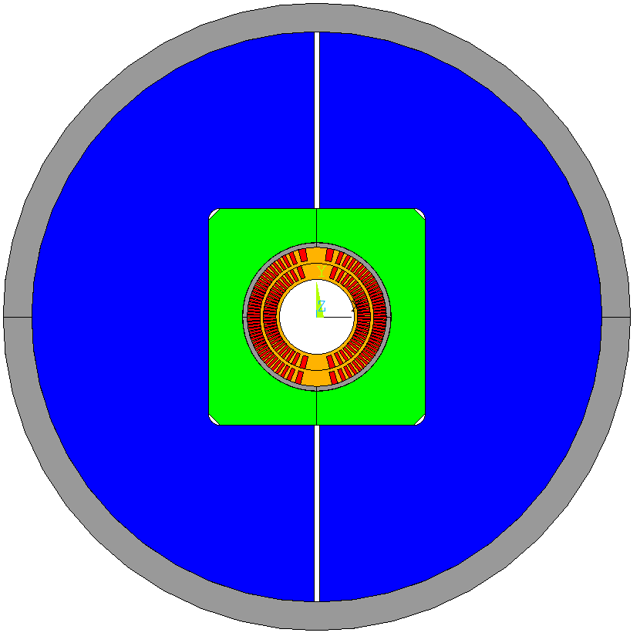
2D Mechanical modelling
Setup of the numerical simulations (ANSYS)
Horizontal and vertical keys
Steel Pads
  The simulation is divided in 5 load steps:
    Vertical bladders inflation (max 40 MPa pressure) and vertical keys insertion
    Vertical bladders deflation and horizontal bladder inflation (max 40 MPa pressure) with horizontal keys insertion
    Horizontal bladders deflation-> assembly at room temperature
    Cool down of the assembly to 1.9 K
    Operation->Lorenz forces acting on the conductor according to short sample limit (1.9 K, 12 T)
2
Coil Pack
1
Al Shell
horizontal and vertical bladders
Iron Yoke

Slide 5
Summary
2D Mechanical modelling of CD1 dipole with ANSYS
Design’s objectives
Baseline Design (+ excursus on CD2)
Nominal Design vs. Material Properties
Mechanical tolerances
Parametric Study
Conclusions

Slide 6
Design’s Objectives
What we care the most
  Limit the maximum stress on the conductor
  Keep the maximum stress of the mandrel below 0.2% yield stress
  Guarantee:
    pad/pad contact interface
    Extra margins for steel pads configuration (using in the simulations Lorenz force maps associated to ultimate load (12 T, I_{ss}=20 kA at 1.9 K))
For the other materials of the assembly
  Aluminum for external and coil assembly shells (Al 7075)
  Ferromagnetic Iron yoke
  Steel for the pads (316LN)
Notes:
Table for objectives

Slide 7
2D Mechanical modelling of CD1 dipole with ANSYS
Design’s objectives
Baseline Design (+ excursus on CD2)
The Design vs. Material Properties
Mechanical tolerances
Parametric Study
Conclusions

Slide 8
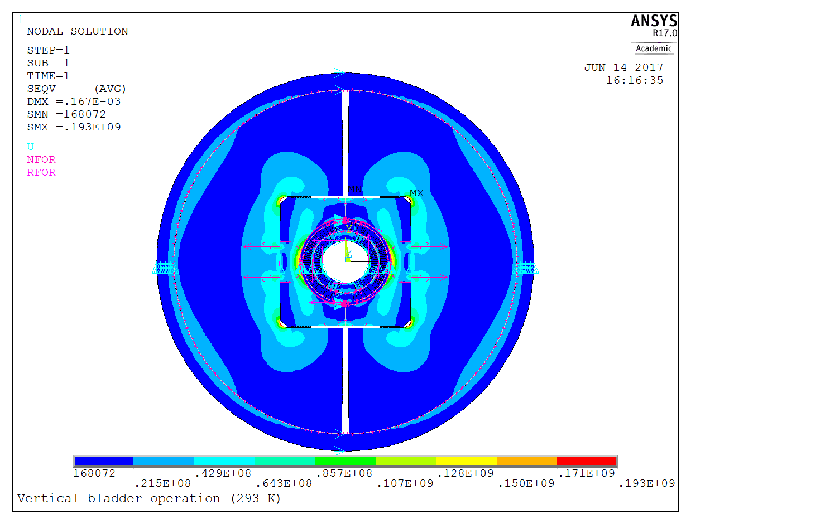
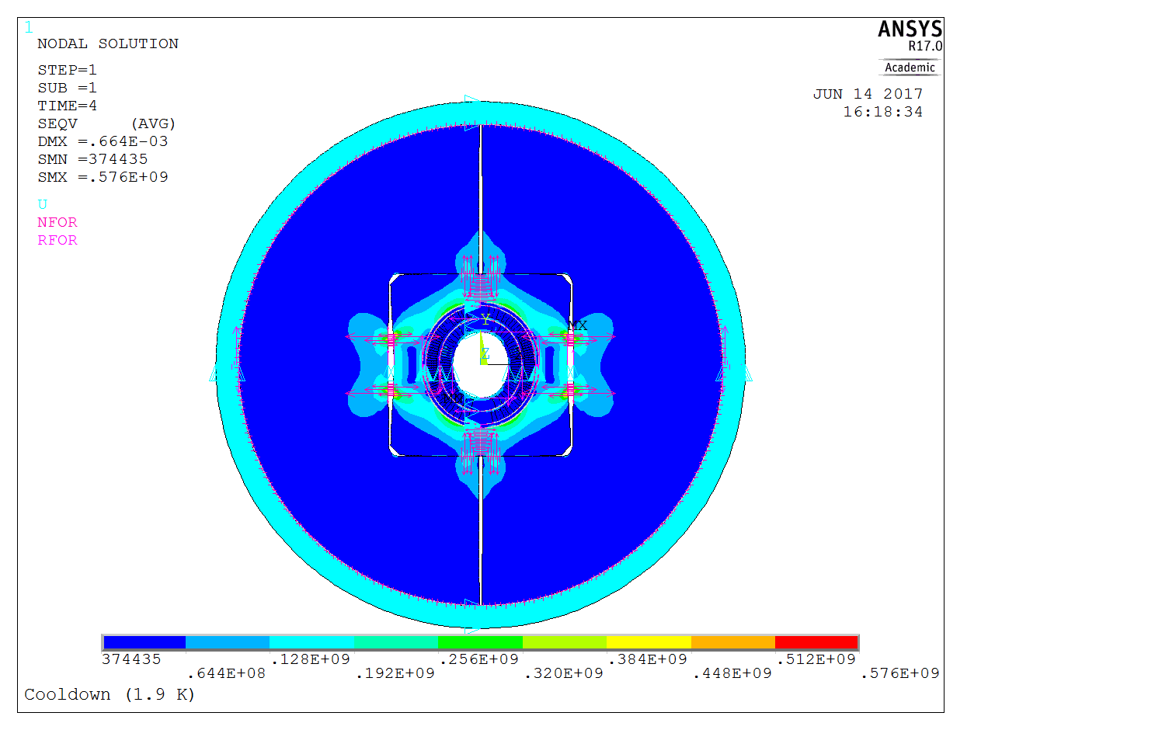
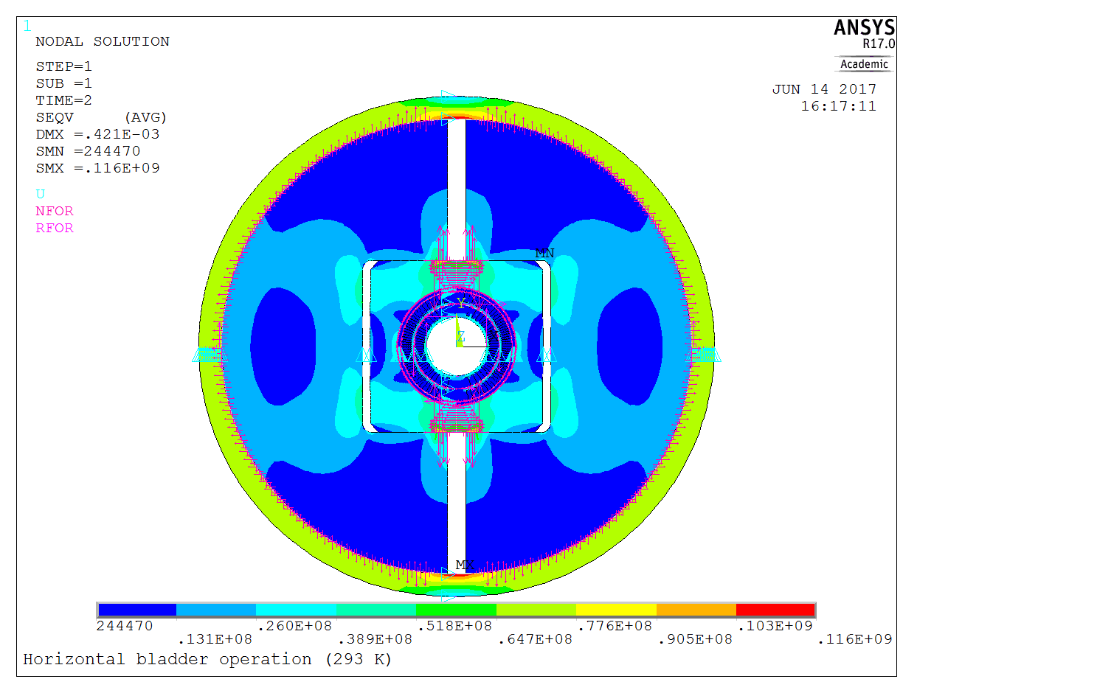
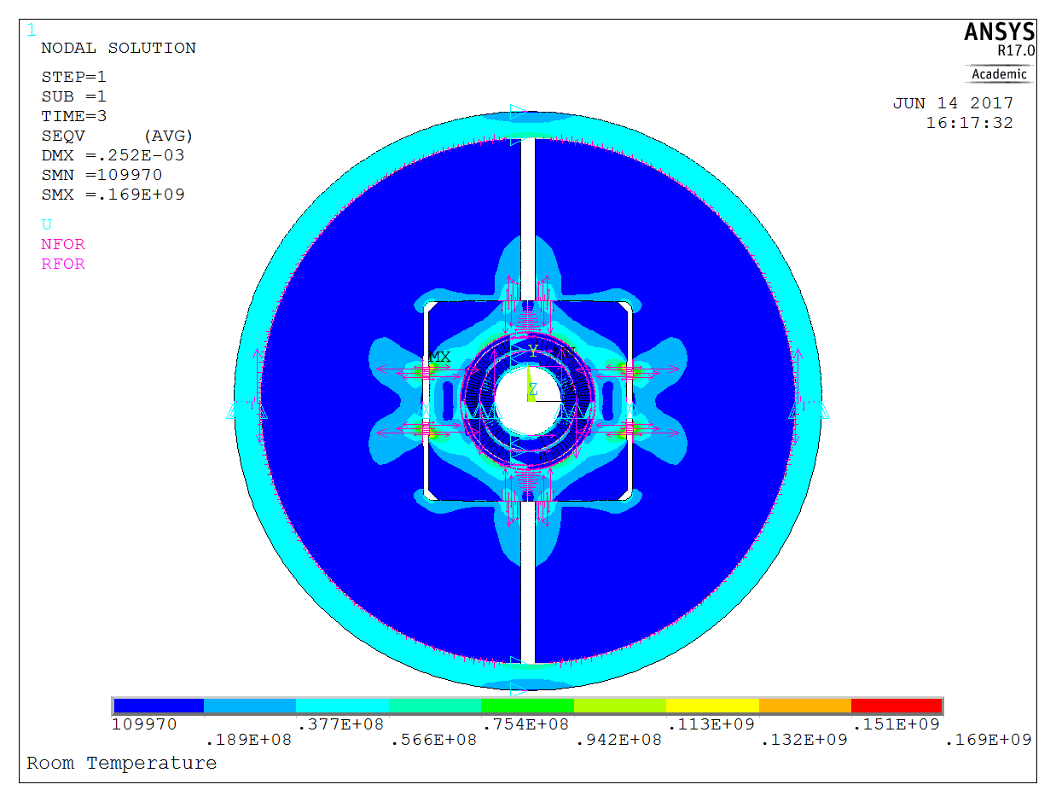
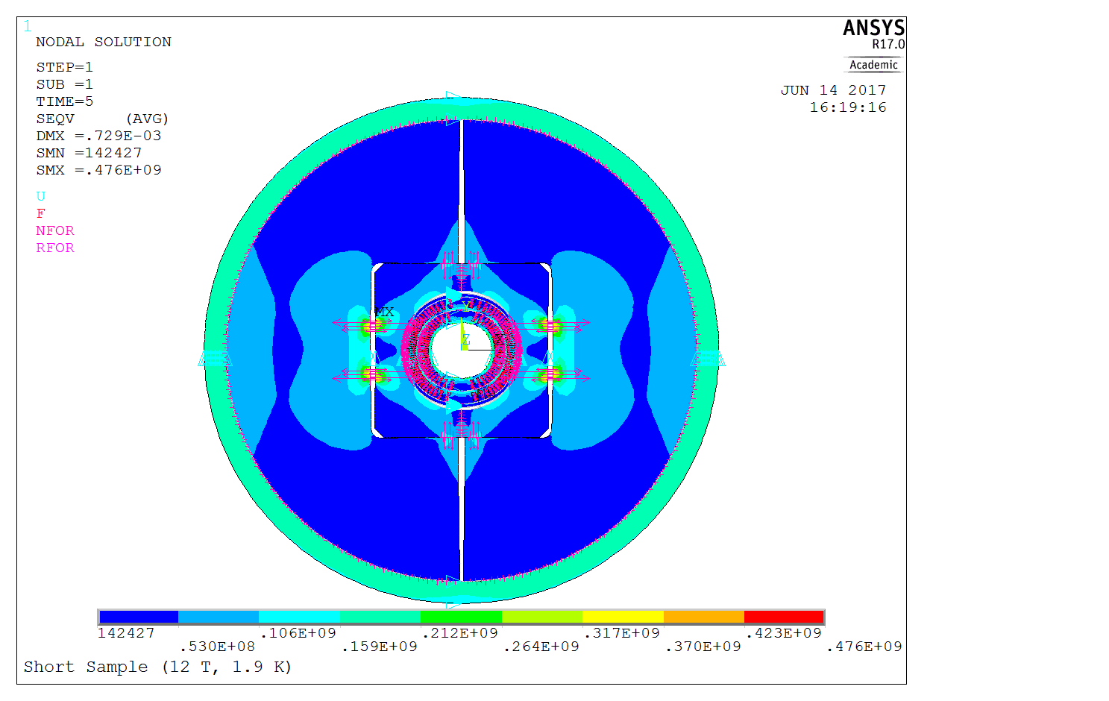
The Magnet
Assembly - room temp.
Cool down 1.9 K
Vert. bladder operation
Hor. bladder operation
Operation at short sample limit (1.9 K, 12 T)
Room temp. steps
1.9 K steps

Slide 9
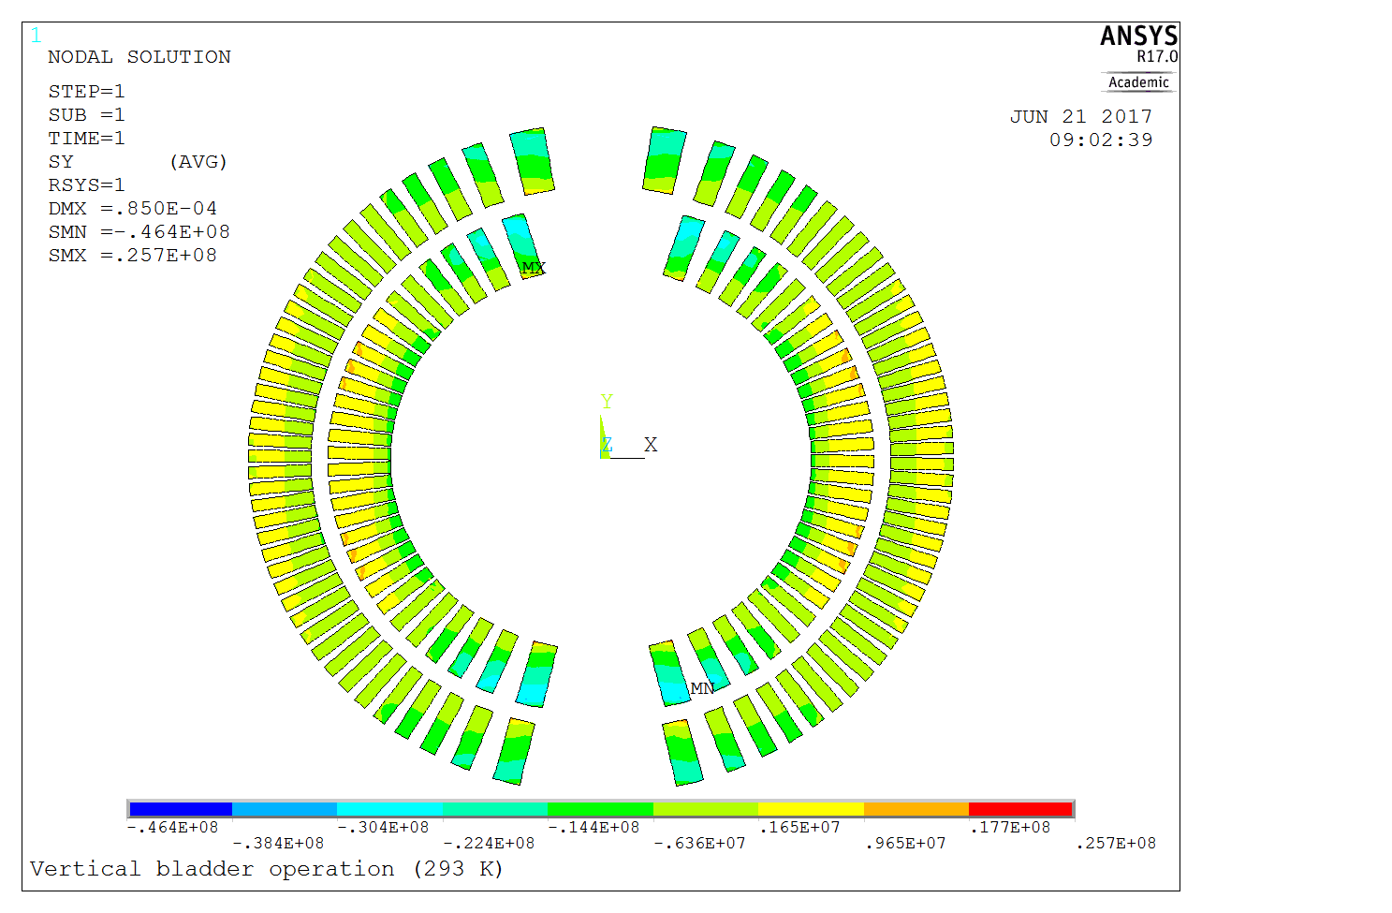
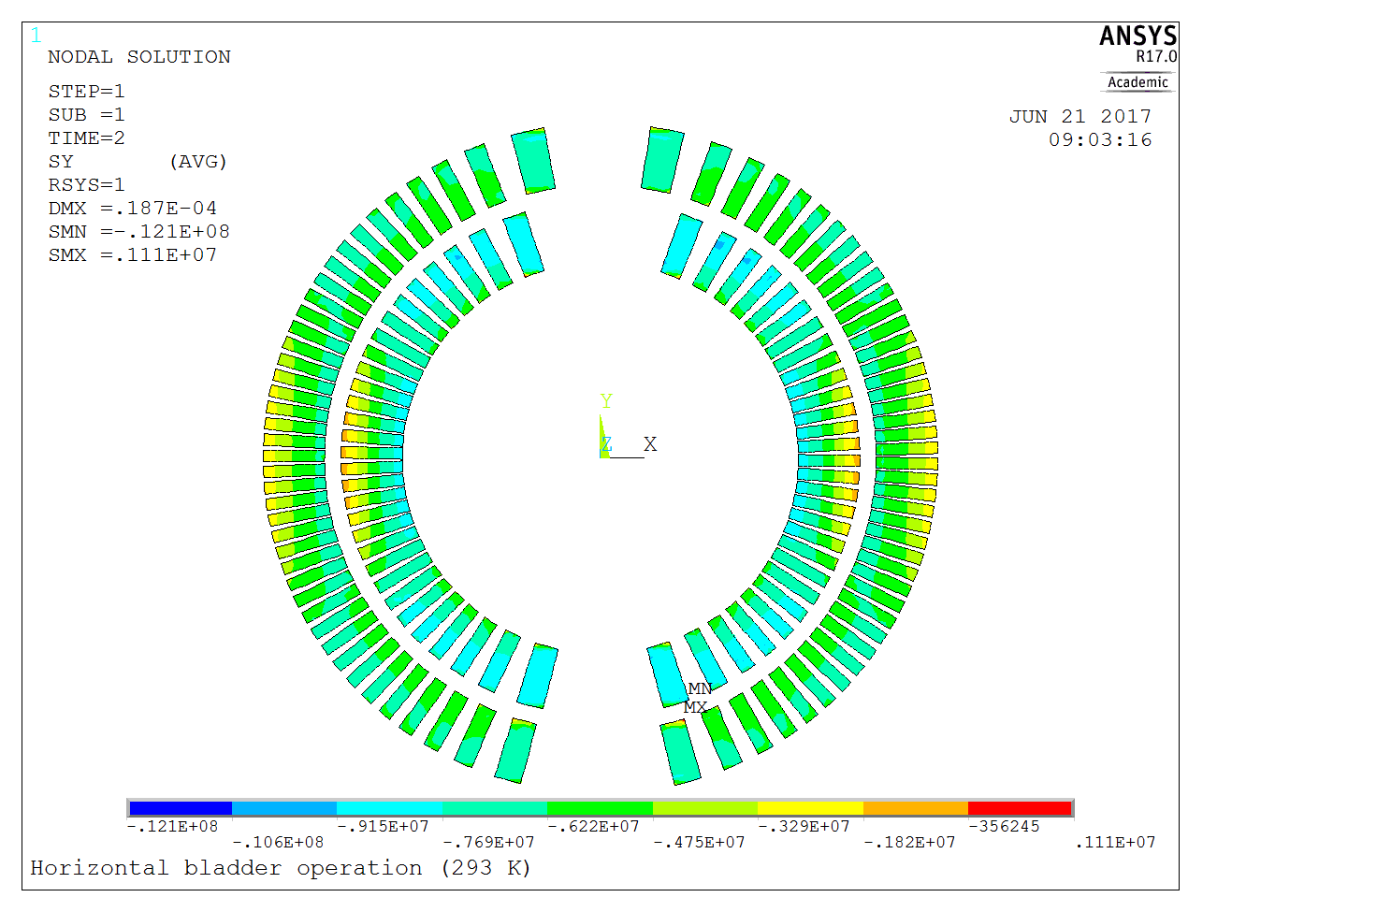
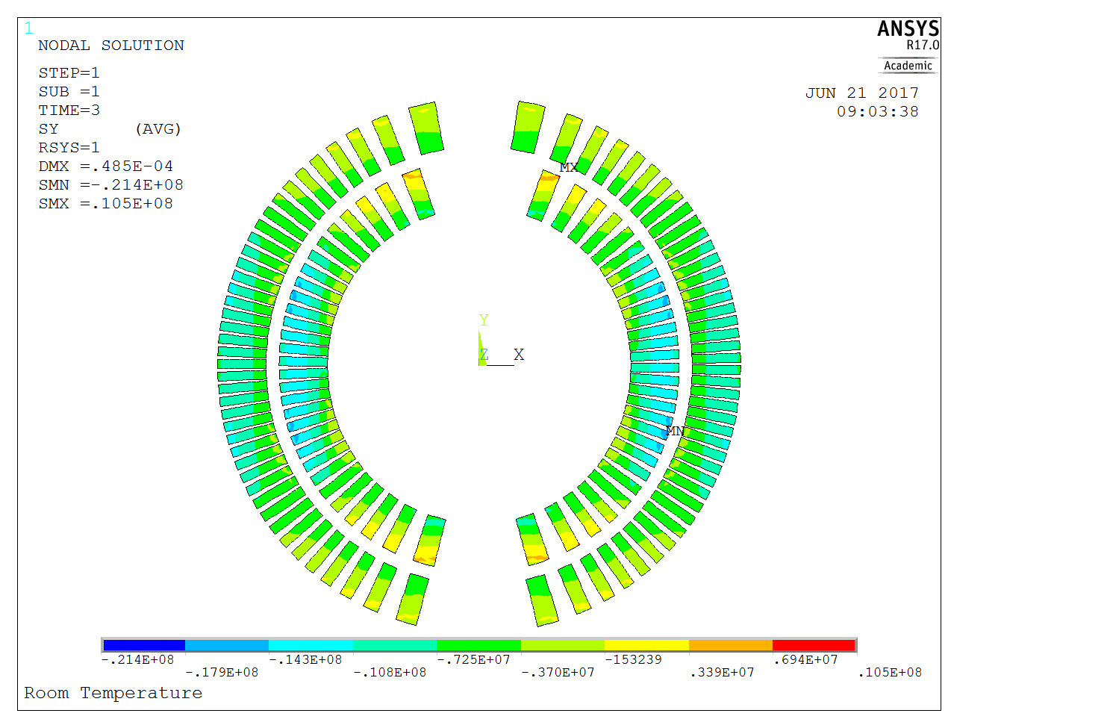
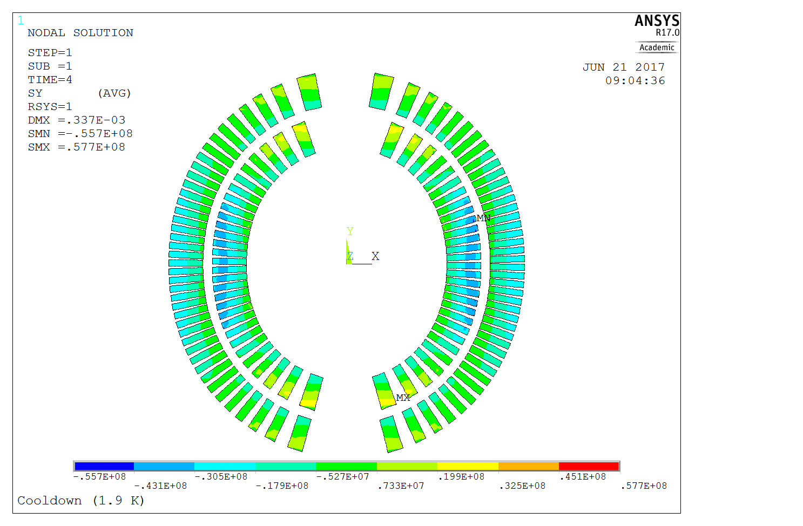
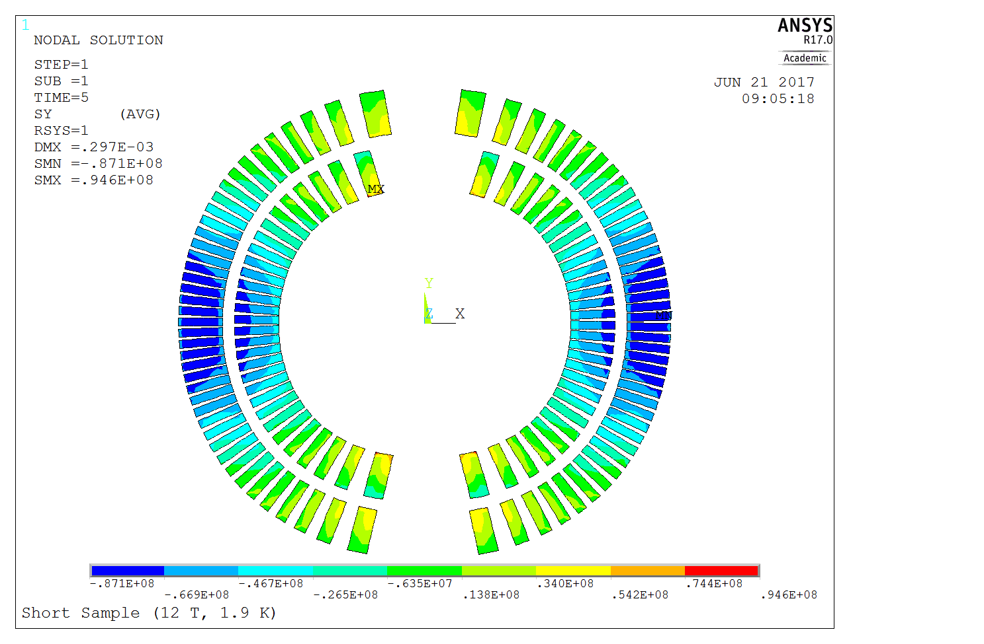
The Coil
Vert. bladder operation
Hor. bladder operation
Assembly - room temp.
Room temp. steps
(σ_{θ} - Azimuthal)
Cable σ_{θ} = [- 46.4, 25.7] MPa
Cable σ_{θ} = [-12.1, 1.1] MPa
Cable σ_{θ} = [-21.5, 10.5] MPa
Cable σ_{ν}^{max} = 45.6 MPa
Cable σ_{ν}^{max} = 11.6 MPa
Cable σ_{ν}^{max} = 19.8 MPa
Operation at short sample limit (1.9 K, 12 T)
Cool down 1.9 K
Cool down
and
operation steps
(σ_{θ} - Azimuthal)
Cable σ_{θ} = [-55.7, 57.7] MPa
Cable σ_{θ} = [-87.1, 94.6] MPa
Cable σ_{ν}^{max} = 66.4.5 MPa
Cable σ_{ν}^{max} = 101 MPa

Slide 10
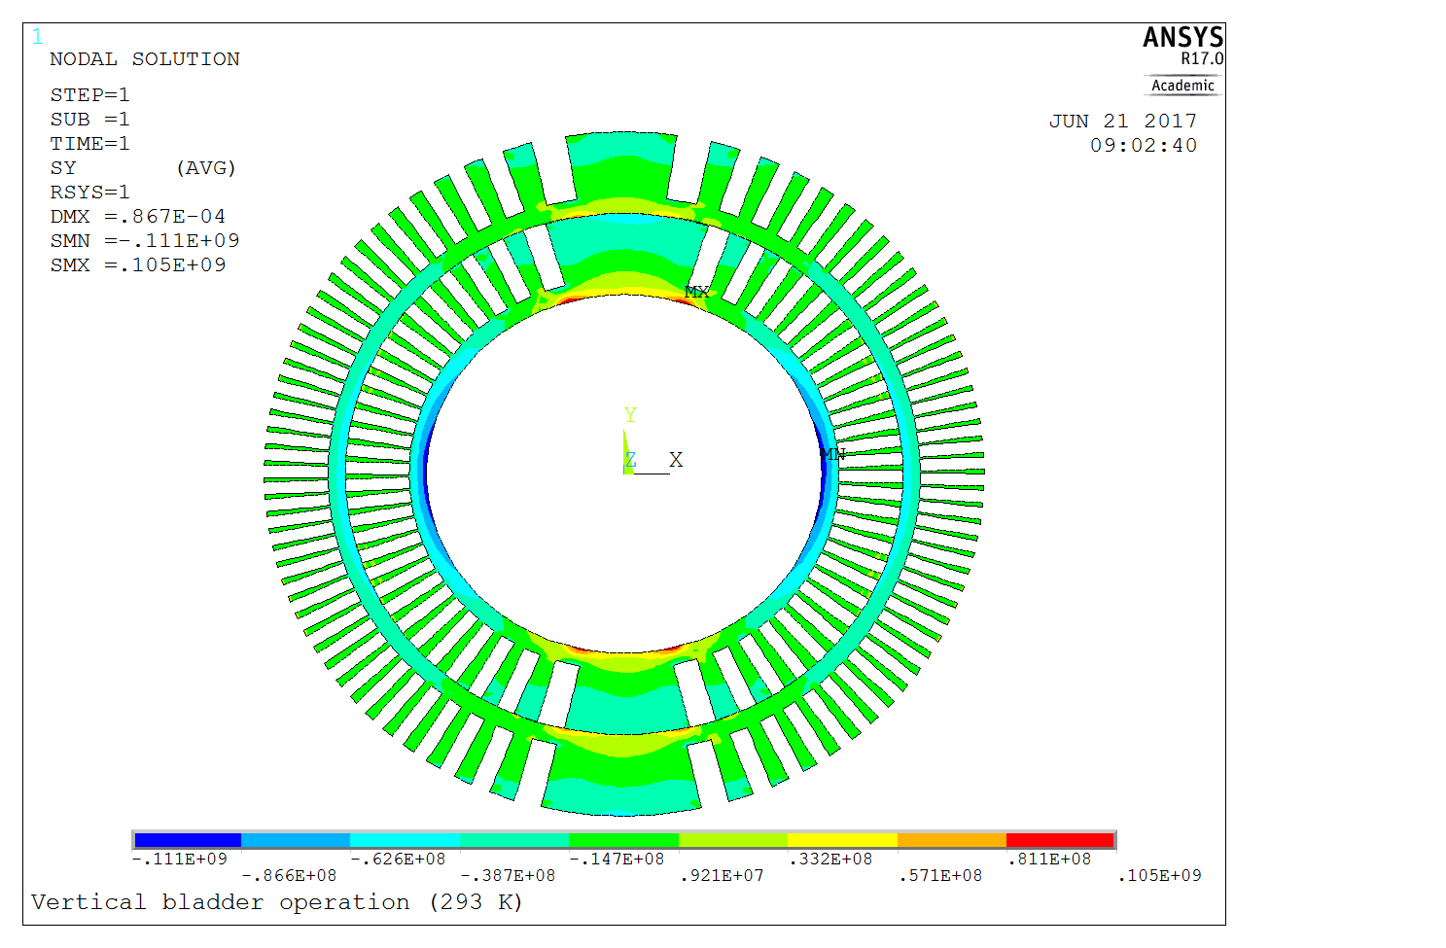
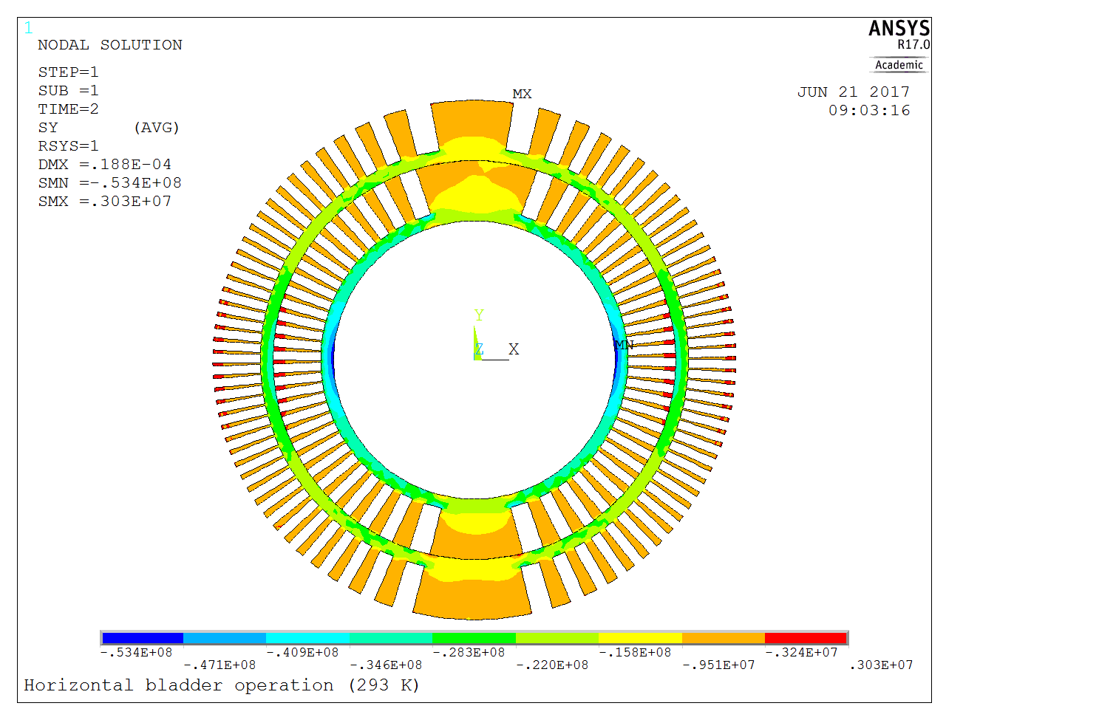
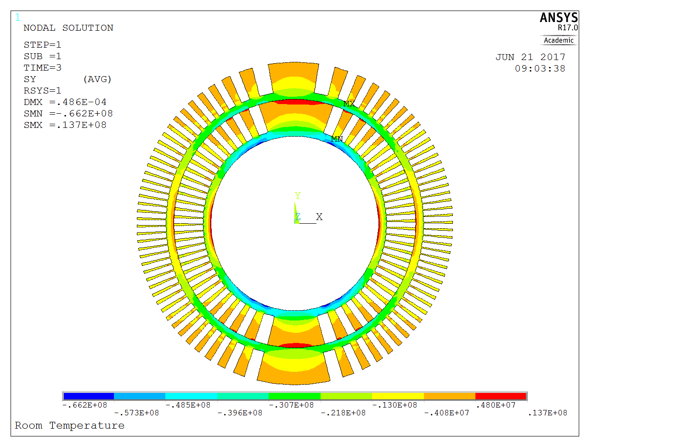
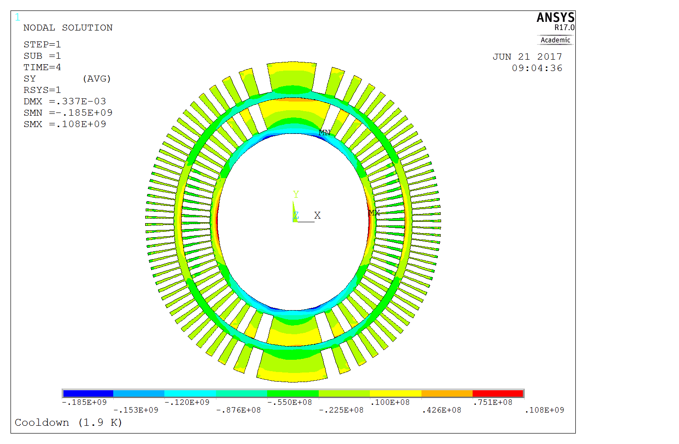
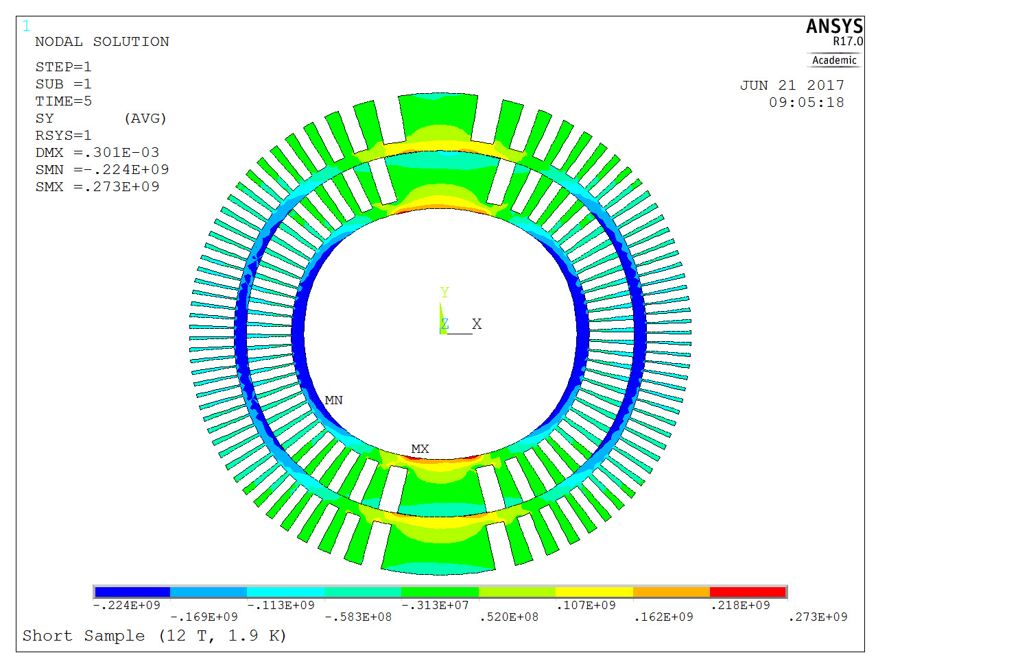
The Former
Vert. bladder operation
Hor. bladder operation
Assembly - room temp.
Room temp. steps
(σ_{θ} - Azimuthal)
Former σ_{θ}= [-110.6, 105.0] MPa
Former σ_{θ} = [- 53.4, 3.0] MPa
Former σ_{θ} = [-66.2, 13.7] MPa
Former σ_{ν}^{max} = 110.6 MPa
Former σ_{ν}^{max} = 53.4 MPa
Former σ_{ν}^{max} = 65.9 MPa
Operation at short sample limit (1.9 K, 12 T)
Cool down 1.9 K
Cool down
and
operation steps
(σ_{θ} - Azimuthal)
Former σ_{θ} = [-185.2, 108]MPa
Former σ_{θ} = [-224.0, 273.0]MPa
Former σ_{ν}^{max} = 184.8 MPa
Former σ_{ν}^{max} = 271.6 MPa

Slide 11
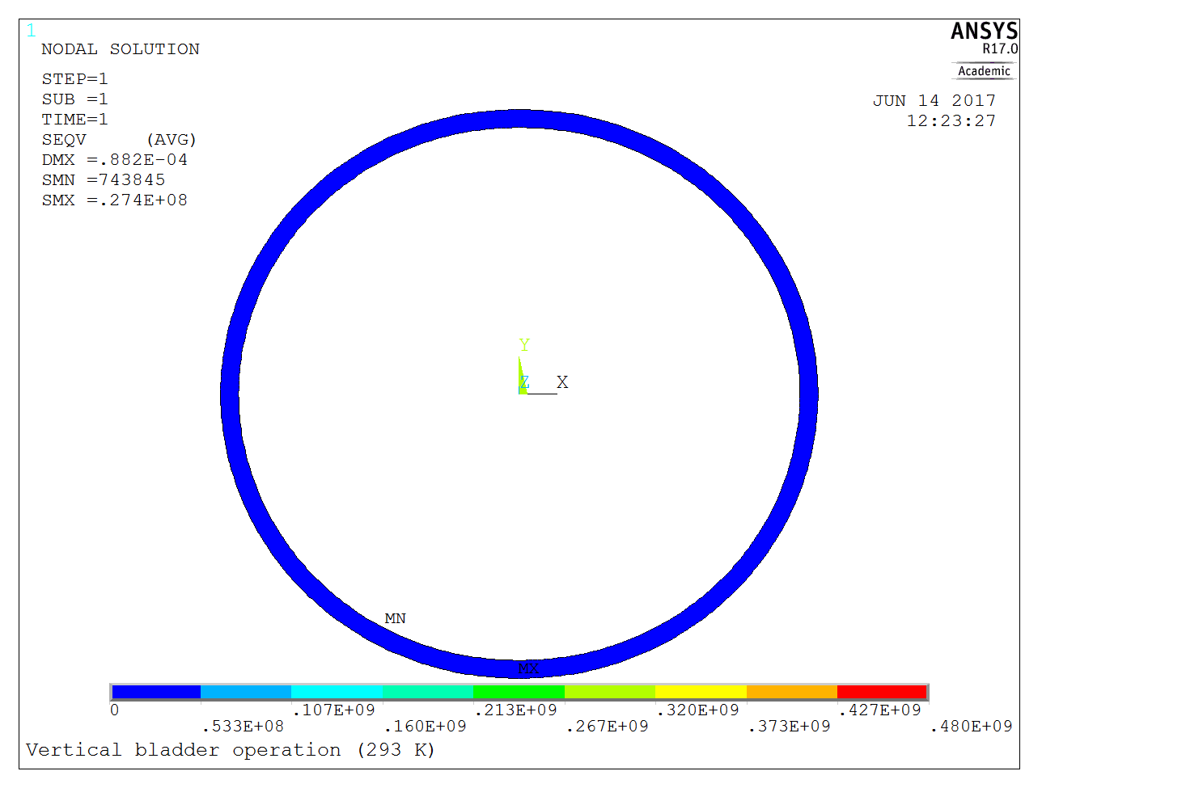
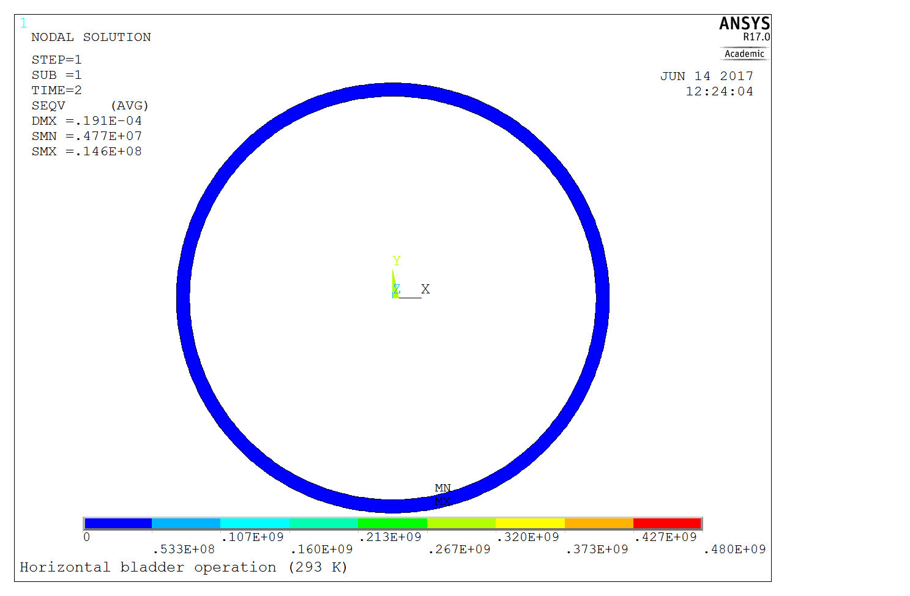
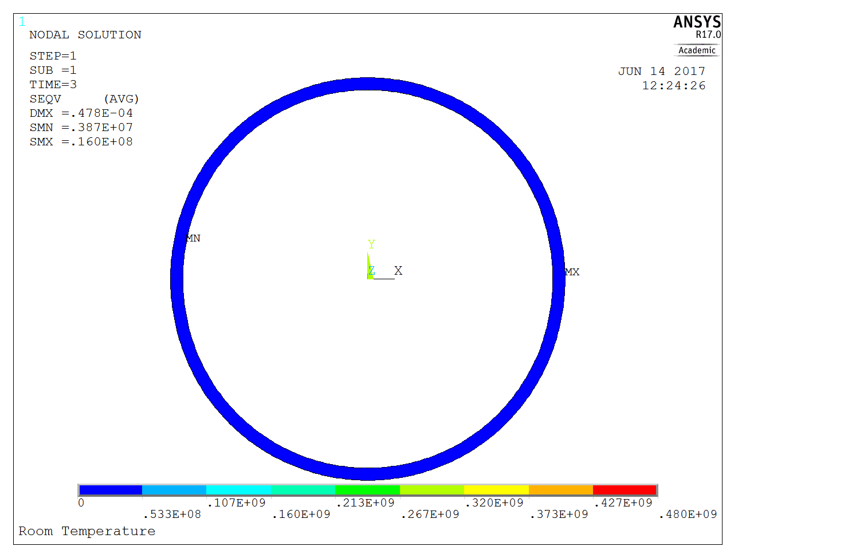
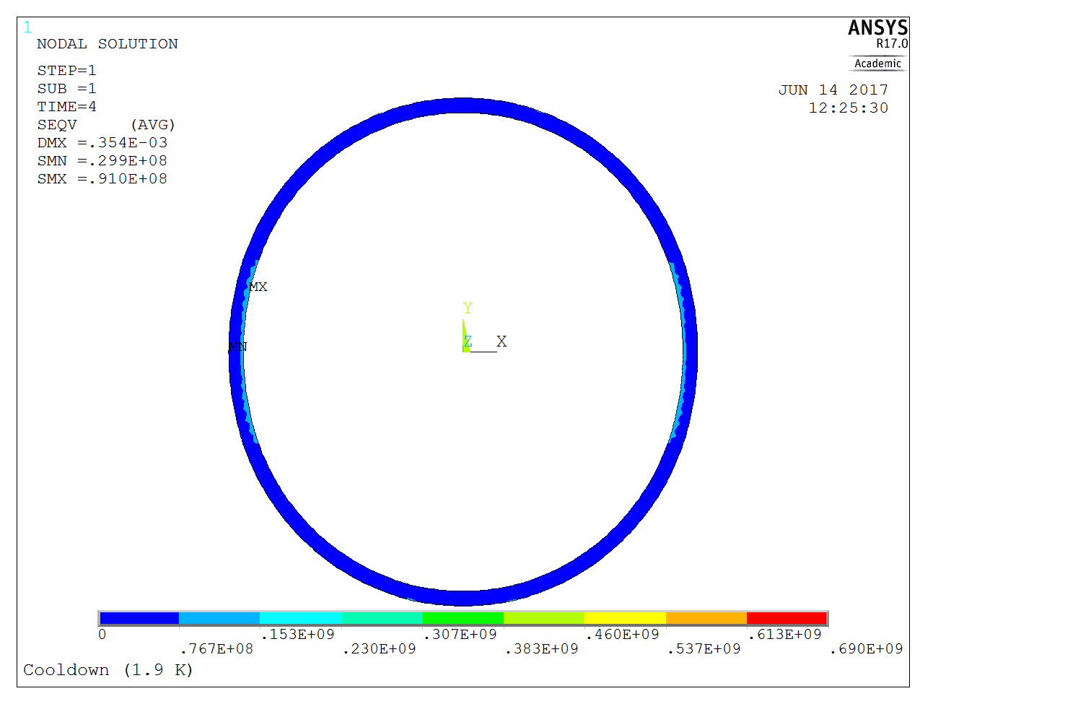
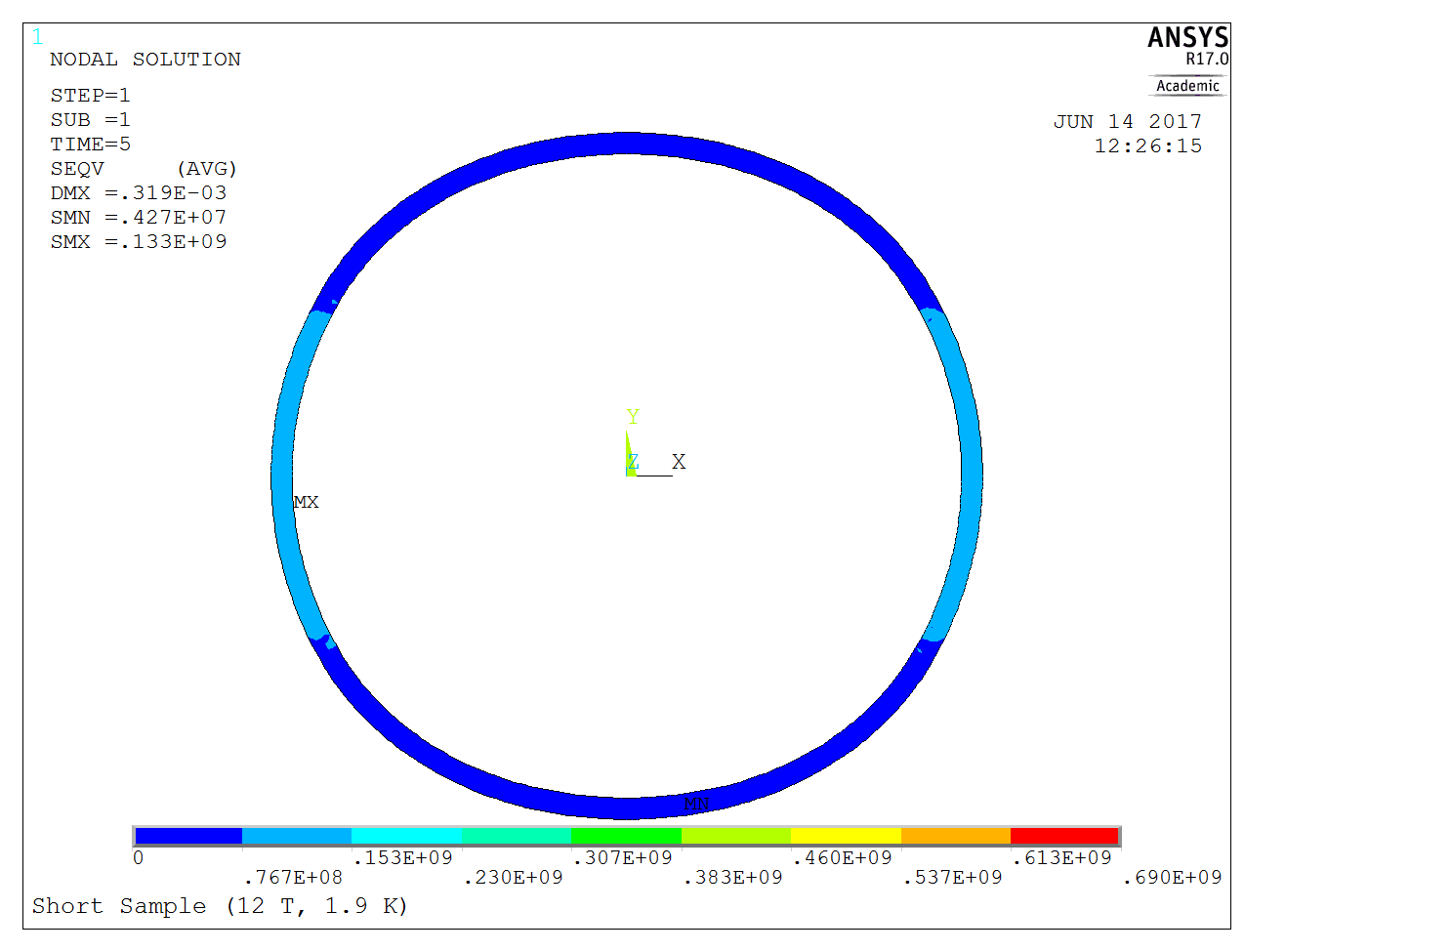
The Protective Coil Pack Shell
Vert. bladder operation
Hor. bladder operation
Assembly - room temp.
Room temp. steps
Prot. Shell σ_{ν}^{max} = 27.4 MPa
Prot. Shell σ_{ν}^{max} = 14.6 MPa
Prot. Shell σ_{ν}^{max} = 16.0 MPa
Operation at short sample limit (1.9 K, 12 T)
Cool down 1.9 K
Cool down
and
operation steps
Prot. Shell σ_{ν}^{max} = 91.0 MPa
Prot. Shell σ_{ν}^{max} = 133.5 MPa

Slide 12
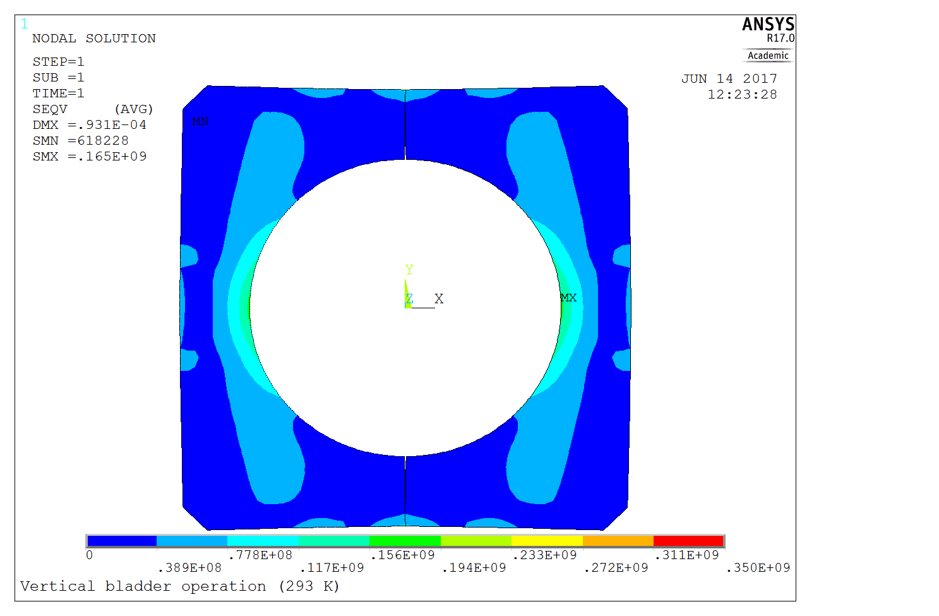
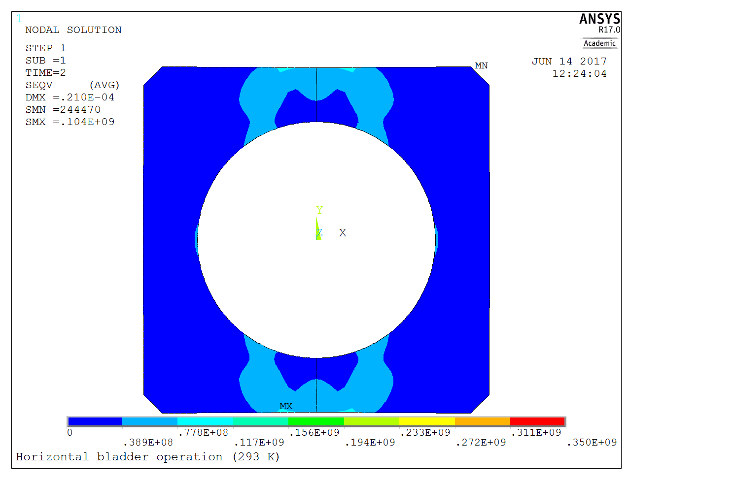
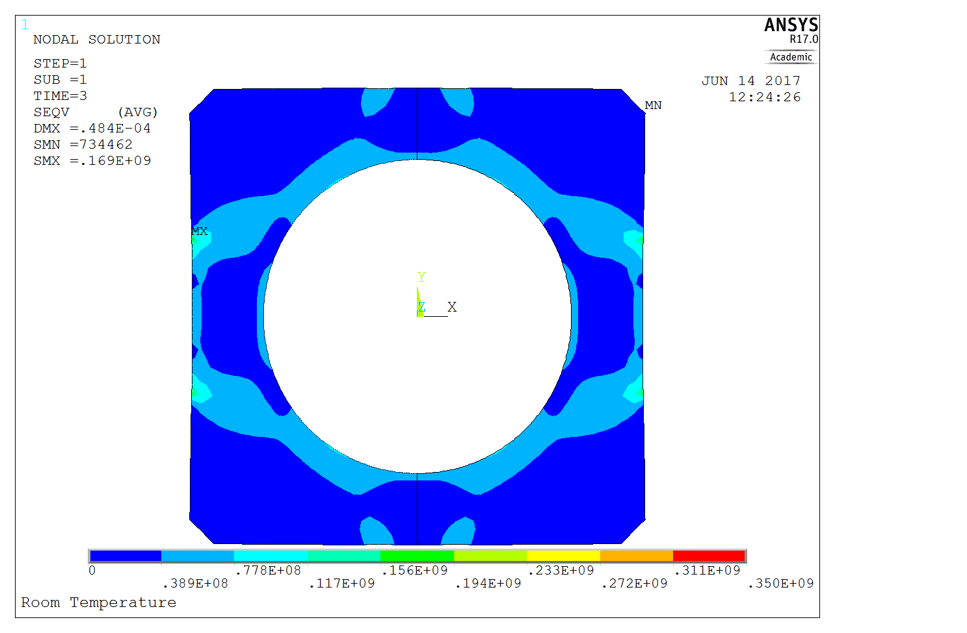
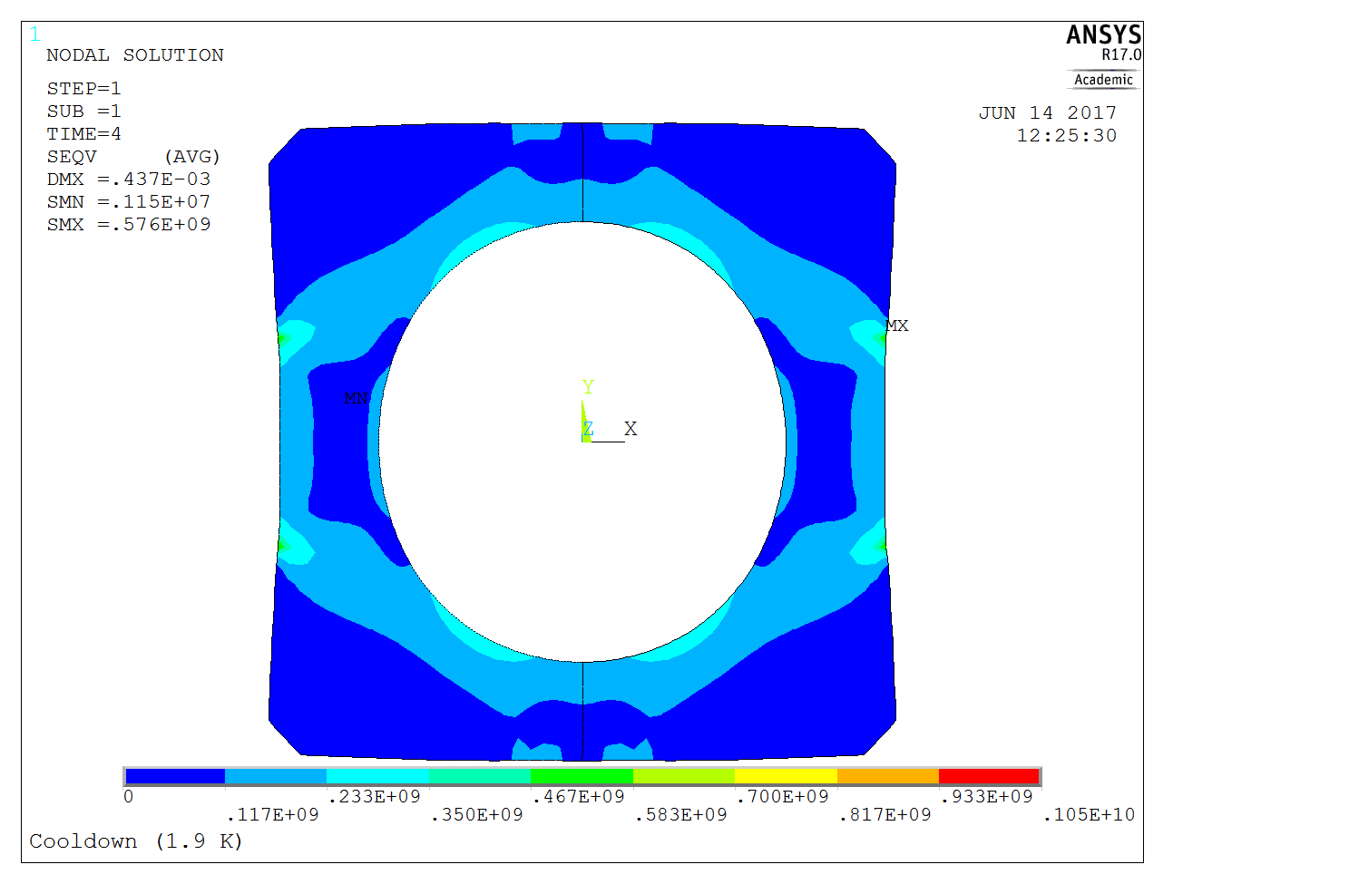

The Steel Pads
Vert. bladder operation
Hor. bladder operation
Assembly - room temp.
Room temp. steps
Pads IR σ_{ν}^{max} = 165.5 MPa
Pads IR σ_{ν}^{max} = 48.0 MPa
Pads IR σ_{ν}^{max} = 80.6 MPa
Operation at short sample limit (1.9 K, 12 T)
Cool down 1.9 K
Cool down
and
operation steps
Pads IR σ_{ν}^{max} = 316.3 MPa
Pads IR σ_{ν}^{max} = 161.0 MPa

Slide 13
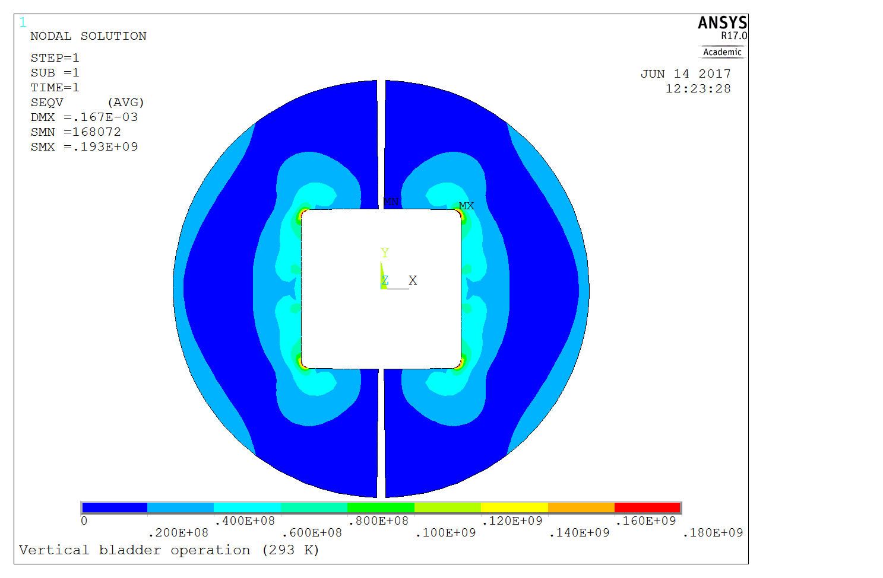
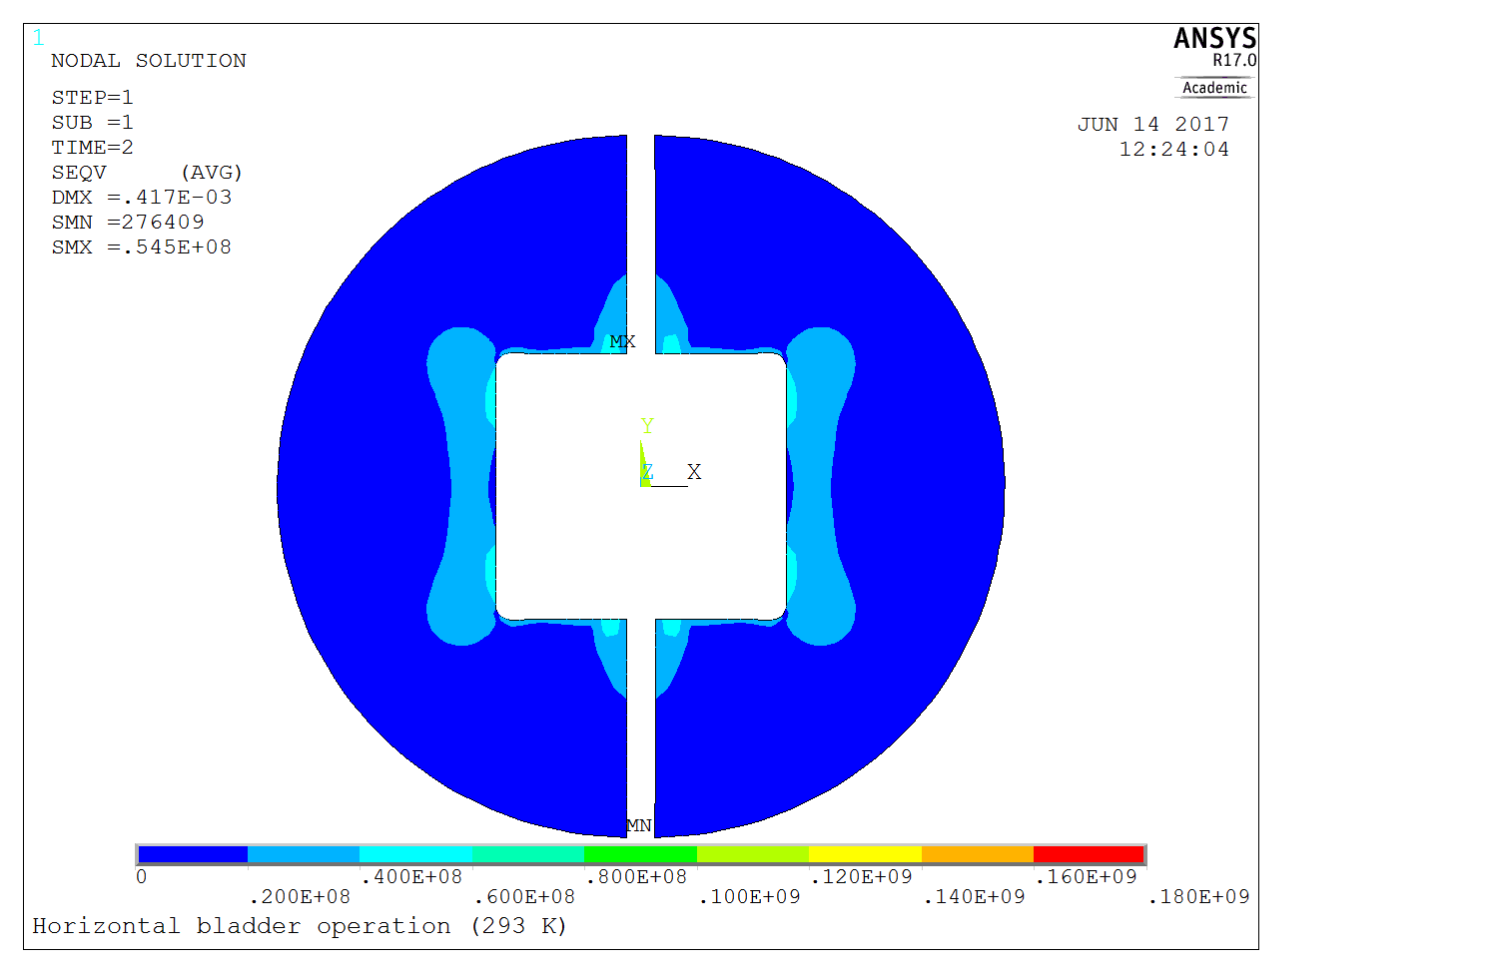
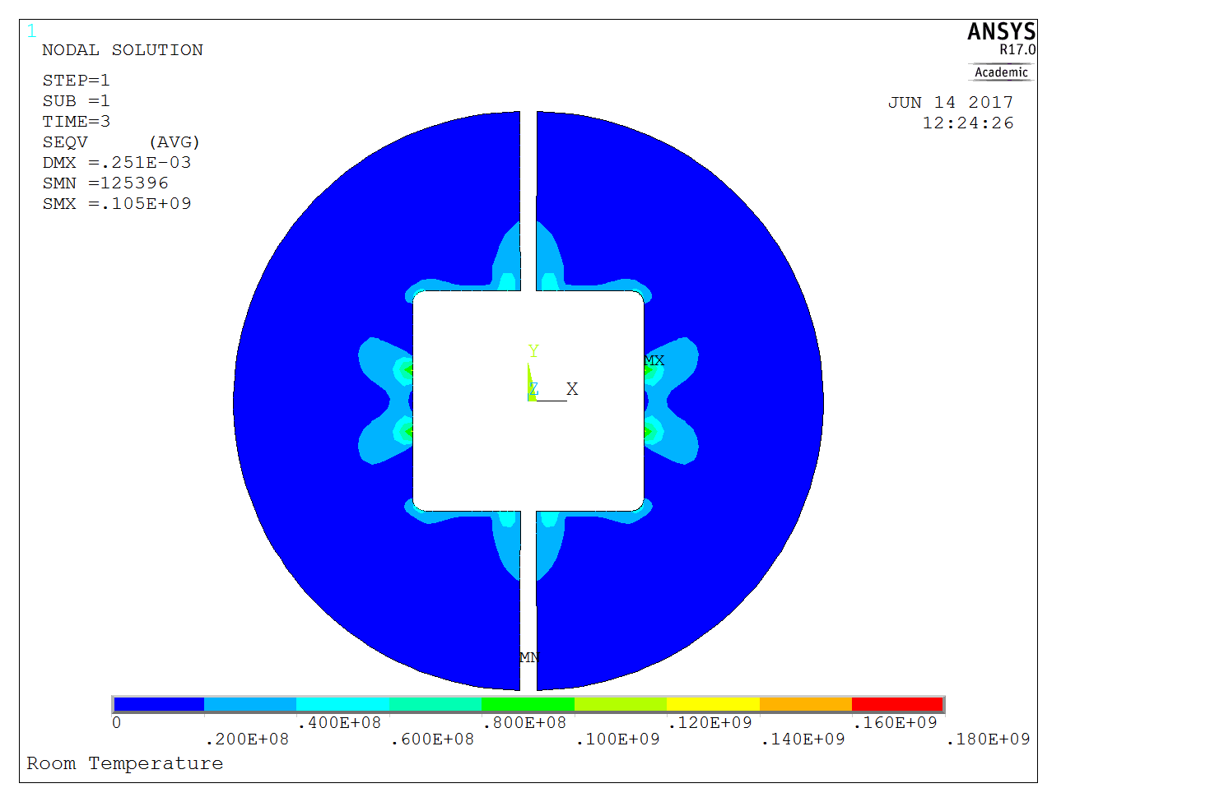
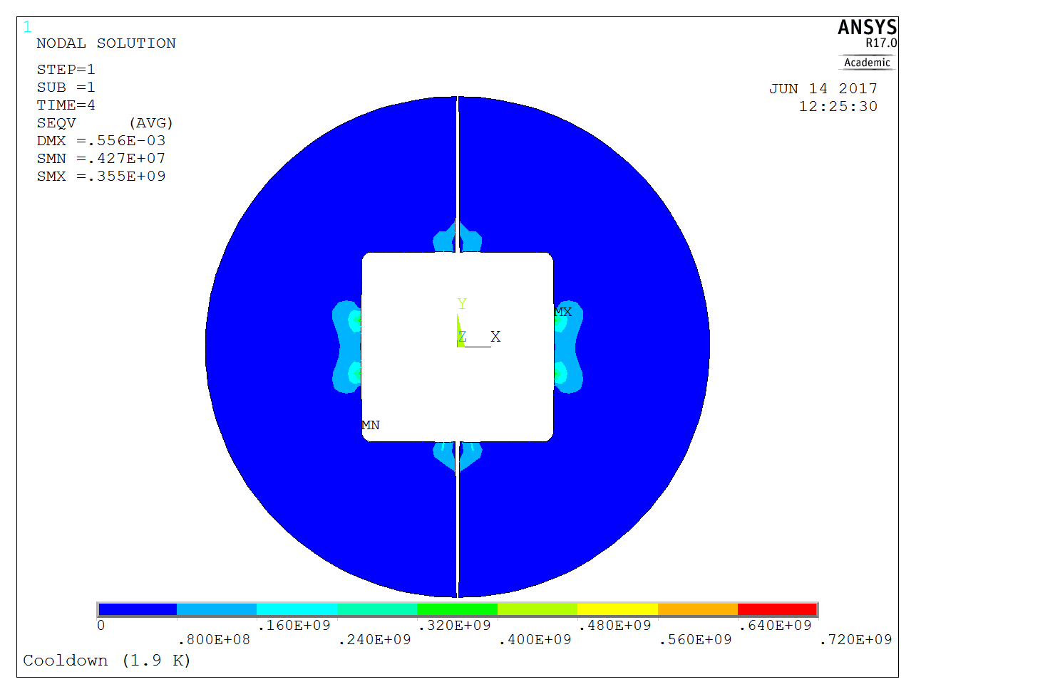
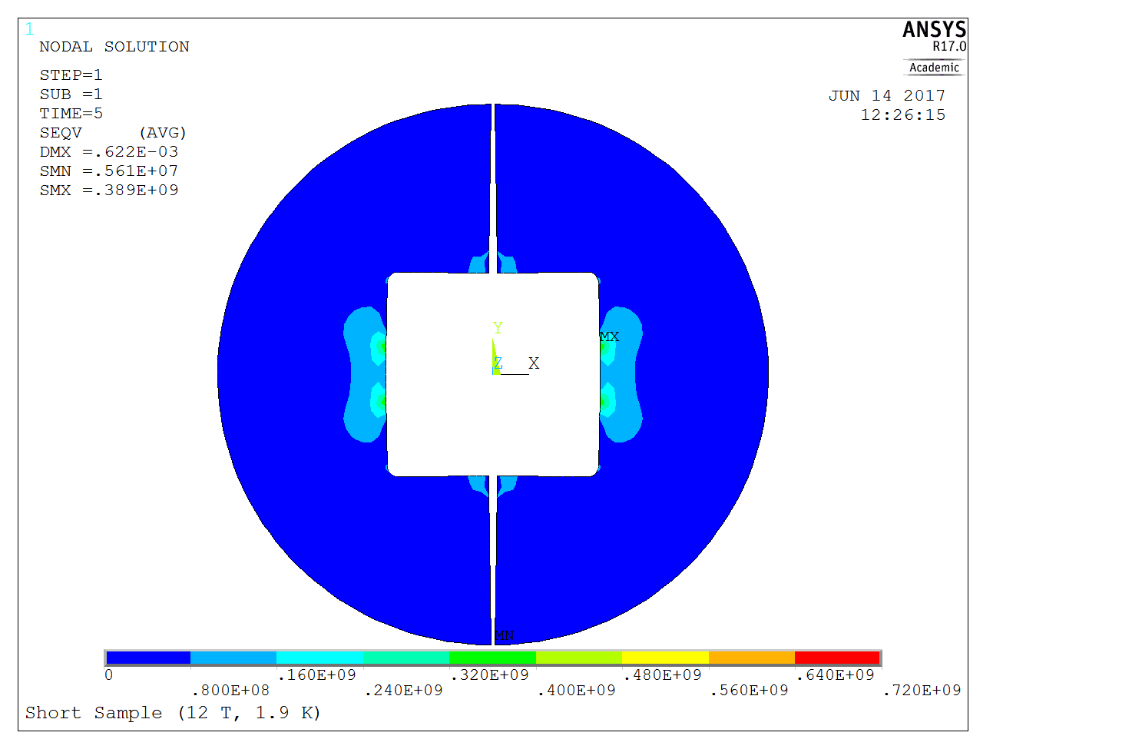
The Iron Yoke
Vert. bladder operation
Hor. bladder operation
Assembly - room temp.
Room temp. steps
Yoke σ_{ν}^{max} > 180 MPa
Yoke σ_{ν}^{max} = 54.5 MPa
Yoke σ_{ν}^{max} = 105.0 MPa
Operation at short sample limit (1.9 K, 12 T)
Cool down 1.9 K
Cool down
and
operation steps
Yoke σ_{ν}^{max} = 355.0 MPa
Yoke σ_{ν}^{max} = 389.0 MPa

Slide 14
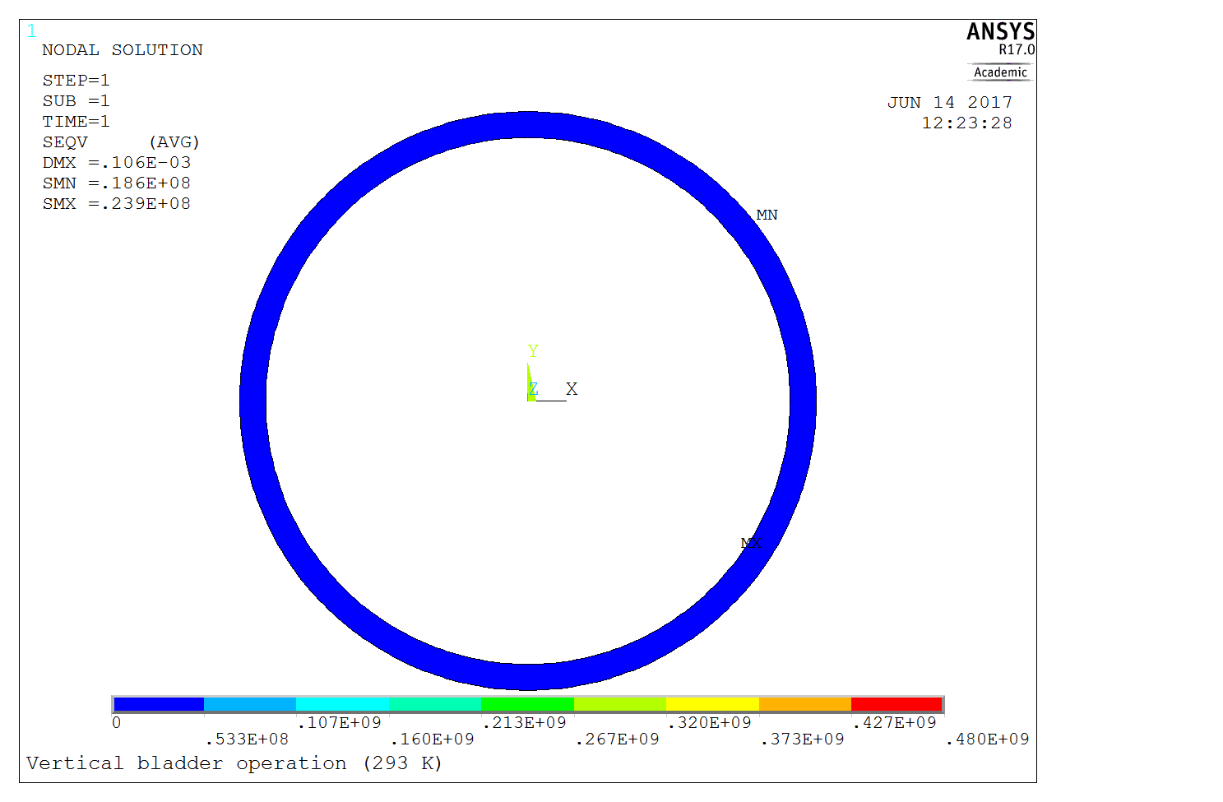
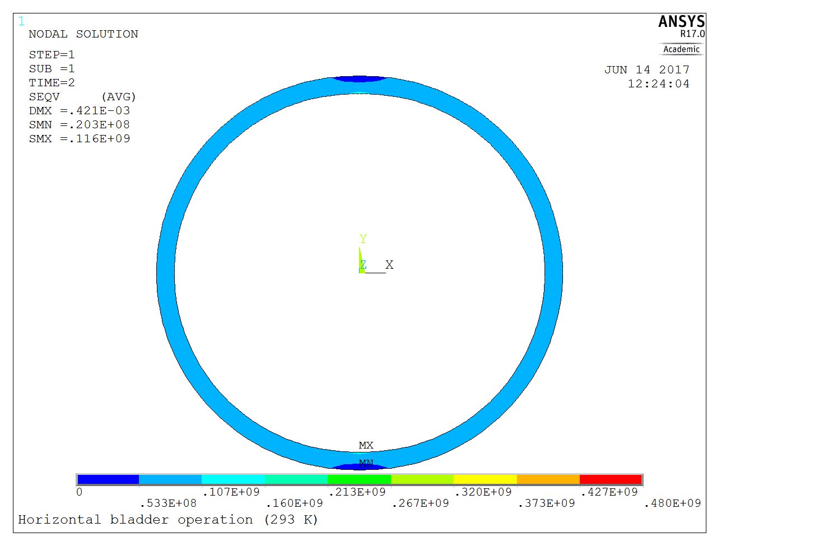
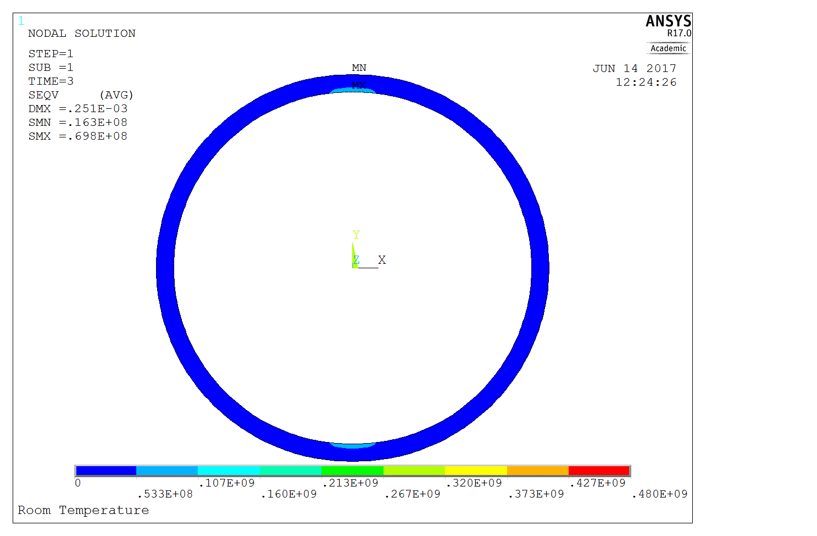
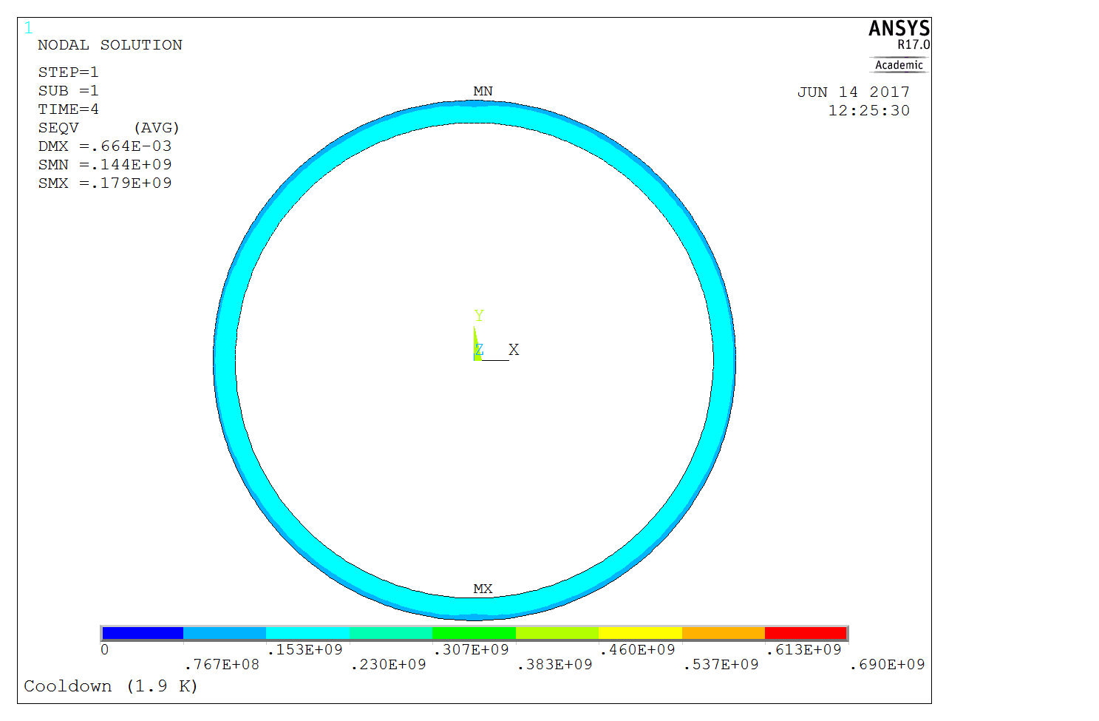

The Support Shell
Vert. bladder operation
Hor. bladder operation
Assembly - room temp.
Room temp. steps
Shell σ_{ν}^{max} = 23.9 MPa
Shell σ_{ν}^{max} = 116.3 MPa
Shell σ_{ν}^{max} = 69.8 MPa
Operation at short sample limit (1.9 K, 12 T)
Cool down 1.9 K
Cool down
and
operation steps
Shell σ_{ν}^{max} = 179.0 MPa
Shell σ_{ν}^{max} = 208.0 MPa

Slide 15
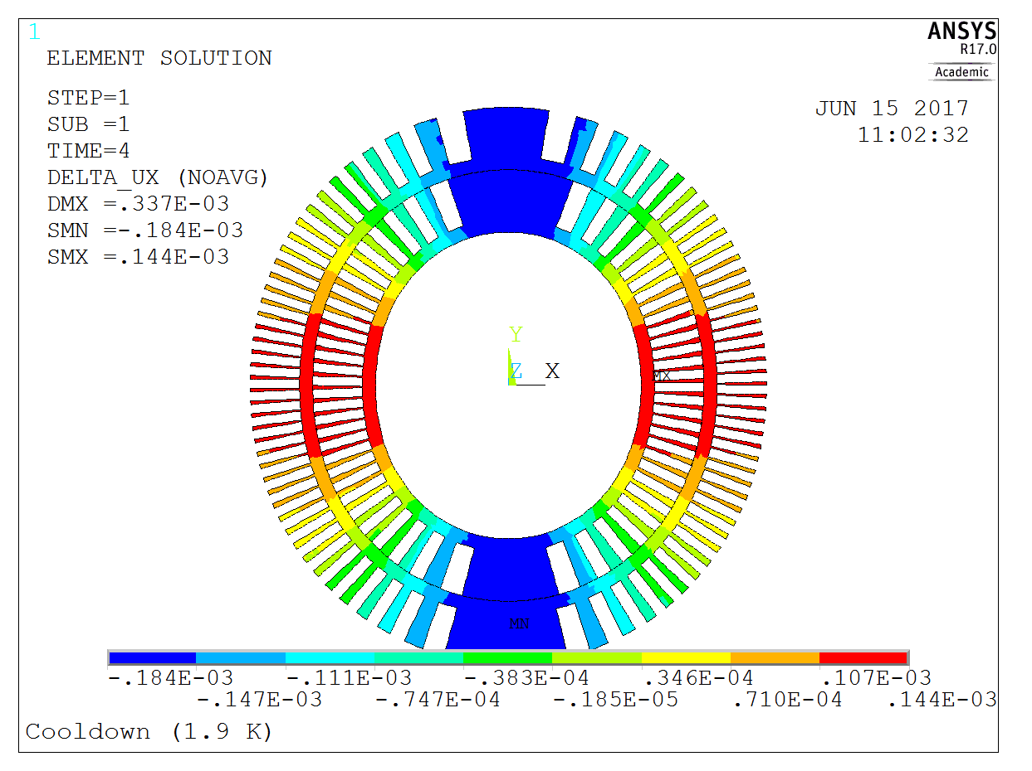
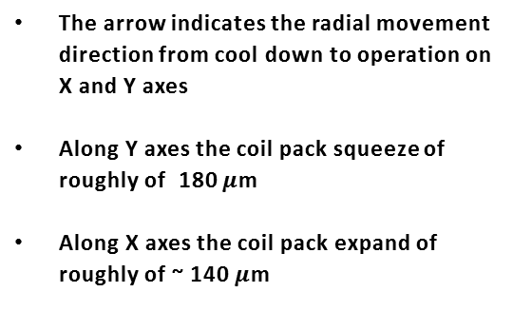
Former Displacement
Radial displacement difference of the former between
cool down and short sample load steps
The arrow indicates the radial movement direction from cool down to operation on X and Y axes
Along Y axes the coil pack squeeze of roughly of 180 $μ$m
Along X axes the coil pack expand of roughly of ~ 140 $μ$m

Slide 16
2D Mechanical modelling of CD1 dipole with ANSYS
Design’s objectives
Baseline Design (+Excursus on CD2)
The Design vs. Material Properties
Mechanical tolerances
Parametric Study
Conclusions

Slide 17
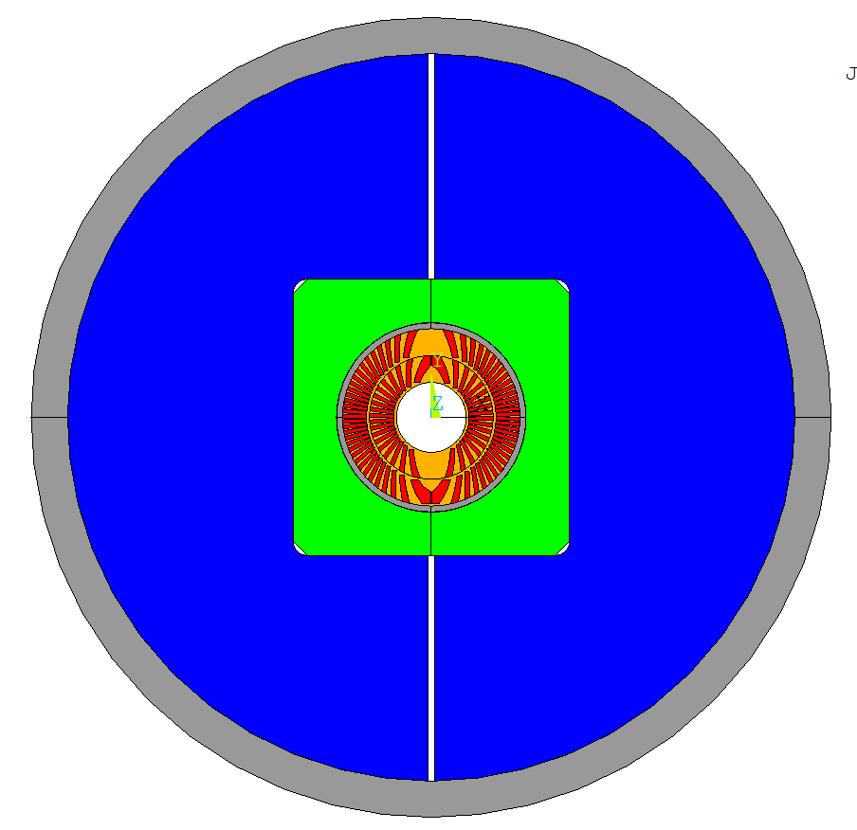
CD2 mechanical structure
Horizontal and vertical keys
Steel Pads
  The CD2 design:
    Same Layer-2 OD =122 mm of CD1
    Inclined cable channels
    Same Bladder and Key structure of CD1
    2D Simulations -> 5 steps (as for CD1)and same B&K config.
      Operation->Lorenz forces acting on the conductor according to test condition (4.2 K, 10.5 T) , limited by the test station I_{max}=22 kA
2
Coil Pack
CD2
1
Al Shell
horizontal and vertical bladders
Iron Yoke

Slide 18
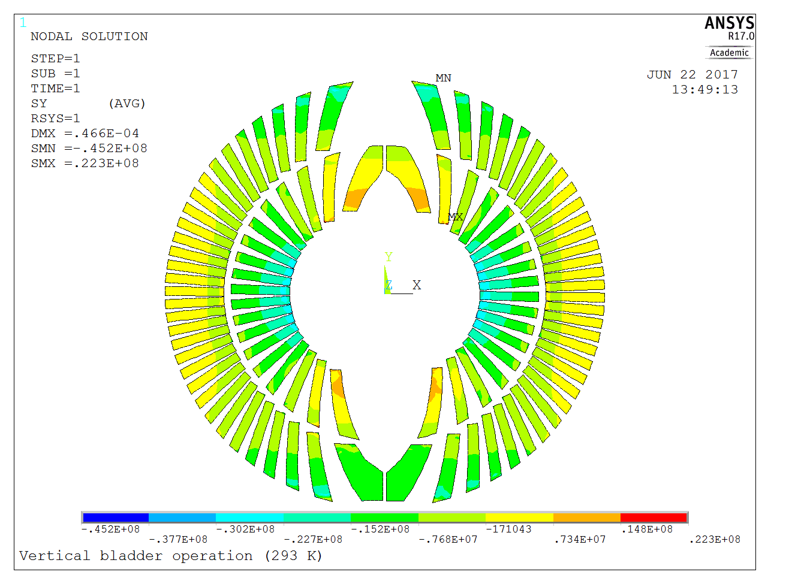
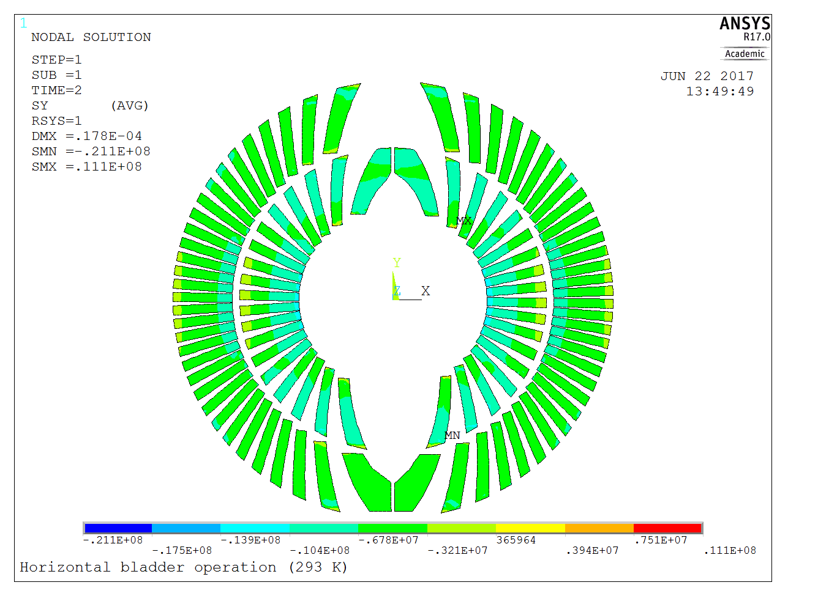
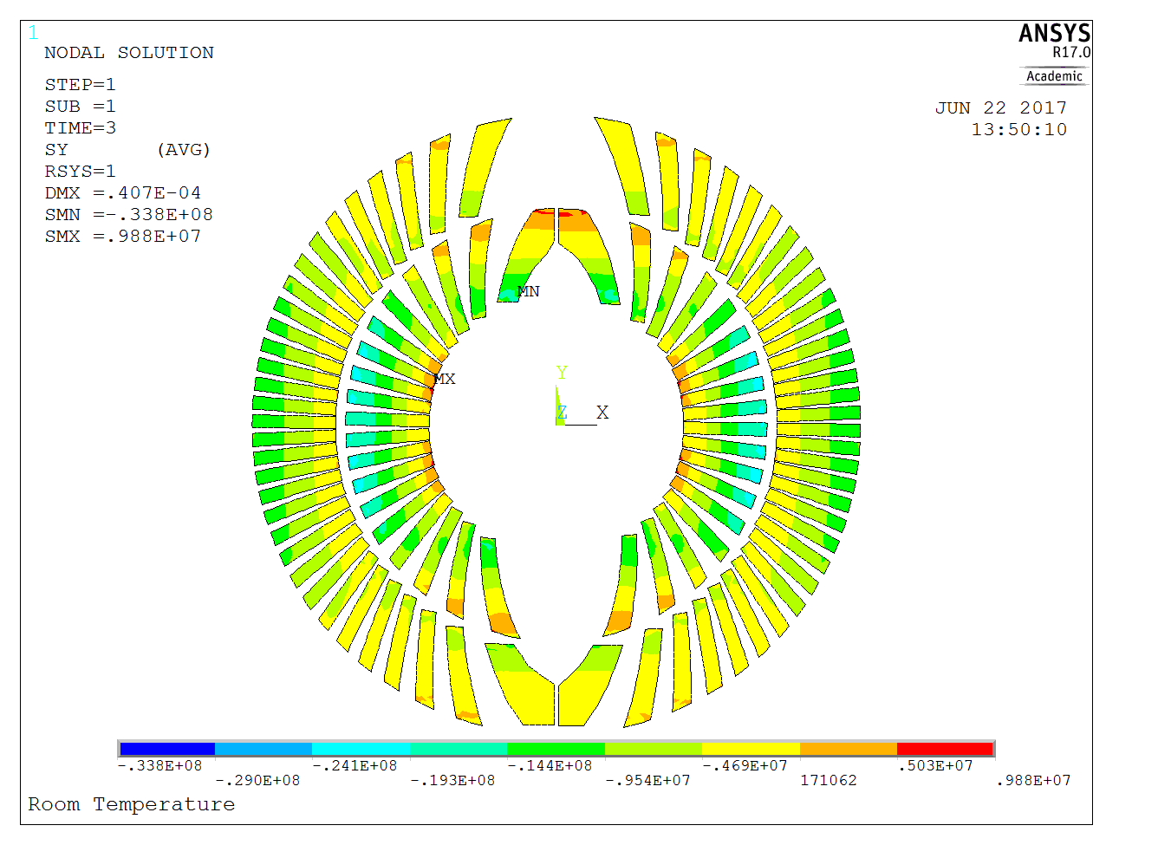
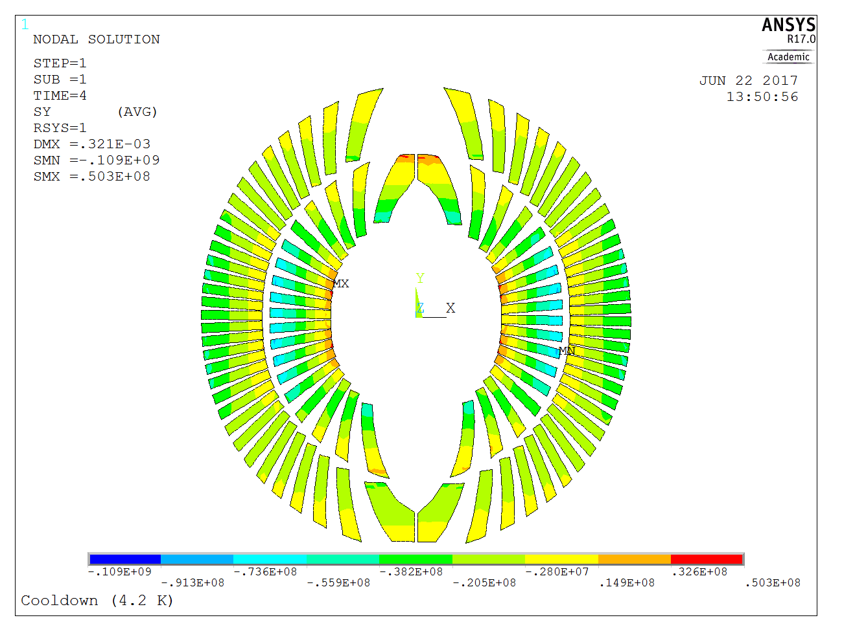
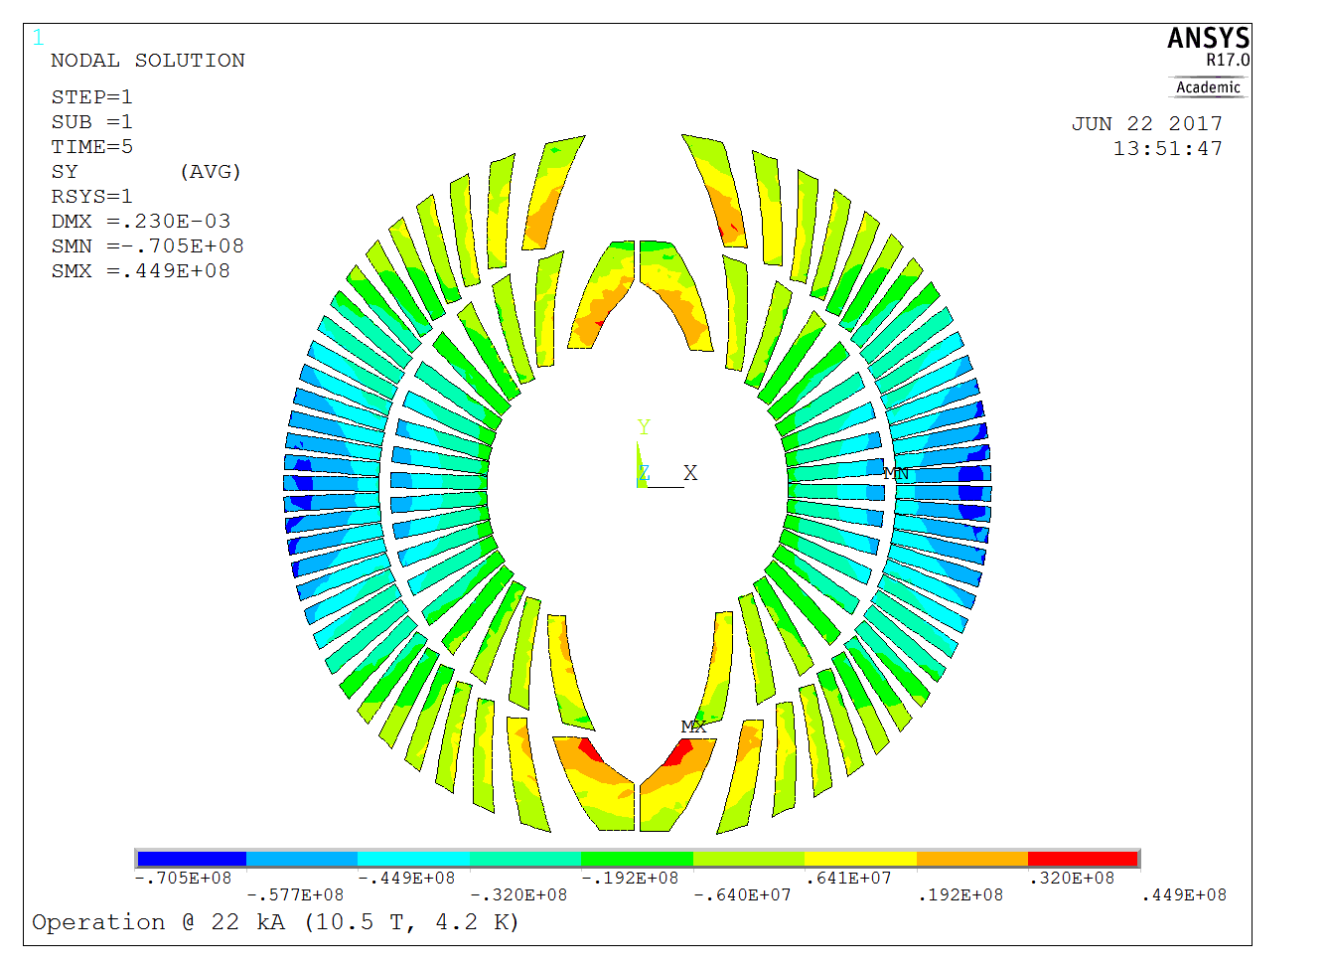
CD2- The Coil
Vert. bladder operation
Hor. bladder operation
Assembly - room temp.
Room temp. steps
(σ_{θ} - Azimuthal)
Cable σ_{θ} = [- 45.2, 22.3] MPa
Cable σ_{θ} = [-21.1, 11.1] MPa
Cable σ_{θ} = [-33.8, 9.8] MPa
Cable σ_{ν}^{max} = 46.2 MPa
Cable σ_{ν}^{max} = 20.8 MPa
Cable σ_{ν}^{max} = 33.0 MPa
Operation at short sample limit (1.9 K, 12 T)
Cool down 1.9 K
Cool down
and
operation steps
(σ_{θ} - Azimuthal)
Cable σ_{θ} = [-109.0, 50.3] MPa
Cable σ_{θ} = [-70.5, 44.9] MPa
Cable σ_{ν}^{max} = 102.0 MPa
Cable σ_{ν}^{max} = 72.4 MPa

Slide 19
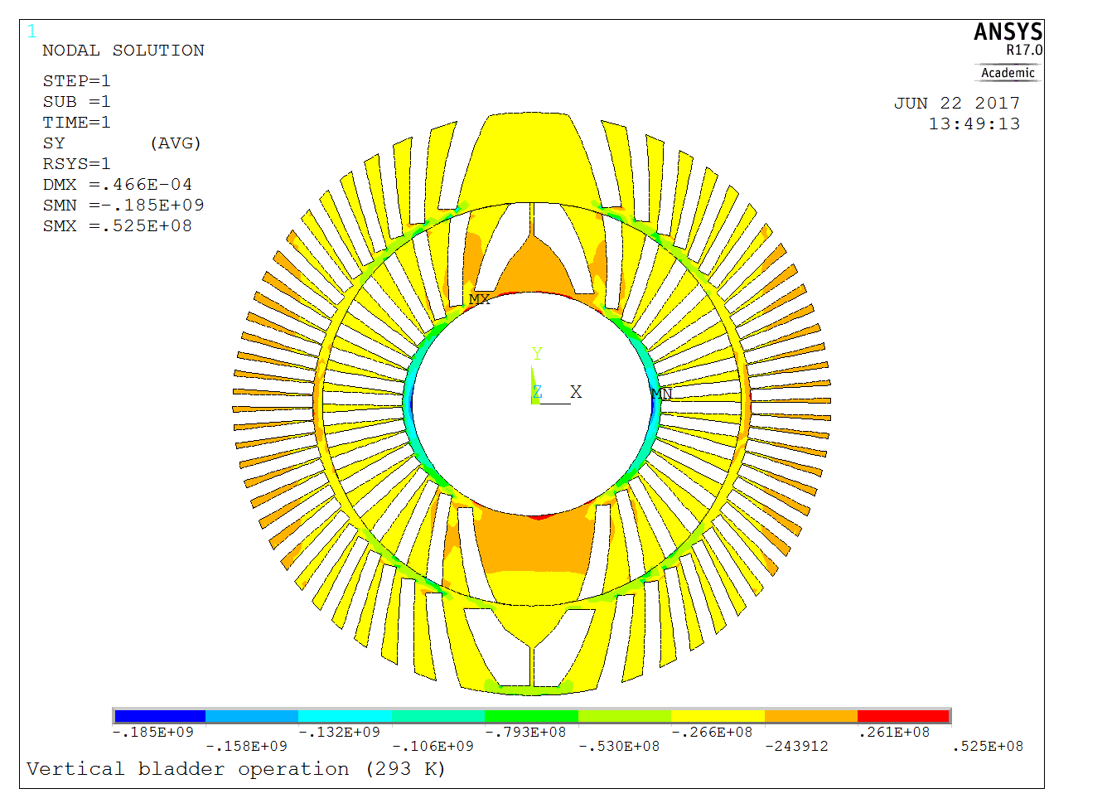
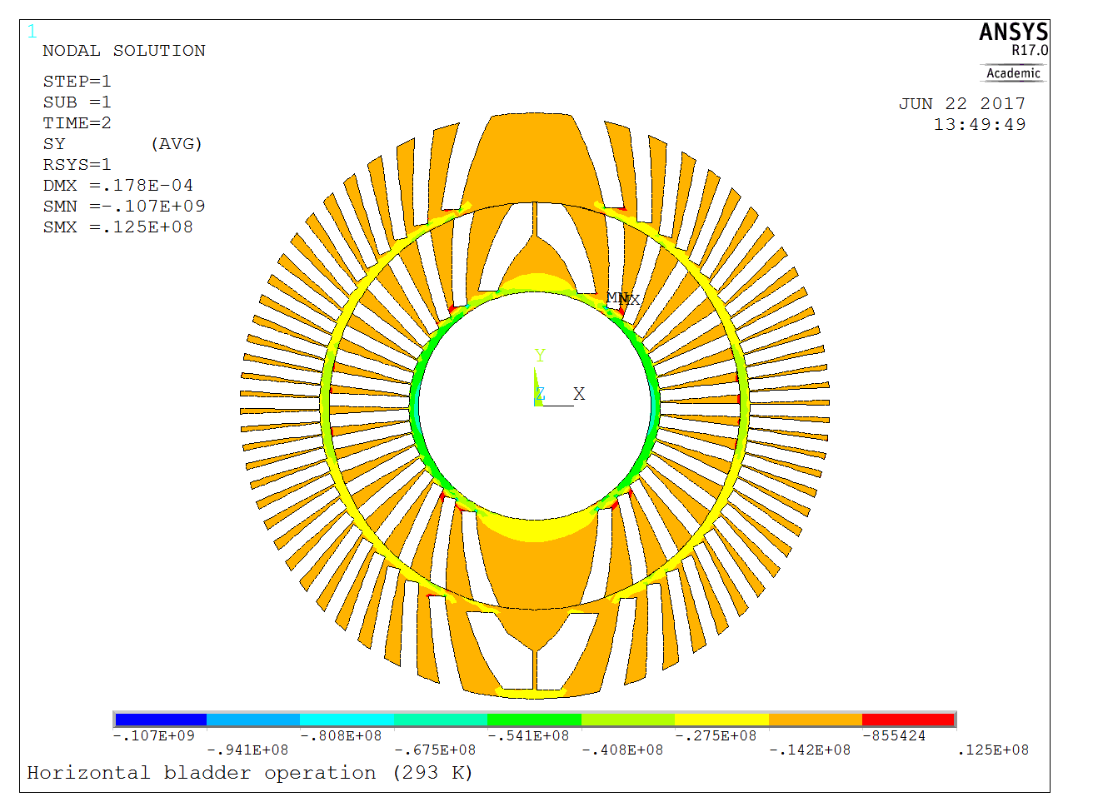
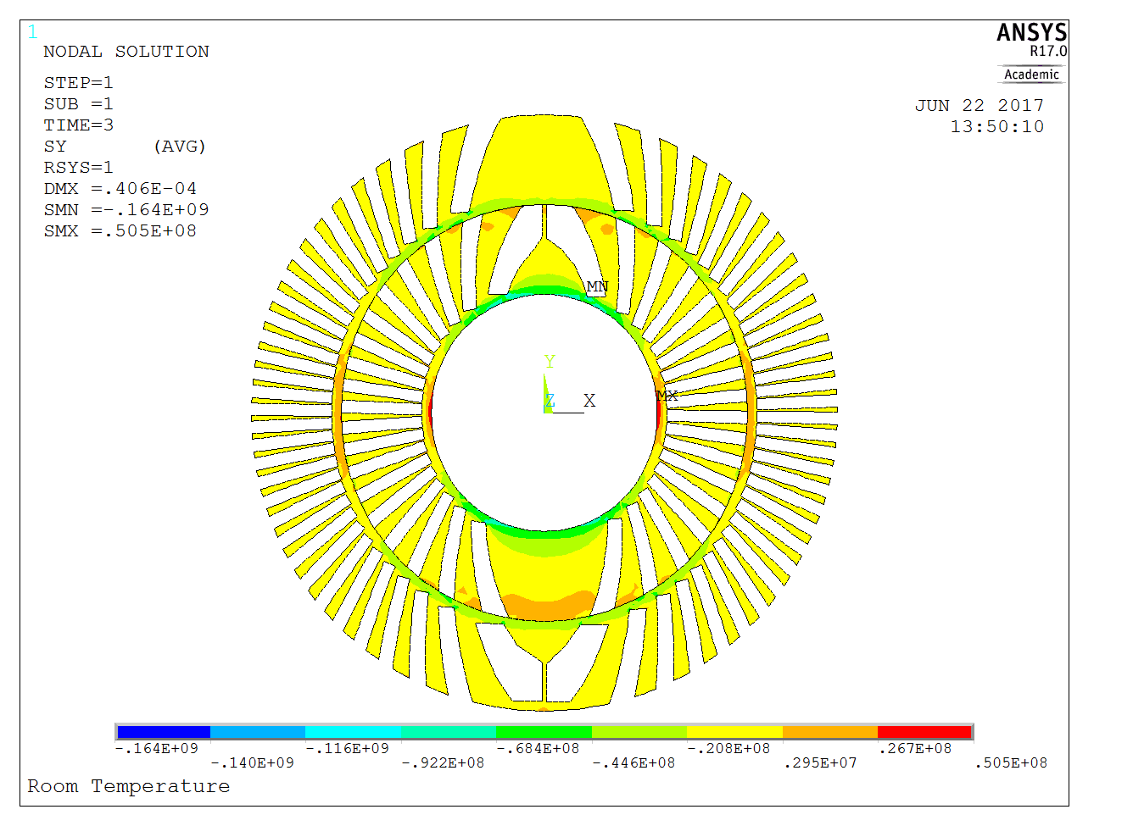
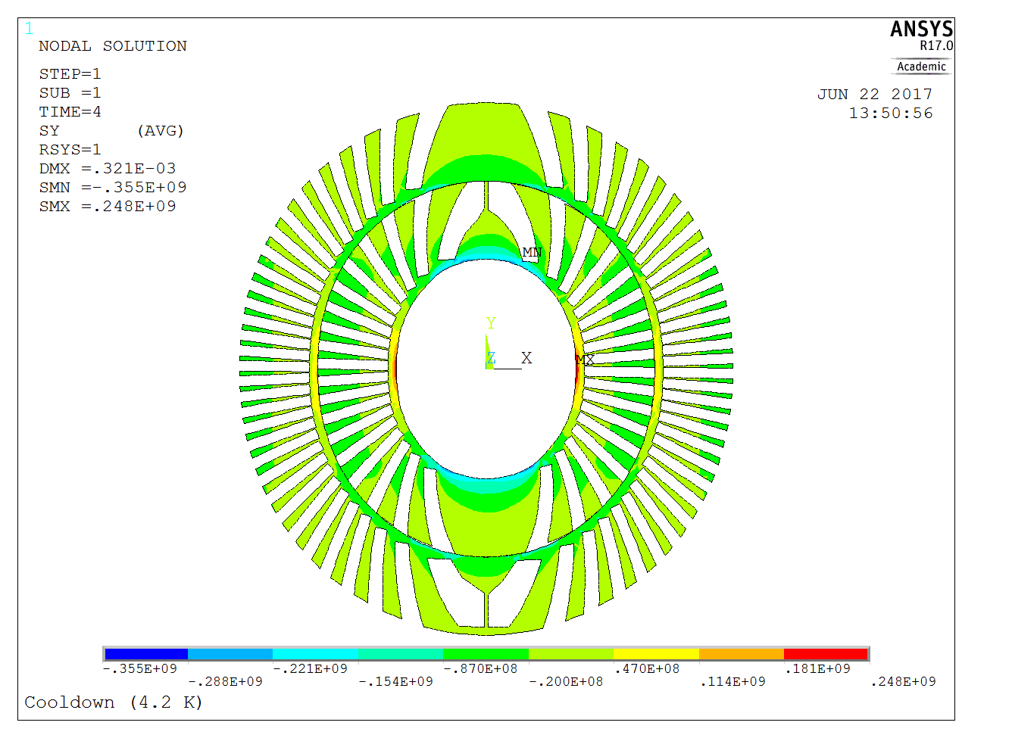
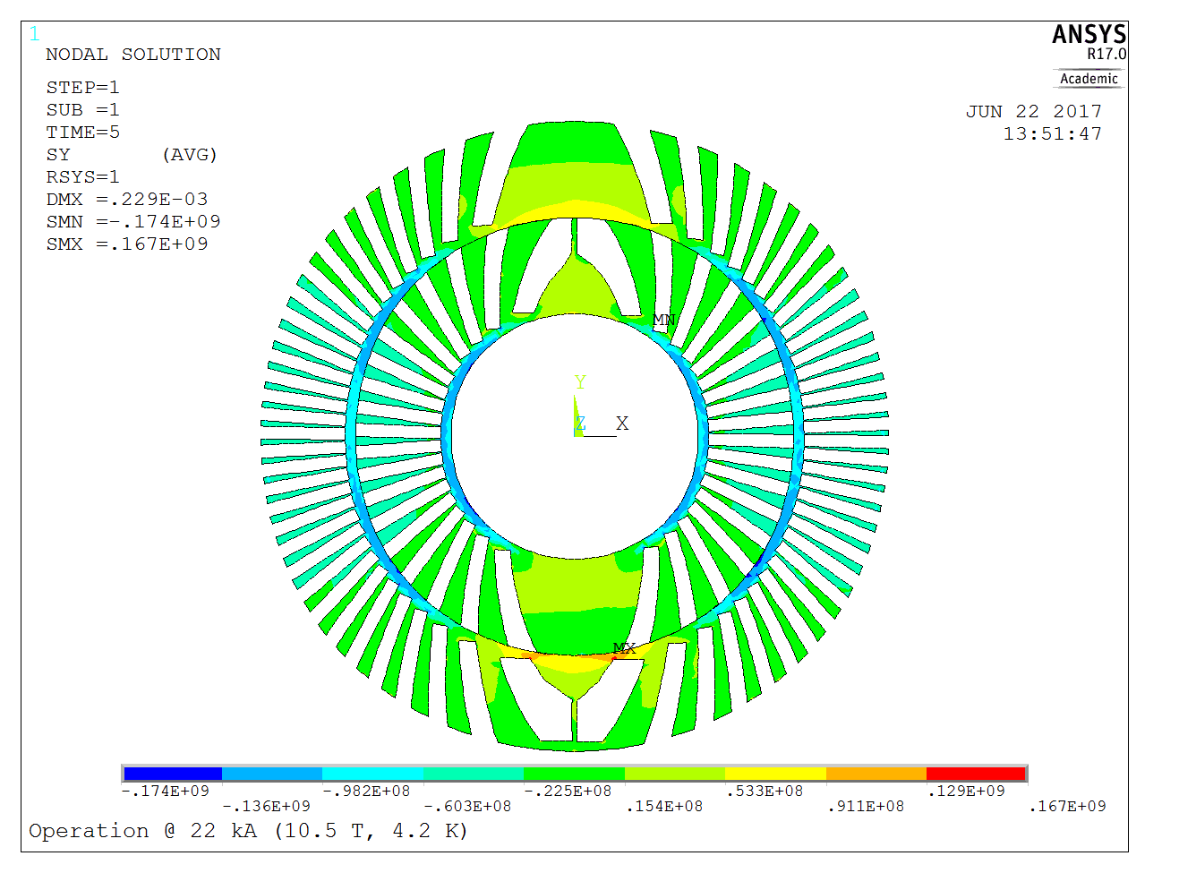
CD2-The Former
Vert. bladder operation
Hor. bladder operation
Assembly - room temp.
Room temp. steps
(σ_{θ} - Azimuthal)
Former σ_{θ}= [-185.0, 52.5] MPa
Former σ_{θ} = [- 107.0, 12.5] MPa
Former σ_{θ} = [-164.0, 50.5] MPa
Former σ_{ν}^{max} = 185 MPa
Former σ_{ν}^{max} = 100 MPa
Former σ_{ν}^{max} = 158 MPa
Operation at short sample limit (1.9 K, 12 T)
Cool down 1.9 K
Cool down
and
operation steps
(σ_{θ} - Azimuthal)
Former σ_{θ} = [-355.0, 248.0]MPa
Former σ_{θ} = [-174.0, 167.0]MPa
Former σ_{ν}^{max} = 340 MPa
Former σ_{ν}^{max} = 175.0 MPa

Slide 20
2D Mechanical modelling of CD1 dipole with ANSYS
Design’s objectives
Baseline Design
Nominal Design vs. Material Properties
Mechanical tolerances
Parametric Study
Conclusions

Slide 21
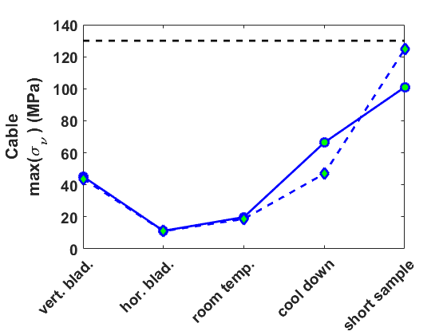
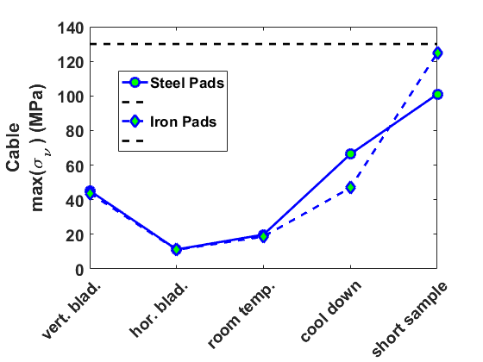
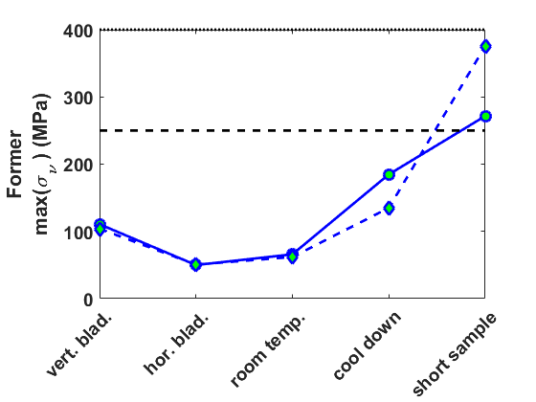
Pads: Steel vs. Iron
Von Mises (σ_{ν}) maximum stresses
cable and former for the 5 load steps
23 MPa
Why steel instead of iron
Thermal contraction of steel higher than iron
Thermal contraction of steel much closer to the one for the coil pack
For the iron pads, after cool down the differential thermal contraction gives a smaller value of pre-stress leading to higher maximum stress at operating conditions
--- cable limit
104 MPa
---room temp. limit
… cold (1.9 K) limit

Slide 22


Conductor’s
Mechanical Properties
Von Mises (σ_{ν}) maximum stresses
cable and former for the 5 load steps
Mechanical Properties for comparison
Used for simulations
--- cable limit
The only remarkable differences are
7.7 MPa higher peak stress for Cond. Prop.2 on the cable at short sample operating condition
85 MPa higher peak stress for Cond. Prop.3 on the former at short sample operating condition
---room temp. limit
… cold (1.9 K) limit

Slide 23
2D Mechanical modelling of CD1 dipole with ANSYS
Design’s objectives
Baseline Design
The Design vs. Material Properties
Mechanical tolerances
Parametric Study
Conclusions

Slide 24


Mechanical Tolerances
Horizontal and vertical keys
Tolerances of interest:
Mismatch between radii of coil and pads assemblies (OR1-IR2) ≠ 0 (coil/pad radial)
Horizontal key tolerance (hor. key)
Vertical key tolerance (vert. key)
Pad/pad interface contact (pad/pad cont.)
2
1
Use ANSYS contact technology
(coil/pad radial) < 0 → gap
(coil/pad radial) > 0 → compression
(hor. or vert. key) < 0 → undersize key
(hor. or vert. key) > 0 → oversize key
(pad/pad cont.) < 0 → undersize pads
(pad/pad cont.) > 0 → oversize pads
Coil pack
horizontal and vertical bladders
OR1
pad/pad cont.
vert. key
hor. key
IR1

Slide 25
2D Mechanical modelling of CD1 dipole with ANSYS
Design’s objectives
Baseline Design
The Design vs. Material Properties
Mechanical tolerances
Parametric Study
Conclusions

Slide 26
Parametric study and design’s objective
Use a ± 100 µm tolerance on the parameters of interest with a 50 µm step (five values for each parameter, reasonable computation time 5x5x5x5 simulations)
Nominal values of the parameters
  coil/pad radial gap equals to 0.0 mm
  hor. key interference of 0.3 mm
  vert. key interference of 0.0 mm
  pad/pad contact gap equal to 0.0 mm
For any combination of the parameters tolerances:
Maximum stress on the conductor below 130 MPa
Maximum stress on the former below 250 MPa at room temp and 400 MPa. at 1.9 K
The pad/pad interface has to be in contact during all the operating conditions.
If any of the maximum allowed stresses on the conductor and on the former are exceeded, the parameters combination is considered to be harmful for the magnet operation
A pad/pad interface not in contact during all the steps

Slide 27


Sensitivity to Parameters
One-factor-at-the-time
One-factor-at-the-time (quick check of important parameters)
Average the stress values over all the simulations runs for a given param. value and load step
Display the average as a function of the load step and param. value
Color map identify the spread on the results
Coil/pad radial mismatch has the larger influence on maximum stresses
Horizontal and vertical keys tolerances have a minor influence
Pad/pad contact tolerance can play a rule
We can restrict ourselves to the interactions between two parameters

Slide 28

Sensitivity to Parameters
Two Parameters Analysis
Varying two parameters while keeping the others at their nominal value:
All good
Pad/pad interface
Stresses values exceeded
FIRST ROW
  ± 100 µm tolerance on the coil/pad radial mismatch can not be accepted (required below 50 µm);
  A ± 50 µm tolerance on the hor. and vert. key must be considered
  Better to leave a small gap between coil and pad (≤ 50 µm)
2nd, 3rd and 4th ROWS
  Any combination of the other parameters gives a safe scenario
  Using tighter tolerances help to guarantee pad/pad contact

Slide 29


Defining Tolerances
Results from parametric study
with target tolerances
  Target tolerances (according to the procurement of mechanical parts)
  coil/pad radial → [-40, 0] µm
  hor. key → ± 50 µm
  vert. key → ± 50 µm
  pad/pad contact → ± 25 µm
  4 simulations runs above limit -by a small amount- out of 625 simulations (5 values per tolerance):
  THIS IS NOT GOING TO BE A PROBLEM: WE HAVE EXTRA MARGINS!

Slide 30
2D Mechanical modelling of CD1 dipole with ANSYS
Design’s objectives
Baseline Design
The Design vs. Material Properties
Mechanical tolerances
Parametric Study
Conclusions

Slide 31
Conclusions
A parametric study on the 2D model of CD1 magnet is carried out
Critical tolerances a parameter sensitivity is investigated
Tolerances for technical design are defined
Numerical Results from 2D simulations show the feasibility of the CD1 design

Slide 32





CD1 - The Coil
Radial Stress
Vert. bladder operation
Hor. bladder operation
Assembly - room temp.
Room temp. steps
(σ_{r} - Radial)
Cable σ_{r} = [- 46.6, 29.0] MPa
Cable σ_{r} = [-10.7, 16.6] MPa
Cable σ_{r} = [-21.1, 5.3] MPa
Operation at short sample limit (1.9 K, 12 T)
Cool down 1.9 K
Cool down
and
operation steps
(σ_{r} - Radial)
Cable σ_{r} = [-63.7, 54.6] MPa
Cable σ_{r} = [-104.0, 36.2] MPa

Slide 33





CD1 - The Former
Radial Stress
Vert. bladder operation
Hor. bladder operation
Assembly - room temp.
Room temp. steps
(σ_{r} - Radial)
Former σ_{r}= [-50.2, 102.0] MPa
Former σ_{r} = [- 20.2, 30.6] MPa
Former σ_{r} = [-16.9, 28.8] MPa
Operation at short sample limit (1.9 K, 12 T)
Cool down 1.9 K
Cool down
and
operation steps
(σ_{r} - Radial)
Former σ_{r} = [-86.4, 78.7]MPa
Former σ_{r} = [-204.0, 174.0]MPa

Slide 34





CD2 - The Coil
Radial Stress
Vert. bladder operation
Hor. bladder operation
Assembly - room temp.
Room temp. steps
(σ_{r} - Radial)
Cable σ_{r} = [-26.5, 24.7] MPa
Cable σ_{r} = [- 20.5, 10.2] MPa
Cable σ_{r} = [-22.2, 8.7] MPa
Operation at short sample limit (4.2 K, 10.5 T)
Cool down 4.2 K
Cool down
and
operation steps
(σ_{r} - Radial)
Cable σ_{r} = [-76.5, 43.6] MPa
Cable σ_{r} = [-79.0, 47.3] MPa

Slide 35





CD2 - The Former
Radial Stress
Vert. bladder operation
Hor. bladder operation
Assembly - room temp.
Room temp. steps
(σ_{r} - Radial)
Cable σ_{r} = [-57.7, 66.0] MPa
Cable σ_{r} = [- 36.3, 40.8] MPa
Cable σ_{r} = [-32.2, 44.6] MPa
Operation at short sample limit (4.2 K, 10.5 T)
Cool down 4.2 K
Cool down
and
operation steps
(σ_{r} - Radial)
Cable σ_{r} = [-95.9, 143.0] MPa
Cable σ_{r} = [-169.0, 62.6] MPa

