Slide 1
CD1 Mechanical Model –
Technical Design Status
Serguei Sidorov :: Paul Scherrer Institut
26.06.2017, CD1 Conceptual Design Review

Slide 2
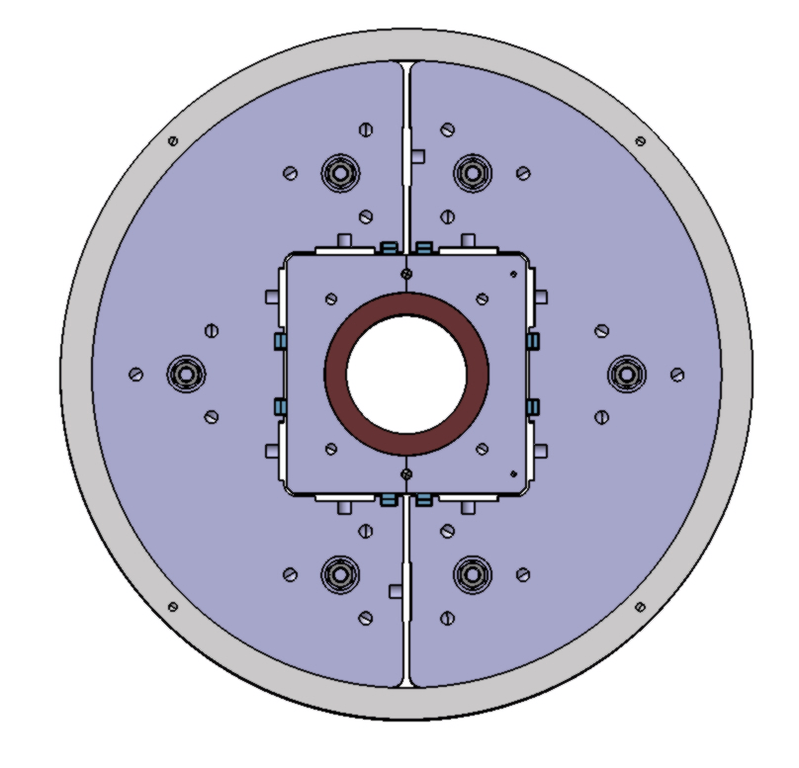
Mechanical Model Assembly
1. Overview
Shell
Yoke
Loading keys
Dummy Coil
Length = 310mm, weight = 480 kg

Slide 3
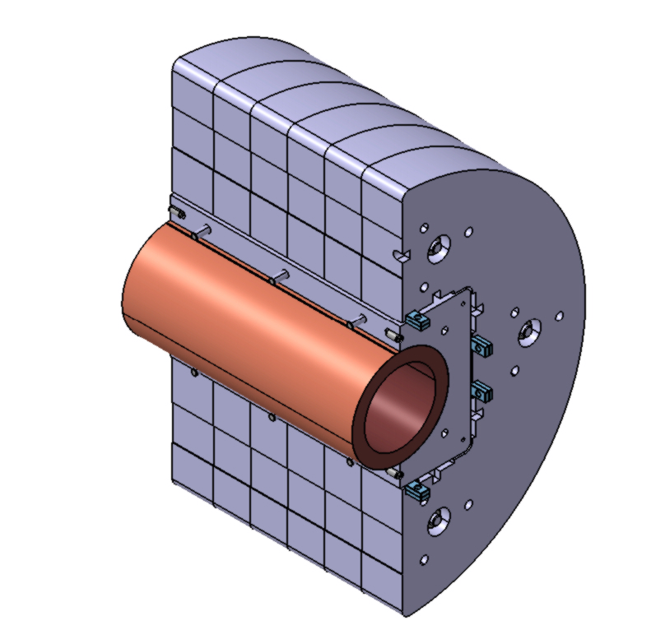
Mechanical Model Assembly
50mm thick
55mm thick
55mm thick

Slide 4
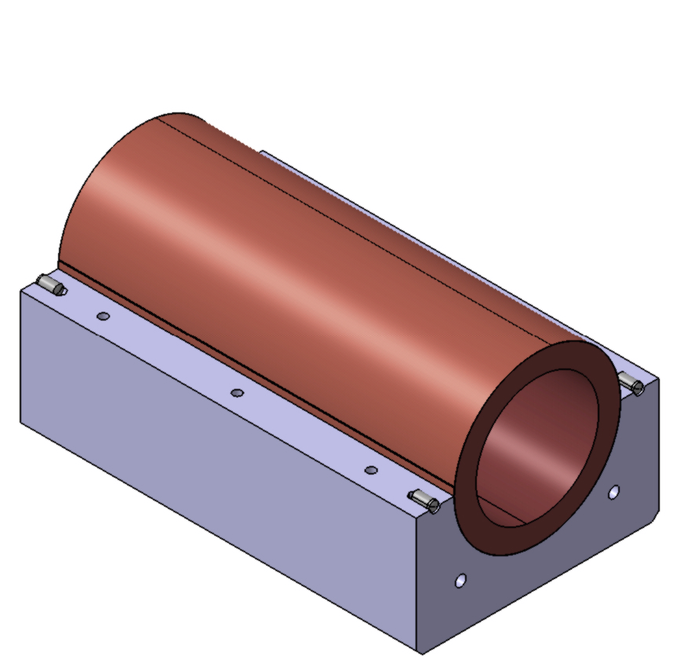
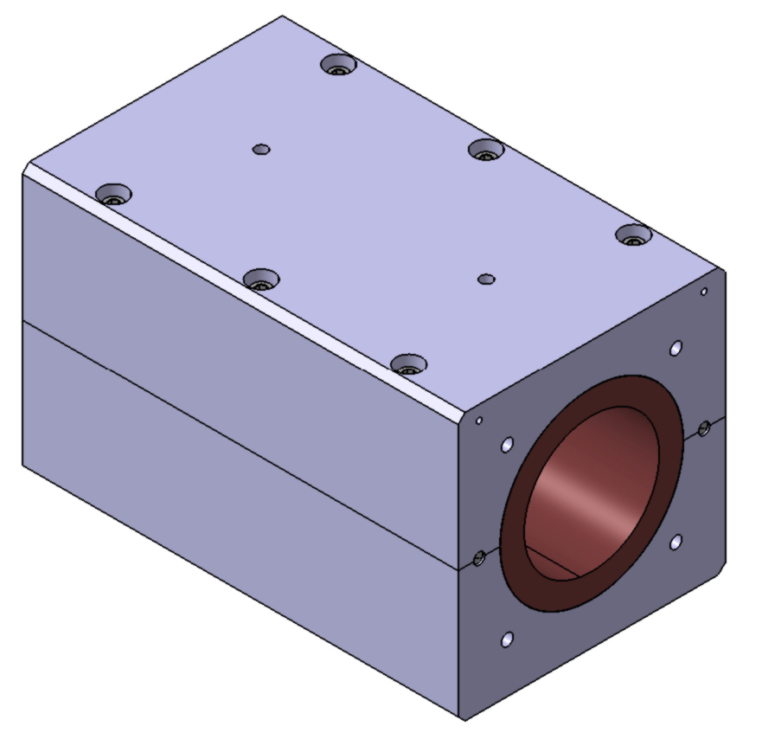
Mechanical Model Assembly
2. Assembly procedure
Two kapton layers 0.125mm thick will be applied on the dummy coil before the coil is assembled with pads.

Slide 5
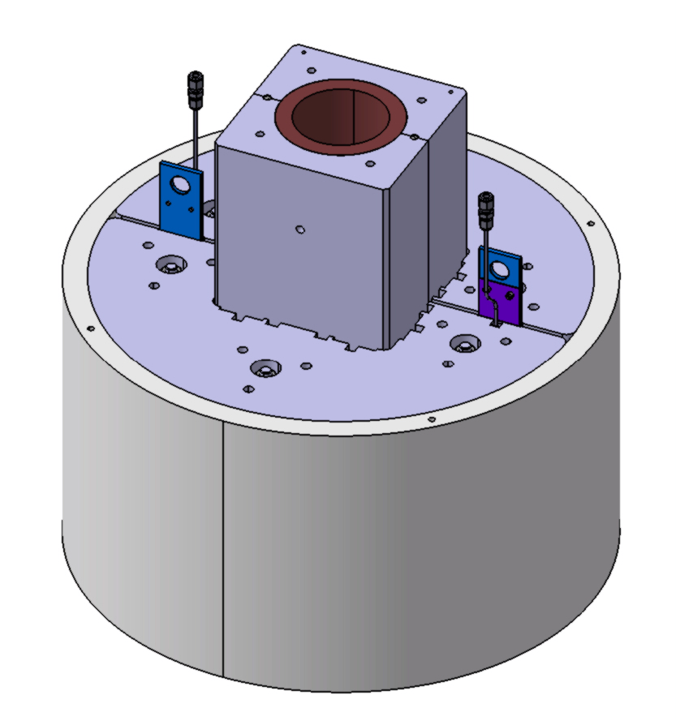
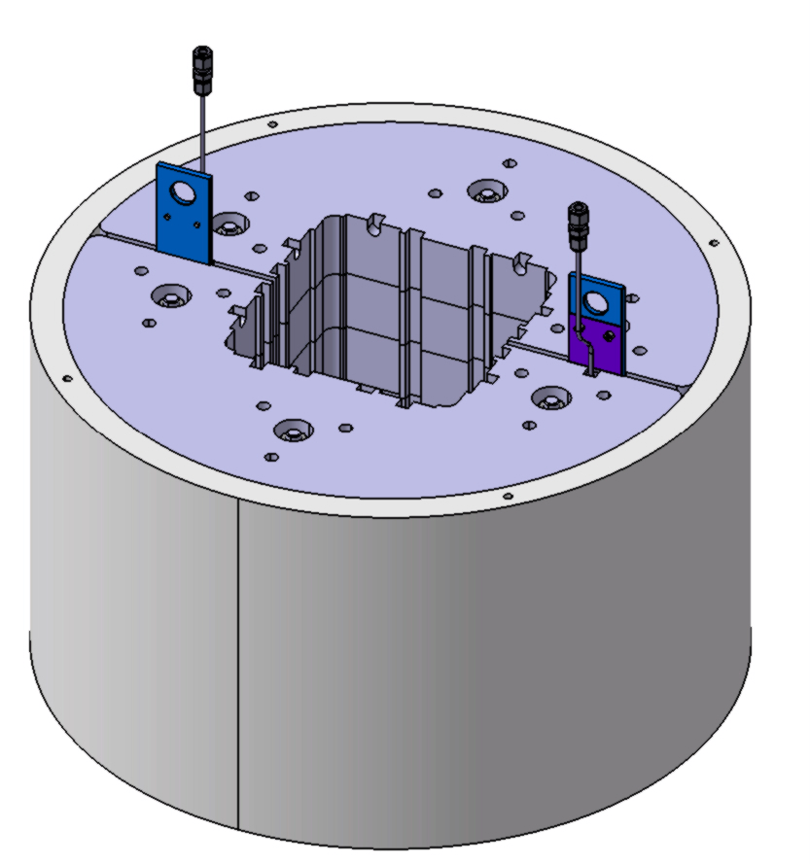
Mechanical Model Assembly
Two yoke halves are inserted into the outer shell and the bladders are used to put two halves into position for the pads/coil insertion.

Slide 6
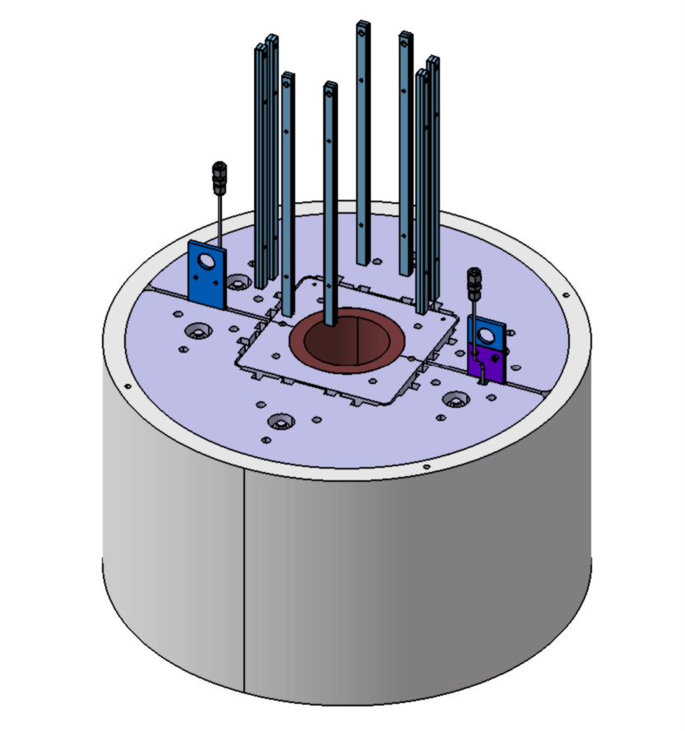
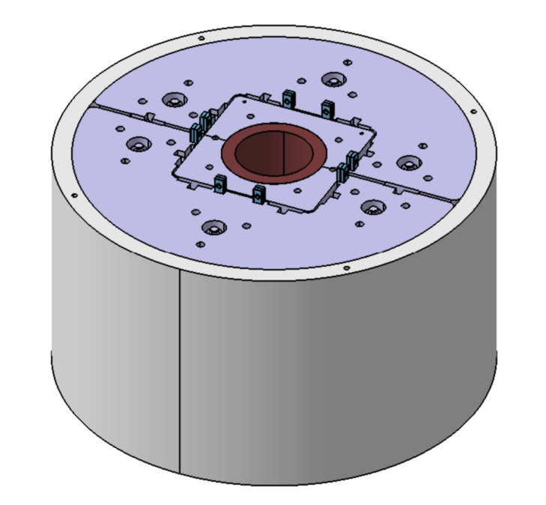
Mechanical Model Assembly
The loading keys are inserted just to keep the pads with the dummy coil in the center of the yoke. Two bladders are removed. The assembly is ready for the coil pre-loading.

Slide 7
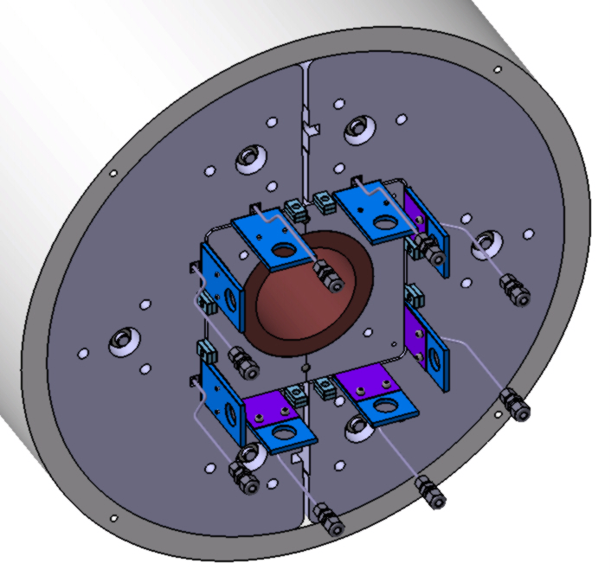
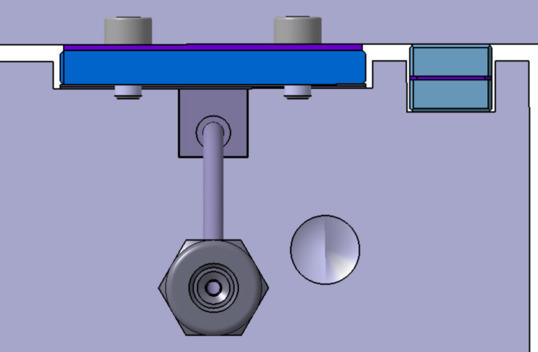
Mechanical Model Assembly
Eight bladders are installed between the pads and the yoke. The preloading begins.

Slide 8
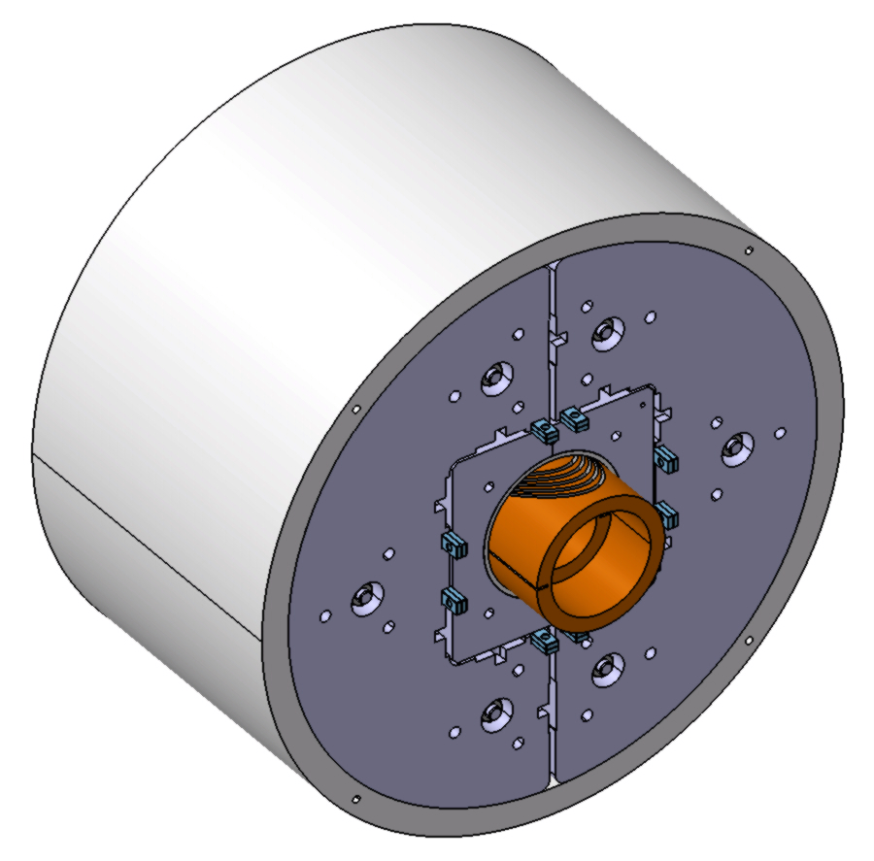
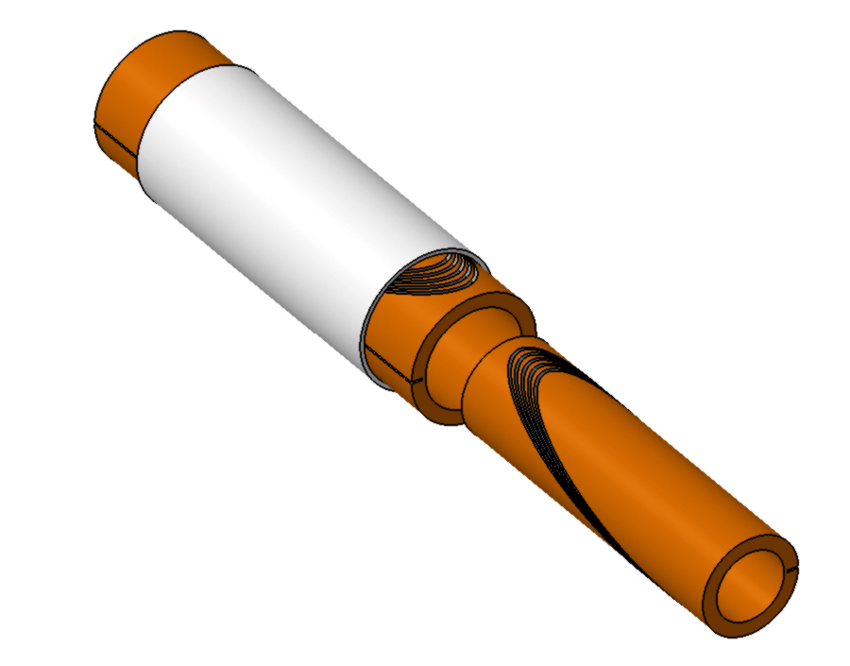
Mechanical Model Assembly
3. Alternative solution.
As an alternative solution, using the presented structure, we will be able to pre-stress the impregnated short test formers in order to check the toughness of the impregnation and the full assembly procedure.

Slide 9
Mechanical Model Assembly
4. Conclusion/Status.
LBNL’s engineer Ray Hafalia has reviewed our design. Remaining points:
Should there be a groove for bladders also on the pad side?
Are the two Kapton layers, totaling 0.25 mm, the right tool for a) creating space for Fuji-paper tests, b) transmitting radial forces, c) adding to radial ground insulation?
After the feedback of this conceptual-design review and when discussions with Ray are included into design, we intend to go directly into procurement in order to test this this model in autumn.

Slide 10
Wir schaffen Wissen – heute für morgen

