Slide 1
Technological Challenges, R&D Topics, and Infrastructure Plans
B. Auchmann (CERN/PSI), R. Felder (PSI), J. Gao (PSI), G. Montenero (PSI)
G. Rolando (CERN), S. Sanfilippo (PSI), S. Sidorov (PSI)
26.06.2017, CD1 Conceptual Design Review

Slide 2
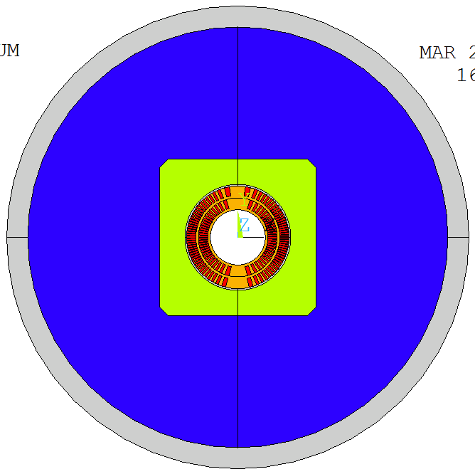
Overview
Test and R&D Topics
  Quench Protection
  Smart Insulation
  Former Manufacturing
  Former-Material Characterization
  Winding and Reaction Tests
  Instrumentation and Soldering Trials
  Impregnation Tests
  Structure Assembly
Infrastructure Plans

Slide 3
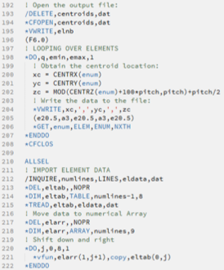
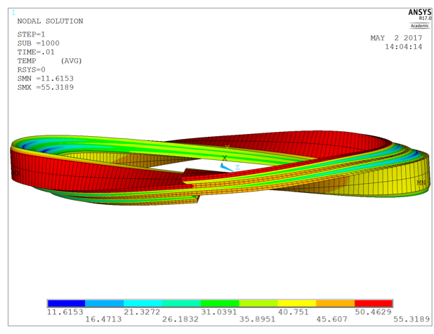
Quench Simulation
Tool : Mecanical APDL (ANSYS Parametric Design Language)
    A scripting language to build models & analyses
    Features : design optimization & adaptive meshing
Electric
Electro-thermal
Electro
magnetic

Slide 4
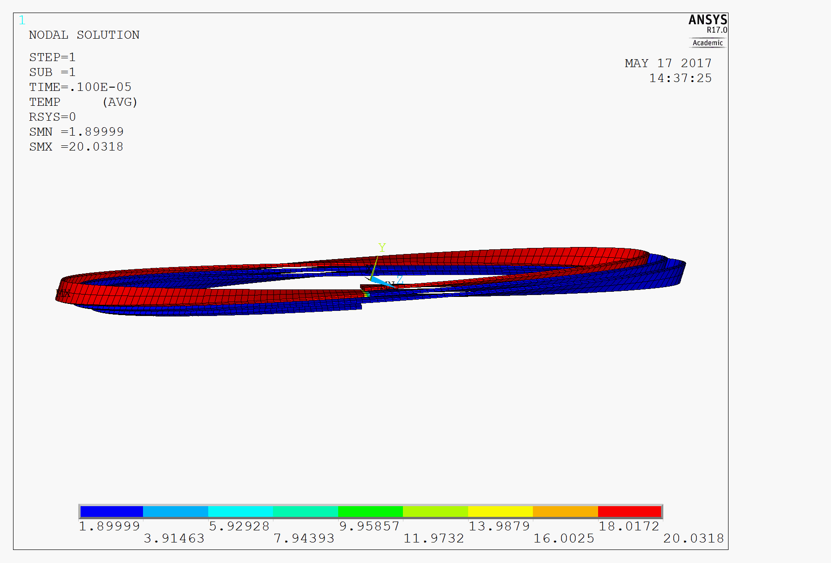
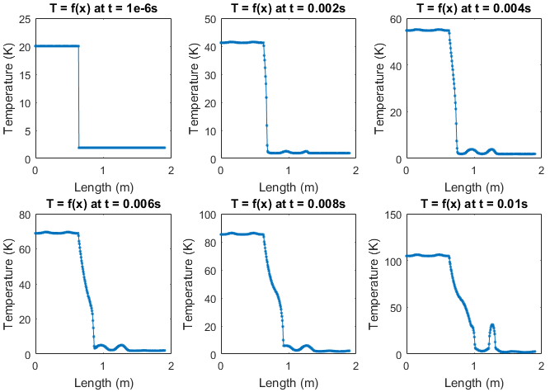
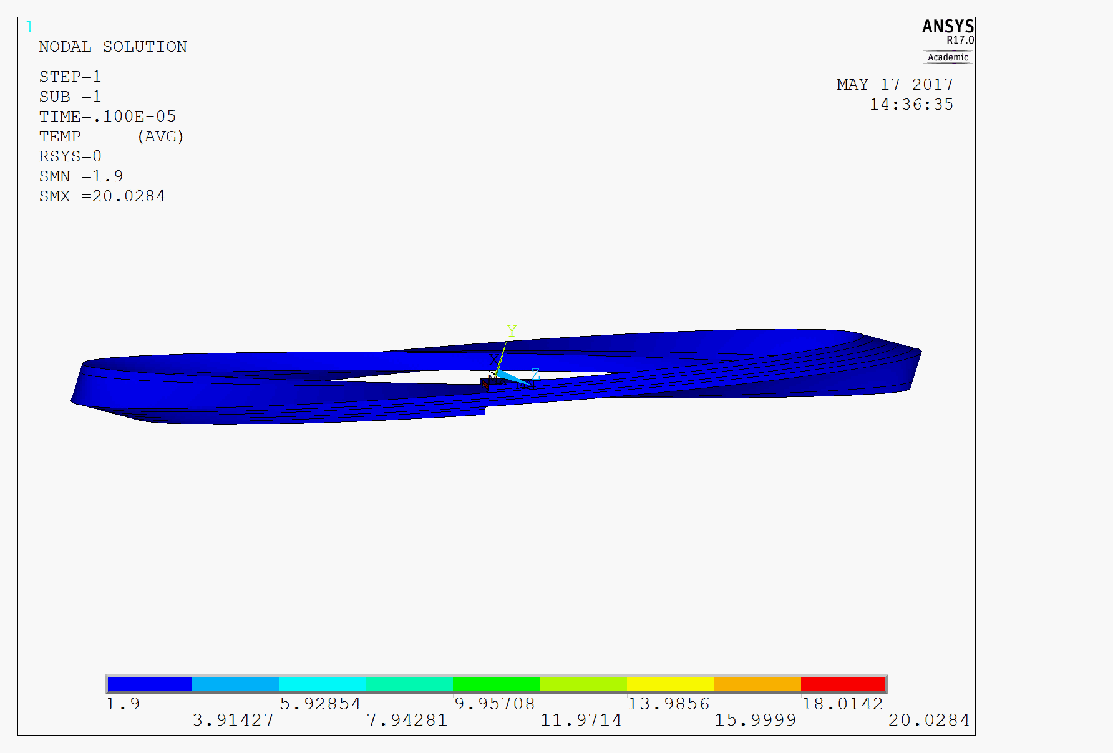
Quench Simulation
Model I : Helical Propagation
  Determination of propagation velocity per layer and per excitation level.
  Quantification of detection problem.
  CD1 Layer1 3-turn model results, working at I_{ss} = 20kA, IC : T = 20K for 1st turn

Slide 5
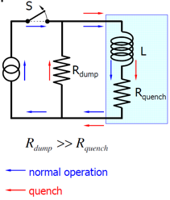
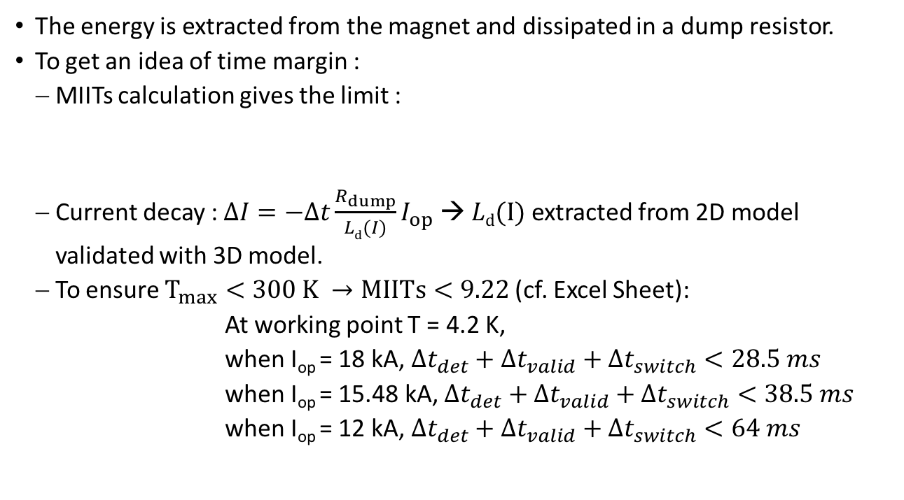
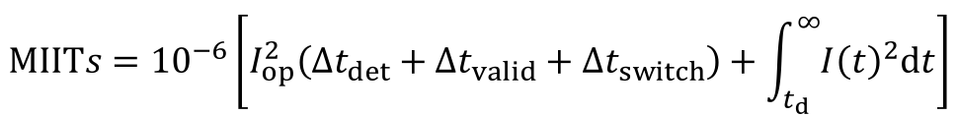
CD1 Quench Protection
The energy is extracted from the magnet and dissipated in a dump resistor.
To get an idea of time margin :
  MIITs calculation gives the limit :
  Current decay : $∆I=−∆t\frac{R_{dump}}{Ld(I)}I_{op}$ → $Ld(I)$ extracted from 2D model
  validated with 3D model.
  To ensure $T_{max}<300 K →MIITs<9.22$ (cf. Excel Sheet):
  At working point T = 4.2 K,
  when I_{op} = 18 kA, $∆t_{det}+∆t_{valid}+∆t_{switch}<28.5 ms$
  when I_{op} = 15.48 kA, $∆t_{det}+∆t_{valid}+∆t_{switch}<38.5 ms$
  when I_{op} = 12 kA, $∆t_{det}+∆t_{valid}+∆t_{switch}<64 ms$
$$MIITs={10}^{−6}\left[I_{op}^{2}\left(∆t_{det}+∆t_{valid}+∆t_{switch}\right)+\int_{t_{d}}^{∞}{{I\left(t\right)}^{2}dt}\right]$$

Slide 6
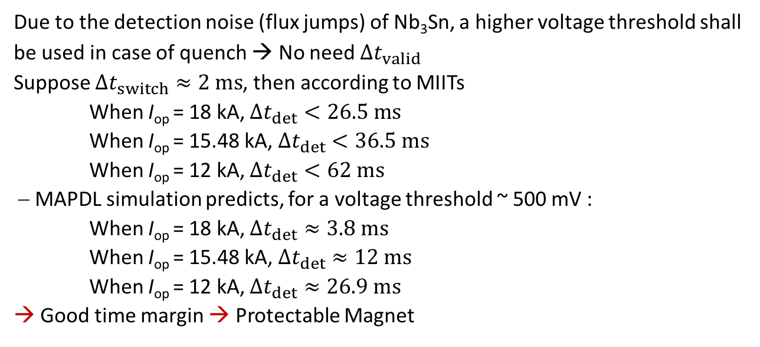
CD1 Quench Protection
  Due to the detection noise (flux jumps) of Nb₃Sn, a higher voltage threshold shall be used in case of quench → No need $∆t_{valid}$
  Suppose $∆t_{switch}≈2 ms$, then according to MIITs
  When I_{op} = 18 kA, $∆t_{det}<26.5 ms$
  When I_{op} = 15.48 kA, $∆t_{det}<36.5 ms$
  When I_{op} = 12 kA, $∆t_{det}<62 ms$
  MAPDL simulation predicts, for a voltage threshold ~ 500 mV :
  When I_{op} = 18 kA, $∆t_{det}≈3.8 ms$
  When I_{op} = 15.48 kA, $∆t_{det}≈12 ms$
  When I_{op} = 12 kA, $∆t_{det}≈26.9 ms$
  → Good time margin → Protectable Magnet
Cable w/o insul
Cable with insul

Slide 7
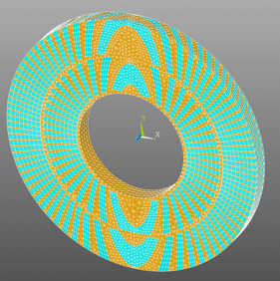
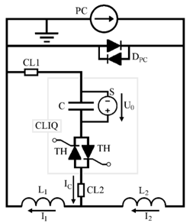
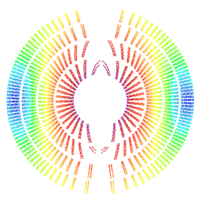
MAPDL Quench Simulation with LBNL
Next Simulation Goals:
  Generation of slice model with continuous
  mesh for electro-thermal simulation.
  With L. Brouwer (LBNL), creation of
  user-defined electrodynamic and thermal
  elements for cable-eddy current simulation
  and quench simulation, respectively.
  Simulation of a CLIQ discharge in CD1
  slice prior to its test.
  Eventually, full CD1 quench simulation
  on cluster.
+
–
+
–
Courtesy: E. Ravaioli

Slide 8
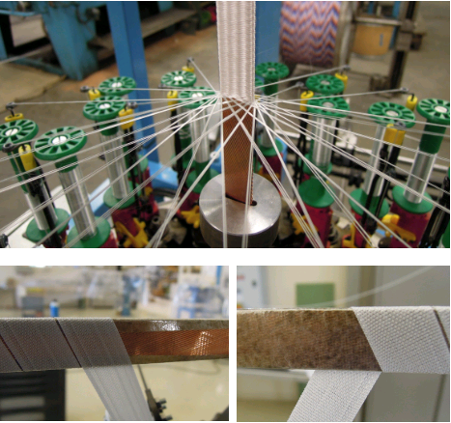
Insulation
Baseline: Copy-paste from 11-T insulation.
  Mechanical reinforcement of frail cable
  edges via mica.
  No particular worries about strain-
  enhancement due to open
  mica C due to CCT stress management.
  In contact with Jacky Mazet to coordinate
  requests and develop tooling for mica and
  co-wound wire (see next slide).
Alternative: closed mica wrap (all 4 sides
with overlap)
  Use sleeve and do impregnation tests.

Slide 9
Smart Insulation
Goal: Accelerate quench detection in CCT HFMs.
  Baseline: Co-wound copper wire for inductive compensation (see Feather 2, G. Kirby et al.).
  Co-wound copper wire terminated with diodes for inductive compensation and passive quench-back heater (see HL-LHC D2 corrector, G. Kirby et al.).
  Co-wound SC wire with series resistance shorting SC cable; apply stationary bias current (~1 A) for thermal quench detection (sudden current drop; see G. Montenero idea for
  HL-LHC SC link protection).
  Co-wound Rayleigh-scattering Interrogated Optical Fiber.
Work with Jacky and firm to include wire in between mica and S2 braid.

Slide 10
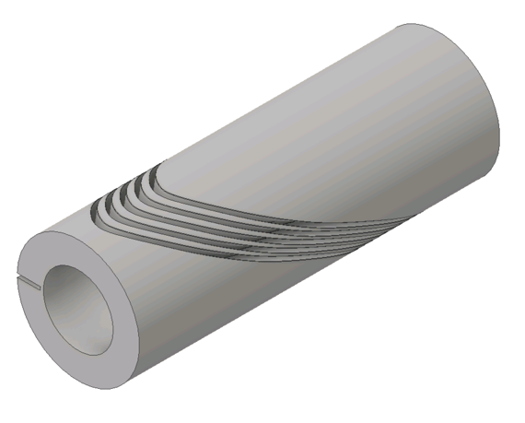
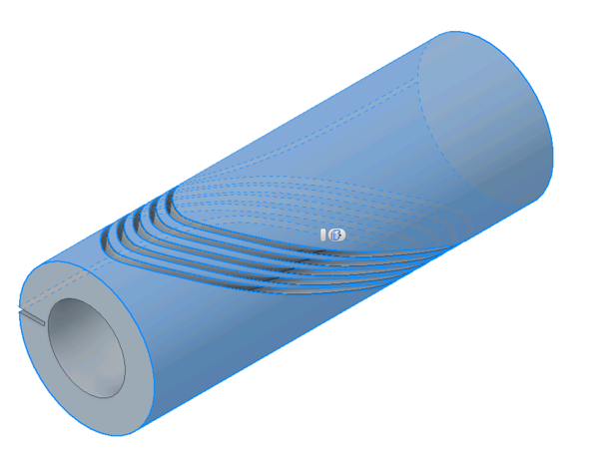
Manufacturing Trials
Ongoing at Swiss (CuAl7Si2) and Dutch (CuAl10Fe5Ni5) companies.
Baseline is CuAl7Si2 to avoid magnetic-field distortion.
5 turns per layer.
CD1 IL and OL, followed by CD2 IL.

Slide 11
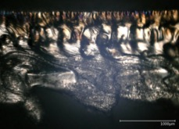
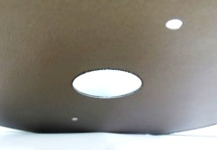
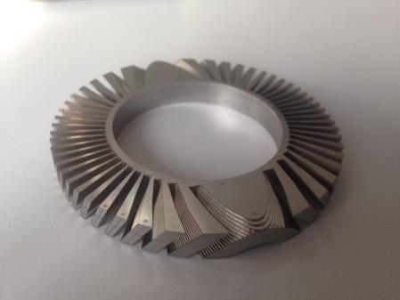
Manufacturability and Cost
Collaboration with IWS Fraunhofer on fabrication of thin-lamination formers.
  Laser weld-cutting.
  Goal: improve scalability and cost.
If proof-of-concept successful, we plan to
apply for D/A/CH funding to develop a mature
manufacturing technology.
Potentially interesting for manufacturing of
curved CCT formers.
Notes:
add more on former manufactuiring, insulation, impregnation challenge

Slide 12
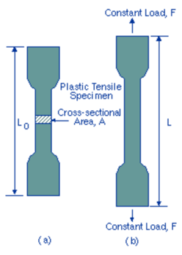
Al-Bronze Characterization
Determine Al-bronze tensile strength post reaction at room temperature and in cryogenic conditions.
Manufacture normed sample and ask CERN EN/MME for characterization (PSI team account).

Slide 13
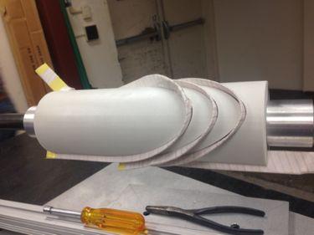
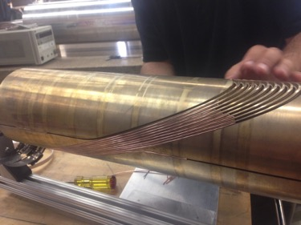
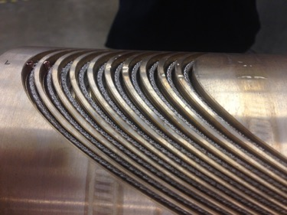
Winding and Reaction Tests
CD1 winding test with metal and 3-D printed test formers.
CD2 winding test with metal test former and FNAL-supplied copper cable.
CD1 test reaction with 5-turn Al-bronze test former. Determine cable elongation and verify channel dimensions. Validate clamping technique (below: copper wires and hose clamps).

Slide 14
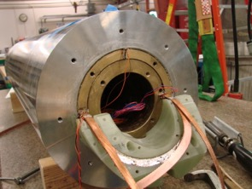
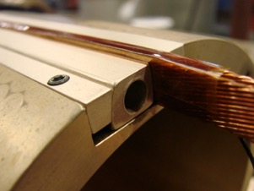
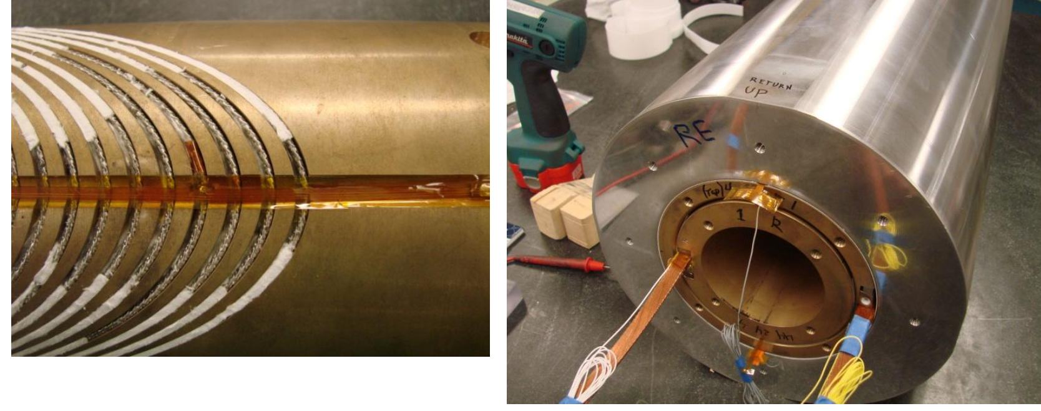
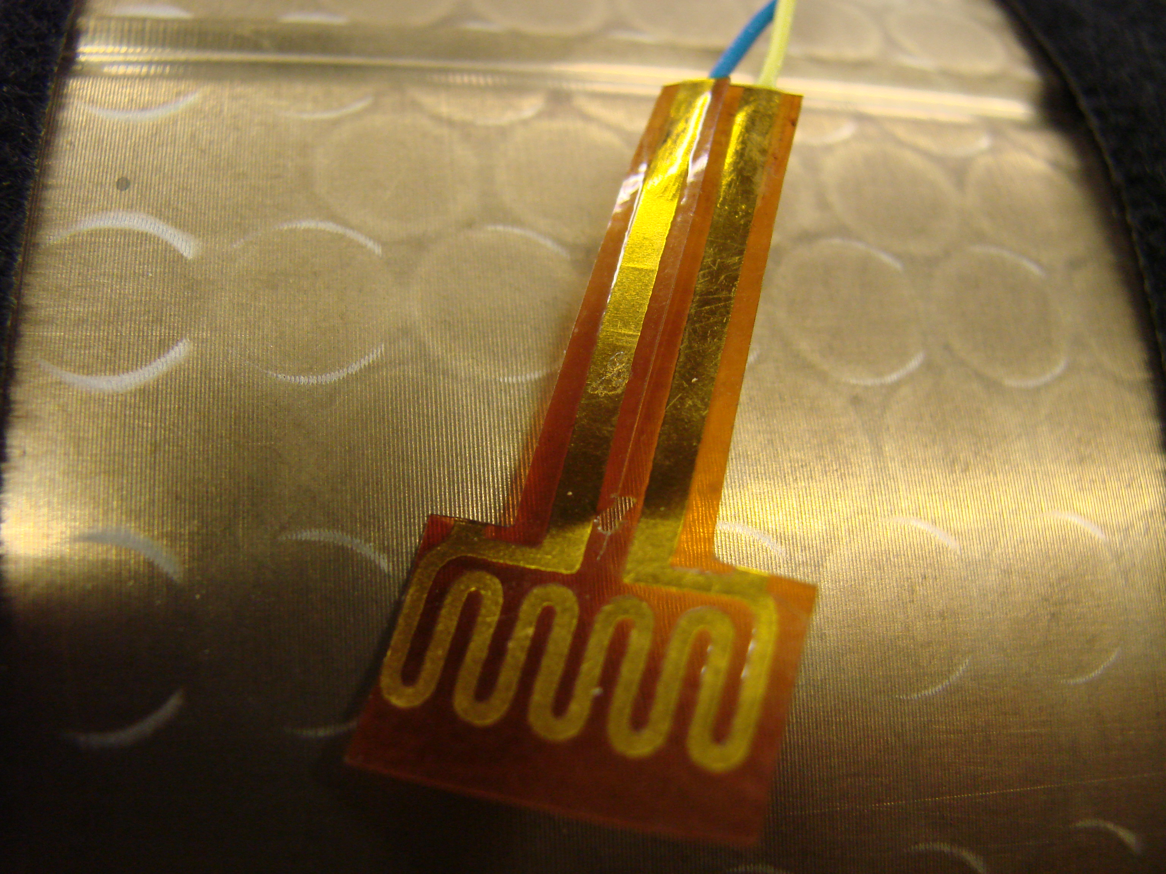
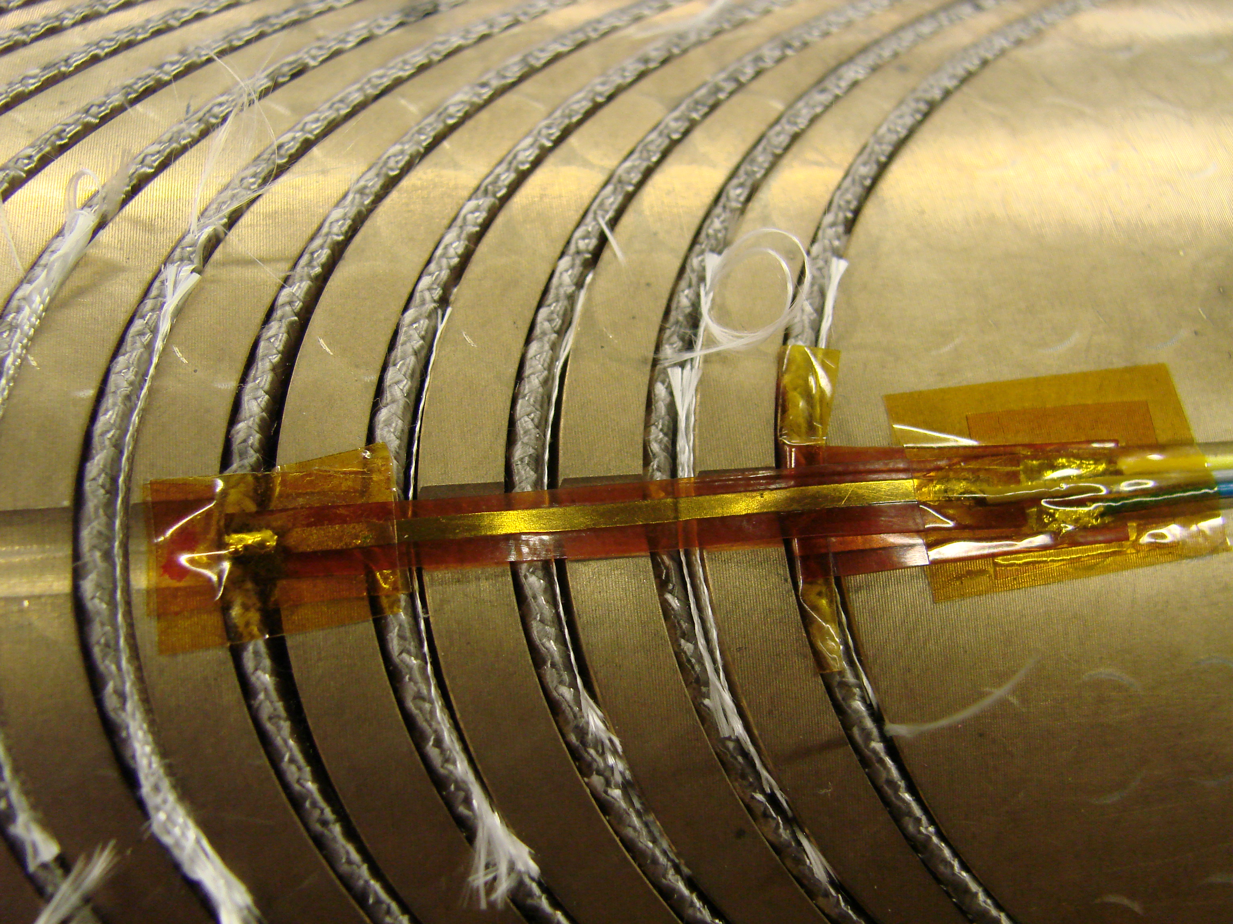
Instrumentation and Soldering Trials
Learn from CERN and PSI:
  Nb3Sn/Nb-Ti splices.
  Nb-Ti/Nb-Ti joints.
  PCB wiring.
  Voltage taps.

Slide 15
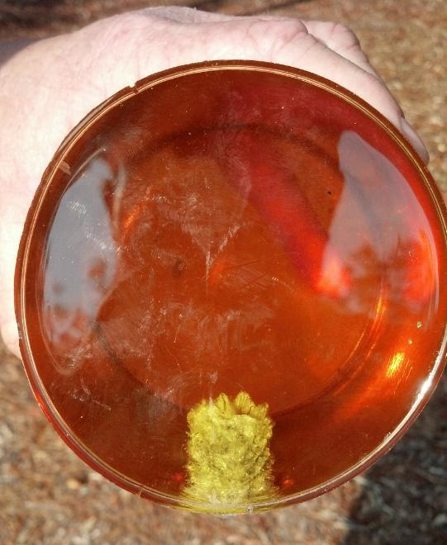
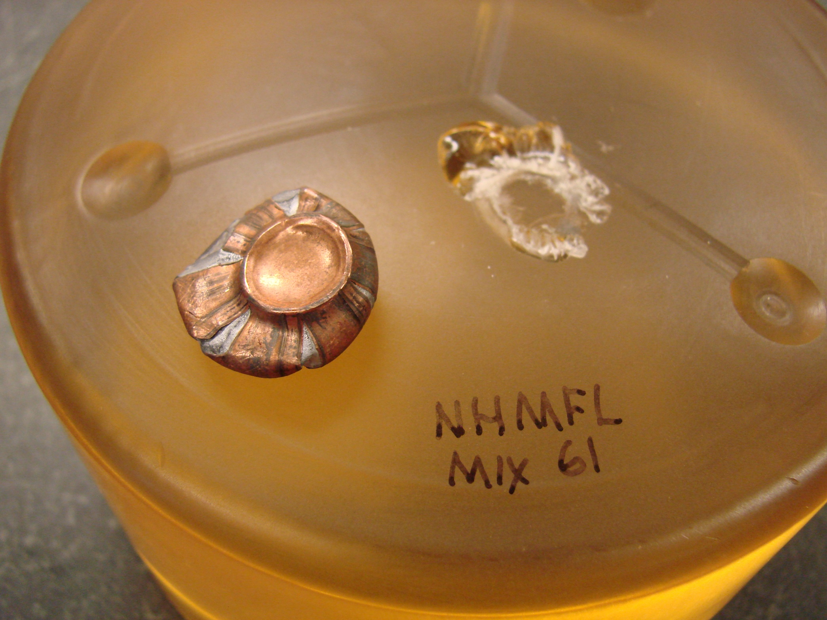
Impregnation Trials
CD1 test impregnations with 3D printed formers (probably Duraform, following advice by Remy and Sebastien).
  Set up impregnation process.
  First trials, vacuum-bag impregnation of single layer.
  Compare CTD 101K with NHMFL61.
  Sleeve insulation with mica C and mica wrap.
  Cut up samples to observe filling quality.
D. Markiewicz (NHMFL): “I cannot say strongly enough how different
the NHMFL epoxies are from CTD101 in fracture toughness.“

Slide 16
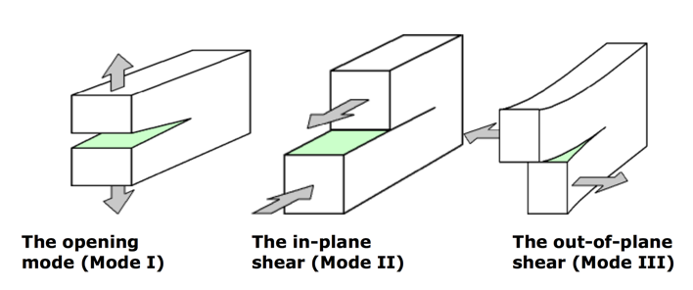
Metal-Resin Adhesion
R&D on improved metal-resin bonding strength.
Determine effective primary to improve metal-resin adhesion.
Test different metal surface conditions (sandblasting, vs. polishing).

Slide 17
Former Coating
Discuss SiOx chemical vapor deposition coating for enhanced and reaction-hard former insulation.
Contact experts at PSI and ETHZ.
Study consequences for resin adhesion.

Slide 18
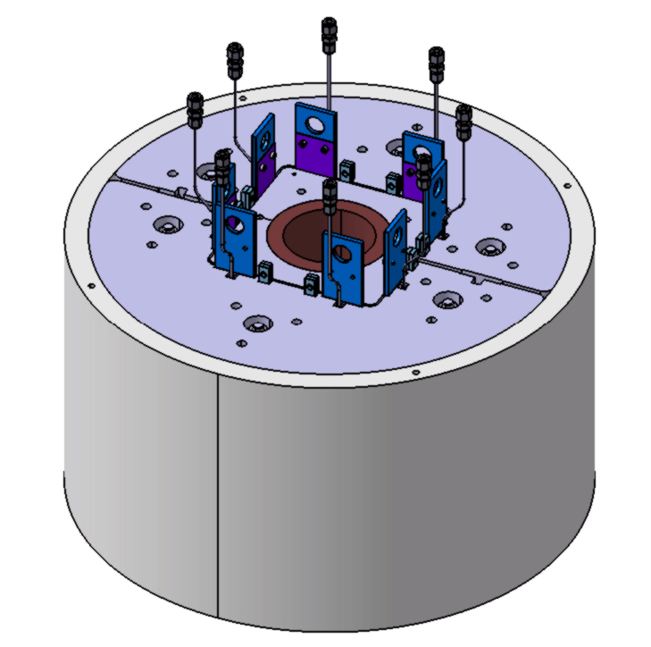
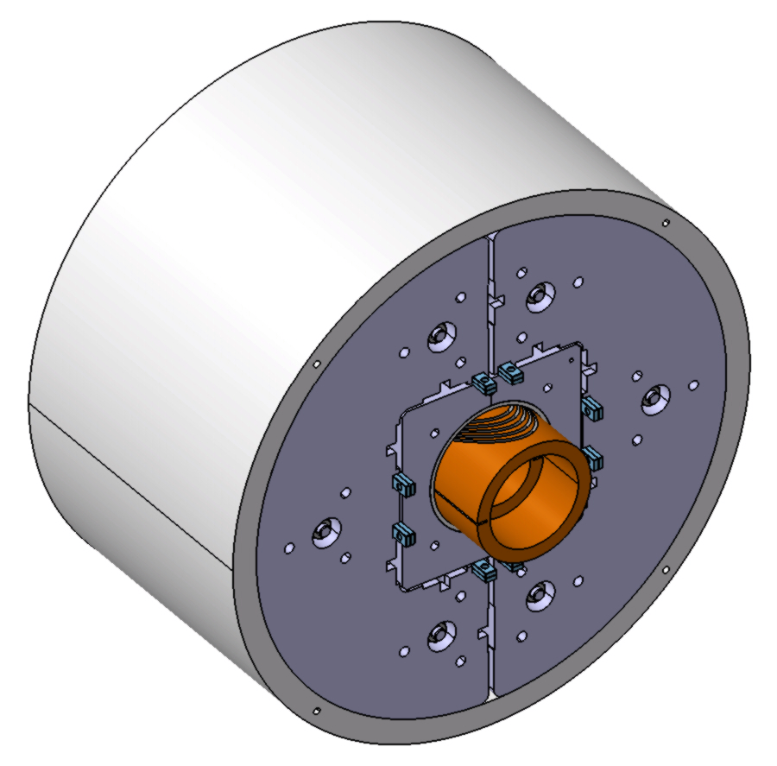
Short Mechanical Model
Mechanical model with dummy coil:
  Set up mechanical measurement system.
  Equip short model with dummy coil with strain gauges.
  Validate structure vs. ANSYS model.
Mechanical model with assembled 5-layer test formers:
  Impregnate 5-layer test formers.
  Load them in, both, vertical and horizontal position in the mechanical model.
  Study cracking, delamination, etc.

Slide 19
Overview
Test and R&D Topics
Infrastructure Plans
  Mechanical Measurements
  Impregnation System
  Reaction Furnace

Slide 20
Preface
PSI is currently involved in four different project involving Nb3Sn technology:
  FCC Design Study CD1/2.
  SLS 2.0 SuperBend magnet (Nb3Sn racetrack).
  Superconducting gantry (tilted racetracks, with industry).
  Racetracks for magnetization of bulk-HTS SC undulators.
SC magnets for light sources and proton therapy are of strategic long-term interest for PSI.
The FCC Design Study also serves to build up competence as well as infrastructure at PSI.
This investment, in turn, can help HFM R&D for FCC.

Slide 21
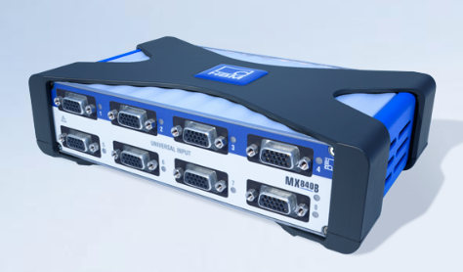
Mechanical Measurements
Invest in 16-channel HBM measurement system (same as CERN and LBNL)
Strain gauges
LVDTs
Temperature sensors
Quote received, ready to launch procurement.

Slide 22
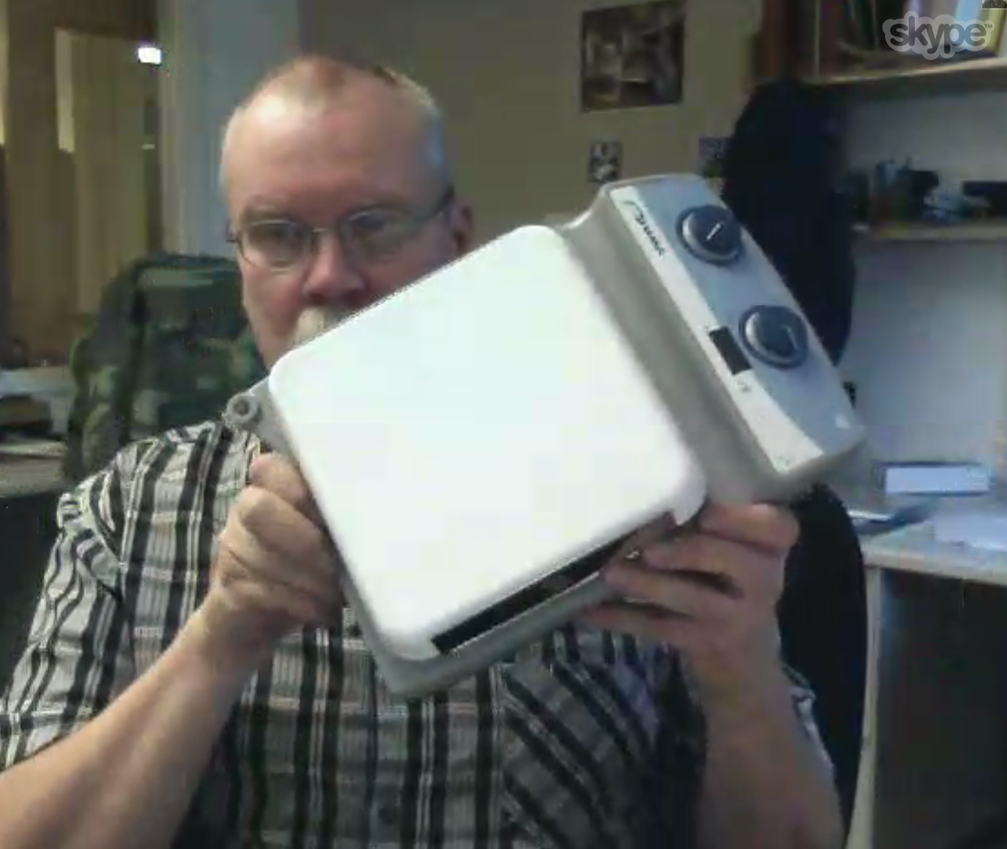
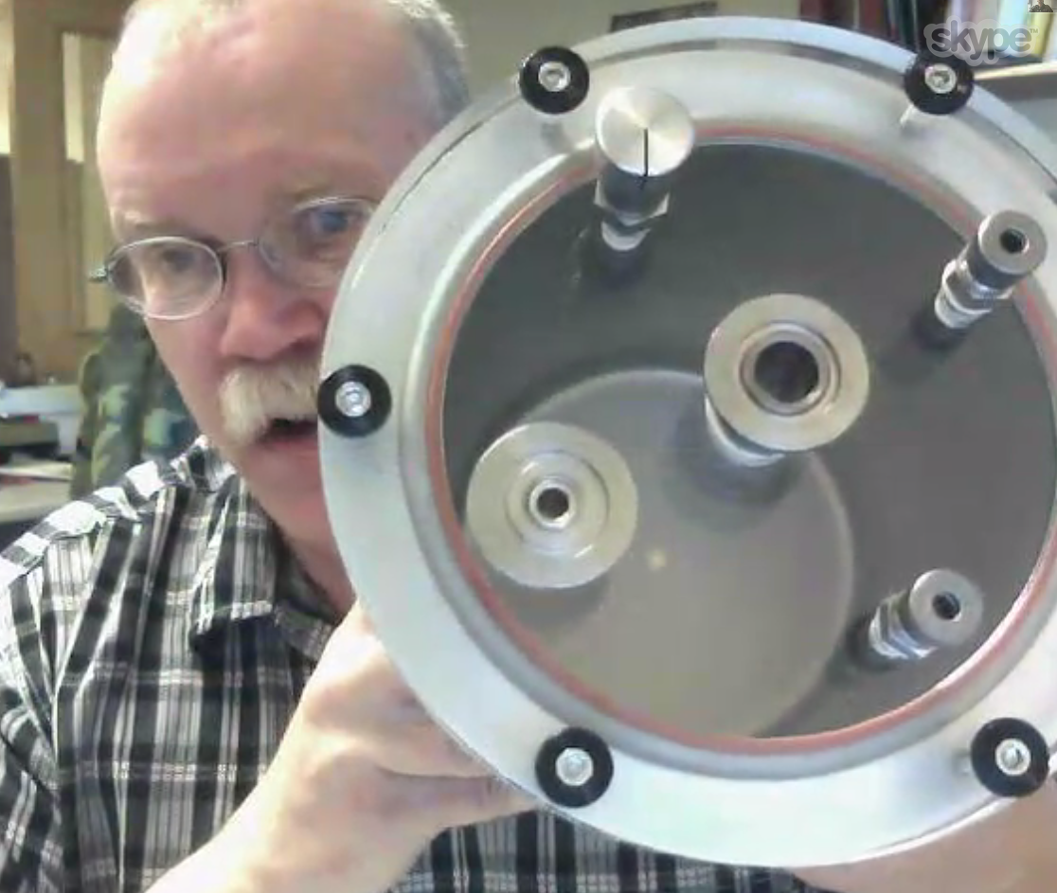
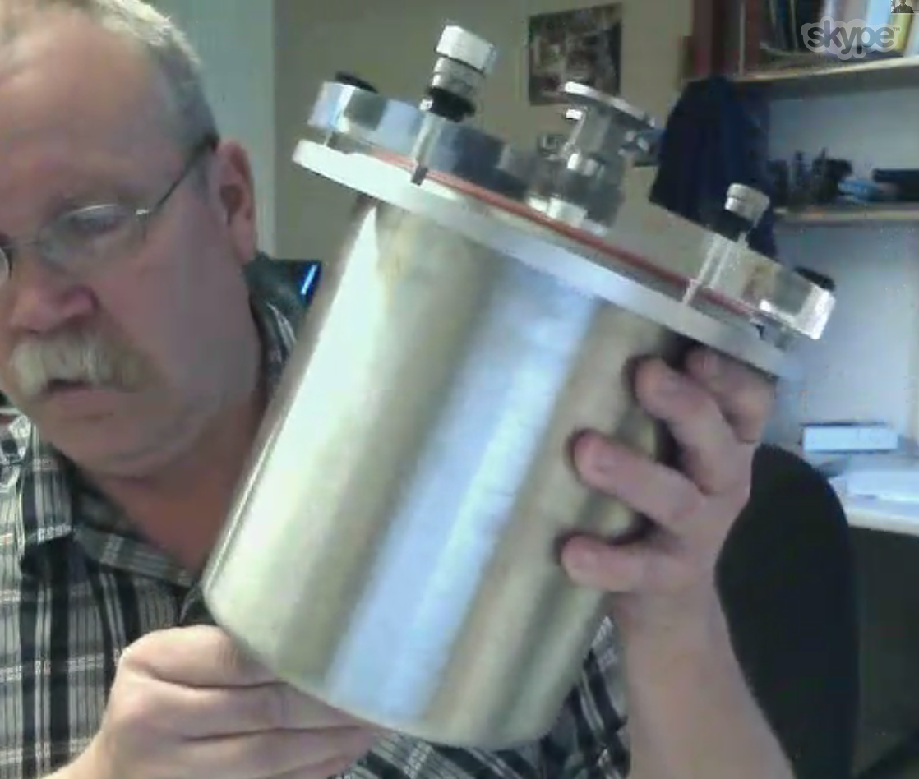
Impregnation System
Baseline:
  Build mixer pot.
  Heating plate with magnetic mixer.
Alternative:
  buy mixer with impeller and heating mats.
Perform first trials directly in PSI heating chamber.
Skype consulting with Jim Swanson (LBNL).

Slide 23
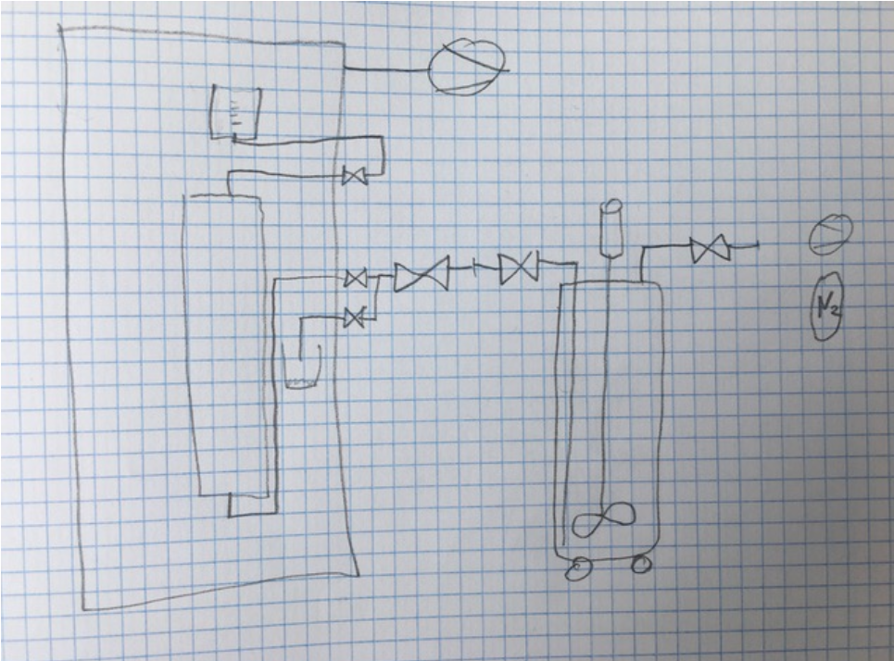
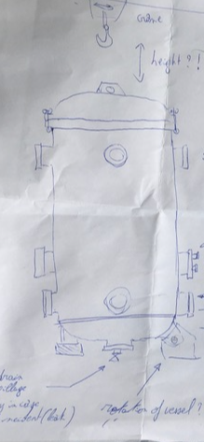
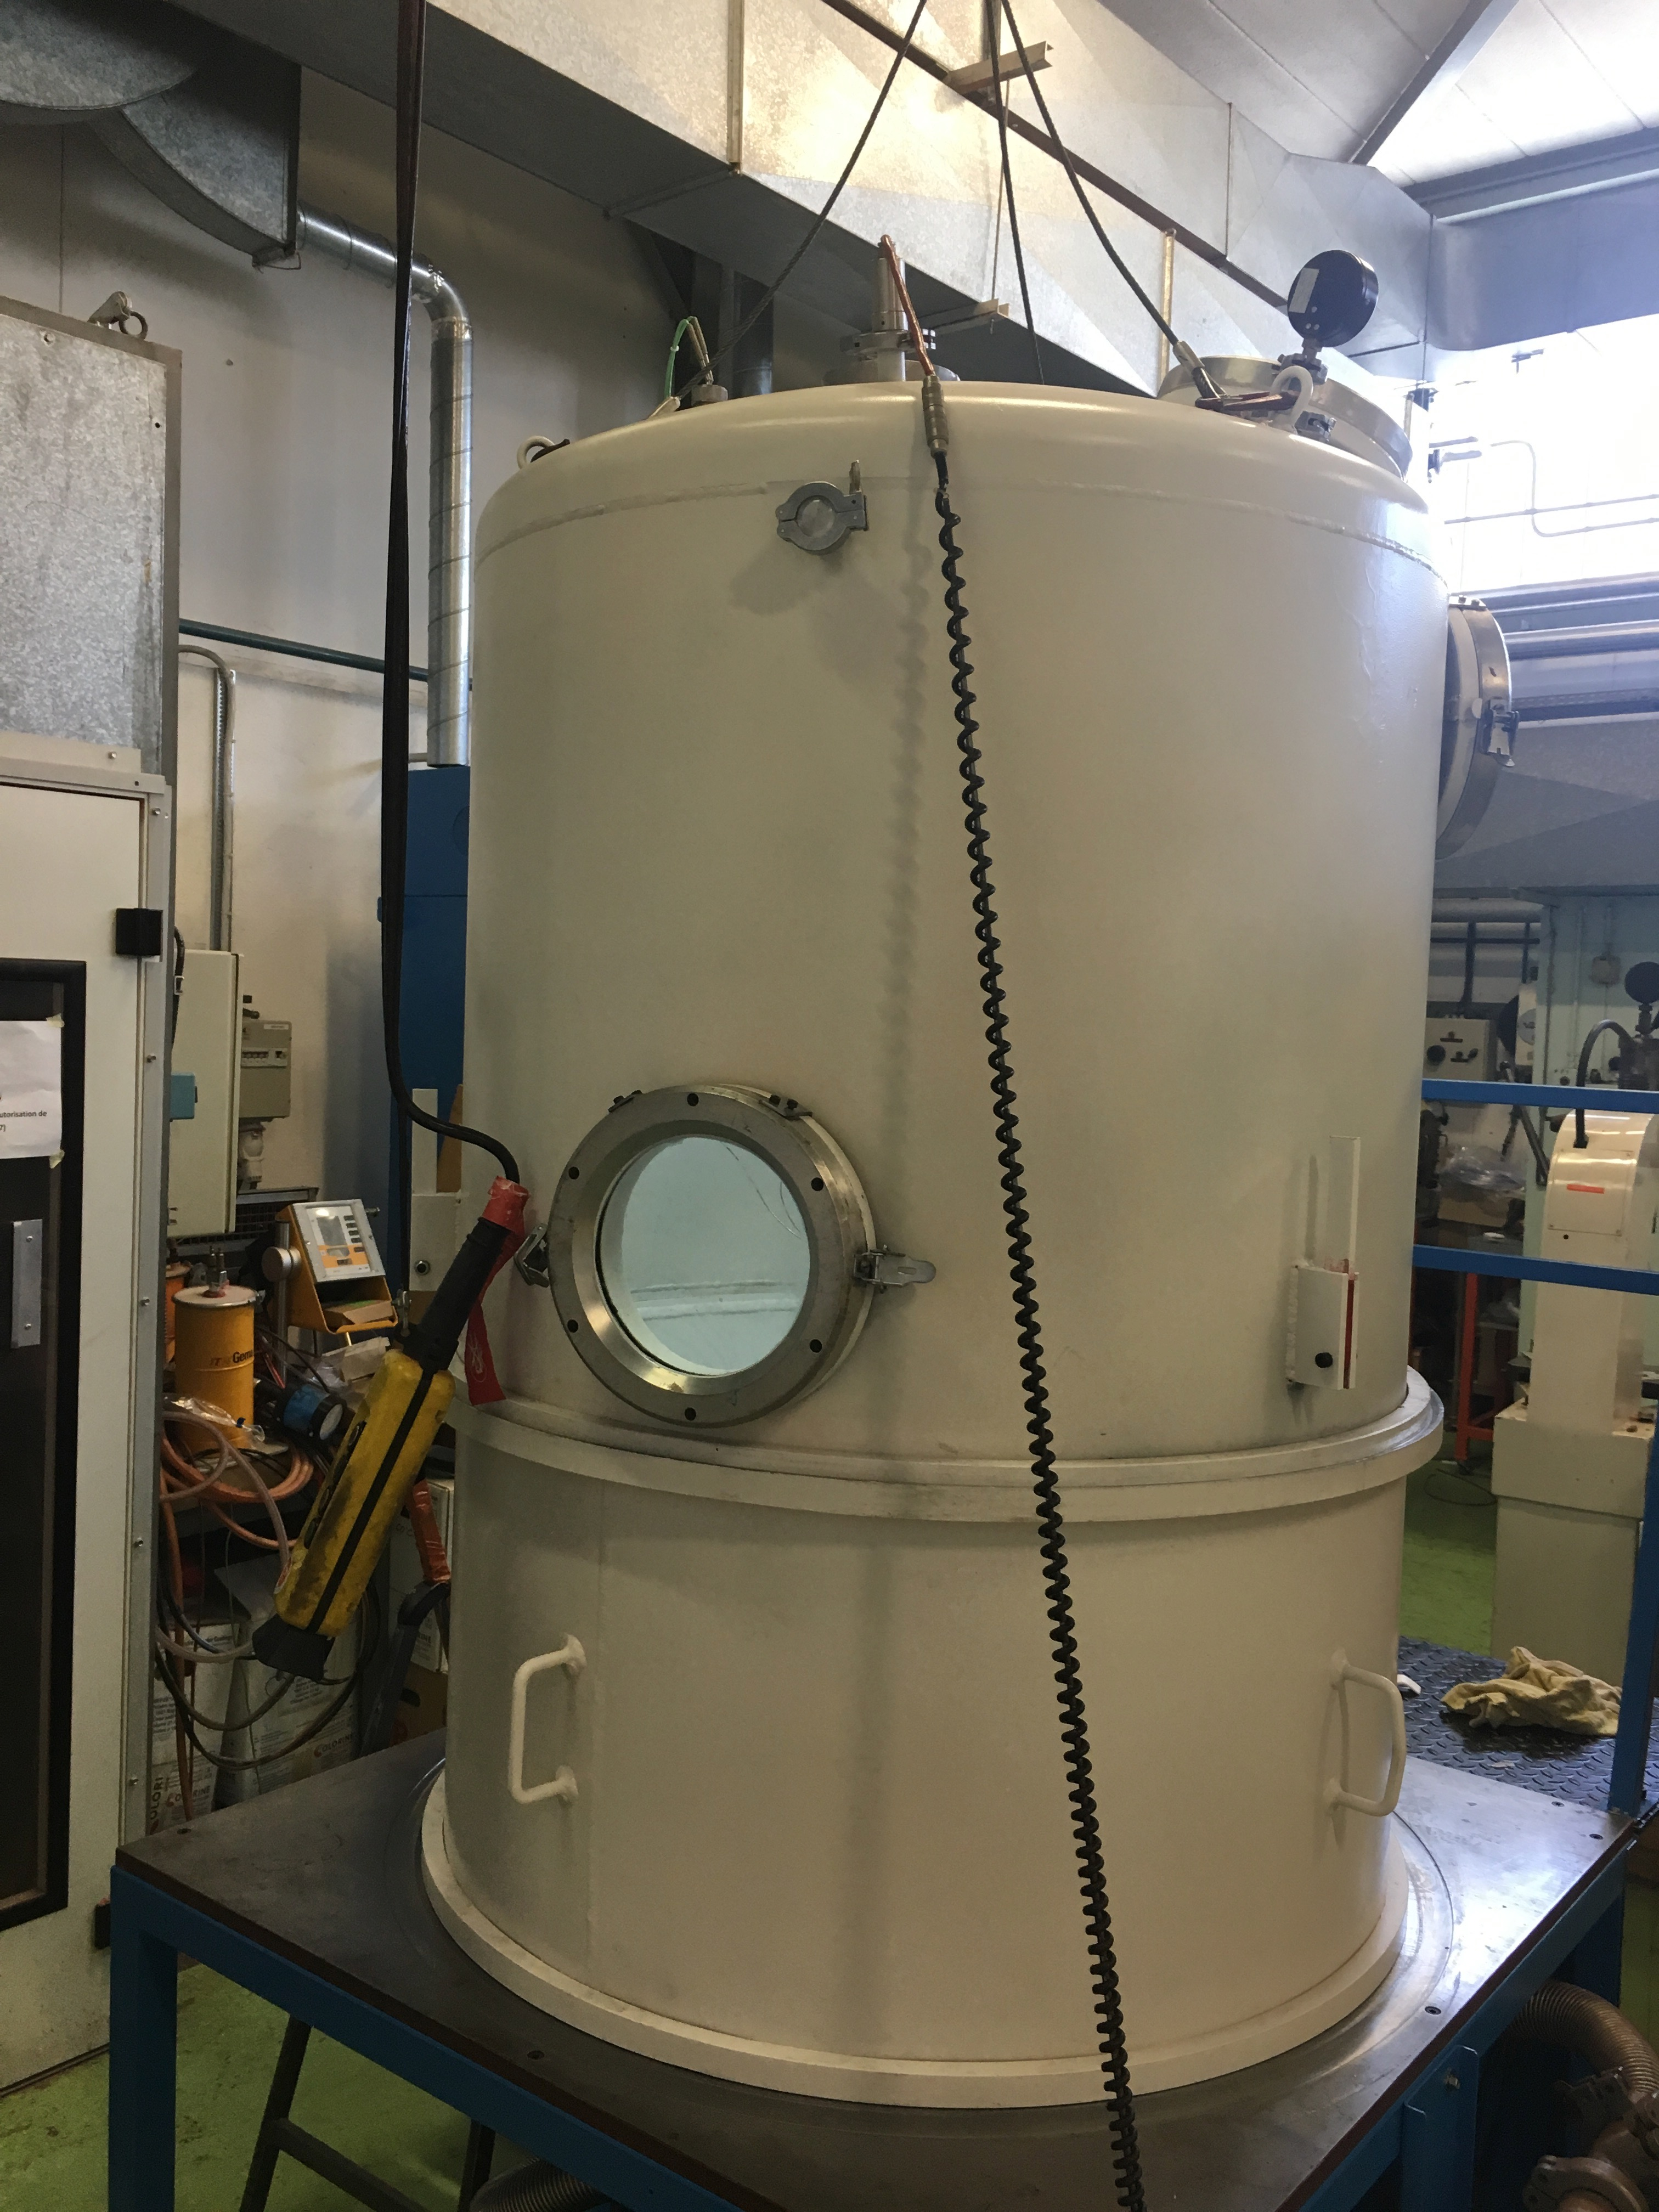
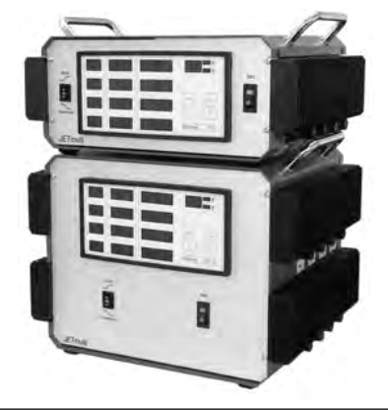
Impregnation System
In preparation of CD1 coil manufacturing,
buy heaters and heat-regulation system.
Procure a vacuum vessel (initial market survey completed).
Procure vacuum system from PSI Vacuum group.

Slide 24
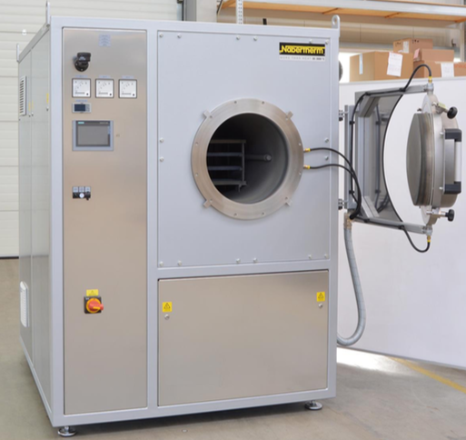
Reaction Furnace
Invest in reaction furnace of adequate size
for all foreseeable (next 4-5 years) projects.
Operational volume: 250x250x1200 mm.
Fulfilling slightly adjusted specs from
CERN reaction furnaces (latest CERN spec
dates from 2014).
Initial market survey completed.

Slide 25
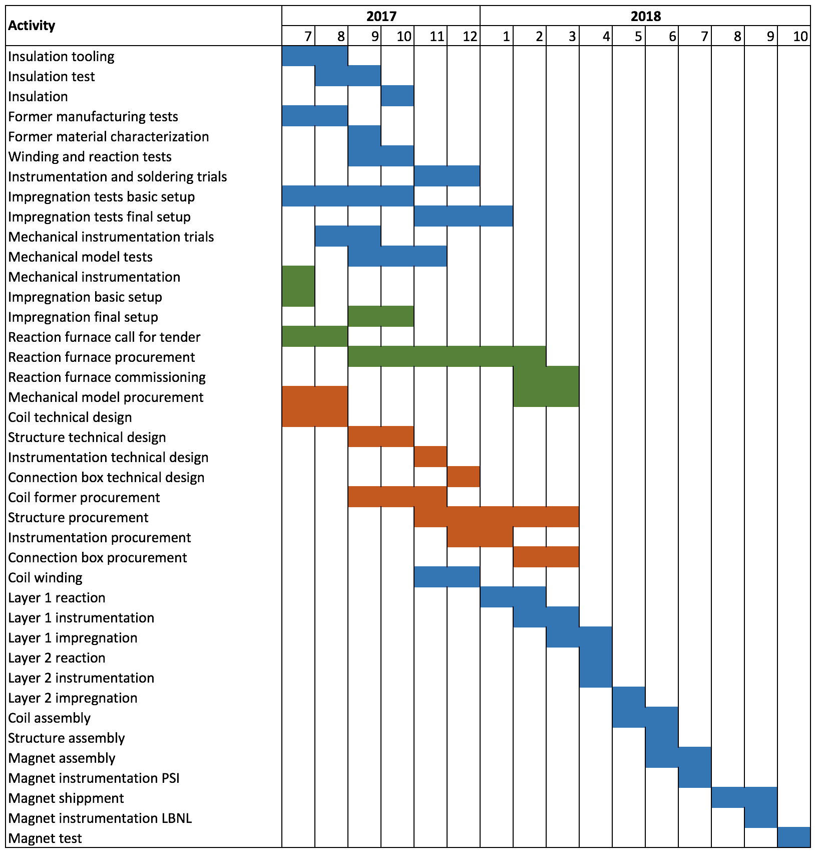
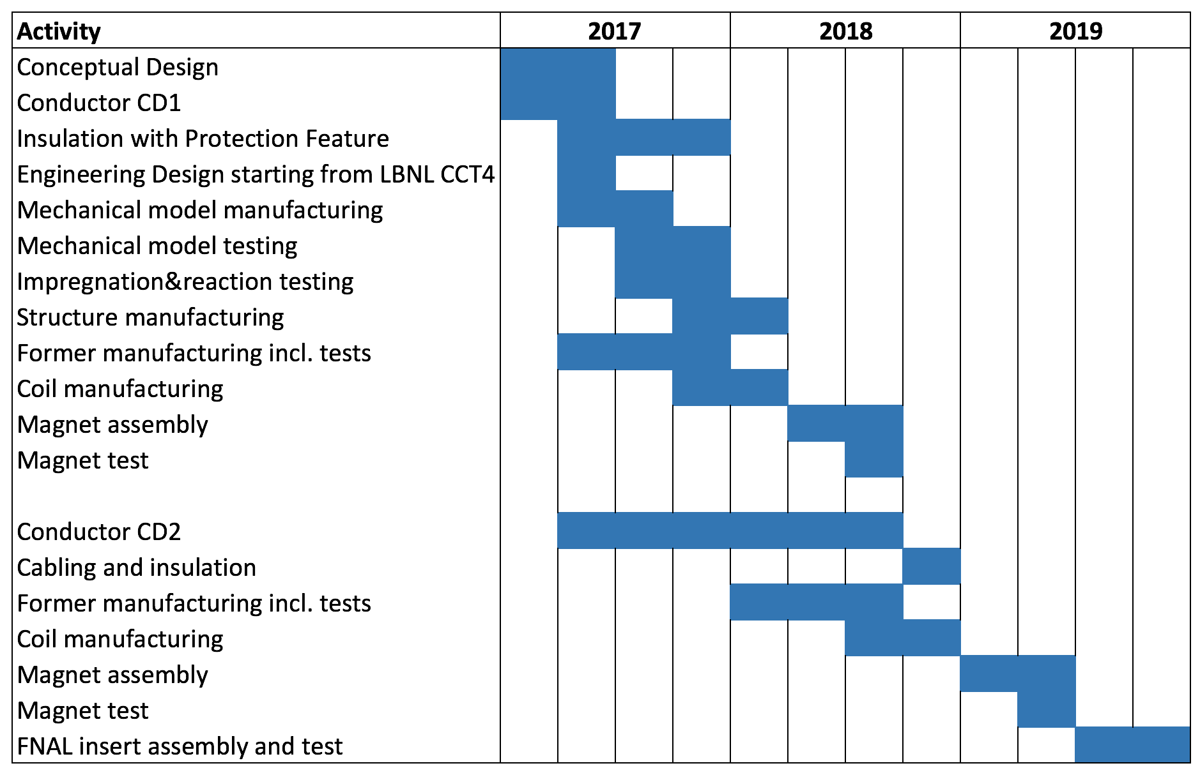
Planning
CD1 + Testing +
Infrastructure
Planning
General Planning
Tests
Infrastructure
Components
Team:
Bernhard (cable, furnace procurement)
Jiani (quench simulation and quench instrumentation)
Giuseppe (FEA, mech. instrumentation, impregnation)
Marco (3D EM FEA)
Roland (instrumentation, impregnation, assembly)
Serguei (tech. design, procurement, QA)
Fabrication

Slide 26
Discussion
Every step in the project is new for PSI and requires external support, training and testing.
The schedule is packed and we need to defend PSI resources (Serguei and Roland) against competing PSI projects.
PSI has approved funds to invest in infrastructure, pending the opinion of the review committee.
Planning uncertainties/risks:
  Reaction infrastructure may arrive late for the first CD1 layer(s), in which case we would seek support to react at CERN.
  Coil fabrication schedule could change if both layers are impregnated together and/or coils are reacted at CERN.
  CD2 component procurement must start before CD1 test results arrive.
Additional info:
  CD1 magnet testing will occur at LBNL (contrary to previous baseline which foresaw testing at CERN).

