Slide 1
Exploring Image Sensor Applications
STREAM WINTER SCHOOL 2017
WP5 & WP6
CALLUM WOOD (ESR7-WP5)
ANDREA FERRETTI (ESR13-WP5)
EVGENIIA FILIPPOVA (ESR16-WP6)
Notes:
30s A

Slide 2
AGENDA
Part 1: Motivation & Basics
Motivation
Description of image sensors and their operation.
Part 2: Existing Applications
Electron Microscopy Detectors
Radiation Detectors
Part 3: Future Applications Analysis
Finding new application areas: Technological Competence Leveraging
Conclusion and Open Discussion
1
Notes:
1m A

Slide 3
EXPLORING NEW IMAGE SENSOR APPLICATIONS
Part 1: Motivation & Basics
Part 2: Existing Applications
Part 3: Future Applications
How do we see the invisible?
Expanding the field-of-use of image sensor applications.
Presenting the fundamentals of image sensors and some existing applications.
Exploration of possible future applications.
2
Notes:
1’30secs C

Slide 4
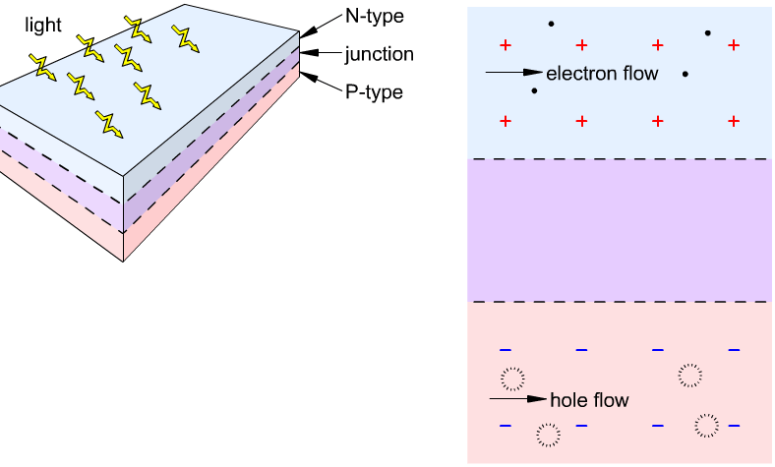
HOW IMAGE SENSORS WORK
Part 1: Motivation & Basics
Part 2: Existing Applications
Part 3: Future Applications
Photodetector basics:
Photons can free electrons.
Electrons (-ve) and holes (+ve) drift in opposite directions in presence of electric field.
They collect at electrodes to generate a voltage signal.
Combining pixel signals together provides a 2D image.
Simple Solar Cell
Source: http://iamtechnical.com/solar-cell
3
Notes:
2’20sec C

Slide 5
TYPES OF IMAGE SENSORS
Part 1: Motivation & Basics
Part 2: Existing Applications
Part 3: Future Applications
The most common devices are Charge Coupled Device (CCD) and CMOS:
CMOS:
Faster acquisition.
Higher sensitivity - better contrast and detectability.
CCD:
Higher dynamic range.
Longer exposure required.
4
Notes:
3’05s E

Slide 6
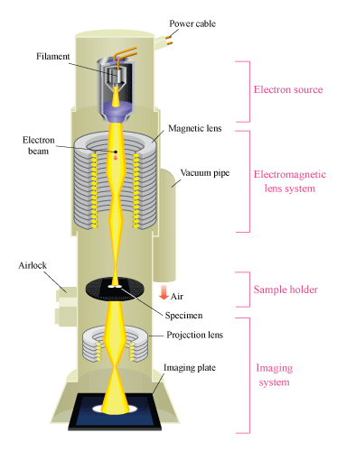
ELECTRON MICROSCOPY
Part 1: Motivation & Basics
Part 2: Existing Applications
Part 3: Future Applications
Optical microscopy resolution limited ( d = λ/2NA ) due to lower wavelength boundary of visible light spectrum.
Operation in a glance:
Electron emitters generate electron beam
E-field acceleration determines energy ( λ= h/P )
5
Notes:
3’50s A

Slide 7
ELECTRON MICROSCOPY
Part 1: Motivation & Basics
Part 2: Existing Applications
Part 3: Future Applications
Optical microscopy resolution limited ( d = λ/2NA ) due to lower wavelength boundary of visible light spectrum.
Operation in a glance:
Electron emitters generate electron beam
E-field acceleration determines energy ( λ= h/P )
Magnetic coils collimate/position the beam
6
Notes:
15s

Slide 8
ELECTRON MICROSCOPY
Part 1: Motivation & Basics
Part 2: Existing Applications
Part 3: Future Applications
Optical microscopy resolution limited ( d = λ/2NA ) due to lower wavelength boundary of visible light spectrum.
Operation in a glance:
Electron emitters generate electron beam
E-field acceleration determines energy ( λ= h/P )
Magnetic coils collimate/position the beam
Particle-Sample Interaction: electrons may scatter in different directions
Scanning EM (SEM) exploits back-scatter
Transmission EM (TEM) exploits front-scatter
TEMs are currently the leading device for achieved resolution.
7
Notes:
35s

Slide 9
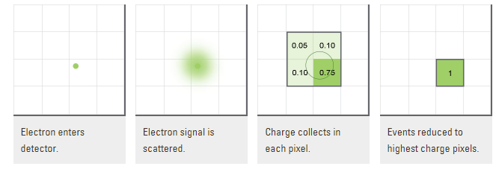
ELECTRON MICROSCOPY FIELDS/TECHNIQUES
Part 1: Motivation & Basics
Part 2: Existing Applications
Part 3: Future Applications
TEM Modes: CTEM / STEM / Diffraction
Different application fields: Life Science, Materials Science, Semiconductor Analysis..
Major latest EM outbreaks:
Electron counting technique enabled last resolution revolution - as opposing to normal charge integration mode.
Cryo-EM used to reduce Biological sample damage - it enabled 2017 chemical Nobel prize winning
8
Notes:
1m

Slide 10
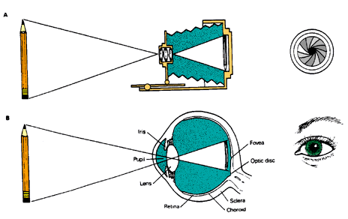
DETECTORS FOR ELECTRON MICROSCOPY
Part 1: Motivation & Basics
Part 2: Existing Applications
Part 3: Future Applications
Detectors play a major role in this dramatic atomic resolution improvement.
Optical analogy to human eye: detectors are sensitive to particles as human eye is to light, transforming incident particles into electric signals.
Detection history in EM:
FILM: no live analysis
CCD: low frame-rate
CMOS: rolling shutter
Different characteristics needed:
Diffraction -> high dynamic range
Life Science -> low noise, high sensitivity
Material Science -> radiation hardness
9
Notes:
1’15 A

Slide 11
ENVIRONMENTAL RADIATION DETECTION
Part 1: Motivation & Basics
Part 2: Existing Applications
Part 3: Future Applications
Why?
Vital for health and safety.
Areas:
Radioactive pollutants in water (drinking water, waste treatment, sea), underground (mining, drilling), agriculture (soil, across food-chain).
10
Notes:
30’ C

Slide 12
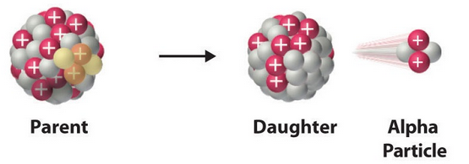
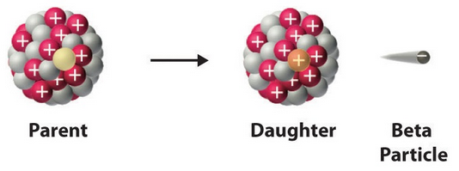
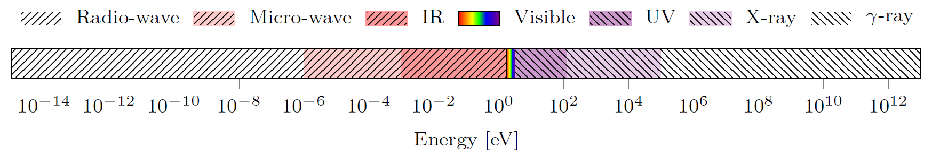
WHAT WE WANT TO DETECT
Part 1: Motivation & Basics
Part 2: Existing Applications
Part 3: Future Applications
Alpha-particles and beta-particles.
Electromagnetic radiation (gamma rays, x-rays, ultraviolet, near-infrared).
Alpha and Beta Decay
Source: chem.libretexts.org, Introductory Chemistry (Tro).
Electromagnetic Radiation Spectrum
11
Notes:
1’20

Slide 13
IMAGE SENSORS FOR RADIATION DETECTORS
Part 1: Motivation & Basics
Part 2: Existing Applications
Part 3: Future Applications
Geiger-Müller: Gas-filled chamber with electrodes - no image sensor.
✘ Can only find count rate.
Scintillator: Plastic/Crystal that absorbs radiation and emits light .
✔ Signal scales with energy of radiation.
✘ Multiple components - photomultiplier tube for detection.
Solid-State (Image Sensor): ✔ Signal also scales with energy.
✔ Higher energy resolution than scintillator.
✔ Fewer components.
12
Notes:
1m

Slide 14
USING CMOS
Part 1: Motivation & Basics
Part 2: Existing Applications
Part 3: Future Applications
Many different technologies are already used for image sensors.
Why use CMOS technology?
Radiation hard, monolithic sensors, smart sensor arrays.
Mass produced, commercial process - high availability.
13
Notes:
25s C

Slide 15
ELECTRON MICROSCOPY & RADIATION DETECTORS - WHAT ELSE?
Part 1: Motivation & Basics
Part 2: Existing Applications
Part 3: Future Applications
?
Electron Microscopy
?
?
?
?
?
Radiation Detectors
?
?
?
?
?
14
Notes:
20s E

Slide 16
SEARCH FOR NEW APPLICATION FIELDS TO IMAGE SENSORS
Part 1: Motivation & Basics
Part 2: Existing Applications
Part 3: Future Applications
Analyzing the technology from the user’s perspective with a focus on: problem solved and benefits derived.
Identification of technology benefits
1
15
Notes:
2min
Analyzing the technology from the user’s perspective with a focus on: problem solved and benefits derived
Search for similar problems the technology may solve and for persons who might benefit from the technology
Firstly rough assessment of the technology according to strategic fit and benefit relevance; further in-depth analysis of market and competitors
Business model should answer the question, how exactly should the company enter the market within a specific application area

Slide 17
SEARCH FOR NEW APPLICATION FIELDS TO IMAGE SENSORS
Part 1: Motivation & Basics
Part 2: Existing Applications
Part 3: Future Applications
Analyzing the technology from the user’s perspective with a focus on: problem solved and benefits derived.
Identification of technology benefits
1
Search for similar problems the technology may solve and for persons who might benefit from the technology.
Search for application fields
2
15
Notes:
2min
Analyzing the technology from the user’s perspective with a focus on: problem solved and benefits derived
Search for similar problems the technology may solve and for persons who might benefit from the technology
Firstly rough assessment of the technology according to strategic fit and benefit relevance; further in-depth analysis of market and competitors
Business model should answer the question, how exactly should the company enter the market within a specific application area

Slide 18
SEARCH FOR NEW APPLICATION FIELDS TO IMAGE SENSORS
Part 1: Motivation & Basics
Part 2: Existing Applications
Part 3: Future Applications
Analyzing the technology from the user’s perspective with a focus on: problem solved and benefits derived.
Rough assessment of the technology according to strategic fit and benefit relevance; further in-depth analysis of market and competitors.
Identification of technology benefits
Analysis of application fields
1
3
Search for similar problems the technology may solve and for persons who might benefit from the technology.
Search for application fields
2
15
Notes:
2min
Analyzing the technology from the user’s perspective with a focus on: problem solved and benefits derived
Search for similar problems the technology may solve and for persons who might benefit from the technology
Firstly rough assessment of the technology according to strategic fit and benefit relevance; further in-depth analysis of market and competitors
Business model should answer the question, how exactly should the company enter the market within a specific application area

Slide 19
SEARCH FOR NEW APPLICATION FIELDS TO IMAGE SENSORS
Part 1: Motivation & Basics
Part 2: Existing Applications
Part 3: Future Applications
Analyzing the technology from the user’s perspective with a focus on: problem solved and benefits derived.
Rough assessment of the technology according to strategic fit and benefit relevance; further in-depth analysis of market and competitors.
Identification of technology benefits
Analysis of application fields
1
3
Search for similar problems the technology may solve and for persons who might benefit from the technology.
Design of a business model
Search for application fields
Business model should answer the question: “how exactly should the company enter the market within a specific application area?”
2
4
15
Notes:
2min
Analyzing the technology from the user’s perspective with a focus on: problem solved and benefits derived
Search for similar problems the technology may solve and for persons who might benefit from the technology
Firstly rough assessment of the technology according to strategic fit and benefit relevance; further in-depth analysis of market and competitors
Business model should answer the question, how exactly should the company enter the market within a specific application area

Slide 20
SOME USEFUL QUESTIONS TO ASSESS A MARKET ATTRACTIVITY OF AN APPLICATION FIELD
Part 1: Motivation & Basics
Part 2: Existing Applications
Part 3: Future Applications
How many benefits offered by the technology are relevant for this application field?
How relevant is/will be the problem solved by the technology in this application area?
Can this new market be served with existing resources of the company?
Is it possible and reasonable to enter the market in the near future?
Is it strategic important for the company to enter this market?
Is the business model scalable?
How the company will differ from the competitors (unique value proposition)?
?
?
?
?
?
?
?
16
Notes:
1’40 E

Slide 21

CONCLUSION:
Image sensors are in rapid expansion, especially CMOS devices.
They play a fundamental role in many modern applications.
CAN WE EXPLOIT THEM EVEN MORE?
Part 1: Motivation & Basics
Part 2: Existing Applications
Part 3: Future Applications
Time for questions and open discussion.
17
Notes:
40s C

