Slide 1


Working group on the use of novel accelerator techniques
Status report
Erik Adli
Dep. of Physics, University of Oslo, Norway and CERN
May 3, 2017

Slide 2
Mandate
Look at interesting long term perspectives for LC installations
  potential use of these in Linear Collider implementations as future stages of the existing plans for Higgs factory
  Could be everything from reuse of tunnel, extend linac, afterburner, improvements of BDS ...
The studies can also help to identify R&D priorities for novel accelerator schemes by considering their compatibilities with CLIC and ILC technologies.
Input to European Strategy (end 2018)

Slide 3
Meetings so far
17/2 :
Daniel Schulte, Requirements for linear colliders
24/3 :
Patric Muggli, An overview of novel accelerator technologies
21/4 :
Philipp Roloff, Physics considerations for multi-TeV collisions

Slide 4
Luminosity Challenge for Linear Colliders
From Daniel's slides
Efficiency will limit beam power in plasma-based colliders
Likely find practical efficiency to be smaller in plasma-based colliders than assumed now
Have to improve luminosity per beam current
  Could be useful for linear colliders in general, but also means no low-hanging fruit known
Still have to push efficiency as much as possible
Reduce the vertical beamsize (betafunction and emittance) as much as possible
Smaller emittances needs
  better emittance preservation in main linac (but more difficult than in LC)
  better sources
    e.g. undulator-based damping?
Smaller betafunction could be achieved using novel beam delivery system design

Slide 5
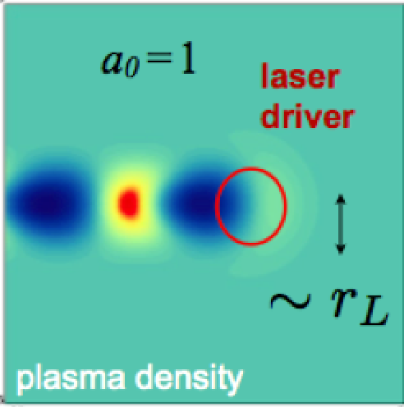
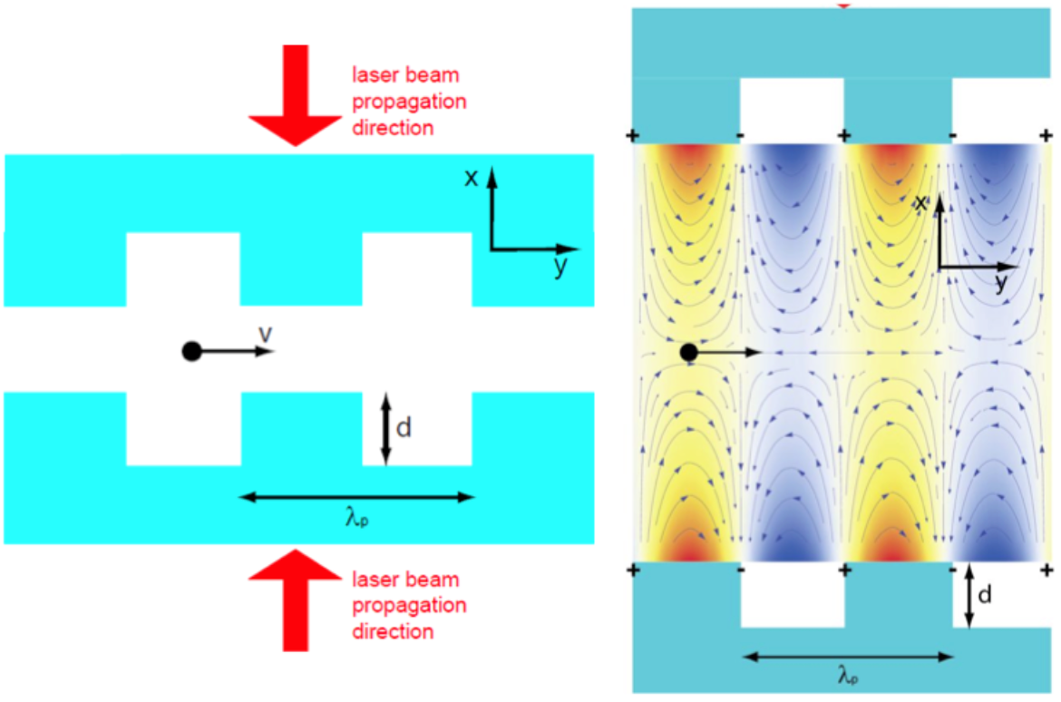
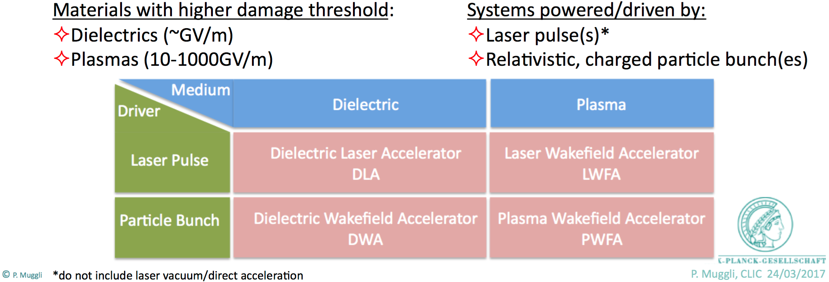
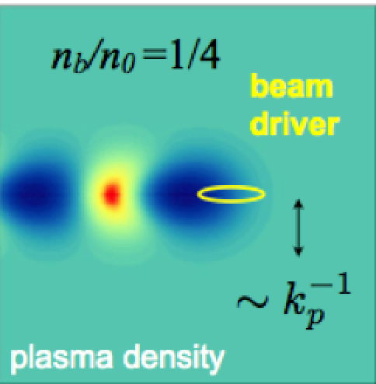
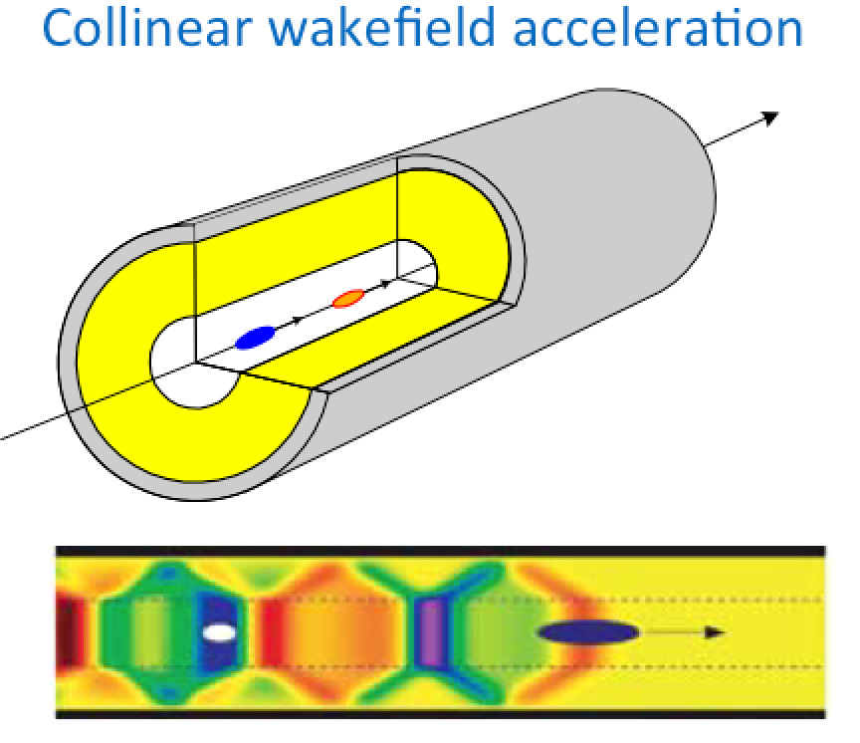
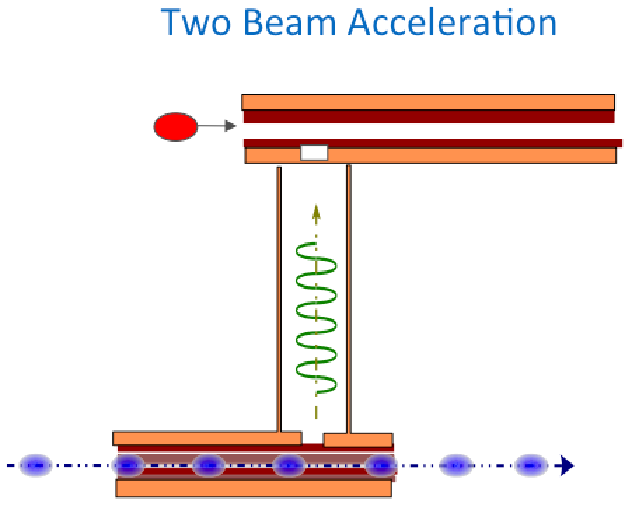
Patric's talk :
DLA
LWFA
DWA
TBA
DWA COL
PWFA

Slide 6
DLA
LWFA
Charge asymmetric in the non-linear regime (blow-out)
- e-: promise of good emittance preservation during acceleration
- e+: less clear
Charge symmetric
- same acceleration mechanism for e- and e+
DWA
TBA
DWA COL
PWFA

Slide 7
Philipp's talk, some conclusions :
Assume TeV e- beams are available, but not e+ beams (potential case for plasma) :
TeV-scale e- e- colliders: limited interest
Asymmetric collisions (e.g. E_{com} = 3 TeV using e- at 11 TeV, e+ at 200 GeV) : limited interest;
  requires new detector concepts to catch strongly boosted physics (< 10 deg)
  beam power would increase as E²_{com} -> poor efficiency
TeV-scale gamma-gamma colliders: while not as good as e- e+, could be of interest. Topic will be revisited by Philipp; he needs input in form of photon spectrum
Luminosity needs for 10-30 TeV machines :
For Higgs physics a luminosity similar to CLIC 3 TeV would give interesting physics
Reach for new physics increases with energy
luminosity needs for new physics increase with energy, but to say how high luminosity is needed.
Time structure:
Both pulsed (CLIC) or continuous (LHC) bunch time structure is OK

Slide 8
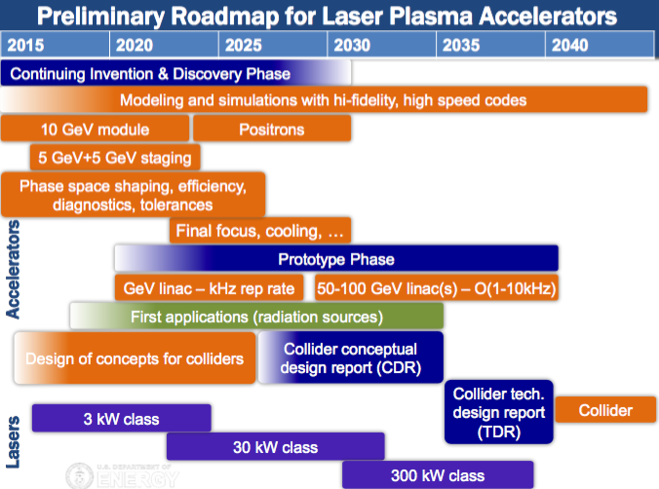
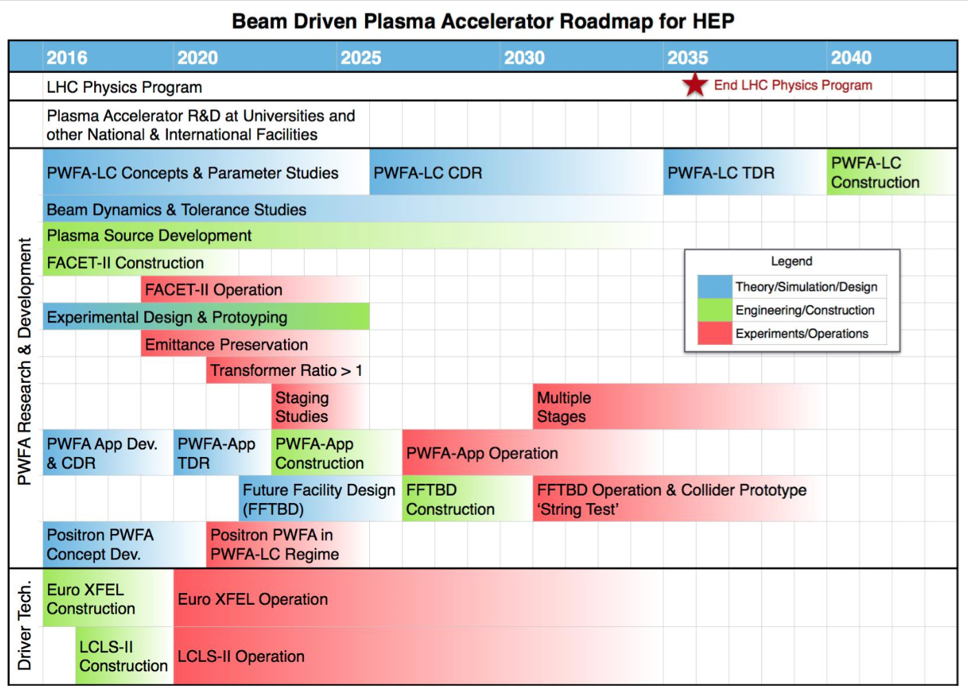
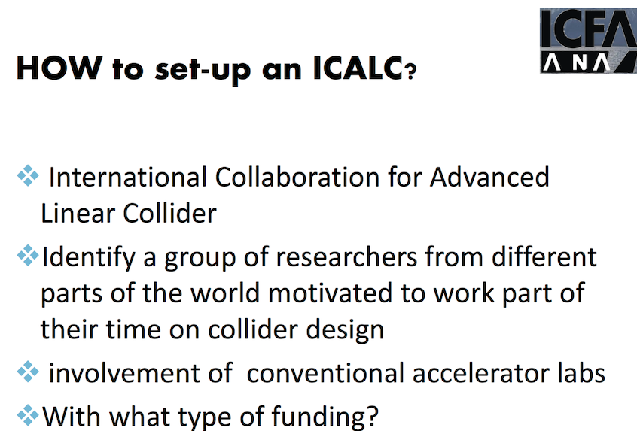
Community
The novel accelerator community is large; US traditional leader.
They have their own HEP-collider roadmaps; in the US formally adopted by DOE after years of consultation).
  They are interested in developing the technology; seems less interest in developing linear collider designs (too early, also according to their road maps)
  They are not interested in being constrained or down-selecting technology at this point.
  They plan to provide their own, independent, input on to the HEP-strategy
From "ANAR"
Still, I think both parts (CLIC and NAT) would benefit from cooperation :
  how can NAT contribute to the CLIC project
  how can we contribute to the NAT community
"ANAR" workshop (last week) : planning for Europe, good time to discuss

Slide 9
Next steps
Start collaboration with Argonne on TBA-DWA (dielectrics): technology close to CLIC, and can easier be evaluated (next meeting, Friday May 12th, 14h00)
Start studies on plasma colliders concepts within CLIC, in order to better understand promises and challenges ourselves
  To develop collider concepts further does not imply need for more experiment; design activities are "lagging" behind
Find best strategy to cooperate within HEP-roadmap of the NAT community

