Slide 1
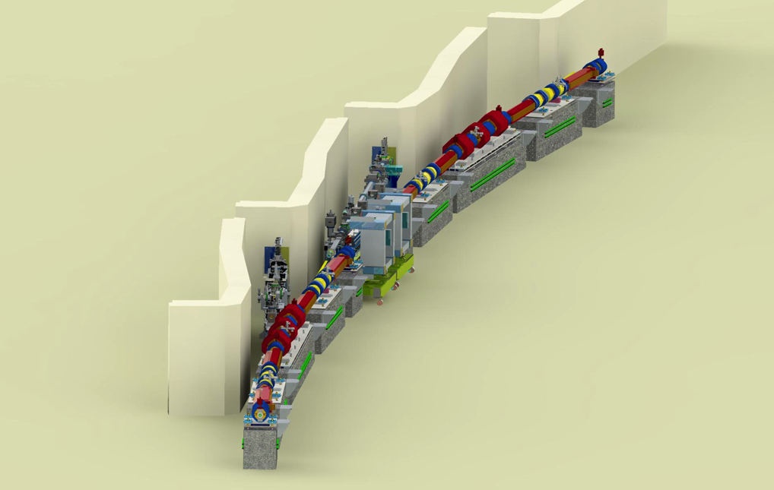
Challenges for High Charge Operation of the APS Injection System
Advanced Photon Source Upgrade Project:
The World’s Leading Hard X-ray Light Source
Joe Calvey
Assistant Physicist
Argonne National Laboratory
Topical Workshop on Injection and Injection Systems
August 29, 2017
Notes:
Univ of Chicago Review, Aug. 30, 2010
1

Slide 2
Injector working group
K. Harkay – PAR/Booster Machine Manager
J. Calvey – Deputy PAR/Booster Machine Manager
C-Y. Yao- injector expert, semi-retired
Physics team: M. Borland, J. Dooling, L. Emery, R. Lindberg, V. Sajaev, N. Sereno, Y.-e. Sun, Y.-P. Sun, A. Xiao, U. Wienands
RF group: T. Berenc, D. Horan, A. Goel, G. Waldschmidt
Engineering, Software, Controls, & Operations Team: A. Brill, J. Carter, H. Bui, R. Flood, G. Fystro, A. Hillman, L. Morrison, S. Pasky, A. Pietryla, T. Puttkammer, H. Shang, R. Soliday, J. Wang, F. Westferro, S. Xiang, S. Xu

Slide 3
Outline
Overview of APS injector complex
High charge issues in the particle accumulator ring:
  Bunch length blowup
  Beam capture in 12th harmonic cavity
  Longitudinal instability
  Ion trapping
High charge issues in the booster synchrotron:
  Injection efficiency
  Beam loading compensation
  RF Frequency ramp

Slide 4
Introduction
APS injectors were originally designed to deliver up to 6 nC.
  Typical operation: 2-3 nC
R&D is underway to study the high-charge performance. The charge and beam quality are limited primarily by longitudinal effects.
So far we have achieved 16 nC in PAR, 12 nC in booster
The present injectors are capable of supporting 200 mA in a total of 72 to 324 bunches (i.e., 2.5 nC to 11 nC).
Improvements to support 200 mA in 48 bunches (16 nC) are being developed.

Slide 5

APS Injector Complex
In normal operations, injector delivers 2-4 nC single bunch charge to the storage ring at 2-Hz rate.
Booster-to-storage ring transport line (BTS)
Booster (7 GeV)
Single bunch; 2 Hz rep rate
Magnet ramp linear; RF ramp ~E⁴ (352 MHz)
Natural emittance: 132 nm
Off-momentum emit: 87 nm
RG2 RG1 PCG
Particle accumulator ring (PAR) (375 MeV)
Single bunch; 2-4 nC, 2-Hz rep rate
Captures linac pulses in RF1 (9.8 MHz); compresses damped beam in RF12 (117 MHz); bunch cleaning system
Linac (375 MeV)
1 nC/pulse; 30 Hz rep rate
Thermionic RF guns: RG1, RG2 (1 hot spare)

Slide 6
APS Injectors: High Charge
Linac essentially unchanged
PAR and booster run at 1-Hz rep rate, which allows for accumulation up to 20 nC in the PAR
Booster ramps to 6 GeV
Booster-to-storage ring transport line (BTS)
Booster (6 GeV)
Single bunch; 1 Hz rep rate
Magnet ramp linear; RF ramp ~E⁴ (352 MHz)
Natural emittance: 97 nm
Off-momentum emit: 64 nm
RG2 RG1 PCG
Particle accumulator ring (PAR) (375 MeV)
Single bunch; up to 20 nC, 1-Hz rep rate
Captures linac pulses in RF1; compresses damped beam in RF12 (117 MHz); bunch cleaning system
Linac (375 MeV)
1 nC/pulse; 30 Hz rep rate
Thermionic RF guns: RG1, RG2 (1 hot spare)

Slide 7
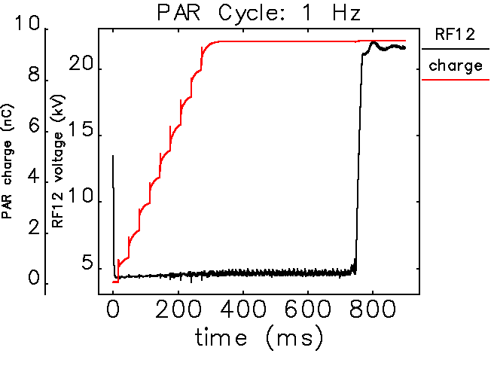
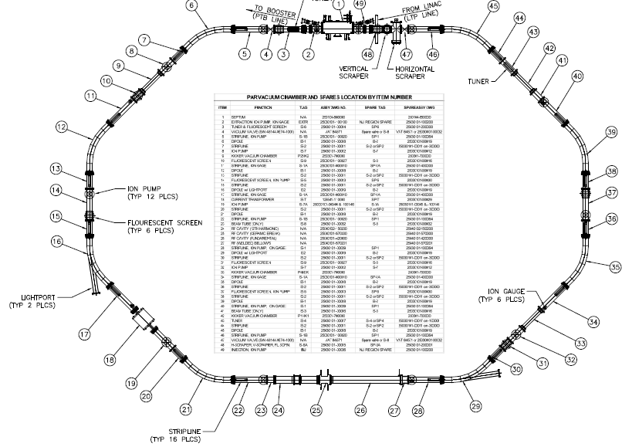
PAR overview
Modeled after DESY’s PIA ring
1 nC bunches from linac injected every 33 ms
1 Hz mode developed to allow accumulation for 750 ms
At 750 ms, 12th harmonic cavity is turned on, shortening the bunch to ~350 ps (zero current)
Highest charge achieved in PAR: ~16 nC
Concerns for high charge operation:
  Reduced injection efficiency at very high charge (> 16 nC injected)
  Fundamental RF1 trips, believed caused by beam loading and HOMs presented to non-isolated amplifier
  Significant bunch length blowup, accompanied by longitudinal instability.
  Vertical beam size growth, likely due to ion trapping

Slide 8
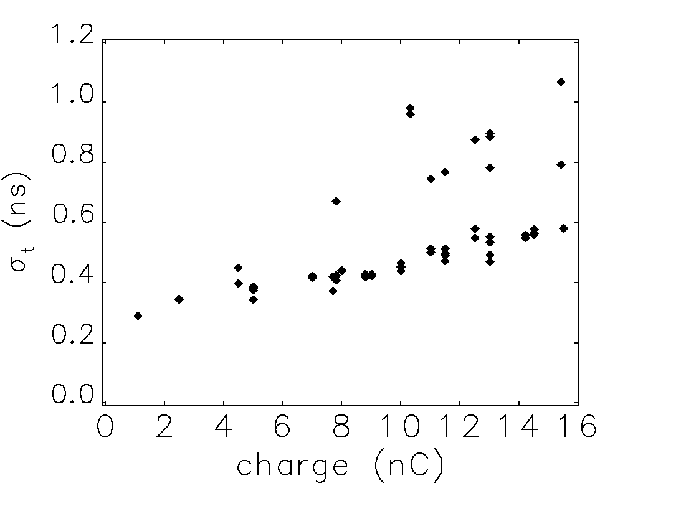
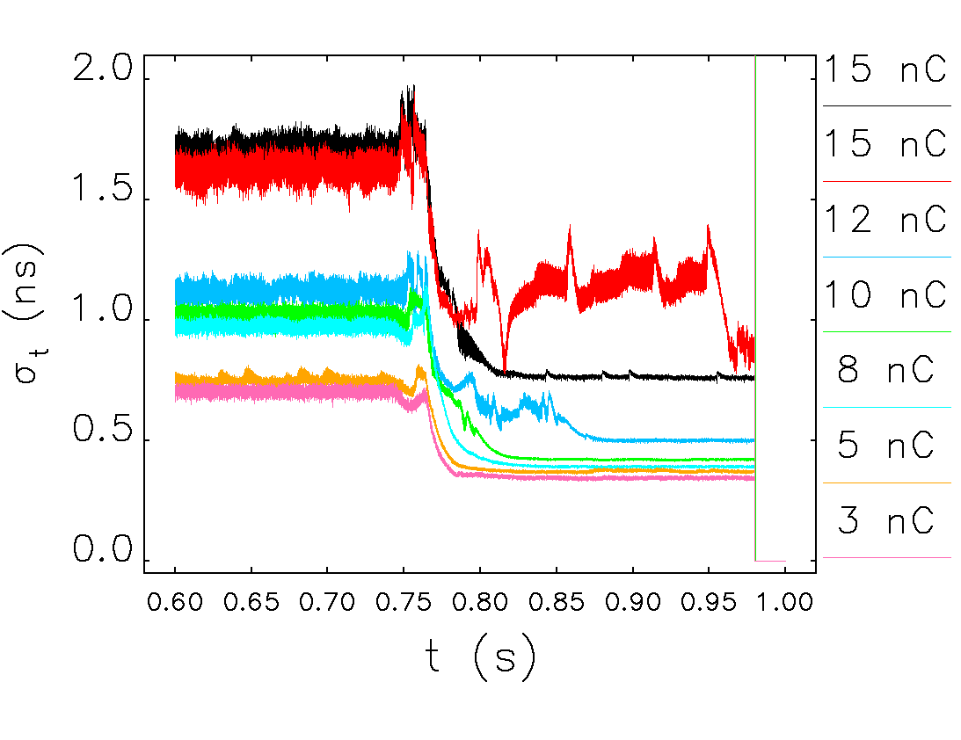

PAR bunch length blowup
Data were acquired with a photodiode signal, calibrated using a laser and streak camera.
Plot on left shows average bunch length over 10 turns at 900 ms in cycle. There is a linear trend towards twice the bunch length (potential well distortion), as well as instances of extreme bunch length blowup due to an instability (Robinson-type or microwave).
Plot on right shows bunch length before and after RF 12 capture (750 ms). Sawtooth instability can be seen at 10, 12, 15 nC.
PDR 4-3.13.2
J. Dooling
K. Harkay

Slide 9
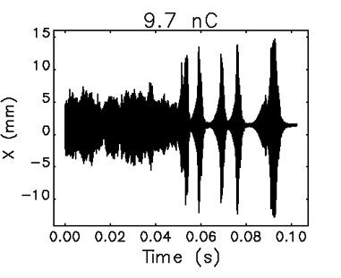
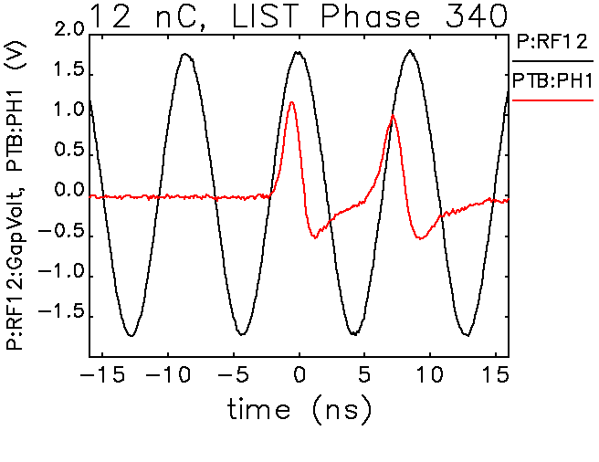
PAR harmonic tuning
12th harmonic cavity detuning and phase must be carefully optimized for good capture at high charge
  Bad choice of parameters leads to double bunching and/or instability
  Left: sawtooth instability after RF12 turn-on (dashed line) measured by new turn-by-turn BPM (in a dispersive section)
  Right: double-bunching in PAR-to-booster transfer line

Slide 10
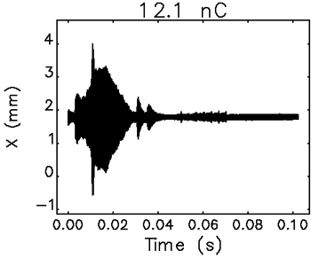
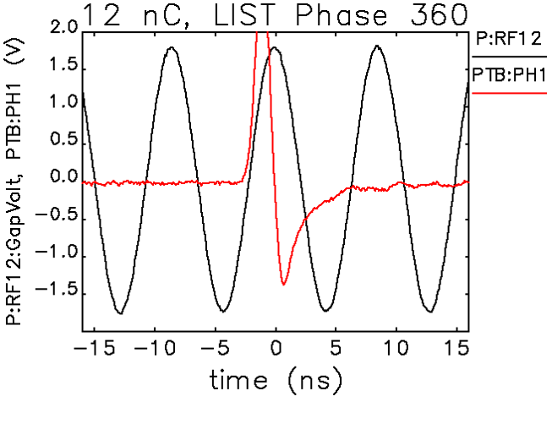
PAR harmonic tuning
12th harmonic cavity detuning and phase must be carefully optimized for good capture at high charge
  Both problems mitigated with good choice of tuning parameters

Slide 11
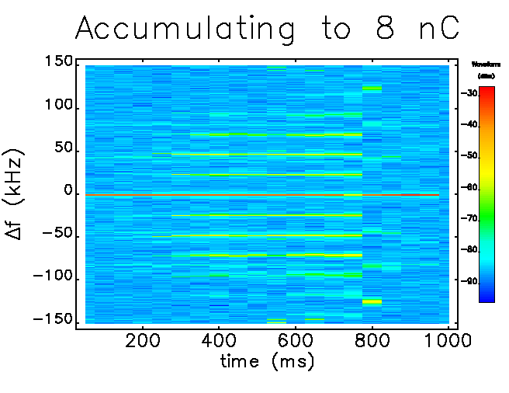
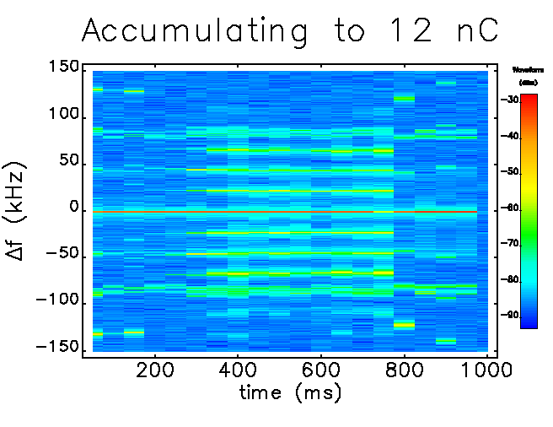
PAR longitudinal instability
Beam is longitudinally unstable before 12th harmonic turn-on
  Multiple synchrotron sidebands observed after accumulation (dotted line)
  Bunch is long; instability is consistent with long-range, resonator impedance.
With proper tuning of 12th harmonic detuning and phase, can stabilize beam after turn-on (dashed line)
At higher charge, 12th harmonic synchrotron tune is visible after turn-on
  Seems to persist until next turn, probably AGC loop is not fast enough
At very high charge, beam remains unstable for entire cycle

Slide 12
Modeling of PAR beam loading
Modeling of PAR beam loading is in early stages
Beam loading in 12th harmonic cavity is significant, even when it's detuned
  Simple calculation gives ~14 kV at 20 nC and -140 kHz
  (compared to ~22 kV cavity voltage when RF12 enabled)
  Preliminary simulations suggest that the cavity could be used passively at very high charge
Things to model:
  Beam loading in both cavities
  Harmonic capture in the presence of beam loading
  Cavity HOMs (measurements are underway)
  Efficacy of cavity feedback loops at high charge
  Develop PAR impedance model

Slide 13
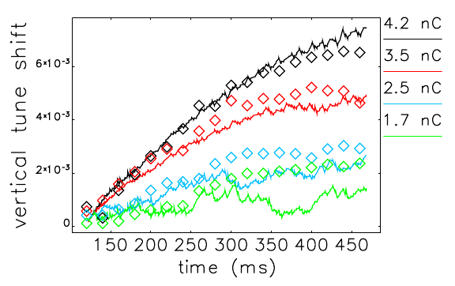
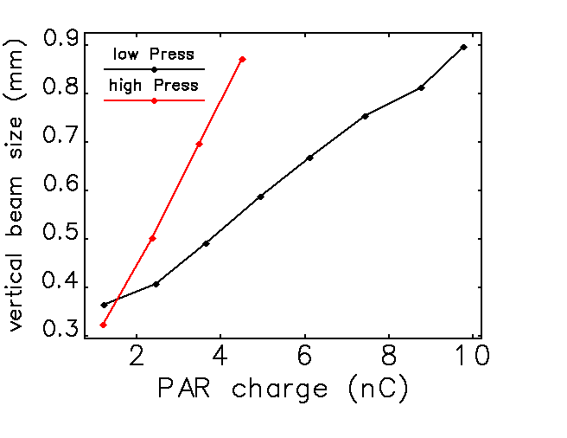
PAR ion effects
Trapped ions cause a positive tune shift with charge, which increases along the PAR cycle. This effect has been reproduced with simulations [1,2]
We haven’t observed coherent ion instability, and don’t anticipate it at high charge
We believe ions are responsible for vertical beam size blowup with charge
  Effect was stronger when
  pressure was high after a vacuum
  intervention
  Plan to model this with
  IONEFFECTS element in ELEGANT
Measured PAR Vertical Beam Size
[1] L. Wang et al, PRST-AB 14, 084401 (2011).
[2] J. Calvey et al. THPOA14, Proc. NAPAC16.

Slide 14
PAR plans
Continue to study longitudinal blowup / instability with modeling, as well as improved diagnostics
  Photodiode and streak camera
  Detailed measurements of cavity HOMs
  BPMs with turn-by-turn capability (2 so far)
  Upgrade of RF diagnostics is underway
Absorptive filter to cure fundamental RF trips (to be installed this fall)
Mitigate vertical beam size blowup, if needed
  Beyond vacuum conditioning, ion trapping could be mitigated further: e.g., NEG coating, adding more pumps, or clearing electrodes.
Test alternate modes of operation:
  Operate RF12 in passive mode
  Operate at higher beam energy

Slide 15
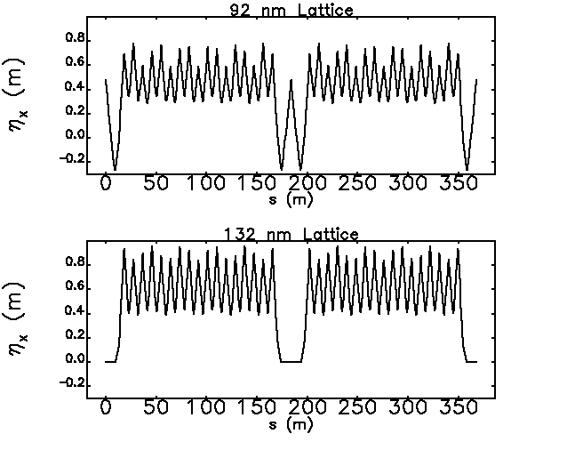
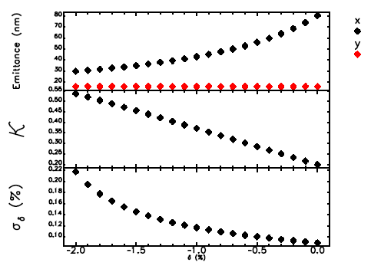
Booster overview
Low emittance lattice
Ramp from 375 MeV to 7 GeV in 225 ms
Two lattices studied:
  Original (97 nm natural emittance at 6 GeV)
  Low emittance (68 nm at 6 GeV)
  Low emittance lattice has nonzero dispersion in the straight sections
Run off-momentum
  Reduces horizontal and vertical emittance
  Original lattice meets storage ring injection requirements (ε_{x}=60 nm, ε_{y}=16 nm) if run far enough off-momentum
  Increased energy spread may reduce collective instabilities at SR injection
Recently upgraded BPM system to allow for orbit correction along the ramp
Original lattice
M. Borland

Slide 16
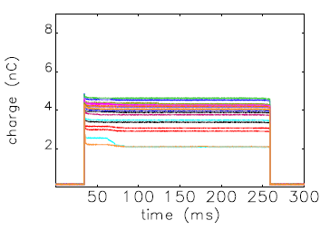
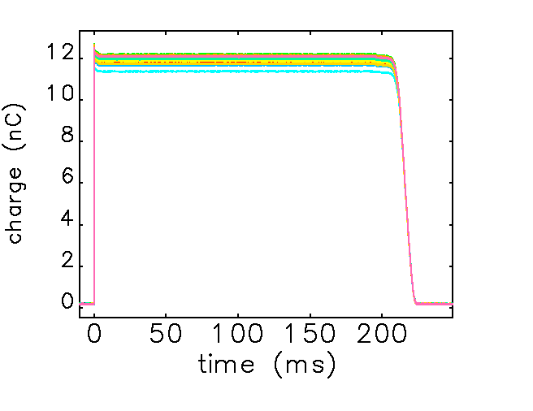
Booster injection efficiency
Main limiting factor to achieving high charge operation is reduced injection efficiency in the booster.
Goal is 17 nC (e.g. 85% efficiency for 20 nC injected charge)
Originally planned to use low emittance booster lattice for high charge operation
  Showed large losses in first few ms of ramp
  Significant shot-to-shot variation
  Maximum booster charge ~5 nC
Switched back to original lattice
  After optimization of injection voltage, cavity detuning, and ramp parameters, shows much better injection efficiency
  Maximum charge in booster ~12 nC
  Still observe early losses at high charge
We have investigated this issue using particle tracking simulations
Low emittance
Original

Slide 17
Booster simulations
Particle tracking done with ELEGANT [1]
  Track element-by-element
  50,000 macroparticles
  Track 3000 turns (3.5 ms)
    Where most losses occur
Model includes:
  Transverse and longitudinal impedance [2]
  Beam loading in RF cavities
Simulation parameters:
  Transverse beam size measured on flag in PAR-to-booster transfer line
    Vertical beam size blowup caused by ions in the PAR [3]
  PAR bunch length measured photodiode detector (~350 ps at low charge)
  RMS energy mismatch between booster and injected beam
    Caused by variation in dipole ramp
    Estimated to be ±0.5% based on amplitude of synchrotron oscillations
  RMS transverse offsets
[1] M. Borland. ANL/APS LS-287, (2000).
Y. Wang et al. Proc. of PAC 2007, 3444–3446 (2007).
[2] R. R. Lindberg et al. Proc. IPAC 2015. TUPJE078.
[3] J. Calvey et al. THPOA14, Proc. NAPAC16.

Slide 18
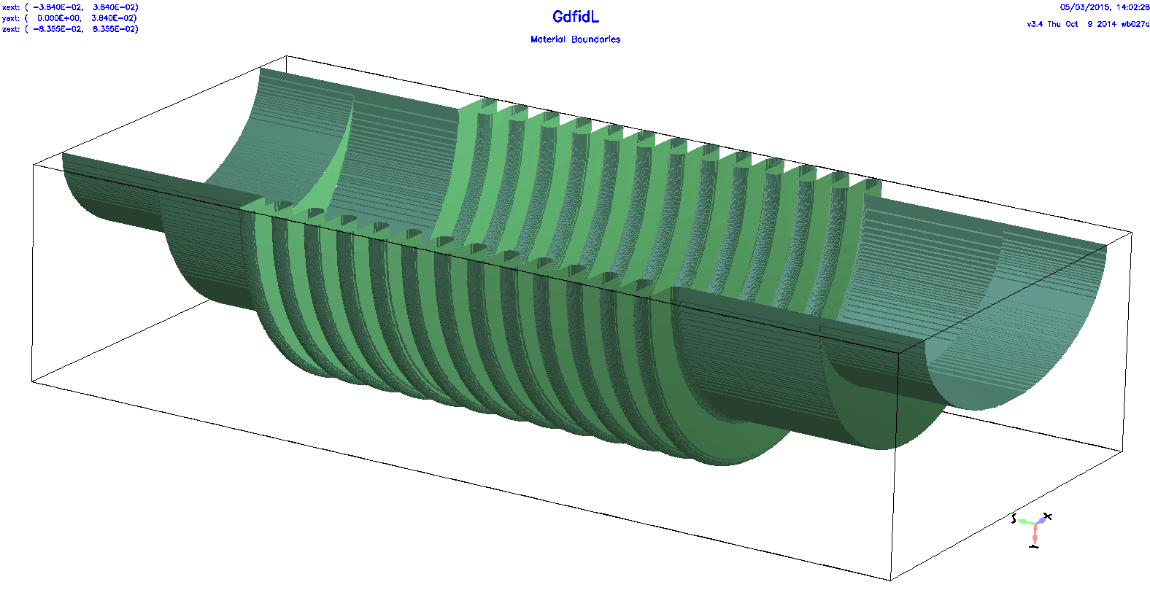
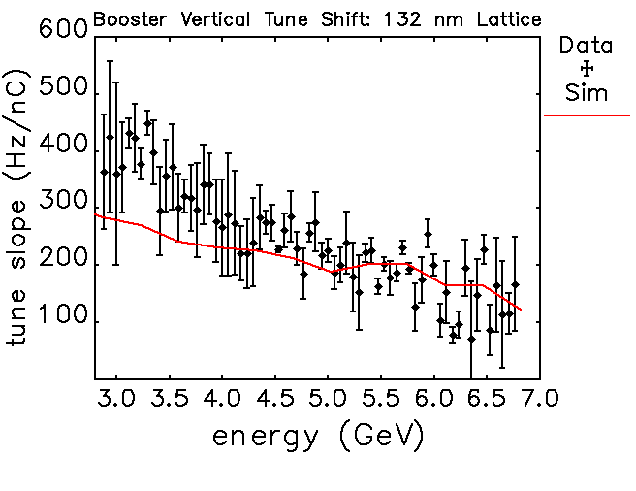
Booster impedance model
Developed using same technique as storage ring model (by R. Lindberg)
Elements included:
  RF cavities (4)
  RF cavity bellows (10)
  Booster bellows (40)
  T‐vacuum port (37)
  X‐vacuum port (37)
  4‐blade stripline (2)
  Flange gaps (120)
Compare simulated and measured tune shift with charge
  Good agreement between model and measured data above 3 GeV
  Data is very noisy earlier in the ramp
GdfidL¹ Model of Booster Bellows
[1] W. Bruns. The GdfidL Electromagnetic Field simulator.

Slide 19
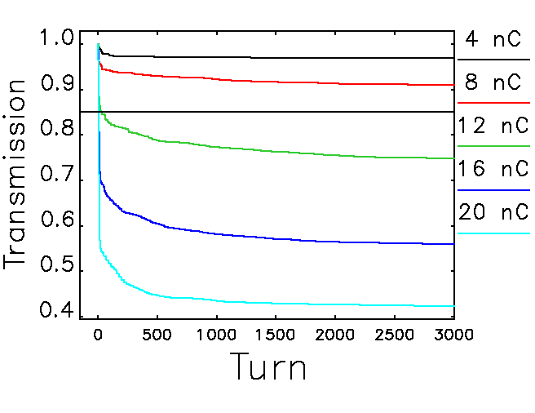
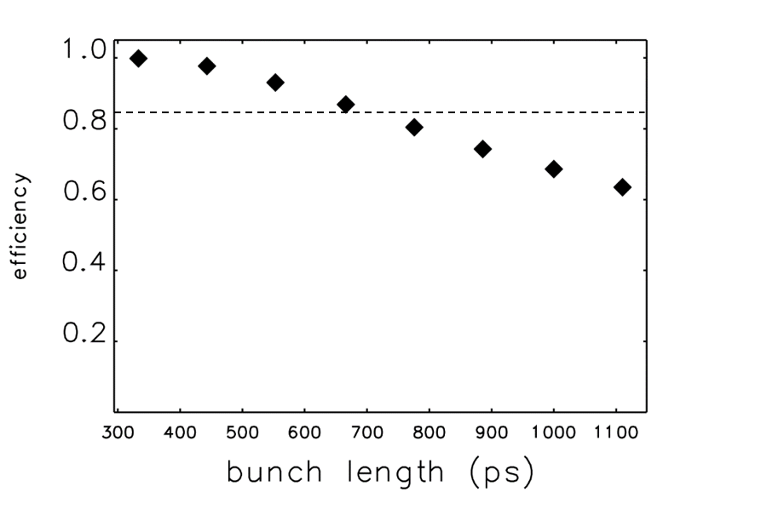
Simulation results
Predicted efficiency is very good up to ~10 nC injected charge
Predicted transmission begins to drop at higher charge
  Most losses occur in first ~500 turns
  Many particles lost on the horizontal aperture at high dispersion locations
Beam loading is biggest contributor to simulated losses at high charge
PAR bunch length blowup results in some particles not being captured in RF bucket
  Left plot shows efficiency with blowup, but no other collective effects
Small (~3-5%) losses due to vertical beam size blowup in PAR

Slide 20
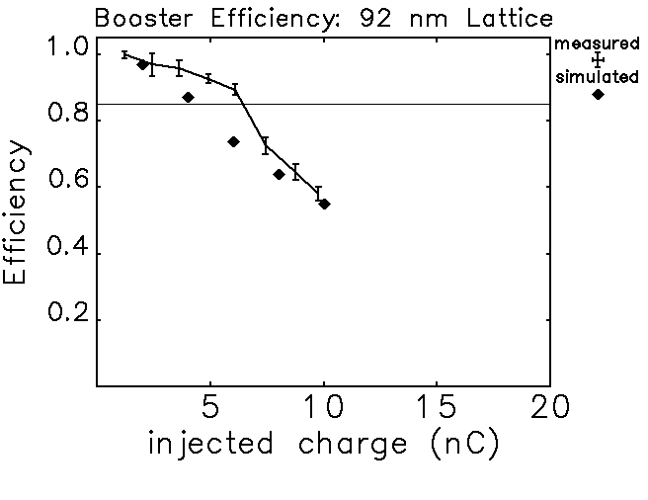
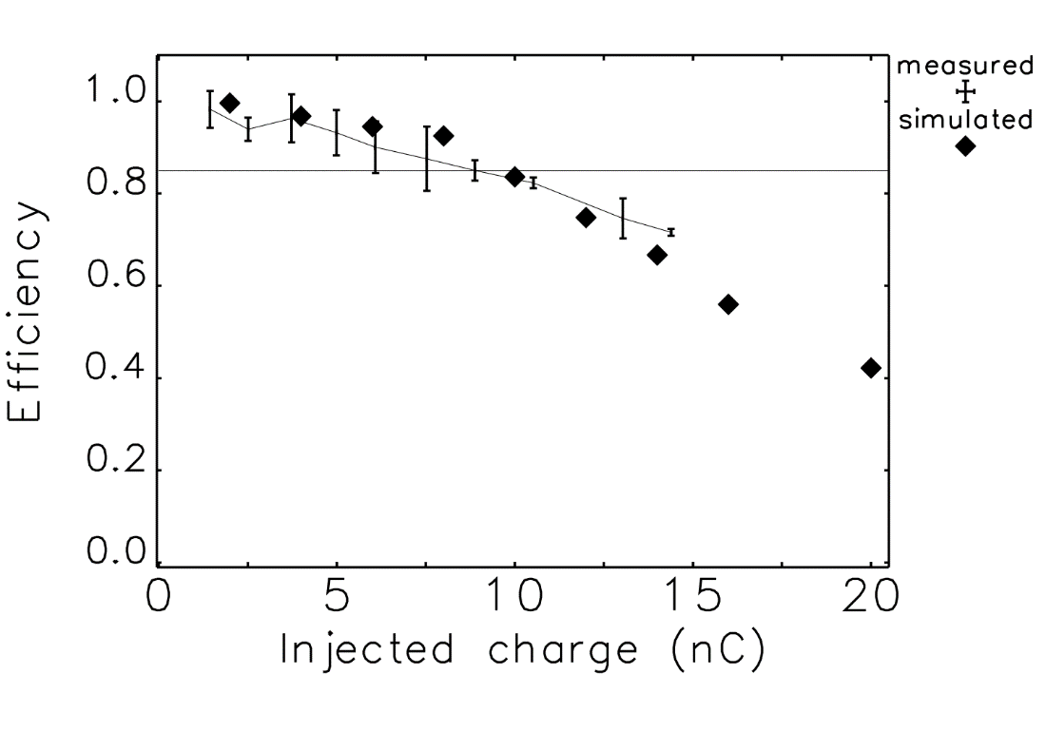
Simulated injection efficiency
Simulation matches measured injection efficiency for both lattices
Maximum surviving charge in low emittance lattice is ~5 nC. This lattice has non-zero dispersion in the straight sections, which causes two problems [1]:
  Closed orbit depends on energy offset (which varies shot-to-shot)
  Synchro-betatron coupling (due to dispersion in RF cavities)
Original lattice injection efficiency is > 85% up to 10 nC
[1] J. Calvey et al. WEA1CO03, Proc. NAPAC16.
Booster Efficiency: low emittance lattice
Booster Efficiency: original lattice

Slide 21
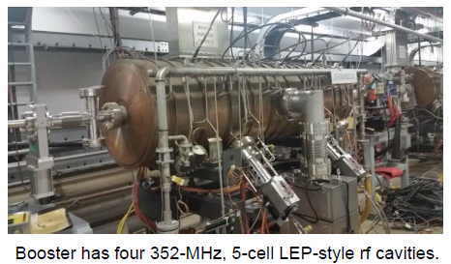
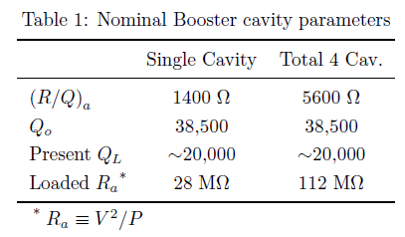
Beam loading
The large shunt impedance of the booster cavities presents many challenges for beam-loading
At 20 nC, beam loading voltage at resonance is 1.4 MV
  Desired injection voltage is 600 kV.
The beam-induced voltage builds up quickly since the cavity time constant is only 18 μsec (15 booster turns)

Slide 22
Injection vs extraction
Rf requirements are very different at injection and extraction
Injection:
  Want to mitigate beam loading by detuning cavities
  Optimal detuning: -27 kHz
  Want to injection on-momentum to maximize injection efficiency
Extraction:
  Want to be near resonance to minimize power requirements
  Optimal detuning: -2 kHz
  Want to extract off-momentum (by at least -0.6%) to meet emittance requirements for injection into storage ring
Plan to change momentum offset by changing frequency along ramp

Slide 23
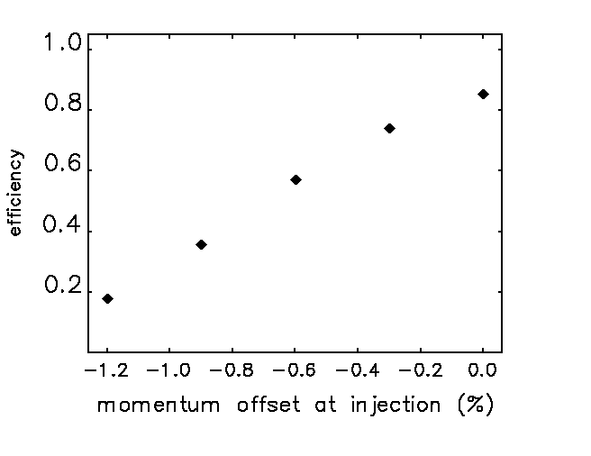
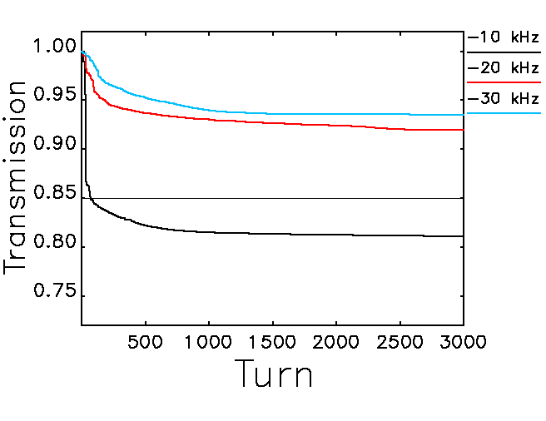
Preferred solution: dynamic tuning
Inject on-momentum
  Moves beam away from horizontal aperture: improves transmission
Detune cavities by 20 – 30 kHz at injection
  Reduces beam loading: further improves transmission
Achieve injection efficiency goal with -20 kHz (or more) detuning
  Assumes PAR bunch length blowup is cured. If not, maximum efficiency is ~85%
Sweep cavity frequency along ramp to bring cavities near resonance at extraction
  Requires 50 kHz tuning range (20 kHz for frequency ramp + 30 kHz detuning)
  Dynamic tuner design (ferrite) is under development

Slide 24
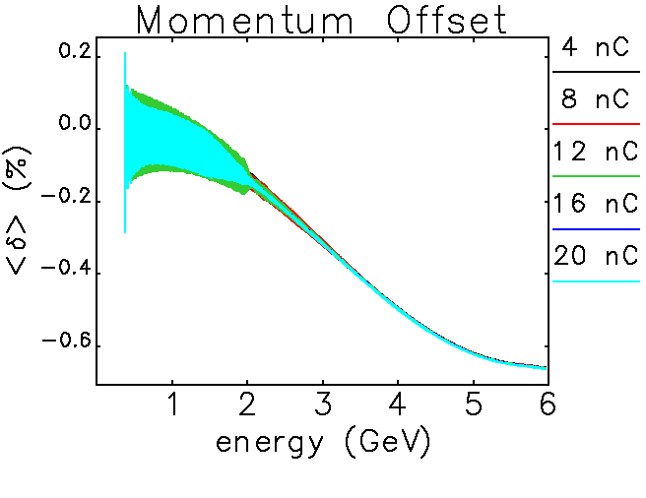
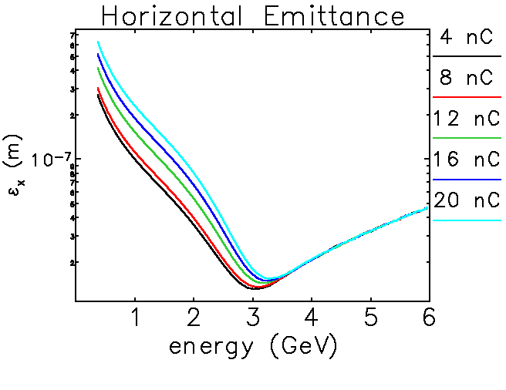
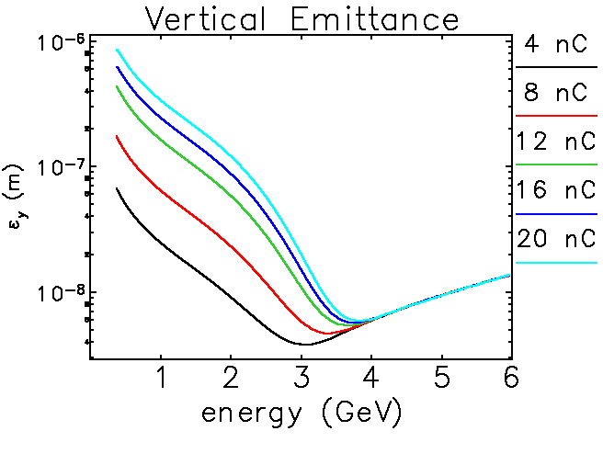
Full ramp simulations
Simulations using ILMATRIX
  Includes impedance, but not beam loading
  Includes frequency ramp
No transverse instability is expected up to 20 nC
No growth in emittance or energy spread
Meets emittance requirements for storage ring injection (ε_{x}=50nm, ε_{y}=16nm)

Slide 25
Summary
High charge operation of the APS injectors has presented many interesting challenges
PAR:
  Biggest issue is bunch length blowup / instability
  Plan to investigate this with a combination of modeling and improved diagnostics
  Transverse blowup due to ions may have some effect on efficiency, mitigation options exist if necessary
Booster:
  Meet transverse emittance requirements by running off-momentum
  Injection efficiency issue has been studied with simulations
  Beam loading looks to be the most important factor at very high charge
  Plan to mitigate this with dynamic tuning + frequency sweep, though other options are available

Slide 26
Thanks for your attention!

Slide 27
Backup slides

Slide 28
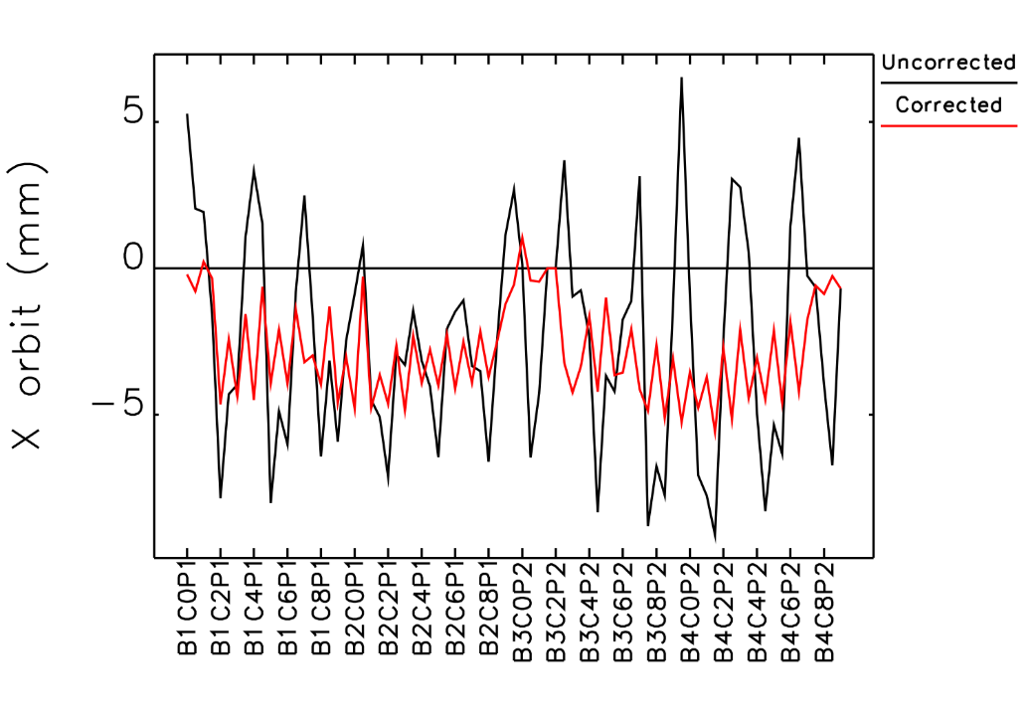
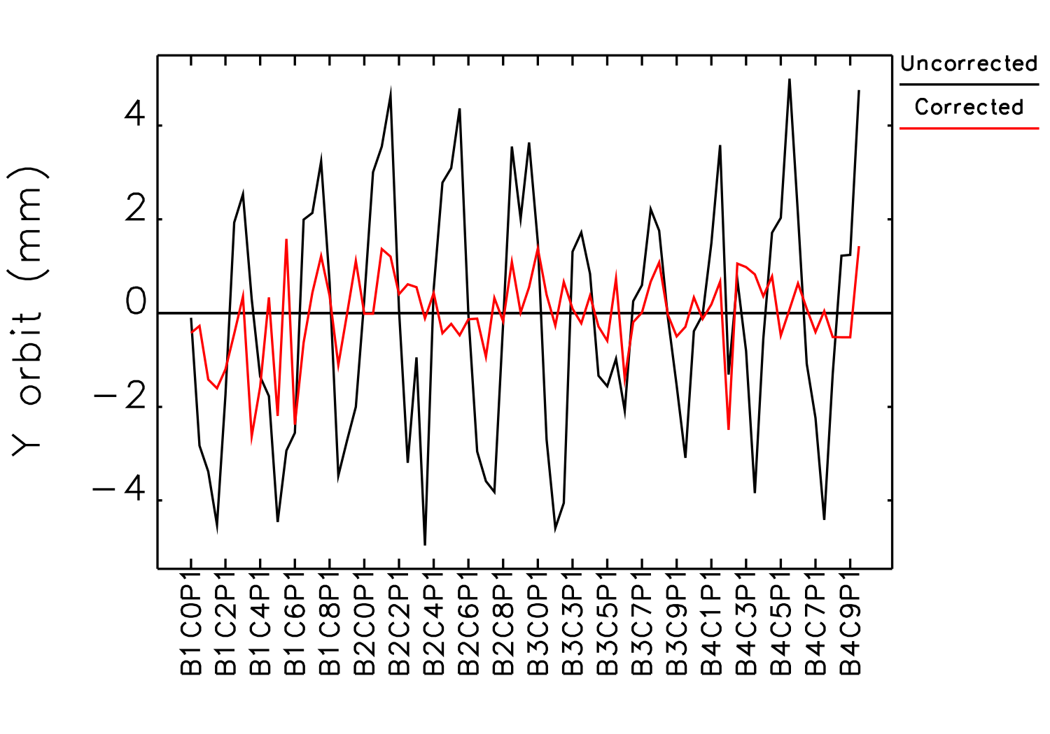
Booster orbit corrected over cycle using new BPMs
Orbit corrected over the Booster cycle using new BPMs and corrector ramps. One (of ten) time slots shown.
Rms orbit error is reduced significantly.
Injection dynamics are improved with corrected orbit: 100% eff at low charge, and ~1 nC higher charge limit (including PAR rf tuning).
LOCO measurements and analysis are ongoing. The need for lattice correction will be evaluated; implementation would require shunts or small power supplies.
Addresses #2908
PDR 4-3.13.4

Slide 29
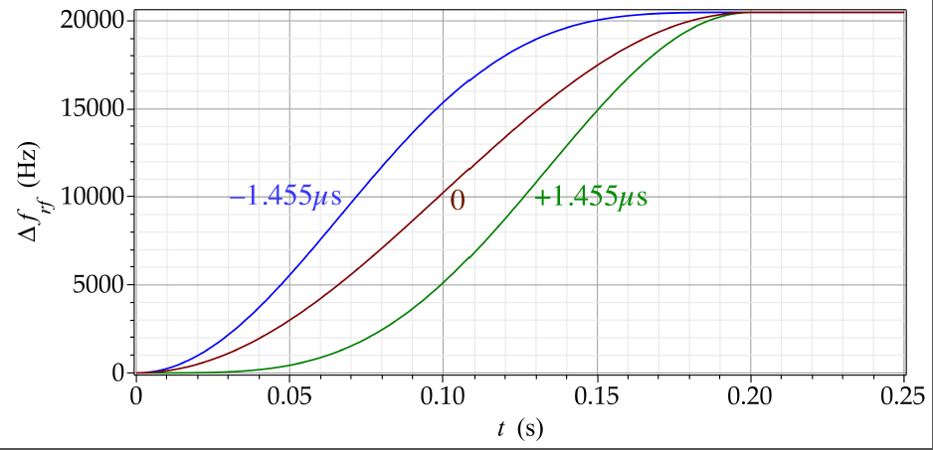
Booster-storage ring injection synchronization concept
Beam transfer happens when the Booster bunch coincides in time with the storage-ring (SR) bucket to be filled and the energies match.
The Booster rf follows a program that ensures this for a given SR bucket while moving the momentum of the beam in the desired way.
A (1-cos(πt/t₁)) component to change momentum
A (1-cos(2πt/t₁)) component to adjust path length (phase).
Each SR bucket gets its own Booster rf program
Graph shows the shortest and longest path through the Booster
No. of turns in Booster varies.
Tuning of RF cavities needs to follow
Δp/p=–0.6%
damp
Δp/p=0
inj.
t₁
extr.
U. Wienands

Slide 30
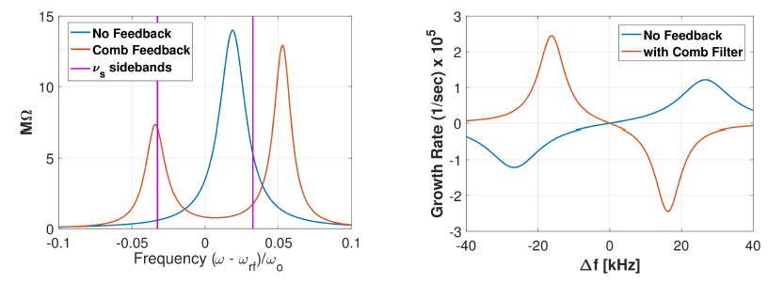
Alternate scheme: comb filter
Sweep booster frequency, keep tuners fixed
  Detuning will go from ~+20 kHz to +2kHz
  Robinson unstable
Comb filter modifies the cavity impedance, provides damping when cavity is tuned to the “wrong” side for Robinson stability
Other options, including direct RF feedback and feed-forward, are also under investigation
So far, simulations point towards dynamic tuning as the best option
T. Berenc

Slide 31
Other beam loading compensation options
Fixed frequency and fixed cavity detuning
  Can improve transmission through detuning, but this requires excessive RF power at extraction (200+ kW/cavity)
  Requires high power couplers: significant technical risk
Direct RF feedback
  Reduces effective impedance seen by beam
  Also reduces Robinson damping
  Implementation complicated by differential delay between the injection side and extraction side cavities (which are driven by a single klystron on the extraction side)
RF feed-forward to counteract transient beam loading
Preliminary simulations indicate these options are inferior to heavy detuning, but more work is needed

