Slide 1
Building 947 Project: Kick-off meeting
Tony Fowler, TE-ABT

Slide 2
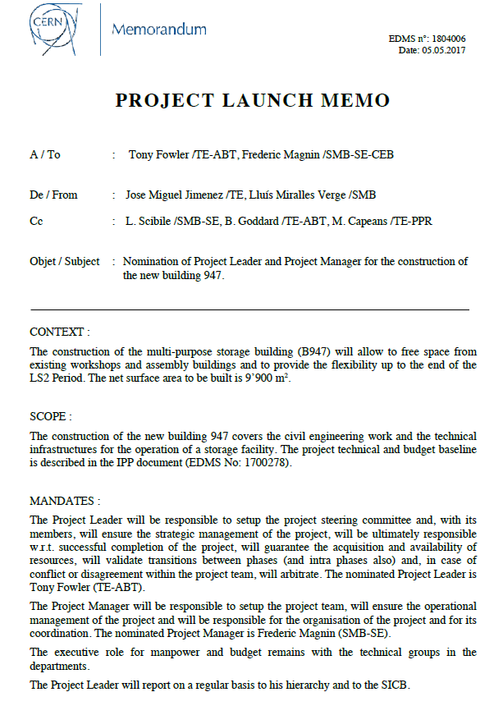

Slide 3
  Goals of the Meeting
Review the present status of the Project
Propose a Project Breakdown Structure:
  SMB managed components (interface with contractors and CERN Service groups)
Propose a Project Coordination and Reporting Structure (Steering):
  Project status and review
  Scheduling (including PLAN)
  Budget overview/control
  Transition to Installation phase
  Definition of ‘Core’ and ‘Extended’ Project Team
  Etc.

Slide 4
  Motivation for a Multi-purpose storage building
The construction of a multi purpose storage building allows to free space from existing workshops and assembly buildings and to provide the flexibility up to the end of the LS2 Period needed for:
  Storage space needed for LIU & HL-LHC Projects;
  Storage space for LHC Detectors to make available space for assembly and testing of superconducting RF modules to match the HL-LHC requirements;
  Storage of light radioactive equipment removed from the accelerator tunnels (and displaced from other radioactive storage areas).
The strategy is to maximize the capacity of the building within a well-defined budget envelope - the provisional target is 9900m².
Building delivery is scheduled for October 2018.
More details at IPP-2016-19
Notes:
LHC Detectors = ATLAS

Slide 5
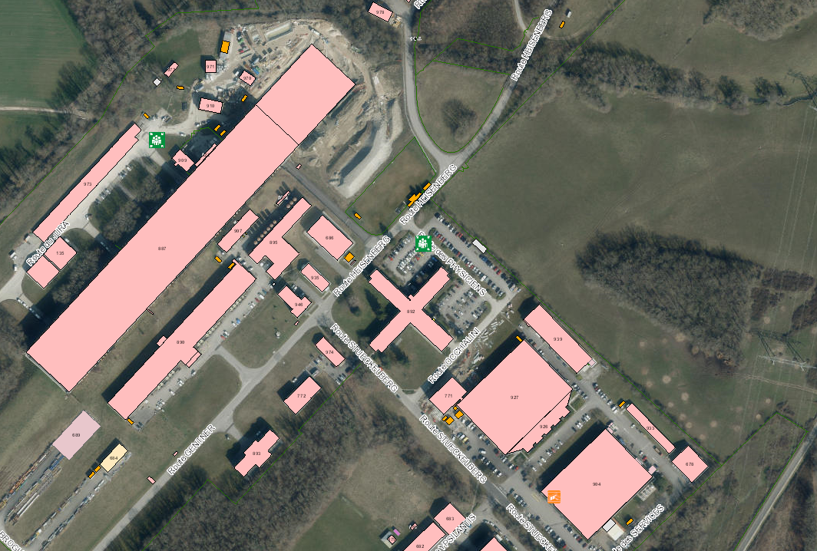
  Building 947: Situation
B947
887
927
904

Slide 6
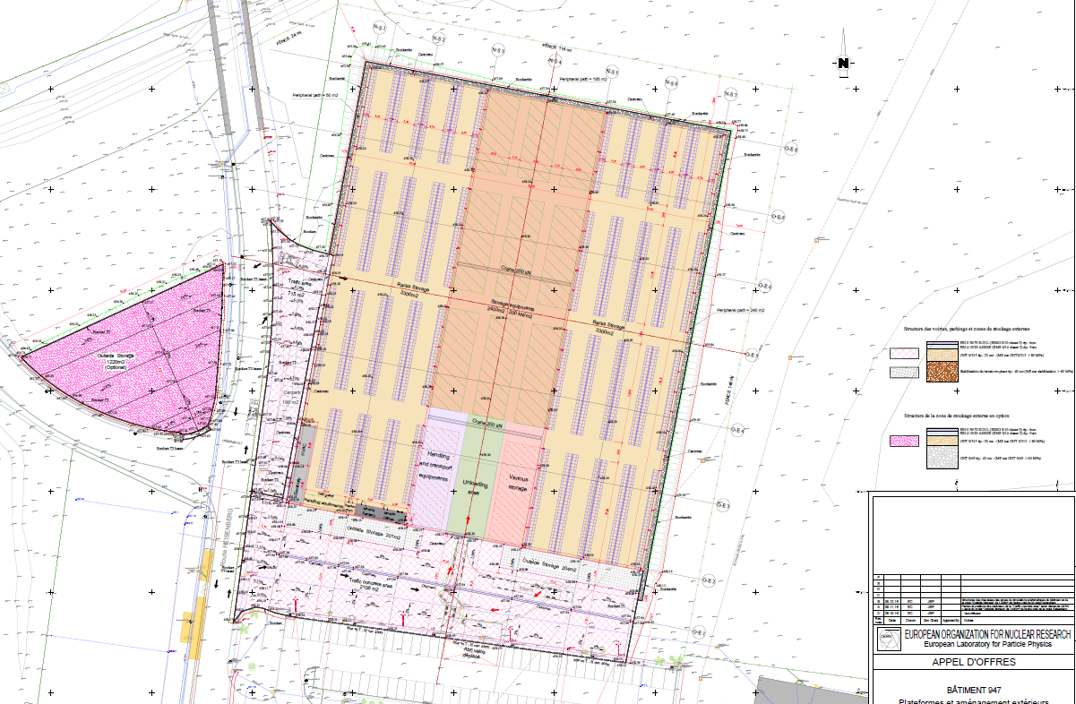
  Building 947: Plan
90m
110m
B. 892

Slide 7
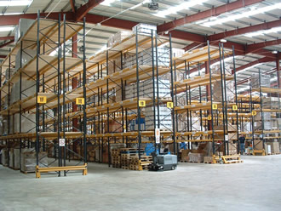
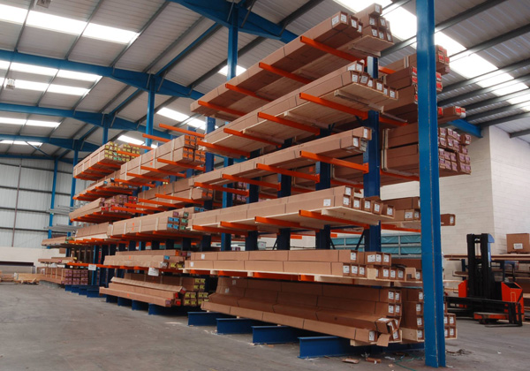
  Building 947: Profile

Slide 8
Provisional Space Allocation*
Group | Type | Description | Requested Surface | Compensatory |  | Comments | B947 Surface
HSE | New | Light Rad Building | 3500
 |  |  |  | ISR2 (TE-VSC Beamscreen storage) | 500 | TE-VSC move to 947
 |  |  |  | ISR8 (TE-MSC ) | 1100 | TE-MSC move to B311
 |  |  |  |  |  | Total | 1900
TE-VSC | Transfer | From ISR2 | 500 | ex-ISR2
 |  |  |  |  |  | Total | 500
HL-LHC | New | Collimators and SC link | 1400
 |  |  |  | B927 (TE-MSC) | 600 | TE-MSC move to 947
 |  |  |  | B927 (EN-HE) | 800 | EN-HE move to 947
 |  |  |  |  |  | Total | 0
 | New | Magnet Production | 1500
 |  |  |  | B180 (ATLAS) | 1000
 |  |  |  |  |  | Total | 500
 | New | Swing Space | 1200
 |  |  |  |  |  | Total | 1200
ATLAS | Transfer | From B180 | 500 |  |  | (missing 500m2?)
 |  |  |  |  |  | Total | 500
EN-HE | Transfer | From B927 | 800
 |  |  |  |  |  | Total | 800
TE-MSC | Transfer | From B927 | 600
 |  |  |  |  |  | Total | 600
LIU | New | Swing Space | 2000
 |  |  |  |  |  | Total | 2000
TE-MSC | New | Swing Space | 1800 |  |  | 2018-ISR
 |  |  |  |  |  | Total | 1800
 |  |  |  |  |  | Grand Total | 9800
* IPP, edms no. 1700278

Slide 9
  Communication
Indico Site: https://indico.cern.ch/category/9239/
EDMS: https://edms.cern.ch/ui/#!master/navigator/project?P:1706527320:1706527320:subDocs
DFS: \\cern.ch\dfs\Departments\TE\Projects\Building947 (not yet active)
Egroup: building947-project-team
Sharepoint Website: https://espace.cern.ch/te-project-building947

