Slide 1

Longitudinal uncertainty of MQXF magnets
(large scale metrology point of view)
Hélène Mainaud Durand, on behalf of EN/ACE/SU/MTI
CERN
93rd HL-LHC WP2 meeting – 9 May 2017

Slide 2
What is foreseen in the baseline?
Monitoring of the longitudinal relative position of each cryostat w.r.t tunnel floor.
Monitoring of the 5 DOF position (radial & vertical translations + 3 rotations) of the cold mass (mechanical axis) w.r.t. cryostat using FSI system.
Such a 5 DOF monitoring could be transformed «for free» in a 6 DOF, considering the example of crab cavities.
Outline:
  A brief remind concerning the alignment objectives of crab cavities
  Solution proposed
  Study of configuration proposed
  Results obtained @ 20°C.
  Extrapolation to IT cold mass

Slide 3
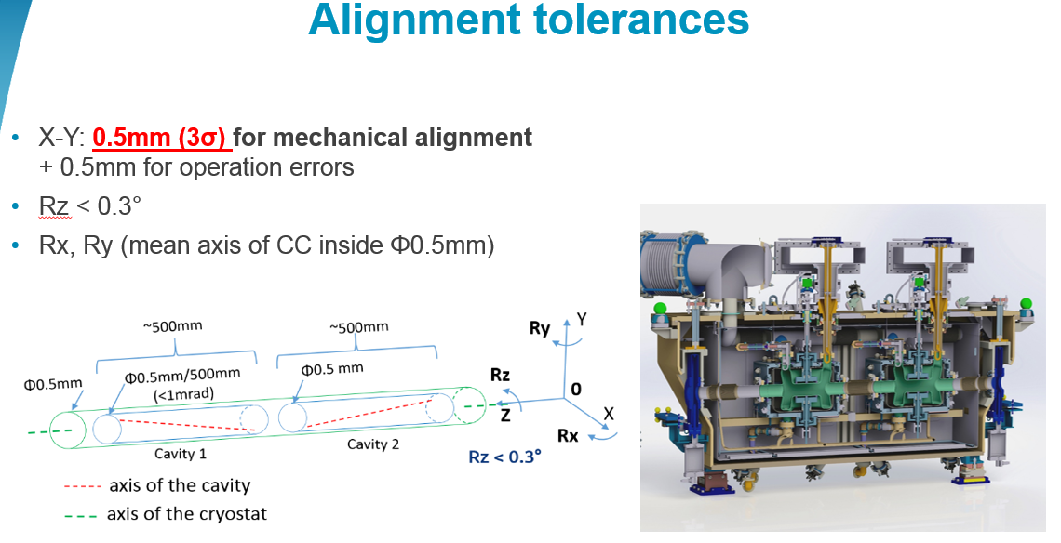
Alignment objectives for crab cavities
From Mateusz Sosin

Slide 4
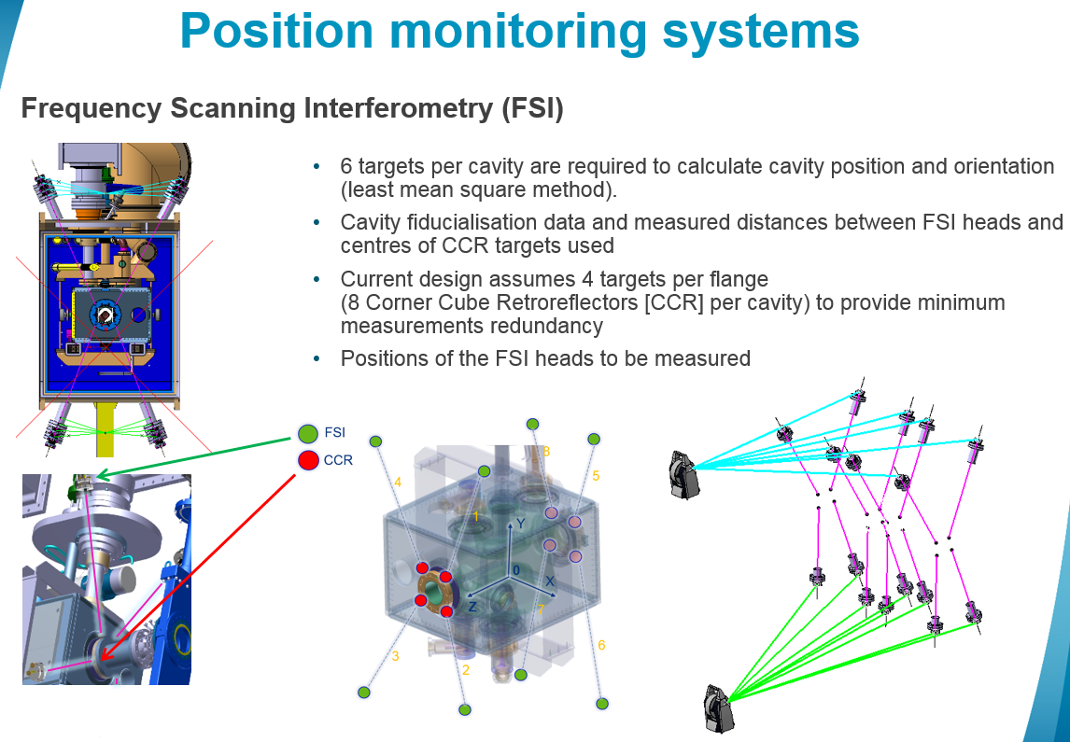
FSI solution for crab cavities
From Mateusz Sosin

Slide 5
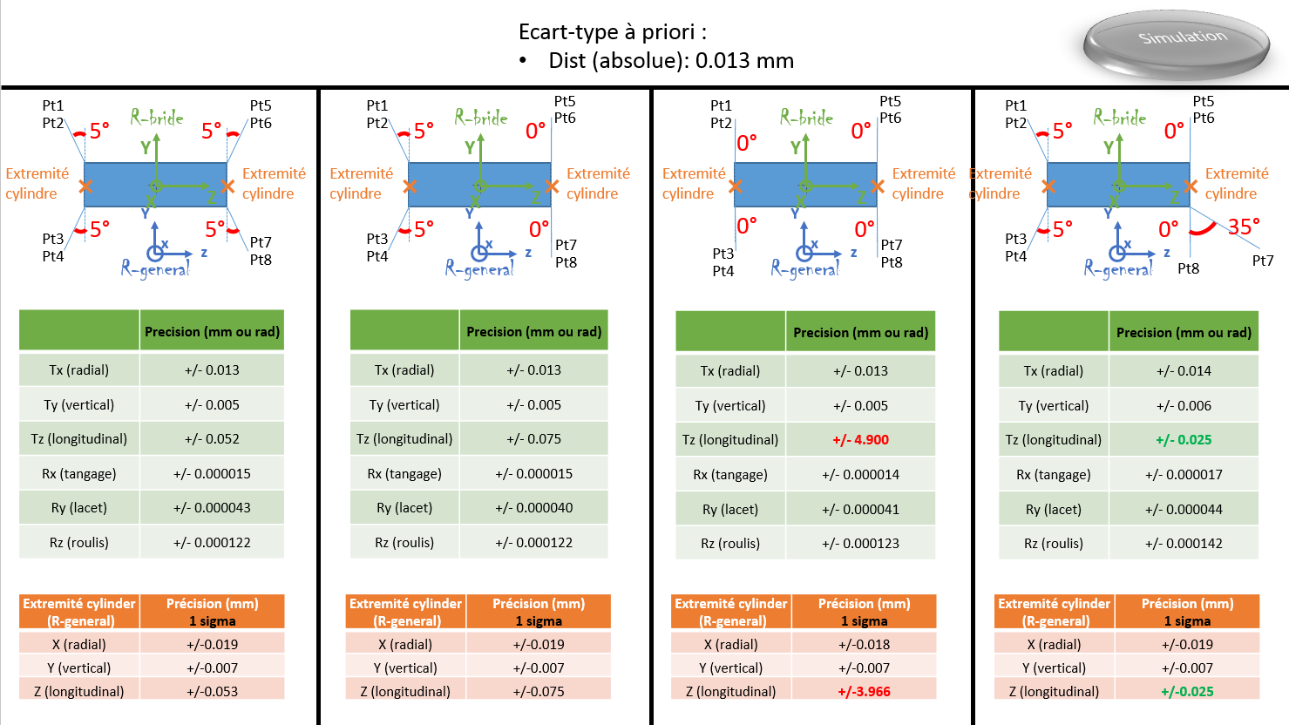
Study of configurations via simulations
From Vivien Rude

Slide 6
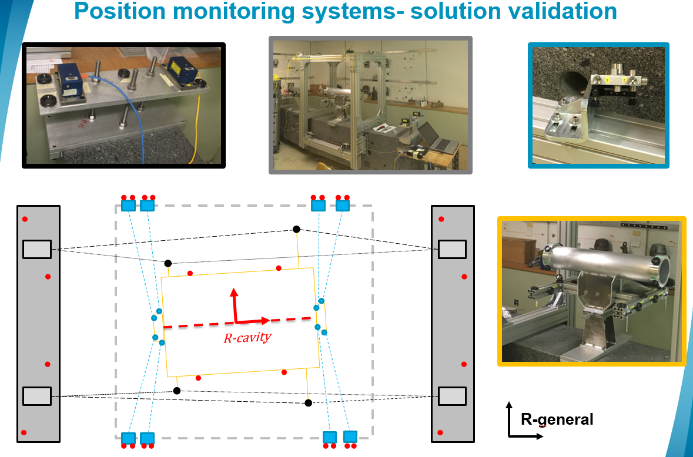
Results obtained at 20°C
From Vivien Rude

Slide 7
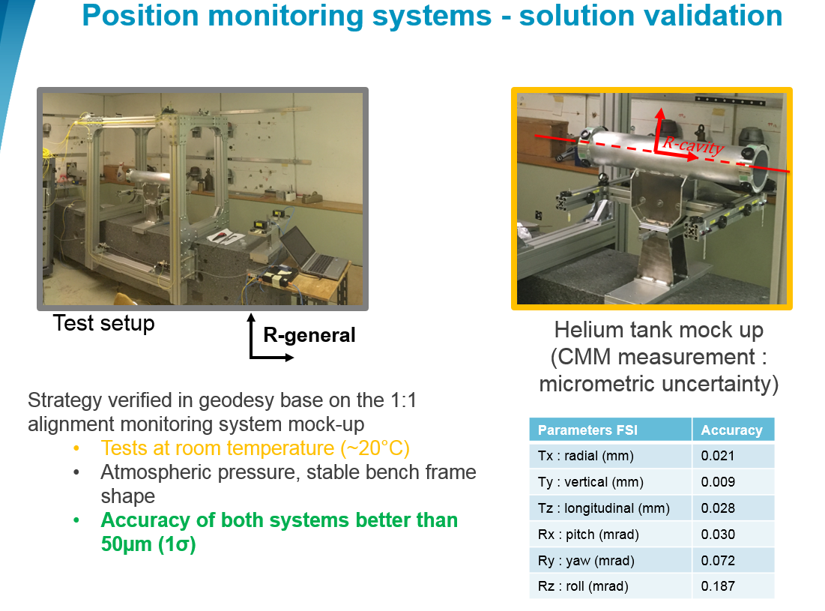
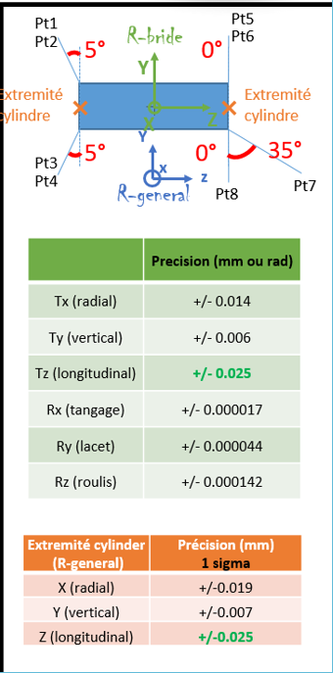
Results obtained at 20°C
From Vivien Rude

Slide 8
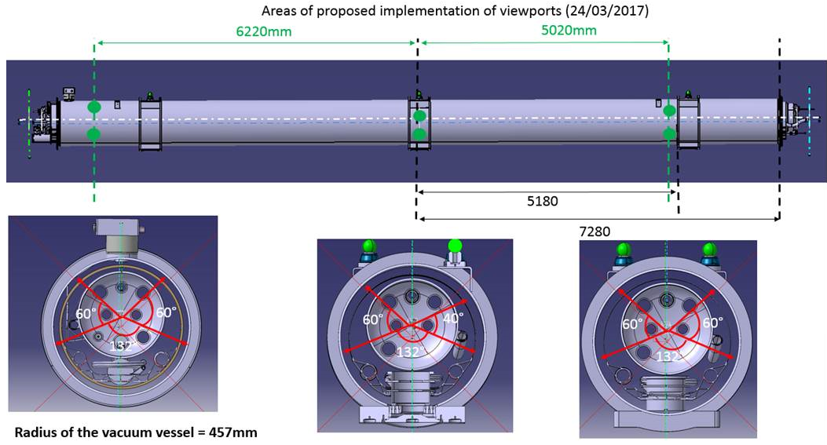
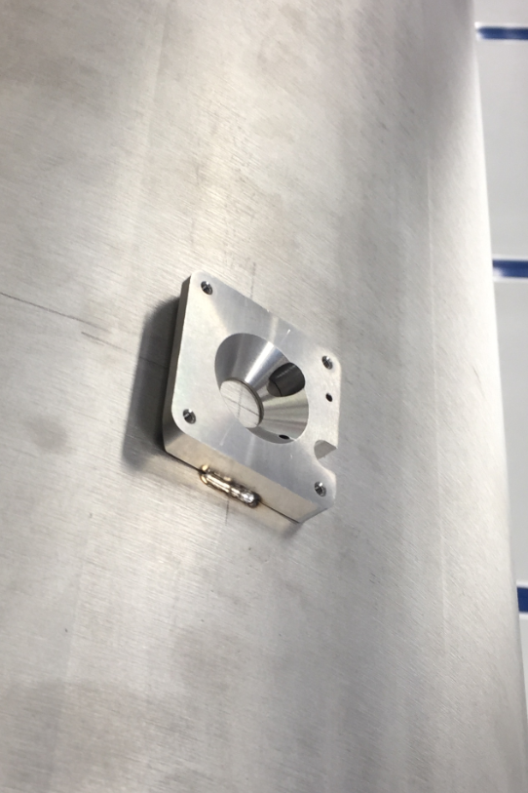
Extrapolation to MQXF magnets
Next step: validation of the FSI system under cold & vacuum conditions on a dipole in SM18.
From Frédéric Micolon

Slide 9
Extrapolation to MQXF magnets
A good configuration of the FSI lines of sight will allow the monitoring of the cold mass position w.r.t. cryostat according to 6 DOF, within tens of microns of accuracy.
Be careful, this is the monitoring of the mechanical axis w.r.t cryostat.
The accurate determination of the magnetic axis w.r.t. mechanical axis, especially in the longitudinal axis has to known as well (use of the AC mole?).

Slide 10
Thank you very much

Slide 11
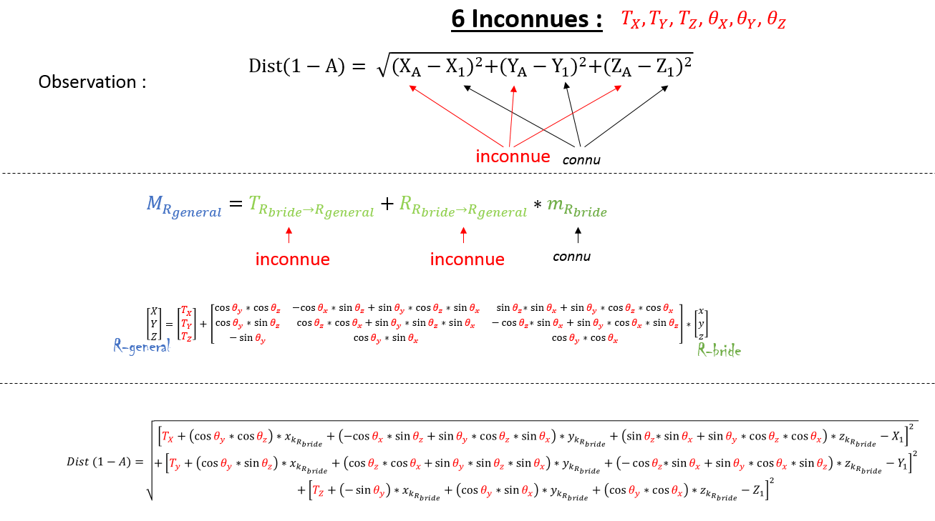
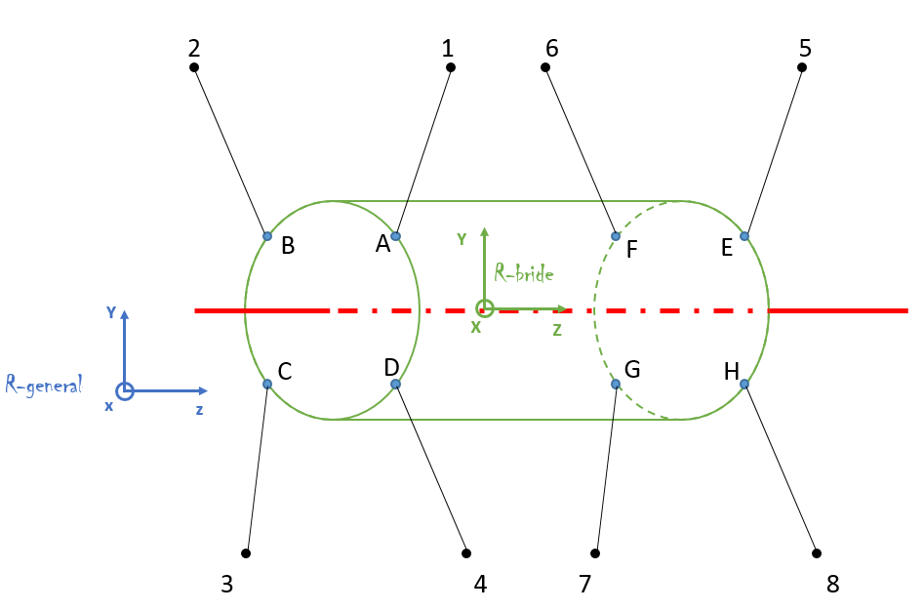

Slide 12
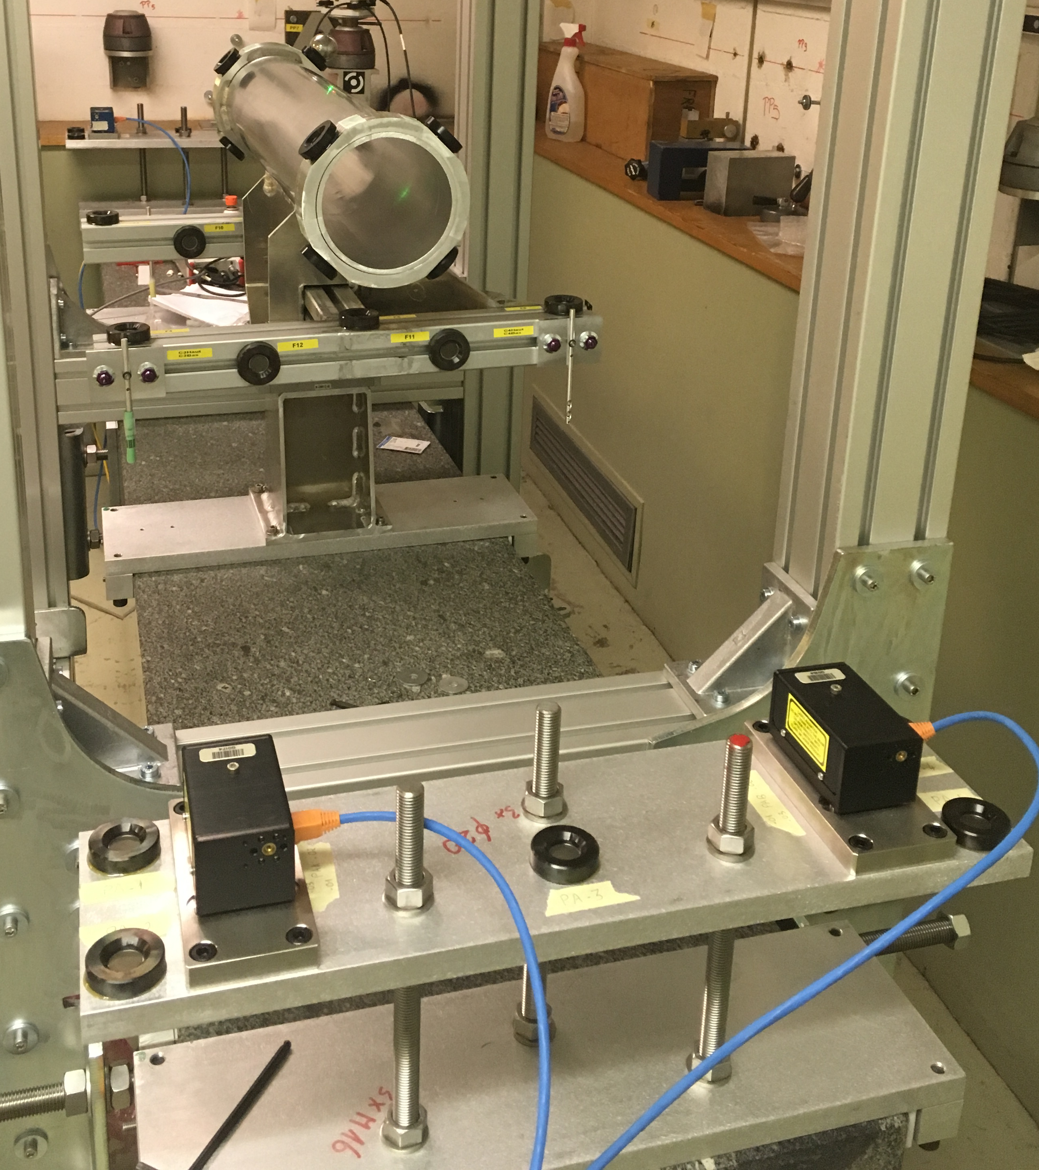
Position monitoring systems- solution validation
Feedthrough
(FSI head)
FSI device
BCAM device
R-general
Cryostat
Viewport
Cryostat
axis
Cavity axis 1
Cavity axis 2
V. Rude

