Slide 1
Bad Seeds
R. De Maria, F. Van der Veken, M. Giovannozzi, A. Mereghetti
WP2 meeting

Slide 2
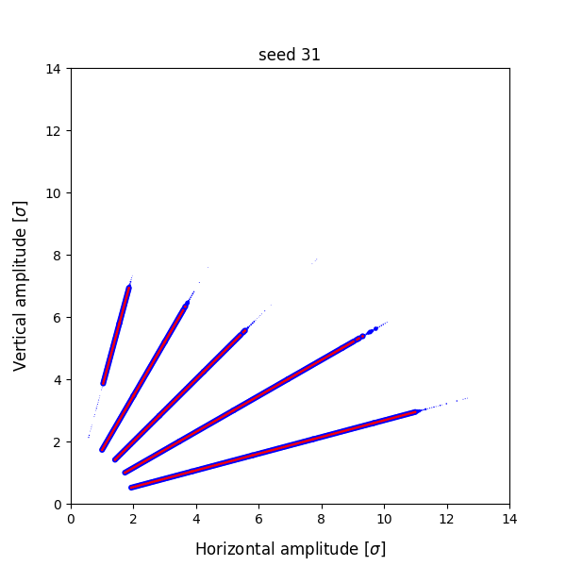
Bad Seeds
hl10_NLC_align_b3_dy_1000_B4 Seed 31

Slide 3
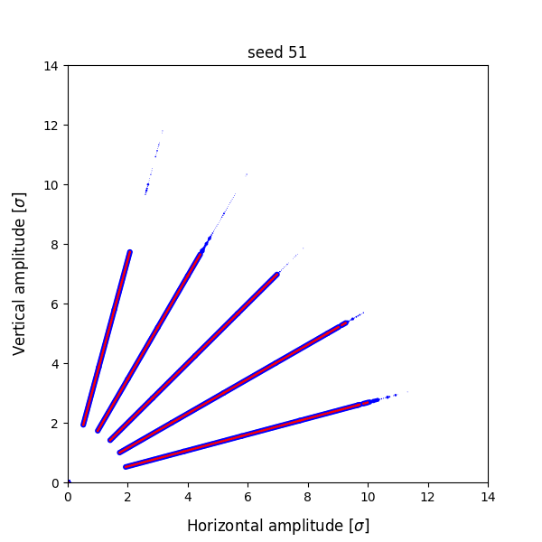
Bad Seeds
hl10_NLCnoD2_align_b6_dpsi_500_B1 51

Slide 4
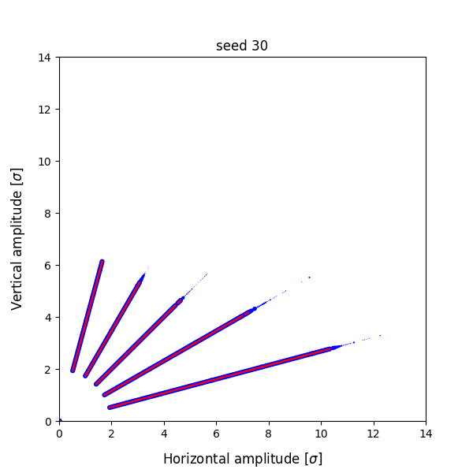
Bad Seeds
hl10_NLCnoD2corrected_a4steps_+10_B4 30

Slide 5
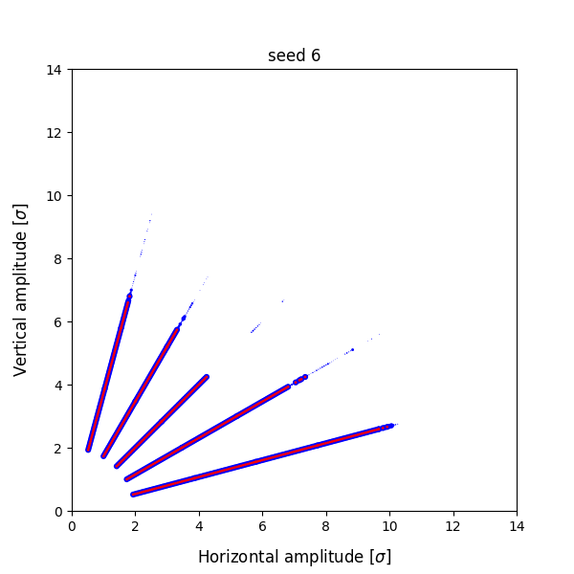
Bad Seeds
hl10_NLCnoD2corrected_a4steps_+10_B4 6

Slide 6
Common Features
Simulation computes pre-processing correctly
All trajectories in one job are tracked in the order of thousand turns and then lost
Trajectories are not correct (a new simulation does not reproduce the results)
Post-processing gives realistic resulting from incorrect trajectories
No error message report
Results looks produced by LHC@Home, but we could not investigate further because too much time passed from results production.

Slide 7
SixDB
Sixdb has a new command “check_results” that compares the first and last particle of two consecutive jobs
The code detected all bad seeds identified by Frederik and few more.
Please use this command on recent results both produced by LHC@Home and LXBATCH.

