Slide 1

DA targets with beam-beam for HL-LHC based on LHC experience
Y. Papaphilippou and D. Pellegrini
with contributions of: F. Antoniou, S. Fartoukh,
G. Iadarola, N. Karastathis
HI-LUMI WP2 – 09/05/2017

Slide 2
A foreword on DA
The DA obtained from tracking simulations depends on several conventions:
  Number of turns: 1M = 90 s of beam time
  Choice of initial momentum: 27e-5 ~ ¾ of the bucket height (see also D. Pellegrini, 81th WP2)
  Number of angles for min DA: 5
  Specific machine realisation (with or without errors)
Strategy: keep these fixed to have consistent estimations for comparison with the machine performance.
A variation may result in different DA targets.
We focussed on Beam1, presenting the shorter lifetime during the entire year, investigations of Beam2 are planned.

Slide 3
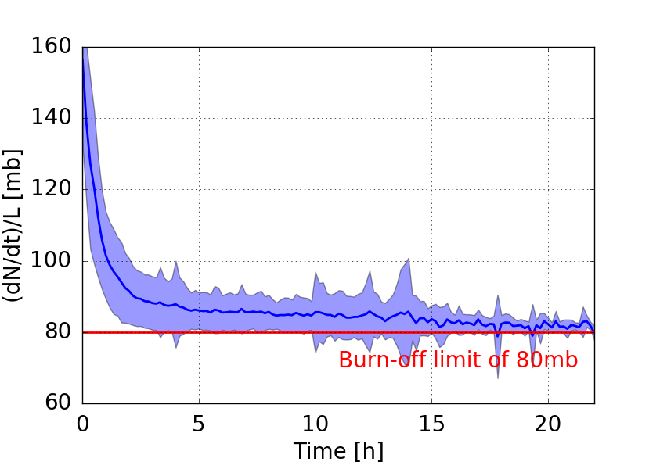
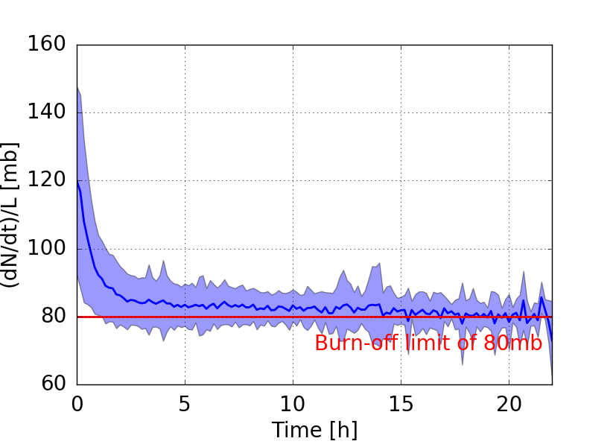
Losses during the fill
Beam 1
Beam 2
F. Antoniou
Normalised loss-rate, approaches burn-off limit within first 2-3h.
These early losses appear to be correlated with DA.
Cleaning of tails? Investigations are ongoing…

Slide 4
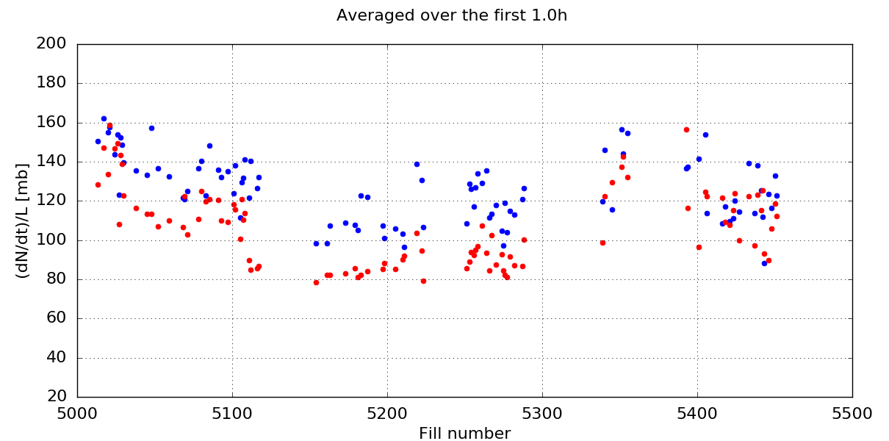
1st hour losses along the year
Beam 1
Beam 2
B1 Tune Adj
Transition to BCMS
Crossing angle reduction
Burnoff Limit
Larger DA over this period
F. Antoniou

Slide 5
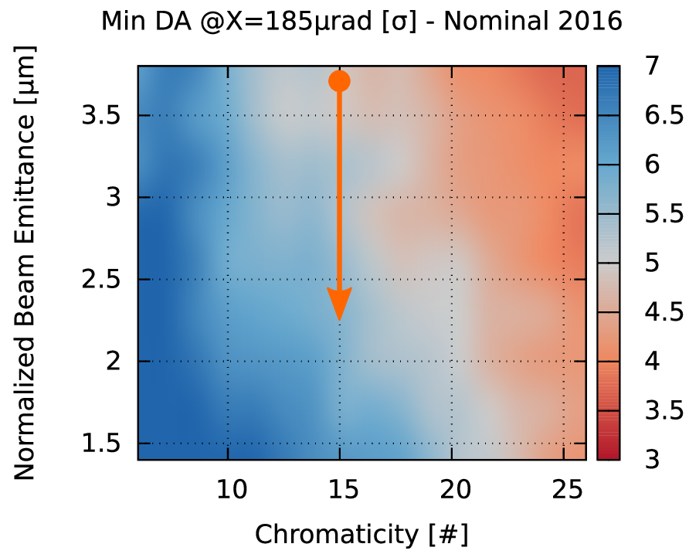
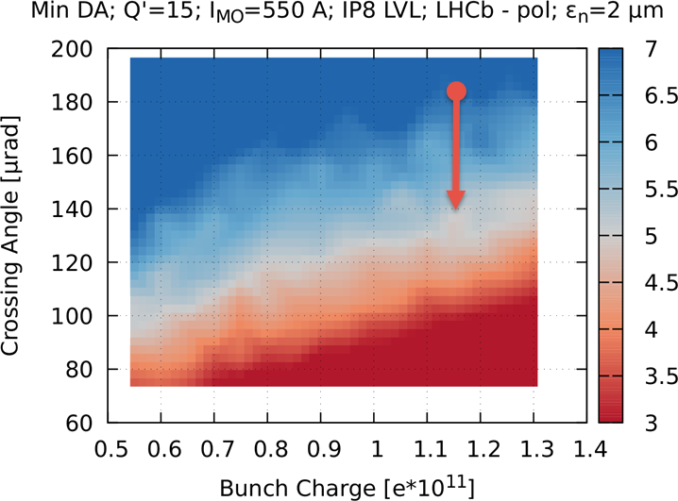
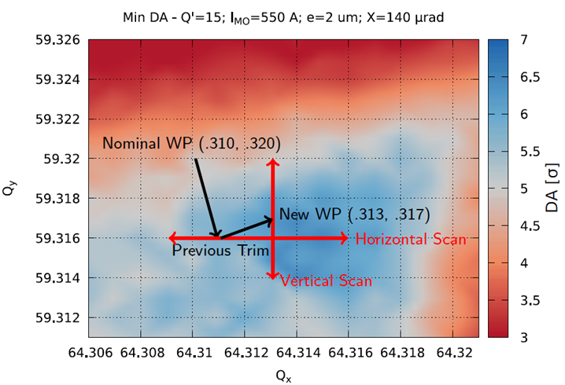
DA follow up along 2016 Run
Reduction of emittance, increasing the DA from 5 to 6 σ
Reduction of crossing angle, reducing the DA from 6 to 5 σ
Tune adjustment bringing restoring the DA from 5 to 6 σ
What is the impact on the integration of luminosity?

Slide 6
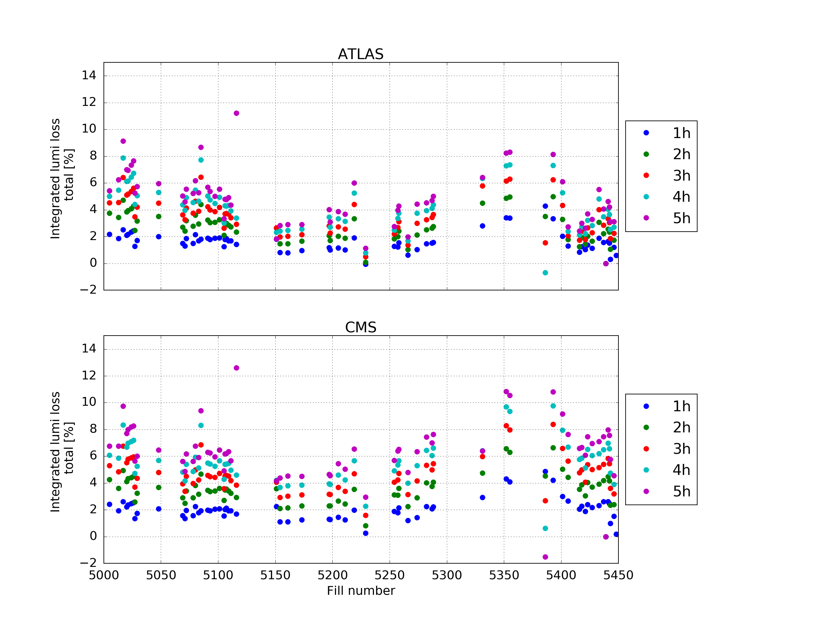
Luminosity loss
  The integrated luminosity loss along the fills from:
  emittance blow-up (compared to the expected evolution), extending for the entire fill duration.
  beam losses localised in the first few hours.
  The contribution of losses is up to 2~3 %, while the crossing reduction came with a 10 % increase.
  Trading DA for performances can be worth the losses.
Some uncertainty from BSRT recalibrations
F. Antoniou

Slide 7
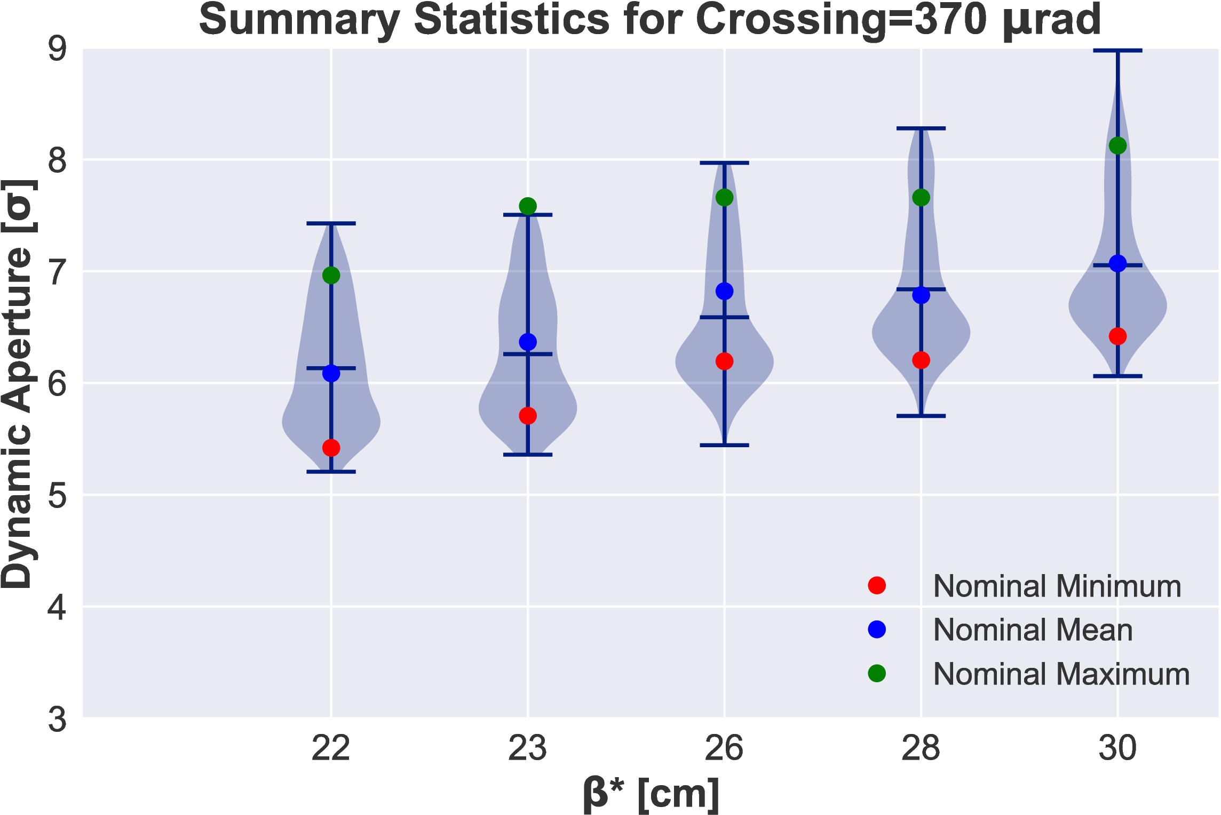
Uncertainty from errors with beam-beam
  Errors evaluated in an area around the target luminosity for the nominal intensity at the end of levelling.
  With tolerances such that the correction is effective, the errors have limited impact on DA with bb.
  Very few seeds and angles going below the minimum DA without errors.
  A maximum loss of 1σ DA is a conservative assumption.
N. Karastathis, 90th WP2

Slide 8
Conclusions
Experience with the LHC and the current DA conventions:
  A DA of 6 σ is comfortable.
  The machine can run with 5 σ DA, although this causes increased losses at the beginning of the fill.
  It is worth to go to 5 σ with luminosity-boosting settings (eg. Xing).
Design phase (unknown machine realisation):
  With nominal parameters it is better to target 6 σ avoiding to be cornered with a bad seed.
  5 σ is not unrealistic in view of DA recovery techniques (tune control to 10⁻³, BBLR compensation techniques - wire and negative MO), it is worth to consider the performance gain.

Slide 9
Backup

Slide 10
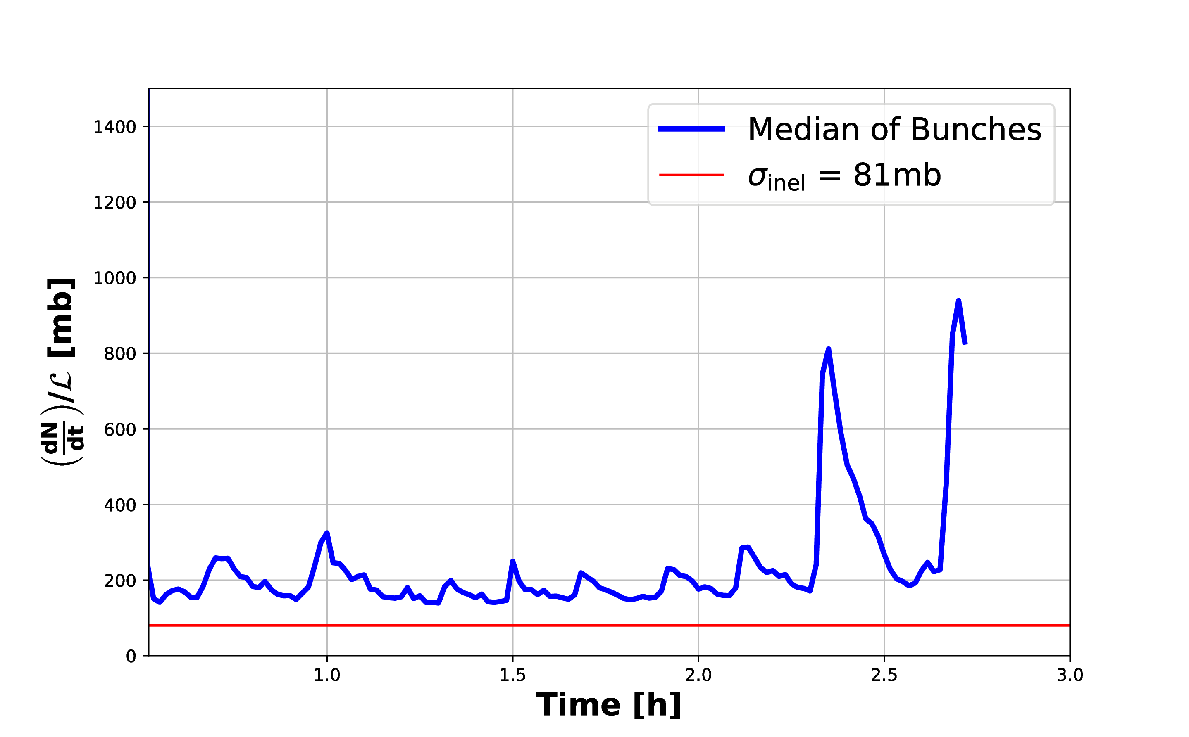
Losses Analysis during MD on Xing reduction
Does not converge to the burnoff limit.
Extra mechanisms for losses are present (eg. tune drifts)
N. Karastathis et al.

