Slide 1

SPS Test-stand Integration
G.Vandoni
International Review of the Crab-Cavity Performance for HiLumi April 2017

Slide 2
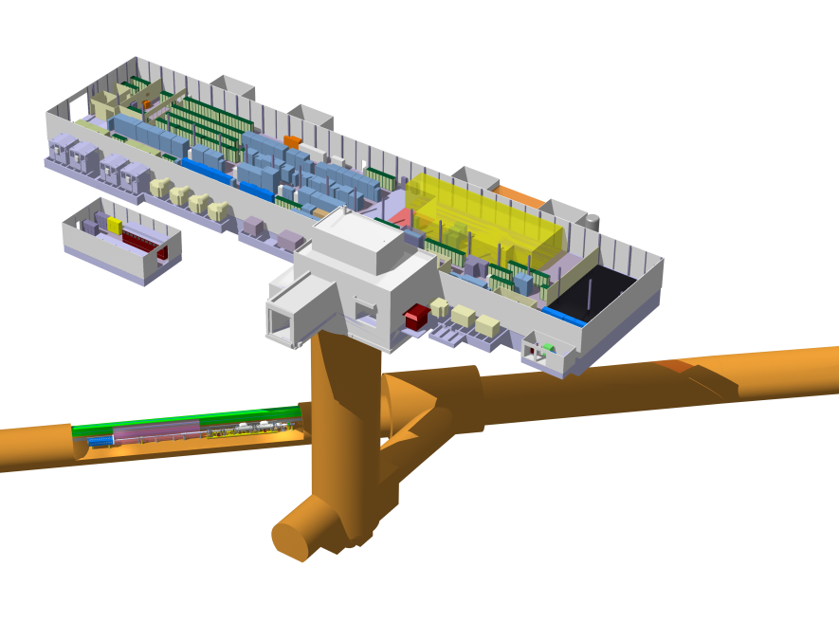
Cryogenic refrigeration & distribution
He
BA6 – surface area
Cryogenic Tanks
Warm pipework CRG
Cryogenic compressor
N2
PA6 - shaft
LN₂ insulated lines
CC SPS test stand
TA6 - alcove
COLD-BOX
Valve-box 2
Valve-box 1

Slide 3
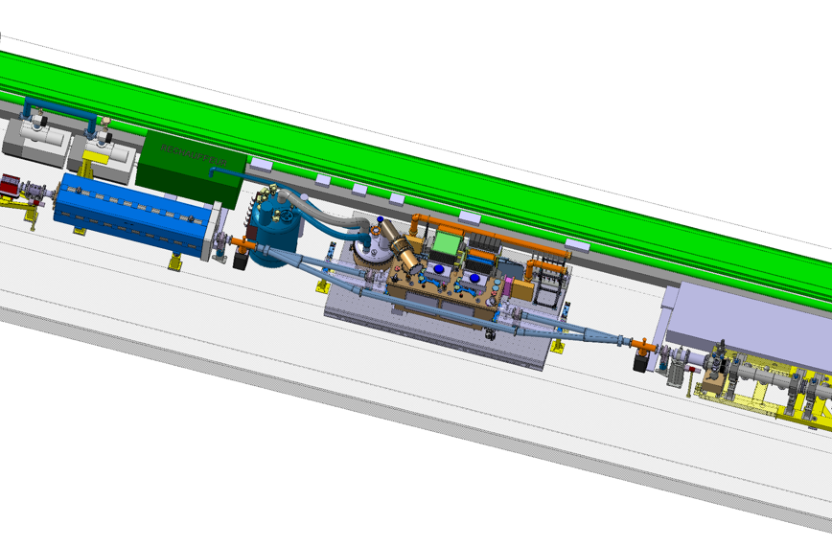
HL-LHC CrabCavity SPS test stand
Service box
RF power, loads & circulators
Valve-box2
Y-chamber + VVS valves
Transfer table
Cryo-module
Transport lane

Slide 4
WP4 Planning
(E)YETS=(Extended) Year-End Technical Stop
SPS prototype beam tests
preparation
SPS Test (CM1)
SPS Test (CM2)
2015
2016
2017
2018
2019
2020
2021
2022
2023
2024
2025
2026
YETS
EYETS
YETS
Run 2
LS2
Run 3
LS3
Run 4
Test run
TS-bound activities

Slide 5
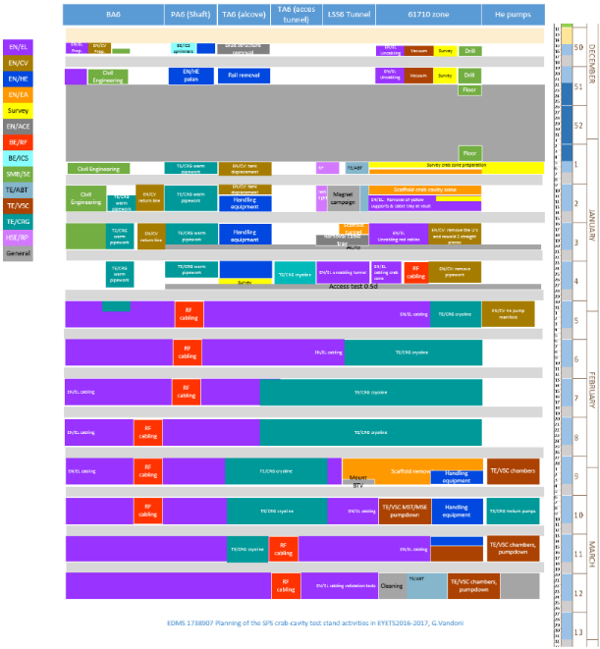

EYETS goals and achievements
12.4 weeks
Objective
Cable (211, 20km) | 80%
Cryo distribution line
3 rails (4 tons CMU)
Vacuum sectorization
Civil engineering
RF power lines
Water pipework
Warm cryo pipework | 75%
He pumps
Survey
3D scan new configuration

Slide 6
From EYETS to YETS
CRYO
Service Box, ValveBoxes, precommissioning at warm
Installation of GHe and LN2 tanks
BA6 SURFACE BUILDING
Installation of power equipment, connections and commissioning
Construction of 3 slabs for cryogenic tanks and transformer
False floor of Faraday cage
INFRASTR.
Installation of RF power equipment, connections and commissioning
BE/RF
Faraday cage for LLRF
Tendering
Production
assembly
!
LLRF

Slide 7
A challenging YETS
9 weeks
9
23/2

Slide 8
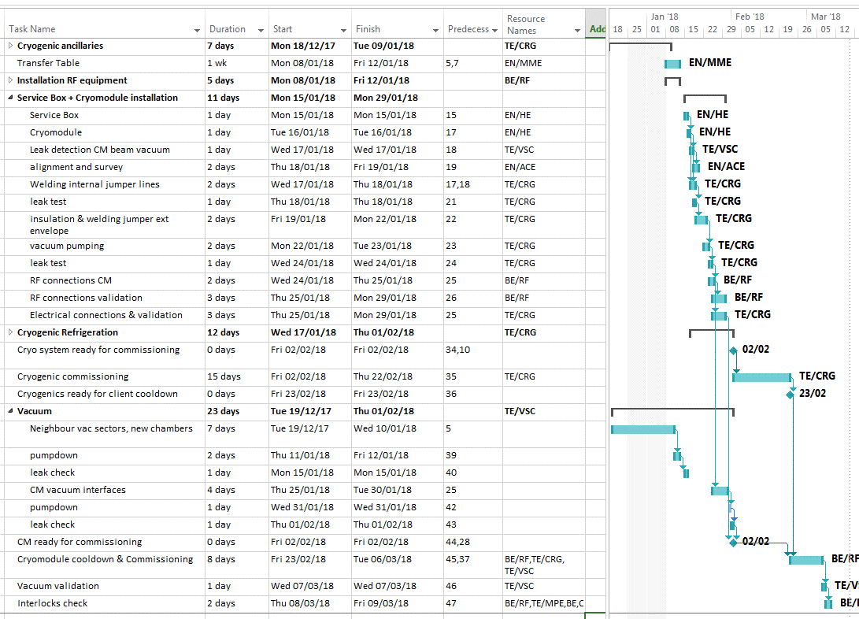
YETS detailed planning

