Slide 1


Pre-Booster Damping Ring Design for the FCC e⁺e⁻ Injector
Özgür ETİŞKEN
Ankara University
Physics Department-PhD Student
Supervisors: Dr. Yannis Papaphilippou (CERN) and Prof. Dr. Abbas Kenan ÇİFTÇİ (A.U)
8th FCCee Injector Meeting, CERN, March 2017

Slide 2
Outline
Thesis Description
Why an alternative Design?
Parameter scaling
Some Calculations for general design parameters
Lattice Design
Straight Sections
Phase advance-chromaticity-emittance relations
Extraction emittance of pre-booster damping ring
Preliminary IBS simulations
8th FCCee Injector Meeting, CERN, March 2017

Slide 3
Thesis Description
The FCC-ee injector complex needs to produce and to transport a high-intensity e+/e- beam at a fast repetition rate of about 0.1 Hz for topping up the collider at its collision energy. A basic parameter set exists for all the collider energies, assuming a 10 GeV linac operating with a large number of bunches being accumulated in the existing SPS, which serves as pre-accelerator and damping ring before the bunches are transferred to the high-energy booster. The purpose of this PhD thesis would be the conceptual design of an alternative damping & accelerator ring, replacing the SPS in the present scheme. This ring should have an injection energy of around 6 GeV and extraction energy of around 20 GeV. Apart from establishing the basic parameters of the ring, the thesis work will include the optics design and layout, single particle linear and non-linear dynamics optimization, including magnetic and alignment error tolerances. The PhD thesis may also contain some basic estimations of collective effects, including intra-beam scattering, single and multi-bunch instabilities and impedances, two-stream effects (e-cloud and ion instabilities) and address the issue of synchrotron radiation handling.
8th FCCee Injector Meeting, CERN, March 2017

Slide 4
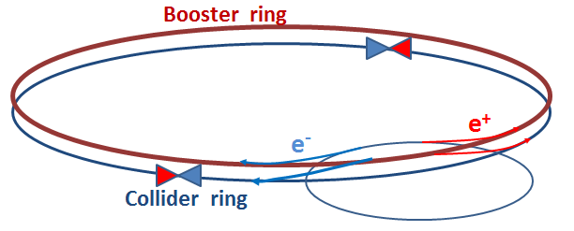
Alternative Damping Ring Synchrotron Design
Linac
Pre-booster design,
Booster same
tunnel with main ring,
Collider ring.
20 GeV to final energy
6 - 20 GeV
Initial plan was considering CLIC based linac and SPS as Pre-Booster Damping Ring (PPDR) but issues with:
  machine availability, synchrotron radiation, new RF system…
This is why a “green field” alternative design is interesting
And, a new linac design by S.Ogur and PBDR design study by myself are started
8th FCCee Injector Meeting, CERN, March 2017

Slide 5
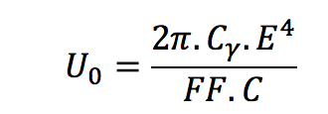
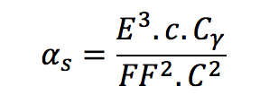
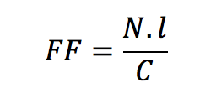
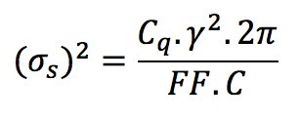
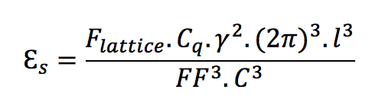
Parameter space
Scaling of important parameters impacting machine layout;
  Energy loss per turn
  Damping times
  Energy spread
  Emittance
Filling Factor
8th FCCee Injector Meeting, CERN, March 2017

Slide 6
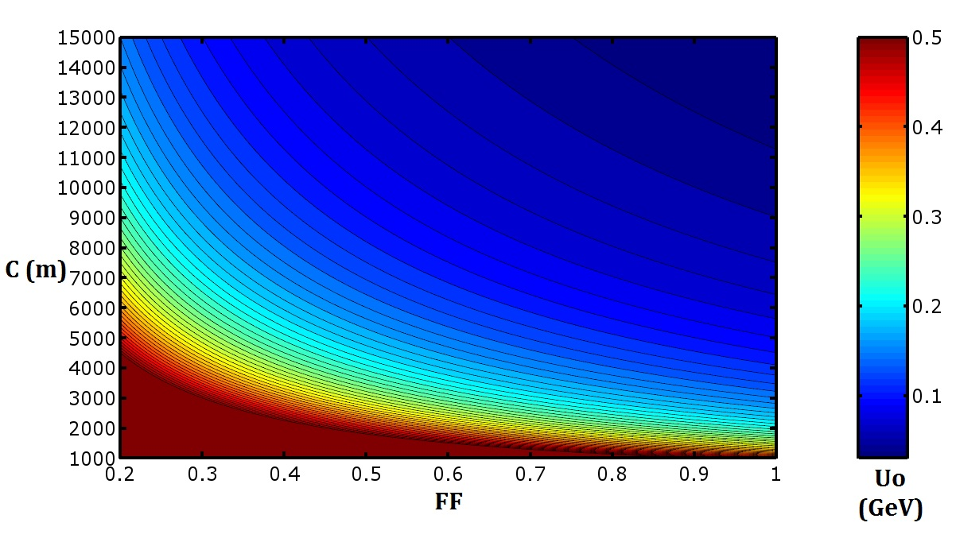
Energy Loss Per Turn (30 GeV)
Scaling of Energy loss/turn with filling factor and circumference
For 30 GeV, the area below 50MeV/turn is for very high filling factors and circumferences
8th FCCee Injector Meeting, CERN, March 2017

Slide 7
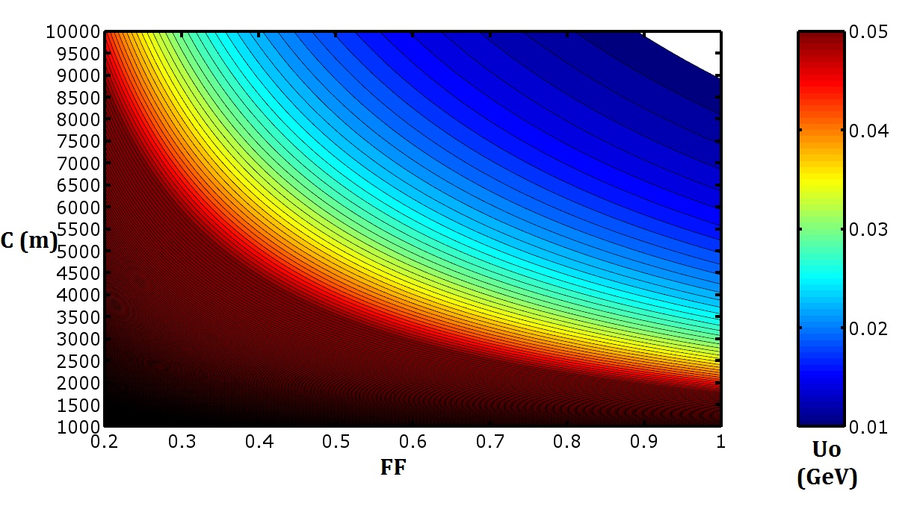
Energy Loss Per Turn (20 GeV)
Scaling of energy loss/turn with filling factor and circumference
For 20 GeV, the area below 50MeV/turn is wide
The lowest circumference of around 2.5km is for high filling factors (FF) of around 0.7
8th FCCee Injector Meeting, CERN, March 2017

Slide 8
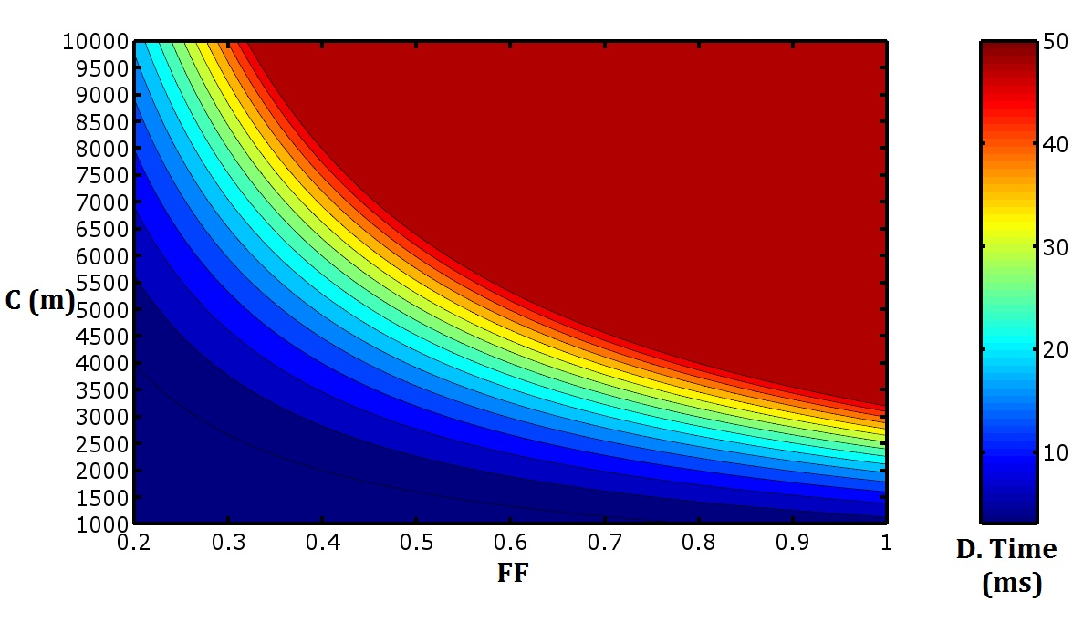
Damping Time (20 GeV)
Scaling of damping time with filling factor and circumference
For the area we remarked before, the values are acceptable and do not vary so much.
8th FCCee Injector Meeting, CERN, March 2017

Slide 9
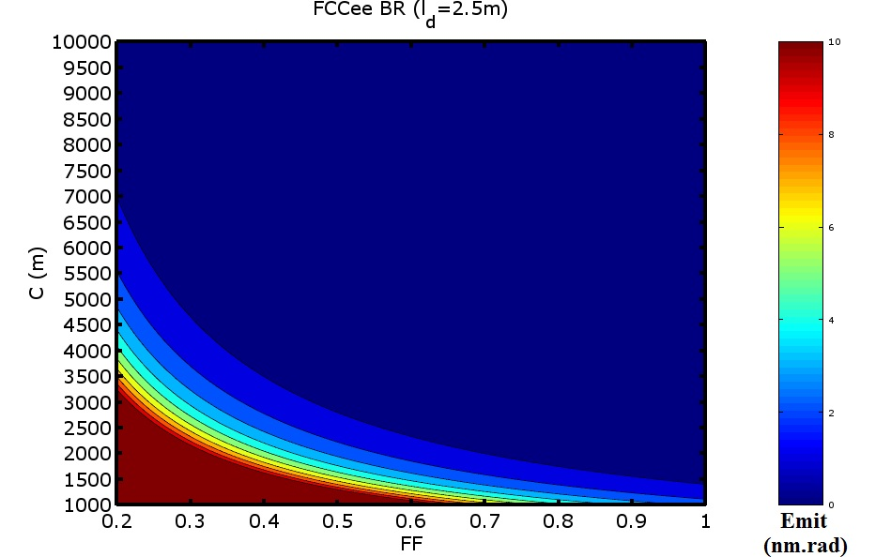
Emittance (20 GeV)
- It seems that the ring will be about 3 km for around 1 nm.rad assuming that the FF is about 0.7.
8th FCCee Injector Meeting, CERN, March 2017

Slide 10







Estimation of dipole length
with basic formulas
E= 20 GeV
U=50 MeV; max Uo for min. C
ε_{s} is around 1nm.rad
$U(keV)=$ 26.5x$E^{3}\left(GeV\right)xB(T)$
$$N=700$$
$$θ={0.514}^{0}$$
$$B=0.239 T$$
$$l=2.5 m$$
8th FCCee Injector Meeting, CERN, March 2017

Slide 11
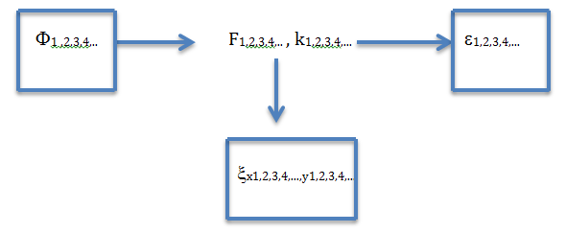
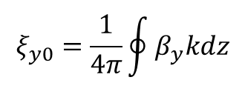
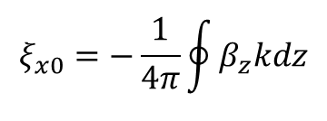
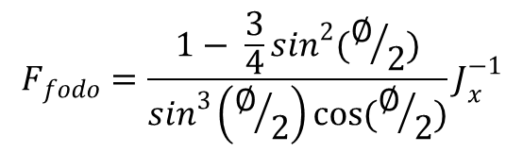

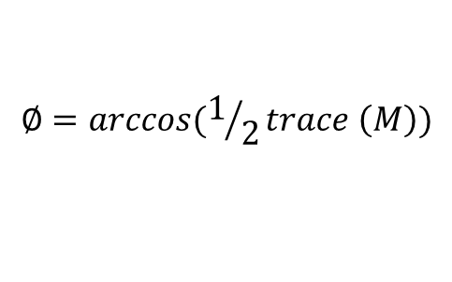
Phase Advance, Emittance
and Chromaticity
$$∈_{fodo}=F_{fodo }C_{q}γ^{2}θ^{3}$$
Emittance
$$F_{fodo}=\frac{1− \frac{3}{4}\sin^{2}(∅/2)}{\sin^{3}\left(∅/2\right)\cos{(∅/2)}}J_{x}^{−1}$$
$$ξ_{x0}=−\frac{1}{4π}\oint{β_{z}kdz}$$
Chromaticity
$$ξ_{y0}=\frac{1}{4π}\oint{β_{y}kdz}$$
$$∅=arccos(1/2trace \left(M\right))$$
Phase
8th FCCee Injector Meeting, CERN, March 2017

Slide 12
Determining the main cell
0.15m
0.15m
2.5 m
2.5 m
ld
ld
k2
ld
ld
k1
k2
0.3 m
All k1, k2, ld values are scanned and ‘emittance & chromaticity’
are calculated to be able to obtain most optimum machine
8th FCCee Injector Meeting, CERN, March 2017

Slide 13
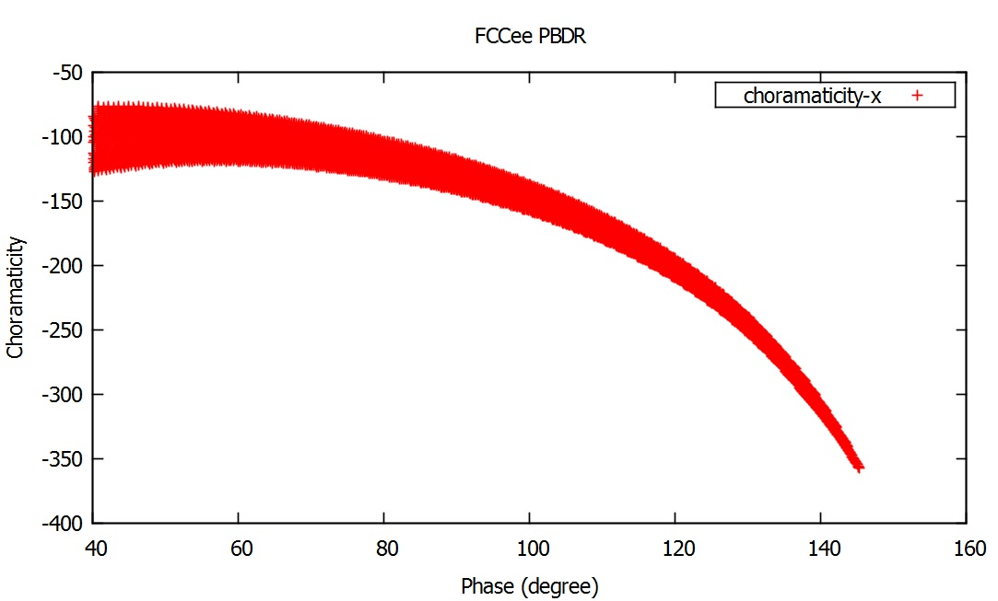
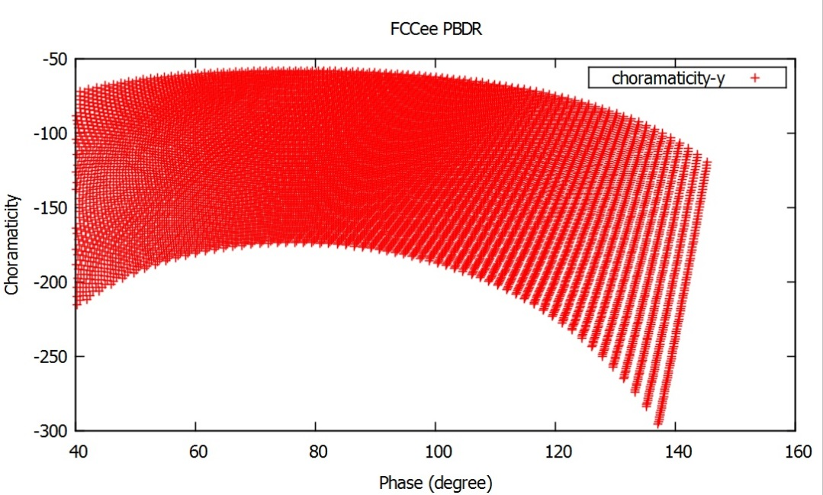
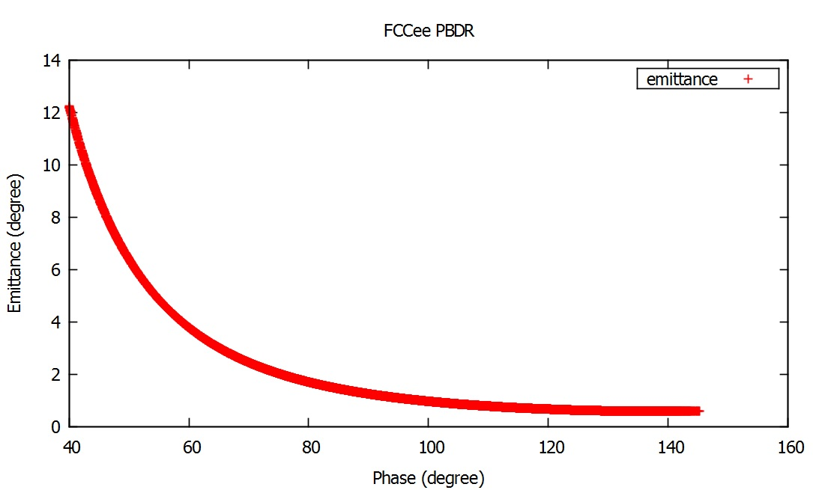
Analytic Approach
Analytical calculation to see all possible
values of the chromaticity and emittances
8th FCCee Injector Meeting, CERN, March 2017

Slide 14
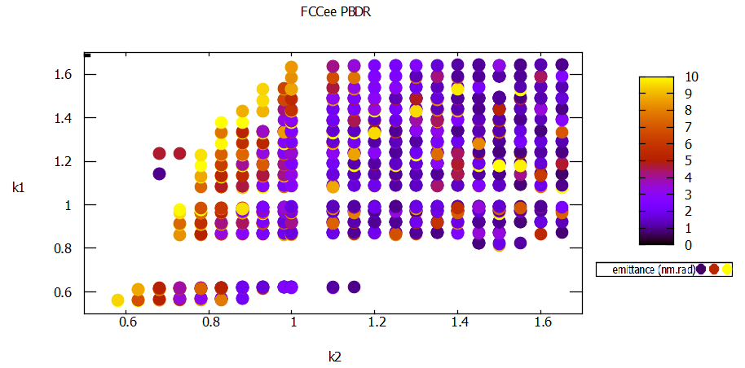
MADX simulations for emittance and chromaticity
- This plot shows how emittance changes with k value (drift length also changes)
8th FCCee Injector Meeting, CERN, March 2017

Slide 15
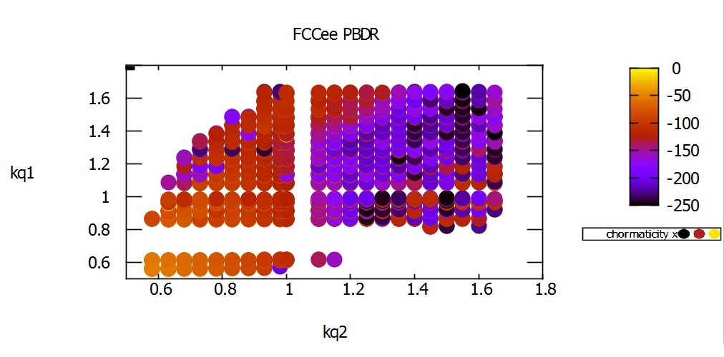
MADX Results for emittance and chromaticity
- This plot shows how chromaticity changes with k value (drift length also changes)
8th FCCee Injector Meeting, CERN, March 2017

Slide 16
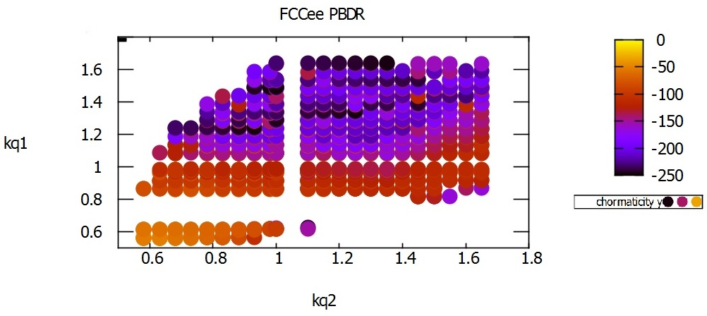
MADX Results for emittance and chromaticity
- This plot shows how chromaticity changes with k value (drift length also changes)
8th FCCee Injector Meeting, CERN, March 2017

Slide 17
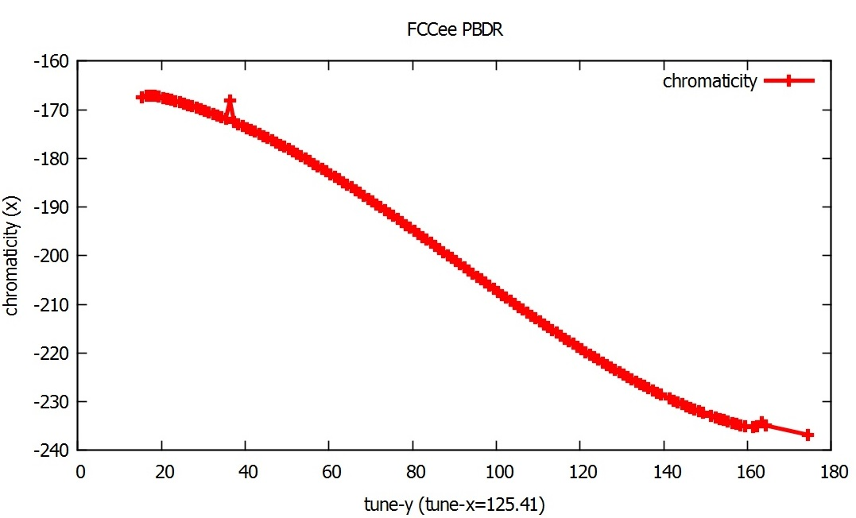
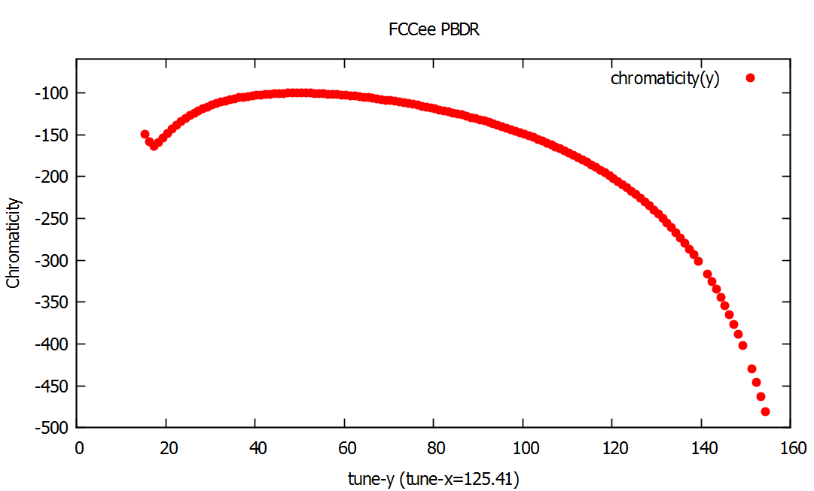
Tune optimization
This plot shows how chromaticity changes with tune (y), we keep the tune-x as a constant
here to provide same emittance.
All these results are checked; and below parameters are determined
k1= -0.931
K2= 1.55
Ld= 0.5 m
8th FCCee Injector Meeting, CERN, March 2017

Slide 18
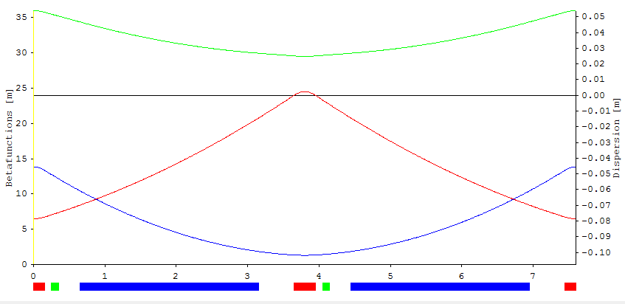
Main Cell of the Booster
0.15m
0.15m
0.5 m
0.5 m
0.5 m
0.5 m
2.5 m
2.5 m
0.3 m
- These are the main fodo cell and betatron functions.
- The whole ring, which is 2736 m, comprises from 2 times repeat of super-period that includes 166 main cells and 2 matching sections.
8th FCCee Injector Meeting, CERN, March 2017

Slide 19
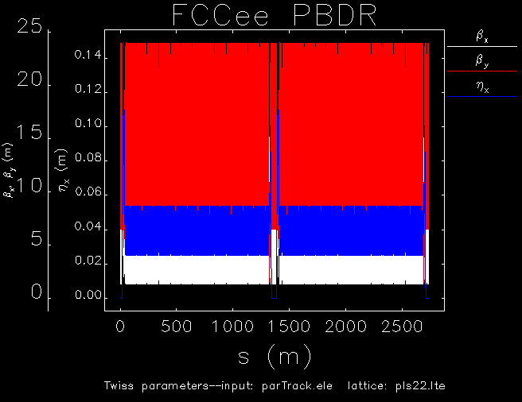
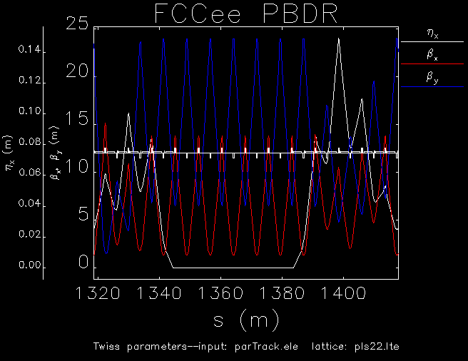
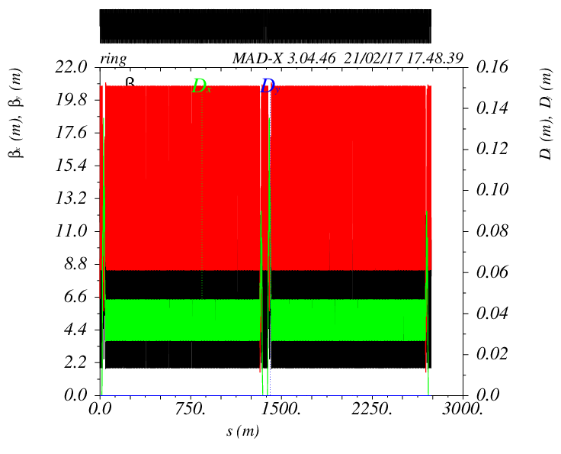
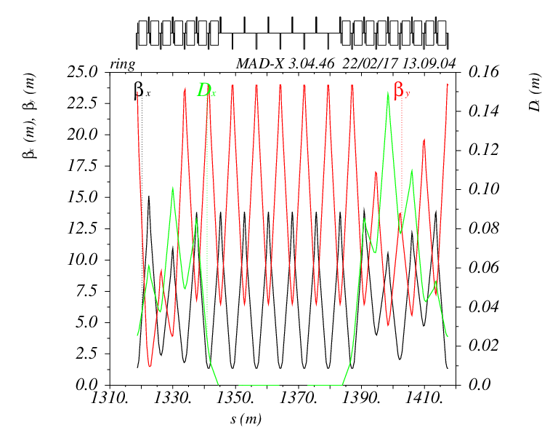
Comparing with other codes
Elegant
MAD X
8th FCCee Injector Meeting, CERN, March 2017

Slide 20
Main Parameters
by OPA, MADX and Elegant
 | OPA | MADX | ELEGANT
Energy | 20 GeV | 20 GeV | 20 GeV
Perimeter | 2736 m | 2736 m | 2736 m
Emittance ɛ_{x} (nm.rad) | 0.741 | 0.743 | 0.741
Energy Spread (10⁻³) | 1.027 | 1.026 | 1.026
Energy Loss per turn | 50813.9 keV | 50818.627 keV | 50818.755 keV
Natural Chromaticity ξ_{x}/ξ_{y} | -169/-106 | -169/-106 | -169/-106
Dx max (m) | 0.14 | 0.14 | 0.14
Betax max (m) | 13.85 | 15.12 | 15.12
Betay max (m) | 23.98 | 24.03 | 24.04
Cell Type | FODO | FODO | FODO
Magnets | Quantity | Length | Strength | Magnetic field | Bending angle | Bending radius | Sagitta
Bending magnet | 700 | 2.5 m | - | 0.07 T/0.239 T | 0.514 degree | 278.9 m | 0.0044 m
Kuadrupol magnets-1 | 353 | 0.3 m | -0.931 m⁻² | 0.049 T / 0.198 T | - | - | -
Kuadrupol magnets-2 | 353 | 0.3 m | 1.55 m⁻² | 0.082 T / 0.330 T | - | - | -
8th FCCee Injector Meeting, CERN, March 2017

Slide 21
Extraction Emittance of PBDR
What the extraction emittance of beam at PBDR which is injection emittance at Main Booster should be?
8th FCCee Injector Meeting, CERN, March 2017

Slide 22
Extraction Emittance of PBDR
What the extraction emittance of beam at PBDR which is injection emittance at Main Booster should be?
Why is it important for PBDR?
8th FCCee Injector Meeting, CERN, March 2017

Slide 23
Extraction Emittance of PBDR
What the extraction emittance of beam at PBDR which is injection emittance at Main Booster should be?
Why is it important for PBDR?
Because it changes many things;
It changes the lattice,
It changes the circumference,
It changes the chromaticity,
It changes the dynamic aperture
etc.
8th FCCee Injector Meeting, CERN, March 2017

Slide 24
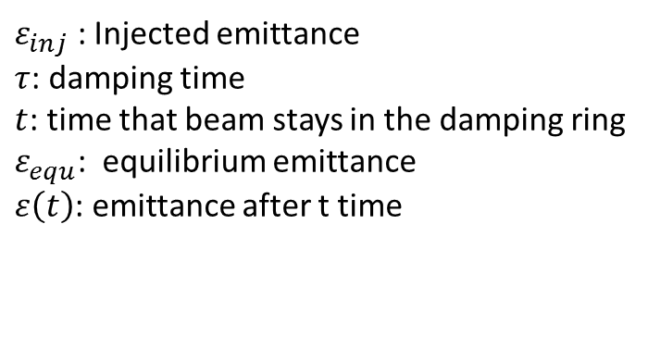
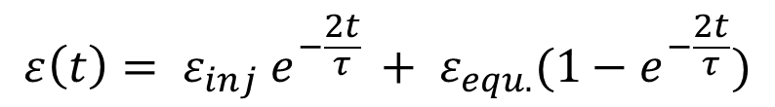
How emittance changes
in a damping ring?
$$ε\left(t\right)= ε_{inj} e^{−\frac{2t}{τ} }+ ε_{equ.}(1−e^{−\frac{2t}{τ}})$$
$ε_{inj}$ : Injected emittance
$τ$: damping time
$t$: time that beam stays in the damping ring
$ε_{equ}$: equilibrium emittance
$ε\left(t\right)$: emittance after t time
8th FCCee Injector Meeting, CERN, March 2017

Slide 25
How emittance changes
in a damping ring?
$$ε\left(t\right)= ε_{inj} e^{−\frac{2t}{τ} }+ ε_{equ.}(1−e^{−\frac{2t}{τ}})$$
$ε_{inj}$ : Injected emittance
$τ$: damping time
$t$: time that beam stays in the damping ring
$ε_{equ}$: equilibrium emittance
$ε\left(t\right)$: emittance after t time
Hovewer, as it is the formula can be used directly in case the energy is not changing in time.
When the energy changes like in our PBDR and Main Booster, the damping time and energy,
so emittance depends on the time and makes everything complicated a little.
8th FCCee Injector Meeting, CERN, March 2017

Slide 26

How emittance changes
in a booster ring?
After some differential and integral transition & calculations it becomes;
$$ε_{inj}=\frac{ε(t)}{e^{\frac{−2t}{τ_{0}}} e^{\frac{−2}{c}\{\left(\frac{−1}{2ν.{\left(E_{inj}+ν.t\right)}^{2}}\right)−\left[3ν.\left(\frac{E_{inj+3.ν.t}}{6.ν^{2}{\left(E_{inj}+ν.t\right)}^{3}}\right)\right]\}}}$$
$τ_{0}=c. E^{3}$ ; damping time
$E_{inj}$= 20 GeV
$$ε\left(t\right)=0.09 nm.rad$$
$ν$: ramp rate
$c= \frac{c_{s}. c_{γ}}{{FF}^{2}.C^{2}}$; constant
8th FCCee Injector Meeting, CERN, March 2017

Slide 27
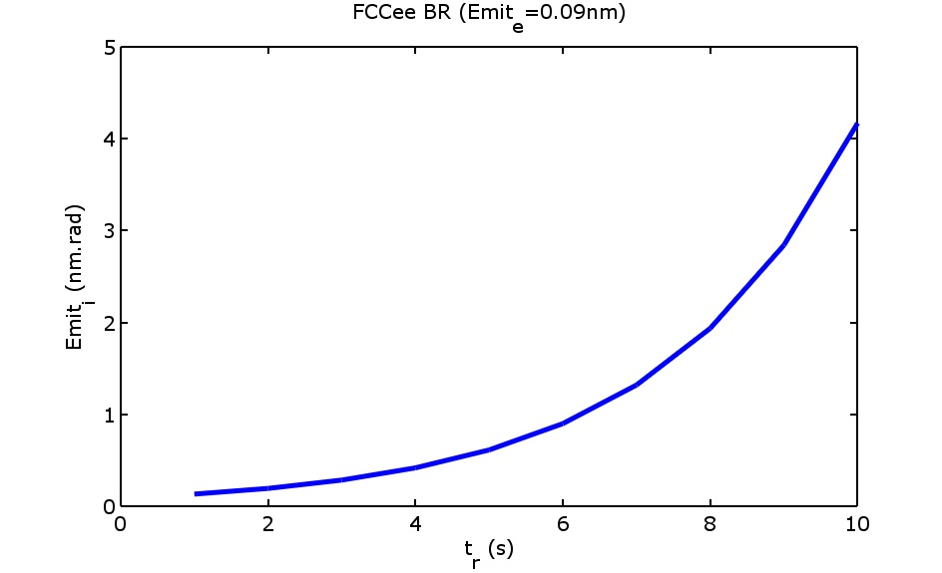
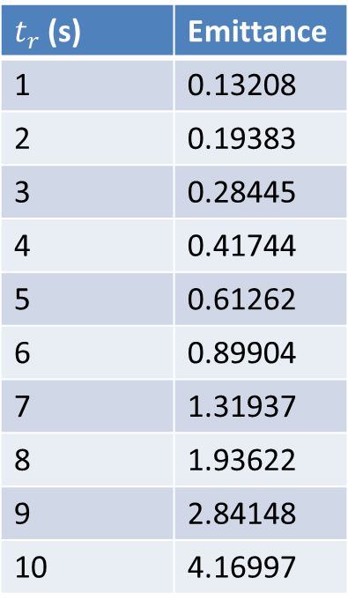
Injection Emittance of Main Booster
$t_{r}$ (s) | Emittance
1 | 0.13208
2 | 0.19383
3 | 0.28445
4 | 0.41744
5 | 0.61262
6 | 0.89904
7 | 1.31937
8 | 1.93622
9 | 2.84148
10 | 4.16997
P.S Cycle time at main booster specified as 12s in IPAC proceeding published in 2016
with the name of ‘Design guidelines for the injector complex of the FCCee’.
8th FCCee Injector Meeting, CERN, March 2017

Slide 28
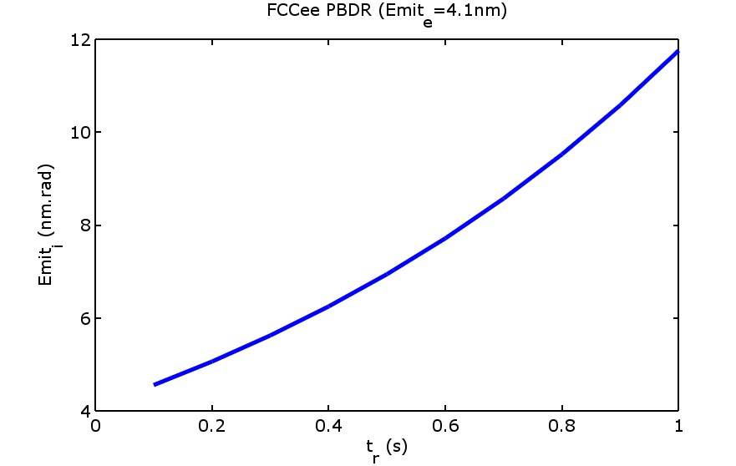
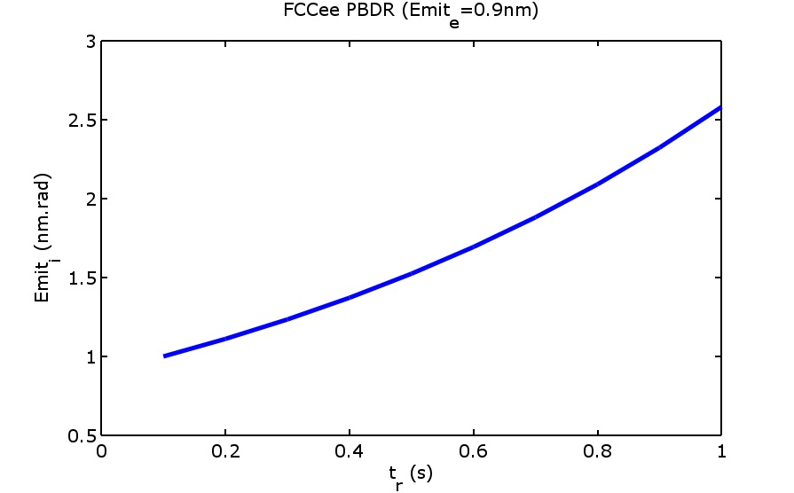
Injection Emittance of PBDR
Two options are calculated here,
4.1 nm.rad extraction emittance of PBDR which corresponds to 10s ramp time in BR,
0.9 nm.rad extraction emittance of pre-booster which means 6s ramp time in BR.
P.S Cycle time at main booster specified as 12s in IPAC proceeding published in 2016
with the name of ‘Design guidelines for the injector complex of the FCCee’.
8th FCCee Injector Meeting, CERN, March 2017

Slide 29
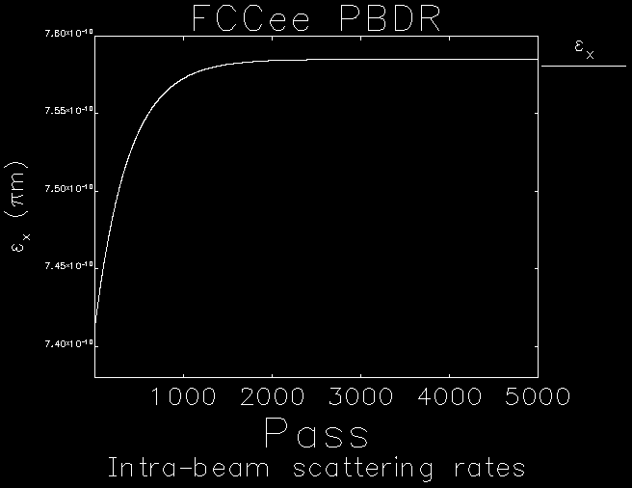
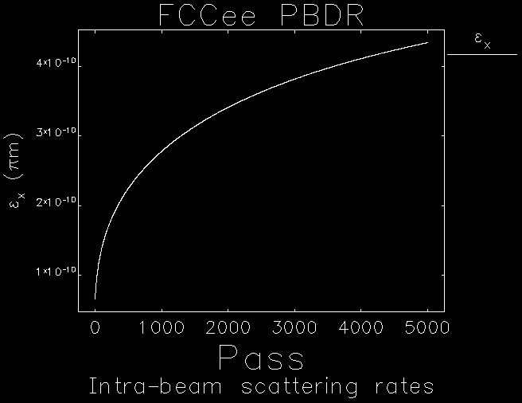
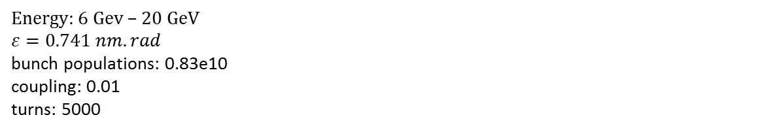
IBS effect: Emittance growth
IBS can be defined as the multiple small-angle coulomb scattering in the beam. This cause emittance growth in all three dimensions. It basically depends on optics and beam properties. Here are some preliminary calculations for IBS effect.
Energy: 6 Gev – 20 GeV
$$ε=0.741 nm.rad$$
bunch populations: 0.83e10
coupling: 0.01
turns: 5000
8th FCCee Injector Meeting, CERN, March 2017

Slide 30
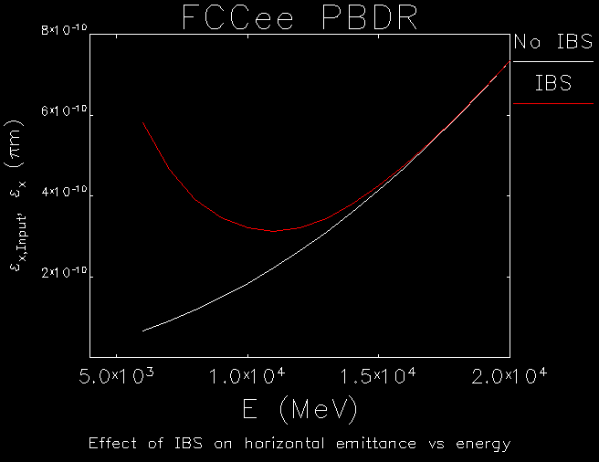
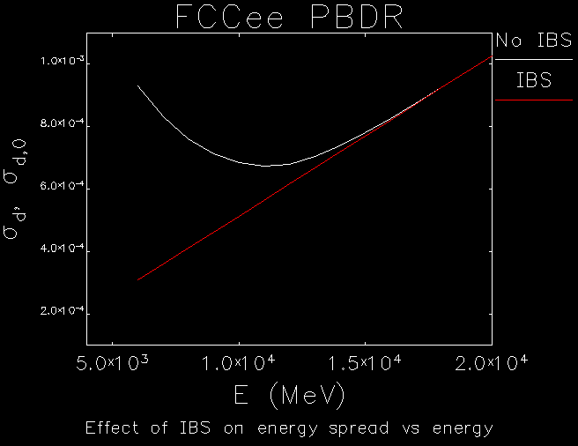
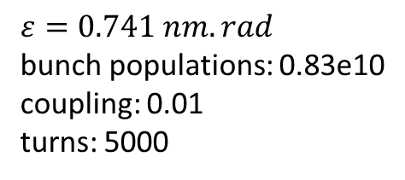
IBS vs Energy
$$ε=0.741 nm.rad$$
bunch populations: 0.83e10
coupling: 0.01
turns: 5000
8th FCCee Injector Meeting, CERN, March 2017

Slide 31
Future studies
Deciding the extraction emittance,
Revising the design according to new emittance,
Correcting the chromaticity and checking the dynamic aperture,
Implementing magnet errors, off momentum, alignment errors
Collective effects
8th FCCee Injector Meeting, CERN, March 2017

Slide 32
Thank you
for this opportunity!
8th FCCee Injector Meeting, CERN, March 2017

