Slide 1
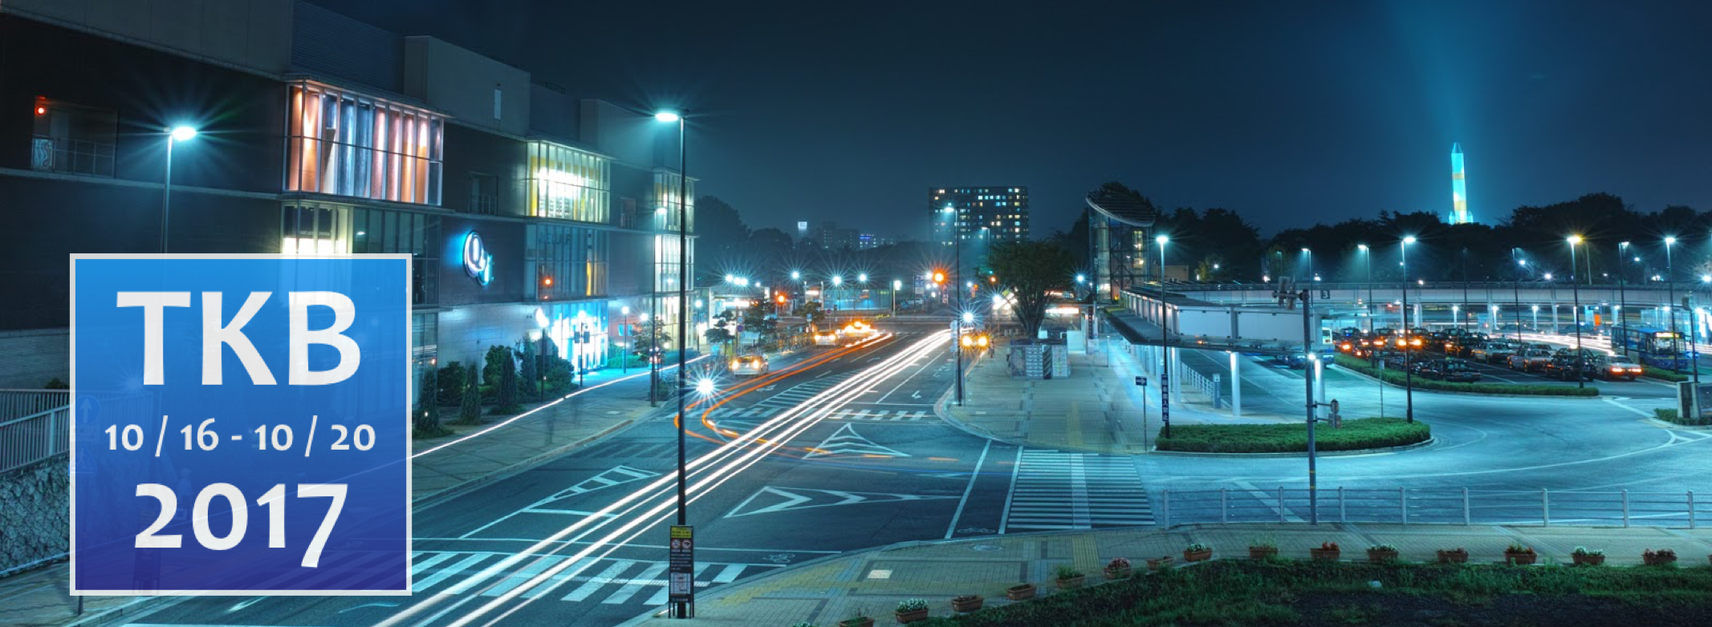

Logistics Information
Local organizers of HEPiX fall 2017 and HUF2017
Computing Research Center
HIGH ENERGY ACCELERATOR RESEARCH ORGANIZATION, KEK

Slide 2
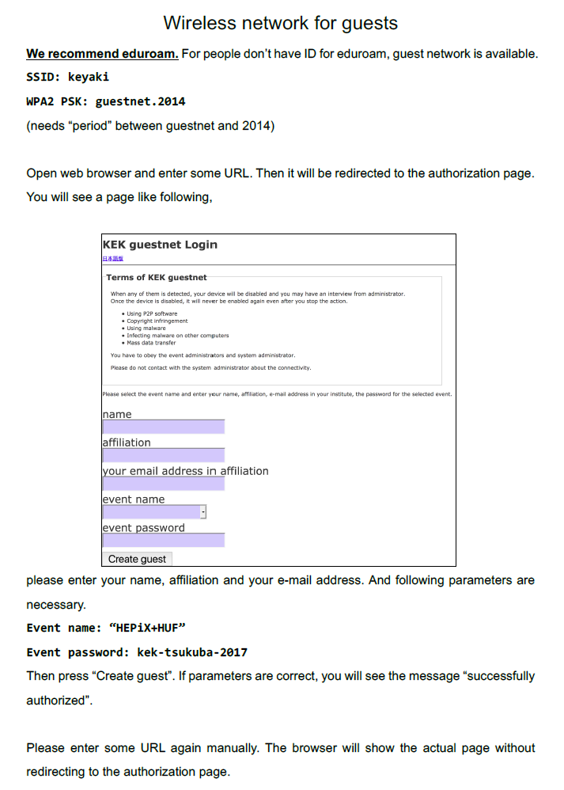
Wi-Fi connection
Both eduroam and special wireless network for guest (called Guest Net) are available. The Guest Net requires an easy procedure registering your information, and need to accept AUP to connect. If you have some problems on the eduroam, please switch to the Guest Net and try it again.
Any other questions, please consult with the conference reception desk located in front of the Kobayashi Hall.

Slide 3
Conference rooms
Three conference rooms:
HEPiX sessions are held at Kobayashi hall entire week.
LHCONE-LHCOPN sessions (not HEPiX networking sessions) are held at the seminar hall located in Bldg. M02 (1F) only for Monday and Tuesday.
HUF sessions are held at the seminar hall in Bldg. K03 (1F) after this joint session.

Slide 4
Video streaming for HEPiX
Appearance of the HEPiX conference at Kobayashi hall is broadcasted including this session. You can access via the following URL. But please do not access unnecessarily from the Kobayashi hall not to put the pressure for the Wi-Fi bandwidth.
 |  | YouTube Live | IBM Cloud Video
Mon | 9:00-12:30 | https://youtu.be/xnviMGGj0as | http://ustre.am/1AhJR
 | 14:00-17:30 | https://youtu.be/kN9ICdxg8yo | http://ustre.am/1AhJR
Tue | 9:00-12:30 | https://youtu.be/RdMq2QT0V2M | http://ustre.am/1AhJR
 | 14:00-17:30 | https://youtu.be/1OkxLNHoPQY | http://ustre.am/1AhJR
Wed | 9:00-12:30 | https://youtu.be/7sh9N9MIIUA | http://ustre.am/1AhJR
 | 14:00-17:30 | https://youtu.be/ywwFuAZs2XU | http://ustre.am/1AhJR
Thu | 9:00-12:30 | https://youtu.be/mHv0dl-o9ms | http://ustre.am/1AhJR
 | 14:00-17:30 | https://youtu.be/JBX2mSSzQsU | http://ustre.am/1AhJR
Fri | 9:00-12:30 | https://youtu.be/AGc4pNoyw0A | http://ustre.am/1AhJR

Slide 5
Conference venue
Restroom:
The capacity of the closest restroom from Kobayashi hall is quite limited. So, please use the restroom in the other building, in case there is a long queue.
Smoking:
Smoking is prohibited in the campus even in the outside except for the designated smoking area.

Slide 6
Coffee/Tea/Water and Lunch
Coffee and Lunch boxes will be served at the counter in front of the Kobayashi hall (Foyer). Please do not take the lunch box for vegetarian, if you did not request at the registration.
If you cannot take a seat at Foyer, the other room is available in the Bldg. K03 (near by HUF conference room). Do not eat any food inside the Kobayashi hall.
Please, bring back the lunch box to the counter where you got it after the lunch. Do not dispose in a rubbish bins.

Slide 7
Conference busses (departure time)
You can take the return bus on Friday first come first served basis. The first bus will leave just after the end of the session. In case you could not get it, please take the next one after the lunch, otherwise please take the public bus.
Date | From Hotels | From KEK | From Banquet Hall (Sansuitei)
Oct. 16 (Mon) | 8:00 (to KEK) | 18:00 (to Reception) Okura Frontier Hotel Tsukuba Main Bldg.
Oct. 17 (Tue) | 8:00 (to KEK) | 18:00 (to Hotels) 19:30 (to Hotels, HEPiX Board Member)
Oct. 18 (Wed) | 8:00 (to KEK) | 18:00 (to HEPiX Banquet) | 22:30 (to Hotels)
Oct. 19 (Thu) | 8:00 (to KEK) | 18:00 (to Hotels) 18:00 (to HUF Banquet) | 22:30 (to Hotels)
Oct. 20 (Fri) | 8:00 (to KEK) | 12:10 (to Hotels, Before Lunch, Max 45 people) 13:30 (to Hotels, After Lunch, Max 45 people) 15:00 (to Hotels, After KEK Facility Tour)

Slide 8
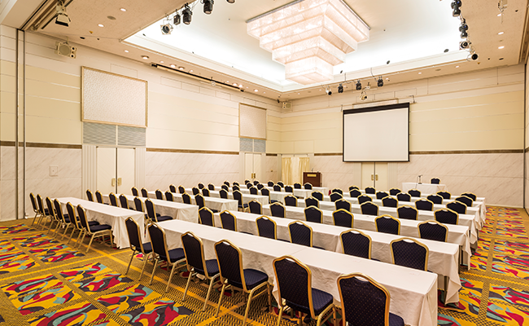
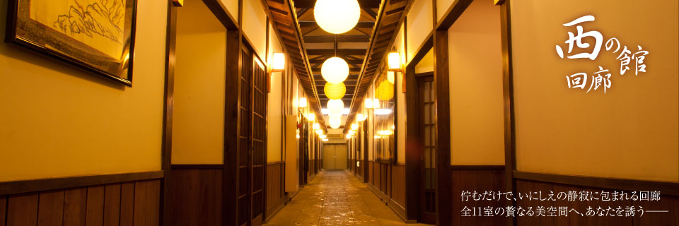
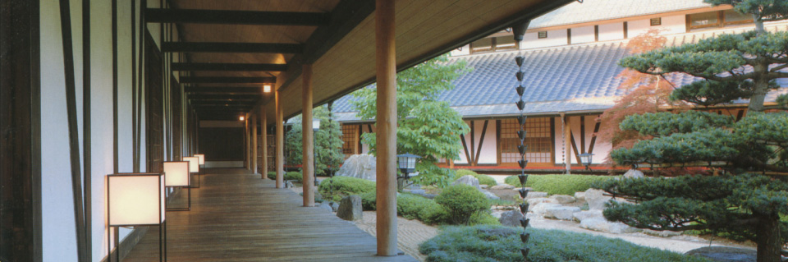
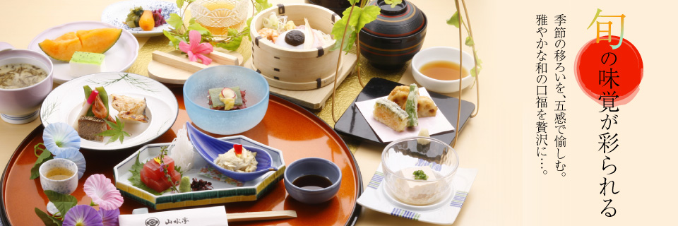
Reception and Banquet
Reception is Today (19:00) at Okura Frontier Hotel (Main. Bldg.)
HEPiX banquet is on Wednesday (19:00) at Sansuitei.
HUF banquet is Thursday (19:00) at Sansuitei.
Please do not take any food before the Kanpai (乾杯) ceremony. It is impolite action according to the Japanese traditional custom.

Slide 9
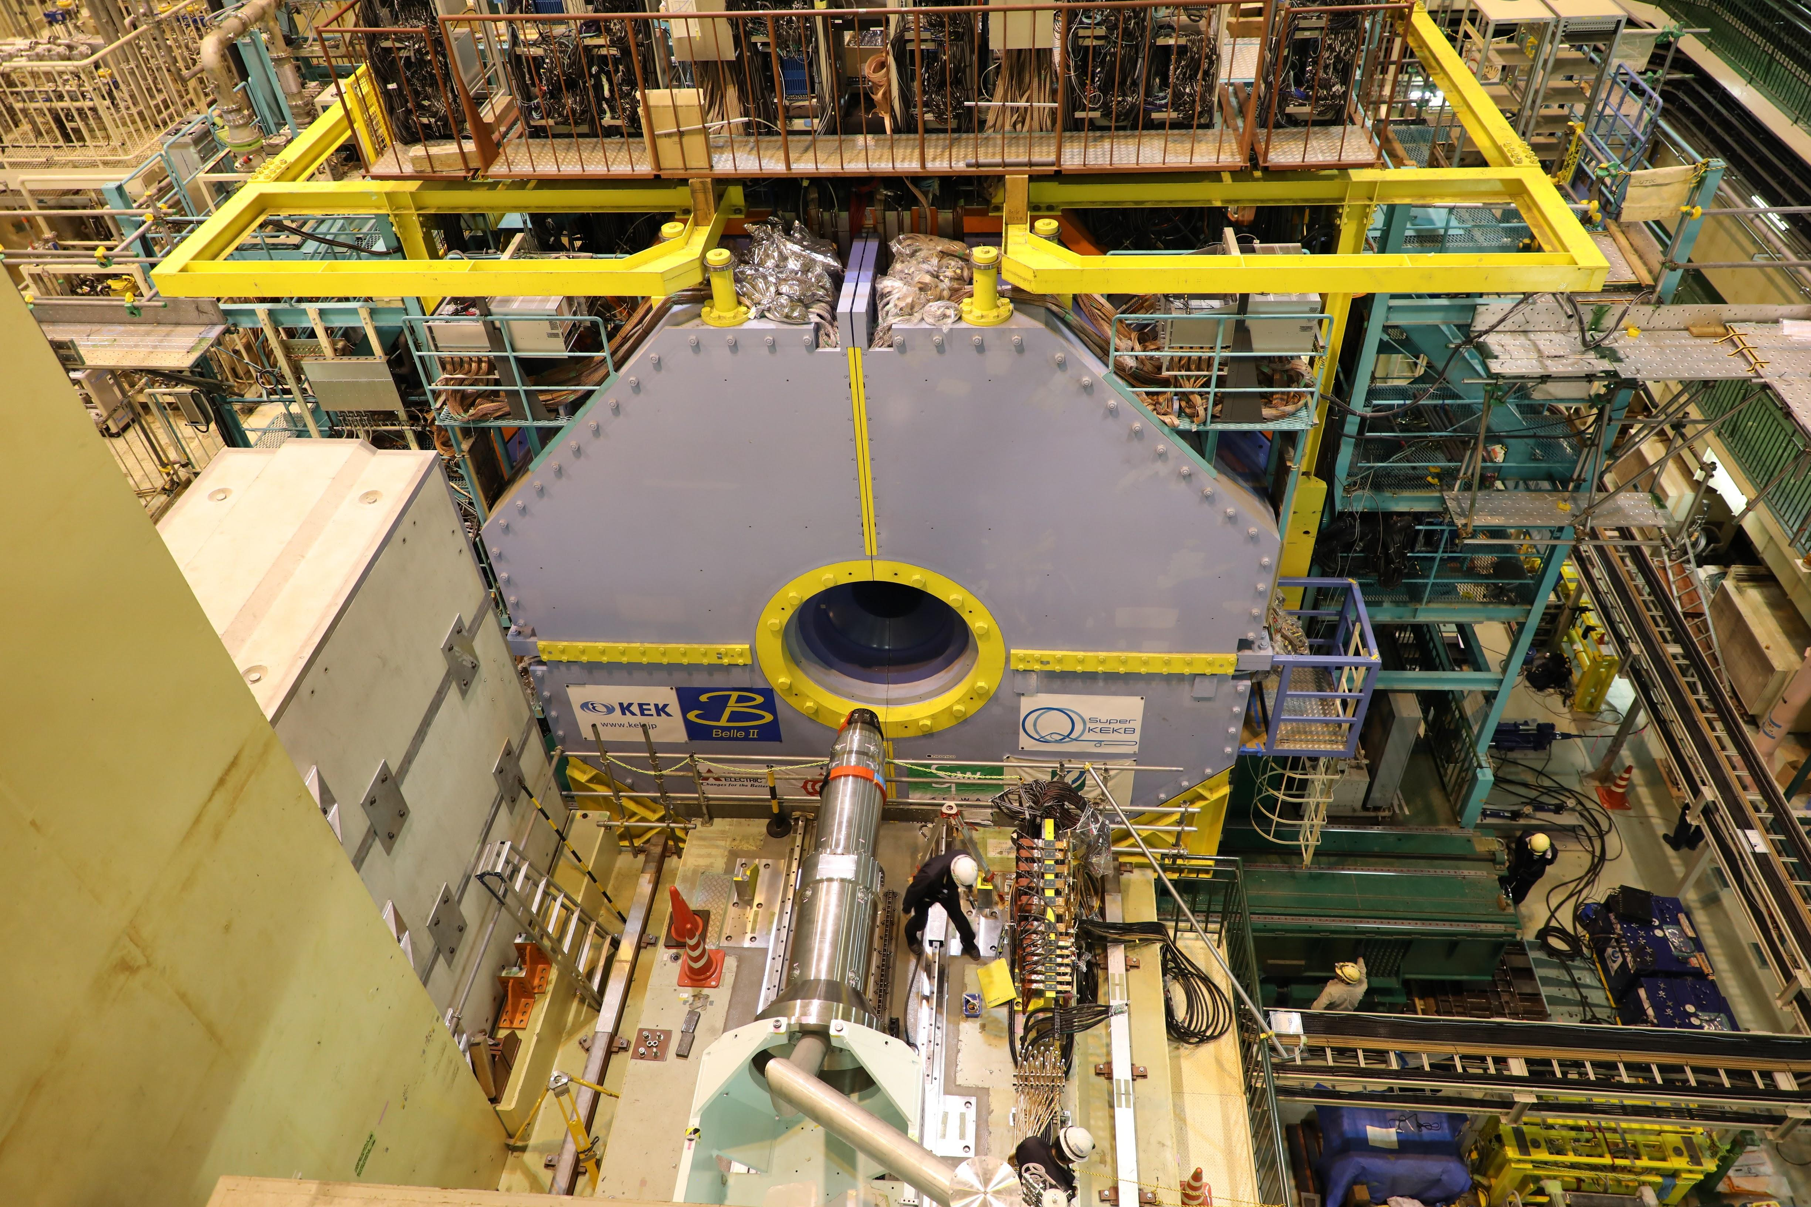
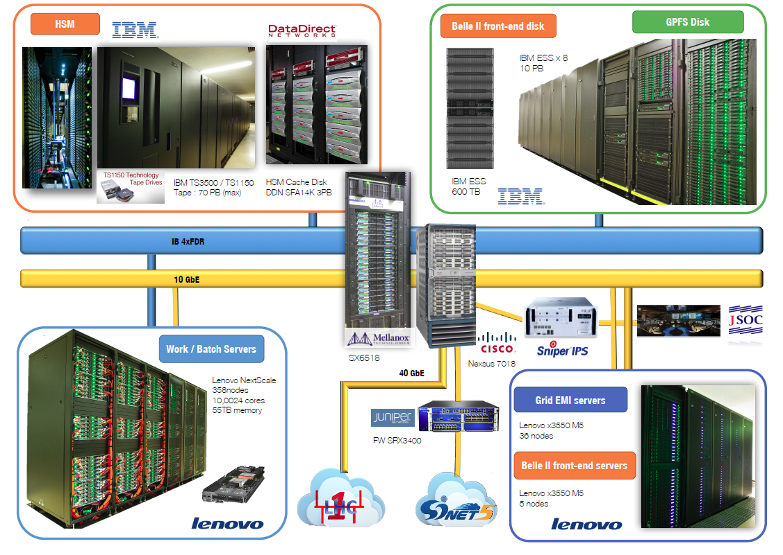
KEK facility tour on Friday
Start at 12:50
Group A: Belle II (SuperKEKB) → KEKCC, Max. 65 people
Group B: KEKCC → Belle II (SuperKEKB), Max. 45 people
So many people registered. We have to divide into two groups. It will be organized after the lunch on Friday.

Slide 10



AOB
There is a printer at the corner of lunch venue (Foyer). You can use it by yourself, for example, printing boarding pass or something.
If you go to Narita airport from Tsukuba center bus terminal for your return trip, you need to reserve the airport bus in advance. You can buy the ticket at the KEK kiosk located at the nearside of cafeteria.
Please refer to the conference web page and travel guide at first.
http://hepix-fall-2017.kek.jp/files/Travel-Information.pdf
Any other problems, please consult with the reception desk.

