Slide 1

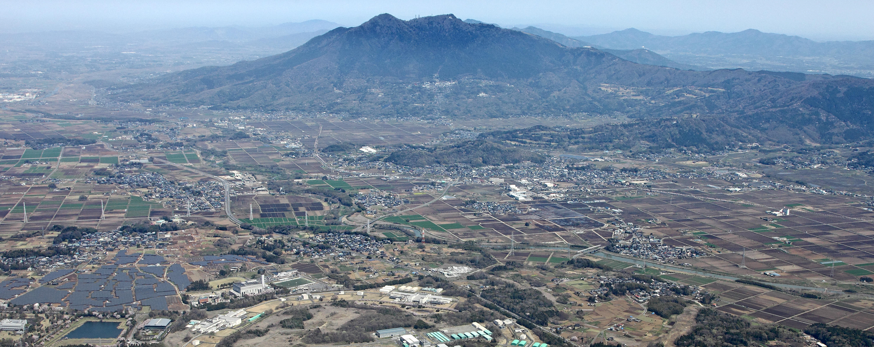

KEK Site Report
Atsushi Manabe and Takashi Sasaki
on behalf of KEK CRC
Computing Research Center
Applied Research Lab.
HIGH ENERGY ACCELERATOR RESEARCH ORGANIZATION, KEK

Slide 2
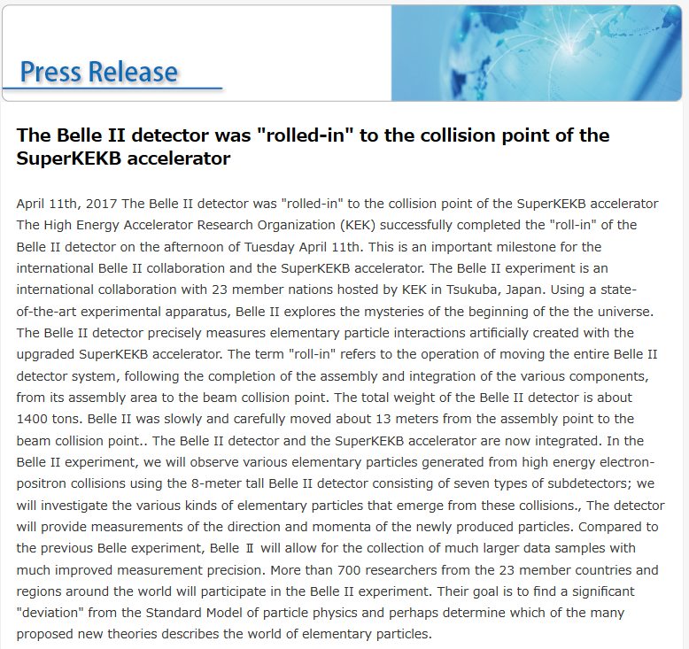
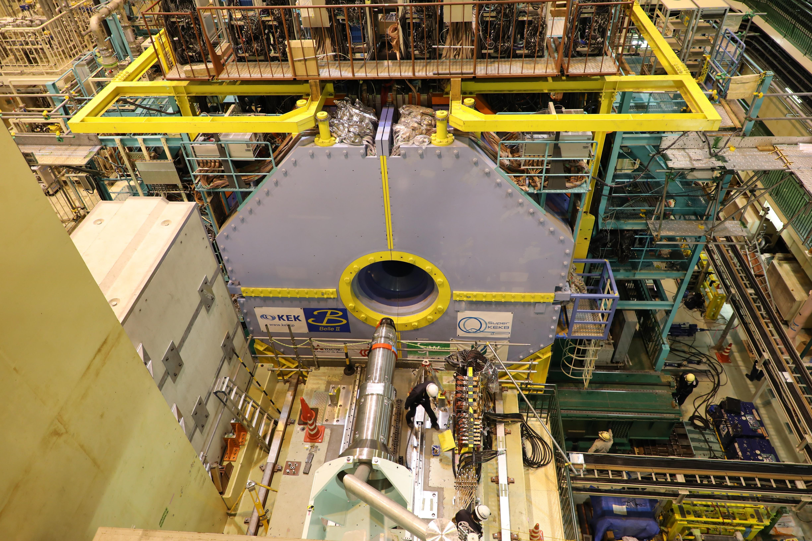
Recent topics from KEK
Mar. 2016: Test operation of SuperKEKB
Successful storage of e⁺e⁻ beam
Apr. 2017: Belle II detector was rolled-in.
Jan. 2018： Phase II (w/o VXD) will start.
Apr. 11, 2017
http://www.kek.jp/en/NewsRoom/Release/20170411171500/

Slide 3
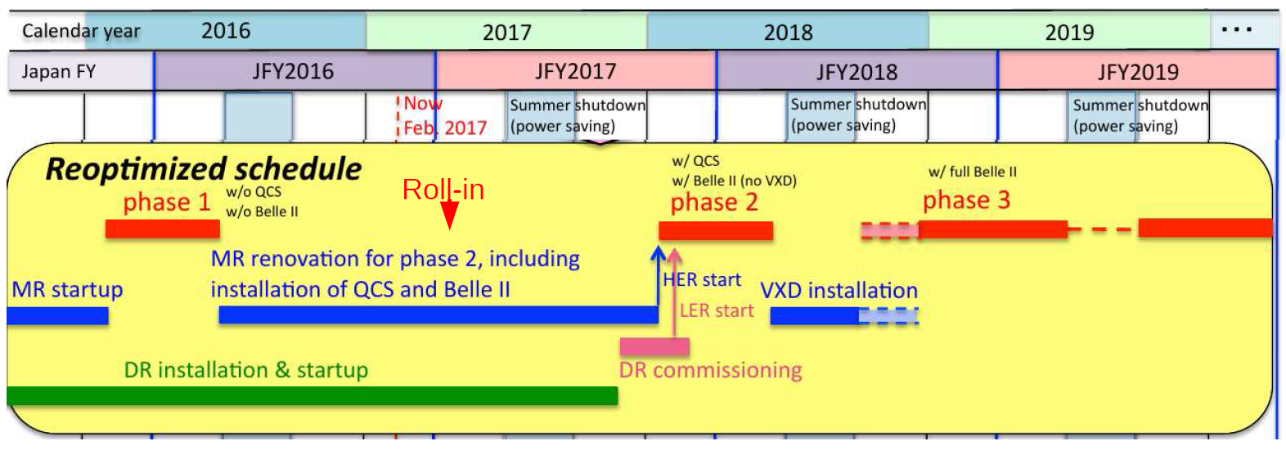
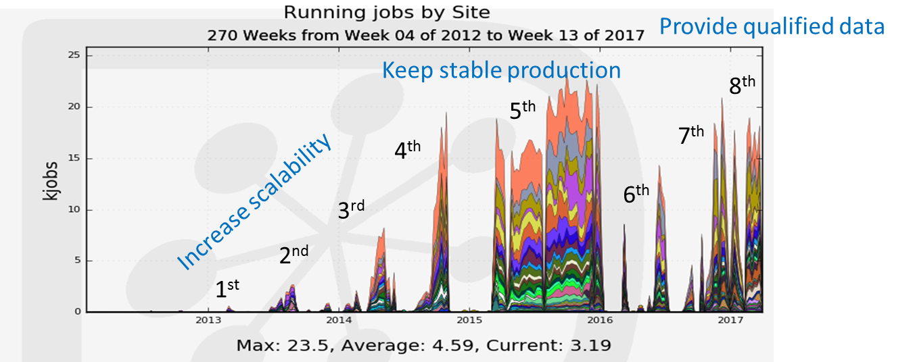
Belle II schedule and distributed computing
K. Akai (B2GM)
R. Ito (JPS meeting)
H. Miyake

Slide 4
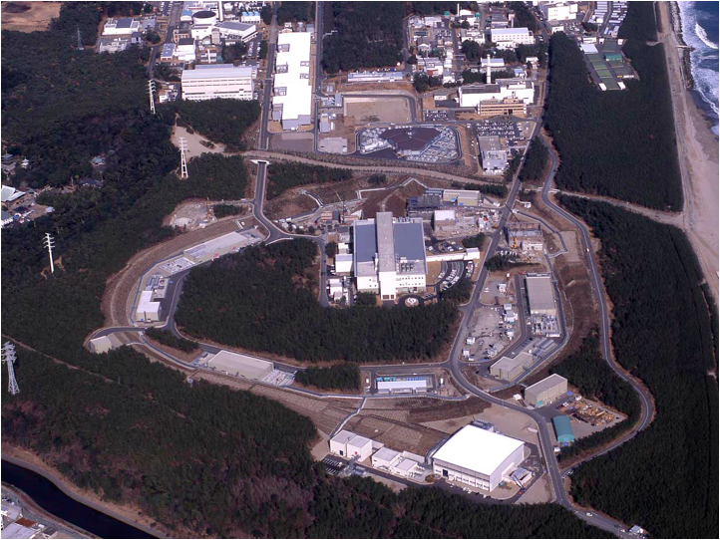



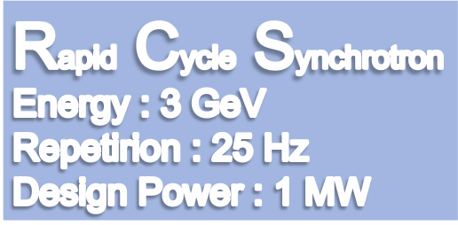





Neutrino Beam to Kamioka
Material and Life Science Facility
Hadron Hall
2

Slide 5
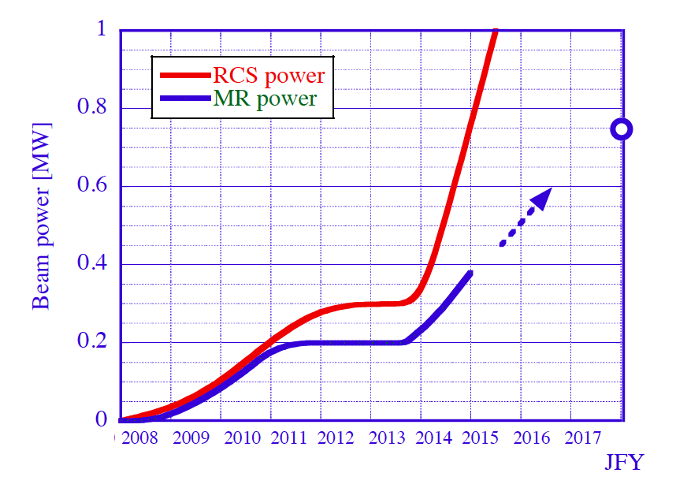
Beam Power
RCS ::1 MW achieved in Jan, 2015
MR ::so far 0.36 MW for FX ; ０.89 MW reachable with new PS
LINAC Upgrade
Renew MR PS
750 kW
MLF one shot
MLF achieved
（user operation）
FX achieved
（user operation）

Slide 6
Networking

Slide 7
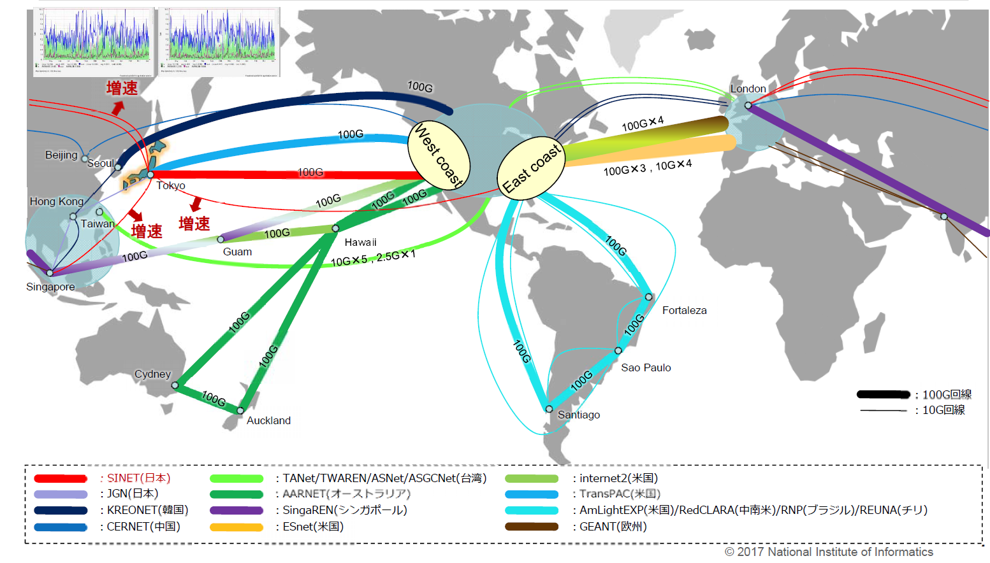

SINET International Connections
SINET5 : Science Information NETwork of Japan ( SINET5 started Apr.2016 with 100G BB)
KEK and major Univ.s are connected to SINET5 with 100G line.

Slide 8
LHCONE extension
Tue 14:00 by S.Suzuki
SINET is providing a LHCONE instance via links to US and EU
  JP-EU link boosted the throughput between KEK and WLCG sites in EU
JGN begins to provide another LHCONE instance at Hong-Kong
  ASGC and KISTI are reachable from KEK via LHCONE

Slide 9
Belle2 Data distribution
Since last summer, we connected KEKCC and High Level Trigger farm of the Belle II DAQ system and tested the performance
KEKCC is ready to import data processed by HLT
KEKCC has additional Grid FTP server for MC data

Slide 10
computing

Slide 11
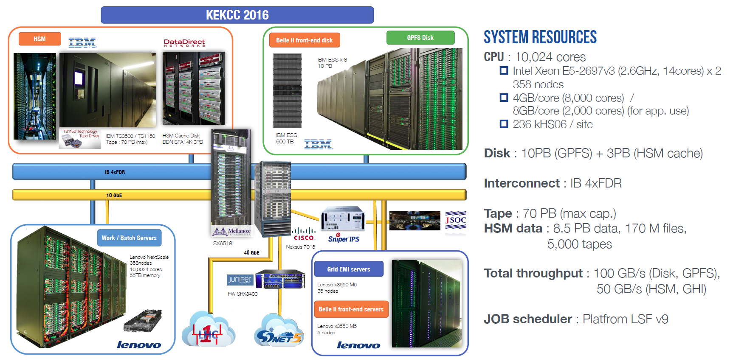
New KEK Central Computer System (KEKCC)
System has already been in production mode since the last September.
K. Murakami (CHEP2016)

Slide 12
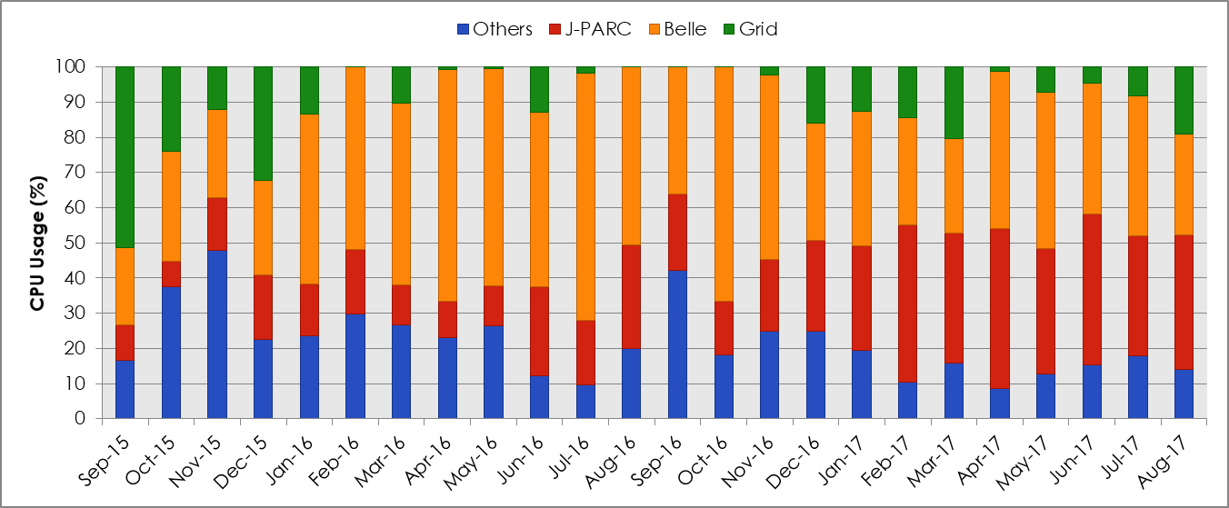
Status of new KEKCC
Compute node
CPU: Intel Xeon E5-2697v3 (2.6GHz, 14cores) x 2
358 nodes, 10,024 cores, 236kHS06/site
Memory: 4GB/core (8,000 cores)
8GB/core (2,000 cores)
Storage
Disk: 10PB (GPFS, IBM ESS x8 racks)
3PB (HSM cache)
Interconnect: InfiniBand 4xFDR (56 Gbps)
Tape: 70 PB (max cap.)
Throughput
100 GB/s (Disk, GPFS), 50 GB/s (HSM, GHI)
CPU usage: breakdown by groups,
normalized by the total CPU usage per month
CPU usage has been reached 80 - 90 % of total resource
Local usage
Almost Belle II
System renewal
Sep. 2016

Slide 13
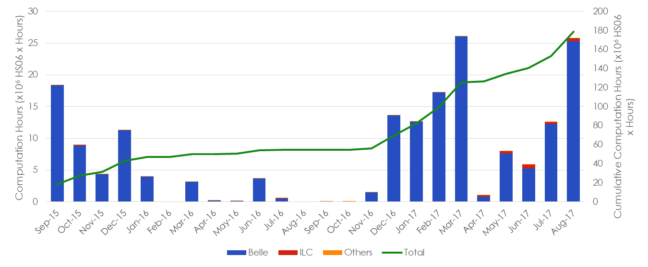

CPU Consumption by Grid jobs
New KEKCC (2016 - )
~168M HS06 hour /month
(23.5 HS06/core)
18% of the total CPU
System renewal
Sep. 2016
KEKCC (2012 - 2016)
~40M HS06 hours/month
(14.7 HS06/core)
50% of the total CPU

Slide 14
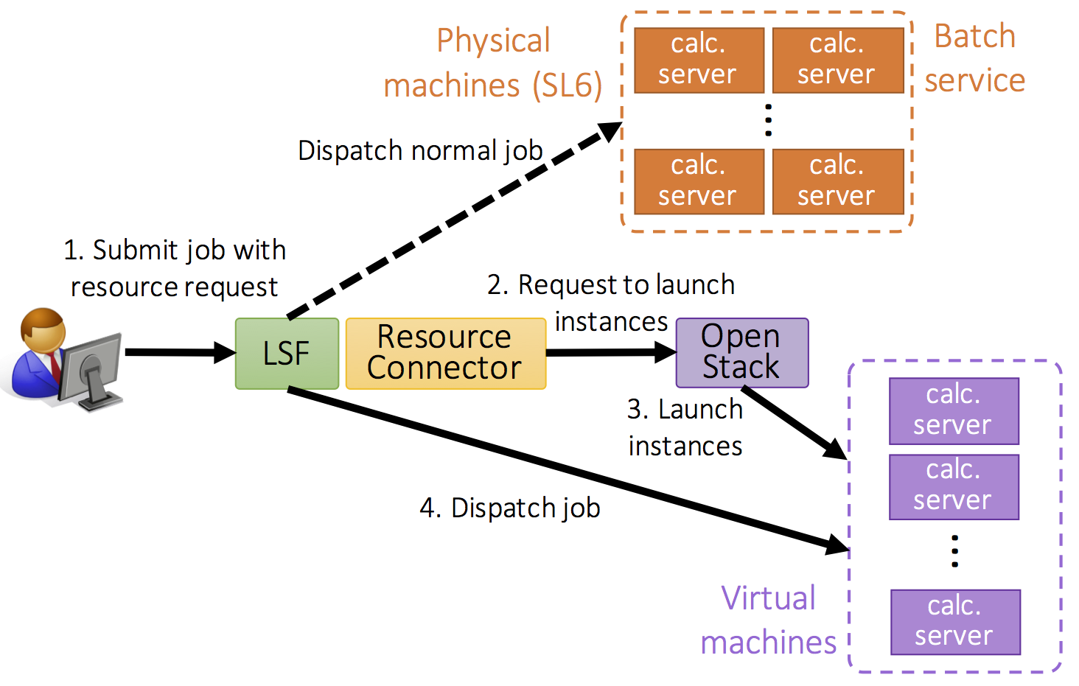
Cloud Deployment at KEK
Thu 11:25 by W.Takase
Integration with batch, GPFS, and LDAP for various kinds of data analyses and elastic resource allocation among the diverse projects at KEK.
Create requested data analysis environment on demand

Slide 15
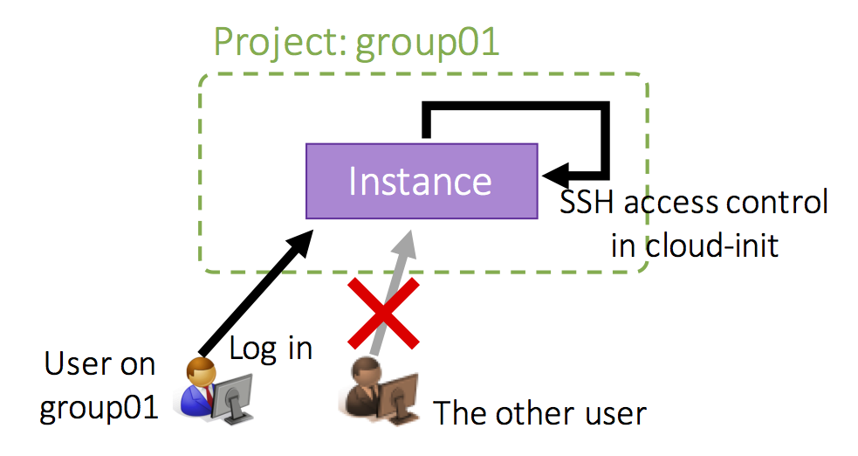
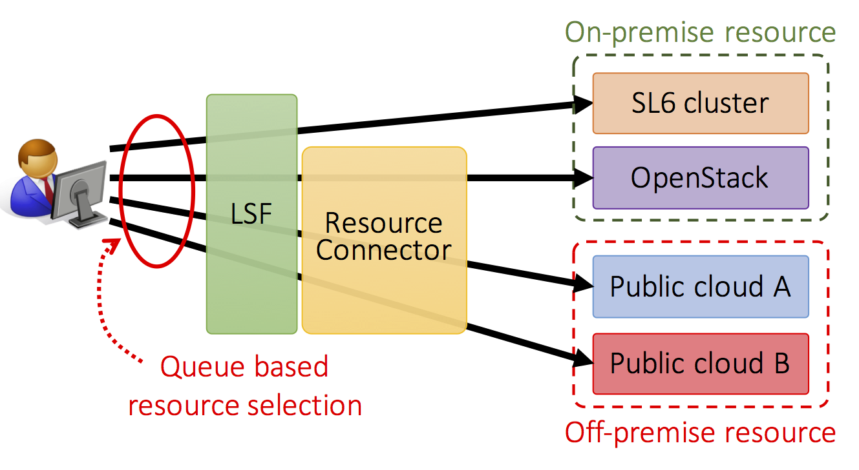
Cloud Deployment at KEK
Group based management
  Access control of instances
  Hardware resource allocation
Plan for public clouds integration

Slide 16
Belle2 Data distribution
Tue 14:00 by S.Suzuki
Since last summer, we connected KEKCC and High Level Trigger farm of the Belle II DAQ system and tested the performance
KEKCC is ready to import data processed by High Level Trigger
KEKCC has additional Grid FTP server for MC data

Slide 17
Information Security

Slide 18
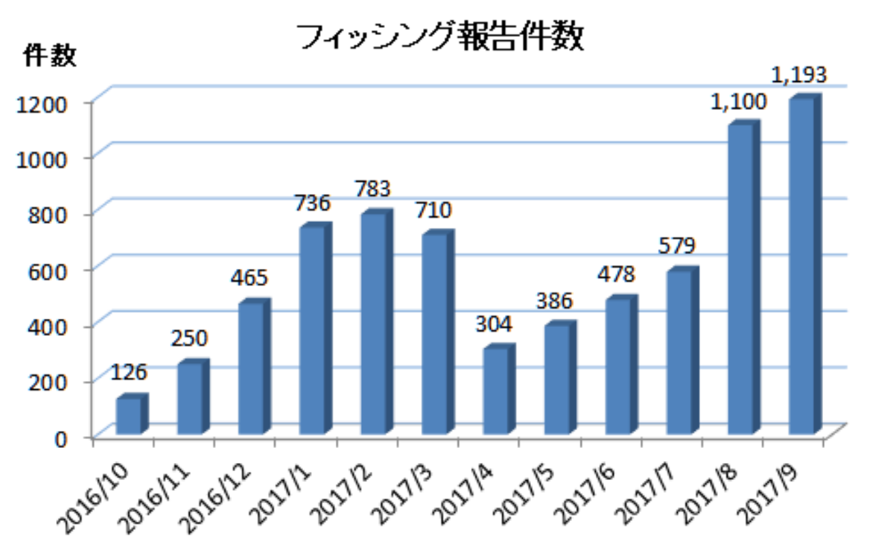
Growing targeted-mail attack in Japan
Thu 9:50 by F. Yuasa
Academia is a target
  Jan 2017: Notice mail about carried over grant funding from JSPS with malicious zip file
KEK users are targeted
  Password reset scam from KEK Webmail administrator
    Notification about mailbox
  Suspicious mails from famous company as Apple, Amazon, NTT-X (Japanese online shop), credit-card company, ...
Number of reports on phishing mails
to Council of Anti-Phishing Japan
https://www.antiphishing.jp/report/monthly/201709.html
It is difficult to protect against such attacks by a mail security appliance and endpoint anti-virus software.

Slide 19
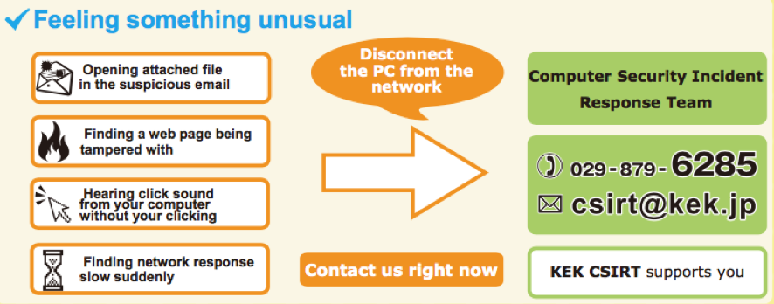
Protection
Number of manual blockings since 2017 April
FW blocking of malicious URLs and IP addresses by CSIRT
  information from JPCERT/CC, IPA, Police, NII-SOCS, MEXT and so on.
Awareness of mail attacks
  a Web notification system in an administrative division has been working. About 1 notification per 2 days.
  A notification mail from network administrator to each mail receiver in J-PARC (Tokai campus only).
Consultation to CSIRT and education through regular security course (offline) by CSIRT member
WannaCry
effect
2017
Extract from security leaflet “KEK computer
security 11 Best Practices” issued in 2017 for
foreign researcher

Slide 20
Brief Summary
Networking:
JAPAN SINET5 boosted KEK-WLCG data transfer and trying to get budget for increasing network bandwidth from JAPAN to ASIA, Europe and US east coast.
Computing:
KEK Central computing system are preparing for the future private cloud infrastructure which manages a mixture of VM/non-VM and on/off premise resources.
Security:
KEK is receiving a lot of targeted-mail attack and try to protect them in a variety of ways.

