Slide 1
A Simple Method to Automatically Shutdown Servers in the Event of Air Conditioning System Failure
Pete Gronbech
Vipul Davda
Notes:
I’m going to talk about a simple method of shutting down servers automatically, if the data centre A/C fails.

Slide 2
The problem
When there is a major failure in the chillers the temperature in a 250KW loaded computer room rockets up in a matter of minutes.
Detailed temperature monitoring around the room is useful during normal working to spot hot spots.
However when there is a failure it’s a binary operation
The A/C is working or
The A/C is not working
If it’s failed the only way to reduce temperature and risk of damage is to remove load, preferable in a clean way. (Particularly out of working hours)
Notes:
As IT guys we usually are not able or allowed to fix the A/C so have to wait for building services or contractors to arrive, which could be hours, at weekends etc.

Slide 3
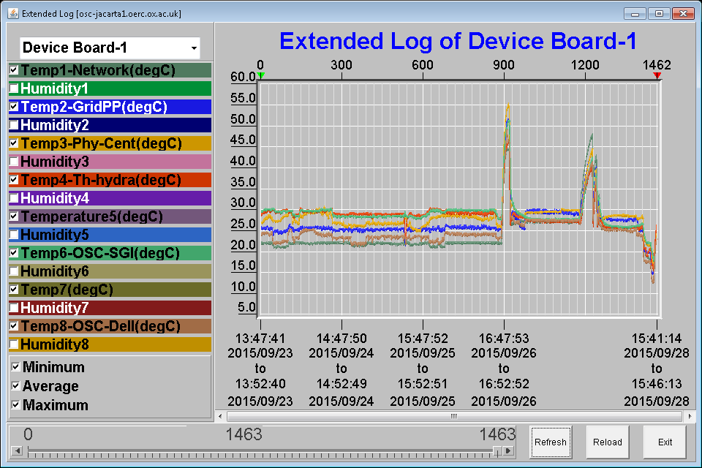
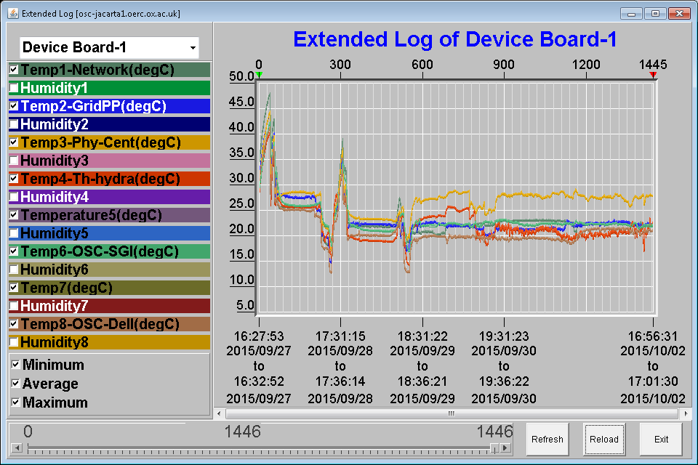
Older temperature monitoring
Example from incident in 2015 showing temperatures hitting 50 degrees C in a matter of minutes.
Saturday 16:19
Sunday 16:13
Monday 17:04
Notes:
This system (Jacarta) can email, phone and send SMS text messages to us.
We then had to manually shutdown servers & ring building services to get the A/C fixed.
Also had to contact the many different groups and ask them to shutdown their servers.

Slide 4
Goal
Simple under floor average temperature monitoring.
Publish on a Web page which can automatically be read by the servers.
The servers query the page then can then decide to shutdown cleanly once a threshold has been passed.
If the majority of the servers shut themselves down automatically the room temperature can be stabilized until A/C can be restored.
The solution is based on simple one wire temperature sensors.
Notes:
Could get the servers to query their own temperature and shut themselves down.
Problem is that the name of various temperatures and values change for each batch of systems.
In fact even some of the same batches give a range of values so setting a threshold value is difficult.
Better to have one value for the whole room.

Slide 5



Temperature Sensors
Temperature Sensor ( DS18B20 )
Four sensors along the centre of the cold aisle
1-Wire USB Interface (DS2401/DS1990A )
http://www.ibuttonlink.com/
Notes:
These are the 1-wire temperature sensors we already had.
If you look at the right hand side of the slide, you can see what the sensors looks like.
They can be daisy chained with RJ25 cables.
The spec say you can have up to 1000 feet of cable.
We used the 1-Wire USB connector to connect sensors to the server.

Slide 6
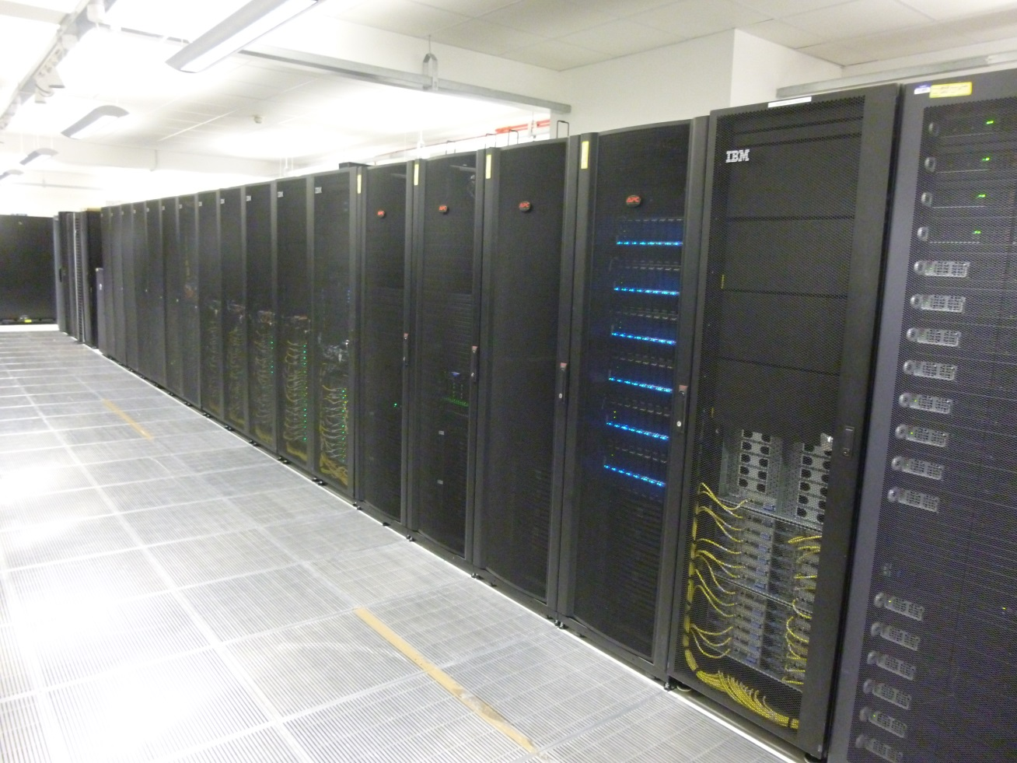


Slide 7
DigiTemp
DigiTemp is software for reading values from 1-wire devices.
DigiTemp is written by Brain Lane.
It is an open source software available under GNU license
Version 3.6.0-4 installed
https://www.digitemp.com/
Notes:
To read the values from the 1 Wire temperature sensors, we used Open Source DigiTemp software written by Brain Lane.
Before you can read the sensors you need to initialize the list of serial numbers (each 1-wire sensor has a unique 64 bit serial number used to address it on the bus).
When you add sensors to your LAN you need to rerun the initialization process -- be aware that the order that they are detected in depends on their number, so when you add new sensors it may change the order of your sensors.
# create the configuration file – detects all attached sensors
digitemp_DS9097U -i -s /dev/ttyUSB0 -c /etc/digitemp.conf
-I Initialize digitemp.conf file, search the bus for all supported devices.

Slide 8
Air Conditioning Failures
16th September 2016 incident
Notes:
Background:
The weekend of 13th/14th August the air conditioning system in the Begbroke data centre failed and the servers had to be brought down manually.
AND On 16th September, the air conditioning unit failed again. Luckily this time it happened during office hours.
So we brought down the worker nodes gradually.
If this had happened during out of hours, it would have taken longer to bring the worker nodes down.
You can see from the graphs, the temperature was going up at around midday on the 16th September. It peaked at about 34 centigrade.
Vip joined the Oxford team on 15th August and one of his first tasks was to come up with a method of shutting down the system automatically.
Luckily Ewan Macmahon already had few temperature sensors connected to a test system.

Slide 9
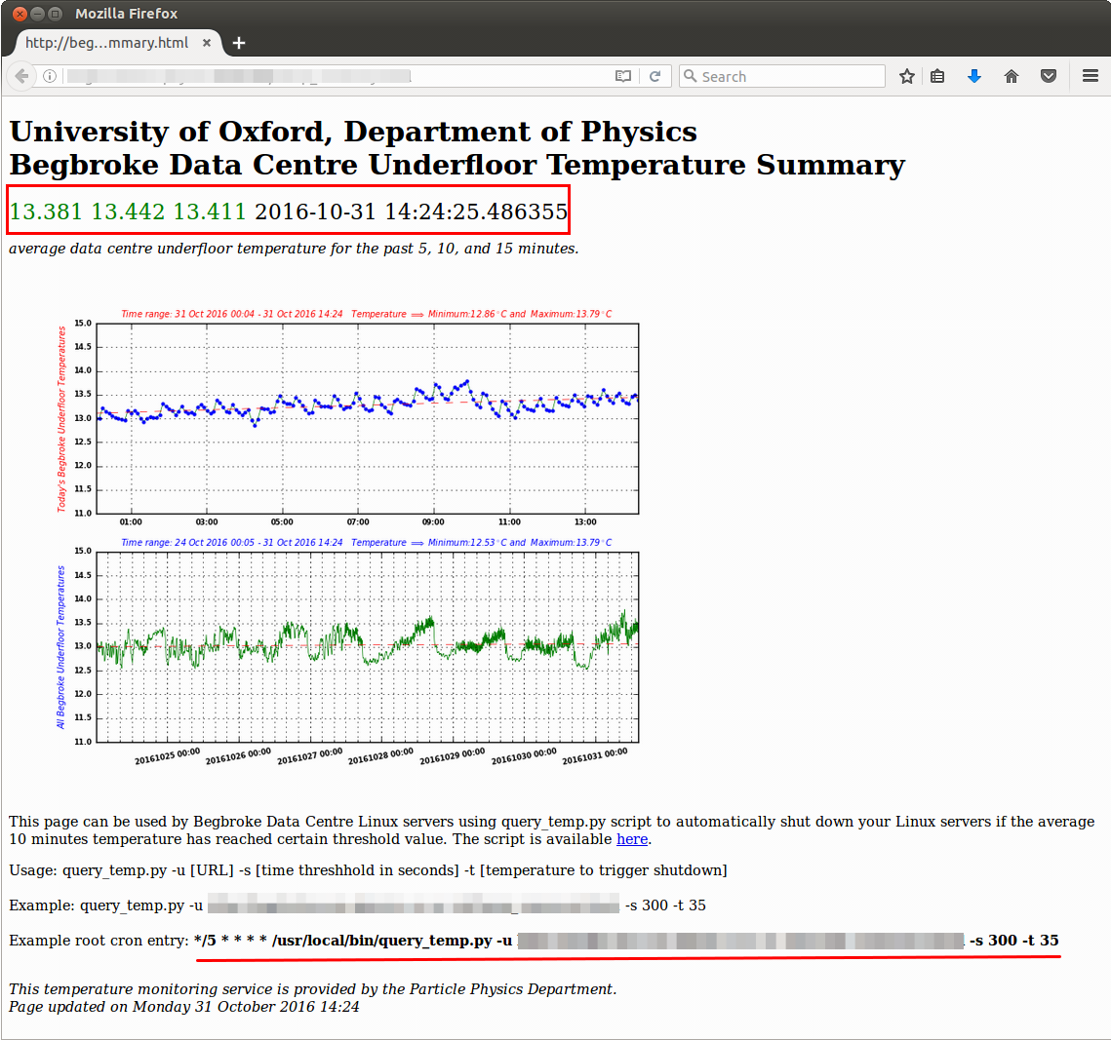
Server Temperature Script
Server Temperature script is written in python
/usr/bin/digitemp_DS9097U -d 60 \
–n 5 -q -c digitemp.conf \
-a –o "%s %C %Y%m%d %H:%M:%S“
Additional Modules used:
  matplotlib
  numpy
  logging
Notes:
Vip wrote a simple Server Temperature script in python. It is about 550 lines of code.
The script calls the above command to collect the average temperature data for 5, 10 and 15 minutes.
The four sensors values are averaged out to give 5 minute temperature value.
It generates the webpage on the right of screen automatically every 5 minutes.
The script also plots the temperature data for the day
For plotting:
I used Matplotlib to plot the graph
And Numpy is used to calculate the trend line. I used least square polynomial fit to calculate the trend line.
For Data file recycling
I use the Logging module to start a new data file at midnight.
It keeps the last seven days of data. Older data is deleted automatically.
# average sensors
digitemp_DS9097U -q -c digitemp.conf -a -o "%s %C %Y%m%d %H:%M:%S"|awk '{ sum += $2 } END { if (NR > 0) print sum / NR " " $3 " " $4}'
(each 1-wire sensor has a unique 64 bit serial number used to address it on the bus)
-d 60 Delay between samples (in seconds).
-n 5 Number of times to repeat the command.
q Quiet output, no copyright banner.
a read all sensors
o – output format %s – sensor, %C output in centigrade, and date format output

Slide 10
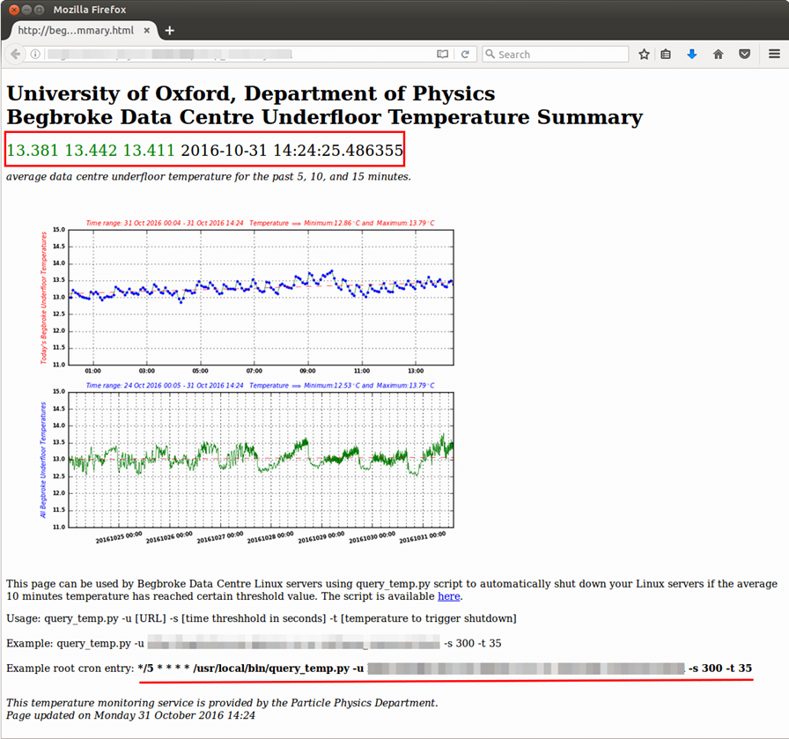
Client Temperature Query Script
Client script is written in python
It requires 3 arguments:
  URL
  threshold temperature to trigger shutdown
  threshold time in seconds
It uses the 10 minute average temperature to trigger shutdown
Notes:
Vip also wrote a small client script to query the temperature.
It is also written in python, it is only 150 lines of code – including comments.
It uses the system’s curl command to connect to the URL
The script requires 3 arguments:
URL
Threshold temperature to trigger shutdown
Threshold time in seconds (To guard against stale data, if date stamp is older than say 300 seconds)
The script automatically shuts down the server if the average 10 minutes temperature has reached the threshold value.
We have implemented this script on all the grid servers. It is under root cron control and runs every five minutes.
The threshold temperature for worker node is set to 35 and for the File system nodes it is set to 50.

Slide 11
Conclusion
Simple temperature monitoring under our control
Does not need rewriting for each new batch of equipment.
Web page can be queried by any server
Our Tier-2 grid cluster can shutdown worker nodes, and secondly storage nodes and if required, finally service nodes.
System can be used by other users of the computer room.
Can sleep a little more soundly.

